Slide 1
Optical lever lasers - To Fix or Not to Fix!!
Suresh Doravari
LIGO-G1500071

Slide 2
Optical Lever Lasers -
To fix or not to fix!
What do we mean by better performance?
Do we need better performance?
How do we obtain better performance?
A comparison of diode lasers and HeNe lasers
Options ahead of us
A possible plan of action

Slide 3
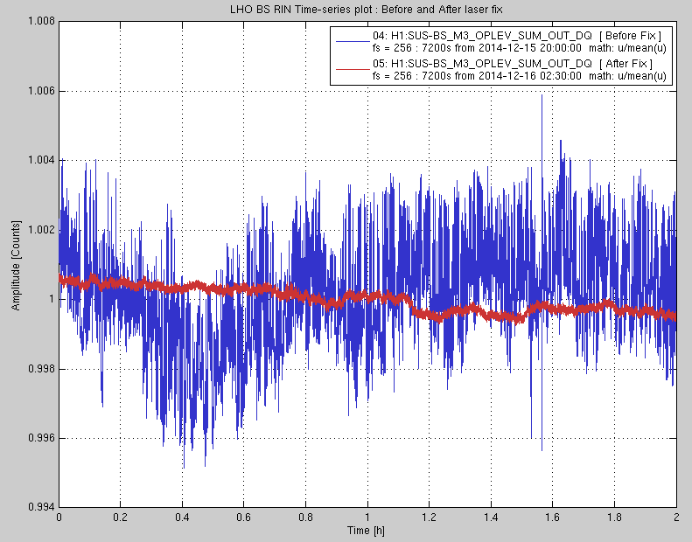
Our current oplev lasers can perform ten times better
Oplev laser power fluctuations : factory spec RIN is 1% , after the fix < 0.1%

Slide 4
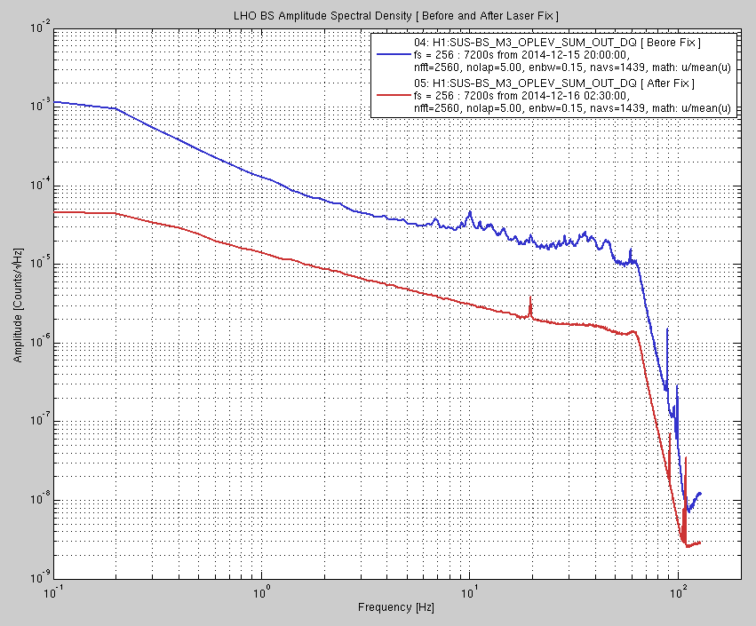
Lower noise across the entire spectrum by an order of magnitude

Slide 5
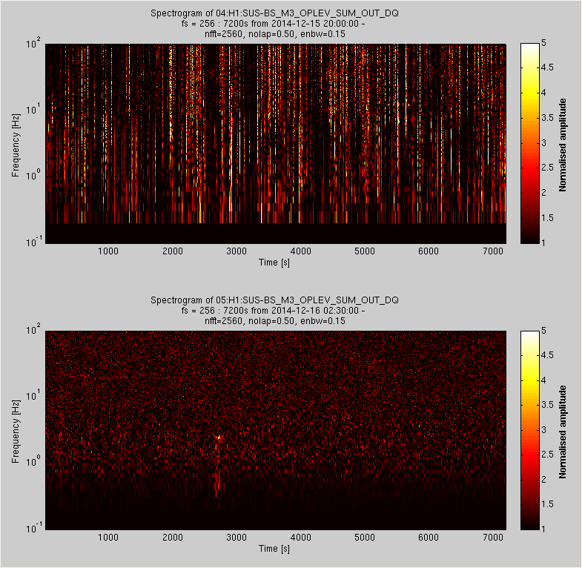
Spectrograms show an absence of glitches after the fix.

Slide 6
Do we need better performance?
School One
The oplevs are used to obtain lock and then the control is
transferred to wavefront sensors.
So glitchy lasers are okay.
School Two
When the weather gets bad
High wind conditions in LHO
Storms in LLO
We will need to engage oplev damping even during lock.
Even obtaining lock may be difficult if the oplev noise is high.
So we do need lasers which do not glitch.

Slide 7
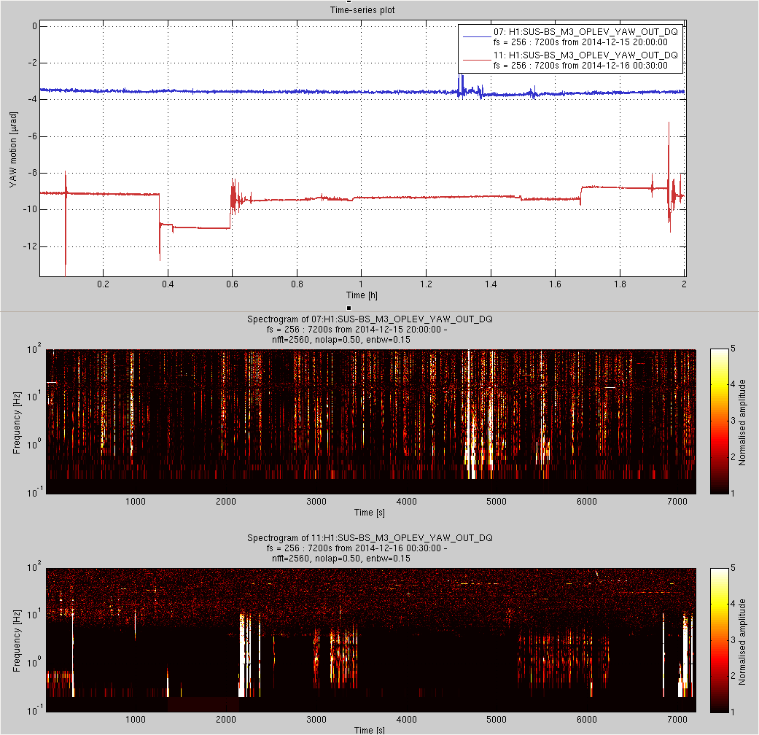
An example of how laser power glitches kick the optic:

Slide 8
How can we obtain better performance?
Fix the ones we have
Tweak alignment to reduce optical feed back
Tweak operating temperature set point
Choose power level for glitch free operation
Reduce fan speed
Passive thermal shielding
Replace them with
Better diode lasers
Get the present supplier to deliver glitch free lasers
Source from Thorlabs or another such standard company
(will require some local tuning for glitch free operation)
He-Ne lasers
Fiber fed He-Ne laser with stabilisation

Slide 9
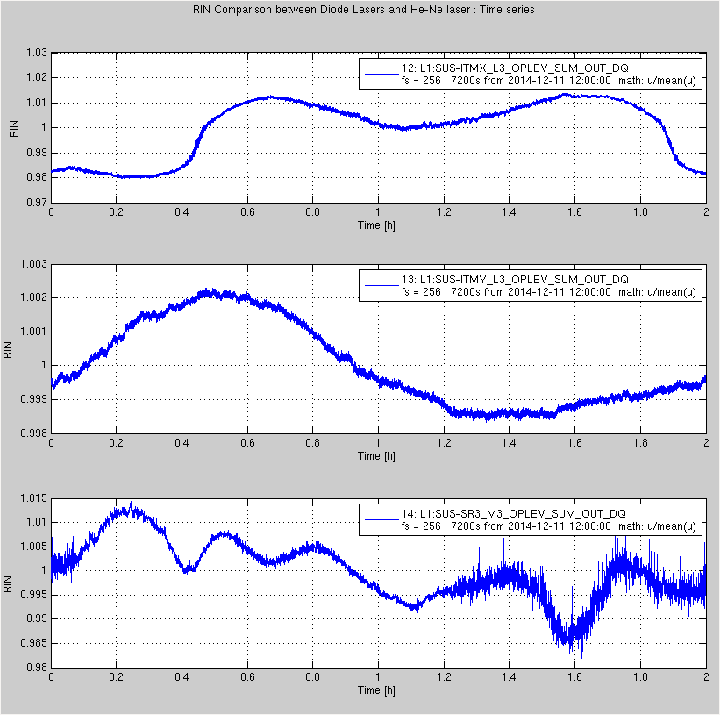
Comparison between He-Ne and Diode lasers

Slide 10
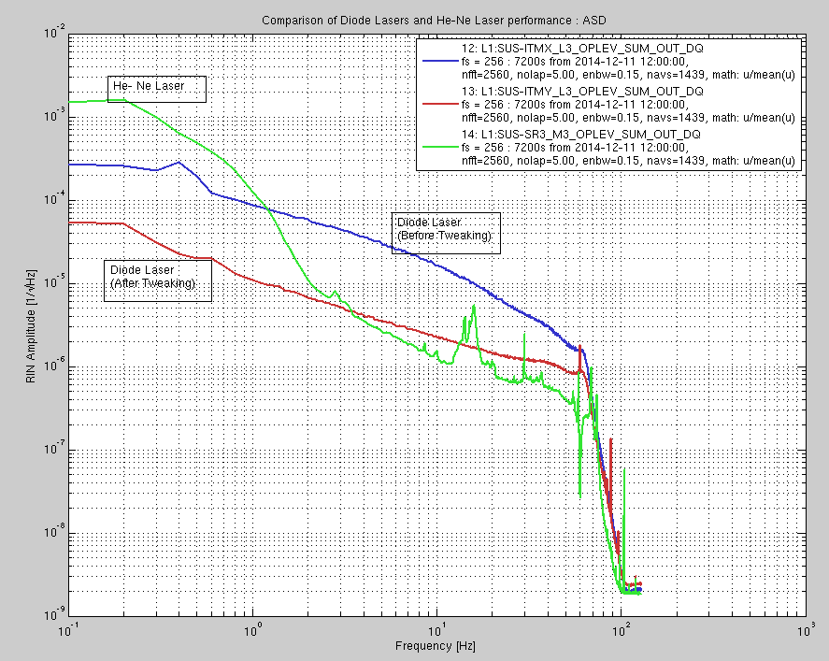
Comparison of He-Ne and diode lasers : Spectra

Slide 11
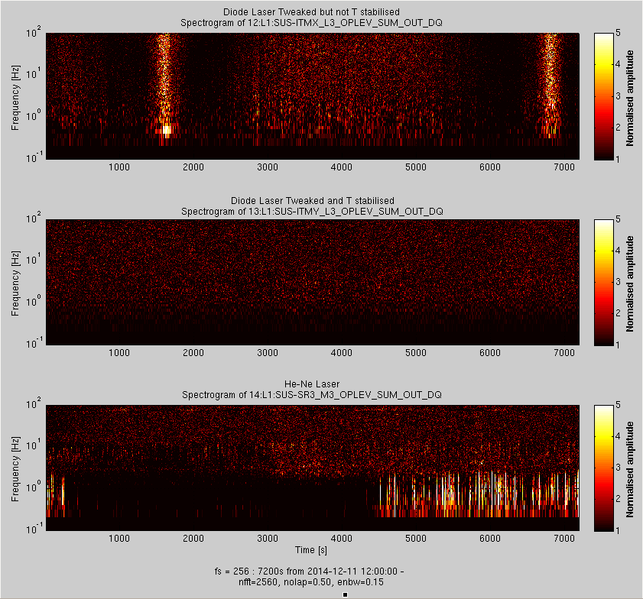
Comparison between He-Ne and Diode lasers : Spectrograms

Slide 12
Options ahead of us
Do nothing and live with the current glitchy lasers
Train the current supplier to build glitch free lasers
Obtain better engineered diode lasers another well established supplier (Thorlabs for eg.) and tune them for glitch free performance our selves
Switch over to He-Ne lasers (either fiber coupled or free space) and do the work needed to stabilize them

Slide 13
A plan of action
Fix the diode lasers currently with us and use them till their end-of-life (at least two years)
In the mean time explore and test other vendors and lasers
Diode lasers from Thorlabs
Stabilised HeNe Lasers with fibers couplers from Newport
(Both these will require some in-house work for stable operation)
In a couple of years time replace the diode lasers as they die with the new solution

