Slide 1
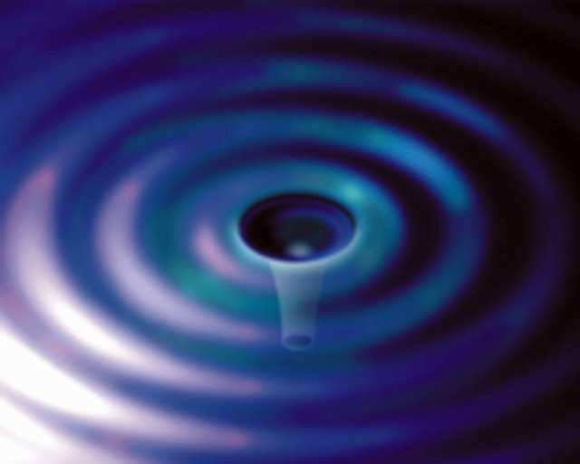
LIGO and Gravitational Wave Detection Workshop
Gregory Harry
American University
National Society of Black Physicists
February 28, 2015
G1500157-v1

Slide 2
Outline of Workshop
Technical Overview of LIGO
  Gravitational Waves
  Gravitational Wave Detectors
  Astronomical Sources for LIGO
  Advanced LIGO Detectors
Break for Informal Discussions
Involvement with LIGO and Outreach
  Joining LIGO
  Open Data and Joint Data Analysis
  Programs for Teachers and Students

Slide 3

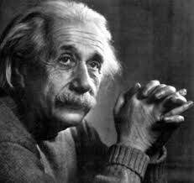
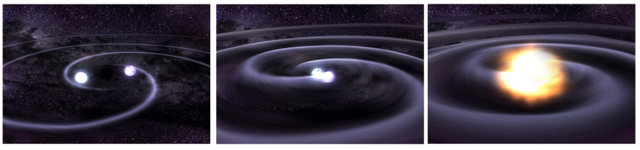


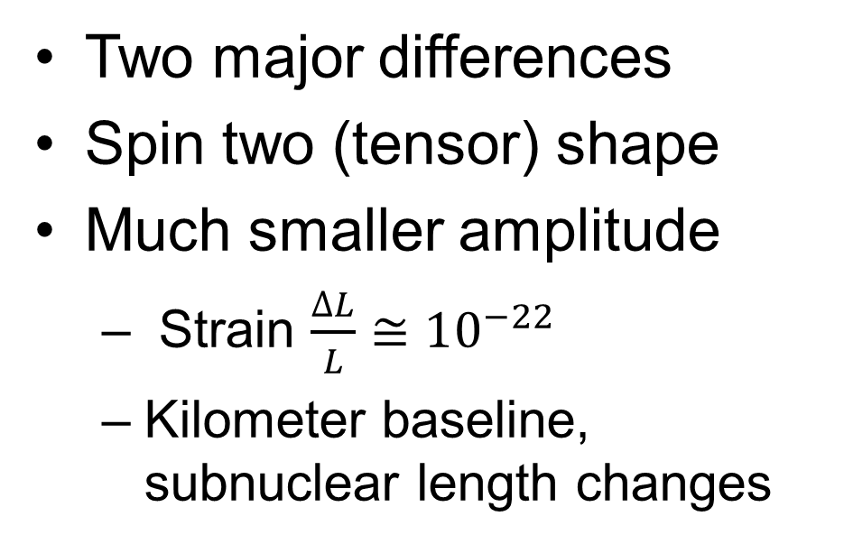
Gravitational Waves
Gravitational waves are a prediction of Einstein’s theory of gravity
Similar to electromagnetic waves (light) from Maxwell’s equations
Two major differences
Spin two (tensor) shape
Much smaller amplitude
  Strain $\frac{∆L}{L}≅10^{−22}$
  Kilometer baseline, subnuclear length changes

Slide 4
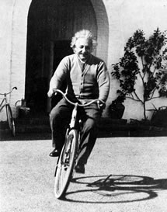
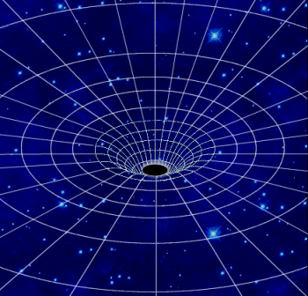
General Relativity turns 100; Gravitational Waves turn 99
General Relativity:
Einstein Field Equations
The metric: distance in
space-time
Weak field approximation:
space-time is slightly
perturbed from flat space-time
Simple wave equation for the metric perturbation h_{μν}
Slide from D. Reitze G1500139

Slide 5
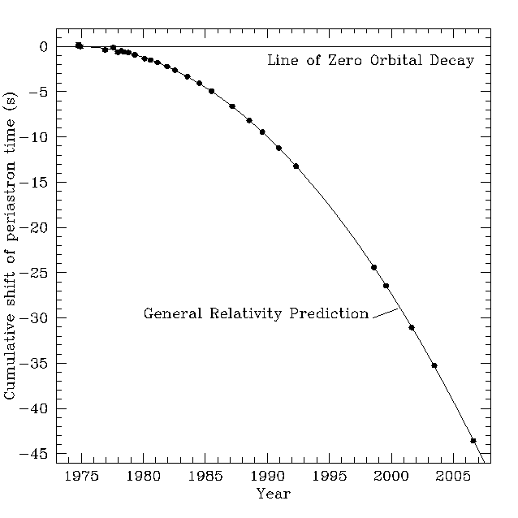
Indirect Evidence for GW
Known binary neutron star binaries will merge within 100 million years
Hulse and Taylor observation
  Change in orbit of neutron star binary
Orbital period decreases
Deviation grows as predicted by Einstein
1993 Nobel Prize to Taylor and Hulse

Slide 6
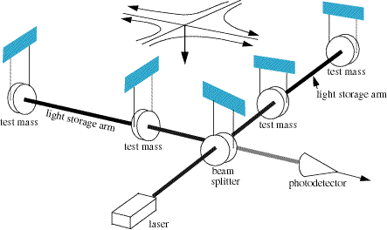
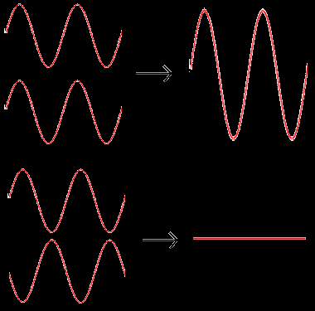
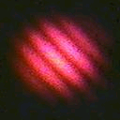
Direct Detection
Interferometers
Light goes down two perpendicular arms
  Similar to Michelson-Morley
Mirrors are free to move
  Suspended as pendulums
  Isolated from seismic noise
Returning light recombines
  Constructively: equal arm length
  Destructively: different arm lengths
Gravitational wave
  Stretch one arm, shrink other
Interference of Light

Slide 7

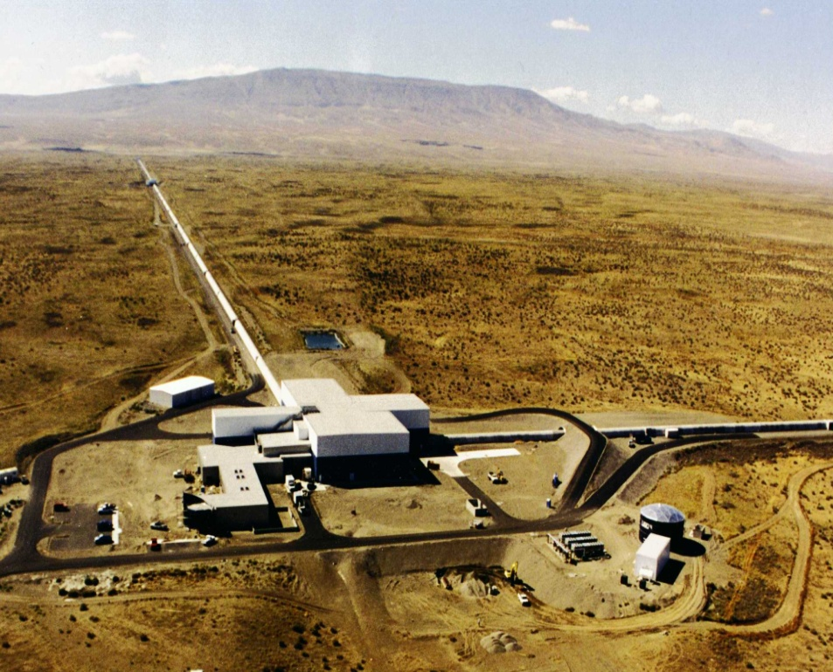

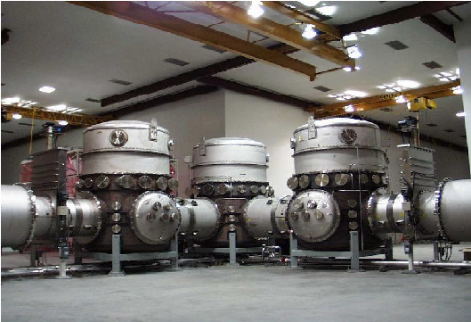
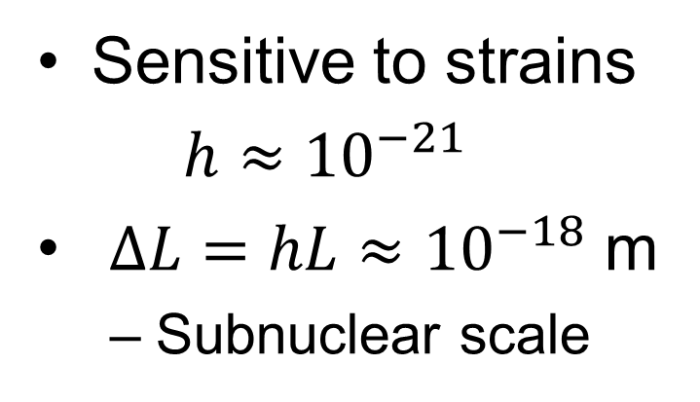
LIGO Detectors
US has two sites
  Livingston, Louisiana (LLO) and Hanford, Washington (LHO)
4 kilometer-long beam tubes
  Entire 8 km length in vacuum
  Low seismic noise environment
Sensitive to strains
$h≈10^{−21}$
$∆L=hL≈10^{−18}$ m
  Subnuclear scale

Slide 8
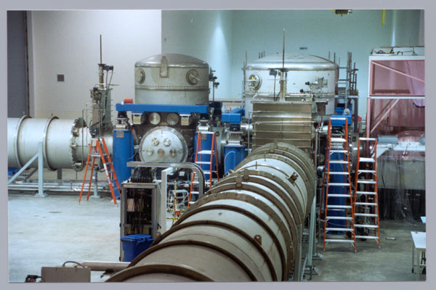
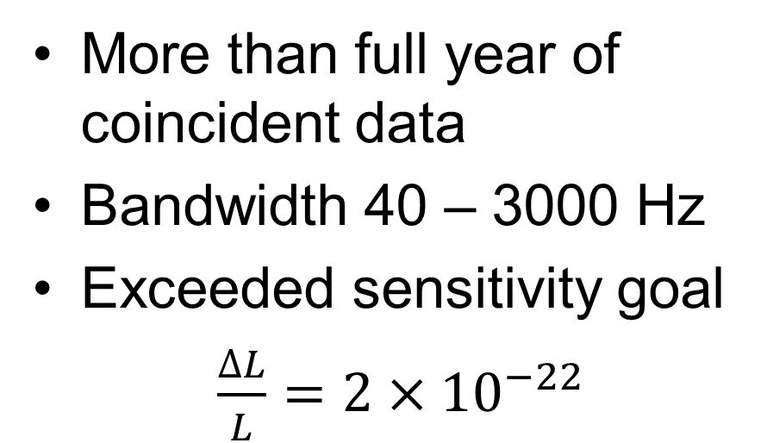
Initial LIGO 2002-10
More than full year of coincident data
Bandwidth 40 – 3000 Hz
Exceeded sensitivity goal
$\frac{∆L}{L}=2×10^{−22}$
3 detectors. 2×4 km/1×2 km
20 W Nd:YAG laser
10 kg silica optics
Steel wire suspensions

Slide 9
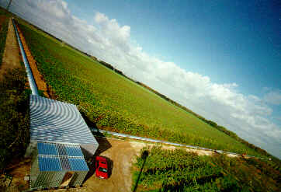
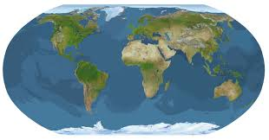
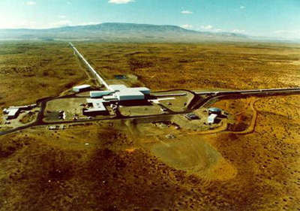
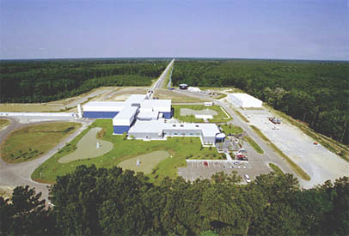
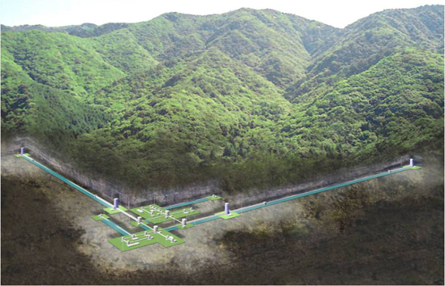
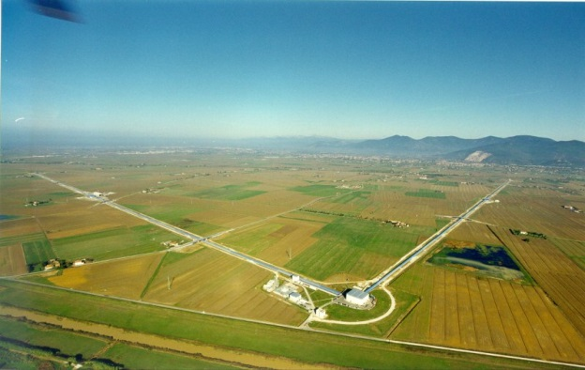
World Network of Detectors
GEO 600 m in Germany
LIGO-India (2022)
LIGO
Virgo 3 km in Italy
KAGRA 3 km in Japan

Slide 10
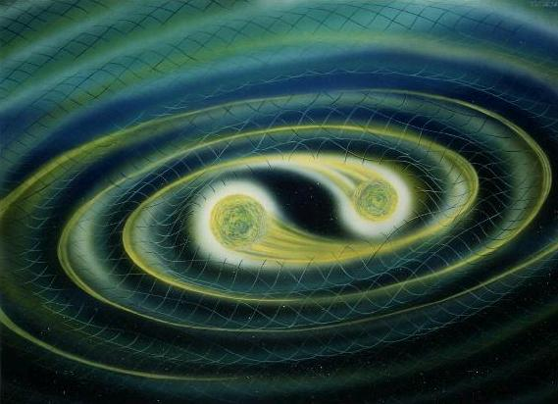
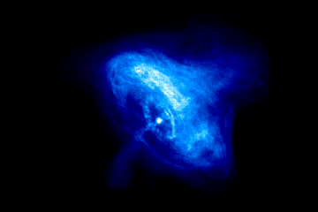
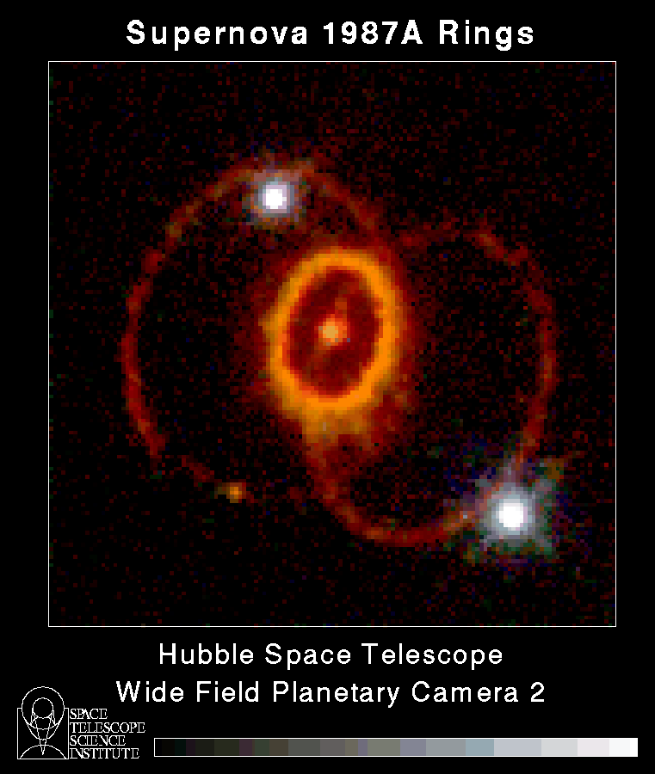
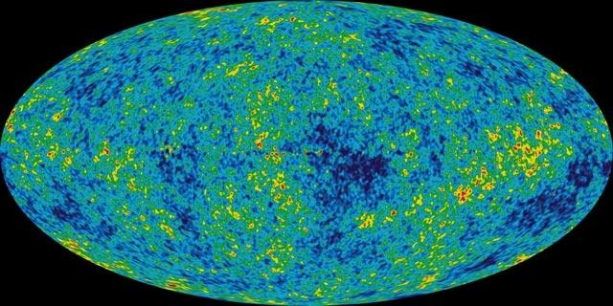
Gravitational Wave Sources
Short Duration Long Duration
Modeled
Unmodeled
Compact Body Inspirals
Periodic Sources
Bursts
Stochastic Background

Slide 11
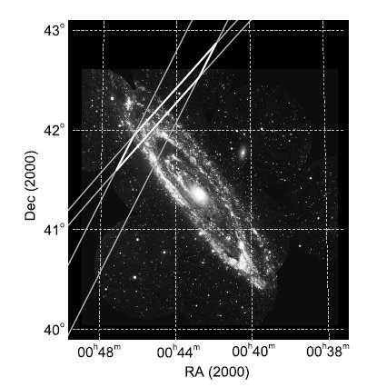
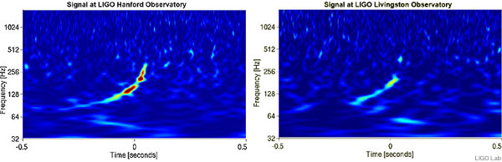
Initial LIGO Astrophysics: Burst and Inspiral Sources
Gama ray bursts (GRBs) may be compact body inspirals
Short GRBs 050311 and 070201
  Locations in galaxies M81 and M31
  Inspiral excluded at >98%
M31, GRB 070201
GW100916
  Consistent with compact body inspiral
  Blind injection done to test analysis process

Slide 12
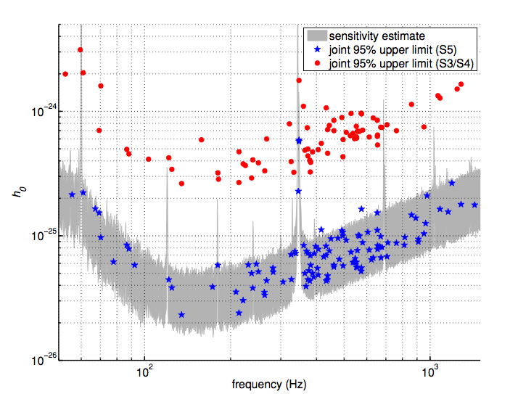
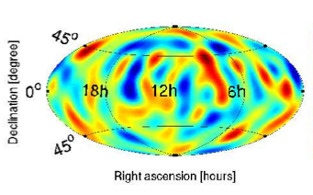
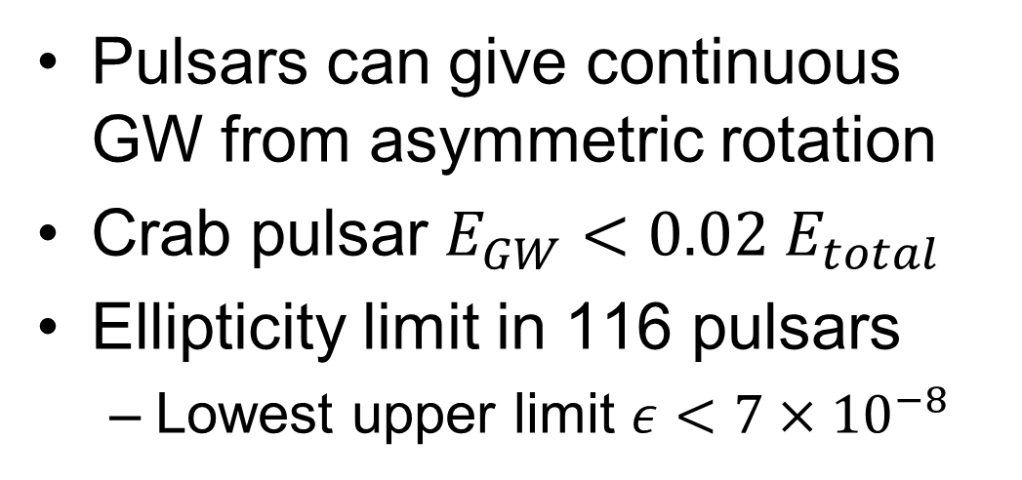
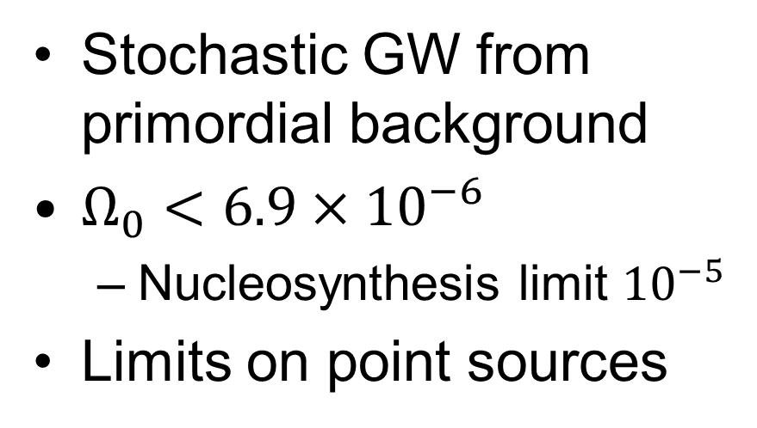
Initial LIGO Astrophysics: Pulsars and Stochastic
Pulsars can give continuous GW from asymmetric rotation
Crab pulsar $E_{GW}<0.02 E_{total}$
Ellipticity limit in 116 pulsars
  Lowest upper limit $ε<7×10^{−8}$
Stochastic GW from primordial background
$Ω_{0}<6.9×10^{−6}$
  Nucleosynthesis limit $10^{−5}$
Limits on point sources

Slide 13
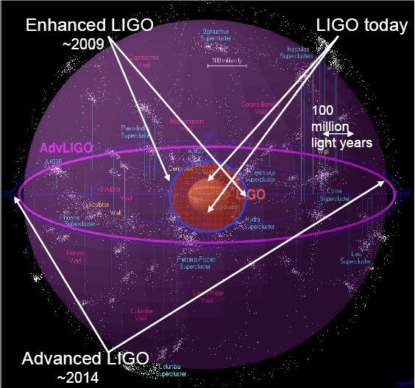
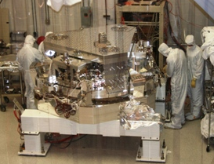
Advanced LIGO
Goal: 10 X sensitivity
  1000 X rate
  10 – 5000 Hz, wider range
  200 Mpc NS inspiral range
  Inspirals possible ~ 1/month
  One day with Advanced LIGO = a few years with initial LIGO
Initial LIGO
Image courtesy of Beverly Berger
Cluster map by Richard Powell
Construction project complete
  Budget began in 2008
  Installation started 2010
  Building three interferometers
  Installation finished Feb 2015

Slide 14
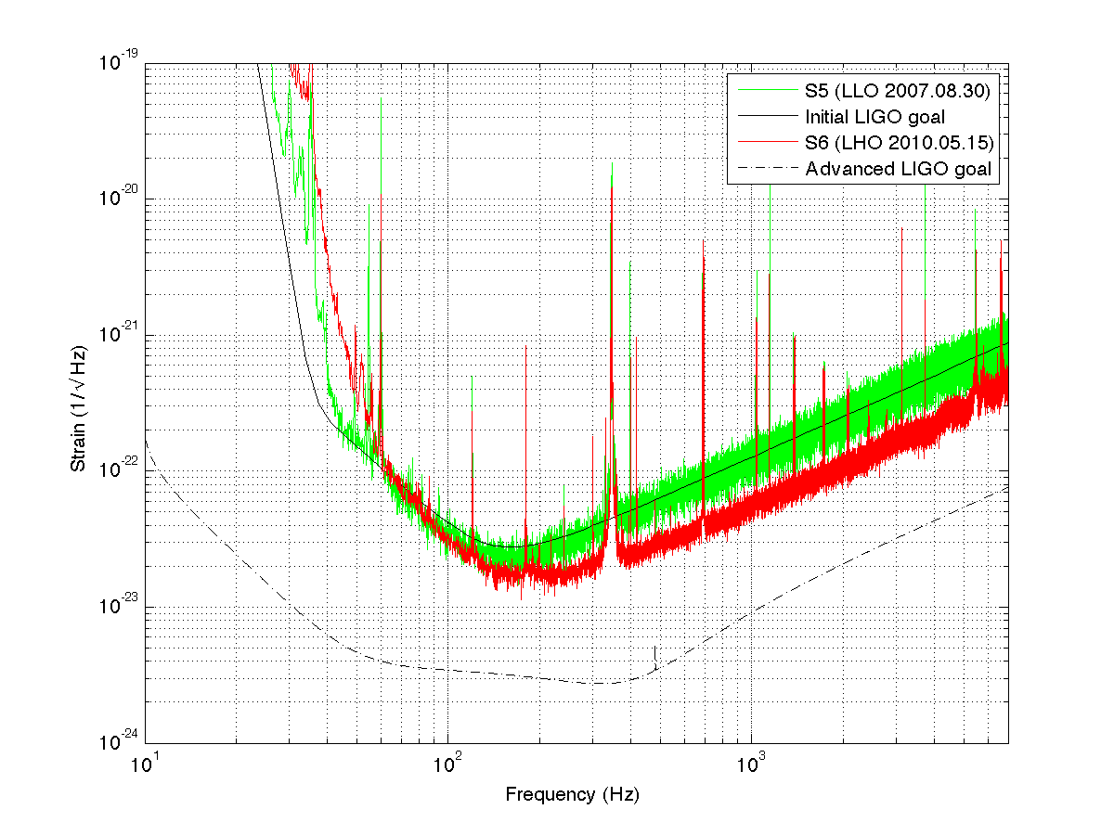
Advanced LIGO Sensitivity
Limited by Earth motion, thermodynamics, and quantum mechanics
Higher
power
laser
Better
seismic
isolation
Better
test masses

Slide 15
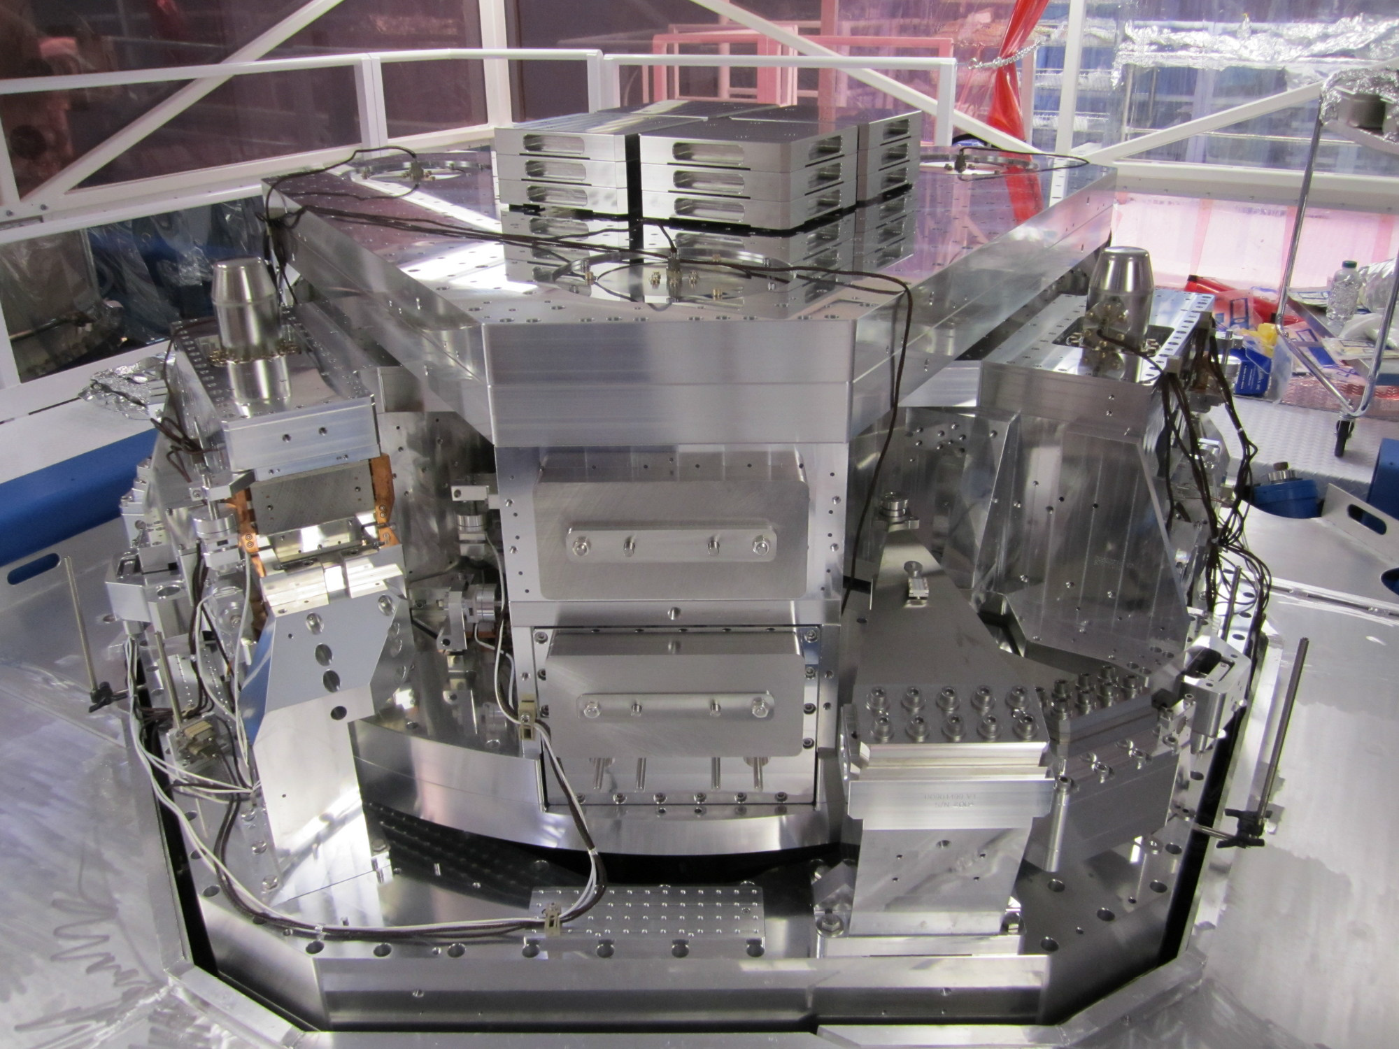
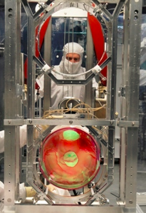
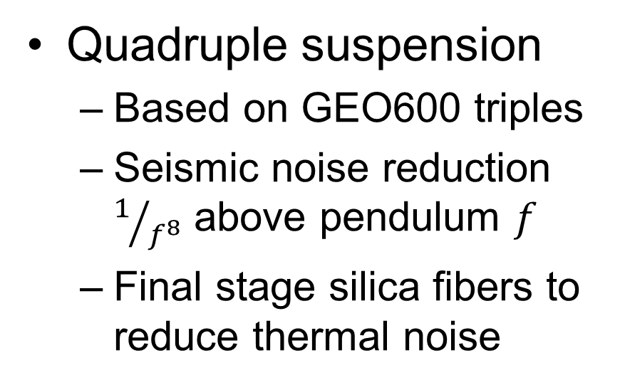
Advanced LIGO Seismic Isolation and Suspension
Seismic isolation
  Hydraulic preisolator external to vacuum
  In vacuum, two stage, 6 DOF active mass/spring system
Quadruple suspension
  Based on GEO600 triples
  Seismic noise reduction $1/{f^{8}}$ above pendulum $f$
  Final stage silica fibers to reduce thermal noise

Slide 16
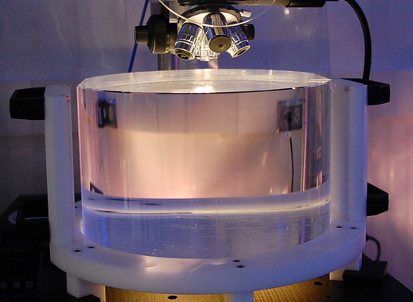
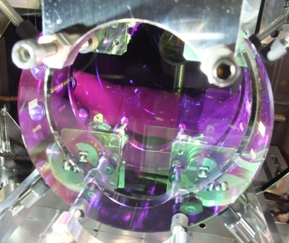
Advanced LIGO Mirrors and Coatings
Fused silica optics
  40 kilograms
  Very low absorption
  < 0.2 nm rms polish
  Monolithic connection to suspension
Optical coatings
  34 centimeter diameter
  5-6 cm beam spot
  Very low absorption
  Titania-doped tantala for low thermal noise

Slide 17
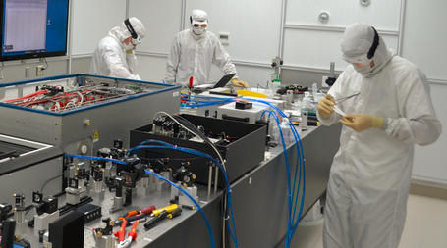
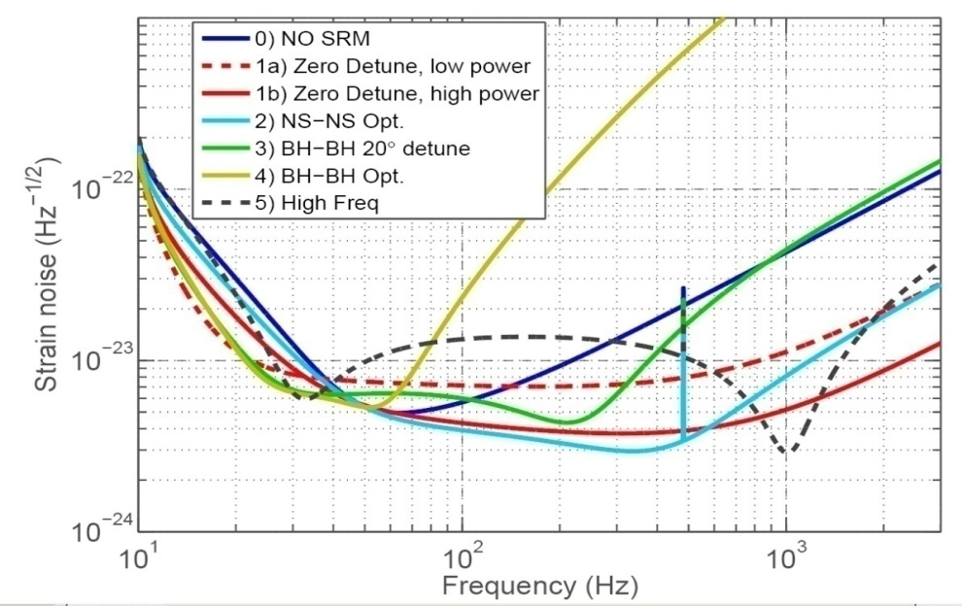
Advanced LIGO Laser and Interferometry
Laser
  Nd:YAG 1064 nm
  Three stage NPRO
  180 Watts
  Shot noise limited
Interferometry
  Power recycling increases arm power to 800 kW
  Signal recycling to tune sensitivity curve
Coating Thermal

Slide 18
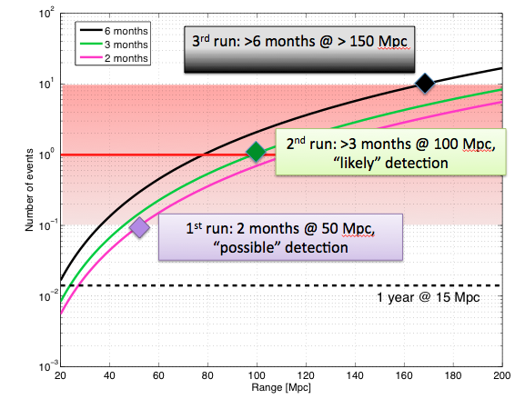
Status and Science Plans
Installation complete
Remaining activities
  Noise reduction at both LLO and LHO
  Computer procurement
See Arxiv/gr-qc/1304.0670, 1003.2480
Goal: Direct detection century after Einstein’s 1916 GW paper
Date | Length | Sensitivity
Summer 2015 | 3 months | 40-80 Mpc
2016/2017 | 6 months | 80-120 Mpc
2017/2018 | 9 months | 120-170 Mpc
2019 | Full year | 200 Mpc

Slide 19

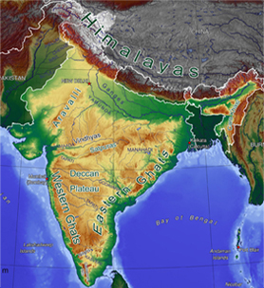
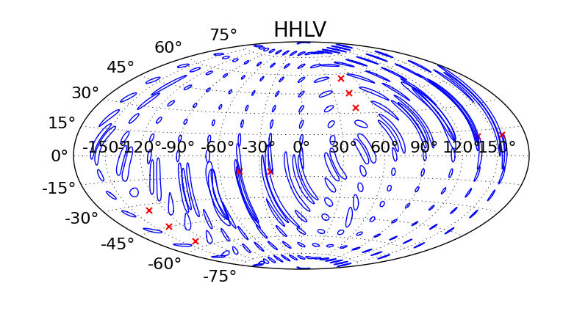
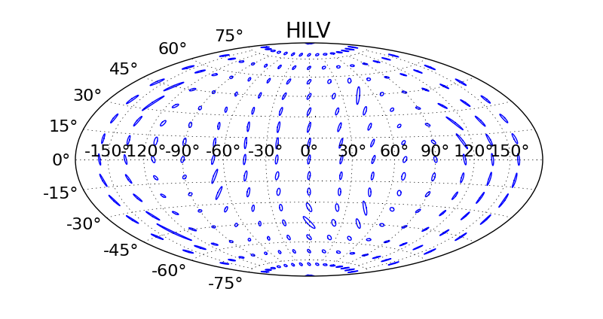
LIGO India
Third Advanced LIGO detector in India
Site selection committee set up
Interferometer hardware stored
Join network 2022
Training and collaboration now

Slide 20
Gravitational Wave Sources for Advanced LIGO
Compact body coalescence
  Neutron stars and black holes
  Inspiral, merger, and ringdown phases
Stellar core collapse
Gamma ray bursts
  Kilonova
Millisecond pulsars
  Known and unknown
Stochastic background
  Cacophony of above sources
  Cosmological origin (?)

Slide 21
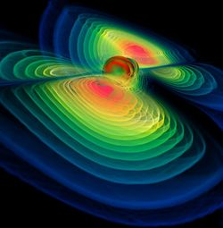
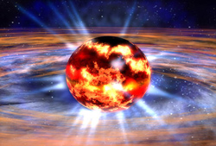
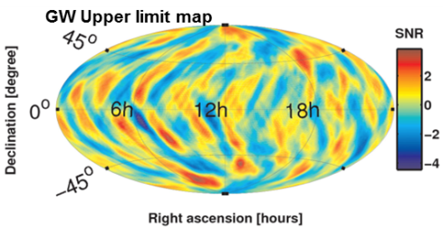
Physics and Astronomy with Advanced LIGO
Fundamental Physics
  Is General Relativity the correct theory of gravity?
  How does matter behave under extreme conditions?
  What equation of state describes a neutron star?
  Are black holes truly bald?
Astrophysics, Astronomy, Cosmology
  Do compact binary mergers cause GRBs?
  What is the supernova mechanism in core-collapse of stars?
  How many low mass black holes are there in the universe?
  Do intermediate mass black holes exist?
  How bumpy are neutron stars?
  Is there a primordial gravitational-wave residue?
  Can we observe populations of weak gravitational wave sources?
  Can binary inspirals be used as “standard sirens” to measure the local Hubble parameter?
Black Hole Merger and Ringdown
Image credit: W. Benger
Neutron Star Formation
Image credit: NASA

Slide 22
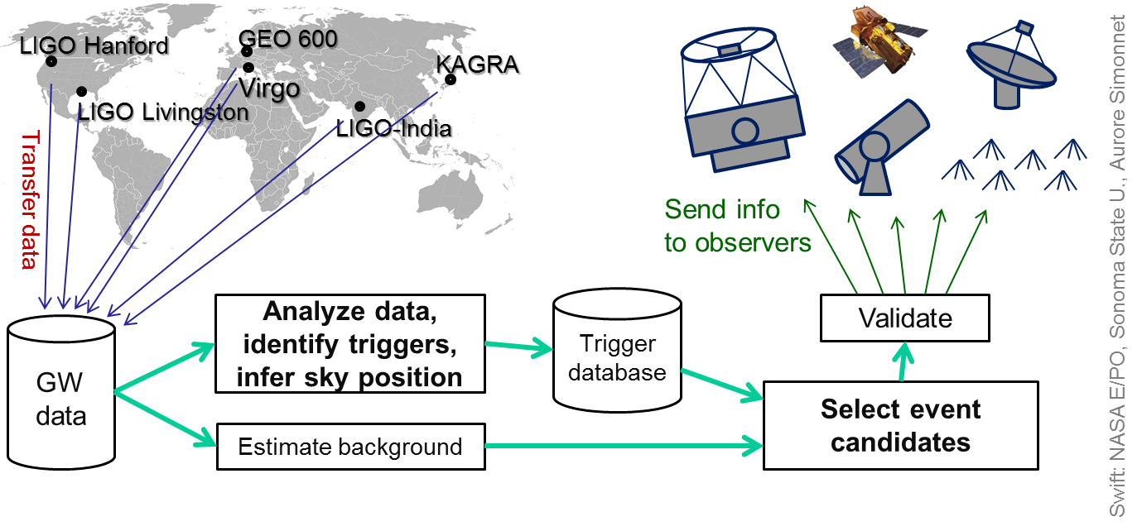
Multimessenger Astronomy
Low latency data analysis happening as data comes in → Generate triggers
Increase confidence in GW detection
More precise sky location, better understanding

Slide 23
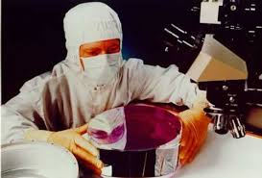




LIGO in the Audience
Gregory Harry – Faculty, American University
  LIGO hardware, optics, thermal noise
Jedidah Isler – Faculty, Syracuse University
  Astrophysics
Jaysin Lord – Grad student, Syracuse University
  Neutron star and black hole searches
Amber Lenon – Grad student, Syracuse
  Gravitational wave astrophysics
Corey Gray – Operator, LIGO Hanford Observatory
  LIGO interferometer status and operation
Martha Casquette – Faculty, Texas Southmost College
  LIGO outreach

Slide 24
Research with LIGO and Outreach
LIGO Scientific Collaboration
Open data and joint analysis
LIGO programs for teachers
  Community college
  High school teacher training
Programs for students
Outreach to the general public
LIGO online

Slide 25

LIGO Scientific Collaboration
Nearly 1000 members from over 80 institutions in 16 countries for the LIGO Scientific Collaboration (LSC)
Large and small departments, graduate and undergraduate institutions, academic and research laboratories
  Several members serving under-represented groups
  Southern University, a Historically Black University
Most US groups supported by single investigator NSF grants
  LIGO Laboratory (Caltech, MIT, Observatories) supported by MRFC from NSF
LSC and LIGO Laboratory make up “LIGO”
  Mission “The LIGO Scientific Collaboration (LSC) is a self-governing collaboration seeking to detect gravitational waves, use them to explore the fundamental physics of gravity, and develop gravitational wave observations as a tool of astronomical discovery”

Slide 26
LSC Organization
Working groups organize LIGO activities
  Hardware groups: Suspensions and Seismic Isolation, Optics, Quantum Noise, Advanced Interferometer Configurations, Detector Characterization
  Data analysis groups: Bursts, Compact body coalescence, Continuous waves, Stochastic
Other groups and committees
  Education and public outreach, Diversity, Academic advisory, Joint running (with Virgo), Software
LIGO Collaboration Meetings
  Joint meetings with Virgo
  Currently twice yearly; Caltech March 2015

Slide 27
Joining the LSC
Anyone willing and able to contribute to LIGO’s mission may apply for membership
  Contributions to one or more of analysis of LIGO data, operation and characterization of current detectors, and development of future detectors
  Contact LIGO Spokesperson Gabriela Gonzalez (gonzalez@lsu.edu)
Must be approved by 2/3 vote of current members
Sign a Memorandum of Understanding with LIGO
  Evaluated by working groups and resigned annually
LIGO Beginner’s Guide available at
  dcc.ligo.org/public/0112/P1400033/005/FinalDocumentAug2014%289%29.pdf

Slide 28

LIGO Diversity Initiatives
LIGO commitment to diversity
  As members of the LIGO Scientific Collaboration, we recognize the importance of diversity to enrich our research and scholarship.
  dcc.ligo.org/public/0107/M1300484/001/LSC-diversity-statement.pdf
  As international collaboration, focus on gender issues over race or ethnicity
Sponsor Undergraduate Research Fellowships for underrepresented minorities
With NSBP - Carl Albert Rouse Fellowship
With National Society of Hispanic Physicists - Victor M. Blanco Fellowship

Slide 29
Joint Analysis with Astronomers
LIGO has Memorandum of Understanding with astronomers to do multimessenger astronomy
High Energy Neutrinos: ANTARES and IceCube
  Short GRBs, SGRs
Low Energy Neutrinos: Super-K, LVD, Borexino
  Core collapse supernova
Gamma Rays: SWIFT
  Short GRBs, galactic supernova
  Low latency
Optical and IR: ROTSE a,b,c,d; TAROT N,S SkyMapper, QUEST, PTF/ZTF, Pi of the Sky, Zadko, Quest, DECam, BlackGEM
  GRB afterglows, galactic supernova
Radio: LOFAR, ETA, NRAO Green Bank, ARECIBO
  BNS mergers, GRB radio afterglows, pulsar glitches

Slide 30
LIGO Open Data
LIGO data available online to anyone interested: losc.ligo.org/about
  Also documentation, tutorials, and tools
  losc.ligo.org/tutorials/
Most recent data from 2005-2007 S5
Will release 2009-2010 S6
Used for student projects and outreach as well losc.ligo.org/projects/

Slide 31


Einstein @ Home
http://einstein.phys.uwm.edu/
Based on SETI@Home
Searching for unknown pulsars
Operating systems:
  Windows
  Mac
  OSX
  Linux
More computing power
Low cost
Notes:
Einstein@home uses coherent search algorithm

Slide 32

Community College Teachers
Two-unit online courses for community college teachers about LIGO science and technology
  LIGO Science course starts July 2015
Coming soon, March 16, 2015
epo.sonoma.edu/projects/ligo/

Slide 33
Secondary School Teachers
LIGO Livingston observatory in Louisiana partners with regional organizations to provide teacher training
  www.ligo-la.caltech.edu/SEC.html
LIGO Hanford observatory in Washington state offers stand alone summer workshops for teachers
  www.ligo-wa.caltech.edu/prof_dev.html
LIGO participates in remote workshops for teachers by invitation from organizers
Hanford observatory also provides summer teacher internships through the STAR teacher program
  www.ligo-wa.caltech.edu/internships.html
Contact William Katzman (wkatzman@ligo-la.caltech.edu) and Dale Ingram (ingram_d@ligo-wa.caltech.edu)

Slide 34
K12 Education Projects
Hanford participates in IU2U to make LIGO seismometer data available to students for research
  www.i2u2.opg/elab/ligo/home/projects.jsp
LIGO science classroom activities
  www.ligo-wa.caltech.edu/activities.html
  www.einsteinsmessengers.org
Kids corner has LIGO games, activities, etc.
  www.ligo-wa.caltech.edu/kids_corner.html

Slide 35



AU Optics Olympiad
LIGO group at American University in Washington DC starting an Optics Olympiad for DC high school students
Day of individual and group competition in optics, physics, and science
Organizing now, looking for volunteers to help with all aspects
  Panel speakers, demonstration development, teacher recruitment, day of volunteers, etc.
  See me after the workshop if you are interested in participating in any way

Slide 36
Opportunities for Undergraduates
LSC research experiences for undergraduates
  International through U Florida www.phys.edu/ireu/index.html
  Other LSC institutions www.ligo.org/students.php
LIGO Laboratory SURF program
  www.ligo.caltech.edu/LIGO_web/students/SURF/

Slide 37
Opportunities for Graduate Students and Postdocs
Many LSC institutions have graduate programs in LIGO science
  wiki.ligo.org/LAAC/UndergraduateResources
  wiki.ligo.org/LAAC/StudentOpportunities
LIGO on Linkedin www.linkedin.com/groups?gid=2626910
From the LIGO Academic Affairs Committee
  “It doesn't hurt to drop the head of a group an email expressing your interest, even if they have not advertised. They will see you are keen and most likely email you if money becomes available. I know people within the LSC who have secured a position this way, or the groups have found money for the right person.”

Slide 38
Outreach to the General Public
Summaries of LIGO publications
  www.ligo.org/science/outreach.php
Public festivals, fairs, and events
  Traveling exhibit
  US Science and Engineering Festival
  World Science Festival
  National Astronomy Night on the Mall

Slide 39
LIGO Online
On the web
www.ligo.caltech.edu
www.ligo.org
On Facebook
www.facebook.com/LigoScientificCollaboration
On Twitter
twitter.com/LIGO
On Youtube
  LIGO Generations www.youtube.com/watch?v=3xVUmmSFxXu
  LIGO, A Passion for Understanding www.youtube.com/watch?v=_OPTo1kPJI
LIGO Magazine
  www.ligo.org/magazine.php

