Slide 1
Mirror profile and intracavity field profile
Hiro Yamamoto LIGO/Caltech
Introduction
Mirror spatial frequency and arm loss
Point scattering and intracavity field
Spiral patterns on ETMs at L1 and H1
  Imbalanced noise by spiral patterns
  Direct measurement of the cone scattering by spiral pattern
Polishing vs coating for the future
Summary, question to be answered
Measured
85ppm

Slide 2
Mirror surface aberration, reflected field and intracavity field
dF
Cavity field
loss
dF⁻
dx
dF⁺
Small size aberration
Reflected
field
* Periodical aberration scatters to a fixed angle
Mirror surface aberration
* Small size aberration scatters back spherically

Slide 3
Measured mirror profile and intracavity field
Mirror profile | Spatial resolution | Field angle | Cause and effect in cavity
Phase map | > 1mm | < 2 x 10⁻⁴ rad, < 1m at 4km | Intracavity fields and near the edge of mirror, cavity modea
PSD, RMS, BRDF | 1μm ~ a few mm by PMM, + phase map | ~ large angle | Characterization of continuous structure, field scattered out to large angle
Integrating sphere | fraction of mm | > 5 degree | Total scattering to almost all angle, effects of non contiguous (point) structures captured. Near backward is covered by others.
COC mirror data (characteristics of mirror) +
appr. Maxwell eq. with rigorous boundary cond.
⇒ IFO observable

Slide 4
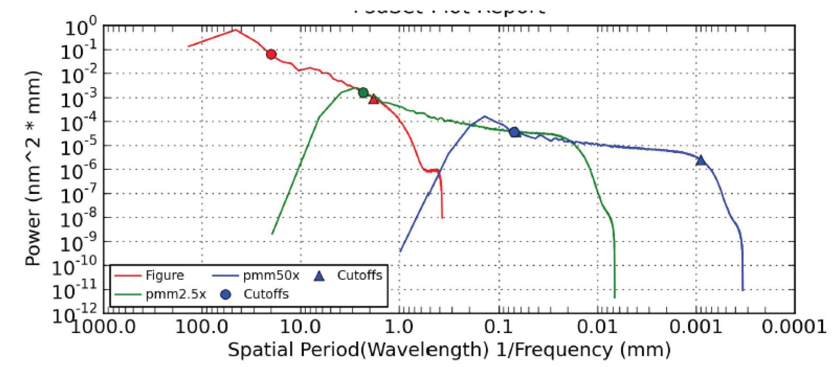
Raw data of mirror profiles

Slide 5
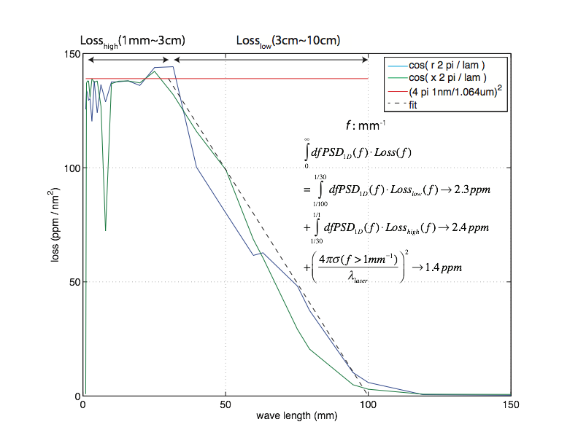
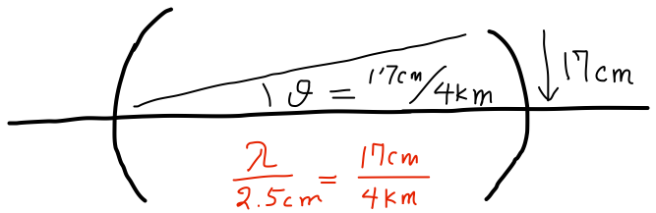
aLIGO cavity scattering loss by wavelength
Mirror surface profile
Loss of intracavity field
vs wavelength
Not so simple PSD
2.3ppm
2.4ppm
1.4ppm
7.83mm
1cm
1mm
Geometrical
acceptance
5

Slide 6
Far field structures field PSD(θ) ≠ mirror PSD(f), const BRDF⇒wrong loss
small aberration
Fresnel approx
Point source : dF ⇒ const BRDF ⇒ 2π dS / λ² x true scattering
PSD to dF :
Δ : 2D amplitude spectral density, ε~1/a few cm

Slide 7
Single propagation vs cavity field
Airy ring outside of mirror
aLIGO simulation :
single propagation vs
resonating field around cavity
iLIGO data by Valera

Slide 8
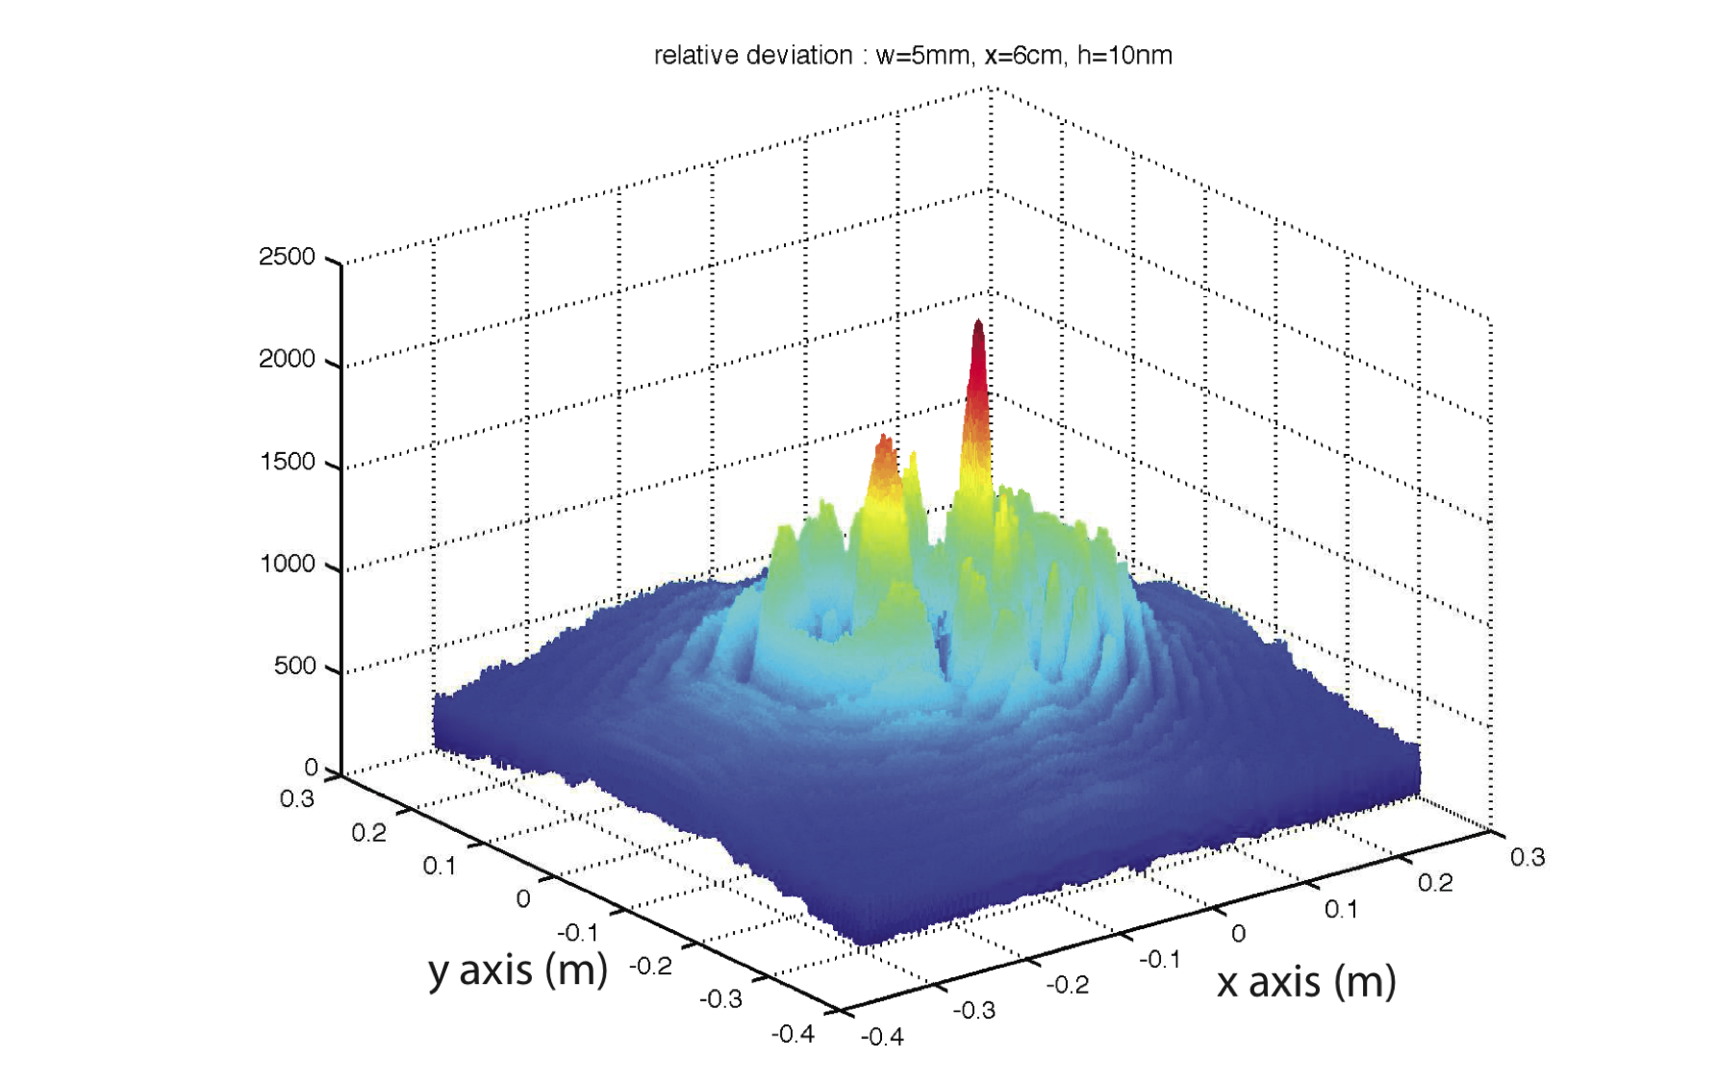
Small anomaly induces widespread tiny disturbance
Disturbance of fields by a point anomaly propagates out spherically
Intracavity field is affected entirely, not partially
Disturbance induced by a point anomaly is widespread weakly
Difficult to measure the effect, except for using the total loss measurement

Slide 9
LMA coating on ETMs
This is about the installed ETMs at L1 and H1
State of the art coating is presented in the talk by Laurent Pinard of LMA

Slide 10
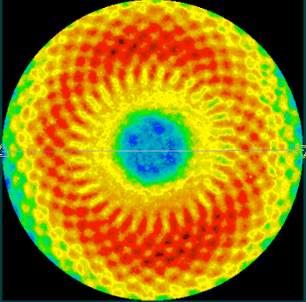
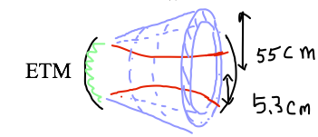
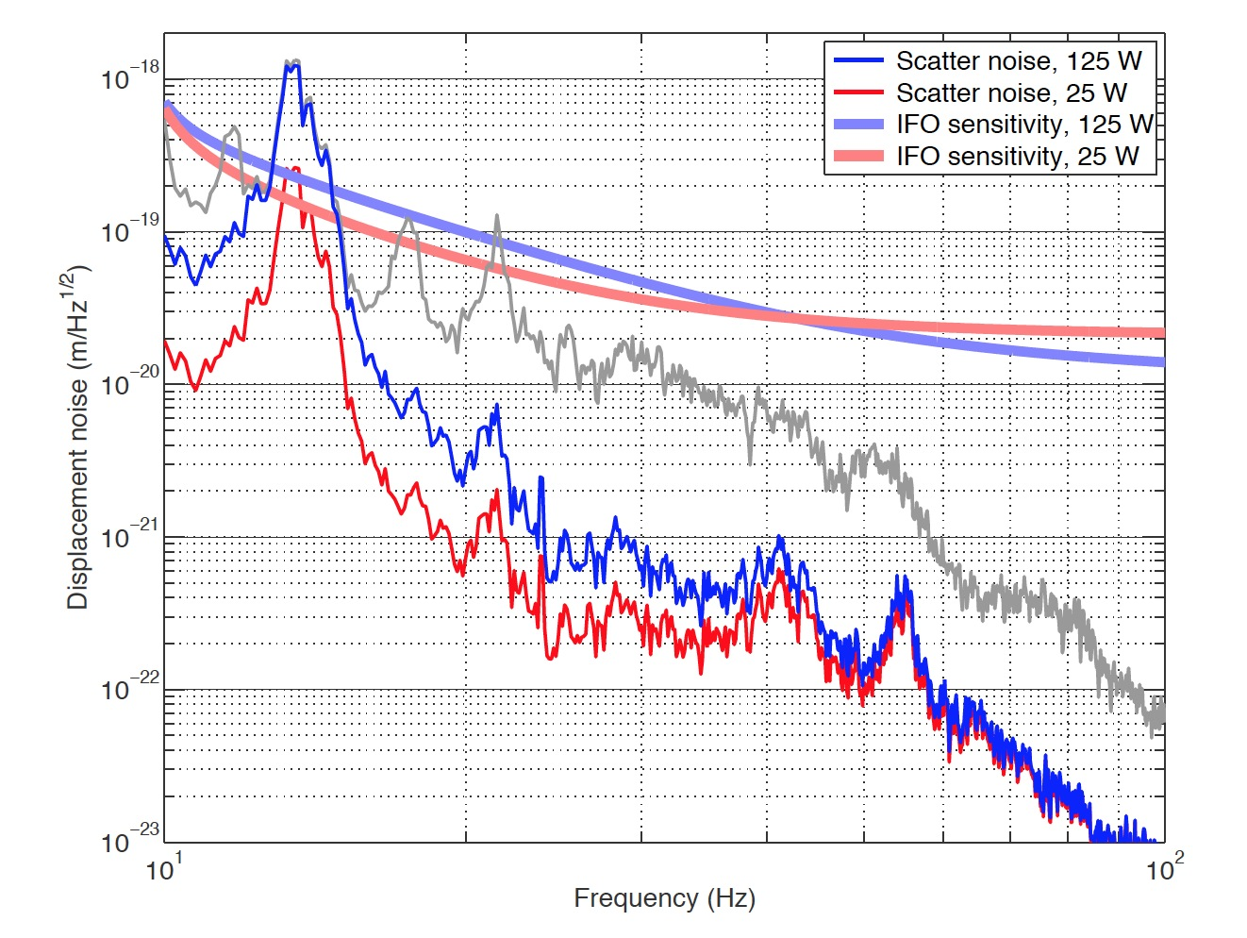
Periodical structure on a mirror induces reflected field into a cone with a fixed angle
Figure loss by two mirrors
~ 15-20ppm
ETM07 map
micro roughness, point scattering
~ 20 ppm
7.83mm
T1300354 by PF,HY
Phasemap resolution in simulation
main beam ⇒
ETM reflection ⇒
larger angle scattering into cone ⇒
reflected by beam tube baffles ⇒
back scattered into ETM ⇒
merged into the main beam

Slide 11
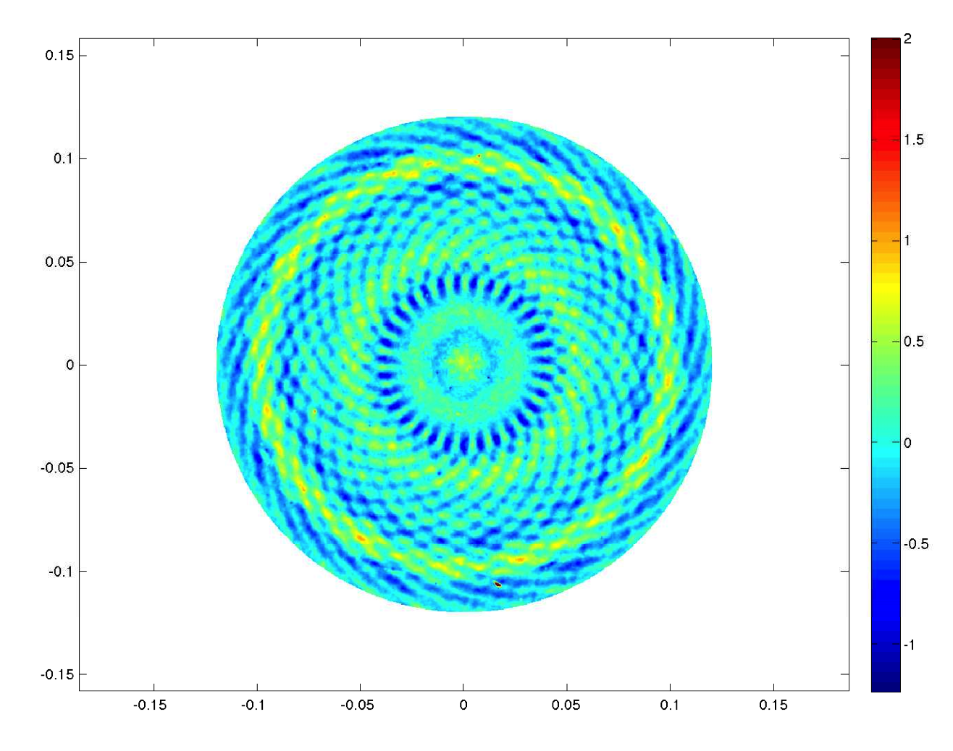
Detection of the scattering to cone using test mass baffle PDs
ETM09 map
Field going to ITM
50cm = 1.064μm / (8mm/4000m)
8mm
Spiral component
11
Real PD diameter is ¼ of

Slide 12
Signature at L1 ITM baffle PDs
Simulation
with spiral
Data @ L1
Simulation
without spiral
Distance of PD from center

Slide 13
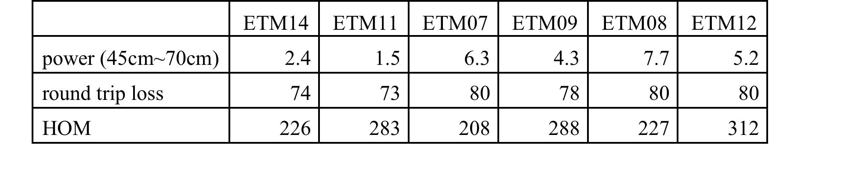
Different backscattering noise?
L1
H1
Small, but into a
fixed direction

Slide 14
For the future …
Polishing, not bad
aLIGO ITM/ETM
Polished map PSD
Round trip loss and HOM
in a symmetric FP cavity

Slide 15
Coating uniformity some improvement wanted

Slide 16
Coating limits larger beam size configuration
Larger optics can accommodate larger beam size
Polishing is good enough for that (solid lines)
Polishing uniformity can limit that (two dashed lines)

Slide 17
Missing loss of 40ppm needs to be well understood to discuss future IFO loss
Phasemap and Caltech/LMA scattering loss measurements
alog13414 ETMY scattering
  Total : 36ppm
  Point scattering : 18ppm
alog13769 Best round trip loss 85ppm
  Extra 30-40ppm, where???
COC data + Model
  Round trip loss error < 14ppm
  Integrated scattering
    7.5ppm by LMA
    9.3ppm by Caltech
  Zygo rms ⇒ loss(<1mm) < 1ppm
  PSD ⇒ loss(<5mm) < 1ppm

