Slide 1
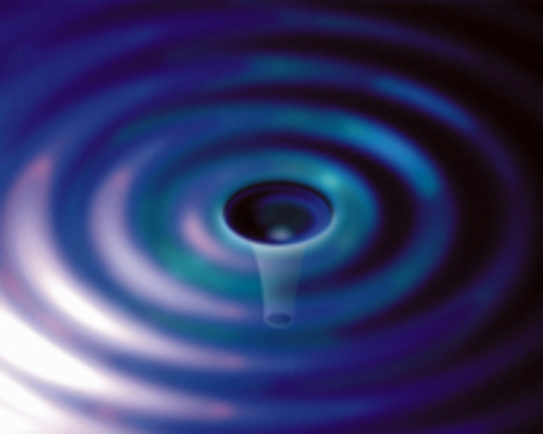
Gravitational Wave Detection and the AU Optics Olympiad
Gregory Harry
Physics Department
American University
July 14, 2015
G1500931

Slide 2
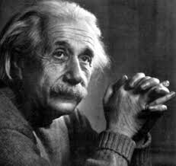
Gravitational Waves
Gravitational waves are a prediction of Einstein’s theory of gravity
Similar to light waves from electricity and magnetism (Maxwell) equations
Two major differences
Spin two (tensor) shape
Much smaller amplitude
Strain $\frac{∆L}{L}≅10^{−22}$
Kilometer baseline, subnuclear length changes

Slide 3
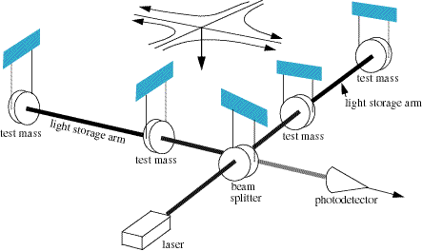
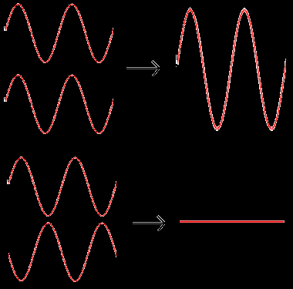
Interferometry
Light goes down two perpendicular arms
Similar to Michelson-Morley
Mirrors are free to move
Suspended as pendulums
Isolated from seismic noise
Returning light recombines
Constructively: equal arm length
Destructively: different arm lengths
Gravitational wave
Stretch one arm, shrink other
Interference of Light

Slide 4
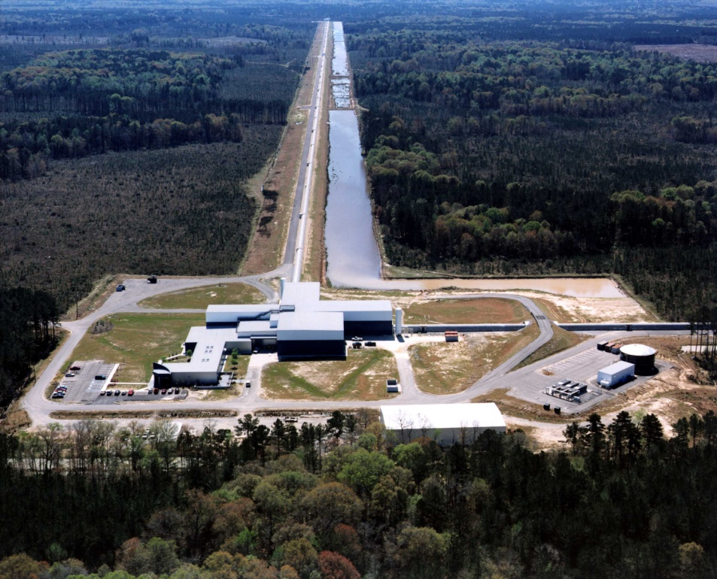
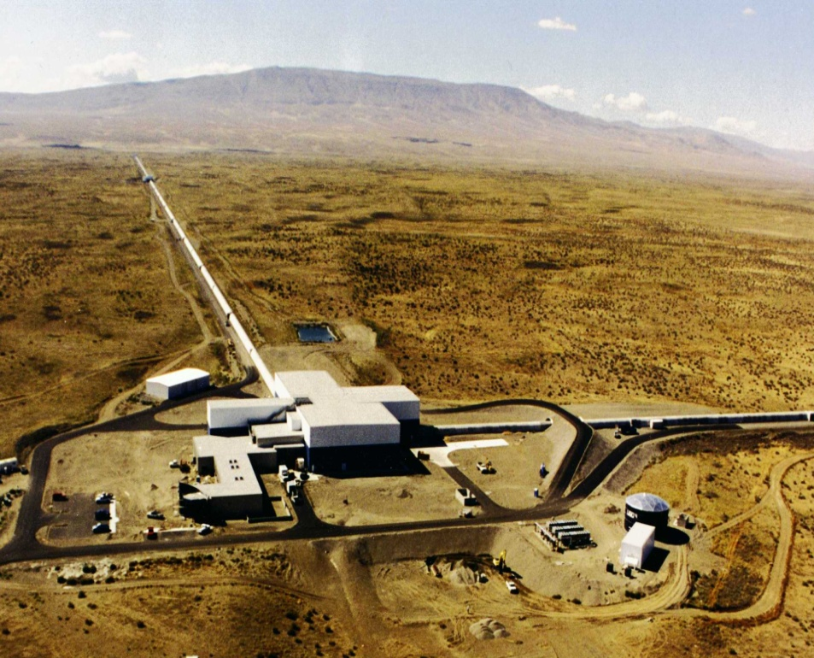
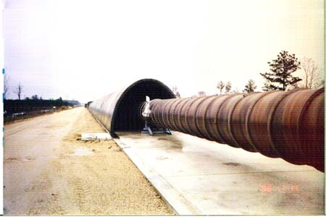
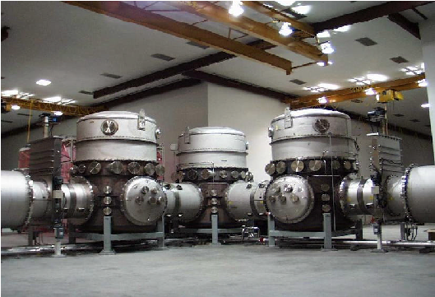
LIGO Detectors
Laser Interferometer Gravitational-wave Observatory (LIGO)
Two sites in the United States
Livingston, Louisiana (LLO) and Hanford, Washington (LHO)
Sites chosen for low seismic noise
4 kilometer-long beam tubes
Entire beam path in vacuum

Slide 5
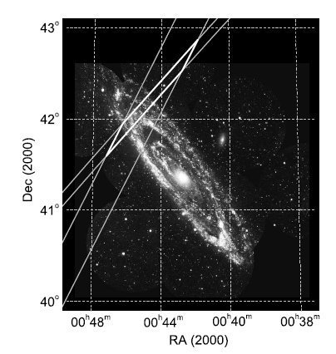
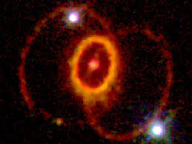
LIGO Astrophysics: Burst and Inspiral Sources
Inspirals are two neutron stars or black holes orbiting around each other
Gama ray bursts (GRBs) may be compact body inspirals
Showed that GRBs in two nearby galaxies were NOT inspirals
M31, GRB 070201
Bursts are other short GW signal
Some supernova
Rapid changes to neutron star structure
Other “bumps in the night”

Slide 6
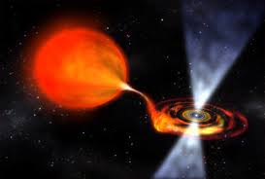
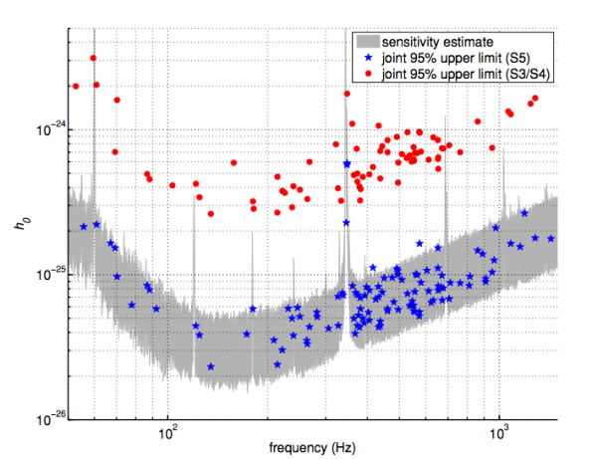
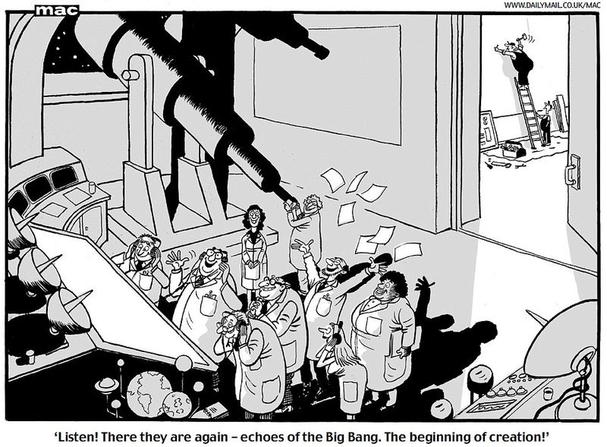
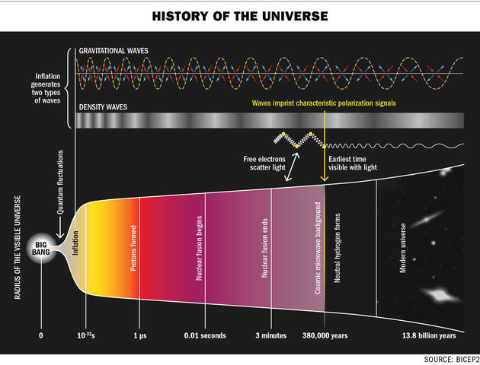
LIGO Astrophysics: Pulsars and Stochastic
Pulsars are rotating neutron stars
Non-spherical pulsars give off GW
Upper limit on bumps
Gravitational wave background from Big Bang
Upper limit on strength
May be too small even with best LIGO sensitivity

Slide 7
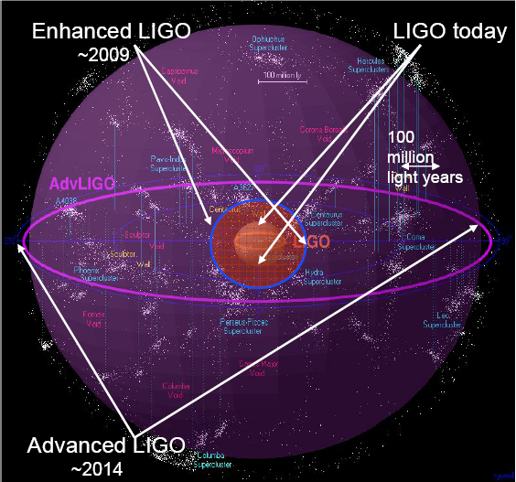
Advanced LIGO
Goal: 10 X sensitivity
1000 X rate
10 – 5000 Hz, wider bandwidth
200 Mpc NS inspiral range
Inspirals possible ~ 1/month
One day with Advanced LIGO = a few years with initial LIGO
Initial LIGO
Image courtesy of Beverly Berger
Cluster map by Richard Powell
Construction project complete
Installation started 2010
Installation finished Feb 2015
Collecting first data fall 2015
Goal: first detection by Einstein centenary

Slide 8
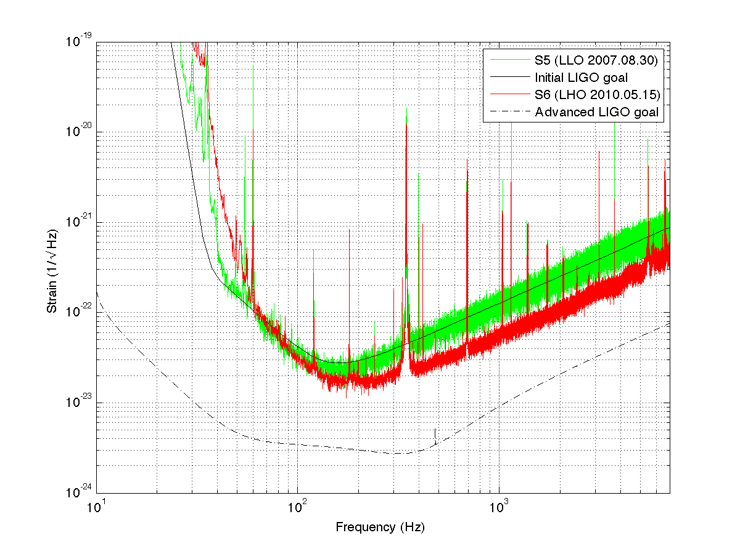
Advanced LIGO Sensitivity
Limited by Earth’s motion, thermodynamics, and quantum mechanics
Higher
power
laser
Better
seismic
isolation
Better
test masses

Slide 9
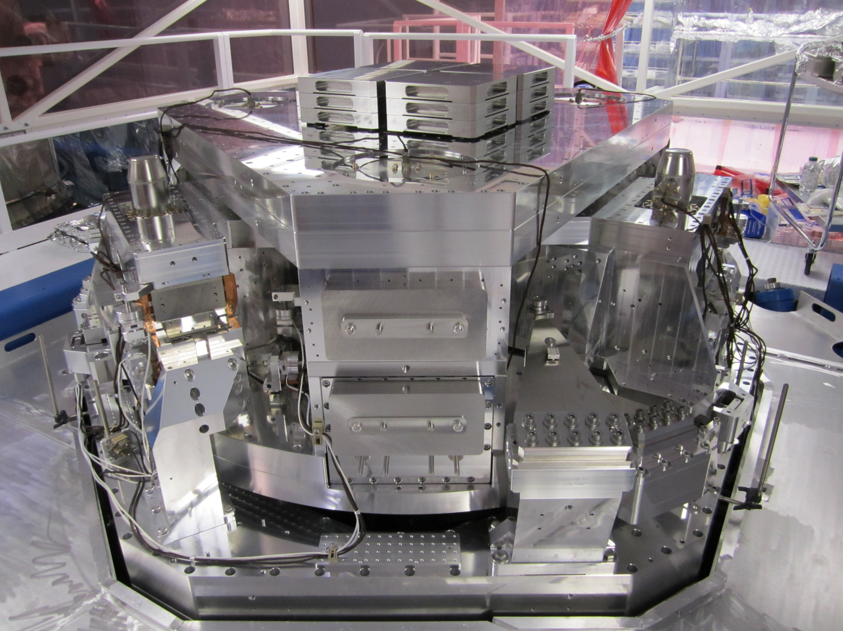
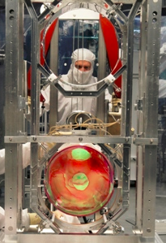
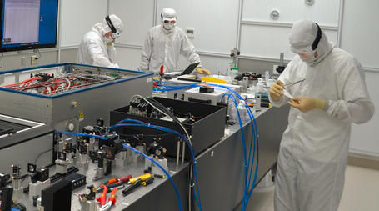
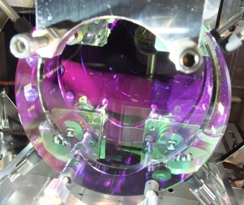
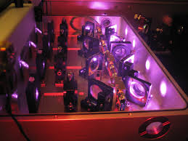
Advanced LIGO Hardware
Seismic isolation
Hydraulics and two stage, mass/spring system
Quadruple suspension
Final stage silica fibers to reduce thermal noise
40 kg silica optics
Optical coatings
Specially developed material for low noise
Laser
Nd:YAG 1064 nm
180 Watts
Reduces shot noise

Slide 10
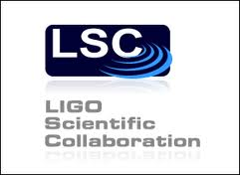
LIGO at AU
AU is a member of the LIGO collaboration
80+ institutions, 16 countries
International collaboration
900+ total members, 500+ US
Campus lab working on reducing thermal noise
Improve mirror properties
Next generation detectors
Train students to enter field
AU LIGO Lab Summer 2013

Slide 11
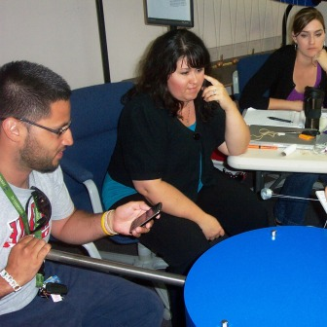
Secondary School Teachers
LIGO Livingston Observatory in Louisiana partners with regional organizations to provide teacher training
www.ligo-la.caltech.edu/SEC.html
LIGO Hanford Observatory in Washington state offers stand alone summer workshops for teachers
www.ligo-wa.caltech.edu/prof_dev.html
LIGO participates in remote workshops for teachers by invitation from organizers
Hanford observatory also provides summer teacher internships through the STAR teacher program
www.ligo-wa.caltech.edu/internships.html
Contact William Katzman (wkatzman@ligo-la.caltech.edu) and Dale Ingram (ingram_d@ligo-wa.caltech.edu)

Slide 12
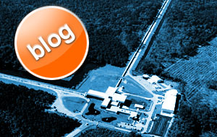
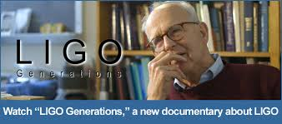
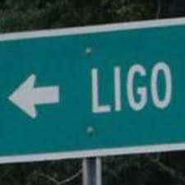
LIGO Online
On the web
www.ligo.caltech.edu
www.ligo.org
On Facebook
www.facebook.com/LigoScientificCollaboration
On Twitter
twitter.com/LIGO
On Youtube
LIGO Generations www.youtube.com/watch?v=3xVUmmSFxXu
LIGO, A Passion for Understanding www.youtube.com/watch?v=_OPTo1kPJI
LIGO Magazine
www.ligo.org/magazine.php

Slide 13
AU Optics Olympiad
LIGO group at American University starting an Optics Olympiad for DC high school students
Day of individual and group competition in optics, physics, and science
Give overview of optical science
Discuss wide application of optics
Tips on applying to college
Introduce STEM careers
Build collaboration between research scientists and schools

Slide 14
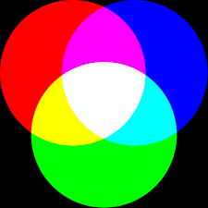
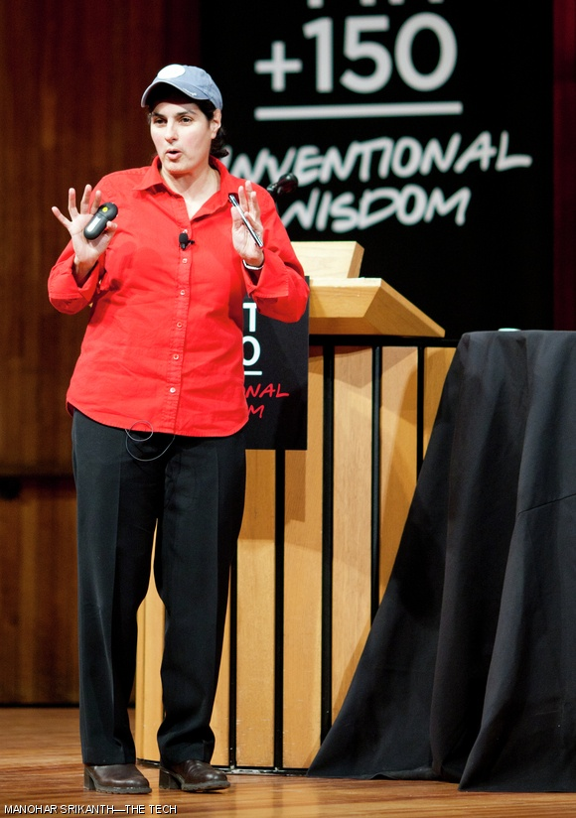
Optics Olympiad Schedule
Morning - optics demonstrations
Inteferometry, color and light mixing, Snell’s law and trigonometry, telescopes, total internal reflection, lasers, IR light
Individual quizzes with trophies
Lunch - guest speaker, panel discussions, and lab tours
MIT Prof. about quantum optics
Afternoon – team competition based on optics trivia questions
Double elimination tournament
Prizes awarded at end of day

Slide 15
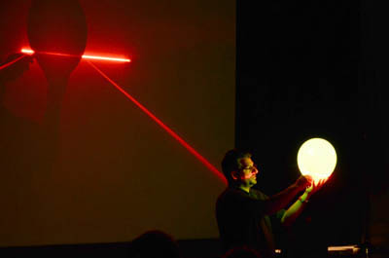
Participate in the Optics Olympiad
Organizing now, looking for help
Advisory committee members
Speakers, demonstrations, class recruitment, “day of” volunteers, etc.
Participate in Optics Olympiad
Tentative date Friday March 4, 2016
Sign up sheets at front
Need feedback on …
What grade level to target?
Appropriate level of math (and physics)
How to recruit schools
Logistics for schools
Other issues we aren’t anticipating

Slide 16
Example Demonstration Interferometer
Learning Objectives
Understand that light is a wave
Be able to describe how interference of waves occurs
Know the length scale of the wavelength of visible light
Script
Generate interest by showing sensitivity
Explain interference of light acting as a wave
Show practical application by measuring < 1 micron of movement

