Slide 1
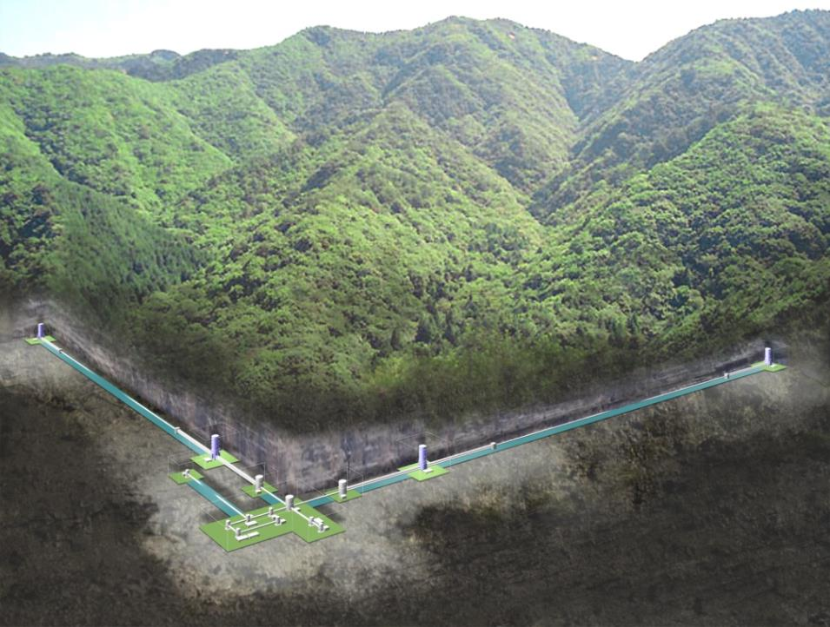

Status of KAGRA
LIGO seminar
Jul. 20, 2015
Caltech, Pasadena, USA
JGW-G150xxxx
Seiji Kawamura (ICRR, UTokyo)

Slide 2
Outline:
Review of KAGRA
Current status
Schedule, Organization, Collaboration
Summary

Slide 3
Outline:
Review of KAGRA
Current status
Schedule, Organization, Collaboration
Summary

Slide 4
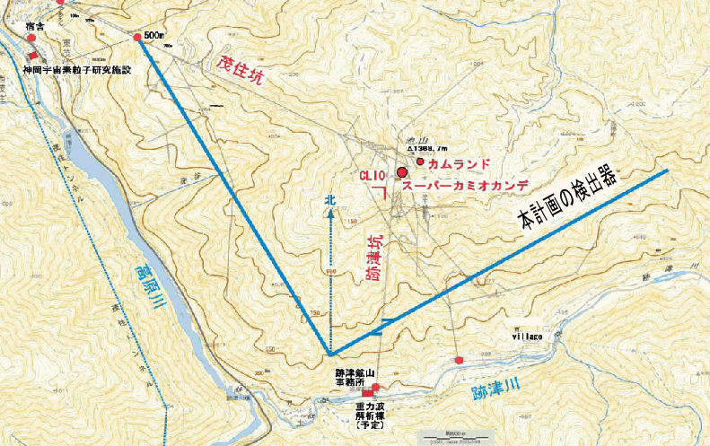
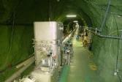
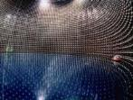
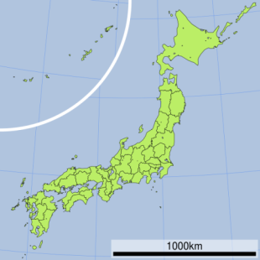
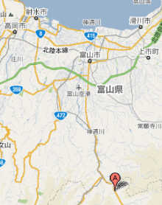
Location (Kamioka)
Mozumi Entrance
CLIO
Super-Kamiokande
3km
K A G R A
3km
Toyama airport
Kamioka◎
◎Tokyo
40min.
by car
Shin-Atotsu Entrance

Slide 5
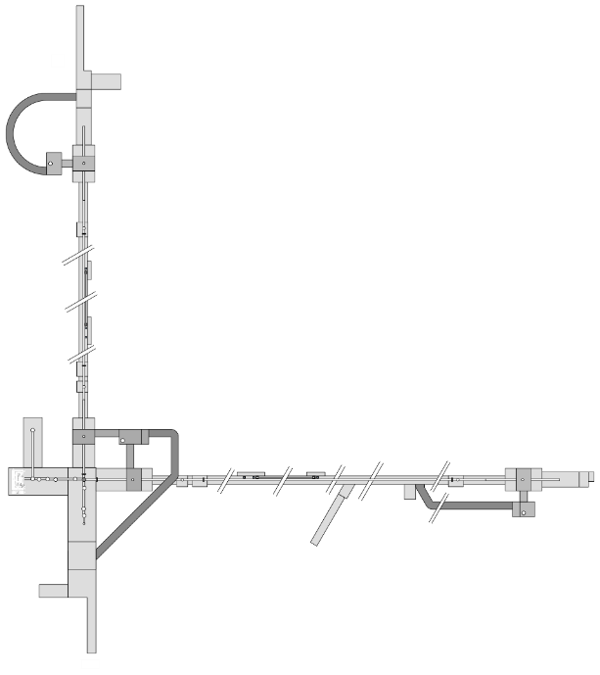
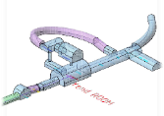
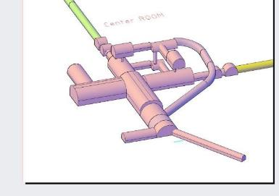
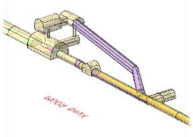
Mozumi
Tunnel Structure
Yend
36
32
35
33
31
29
30
28
3km
Y arm
27
26
Xend
Center
5
3km
12
9
10
11
14
17
4
3
7
8
15
19
20
24
25
18
X arm
23
21
22
13
2
1
New Atotsu

Slide 6
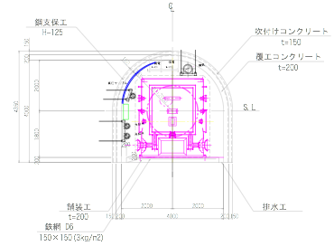
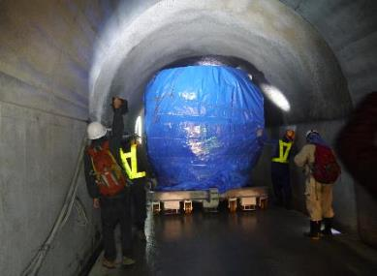
Standard cross-section of the tunnel
4,000
4,000

Slide 7
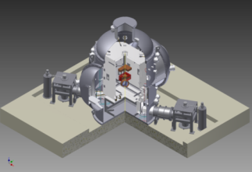
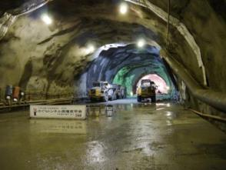
Cryogenic Mirror
Key features of KAGRA
Underground
Technologies crucial for the 3rd-generation detectors;
KAGRA can be regarded as a 2.5-generation detector.

Slide 8


Two technologies + one
Seismic noise
Typical sensitivity of the 1st generation detectors
Strain
Quantum noise
Thermal Noise
Frequency
Underground Cryogenic Mirror Resonant Sideband
Extraction

Slide 9
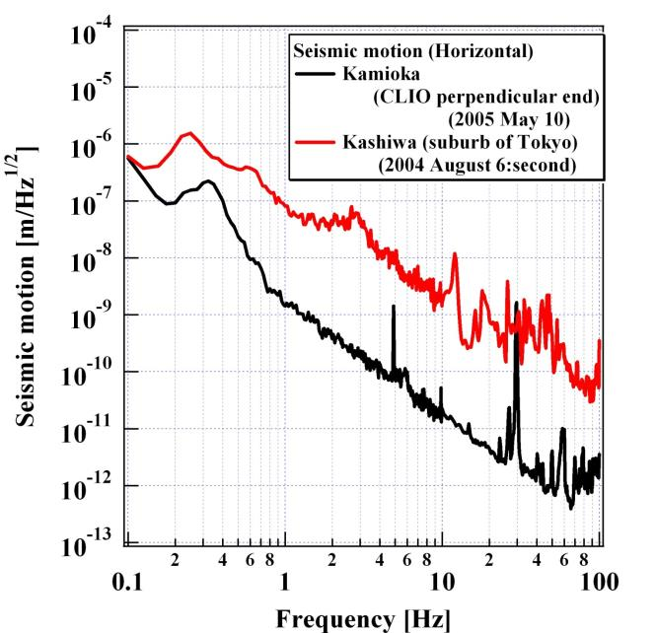
Ground motion in Kamioka mine
Kashiwa
Kamioka

Slide 10
Further seismic isolation is still necessary
Vibration of mirrors:
10⁻¹¹ mHz^{-1/2}
10⁻¹⁸ mHz^{-1/2}
@10 Hz
Should be improved
by 7 orders of magnitude

Slide 11
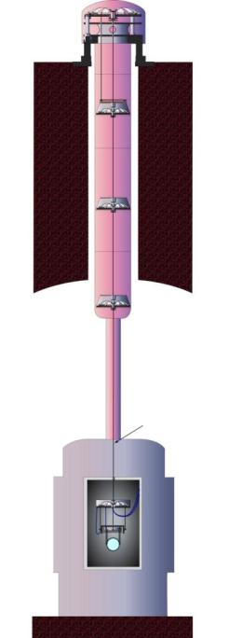
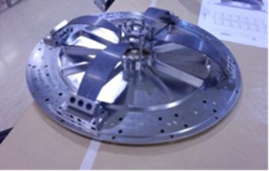
Vibration isolation system
2nd floor
Inverted pendulum
Geometrical antispring
(GAS) filter
Multi-stage pendulum
(with GAS filter)
1st floor
Another pendulum
(with GAS filter)
Mirror suspension
GAS filter
Two-layer structure to avoid the resonances of the tall structure.

Slide 12
Inverted pendulum
Restoring force
= Spring force of Metal rod + antispring force of mass gravity
⇒ Lower resonant frequency

Slide 13
Vertical seismic isolation
Coupling from vertical motion to horizontal motion exists because of:
  earth curvature
  mechanical coupling
  Slope (1/300; for draining spring water)
⇒ Vertical seismic isolation is necessary

Slide 14
Geometric Antispring (GAS) Filter
Restoring force
= Spring force of blade + antispring force of squeezed blades
⇒ Lower resonant frequency

Slide 15
Cryogenic system
Platform (14 K)
Upper mass (15 K)
Mirror (20 K)
Inner shield (8 K)
Outer shield (80 K)
Heat link
Cryocooler
Cryocooler
Cryocooler
Main beam
Beam tube shield

Slide 16
RSE interferometer
Fabry-Perot arm cavity:
Increase the effective arm length
-> Increase the GW signal
Power recycling mirror:
Increase the effective power
-> Improve the shot noise
Signal extraction mirror:
Extract GW signal before cancellation
-> Optimize the quantum noise
Detuned for the best NS-NS inspiral range

Slide 17
Optical configuration
ETM
Interferometer
Resonant sideband extraction with detuning
Power recycling gain: 11
Signal band gain: 15
DC readout
Mode cleaner
26 m
Finesse: 500
ITM
PRM
Input Bench
BS
ITM
400 kW
ETM
80 W
825 W
Laser
Wavelength: 1064 nm
Power: 180 W
NPRO + Fiber amp. + laser module
SEM
Output mode cleaner

Slide 18
Mirror/suspension configuration
ETM
Type-A system
Type-C system
- Cryogenic test mass
Sapphire, 23kg, 20K
- Tall seismic isolator
IP + GASF + Payload
- Mode cleaner
Silica, 0.5kg, 290K
- Stack + Payload
ITM
PRM
BS
ITM
ETM
400 kW
Type-Bp payload
Type-B system
Test mass and Core optics (BS, FM,..)
Silica, 10kg, 290K
- Seismic isolator
Table + GASF + Type-B Payload
- Core optics (BS, SRM,…)
Silica, 10kg, 290K
- IP + GASF + Payload
- Stack for aux. optics
SEM

Slide 19
Ultimate sensitivity limit of KAGRA
Duty factor: > 80%
Inspiral range: 176 Mpc

Slide 20
Expected event rate for NS-NS coalescence
Inspiral range: 176 Mpc
(the same definition as LIGO/Virgo)
Assuming Inspiral rate per galaxy: ∼100 Myr⁻¹
Expected event rate: ∼10 yr⁻¹

Slide 21
Outline:
Review of KAGRA
Current status
Schedule, Organization, Collaboration
Summary

Slide 22
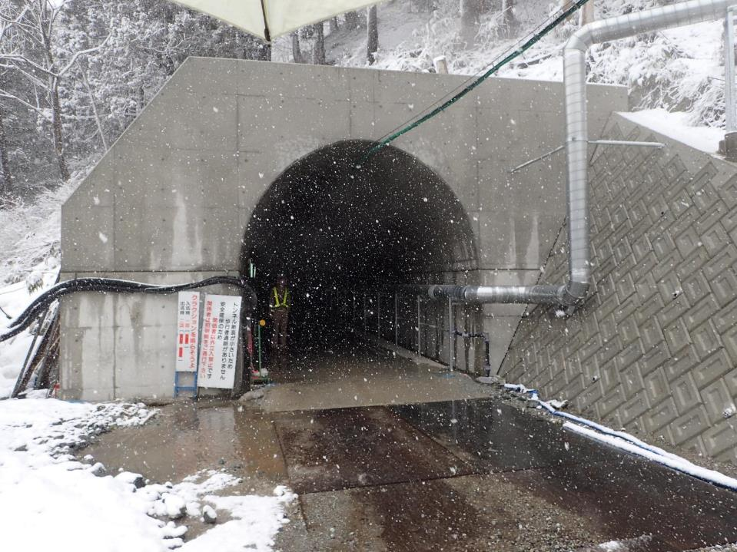
Shin-Atotsu entrance
(2015.3.10)

Slide 23
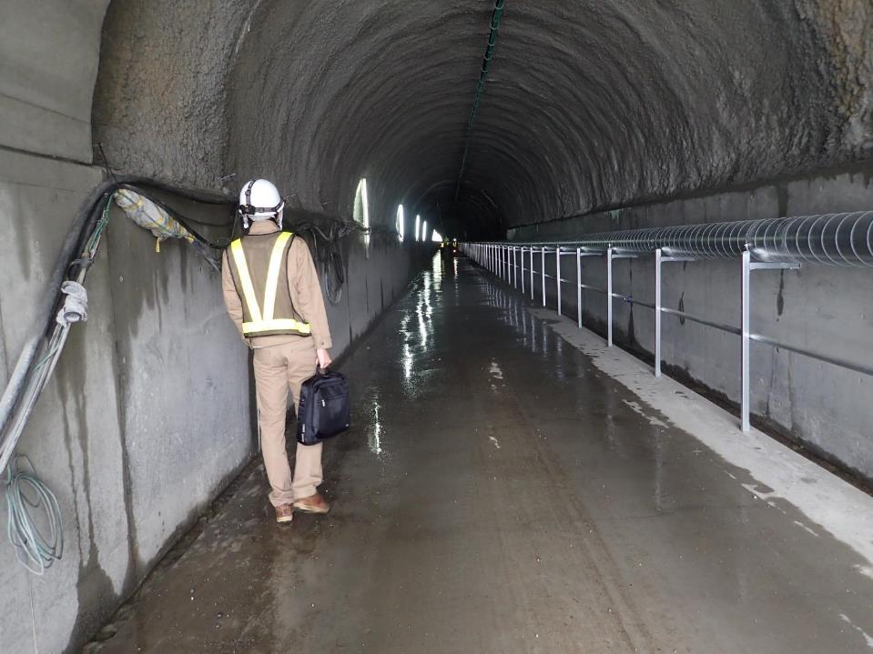
Just inside the entrance (2015.3.10)

Slide 24
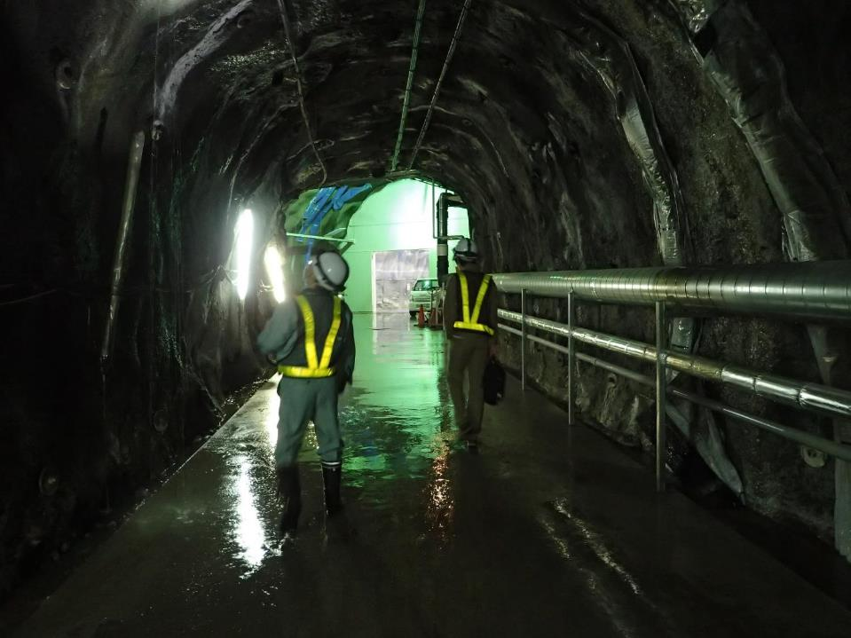
Close to the central area (2015.3.10)
500m away from the entrance

Slide 25
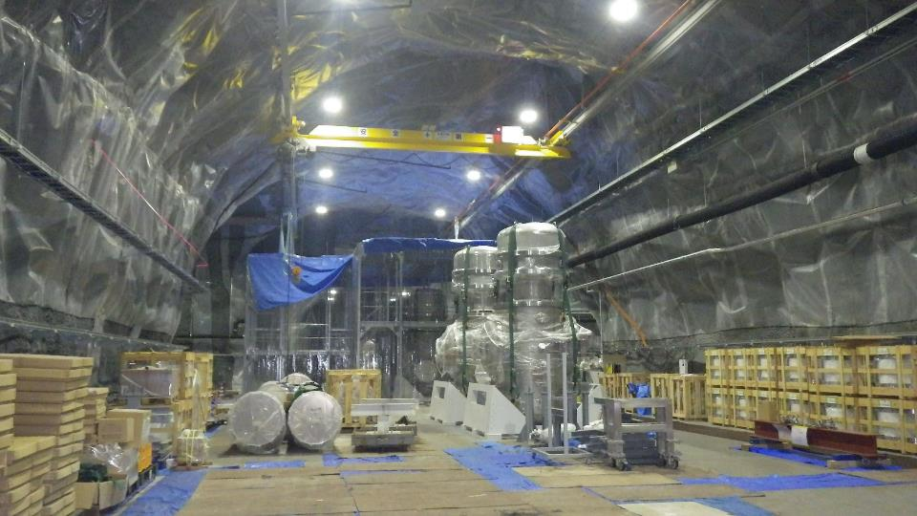
Central area (2015.6.17)

Slide 26
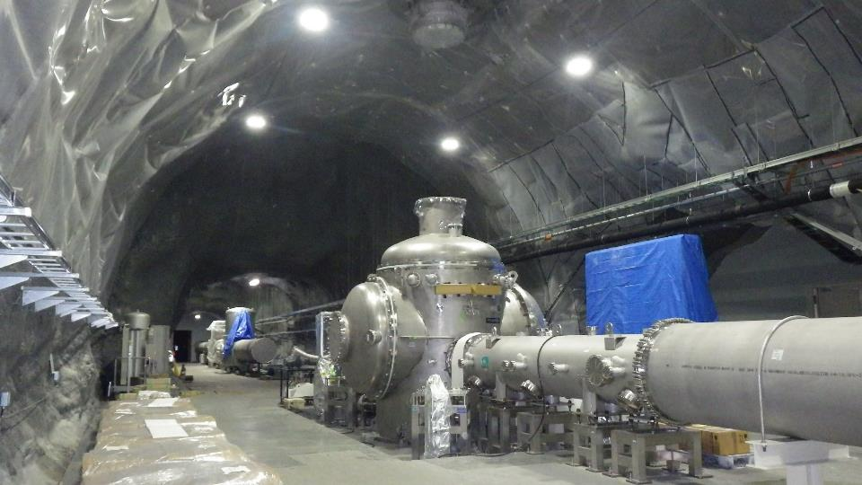
Cryostat and shaft (2015.6.17)

Slide 27
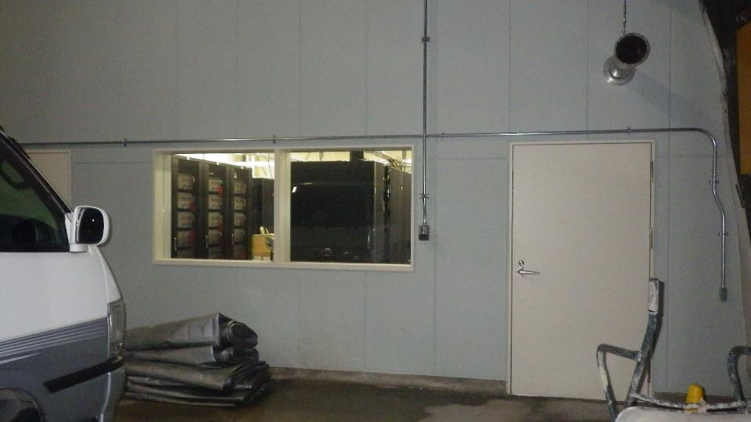
Computer room (2015.6.17)

Slide 28
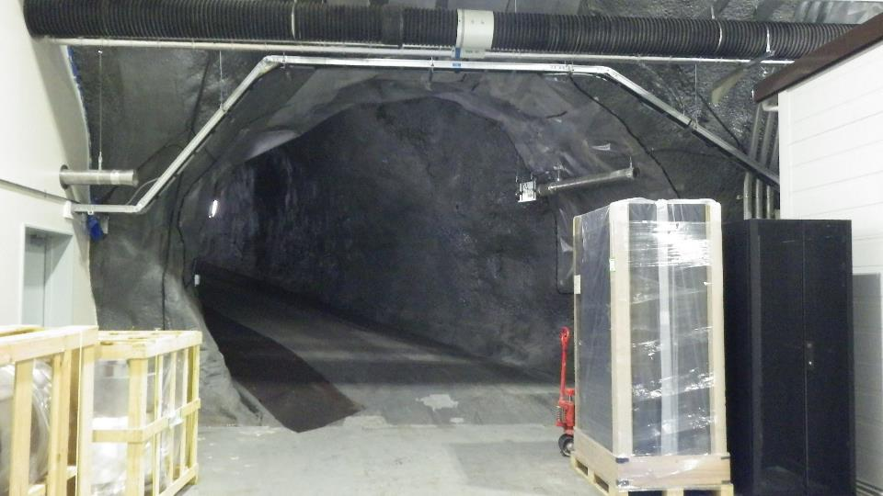
Slope to the 2nd floor (2015.6.17)

Slide 29
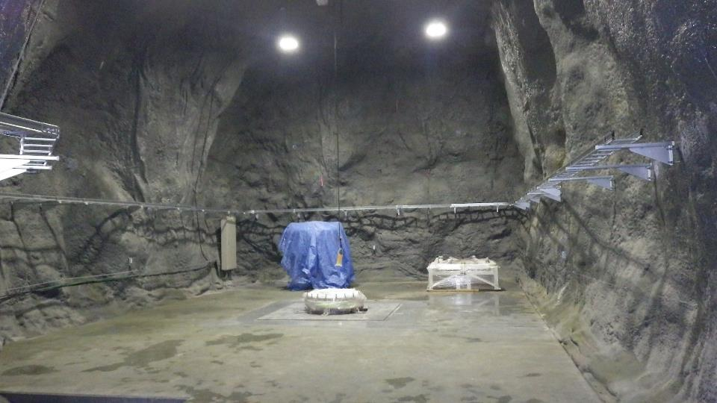
2nd floor (2015.6.17)

Slide 30
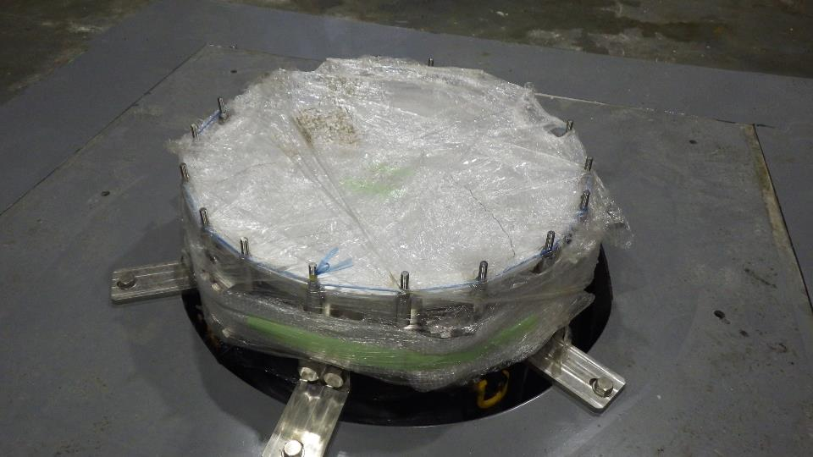
Vacuum system through the shaft (2015.6.17)

Slide 31
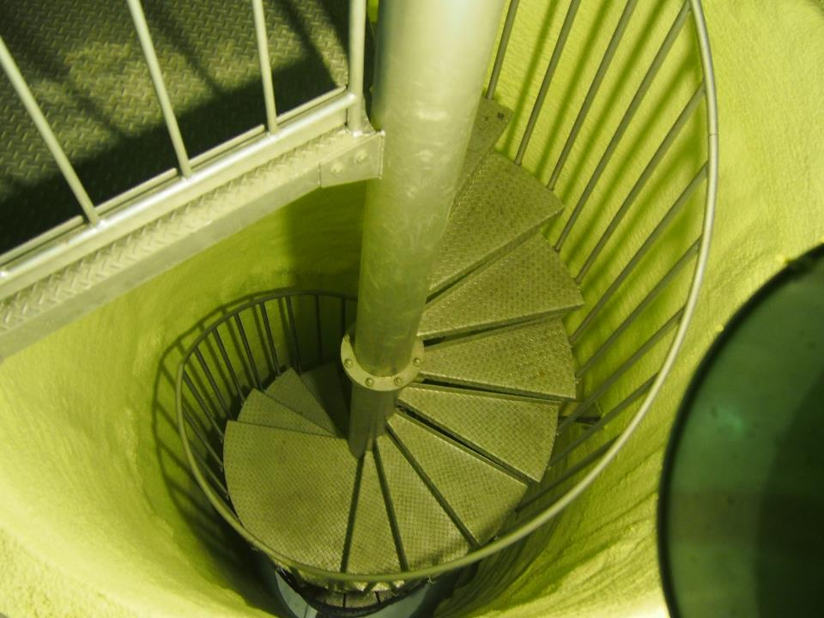
Spiral stairs
東京大学宇宙線研究所広報室

Slide 32
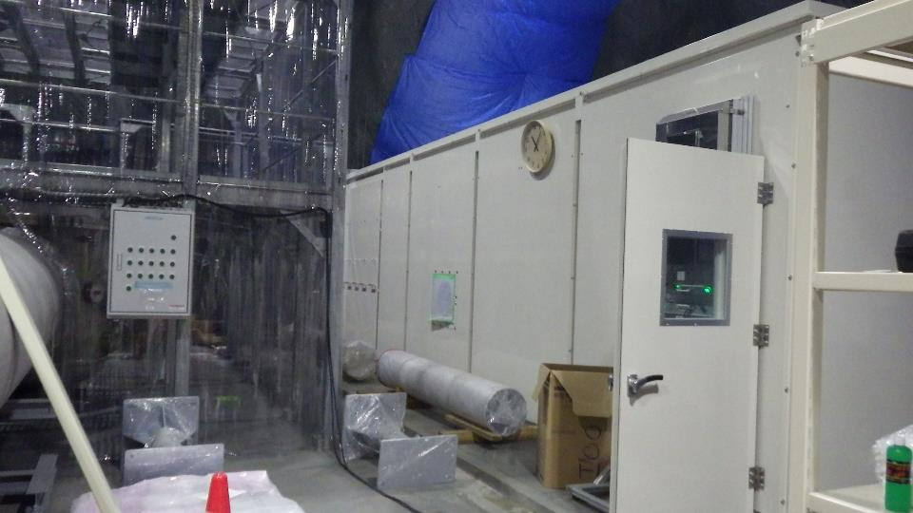
Laser clean room (2015.6.17)

Slide 33
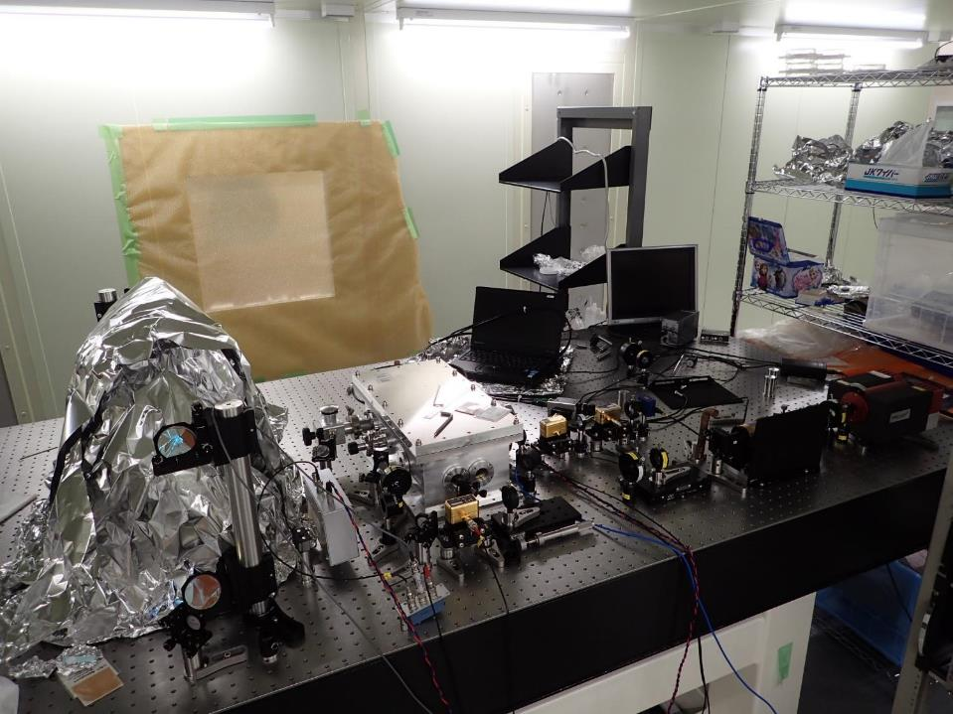
PSL table (2015.3.10)

Slide 34
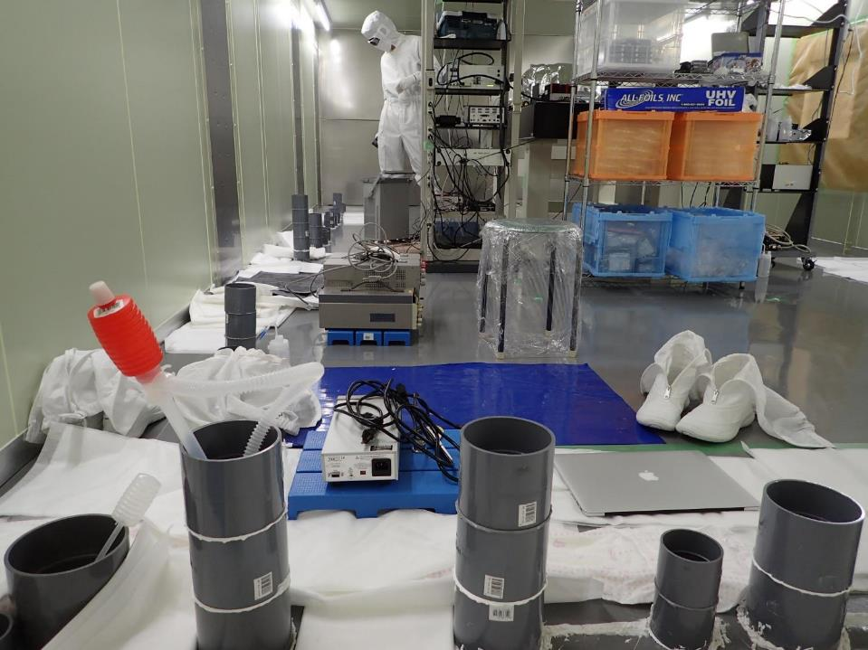
Fighting against water (2015.3.10)

Slide 35
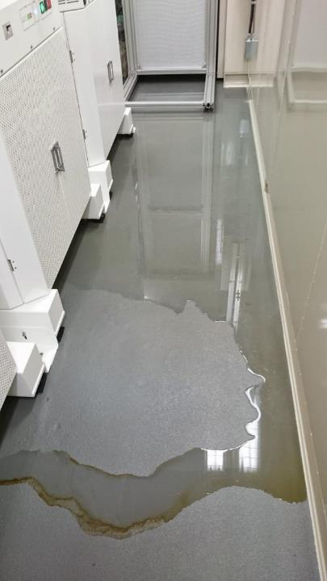
Side of the clean room (2015.3.23)

Slide 36
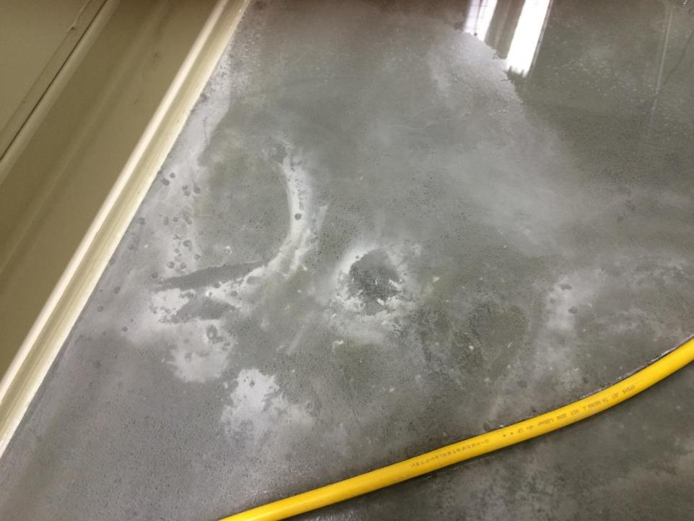
Water coming up from the concrete crack in the side room (2015.4.10)

Slide 37
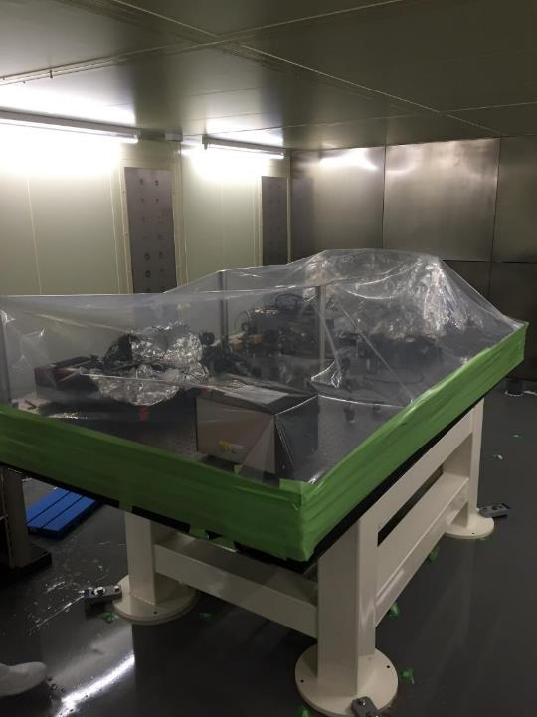
Protection for construction
(2015.3.25)

Slide 38
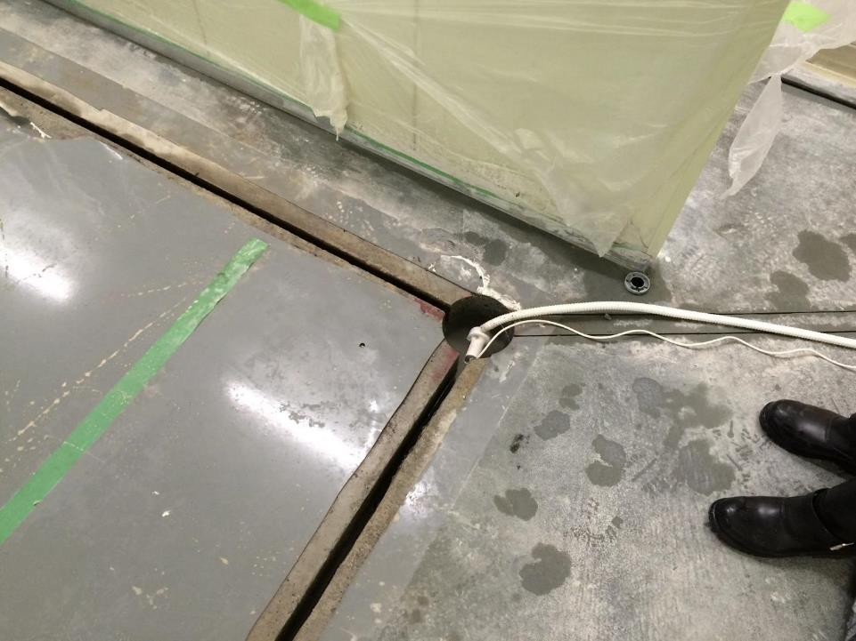
Ditch along the foundation separation area (2015.4.10)

Slide 39
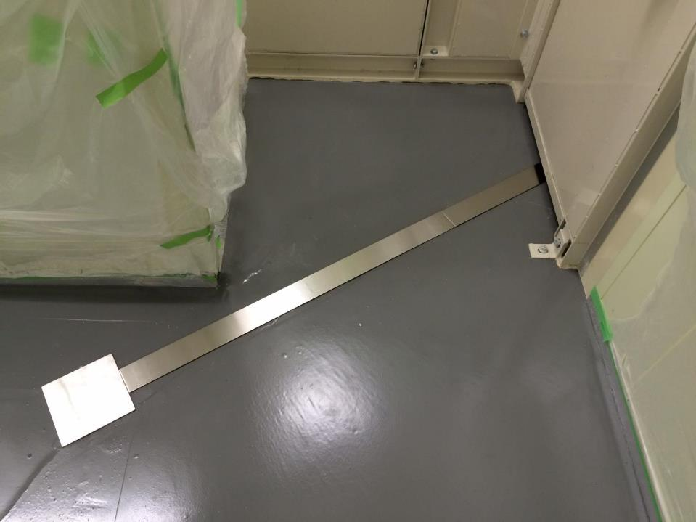
Water drainage ditch (2015.4.21)

Slide 40
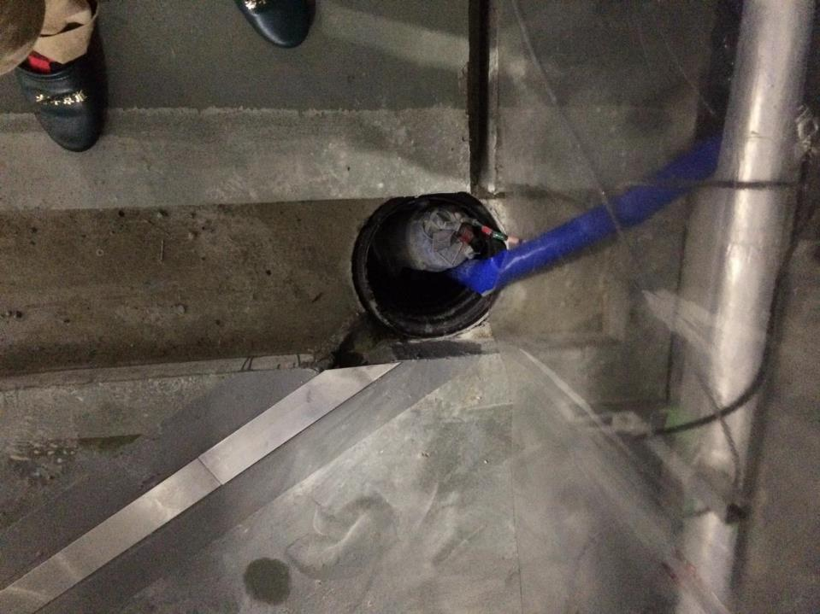
Pump in the hole (2015.4.21)

Slide 41
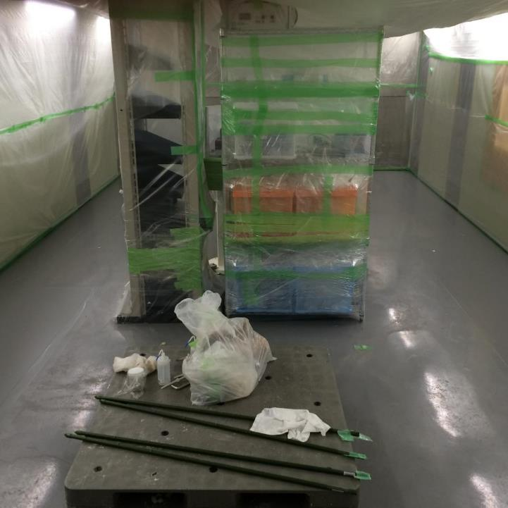
Clean room (2015.4.21)

Slide 42
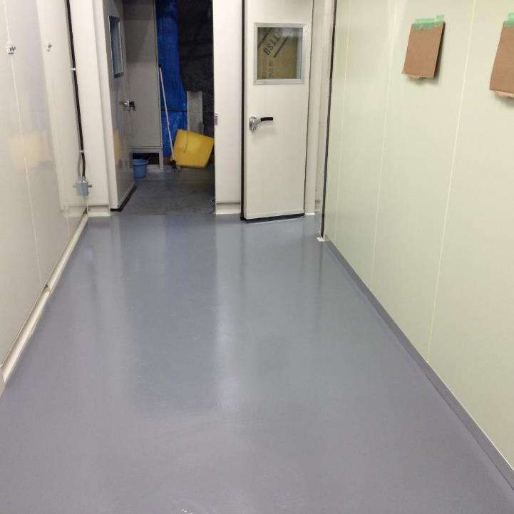
Front room (2015.4.21)

Slide 43
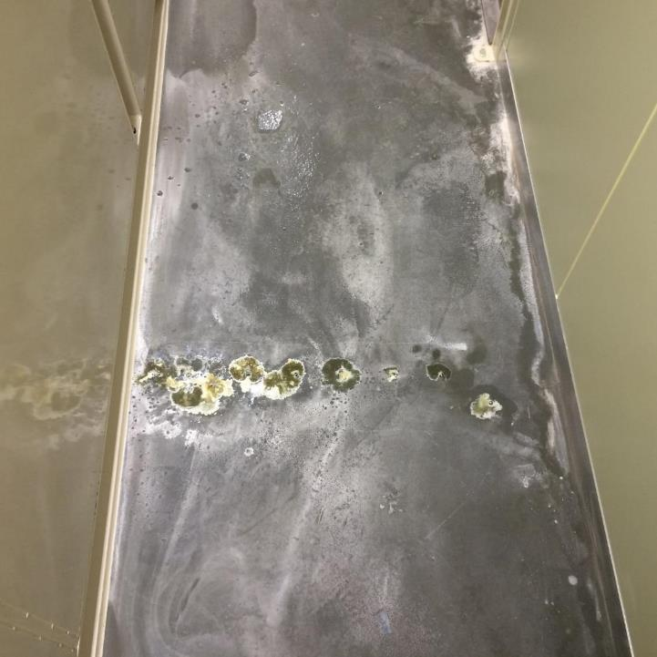
Side room of the clean room (2015.4.21)

Slide 44
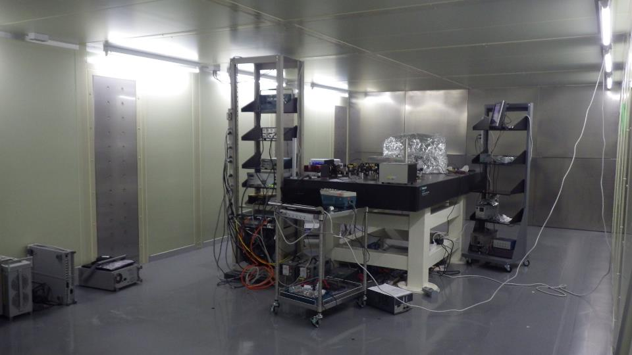
PSL clean room (2015.6.17)

Slide 45
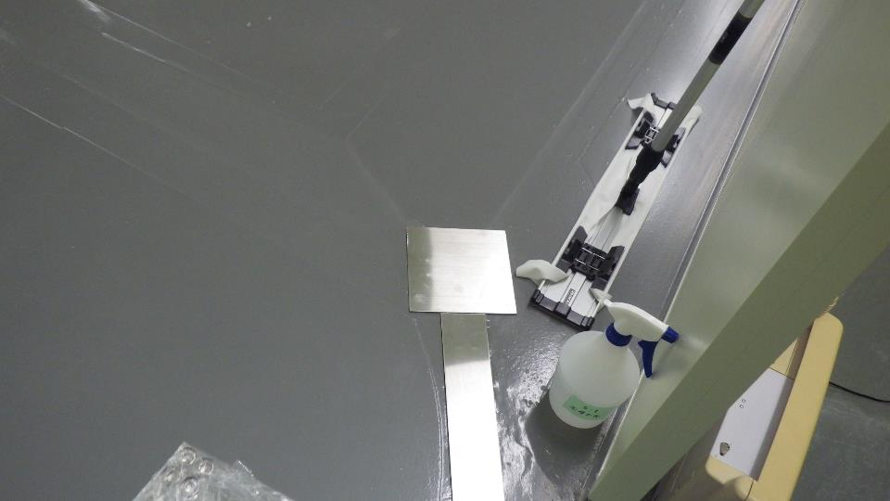
Draining ditch for spring water (2015.6.17)

Slide 46
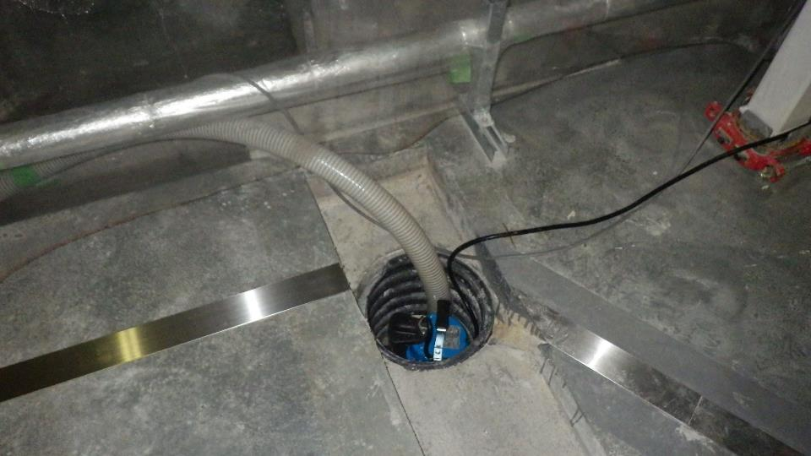
Water pump for spring water (2015.6.17)

Slide 47
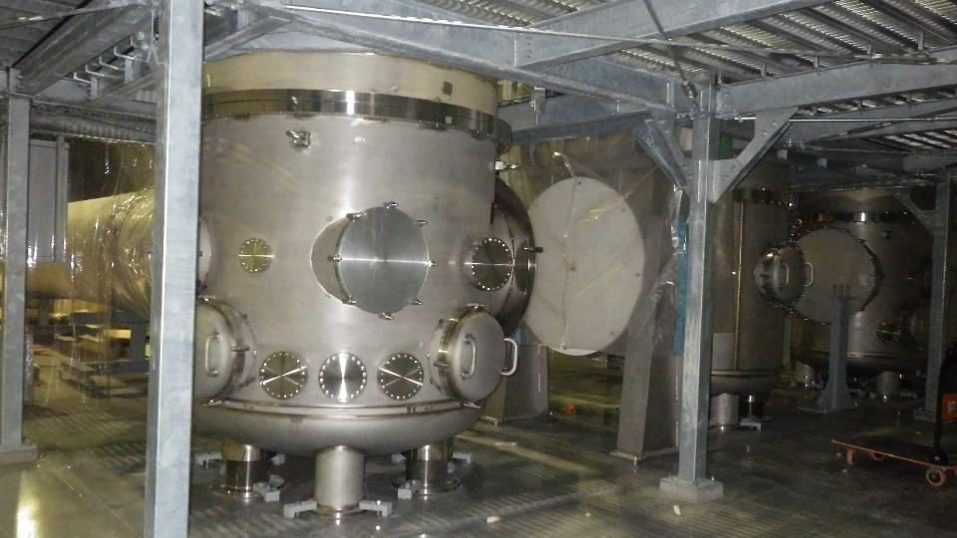
Vacuum chamber for input and output mode cleaner mirrors (2015.6.17)

Slide 48
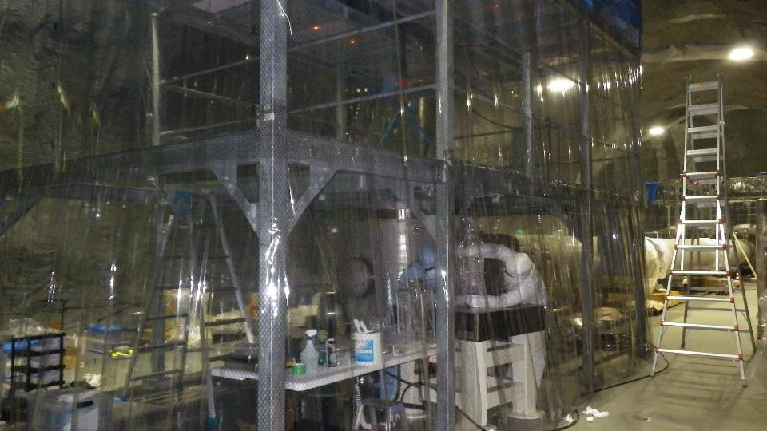
Vacuum chamber for end mode cleaner mirror (2015.6.17)

Slide 49
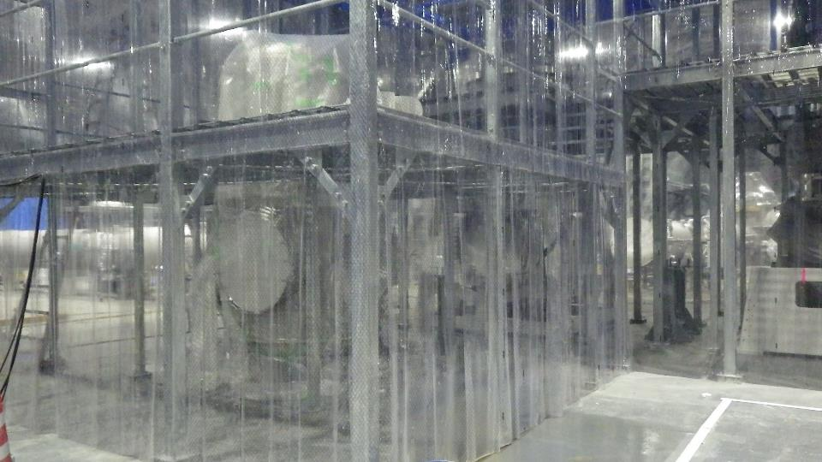
Vacuum chamber for beam splitter (2015.6.17)

Slide 50
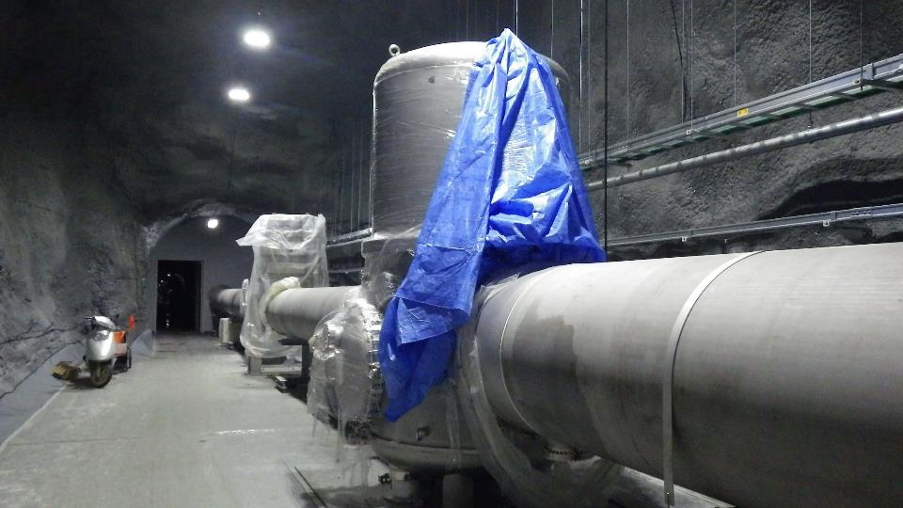
Vacuum chamber for iKAGRA input test mass (2015.6.17)

Slide 51
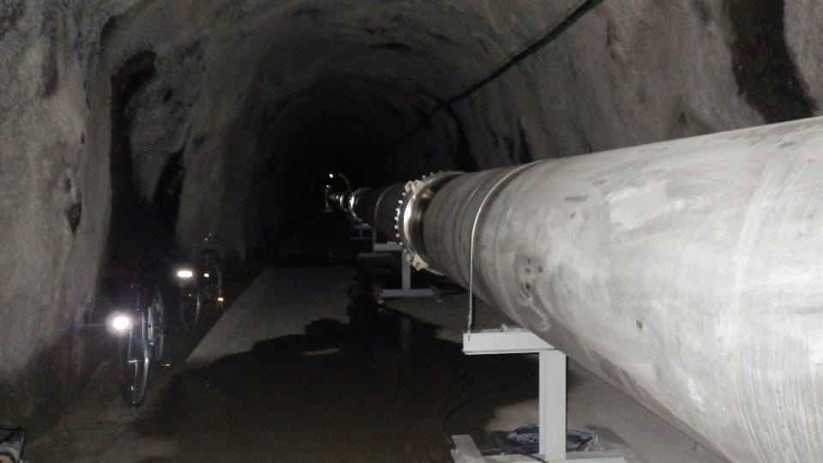
Beam tubes (2015.6.17)

Slide 52
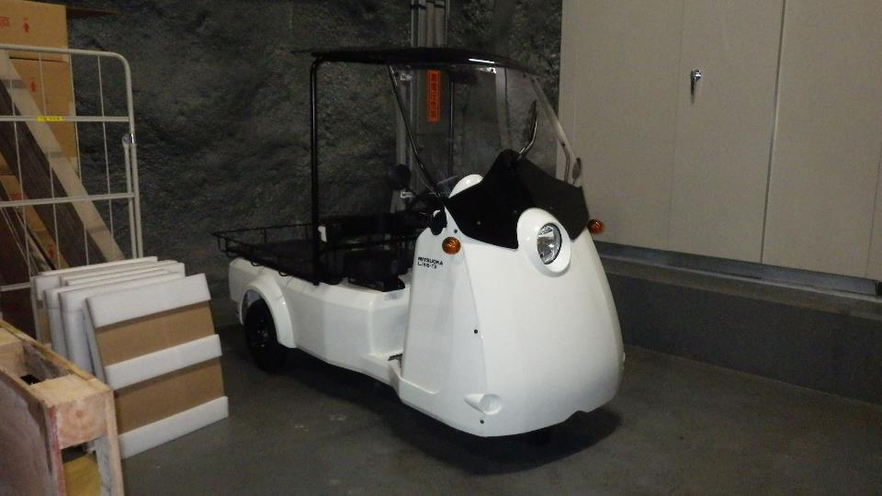
Electric car for driving in X-arm (2015.6.17)

Slide 53
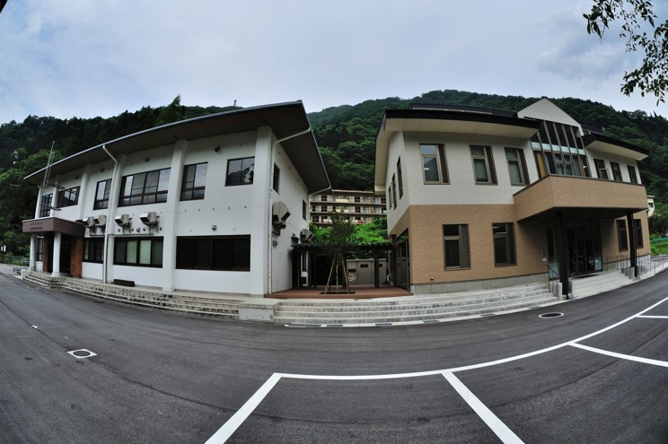
Data analysis building
神田展行氏撮影

Slide 54
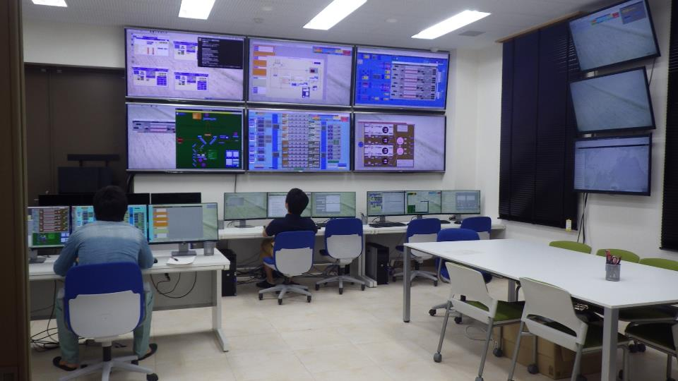
Control room in KAGRA research building (2015.6.17)

Slide 55
Pre-stabilized laser
Pre-mode cleaner: Locked
Faber ring cavity: aligned, to be locked soon

Slide 56


Input mode cleaner
Suspension system: Tested
Magnets and standoff: being attached to MC mirrors
MC Suspension: to be installed soon

Slide 57

Cryogenic suspension
Sapphire spring
[Requirements]
Strength
Heat conductivity
Mechanical loss
The component test showed the current design is OK. We plan to do the prototype test.
In collaboration with ET
Sapphire nail head
Sapphire fiber
Sapphire mirror
Hydroxide Catalysis
Bonding
22cm
Indium Bonding
Sapphire nail head

Slide 58



Reduction of cooling time
Coating all the objects except Sapphire mirrors with DLC can reduce the cooling time from 2 months to 40 days.
The effect was verified by experiment.
1/2 dummy payload coated with DLC
Aluminum sphere coated with DLC

Slide 59
Other progress
The prototype of the payload including the bottom filter was assembled at NAOJ. The transfer function of the isolation system was measured, and the result agreed well with the model.
All the mirrors for iKAGRA were manufactured and it was verified that the requirements were satisfied. A Sapphire mirror for bKAGRA with very low optical loss was test-coated as R&D for coating.
The solid laser amplifier was successfully operated. The laser output power reached 210 W, although the quality of the beam was to be improved.
A lot of progress on the data management system, detector characterization, and data analysis -> talks by Kanda, Hayama, Tagoshi, Oohara, and others

Slide 60
Outline:
Review of KAGRA
Current status
Schedule, Organization, Collaboration
Summary

Slide 61
Schedule of KAGRA
Calendar year
Project start
Tunnel excavation
initial-KAGRA
baseline-KAGRA
Observation
 | 2010 | 2011 | 2012 | 2013 | 2014 | 2015 | 2016 | 2017 | 2018
iKAGRA obs.
Adv. Optics system and tests
Cryogenic system
iKAGRA
Michelson interferometer (changed)
Room temperature
Simple seismic isolation system
bKAGRA
Resonant sideband extraction
Cryogenic temperature
Advanced seismic isolation system

Slide 62
KAGRA management structure
PI
Takaaki KajitaI
KAGRA Council
Program Advisory Board
Theory
T.Nakamura (KU)
Advanced R&D
K.Somiya (TITECH)
International Board of Representative
Executive office members +
International representatives
Safety Committee
S.Kawamura (Chair, ICRR), M. Ohashi (ICRR), S.Miyoki (ICRR), N.Ohishi (NAOJ), H.Ishizaki (NAOJ), H.Ishiduka (ICRR), K.Takayama (ICRR)
Safety Control Office
M. Ohashi (Chair, ICRR), S.Miyoki (ICRR), T. Uchiyama (ICRR), O. Miyakawa (ICRR), H.Ishiduka (ICRR), K.Takayama (ICRR)
Executive Office
T.Kajita (chair, ICRR), M.Ando (UT), S.Kawamura (ICRR), K.Kuroda (ICRR),
M.Ohashi (ICRR), R.Flaminio (NAOJ), Y. Saito (KEK), N.Kanda (OCU), T. Suzuki (KEK)
Committee of Publishing Control
R.Flaminio (chair, NAOJ), N.Kanda (OCU), Y.Saito (KEK), N.Mio (UT), S.Kawamura (ICRR), Z.Zhu (BNU)
Author List Committee
K. Kuroda (chair, ICRR), K. Oohara (Niigata), R. Flaminio (NAOJ), M. Ando (UT), S. Miyoki (ICRR)
Committee of Public Relations
S.Miyoki (chair, ICRR), T.Uchiyama (ICRR), M-K.Fujimoto (NAOJ), Y.Aso (NAOJ), T.Tomaru (KEK)
General Computer and Documentation Team
S.Miyoki (Manager, Documentation, ICRR), O.Miyakawa (Documentation, ICRR), K. Kokeyama (Remote Meeting, ICRR), H. Takahashi (LIGO-DCC, Nagaoka), R. Flaminio (eLog, NAOJ)
System Engineering Office
Y.Saito (Project Manager, KEK), S.Kawamura (Deputy, scheduling &commissioning), M.Ohashi (Deputy, budget&construction), K.Somiya (TITECH), S.Miyoki (ICRR), Y.Aso (NAOJ), M.Ando (bKagra design, UT), T. Suzuki (KEK), T.Uchiyama (ICRR)
External Review Committee
Installation Scheduler
T.Uchiyama (ICRR), H.Ishiduka (ICRR)
Facility
S.Miyoki (ICRR)
Vacuum
T.Uchiyama (ICRR)
Cryogenics
T.Tomaru (KEK)
Vibration Isolation
R.Takahashi (NAOJ)
Mirror
E.Hirose
(ICRR)
Laser
N.Mio
(UT)
Main Interferometer
Y.Aso
(NAOJ)
Input/Output Optics
S.Kawamura (ICRR)
Auxiliary Optics
T.Akutsu (NAOJ)
Analog Electronics
O.Miyakawa (ICRR)
Digital Systems
O.Miyakawa (ICRR)
Data Management
N.Kanda (OCU)
Data analysis
H.Tagoshi (OU)
Geophysics Interferometer
A.Araya (UT/ERI)
Safety
N.Ohishi (NAOJ)
Subchief
Y.Saito
(KEK)
Cryostat
N.Kimura (KEK)
VIS control
Subchief
A.Ueda (NAOJ)
DetChar
K.Hayama (OCU)
Subchief
F.Matsushima
(U Toyama)
Subchief
M.Kamizumi
(ICRR)
Subchief
K.Kokeyama
(ICRR)
DMG
Software
K.Oohara (Niigata U)
Subchief
Y.Itoh
(UT)
Subchief
A.Takamori
(UT/ERI)
Cryo-Payload
K.Yamamoto (ICRR)
ITF control
Y.Michimura (UT)
Subchief
T.Sato
(Niigata U)
Subchief
H.Takahashi
(Eiwa C)

Slide 63
Summary of collaboration
242 members
∼70 Universities/Institutes
∼80 departments
(as of May 1, 2015)

Slide 64
University/Institute/department with many members
ICRR, Univ. of Tokyo: 29 members
NAOJ: 27 members
KEK: 9 members
Univ. of Tokyo (other than ICRR): 15
Osaka City Univ.: 14
Univ. of Toyama: 10
Korea: 18 in total

Slide 65


KAGRA in network
LIGO(H)+LIGO(L)+Virgo
Coverage at 0.5 M.S.: 72%
3 detector duty factor: 51%
LIGO(H)+LIGO(L)+Virgo+KAGRA
Max sensitivity (M.S.): +13%
Coverage at 0.5 M.S.: 100%
3 detector duty factor: 82%
L/H+L/L+V 50%
L/H+L/L+V+LCGT
50%
B. F. Schutz

Slide 66

MOU with LIGO Scientific Collaboration (LSC) and VIRGO
MOU signed
  General part (K-L-V)
  Attachment A (K-L)
    Technical collaboration
  Attachment B (K-L-V)
  Data sharing and analysis
  Attachment C (K-V)
  Technical collaboration

Slide 67
JSPS core-to-core program
Core-to-core program is designed to create world-class research hubs in Japan by conducting collaborations with other countries.
Five year program between FY2013 and FY 2017
Budget
  \16M ($160K; assuming $1 ∼\100) for FY2013
  \16M ($160K) for FY2014
  \14.5M ($145K) for FY2015

Slide 68
Country | Core Institute | Coordinator | Budget pattern
USA | Louisiana State University | Warren Johnson | 1
Italy | European Gravitational Observatory | Michele Punturo | 1
Germany | Albert Einstein Institute | Harald Lueck | 1
UK | University of Glasgow | Sheila Rowan | 1
Netherlands | NIKHEF | Jo van den Brand | 1
France (Joined in 2015) | Centre National de la Recherche Scientifique | Gianpietro Cagnoli | 1
Australia | University of Western Australia | David Blair | 1
Korea | Korea University | Tai Hyun Yoon | 2
China (1) | Beijing Normal University | Zong-Hong Zhu | 2
China (2) | Shanghai Normal University | Xiang-Hua Zhai | 2
Taiwan | National Tsing-Hua University | Shiuh Chao | 2
India | IUCAA | Sanjeev V. Dhurandhar | 2
Vietnam (Joined in 2014) | Hanoi National University of Education | Nguyen Quynh Lan | 2
Pattern1: Sending side covers all the travel expenses.
Pattern 2: Sending side covers airfare and receiving side covers domestic travel costs.

Slide 69
Collaboration with ET
Cryogenic mirror/suspension
  Component test was performed and found to suffice the three requirements (strength, heat conductivity, and mechanical loss)
  Prototype test will be performed soon.
  Kieran Craig, who worked on the issue, will join KAGRA as a postdoc in August.
Vibration isolation system
  Inverted pendulum

Slide 70

ELiTES meeting
Collaboration meeting between ET and KAGRA
Held once a year in Tokyo, Japan
3rd ELiTES meeting in Tokyo on Feb. 9, 2015.

Slide 71
Collaboration with LIGO
Several KAGRA visitors to LHO/LLO to learn installation and commissioning
LIGO speakers in KAGRA F2F meeting share experience of installation and commissioning
LIGO kindly provided test masses for iKAGRA.
University of Florida visited the KAGRA site to help assembly and adjustment of Faraday isolator.
LIGO kindly made it possible that KAGRA members can get access to the LIGO documents including circuit diagrams, technical documents, etc.

Slide 72
Collaboration with Korea
Instrument
  Frequency stabilization system developed jointly by Tai Hyun Yoon (Korea Univ.) and ICRR has been installed for iKAGRA pre-stabilized laser system. He worked on this at ICRR as ICRR visiting professor for two months in 2013 and 2014.
  Tilt sensor has been developed by Kyuman Cho (Sogang Univ.) . If it works well it could be used for bKAGRA mirror angular sensor. He worked on this at ICRR as ICRR visiting professor for almost two months in 2015.
Data analysis and detector characterization
  Code for data analysis has been developed jointly.
  Tool for identifying noise source has been developed jointly.
  Regular telecon and occasional F2F meeting is held now.

Slide 73

Korea-Japan workshop on KAGRA
Held twice a year since 2012
It could be evolved to international workshop on KAGRA; under discussion now
8th Japan-Korea workshop in Gwangju, Korea on Jun. 27, 2015.

Slide 74
Outline:
Review of KAGRA
Current status
Schedule, Organization, Collaboration
Summary

Slide 75
Summary
Most vacuum systems were installed.
The water problem was mostly solved.
We are now working on the pre-stabilized laser and mode cleaner for iKAGRA.
We plan to have an observation run with iKAGRA at the end of 2015.
We made progress on the cryogenic suspension, vibration isolation system, Sapphire mirrors, high-power laser, etc. for bKAGRA.
We plan to start observation runs with bKAGRA at the end of 2017FY.

