Slide 1
Input optics
“IO”
Input optics
EOM
Mode cleaner
Faraday
Other components
9/25/2015

Slide 2
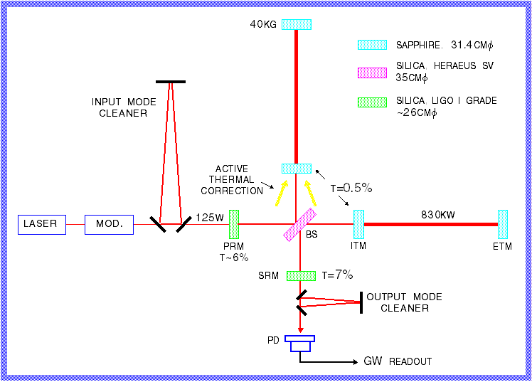
Advanced Interferometer
New features:
Signal recycling
200-watt laser
40 kg test masses
Larger beam size
Higher arm finesse
Moderate recycling factor
Active thermal correction
Better isolation from the ground
Output mode cleaner
9/25/2015

Slide 3
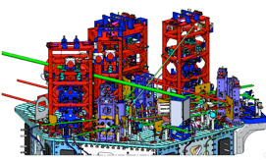
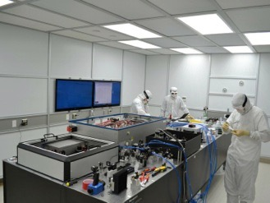
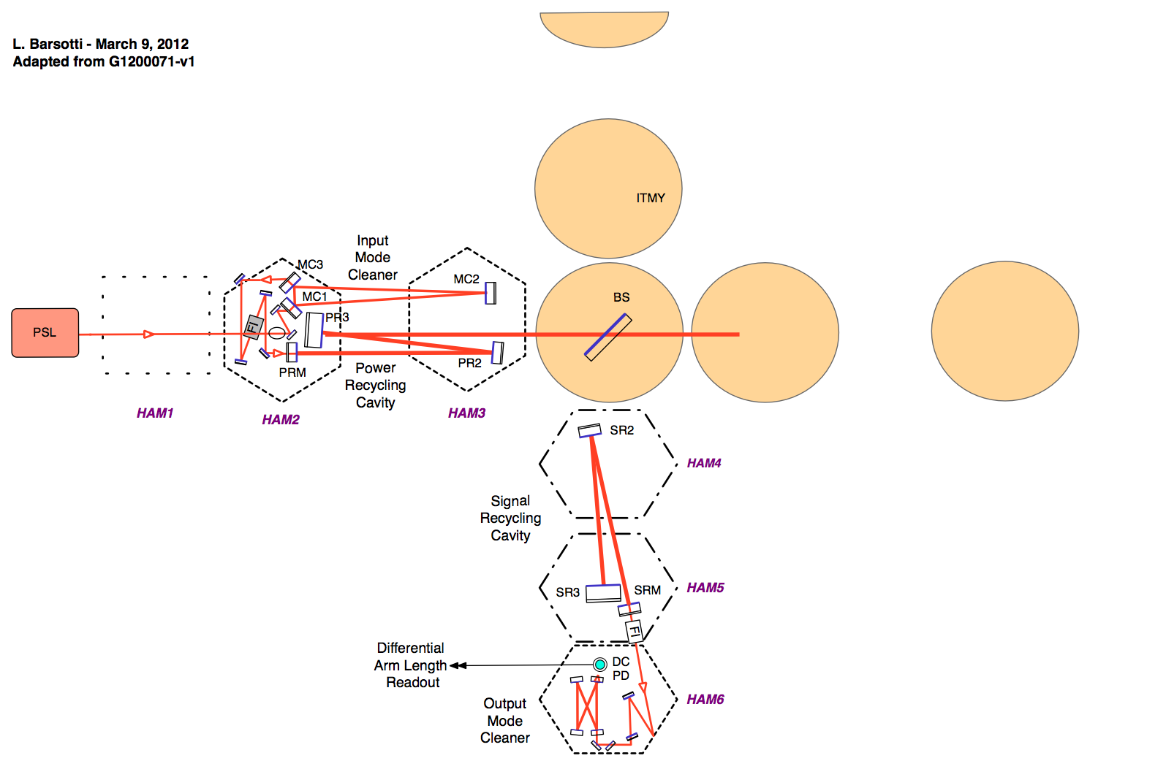
Advanced LIGO IO is very complex

Slide 4
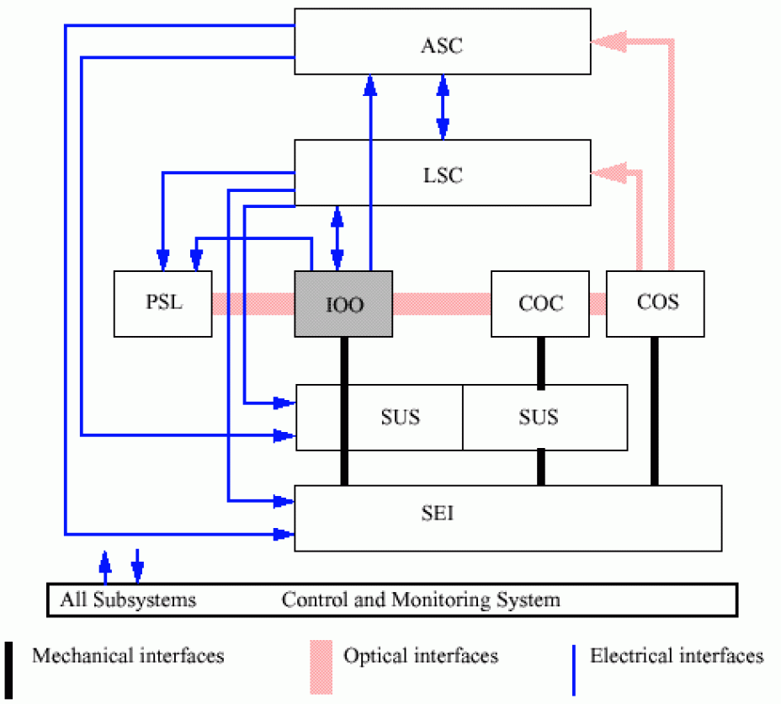
IOO = “input optics”
9/25/2015

Slide 5
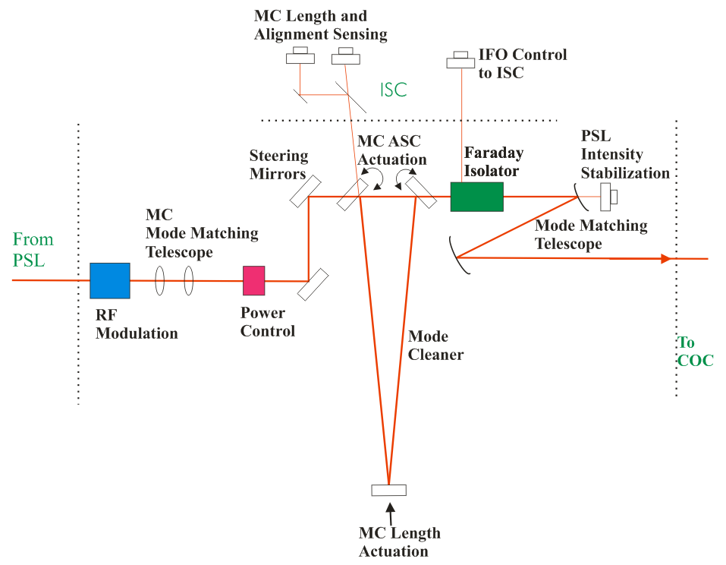
The input optics (IO)
The input optics (IO) conditions the PSL laser light and delivers it to the interferometer.
It provides:
RF modulation for length and alignment control functions
Power control
Laser mode cleaning and frequency stabilization
Isolation of laser from interferometer reflected light
Optical signal distribution to length and alignment control
Mode matching to recycling and arm cavities
Design and fabrication of small PRMs and SRMs
PSL = pre-stabilized laser
COC = core optical components
IMC = input mode cleaner
ISC = interferometer sensing and control
PRM = power recycling mirror
SRM = signal recycling mirror
5
5

Slide 6
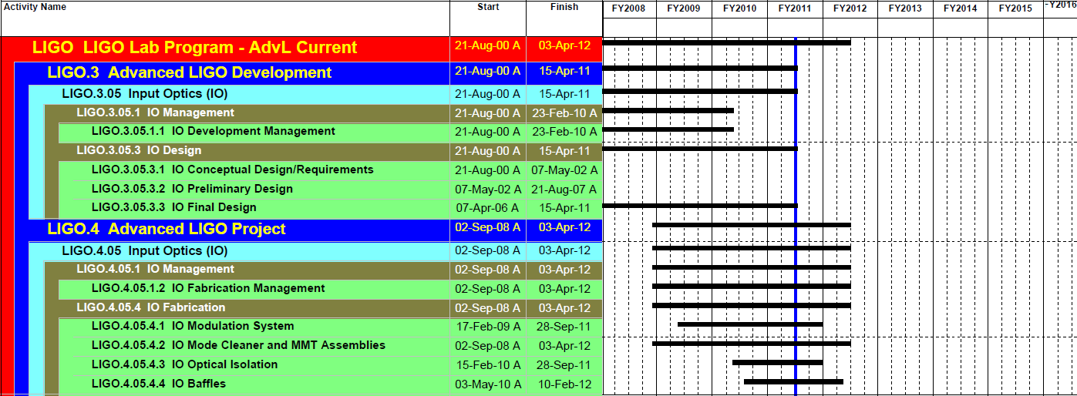
IO Schedule Highlights
Overall IO Final Design substantially completed in Feb 2010
May 2011 is for baffles (additional scope), installation
IO Project phase began in Sept 08
Optics procurement (input mode cleaner, recycling mirrors, steering and mode-matching mirrors) is largest component of the project
Well underway; on track to meet installation schedule

Slide 7
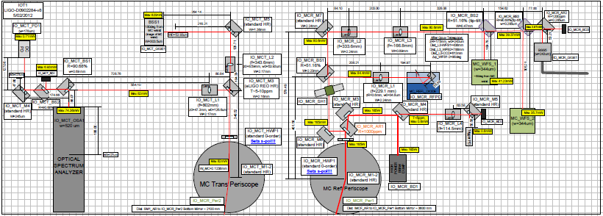
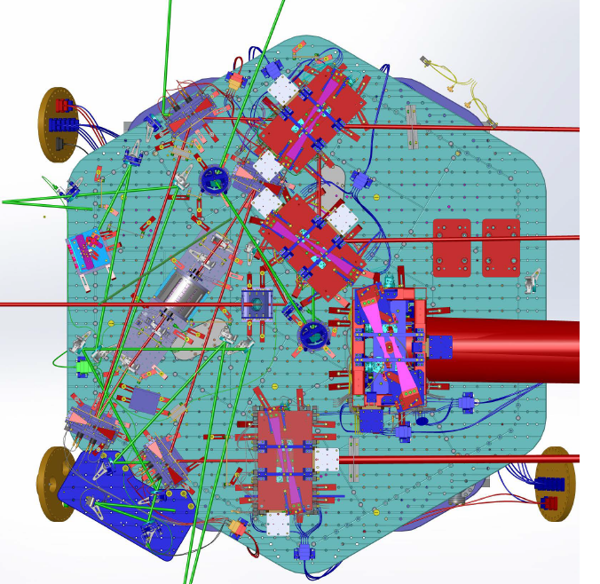
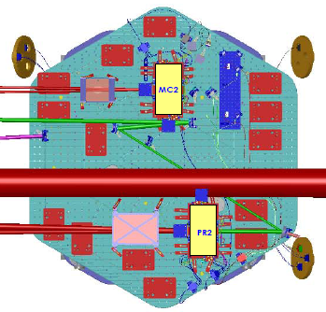
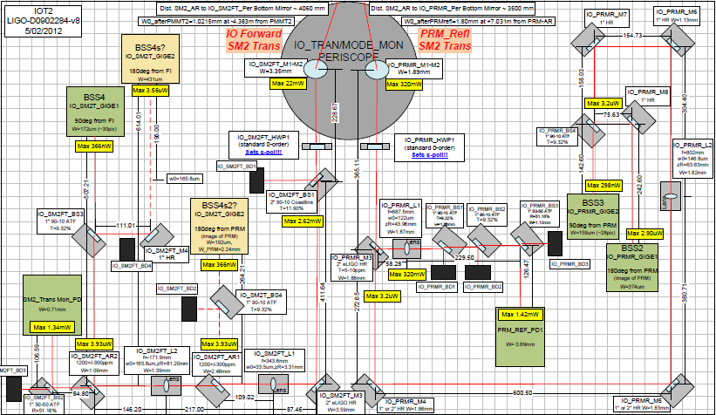
Input Optics full view
G1200911

Slide 8
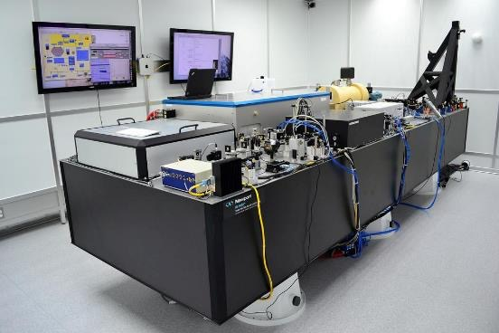
PSL-IO table

Slide 9
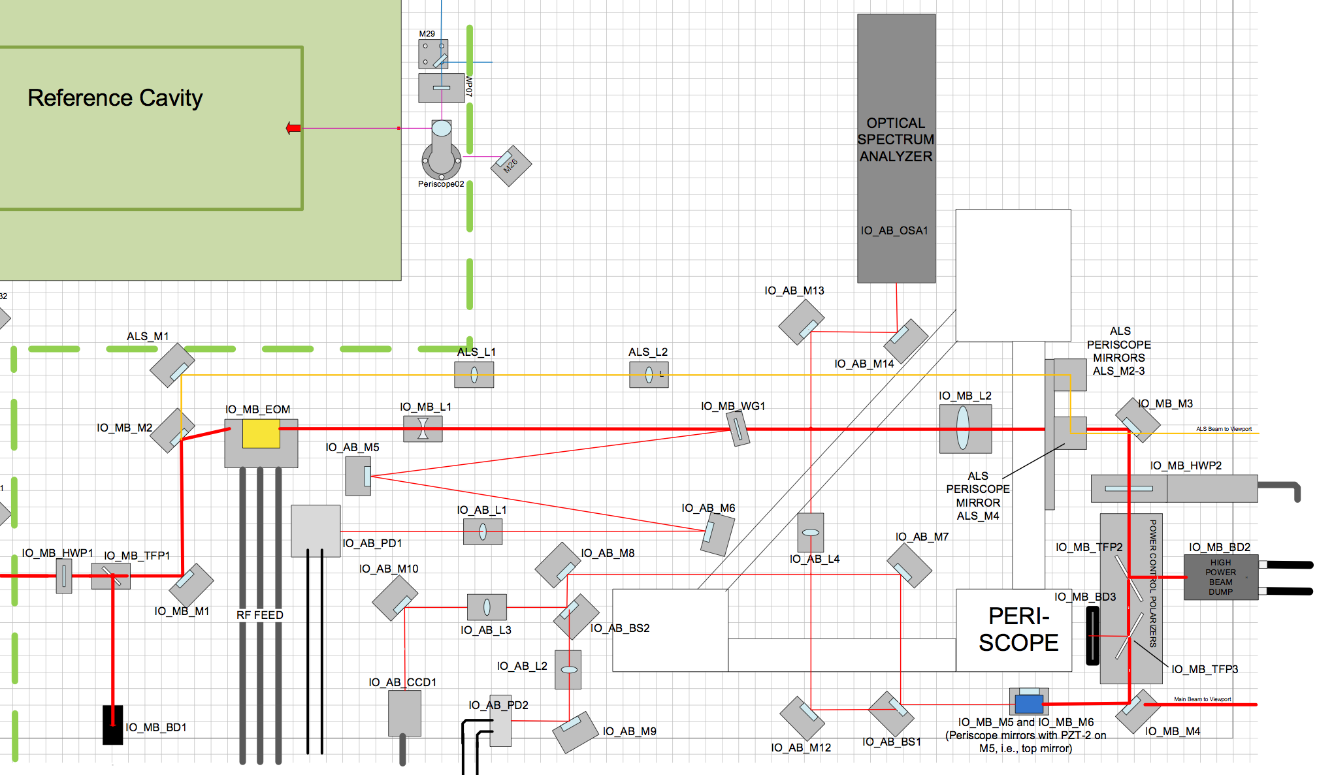
IO on the PSL table
LIGO Scientific Collaboration

Slide 10
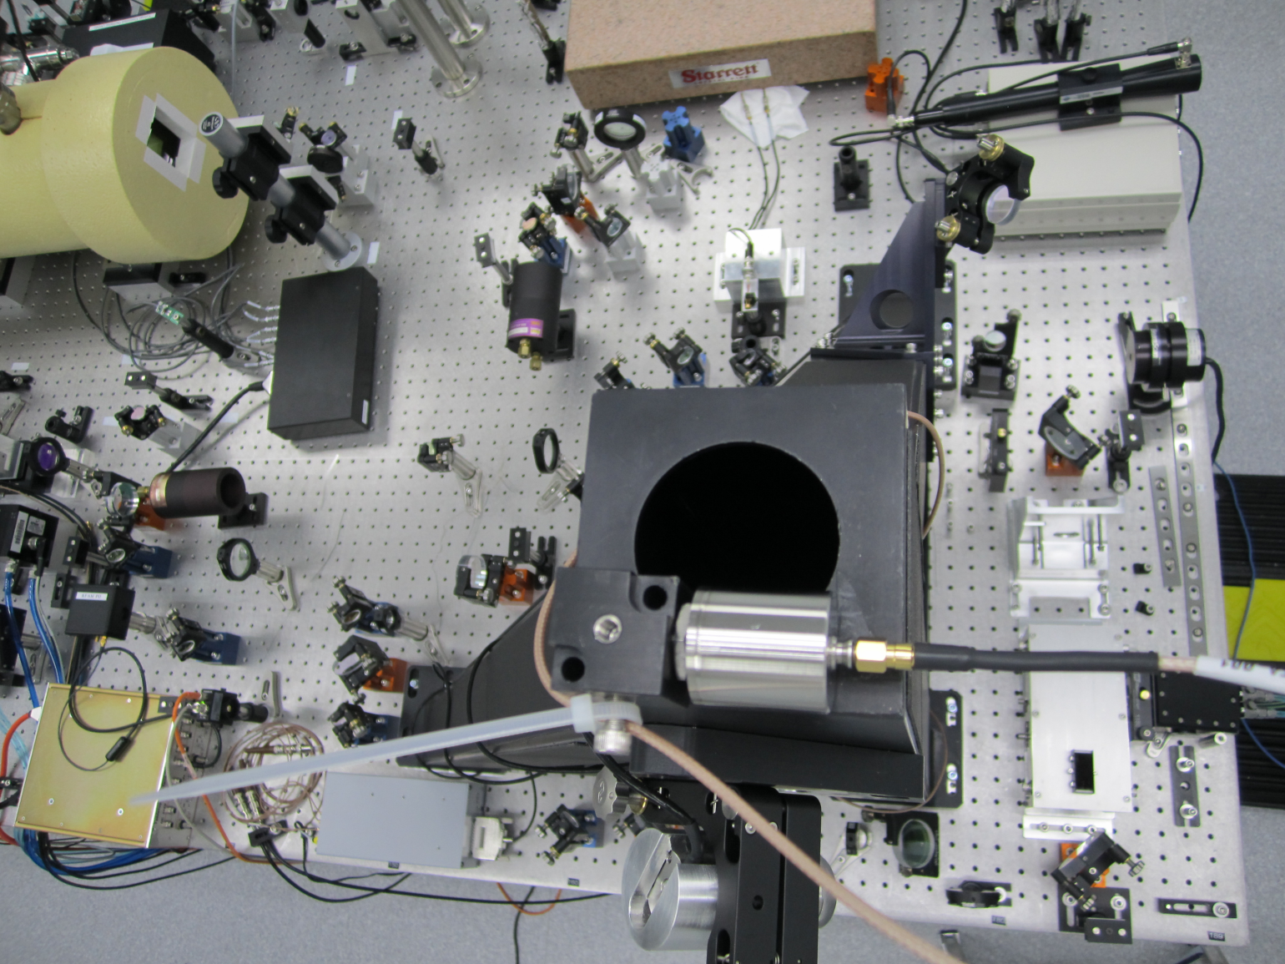
IO on the PSL table
Electro-optic modulator
Mode matching telescope
RFAM photodiode
-
Power control
Beam positioning piezo
Optical Spectrum Analyzer
Beam viewing camera
G1200911

Slide 11
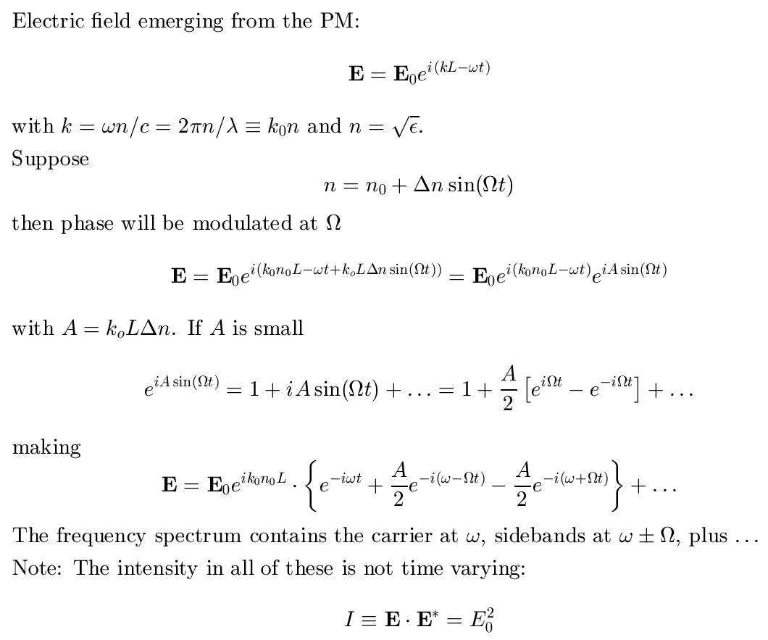
EOM: Phase modulator
9/25/2015

Slide 12
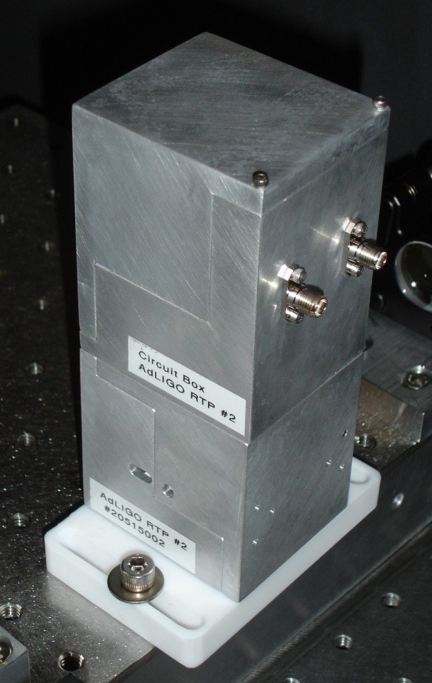
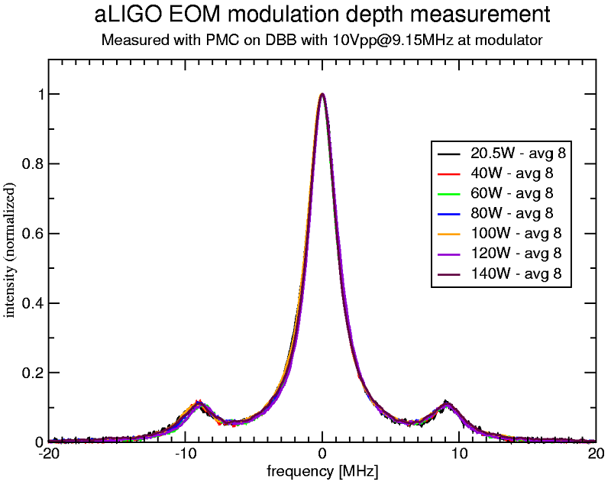
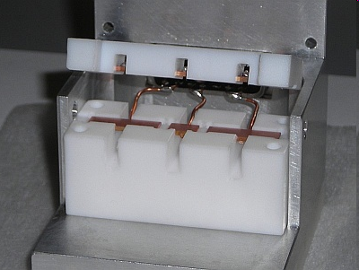
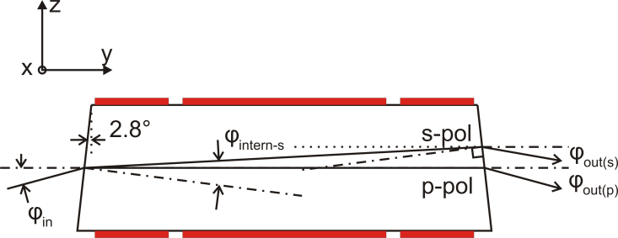
Electro-optic modulator
Modulators use rubidium titanyl phosphate (RTP)
Electro-optic response similar to LiNbO₃
low absorption => low thermal lensing
Multiple electrode configuration
Wedge, to reduce RFAM from polarization impurity
RF matching circuit in separate housing
Installed in enhanced LIGO at both sites
12

Slide 13
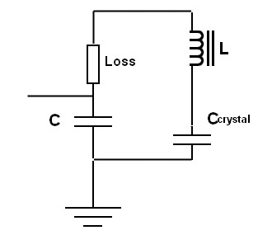
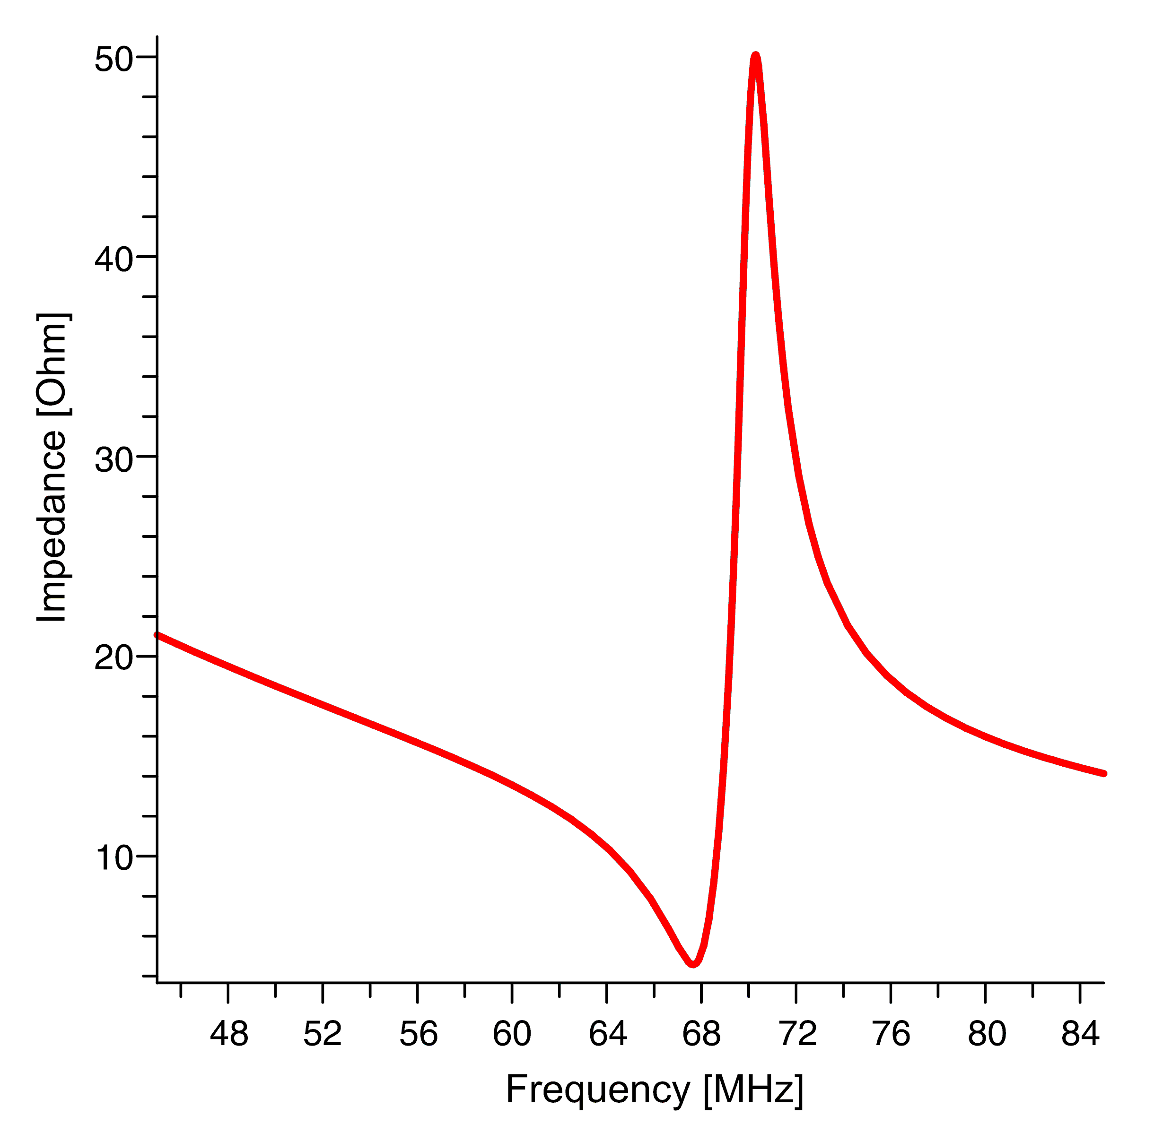
Resonant circuit
Impedance matching circuit in separate housing.
Resonant circuit with 50 Ω input impedance.
Three resonant circuits:
24.5 / 33.0 / 61.2 MHz
LIGO-G070680-00-R

Slide 14
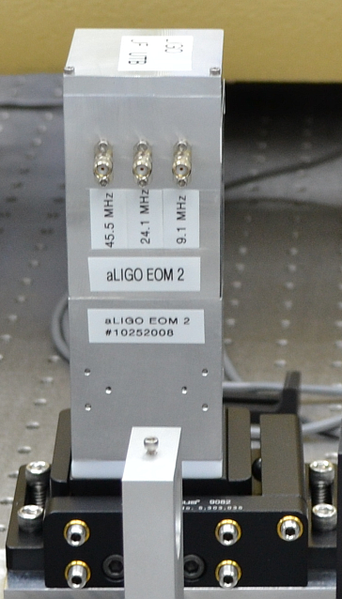
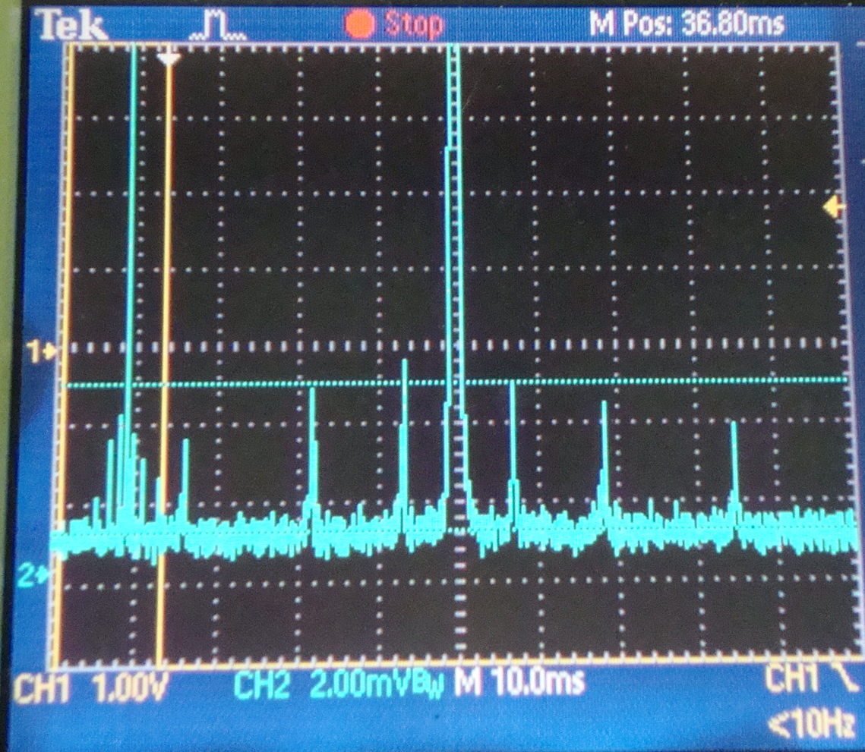
3 RF modulators in one box
9/25/2015

Slide 15
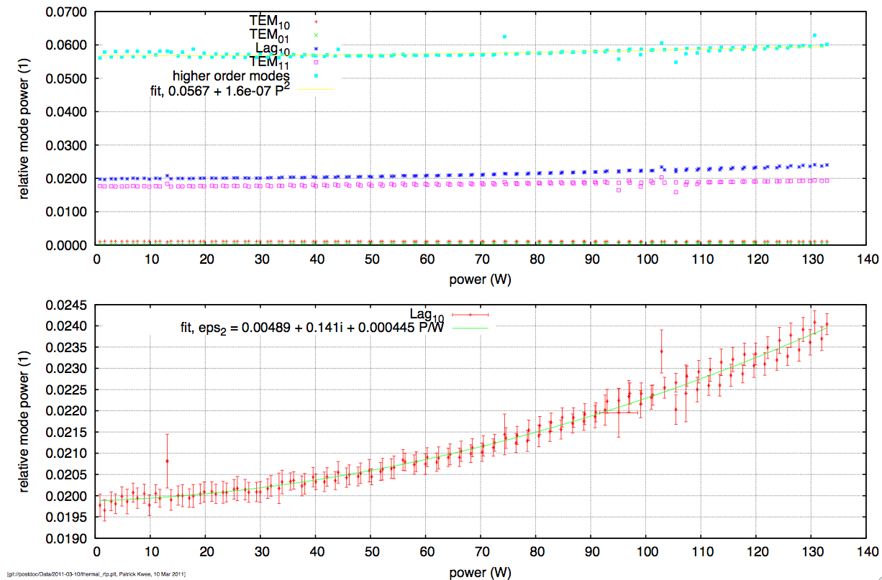
Thermal Lensing in RTP
Data from Patrick Kwee, AEI
LIGO Scientific Collaboration

Slide 16
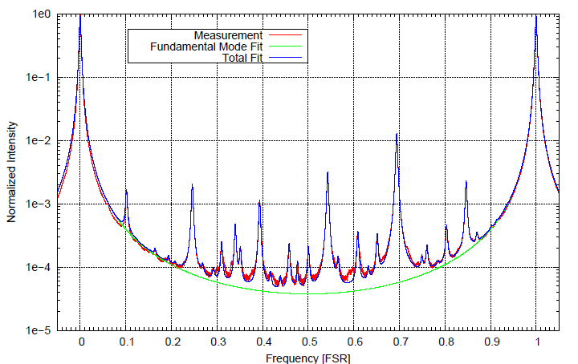
Mode scan at 20 W

Slide 17
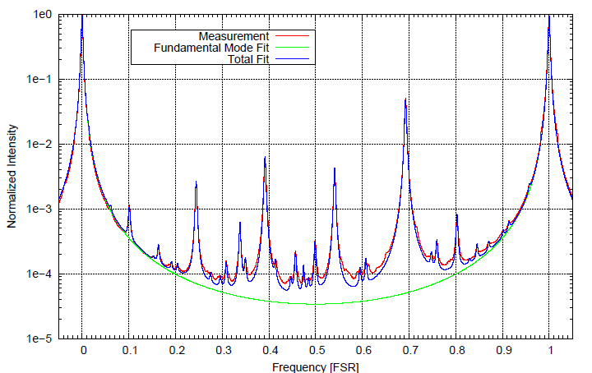
Mode scan at 140 W

Slide 18
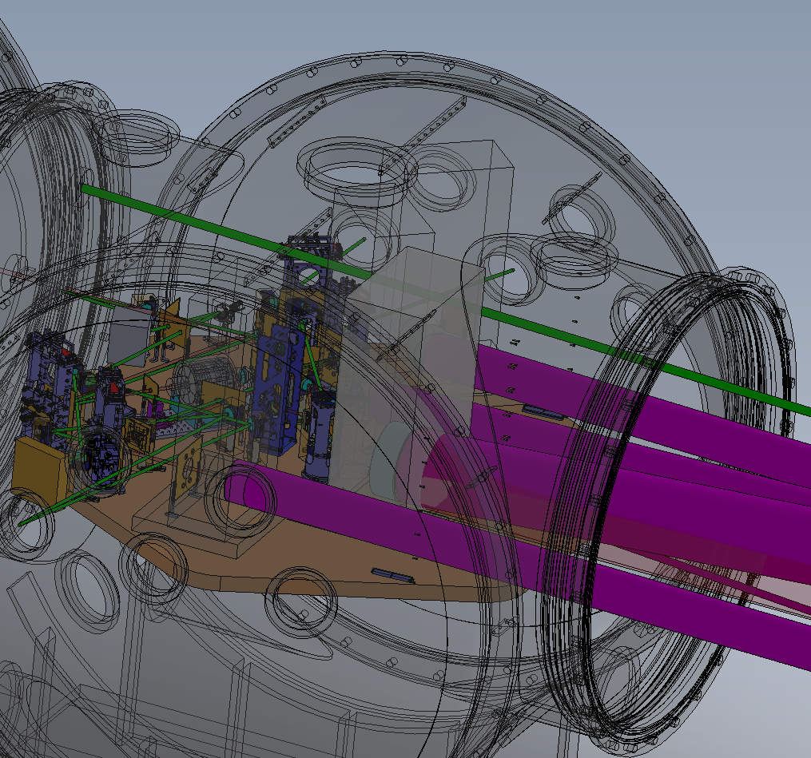
IO: Into the vacuum
Most of the IO is located in HAMs 2 and 3
In-vacuum layout is dense and complex, especially in HAM 2
LIGO Scientific Collaboration

Slide 19
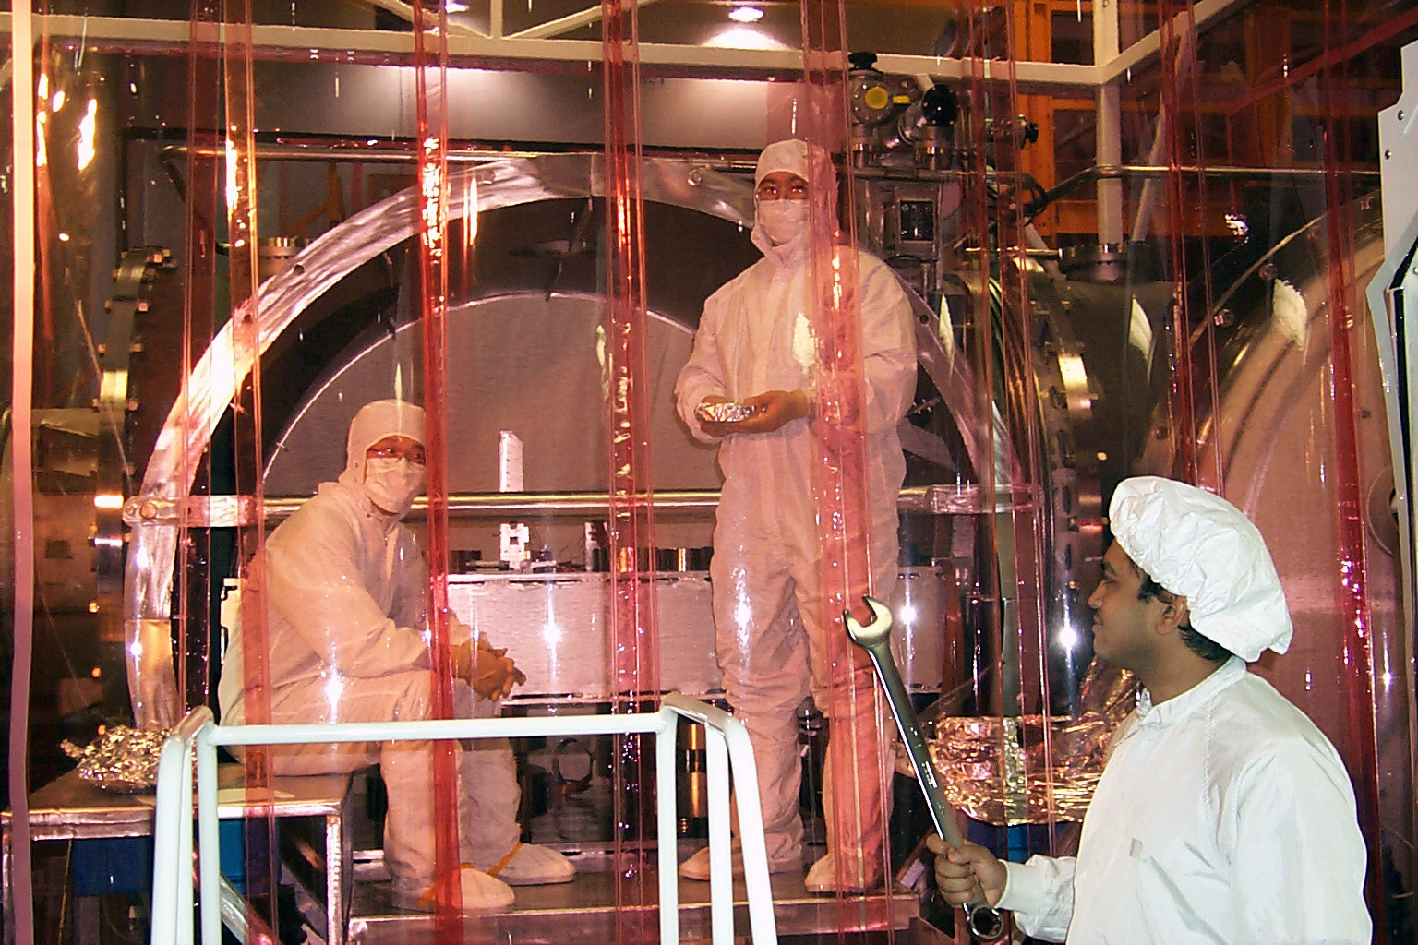
Parts installed in vacuum chambers with incredible precision
9/25/2015

Slide 20
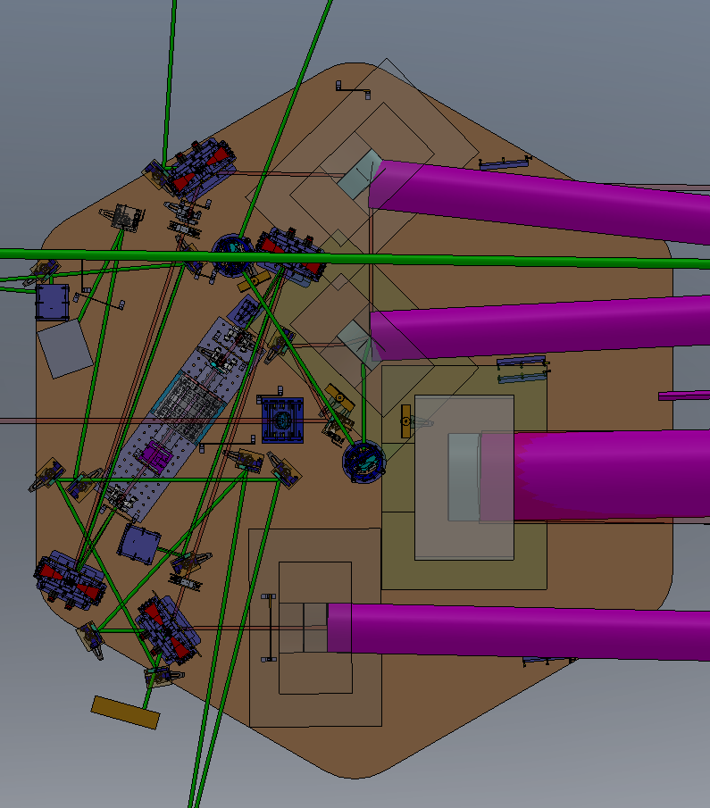
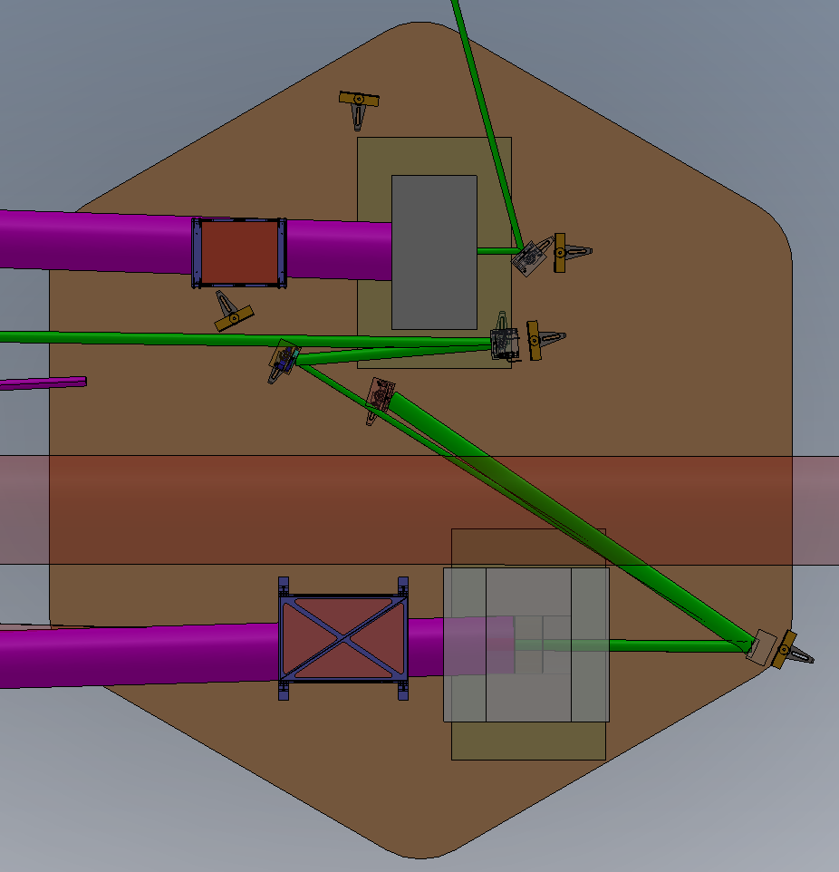
HAM 2 and 3
IMC Transmon
MC REFL
IMC2 Transmon
REFL:
to HAM1
SM1
IMC2
IMC3
PMMT2
ALS: to HAM1
IMC1
ALS: to HAM1
PSL ISS PD
FI
POPA,B: to ISC
PSL beam
To IFO BS
PR3
PMMT1
SM2
PR2
PRM
LIGO Scientific Collaboration

Slide 21
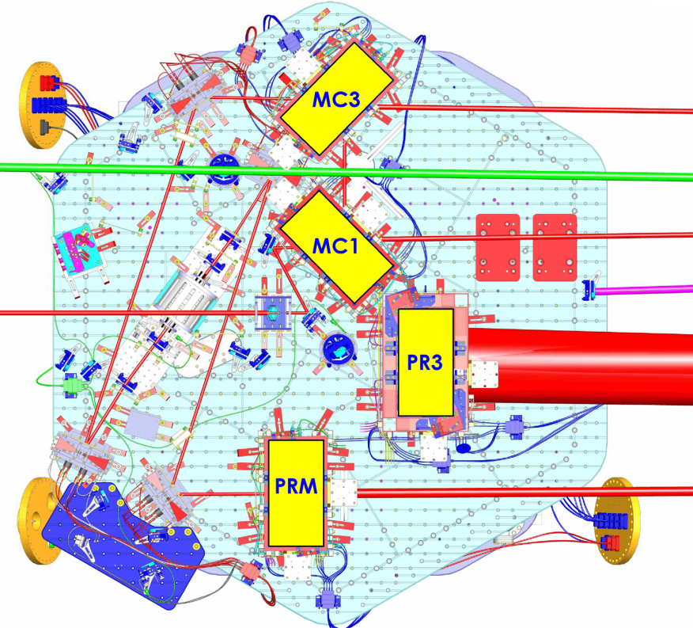
HAM2
25 September 2015

Slide 22
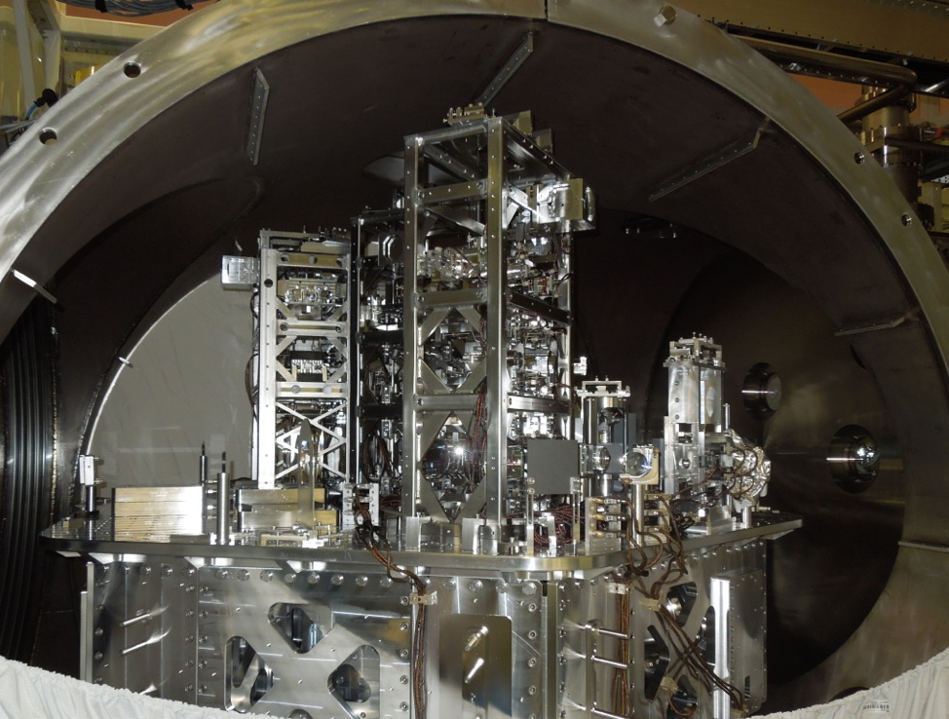
HAM 2
9/25/2015

Slide 23
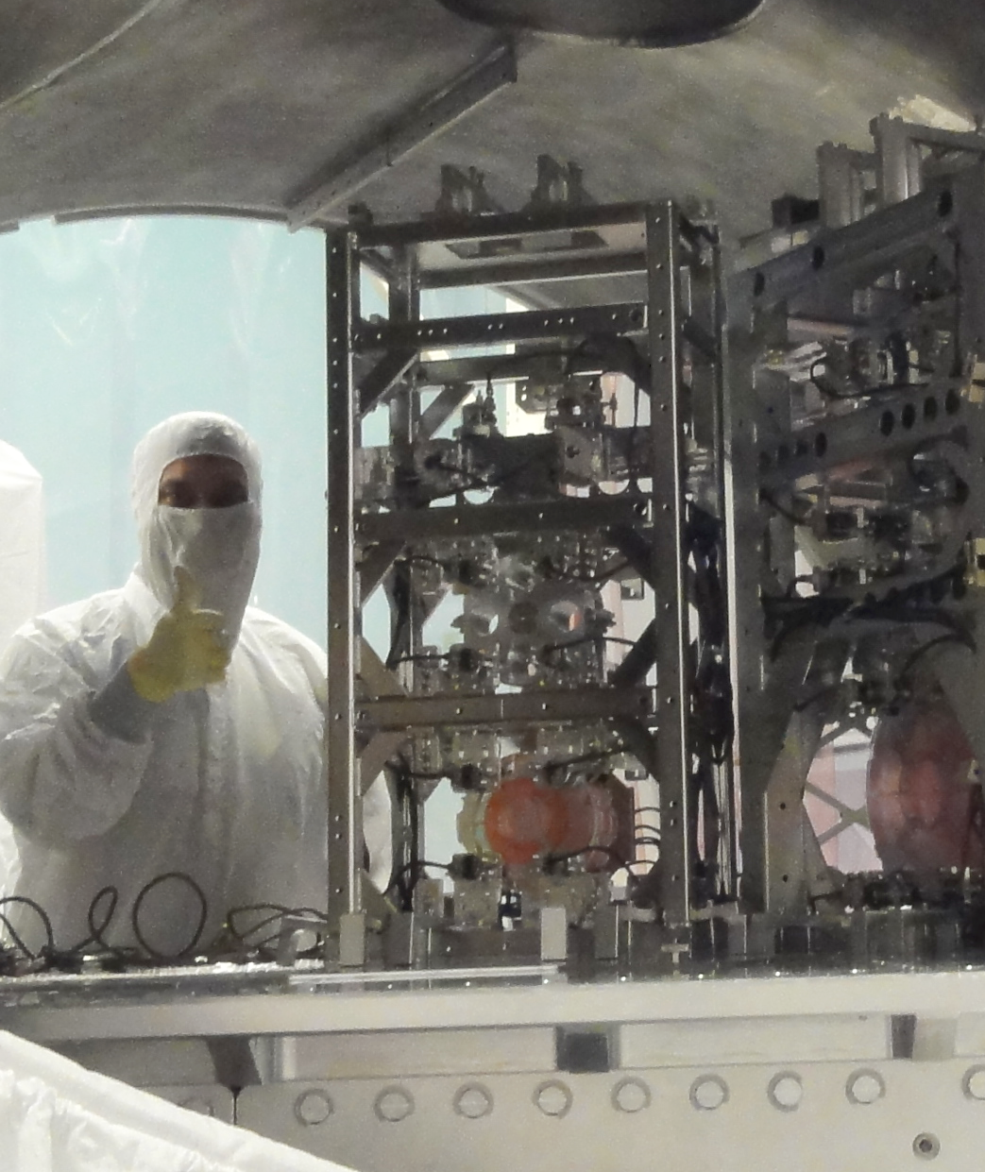
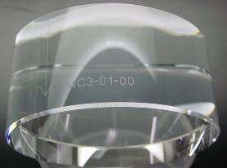
Input Mode Cleaner
Triangular ring cavity
Stabilize pointing
Frequency reference
L/2 = 16.5 m; Finesse = 520

Slide 24
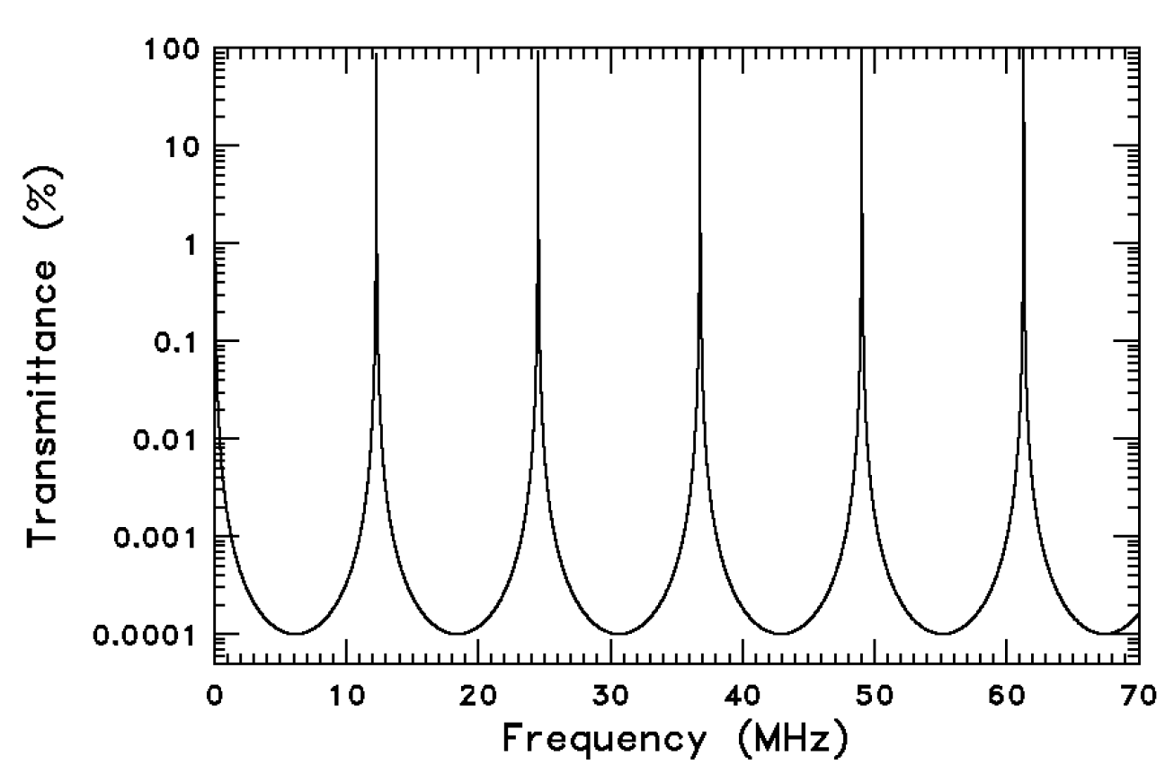
Mode cleaner FSR
9/25/2015

Slide 25
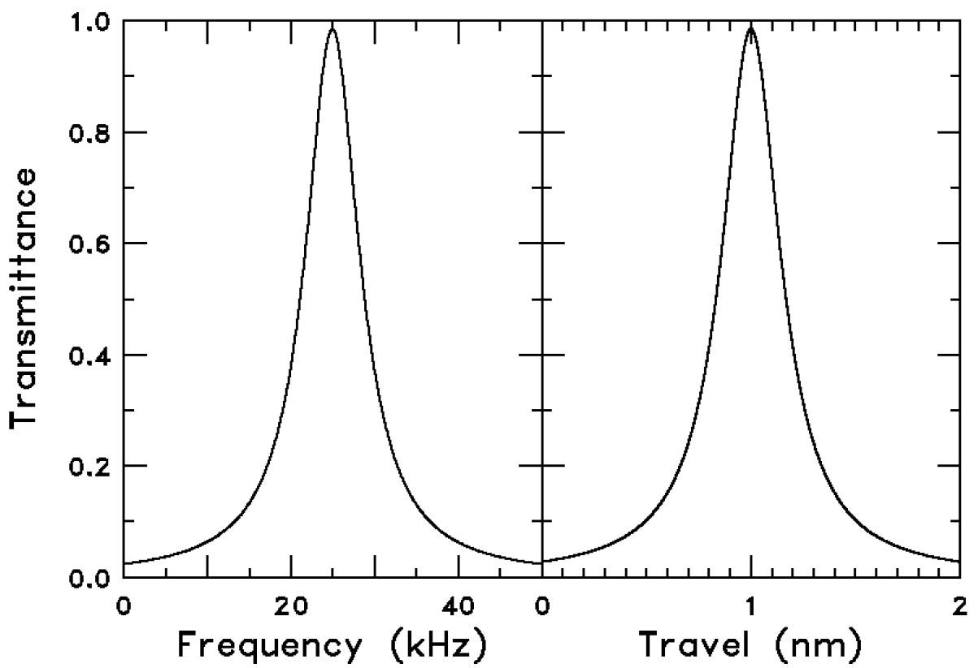
T vs freq vs length
9/25/2015

Slide 26
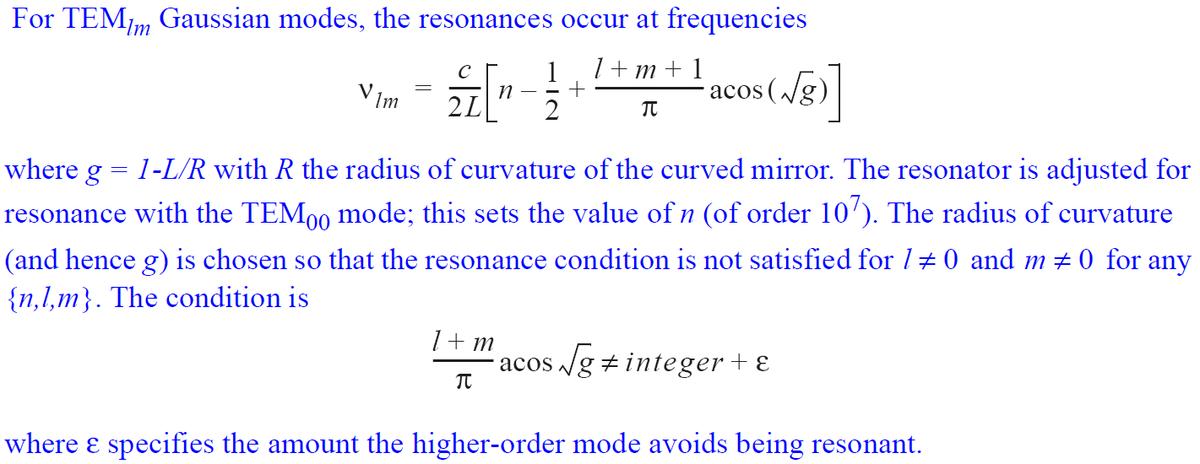
Reject high-order modes
9/25/2015

Slide 27
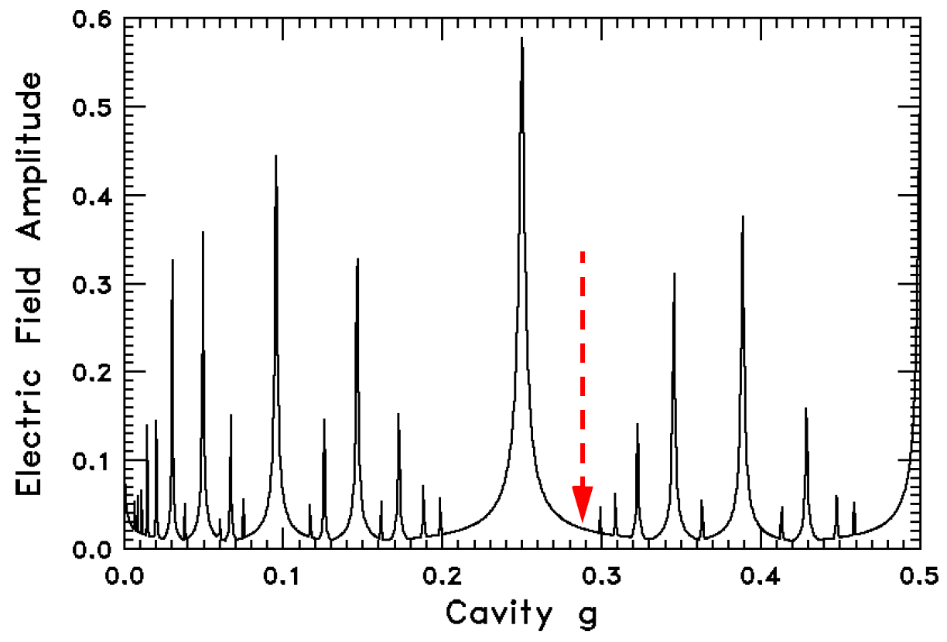
Transmission of HOM
9/25/2015

Slide 28
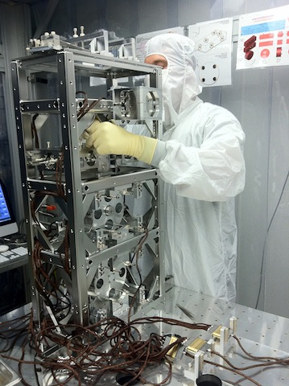
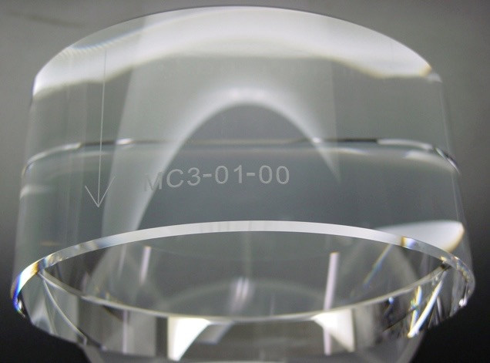
HAM triples
Mirrors suspended as 3 pendulums in series for seismic isolation, control
Mirrors 15 cm diameter x 7.5 cm thick -- 3 kg
12x heavier than iLIGO, to limit radiation pressure noise

Slide 29
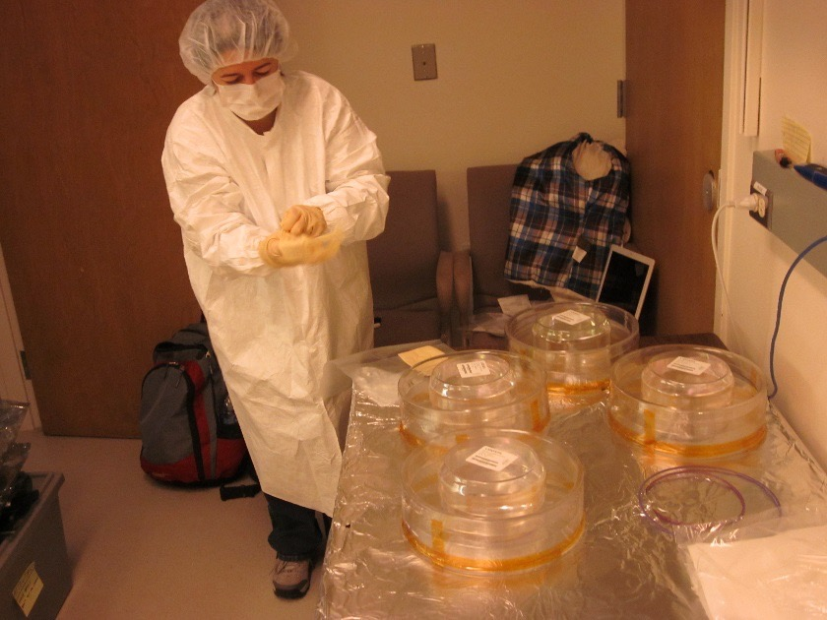
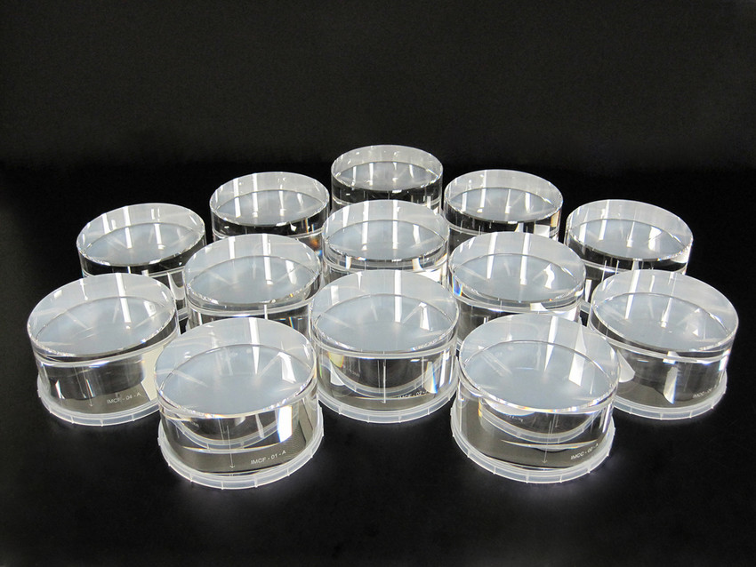
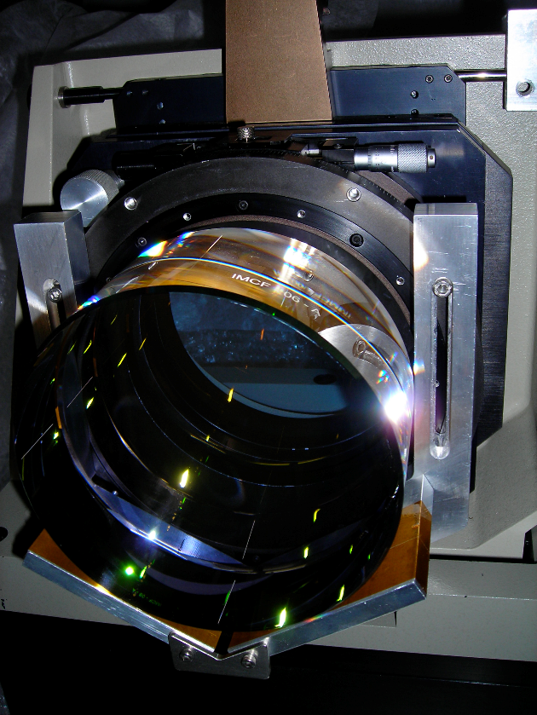
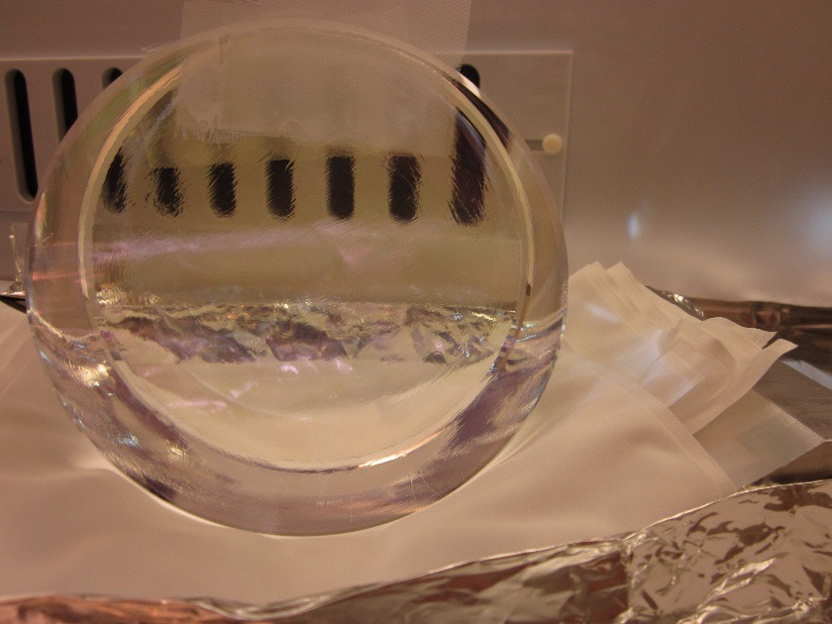
IMC mirrors
LIGO Scientific Collaboration

Slide 30
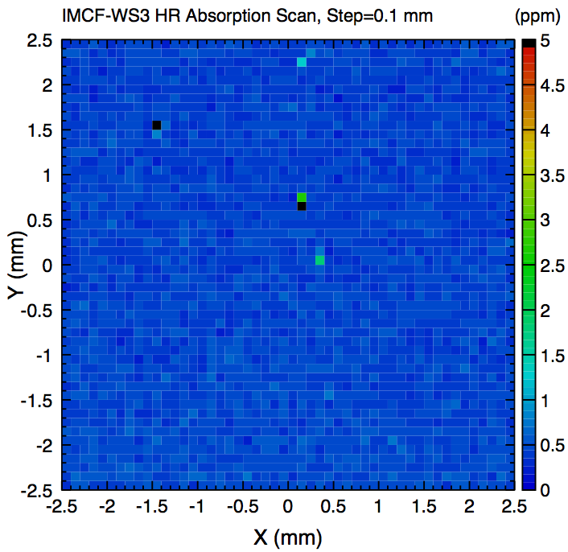
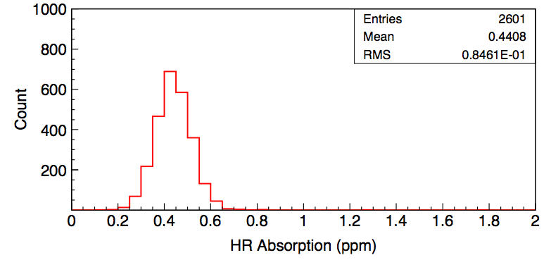
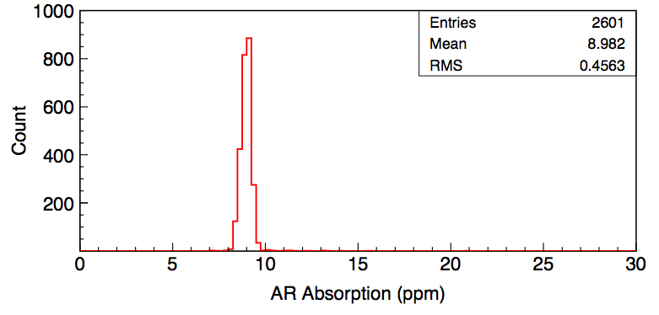
IMC Mirror Absorption
MCF-WS3 witness sample absorption scan
HR absorption
AR absorption
LIGO Scientific Collaboration

Slide 31
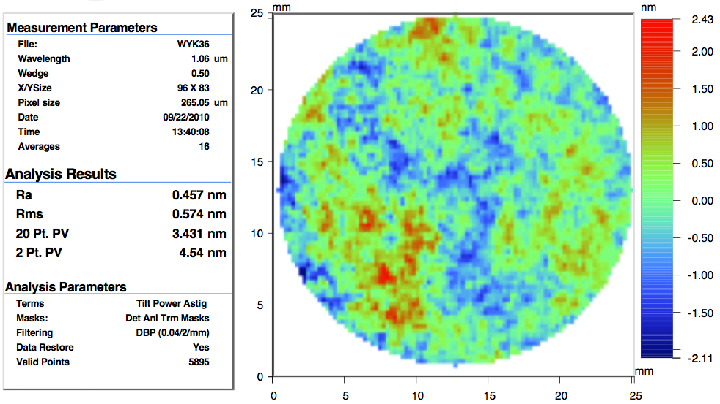
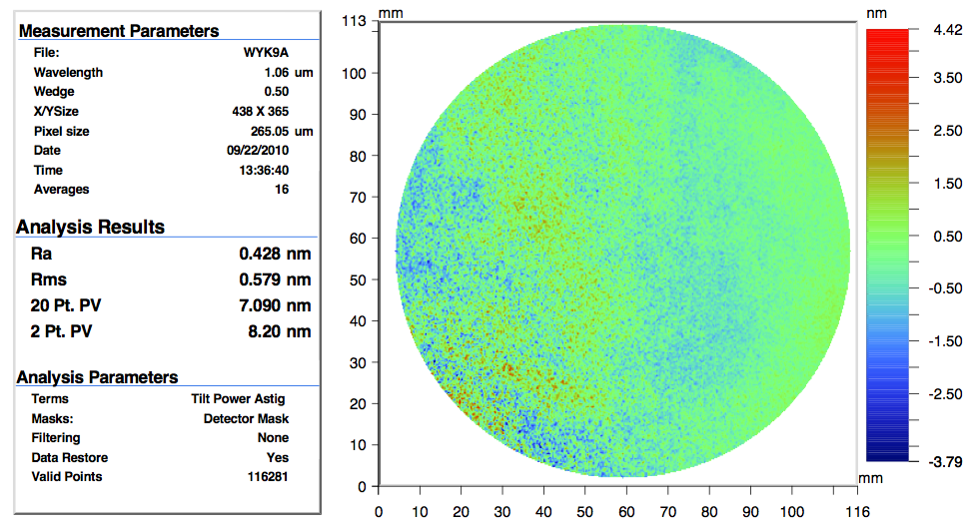
IMC mirror phase maps
LIGO Scientific Collaboration

Slide 32
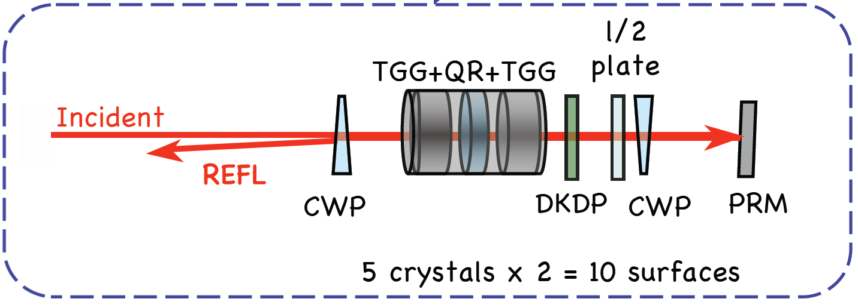
Faraday Isolator
IAP/UF design and construction
Passively compensated (for depolarization and thermal lensing)
Consists of 2x calcite polarizers, 2x TGG crystals, quartz rotator, λ/2 plate and –dn/dT DKDP thermal compensator
Observed >50 dB isolation (in lab)
Faraday installed in enhanced LIGO
25 dB isolation,
1-18 W.
20 μrad REFL drift.
B_{o}
B_{o}
Faraday Rotator Design
TGG Holders
IAP = Institute of Applied Physics, Nizhny Novgorod
TGG = terbium-gallium garnet
DKDP = deuterated potassium dihydrogen phosphate, KD₂PO₄
32

Slide 33
Thermal lens created by TGG and DKDP
DKDP or TGG
Telescope
Focusing lens
Beam Scan
Fiber laser beam
(1-30 W)
5
G060185-00-Z

Slide 34
Faraday isolator
9/25/2015

Slide 35
Faraday
Palashov et al JOSA B (2012)

Slide 36
Faraday design
9/25/2015

Slide 37
Performance
9/25/2015

Slide 38
Other items
Power control: motorized waveplate and 2x thin-film polarizers on PSL table, behind EOMs. T ~ 98%. Extinction ratio 140,000:1
Mode-matching to IMC: 2 lens telescope on PSL table
Periscope: Oil derrick
HAM Aux
PSL = pre-stabilized laser;
EOM = electro-optic modulator
IMC = input mode cleaner
HAM = vacuum chamber
38

Slide 39
HAM Aux (Giacomo)
Single stage (outgrowth of SOS)
4 OSEMs
3 inch optic in an aluminum optic holder
Blades for vertical isolation
Eddy current dampers
25 September 2015
Giacomo Ciani for the IO Group - LVC meeting in Rome, Italy

Slide 40
HAUX locations
SM1
(AKA IM1)
4 per IFO, all in HAM2
They suspend steering and pre-mode-matching mirrors in the IO chain:
SM1 (now IM1)
PMMT1 (now IM2)
PMMT2 (now IM3)
SM2 (now IM4)
PMMT2
(AKA IM3)
PMMT1
(AKA IM2)
SM2
(AKA IM4)
25 September 2015
Giacomo Ciani for the IO Group - LVC meeting in Rome, Italy

Slide 41
IO Baffles: Overview
T0900486-v5
The IO has a high density of high power lasers beams in a very confined space.
It’s a very dangerous place...
The IO baffles serve two purposes:
To prevent scattered light from entering sensing the interferometer and sensing photodiodes
To protect the in-vacuum components from laser damage
IO Baffle types:
Beam dumps - for parking and dumping high power beams
Suspension baffles - for protecting suspension components
Hard apertures and plates - for protecting other components
Scraper baffles - for collecting small angle scattered light
Ghost beam baffles - for blocking specular reflections from AR coatings and other low power
LIGO Scientific Collaboration

Slide 42
IO Baffles
Different materials for different power levels
High power absorbing beam dumps: superpolished SiC @ Brewster angle
High power ‘protectors’: unpolished SiC
Low/medium power (< 5 W): porcelain-coated stainless steel
Very low power (< 500 mW): absorbing black glass
Baffles in HAM2
Periscope Baffle
REFL Beam Dump
LIGO Scientific Collaboration

Slide 43
Source files
Some key sources for IO:
P1500076
E1201013
G1200911
G060185
G070680

Slide 44
Done
Thanks
1000 kg
1000 kg
9/25/2015

