Slide 1
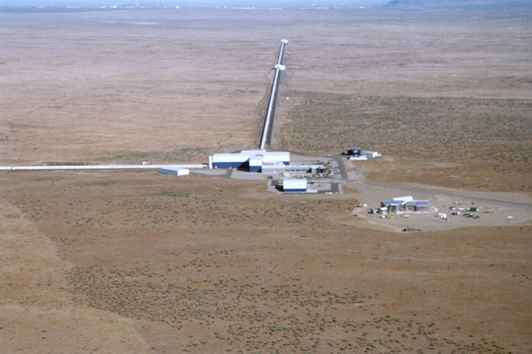
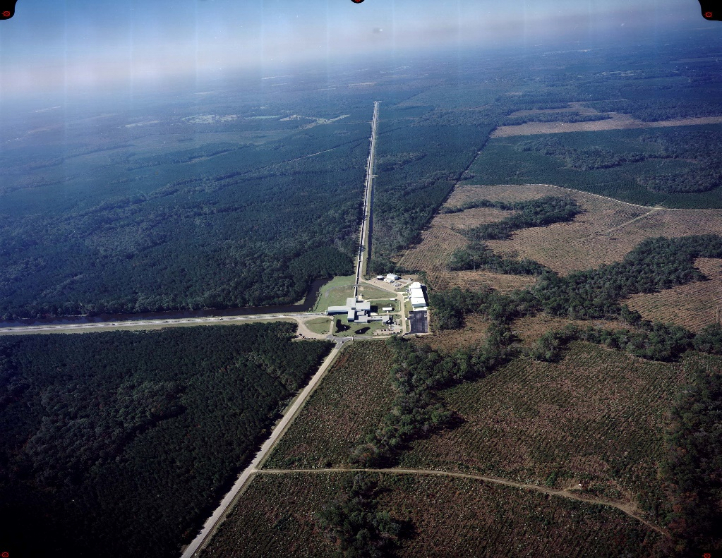
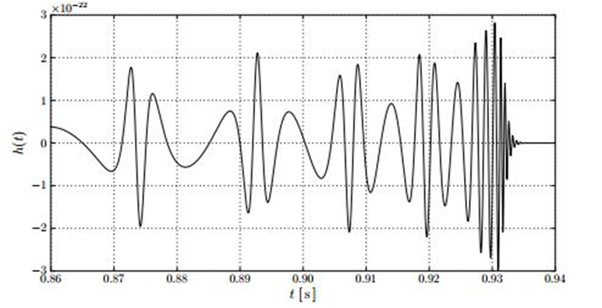
Using BayesWave to Approximate Eccentric Black-Hole Binary Gravitational Waves
Belinda D. Cheeseboro¹ & Sean T. McWilliams¹
¹Department of Physics & Astronomy, West Virginia University
bdc0001@mix.wvu.edu
Abstract
The mission of the Advanced Laser Interferometer Gravitational-Wave Observatory (aLIGO) is to detect gravitational waves that could be caused by the interaction of massive gravitating bodies such as coalescing black holes and neutron stars. BayesWave is an algorithm that can analyze possible gravitational wave event data and determine the likelihood that the event strain contains mostly Gaussian noise, signal, or glitches. The algorithm accomplishes this by using multi-component models and incorporating the Reverse Jump Markov chain Monte Carlo (RJMcMC) to simultaneously perform model selection and fully sample the posterior likelihood to estimate model parameters. We will describe previous investigations using BayesWave, and discuss future work using BayesWave in a new way to detect gravitational wave signals from eccentric black-hole binary sources.
What is aLIGO?
It is the Advanced Laser Interferometer Gravitational-Wave Observatory. The “advanced” portion of the acronym signifies the upgrades made to the two detectors: one in Hanford, Washington and the other in Livingston, Louisiana. These upgrades have improved the sensitivity of the detectors by introducing new equipment. aLIGO is currently undergoing its first observation run “O1” that started in September 2015.
What is BayesWave?
BayesWave is an algorithm that utilizes Bayesian probability theory, Markov chain Monte Carlo (McMC), and Reverse Jump Markov chain Monte Carlo (RJMcMC) methods to analyze the characteristics of a gravitational wave. These characteristics include signal and noise features such as frequency content and duration.
BayesWave uses the McMC to sample the posterior distribution function to find all possible gravitational wave solutions. To model the noise and signal of a gravitational wave, the algorithm uses a three layer model that includes a gravitational wave signal, short duration noise (“glitches”), and Gaussian noise.
Using BayesWave to Detect Eccentric Binary Sources
Our interest in BayesWave lies in its unique way of identifying “glitches”. Although glitches have generally been characterized as detector noise, we believe that aspect of BayesWave is crucial in identifying eccentric binary sources.
The s_{i} are data samples from the ith detector, h is gravitational wave strain. A_{i} is an operator that maps the strain at the geocenter onto the ith detector. The g_{i} represents a glitch from the ith detector and n_{i} is the Gaussian noise.
The RJMcMC is used to determine what characteristics are present in the gravitational wave strain. This information is then used to calculate Bayes Factors. These Bayes Factors are relative probabilities that determine whether the strain data is a combination of glitch and noise, or gravitational wave signal and noise.
The figure above is a simulation of a waveform for an eccentric black hole binary system [3]. From t=0.86 to t=0.91 one can see short frequency bursts occurring periodically before increasing in frequency. Then after t=0.91 you approach the familiar merger and ringdown. We believe these glitch-like bursts shown in the simulation are what can be detected using BayesWave.
These types of sources are very difficult to model and therefore makes it difficult to use methods that require a model. BayesWave is the best candidate for these types of sources because it does not require a rigorous model for the waveform.
The Next Step
Currently we are in the midst of installing a python module called pycbc that will allow us to generate and look at any waveform approximant. The one we are interested in is the EccentricFD approximant that will generate waveforms of eccentric compact binary sources in the frequency domain.
Acknowledgements
I would like to thank my research advisor Dr. Sean T. McWilliams, and most importantly the Department of Graduate Education and Life for recognizing me as a STEM Mountains of Excellence Fellow. This fellowship is funded by a grant provided by the West Virginia Higher Education Policy Commission’s Division of Science and Research.
References
[1] P.T. Baker, “Distinguishing Signal from Noise: New Techniques for Gravitational Wave Data Analysis”, Ph.D., dissertation, Dept. Physics, Montana State Univ., Bozeman, MO, 2013
[2] N.J. Cornish, T. B. Littenberg “BayesWave: Bayesian Inference for Gravitational Wave Bursts and Instrument Glitches”, article, arXiv:1410.3835, 14 Oct 2014.
[3]K. Tai, S. McWilliams and F. Pretorius, 'Detecting gravitational waves from highly eccentric compact binaries', Physical Review D, vol. 90, no. 10, 2014.
This poster has been given LIGO document number LIGO-G1501297

