Slide 1
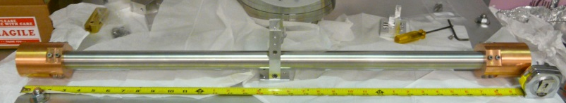
Improving seismic isolation in Advanced LIGO using a ground rotation sensor
04/16/2016
Krishna Venkateswara
for
UW- Michael Ross, Charlie Hagedorn, and Jens Gundlach
aLIGO – SEI team
LIGO-G1600083

Slide 2
Contents
Introduction: Why tilt affects LIGO
BRS at LIGO Hanford and Tilt Data
Next Gen/Compact BRS
Summary

Slide 3
Introduction

Slide 4
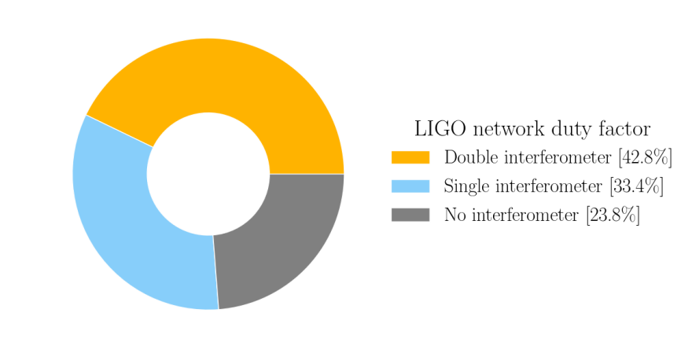
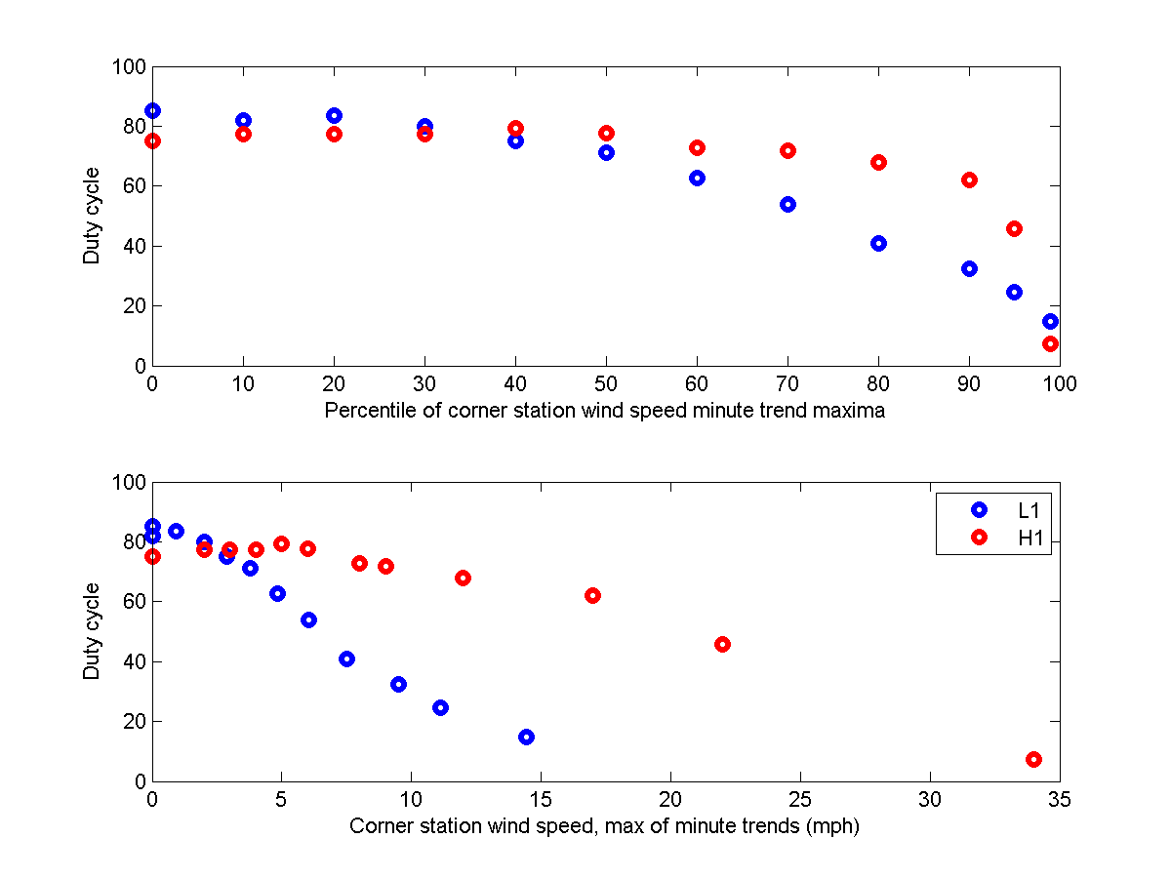
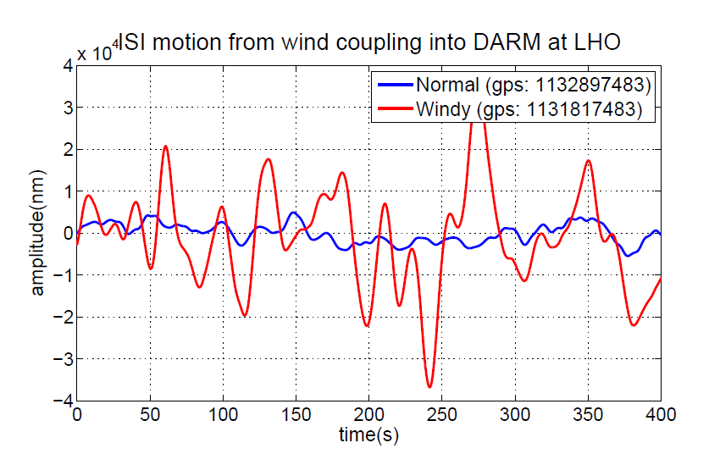
Tilt-problem limits duty cycle of detectors
Source: DetChar Summary Pages
Source: S. Dwyer G1501365
Source: B. Lantz T1500610
Earthquakes, High Wind and High Microseism cause significant down-time of both detectors.
All are primarily related to the problem of tilt-horizontal coupling producing too much ISI motion.

Slide 5
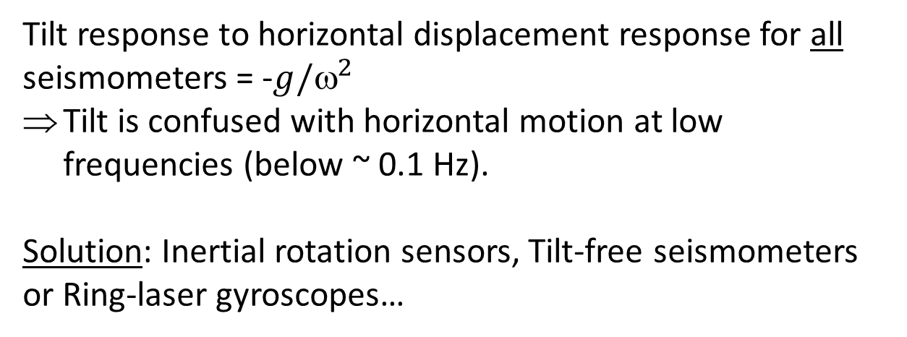
Tilt versus Horizontal displacement
Conventional seismometers and tiltmeters cannot differentiate between horizontal displacement and ground tilt.
δx ∝ ax
δx ∝ gθ
Tilt response to horizontal displacement response for all seismometers = -$g/^{2}$
Tilt is confused with horizontal motion at low frequencies (below ~ 0.1 Hz).
Solution: Inertial rotation sensors, Tilt-free seismometers or Ring-laser gyroscopes…

Slide 6
Beam Rotation Sensors

Slide 7
BRS Concept
Autocollimator
Principle:
Ground tilt is measured by measuring angle between ground and low frequency beam balance.
Horizontal acceleration can be rejected by locating center of mass at the pivot.
Venkateswara, Krishna, et al. "A high-precision mechanical absolute-rotation sensor." Review of Scientific Instruments 85.1 (2014): 015005.

Slide 8
BRS Concept
Autocollimator
Principle:
Ground tilt is measured by measuring angle between ground and low frequency beam balance.
Horizontal acceleration can be rejected by locating center of mass at the pivot.
Venkateswara, Krishna, et al. "A high-precision mechanical absolute-rotation sensor." Review of Scientific Instruments 85.1 (2014): 015005.

Slide 9
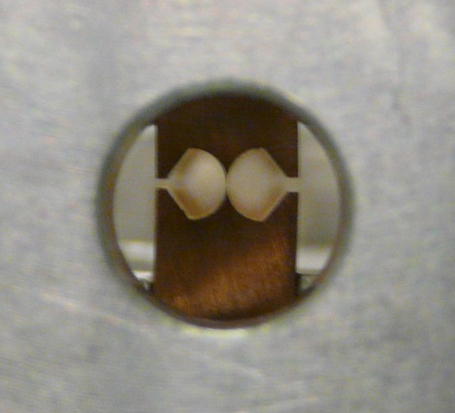
BRS Parameters
Autocollimator
10-25 μm-thick Cu-Be Flexures
Mass | 4-5 kg
Length | 0.9 m
Moment of Inertia I | 0.6 kg m²
Flexure stiffness | 10⁻³ N m
Quality factor | 2000-3000
Distance between pivot and center of mass | Can be tuned to less than 1 µm
Displacement rejection ratio

Slide 10
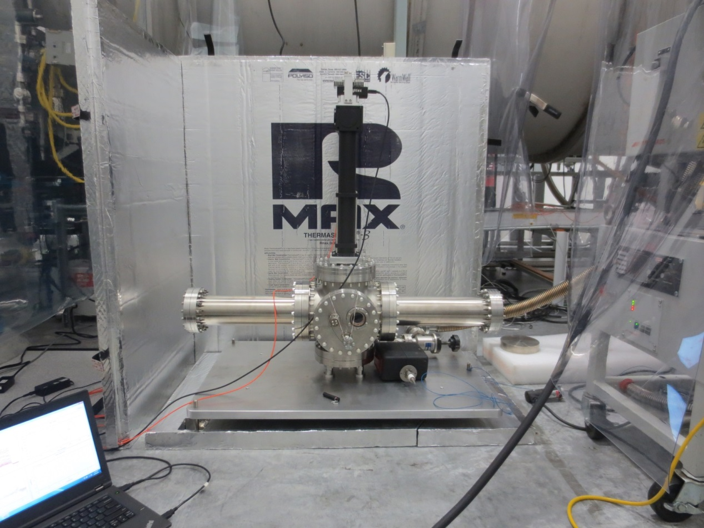
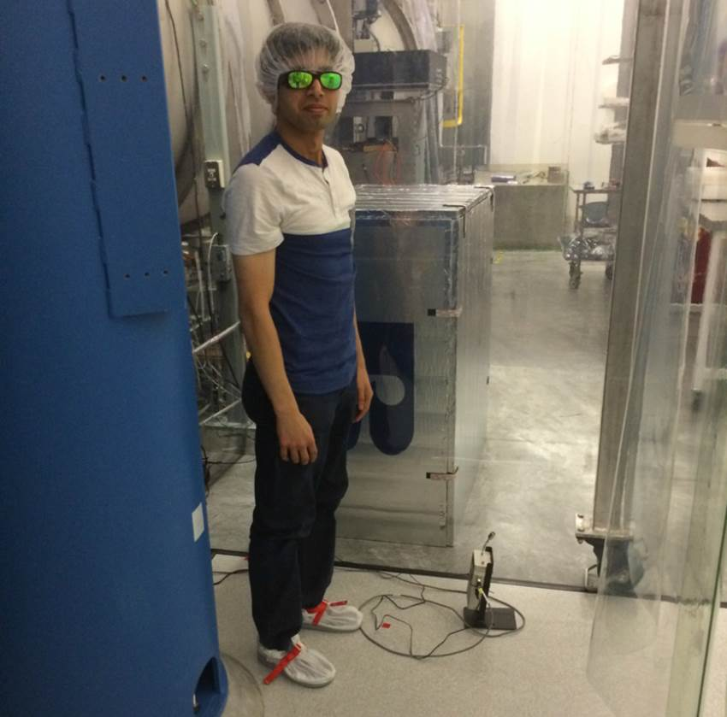
Installation at EX VEA
Ref: LHO 13250

Slide 11
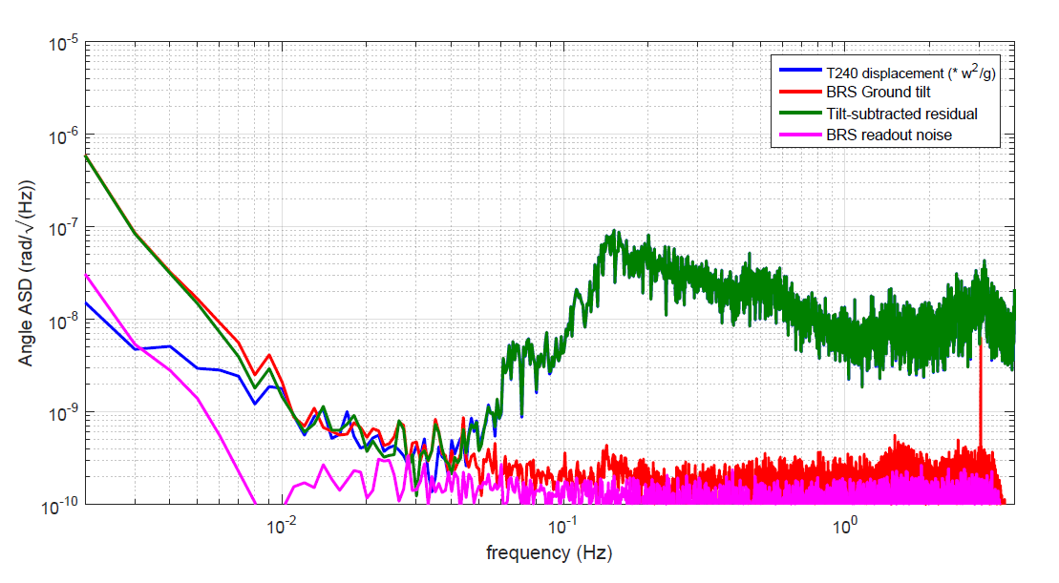
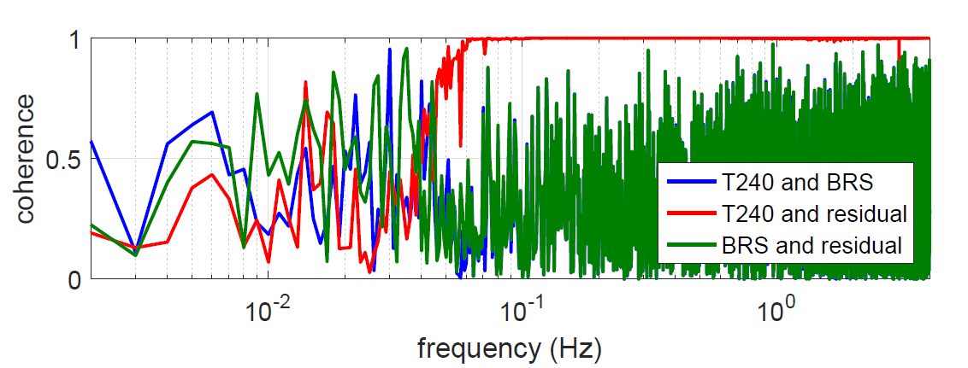
Ground tilt during low wind speeds
Requirement
Autocollimator sensitivity is ~0.1 nrad/√Hz

Slide 12
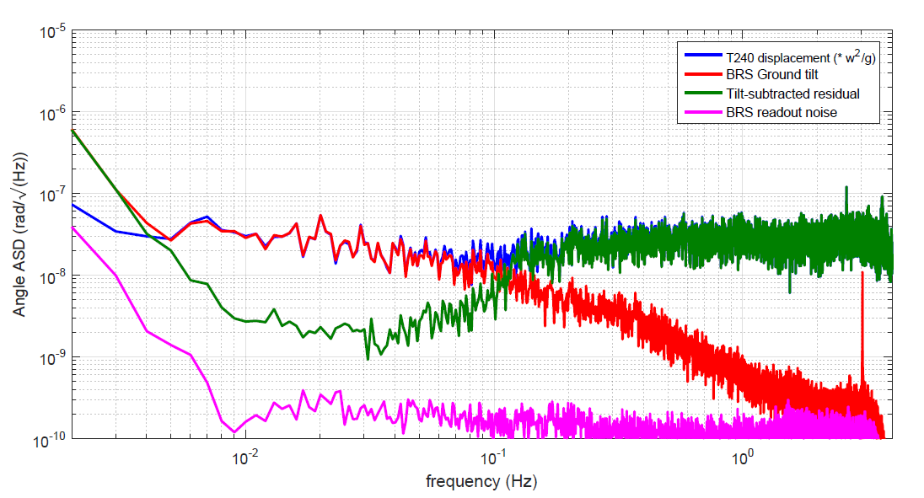
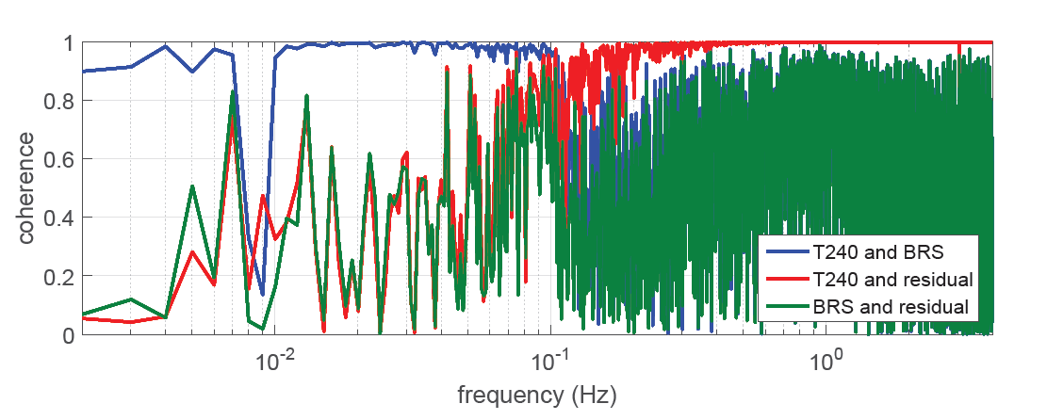
Ground tilt during 20-30 mph winds
Requirement
High coherence between ground seismometer and BRS

Slide 13
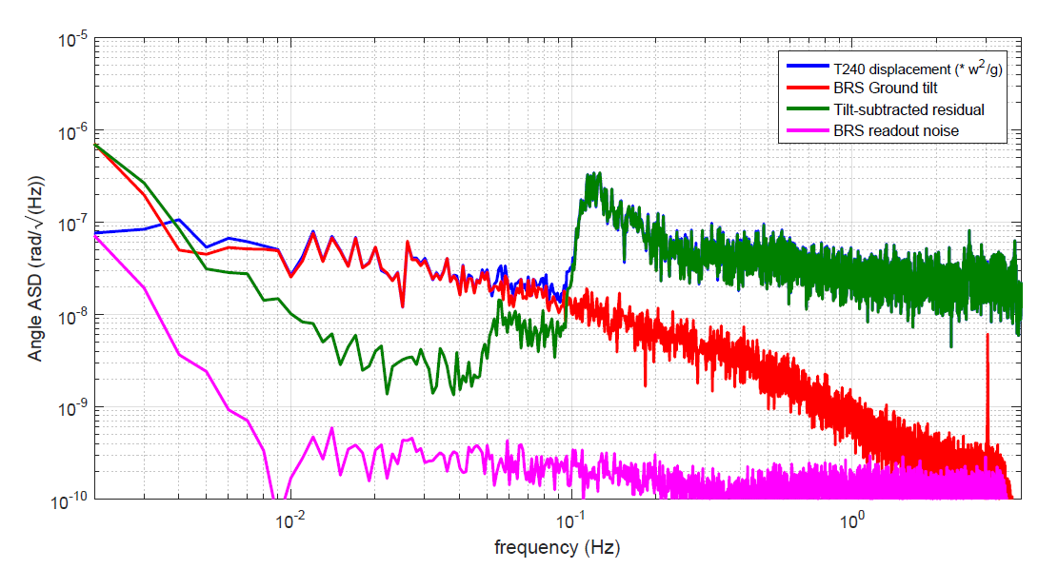
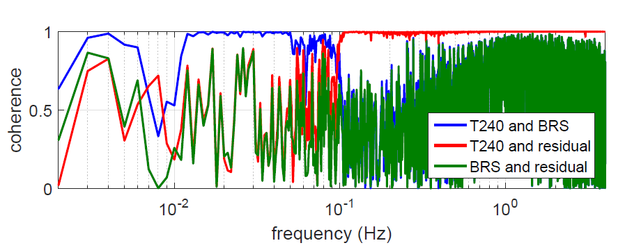
Second example
Primary microseism is visible after tilt-subtraction!
Requirement

Slide 14
Improving Isolation
Order of magnitude less RMS motion
Sacrifice only 2-3 here
Windy Config
Same at QUAD Resonances and above
Nominal Config
Source: J. Kissel, G1500475

Slide 15
Ground tilt from M6.7 Earthquake near Australia
ASD of ground seismometer and BRS Data.
Band-passed time-series signals

Slide 16
Next Gen/Compact BRS

Slide 17
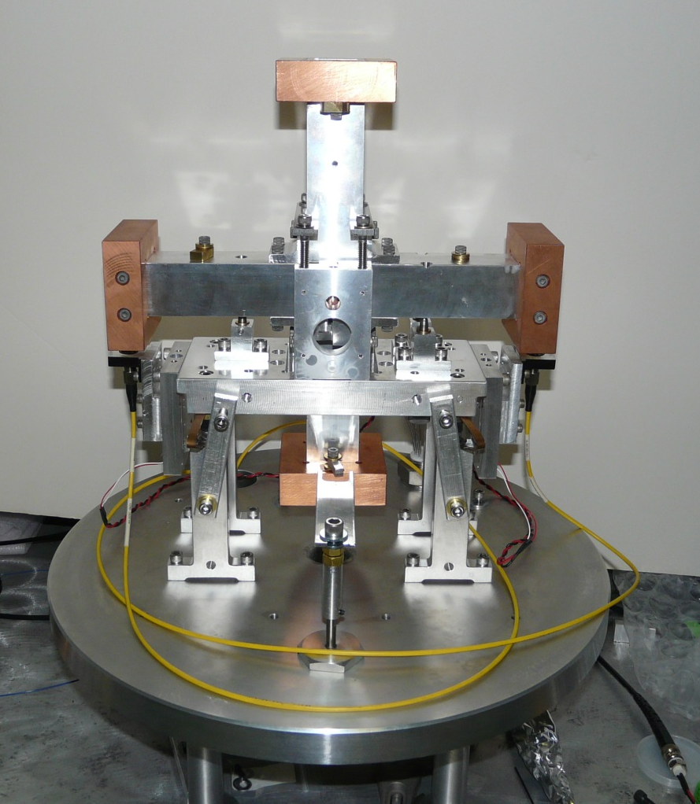
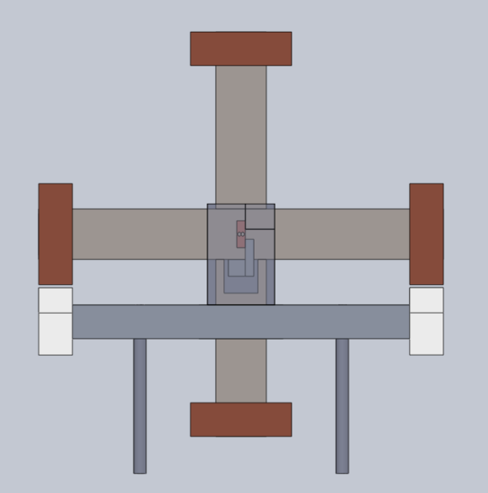
Compact-BRS
30 cm
New features
1. Cross Shape (~0 quadrupole moment) ensures first order insensitivity to gravity gradient noise.
2. New compact interferometric readout with ~10X better sensitivity.

Slide 18
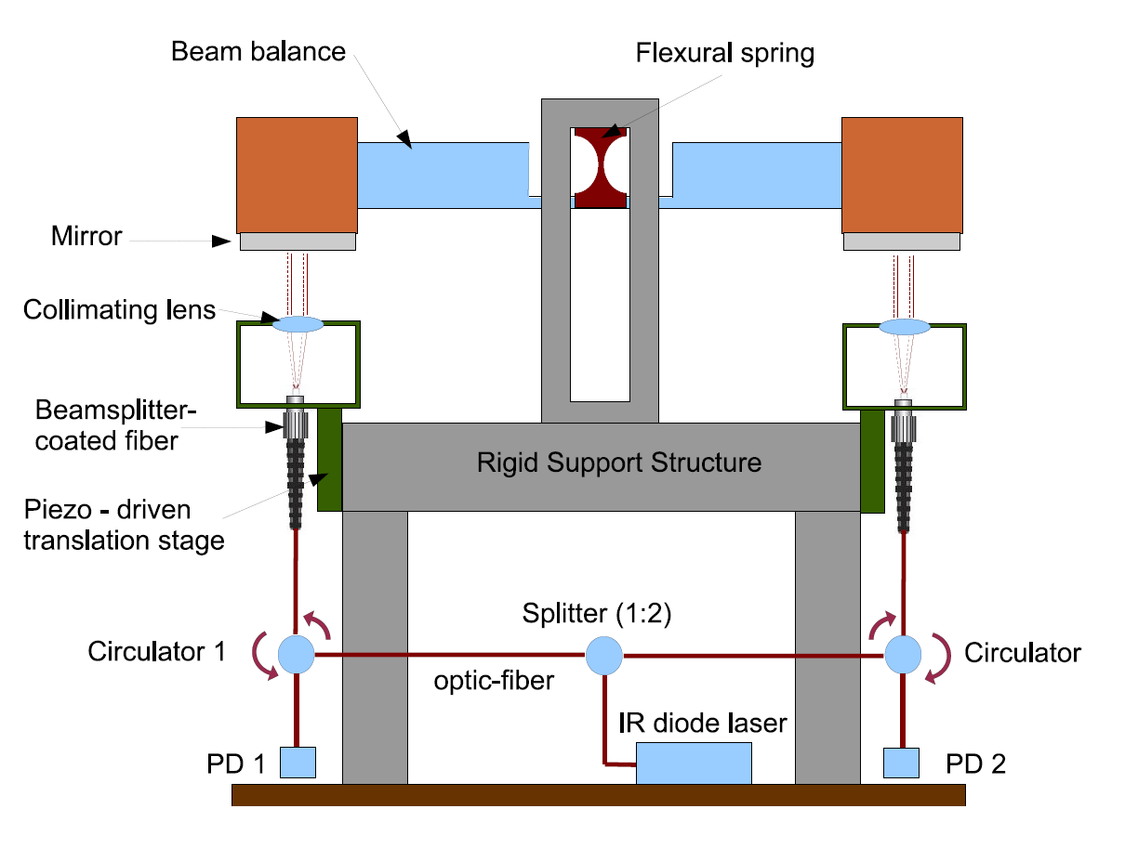
Schematic

Slide 19
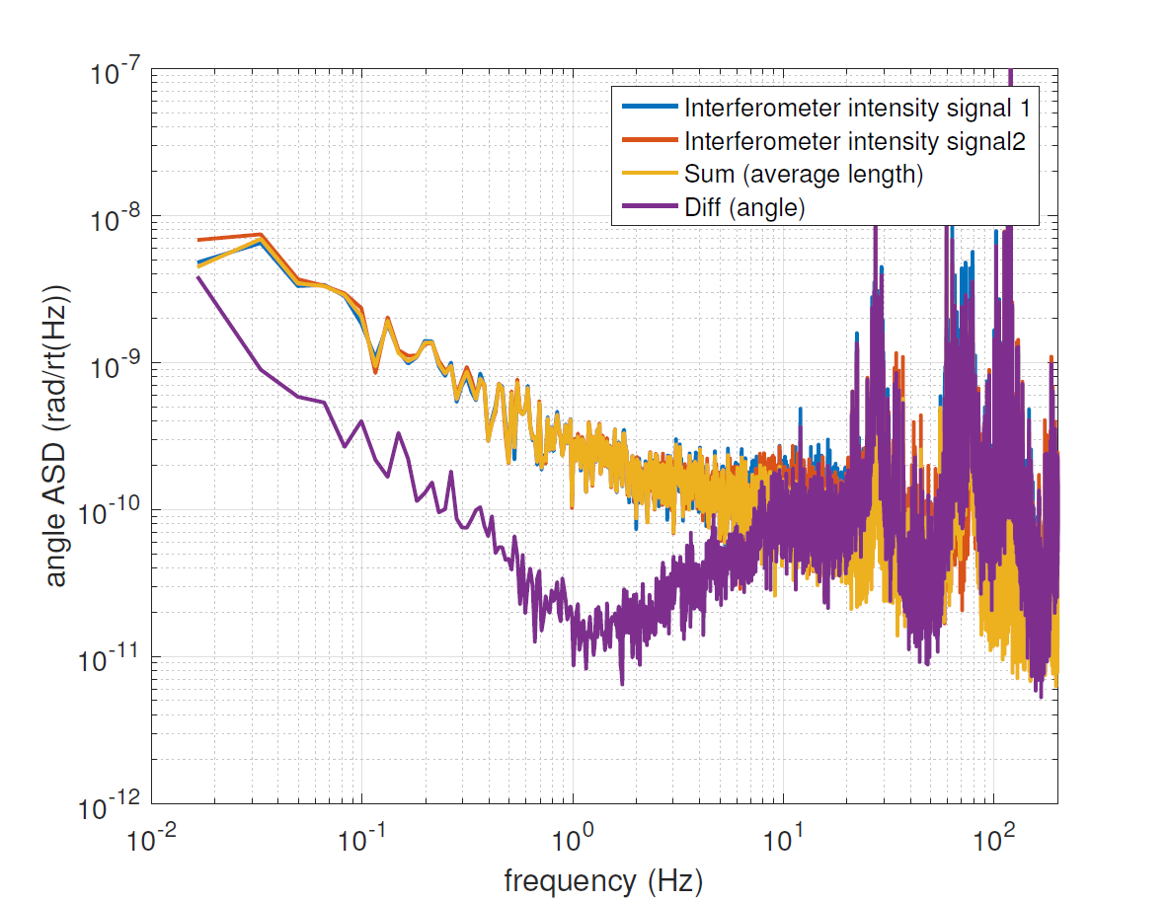
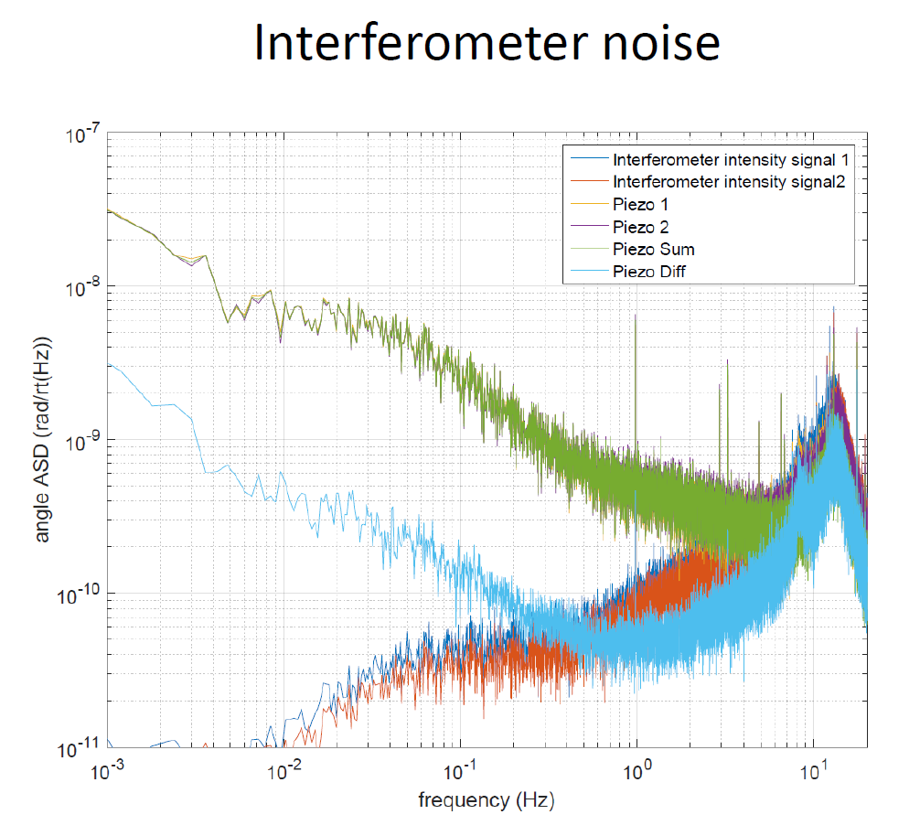
Readout sensitivity
Individual interferometer limited by frequency noise. Differential signal (angle channel) reduced frequency noise by matched cavities.
Readout with “hard control” Piezo – stacks locked at ~ 5 Hz
Tilt Signal is in the drive
~ 3 pm/rt(Hz)
Readout with “soft control” Piezo – stacks locked at ~ 5 mHz
Tilt signal is in the PhotoDiodes

Slide 20
Summary
1. BRS allows an unambiguous separation of tilt and horizontal acceleration between 0.01 to ~30 Hz.
2. BRS-1 and BRS-2 can improve total RMS differential motion of the Optical Platforms in LIGO and improve isolation, especially under windy conditions.
3. A new compact prototype (cBRS) is under development. When placed on the Optical Platforms, it can significantly boost angular isolation. It may also prove useful in Newtonian Noise measurement at 10 Hz.

Slide 21
Thank you!

Slide 22
Extra slides

Slide 23
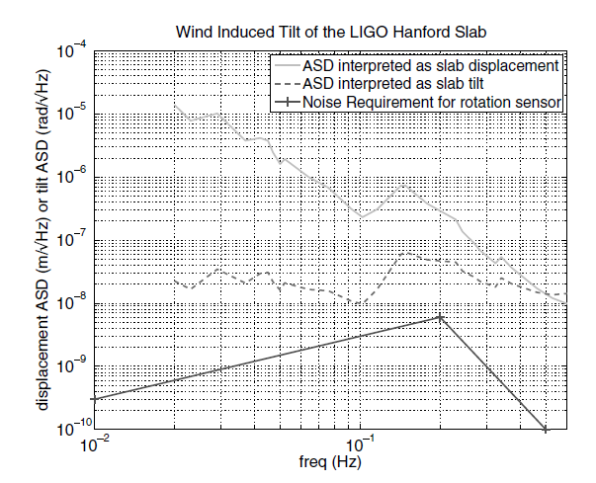
Target sensitivity
from “Requirements for a ground rotation sensor to improve Advanced LIGO” (B. Lantz et al., 2009)

Slide 24
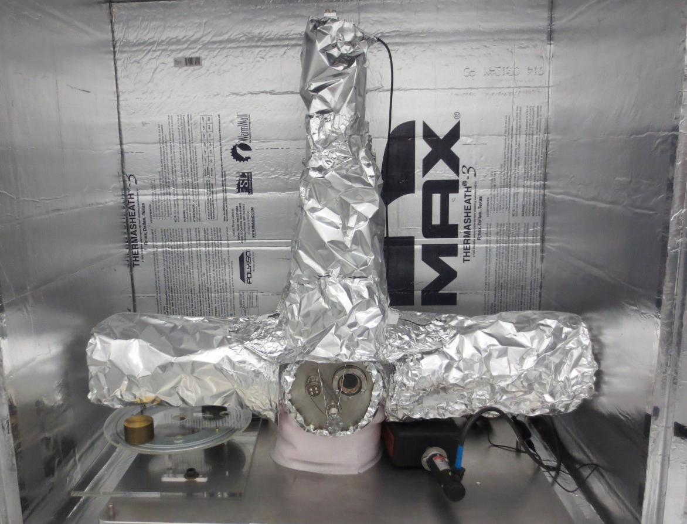
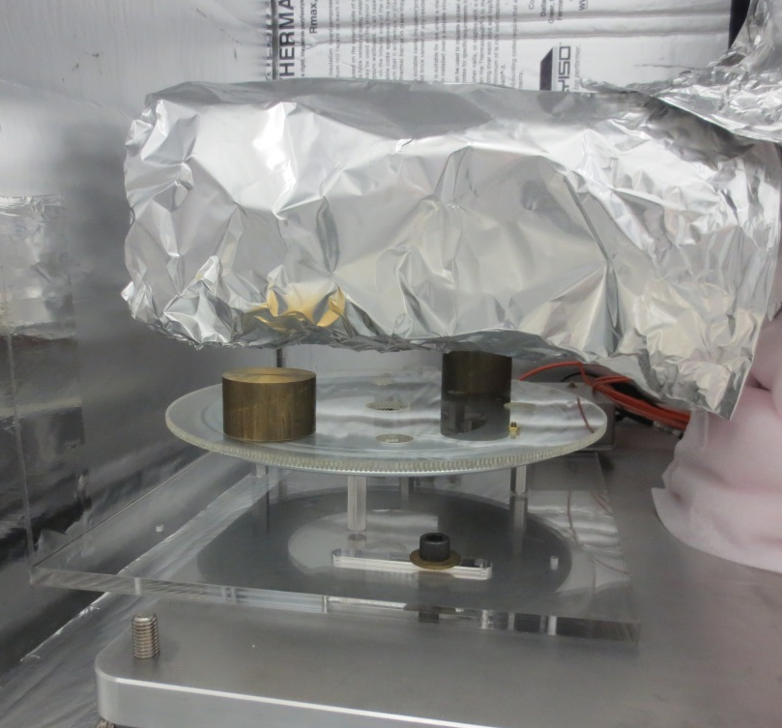
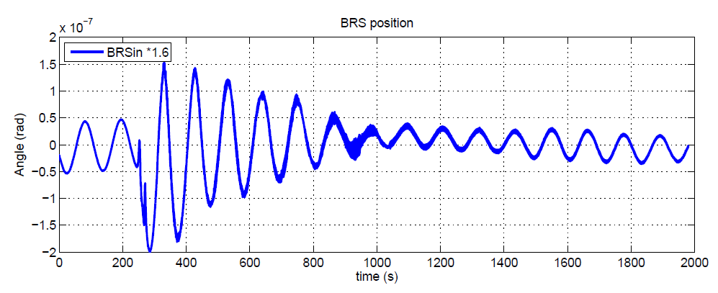
Damper Installation
gravitational feedback system!
A turn-table applies a gravitational torque on the balance to actively damp the beam-balance when amplitude exceeds a threshold.
Ref: LHO 14388

Slide 25

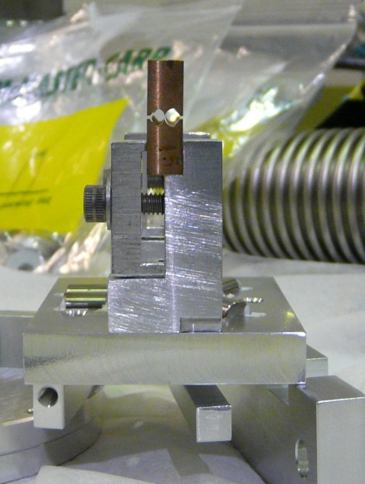
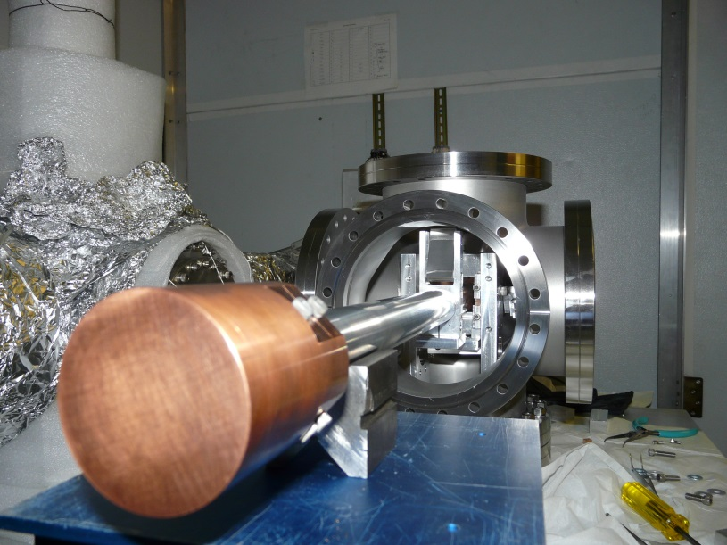
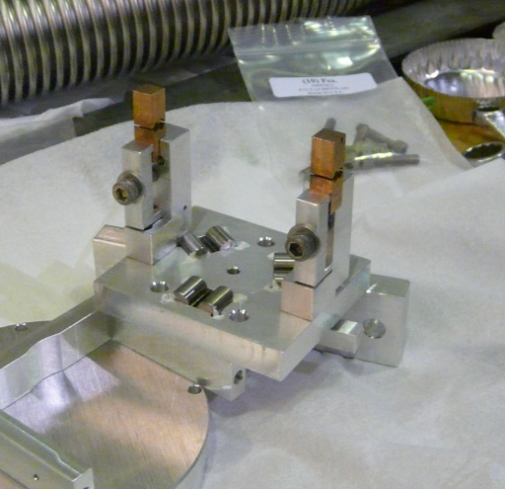
BRS-2 Assembly pictures
Assembled beam and weights
Flexures
Integrated with vacuum chamber

Slide 26
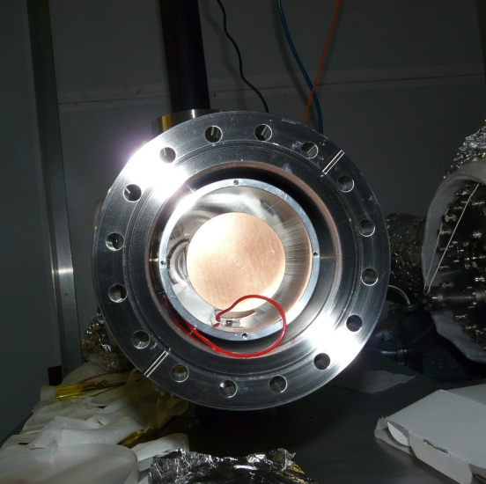
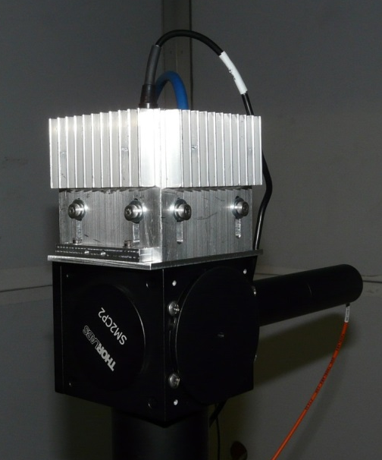
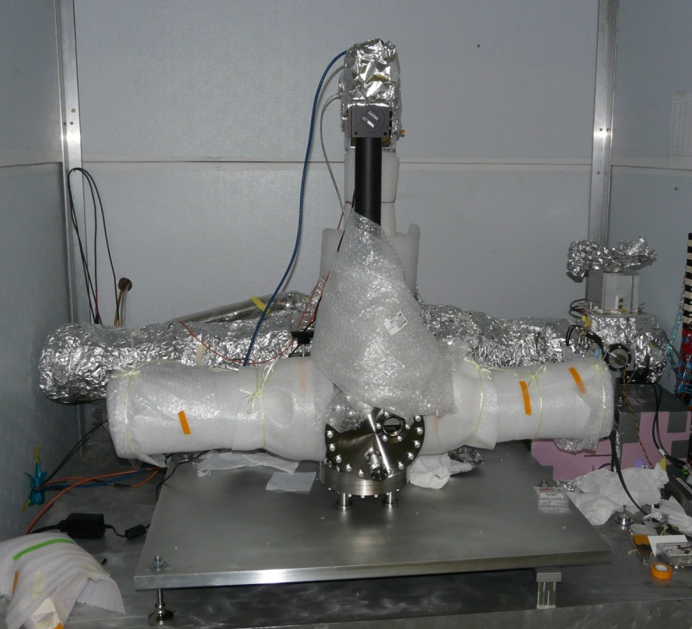
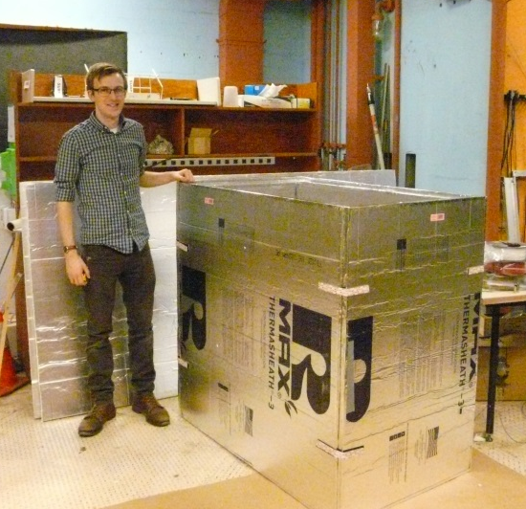
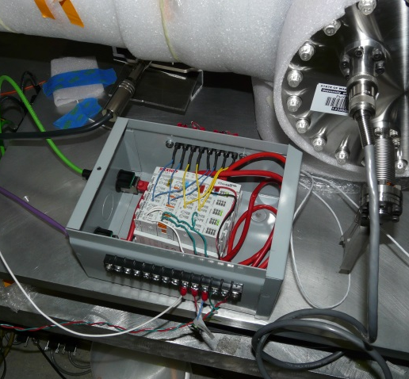
BRS-2 Assembly pictures
Capacitor plates
Basler CCD camera
Beckhoff modules
Foam box

Slide 27
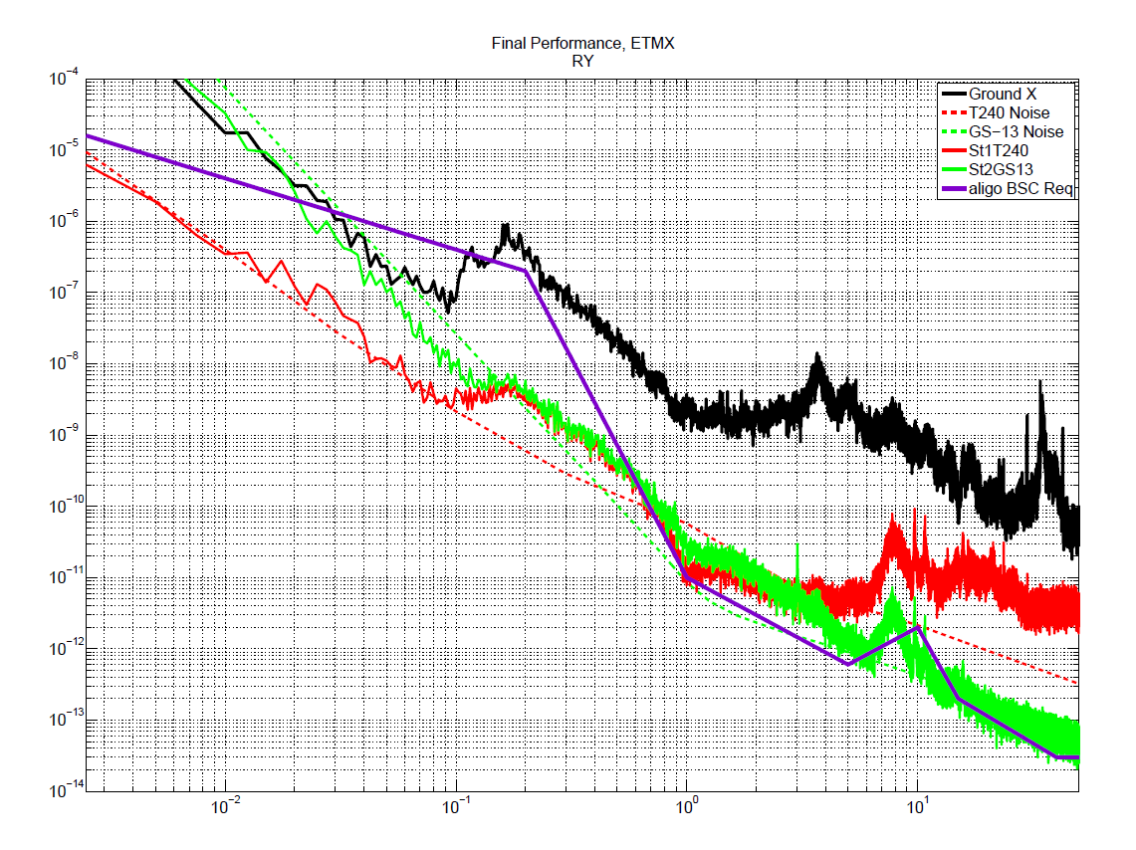
Sensitivity comparison
Angle ASD (rad/rt(Hz))
Current BRS read-out noise
Potential c-BRS read-out noise
Source: J. Warner, LHO 17197
Frequency (Hz)

Slide 28
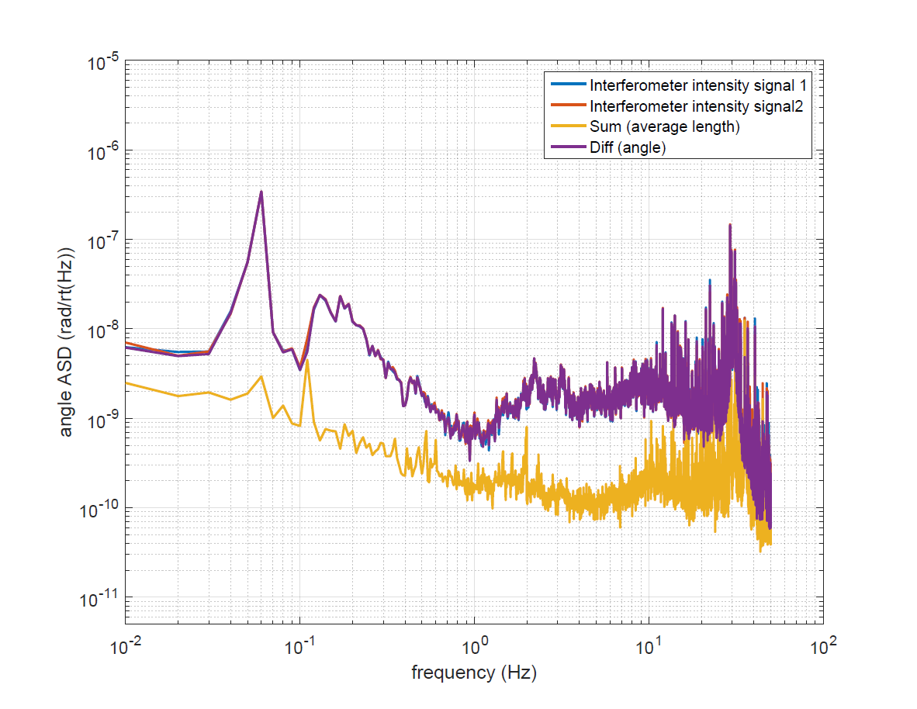
cBRS Tilt data
Current floor is too noisy to assess performance well
Frequency noise is consistent with before
Expectation of ‘sensitivity’ with 10% matching

