Slide 1
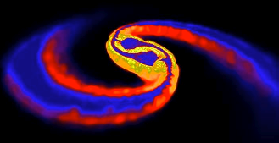
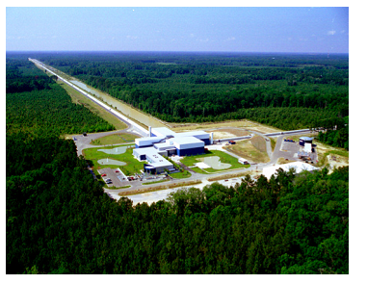
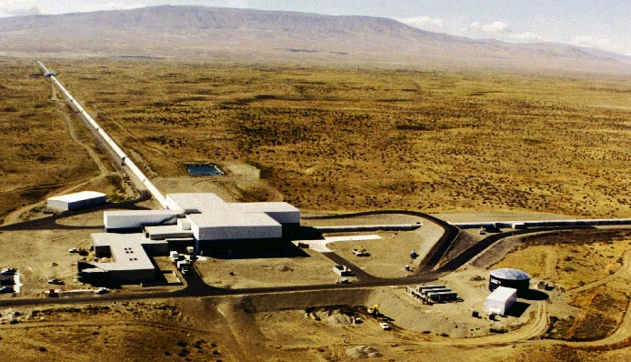
Compact Binary Mergers,
Nuclear EOS, and LIGO
GWs and LIGO
Compact binary mergers
prospects for LIGO GW detection and EM counterparts
Neutron stars
Nuclear EOS
Neutron star mass & radius
BNS mergers
BNS r-process nucleosynthesis
BNS merger constrains on NEOS
“Merging Neutron Stars“ (Price & Rosswog)
LLO
LHO
Alan Weinstein, Caltech
for the LIGO Scientific Collaboration
DOE/NSF NSAC Meeting,
Bethesda, March 23, 2016
LIGO-G1600723

Slide 2
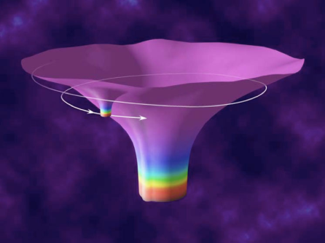
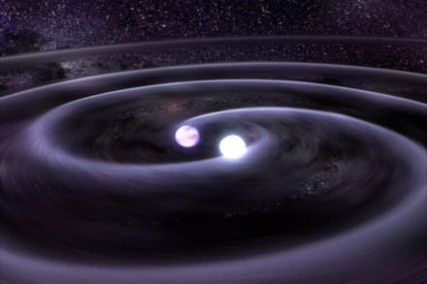

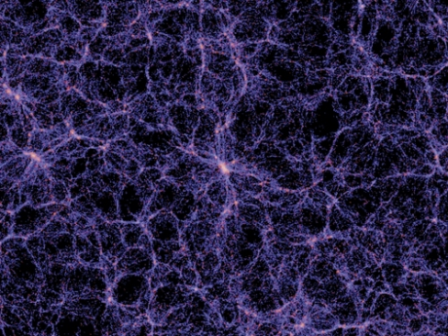

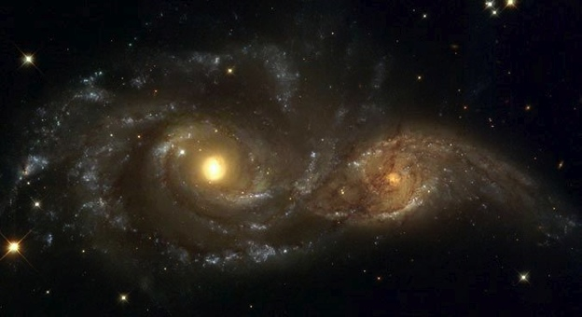
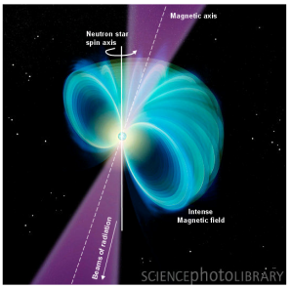

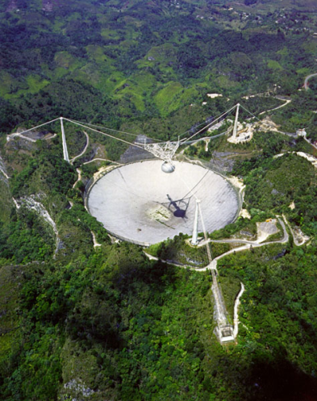
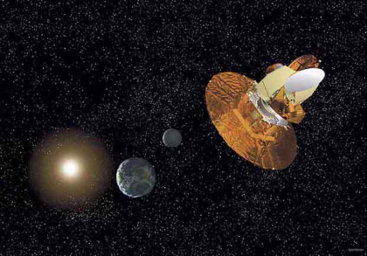
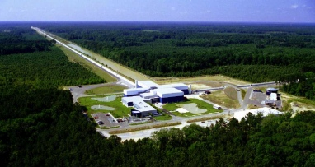
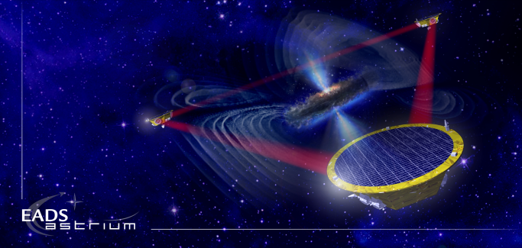
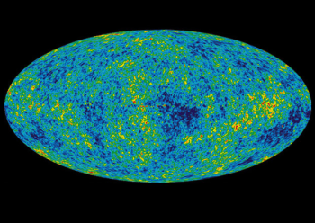
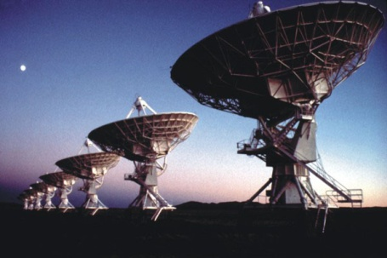
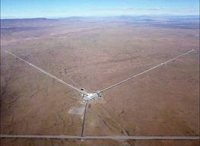
The GW Spectrum
BH and NS Binaries
Supernovae
Cosmic Strings
Relic radiation
Extreme Mass Ratio
Inspirals
Spinning NS
Supermassive BH Binaries
Binary coalescences
10⁻¹⁶ Hz
10⁻⁹ Hz
10⁻⁴ Hz
10⁰ Hz
10³ Hz
Inflation Probe
Pulsar timing
Space detectors
Ground interferometers

Slide 3
The Advanced LIGO detectors
https://dcc.ligo.org/LIGO-P1500237/public/main
Notes:
detection https://dcc.ligo.org/LIGO-P150914

Slide 4













































































LIGO Scientific Collaboration

Slide 5
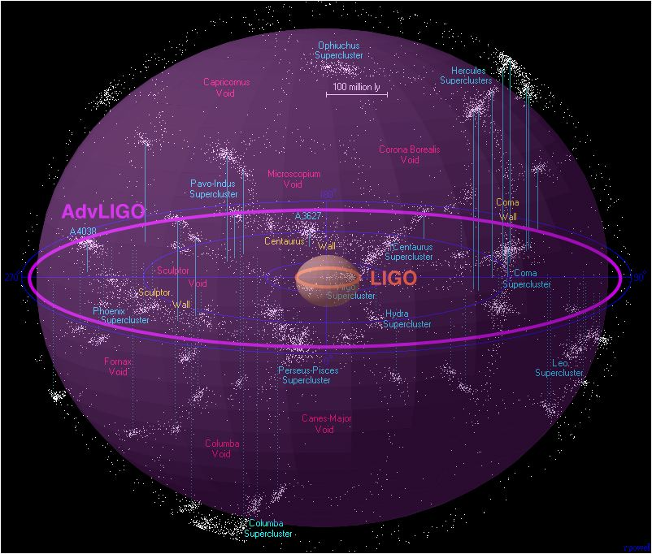
iLIGO → eLIGO → aLIGO
now
₂₀₀₆
₂₀₀₇
₂₀₀₈
₂₀₀₉
₂₀₁₀
₂₀₁₁
₂₀₁₂
₂₀₁₃
₂₀₁₄
₂₀₁₅
_{S5 data run}
_{e-LIGO installation}
_{and commissioning}
_{S6 data run}
_{Dark period}
O1
S6 data analysis & preparations
for Advanced LIGO commissioning and open data
_{Advanced LIGO Project}
_{Commissioning & initial data}
_{With Advanced LIGO}
_{Adv LIGO}
_{Installation}
_{begins}
Improve amplitude sensitivity by a factor of 10x, and…
⇒ Number of sources goes up 1000x!

Slide 6
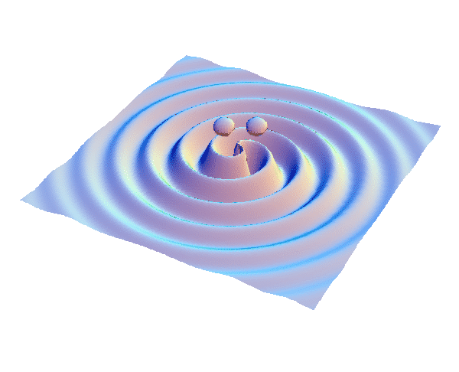
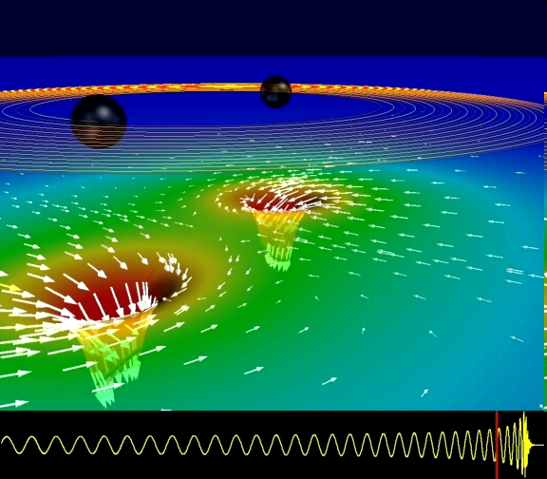
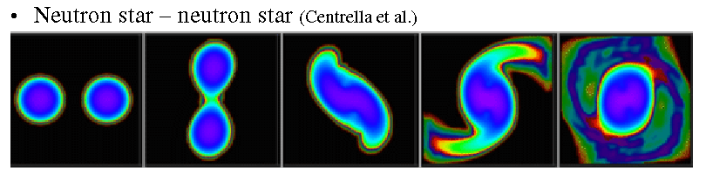
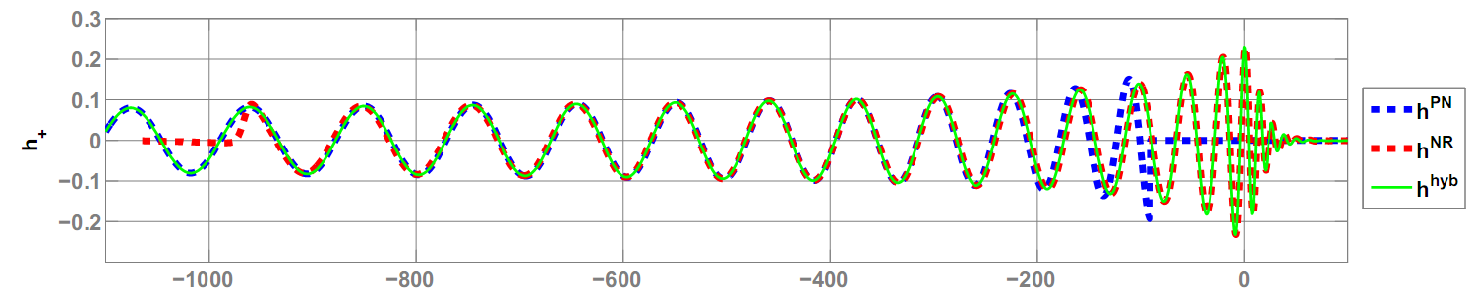
GWs from coalescing compact binaries (NS/NS, BH/BH, NS/BH)
Tidal disruption of neutron star
A unique and powerful laboratory to study
strong-field, highly dynamical gravity
and the structure of nuclear matter
in the most extreme conditions
Gravitational waveform: inspiral merger BH-ringdown
Waveform carries lots of information about binary masses, orbit, merger

Slide 7
Template-based searches
GW150914
> 900 Mpc
BBH
BNS
NSBH
Masses and (aligned) spins
Templates spaced for < 3%
loss of SNR: 250K templates.
Sensitive distance in Mpc
https://dcc.ligo.org/LIGO-P1500269/public/main
Notes:
https://dcc.ligo.org/P1500269/

Slide 8
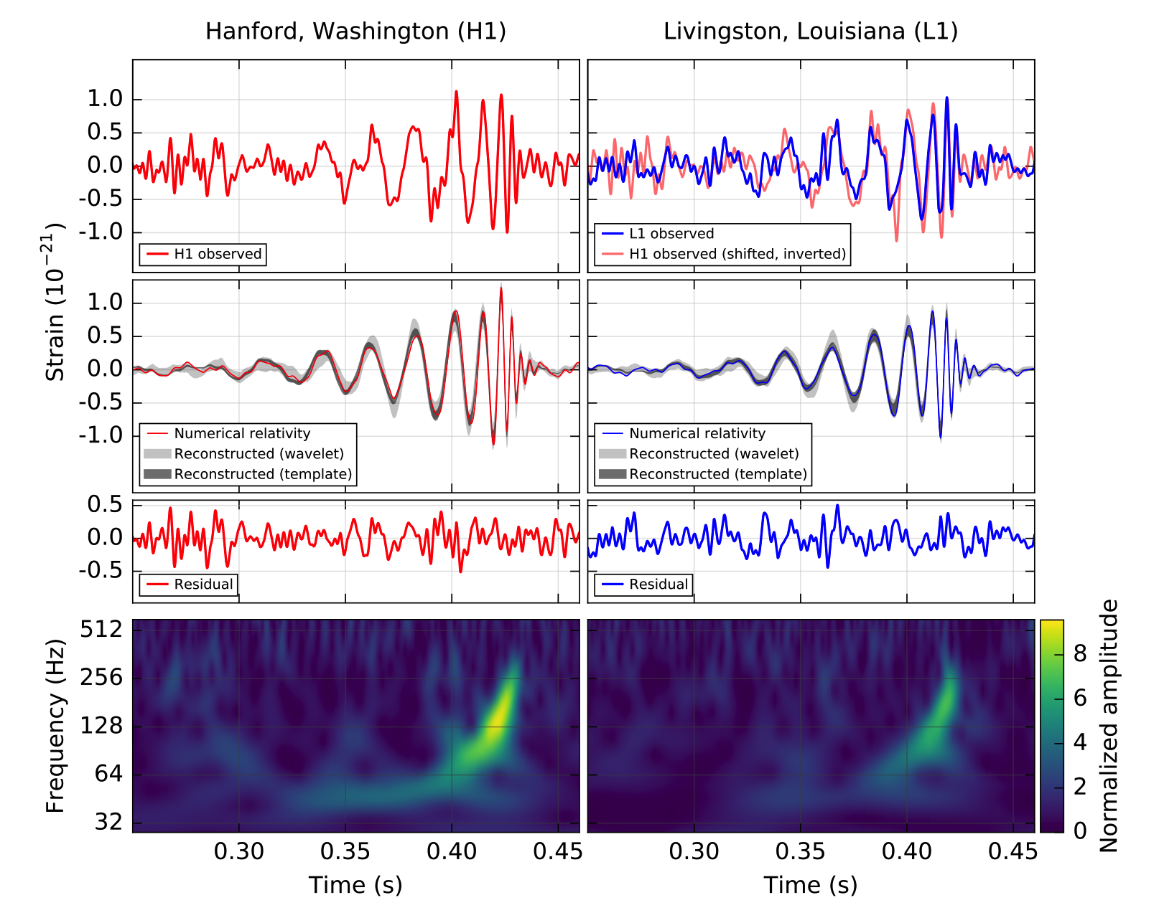
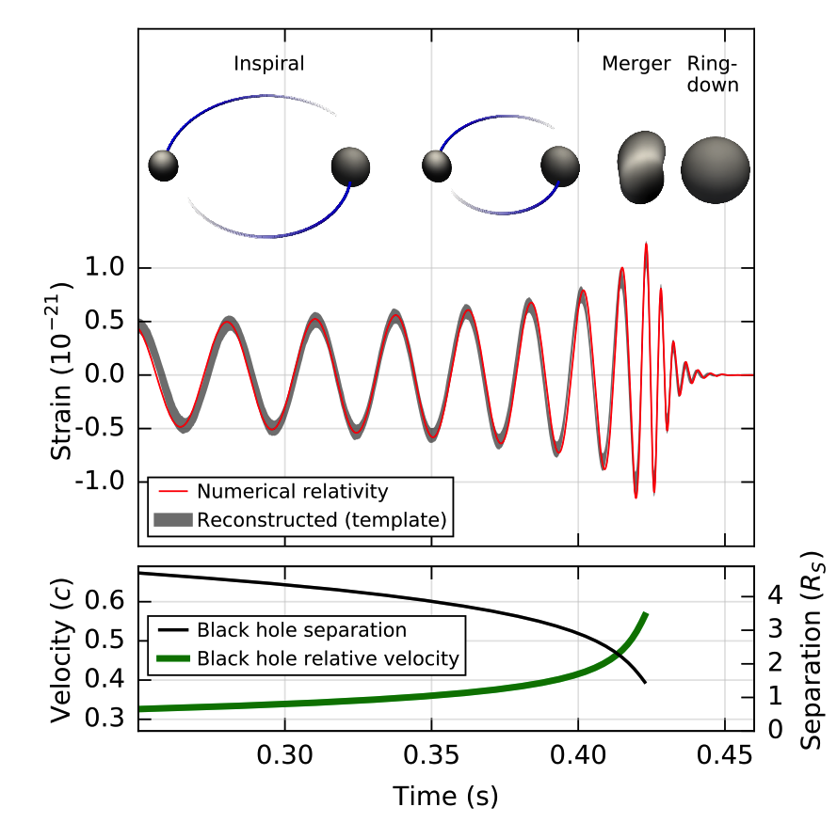

GW150914
Phys. Rev. Lett. 116, 061102 – Published 11 February 2016
https://dcc.ligo.org/LIGO-P150914/public/main
Reconstructed
(no whitening)
Audio:
filtered data
freq-shifted data
reconstructed & shifted
Whitened and band-passed [40-300] Hz
Notes:
detection https://dcc.ligo.org/LIGO-P150914

Slide 9
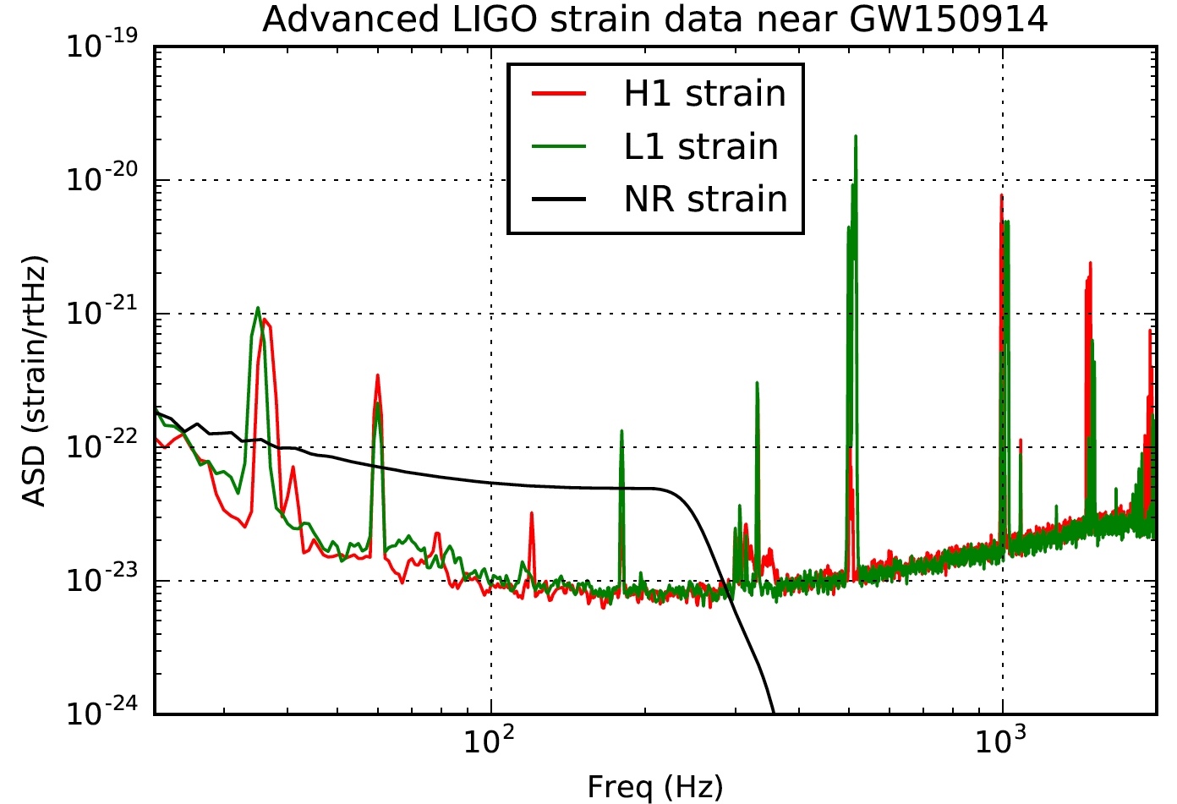
GW150914 in the frequency domain
inspiral
merger
ringdown
Made with data from the
LIGO Open Science Center, losc.ligo.org

Slide 10
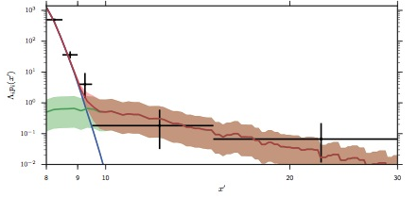
Observed BBH merger rate
https://dcc.ligo.org/LIGO-P1500217/public/main
From GW150914 – like events (high mass BBH),
Rate ~ [2-53] /Gpc³ /yr (comoving frame).
From both events, the observed BBH merger
Rate ~ [2-400] /Gpc³ /yr
GW150914
LVT151012
SNR ρ
Same ballpark as population synthesis models, CCSN rate, etc
iLIGO+eLIGO BBH rate upper limit: ~< 420 Gpc⁻³ yr⁻¹
Aasi, J. et al. 2013, Phys. Rev. D, 87, 022002, arXiv:1209.6533
Notes:
Rates - - https://dcc.ligo.org/P1500217/

Slide 11
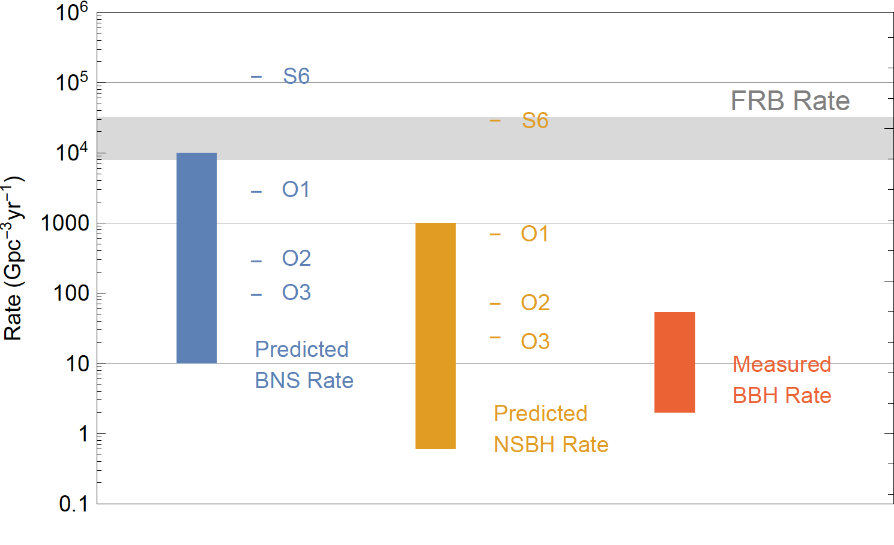
Expected (and measured!) compact binary merger rates
sGRB rate
T. Callister et al, in prep (2016); D.M. Coward et al, MNRAS 425, 1365 (2012), arXiv:1202.2179 ;
B. Abbott et al, Living Rev. Relativity, 19, 1 (2016) arXiv:1304.0670.

Slide 12
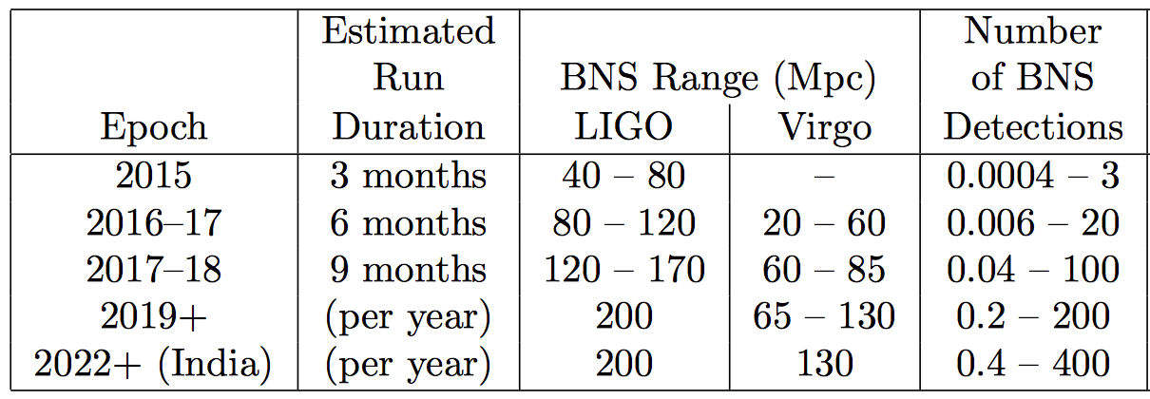
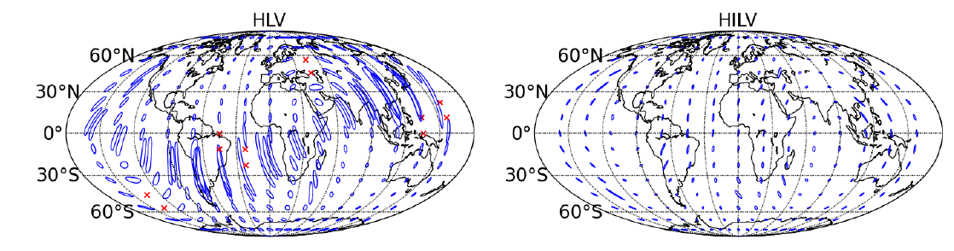
Expected ranges of binary neutron star merger rates and detections
“It’s tough to make predictions, especially about the future” (Yogi Berra)
Estimated BNS rate: [10¹ – 10⁴] Gpc⁻³yr⁻¹
LIGO and Virgo Collaborations,
“Prospects for Observing and Localizing Gravitational-Wave Transients with Advanced LIGO and Advanced Virgo”
Living Rev. Relativity, 19, 1 (2016)

Slide 13
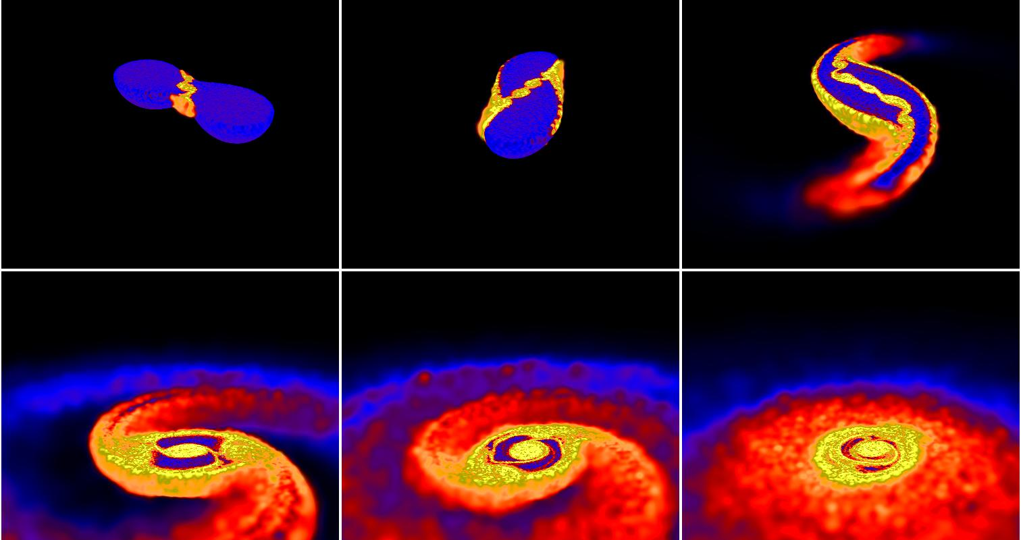
Binary neutron star mergers are a unique laboratory for nuclear (astro)-physics
Daniel Price and Stephan Rosswog

Slide 14
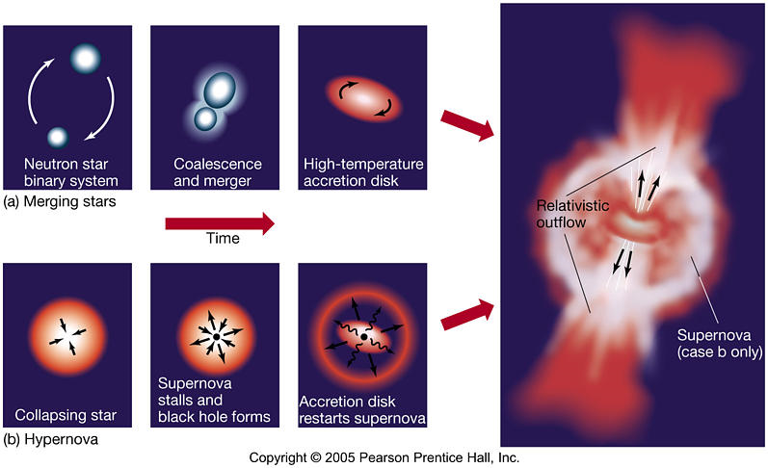
Short-hard and Long-soft GRBs

Slide 15
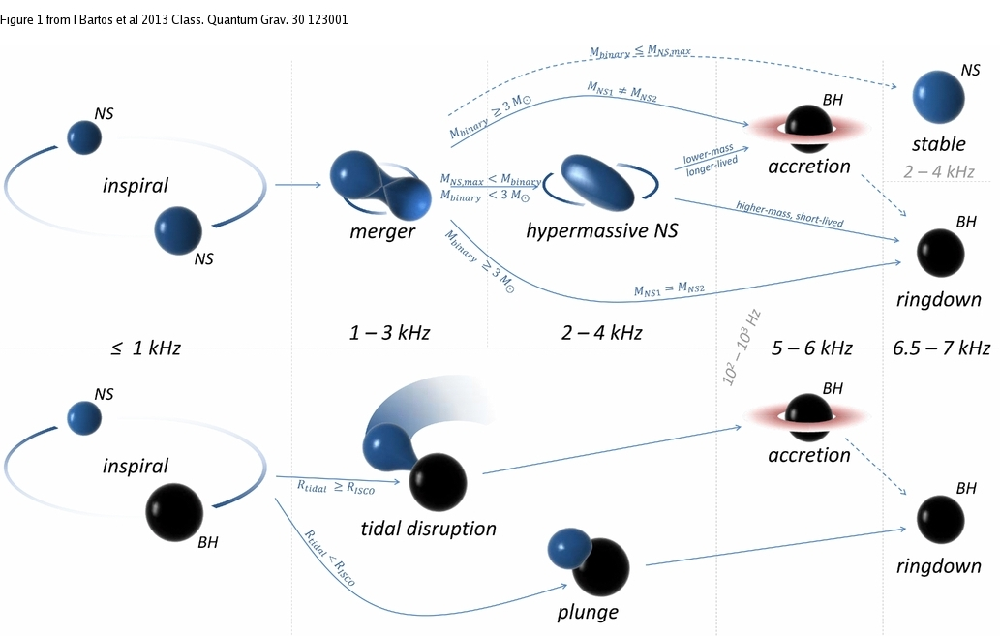
BNS and NSBH mergers

Slide 16
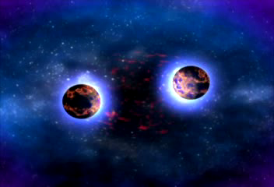
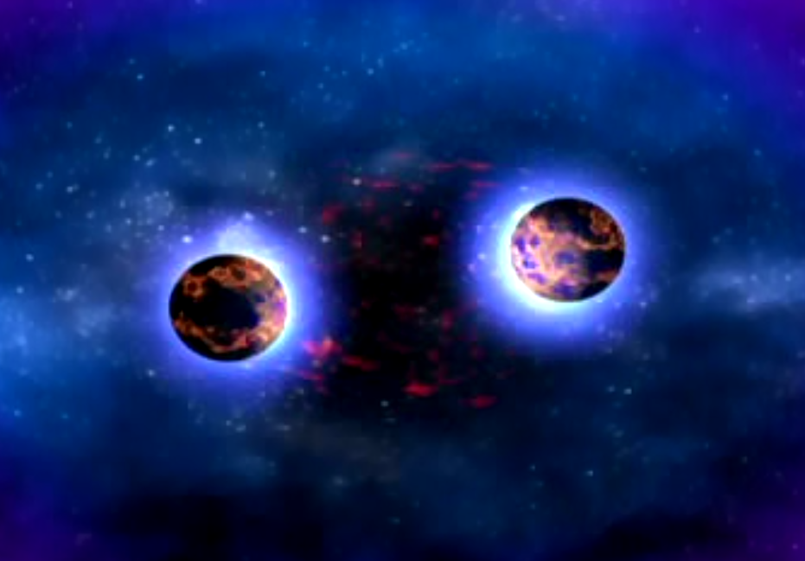
Binary neutron star merger
Dana Berry/NASA
http://www.nasa.gov/mission_pages/swift/bursts/short_burst_nsu_multimedia.html

Slide 17
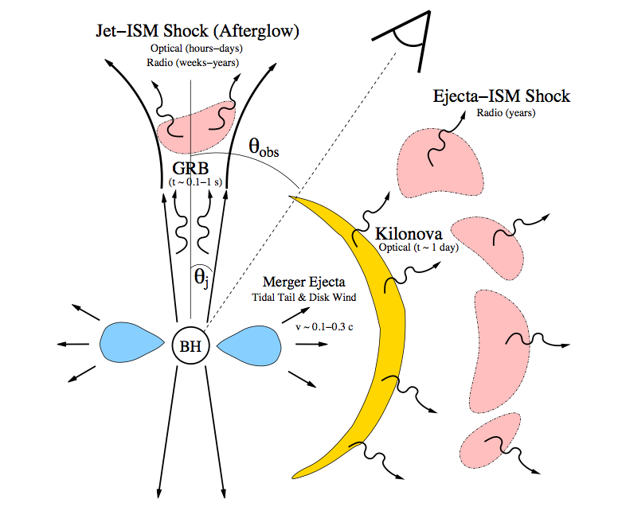
Electromagnetic radiation from sGRB progenitors
Short
GRB
Ejecta-ISM shock
radio emission
from days to years
“kilonova”
Prompt optical emission
from seconds to days
Metzger & Berger 2011

Slide 18
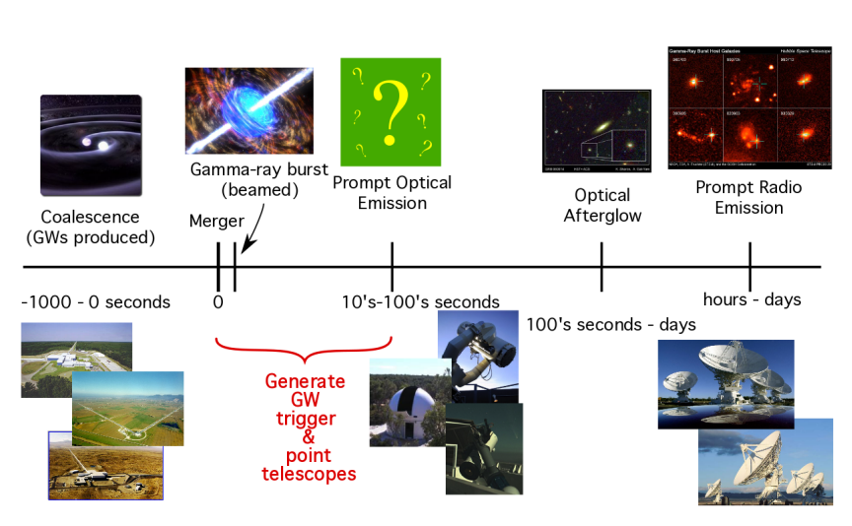
Low-latency identification of transients for rapid (< ~100s) followup
EM counterparts to GW sources (if any) are short-lived and faint

Slide 19
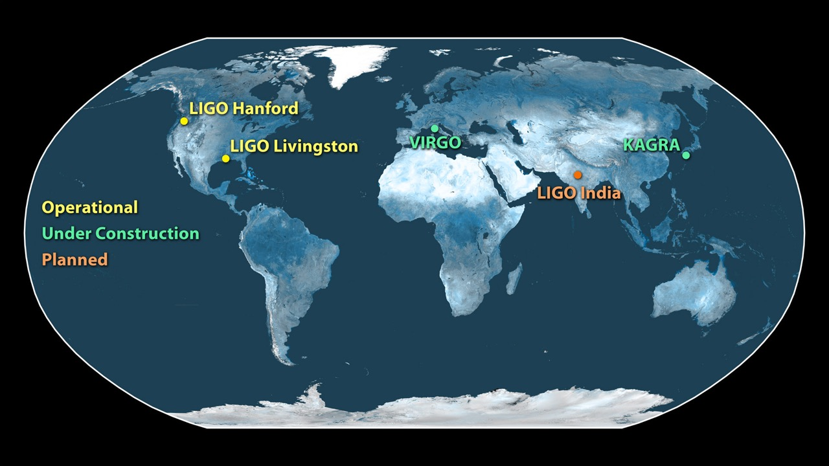
sky localization with the
GW detector network

Slide 20
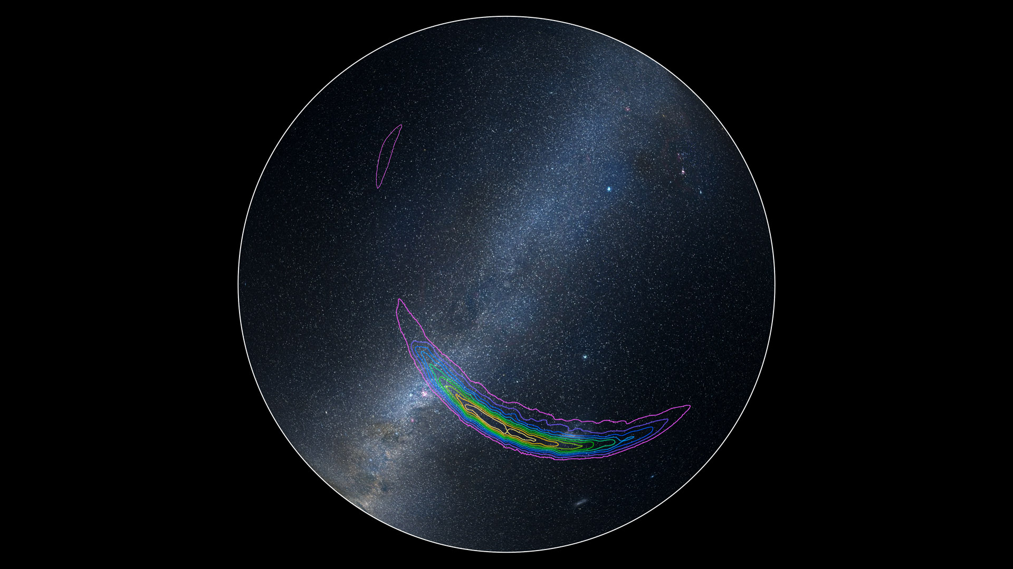
Kasliwal (2016)

Slide 21
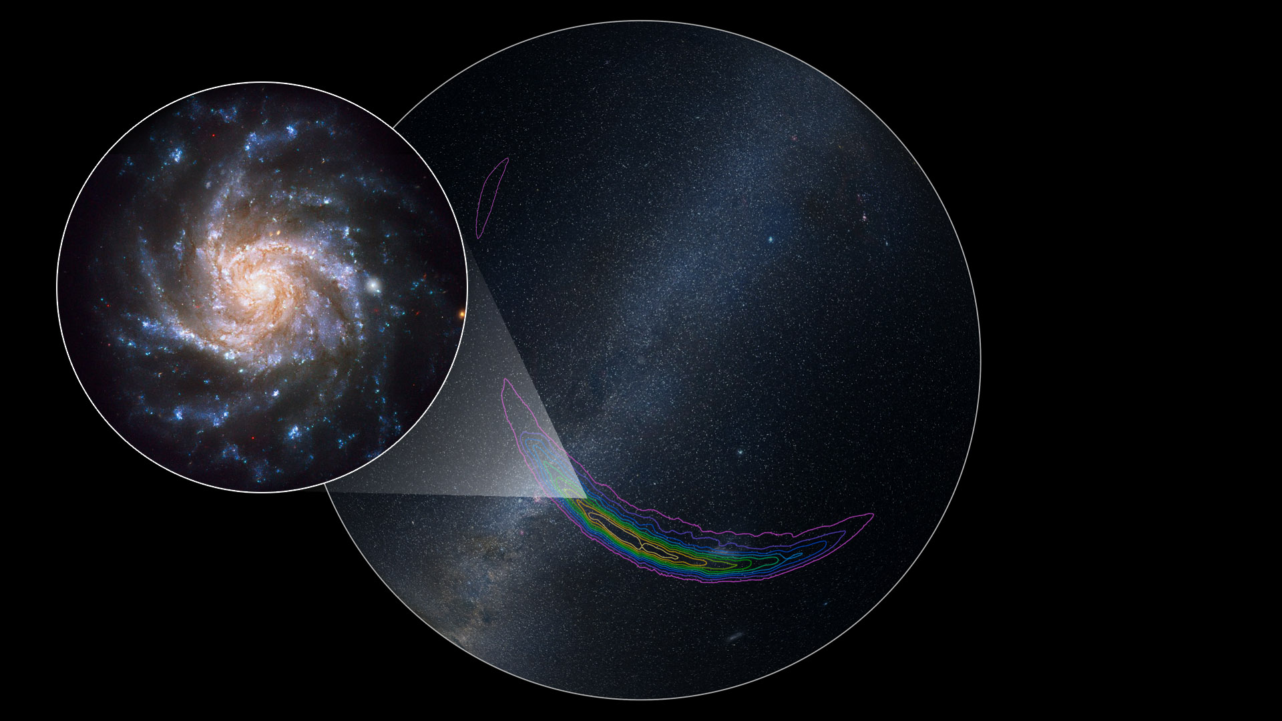
Kasliwal (2016)

Slide 22
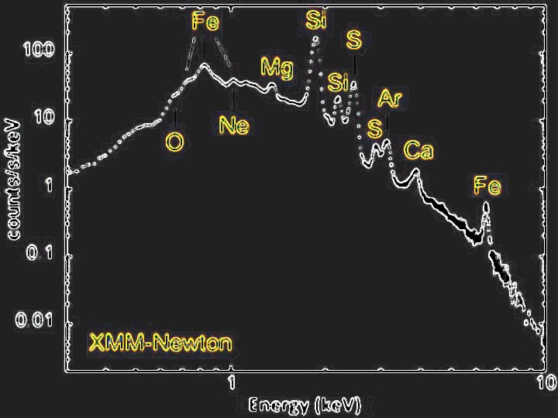
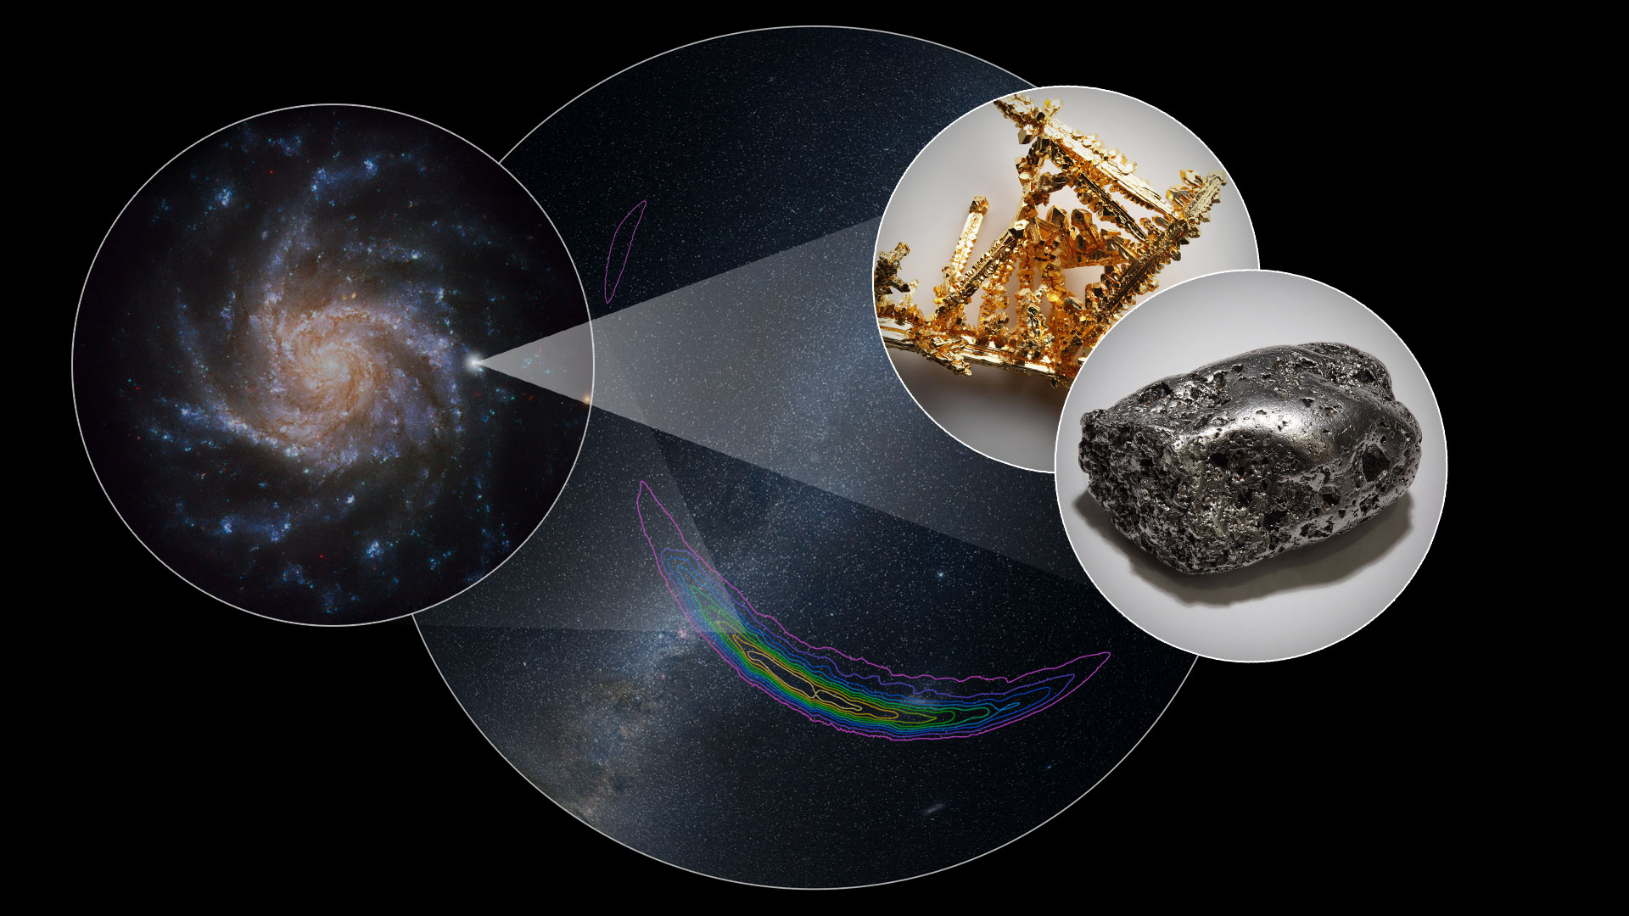
Kasliwal (2016)

Slide 23
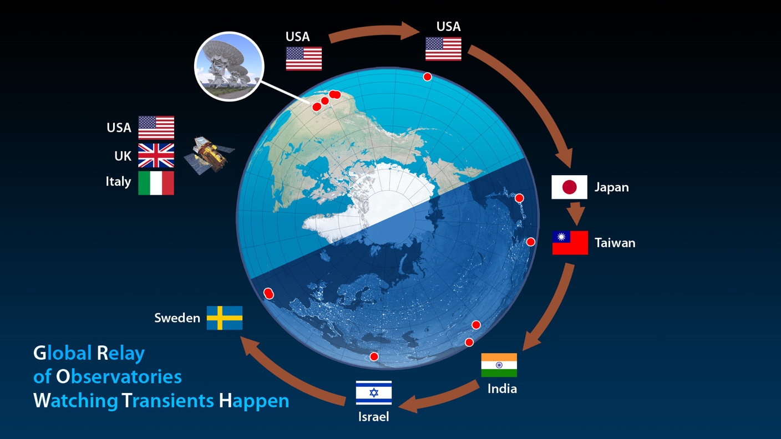
Kasliwal (2016)

Slide 24
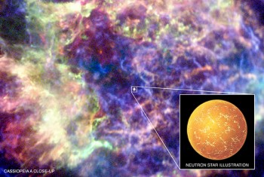

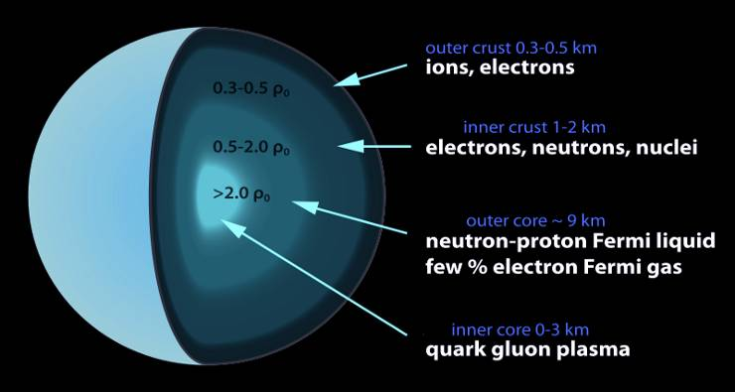
Neutron stars
Remnants of core collapse supernovae
A unique laboratory for fundamental physics
Strong, Weak, EM, gravity –
all under the most extreme conditions
Structure can be revealed through binary mergers
http://www.astro.umd.edu/~miller/nstar.html

Slide 25
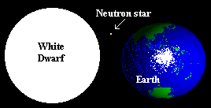
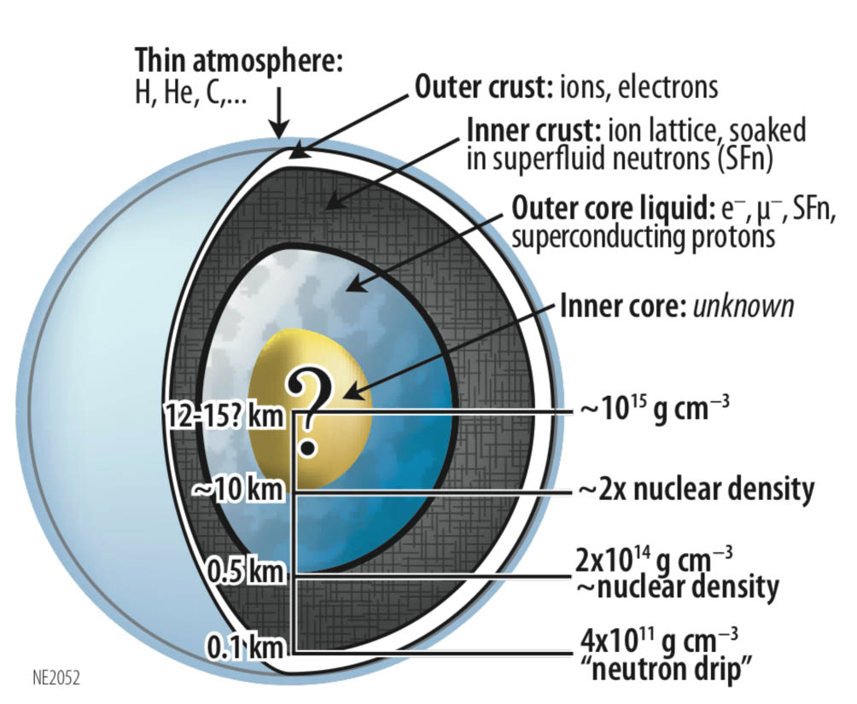
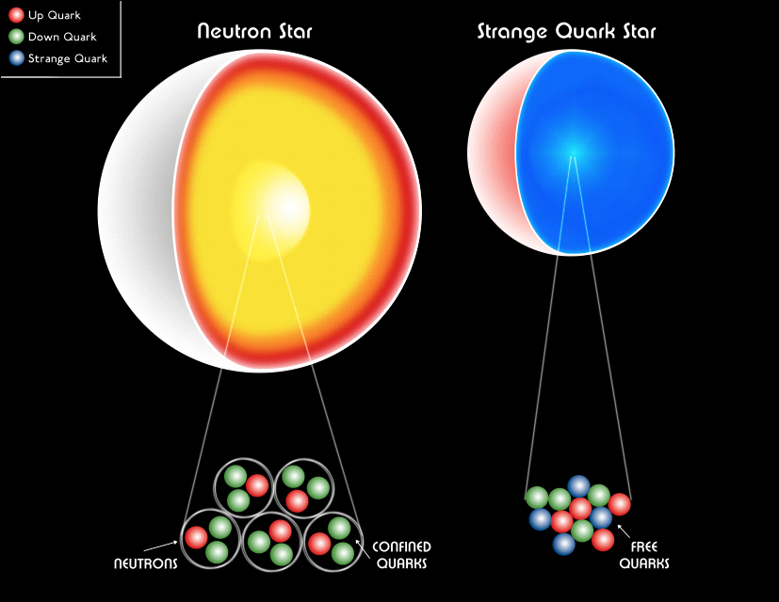
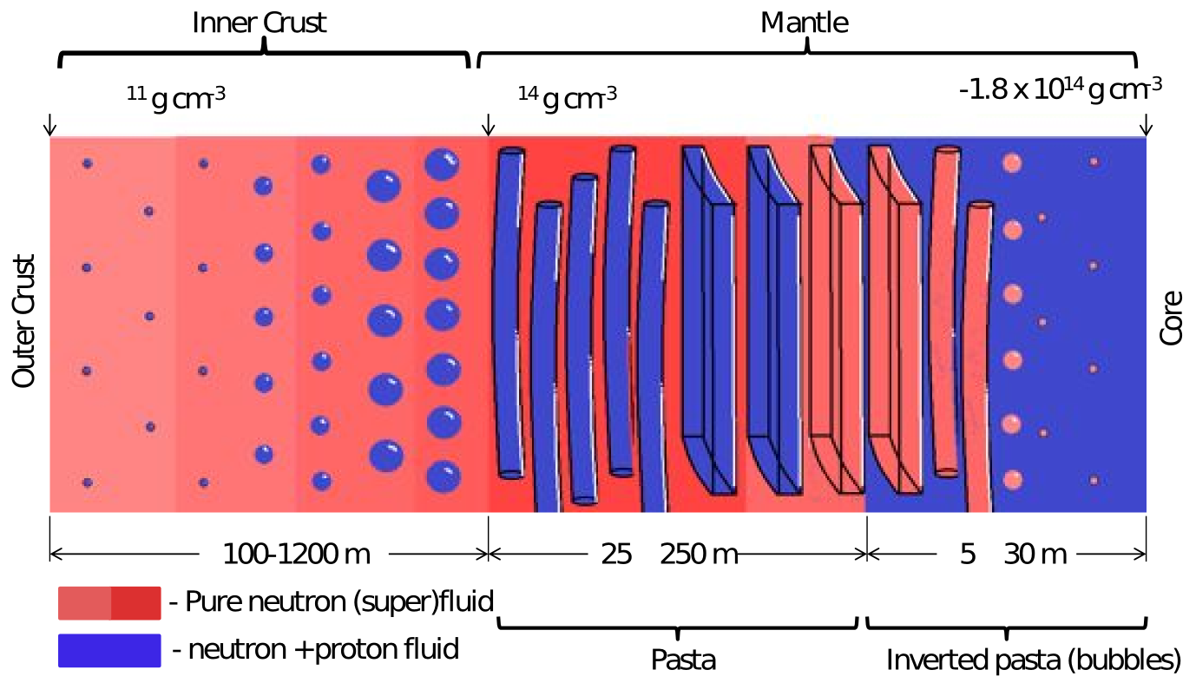
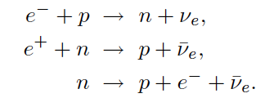
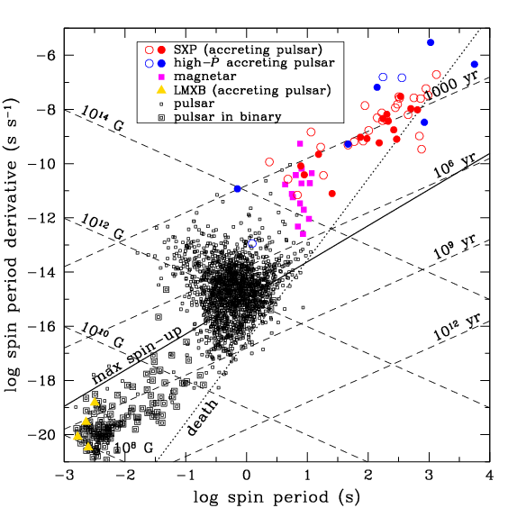
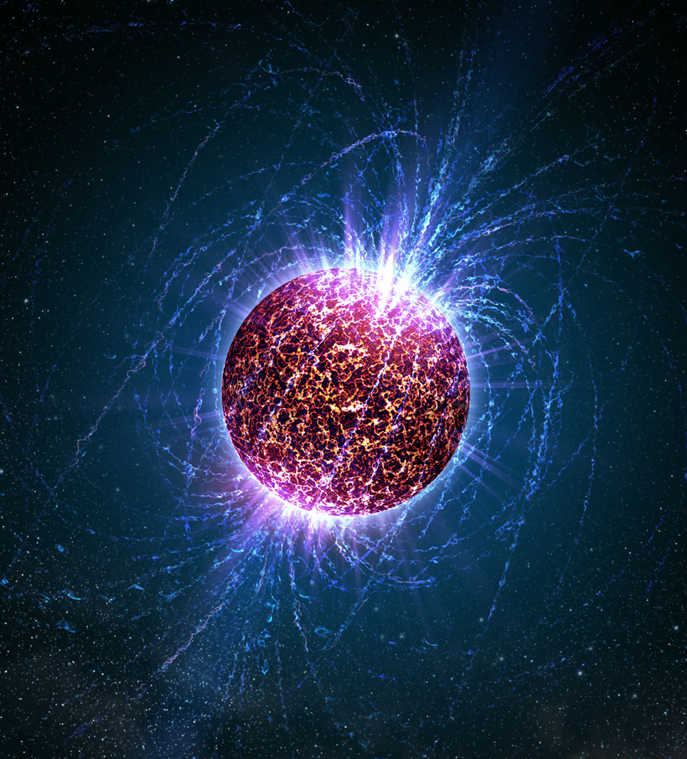
All four fundamental forces under the most extreme conditions
Gravity: Compact stars have gravitational fields GM/c²R ~ O(1), strong tidal effects, strong curvature, highly relativistic
Strong interaction at > 2x nuclear density in core
  Hard repulsive core of nucleon-nucleon interaction plays crucial role
  Potential transition to hyperonic matter, strange quark matter, QGP
  Complex ionic crystal lattice structure in crust: “nuclear pasta”
Weak interaction under extreme conditions with neutrino trapping -> beta equilibrium
EM: Superfluid core supporting extreme magnetic fields (perhaps > 10¹⁵ Gauss at surface), flux tube pinning in core

Slide 26
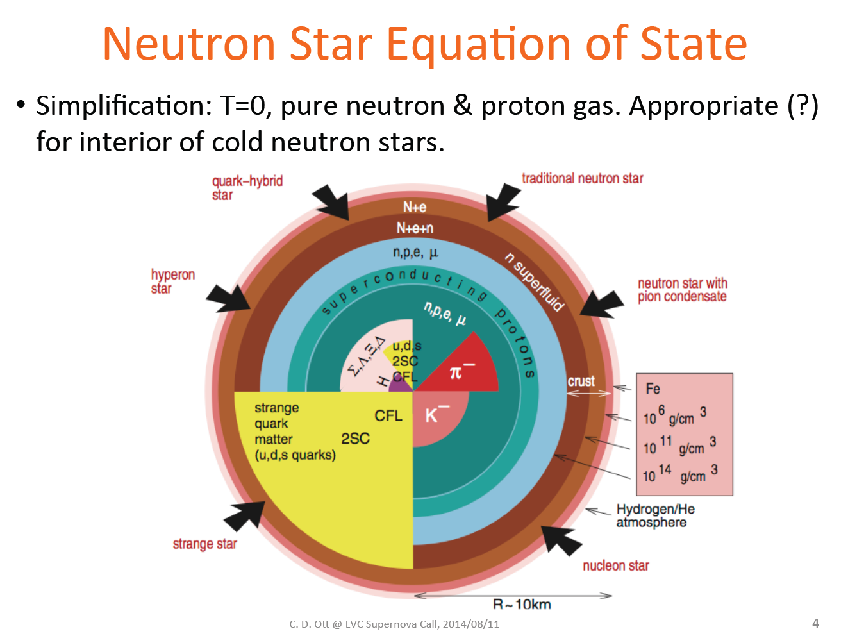

Slide 27

Phase diagram of ground state
BNS mergers
Neutron stars
Weber, Fridolin et al. Acta Phys.Polon.Supp. 3 (2010) 701-710 arXiv:0911.5164

Slide 28

J. Read, CGWAS 2015

Slide 29

“polytrope”
Γ = 5/3 corresponds to a non-relativistic gas.
A relativistic gas has Γ = 4/3, which is unstable to collapse.
Note that (unlike ideal gas law P = nkT)
the result is independent of temperature.
In general, pv^{n} = const is polytropic, with Γ = 1+1/n; here,
n = polytropic index (NOT n = ρ/m_{N})

Slide 30

C. Ott, 2012

Slide 31

C. Ott, 2012

Slide 32

C. Ott, 2012

Slide 33

C. Ott, 2012

Slide 34

C. Ott, 2012

Slide 35

J. Read, CGWAS 2015

Slide 36

Tolman-Oppenheimer-Volkov (TOV) eqns
C. Ott, 2012

Slide 37

Building neutron star mass-radius relation with TOV and NEOS
J. Lattimer, Annu. Rev. Nucl. Part. Sci. 62, 485 (2012)

Slide 38

EOS and Neutron star structure
Knowing masses and radii would really help!
J. Lattimer, Annu. Rev. Nucl. Part. Sci. 62, 485 (2012)
arXiv:1305.3510v1

Slide 39


Neutron star masses
Feryal Ozel, Paulo Freire, http://arxiv.org/abs/1603.02698v1

Slide 40
Mass and radius constraints
2 M
Strange quark models appear to be ruled out…

Slide 41


Astrophysical constraints on masses and radii of NSs
AW Steiner, JM Lattimer, EF Brown. Astrophys. J. 722:33 (2010)
J. Lattimer, Annu. Rev. Nucl. Part. Sci. 62, 485 (2012), arXiv:1305.3510v1

Slide 42

Binary neutron star mergers
Daniel Price and Stephan Rosswog

Slide 43

Matter distribution during the disruption of the neutron star
About half of the remnant material is unbound,
while a relatively low mass hot disk forms.
F. Foucart et al, Phys. Rev. D 90, 024026 (2014) arXiv:1405.1121

Slide 44




The origin of the elements – astrophysical nucleosynthesis
Lightest elements (H, He, Li) forged in Big Bang
Heavier elements (C, O, N, … Fe) forged in the core of massive stars, distributed to ISM by core-collapse supernovae (star-death)
Elements beyond Fe (like Cu, Au, Pb, Pt, U…)
are forged during the SN (“r-process”)
but many/most of them might come from binary neutron star mergers (second-death)
By Cmglee - Own work, CC BY-SA 3.0, https://commons.wikimedia.org/w/index.php?curid=31761437

Slide 45

Nucleosynthesis in binary neutron star collisions
C. Ott; http://www.lippuner.ca/files/nucleosynthesis_000_med.mp4

Slide 46

Nuclear abundances from detailed simulations on BNS mergers

Slide 47

GWs from BNS mergers
S Bernuzzi, T Dietrich, A Nagar, Phys Rev Lett 115, 091101 (2015) arxiv.org:1504.01764

Slide 48

J. Read, CGWAS 2015

Slide 49

J. Read, CGWAS 2015

Slide 50

J. Read, CGWAS 2015

Slide 51

J. Read, CGWAS 2015

Slide 52

J. Read, CGWAS 2015

Slide 53

J. Read, CGWAS 2015

Slide 54

J. Read, CGWAS 2015

Slide 55

J. Read, CGWAS 2015

Slide 56

J. Read, CGWAS 2015

Slide 57

J. Read, CGWAS 2015

Slide 58
Nuclear Astrophysics: NS-NS Mergers
Mass [M_{Sun}]
1.35 + 1.35
1.50 + 1.50
1.60 + 1.60
Sekiguchi+ 11: First full GR NS-NS simulation with realistic microphysics,
finite-temperature nuclear EOS of H. Shen+ ‘98,‘11

Slide 59


Effects of tidal disruption of neutron stars near merger
Credit: Daniel Price and Stephan Rosswog
iLIGO
aLIGO
ET

Slide 60

J. Read, CGWAS 2015

Slide 61

Frequency of peak of final hyper-massive NS resonance

Slide 62


Universality of peak frequency
S Bernuzzi, T Dietrich, A Nagar,
Phys Rev Lett 115, 091101 (2015) arxiv.org:1504.01764

Slide 63



Many observations required to constrain NEOS
Different NEOS’s
Number of
BNS observations
M. Agathos et al (LVC), Phys. Rev. D 92, 023012 (2015), arXiv:1503.05405v1

Slide 64

Constraining the NEOS using GWs from BNS
J. Read, CGWAS 2015

Slide 65
THANK YOU!
Questions?

