Slide 1
VOPO Optical Layout
LIGO MIT Lab
Matichard, Fabrice
Fernandez Galiana, Alvaro

Slide 2
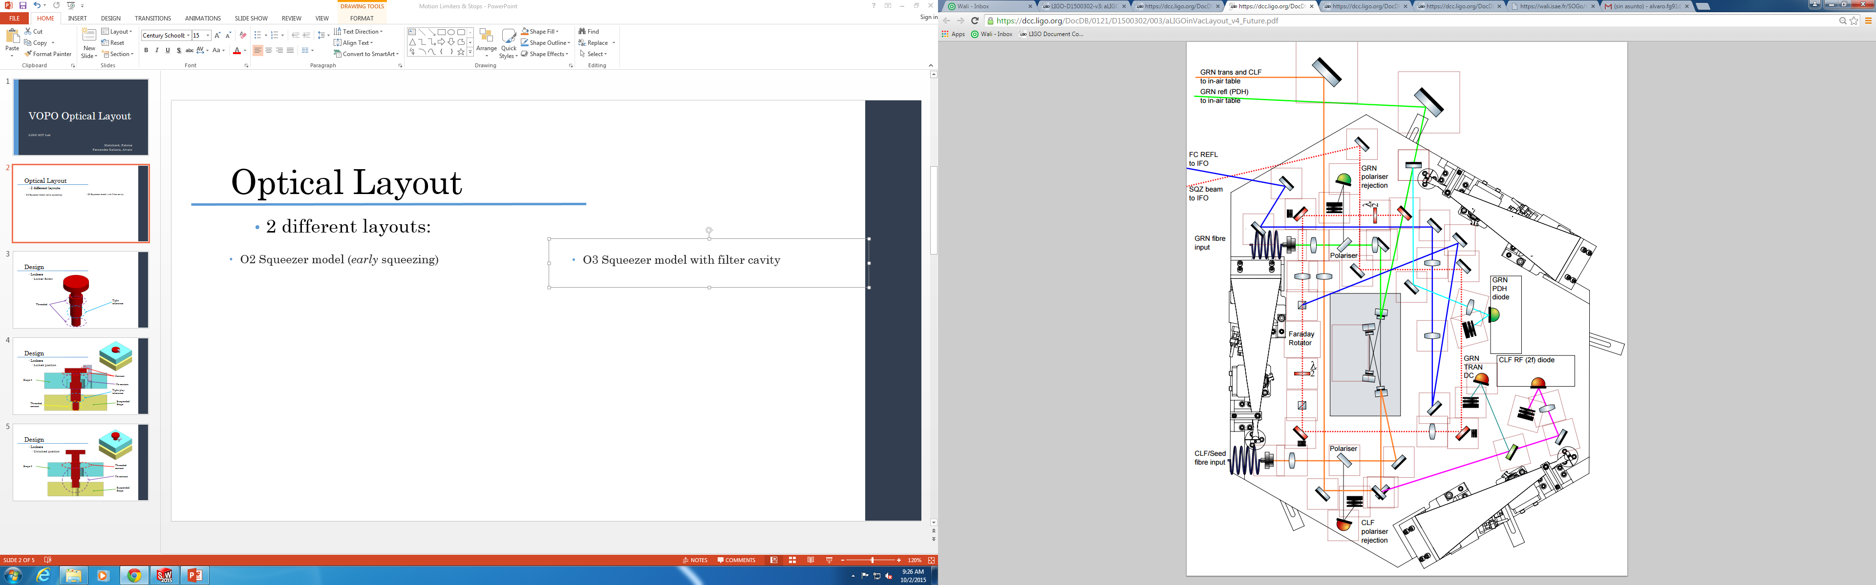
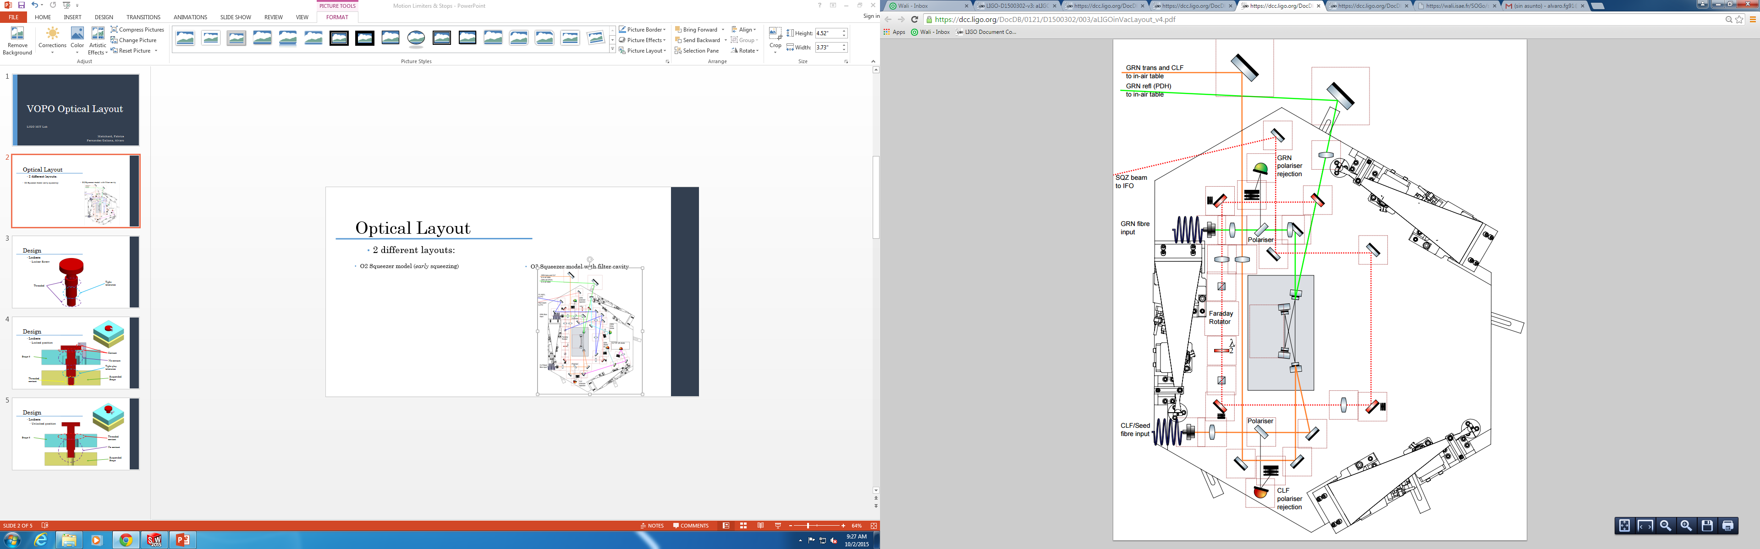
Optical Layout
2 different layouts:
  O3 Squeezer model with filter cavity + RFPD in Vacuum
  O2 Squeezer model (early squeezing)

Slide 3
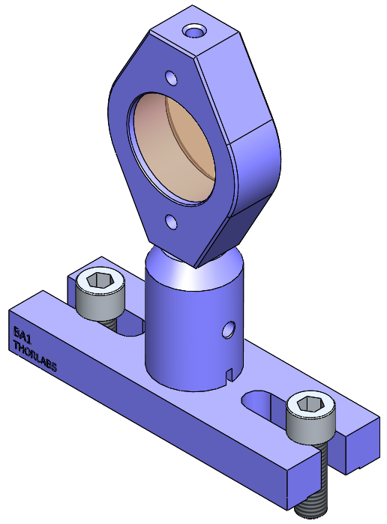
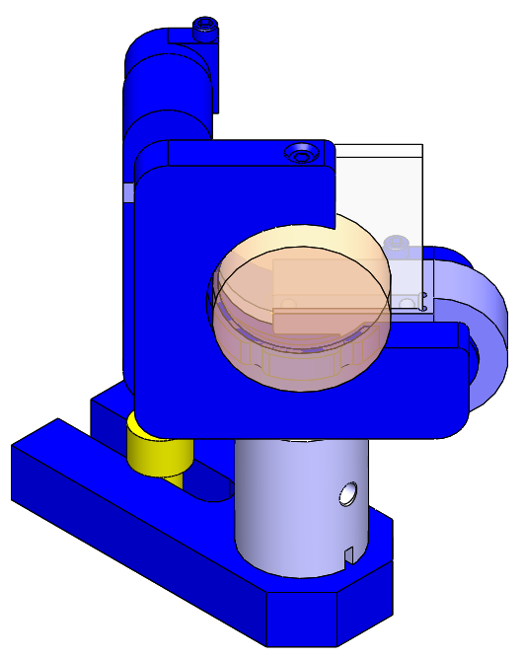
Squeezer Model
Solid Works Optical Layout
Mirror:
  Mass: 159.176 g
  Quantity: 11 / 19
Lens:
  Mass: 121.375 g
  Quantity: 7 / 10

Slide 4
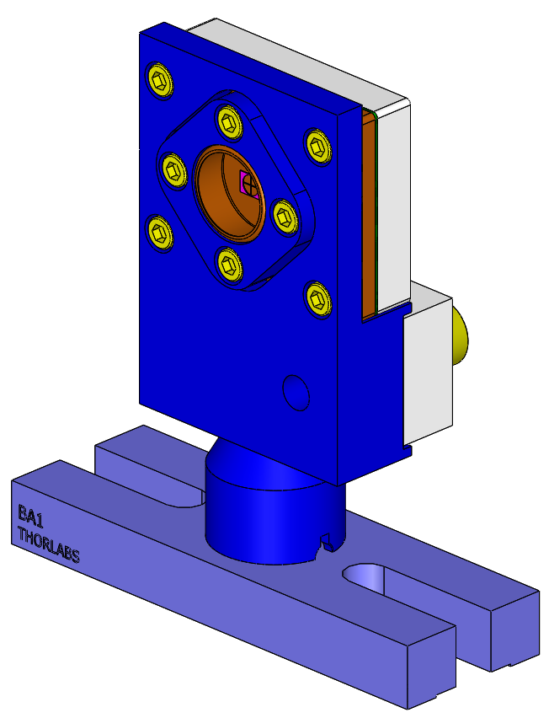
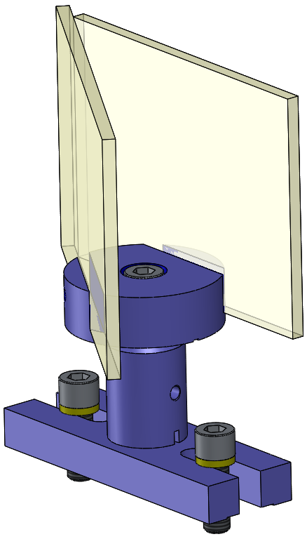
Squeezer Model
Solid Works Optical Layout
QPD:
  Mass: 142.98 g
  Quantity: 2 / 3
Beam Dump:
  Mass: 202.27 g
  Quantity: 2 / 5

Slide 5
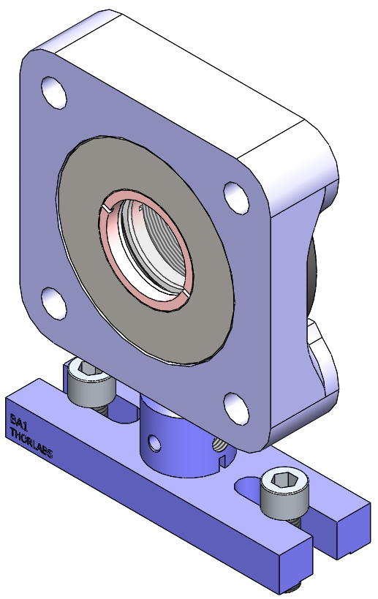
Squeezer Model
Solid Works Optical Layout
Wave Plate:
  Mass: 300 g
  Quantity: 1 / 2
Polarizers:
  Mass: 159.176 g
  Quantity: 2+2 / 2+2
NOTE: At this point the polarizers have been modeled as mirrors. A more realistic model has to be done to the two kinds of polarizers that will be used.

Slide 6
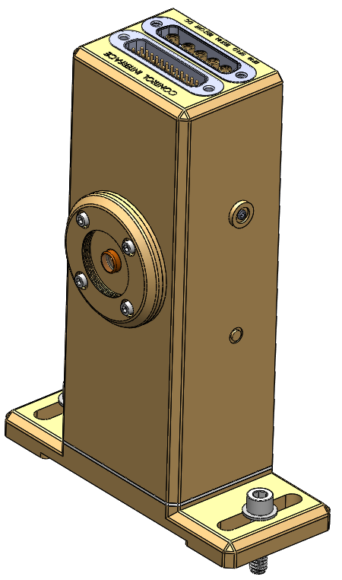
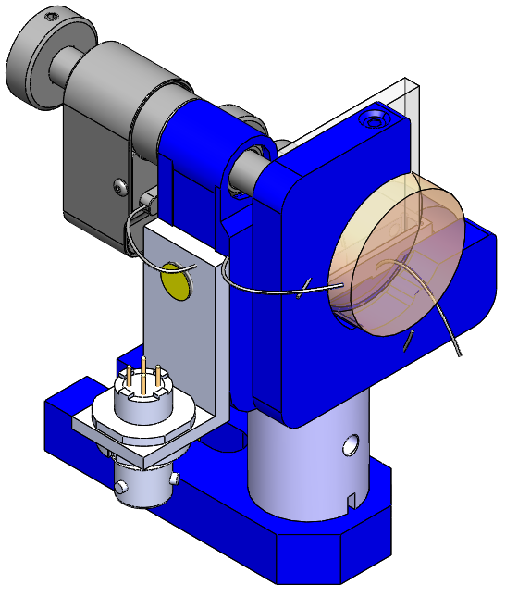
Squeezer Model
Solid Works Optical Layout
RFPD in Vacuum
  Mass: 270.41 g
  Quantity: 0 / 2
Fibers In:
  Mass: 195.175 g
  Quantity: 2 / 2
NOTE: At this point the
fiber In have been modeled
as mirrors with pico motors. A
more realistic model has to be done to
the two kinds of polarizers that will be used.
NOTE: At this point the
model used is for a 4” beam
height while the real one will be at 2.5”

Slide 7
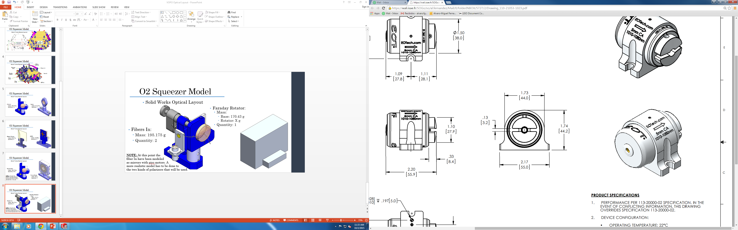
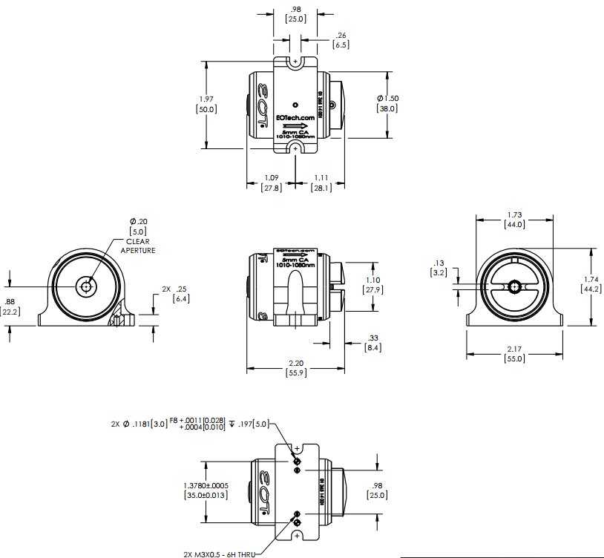
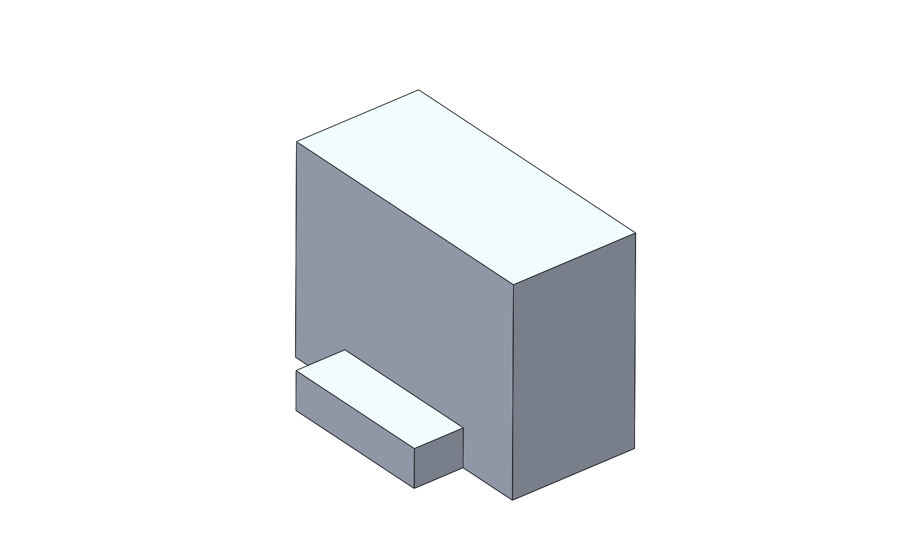
Squeezer Model
Solid Works Optical Layout
EOT Faraday Rotator
Faraday Rotator:
  Mass:
    Base: 170.43 g
    Rotator: X g
  Quantity: 1 / 1
NOTE: At this point the
Faraday Rotator has been
modeled as just its base and
with a rough design that will
be improved once the Faraday
rotator model will be obtained.
Base (6061-T6 Al)

Slide 8
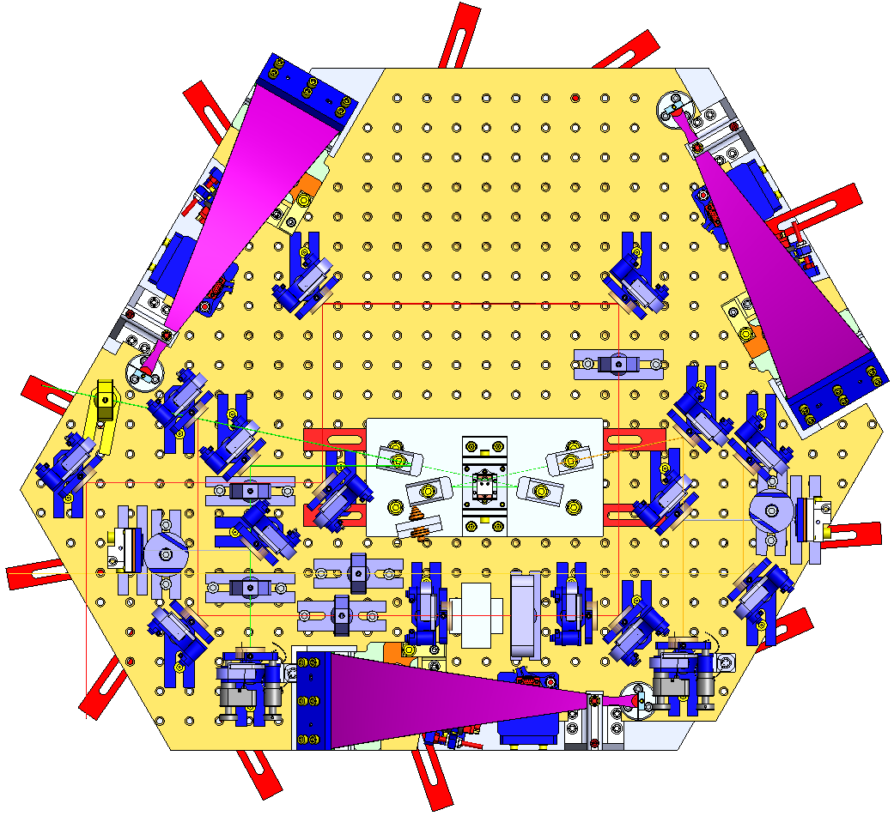
O2 Squeezer Model
O2 Solid Works Optical Layout

Slide 9
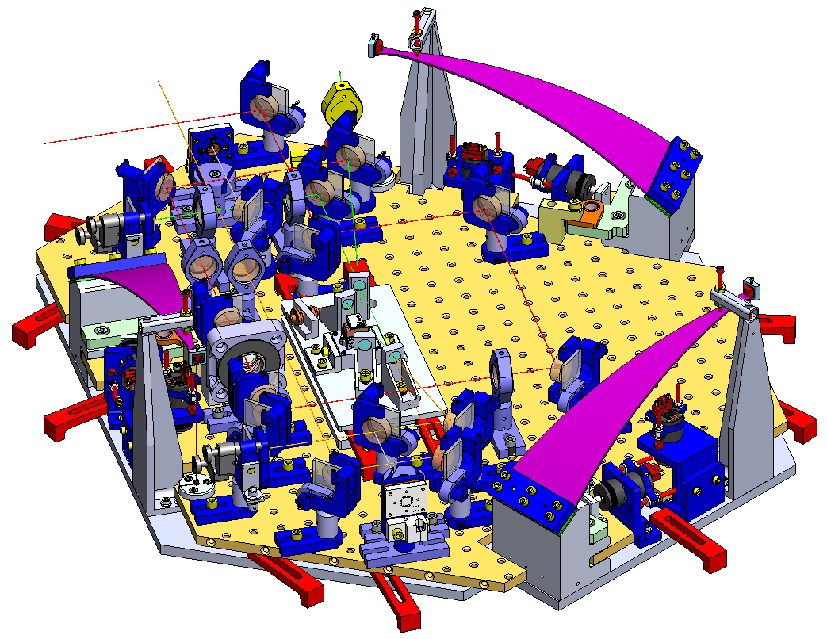
O2 Squeezer Model
Beam Dump (2)
O2 Solid Works Optical Layout
Polarizer (2+2)
Mirror (11)
Faraday Rotator
Lens (2)
Wave Plate
Fiber In (2)
QPD (2)

Slide 10
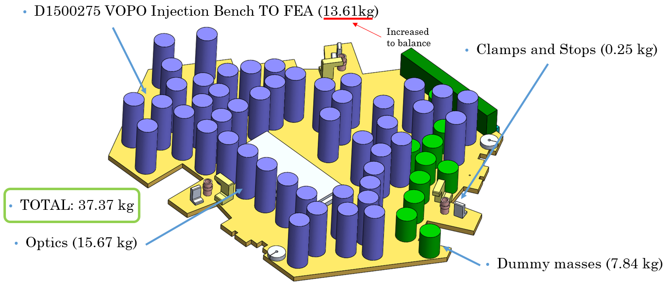
O2 Squeezer Model
Mass Budget
  Without Balancing Masses
Model used in FEA
NOTE: The blades design is made for a 37.5 kg suspended mass. With that design, that means 17.28 kg of balanced mass

Slide 11
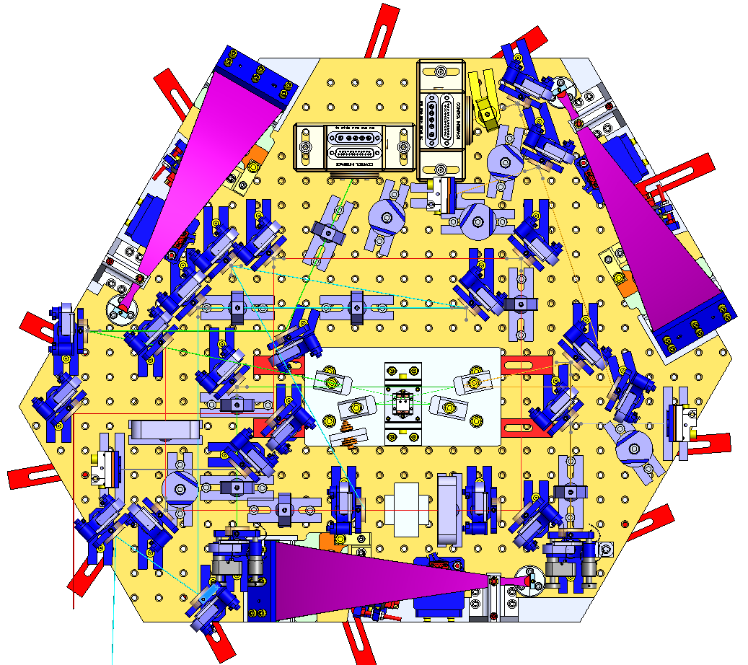
O3 Squeezer Model
O3 Solid Works Optical Layout

Slide 12
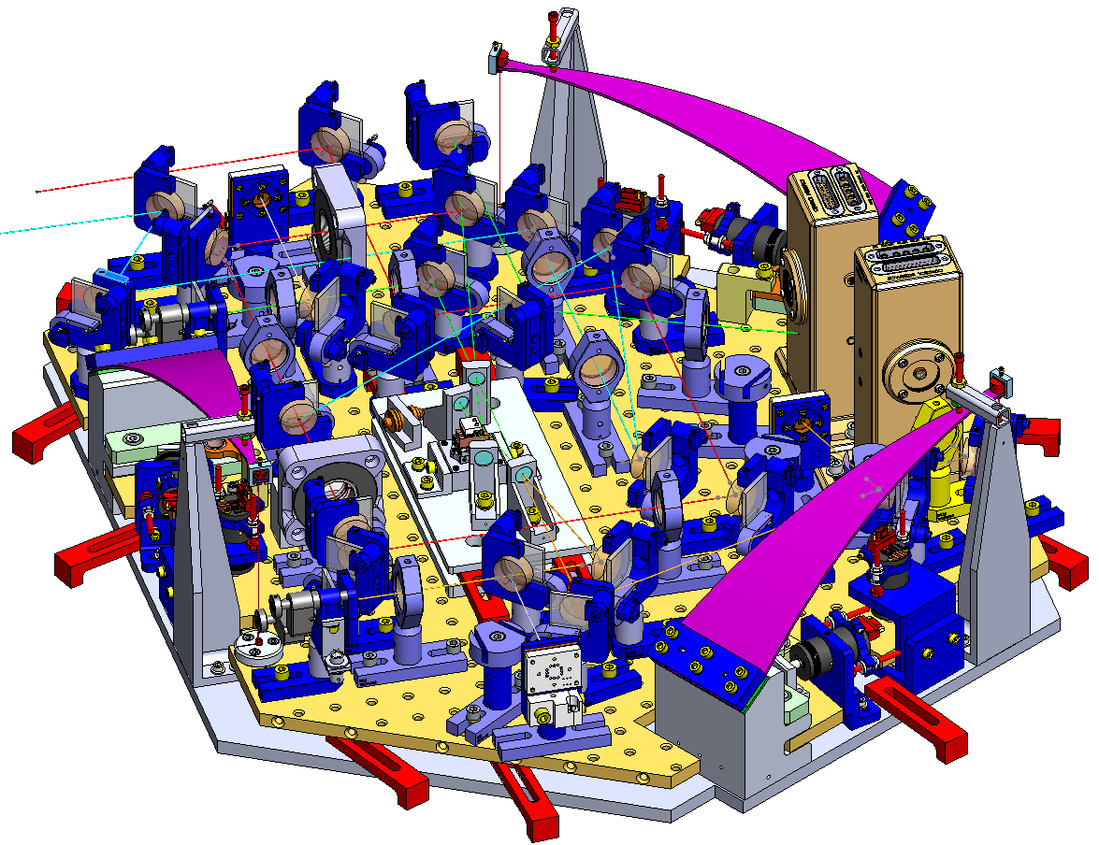
O3 Squeezer Model
Mirror (19)
O3 Solid Works Optical Layout
Polarizer (2+2)
RFPD (2)
Beam Dump (5)
Faraday Rotator
Wave Plate (2)
Lens (7)
Fiber In (2)
QPD (3)

Slide 13
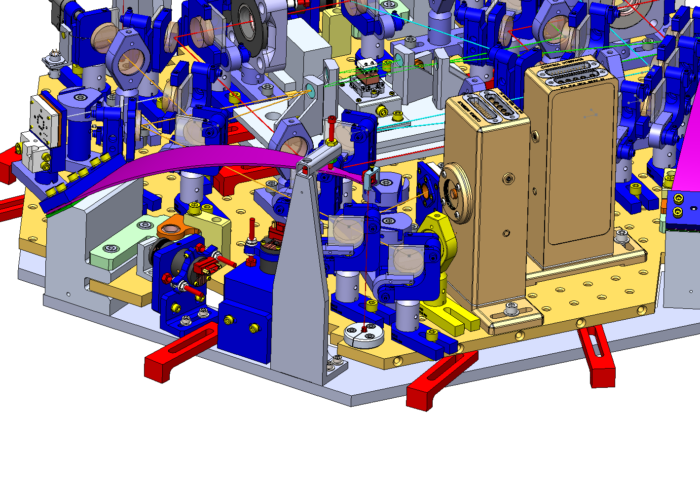
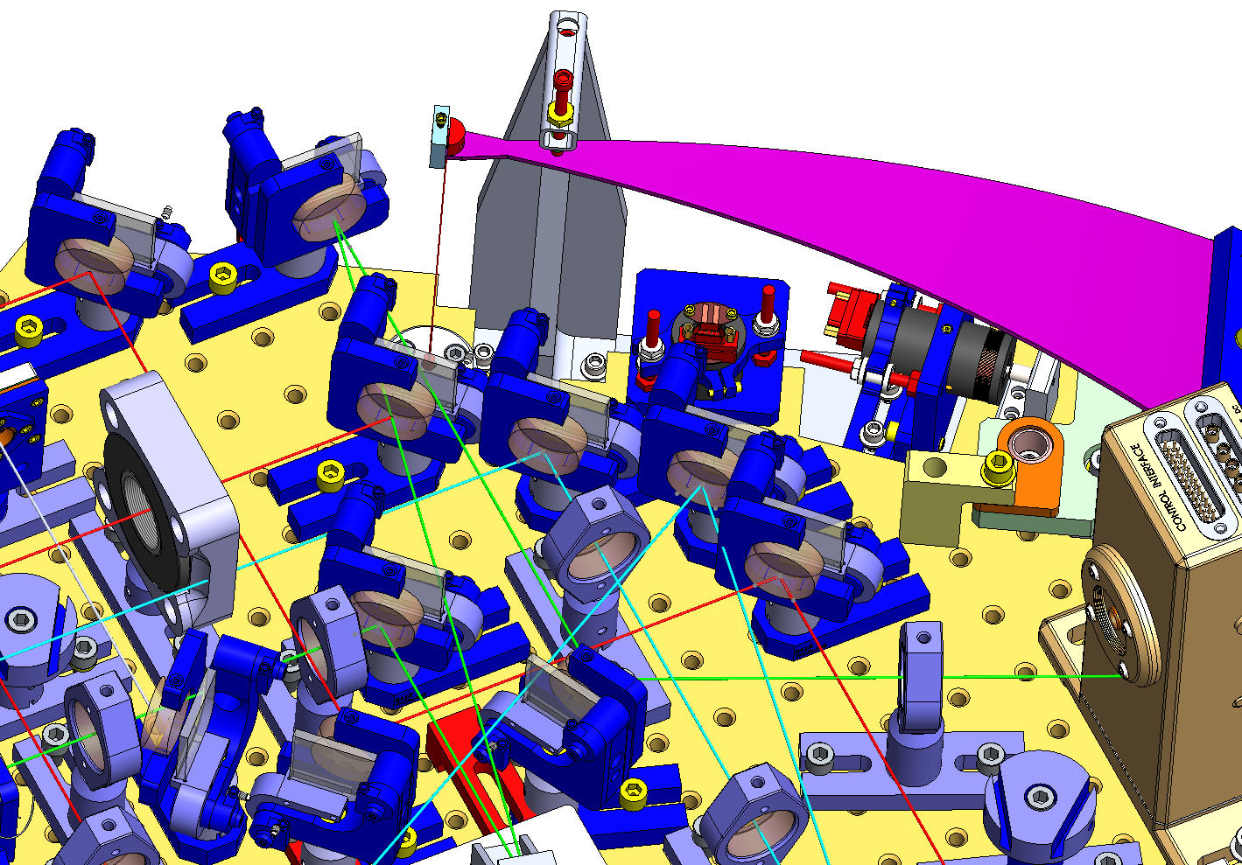
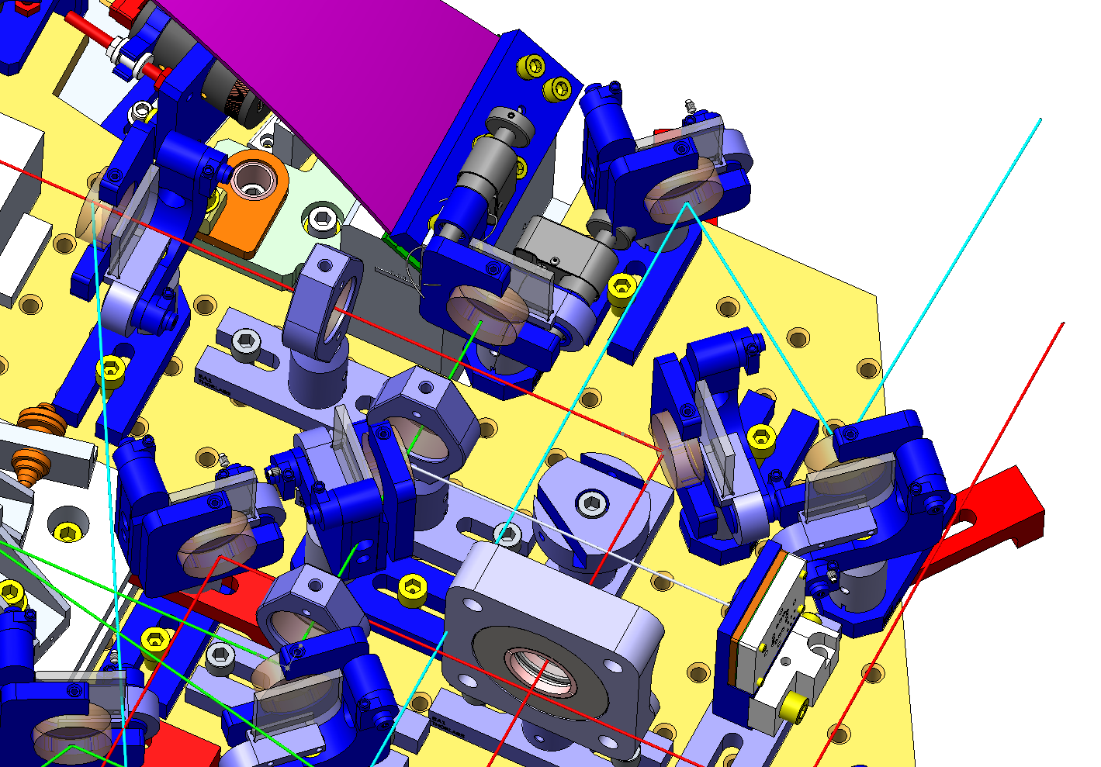
O3 Squeezer Model
O3 Solid Works Optical Layout
  “Conflict” areas
NOTE: One of the biggest fitting
issues involves the 5 beam dumps.
With the configuration shown in the
actual SW model they could not be placed.
So they will have for sure to be redesigned

Slide 14
O3 Squeezer Model
Mass Budget
  Without Balancing Masses
Model used in FEA
NOTE: The blades design is made for a 37.5 kg suspended mass. With this design, that means 14.17 kg of balanced mass

Slide 15
O3 Squeezer Model
Conclusions:
  Layout is “feasible” (Detailed layout is needed to confirm it)
  Model has to be refined with the proper dimensions
  Part masses have to be checked with the existing real pieces
  Beam Dumps will have to be redesigned (lack of space)
  Blade design may have to be reconsidered (17.28kg / 14.17 kg of balancing mass)

