Slide 1
The first detection of gravitational waves with LIGO
Philip Charlton
School of Computing and Mathematics
Charles Sturt University
LIGO-G1601091

Slide 2
GW150914
On September 14, 2015 at 5:50am ET (7:50am AEST) the Laser Interferometric Gravitational-wave Observatory (LIGO) detected the inspiral and merger of a pair of black holes, dubbed GW150914.
This event is the first direct detection of gravitational waves.

Slide 3
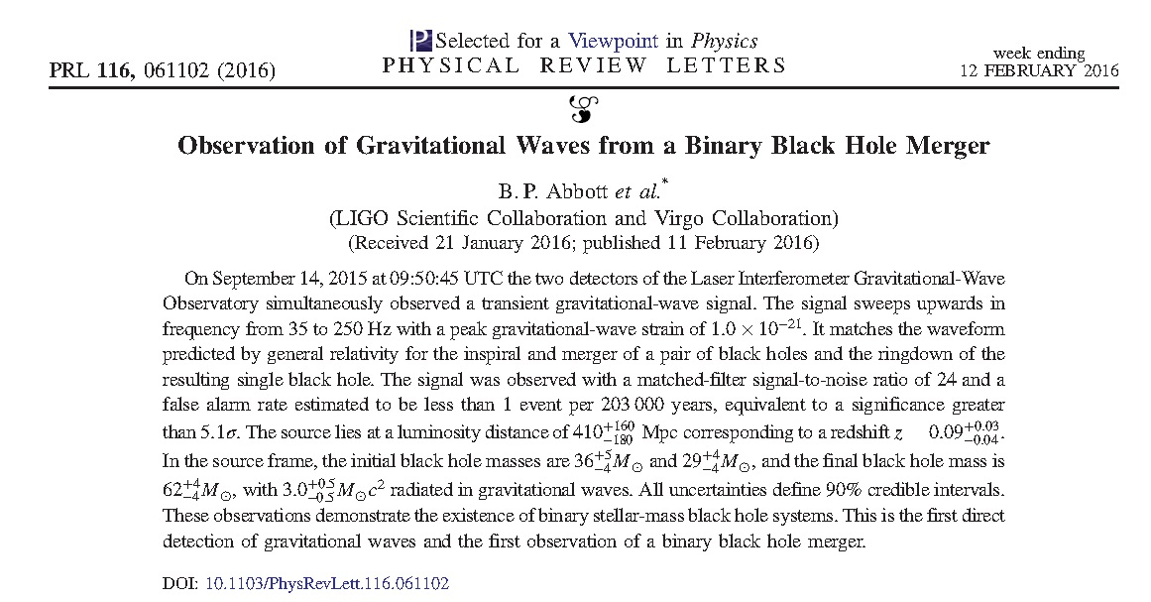
http://journals.aps.org/prl/abstract/10.1103/PhysRevLett.116.061102

Slide 4
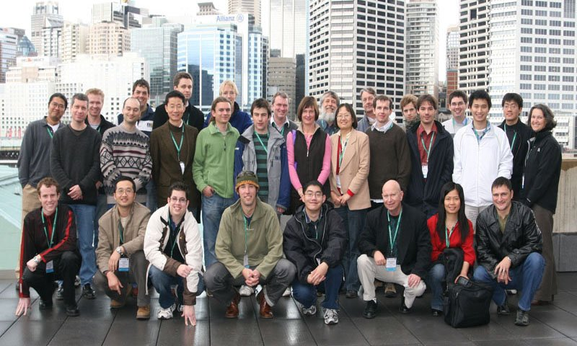
http://www.aciga.org.au

Slide 5
Newton’s gravity
m
r
M

Slide 6
Einstein’s gravity
Sources of the gravitational field are matter and energy
Speed of light c = 3×10⁸ m/s is constant and nothing can exceed it
Instead of space we have space-time with coordinates (ct, x, y, z)
The gravitational field g_{ab} is a tensor instead of a vector. Think of it as a 4×4 array of numbers

Slide 7
Examples
If there were no matter in the Universe at all, we would be living in Minkowski space. This is the ‘flat’ space of special relativity.

Slide 8
Examples
In the exterior region of a star or a black hole we have Schwarzschild space.

Slide 9
Einstein’s equations

Slide 10
Einstein’s equations
Matter and energy causes space to curve
Sources are matter and energy
Field tells matter how to move

Slide 11
Experimental confirmation
1916 Precession of the perihelion of Mercury
1919 Deflection of light by the sun confirmed by Eddington and collaborators
1959 Gravitational redshift confirmed by Pound and Rebka
1974 Orbital decay in a binary pulsar system observed by Hulse and Taylor
1979 Gravitational lensing exhibited by the Twin Quasar
2011 Frame dragging confirmed by Gravity Probe B

Slide 12
Solving Einstein’s equations
Einstein’s equations are a set of ten coupled differential equations for g_{ab}
They are non-linear
Difficult to solve, even by computer
To find exact solutions, we need to make simplifying assumptions

Slide 13
Solving Einstein’s equations
Assume:
Space-time is ‘flat’ Minkowski space plus a small perturbation:
No matter nearby:
Gives us linearised Einstein’s equations in vacuum

Slide 14
Gravitational wave solution
The linearised equations can be solved to give a wavelike perturbation propagating at the speed of light— a gravitational wave!

Slide 15
European Space Agency http://www.esa.int

Slide 16
Sources of gravitational waves
Spinning neutron stars
Supernovae
The Big Bang
Inspiral and merger of a pair of black holes or neutron stars

Slide 17
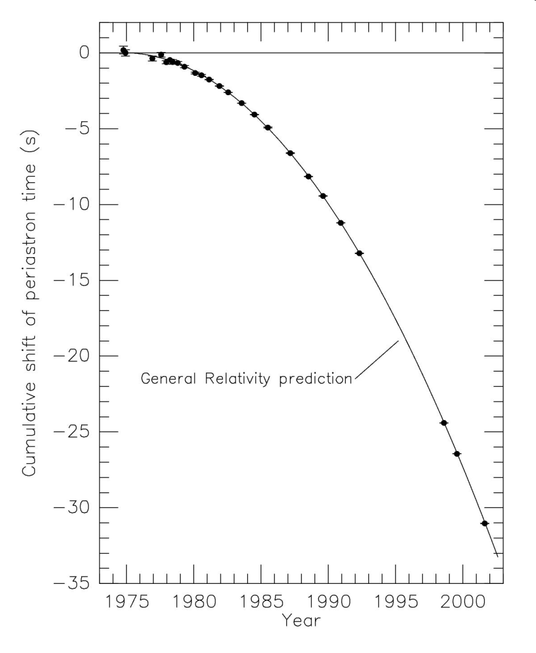
Evidence for gravitational waves
In 1974, MIT astronomers Hulse and Taylor discovered a binary pulsar system.
This plot shows that the observed periastron shift is in excellent agreement with that predicted due to the emission of gravitational waves.
For this discovery, Hulse and Taylor were awarded the 1993 Nobel prize in Physics.
ASP Conf. Ser. 328 (2005) 25
Notes:
will coalescesce in 300 million years

Slide 18
Observing gravitational waves
A passing gravitational wave causes tiny changes in length, of the order of 1 part in 10²¹.
This is the equivalent of a change in the distance between here and the nearest star by the width of a human hair.

Slide 19
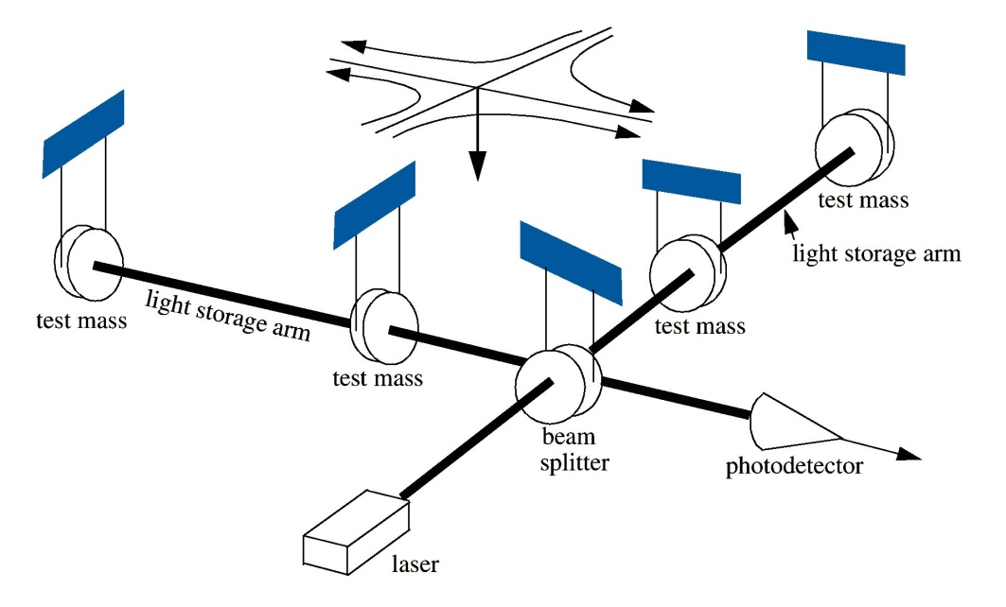
Laser interforemetry
A laser interferometer is ideal for measuring small changes in length.
A passing gravitational wave causes one arm to shrink and one to expand, resulting in a tiny change in the arm length ΔL. The strain h is the fractional change in the arm length.

Slide 20
Interferometer animation
https://www.ligo.caltech.edu

Slide 21
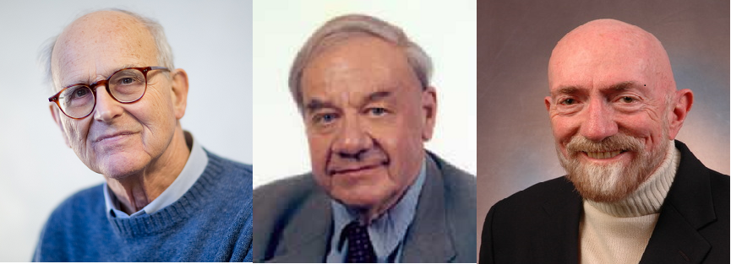
LIGO Begins
1984 LIGO steering committee is formed
Rai Weiss
Ron Drever
Kip Thorne

Slide 22
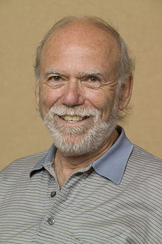
Timeline
1994 With Professor Barry Barish as director, NSF funds LIGO for $US395 million. Construction begins at Hanford, WA and Livingston, LA
1999 LIGO inauguration
2006 First gravitational wave searches at
design sensitivity
2010 Advanced LIGO installation begins
2014 Advanced LIGO complete
2015 Sensitivity 3× initial LIGO is achieved

Slide 23
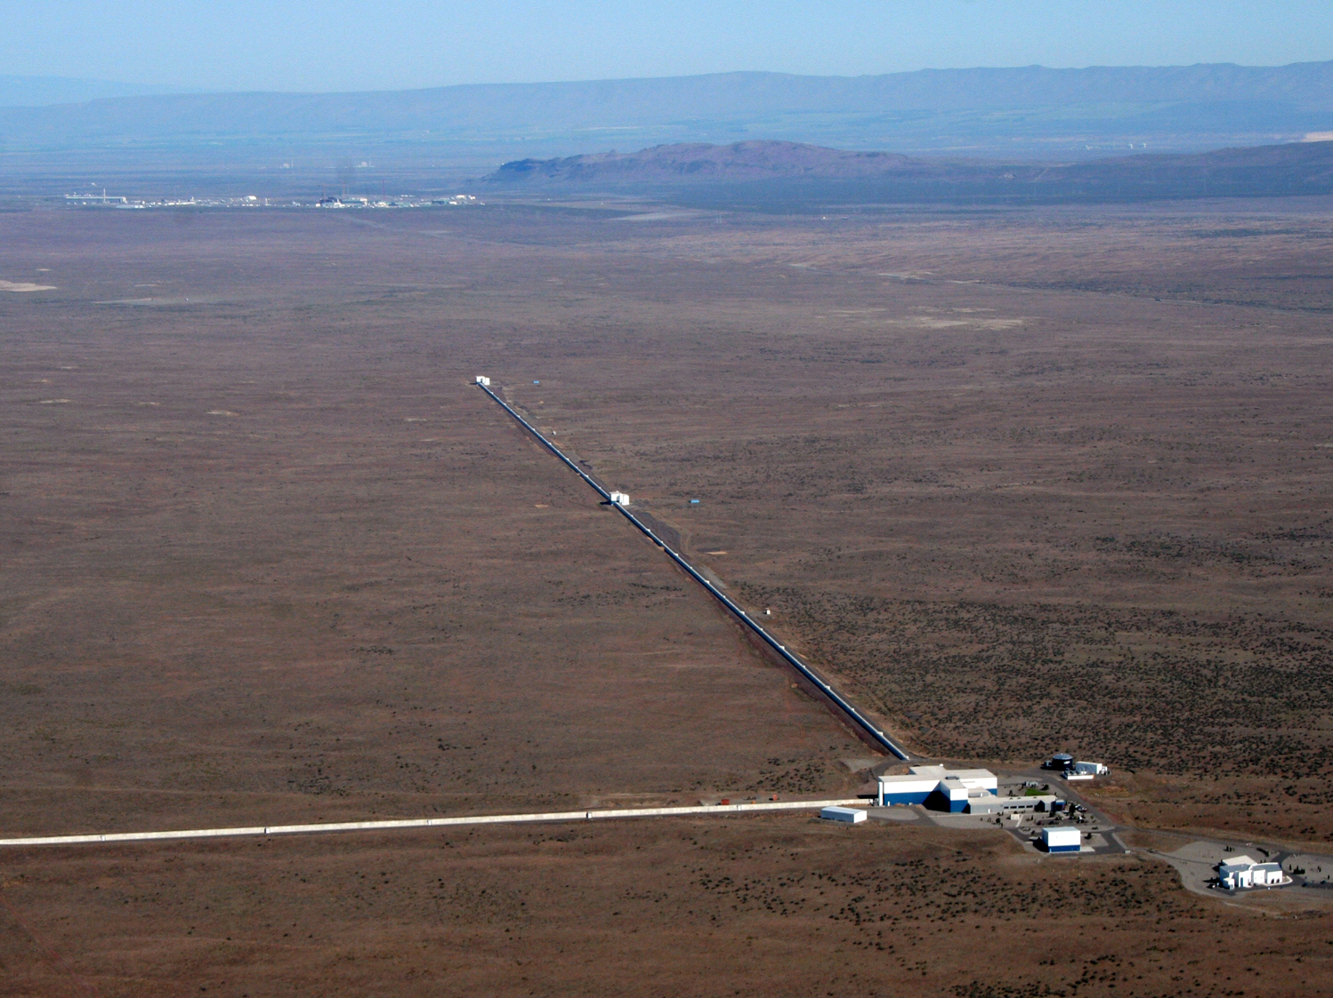
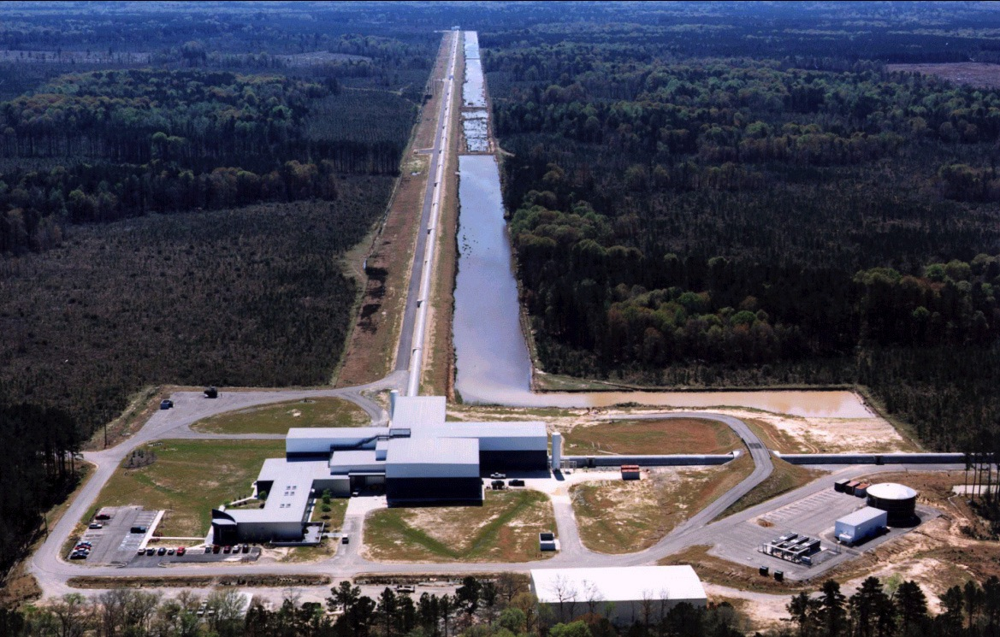
Observatories
LIGO Hanford, Washington
4 km
4 km
3000 km
LIGO Livingston, Louisiana
https://www.ligo.caltech.edu

Slide 24
September 14, 2015: 5:54am ET
Coherent WaveBurst (CWB) reports the event via automatic e-mail
Coherent WaveBurst crew is on guard.
This is high mass binary inspiral!
Looks real! Lets start detection check-list procedure.
Super Mario Galaxy
Notes:
How used in data analysis and mainly potential for reconstruction

Slide 25
The event
Phys. Rev. Lett. 116, 061102 (2016)

Slide 26
Sound
https://www.ligo.caltech.edu

Slide 27
Strong evidence of a GW
Coincident in both detectors, arriving within the light travel time of 10 milliseconds
Consistent with the waveform predicted by general relativity for the inspiral and merger of a pair of black holes
No test signals had been inserted at this time
False alarm rate for a signal this ‘loud’ is less than 1 every 200 000 years

Slide 28
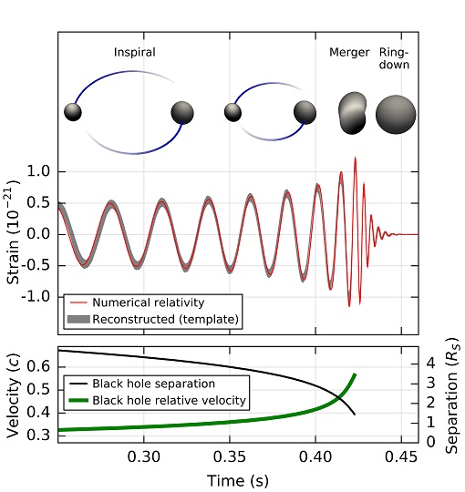
What the waveform tells us
Inspiral of a pair of black holes, 36 and 29 solar masses, about 1.3 billion years ago
Merges into a single 62 solar mass black hole
Energy of 3 solar masses radiated as gravitational waves
Phys. Rev. Lett. 116, 061102 (2016)

Slide 29
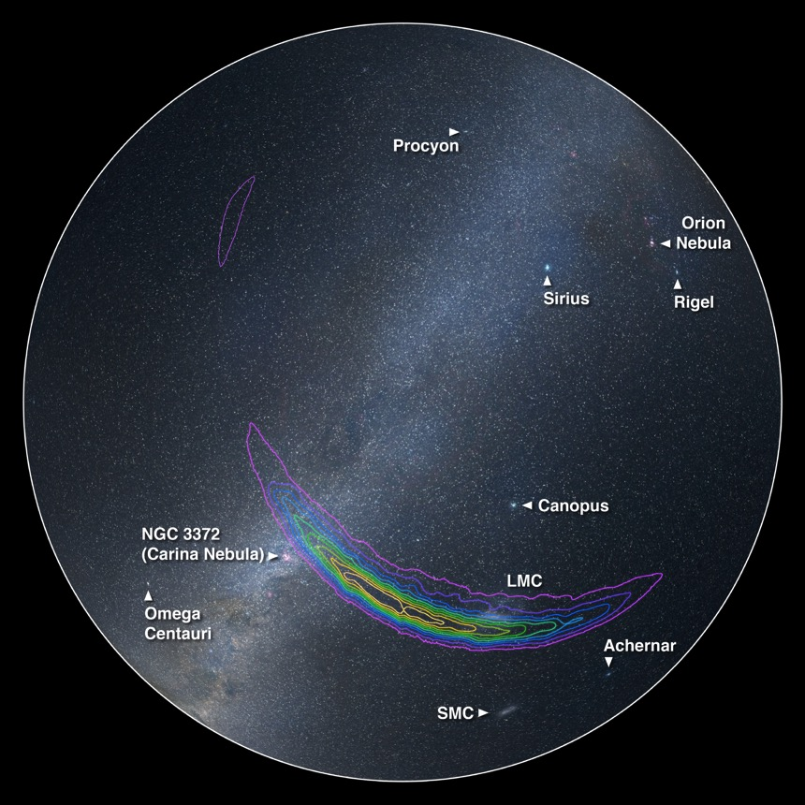
Informa
https://www.ligo.caltech.edu

Slide 30
Merger animation
https://www.ligo.caltech.edu

Slide 31
What comes next
LIGO has made the first observations allowing us to test Einstein’s theory under dynamical, extreme-gravity conditions.
Just as the invention of the radio telescope opened up a new part of the spectrum for astronomers, LIGO has opened up a new window on the Universe which will lead to new and unexpected discoveries –
the beginning of gravitational wave astronomy.

