Slide 1
Parameter Estimation with Higher Order Modes
Rupini Kamat
LIGO Mentors: Patricia Schmidt
with Rory Smith, Yanbei Chen
External Collaborator: Geraint pratten (University of Sussex, uk)

Slide 2
Motivation
Parameter Estimation: detected signal is compared to template waveforms (generated at different points in the binary parameter space)
Some template waveforms only include a few dominant, lower-order “gravitational wave modes”
BUT some systems emit strongly in higher-order modes as well (i.e. precessing systems)
What effect does the inclusion of higher order modes have on parameter estimation results?
Notes:
Precessing vs. non precessing, parameters, effect of precession on waveform
Description of Fisher Matrix Analysis – Main type of analysis used
Results for a single case

Slide 3
Setup
Inspiral Post-Newtonian waveforms
Equations of motion solved at 2PN order (Kidder et al.)
Waveform modes generated at (v⁴)-order (Arun et al.)
Analysis applied to low mass binary black holes
M_{total} ≤ 12 M☉
Higher mode inspiral-merger-ringdown (IMR) waveforms not currently available
Total mass fixed to 12 M☉
All waveforms generated at a fixed polarization angle
Sky location of binary not taken into account
Waveforms are truncated at ISCO
Matches are calculated using zero-detuned high power PSD
f_{min} = 10 Hz

Slide 4
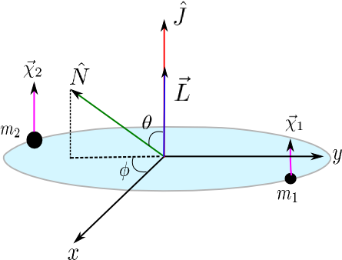
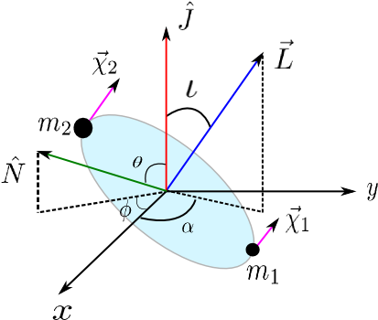
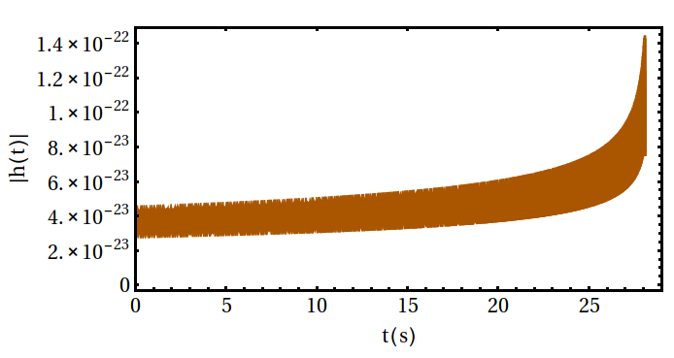
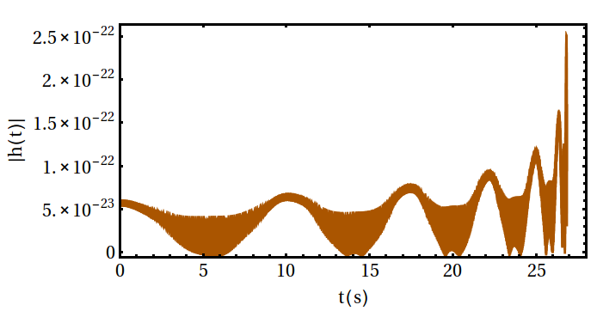
Black Hole Binaries
Non Precessing
Precessing
q = 6; χ₁ = χ₂ = (0, 0, 0.6),
M_{total}= 12 M☉; θ = π/3; φ = 0
q = 6; χ₁ = χ₂ = (0.6, 0, 0),
M_{total}= 12 M☉; θ = π/3; φ = 0
Notes:
http://www.soundsofspacetime.org/spinning-binaries.html
Description of diagram
Point out difference in modulation of waveforms
Play sound?

Slide 5
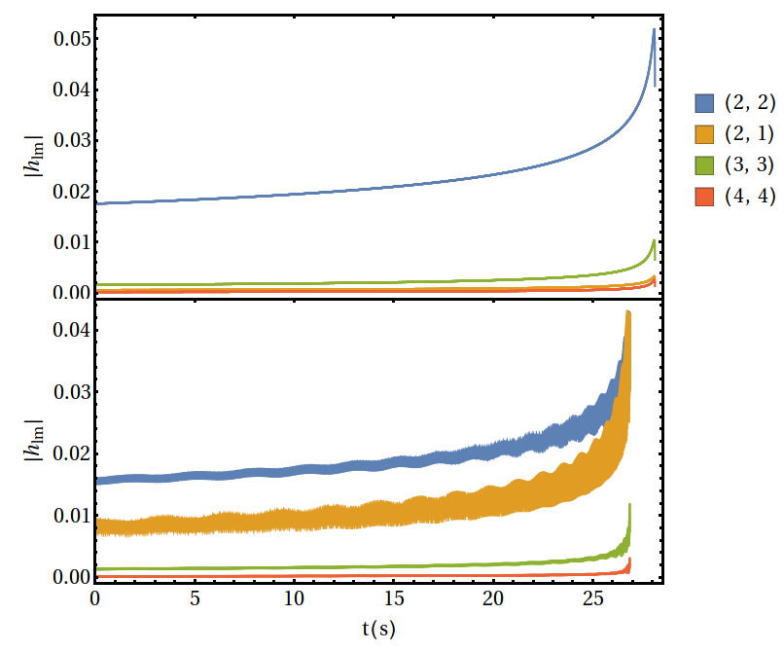
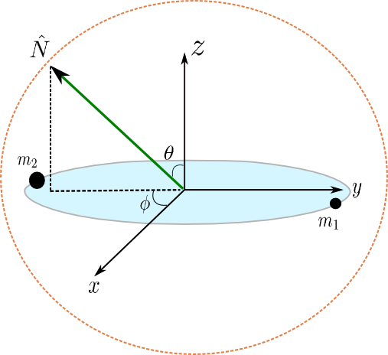
Spherical Harmonic Modes
(Eq. 1)
q = 6; χ₁ = χ₂ = (0, 0, 0.6), M_{total}= 12 M☉
q = 6; χ₁ = χ₂ = (0.6, 0, 0), M_{total}= 12 M☉
Binary source frame

Slide 6
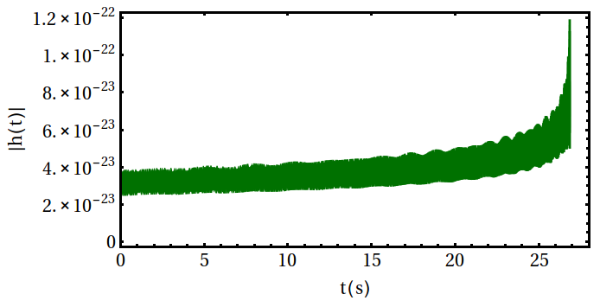
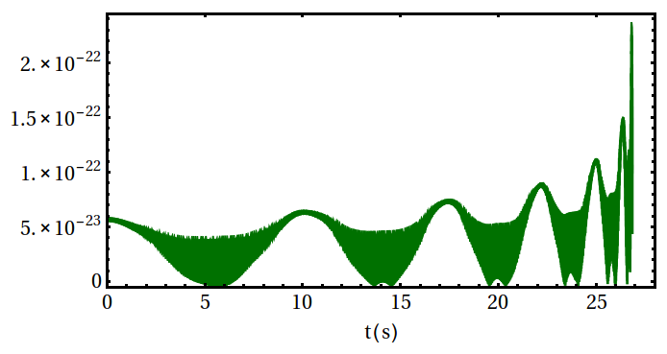
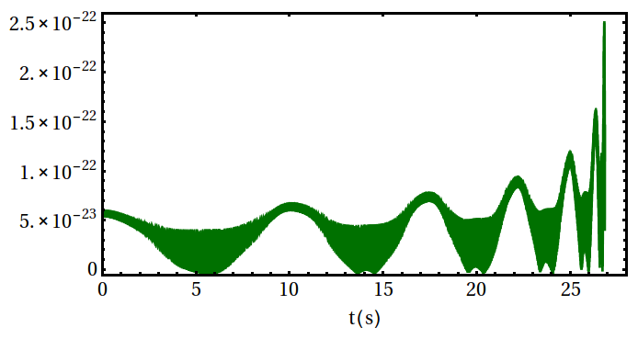
Visualization
Quadrupole (l = 2, m= ±2)
(l = 2)
(l = 2, 3)
(q = 6; χ₁ = χ₂ = (0.6, 0, 0), M_{total}= 12 M☉; θ = π/3; φ = 0)
Notes:
Most radiation along orbital angular momentum, least in orbital plane -> position of red hotspots and blue coldspots indicate orientation of the binary
Quadrupole -> no/minimal visible precession
l =2 strong visible precession
(point out aliasing in animations D: oops)

Slide 7
Match Calculation
Match: normalized, noise-weighted inner product
Measure of similarity between waveforms
Evaluated at different points in the parameter space: for what cases is the inclusion of higher modes most likely to have an effect?
Quadrupole and (l = 2) waveforms
(l = 2) and (l = 2, 3, 4) waveforms

Slide 8
Error Analysis
Fisher Matrix:
General:
GW specific (assuming stationary, Gaussian noise):
Statistical Error:
Systematic Error:
(Eq. 2)
(Eq. 3)
(Eq. 4)
(Eq. 5)
Notes:
Fisher Matrix – measure of how much information some observed data carries about a parameter that can be used to model the data
Given by second-order gradient of log likelihood
For GW, entries given by innerproduct of derivative of waveform wrt each variable
Covariance matrix given by inverse of fisher information matrix
Cov matrix ALONE gives only statistical error
May also exist systematic error that arises from using incomplete waveform templates (templates that use only lower order modes)
equation

Slide 9
Results: Statistical Error
Case: q = 4, m₁ = 2.4 M☉, m₂ = 9.6 M☉, χ₁ = χ₂ = (0.6, 0, 0), θ = π/3,
φ = 0
Blue curve: (l = 2) waveform, Orange curve: (l = 2, 3) waveform, Green curve: (l = 2, 3, 4) waveform
χ_{1z} – χ_{2z} plane: significant correlation, decrease in uncertainty for both parameters
χ_{1x} – χ_{1z} and χ_{1y} – χ_{1z} plane: decrease in correlation, increase in uncertainty for y spin.
2σ_{χ1z}: (l = 2) – 0.00434
HM– 0.00360
2σ_{χ2z} : (l = 2) – 0.00134
HM– 0.001169
2σ_{χ1y}: (l = 2)– 0.01484
HM– 0.015920
2σ_{χ1x}: (l = 2)– 0.03093
HM– 0.03020
Notes:
System: q = 4., x1 = (0.6, 0., 0.), x2 = (0.6, 0., 0.), M = 12 M_sol, theta = pi/3
Conclusions – Little significant effect found by including l = 4 modes. But including l = 3 modes can in some cases decrease statistical error and correlation. In specific cases, however, inclusion of l = 3 modes increases statistical error, but we have yet to see if that increase in statistical error is offset by a decrease in systematic error, systematic error analysis still to come.

Slide 10
Results: Statistical Error (cont.)
χ_{2x} – χ_{2z} and χ_{2y} – χ_{2z}
plane: little to no
visible correlation.
in plane spins independent
from out of plane spins
Precession dynamics
decouple from inspiral
dynamics
χ_{1x} – χ_{1y} plane: slight
increase in correlation,
little significant change in
uncertainty.
χ_{2x} – χ_{2y} plane: correlation
is unchanged, decrease in
uncertainty.
2σ_{χ2x} : (l = 2)– 0.02948
HM– 0.02834
2σ_{χ2y} : (l = 2)– 0.11546
HM– 0.10657

Slide 11
Results: Statistical Error (cont.)
Inclination Angle (θ):
Slight improvement in stat. uncertainty (2σ_{θ} = 0.26117 → 2σ_{θ} = 0.24061)
Negligible correlation: m₁, m₂, and z components of spins
Strong correlation: x and y spin components, and symmetric mass ratio η (η = m₁ m₂ / M_{total} ² )
Little change in correlation with higher modes.
Component masses and mass ratio (m₁, m₂, η):
Little change in statistical uncertainty for m₁, m₂
Slight decrease in statistical uncertainty for η
Negligible correlation for most parameters
Visible correlation between η and x and y spin components.
Little change in correlation with higher modes

Slide 12
Conclusions
Inclusion of l = 3 modes has some effect on statistical uncertainty of certain parameters and correlation between some parameters pairs
l=4 modes appear to have little effect on statistical uncertainty (for the considered case)
Higher modes tend to decrease statistical uncertainty for most parameters, particularly spin components
Effect of higher modes on correlation varies (i.e. correlation increases in χ_{1x} – χ_{1y} plane, decreases in χ_{1x} – χ_{1z} and χ_{1y} – χ_{1z} planes)
Depending on scale of systematic uncertainty, these changes in statistical uncertainty may be negligible
Systematic error analysis currently underway

Slide 13
Future Work
Complete analysis of systematic errors
Comparison to Bayesian parameter estimation
Extend analysis to an ensemble of precessing configurations
Thank you!
Notes:
Conclusions – Little significant effect found by including l = 4 modes. But including l = 3 modes can in some cases decrease statistical error and correlation. In specific cases, however, inclusion of l = 3 modes increases statistical error, but we have yet to see if that increase in statistical error is offset by a decrease in systematic error, systematic error analysis still to come.

