Slide 1
Astronomical Catalogs for Locating Gravitational-wave Events
Kunyang Li
Roy Williams
LIGO SURF 2016
Notes:
Hello everybody, I'm Kunyang Li, and I've been working on Astronomical catalogs for locating gravitational wave events with Dr. Roy Williams this summer. And today I would like to share my results with you.

Slide 2
Skymap Viewer
Galaxy Mass Estimation
Method 1: B Mag (blue light)
Method 2: W1-W2 method (MIR)
Method 3: Evolutionary Population Synthesis and SED fitting (red light)
Comparison between catalogs
Galaxy Cluster Mass Estimation
Method 1: Using cluster richness (optical)
Method 2: Using total luminosity (X-Ray)
Method 3: Using Sunyaev–Zel'dovich Effect (G lensing)
Metallicity Estimation
Metallicity from SED fitting
Method 1: mass-metallicity relation (MZR)
Future Work
Summary
Notes:
This is the outline of my talk today. Firstly, I'm proud to introduce the newest version of the Skymap Viewer, a tool for EM follow-up observations. Then I will go through the details of mu contribution to Skymap Viewer, which is mass and metallicity estimation for galaxy and galaxy cluster catalogs included in Skymap Viewer. Lastly, I will go over possible future works for developing Skymap Viewer.

Slide 3
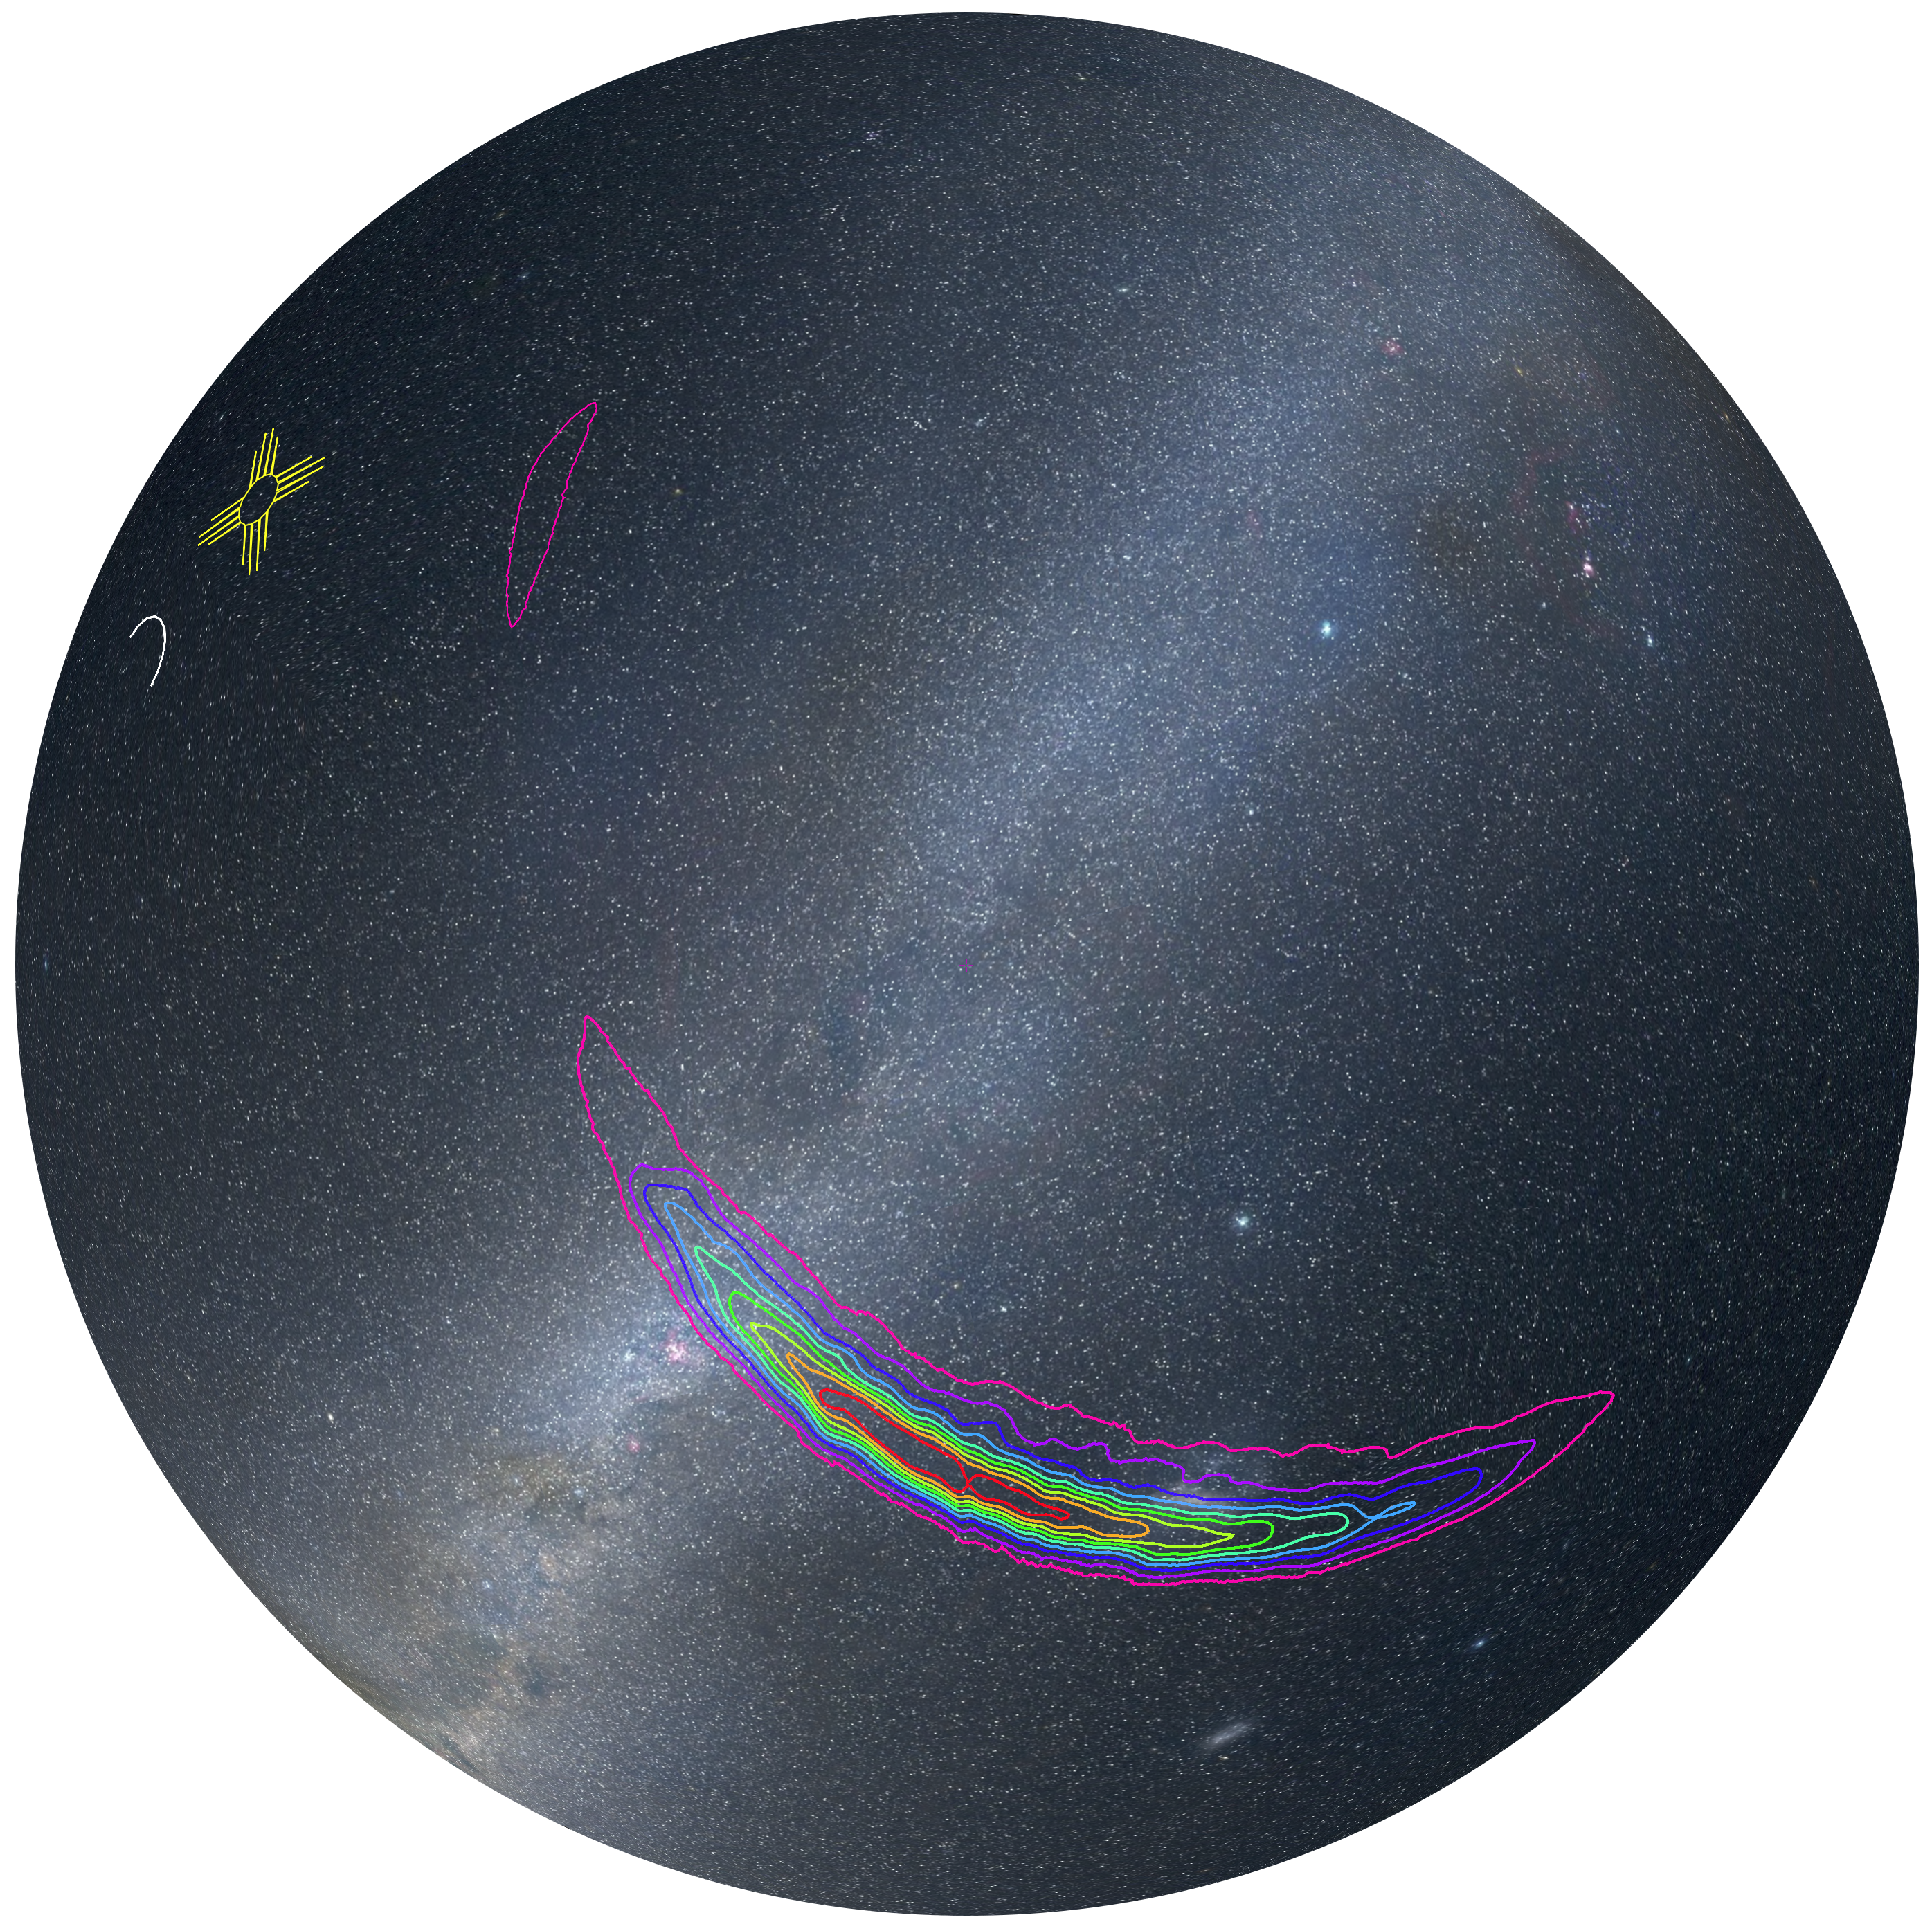
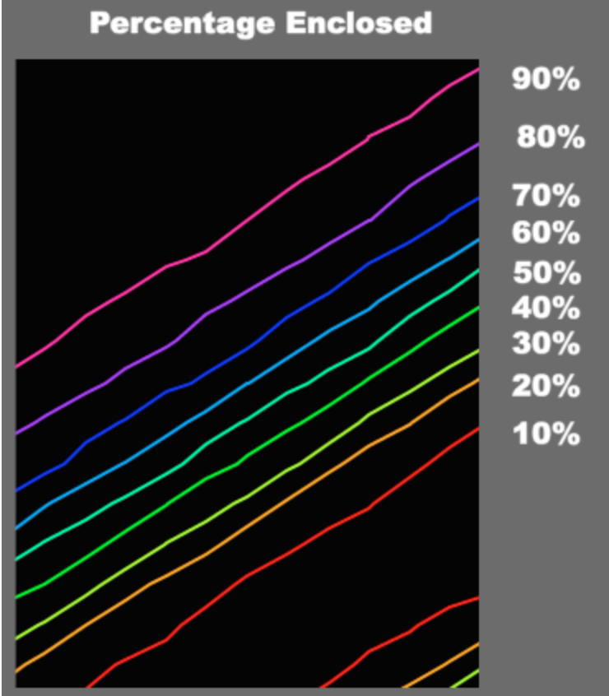
Skymap Viewer
Skymap Viewer is an interactive, web-based tool to display a sky map along with a host of relevant information for follow-up observers.
The sky map is shown as a contour plot, each color-coded line enclosing a given percentage of the total probability.
GW150914
Notes:
In general, Skymap Viewer is an interactive web-based tool to display the sky map of a GW event along with relevant information for follow-up observers. This figure shows the first LIGO detection in Skymap Viewer. The GW signal is shown as a probability contour plot with the color code shown to the right.

Slide 4
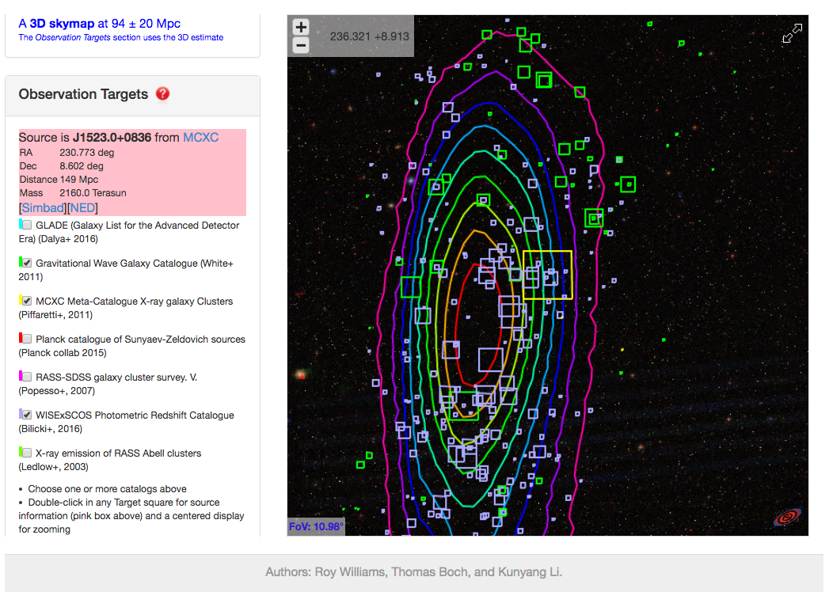
Skymap Viewer
catalogs available:
2MASS-GLADE
GWGC (OPT)
MCXC galaxy clusters
Planck (SZ)
RASS-SDSS (X-Ray)
WISExSCOS galaxies
RASS-Abell
area of each square is prop. to MASS * 3D prob density
double-click in square for pink info and centering
Skymap Viewer :
https://losc.ligo.org/s/skymapViewer/
(R.Williams, T.Boch, K.Li)
Notes:
The newest version of Skymap viewer includes 7 catalogs for galaxies and galaxy clusters in different bands. When a catalog is checked, all objects in the catalog will be shown with a square centered at each object, representing the relative probability of finding the source of GW event in the object. The area of the square, hence the total probability is proportional to the stellar mass * the GW signal as a 3D probability density at the location of the object in spacetime. Double clicking on each square will give you more relevant information of the object, i.e. metallicty and distance.

Slide 5
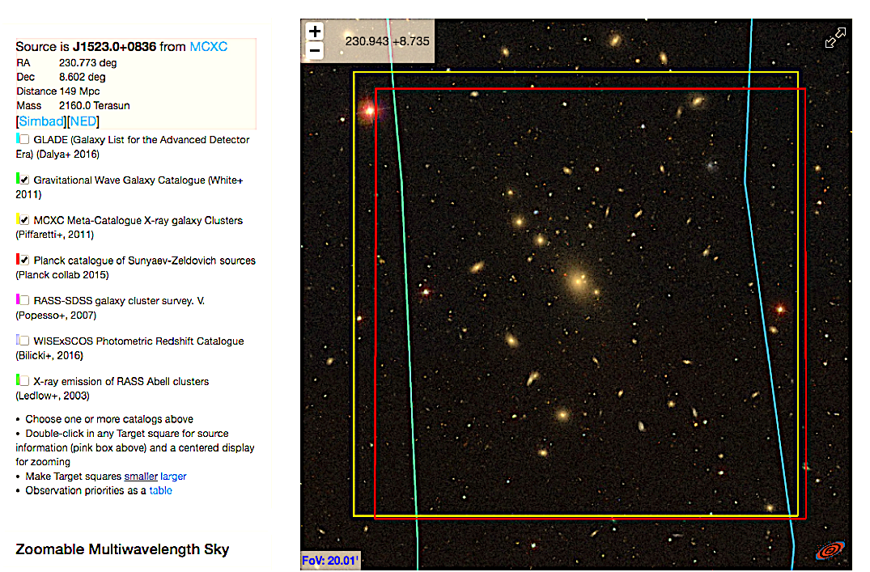
keep zooming
here is prime observational target Abell 2063
Skymap Viewer :
https://losc.ligo.org/s/skymapViewer/
(R.Williams, T.Boch, K.Li)
Notes:
You can also zoom in for the details of each objects, this picture shows a Abell cluster.

Slide 6
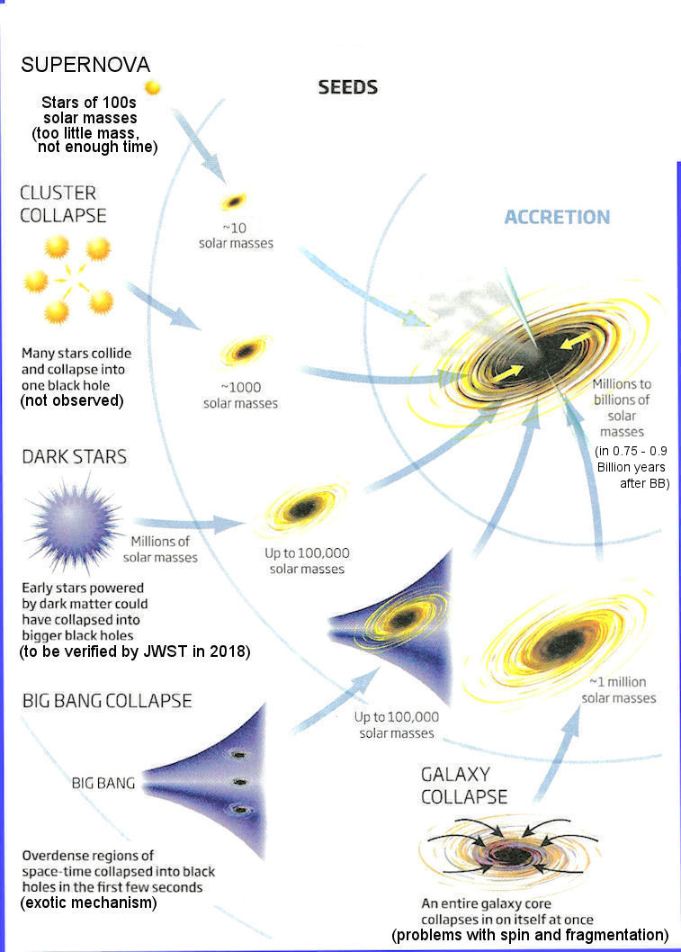
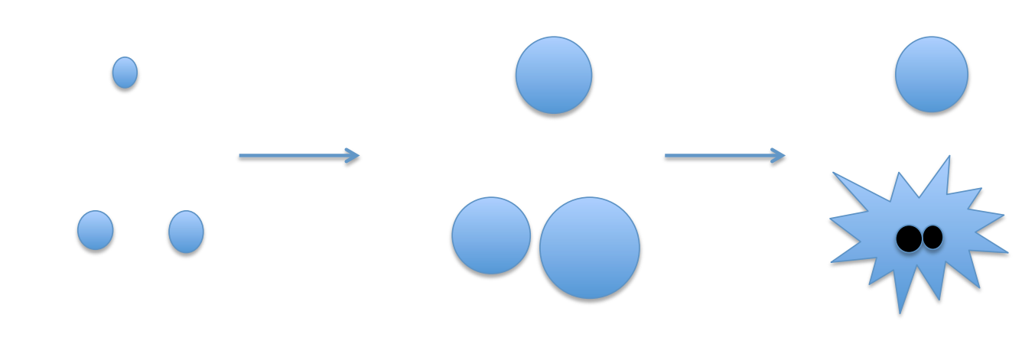
Mass as Astrophysical Prior
Probability = MASS * 3D prob density (GW signal)
Number of GCs (Dynamical interaction) $∝$ galaxy mass
DM (Primordial BHs) $∝$ galaxy mass
Low Metallicity (only required by massive BBHs)
Pop III stars
BBHs in hierarchal three-body system
Rotational mixing
Notes:
We use mass as the basic prior for the probability because 4 out of 5 black hole seed formation scenarios depends on total mass. For example, globular clusters are known as BBH factory due to dynamical interaction in their centers, and the number of GC is proportional to the galaxy stellar mass. Also, the formation of primordial BBH is proportional to the DM, which is again proportional to the stellar mass. For finding relatively massive BBH, low metallicity is also helpful, because massive progenitors tends to form in low metallicity environment, like Pop III stars.

Slide 7
Galaxy Mass Estimation
Method 1: Using B band photometry data to estimate galaxy mass:
Assumption: all stars in galaxies have the same mass-to-light ratio as the Sun
Input: apparent B band magnitude, redshift (z)
$M_{g}≅L_{B}∗\frac{M_{⨀}}{L_{B⨀}}$
$$Output:galaxy mass M_{g}$$
Method 2: Using W1-W2 band photometry data:
The W1 band ($3.4 μm)$of WISE survey is dominated by the light from old stars and can be used as an effective measure of stellar mass (Jarrett et al. 2013).
$$Input:W1, W2, redshift$$
$$\log\left(\frac{M_{g}}{L_{W1}}\right)=−1.96\left(W_{1}−W_{2}\right)−0.03$$
$$Output:galaxy mass M_{g}$$
Notes:
Now I want to go through the 3 methods I used for galaxy stellar mass estimation. The first method is using B band luminosity times the mass-to-light ratio of the Sun in B band. This method is expected to be the least accurate among the 3, because the assumption: all stars in galaxies have the same mass-to-light ratio of the Sun. Also, the blue light from galaxies are dominated by star formation activity and are heavily absorbed and scattered by dust and gas. The second method is for IR catalogs. According to Cluver 2014, the empirical relation between optically determined stellar mass (estimated from SPS models) and W1, W2 magnitude is shown as equation 2. Because W1, W2 are MIR band, which are dominated by old star population, so we expect this method to be the most accurate method among the 3.

Slide 8
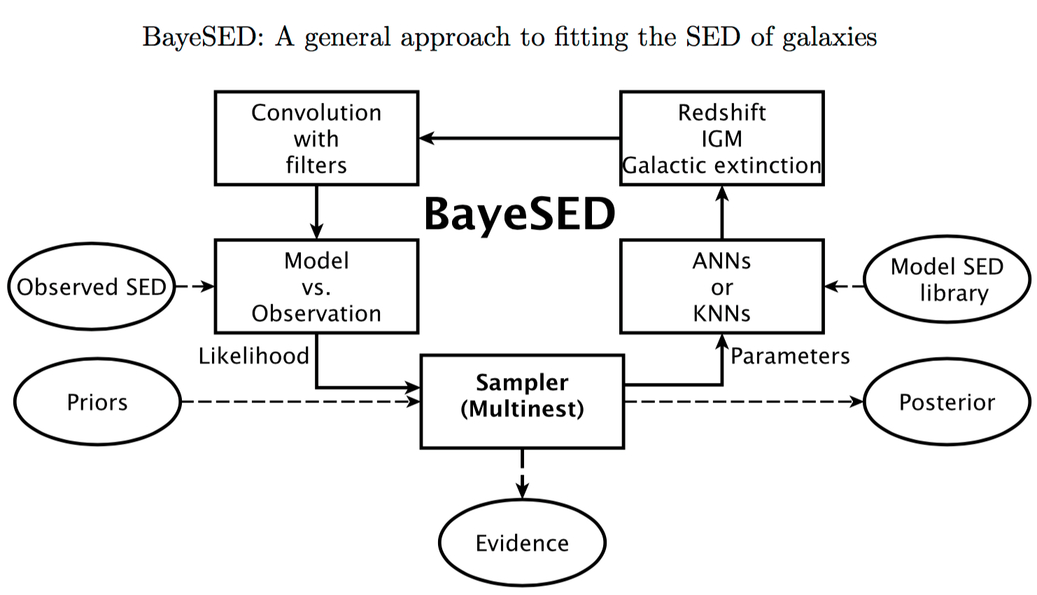
Galaxy Mass Estimation
Method 3: Evolutionary Population Synthesis and SED fitting (BayeSED)
BayeSED code algorithm flow chart:
Input B JHK photometry data (broad band SEDs), redshift
Output include galaxy mass, metallicity, etc.
Han & Han 2014
B,J,H,K filter response function
Calzetti (2000) dust screen
SPS model: Bruzual Charlot (2003)
Input observed SED from GLADE-2MASS
PCA
IMF:Chabrier (2003)
$$\overset{⃑}{A}$$
SFH: SFR$∝e^{\frac{t}{τ}}$
$$\overset{⃑}{X}$$
Nested Sampling
Largest Bayesian evidence indicates best-fitted model
Output best-fitted model parameters (mass, metallicity, etc.)
Notes:
The 3rd method is fitting galaxy spectral energy distribution with galaxy models generated by evolutionary population synthesis code. This task is done by a Bayesian fitting code named BayeSED. We applied this method on GLADE-2MASS cataloge, which provides B, J, H, and K band photometry data. The algorithm is shown here as a flow chart.

Slide 9
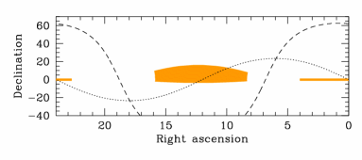
Mass comparison between galaxy catalogs
Stripe 82-Massive Galaxy Catalog (S82-MGC)
S82-MGC is a part of the SDSS that was covered many times
2 magnitudes deeper than the SDSS survey
Relatively precise stellar mass estimated by Bayesian SED fitting between Y JHK photometry from the UKIDSS Large Area Survey (LAS) and FSPS models (FSPS: Flexible Stellar Population Synthesis Conroy et al. 2010)
Covers only a small area: ~250 ${degree}^{2}$,
Can be used to compare mass estimated by different methods
Stripe 82
Notes:
Now we have these stellar mass estimated from 3 galaxy catalogs using 3 different methods. And the next question is: how well do they agree with each other? So I cross-matched these 3 catalogs with another catalog --Stripe 82, which serves as a mass standard, to test how accurate these results are. Stripe 82 is the most well-studied part of SDSS, with photometry data in 4 IR bands , which are ideal for stellar mass estimation. Also the mass provided in stripe 82 is generated using Bayesian fitting code, which is relatively accurate.

Slide 10
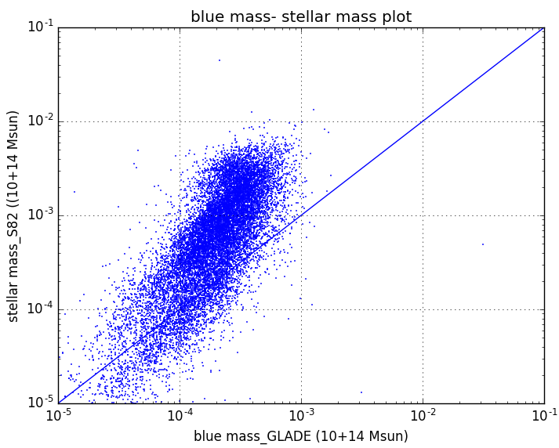
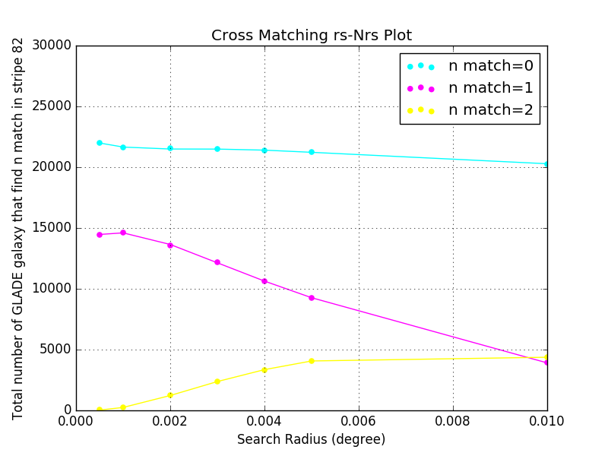
Mass comparison between galaxy catalogs
Comparison between GLADE (B mag method) and S82-MGC
Cross-matching GLADE and S82-MGC using best search radius (~0.01 deg)
Compare stellar mass of the same group of galaxies (14,878) estimated by applying B mag method and SED fitting method to data from two catalog.
Mass estimation using B mag method is smaller by ~1 mag due to heavy dust attenuation in blue band
Notes:
First, I cross-matched GLADE catalog with Stripe 82 using the best search radius, which is about .01 degree as shown in the left plot. So that, we are comparing the mass of the same galaxies in these 2 catalogs. The comparison result is shown in the right plot. Horizontal axis is mass estimated using blue luminosity from GLADE, and the Vertical axis is mass from Stripe 82. The blue mass is smaller than the standard for big old galaxies, and is larger than the standard for small young galaxy. This result is expected, because blue light is dominated by star formation activity, which tends to happen in young, hence small galaxies. But seldom happens in big old galaxies. The hot gas from active stellar regions contributes to the blue light of the galaxy and this makes the mass of young galaxies larger than their stellar mass. In the case of old galaxies, there is not hot gas to fake stellar mass. Besides, compared to red light, blue light, which has a shorter wavelength is easier to be scattered and absorbed by ISM and IGM. So the heavy dust attenuation in blue band explained why older galaxies' blue mass are smaller than their real stellar mass.

Slide 11
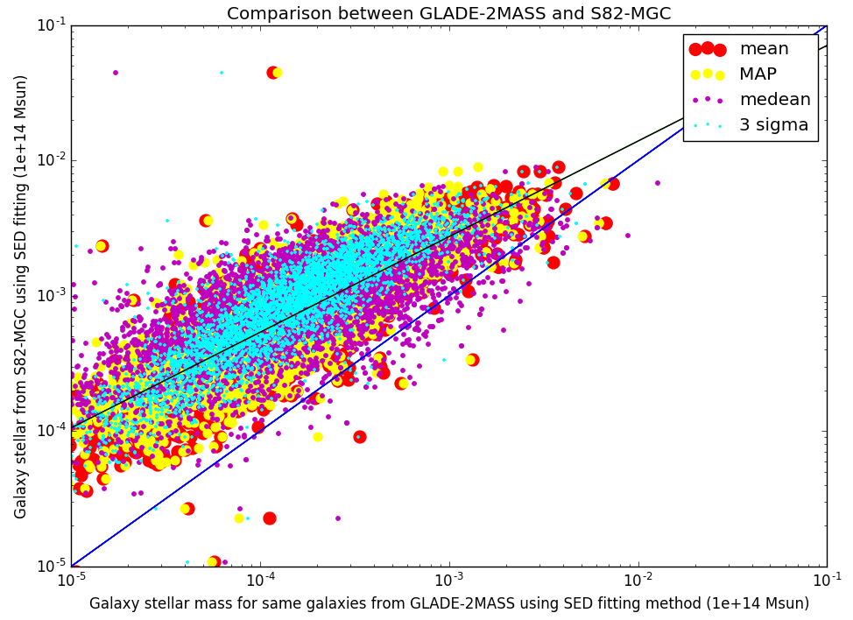
Stellar mass comparison between galaxy catalogs
Comparison between GLADE-2MASS (SED fitting method) and S82-MGC
Cross-matching GLADE-2MASS and S82-MGC using best search radius ( 0.0005 deg)
$M_{0}\sim 0.36M^{0.71}$: GLADE-2MASS doesn’t have data in optical and NIR band
Log$(M_{0})$=0.71log $(M)$-0.44
Log$(M_{0})$=log $(M)$
Notes:
We did the same cross-matching process between 2MASS and stripe 82. The best search radius for 2MASS is ~1.8 arcsecond. The horizontal axis shows mass estimation from GLADE-2MASS using BayeSED code and B,J,H,K band photometry data. and The vertical axis shows mass from stripe 82. The comparison tells us the mass estimated by running BayeSED code on 1 blue band and 3 IR bands(B,J,H,K) data in GLADE-2MASS is in general smaller than stellar mass estimated by using the same method but on 4 IR bands (Y,J,H,K). This is also as expected, because Bayesian fitting method is extremely sensitive to input photometry data. However, As shown in the previous comparison plot, the B band data makes mass estimation smaller than the real values due to dust attenuation in general. So, we are not surprised to see the mass estimation partially based on B mag is in general smaller.

Slide 12
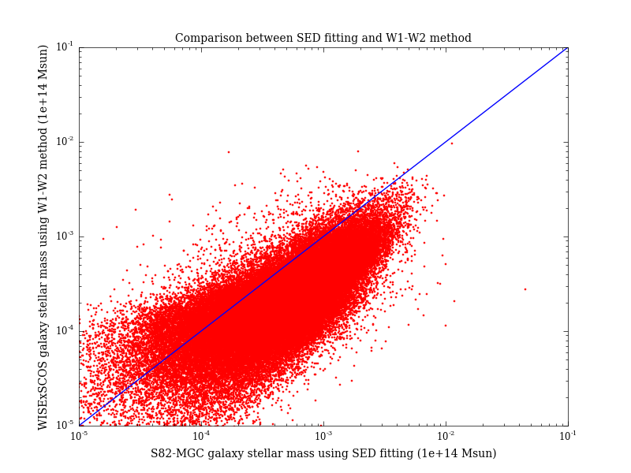
Mass comparison between galaxy catalogs
Comparison between WISExSCOS (W1-W2 method) and S82-MGC
Cross-matching WISExSCOS and S82-MGC using best search radius (~0.01 deg)
Compare stellar mass of the same group of galaxies (74,403) estimated by using W1-W2 method and SED fitting method
Mass estimation is larger than expectation, because of the MIR thermal emission of dust in galaxies.
Notes:
The same comparison procedure was applied to WISExSCOS cataloge. The best search radius is ~.01 deg. The horizontal axis is the standard mass and the vertical axis is mass estimation by using W1,W2 method. As shown in the plot, this method has larger uncertainty, but the overall trend agrees with what we expected.

Slide 13
Galaxy Cluster Mass Estimation
Method 1: Using galaxy richness of a cluster(Optical)
Estimate galaxy cluster mass using the stacked velocity dispersion- richness relation derived from MacBCG catalog data (Koester et al. 2007) and Virial theorem
$$Assumption:virialized galaxy clusters$$
$$Input:dynamical radius, richness$$
$$\ln{σ\left(N_{200}\right)}=\left(5.52±0.04\right)+\left(0.31±0.01\right)ln⁡(N_{200})$$
$M_{200}=\frac{5R_{200}∗σ{\left(N_{200}\right)}^{2}}{G}$ (Virial theorem)
$$Output:galaxy cluster mass$$
Estimate galaxy cluster mass using the central halo mass-richness relation (Sheldon et al. 2007) derived by applying cross-correlation cluster lensing method on SDSS II data
$$Input: richness$$
$$M200|20=(8.8±0.4±1.1)×{10}^{13}h^{−1}M_{⨀}$$
$$α=1.28±0.04$$
$$M200\left(N200\right)=M200|20∗{\left(\frac{N200}{20}\right)}^{α}$$
$$Output:galaxy cluster mass$$

Slide 14
Galaxy Cluster Mass Estimation
Method 2: Using total luminosity (X-Ray)
X-Ray observation: no cluster richness valid
Mass estimation from L500 (the approximate total luminosity) using the L-M relation given in Arnaud et al. (2010)
$$Input:total luminosity (L_{500})$$
$$h{\left(z\right)}^{−7/3}\frac{L_{500}}{{10}^{44}}\frac{erg}{s}=C{\left(\frac{M_{500}}{3×{10}^{14}M_{⨀}}\right)}^{α}$$
$$\log\left(C\right)=0.274$$
$α=1.64$
$$Output:cluster mass (M_{500})$$
Method 3: Using Sunyaev–Zel'dovich Effect (gravitational lensing)
Planck catalog (439) : cluster mass provided by using gravitational lensing (von der Linden et al. 2014b; Hoekstra et al. 2015)

Slide 15
Mass-distance distribution plot of 5 catalogs in Skymap Viewer
BNS range for aLIGO (GWGC)
GW150914
LVT151012
GW151226

Slide 16
Metallicity Estimation
For all GLADE-2MASS galaxies, metallicities are estimated together with stellar mass using the BayeSED.
Metallicities of WISExSCOS galaxies, on the other hand, are derived from stellar mass using the empirical mass-metallicity relation:
Assumption: metallicity of a galaxy is uniform and equals to the mean metallicity of the star forming gas in the galaxy.
$$Input:galaxy mass \left(M_{gal}\right), redshift (z)$$
$$\log\left(\frac{Z_{gas}}{Z_{Sun}}\right)=0.35\left[\log\left(M_{gal}\right)−10\right]+0.93e^{−0.43z}−1.05$$
$$Output:galaxy metallicity (Z_{gas})$$
The mass-metallicity relation comes from high-resolution cosmological simulation suite FIRE , and it agrees with both gas and stellar metallicity measurements observed at low redshifts for ${10}^{4}<M_{gal}<{10}^{11}M_{⨀} ,$as well as the data at higher redshifts.

Slide 17
Future Work
More catalogs (PanSTAR, etc.)
Improve the accuracy in stellar mass estimation
Add metallicity and SFR to each galaxy
Better localization from GW network (HLVIK) will make Skymap Viewer more helpful
Summary
Mass and distance estimations for 7 catalogs
Observation priority is constructed by stellar mass * skymap
Testing different stellar mass estimation by cross-matching with S82-MGC (SDSS)

Slide 18
Thank you!
Dr. Roy Williams
Dr. George Djorgovski

Slide 19
References
[2] Harold G. Jr.; Olowin Ronald P. Abell George O.; Cor- win. “A catalog of rich clusters of galaxies”. In: Astro- physical Journal 70 (1989), pp. 1–138.
[3] Bundy Kevin et al. “The Stripe 82 Massive Galaxy Project. I. Catalog Construction”. In: The Astrophys- ical Journal Supplement Series 221.Issue 1 (2015). doi: 10.1088/0067-0049/221/1/15.
[4] Bundy Kevin et al. “The UKIRT Infrared Deep Sky Survey (UKIDSS)”. In: MNRAS 379.Issue 4 (2007), pp. 1599–1617. doi: 10.1111/j.1365-2966.2007.12040.x.
[5] Maciej Bilicki et al. “TWO MICRON ALL SKY SUR- VEY PHOTOMETRIC REDSHIFT CATALOG: A COMPREHENSIVE THREE-DIMENSIONAL CEN- SUS OF THE WHOLE SKY”. In: The Astrophysical Journal Supplement Series 210.1 (2013).
[6] Planck Collaboration: P.A.R. Ade et al. “Planck 2015 results. XXIV. Cosmology from Sunyaev-Zeldovich clus- ter counts”. In: Astronomy Astrophysics szcosmo2014 (2014).
[7] Xiao-Qing Wen et al. “The stellar masses of galaxies from the 3.4 m band of the WISE All-Sky Survey”. In: MNRAS (2013). doi: 10.1093/mnras/stt939.
[8] Maciej et al. Bilicki. “WISE SuperCOSMOS Photo- metric Redshift Catalog: 20 Million Galaxies over 3/pi Steradians”. In: The Astrophysical Journal Supplement Series 225.1 (2016). doi: 10.3847/0067-0049/225/1/5.
[9] Ilias; Mun ̃oz Julian B.; Ali-Ha ̈ımoud Yacine; Kamionkowski Marc; Kovetz Ely D.; Raccanelli Alvise; Riess Adam G. Bird Simeon; Cholis. “Did LIGO detect dark matter?” In: eprint arXiv 1603.00464 (2016).
[10] Thomas Boch. Aladin Lite. 2014. url: http://aladin.u- strasbg.fr/AladinLite/ (visited on 10/2014).
[11] S. Bruzual G.; Charlot. “Stellar population synthesis at the resolution of 2003”. In: MNRAS 344.4 (2003), pp. 1000–1028. doi: 10.1046/j.1365-8711.2003.06897.x.
[12] Daniela et al. Calzetti. “The Dust Content and Opac- ity of Actively Star-forming Galaxies”. In: The As- trophysical Journal 533.2 (2000), pp. 682–695. doi: 10.1086/308692.
[13] Gilles Chabrier. “Galactic Stellar and Substellar Initial Mass Function”. In: The Publications of the Astronom- ical Society of the Pacific 115.809 (2003), pp. 763–795. doi: 10.1086/376392.
[14] M. E et al. Cluver. “Galaxy and Mass Assembly (GAMA): Mid-infrared Properties and Empirical Rela- tions from WISE”. In: The Astrophysical Journal 782.2 (2014). doi: 10.1088/0004-637X/782/2/90.
[15] Ofer Collister Adrian A.; Lahav. “ANNz: Estimat- ing Photometric Redshifts Using Artificial Neural Net- works”. In: ().
[16] James E.; White Martin Conroy Charlie; Gunn. “The Propagation of Uncertainties in Stellar Population Syn- thesis Modeling. I. The Relevance of Uncertain Aspects of Stellar Evolution and the Initial Mass Function to the Derived Physical Properties of Galaxies”. In: The Astrophysical Journal 699.Issue I (2009), pp. 486–506. doi: 10.1088/0004-637X/699/1/486.
[17] James E.; White Martin Conroy Charlie; Gunn. “The Propagation of Uncertainties in Stellar Population Synthesis Modeling. II. The Challenge of Comparing Galaxy Evolution Models to Observations”. In: The As- trophysical Journal 708.Issue I (2010), pp. 58–70. doi: 10.1088/0004-637X/708/1/58.
[18] S. P. et al. Driver. “Galaxy and Mass Assembly (GAMA): survey diagnostics and core data release”. In: Monthly Notices of the Royal Astronomical Soci- ety 413.2 (2011), pp. 971–995. doi: 10.1111/j.1365- 2966.2010.18188.x.
19] Dawn K. et al. Erb. “H Observations of a Large Sample of Galaxies at z 2: Implications for Star Formation in High-Redshift Galaxies”. In: The Astrophysical Journal 647.1 (2006), pp. 128–139. doi: 10.1086/505341.
[20] E.S.Phinney. “The rate of neutron star binary mergers in the universe - Minimal predictions for gravity wave detectors”. In: Astrophysical Journal Letters 380.ISSN 0004-637X (1991), pp. 17–21. doi: 10.1086/186163.
[21] G. Galgo czi-P. Raffai R. S. de Souza G. D alya Z. Frei.
[32] Xiangcheng et al. Ma. “The origin and evolution of the galaxy mass-metallicity relation”. In: MNRAS 456.2 (2016), pp. 2140–2156. doi: 10.1093/mnras/stv2659.
[33] F. et al. Mannucci. “LSD: Lyman-break galaxies Stellar populations and Dynamics - I. Mass, metallicity and gas at z 3.1”. In: MNRAS 398.4 (2009), pp. 1915–1931. doi: 10.1111/j.1365-2966.2009.15185.x.
[34] Paul; Cantiello Matteo; MacFadyen Andrew I. Perna Rosalba; Duffell. “The Fate of Fallback Matter around Newly Born Compact Objects”. In: ApJ 781.2 (2014). doi: 10.1088/0004-637X/781/2/119.
[35] M.; Pratt G. W.; Pointecouteau E.; Melin J.-B. Pif- faretti R.; Arnaud. “The MCXC: a meta-catalogue of x-ray detected clusters of galaxies”. In: Astronomy As- trophysics 534.A109 (2011).
[36] Meagan; Pattabiraman Bharath; Chatterjee Sourav; Haster Carl-Johan; Rasio Frederic A. Rodriguez Carl L.; Morscher. “Binary Black Hole Mergers from Globular Clusters: Implications for Advanced LIGO”. In: Physi- cal Review Letters 115.5 (2015).
[37] Kunyang Li. Roy Williams Thomas
An Extended List of Galaxies for Gravitational-Wave Searches in the Advanced Detector Era. 2016. url: http://aquarius.elte.hu/glade/GLADE ̇Documentation ̇1.3.pdf
(visited on 01/2016).

Slide 20
References
[19] Dawn K. et al. Erb. “H Observations of a Large Sample of Galaxies at z 2: Implications for Star Formation in High-Redshift Galaxies”. In: The Astrophysical Journal 647.1 (2006), pp. 128–139. doi: 10.1086/505341.
[20] E.S.Phinney. “The rate of neutron star binary mergers in the universe - Minimal predictions for gravity wave detectors”. In: Astrophysical Journal Letters 380.ISSN 0004-637X (1991), pp. 17–21. doi: 10.1086/186163.
[21] G. Galgo czi-P. Raffai R. S. de Souza G. D alya Z. Frei.
[32] Xiangcheng et al. Ma. “The origin and evolution of the galaxy mass-metallicity relation”. In: MNRAS 456.2 (2016), pp. 2140–2156. doi: 10.1093/mnras/stv2659.
[33] F. et al. Mannucci. “LSD: Lyman-break galaxies Stellar populations and Dynamics - I. Mass, metallicity and gas at z 3.1”. In: MNRAS 398.4 (2009), pp. 1915–1931. doi: 10.1111/j.1365-2966.2009.15185.x.
[34] Paul; Cantiello Matteo; MacFadyen Andrew I. Perna Rosalba; Duffell. “The Fate of Fallback Matter around Newly Born Compact Objects”. In: ApJ 781.2 (2014). doi: 10.1088/0004-637X/781/2/119.
[35] M.; Pratt G. W.; Pointecouteau E.; Melin J.-B. Pif- faretti R.; Arnaud. “The MCXC: a meta-catalogue of x-ray detected clusters of galaxies”. In: Astronomy As- trophysics 534.A109 (2011).
[36] Meagan; Pattabiraman Bharath; Chatterjee Sourav; Haster Carl-Johan; Rasio Frederic A. Rodriguez Carl L.; Morscher. “Binary Black Hole Mergers from Globular Clusters: Implications for Advanced LIGO”. In: Physi- cal Review Letters 115.5 (2015).
[37] Kunyang Li. Roy Williams Thomas
An Extended List of Galaxies for Gravitational-Wave Searches in the Advanced Detector Era. 2016. url: http://aquarius.elte.hu/glade/GLADE ̇Documentation ̇1.3.pdf
(visited on 01/2016).
[22] P. A. A.; de Carvalho R. R.; Kohl-Moreira J. L.; Capelato H. V.; Djorgovski S. G. Gal R. R.; Lopes. “The Northern Sky Optical Cluster Survey. III. A Clus- ter Catalog Covering PI Steradians”. In: The Astronom- ical Journal 137.2 (2009), pp. 2981–2999.
[23] A. C.; Irwin M. J.; MacGillivray H. T. Hambly N. C.; Davenhall. “The SuperCOSMOS Sky Survey - III. Astrometry”. In: Monthly Notices of the Royal As- tronomical Society 326.4 (2001), pp. 1315–1327. doi: 10.1111/j.1365-2966.2001.04662.x.
[24] A. M. et al. Hopkins. “Galaxy And Mass Assem- bly (GAMA): spectroscopic analysis”. In: Monthly No- tices of the Royal Astronomical Society 430.3 (2013), pp. 2047–2066. doi: 10.1093/mnras/stt030.
[25] Philip F. et al. Hopkins. “Galaxies on FIRE (Feedback In Realistic Environments): stellar feedback explains cosmologically inefficient star formation”. In: MNRAS 445.1 (2014), pp. 581–603. doi: 10.1093/mnras/stu1738.
[26] Erin S.; Wechsler Risa H.; Rozo Eduardo; Koester- Benjamin P.; Frieman Joshua A.; McKay Timothy A.; Evrard August E.; Becker Matthew R.; Annis James Johnston David E.; Sheldon. “Cross-correlation Weak Lensing of SDSS galaxy Clusters II: Cluster Density Profiles and the Mass–Richness Relation”. In: eprint arXiv 0709.1159 (2007).
[27] T. A.; Annis J.; Wechsler R. H.; Evrard-A.; Bleem L.; Becker M.; Johnston D.; Sheldon E.; Nichol R.; Miller C.; Scranton R.; Bahcall N.; Barentine J.; Brewington H.; Brinkmann J.; Harvanek M.; Kleinman S.; Krzesin- ski J.; Long D.; Nitta A.; Schneider D. P.; Sneddin S.; Voges W.; York D. Koester B. P.; McKay. “A MaxBCG Catalog of 13,823 Galaxy Clusters from the Sloan Dig- ital Sky Survey”. In: The Astrophysical Journal 660.1 (2007), pp. 239–255.
[28] Peter Meszaros Ian Shoemaker Nicholas Senno Kohta Murase Kazumi Kashiyama. “Ultrafast Outflows from Black Hole Mergers with a Mini-Disk”. In: ApJ Letter 822.1 (2016). doi: 10.3847/2041-8205/822/1/L9.
[29] Shea; Clausen Drew; Hopkins Philip Lamberts Astrid; Garrison-Kimmel. “When and where did GW150914 form?” In: eprint arXiv:1605.08783 (2016). doi: 2016arXiv160508783L.
[30] Henry et al. Lee. “On Extending the Mass-Metallicity Relation of Galaxies by 2.5 Decades in Stellar Mass”. In: The Astrophysical Journal 647.2 (2006), pp. 970– 983. doi: 10.1086/505573.
[31] J et al. Liske. “Galaxy And Mass Assembly (GAMA): end of survey report and data release 2”. In: Monthly Notices of the Royal Astronomical Society, 452.2 (2015), pp. 2087–2126. doi: 10.1093/mnras/stv1436.
Boch. Skymap Viewer. https://losc.ligo.org/s/skymapViewer 08/2016).
2016. (visited on
[38] Takayuki Seto Naoki; Muto. “Resonant trapping of stars by merging massive black hole binaries”. In: MNRAS 451.4 (2011). doi: 10.1111/j.1365-2966.2011.18988.x.
[39] M. F et al. Skrutskie. “The Two Micron All Sky Survey (2MASS)”. In: The Astronomical Journal 131.Issue 2 (2006), pp. 1163–1183. doi: 10.1086/498708.
[40] Christy A. et al. Tremonti. “The Origin of the Mass- Metallicity Relation: Insights from 53,000 Star-forming Galaxies in the Sloan Digital Sky Survey”. In: The Astrophysical Journal 613.2 (2004), pp. 898–913. doi: 10.1086/423264.
[41] E. J.; Dhillon V. S. White Darren J.; Daw. “A list of galaxies for gravitational wave searches”. In: Classical and Quantum Gravity 28.8 (2011). doi: 10.1088/0264- 9381/28/8/085016.
[42] Edward L et al. Wright. “The Wide-field Infrared Sur- vey Explorer (WISE): Mission Description and Initial On-orbit Performance”. In: The Astronomical Jour- nal 140.6 (2010), pp. 1868–1881. doi: 10.1088/0004- 6256/140/6/1868.
[43] Donald G et al. York. “The Sloan Digital Sky Sur- vey: Technical Summary”. In: The Astrophysical Jour- nal Supplement Series 120.3 (2000), pp. 1579–1587. doi: 10.1086/301513.
[44] Zhanwen Han Yunkun Han. “BayeSED: A General Ap- proach to Fitting the Spectral Energy Distribution of Galaxies”. In: ApJS 215.2 (2014). doi: 10.1088/0067- 0049/215/1/2.
[45] Nobuhiro; Finoguenov Alexis; Smith Graham P.; Piffaretti-Rocco; Valdarnini Riccardo; Babul Arif; Evrard August E.; Mazzotta Pasquale; Sanderson Alas- tair J. R.; Marrone Daniel P. Zhang Yu-Ying; Ok- abe. “LoCuSS: A Comparison of Cluster Mass Measure- ments from XMM-Newton and Subaru—Testing Devi- ation from Hydrostatic Equilibrium and Non-thermal Pressure Support”. In: The Astrophysical Journal 711.2 (2010), pp. 1033–1043.

Slide 21
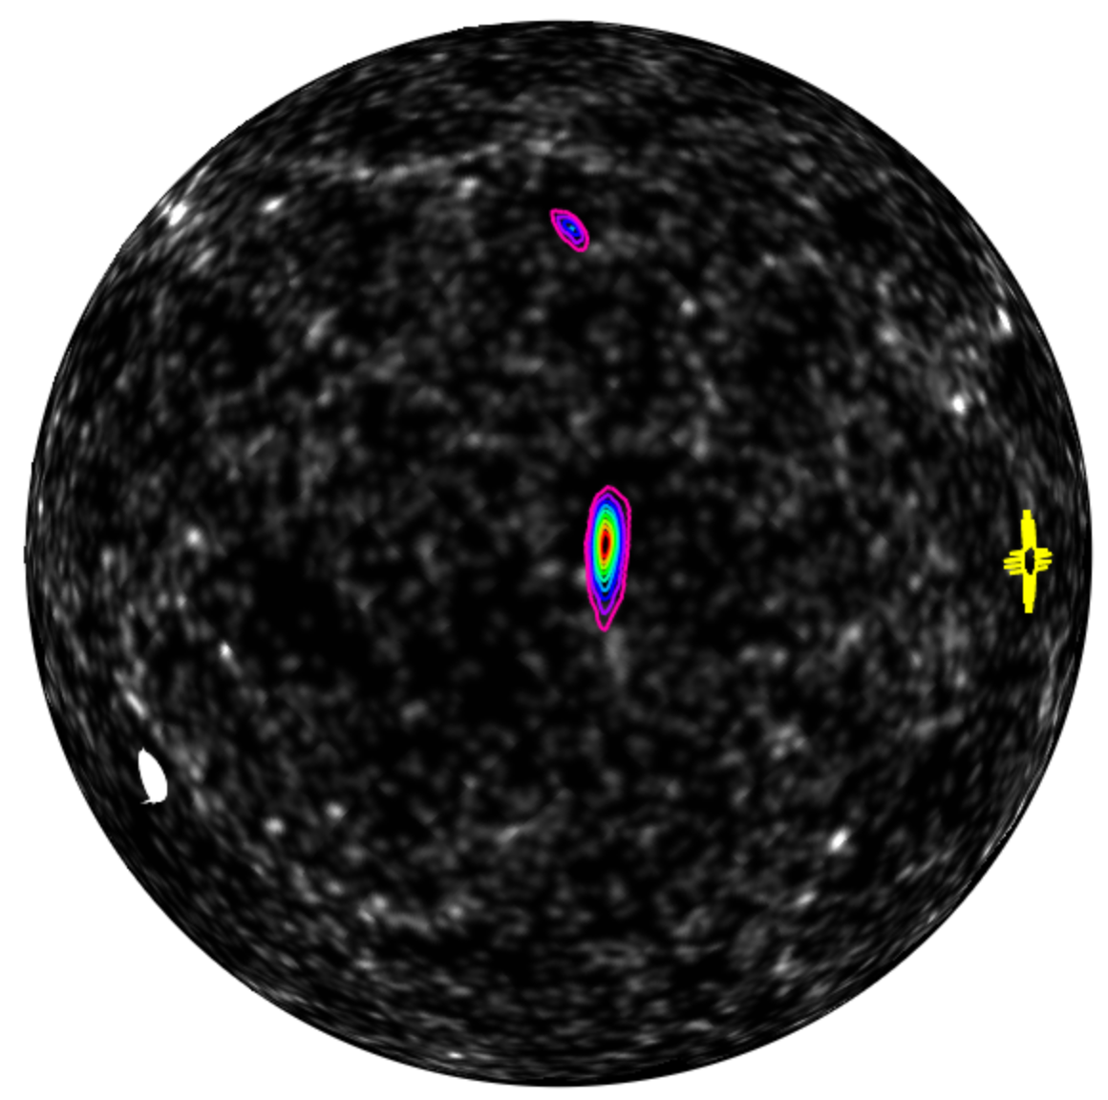
Extra Slids
FOV=180d
simulated HLV skymap from First2Years
contours are deciles of probability
many backgrounds, here shown 2MASS galaxy density*
* density of 2MASS galaxies 85 to 128 Mpc Antolini+Heyl 1602:07710
Skymap Viewer coming soon to
https://losc.ligo.org/s/skymapViewer/
(R.Williams, T.Boch, K.Li)

Slide 22
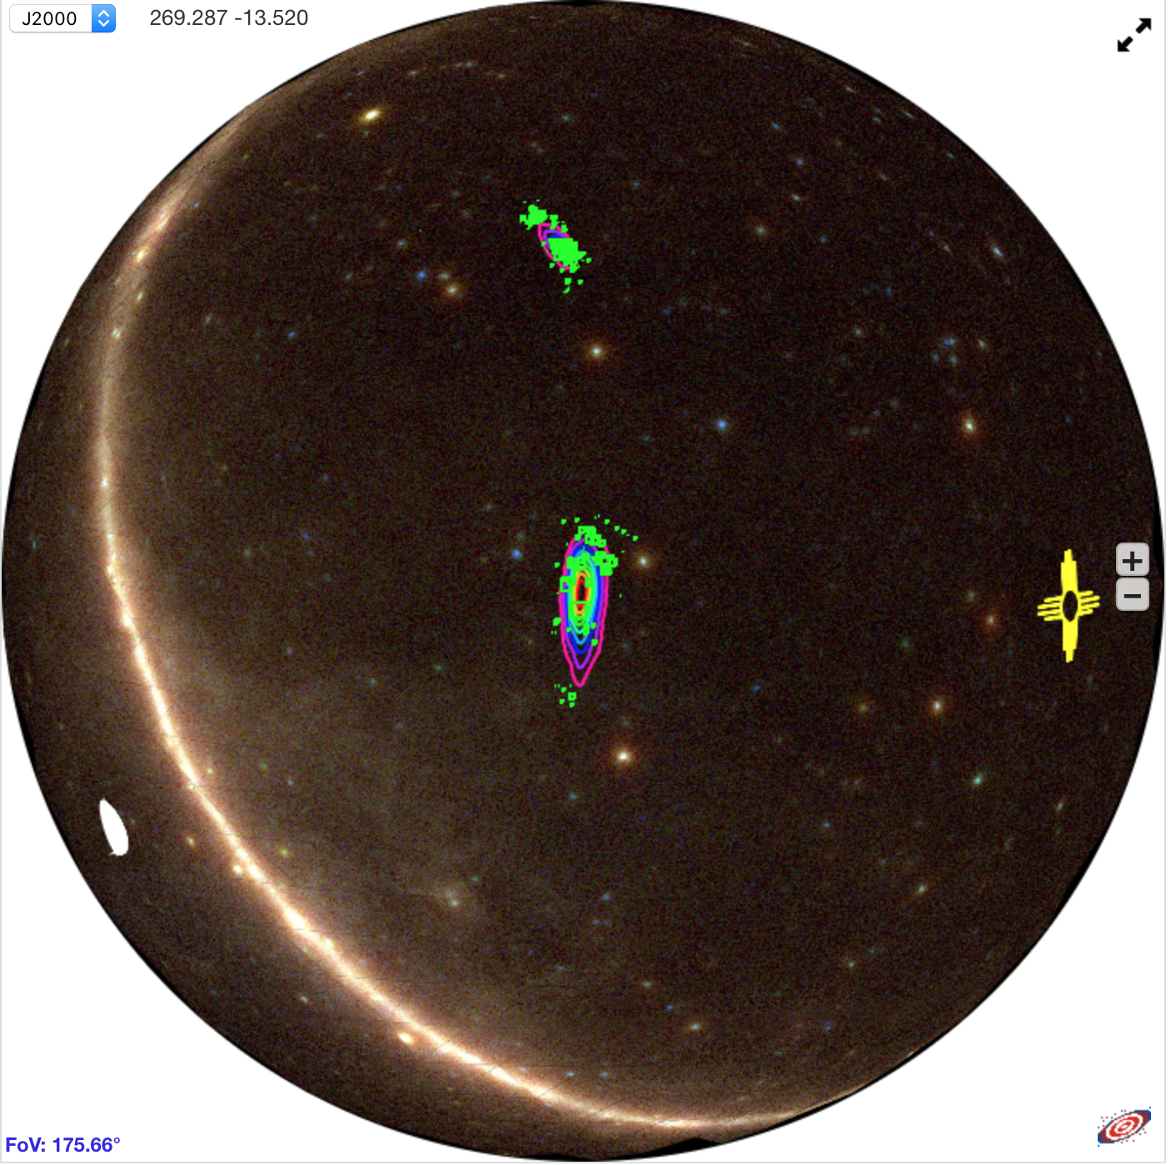
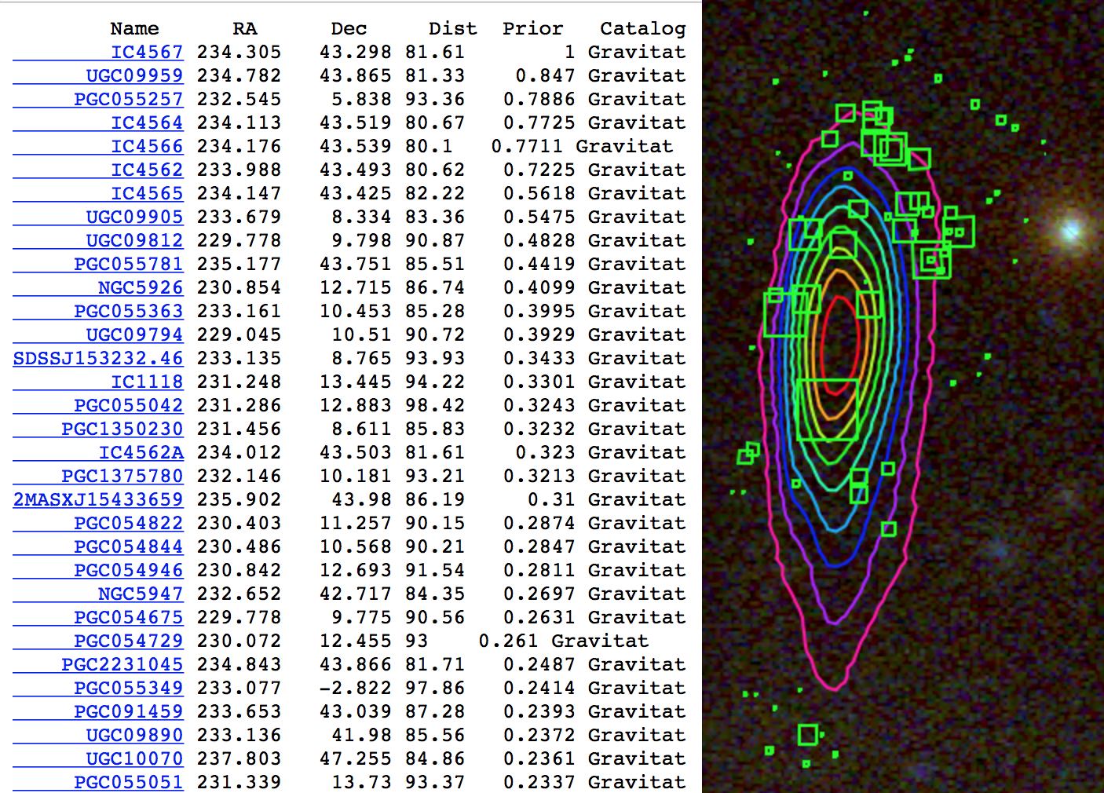
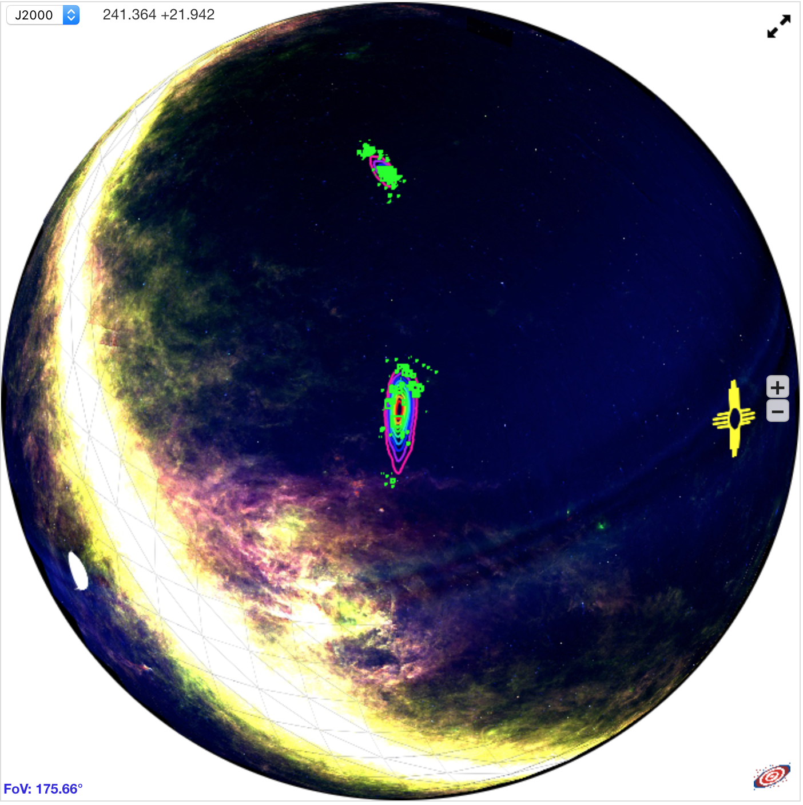
Skymap Viewer
AladinLite enables drill-down from whole-sky to arc-second resolution, including image surveys from radio to gamma-ray wavelengths.
Visualize arbitrary astronomical catalogs in terms of observation priority , which combines knowledge from the gravitational wave detection (the sky map), with known astrophysical objects (i.e. galaxies and galaxy clusters).
Fermi (Gama-Ray)
IRAS (IR)

Slide 23
Galaxy Stellar Mass Estimation
Method 1: Using B band photometry data to estimate galaxy stellar mass:
Assumption: all stars in galaxies have the same mass-to-light ratio of the Sun
Input: apparent B band magnitude, redshift (z)
$$m_{B}−M_{B}=5\log\left(d\right)−5$$
$$L_{B}=\frac{L_{B⨀}}{{10}^{0.4(M_{B}−M_{B⨀})}}$$
$M_{g}≅L_{B}∗\frac{M_{⨀}}{L_{B⨀}}$
$M_{B⨀}$=5.48 mag (absolute magnitude of the Sun in B band)
$L_{B⨀}$=$\frac{{3×10}^{33}erg}{s}$ (B band luminosity of the Sun)
$M_{⨀}$=${1.989×10}^{30}kg$ (mass of the Sun)
$$Output:galaxy stellar mass M_{g}$$

Slide 24
Galaxy Stellar Mass Estimation
Method 3: Using W1-W2 band photometry data
The W1 band ($3.4 μm)$of WISE survey is dominated by the light from old stars and can be used as an effective measure of stellar mass (Jarrett et al. 2013).
$$Input:W1, W2, redshift$$
$$\log\left(\frac{M_{stellar}}{L_{W1}}\right)=−1.96\left(W_{1}−W_{2}\right)−0.03$$
$$L_{W1}\left(L_{⨀}\right)= {10}^{−0.4(M−M_{Sun})}$$
-$M_{Sun}=3.24$
-$M:W_{1}band absolute magnitude$
-$W_{1}−W_{2}:rest frame color$
$$Output:galaxy stellar mass M_{stellar}$$

Slide 25
Galaxy Stellar Mass Estimation
GLADE-2MASS catalog (548,876 galaxys): B, J, H, K band magnitude and redshift
Evolutionary population synthesis model library: Bruzual Charlot (2003) (BC2003)
IMF (Initial Mass Function) adopted: Chabrier (2003)
SFHs (Star Formation History) of galaxies: $SFR∝ e^{t/τ}$
t : the time since the start of star formation
$τ$ : the e-folding star formation timescale
Dust attenuation:
A uniform dust screen
Dust extinction law adopted: Calzetti et al. (2000)
BC2003 parameter grid:
$\log\left(\frac{τ}{yr}\right) ∈\left[6.5, 11\right], step size=0.1 yr$
$\log\left(\frac{t}{yr}\right) ∈\left[7.0, 10.1\right], step size=0.05 yr$
$Av ∈\left[0, 4\right], step size=0.2$
Metallicity $∈\left\{0.004, 0.008, 0.02, 0.05\right\}$
243,434 model SEDs in the library, which we used to compare with observed galaxy SEDs in GLADE-2MASS.

Slide 26
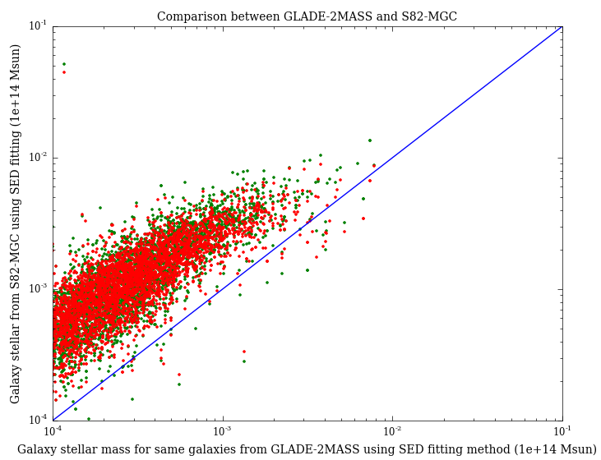
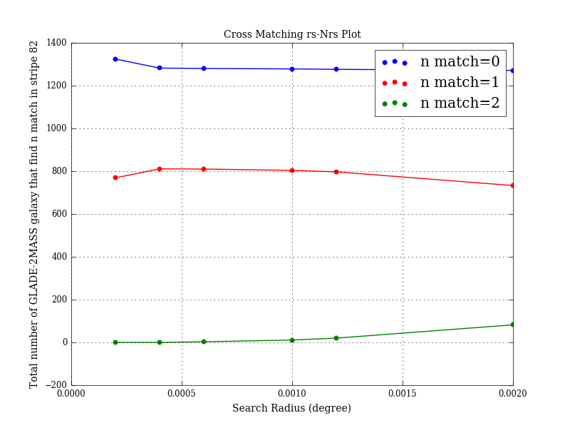
Stellar mass comparison between galaxy catalogs
Comparison between GLADE-2MASS (SED fitting method) and S82-MGC
Cross-matching GLADE-2MASS and S82-MGC using best search radius ( 0.0005 deg)
Compare stellar mass of the same group of galaxies both estimated by using SED fitting but using different data from two catalogs.

Slide 27
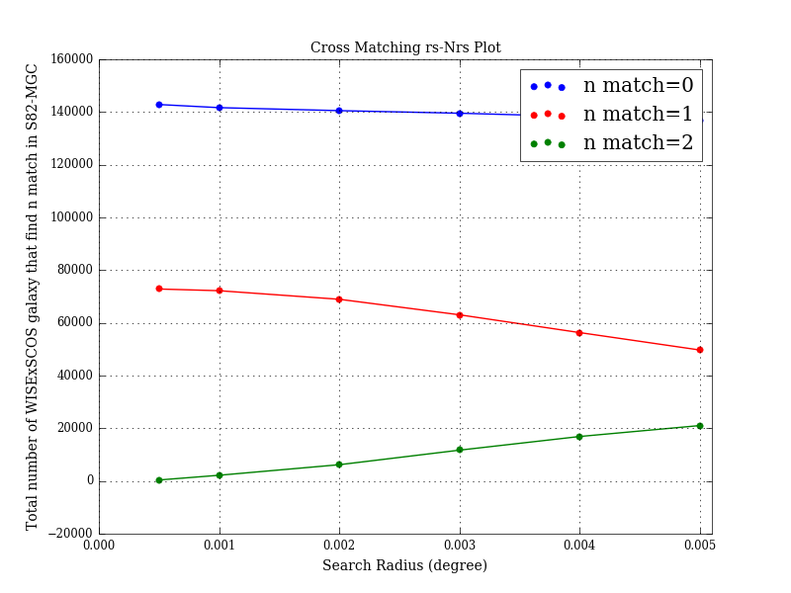
Stellar mass comparison between galaxy catalogs
Comparison between WISExSCOS (W1-W2 method) and S82-MGC
Cross-matching WISExSCOS and S82-MGC using best search radius (~0.01 deg)
Compare stellar mass of the same group of galaxies (74,403) estimated by using W1-W2 method and SED fitting method

Slide 28
Galaxy Cluster Stellar Mass Estimation
Method 1: Using galaxy richness of a cluster(Optical)
Estimate galaxy cluster mass using the stacked velocity dispersion- richness relation derived from MacBCG catalog data (Koester et al. 2007)
$Input:R_{200}, N_{200}$
-$R_{200}:the radius inside which the average density is 200∗critical density(z)$
-$N_{200 }:the number of galaxies enclosed by theR_{200} circle$
$$\ln{σ\left(N_{200}\right)}=\left(5.52±0.04\right)+\left(0.31±0.01\right)ln⁡(N_{200})$$
$M_{200}=\frac{5R_{200}∗σ{\left(N_{200}\right)}^{2}}{G}$ (Virial theorem)
-$σ\left(N_{200}\right):the stacked velocity dispersion at{ R}_{200} (dynamical cluster radius)$
$$Output:galaxy cluster mass$$

Slide 29
Metallicity Estimation
For all GLADE-2MASS galaxies, metallicities are estimated together with stellar mass using the BayeSED.
Metallicities of WISExSCOS galaxies, on the other hand, are derived from stellar mass using the empirical mass-metallicity relation:
Assumption: metallicity of a galaxy is uniform and equals to the mean metallicity of the star forming gas in the galaxy.
$$Input:galaxy mass \left(M_{gal}\right), redshift (z)$$
$$\log\left(\frac{Z_{gas}}{Z_{Sun}}\right)=0.35\left[\log\left(M_{gal}\right)−10\right]+0.93e^{−0.43z}−1.05$$
$$Output:galaxy metallicity (Z_{gas})$$
The mass-metallicity relation comes from high-resolution cosmological simulation suite FIRE , and it agrees with both gas and stellar metallicity measurements observed at low redshifts for ${10}^{4}<M_{gal}<{10}^{11}M_{⨀} ,$as well as the data at higher redshifts.

