Slide 1
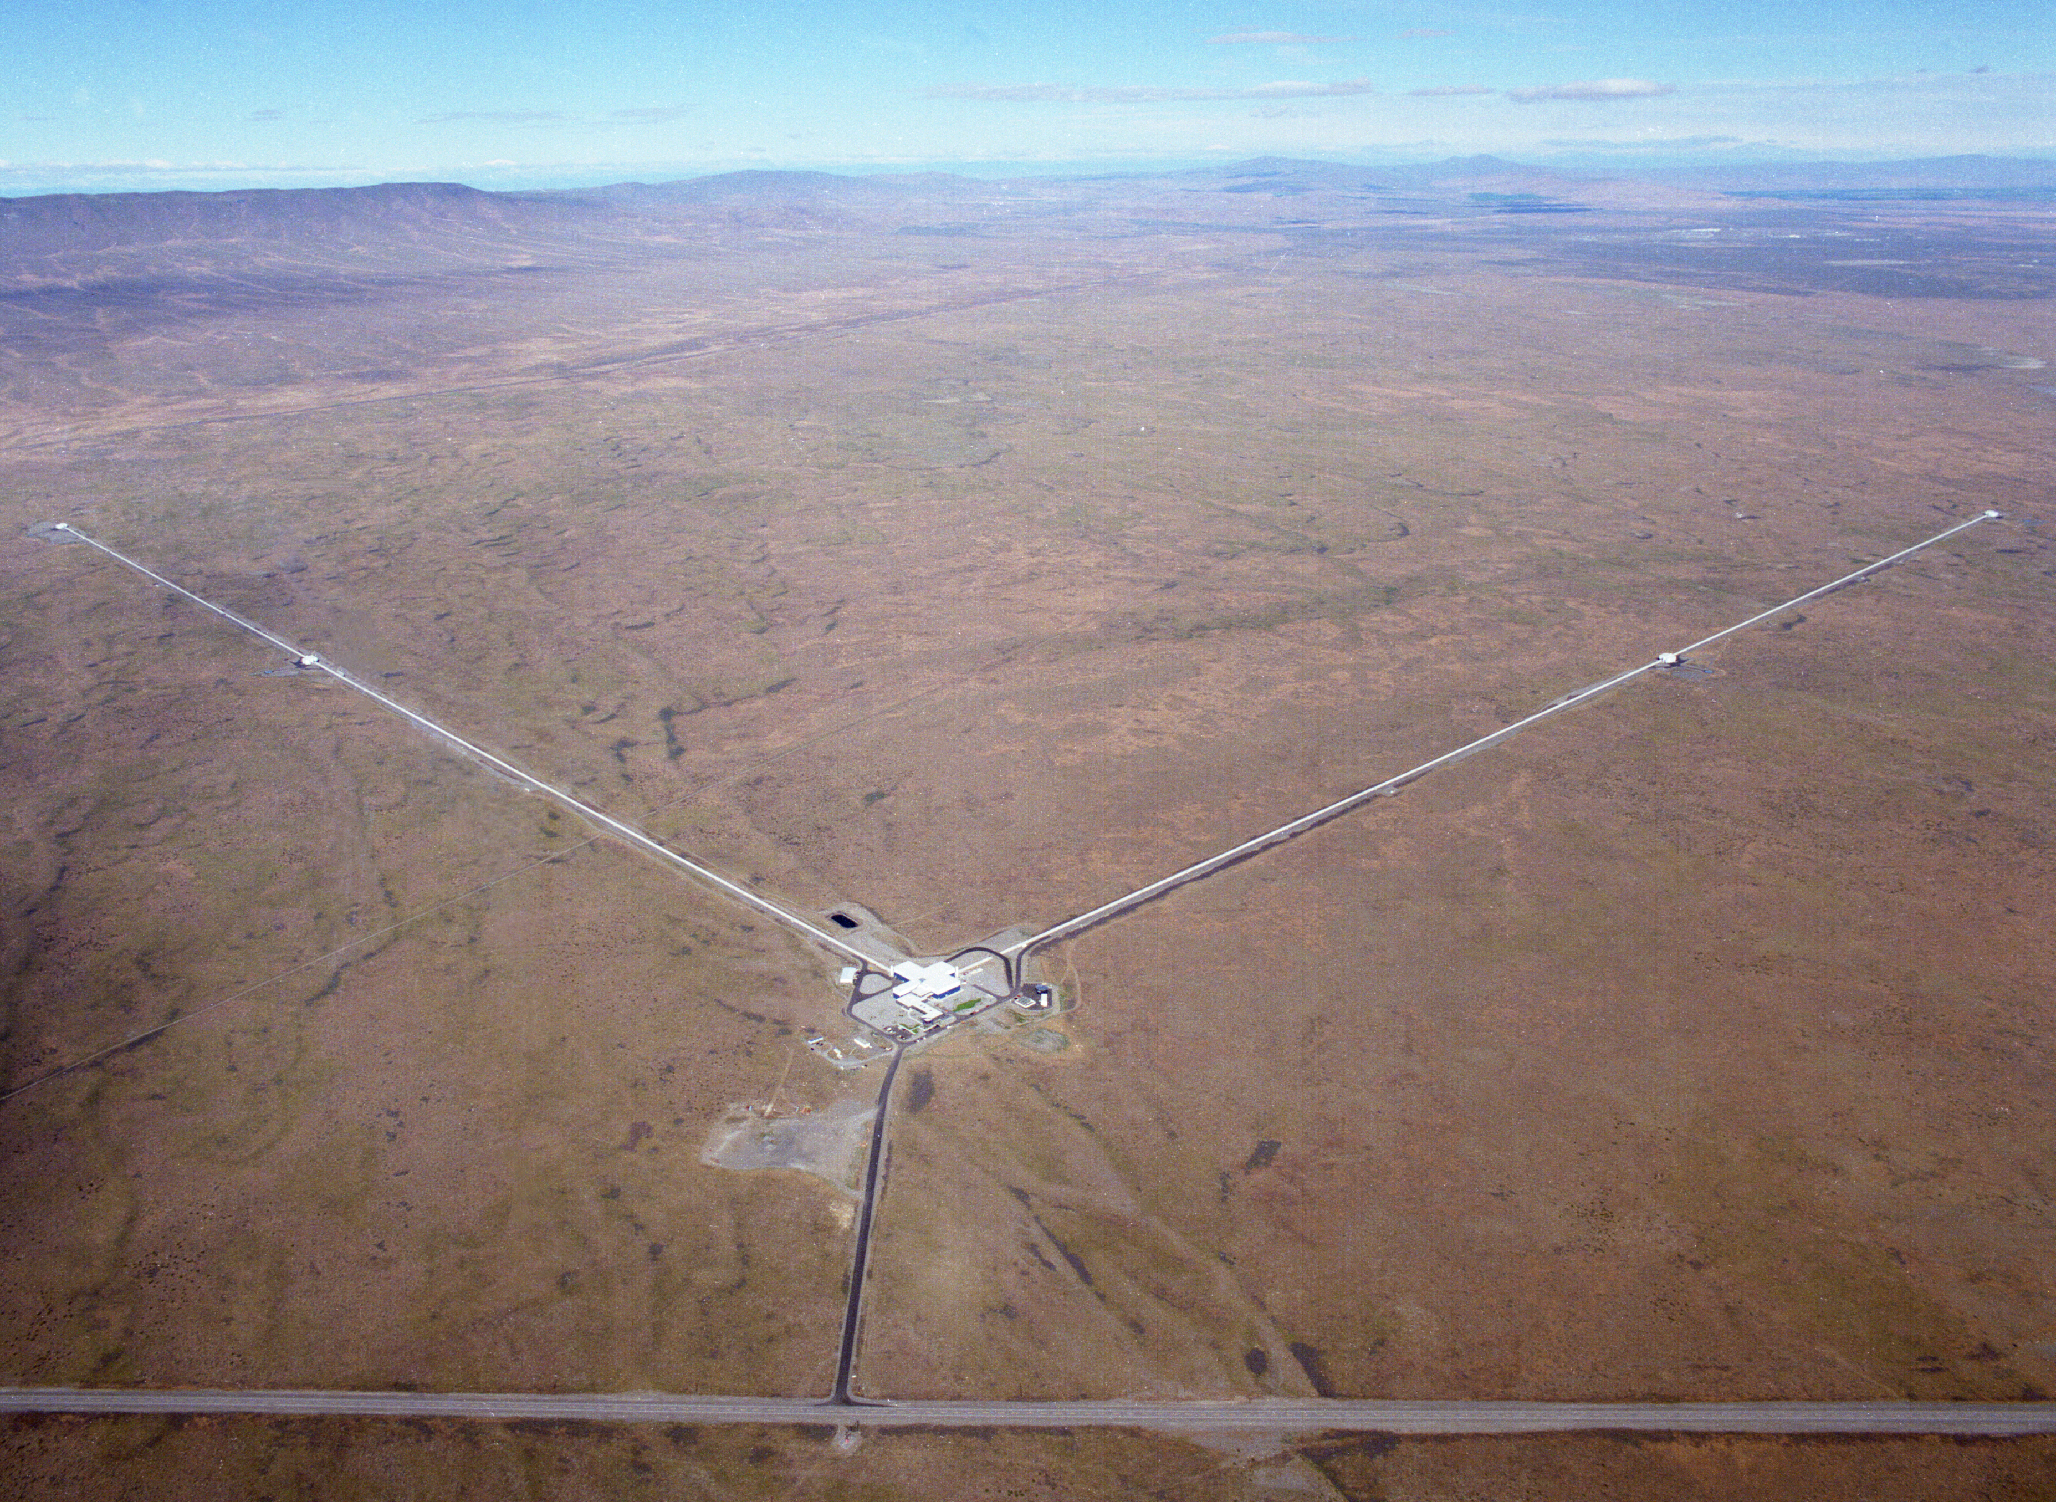
Finding the Voice of the Universe
Fred Raab, for the LIGO Scientific Collaboration and the Virgo Collaboration

Slide 2
The stage for this story is space and time.

Slide 3
The Origins of Relativity
Relativity describes how things move through space and time
Galileo (1564-1642) first realized that uniform (constant velocity) motion was relative
  Consider two canoes on a placid lake, moving relative to each other. How do we establish which canoe is moving? We can only describe an object as moving if we can relate that motion to some frame (Shoreline? Water surface? Canoeist?)
  Motion of either canoe is relative to a reference frame, implying there is no such thing as absolute motion
Isaac Newton (1643-1727), the master of motion, codified Galilean relativity into his laws of mechanics
  space and motion were defined relative to a reference frame
  time was an absolute quantity ⇒ all clocks ticked at the same rate
  law of universal gravitation ⇒ “action at a distance”

Slide 4
Fast Forward 200 Years
About 100 years ago, Albert Einstein (1879-1955) began to explore anew the concepts of space and time
  Only two forces were known at that time: electromagnetism & gravity
  Theory of electromagnetism had correctly described motors, generators, radio and light transmission
  Newton’s mechanics had correctly described motion of neutral matter, including an accurate description of how gravity acts, but not how it arises
  But the two theories were incompatible in the description of rapidly moving electrical charges
Einstein eventually discovered that the incompatibility was caused by the presence of “absolute” time
  Two travelers in relative motion, not only cannot define who is moving, if they move fast enough they also disagree on the time between events

Slide 5
Special Relativity
Einstein’s Special Theory of Relativity (1905) described motion of matter in the absence of gravity
  Everything is relative, except the speed of light, which is absolute, in agreement with electromagnetism
  Speed of light is a property of space
  There is a special symmetry between space and time, mass and energy
  All observers in relative motion observe the same laws of physics but they disagree on the definitions of time and space used to describe those laws
Predictions:
  Moving rulers contract
  Moving clocks tick slower
  Matter is just a “frozen” form of energy (e.g., nuclear power industry)

Slide 6
Basics of General Relativity and Gravitational Waves
Wherein it is realized that space and time are things whose properties are manifested by phenomena that we collectively refer to as “gravity”.

Slide 7

Special Relativity and the Case of the Missing Sun
Notes:
Suppose that an instant before time T=0, the Sun would disappear. What would happen to the orbit of Earth? Most people would expect Earth to immediately hurtle out into space, since the gravitational pull of the sun would no longer hold it. But special relativity says that information cannot travel faster than light. So Earth would continue to orbit the Sun that we can see is no longer there until folks on Earth see the Sun disappear. Right near the edge of the vanished Sun, its gravity disappears right away. Later and later its gravity disappears farther and farther away until it eventually (at T = 8 min 20 sec) it disappears at Earth. That front of disapearing gravity is the gravity wave front.

Slide 8
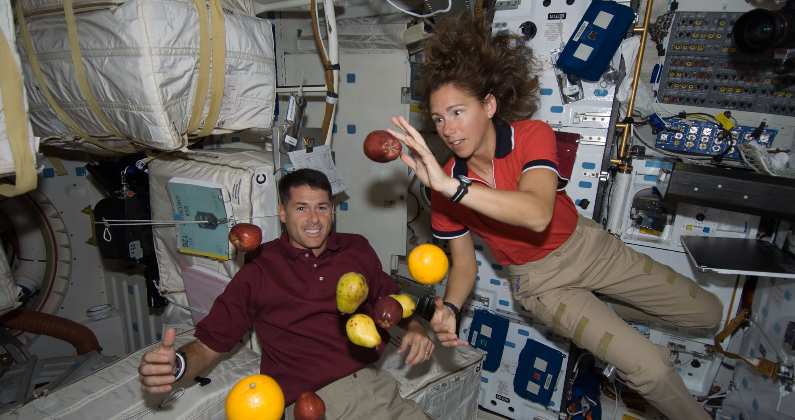
Free fall is weightless

Slide 9
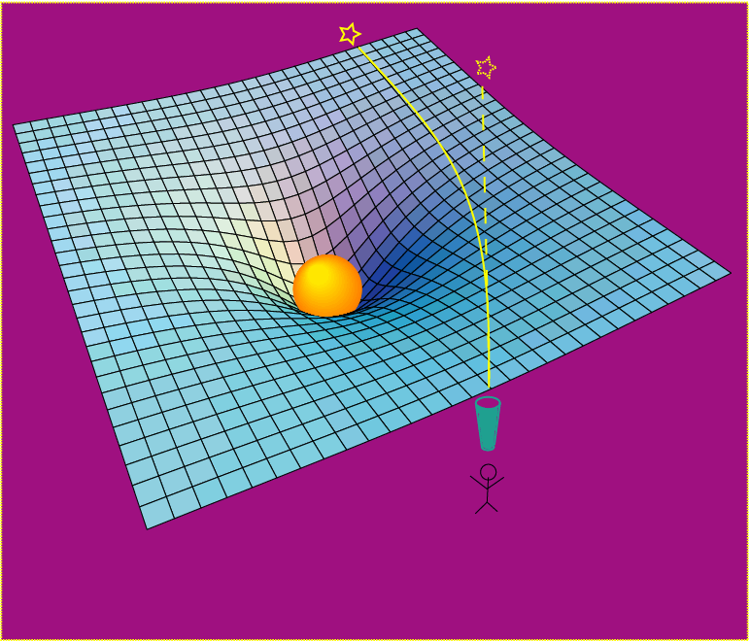
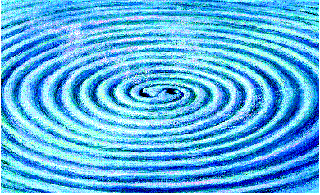
Einstein’s General Relativity re-wrote the rules of space and time
Rendering of space stirred by two orbiting black holes
A massive object shifts apparent position of a star
Empty space and time are things, with real physical properties. Space has a shape, a stiffness and a maximum speed for information transfer.

Slide 10
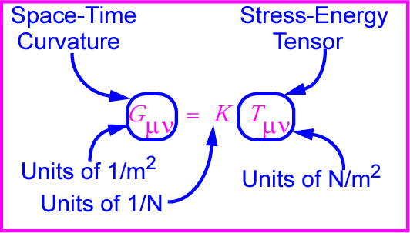
Gravitational waves: hard to find because space-time is stiff!
Following I.R. Kenyon, General Relativity
K~[G/c⁴] is combination of G and c with units of 1/N
K ~ 10⁻⁴⁴ N⁻¹
⇒ Wave can carry huge energy with miniscule amplitude!

Slide 11
Expected strength
Sense of scale: strain from a binary neutron star pair
  M = 1.4 M,
  r = 10²³ m (15 Mpc, Virgo),
  R = 20 km
  f_{orb} = 400 Hz

Slide 12
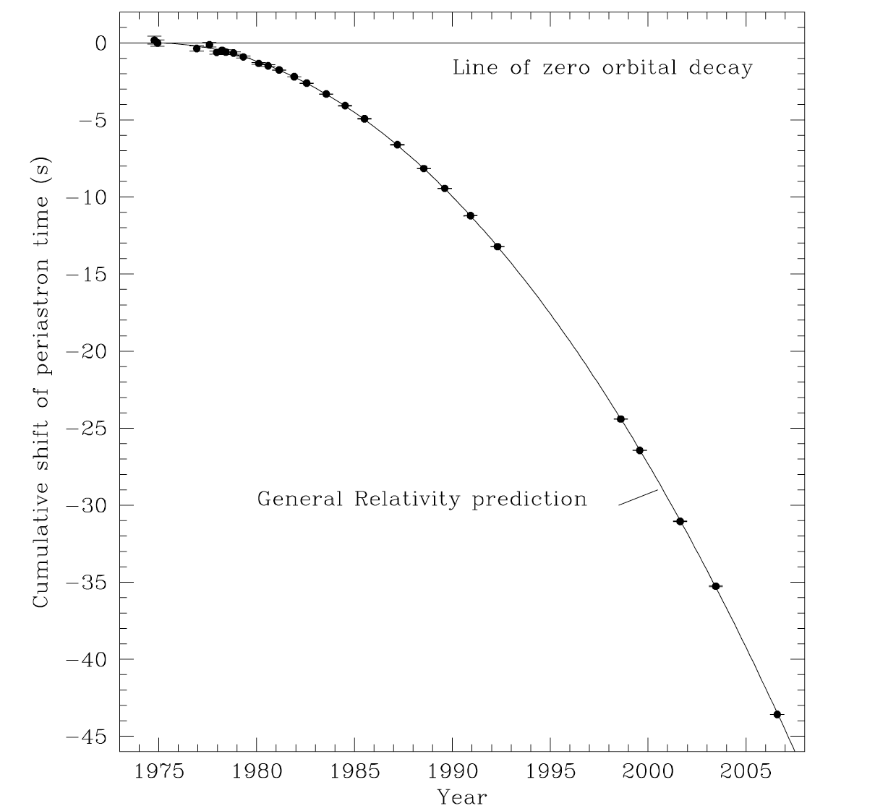
Gravitational Waves a well-understood transmitter
Neutron Binary System – Hulse & Taylor
PSR 1913 + 16 -- Timing of pulsars
Emission of gravitational waves
•
17 / sec
•
~ 8 hr
Neutron Binary System
separated by 10⁶ miles
m₁ = 1.4m; m₂ = 1.36m; ε = 0.617
Prediction from general relativity
spiral in by 3 mm/orbit
rate of change orbital period
J.M. Weisberg, D.J. Nice, J.H. Taylor, Astrophys. J., 722, 1030 (2010).

Slide 13
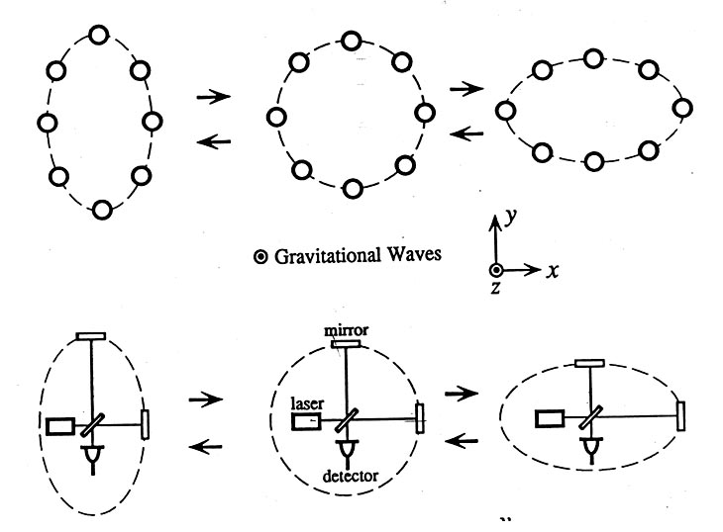
Basic idea for detection is simple
GW amplitude h = (R_{x}-R_{y})/R
Spatial asymmetry induces relative phase shifts on light in arms

Slide 14
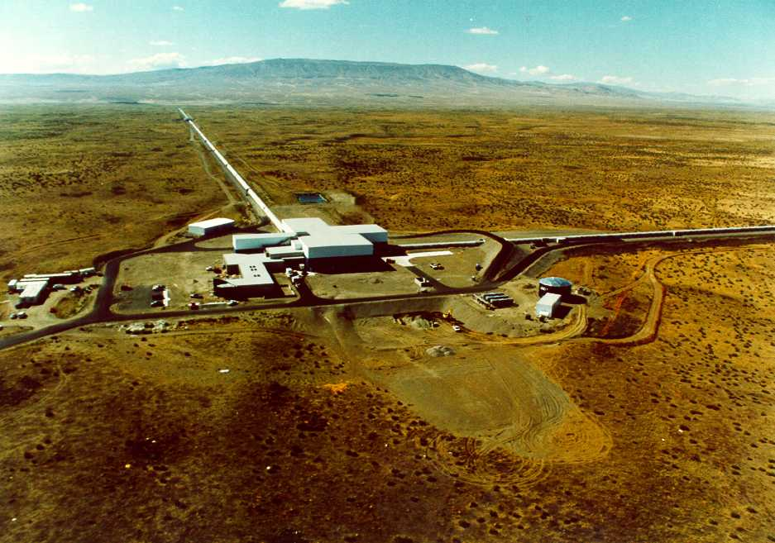
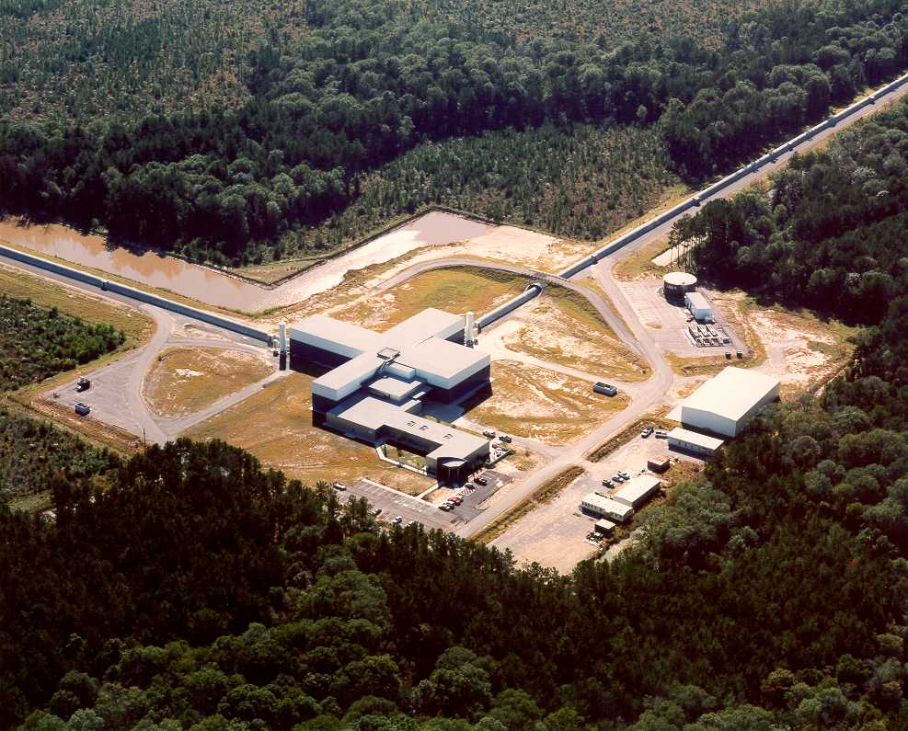
The Laser Interferometer
Gravitational-Wave Observatory
LIGO (Washington)
LIGO (Louisiana)
Brought to you by the National Science Foundation; operated by Caltech and MIT; the research focus for more than 1000 LIGO Scientific Collaboration members worldwide.

Slide 15
The actors are monster objects called “black holes” which became locked in a death spiral and died in an event of unimaginable violence.

Slide 16
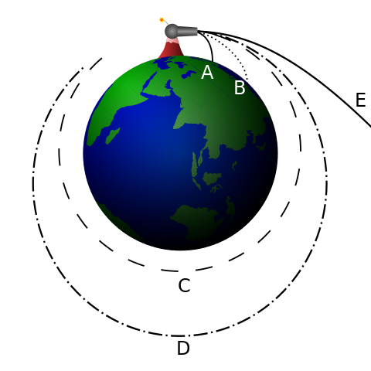
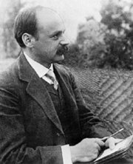
Schwarzschild Black Hole
Escape Velocity
Schwarzschild Radius
Object Schwarzschild Radius
Earth 1 cm (size of marble)
Sun 3 km (2 miles)‏
Newton’s Cannonball
Credit: Brian Brondel
Karl Schwarzschild
LIGO-G0900422-v1
Notes:
16
16

Slide 17
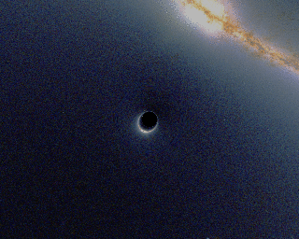
Illustration of How a Black Hole Distorts Background Light
https://en.wikipedia.org/wiki/File:BlackHole_Lensing.gif

Slide 18
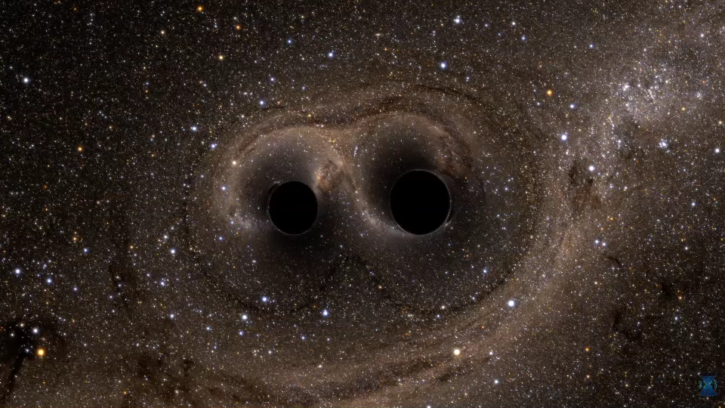
The story starts a long time ago in a part of our universe far, far away…
Notes:
18
18

Slide 19
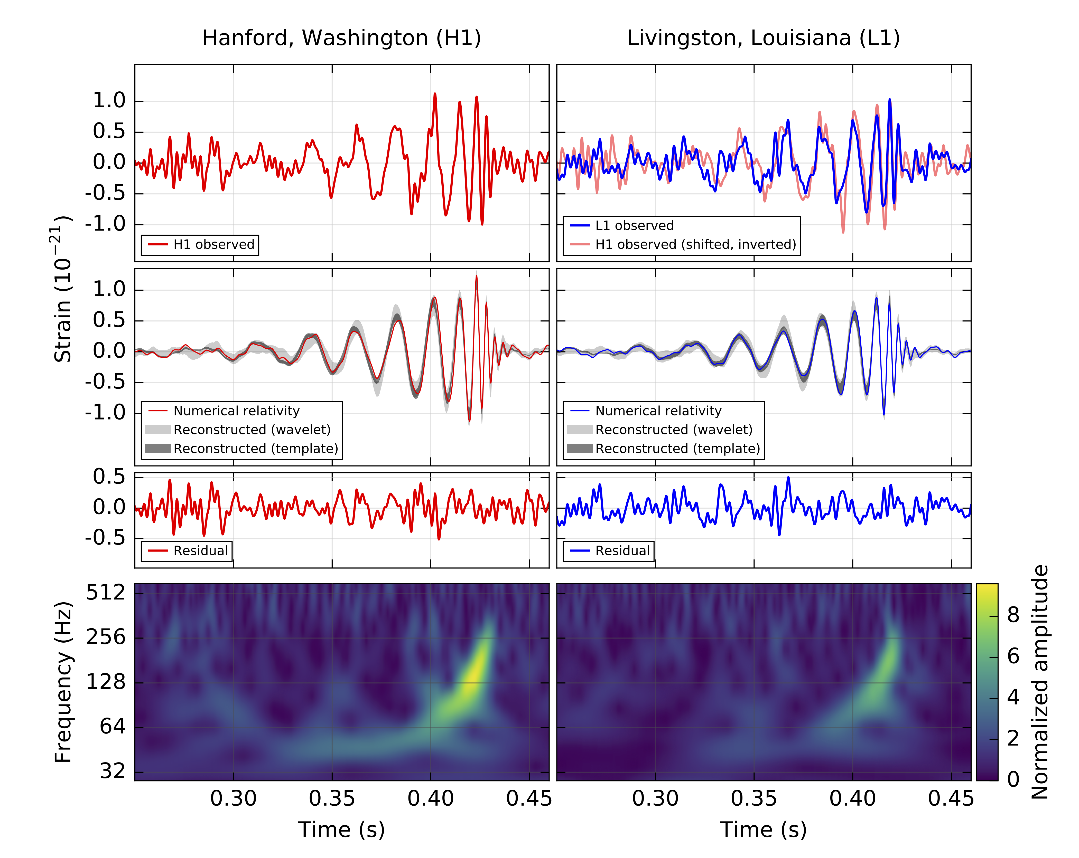
Observed on Sep 14, 2015
PRL 116, 061102 (2016)

Slide 20
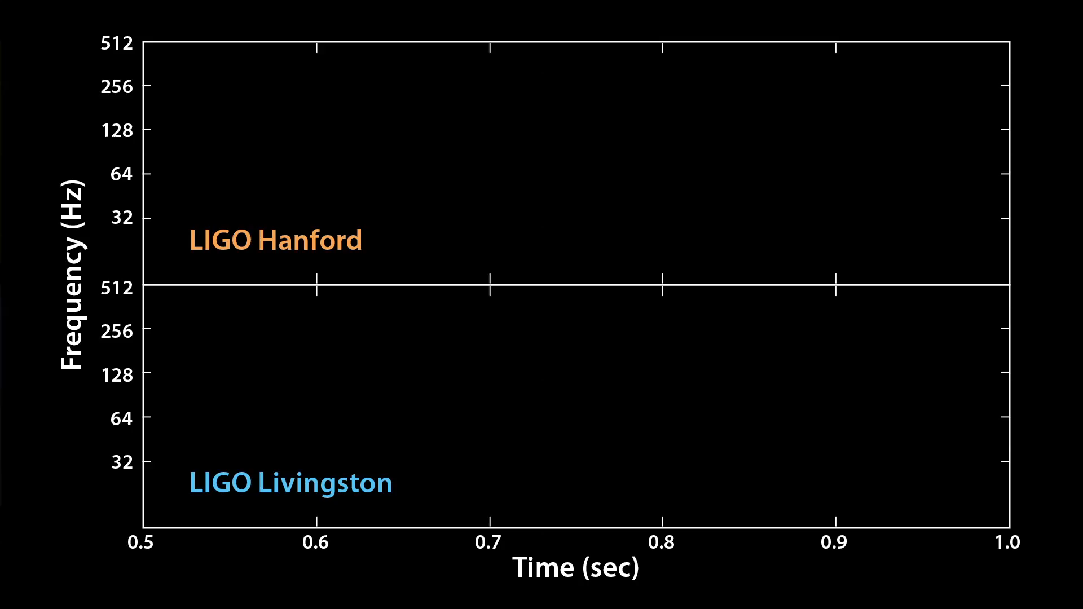

Slide 21
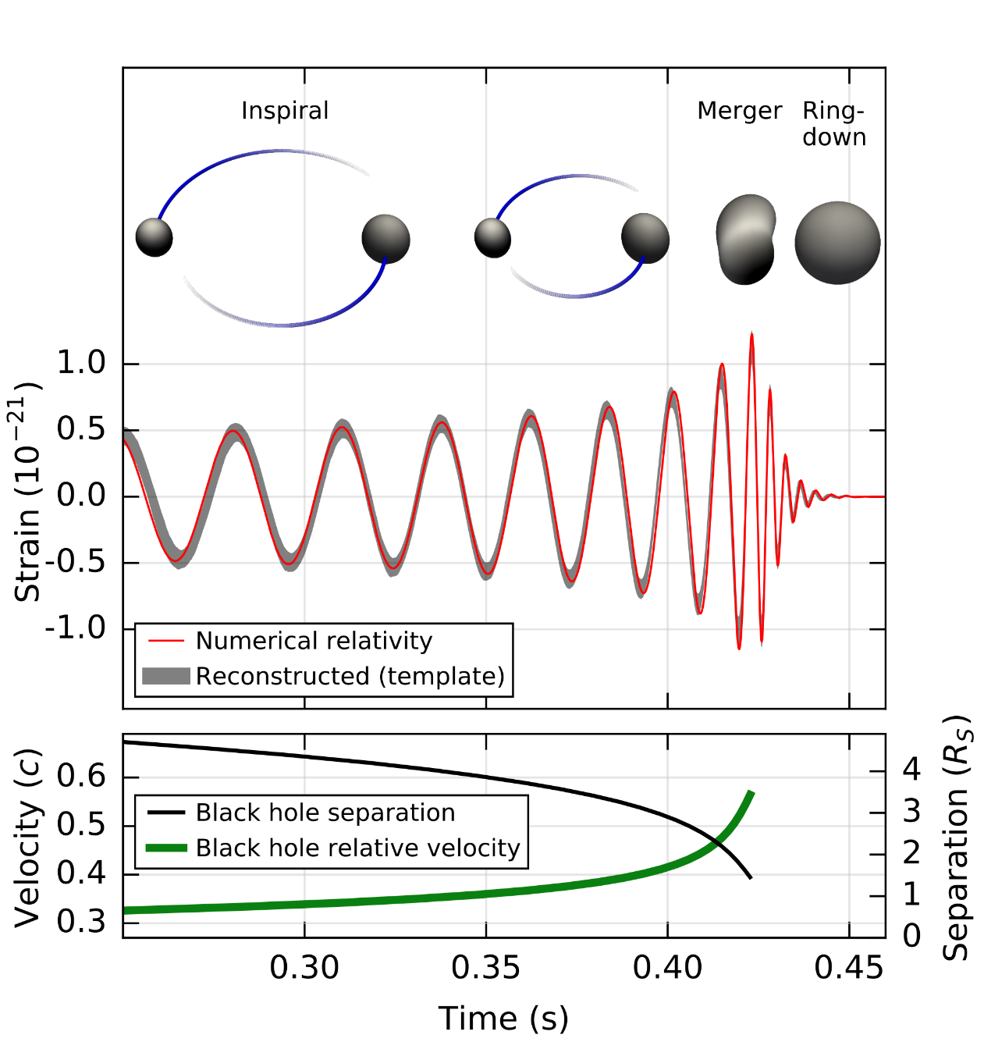
A signal from a binary black hole merger
PRL 116, 061102 (2016)

Slide 22
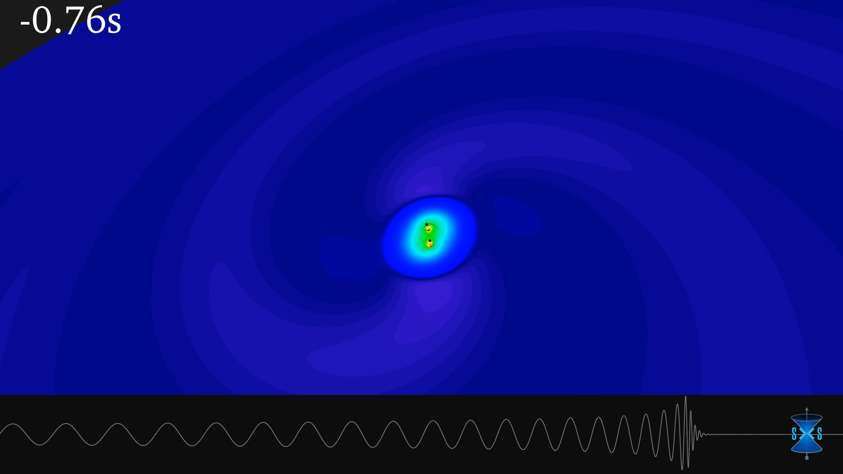
A signal from a binary black hole merger

Slide 23
Long, long ago?
Far, far away?
GW150914 occurred more than a billion years ago.
At that time, life on Earth consisted of only single-cell creatures.
We can express vast distances using light, which travels at a speed of 30 cm per nanosecond:
  Moon is 1.3 light-sec away
  Sun is 8.3 light-minutes away
  Jupiter is 35-52 light-minutes away
  Globular cluster M13 is 21,000 light years away
  M31, the Andromeda Galaxy, is 2.3 million light years away
M31 is our closest large galaxy. In the volume that we can see systems like GW150914, there are more than 5 million galaxies.

Slide 24
GW150914
This first gravitational wave discovery was named GW150914:
  Event type = gravitational wave
  Detection year = 2015
  Detection month = 09 = September
  Detection day = 14
This was the most energetic event ever detected by humans, converting a mass equivalent to a million Earths into gravitational-wave energy.
For a few tenths of a second the power in this gravitational wave was 50 times greater than the total power output of all the stars in the universe.
But there were more discoveries to come…

Slide 25
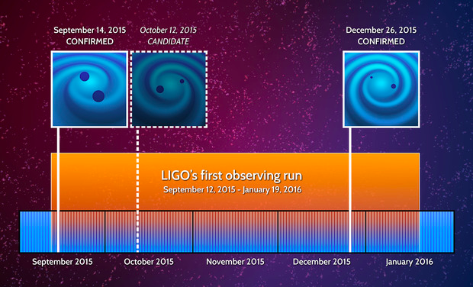
Discovery Timeline – Advanced LIGO’s 1st Observations
Courtesy Caltech/MIT/LIGO Laboratory

Slide 26
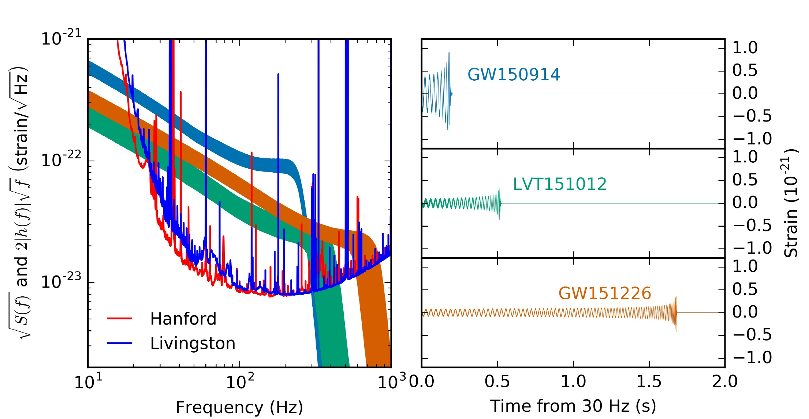
Advanced LIGO’s First Observations
ArViv:1606.04856; see also PRL 116, 241103 (2016) for GW151226.

Slide 27
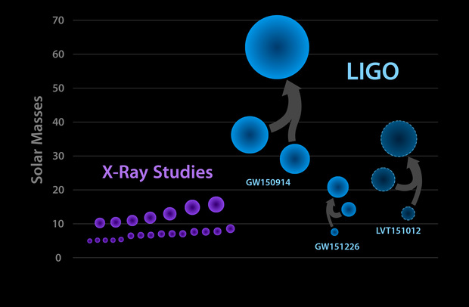
Known Stellar-Mass Black Holes – June 2016
Courtesy Caltech/MIT/LIGO Laboratory

Slide 28
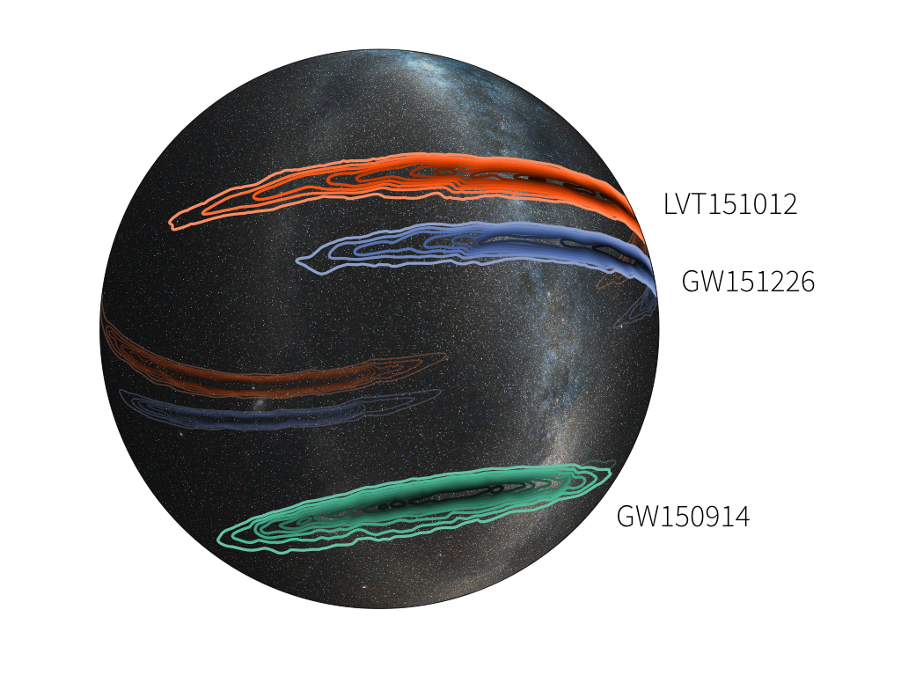
Unfortunately, Sky Localization Is Poor With Only Two Detectors
Image credit: LIGO (Leo Singer) /Milky Way image (Axel Mellinger)

Slide 29


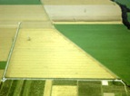

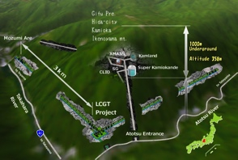



The advanced GW detector network:
2015-2025
Advanced LIGO
Hanford
2015
GEO600 (HF)
2011
KAGRA
>2018
Advanced LIGO
Livingston
2015
Advanced
Virgo
2017
LIGO-India
2024
29
29

Slide 30
LIGO-India Concept
Started as a partnership between LIGO Laboratory and IndIGO collaboration to build an Indian interferometer
  LIGO Lab (with its UK, German and Australian partners) provides components for one Advanced LIGO interferometer (H2) from the Advanced LIGO project
  LIGO Lab provides designs and design assistance for facilities and vacuum system and training for Indian detector team
  India provides the infrastructure (site, roads, building, vacuum system), staff for installation & commissioning, operating costs
LIGO-India would be operated as part of LIGO network to maximize scientific impact
Major enhancement to the global network and to the capabilities for GW astrophysics and Multi-messenger Astronomy

Slide 31
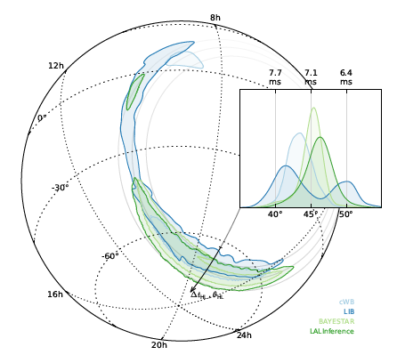
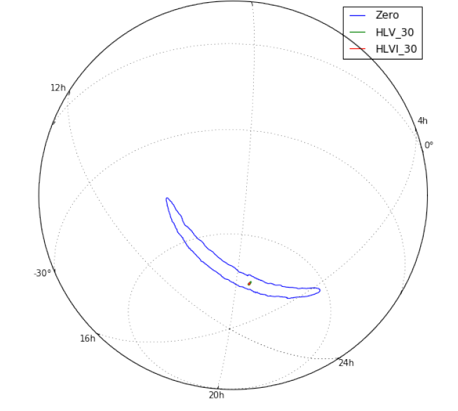
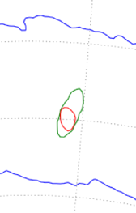
Improved Localization:
LIGO→Virgo→LIGO-India
GW150914: LIGO →LV →LVI
(Preliminary)
GW150914: LIGO only
375° → 9.3° → 7.8°
(99% confidence level)

Slide 32
What did it take to make these discoveries?
This was a high-risk, high-reward endeavor that took decades to produce discoveries. It required:
  Vision and persistence by proposers and funders of the R&D and construction to overcome the technical challenges;
  Humility
    Don’t overpromise
  Transparency
    Be honest about progress and challenges
  Openness
    Need a village of experts, not a guru
  Optimism
    Failure is the tuition we pay for learning

Slide 33
Issues to address in 1989 proposal to build a gravitational wave detector
Signal has never been detected directly
Understanding of either source strengths or source populations ranges from “not well” to “poorly” known
Simple arguments based on available information indicate the need to cover a space-time volume from billions to a trillion times larger than previous detector searches
Need to scale up size 100-fold from largest existing device
Need to push frontier of measurement science, but no law of physics prevents it
Any feasible detector using current or close-to-hand technology may not be sufficiently sensitive to make detections
Very expensive: failure is not an option
Strategy: build initial km-scale facilities and a pathfinder detector (iLIGO) and conduct searches, while pushing R&D toward an advanced detector (aLIGO) capable of routine detections

Slide 34
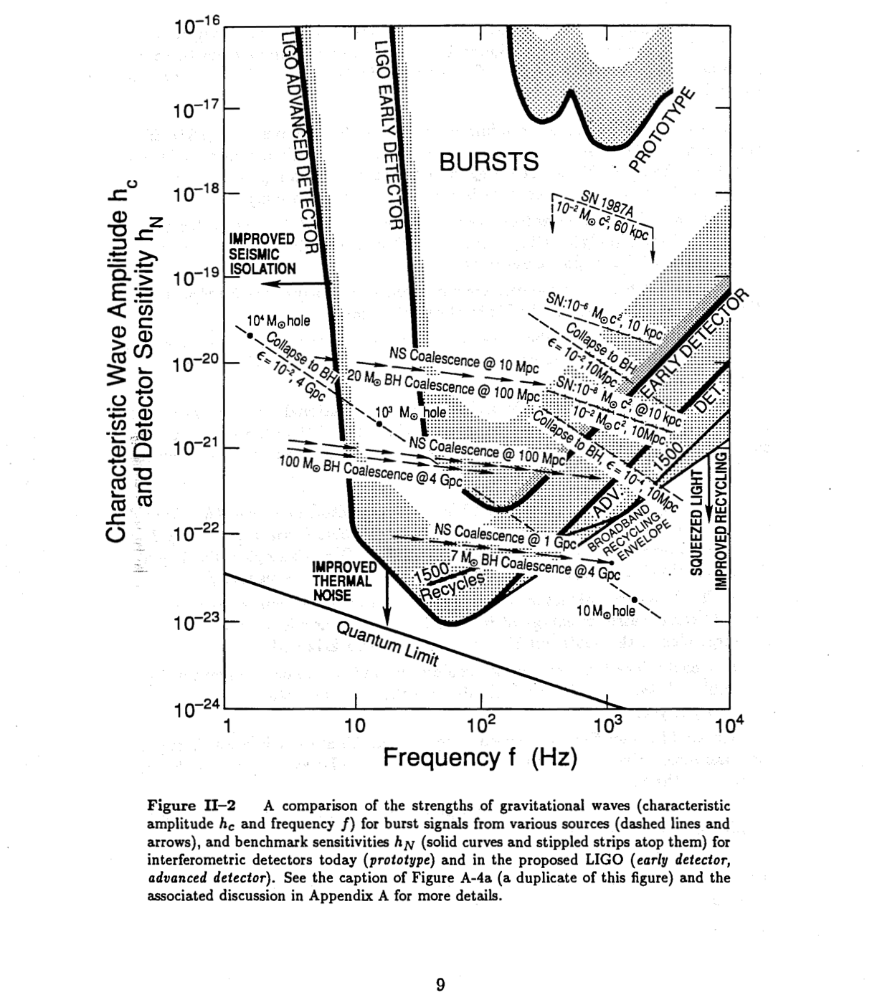
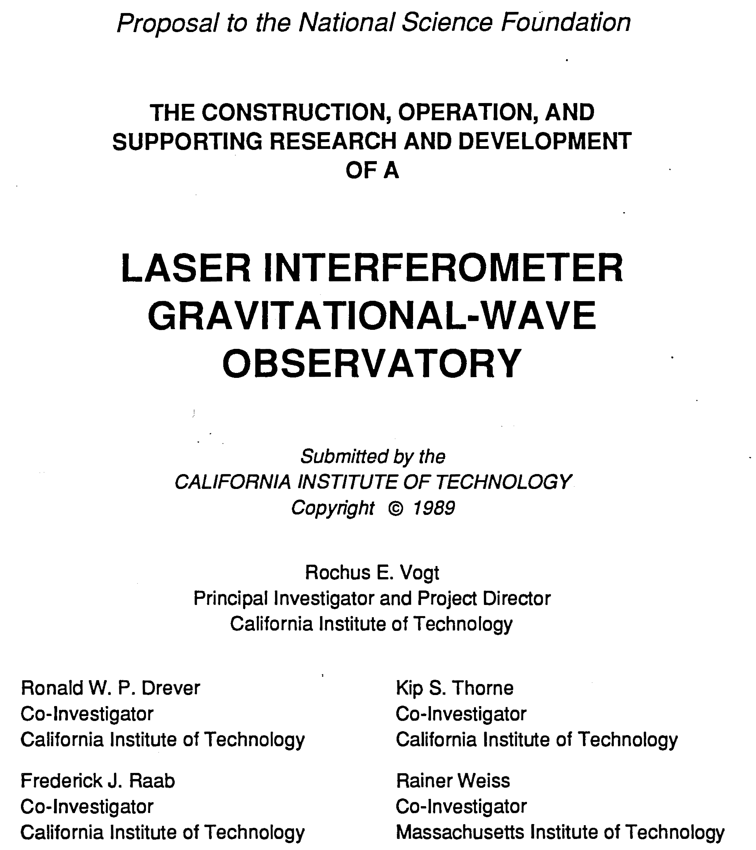
Original detection strategy

Slide 35
Some of the technical challenges for design and commissioning
✓
Typical Strains < 10⁻²¹ at Earth ~ 1 hair’s width at 4 light years
Understand displacement fluctuations of 4-km arms at the millifermi level (1/1000th of a proton diameter)
Control km-scale arm lengths to 10⁻¹³ meters RMS
Detect optical phase changes of ~ 10⁻¹⁰ radians
Hold mirror alignments to 10⁻⁸ radians
Engineer structures to mitigate recoil from atomic vibrations in suspended mirrors
Do all of the above 7x24x365
✓
✓
✓
✓
✓
✓
S5 science run 14Nov05 to 30Sep07

Slide 36
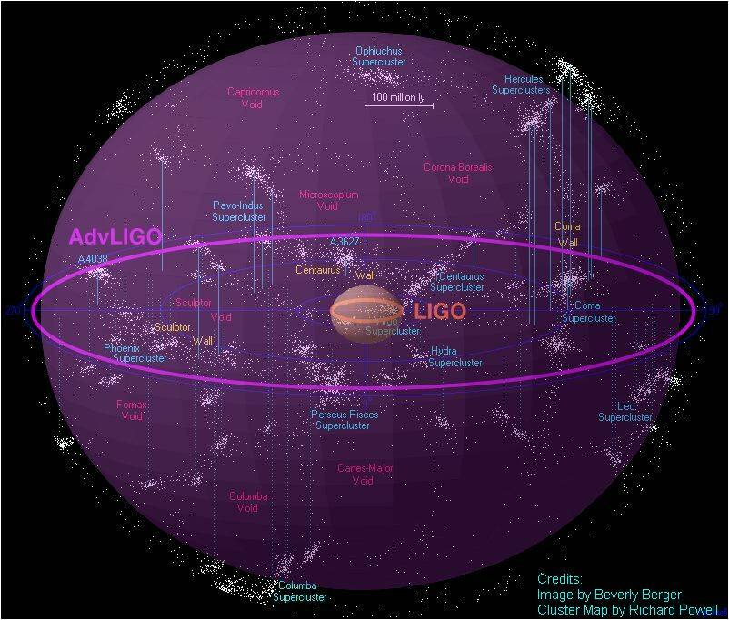
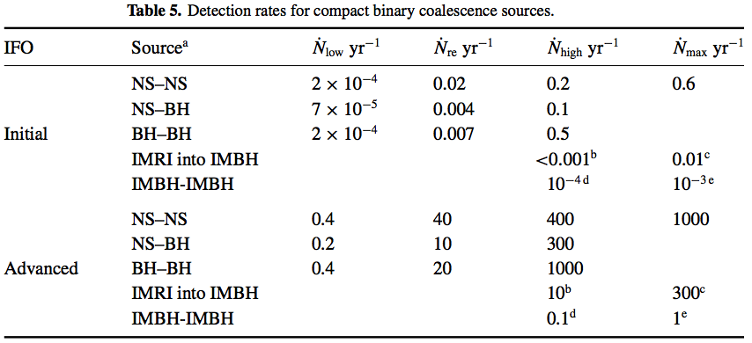
Expected event rates
Binary neutron stars
Initial LIGO reach: 15Mpc; rate ~ 1/50yrs
Advanced LIGO ~ 200Mpc
‘Realistic’ rate ~ 40 events/yr
Rates paper: Class. Quant. Grav,
27 (2010) 173001
Notes:
From i) observations of double neutron stars in our galaxy, and
ii) Population synthesis modeling.
Suffers from small sample size, and the assumption the sample is representative
Suffers from unknowns like birth velocities, companion mass distribution etc

Slide 37
Now what?
These first observations open up access to a vast new frontier for exploration
How and where have these objects been formed?
Initial observations indicate that stellar-mass or “heavy” black hole binaries merge hourly somewhere in the universe
What can these mergers teach us?
Where is the matter?
  No “known” form of matter can explain LIGO’s early discoveries, and they behave like black holes.
  Can we prove that these objects are black holes?
  Where are the neutron stars and how do they behave?

Slide 38

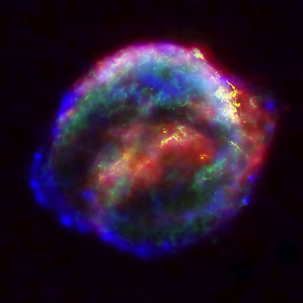

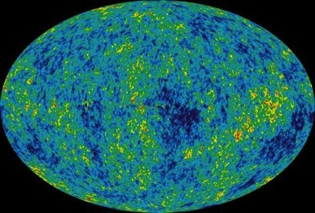
Astrophysical Sources of Gravitational Waves
Coalescing Compact Binary Systems: Neutron Star-NS, Black Hole-NS, BH-BH
- Strong emitters, well-modeled,
- (effectively) transient
Asymmetric Core Collapse Supernovae
- Weak emitters, not well-modeled (‘bursts’), transient
Credit: Chandra X-ray Observatory
Credit: AEI, CCT, LSU
Cosmic Gravitational-wave Background
- Residue of the Big Bang
- Long duration, stochastic background
Spinning neutron stars
- (nearly) monotonic waveform
- Long duration
NASA/WMAP Science Team
Casey Reed, Penn State
Notes:
LIGO is designed to be an observatory, not a one-off proof that GWs exist. What do we look for?
There are number of predicted astrophysical sources of gravitational radiation, and most of them involve cataclysmic events.
Binary systems – NSs and BHs, most likely source, theoretically well understood with known waveforms
Bursts – GW emissions that are not well modeled or understood. These include asymmetrically core collapse supernova, cosmic strings, and perhaps unknown sources
The residual GW background
Continuously emitting sources such as spinning neutron stars, which have a pure monotone emission.

Slide 39
Astrophysical Sources of Gravitational Waves
Coalescing Compact Binary Systems: Neutron Star-NS, Black Hole-NS, BH-BH
- Strong emitters, well-modeled,
- (effectively) transient
Asymmetric Core Collapse Supernovae
- Weak emitters, not well-modeled (‘bursts’), transient
✓
Credit: Chandra X-ray Observatory
Credit: AEI, CCT, LSU
Cosmic Gravitational-wave Background
- Residue of the Big Bang
- Long duration, stochastic background
Spinning neutron stars
- (nearly) monotonic waveform
- Long duration
NASA/WMAP Science Team
Casey Reed, Penn State
Notes:
LIGO is designed to be an observatory, not a one-off proof that GWs exist. What do we look for?
There are number of predicted astrophysical sources of gravitational radiation, and most of them involve cataclysmic events.
Binary systems – NSs and BHs, most likely source, theoretically well understood with known waveforms
Bursts – GW emissions that are not well modeled or understood. These include asymmetrically core collapse supernova, cosmic strings, and perhaps unknown sources
The residual GW background
Continuously emitting sources such as spinning neutron stars, which have a pure monotone emission.

Slide 40
Frequency-Time
Characteristics of GW Sources
time
Ringdowns
Broadband Background
Bursts
frequency
CW (quasi-periodic)
Chirps
Earth’s orbit
Earth’s rotation
frequency
frequency
time
time

Slide 41
Sensitivity and Noise
The keys to improving detectors are sensitivity and noise. The lower the noise the higher the sensitivity.
Range is proportional to sensitivity. Range is the average distance at which a source can be detected with confidence.
Event rate is proportional to volume, which is proportional to Range cubed.
Thus a factor of 2 in sensitivity gives a factor of 8 in event rate (nearly an order of magnitude).

Slide 42
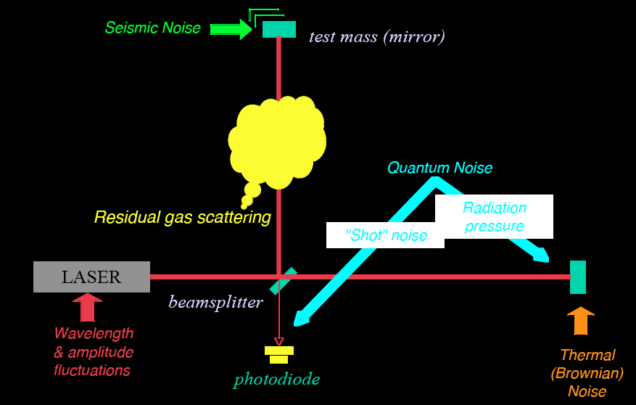
Noise cartoon
R. Adhikari

Slide 43
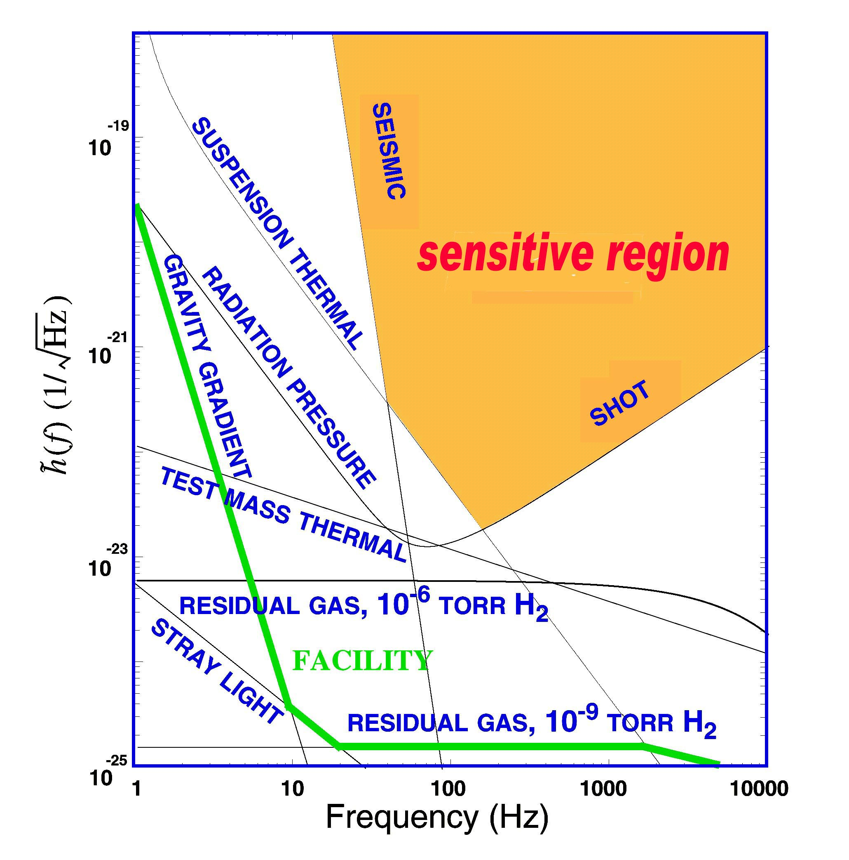
What Limits Sensitivity of Interferometers?
DESIGN
Seismic noise & vibration limit at low frequencies
Atomic vibrations (Thermal Noise) inside components limit at mid frequencies
Quantum nature of light (Shot Noise) limits at high frequencies
Myriad details of the lasers, electronics, etc., can make problems above these levels
Typical early LIGO noise estimates
COMMISSIONING

Slide 44

Optical configuration
Complete detector description in Class. Quantum Grav. 32 (2015) 074001

Slide 45
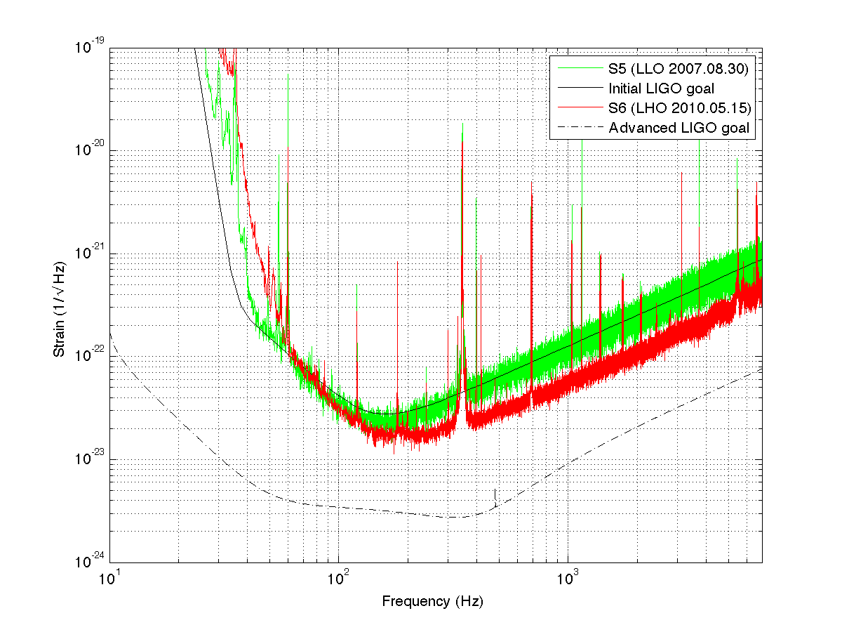
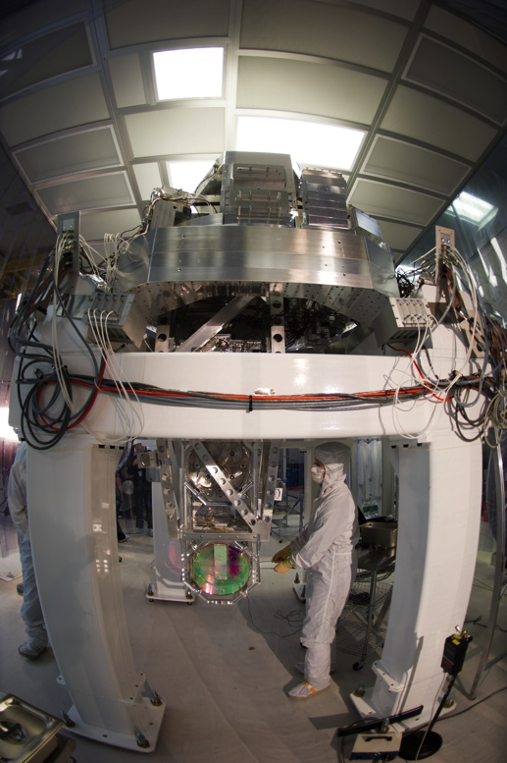
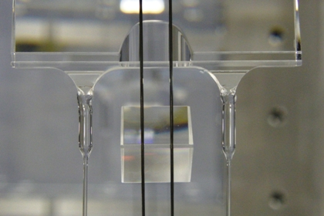
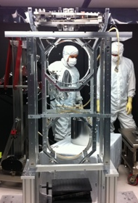
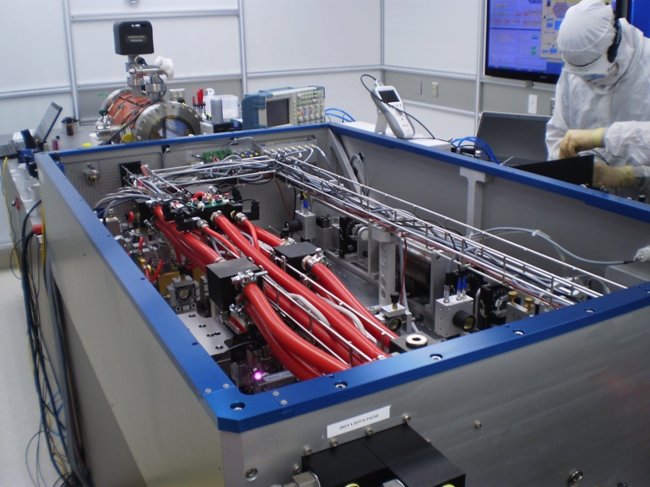
Better
seismic
isolation
Higher
power
laser
Better
test masses
and
suspension
Notes:
Sathya pointed out need to mitigate gravity gradient noise.
We need Krishna’s tiltmeters! Testing at endstation.
Tilt-to-length coupling in an inertial sensor.

Slide 46
Principal noise terms
https://dcc.ligo.org/public/0113/T1400316/004

Slide 47
Initial S6 / Advanced O1
Design / A+ Upgrade
https://dcc.ligo.org/public/0113/T1400316/004; https://dcc.ligo.org/LIGO-G1500623
~3 x the sensitivity
made the difference
And we can
go beyond
~3 x to go!

Slide 48
Science drives Requirements
Stellar Evolution at High Red-Shift: Black Holes from the first stars (Population III)
  Reach z>~10
  At least moderate GW luminosity distance precision
Independent Cosmology and the Dark Energy Equation of State
  Needs precision GW luminosity distance and localization for EM follow-ups (for redshift)
Checking GR in extreme regime
  High SNR needed
  GW luminosity distance and localization not essential

Slide 49
Advanced LIGO upgrade path
Advanced LIGO is limited by
quantum noise & coating thermal noise
Squeezed vacuum to reduce quantum noise
Options for thermal noise:
  Better coatings
  Cryogenic operation
  Longer arms (new facility)

Slide 50
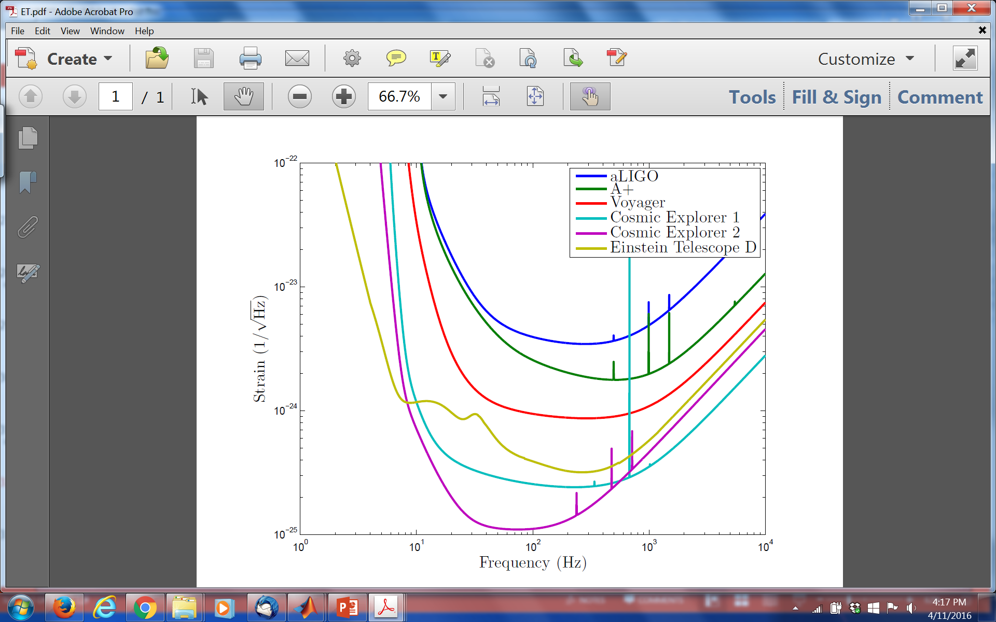
Upgrade possibilities
https://dcc.ligo.org/public/0113/T1400316/004; www.et-gw.eu

Slide 51
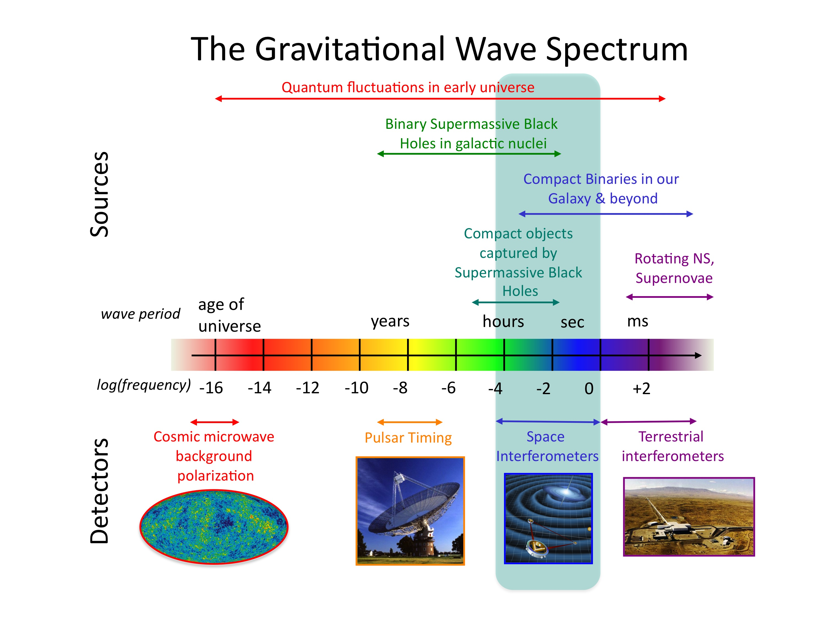
Credit: NASA

Slide 52
Gravitational-Wave Astronomy as of today.
The 1st observing run of LIGO’s 2nd-generation detectors has initiated Gravitational-Wave Astronomy, opening a new frontier for exploration.
We have seen the annihilations and the births of black holes for the first time.
General Relativity provides a powerful framework from Earth-bound physics to mergers of stellar mass black holes at velocities near the speed of light.
Black Hole Binaries exist and merge hourly somewhere in the universe
An emerging international network of detectors soon will provide more accurate positions of sources to enable EM follow-ups of GW events.
It is possible to develop more powerful generations of detectors and there is much physics still to be harvested from their observations.

Slide 53
What will be the legacy of LIGO discoveries?
Attempts in the 19th century to explain why the sky is blue, sunsets red and clouds white led to the 20th century economy:
  Atomic and nuclear physics and modern materials
  Modern chemical and pharmaceutical industries
  Modern electronics and computer industries
  Unraveling the structure of DNA and other bio-molecules, leading to modern biochemistry and gene therapy
  Development of almost all medical diagnostic machines
  Also a new phrase, “Blue-sky research”
LIGO discoveries likely will revolutionize our understanding of space, time, matter and energy, as well as redefine what people can imagine and build.

Slide 54
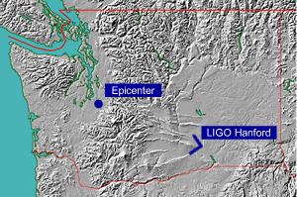
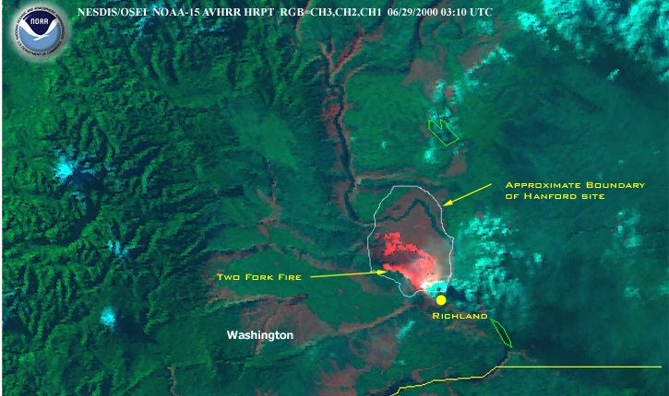
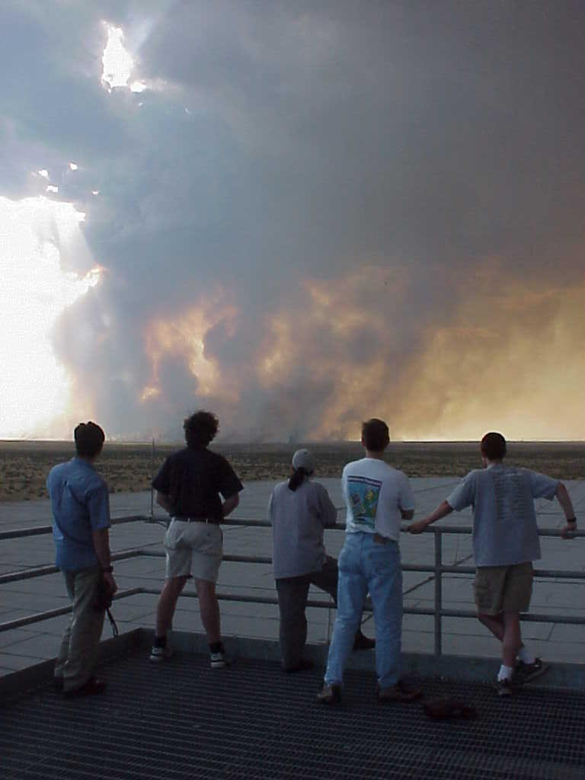
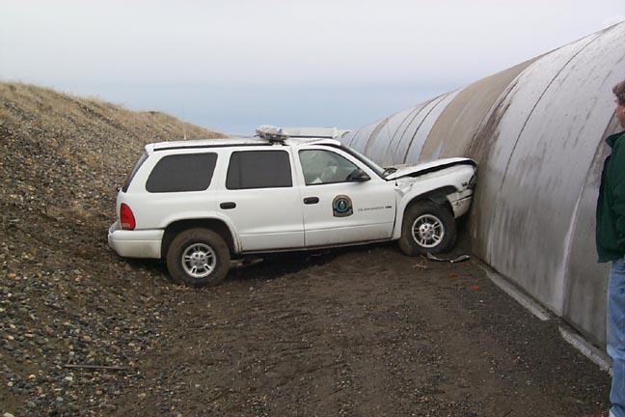
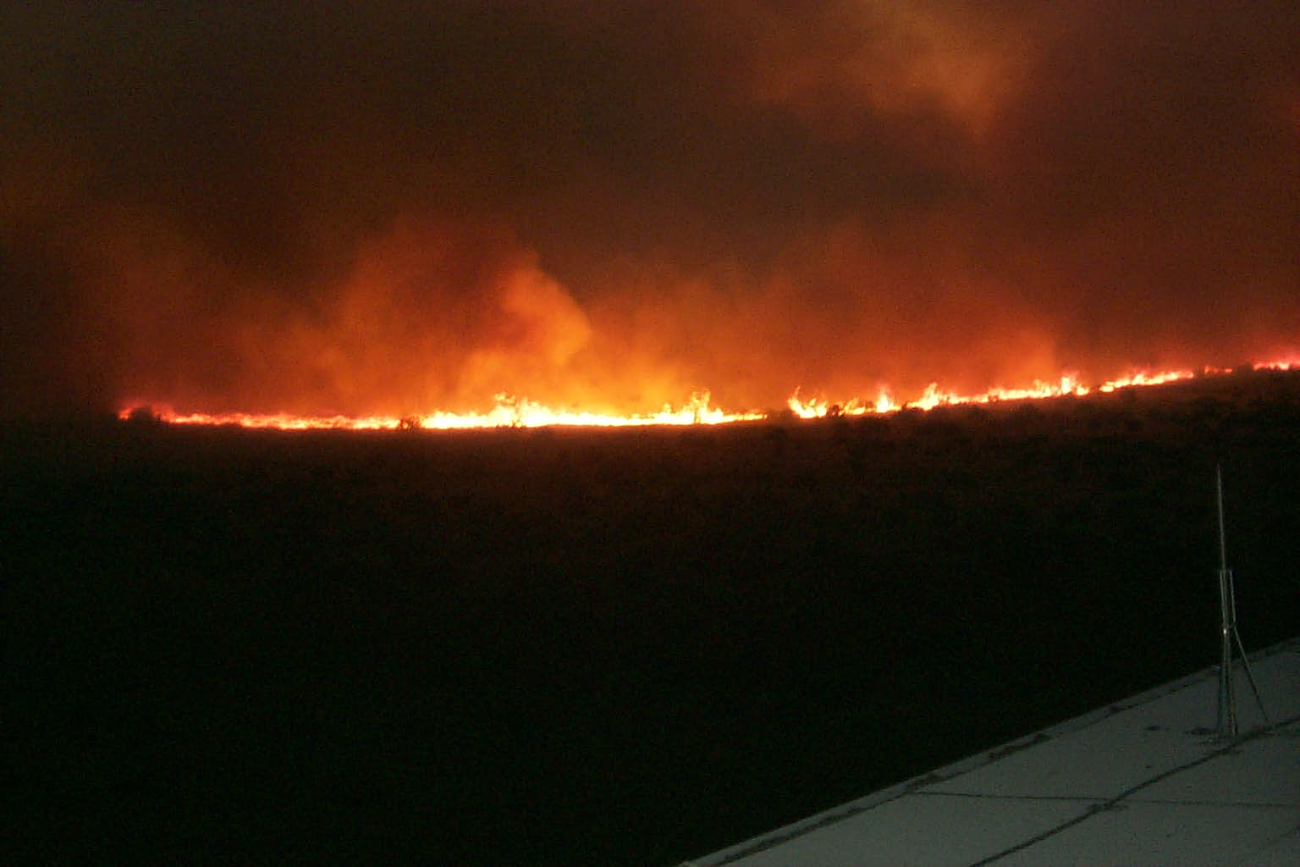
It’s never as easy as it looks…

