Slide 1
Update on LIGO Voyager Cryogenics at Stanford
Brett Shapiro
Brian Lantz, Litawn Gan, Dan Fan, Sanditi Khandelwal, Ian Gomez, Edgard Bonilla
LVC Glasgow – 30 August 2016

Slide 2
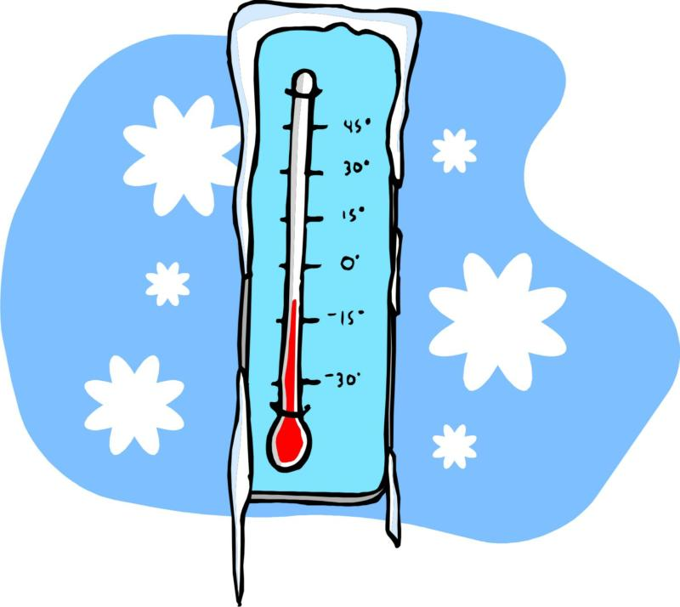
Experiment Goals
Heat shield at about 80 K to radiatively keep the test mass at 123 K

Slide 3
Experiment Goals
Heat shield at about 80 K to radiatively keep the test mass at 123 K
Seismically isolated shield to avoid scattered light noise and possibly Newtonian noise

Slide 4
Contents
Overview
Measured thermal response
Expected scattered light noise from cryo vibrations
Expected Newtonian noise from cryo vibrations

Slide 5
Actively controlled shield (ETM)
Vacuum chamber
Vib. isolated optics table
Gnd
Gnd
Gate Valve
Gate Valve
z
10 m
124 K test mass
Notes:
The approach we’ve decided to take is shown by this cartoon of a LIGO end station.
Here’s the test mass inside the test mass chamber.

Slide 6
Actively controlled shield (ETM)
Vacuum chamber
Vib. isolated optics table
Gnd
Gnd
Gate Valve
Gate Valve
z
10 m
80 K heat shield for ≈5 W cooling
124 K test mass
Notes:
There’s an 80 K heat shield surrounding the test mass, giving us about 5 W of cooling power, just by radiation.

Slide 7
Actively controlled shield (ETM)
Vacuum chamber
Cold link
Vib. isolated optics table
Gnd
Gnd
Gate Valve
Gate Valve
z
10 m
80 K heat shield for ≈5 W cooling
124 K test mass
Notes:
The heat shield is cooled by some flexible cold link that goes off to the vacuum wall.

Slide 8
Actively controlled shield (ETM)
Vacuum chamber
Cold link
Vib. isolated optics table
80 K baffled beam tube shield
Gnd
Gnd
≈ 900 mm dia
Gate Valve
Gate Valve
z
10 m
80 K heat shield for ≈5 W cooling
124 K test mass
Notes:
And then there is also a shield inside the beam tube so that we can get the laser beam in without leaking too much heat into the shield through that large hole the laser has to pass through

Slide 9
Actively controlled shield (ETM)
Vacuum chamber
Blade springs
Cold link
Vib. isolated optics table
80 K baffled beam tube shield
Gnd
Gnd
≈ 900 mm dia
Gate Valve
Gate Valve
z
10 m
80 K heat shield for ≈5 W cooling
124 K test mass
Notes:
The shield around the test mass hangs from the ground, and it is suspended by springs to give it some vibration isolation, because the shield does require some isolation to minimize the coupling of scattered light, which we’ll talk about more later.
We could have hung it from the optics table, which is already very well isolated, but we chose not to do this just to avoid the whole issue of integrating the cryogenics with a high performance seismic isolation system.

Slide 10
Actively controlled shield (ETM)
Relative displacement sensors
Actuators
Vacuum chamber
Blade springs
Cold link
Vib. isolated optics table
80 K baffled beam tube shield
Gnd
Gnd
≈ 900 mm dia
Gate Valve
Gate Valve
z
10 m
80 K heat shield for ≈5 W cooling
124 K test mass
Notes:
Reworking our conceptual design, what we think we should do, is to take some of Odylio’s advice, …

Slide 11
Actively controlled shield (ETM)
Relative displacement sensors
Actuators
Vacuum chamber
Blade springs
LN₂ pipe
Vib. isolated optics table
80 K baffled beam tube shield
Gnd
Gnd
≈ 900 mm dia
Gate Valve
Gate Valve
z
Cu braid
10 m
80 K inner shield
77 K outer shield
124 K test mass
Notes:
…and add a second heat shield outside the first one. The outside shield doesn’t need to have any isolation, because the test mass only sees the inner shield. So we can do a really good job of cooling the outer shield with liquid nitrogen pipes, which prevent the inner shield from seeing the warm outside environment. Likely, the inner shield will still need a copper braid connection to the outer one because the scattered light will create too much of a heat load to cool the inner shield by radiation alone.

Slide 12
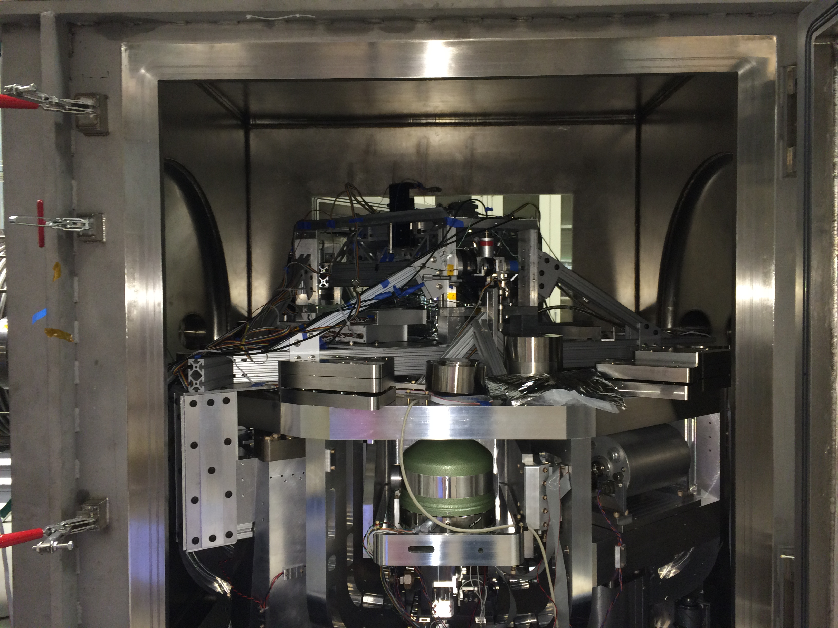
Stanford Cryogenic Heat Shield Experiment – 6 August 2016

Slide 13
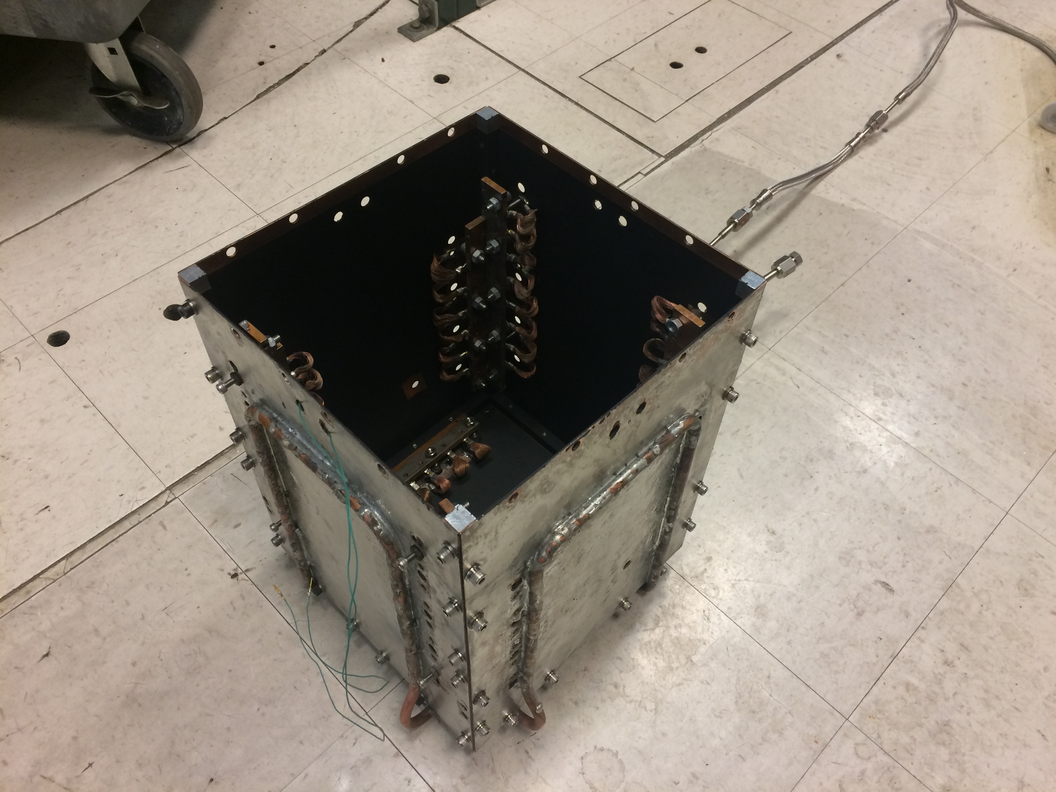
Cu outer heat shield
Black paint on inner surface
Cu cold links to inner shield
Liquid nitrogen pipes

Slide 14
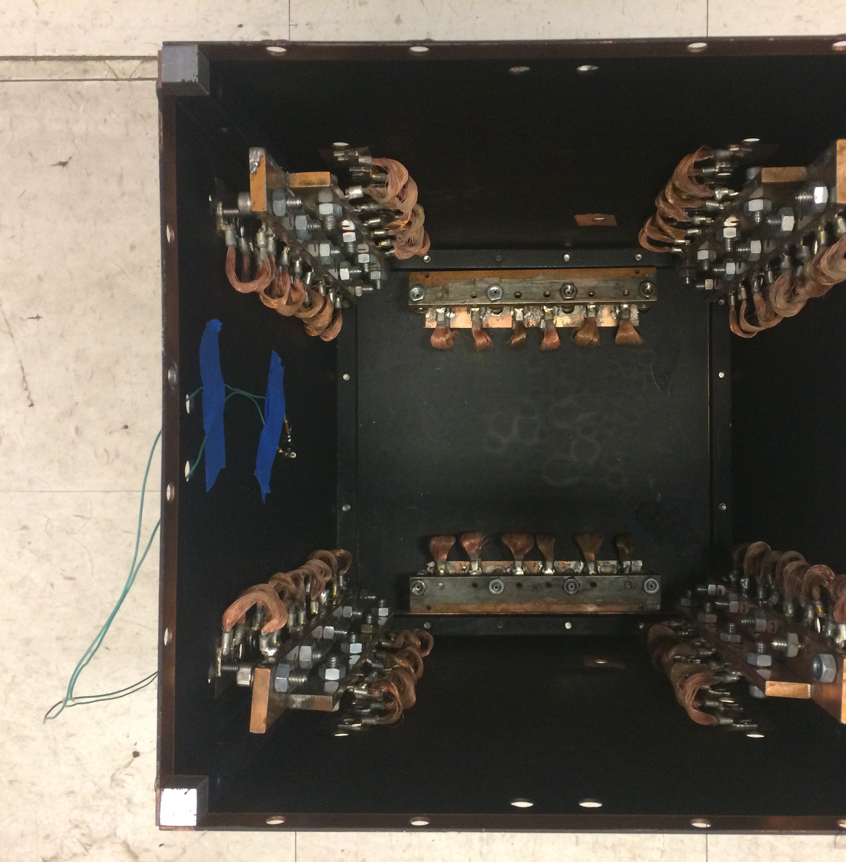
Cu outer heat shield
Black paint on inner surface
Temperature sensor
Cu cold links to inner shield

Slide 15
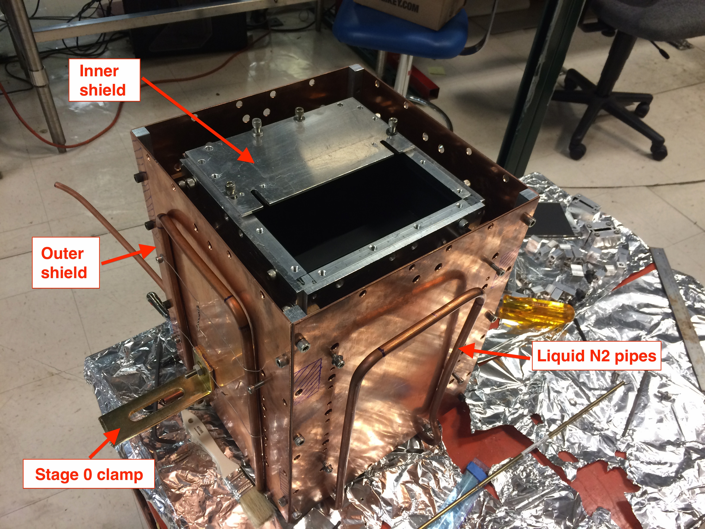

Slide 16
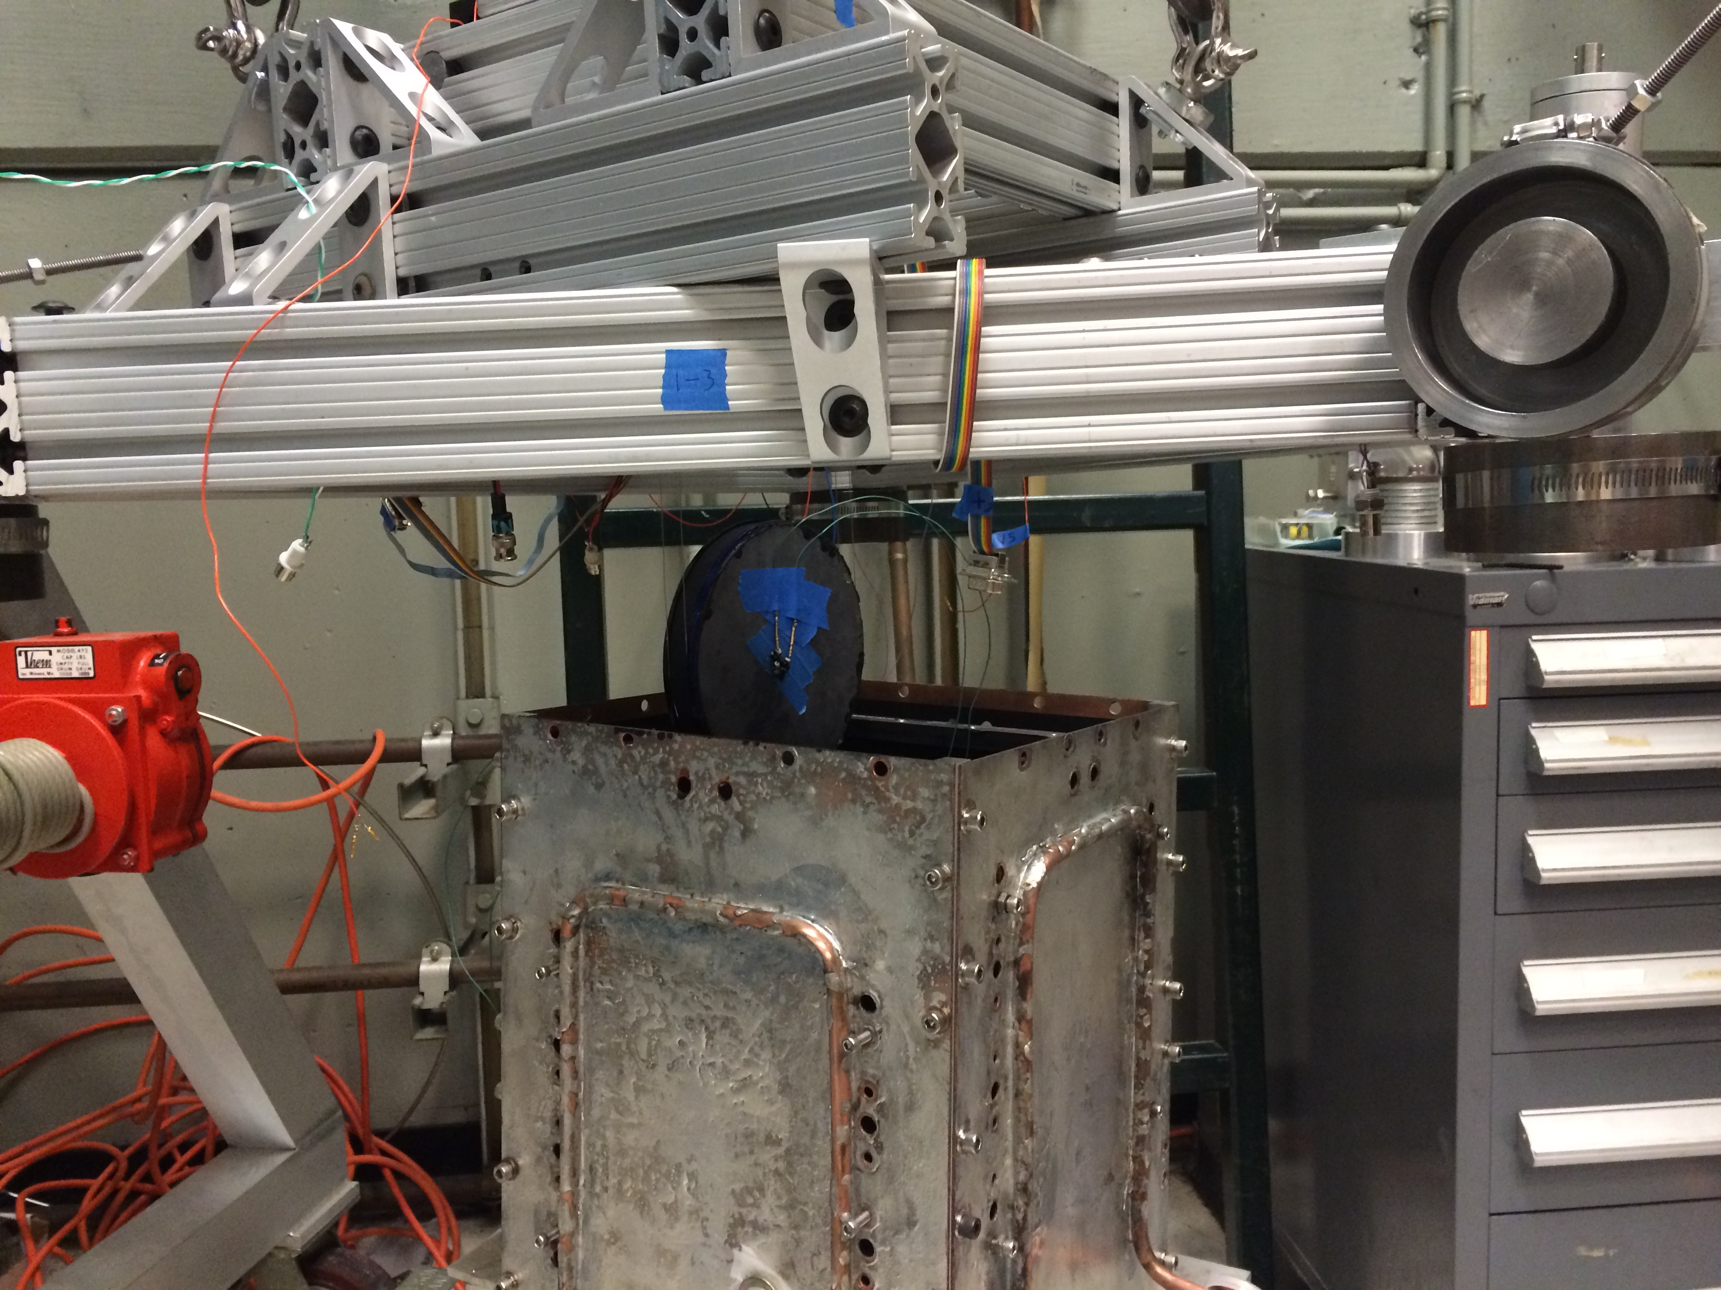
Test mass installation
Si test mass
1 kg, 6 inch dia
Actively controlled support platform for inner shield
Temperature sensor
Outer Shield

Slide 17
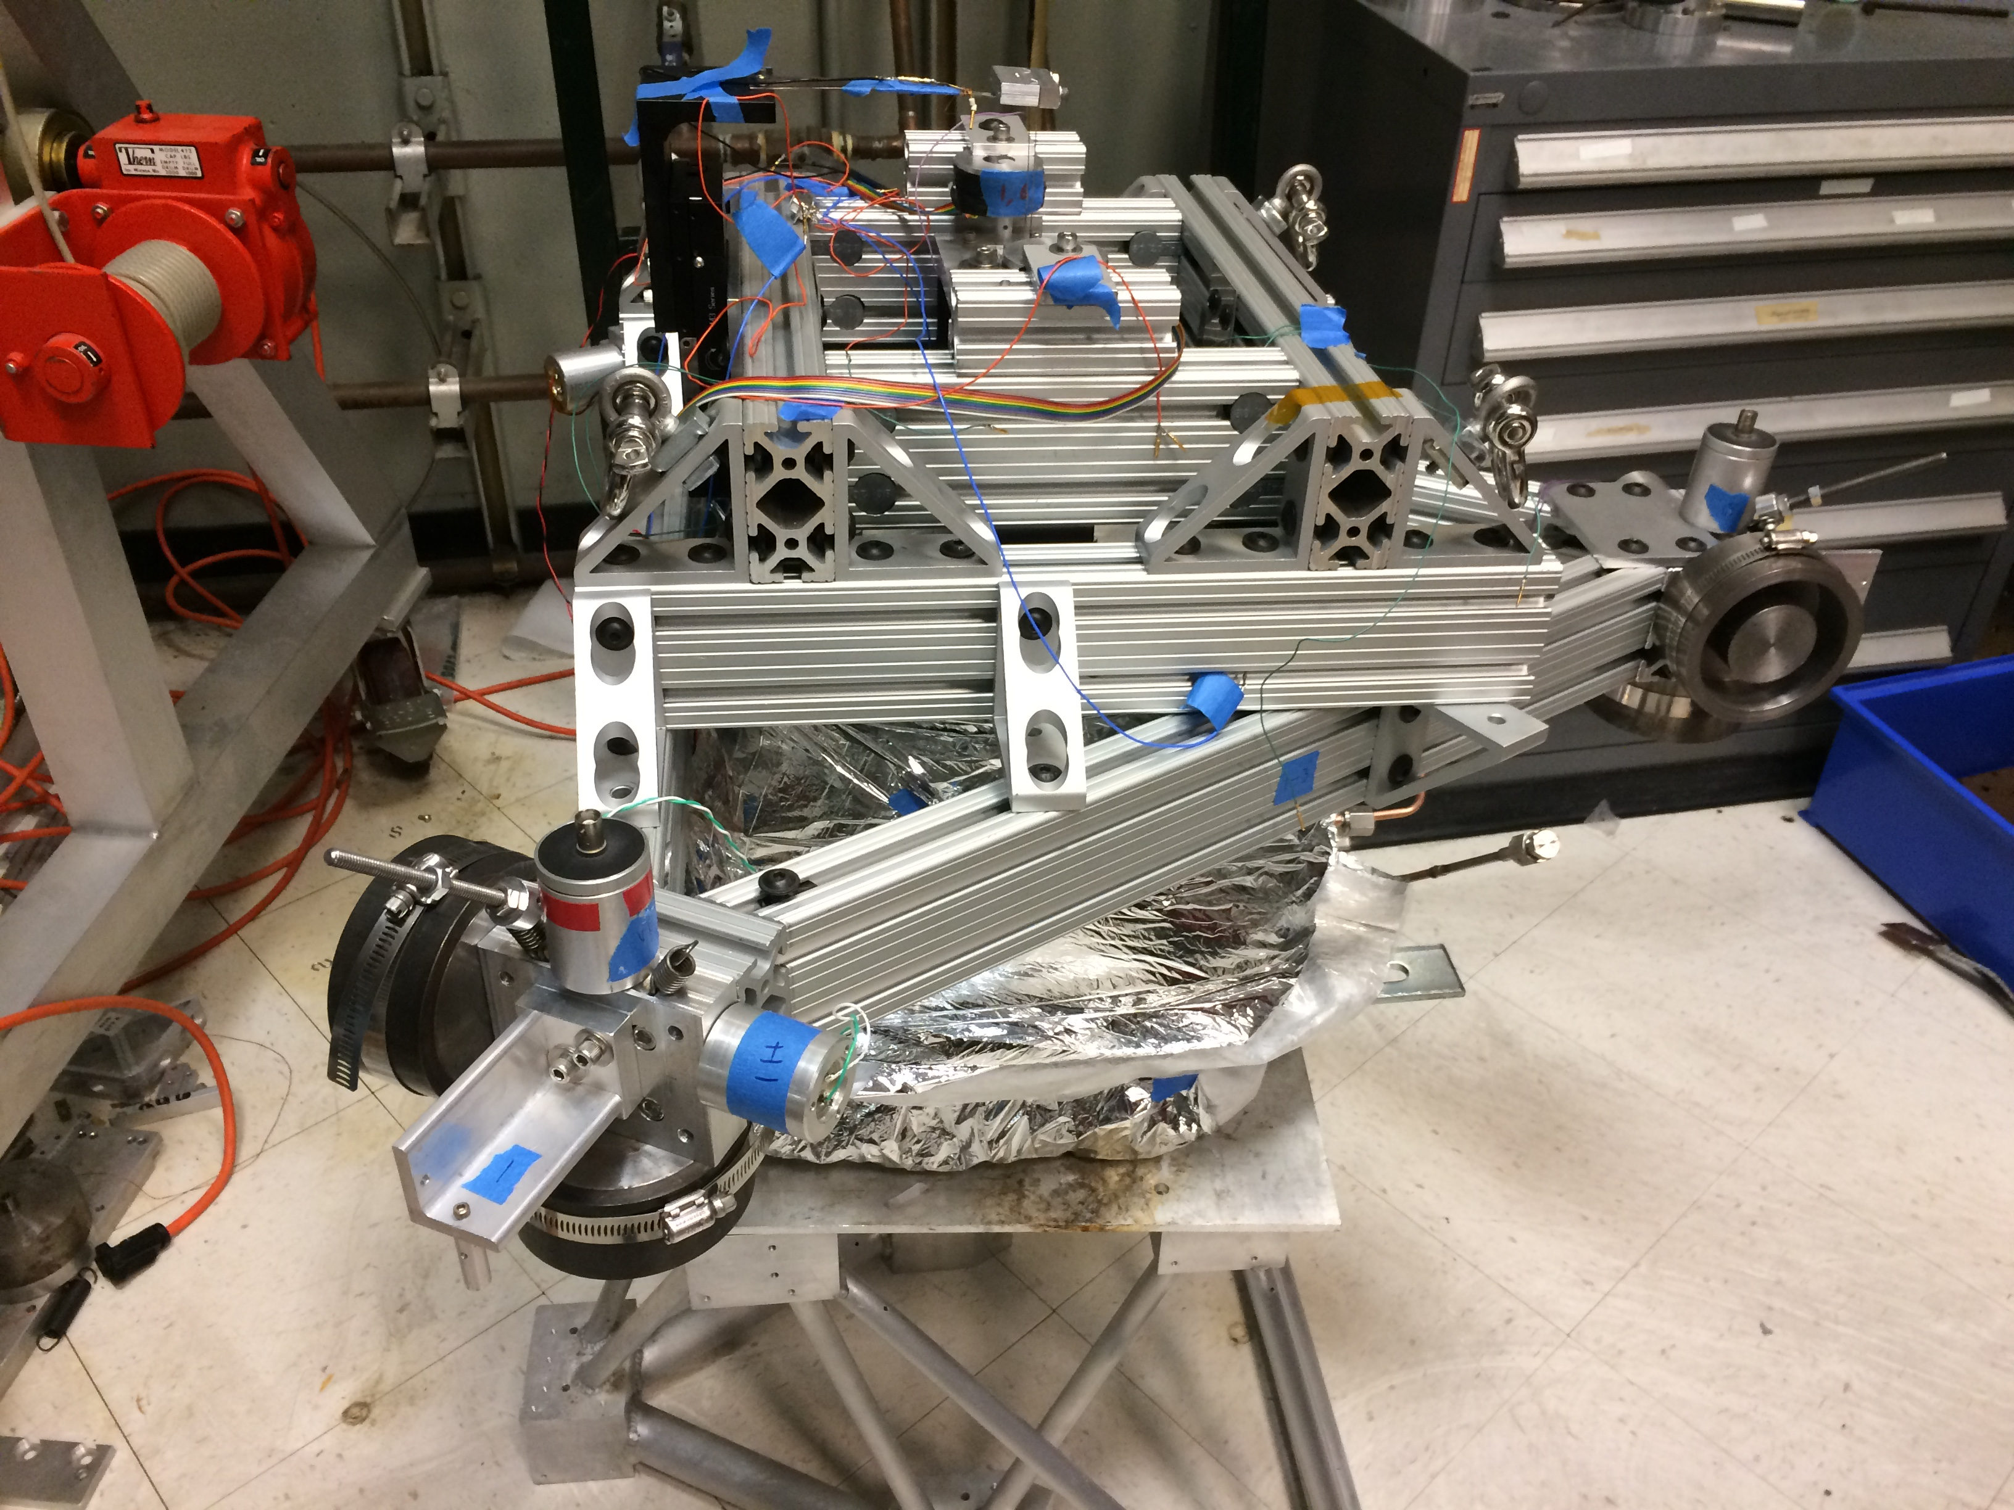
Suspension spring
Geophone
Actuator
OSEM flag
Outer shield wrapped in
insulation
Assembled cryo experiment before installation into chamber

Slide 18
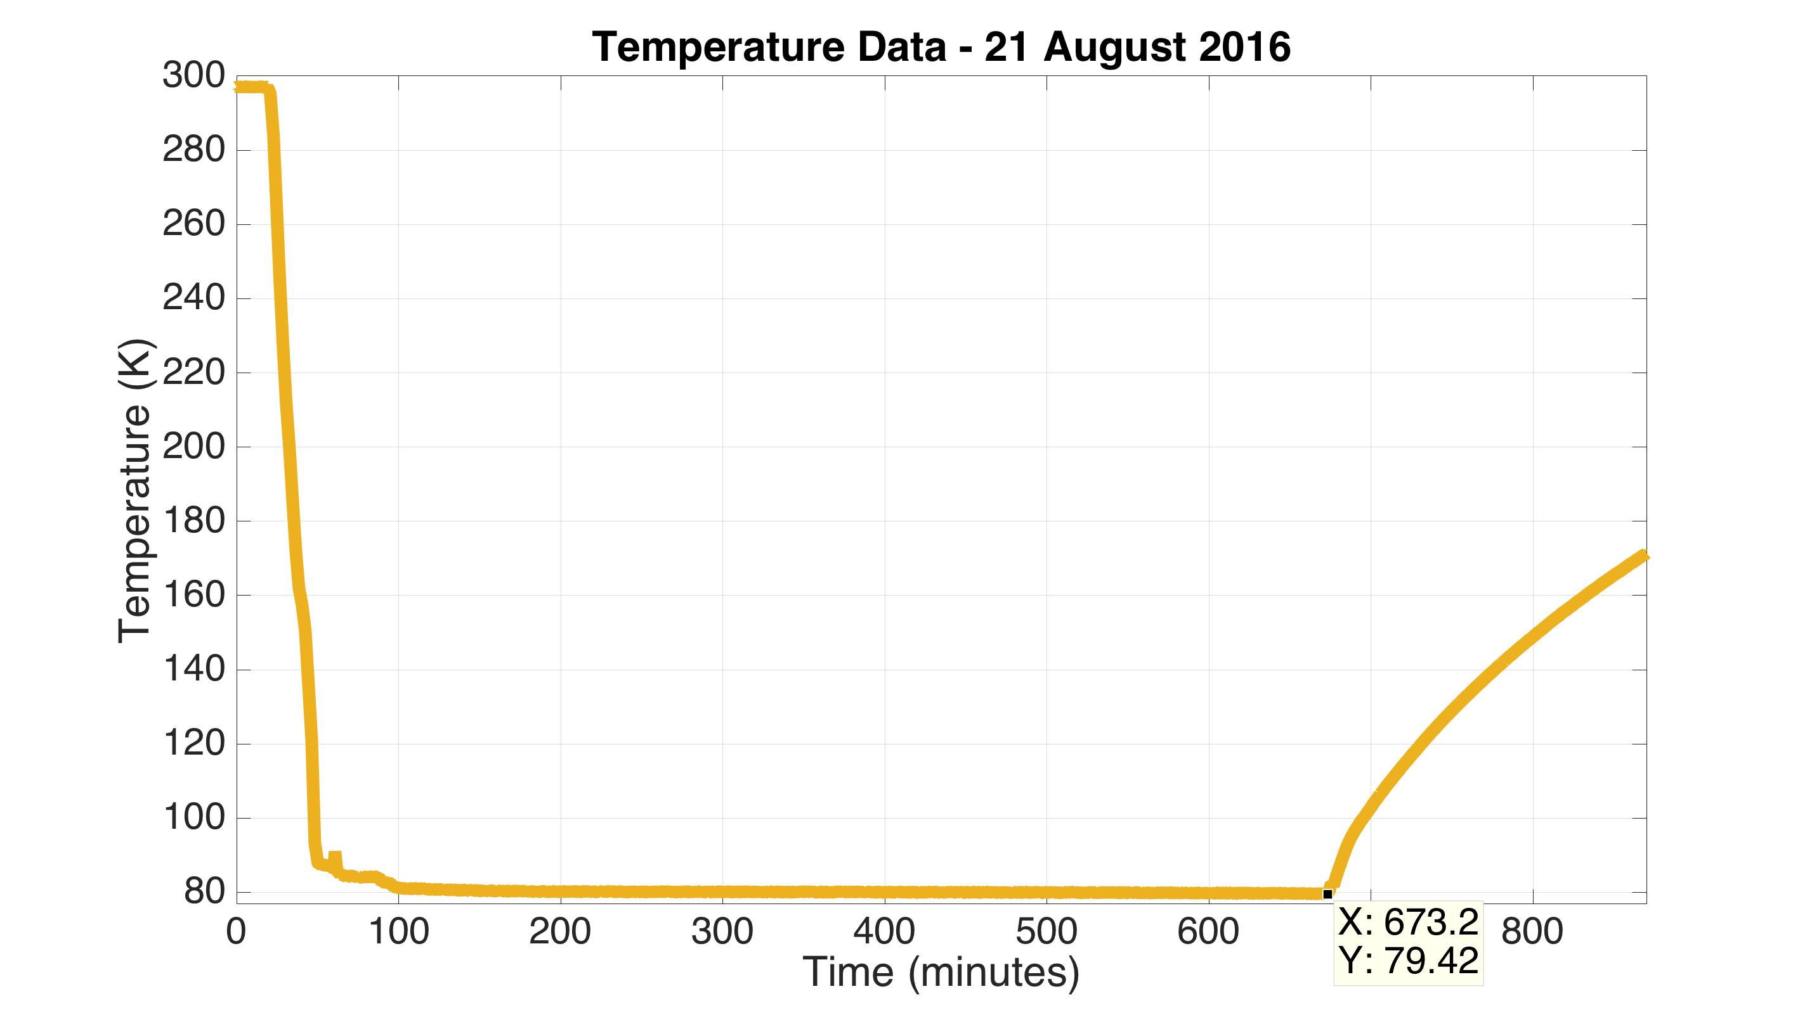
Measured Temperature Response
Outer shield

Slide 19
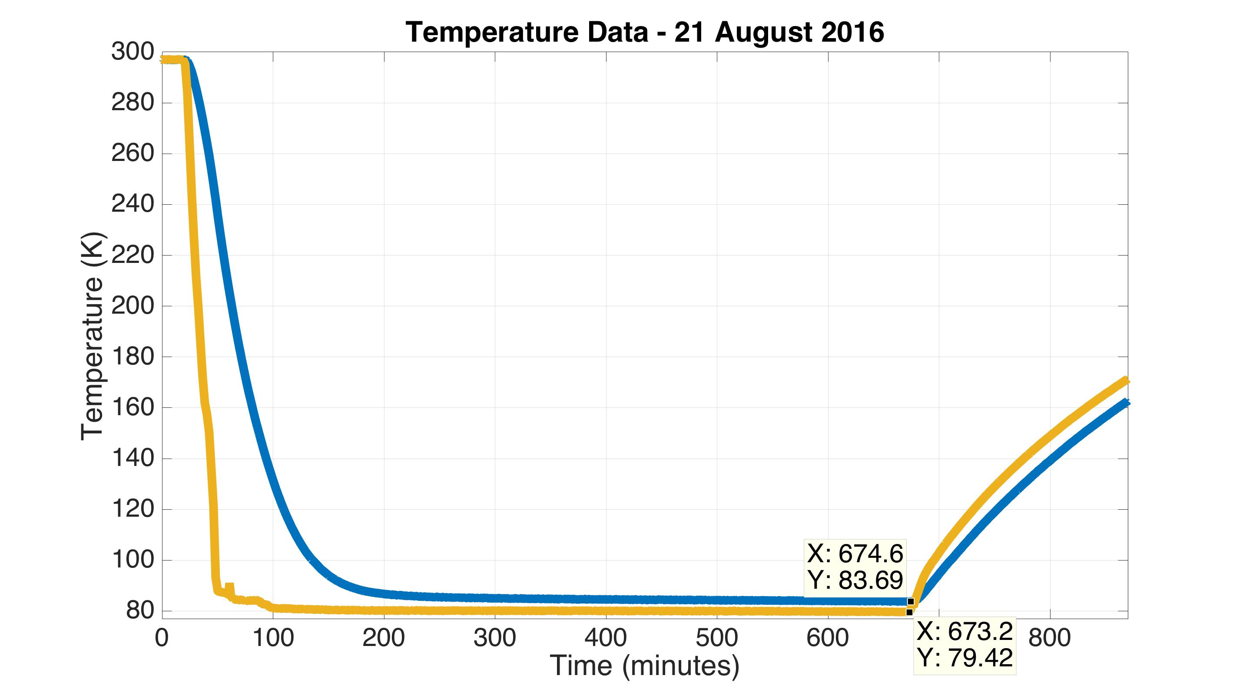
Measured Temperature Response
Inner shield
Outer shield

Slide 20
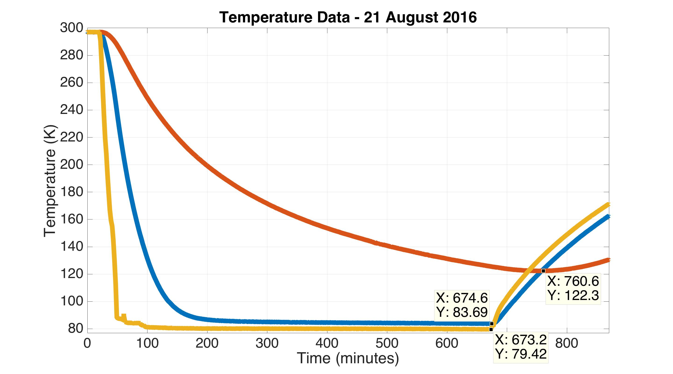
Measured Temperature Response
Test mass
Inner shield
Outer shield

Slide 21
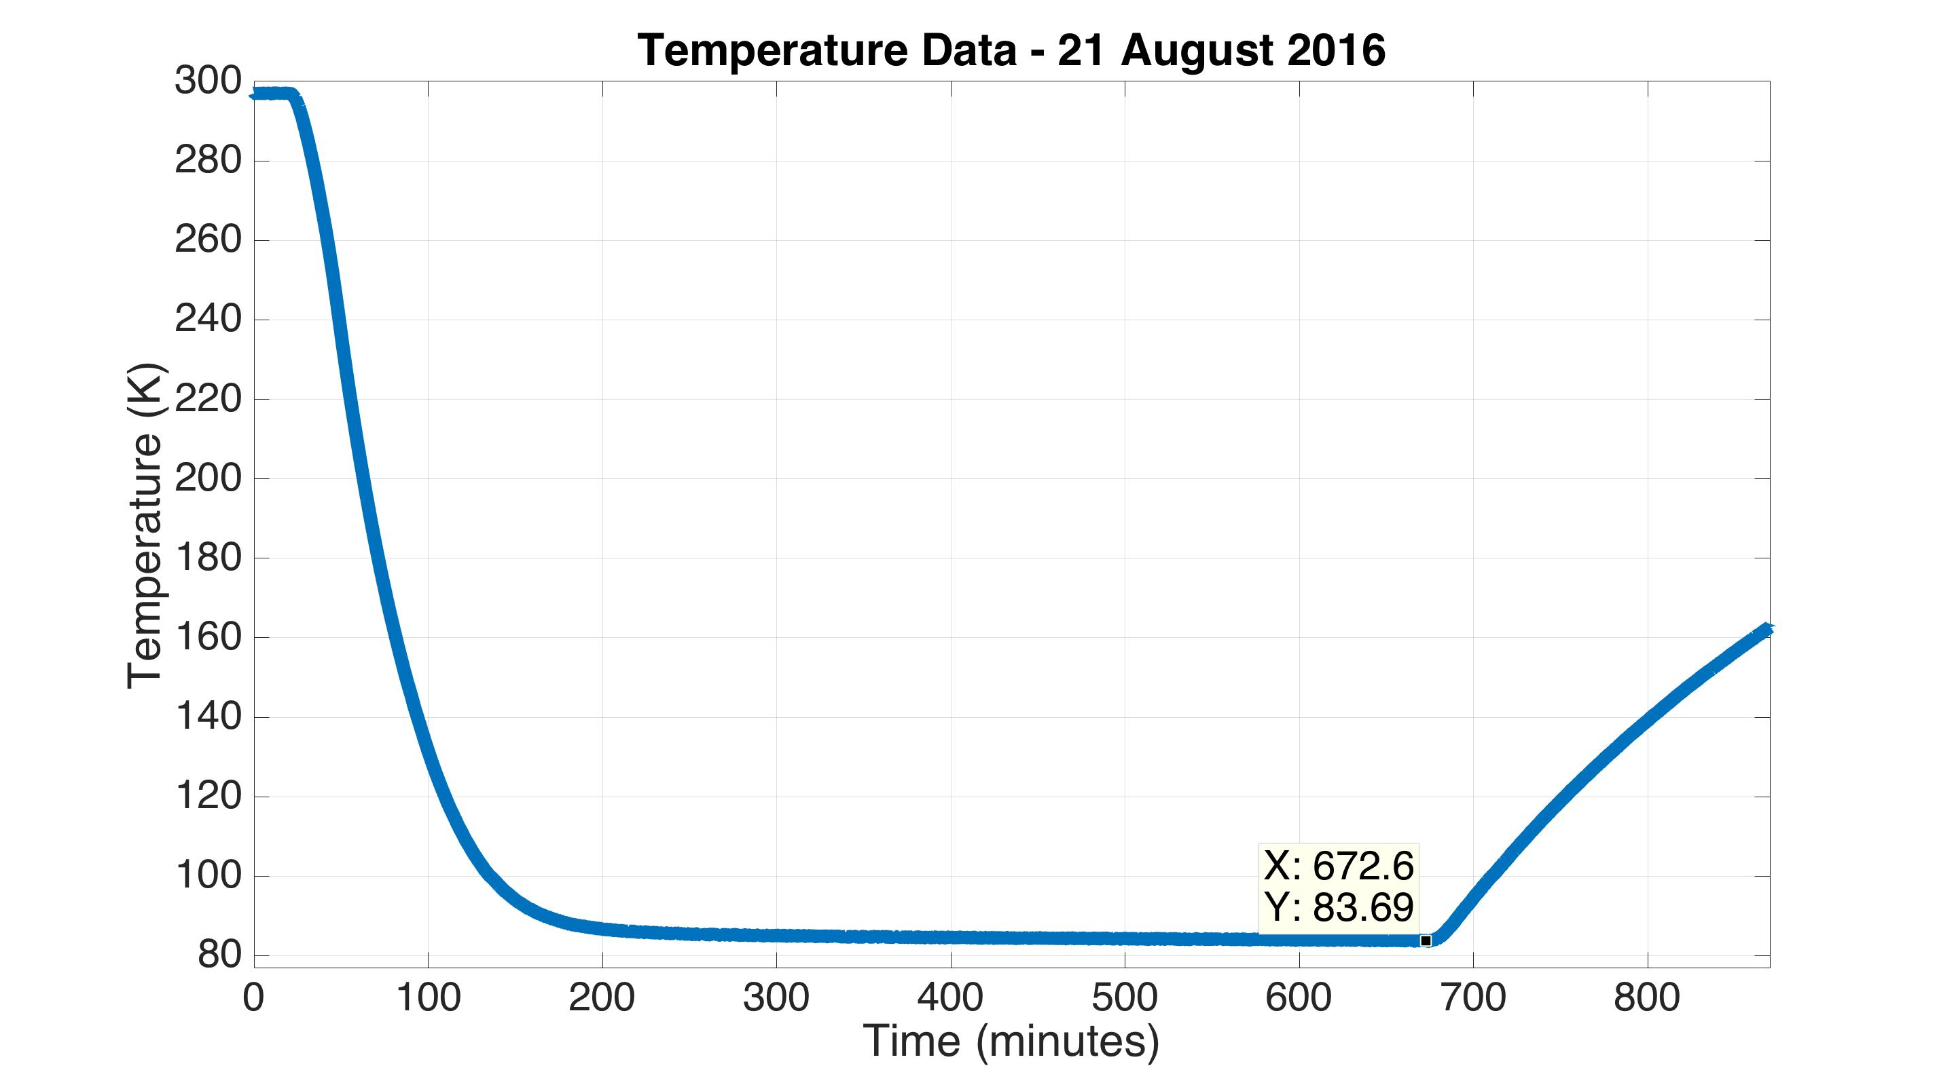
Measured Temperature Response
Estimated heat leak is 12 W
Expect up to 10 W from conduction
At least 2 W from radiation
Inner shield

Slide 22
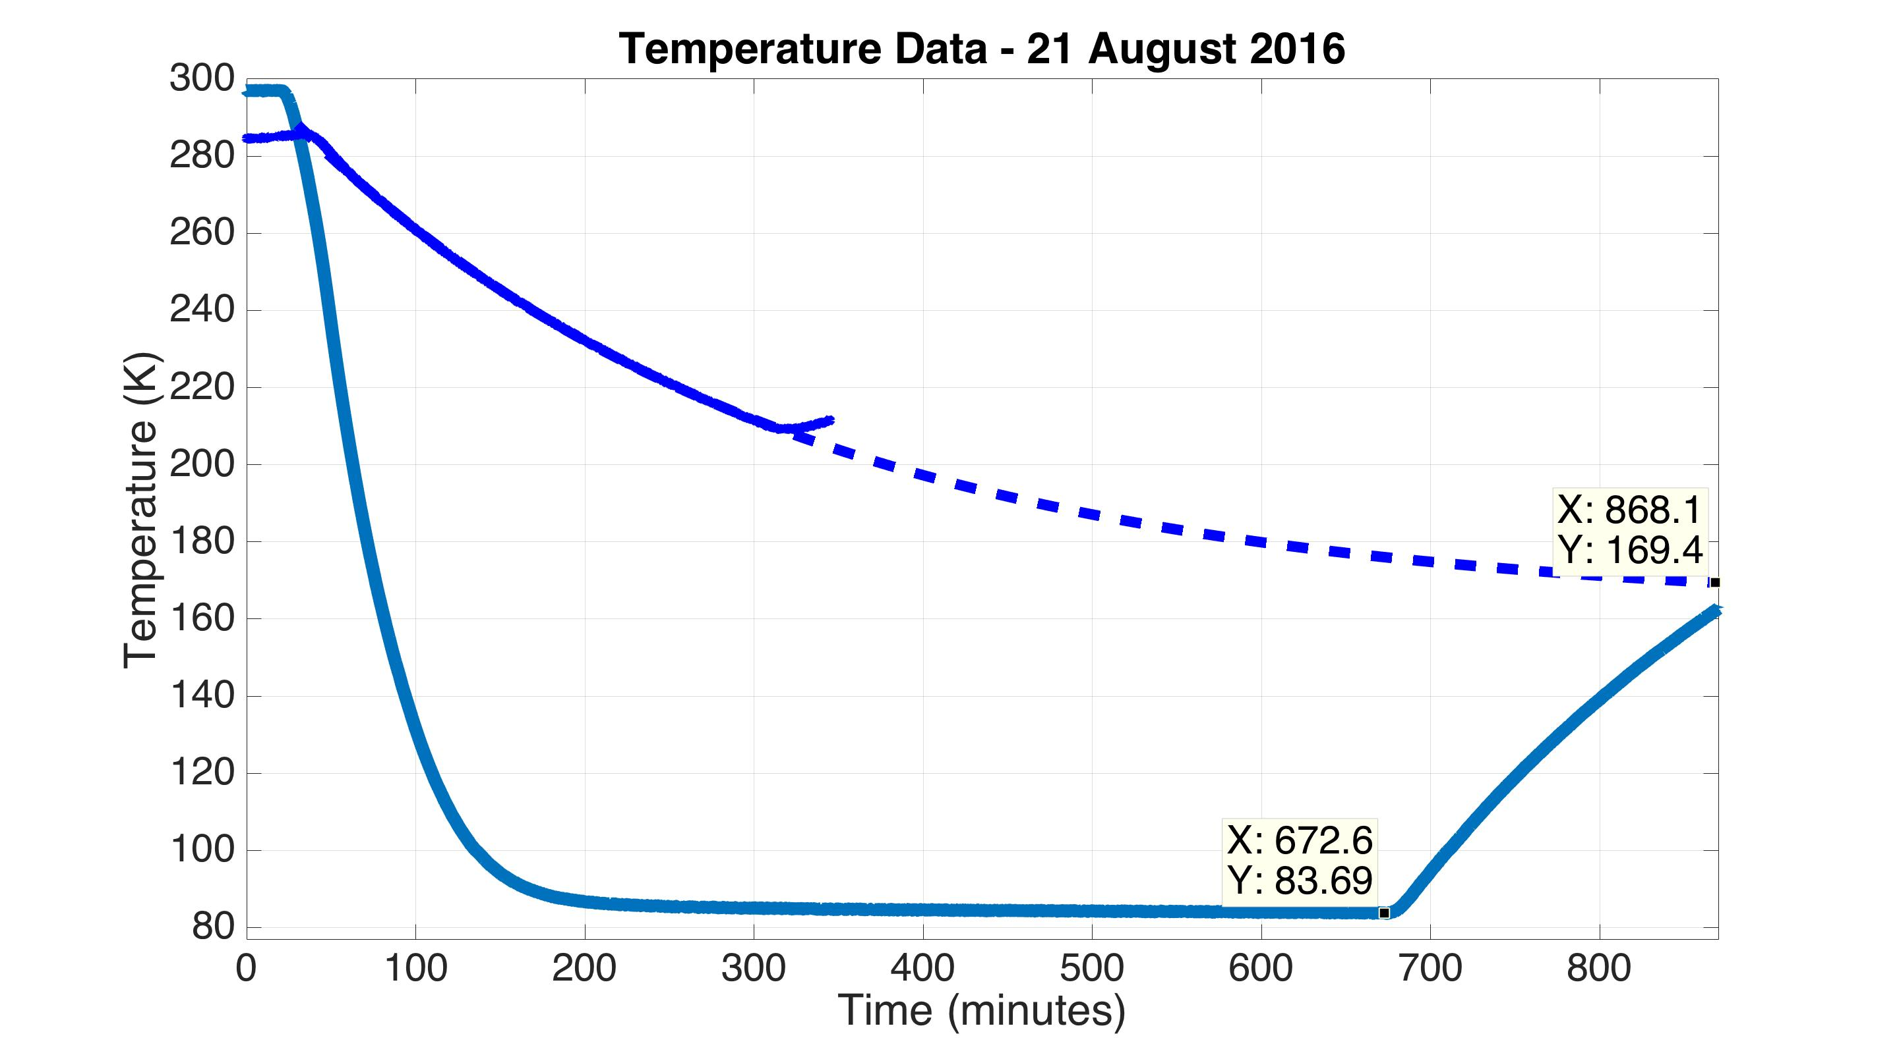
Measured Temperature Response
Inner shield
- with no outer shield and fewer cold links
40 W heat leak
Inner shield
12 W heat leak

Slide 23
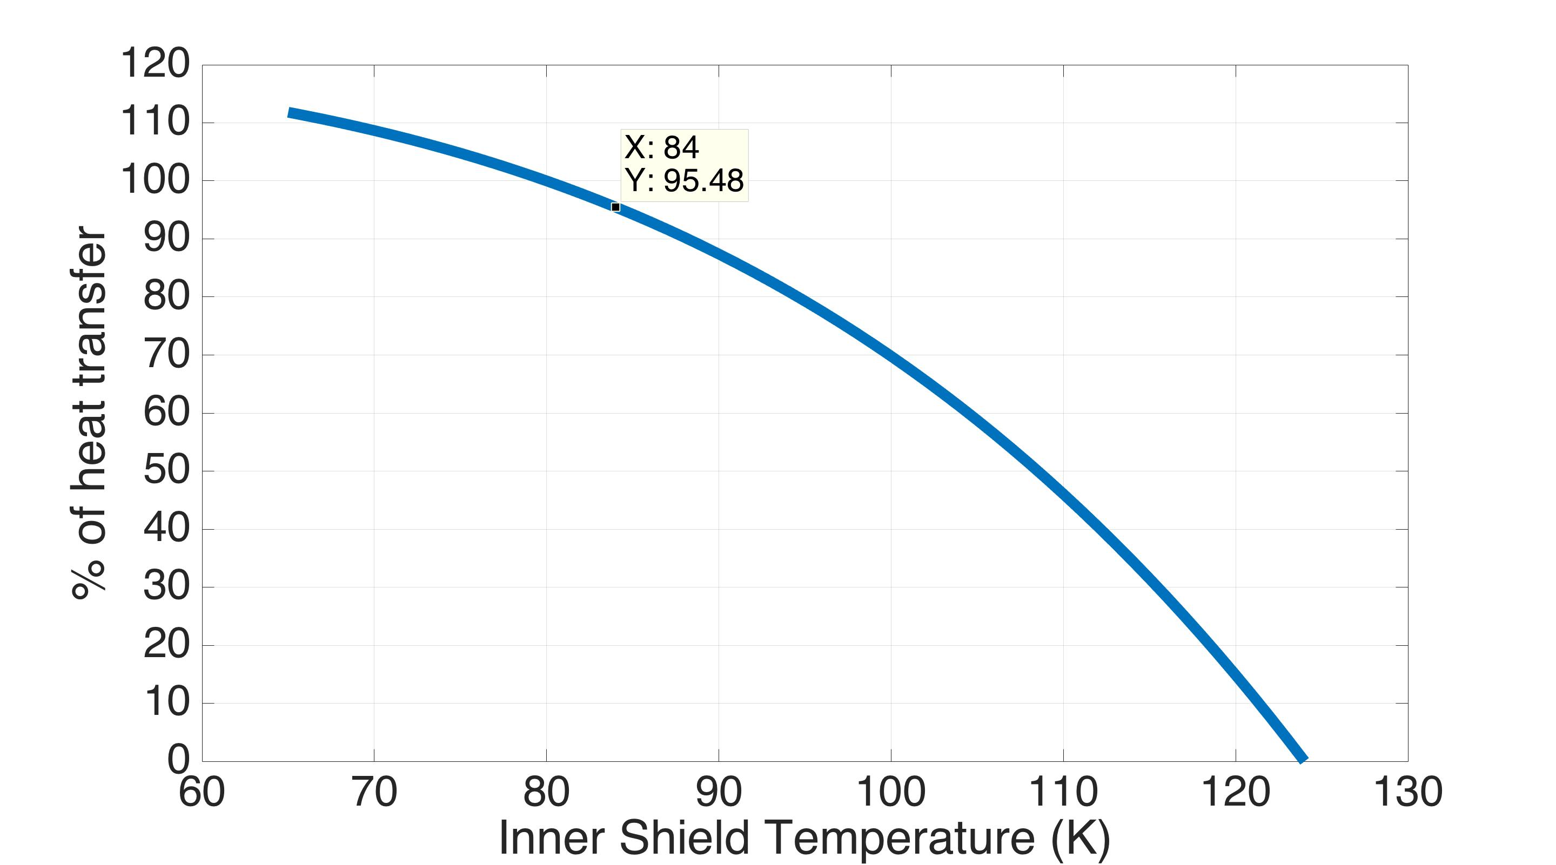
Test Mass Heat Transfer vs Shield Temp
80 K baseline
temperature

Slide 24
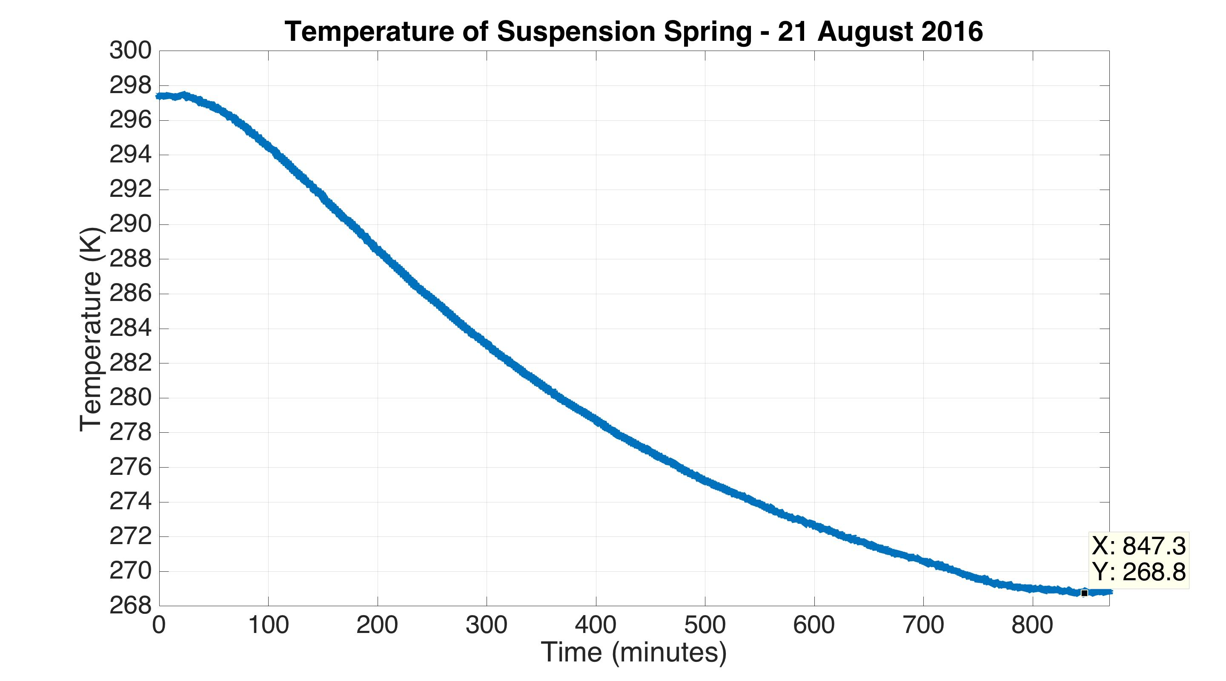
Measured Temperature Response
Suspension spring

Slide 25
Scattered Light Noise

Slide 26
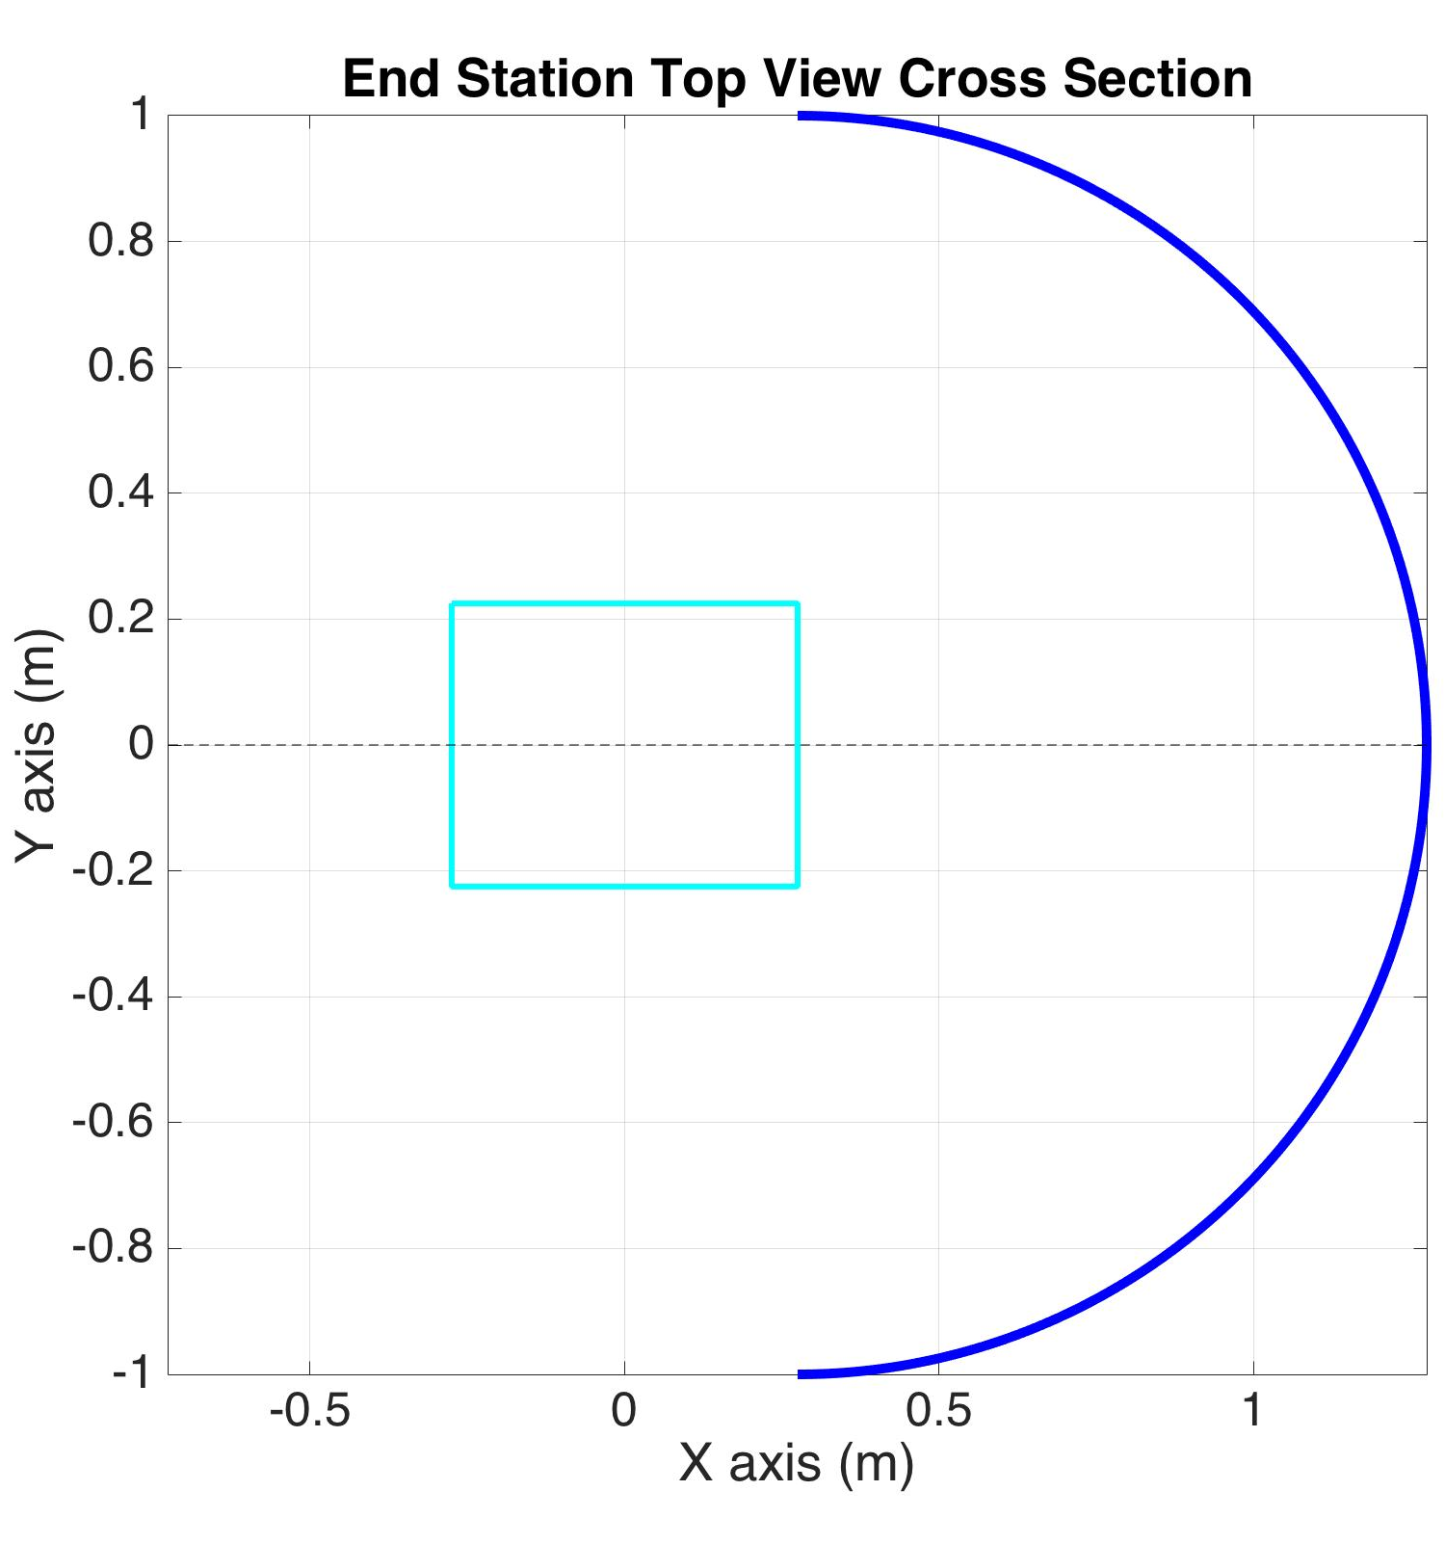
Scattered light noise simulation
10 ppm scatter
Test mass
3 MW laser
Simplified shield
1 m radius
Notes:
In order to determine how well isolated seismically the shield needs to be, we need to estimate how much noise we can expect from the scattered light. The way the scattered light works is that some small pieces of the 3 MW beam hitting the test mass scatter away, at the level of 10 ppm, hit the shield, which is moving with some displacement spectrum, and then a small piece of that comes back to the test mass and recombines into the interferometer. That recombined light carries information about the shield displacement, which will appear as noise in the interferometer. This sketch is from a Matlab simulation that models the scattered light noise. It uses a simplified shield geometry, which is a 1 m radius sphere. 1 m was chosen just because it is a round number. It is likely the real thing will be smaller since this would fill nearly the entire chamber.

Slide 27
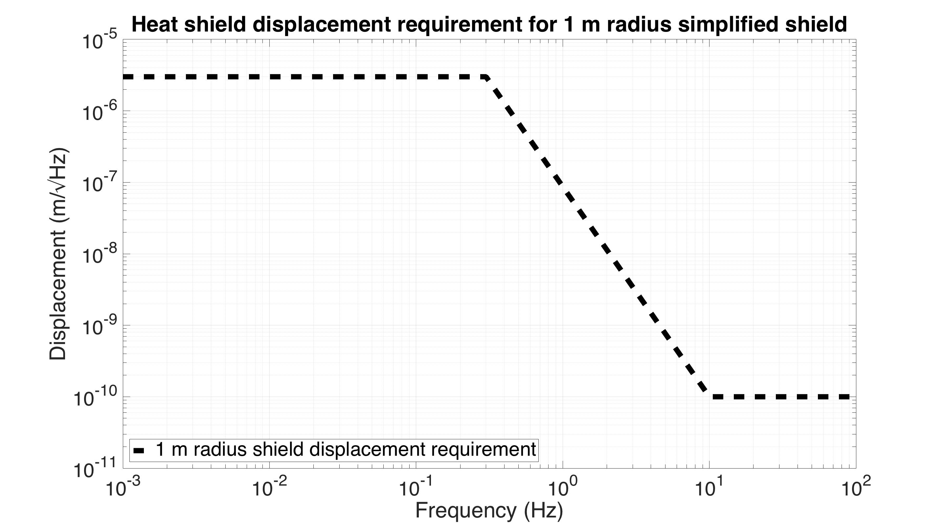
Scattered light noise simulation
3 MW laser
Test mass
Simplified shield
1 m radius
Notes:
For this simulation, I made an educated guess of how low the shield displacement spectrum needs to be, which I show here with this black dashed line in units of meters / sqrt(Hz) vs frequency.

Slide 28
Scattered light noise simulation
Magnitude proportional to shield radius
3 MW laser
Test mass
Simplified shield
1 m radius
Notes:
It turns out the scattered light noise is roughly inversely proportional to the shield radius. So if we for example divide the shield radius by 2, then we also should move this displacement requirement curve down by 2.

Slide 29
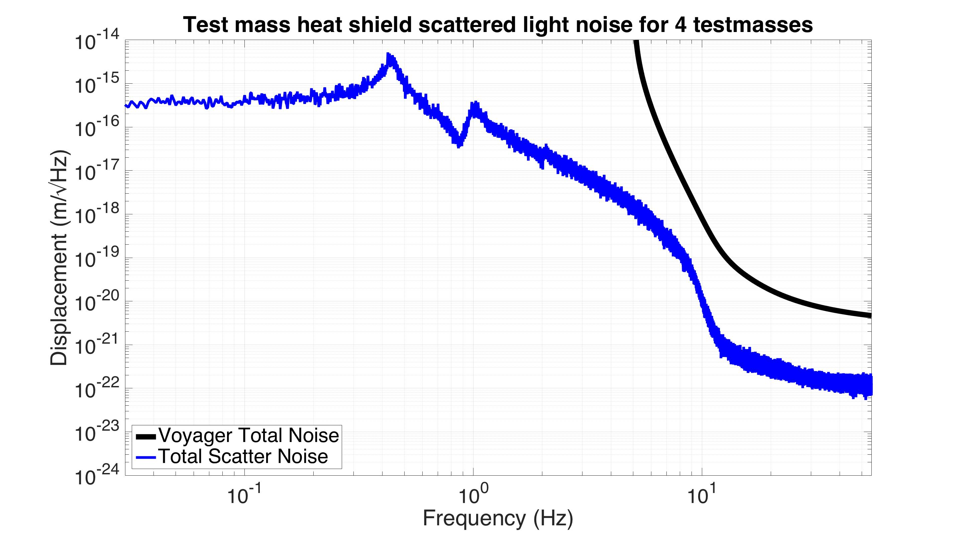
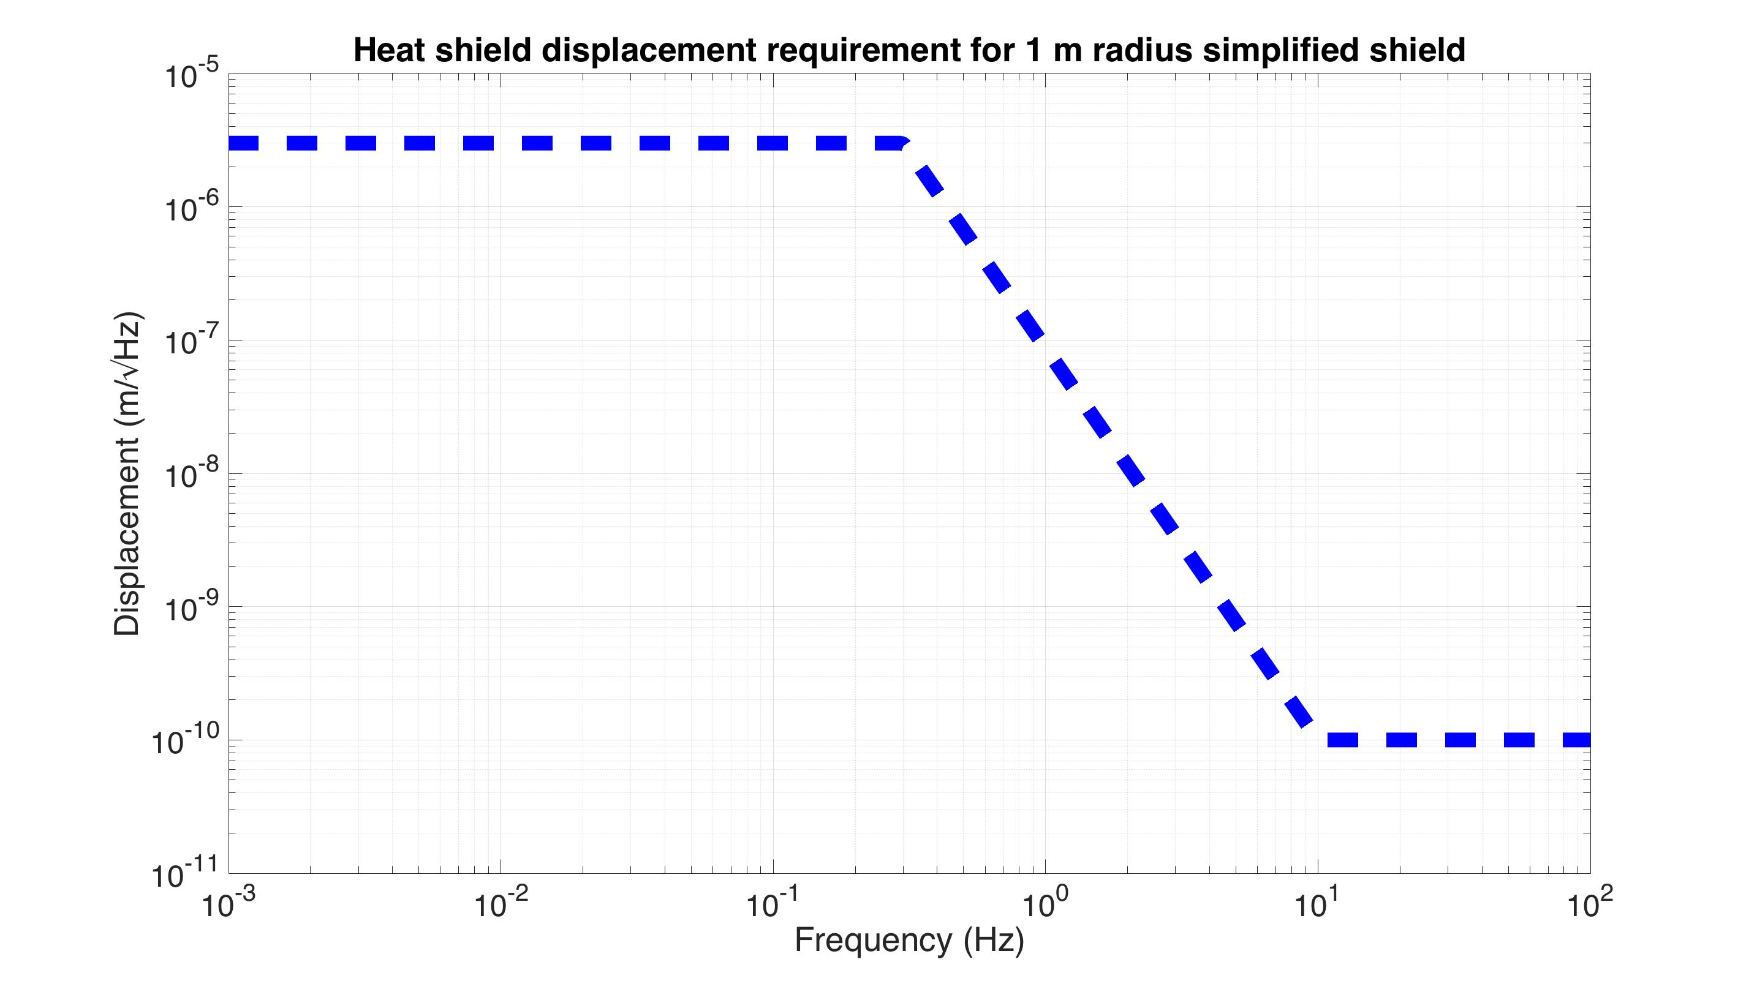
Scattered light noise simulation
Shield displacement requirement
simulation
Notes:
This fuzzy blue line, is a simulation of the effective displacement noise seen by a LIGO voyager interferometer given that displacement requirement curve. The black curve is the baseline Voyager noise performance we saw earlier. So you can see the scattered light nose is in at least 2 orders of magnitude away from our performance goal at all frequencies.
It turns out though, that this noise is highly nonlinear.

Slide 30
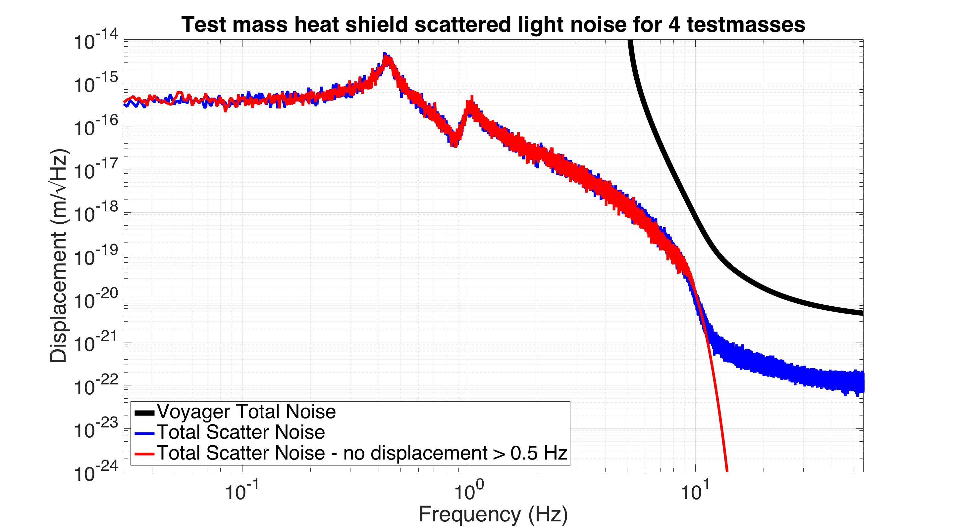
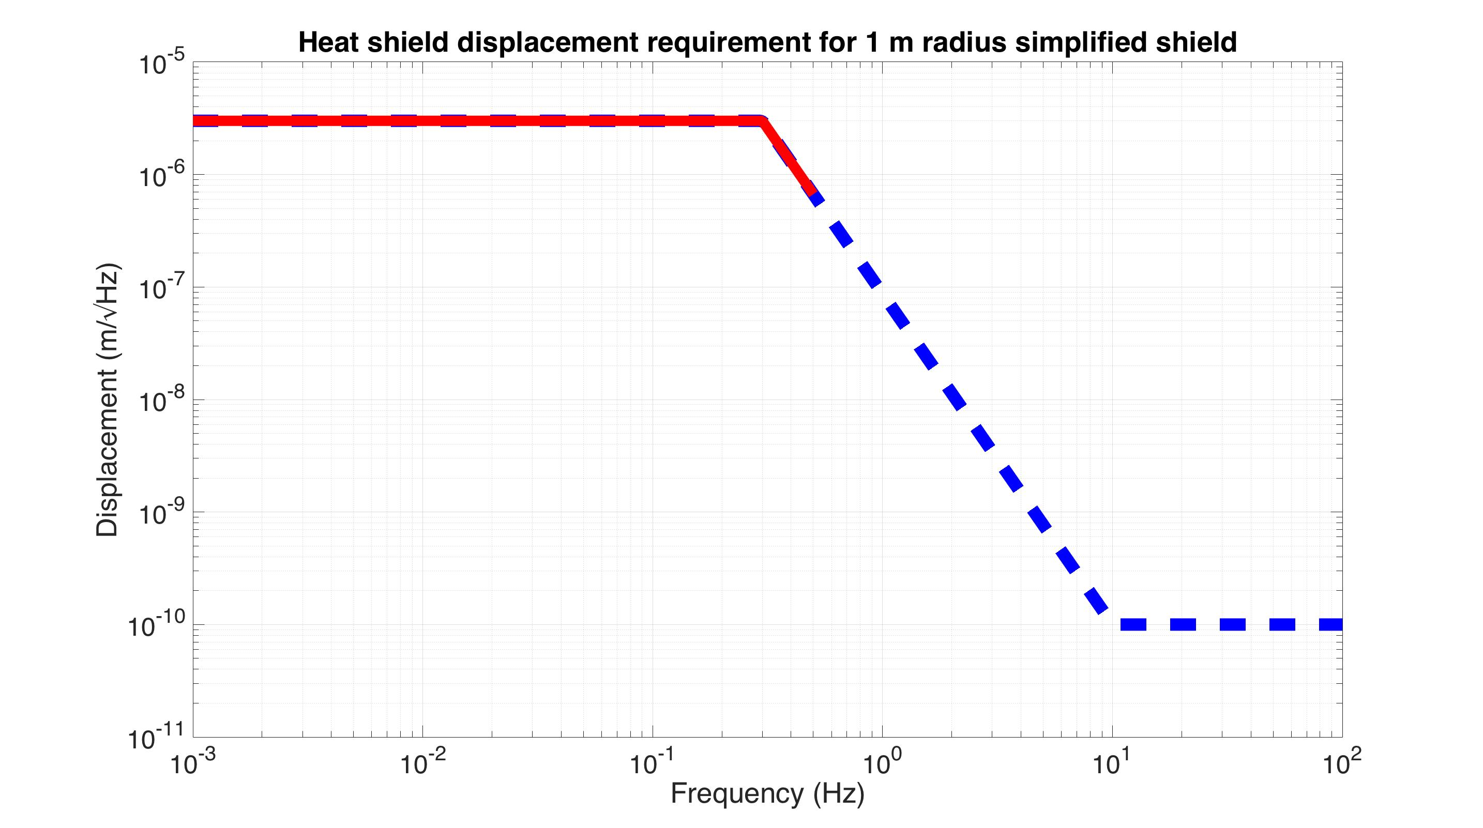
Scattered light - upconversion
No shield displacement
simulation
Notes:
To get a feel for this, on this next slide, I’ve eliminated all the shield’s displacement above 0.5 Hz. So all this noise you see here up to 10 Hz is coming entirely from displacement below 0.5 Hz. This suggests that most of the vibration isolation we need is at low frequencies.

Slide 31
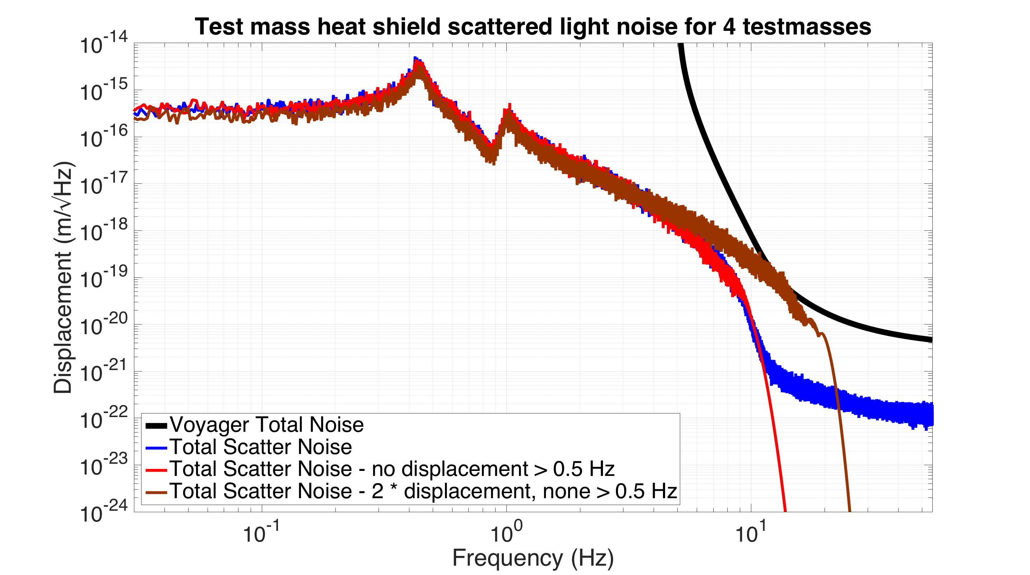
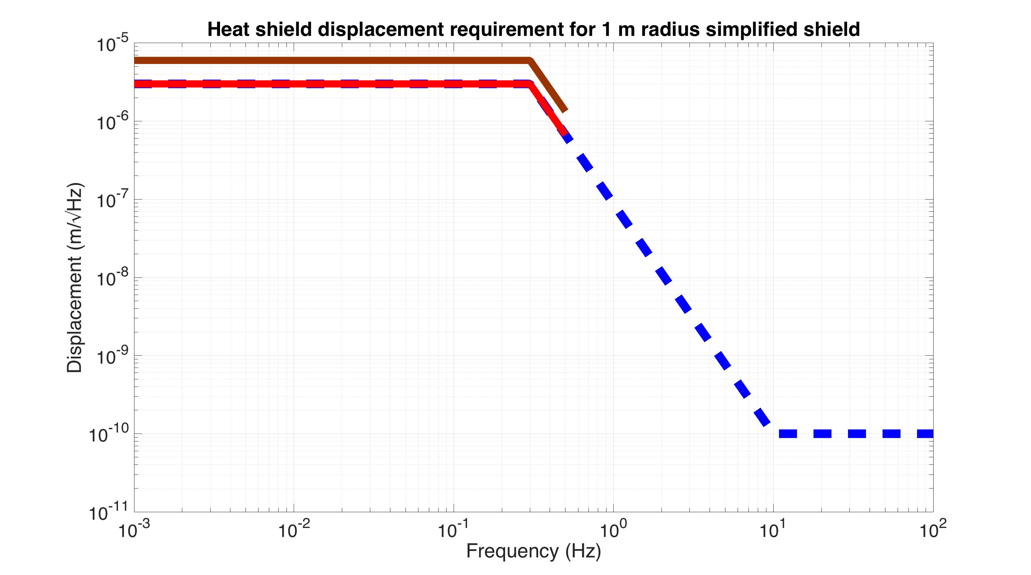
Scattered light - upconversion
No shield displacement
simulation
Notes:
To explore this nonlinear behavior some more, here I’ve amplified the shield’s displacement by a factor of 2. There is still 0 displacement above 0.5 Hz. You can see that this 10 Hz shoulder has moved up to about 20 Hz, even though the low frequency noise is no worse.

Slide 32
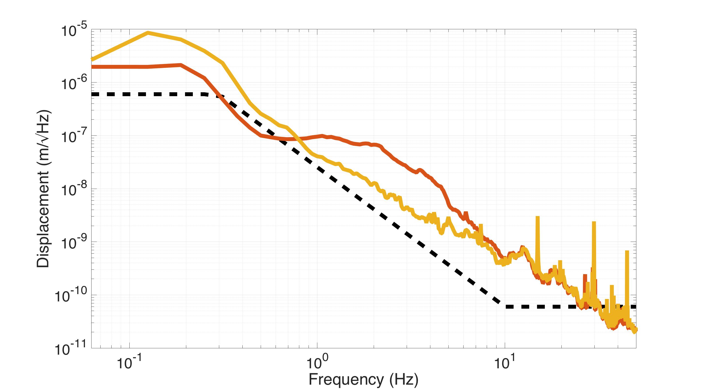
Shield Seismic Isolation
LLO Dec 95th percentile
LLO Aug 95th percentile
0.2 m radius heat shield requirement
seismic data from T1500224

Slide 33
Shield Seismic Isolation
LLO Dec 95th percentile
Stanford Exp.
LLO Aug 95th percentile
0.2 m radius heat shield requirement
seismic data from T1500224

Slide 34
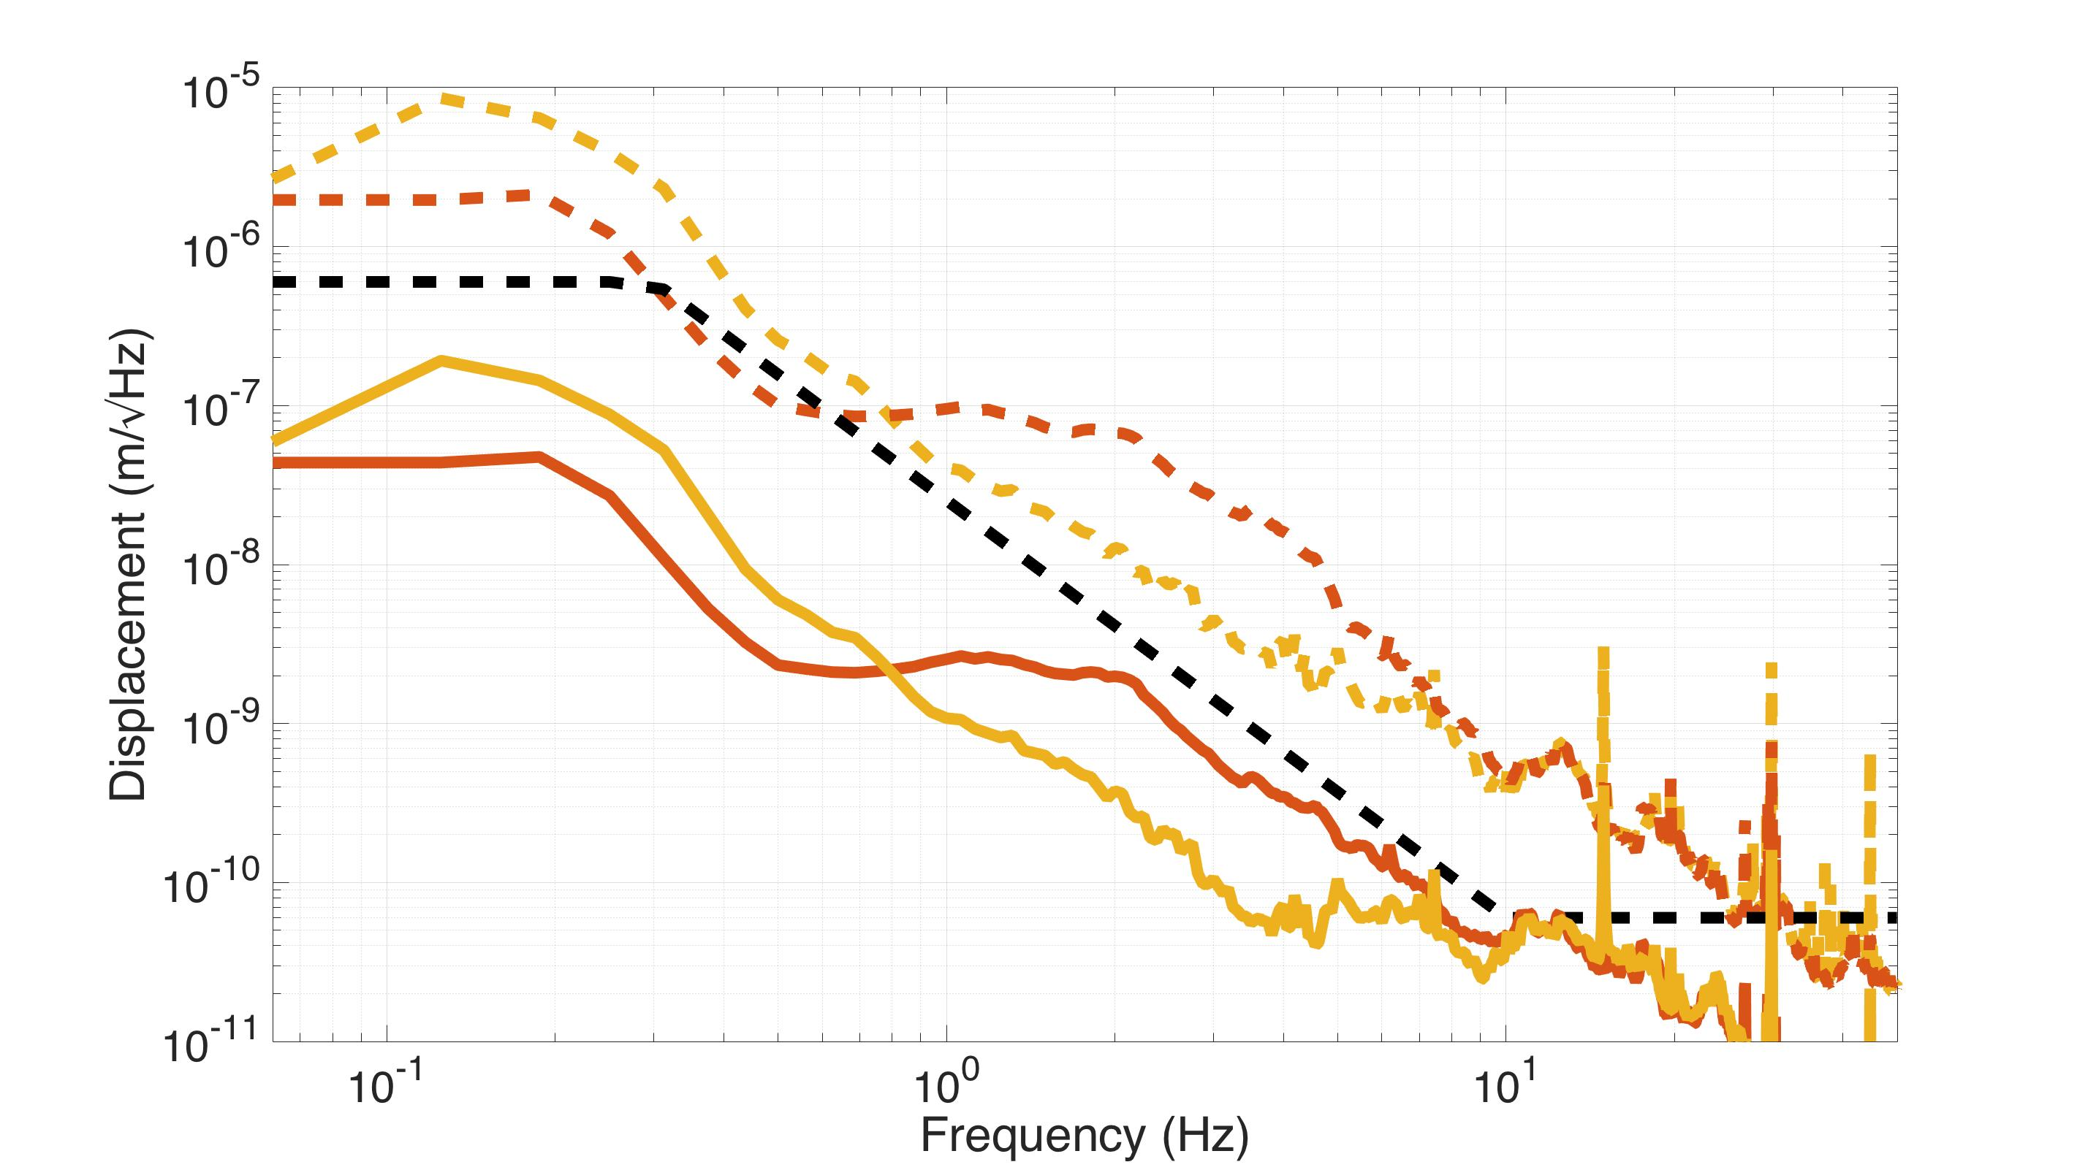
Shield Seismic Isolation
Simulated performance with isolation loops designed for Stanford heat shield
Stanford Exp.
LLO Aug 95th percentile
LLO Dec 95th percentile
seismic data from T1500224

Slide 35
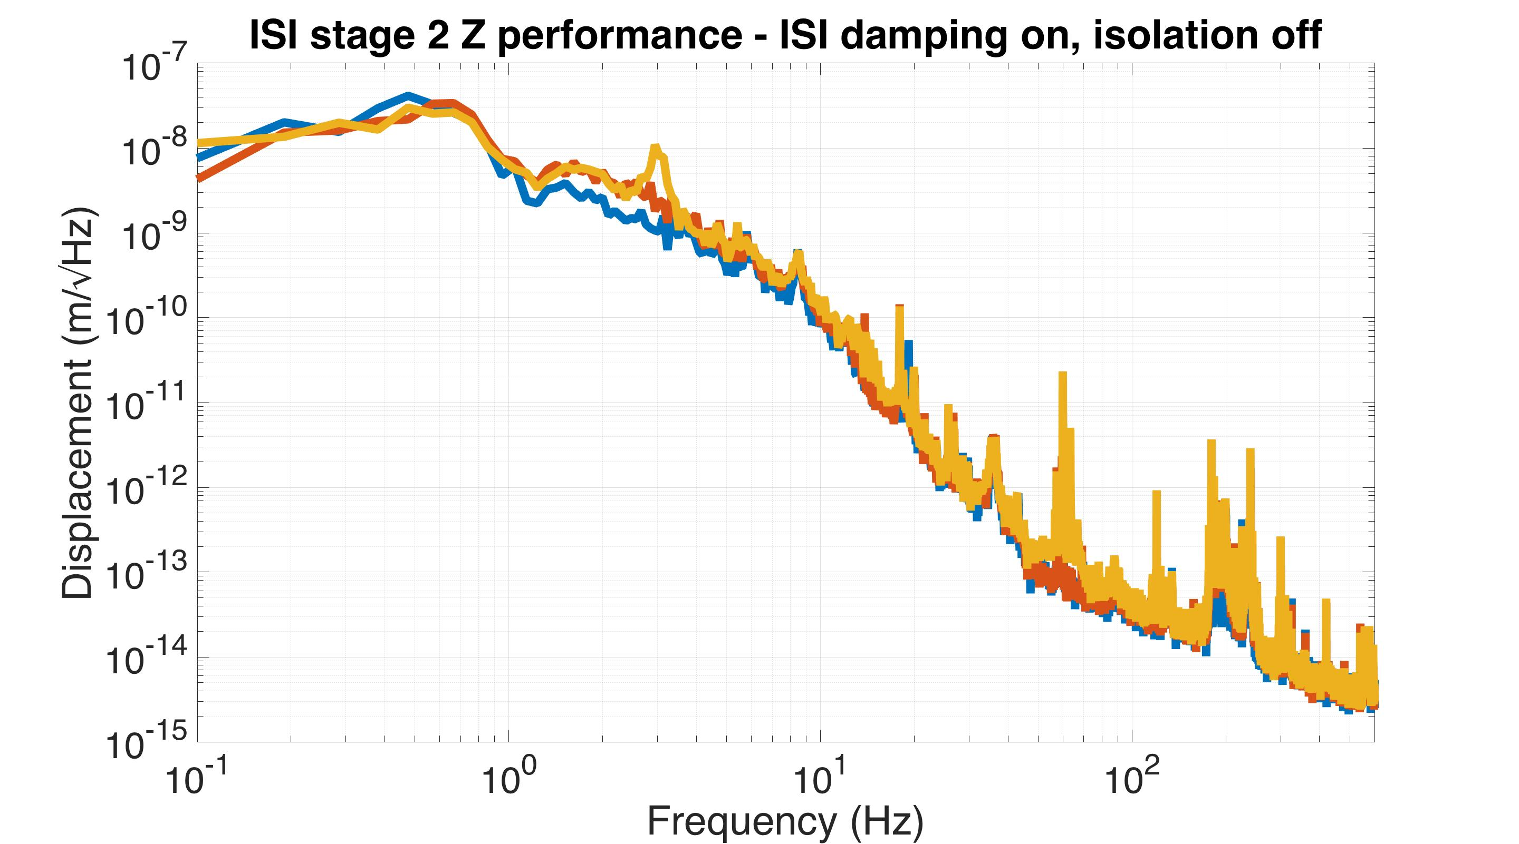
Cryo induced vibrations on ISI
Cryo on, heat shield isolation on
Cryo on
heat shield isolation off
Cryo off
Heat shield isolation off

Slide 36
Newtonian Noise
Courtesy of Edgard Bonilla
Simulations based on Nick Lockerbie’s G1200625

Slide 37
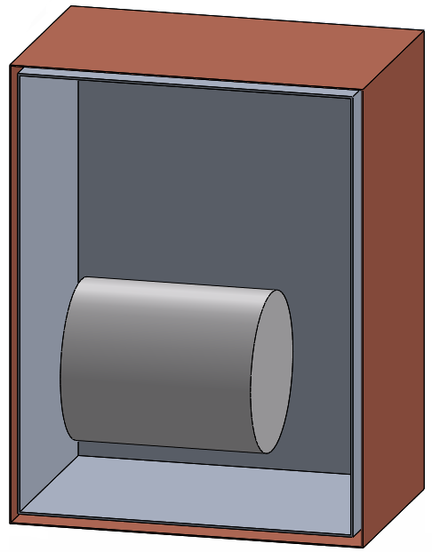
Shield Newtonian Noise Simulation
Outer shield
180 kg of Cu
Inner shield
100 kg of Al
1.25 m
Silicon Test Mass
45 cm diameter
54 cm length
200 kg
Notes:
This is the simple model for the LIGO Voyager test mass placed inside the heat shields. The dimensions of the test mass are 45cm diameter / 54cm length silicon cylinder, which gives about 200Kg mass. For calculation purposes we set the walls far enough as for the test mass to rotate freely around its Center of Mass (CM) without touching any of the walls.
The inner box’s dimensions are length=95cm / height=125cm / width=75cm . It is made of ¼” thick aluminum walls. Its mass is approximately 100 Kg
The outer box’s walls surround the inner box leaving a 1 inch space in between. It is made of 1/8” thick copper walls . Its mass is approximately 180Kg

Slide 38
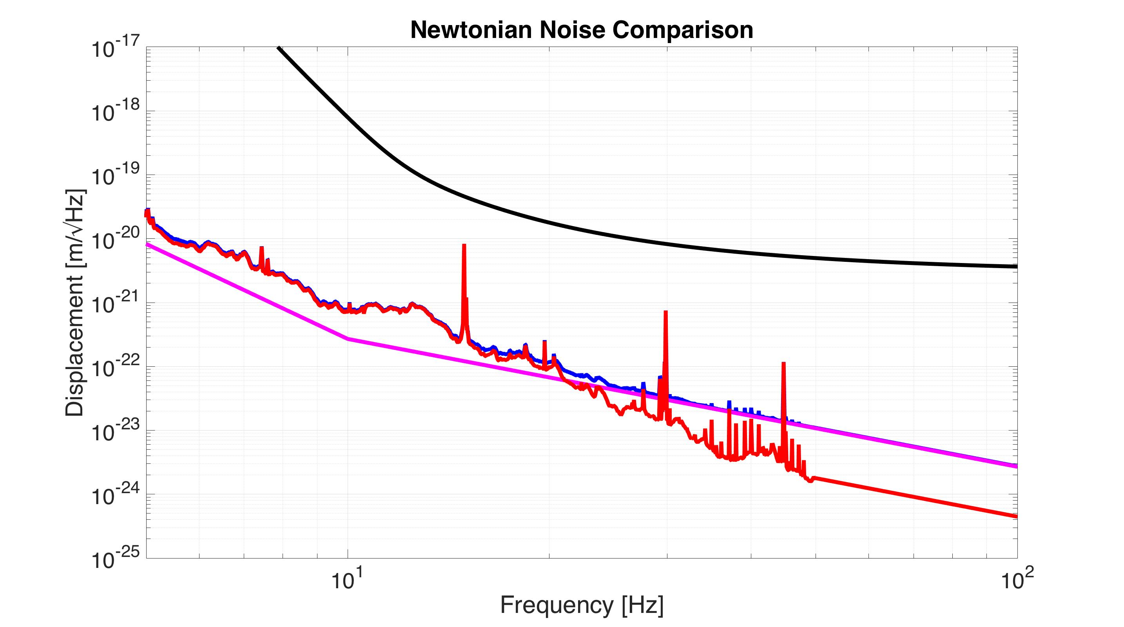
Shield Newtonian Noise Simulation
Estimated Voyager requirement curve
Total
Inner shield contribution
Outer shield contribution
assuming 95th percentile seismic noise from LLO Dec 2009

Slide 39
Shield Newtonian Noise Simulation
Newtonian upper limit estimation
- Assume all shield mass concentrated into a single point
‘Outer shield’ point mass
‘Inner shield’ point mass
Test Mass

Slide 40
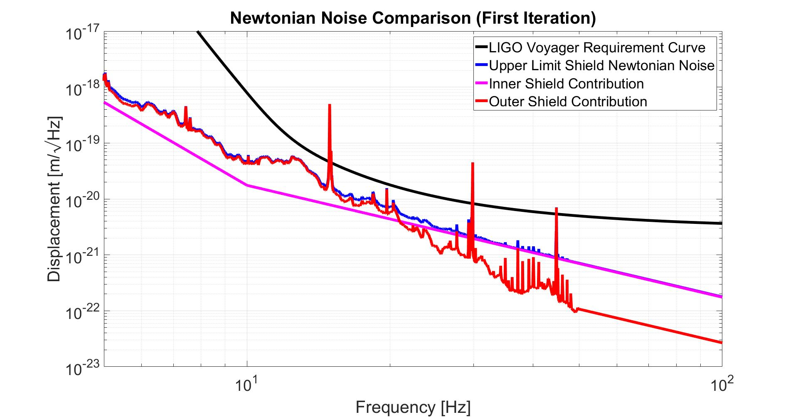
Estimated Voyager requirement curve
Total
Inner shield contribution
Outer shield contribution
assuming 95th percentile seismic noise from LLO Dec 2009
Notes:
Results of the numerical estimation of the Newtonian Noise introduced by the heat shields’ motion. The calculation was made with the setup described in the previous slide, by using the maximum gradient amplitude (just a linear approximation).
The inner shield contribution comes from the required displacement ASD from light scattering noise calculations (?) The outer shield contribution is calculated by assuming the motion of the outer shield is similar to (the 95% LLO ground motion data)
The total noise comes from an uncorrelated sum of both contributions.

Slide 41
Conclusions – what’s good
80 K heat shield and seismically isolated optics are not mutually exclusive in a LIGO-like environment.
Scattered light appears to be manageable with reasonable amounts of vibration isolation
Can be further helped with clever light absorbing geometries and sufficiently black paint
Newtonian noise appears to not be a concern

Slide 42
Conclusions – what needs more work
More work needed on the initial test mass cooling. In contact with Charlie Danaher at HPD.
Suspension springs likely needed thermal control

Slide 43
Extra Slides

Slide 44
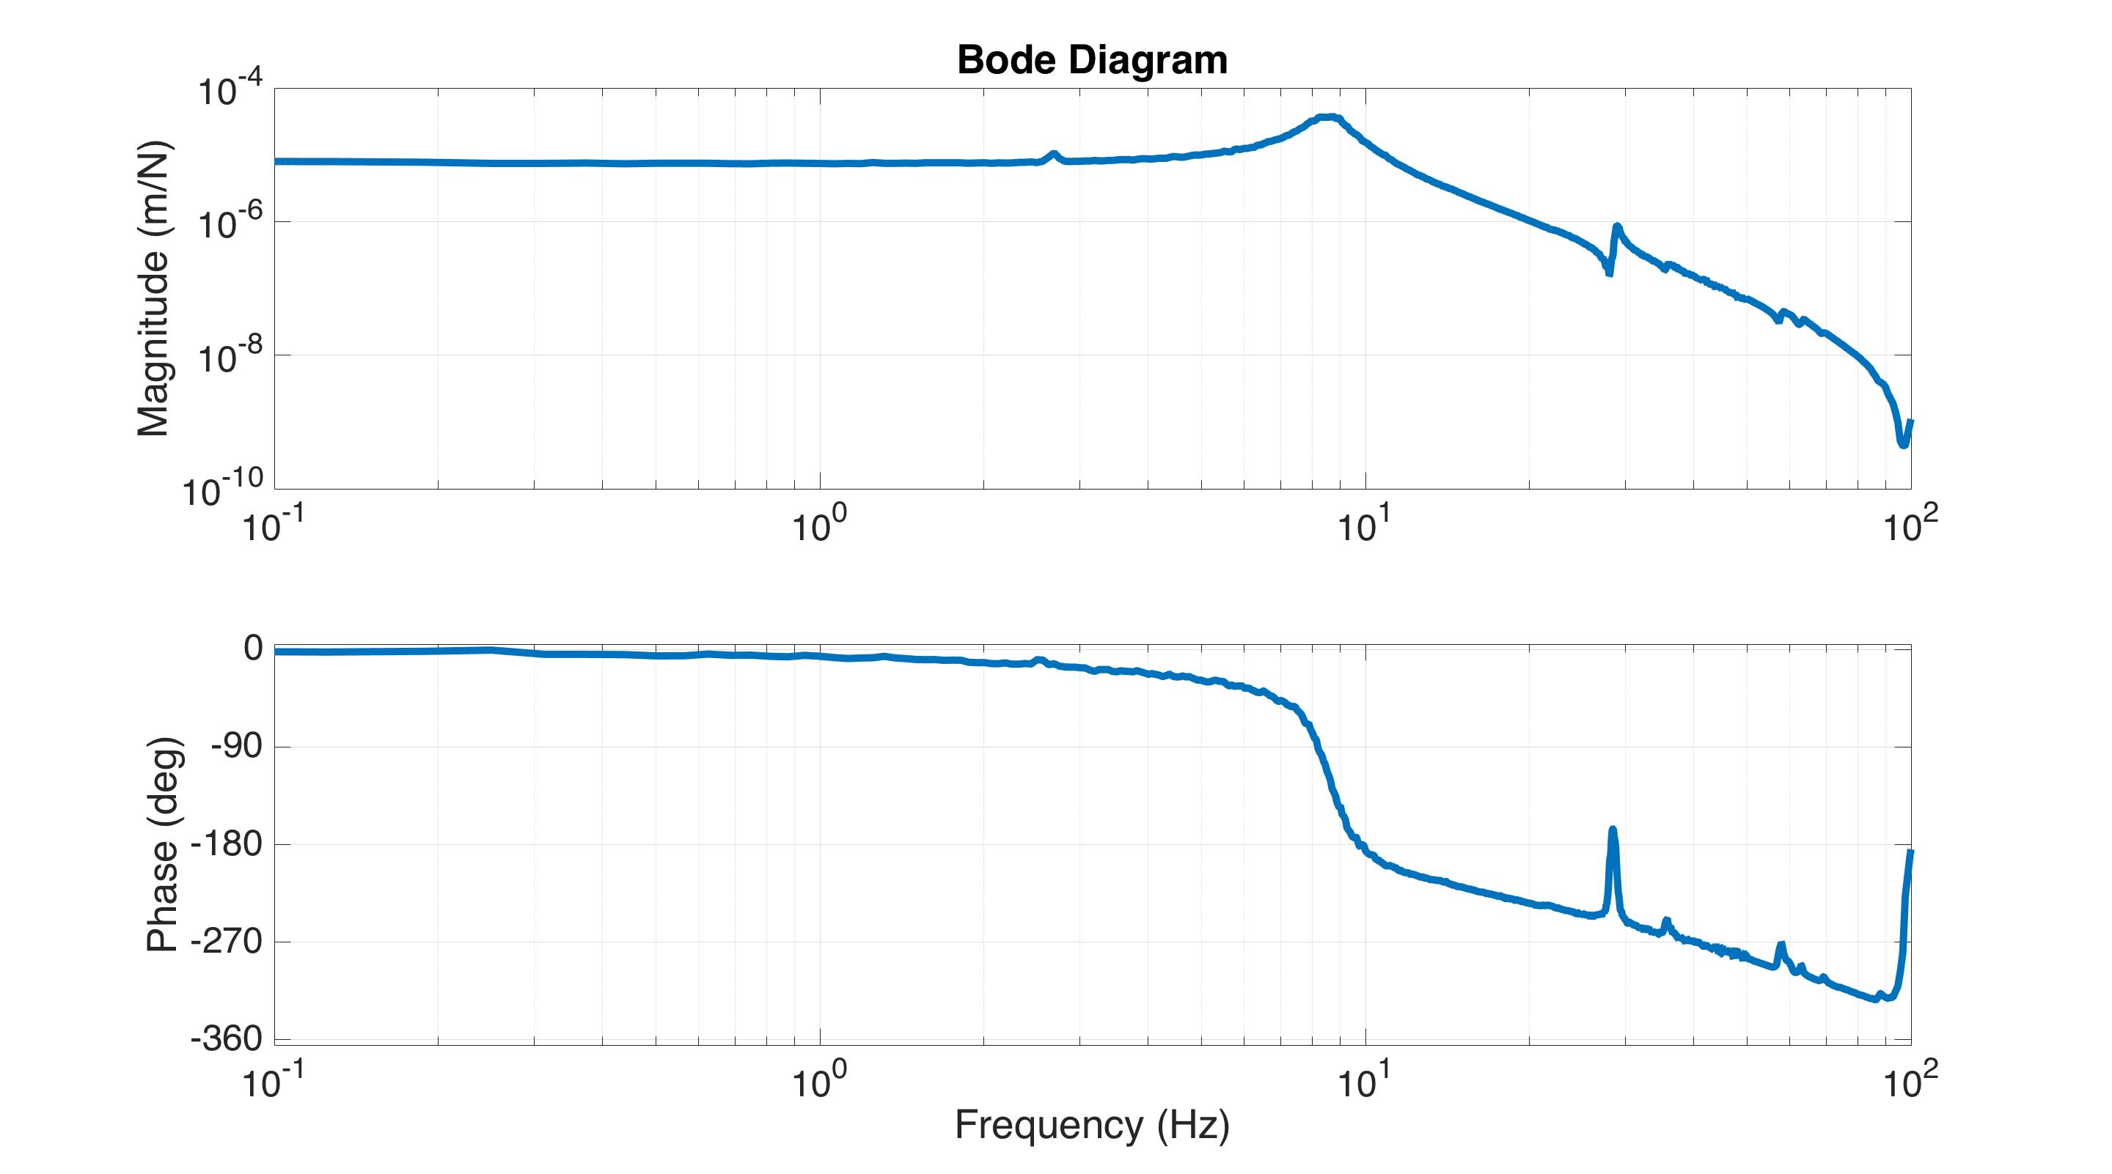
Inner Shield Vertical Plant

Slide 45
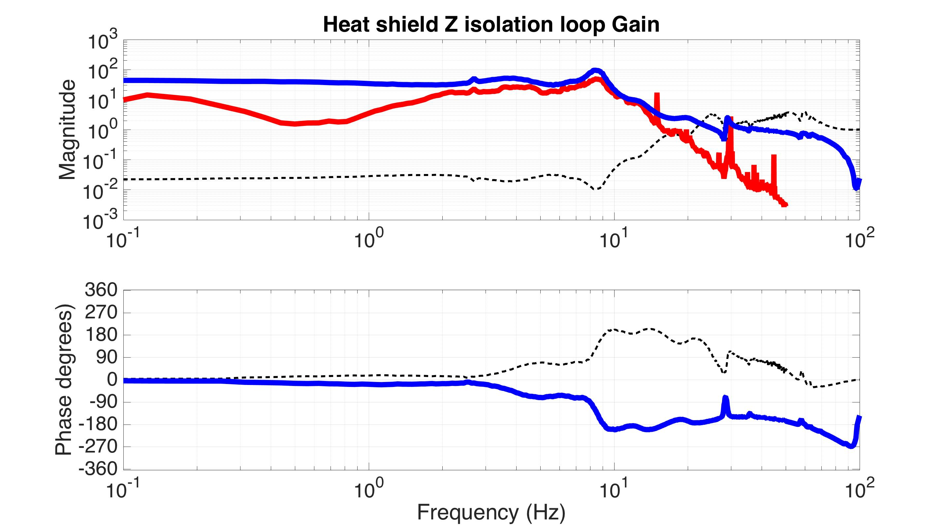
Shield Seismic Isolation
Stanford loop gain
Stanford loop gain requirement
1 / (1 + loop gain) -> sensitivity TF

Slide 46
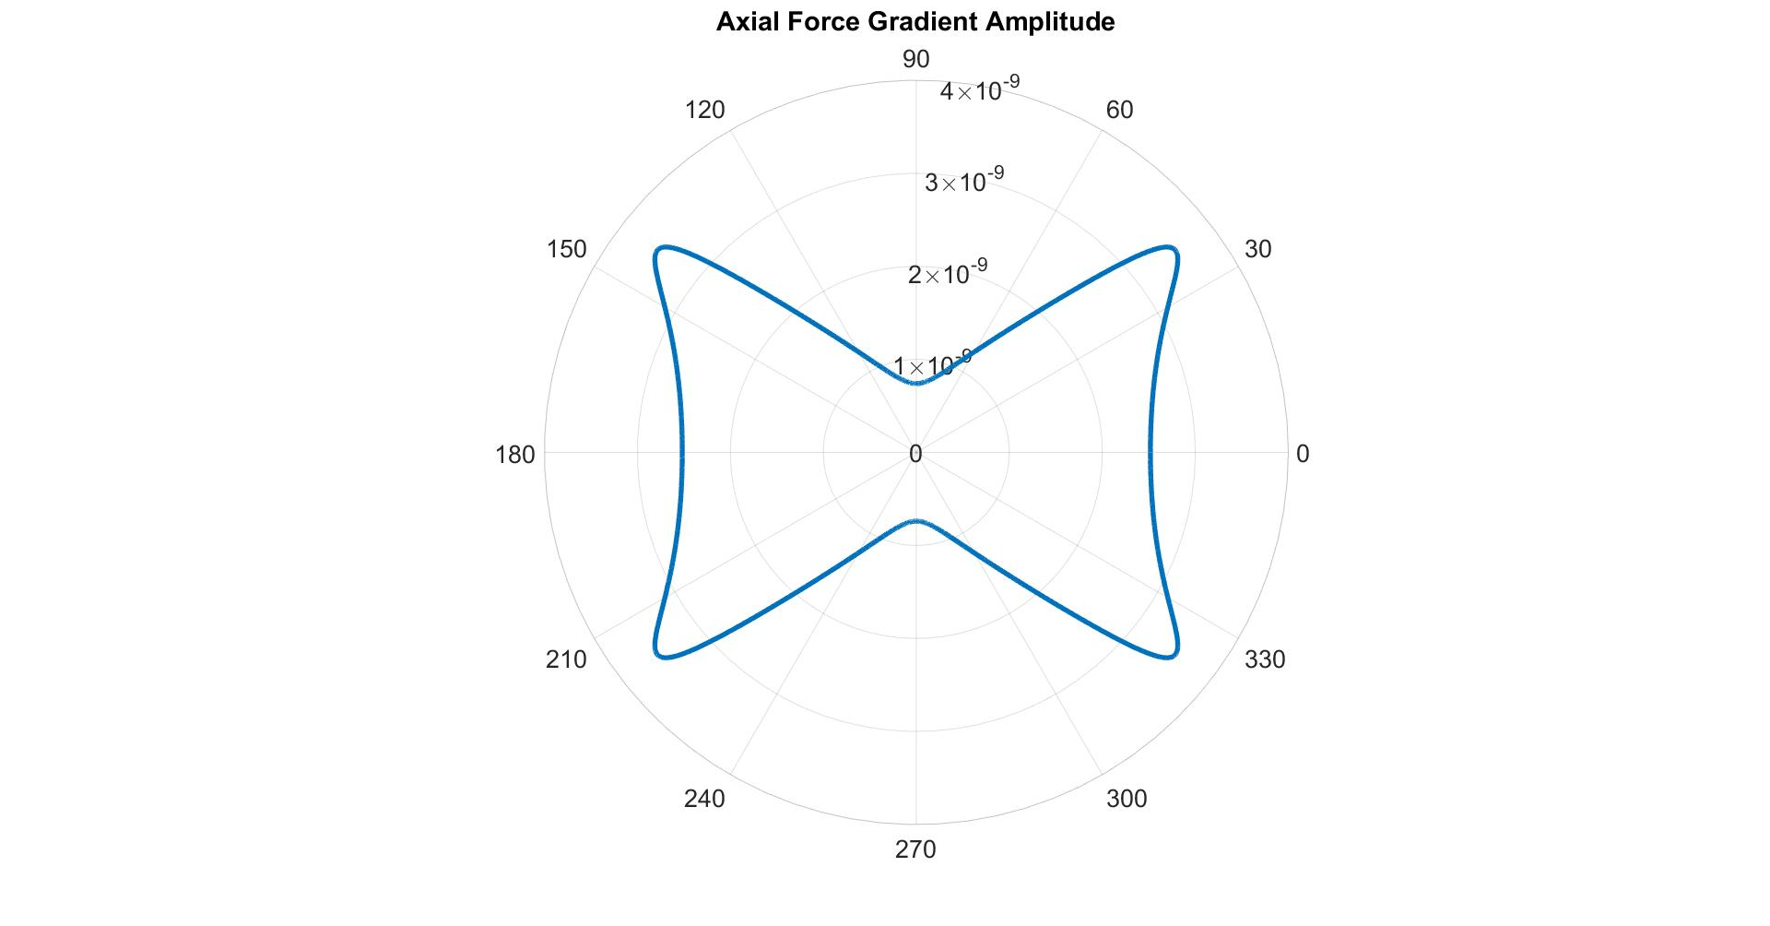
Notes:
Axial Force Gradient amplitude for a point mass as a function of the angular position. Test mass for reference.
For these calculations we assume that the point mass is 37cm away from the CM. Implying that the closest it can be to any point on the test mass is 1inch (on the corners)
The maximum amplitude is reached close to the corner of the test mass, at an angle of 38°, with the point mass moving in the direction indicated by the red arrows (67° respect to the horizontal)
The results in the next slide come from placing two point masses like this one, representing the inner an outer shields, placed at 37 and 39.5 cm away respectively. The noise is calculated by using the maximum gradient (linear approximation) which is the worst possible scenario for the noise generation.

Slide 47
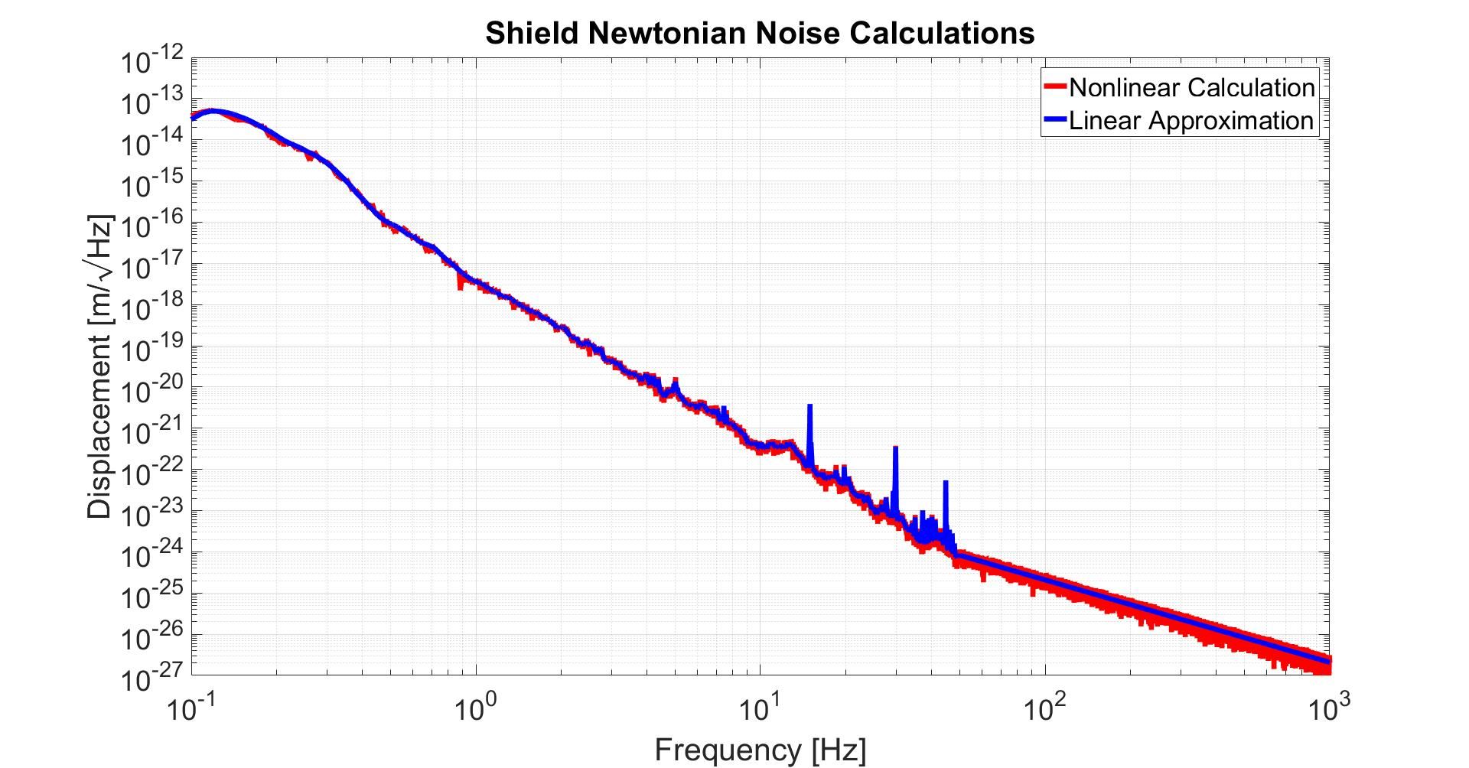
Notes:
A comparison of the Linear and Non-Linear calculations of the Newtonian Noise. The Non-Linear one was made by placing a 1Kg point mass on the place with the maximum gradient at a given distance and then moving it in the gradient’s direction with an amplitude time series corresponding to the (LLO 95% ground motion data); calculating the time series of the force exerted on the test mass and then integrating twice. The linear approximation was made by just multiplying the maximum gradient value by the (LLO 95% ground motion ASD) and integrating twice.
The two results are exactly the same up to the computer’s accuracy. The peaks observed come directly from the ground motion data.

Slide 48
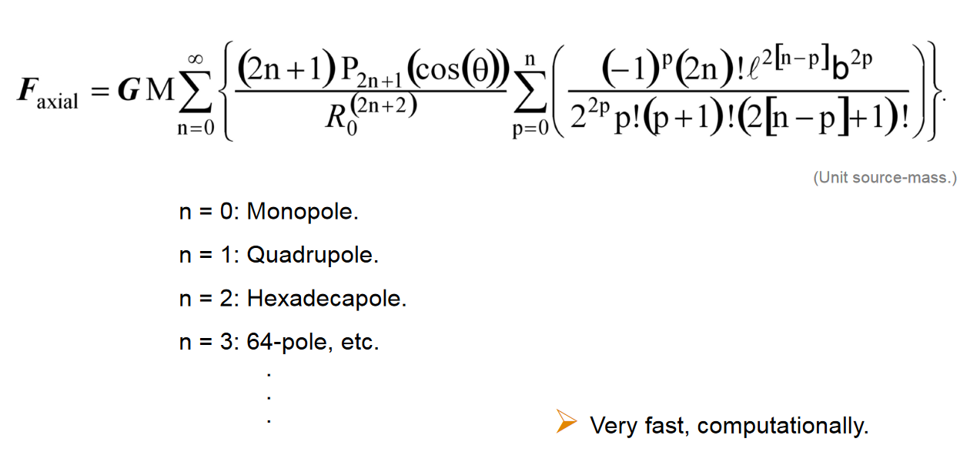
Point mass
: Distance to CM
: Angular Position
0.225 m (Radius).
0.27 m (Semi axial-length).
Equation from G1200625

Slide 49
Actuator
Vacuum wall
Relative displacement sensors
Cu braid
cold link
LN₂ pipes
Inertial sensors - geophones
LN₂ supply
Heat shield support structure
Heat shield
80 K
LN₂ return
Actively isolated optics table (300 K)
GN₂ feedthrough
Intermediate stage (300 K)
Ground
Spring
Ground
Notes:
Instead, I’ll show a simplified cartoon of how it works, which is basically what we just saw earlier. The main difference is that our ISI sits below the optic instead of above. But you still have a heat shield hanging from some springs mounted to stage 0. It’s then cooled with some flexible copper braids between it and a liquid nitrogen pipe. We’ve taken the conservative approach of installing sensors and actuators for isolation control, just in case we need them.

Slide 50
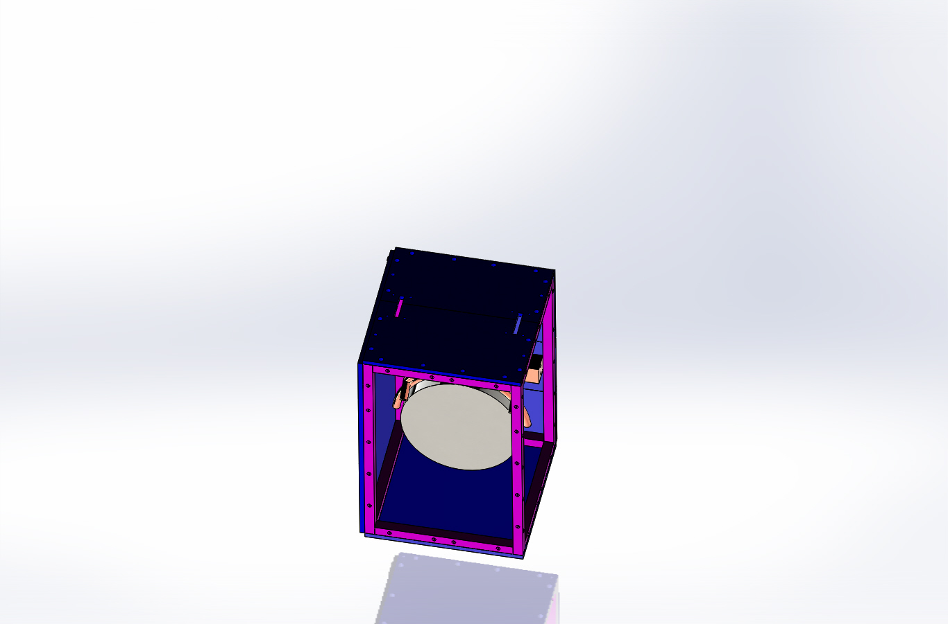
Test mass heat shield
Holes for suspension wires
Inner heat shield 80 K
Cold finger for initial cool down
Test mass 124 K

Slide 51
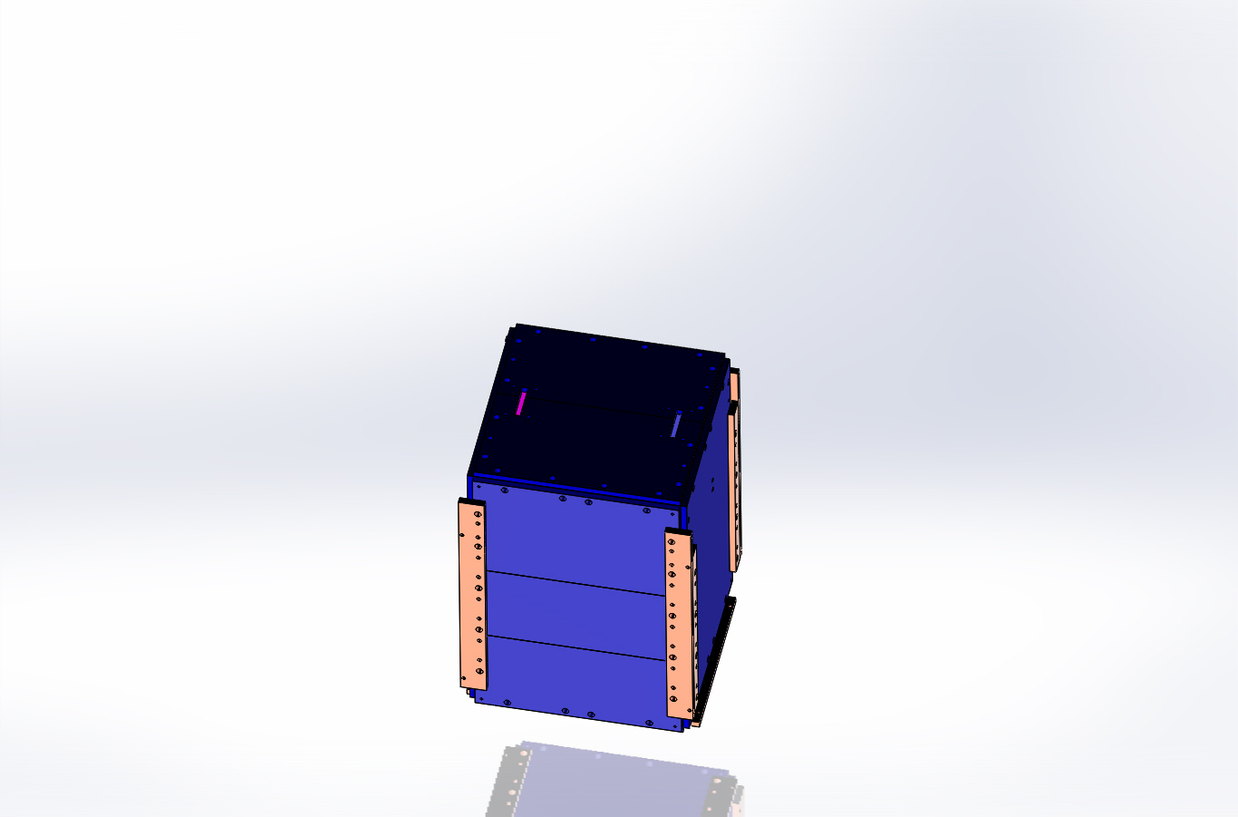
Test mass heat shield
Connections for the Cu cold links that cool the inner shield (cold links not shown)

Slide 52
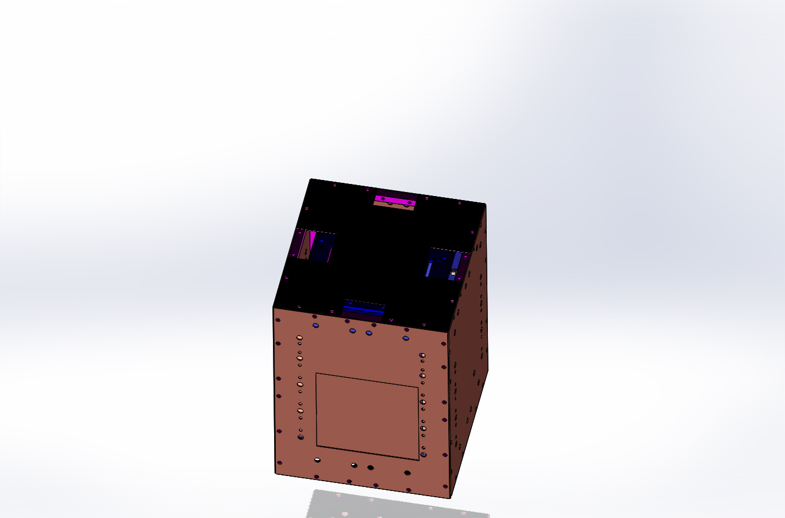
Aluminum low emissivity plates (ribs boost vibrational frequencies)

Slide 53
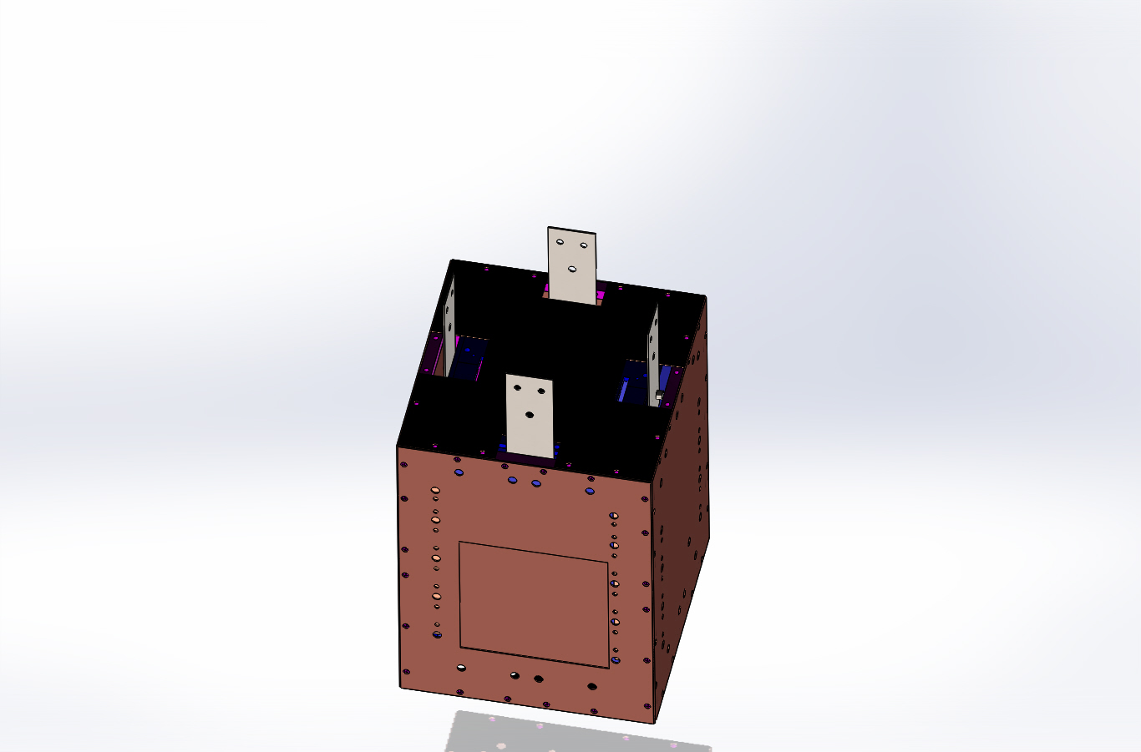
Flexible stainless strips attach the heat shield to its (warm) suspended stage

Slide 54
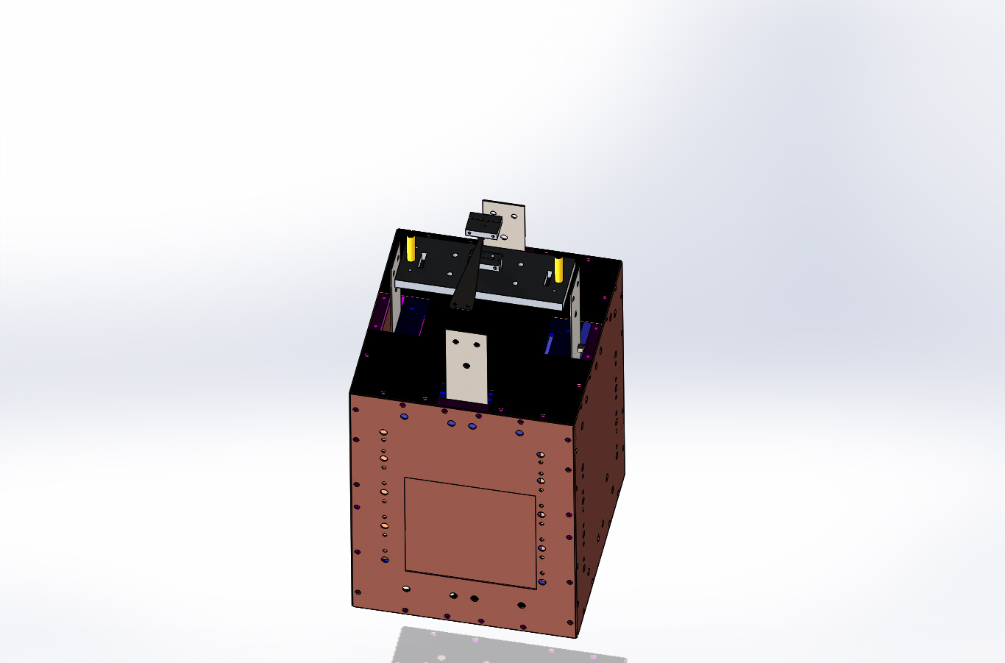

Slide 55
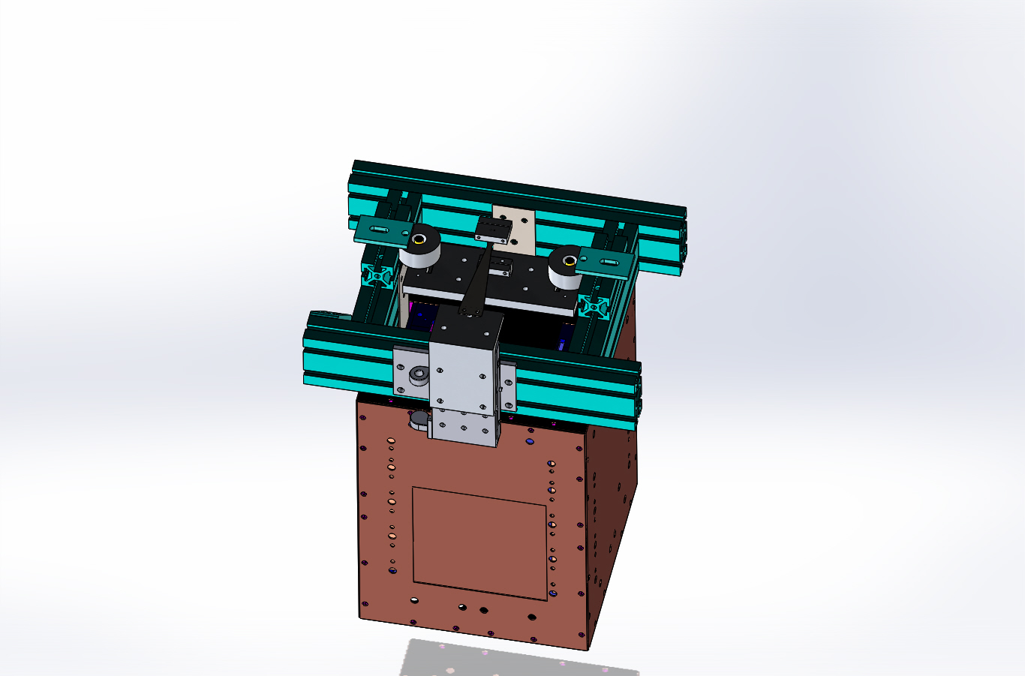
Vertical suspension OSEMs
Suspension spring mounted to vertical translation stage

Slide 56
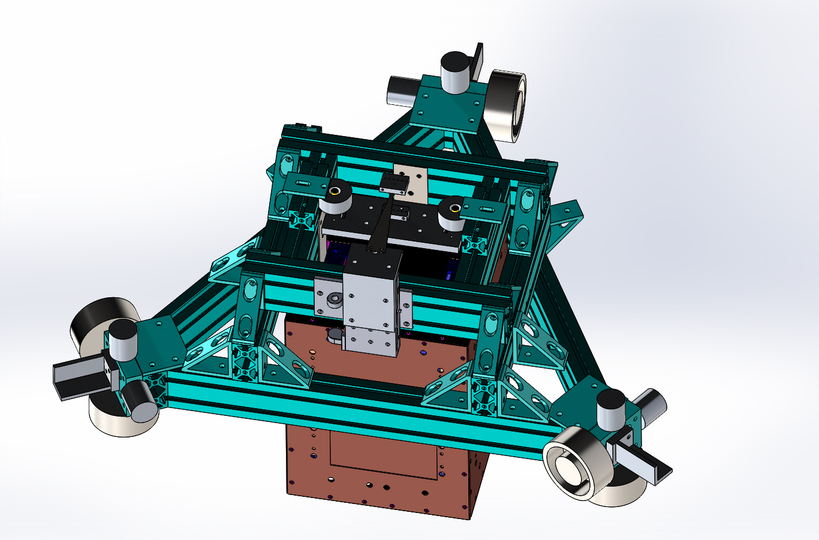
The complete heat shield stage
Geophones
OSEM flag post
Actuator magnets

Slide 57
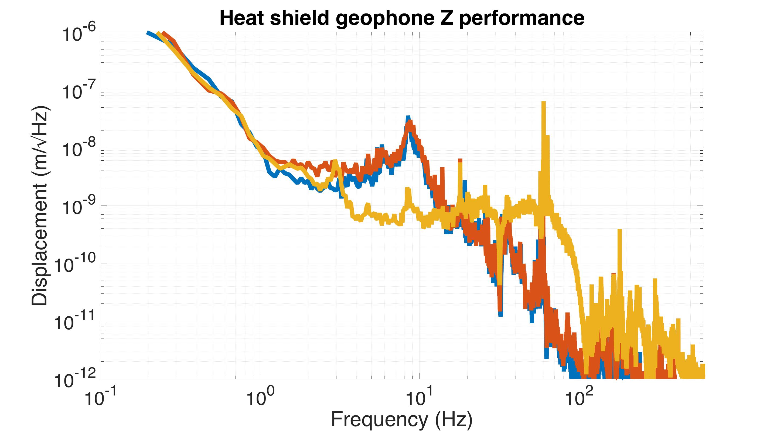

Slide 58
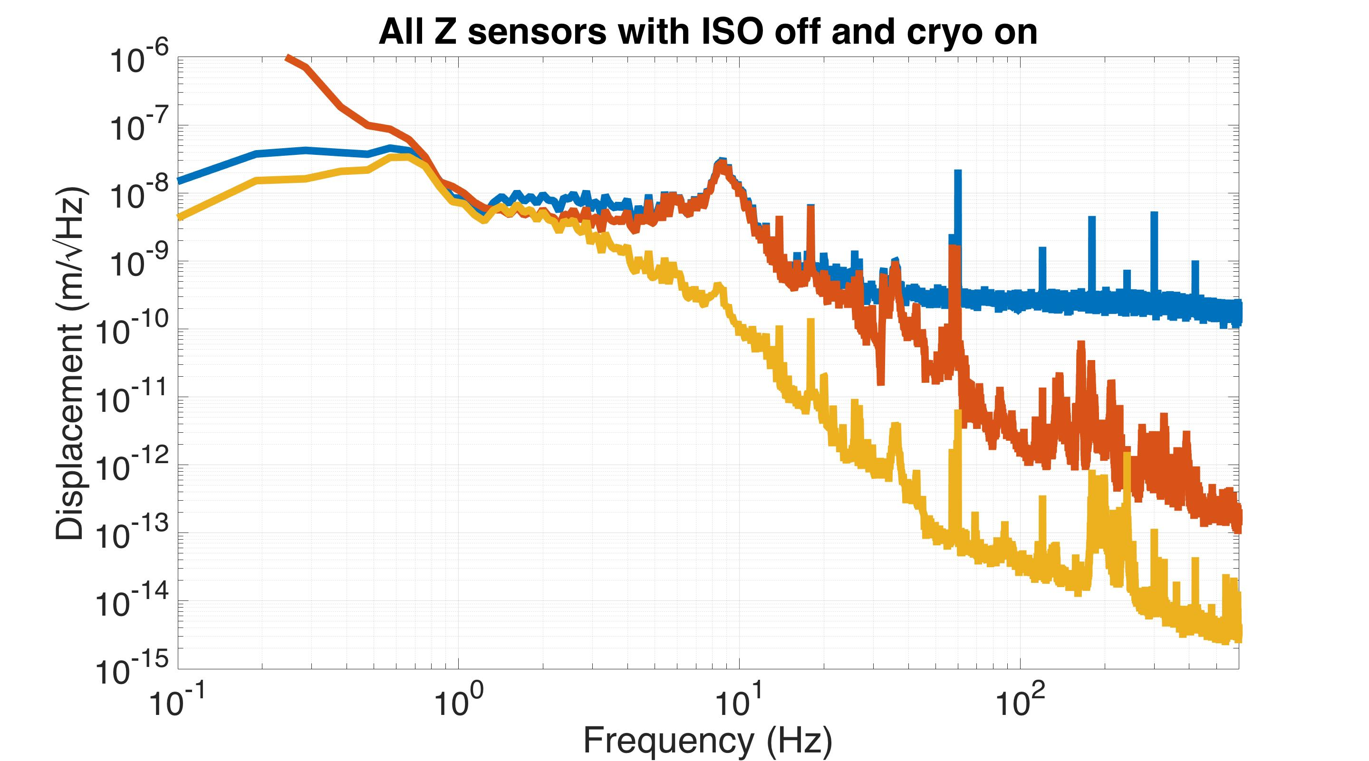

Slide 59
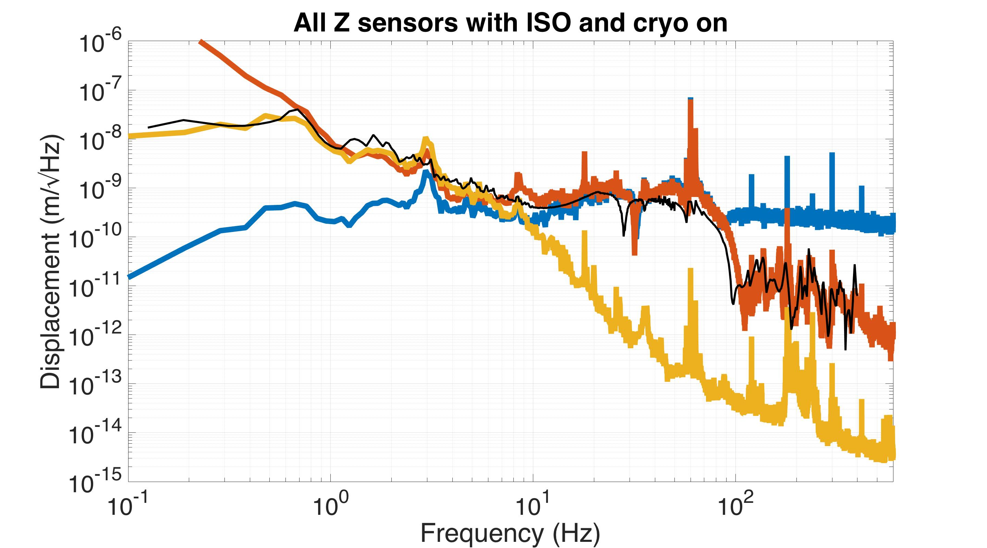

Slide 60
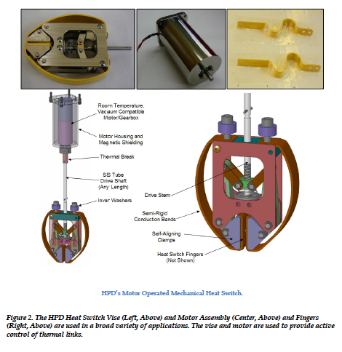
HPD cold fingers

Slide 61
HPD Braids

