Slide 1
Interferometer configurations for Gravitational Wave Detectors
引力波
LIGO-G1601926-v1
Koji Arai (新井宏二) – LIGO Laboratory / Caltech
GW mini-school: Beijing Normal University 2016/9/15~18

Slide 2
Optical configurations

Slide 3
Laser interferometry
GW detection
= High sensitive detection of displacement
Laser interferometry is an indispensable technology (lambda ~ 1um)
We use optical cavities in many places
What is an optical cavity?

Slide 4
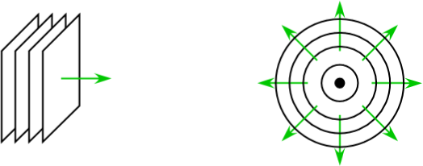
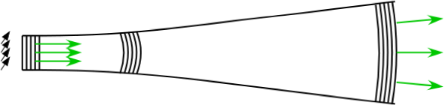
Gaussian beam
Propagation of EM waves
  Plane wave Spherical
  wave
  Gaussian beam:
  A solution to paraxial approximated wave equation
  Amplitude distribution of the beam is Gaussian
Equiphase
Planes
Rayleigh range
Coherent
Light source
Spherical-
wave like
waist
divergence
angle
Plane-wave like

Slide 5
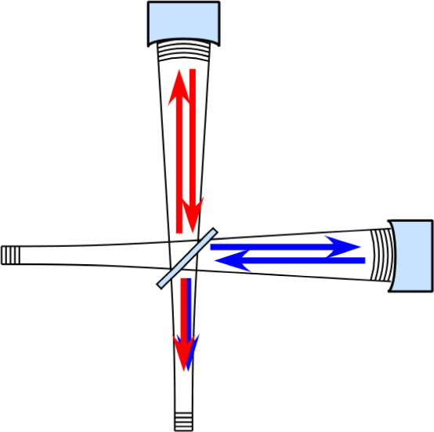
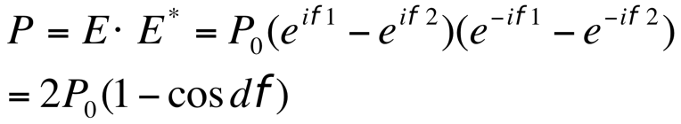
Fringes
Two beams overlap at the BS
Differential change of the arm length
=> fringe condition changed
Power
Bright Fringe
Power
Dark Fringe
dx

Slide 6
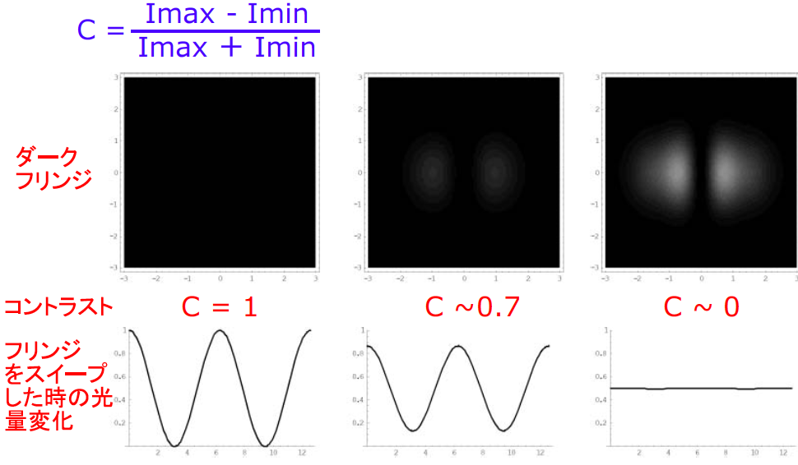
Fringes
Contrast
Contrast Defect with mirror tilting
Dark Fringe
Contrast
Light intensity
at the output with a mirror swept

Slide 7
Simplified interferometer GW detector
Differential motion => Michelson interferometer

Slide 8
Introduction ~ Interferometer?
Interferometry
  Utilize characteristic of a Michelson
  interferometer as a length comparator
Michelson
Interferometer
In reality...
Fabry-Perot cavity
Advanced LIGO
Dual-Recycled Fabry-Perot Michelson Interferometer
No worries: It’s just a combination of MI and FPs

Slide 9
Plain wave (single mode) model

Slide 10
Michelson interferometer
Light intensity at the output port
  Difference of the electric fields from the arms
  Output intensity is sensitive
  to the differential phase

Slide 11
Michelson interferometer
Frequency response of the Michelson to GWs
Frequency response
of the Michelson interferometer
Ω: optical angular frequency, λ_{OPT} laser wavelength
ω: angular frequency of GW, λ_{GW} wavelength of GW
Jean-Yves Vinet,et al
Phys. Rev. D 38, 433 (1988)

Slide 12
Michelson interferometer
Frequency response of the Michelson to GWs
Cut off freq
longer -> lower
DC Response
longer -> larger
Notch freq
f = n c / (2 L)
  Michelson arm length optimized for 1kHz GW
  -> 75km, too long!

Slide 13
Michelson shot noise limit
Quantum noises: Shot noise
  Photon shot noise associated with photodetection
  Michelson interferometer
  Michelson response (@DC)
  i_{DC} : DC Photocurrent
  η : PD Quantum Efficiency
  ν : Optical Frequency
at the limit of d𝜙->0
Michelson
Strain Sensitivity
Shot-noise limit of the Michelson phase sensitivity
  1.3x10⁻²⁰ 1/sqrtHz
  @1W, 1064nm, 4km
  (5x10⁻¹⁷ m/sqrtHz)

Slide 14
Supplemental slide
Shot noise derivation

Slide 15
Fabry-Perot optical resonator
Storing light in an optical cavity
  Input vs circulating: constructive
  Prompt reflection vs leakage: destructive
  => The circulating field grows up
  N times more power
  Equivalent to have N times longer arm
99%
99.999%
Finesse
Folding Number

Slide 16
Fabry-Perot optical resonator
Storing light in an optical cavity

Slide 17
Fabry-Perot optical resonator
Storing light in an optical cavity
  Field equations
Very fast phase response

Slide 18
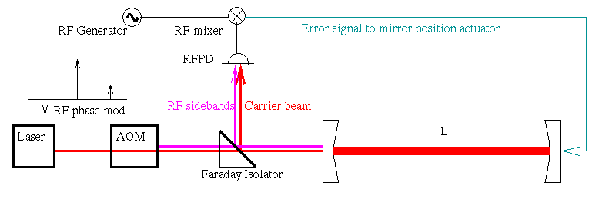
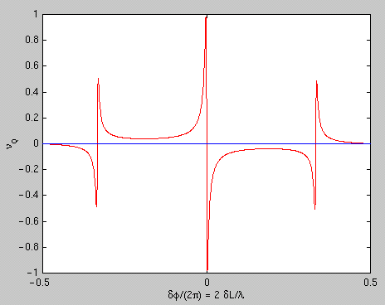
Pound-Drever-Hall technique (PDH)
Signal extraction scheme for the cavities
  Phase modulation -> RF optical sidebands
  Reflected beam -> detected / demodulated
V
Laser
Electro-Optic
Modulator
Faraday
Isolator
or
Pick-off mirror
dL or f

Slide 19
Fabry-Perot optical resonator
Storing light in an optical cavity
Finesse
Cutoff freq “Cavity pole”
DC Response
amplification
  1. FP increases stored power in the arm
  2. FP increases accumulation time of the signal
  => Above the roll-off, increasing F does not improve the response

Slide 20
Fabry-Perot Michelson Interferometer
Differential nature of the Michelson
+ Longer photon storage time of Fabry-Perot cavities
= Fabry-Perot Michelson Interferometer
Basic form of the modern interferometer GW detector

Slide 21
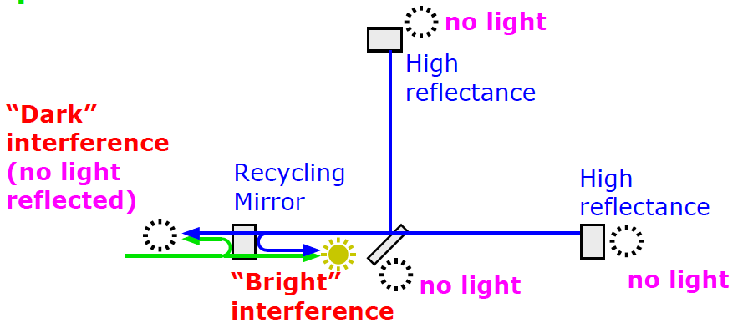
Optical Recycling Technique
Power recycling
  Place a mirror in front of the interferometer
  to form a cavity with the Michelson (compound mirror)
  “Power Recycling Mirror”
  The internal light power is increased
  = equivalent to the increase of the input laser power
compound mirror

Slide 22
Optical Recycling Technique
Power-recycled Fabry-Perot Michelson Interferometer
  Internal light power in the arms is increased
From the laser side /
common arm length change
It looks like a three mirror caivty
= high finesse cavity
For the differential motion (=GW)
It looks like just an arm cavity

Slide 23
Optical Recycling Technique
Dual-recycled Fabry-Perot Michelson Interferometer
  Another mirror is added at the dark port
  “Signal Recycling Mirror”
  Dual recycling allows us to set different storage times
  for common and differential modes
Common mode
= high finesse three mirror cavity
Differential mode (=GW)
= low (or high) finesse three mirror cavity

Slide 24
To tuned or not to tune
Bandwidth of the detector can be changed
  by changing the resonant phase of the signal recycling cavity (SRC)
Optimize the curve depending on the noise shape
Dynamic signal tracking
Signals: resonant in SRC
(Resonant Sideband Extraction)
Signals: anti-resonant in SRC
(Signal Recycling)

Slide 25
Summary
Optical phase measurement => Interferometry
Michelson interferometer: requires too long arm
Fabry-Perot arm: longer light storage time
Optical recycling technique:
allows us to set different storage time for the incident light and the GW signals
  Power recycling: maximize the stored light power
  Resonant sideband extraction: optimize the signal bandwidth

