Slide 1
LITTLE PRE-MODE CLEANER
&
TILT-FREE SEISMOMETER
Veronica Leccese, Dr. Dooley Research Group

Slide 2
Outline
Little Pre-Mode Cleaner (PMC)
Laser beam and its instability
Solution: PMC
Little PMC building
Future work
Tilt-free seismometer
Seismic noise in LIGO: solutions
Tilt-to-translation coupling and tilt-free sismometer
Tilt injection: current driver
Future work

Slide 3
LITTLE PRE-MODE CLEANER

Slide 4
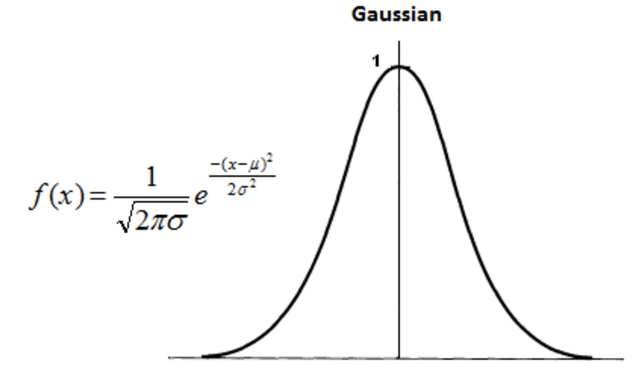
Laser emission: Gaussian beam
Gaussian beam is a beam of monochromatic electromagnetic radiation whose transverse magnetic and electric field amplitude profiles are given by the Gaussian function; this also implies a Gaussian intensity profile.
Gaussian beams and the higher-order Gaussian modes are solutions to the wave equation for an electromagnetic field in free space or in a homogeneous dielectric medium:
$${(∇}^{2}+k^{2})\tilde{E}\left(x,y,z\right)=0$$

Slide 5
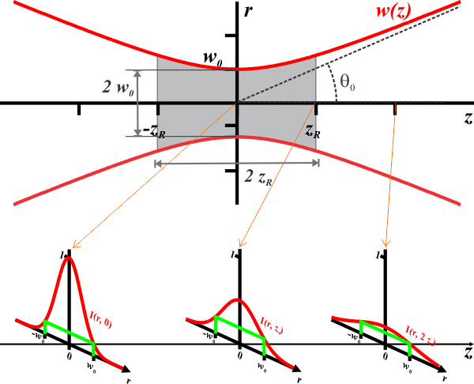
The electric field of the fundamental transverse Gaussian mode ( TEM₀₀) is:
$$E\left(r,z\right)=E_{0}\frac{w_{0}}{w(z)}exp⁡(−\frac{r^{2}}{{w\left(z\right)}^{2}}−jkz−jk\frac{r^{2}}{2R\left(z\right)}+jψ\left(z\right))$$
where
$w\left(z\right)=w_{0}\sqrt{1+{\left(\frac{z}{z_{R}}\right)}^{2}}$ is the radius at the plane z
$$z_{R}=\frac{π}{w_{0}^{2}λ}$$
is the Rayleigh length
$R(z)=z[1+{\left(\frac{z}{z_{R}}\right)}^{2}]$ is the radius of curvature of the
beam’s wavefront
$ψ(z)=\tan^{−1}(\frac{z}{z_{R}})$ is Gouy phase shift

Slide 6
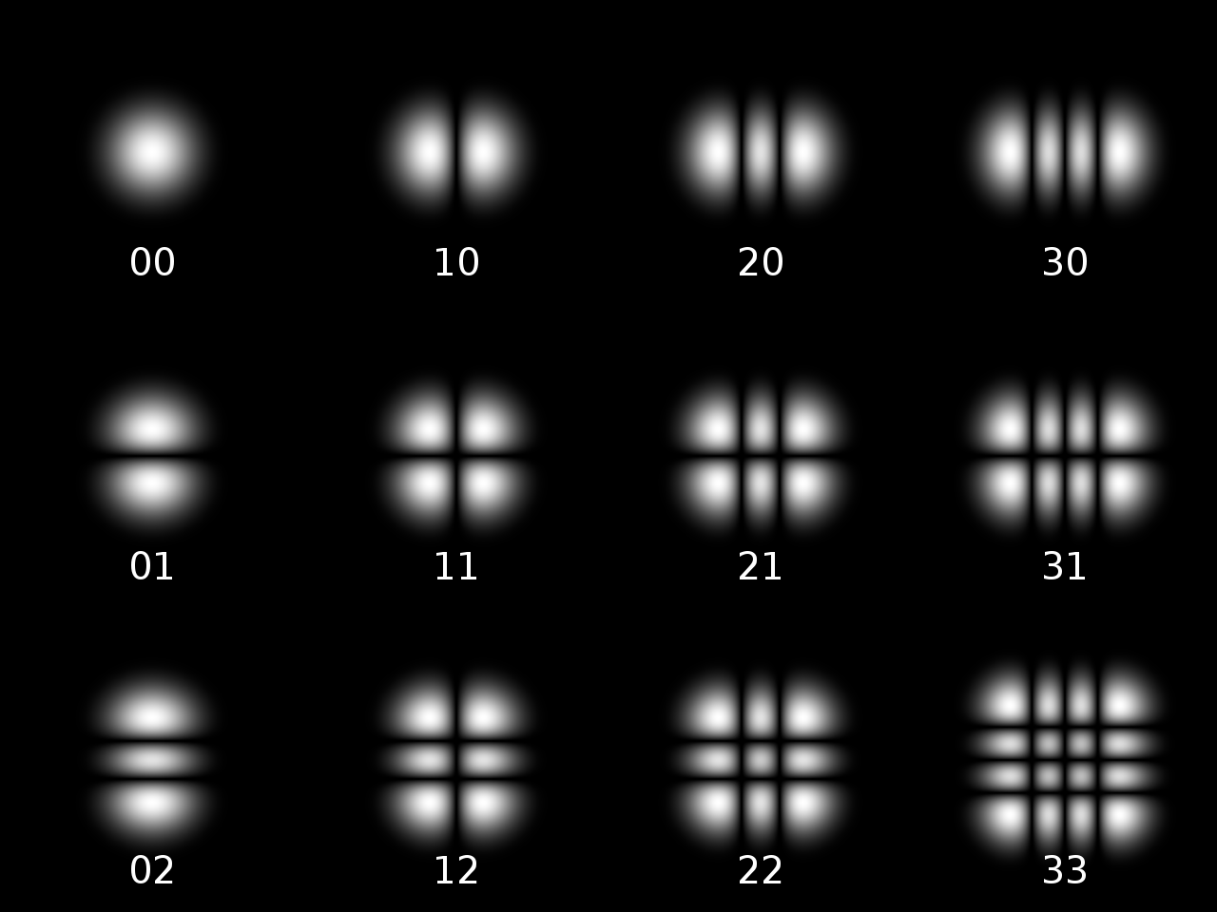
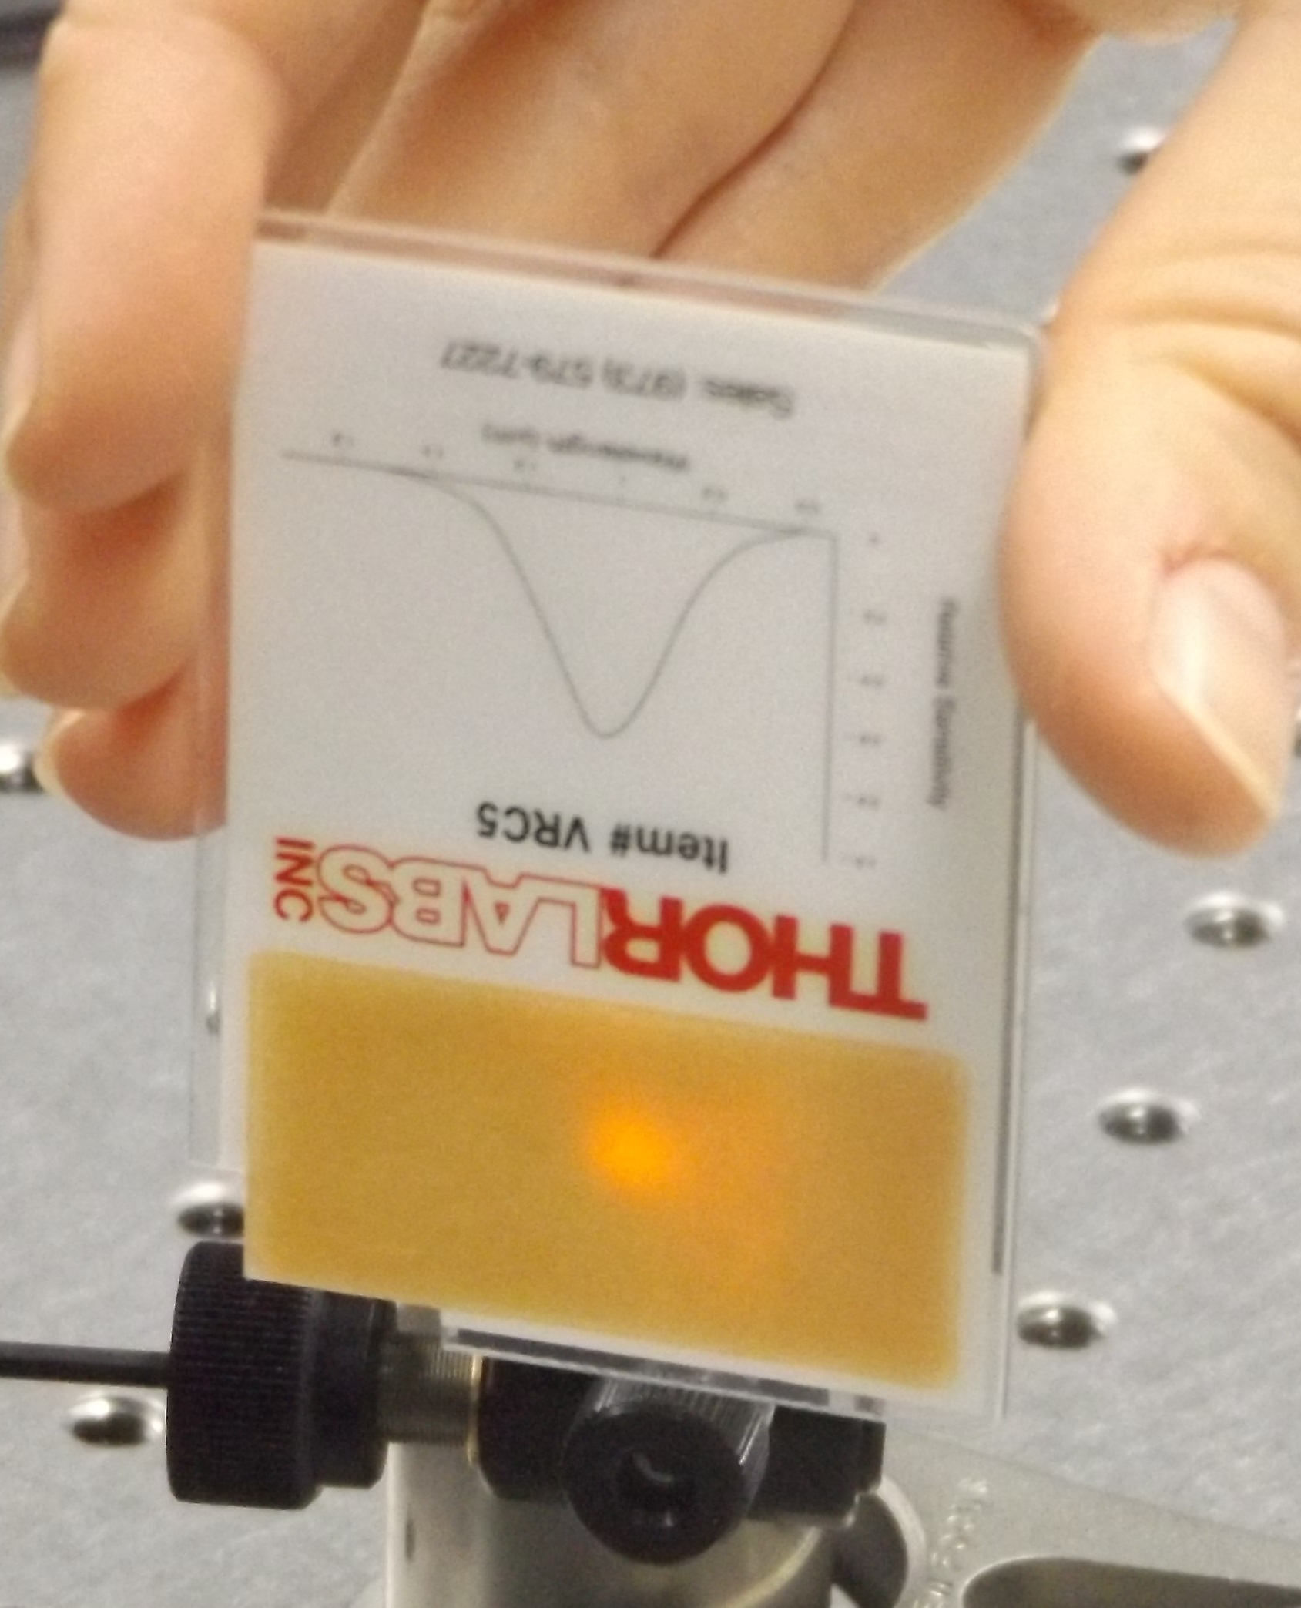
TEM₀₀ describes the intended output of most lasers, as such a beam can be focused into the most concentrated spot
Problem:
the electric field of the laser beam cannot be described only by the one of TEM₀₀ because of the presence of higher-trasversal modes.
$$T_{mn}$$
Wikipedia

Slide 7
Instability of the laser beam
Spatial instability, known as beam jitter, is due to the mixing of higher order modes with the fundamental mode (TEM00).
Amplitude and phase fluctuations are created by beam jitter whenever the beam interacts with a spatially sensitive element such as an optical cavity
Frequency instability
NOISE SOURCES

Slide 8
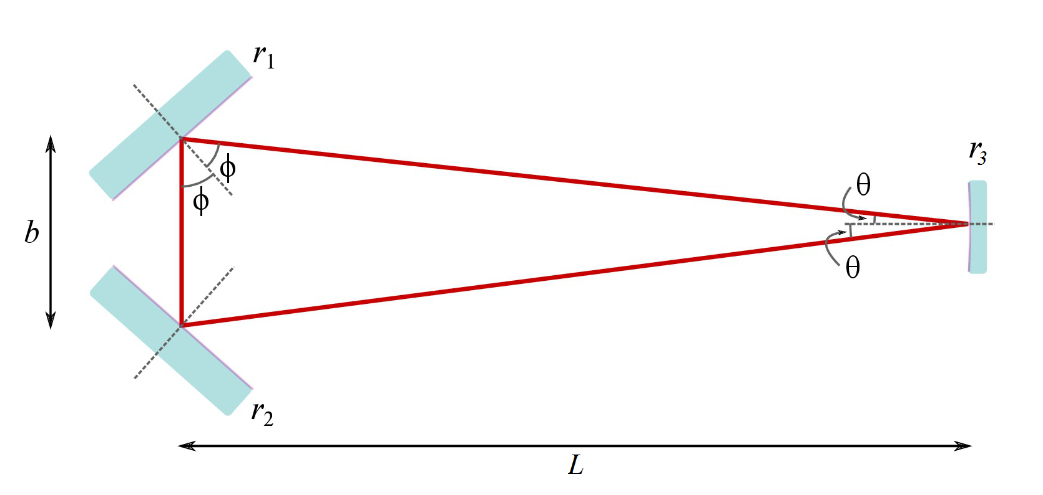
Solution: Pre-Mode Cleaner (PMC)
It’s a triangular ring cavity

Slide 9
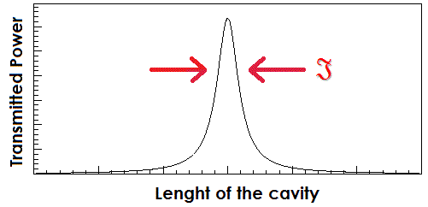
Only the fundamental mode is resonant – hence ‘Mode cleaner’ - and the higher order modes, having different cavity eigen frequencies, are attenuated or suppressed.
Transmission = $T_{mn}=T_{00}\frac{1}{{\left[1+{\left(\frac{2}{π}𝔍sin\left(\frac{2πL}{c}∆ν_{mn}\right)\right)}^{2}\right]}^{1/2}}$
where
$𝔍$ is the finesse of the cavity
$∆ν_{mn}=\frac{c}{2L}(m+n)\frac{1}{π}arccos⁡(\sqrt{1−\frac{L}{R}})$
is the difference in frequency between any higher order mode TEM_{mn} and the fundamental mode TEM₀₀

Slide 10
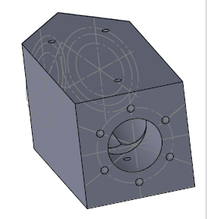
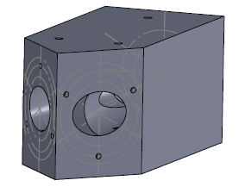
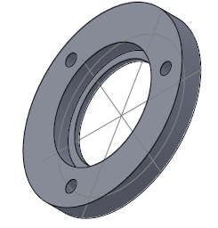
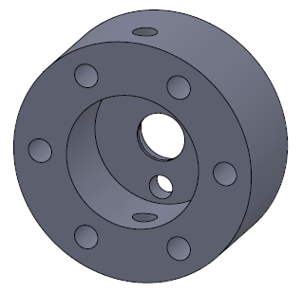
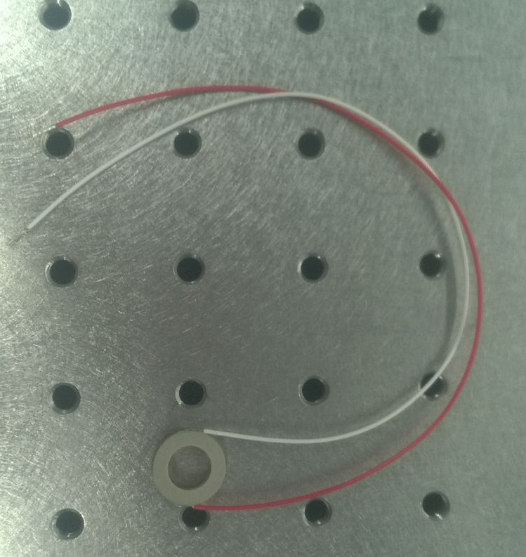
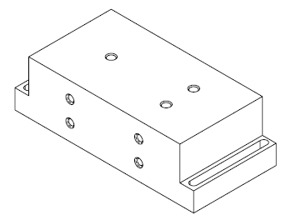
Building a Little PMC
What do we need?
A spacer
Two clamps and an endcup
A base
Two flat mirrors and a curved mirror
Piezoelectric transducer (PZT)
DCC E1400332-v1

Slide 11
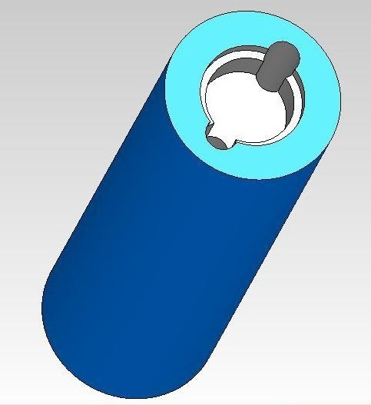
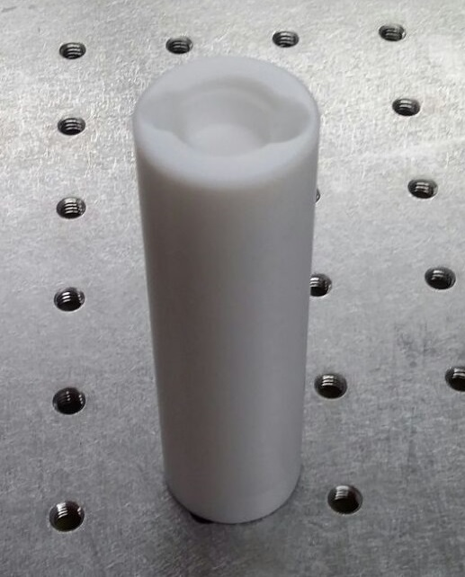
Jig

Slide 12
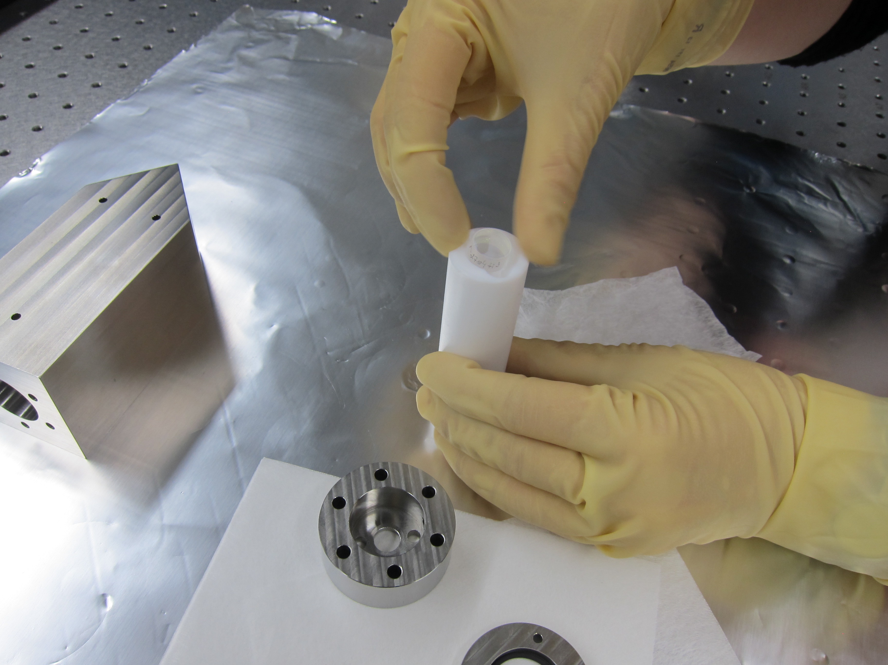

Slide 13
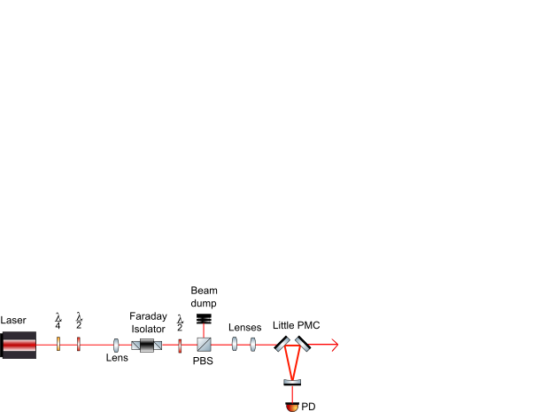
Set up for testing the Little PMC
z

Slide 14
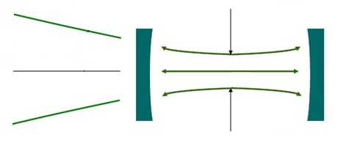
Mode matching
How much is the waist of the beam?

Slide 15
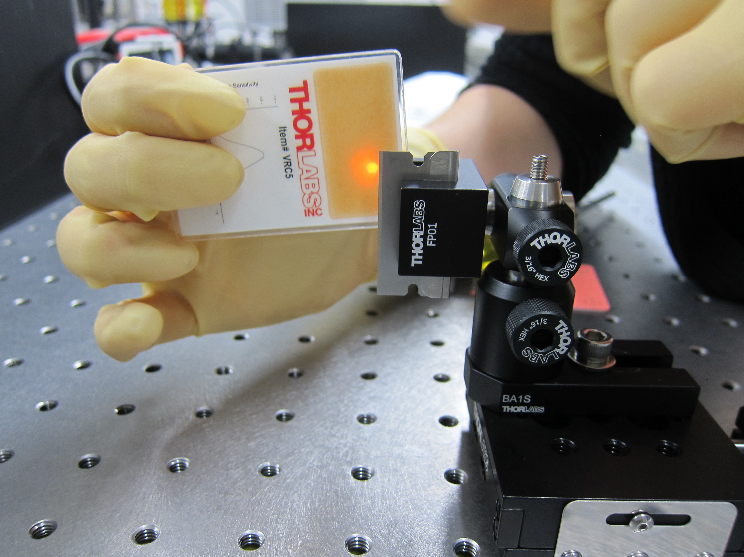
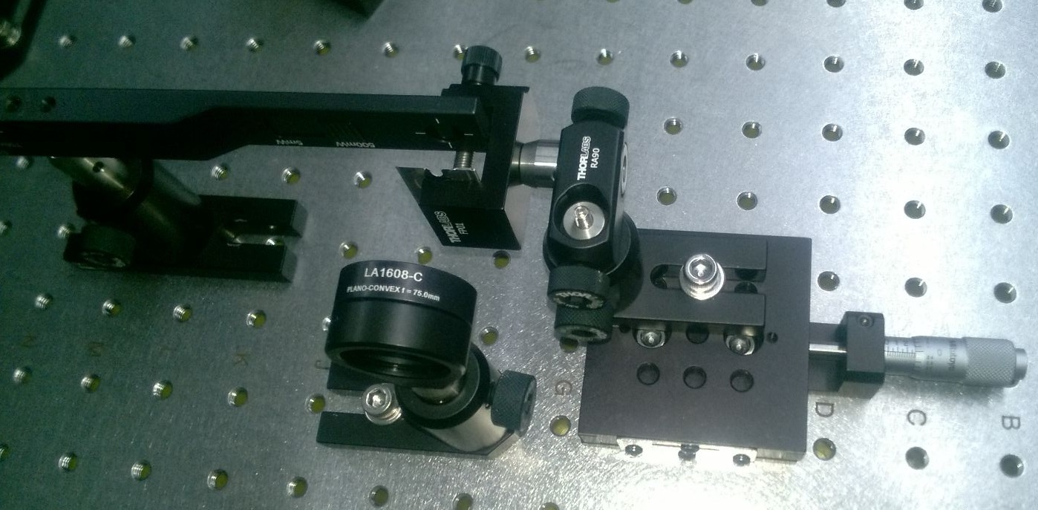
Measuring the beam size

Slide 16
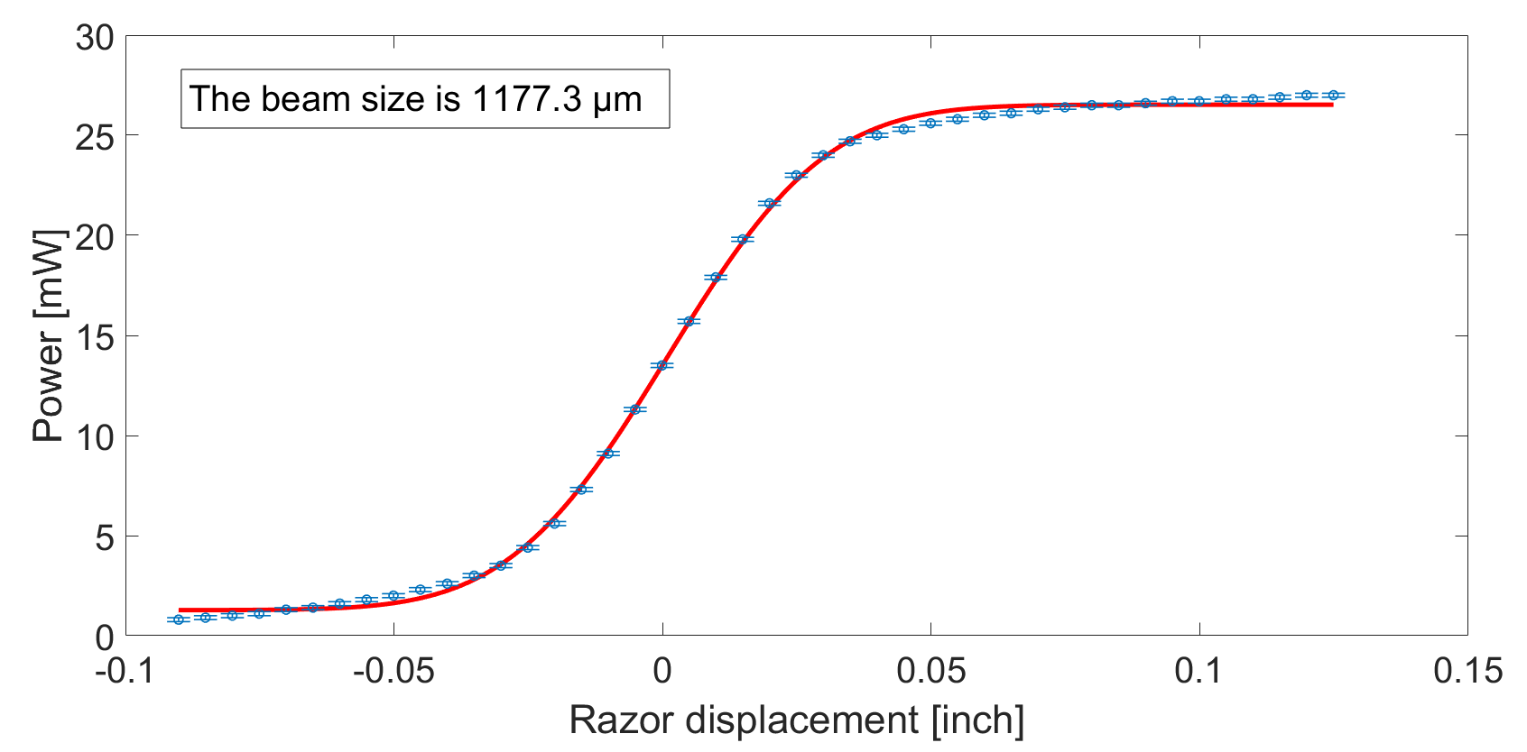
$$P(x,y)=\int_{−∞}^{+∞}{\int_{−∞}^{x}{\frac{2P_{0}}{πw{\left(z\right)}^{2}}}exp(\frac{−(2x^{′2}+2y^{2})}{w{\left(z\right)}^{2}})}dx^{′}dy$$

Slide 17
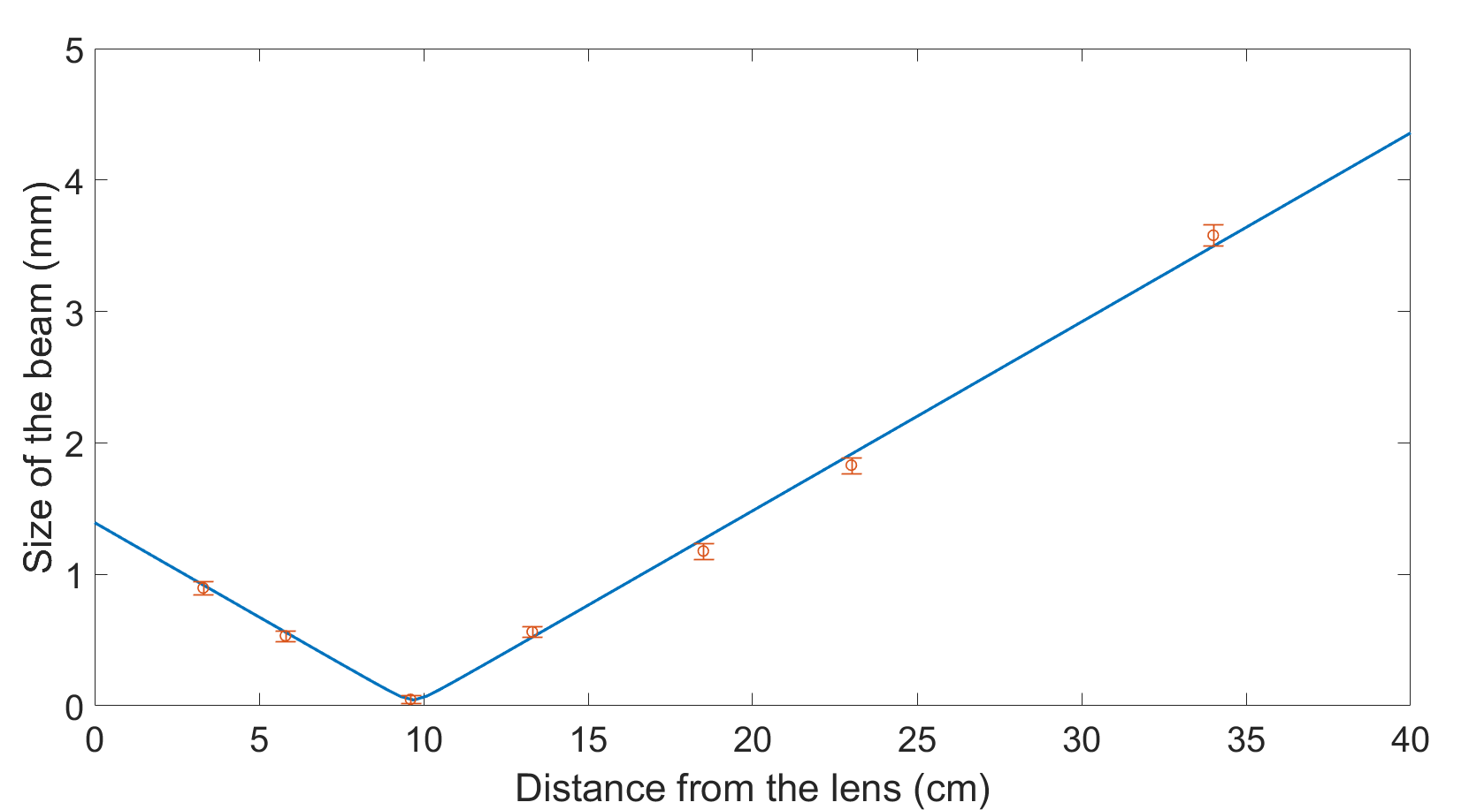
$$z (cm)$$ | $$w(z) (mm)$$
3.3±0.5 | 0.90±0.05
5.8±0.5 | 0.53±0.04
9.6±0.5 | 0.049±0.003
13.3±0.5 | 0.56±0.04
18.5±0.5 | 1.18±0.06
23±0.5 | 1.83±0.06
34±0.5 | 3.58±0.08
$$w\left(z\right)=w_{0}\sqrt{1+{\left(\frac{z}{z_{R}}\right)}^{2}}$$
$w_{0}=0\text{.043}\text{±}0.003 mm$ $w_{0}^{th}=0.04\text{4}\text{±}0.001mm$
$z_{0}=9.4 \text{±}$ $0.\text{5} mm$from the lens

Slide 18
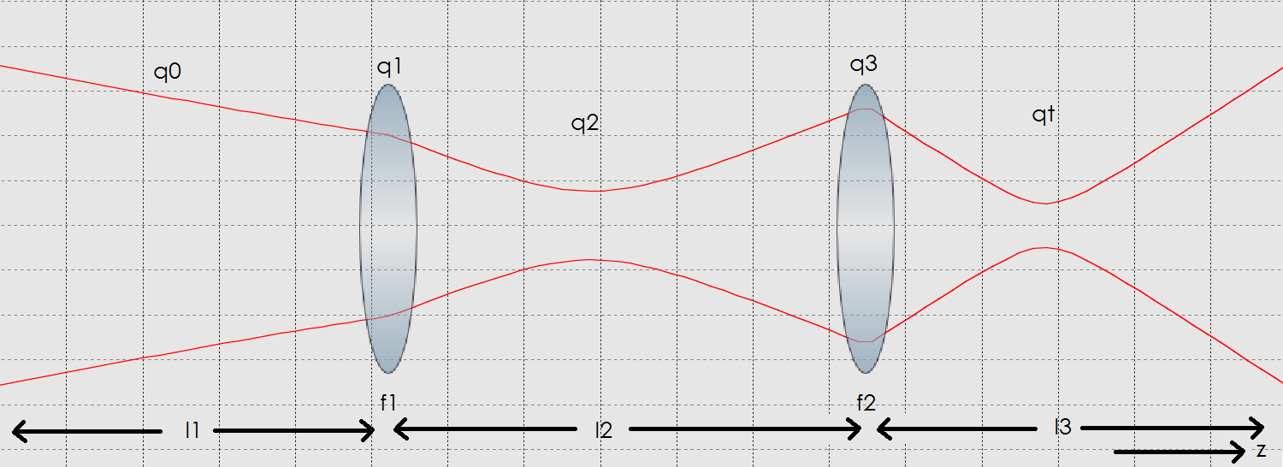
Choise of lenses
$$\left(\begin{matrix}1 & z_{t} \\ 0 & 1\end{matrix}\right)\left(\begin{matrix}1 & 0 \\ −1/{f_{2}} & 1\end{matrix}\right)\left(\begin{matrix}1 & l_{2} \\ 0 & 1\end{matrix}\right)\left(\begin{matrix}1 & 0 \\ −1/{f_{1}} & 1\end{matrix}\right)\left(\begin{matrix}1 & l_{1} \\ 0 & 1\end{matrix}\right)\left({1 \atop 1/{q_{0}}}\right)=\left({1 \atop 1/{q_{t}}}\right)$$
where
$$\frac{1}{q}=\frac{1}{R}−j\frac{λ }{π{w(z)}^{2}}$$
and
$$q=\left(z−z_{0}\right)+q_{0}$$

Slide 19
Future work
Gluing the PZT to the mirror and the mirror on the endcup
Driver for the PZT
Lock the PMC
Characterize the PMC (i.e. measure the mode matching and the transmission)
Use the cavity in optic experiments (e.g. squeezed light)

Slide 20
TILT-FREE SEISMOMETER

Slide 21
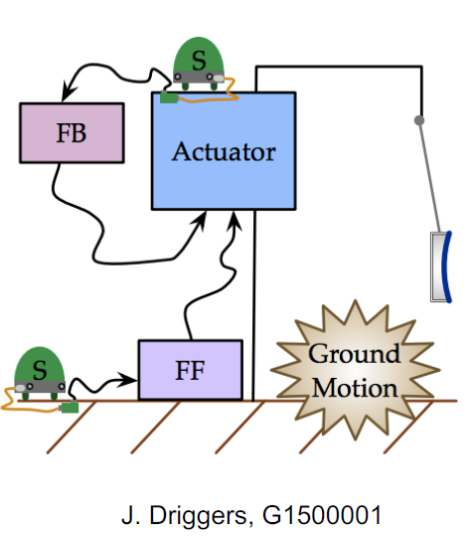
Seismic noise in LIGO: solutions
Seismic noise due to vibration of the laboratory is a low frequency limit for the interferometer in LIGO
Active isolation
Passive isolation
Multiple stages platforms separated by spring assembly for the optics and suspension of the optics themselves

Slide 22
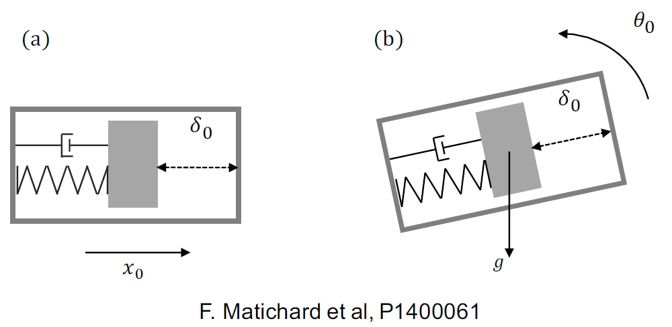
Active isolation problem: tilt-to-translation coupling
At low frequency (< 40 mHz) the seismometer signals are too contaminated by ground tilt to be used for active control

Slide 23
Two different approches
Measuring tilt
Filtering tilt
Independently measure ground tilt and subtract it
Mechanically filter tilt
Suspended structure

Slide 24
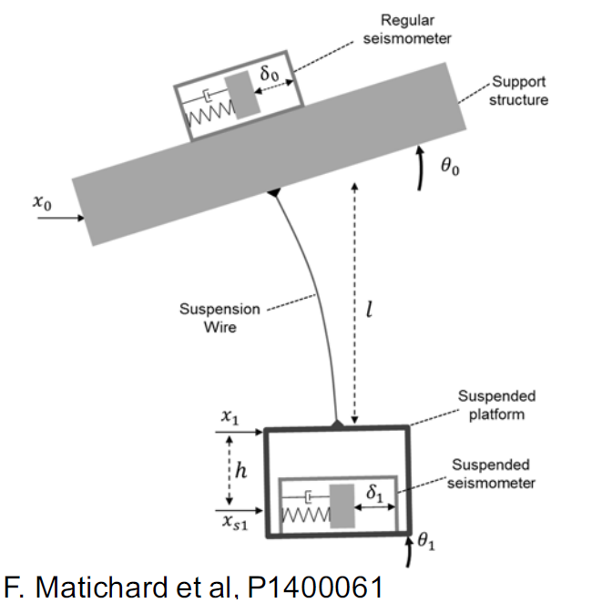
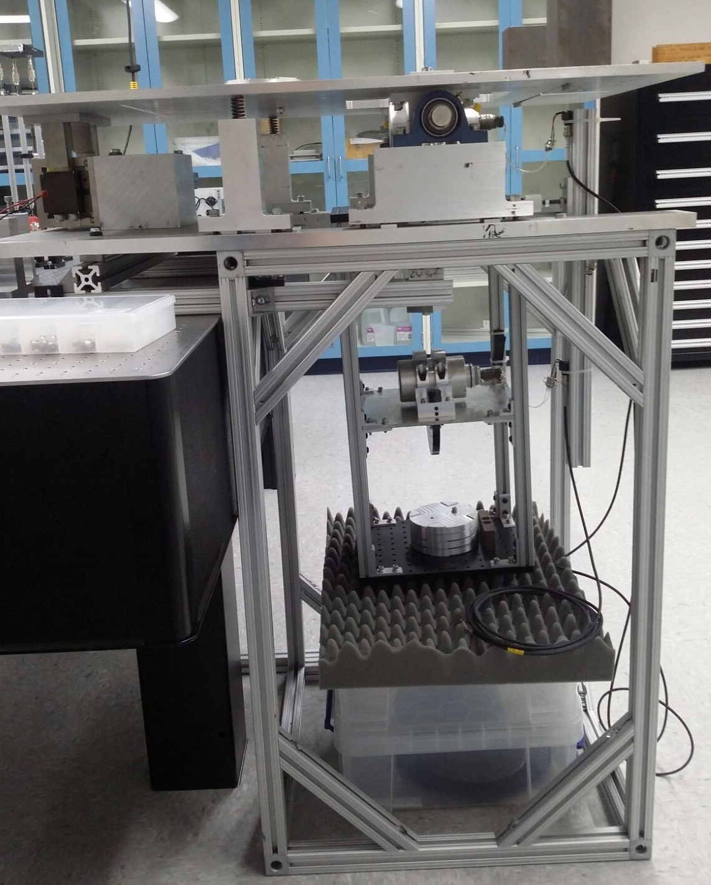
Tilt-free seismometer

Slide 25
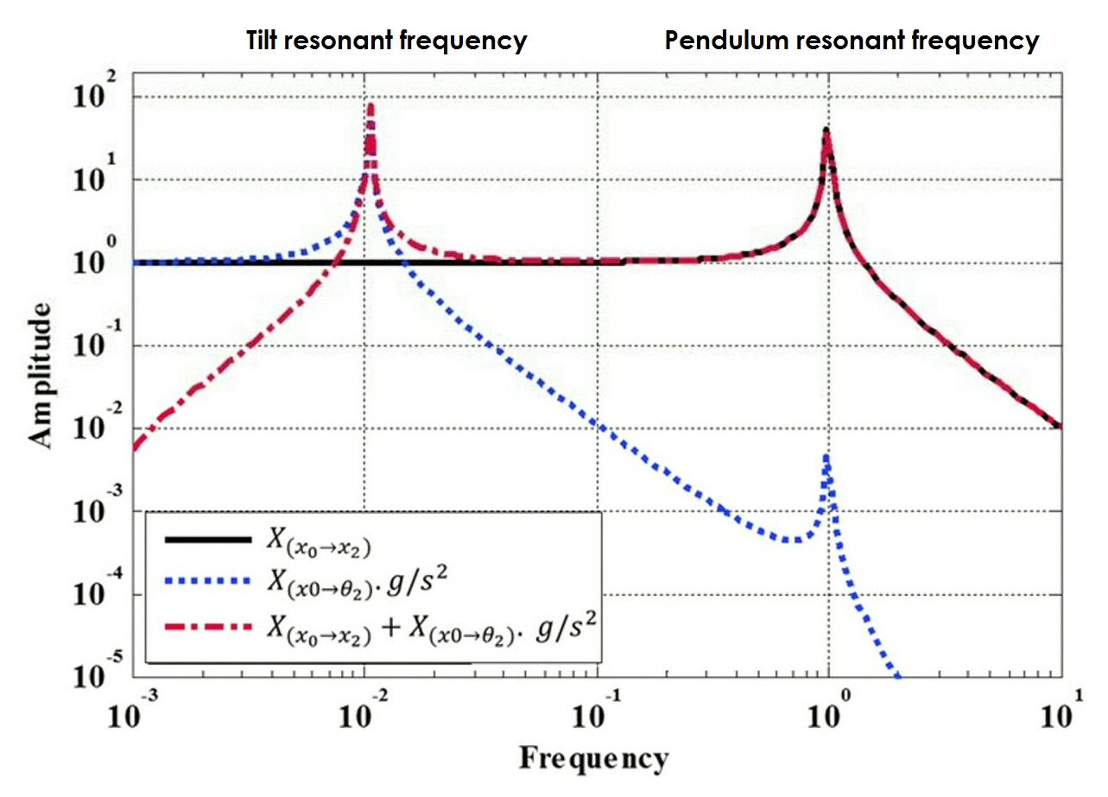
Below the pendulum resonant frequency: the suspended platform motion follows ground translation
Above the tilt resonant frequency: ‘tilt-free’
Between the tilt and pendulum frequencies: good translation sensitivity of the suspended seismometer
F. Matichard, DCC P1400060

Slide 26
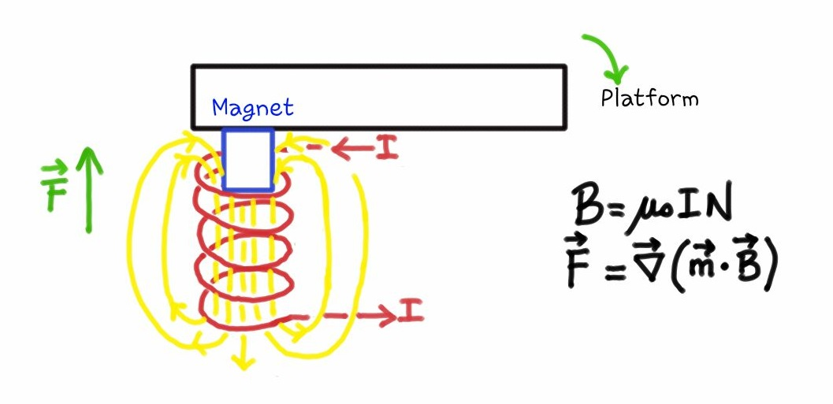

Slide 27
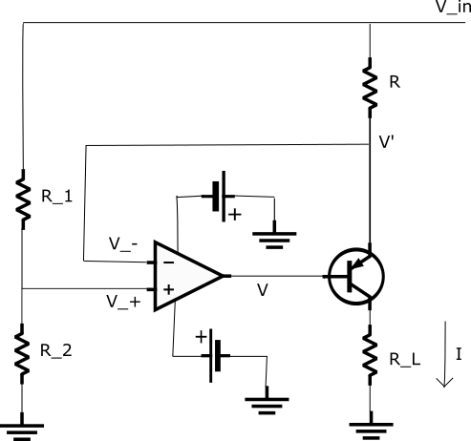
Tilt injection: current driver for the coil
$$V_{+}=V_{−}=V^{′}=V_{in}\frac{R_{2}}{{(R}_{1}+R_{2})}$$
$$V_{in}−V^{′}=RI$$
$$I=\frac{V_{in}(1−\frac{R_{2}}{{(R}_{1}+R_{2})}) }{R}$$

Slide 28
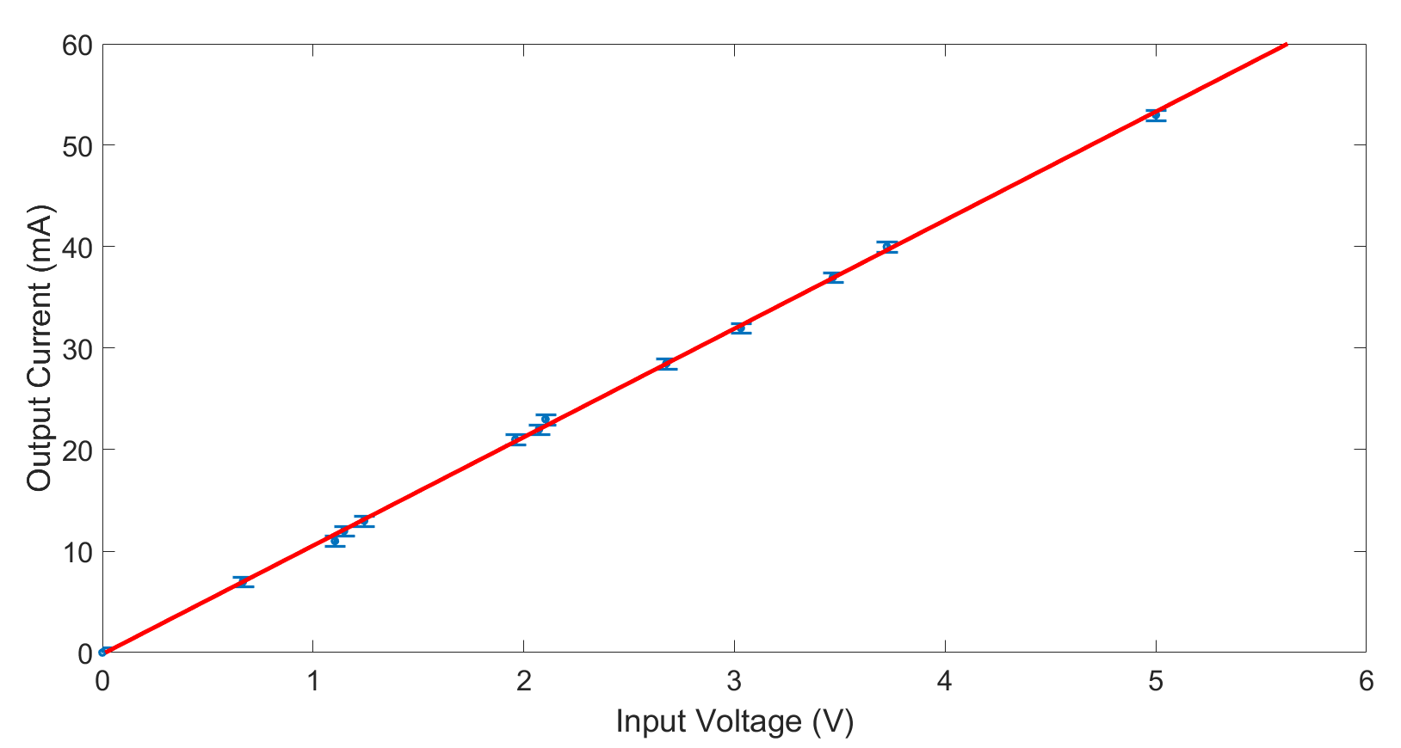
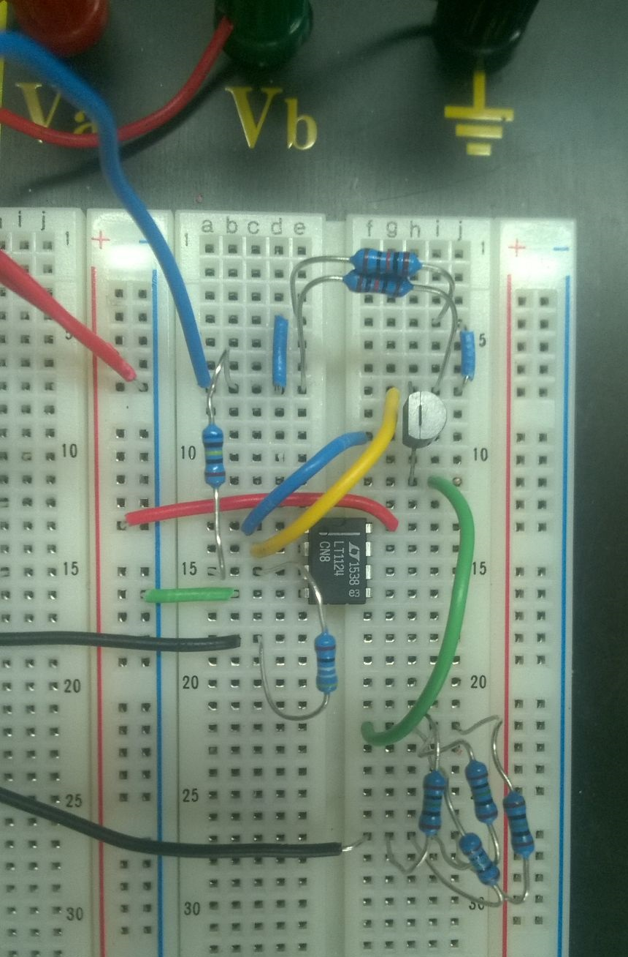

Slide 29
Future work
Test the circuit with the coil
Solder components to breadboard
Measurement of the tilt to displacement transfer function

Slide 30
Acknowledgments
Dr. Kate Dooley
Dr. Marco Cavaglià
Dr. Antonio Perreca
Dr. Lucien Cremaldi
Dr. Giancarlo Cella
Mohammad Afrough
Camillo Cocchieri
INFN, NSF and LIGO
Thank you for your attention!

