Slide 1
Guestimation of large angle scattering
H. Yamamoto
Limited data and knowledge about large angle scattering
  Discrepancy between data about test mass mirrors and the arm loss
  Uncertainty about the prediction of stray lights
Loss = mirror surface aberration disturbance in a cavity
  More data of uncoated surface and limited data of coated surface
  How to connect uncoated surface data to coated surface information
  How to properly include necessary effects, like source size effect, diffraction effect …
Limited in situe measurements
  OpLev BRDF : BRDF(ITM@1.2°) ~ 10 x BRDF(ETM@7.7°)
  ACB PD – proper handling of diffraction tail
  Camera image
What are useful for further understanding
  Scattering with spatial wavelength of 0.05~1mm
  Scattering in angle > 20°
  Integrating sphere covering smaller angle
  ???
1

Slide 2
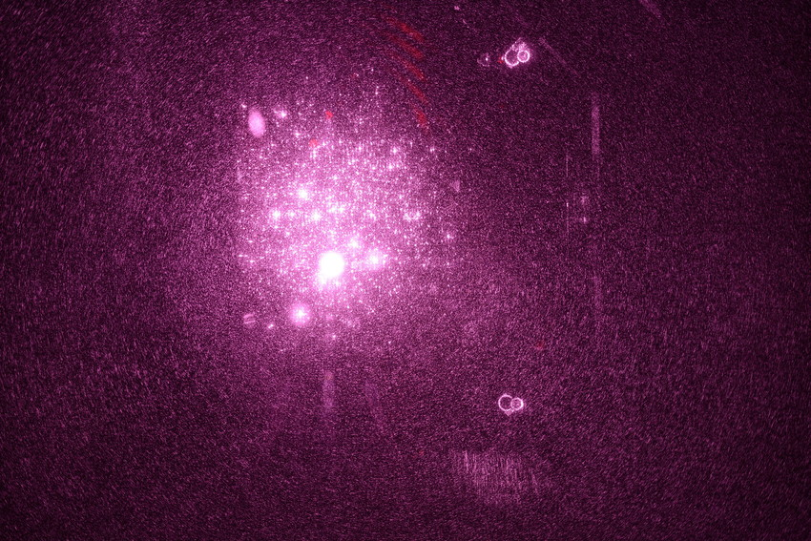
Different faces of mirror surface
Phasemap of coated and uncoated surface
ETM Pcal Camera Image
1cm
1mm
Phasemap and PMM
Integrating sphere loss histogram

Slide 3
IFO Geometry
0.66°
0.0024°

Slide 4
mirror surface aberration and scattered fields
Huygen’s integral
Far field distribution & ASD/PSD
No far field interference effect on dP
dP/P~(a/w)² =(0.5μ/5cm)²=10⁻¹⁰
(D~1/2π)

Slide 5
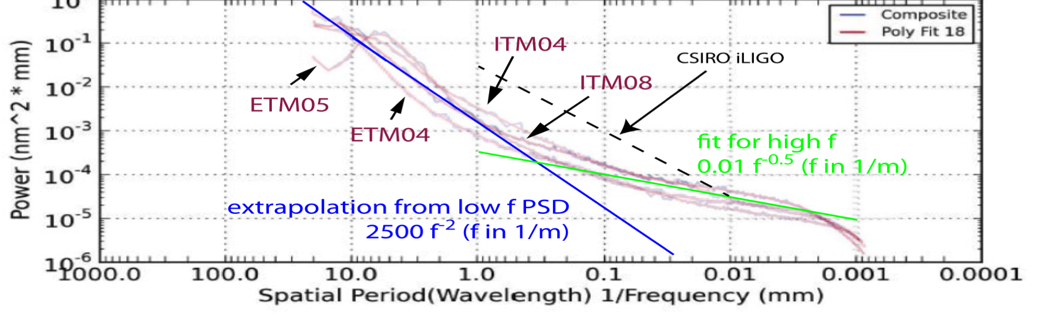
IFO geometry and
mirror surface wavelength
Polished surface PSD
Polished surface PSD
Integrating sphere
BRDF
θ=λ_{laser}/λ_{spatial}

Slide 6
Distrubance of field in a cavity
Mirror finite aperture | Surface figure error | Microroughness - PSD | Point defects
Non-gaussian diffraction tail ~ θ⁻³ | Change of resonating field and larger tail | Fixed angle scattering by interference of far field | Scattering by small sources located randomly
1.9ppm for A=32.6cm | H1x:20ppm,H1y=16ppm L1x:18ppm,L1y=15ppm | 10~20ppm ? | 10~30ppm ?
Airy ring outside of mirror θ < 0.003° | λs > 5mm or θ < 0.01° | λs < 1mm or θ > 0.06°, BRDF~1/θ^{n}, n~1.5-3 | All angle, measurable at large angle ?

Slide 7
Field around mirror with airy ring
Airy ring

Slide 8
Field tail by figure error

Slide 9
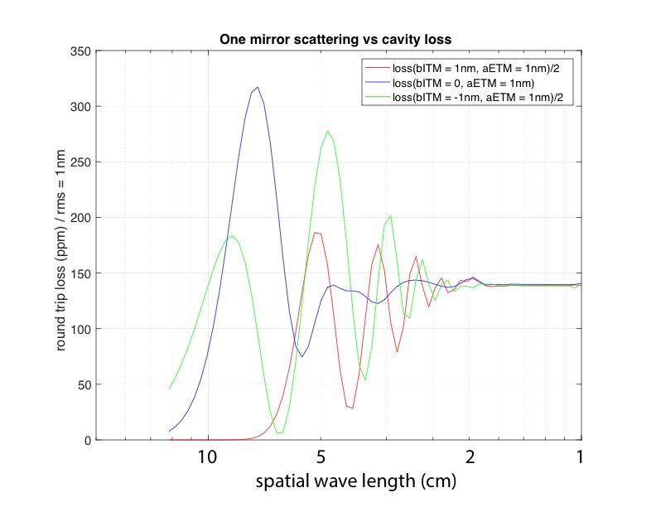
Surface aberration and cavity loss or when golden rule applies
Loss by aberration on two mirrors are independent, or scattered fields are out of cavity, or GOLDEN RULE
λ_{s}
Loss depends on relations of aberrations, or scattered fields stay in cavity

Slide 10
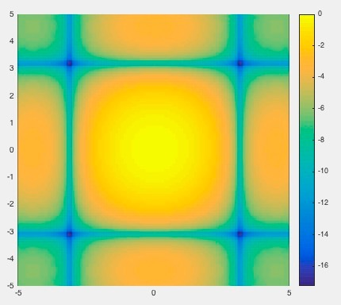
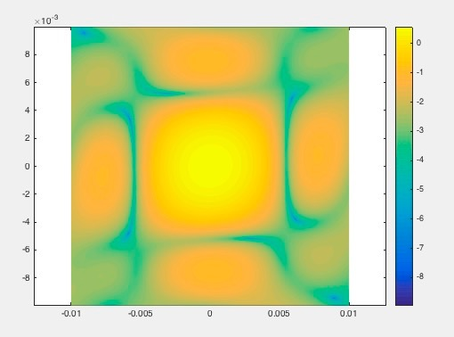
Angular distribution scattered by small anomalies
Power distribution depends on the size of source
Clustered small sources scatter like a big source
Far field
sources

Slide 11
Uncoated surface PSD and known losses

Slide 12
BRDF by OpLev for ITM and ETM
L1 alog 28668, H1 alog 30622
 | ITMX | ITMY | ETMX | ETMy
 | θ=1.2° |  | θ=7.7°
L1 | 250ppm | 500ppm | 30ppm | 43ppm
H1 | 260ppm | 420ppm | 37ppm | 28ppm
Polished surface PSD to BRDF
OpLev BRDF : reflection by coated surface from all sources
BRDF(θ)=A x polished surface BRDF + total point scatter / 2π
A = 8, total point scatter = 30ppm

Slide 13
OpLev data and PSD

Slide 14
Integrating sphere large (θ > 1°) and small(θ < 1°) angle
Lens moved out of the path to reduce noise
Beam diverging toward the second mirror,
which induces larger tail noise of the undisturbed beam.
Hole in the mirror
θ > 0.3°
θ > 0.7°

Slide 15
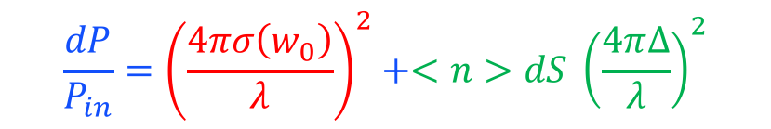
aLIGO ITM07 TIS(θ≥1°) using integrating sphere
θ≥1°
Scattering in the central 160mm by 0.4mm laser with 1mm step
Continuous roughness
Point scattering
$$\frac{dP}{P_{in}}={\left(\frac{4πσ\left(w_{0}\right)}{λ}\right)}^{2}+<n>dS {\left(\frac{4π∆}{λ}\right)}^{2}$$
σ(w) : rms with f > 1/w
<n> : density of point defects
dS : size of point defect
Δ : characteristics of point defect

Slide 16
Roughness before and after coating
<TIS> data (w/ coating) vs Zygo rms (w/o coating) at λ_{space} = 70 ~1μm :
rms(w/ coat) ~ a few x rms(w/o)
PSDs with and without coating
λ_{s} > several mm : figured changed
λ_{s} ~ few mm : roughness amplified?
σ=0.68nm
50x PMM
Unoated surface loss
2mm
σ=0.17nm
σ=0.30nm
Coated surface loss
2mm
σ=0.16nm

Slide 17
PD1 (1°<θ<75°) vs
PD2 (0.45°<θ<1°)
θ<1°
θ>1°
very preliminary
larger PD2 ⇒ larger coherent scattering area (single or clustered)
Insensitive to calibration
If PD2 is due to
geometry of sphere
or due to leak of PD1, PD2/PD1 will be constant
larger PD1 ⇒ larger reflector area (100ppm PD1→ > 2μm defect)
( Total reflection < laser power x reflector area )

Slide 18
Summary
Guestimation error ~ factor of several
Missing information
  Roughness at spatial wavelength ~ 0.05-1mm
  Coated surface vs uncoated surface qualities
  Total loss by random point defects
Measurements
  Upgrade of integrating sphere to cover smaller angle
  More measurements by Fizeau IFO with magnification
  Camera image analysis
  ???

