Slide 1
O2 DARM Loop Design Comparisons and Critiques
E. Goetz, J. Kissel, for the Calibration Team
For similar O1 critique, see LIGO-G1501372

Slide 2
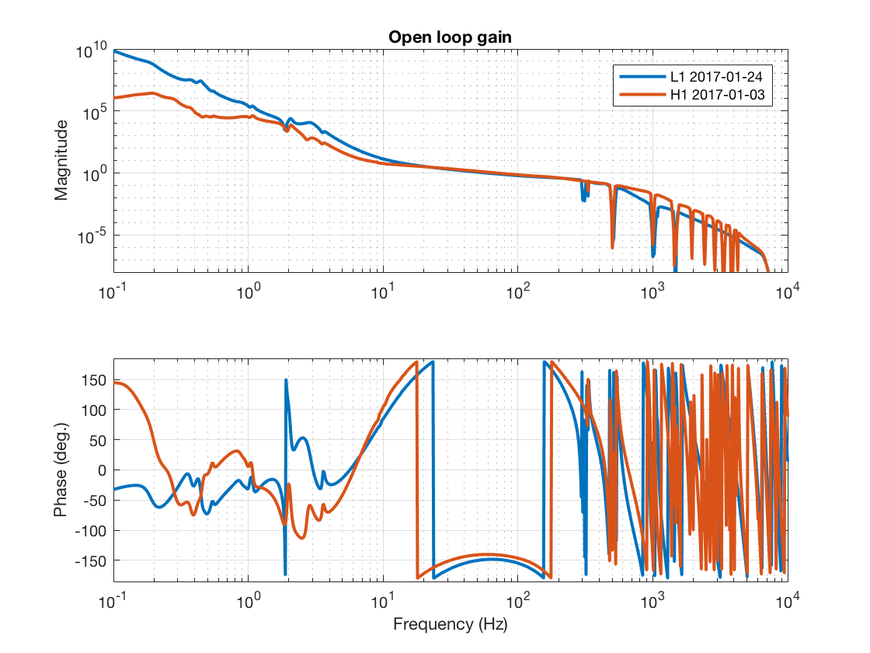
DARM Open Loop Gain TF (Big Picture)
Roughly the the same UGF
H1 has notched out 2 kHz and above violin modes
H1 still may need more gain at low frequency
Good compromise on aggression of filtering

Slide 3
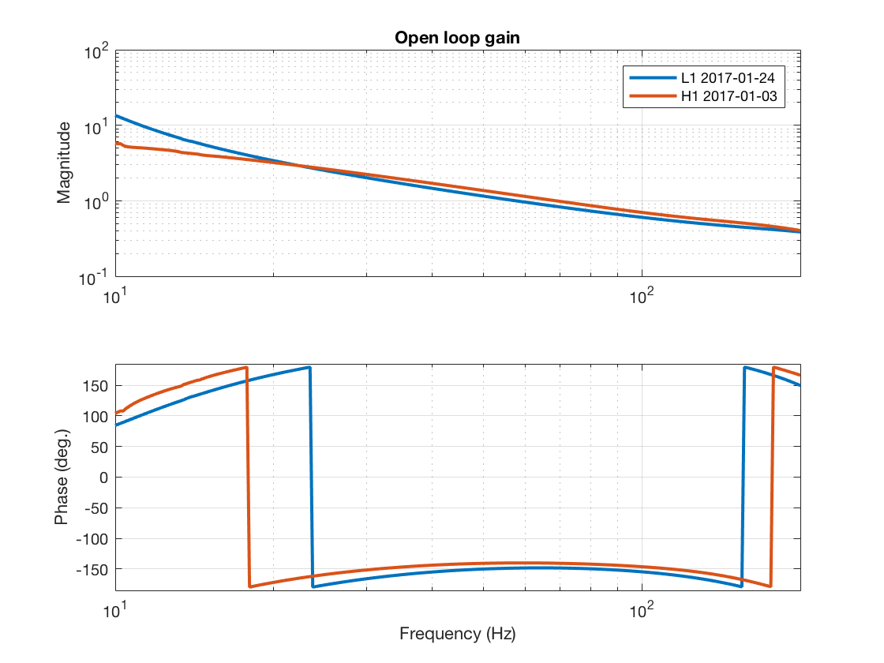
DARM OLGTF (UGF Zoom)
L1 UGF: 57.5 Hz
H1 UGF: 68.4 Hz
Good compromise on aggression of filtering
H1 Phase Margin: 39.4 deg
L1 Phase Margin: 31.4 deg

Slide 4
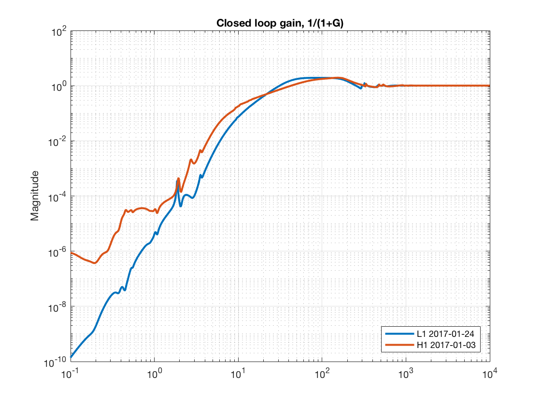
DARM Open Loop Gain TF
L1 Max Suppression: 1.9
H1 Max Suppression: 1.9
Both have plenty of gain margin
H1 has a couple of orders of magnitude less suppression around the microseism

Slide 5
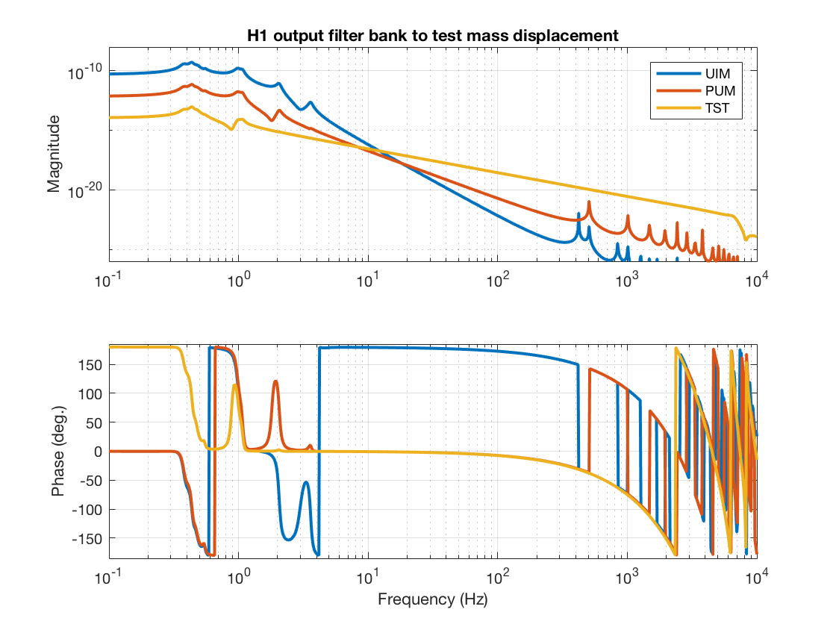
Actuator Strength Comparison

Slide 6
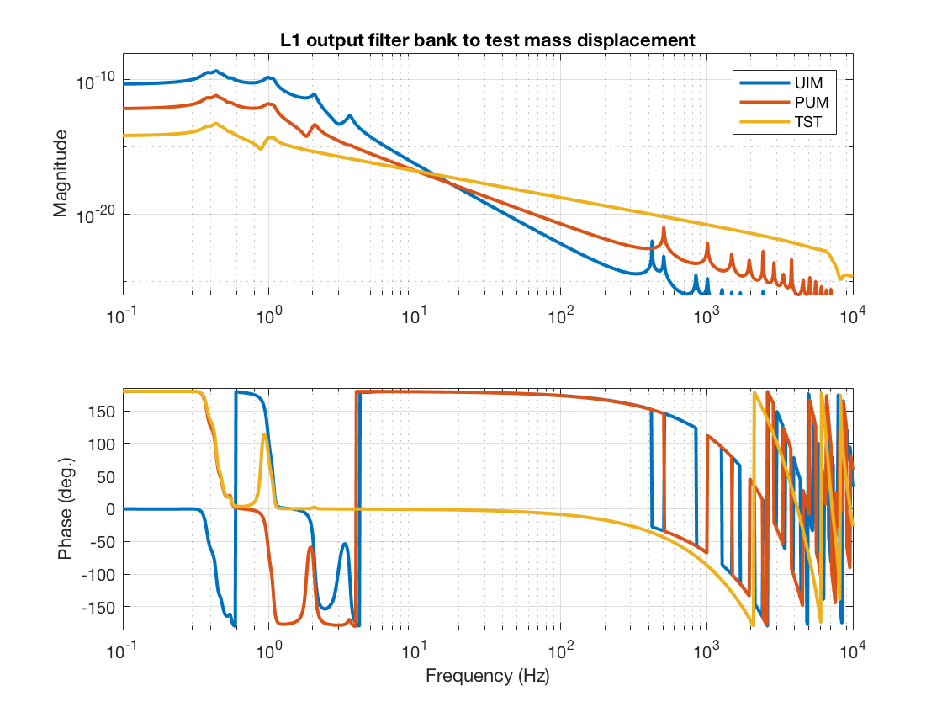
Actuator Strength Comparison
FIXED: L1 now includes all harmonics in the suspension model
Different PUM COILOUTF convention → PUM and TST have different signs

Slide 7
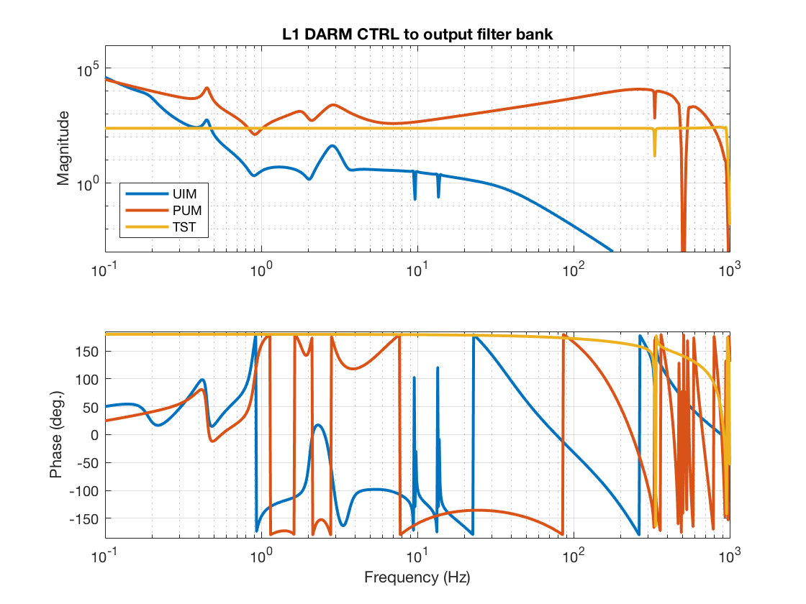
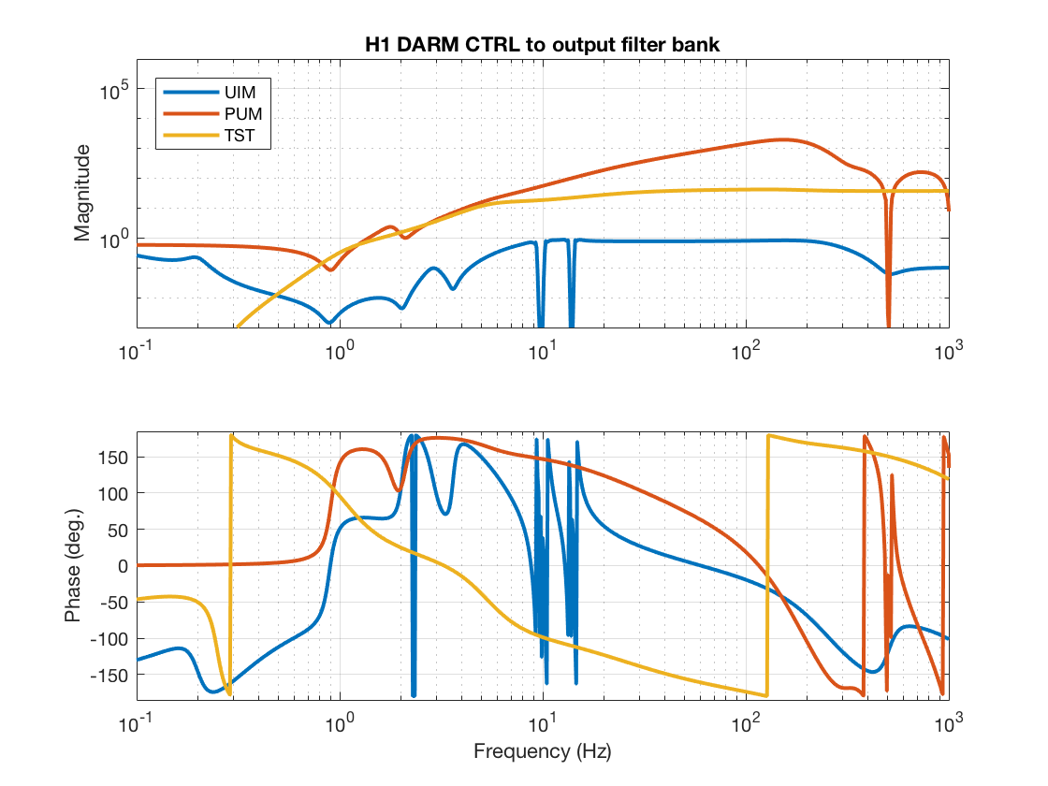
Actuator Comparison (Hierarchy Filters)
Both sites have a mish-mash of “offloaded” vs. “distributed” hierarchy filters due to staggered design
L1 does more loop shaping in the DARM bank (because of all the notching done at H1)
Note the difference in HF cut-off filter for all stages…

Slide 8
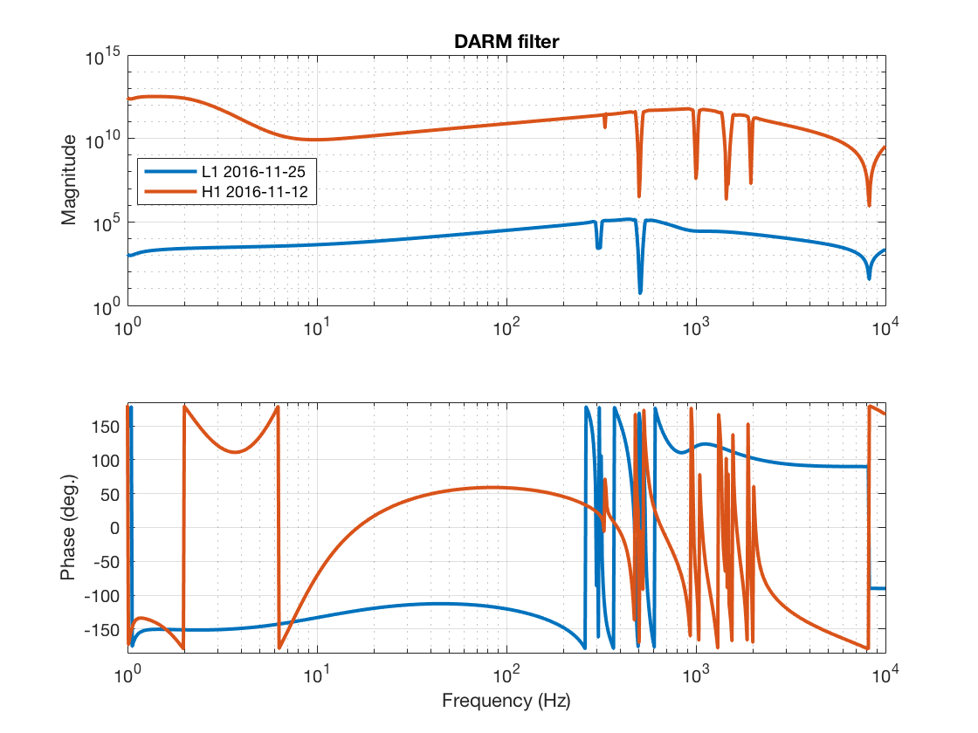
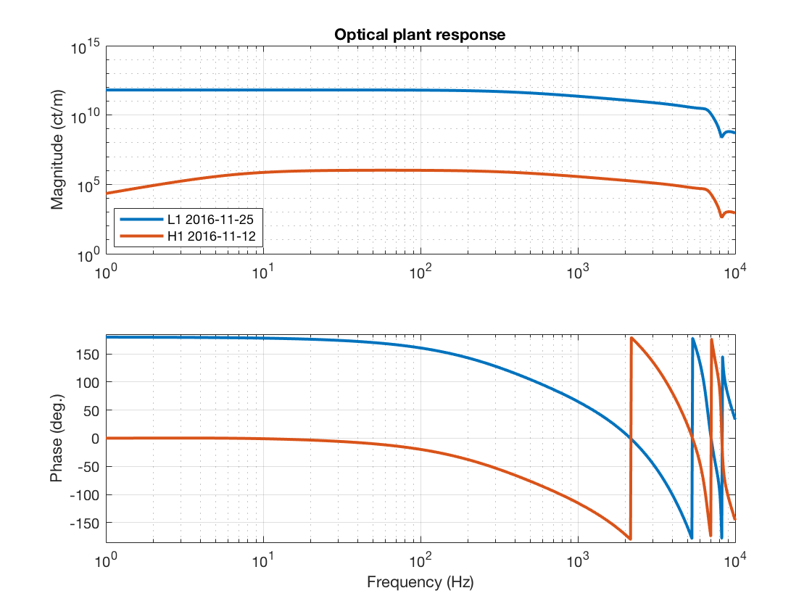
The DARM Filter and Sensing Function
H1 boosts LF in the DARM bank
Digital gains (and a sign) are distributed differently on the sensing side,
so DARM filter gain and sign compensate, otherwise pretty similar…
actual optical gain: ~3 mA/pm at both sites
But because of the different design choices, with frequency response and gains all over the place, tough to get a feel for the loop shaping from just one filter or plot
SEE APPENDIX A FOR
FURTHER DISCUSSION

Slide 9
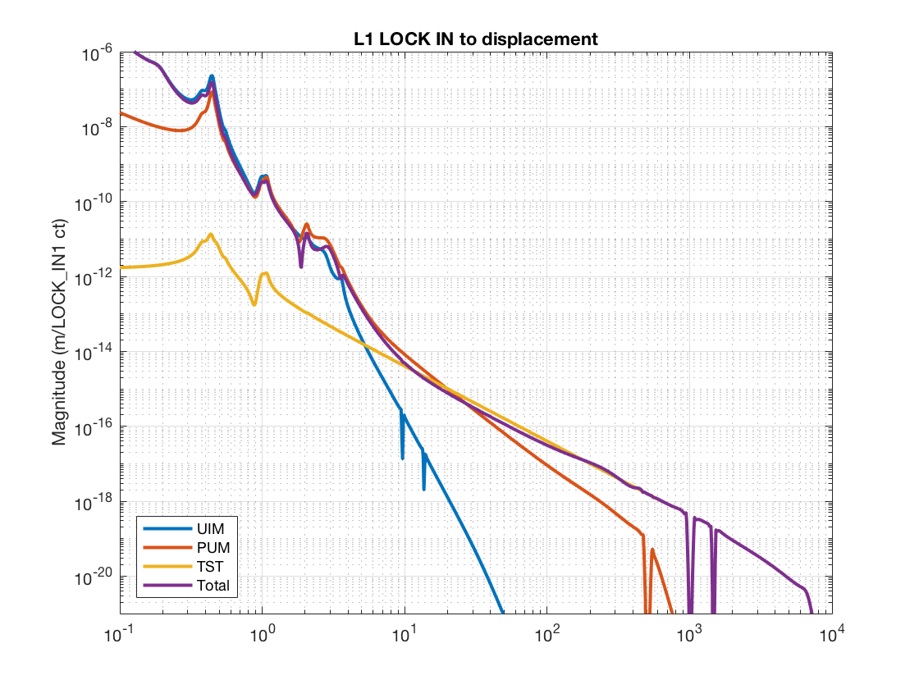
L1 Actuator Authority (Big Picture)
“Strength” = from DRIVEALIGN OUT to Test Mass Displacement
“Authority” = from LOCK IN to Test
Mass Displacement
Authority re-mathed to show it as a Distributed system, so “cross-over” frequencies mean something
L1 does all their LF boosting in the actuator filters
Just a bit of light notching,
not too aggressive of a HF cut-off

Slide 10
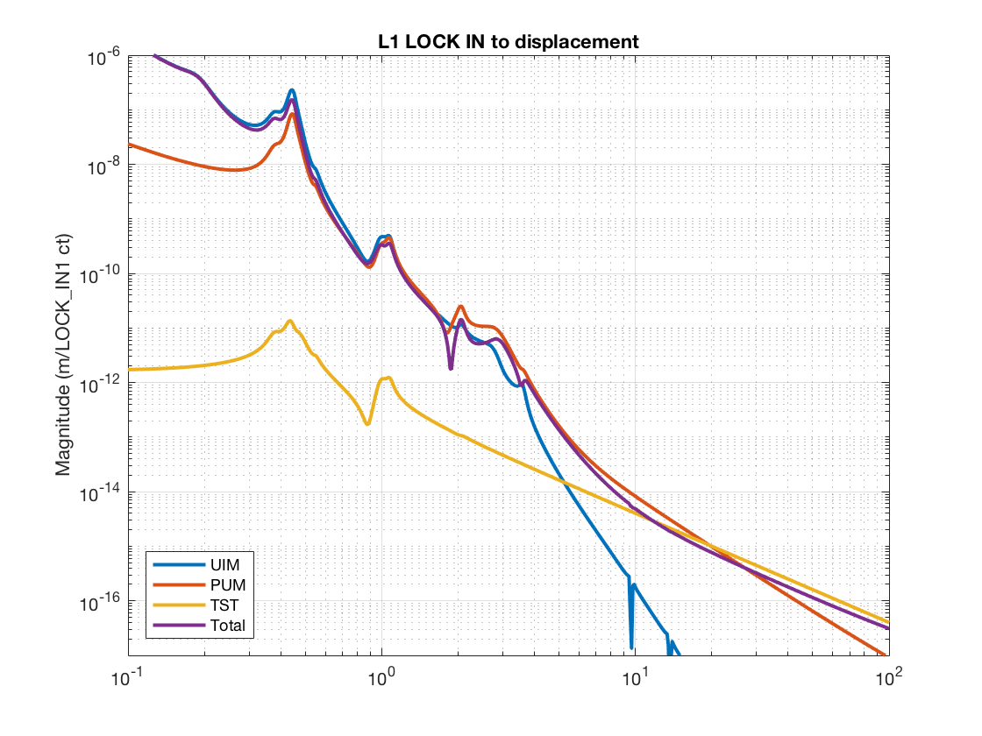
L1 Actuator Authority (X-over Zoom)
UIM/PUM
Cross-over: (Ill-defined, but PUM is rolled off by) 0.45 Hz
Cross-over stability kinda risky here, but it’s hard!
PUM / TST
Cross-over: 20 Hz
Cross-over stability pretty good!

Slide 11
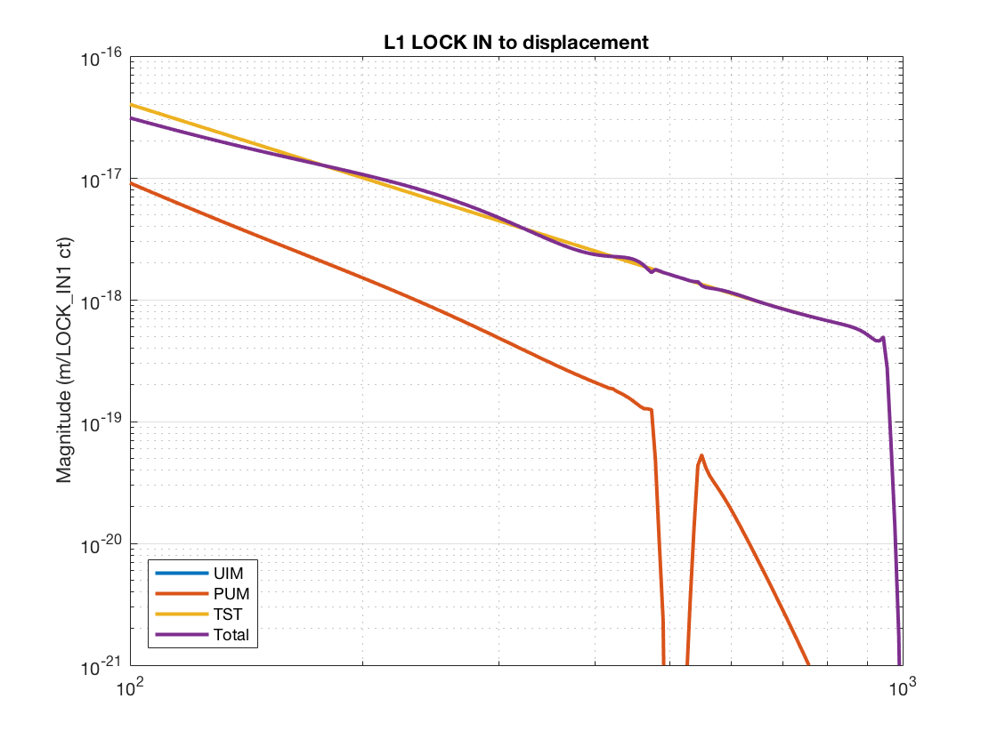
L1 Actuator Authority (HF Roll-off Zoom)
some icky wiggles
PUM is nicely rolled off above cross-over, but there’s still some phase interaction that causes some icky wiggles in the total TF of the “super actuator”

Slide 12
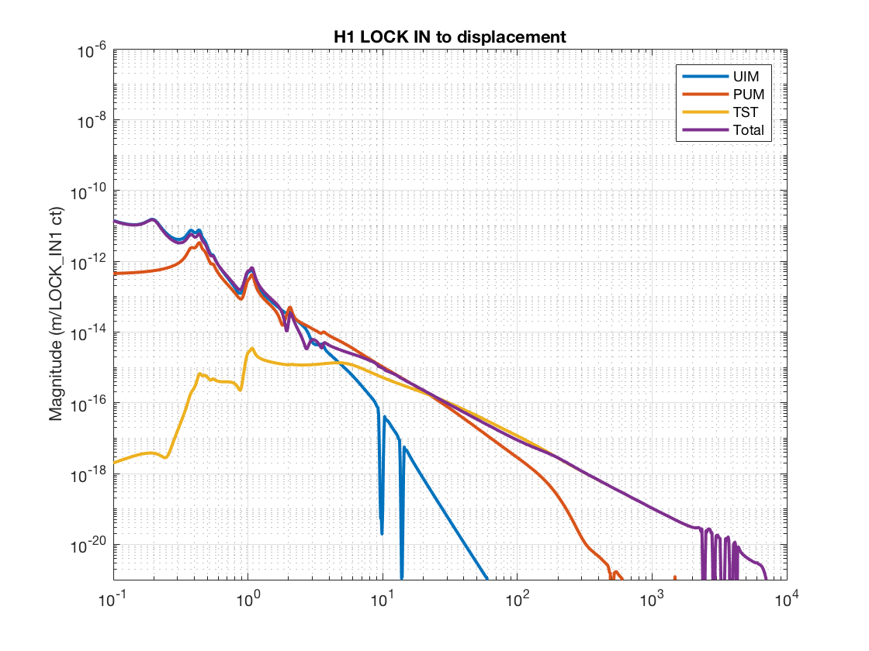
H1 Actuator Authority (Big Picture)
Shown to same scale as L1 on Slide 9
Don’t be alarmed: remember H1 does its boosting in the DARM bank (will show with DARM filter later)
Loooooot of high-frequency notching
FIXED: no ridiculous cutoff filter
Interesting: UIM Bounce and Roll notches aren’t as aggressive…

Slide 13
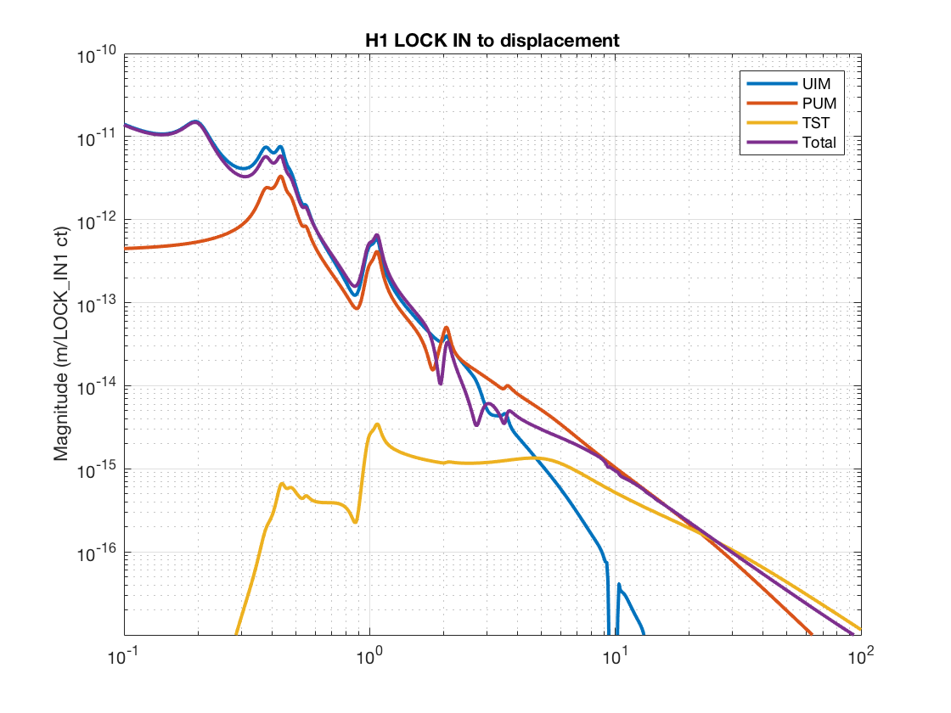
H1 Actuator Authority (X-over Zoom)
Shown to different scale from L1 on Slide 10
UIM/PUM
Cross-over: (Ill-defined, but PUM is rolled off by) 0.45 Hz
Similarly risky cross-over here, but it’s hard!
PUM / TST
Cross-over: 22 Hz

Slide 14
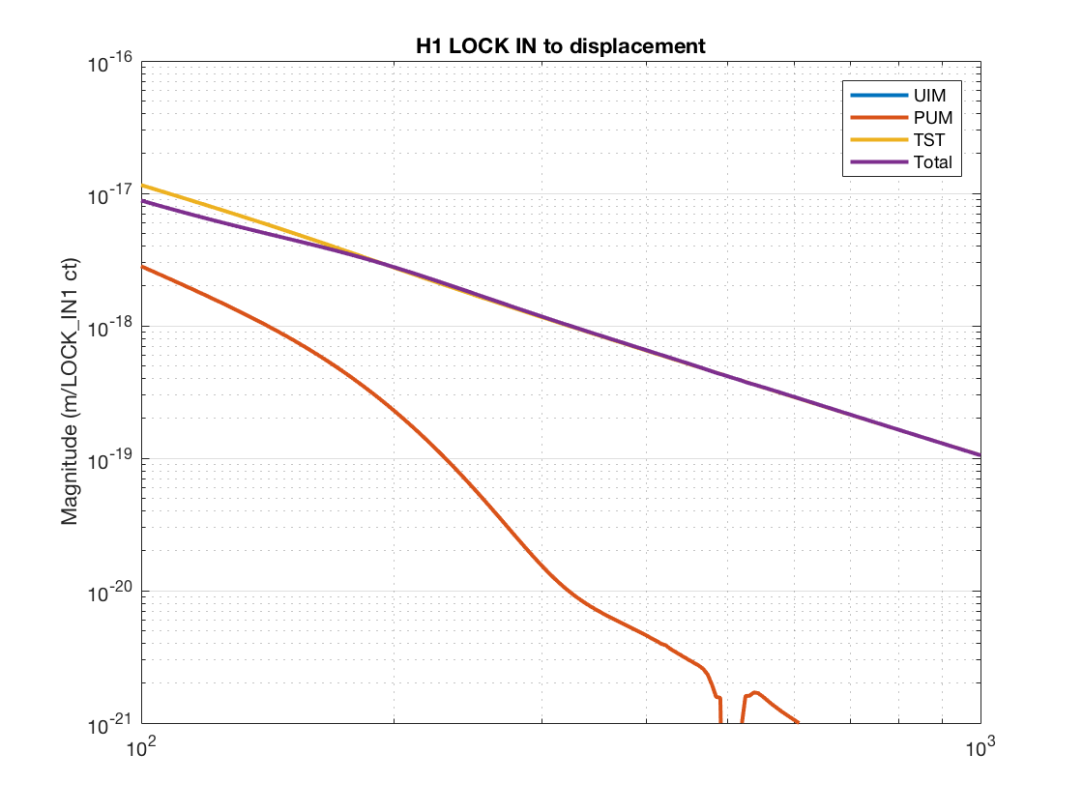
H1 Actuator Authority (HF Roll-off Zoom)
FIXED!

Slide 15
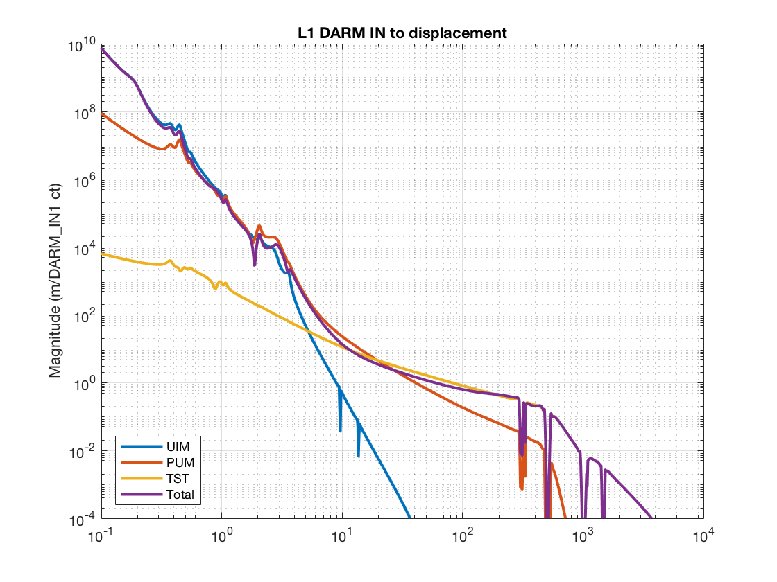
Authority Including DARM Filter (scaled by optical gain)
Looks pretty DARM clean!

Slide 16
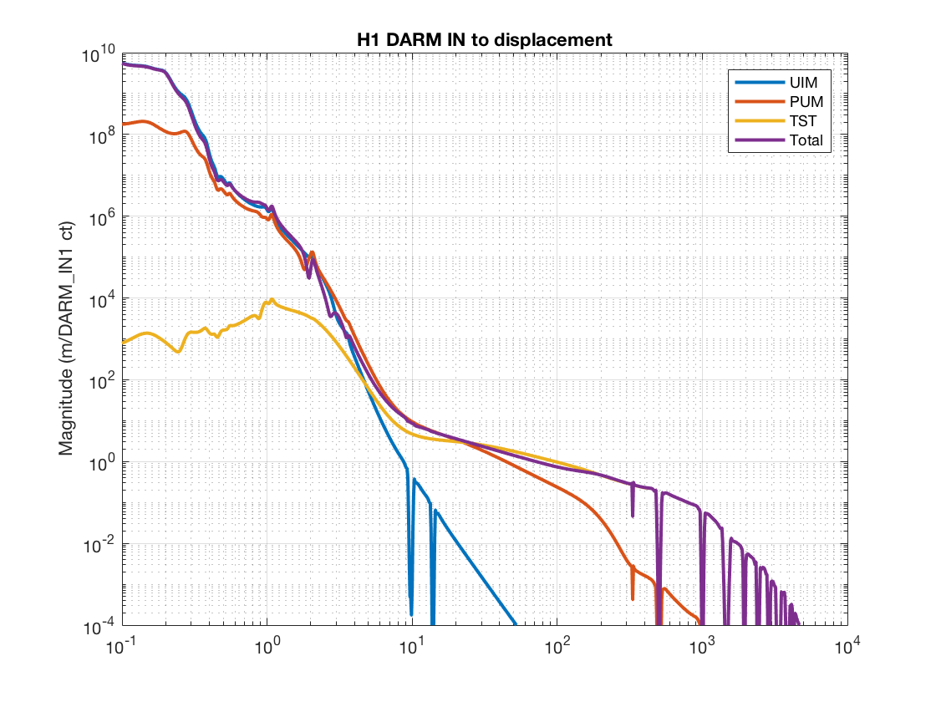
Authority Including DARM Filter (scaled by optical gain)
FIXED: Boost similar to L1’s
FIXED: Looks much better

Slide 17
Conclusions
H1 DARM Loop has been cleaned up since O1
  FIXED: More boosting at low-frequency
  FIXED: Better / simpler distribution filters
  Less notching?
Frequency response is splayed out everywhere at both sites, evident that “design” was staggered and piecemeal
  Both sites should consider consolidating, for easier analysis of performance

Slide 18
APPENDIX A: Sensing Function Units
“Why are the sensing functions (in [ct/m])
so incredibly different (6 orders of magnitude) between sites?”
This has entirely and only to do with a different choice of digital allocation of gains.

Slide 19
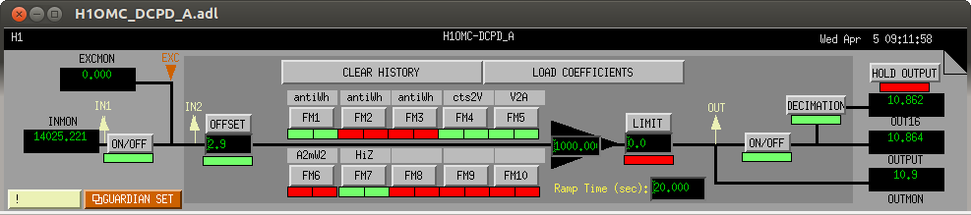
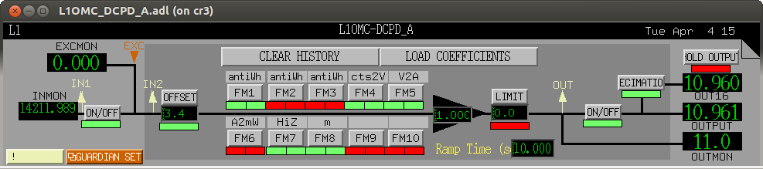
APPENDIX A: Sensing Function Units
Both sites convert raw DCPD ADC counts into [mA]
ADC
Counts
(Transimp. Amp)⁻¹
switchable
A -> mA
“mA”
Counts
(ADC Gain)⁻¹

Slide 20
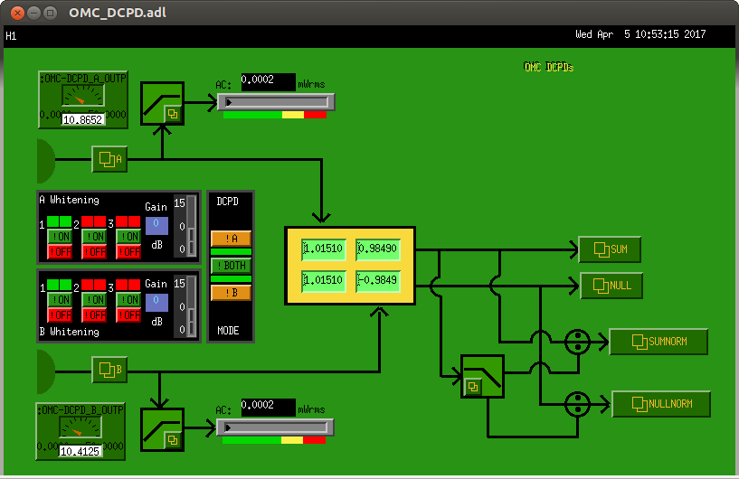

APPENDIX A: Sensing Function Units
Both sites balance and add the DCPDs
to create
${IFO}:OMC-DCPD_SUM_OUT_DQ
Empty (Unity Pass Through)
at both sites
${IFO}:OMC-DCPD_SUM_OUT_DQ
Coefficients very close to unity
see e.g. LHO aLOG 29856
for how this is calculated
Balancing Matrix

Slide 21
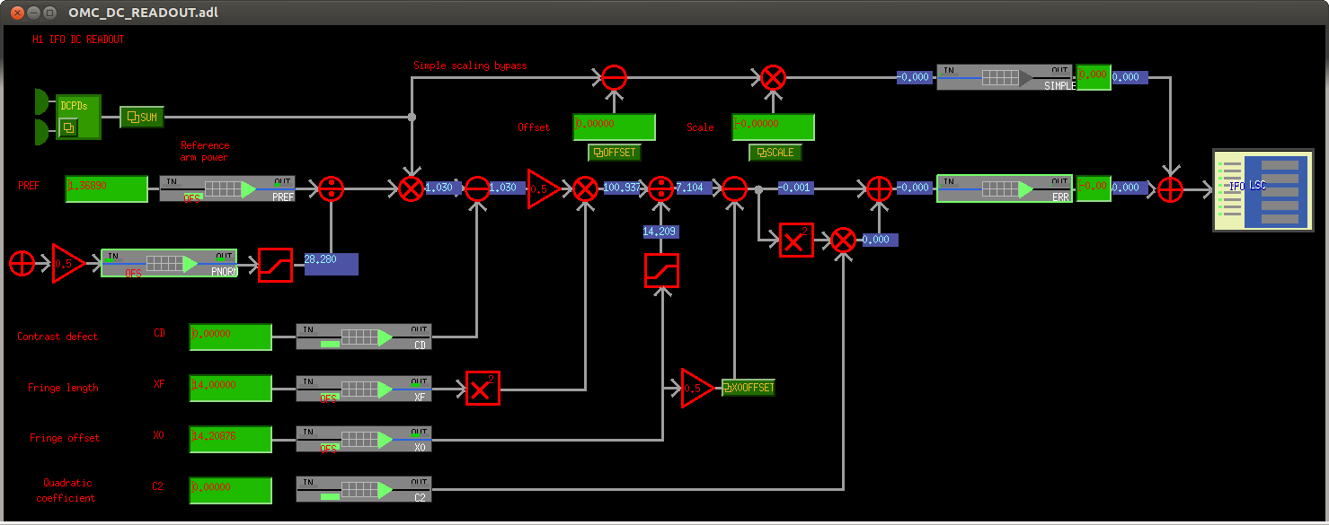
APPENDIX A: Sensing Function Units
But from here, they depart from each other soley due to how, historically, the sites were commissioned in parallel…
Bypassed for simplicity in Oct 2013 (see LHO aLOG 9100), and never looked back
DC Readout Normalization Scheme
developed in eLIGO, T0900023
(re)commissioned for aLIGO in May-July 2015 (see e.g. LHO aLOG 19233, 18470)

Slide 22
APPENDIX A: Sensing Function Units
While there were efforts to calibrate DARM_ERR into displacement units, it all boils down to whether DARM ERR needed to originally be in “pm” or “um” and was never reconciled:
The scale factors are geared such that DARM_ERR is in “pm” so the OFFSET in the DARM bank can be the DARM OFFSET in physical units.
Collectively it’s about 1/ (4.5 [mA/pm]) ~ 0.2
unity
passthroughs
100
“pm”
-0.0229
12.6
“um”
~0.048
196
~0.07
~ -8.7e-7
~14.2
This gain factor is such that the OMC DCPD error signal matches the AS AIR, and AS AIR error is matched to ALS DIFF, which was originally (roughly) calibrated in “um”
Scale factor collectively works out to about
1e-6 [um/pm] / (2.7 [mA/pm]) ~ 3.6e-7
In other words, both sites are normalizing their DARM loop gain to some reference time with the optical gain was ~ 4.5 / 2.7 [mA/pm]

Slide 23
APPENDIX A: Sensing Function Units
DARM
Filter Gain ~1e2
EPICs Gain 0.57
“pm”
“um”
DARM
Filter Gain ~1e10
EPICS Fain 1400
And as we’ve seen on pgs 2, 15 and 16, the open loop gains and actuation authority are virtually identical, so that gain discrepancy is made up for in the DARM banks.
Side note: as of O2, L1 still hasn’t split their DARM bank into two, and that’s shown here

Slide 24
APPENDIX A: Sensing Function Units
H1
This explains the difference between the site’s transfer function between the OMC DCPD SUMM (in [mA]) and DARM_IN1 (i..e DARM_ERR in [ct])
L1
So, if we use this entirely digital transfer function to “correct” (namely, undo) the sensing function from DARM_ERR counts to mA on the DCPDs, we get….

Slide 25
APPENDIX A: Sensing Function Units
The modeled optical gain is about ~3.7 [mA / pm] for both observatories (and remember, measurement matches our model very well).
BUT, that “mA” is an function of how well commissioners filled out the DCPD banks – namely the “V2A” and “HiZ” filter modules in the OMC DCPD Banks
H1
L1
Side notes:
the sites also chose different sides the the quadratic for the DARM offset, so the phase is 180 different at low frequency.
Remember L1 doesn’t include any SRC detuning, because they hadn’t been able to measure it before O2 (now they have, see LLO aLOG 32495)

Slide 26
APPENDIX A: Sensing Function Units
Conclusions
On a loglog plot, the two sites have virtually identical sensing function optical gains in physical units, as expected.
The sensing function’s optical gain in the DARM loop model is necessarily in unphysical units and very different in scale in order to cover the choices in digital gain distribution.
For the purposes of a paper, the sensing function can be scaled from the model’s unphysical units to physical units using the transfer function between
LSC-DARM_IN1_DQ / OMC-DCPD_SUM_OUT_DQ
But, if we want traceable accuracy and precision, we should be sure to understand how the digital filters in the DCPD banks were populated.

