Slide 1
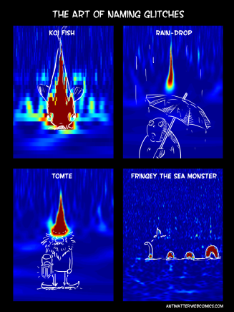
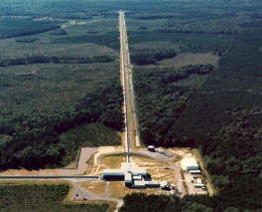
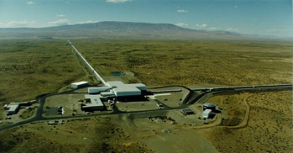



Searching for Gravitational Waves with LIGO: the role of blind injections and blind analyses
Alan J Weinstein
LIGO Laboratory, Caltech
LIGO Scientific Collaboration
KIPAC Blind Analysis Workshop
March 13, 2017
LIGO Livingston
Observatory
LIGO Hanford Observatory
LIGO Laboratory, Caltech
N. Kijbunchoo, LIGO
LIGO-G1700539

Slide 2
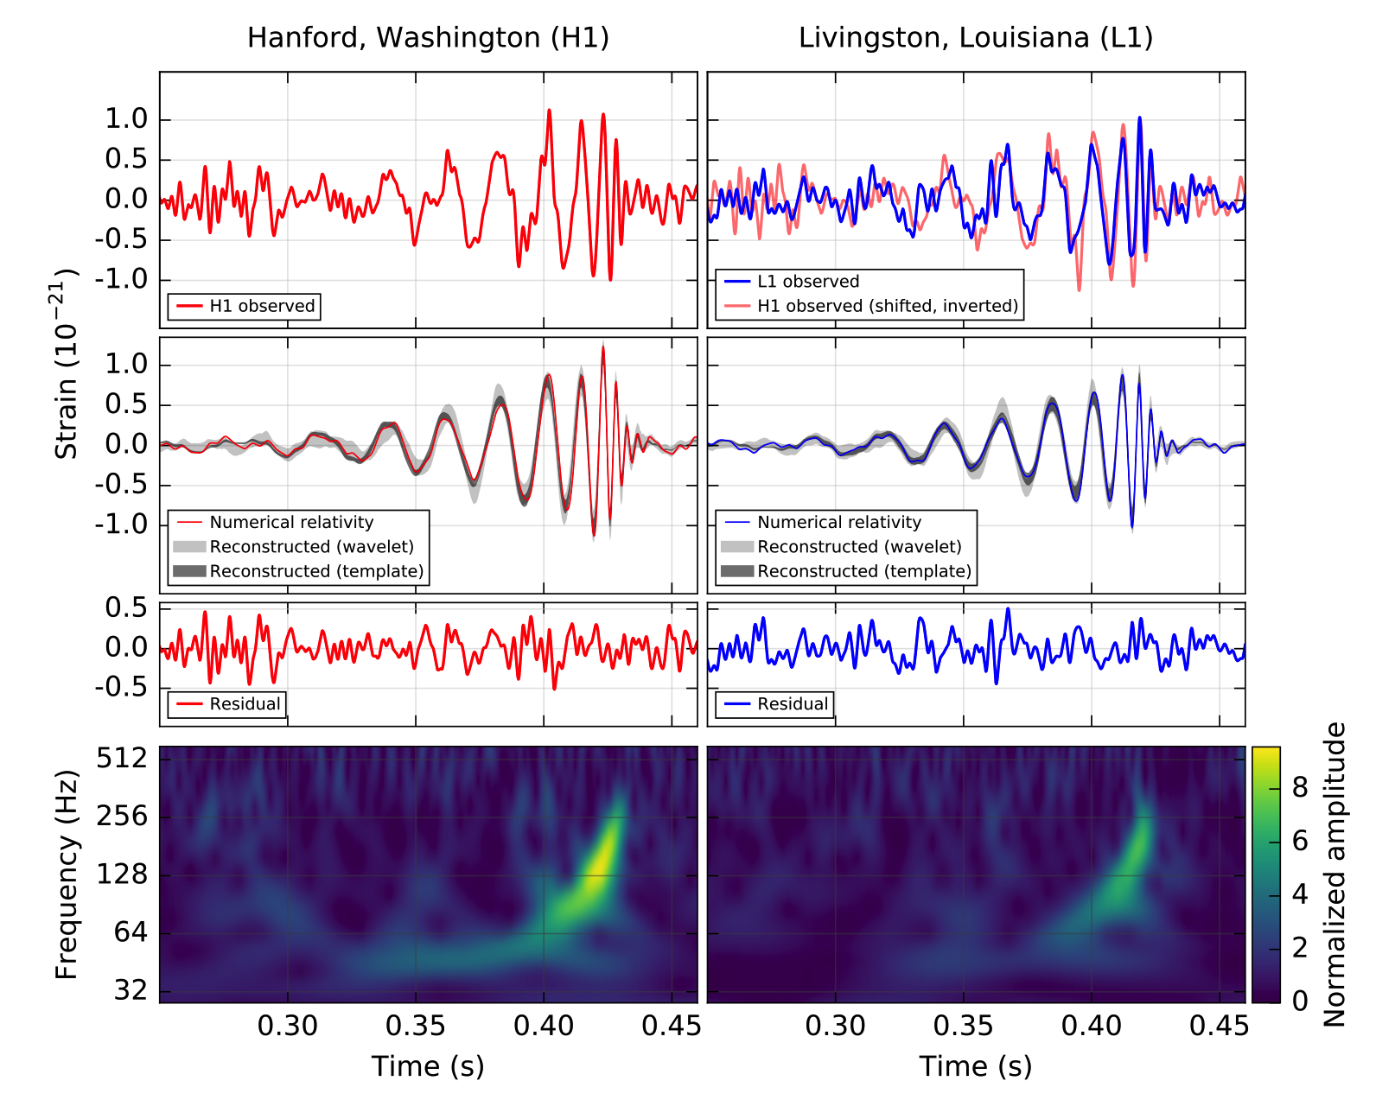
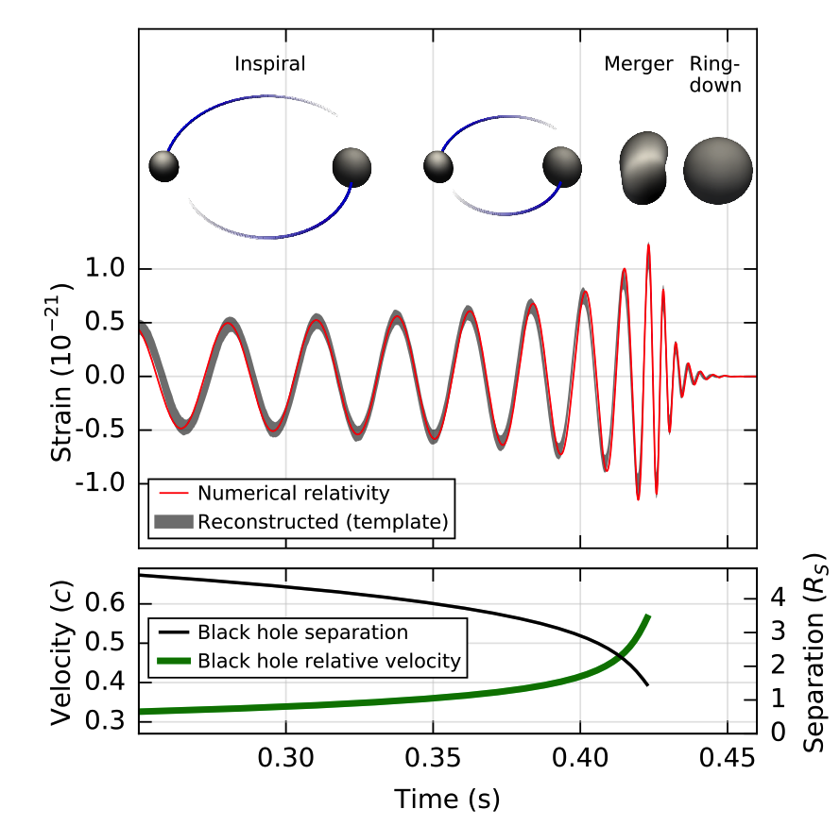

Discovery: GW150914
Phys. Rev. Lett. 116, 061102 – Published 11 February 2016
Reconstructed
(no whitening)
Audio:
filtered data
freq-shifted data
reconstructed & shifted
Whitened and band-passed [40-300] Hz
Notes:
detection https://dcc.ligo.org/LIGO-P150914

Slide 3
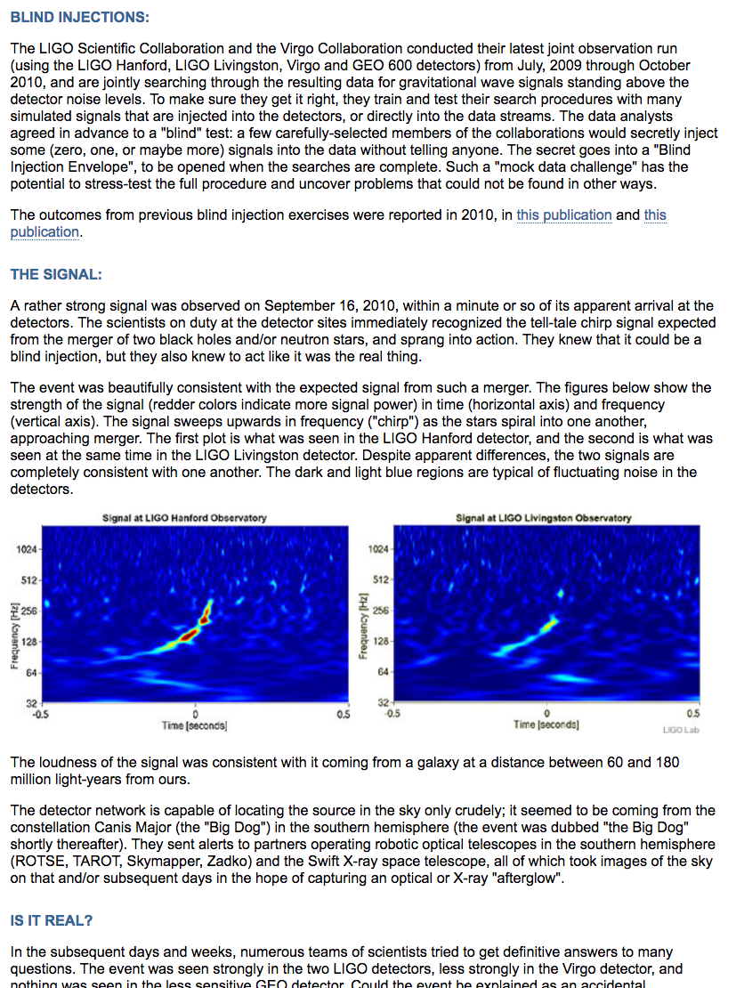
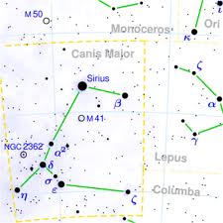
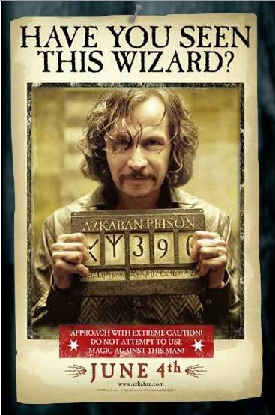
LIGO’s FIRST “discovery”: the BIG DOG

Slide 4
Blind injections
We have an event! Nobel Prize!! Stay up all night elevating the event!
Nah, it’s probably a blind injection – kill the event, get some sleep.
So, what’ll it be? Nobel prize, or a good night’s sleep?
Argh!!! Confirmation bias!
This was the genius of the fake signal injection: Whatever the prior belief of an individual scientist might be, it gave him or her reason to doubt it.

Slide 5
We wrote a paper …
(Observation / evidence / discovery ...)

Slide 6
The envelope
When Jay Marx opened his envelope in the LIGO Collab meeting in 2011
and told us all that the Big Dog was a Big Fake,
and that we had just completed the first successful discovery fire drill in gravitational wave observation history,
we still treated it as a moment of celebration.
We raised glasses of champagne, and toasted our
fake success (insert appropriate emoji, if one exists).
The success: our collaboration had agreed for the first time what standards we’d use, and how we’d minimize our biases.
For the first time, we had decided what we need to have enough evidence for a detection and a great discovery.

Slide 7
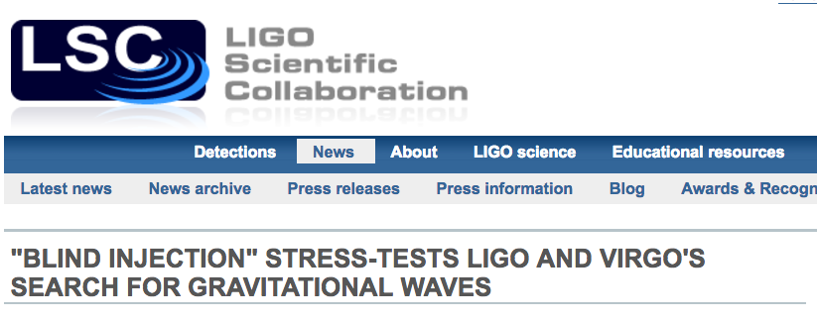
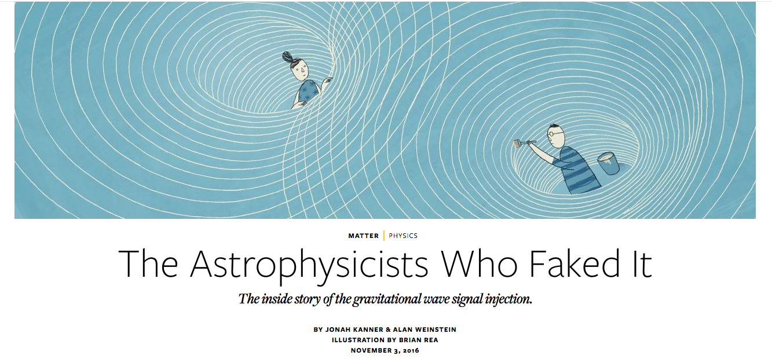
Documenting the emotional stress
http://nautil.us/issue/42/fakes/the-cosmologists-who-faked-it
Notes:
http://nautil.us/issue/42/fakes/the-cosmologists-who-faked-it

Slide 8
Was GW150914 a blind injection?
Fast forward to September 14, 2015:
We remembered the Big Dog saga, September 16, 2010. But …
We were told: “there was no blind injection team convened for Advanced LIGO,
and this wasn’t a blind injection.”
In our electronic logbook: “There were NO Transient Injections during G184098 Candidate Event.” (award for best e-log entry of the year.)
Still, we doubted this. We asked to look at the blind injection data channel.
The response: “Go right ahead.” We looked and found nothing.
Was GW150914 a blind injection?
  Check the not-so-secret blind injection channel. Nothing.
  A double-blind injection? Check the secret blind injection channel.
    There was no secret blind injection channel.
  A rogue injection, by a disaffected ex-employee? How to hide the evidence?
    We couldn’t figure out how to do it ourselves!
  An evil genius?
    Smarter than us!?

Slide 9
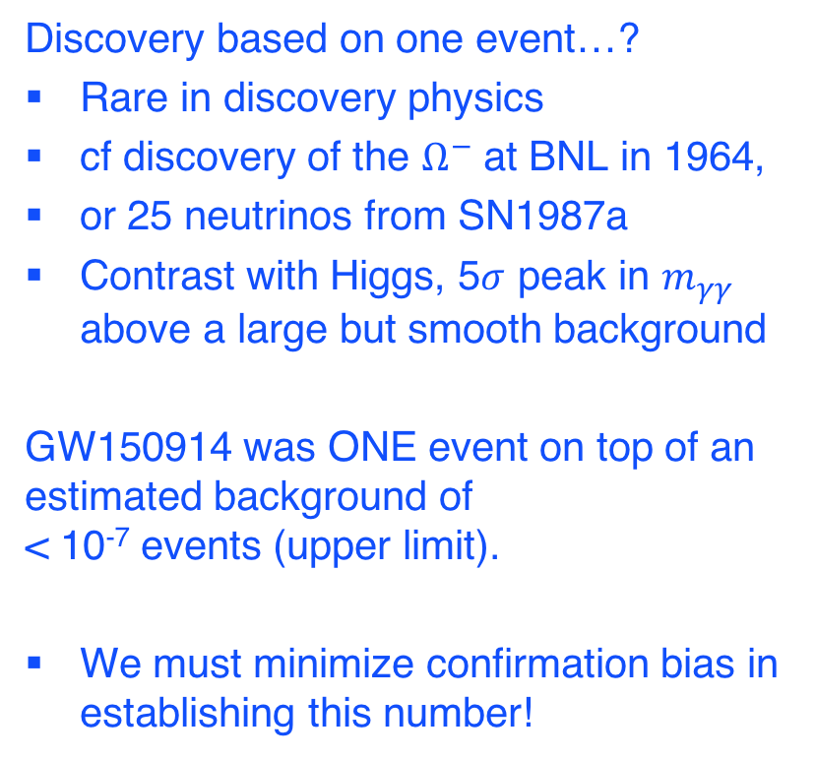
Blind analyses in LIGO GW searches
Discovery based on one event…?
Rare in discovery physics
cf discovery of the $Ω^{−}$ at BNL in 1964,
or 25 neutrinos from SN1987a
Contrast with Higgs, 5$σ$ peak in $m_{γγ}$ above a large but smooth background
GW150914 was ONE event on top of an estimated background of
< 10⁻⁷ events (upper limit).
We must minimize confirmation bias in establishing this number!

Slide 10
CDMS open box, 2007

Slide 11
The Advanced LIGO detectors
Abbott, et al., LVC,Phys. Rev. X 6, 041015 (2016)
Notes:
detection https://dcc.ligo.org/LIGO-P150914

Slide 12
The big issue: non-Gaussianity and non-stationarity of detector data
Detector mis-behaviors could produce glitches that can be mistaken for an astrophysical signal (non-Gaussianity).
Detector mis-behaviors change as we work to improve sensitivity … on ~ hour timescales!
(non-stationarity)

Slide 13
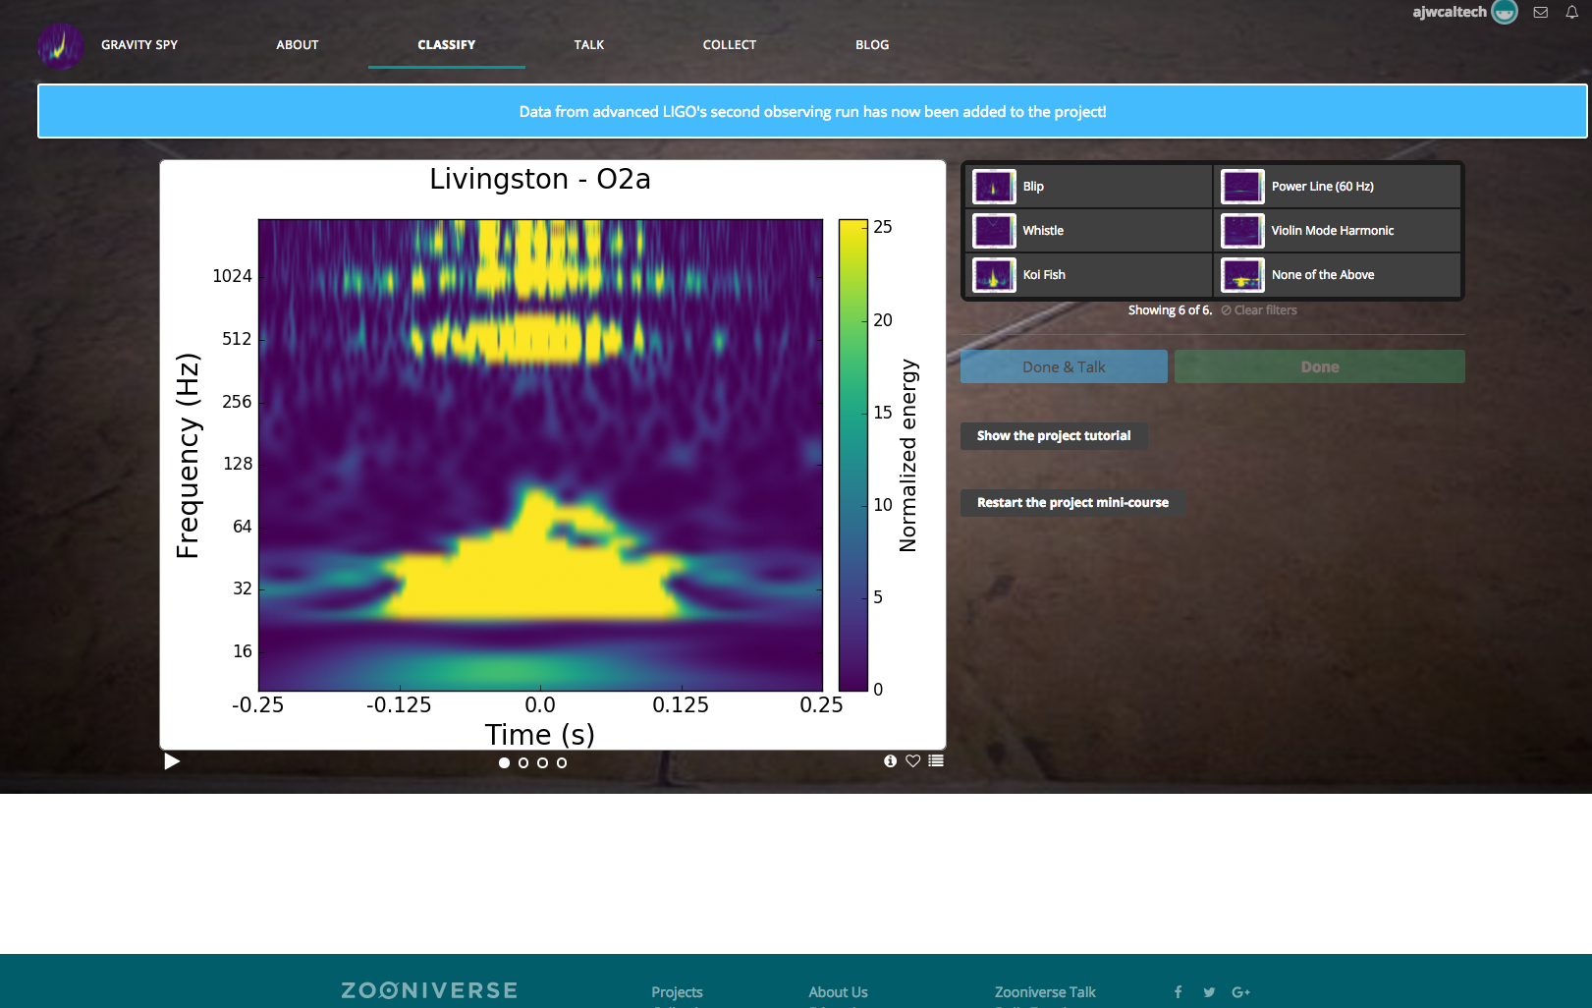
Classify LIGO glitches, and train a machine-learning algorithm!
https://www.zooniverse.org/projects/zooniverse/gravity-spy
Notes:
https://www.zooniverse.org/projects/zooniverse/gravity-spy

Slide 14
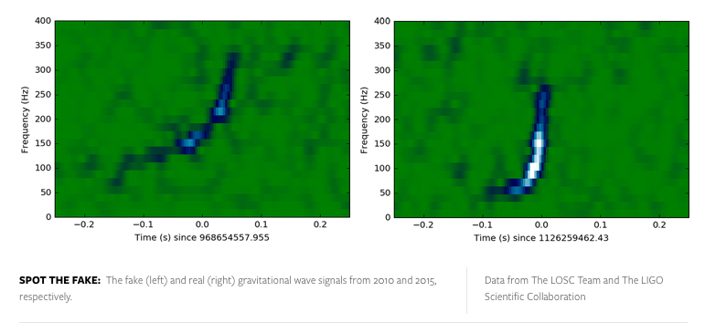
Which is the real event?
It’s very hard to imagine how detector glitches could fake a signal like this!
But … sometimes it’s hard to tell ...

Slide 15
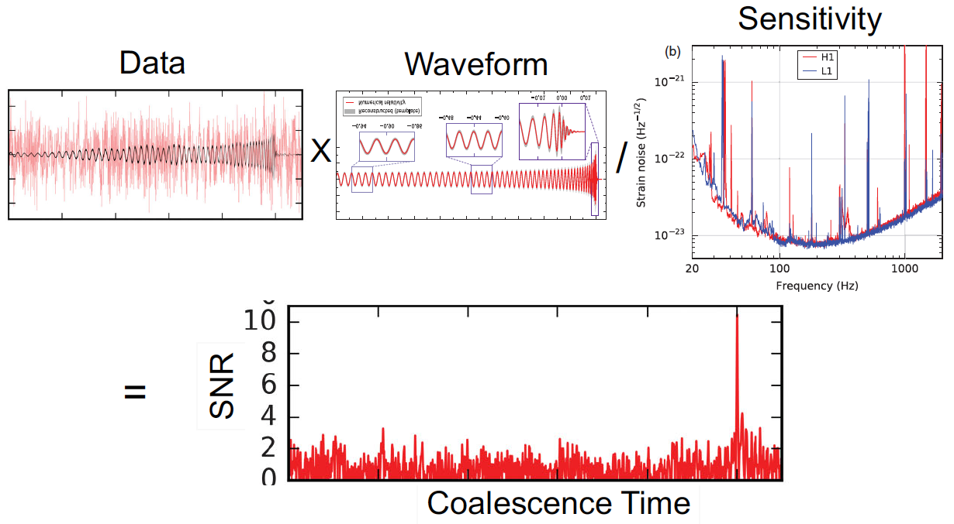
Matched Filtering

Slide 16
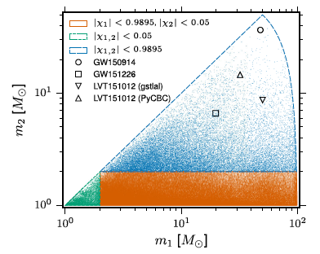
Template-based searches
GW150914
> 900 Mpc
BBH
BNS
NSBH
Masses and (aligned) spins
Templates spaced for < 3%
loss of SNR: 250K templates.
Sensitive distance in Mpc
Abbott, et al., LIGO Scientific Collaboration and Virgo Collaboration, “Binary Black Hole Mergers in the first Advanced LIGO Observing Run”, https://arxiv.org/abs/1606.04856, accepted in Phys. Rev. X
https://dcc.ligo.org/LIGO-P1500269/public/main
Notes:
https://dcc.ligo.org/P1500269/

Slide 17
Ranking the detection candidates
Detector noise is of limited “loudness” (SNR)
Rank events by loudness
claim detection if an event is louder than the noise
The challenge is to estimate the background under a loud event,
if it is << 1 event
Our most powerful tool: multi-detector coincidence
  In the first Advanced LIGO observing run
  (O1, Sep 2015 – Jan 2016) we had two detectors: H1 and L1
  Require coincidence in time (within light-travel time (±10 ms)
  and waveform model timing error ±2 ms)
Background estimated from time slides (“anti-coincidence”), which can’t come from real GWs

Slide 18
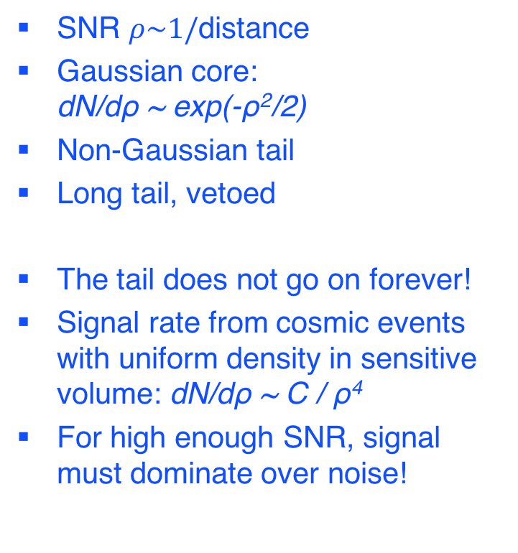
Candidate event trigger
SNR distribution
SNR $ρ\sim 1/$distance
Gaussian core:
dN/dρ ~ exp(-ρ²/2)
Non-Gaussian tail
Long tail, vetoed
The tail does not go on forever!
Signal rate from cosmic events with uniform density in sensitive volume: dN/dρ ~ C / ρ⁴
For high enough SNR, signal must dominate over noise!
Notes:
Characterization of transient noise in Advanced LIGO relevant to gravitational wave signal GW150914 (LIGO-Virgo Collaborations, B. Abbott et al), Classical and Quantum Gravity, 33, 134001 (2016), https://arxiv.org/abs/1602.03844v3

Slide 19
Removing detector misbehavior “blindly”
Must veto non-Gaussian instrumental glitches, without bias
How do we know that a glitch isn’t a GW signal?
Are most powerful tool – coincidence.
Assumed uncorrelated between detectors –
“anti-coincidence” time-slides can’t be GW signals.
We use these time-slide triggers to identify glitches in the strain data,
and then look for correlations with data from our hundreds of physical environment monitoring sensors (seismometers, accelerometers, microphones, RFI monitors, voltage monitors, …)
and thousands of interferometric detector monitoring data channels (everything but the strain data channel).
From all of this, we define and veto times with clear (witnessed), or not so clear, detector misbehavior,
without ever looking at the coincident event triggers (closed box).

Slide 20
Removing detector misbehavior “blindly”
Assumed uncorrelated between detectors –
“anti-coincidence” time-slides can’t be GW signals.
But … correlated glitches between detectors 3000 km apart:
  Lightening storms – we monitor them, they don’t produce glitches in the detector,
  and they don’t look like signals in EM/RF detectors on site
  Schumann resonances (global geomagnetic field)
  GPS-based timing system – these can produce instrumental spectral lines!
We have found no evidence for correlated transient noise between H1 and L1, and are convinced that this could not be responsible for our detected events.
Lightning over India
Comb at n*1.000 Hz

Slide 21
p-value vs. p-astro
Our job is to convince ourselves, and you, that (free of bias) the event we see is not consistent with background from environmental or instrumental misbehavior.
If the probability that an event is consistent with background (p-value, or False Alarm Probability FAP) is sufficiently small, you might conclude that it must be a real GW signal.
But… what if GR is wrong, and GWs don’t exist (and we’ve been fooled by the Hulse-Taylor binary)?
Then, no matter how small the p-value, the event is background, with certainty!
We need to quantify the prior on the existence, and rate, of GWs from the sources that we are considering.
Until we can estimate the rate (ideally, through direct observation),
we don’t know the probability that the event is astrophysical.
We’ve got a chicken-and-egg problem.
Fortunately, that’s only true for the first event. One event gives us an estimate on the prior, which we can use to compute p-astro for the 2nd event, and so on.

Slide 22
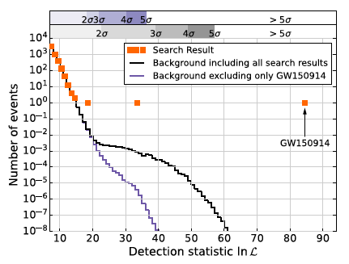
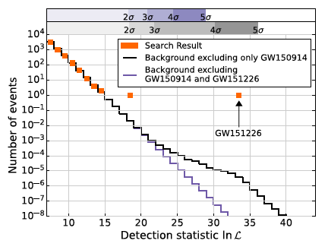
Opening the box: Search results
Advanced LIGO Observing Run O1
LVT151012
Tune analysis pipeline and data quality vetoes “blindly”, using time-slid data to estimate the background, and software injections for the signal.
All tuning finalized before “opening the box” on in-time coincident triggers.
We find three events above estimated “background” from accidental coincidence of noise triggers.
Two have high significance (> 5σ).
Abbott, et al., LIGO Scientific Collaboration and Virgo Collaboration, “Binary Black Hole Mergers in the first Advanced LIGO Observing Run”, https://arxiv.org/abs/1606.04856, accepted in Phys. Rev. X
https://arxiv.org/abs/1606.04856 (Accepted by Phys. Rev X)
Notes:
https://dcc.ligo.org/P1500269/

Slide 23
The “little dogs”
Background estimation makes use of data that include signals!
Time-slides don’t eliminate this possibility
We assume that the signal population is much smaller than the noise trigger population; single-detector triggers are overwhelmingly noise
But for a loud event like GW150914, the loudest single-detector triggers, and the loudest time-slide coincident triggers,
are associated with the event.
And we know which ones they are! So we can remove them.
But should we? Removing them is an un-blinding bias, and a particularly dangerous one.
But leaving them in is crazy, no?

Slide 24
To kill the “little dogs”, or not?
But leaving them in is crazy, no?
There is no right answer to this question (that I know of).
All we can do is “bracket” the true best background estimate: leave in the little dogs, or take them out.
Can be repeated hierarchically
First observation: Is it signal or is it background?
This is a deep problem in discovery physics!
First observation is a discovery! 😍
Second observation is a confirmation 😛.
Third observation is a distribution 🙄.
Fourth observation is a calibration😒.
Fifth observation is background 😠

Slide 25
Accumulating sufficient statistics for background estimation
To get enough statistics in time-slides to call one event a 5σ detection, we need ~ 10⁷ trials for each observation.
We require time-coincidence within ~ 0.01 s, but a 0.01 s time-slide is too short, because our waveforms have significant auto-correlation out to 0.1 s. We dare not time-slide any shorter than that.
In 10 days of double-coincident observing, we have roughly 10⁷ un-correlated double-coincidence trials, and (10⁷)² time slides.
We dare not go longer, because the detector noise is non-stationary and can change noticeably (especially for the loudest glitches)
over ~10 days.
So… we have to wait for 10 days to collect enough noise triggers to estimate the background for a loud event to claim 5σ detection,
(FAP < 10⁻⁷, FAR < 1/200,000 yrs), before opening the box.
Can we wait that long? Well, yes and NO!

Slide 26
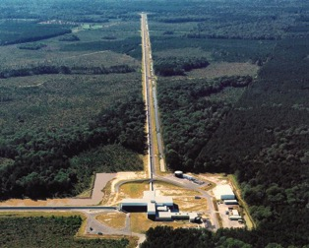
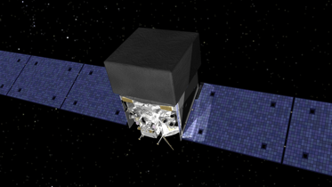
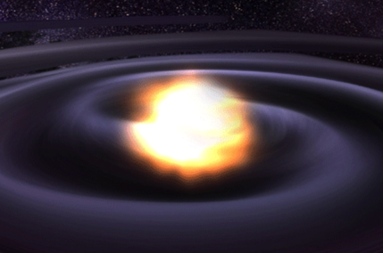
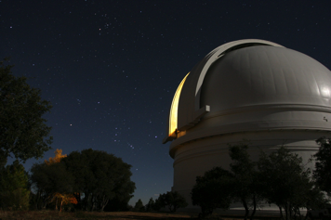
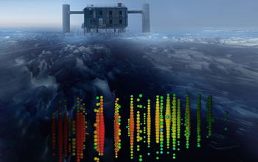
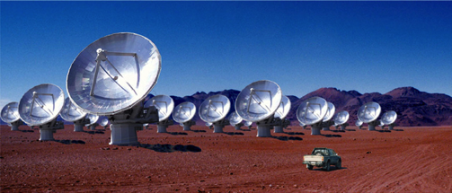
Multi-messenger Astronomy with Gravitational Waves
astrophysical fireball
Binary Neutron Star Merger
X-rays/Gamma-rays
X-rays, γ rays
Gravitational Waves
GWs
Visible/Infrared Light
optical
Neutrinos
neutrinos
Radio Waves
radio

Slide 27
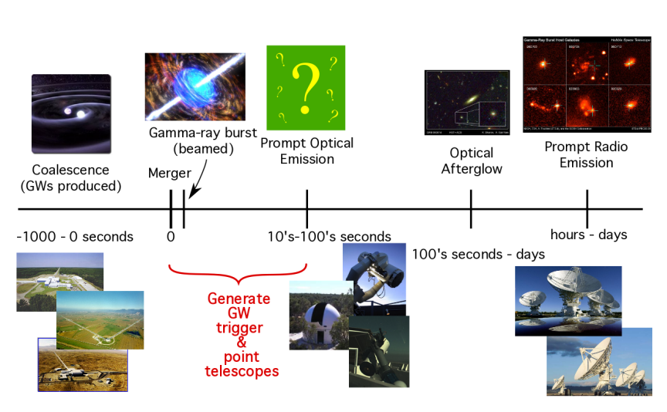
Low-latency identification of transients for rapid (< ~100s) followup
EM counterparts to GW sources (if any) are short-lived and faint

Slide 28
Are we really doing a blind analysis?
Can we “open the box” at low latency (to alert our EM partners), then close it again for 10 days, then open it again, and claim that we are doing a proper blind analysis?
Can we automate the data quality procedures to make them “blind” to anything we see at low latency?
Well, we can try. But data quality investigations often lead to new kinds of detector misbehavior that must be dealt with before opening the box again.
In the end, a purist would conclude that we are not really conducting a true blind analysis.
In our case, discovery science means not only discovering new signals,
but also discovering new backgrounds (detector misbehavior).
In some sense, our (engineered) detectors may be more complicated to understand than binary black hole mergers 🤔
They are the “evil genius” that could fool us!

Slide 29
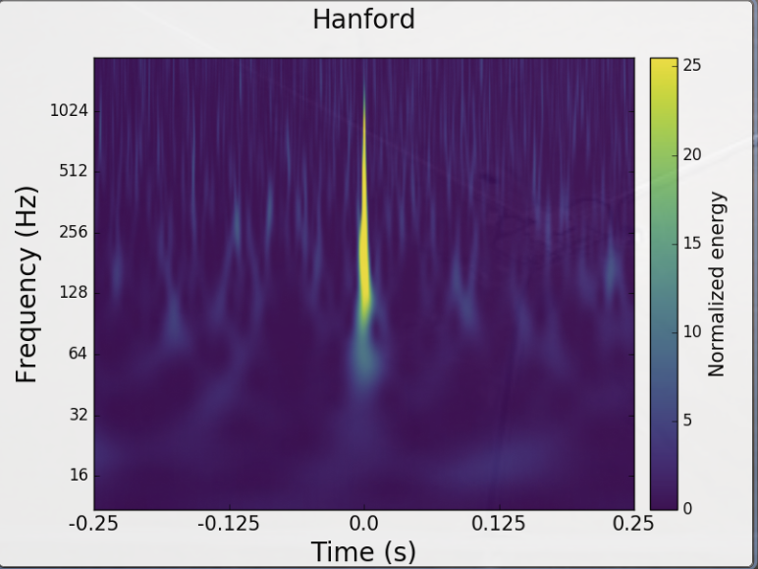
How to get it wrong: high mass binary black holes, higher order modes
Excess power
above f_{ringdown}
High mass BBH template

Slide 30
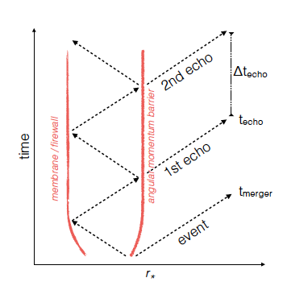
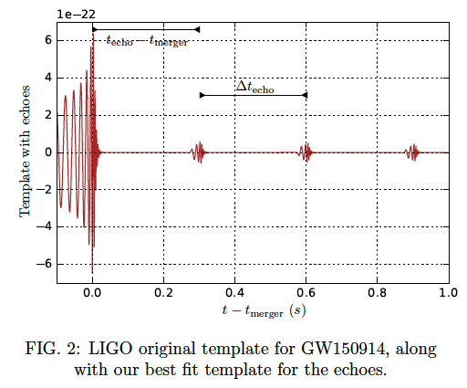
How to get it wrong: echoes from the abyss
When is a BH not a BH?
Planck-scale departures from GR (firewalls, fuzzballs, gravastars) near the putative BH horizons can lead to “echoes”.
repeating damped echoes with
time-delays of 8M logM
Abedi, Dykaar, and Afshordi, arXiv:1612.00266v1
“… we find tentative evidence for
Planck-scale structure near black hole horizons at 2.9σ significance level”
But… if you look for ringdowns in LIGO strain noise, you will find it everywhere
(They used 32s of data around GW150914 to estimate the background).

Slide 31

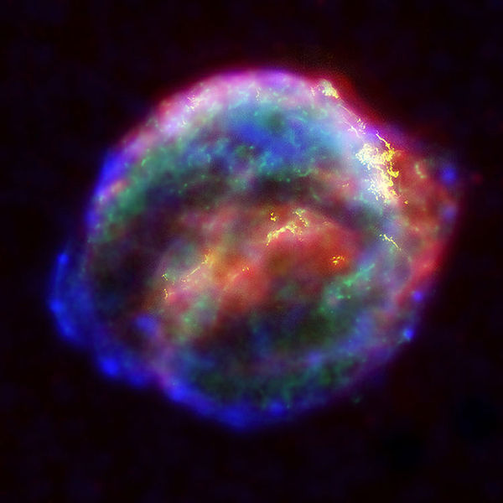

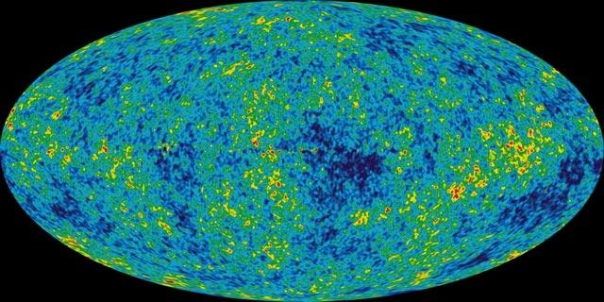
GW sources for LIGO:
The most energetic processes in the universe
Coalescing Compact Binary Systems: Neutron Star-NS, Black Hole-NS, BH-BH
- Strong emitters, well-modeled,
- (effectively) transient
Asymmetric Core Collapse Supernovae
- Weak emitters, not well-modeled (‘bursts’), transient
- Cosmic strings, soft gamma repeaters, pulsar glitches also in ‘burst’ class
Credit: Chandra X-ray Observatory
Credit: AEI, CCT, LSU
Spinning neutron stars
- (effectively) monotonic waveform
- Long duration
Cosmic Gravitational-wave Background
- Residue of the Big Bang, long duration
- Long duration, stochastic background
NASA/WMAP Science Team
Casey Reed, Penn State
Notes:
LIGO is designed to be an observatory, not a one-off proof that GWs exist. What do we look for?
There are number of predicted astrophysical sources of gravitational radiation, and most of them involve cataclysmic events.
Binary systems – NSs and BHs, most likely source, theoretically well understood with known waveforms
Bursts – GW emissions that are not well modeled or understood. These include asymmetrically core collapse supernova, cosmic strings, and perhaps unknown sources
The residual GW background
Continuously emitting sources such as spinning neutron stars, which have a pure monotone emission.

Slide 32
Frequency-Time
Characteristics of GW Sources
time
Ringdowns
Broadband Background
Bursts
frequency
CW (quasi-periodic)
Chirps
Earth’s orbit
Earth’s rotation
frequency
frequency
time
time

Slide 33
“Unmodeled” Transient
GWs (Bursts)
From, eg, Galactic CCSNe, magnetar flares/starquakes, …
Short duration, potentially broad-band; … unknown!
A starquake might produce a narrow-band “ringdown” waveform. It is very easy to find ringdowns in aLIGO detector noise!
Outliers from a “blind” search pipeline are scrutinized by hand for any evidence of instrumental misbehavior. Very hard to automate in a blind way.
Coincidence with similar morphology is our most powerful tool.
But… we cannot claim to be doing a truly blind search.

Slide 34
GW Burst candidate event from 2003
Initial LIGO’s second Science Run (S2) from Feb 14 - Apr 14, 2003
We prepared a rigorously blind analysis pipeline / procedure for identifying GW burst candidates,
with a pre-defined threshold on signal significance, based on excess power in the t-f plane,
set to a false alarm probability (p-value) of 0.05.
Much care went into data quality vetoes and methods to suppress detector noise glitches, understanding detector performance and misbehaviors from single-detector triggers and time slides.
One event appeared in the open box, at triple coincidence (H1, H2, L1; with H1 and H2 co-located in the same vacuum envelope).

Slide 35
Loudest event in S2 burst search, triple coincidence

Slide 36
The Airplane Event
It was rapidly identified as acoustic noise from a low-flying propeller plane over Hanford, somehow getting into the strain channels of both H1 and H2, accidentally coincident with a small upward fluctuation in noise in L1.
Could hear the plane in microphones throughout the site;
easy to veto post-facto.
Why did we not have a veto in place already?
Private planes are not allowed to fly over Hanford! The pilot was lost!
Discussion of whether to exclude or include the candidate event in computation of upper limits spurred a protracted “religious war” between blind analysis statistical purists, and people who thought (post-factor) that it was too premature to apply strict blinding,
including all the instrument scientists who invented, designed, built, optimized and operated the detectors, who thought the analysists were crazy people.
Subsequent runs: more careful acoustic vetoes; optical sensing systems in acoustically-shielded “meat-lockers”. IN Advanced LIGO, they are in vacuum on seismic isolation platforms.

Slide 37
Continuous GWs from spinning neutron stars (pulsars)
These are not events in time, they are “events” in frequency (spectral lines).
They are expected to be very weak, visible only after long FFTs and averaging over months of data.
They are Doppler modulated with sidereal and annual periods, which must be corrected for.
LIGO detectors have lots of spectral lines from terrestrial (instrumental and environmental) sources.
Many are strong, and don’t have the unique sidereal modulation.
Many are weak (combs), and/or do have solar-day and annual modulation.
Outliers from a “blind” search are scrutinized by hand; we cannot claim to be doing a blind analysis.
“When in doubt, take more data!”

Slide 38
Take-home message
Discovery science is tricky!
Doing an un-blinded search carries much opportunity for subtle biases – dangerous!
It really helps to have a very well-defined model of the signal being searched for,
and a really well-understood detector,
and redundancy (coincidence between multiple detectors),
and a really robust estimate of the background,
and hope that you can really tell the difference between signal and background reliably and robustly, even before opening the box.
Discovery science often doesn’t come so simply …
So it can happen that doing a truly blind analysis is dangerous!
And … beware the evil genius!

