Slide 1
Supernovae & the next generation of GW observatories
Supernovae Workshop
Pasadena
March 18, 2017
Stefan Ballmer
LIGO-G1700567

Slide 2
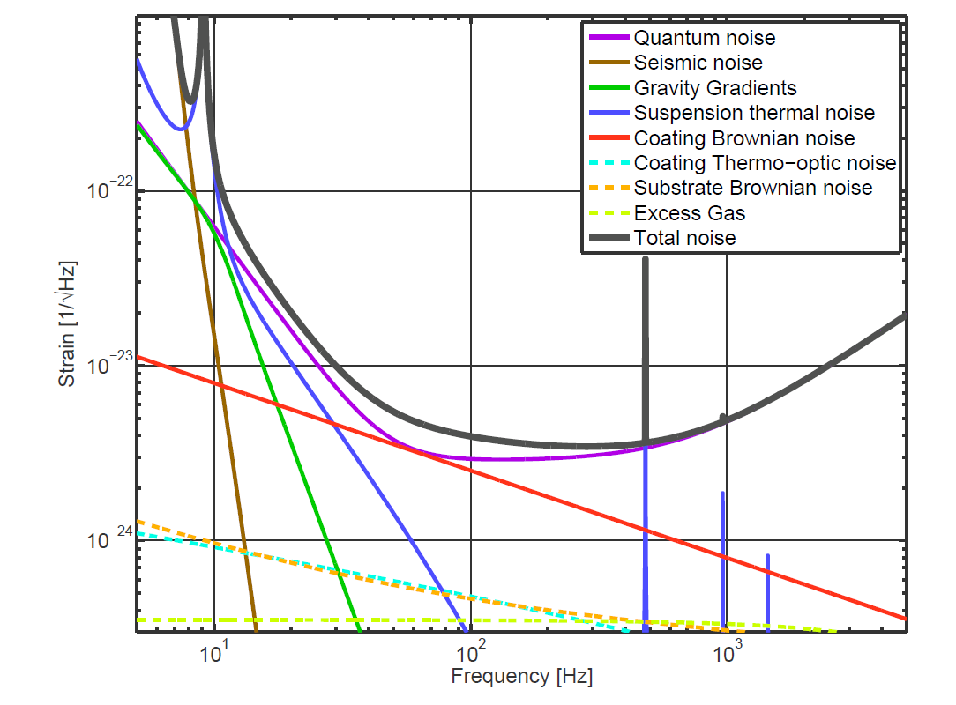
Upgrade Path
At higher frequencies relevant for SN:
Current observatories limited by quantum noise, coating thermal noise

Slide 3
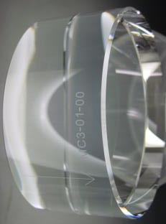
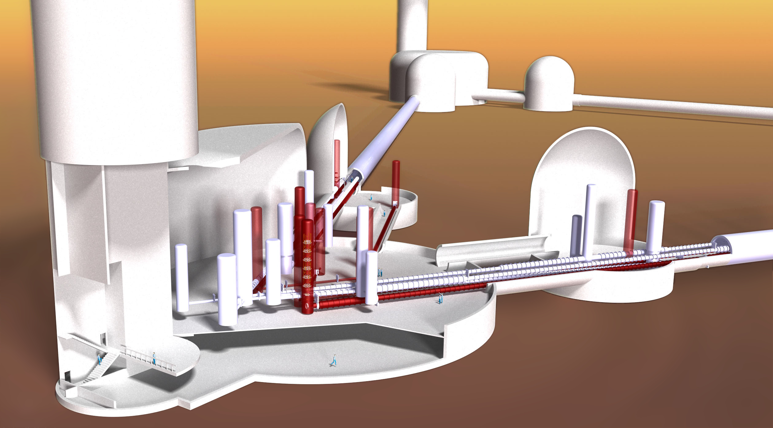
The ways forward
Reduce quantum noise
Thermal noise ~L^{-3/2}
Any
Displacement
noise ~L⁻¹
Reduce thermal noise

Slide 4
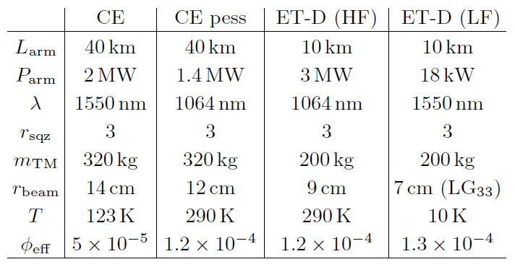
Cosmic Explorer/Einstein Telescope
40km
On surface
10km
Underground
Xylophone

Slide 5
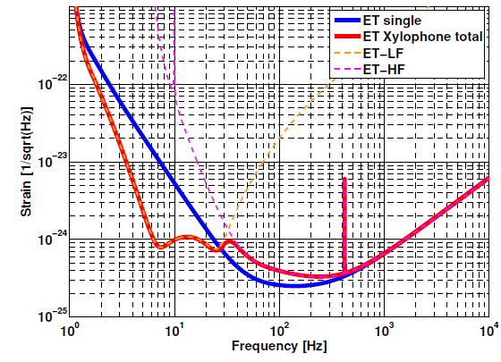
3G Concepts

Slide 6
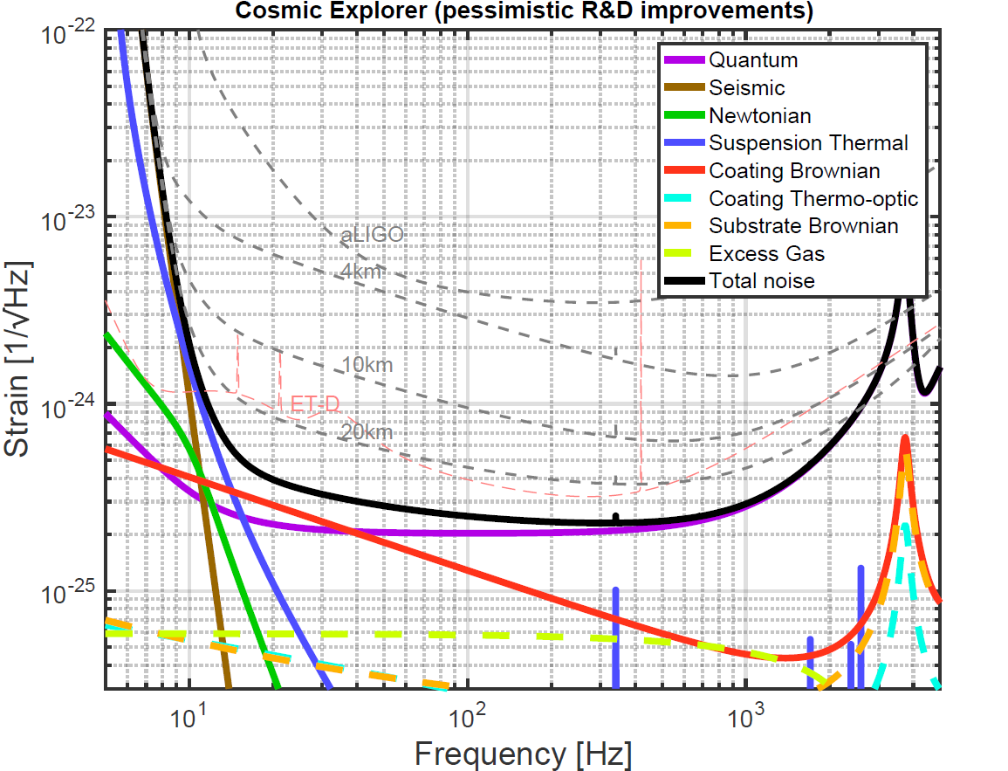
CE pessimistic
scale matched to previous slide
3G Concepts

Slide 7
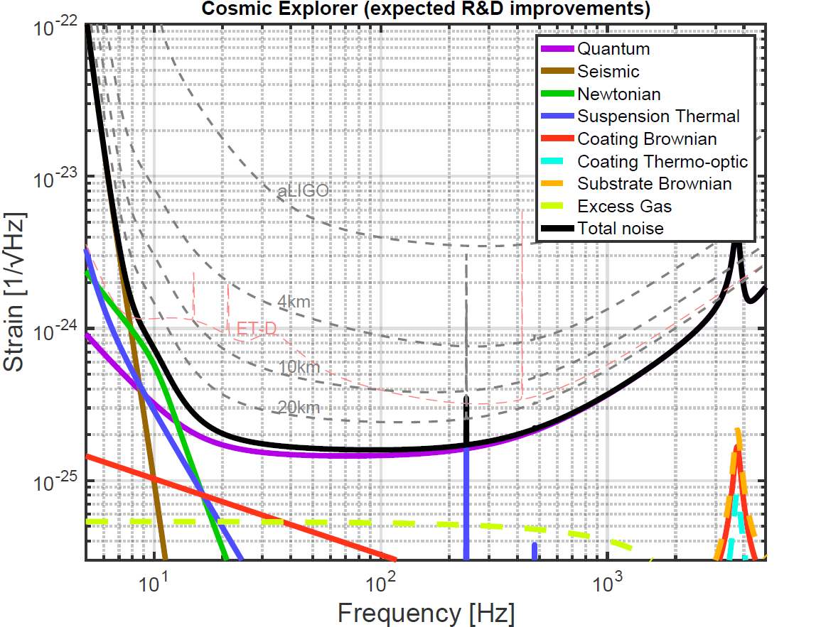
CE expected
scale matched to previous slide
3G Concepts

Slide 8
Additional thoughts, 1
Polarization?
  Do we need to know both polarizations?
  Do we need 2 detectors seeing mostly the same?
  Or is one detector (plus neutrino coincidence) good enough?

Slide 9
Measuring luminosity distance: e.g. GW150914
The sun as seen by Super-K (from SK web page)

Slide 10
Additional thoughts, 2
Inclination angle dependence?
Rotational energy dependence?
Calibration will be smaller than this…

Slide 11
Message:
Don’t worry about calibration…

Slide 12
What about detuning?
You can still find old detuned Advanced LIGO design curves with Google (Internet has no delete button)
The idea was:
  With an off-resonance signal
  recycling mirror an optical
  resonance can enhance the
  sensitivity
Has serious problems…

Slide 13
Signal Recycling Detuning
In principle, ability to target high frequency sources without squeezing
Less hardware investment with respect to squeezing, but challenge from the controllability of the interferometer
Given the same loss in the interferometer, benefit at high frequency is comparable to frequency dependent squeezing in a narrow band, worse elsewhere
Signal recycling detuning not particular beneficial for high frequency sources
Interesting cases for low-mid frequencies regions
Interferometer control more challenging
See G1500599

Slide 14
High frequency response of long IFO
For 40km the Free Spectral Range moves from 37kHz to 3.7kHz
  Significant antenna pattern changes
    Frequency dependent antenna pattern
    Deviations from simple cavity pole

Slide 15
Still relevant – for 40km divide all frequencies by 10…
See LIGO-G060665

Slide 23
Extra Slides

