Slide 1
wind
quakes
G1700891-v1
LF disturbance
Noisy or saturated
Lock correction
Ruggi’s Global Inverted Pendulum Control
E. Majorana for the SUSP commissioning group

Slide 2

outline
A quick report on GIPC, the Global Inverted Pendulum Control, developed at Virgo in the past years by P. Ruggi et Al.
In terms of operation configurations, GIPC is the last strategy implemented, as the stable operation of the whole interferometer is achieved.
The work to set again GIPC operation in Advanced Virgo are going on.

Slide 3
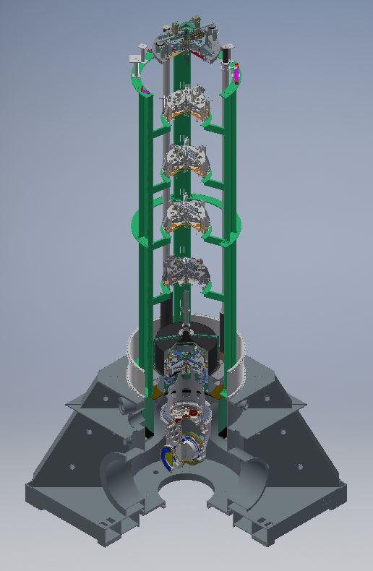
Monolithic suspensions: overall system
In AdV the first 5 stages (hor and ver) of the Super-Attenuator are the same as in initial Virgo.
The last filter of the Super attenuator, prolonged downwards, is in the same vacuum environment of the payload and surrounds it: the “actuation cage”.

Slide 4
Overall Suspension Attenuator: Virgo ➔ AdV
Top-stage floating body:
4D (3H+Vertical),
position ctrl VS ground (or gbl) and damping (acceleration).
Inverted Pendulum
Bottom ring:
3D (tilts+Vertical),
position ctrl VS ground actuated from ground
TESTED
SA last stage:
6D,
position damping VS ground
Payload suspension point
ground
Payload:
6D,
position ctrl VS ground (or gbl) actuated from SA last stage
No tilt sensor (so far)

Slide 5
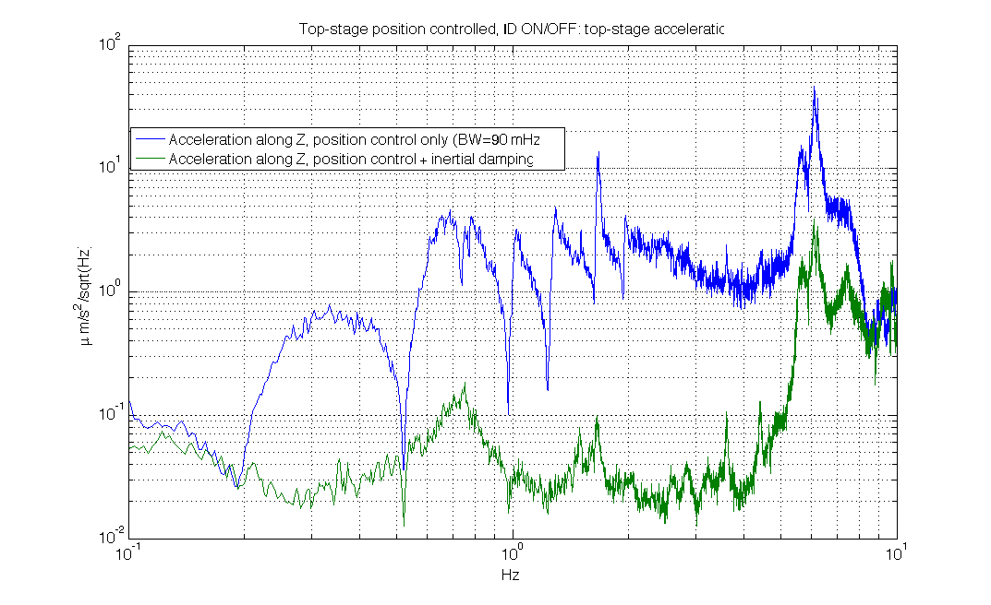
SuperAttenuator: Inertial Damping ON/OFF

Slide 6
Scheme Last filter + Payload :Virgo ➔ AdV
to the 5° filter of seismic isolator
last filter, auxiliary
damped from ground
Virgo
AdV
suspension point
marionette control
driving, isolated
by 6H and 5V
AdV actuation cage
mirror control
driving, isolated
by 8H and 6V
mirror control
driving, isolated
by 6H and 5V
relevant for thermal noise

Slide 7
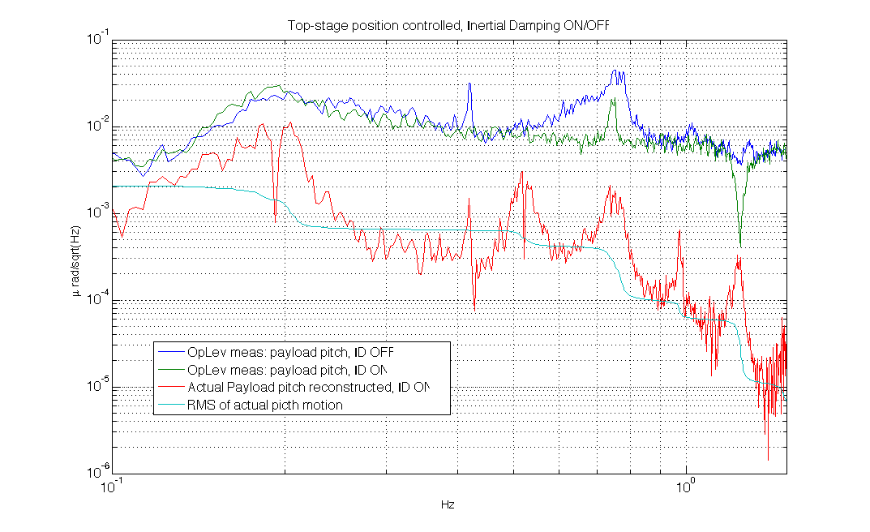
Payload angular accuracy VS ID
The Inertial damping allows to reduce the residual angular movement ~2 nrad,
(only partially seen by ground-based OpLeV)
Reconstruction
using ratio
ID_ON/ID_OFF
Reducing microseism through Top stage control is crucial
AdV payloads have no or just few resonances in microseism region
Reducing microseism contamination through position sensors in standalone is crucial.
N
N
GWDAW – Hamilton Island, May 9 2017

Slide 8
Sensor blending and Low Pass shaping
x, a_{x} = position and acceleration Laplace’s Tr.
x_{s} = seism driven sensor reference
qi = “quasi-inertial”
Increase LP(s) slope and shaping
Reduce Position/Acc crossover frequency
ACC
+
“Reduce”
+
HP_{s}
tilt noise
+
+
Lesser microseism injected
LP_{s}
L-mix
PID
-
+
IP
Allowed as tilt noise is low
+
+
+
HP_{w}
+
set
+
seism
LP_{w}
LVDT
+
+
Two blending strategies are available in-line. The choice
is presently enabled manually upon weather condition
(wind, microseism). In AdV an optimized design strategy to minimize background noise through the sensors to chose properly the blending is applied (L. Trozzo)

Slide 9
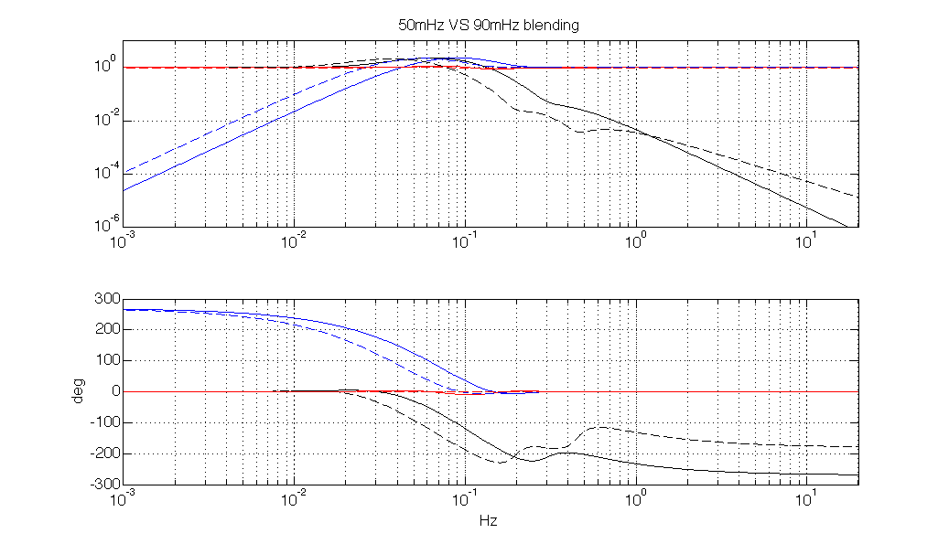
Preparatory tests ongoing: recombined FP lock, single arm
ETM S_ATTENUATOR
lesser “inertial”:
Using local top stage
position sensor injects μseism noise
IP passive attenuation provides FP a cavity correction signal “cleaned” (~ 0.2)
μseism region
Blending at higher
frequency at ETM
is feasible
“tilt noise” through ETM accelerometer negligible
ITM S_ATTENUATOR
more “inertial”,
reduced position sensor background noise (μseism)
BUT
more affected by background “tilt noise”
Top-stage is expected to be shaken more by tilt noise
(lock saturation below)
Notes:
ti passo i gps di due bei lock 1177409816, durata 1800 secondi vento medio: 45.6 GIPC con poli bassi (credo 0.12) 1177411816, durata 2000 secondi vendo medio: 41,.3 GIPC con poli a 0.18

Slide 10
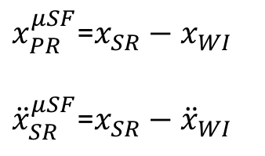
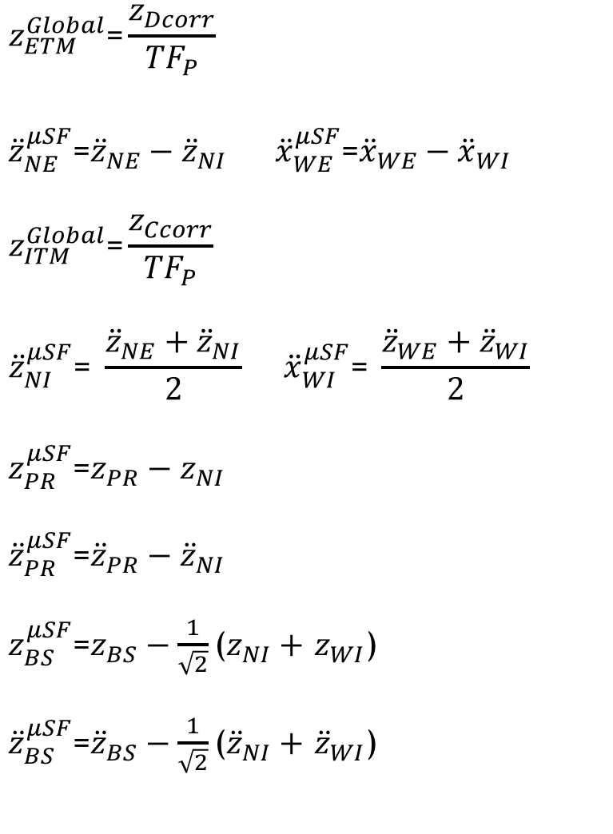
μSeism-Free platform AND Global Inverted Pendulum Control
$$z_{ETM}^{Global}\text{=}\frac{z_{Dcorr}}{{TF}_{P}}$$
$${\ddot{z}}_{NE}^{μSF}\text{=}{\ddot{z}}_{NE}−{\ddot{z}}_{NI} {\ddot{x}}_{WE}^{μSF}\text{=}{\ddot{x}}_{WE}−{\ddot{x}}_{WI}$$
$$z_{ITM}^{Global}\text{=}\frac{z_{Ccorr}}{{TF}_{P}}$$
$${\ddot{z}}_{NI}^{μSF}\text{=} \frac{{\ddot{z}}_{NE}+{\ddot{z}}_{NI}}{2} {\ddot{x}}_{WI}^{μSF}\text{=} \frac{{\ddot{z}}_{WE}+{\ddot{z}}_{WI}}{2}$$
$z_{PR}^{μSF}$=$z_{PR}−z_{NI}$
${\ddot{z}}_{PR}^{μSF}$=${\ddot{z}}_{PR}−{\ddot{z}}_{NI}$
$z_{BS}^{μSF}$=$z_{BS}−\frac{1}{\sqrt{2}}$($z_{NI}+$ $z_{WI}$)
${\ddot{z}}_{BS}^{μSF}$=${\ddot{z}}_{BS}−\frac{1}{\sqrt{2}}$(${\ddot{z}}_{NI}+$ ${\ddot{z}}_{WI}$)
PINNING ITMs
DIFF on ETM
COMM on ITM
WE
2
DIFF position
deduced from lock correction
4
COMM position
deduced from lock correction
3
END-INPUT
COMM and DIFF
acceleration
WI
1
$x_{PR}^{μSF}$=$x_{SR}−x_{WI}$
${\ddot{x}}_{SR}^{μSF}$=$x_{SR}−{\ddot{x}}_{WI}$
PR
NI
NE
BS
GlobalControl (lock signal)
The 4th recombination to be studied
(just tested)

Slide 11
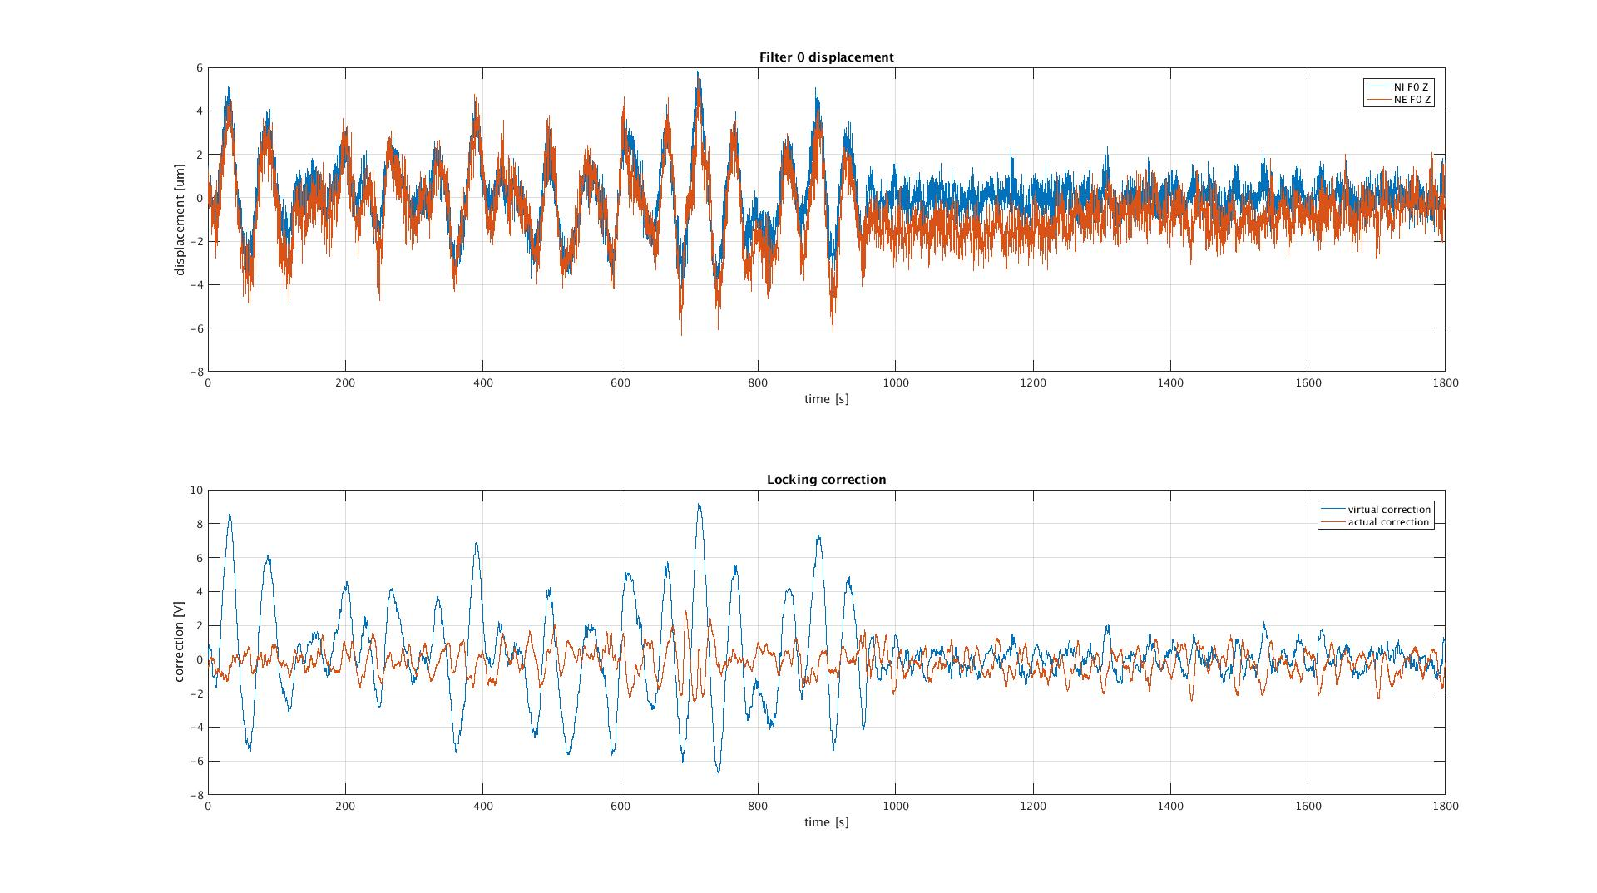
Preparatory tests ongoing: recombined FP lock, single arm
ETM Top-stage follows ITM
GIPC
STANDALONE
Without GIPC: virtual correction due to differential motion of the two mirrors, driven at LF by the ITM, where a LF crossover is applied.
➔to complete the scheme: smart cure (subtraction) of useism background noise, by combining IP in the central area, and optimization at the level of ITM IP.
The real lock correction is not significantly spoiled by
tilt noise

Slide 12
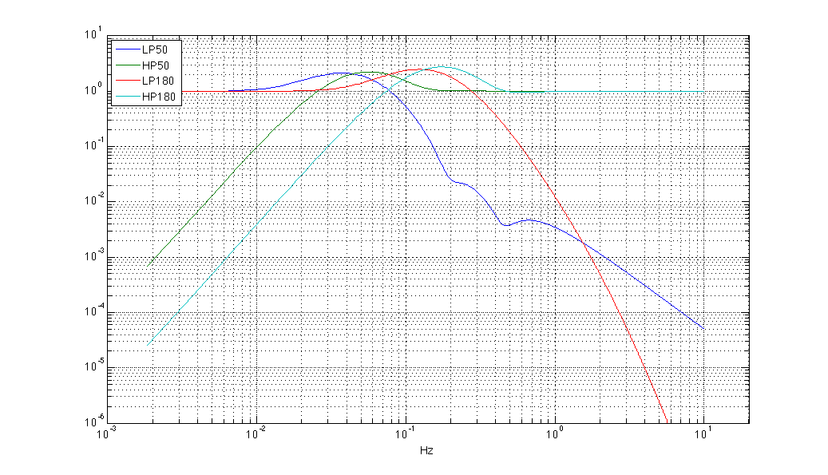
Preparatory tests ongoing: recombined FP lock, single arm
Is it possible (and meaningful) to further increase the blending blending frequency ?
20 smaller “tilt noise reinjection)
standalone control of IP with such high crossover would be meaningless !
AdV:BLENDING TESTED UP TO 180 mHz !
(in V+ achieved 110-120 mHz)
Notes:
ti passo i gps di due bei lock 1177409816, durata 1800 secondi vento medio: 45.6 GIPC con poli bassi (credo 0.12) 1177411816, durata 2000 secondi vendo medio: 41,.3 GIPC con poli a 0.18

Slide 13
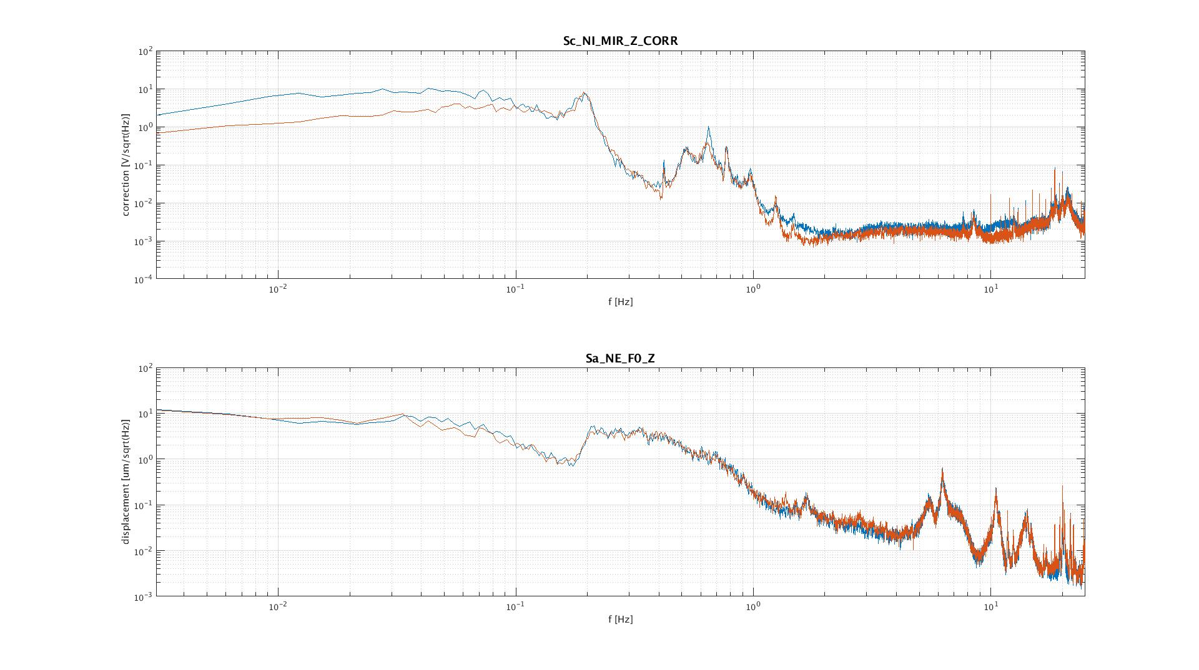
Preparatory tests ongoing: recombined FP lock, single arm
Lock correction reduced : i.e. ETM tilt background removed.
Wind speed: 42-45 km/h (ave)
April 28 2017
Blending cavity Length/Acc at medium-high frequency (GIPC crossover 120 mHz)
displacement RMS unchenged
ETM: Blending cavity Length/Acc at high frequency (GIPC at 180 mHz)
AdV:BLENDING TESTED UP TO 180 mHz !
(in V+ achieved 110-120 mHz)
Notes:
ti passo i gps di due bei lock 1177409816, durata 1800 secondi vento medio: 45.6 GIPC con poli bassi (credo 0.12) 1177411816, durata 2000 secondi vendo medio: 41,.3 GIPC con poli a 0.18

Slide 14
Acc
2
HPLP(fx50)
Corr
IP
SA
ITM
HPLP(fx50) = Sensor blending ~50 mHz
GIPC
1
μS_ITM ground
3
LVDT
FP(NE-NI)
Acc
5
-
4
+
HPLP(fx90) = Sensor blending ~90 mHz
-
HPLP(fx90)
Corr
IP
SA
ETM
+
μS_ETM ground
GIPC
STANDALONE
LVDT
1/Top_TM

Slide 15

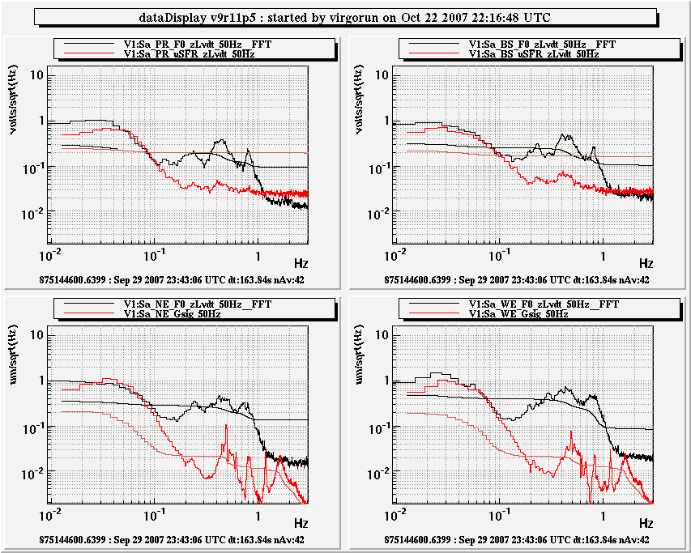

Pics from the past:
potentially with AdV we
can do even better
Better payloads,
Optimized study
μSeism evasion strategy: an example
quiet
INPUT mirror suspensions used as drift controlled reference
local LVDTs, used in-loop sense and re-inject μseismic noise
Central area
ITM as reference
Combined channels:
μSFR (μSeism-Free
Reconstruction, the noise is coherent because central area suspensions are close each other)
+
GIPC (Global-Inverted-Pendulum Control, for 3-km- separated susp.)
ETM

Slide 16
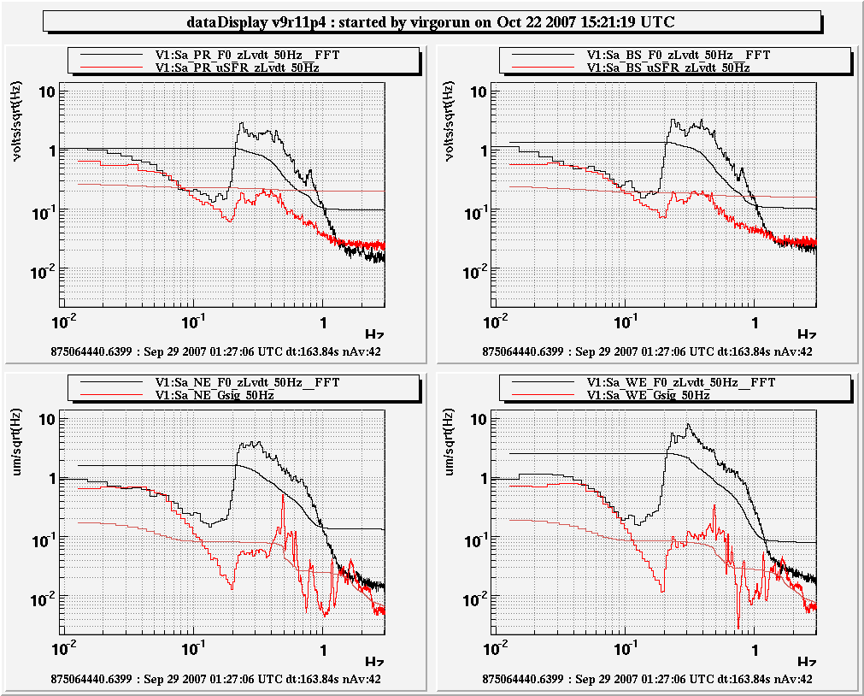
Pics from the past:
potentially with AdV we
can do even better
Better payloads,
Optimized study
μseism: rejection VSR1start-VSR1stop
sea
INPUT mirror suspensions used as drift controlled reference
local LVDTs, used in-loop sense and re-inject μseismic noise
Central area
ITM as reference
Combined channels:
μSFR (μSeism-Free
Reconstruction, the noise is coherent because central area suspensions are close each other)
+
GIPC (Global-Inverted-Pendulum Control, for 3-km- separated susp.)
ETM

Slide 17
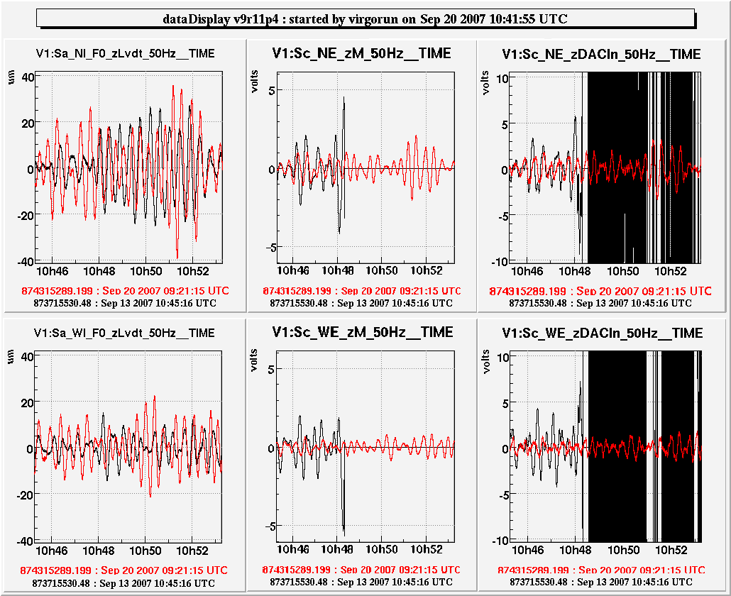
Pics from the past:
potentially with AdV we
can do even better
Better payloads,
Optimized study
MSC VS robustness : earthquakes/stable GIPC
Comparison of two events with similar local amplitude
A “lucky” occurrence !*
40 μm peak
Previously we had
saturation as the
amplitude was
less than 20 μm
MARIO:
small residual
correction (~7 μm)
The system
is much more
robust .
Correction dynamics more
than doubled.
EM-MSC-251007
(*Indonesia M6.8, Sep-20-08.31):

Slide 18
Conclusions
Global Inverted pendulum control is a way to evade indirect microseism contamination due to the sensors
(both Pos and Acc) used in top stage SuperAttenuator control.
The blending at the ETM should be at higher frequency with respect to the standalone
➔ no accelerometer “wind noise” contamination there
In absence of Tiltmeter, “wind noise” remains, but it is quite reduced, in case of HQ the lock is more robust.
The scheme was used intensively in Virgo.
AdV news:
Better payloads (pitch/roll very LF, even below 50 mHz, reduced the impact of microseism on residual tilt.)
Higher frequency Pos/Acc-blending for ETM SuperAttenuators (up to 180 mHz !!) tested.
Common mode reallocation at ITM top-stages, just tested: the advantage of full diagonalization isn’t clear yet.
In case of background noise with different properties along the two arms, the blending at the ITMs can be specified using an optimized strategy that exploits direct measurement of seismic noise (P. Ruggi, L. Trozzo).
GWDAW – Hamilton Island, May 9 2017

