Slide 1
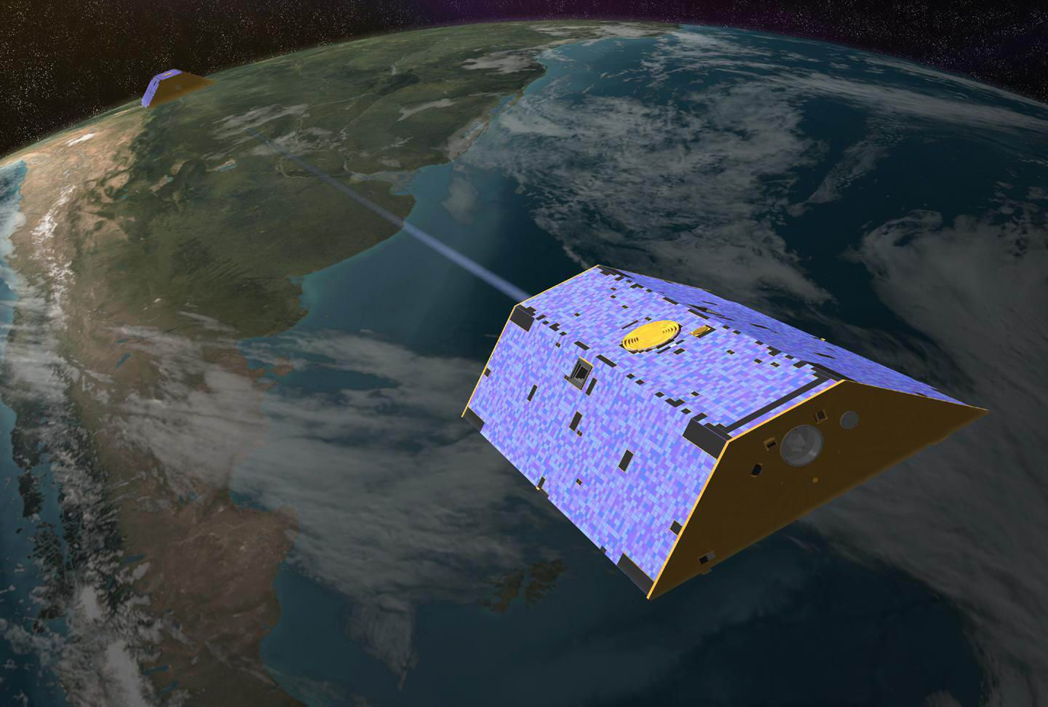












Flight Phasemeter on the Laser Ranging Interferometer on the
GRACE Follow-On Mission
An inter-spacecraft laser interferometry technology demonstrator with similarities to LISA
Robert Spero for the LRI Team
NASA’s Jet Propulsion Laboratory,
California Institute of Technology
GRACE-FO
LRI Management
LRI implementation
Amaldi 12, 13 July 2017
Image from http://www.csr.utexas.edu/grace/
Inspiring video: https://www.youtube.com/watch?v=fKVPFyu_tHQ

Slide 2

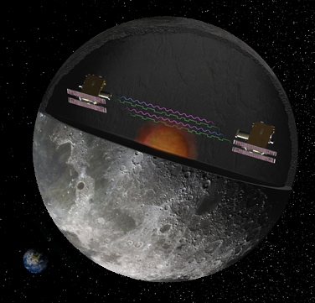
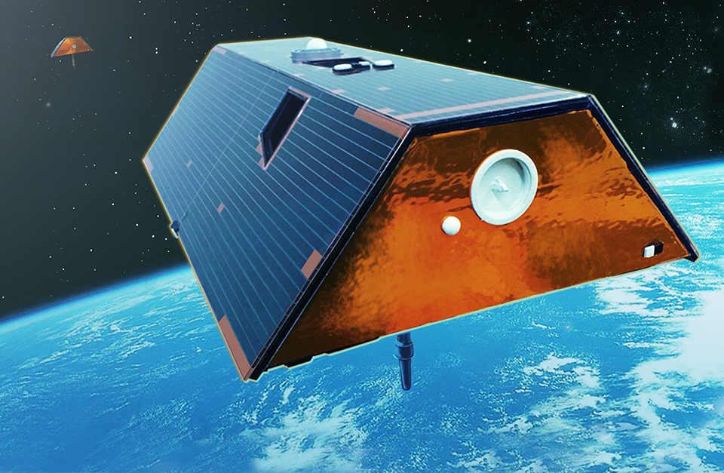
Gravity-Sensing: Precision Phase Measurement Instruments in Space
Microwave Instrument ~ Micrometer Precision
Gravity Recovery and Climate Experiment (GRACE),
Earth Science, microwave measurements (micrometers)
2002-present.
Gravity Recovery and Interior Laboratory (GRAIL),
Planetary science, microwave measurements (micrometers)
Sept 10, 2011 – Dec 17, 2012
Laser Instrument ~ Nanometer to Picometer Precision
Laser Interferometer Space Antenna (LISA)
Astrophysics, (picometers)
-> ESA Cosmic Visions L3 (2034)
GRACE Follow-On
Earth Science,
Microwave (micrometers), Laser (nanometers)
Laser Ranging Interferometer as Joint US-German instrument
2017 or early 2018 launch

Slide 3
The Laser Ranging Interferometer (LRI) on GRACE Follow-On
The LRI is a (highly successful) partnership between the US and Germany*
Joint: Instrument Management shared between JPL and AEI
US (NASA/JPL): Phasemeter, Laser, and Optical Cavity,
Germany (GFZ/AEI, STI, DLR): Optical Bench, Photodetectors, Triple Mirror Assembly, Baffles
First interspacecraft laser interferometer (a different pathfinder for LISA)
LRI Phasemeter was design based on LISA technology and capabilities
LISA/LRI have similar
  Phase tracking/signal readout
  Received optical power
  Lasers
  Photodetectors
  Laser frequency control (phase locking and frequency stabilization)
*- see partner list in backup

Slide 4
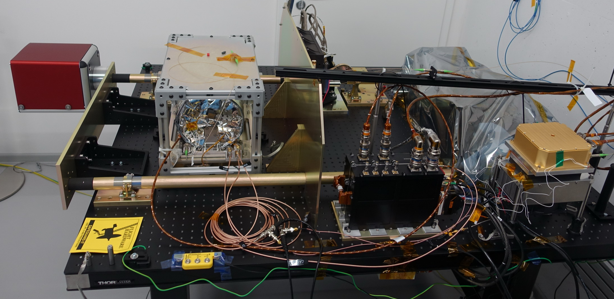
LRI 1 at STI
LRI Flight Hardware just prior to spacecraft integration
OBE
(DLR)
TMA
(STI/Cassidian)
CAV
(BATC)
OGSE
(DLR)
OBA
(STI)
LAS
(Tesat)
Baffles
(STI)
LRP
(JPL)
German
US
Immenstaad am Bodensee

Slide 5
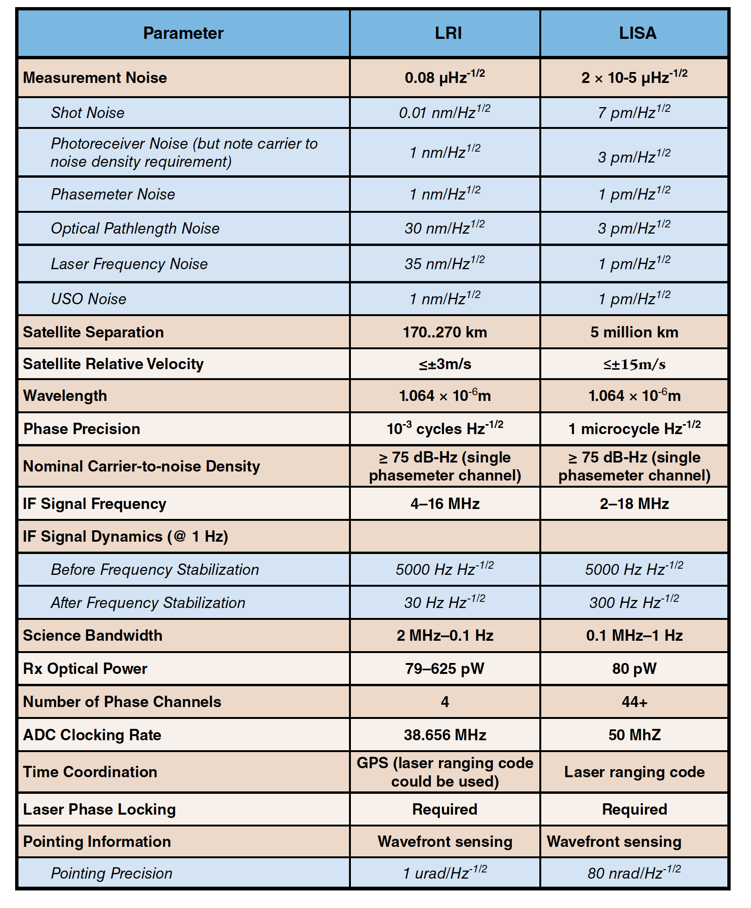
Comparison of the LRI and LISA
LRI design based on LISA technology
and capabilities.
Designed by LISA scientists and technologists (NASA and Germany)
LRI top level precision relaxed
Tighter laser stability requirement
Similar:
  Doppler Shift and IF signal
  Received optical power
  Science Signal Frequency
Both LRI and LISA require:
Low light power tracking
Differential Wave Front sensing
LRI provides a relevant technology
demonstration for LISA and represents a
valuable step towards LISA tech-development
80 nm/rtHz
20 pm/rtHz
2mHz – 100mHz
0.1 mHz – 1Hz
NASA Technology Development Roadmap for a Future Gravitational-Wave Mission

Slide 6
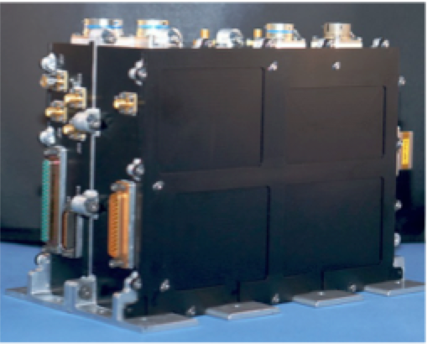
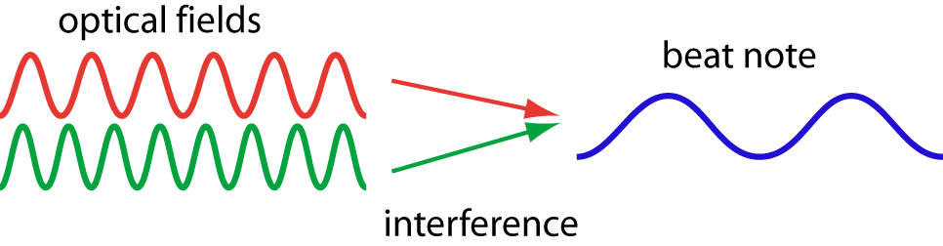
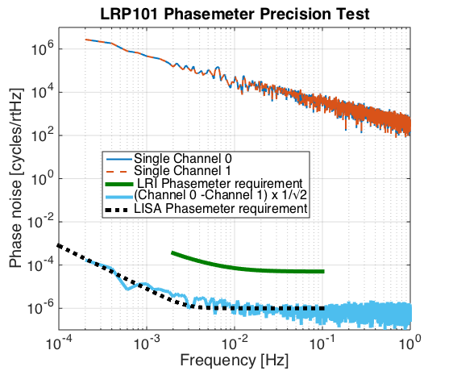
LRI Flight Phasemeter aka
Laser Ranging Processor (LRP)
f₁
f₂
f_{beat} = f₁ - f₂
The phasemeter measures the science signal as a
mHz phase modulation on a MHz beat signal.
LRP developed at JPL, based on the LISA Phasemeter
LRI Flight model Phasemeter
The LRP implements the LISA phase tracking and
frequency control algorithms, including:
Phase tracking
Differential wavefront sensing (and control)
Laser Phase Locking
Laser frequency stabilization
Has only 4 input channels (vs 34 for LISA)
Relaxed precision requirement, but ~ LISA performance
Simulated Laser
Frequency Noise
Residual error

Slide 7
All functions of the Phasemeter at TRL 4 or Flight
The phasemeter core functionality:
  Produces science data (interferometer readout)
  Offset phase locks the slave laser to the received laser light
  Stabilizes the master laser to the frequency reference (cavity)
  Derives differential wavefront sensing signals for laser pointing
  Measures “clock sidebands” for USO noise cancellation
  Measures inter-spacecraft separation to 1m absolute accuracy to facilitate Time Delay Interferometry
All above functions have been demonstrated at TRL 4/5 or above for LISA required levels.
Blue functions have been demonstrated at TRL 9 (FLIGHT) for LRI
(some performance requirements not tested to LISA levels – e.g. phase locking – due to relaxed requirements for LRI)
Note: This presentation covers the US Phasemeter efforts. See Backup for references. For updates on parallel AEI efforts see LISA-Metrology System FinalReport (2016)
http://hdl.handle.net/11858/00-001M-0000-0023-E266-6

Slide 8
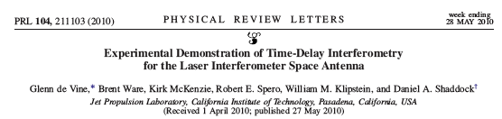
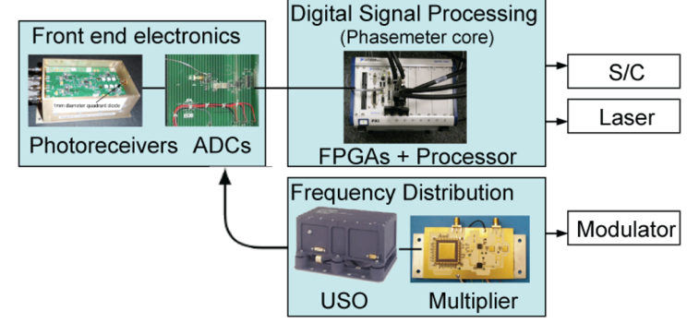
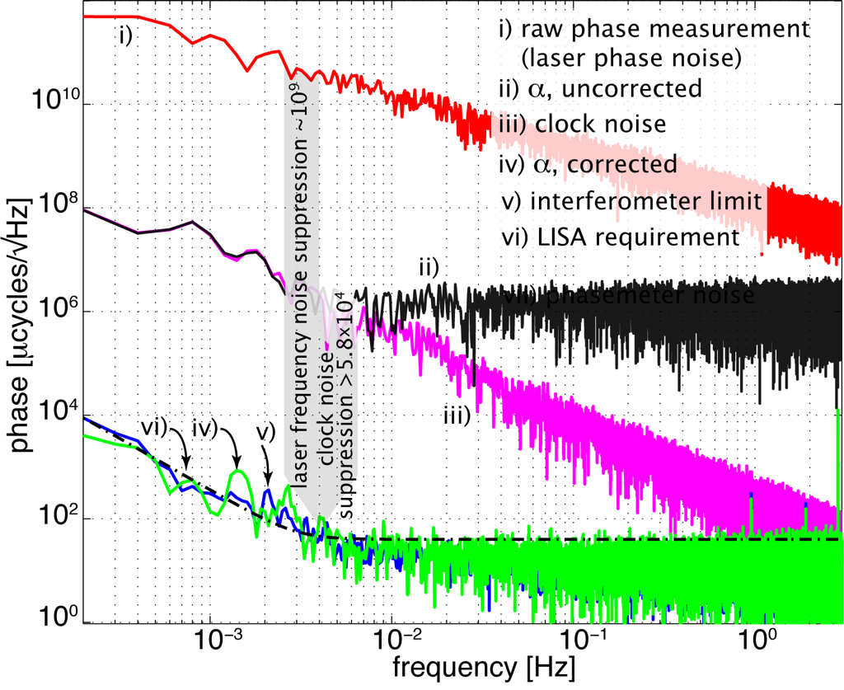
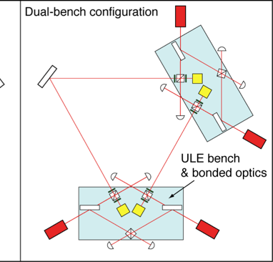
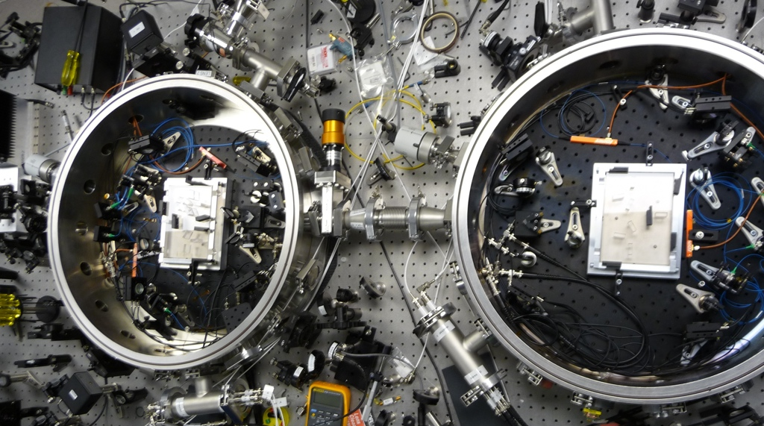
Time Delay Interferometry with the LISA Phasemeter (LRP in progress)
JPL LISA interferometer testbed built to demonstrate the phasemeter
and measurement system performance to TRL 4.
- Currently working to test the LRP (LRI phasemeter) on the
JPL LISA Interferometry testbed.
  Retired the highest LISA phase measurement risk¹
  Frequency noise removal to interferometer displacement limit
  Clock Tone Transfer via GHz phase modulation
  Interpolation of data streams onto common time-base
Upgrading to TRL5 with GFO HW
  ¹ NASA’s LISA Technology Development Plan V 1.0 ( 2005)

Slide 9
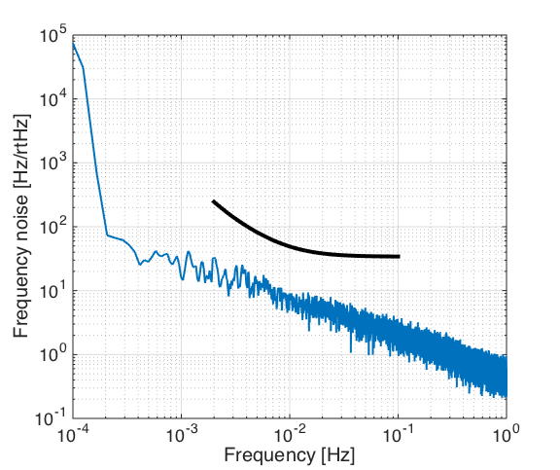
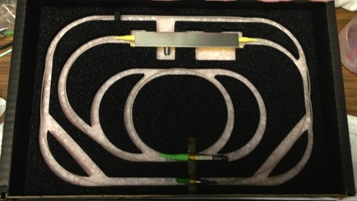

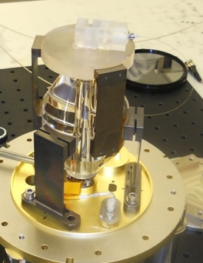
Laser Frequency Stabilization Using Flight Phasemeter with flight Cavity and flight Laser (LRI-U)
LRP implements laser frequency control
(locks laser to cavity resonance)
  Near mirror thermal noise stability
Similar to Laser on LISA Pathfinder
  Wavelength: 1064 nm
  Nd:YAG Non-Planar Ring Oscillator
Laser output power: 25 mW +/- 20%
LRP implements laser frequency control (locks laser to cavity assembly)
LISA rqmt
GRACE-FO rqmt
Laser
Flight phasemeter controlling flight laser to flight cavity, x2
Optical Cavity

Slide 10
Summary
GRACE Follow-On to launch in late 2017 or early 2018, with the first inter-spacecraft interferometer onboard, the Laser Ranging Interferometer (LRI)
The LRI is a US-German partnership.
  US: Phasemeter, Cavity, Laser, GSE
  Germany: Photoreceivers, Optical Bench, Triple Mirror Assembly, Baffles, OGSE
Instrument design and many technology elements from LISA development
The LRI mission parameters have many similarities to LISA
  Makes the LRI a relevant technology demonstrator for LISA
  Increases maturity of key LISA technologies
  (for US: advanced phasemeter and Optical Cavity)
The LRI provides viable platform to test key LISA technologies in-flight (NASA-APRA grant, PI K. McKenzie)
  Time-Delay Interferometry (see S. Francis, et al., “Tone-assisted time delay interferometry on GRACE Follow-On,” Phys. Rev. D 92, 012005 (2015)
  Arm locking (see J. Thorpe and K McKenzie, “Arm locking with the GRACE follow-on laser ranging interferometer,” Phys. Rev. D 93, 042003 (2016)

Slide 11




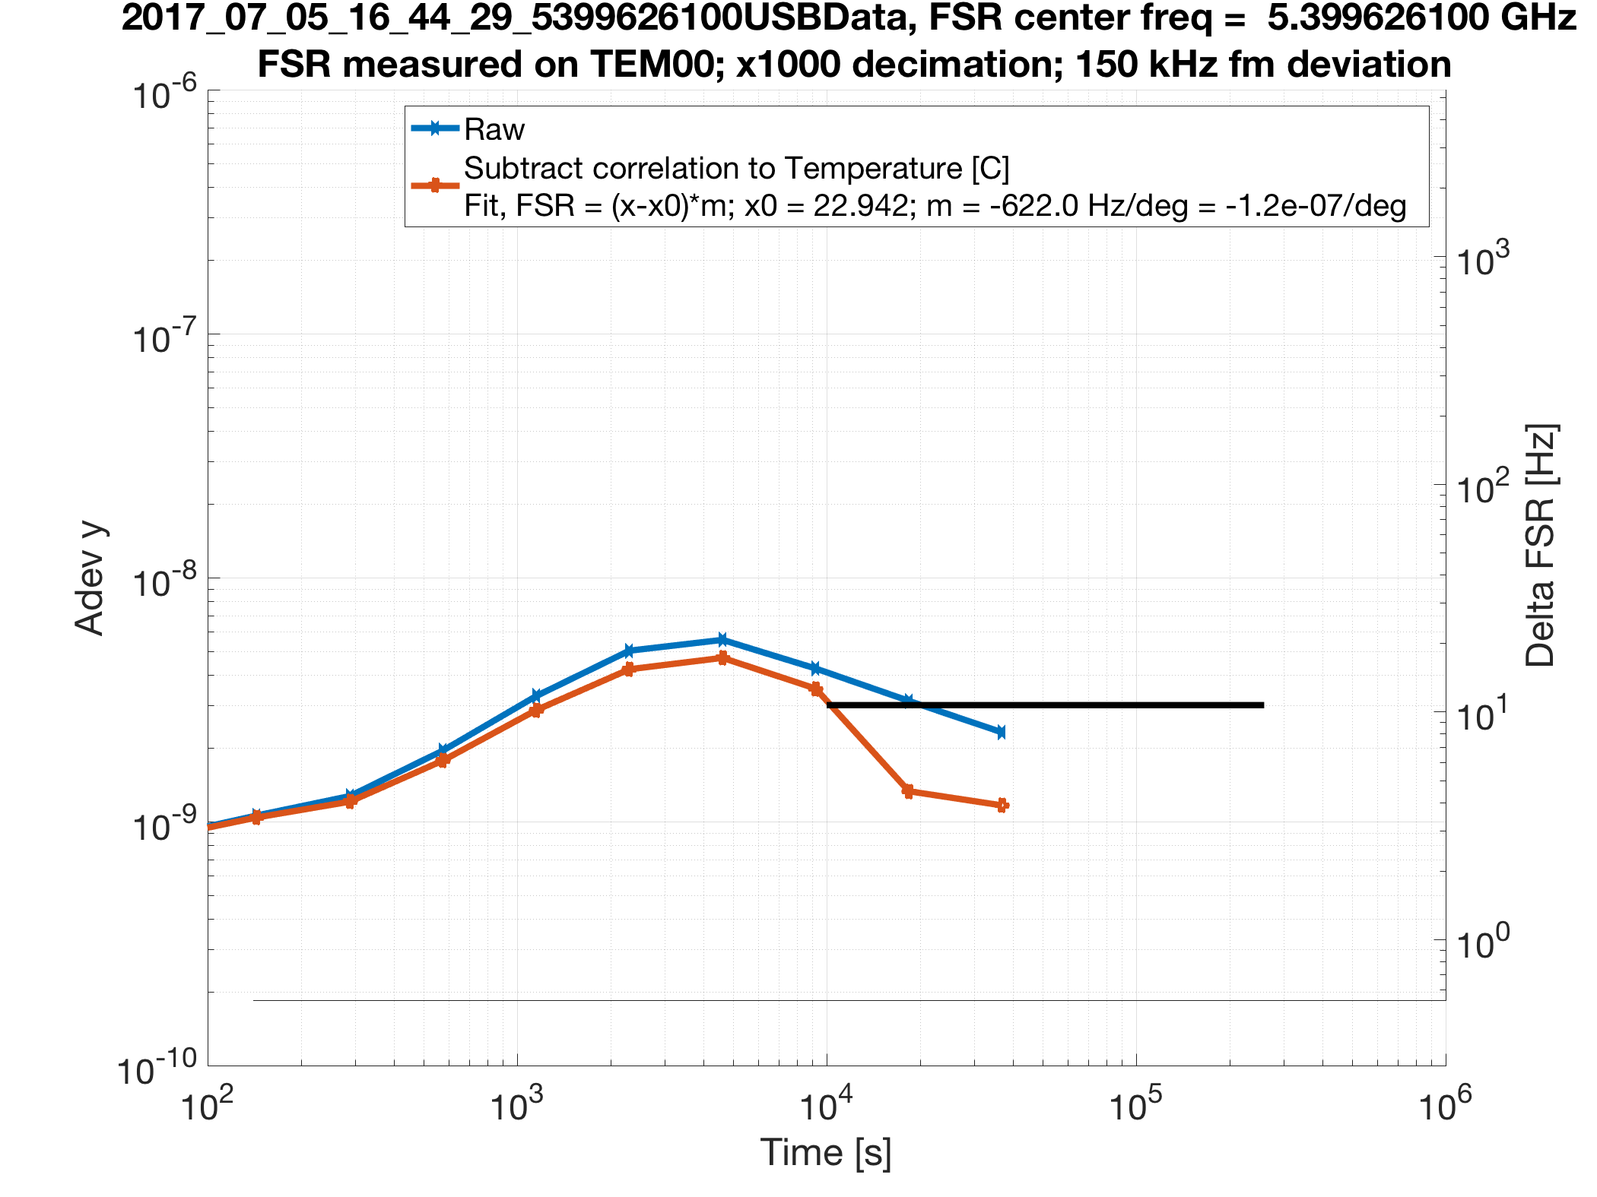
Post-script on calibration (1 of 3)
  Lisa’s signal is strain, . GRACE’s signal is gradient, same as strain.
  Calibration of is achieved by phase-to-length conversion, i.e. laser wavelength .
  Experiment underway to measure to precision of , suited for GRACE or LISA cavity stabilization.
    Measures reference cavity frequency by adding modulation sidebands at multiple of FSR
    Minimal hardware impact

Slide 12
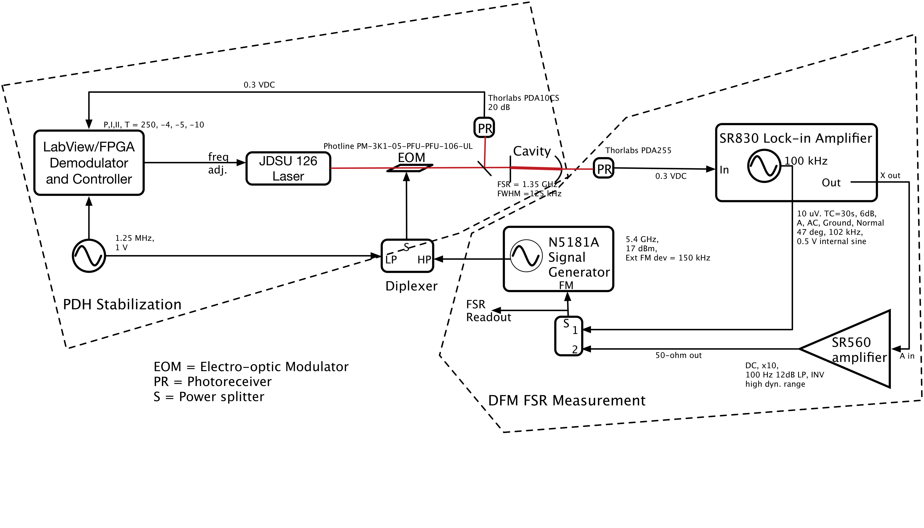
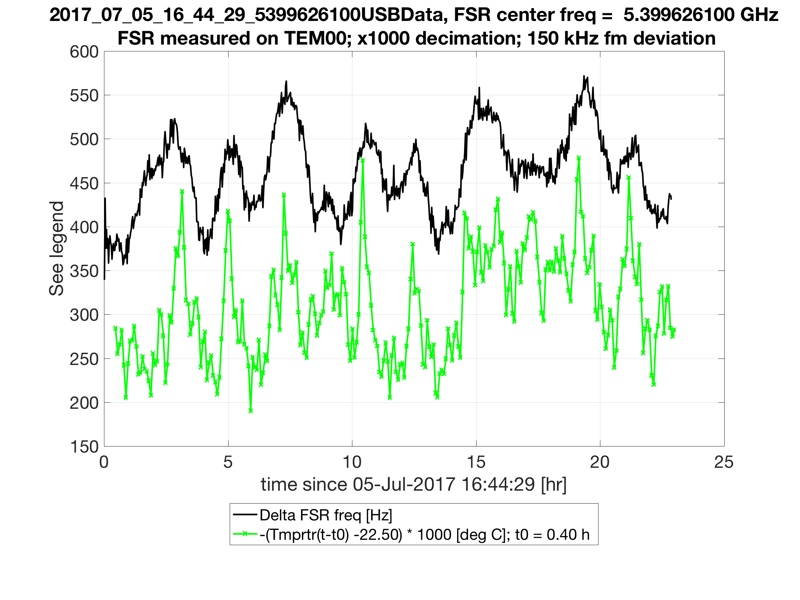


Post-script on calibration (2 of 3)
Frequency correlated to temperature at level of ~ /K. Candidate sources:
Cavity alignment coupling to frequency
Signal generator (easily correctable)
Thermal expansion of cavity spacer (expect /K)
Even without further improvement, likely adequate for GRACE 2. Easily adequate for LISA.

Slide 13

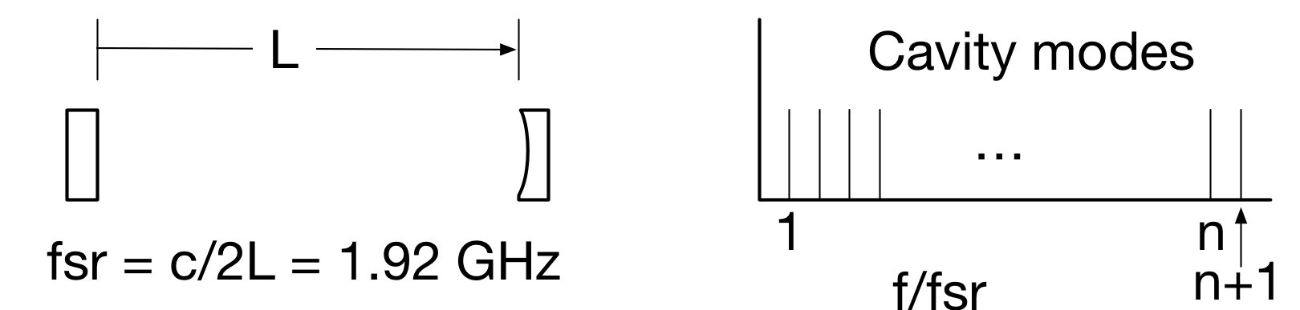
Post-script on calibration (3 of 3)
Big idea: Wavelength-independent strain measurement achievable by measuring both and with respect to reference cavity.
measured as usual, with respect to laser frequency stabilized to cavity.
measured in units of cavity length L by (slowly) slewing lock point to adjacent mode and tracking accumulated round-trip phase at master spacecraft while slave spacecraft remains phase-locked.
Testable on LRI with software upload only!

Slide 14
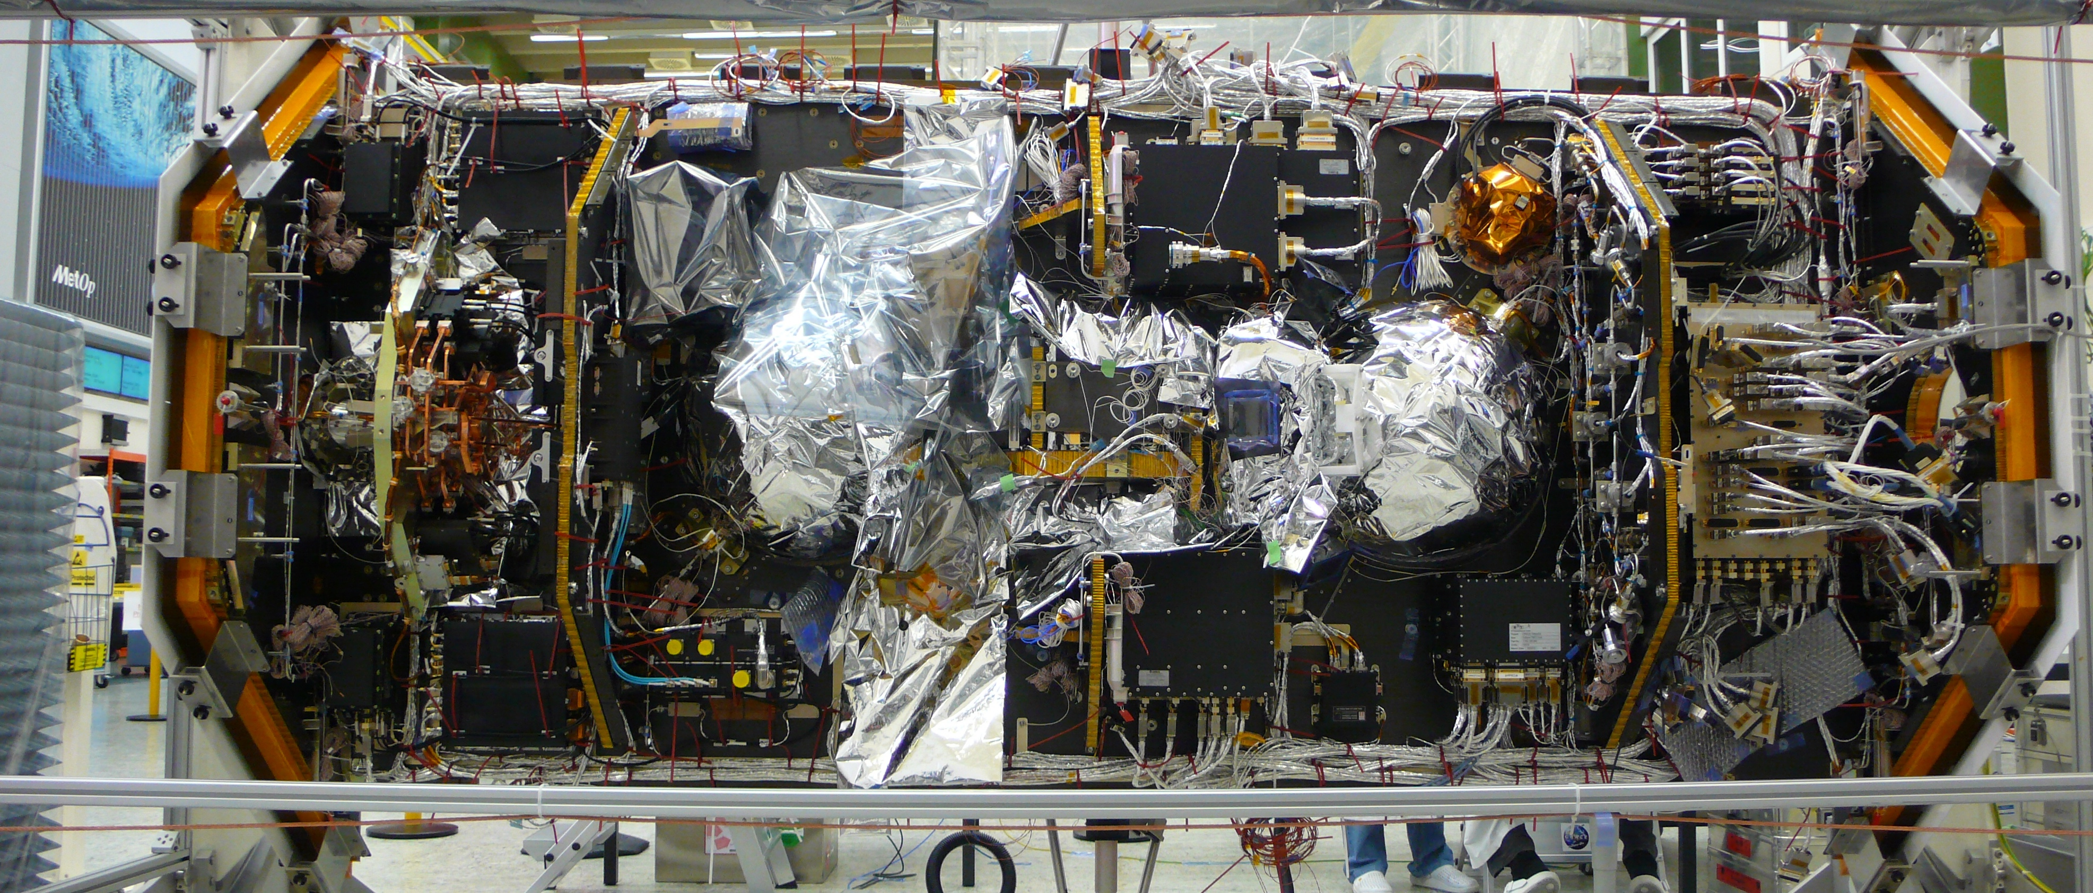
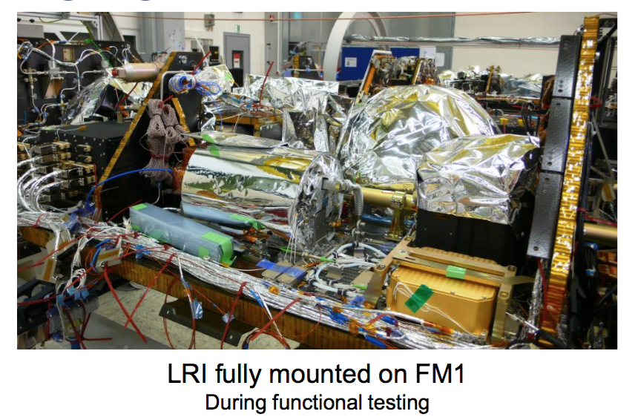
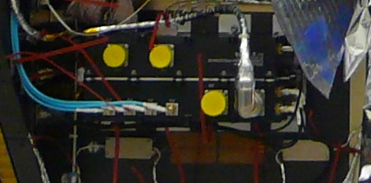
Phasemeter on the GRACE-FO Spacecraft (Airbus DS)
*Photos courtesy of Airbus and JPL
LRP
OBE
Baffles

Slide 15









GFO LRI Team
JPL
Bill Klipstein
Bob Spero
Brent Ware
Serge Dubovitsky
Alex Abramovici
Greg Rosalia
Marty Scarbrough
Christian Liebe
Tony Sherrill
Glenn de Vine
Kirk McKenzie
Andrew Sutton
Jeff Dickson
Brian Bachman
Alex Murray
Chris Woodruff
Yutao He
Ken Clark
David Barr
Mark Katsumura
Kameron Larsen
Jehhal Liu
Max Bize
Mike Burke
Joseph Trinh
Doug Wang
Josh Ravich
Omid Ghassemi
Greg Taylor
Don Nguyen
Tony Grata
Rick Paynter
Valereen Essandoh
Bill Folkner
Rabi Wang
Daniel Shaddock
Peter Halverson
Tesat
Daniel Troendle
Steve Windisch
Juergen Schaeufler
Felix Kern
Steffi Gross
Iris Rock
Reinhard Baehring
Mustafa Cilo
Simon Braeuchle
Bjoern Siebertz
Rudolf Bauer
Hanno Scheife
Claus Seibert
Christoph Seiter
Ball
Michelle Stephens
Bob Pierce
Bengie Amparan
Gretchen Reavis
Mike Sileo
Dave Bender
Mike Comstock
Tracy Copp
Amanda Curry
Mike Davis
Larry Derouin
Michael Hoppes
Jim Howell
Carl Hunsaker
Ken Jackson
Paul Kaptchen
Jim Leitch
Aaron Mann
Mark Neitenbach
Tammy Osborne
Mike Taylor
DLR - QPR
Andreas Eckardt
Thomas Mangoldt
Bernd Zender
Burkhardt Guenther
Thomas Lieder
Josep Sanjuan
Martin Gohlke
Claus Braxmaier
STI
Frank Gilles
Kolja Nicklaus
Kai Voss
Rudolf Faimann
Manfred von Hoegen
Melanie Grossnick
Mark Herding
Timo Liebherr
Anne Götz
Marina Dehne
Vadim Pflug
Christian Diekmann
Andreas Baatzsch
AEI
Gerhard Heinzel
Ben Sheard
Christoph Mahrdt
Vitali Müller
Daniel Schütze
Gunnar Stede
Alexander Görth
Germán Fernández Barranco
Apcon - OBE
Anton Lebeda
Arnold Lebeda
Cassidian - TMA
Georg Luichtel
Roswitha Keppeler
Malte Schwarzer
Martin Hinz
Marcus Zimmermann
Gerhard Dersch
Gerhard Reile
Photline
Philippe LeRoux
Houda Brahimi
Pascal Blind
Vincent Buin
Fatima Oruci
Jerome Hennemann
LRI
Dennis Weise
Reinhold Flatscher
Simon Doerr
ANU
Daniel Shaddock
Roland Fleddermann
Robert Ward
Danielle Wuchenich

Slide 16
JPL LISA Interferometry References
  JPL LISA interferometry contributions since 1996:
  Time Delay Interferometry¹ (1999)
  Post-processing interpolation TDI² – TDI made practical on a spacecraft (2003)
  Development of Arm locking^{3,4} - Use LISA arms as frequency reference
  Velocity-correcting Time Delay Interferometry⁵ (2004)
  Demonstration of clock noise suppression⁶
  LISA Phasemeter TRL 4 Technical Report¹³
  First experimental demonstration of TDI⁷ (2008)
  Invention of picometer phasemeter (US 7,511,469)
  Optical ranging to absolute accuracy to 0.2m rms⁸
  Optical Communications on the laser link (20 kbps)⁸
  Track very low light power (<3pW)
  Design of the GRACE Follow-On LRI⁹ (2012)
  Differential Wavefront Sensing Demonstrated
  Design of LISA TDI experiment for GRACE Follow-On LRI¹⁰
  Design of LISA Arm Locking experiment for GRACE Follow-On LRI¹¹
  Developed Flight Cavity ¹²
1 J. W. Armstrong, F. B. Estabrook, and M. Tinto, ApJ 527 814 (1999)
2 D. A. Shaddock, B. Ware, RE Spero, M Valisineri PRD (2004)
3 B. S. Sheard, M. B. Gray, D. E. McClelland, and D. A. Shaddock, Phys. Lett. A 320, 9 (2003).
4 K. McKenzie, R. E. Spero, and D. A. Shaddock, Phys. Rev. D 80 102003 (2009)
5 D.A. Shaddock et al PRD (2003)
6 W. Klipstein et al., AIP Conf. Ser. No. 873 (2006)
7 G. de Vine, B. Ware, K. McKenzie, R.E. Spero, W. M. Klipstein and D. A. Shaddock PRL (2010)
8 A. Sutton, K. McKenzie, B. Ware, and D. A. Shaddock OE (2010)
9 B. Sheard, G. Heinzel et al Journal of Geodesy . doi:10.1007/s00190-012-0566-3. (2012)
10 S. P. Francis, D. A. Shaddock, A. J. Sutton, et al Phys. Rev. D 92, 012005 (2015)
11 J. I. Thorpe, K. McKenzie accepted PRD 2016
12 W. M. Folkner, G. deVine, W. M. Klipstein, et al Earth Science Tech. Forum, (2010).
13. D.S. Shaddock, B. Ware, R. Spero. W. Klipstein, LIMAS2007-002, LISA Project document (2007, updated 2009)

