Slide 1
Advanced LIGO Core Optics
Specifications
Measurements
  Fizeau Metrology
  Reflectivity, Transmission, Scatter and Absorption
Problems Along the Way
Simulation and Modeling
A Path to Production for A+
Manufacturing and Timetable

Slide 2
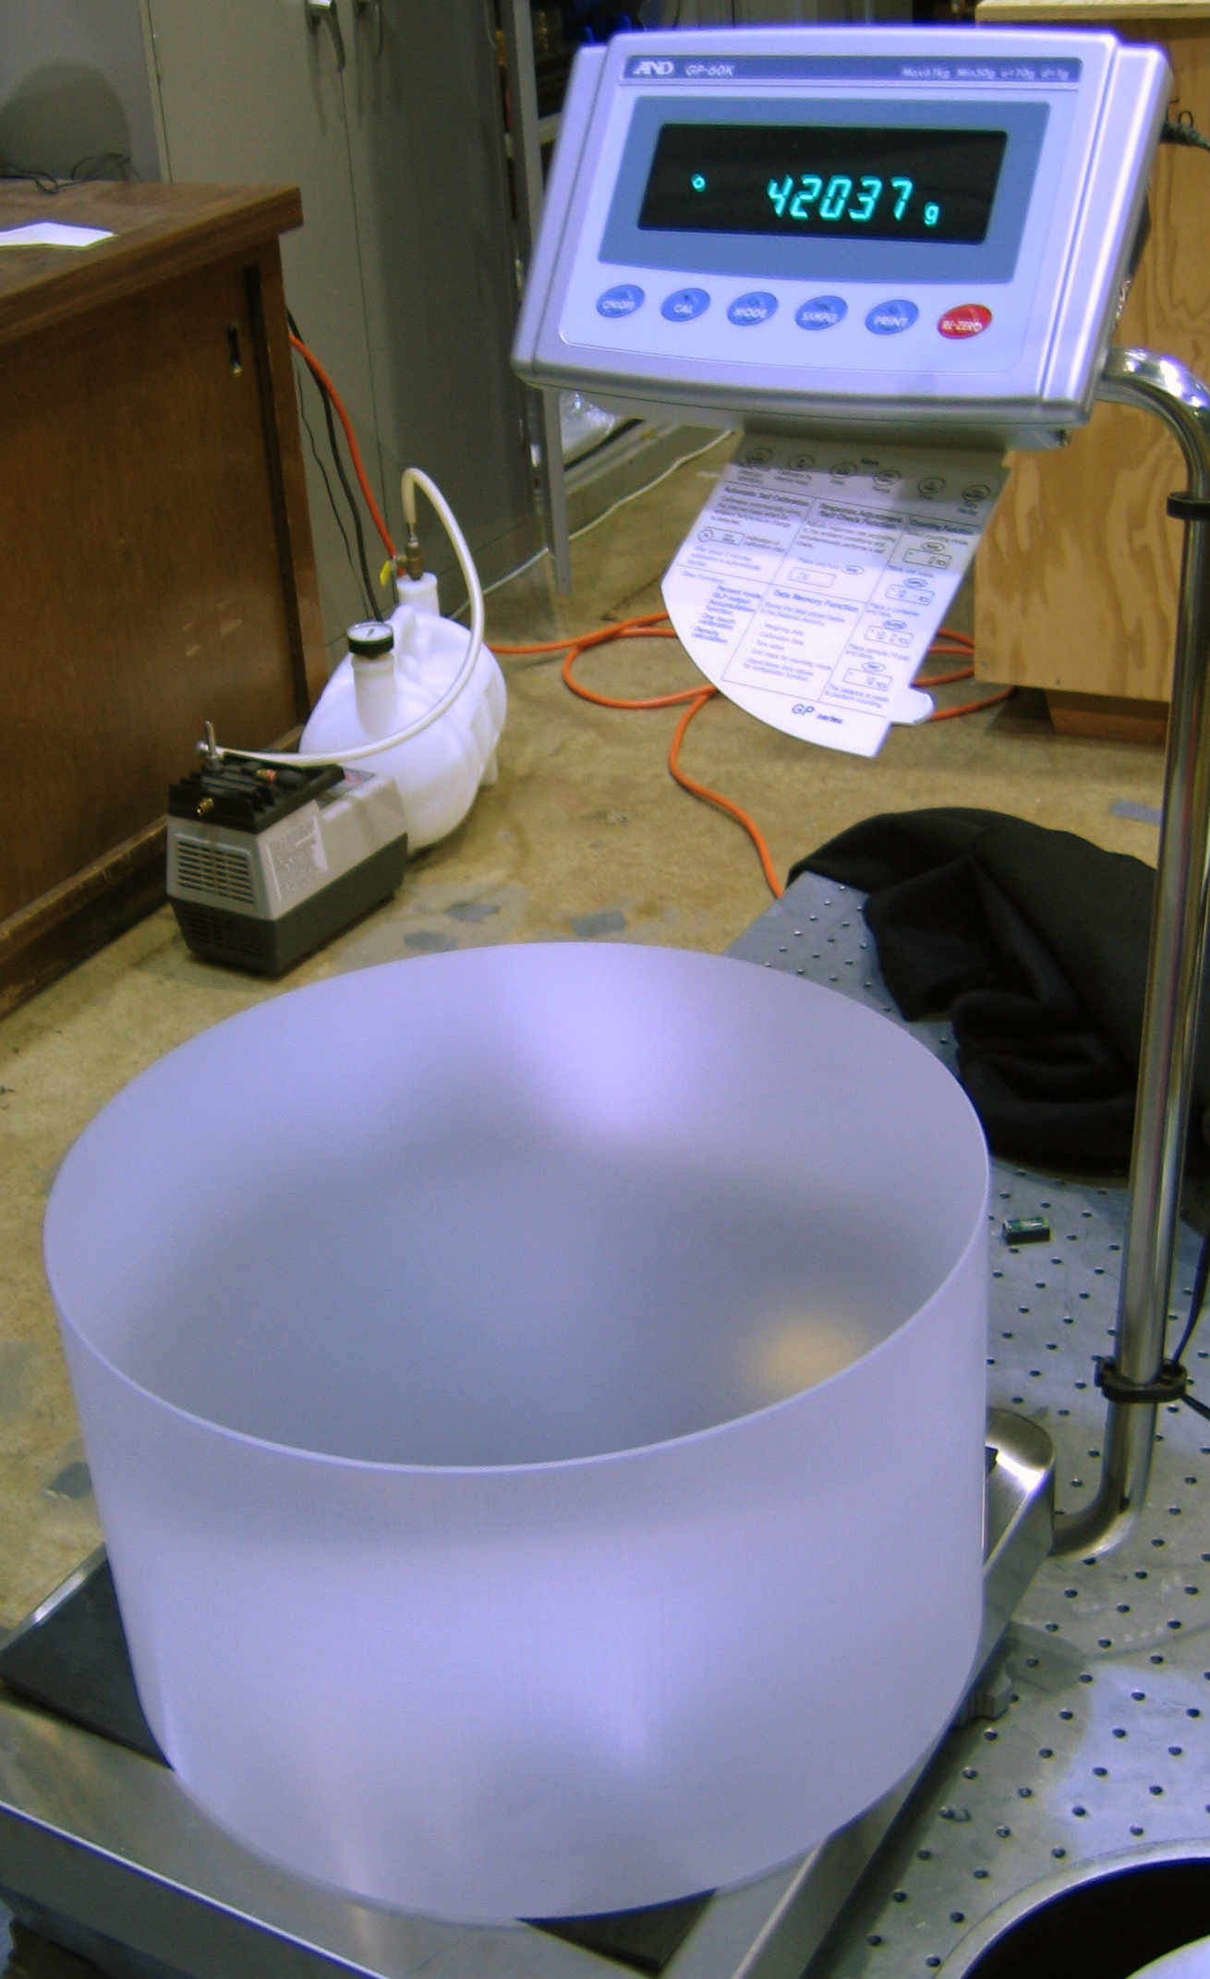
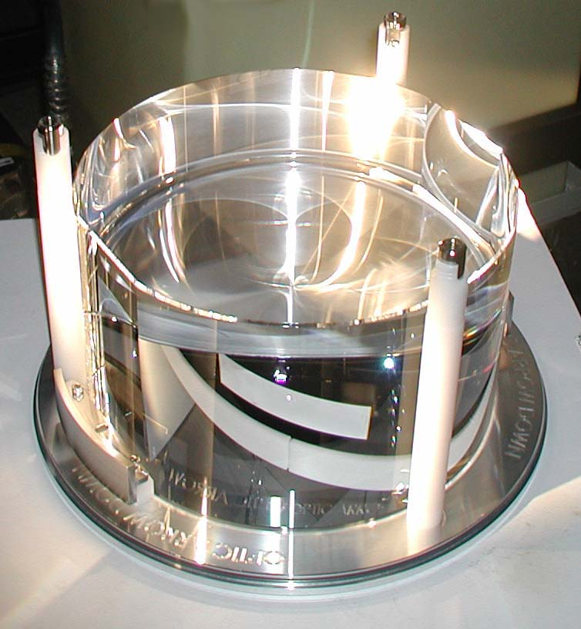
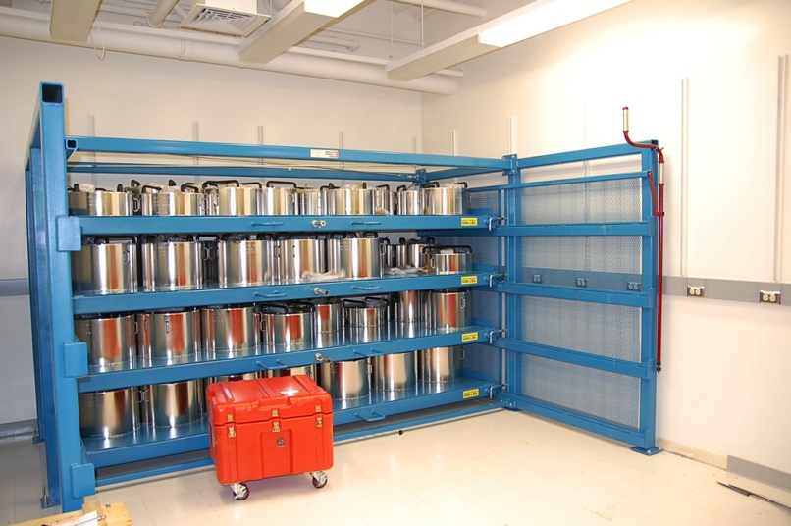
Test Mass Specifications
Radius of Curvature ~2000 m, match ± 3 m
RMS figure error
  Central 300 mm σ_{rms} < 2.5 nm
  Central 160 mm σ_{rms} < 0.3 nm
RMS microroughness
  4 Locations σ_{rms} < 0.16 nm
R > 0.999995, T < 5 PPM
Total Cavity Loss < 75 ppm
SUS
Notes:
Roc Match among type – all ITMs within ±3 m, all ETMs within ±3 m
Divided between figure and microroughness to align with different test instruments

Slide 3
Cavity loss budget
Round Trip Cavity loss 2 surfaces (ppm) | Cavity Budget (ppm) | Actual loss (modeled ) based on average of completed pieces in 2013 (ppm)
Microroughness scatter (>1/mm) | 8 | 2.2 Per mirror
Defects (Polish, Coating, Contamination) | 26 | 10 per mirror includes polish and coating
Coating Absorption | 1 | 0.3 per mirror
Surface Figure Error & Diffraction | 24 | 16.2
ETM Transmission | 5 | 4.2
Total ( required < 75 ppm) | 64 | 45.4
Notes:
We are currently seeing about twice the modeled loss – believed to be attributable to contamination
Figure and Defects are the largest sources of loss -

Slide 4
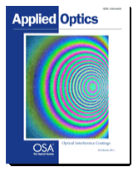
CSIRO mastered uniformity and AR coating reflectivity but struggled with absorption
300 mm diameter, same color scale, Power subtracted (∆ 3.5nm)
Uncoated (m-Zygo EPO)
11.4 nm PV 1.7 nm rms
Coated at CSIRO (m-LIGO)
9.8 nm PV 1.6 nm rms
Mark Gross, Svetlana Dligatch, and Anatoli Chtanov,
"Optimization of coating uniformity in an ion beam sputtering
system using a modified planetary rotation method,”
Appl. Opt. 50, C316-C320 (2011)
Notes:
Figure change from coating non-uniformity is potentially the largest source of loss
CSIRO mastered Uniformity early on - but had continuing problems with absorption.

Slide 5
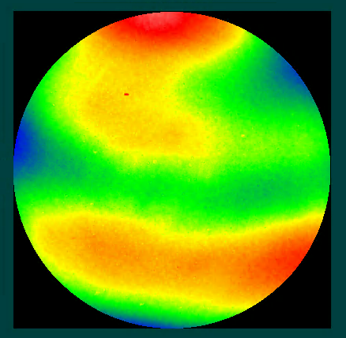
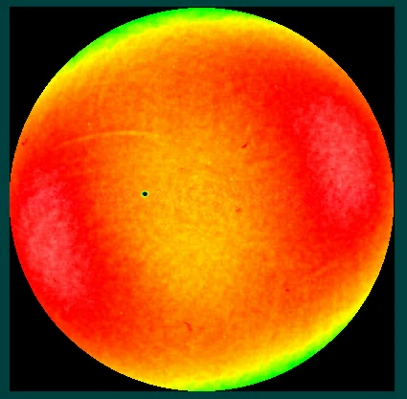
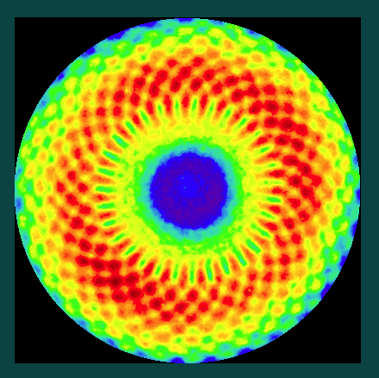
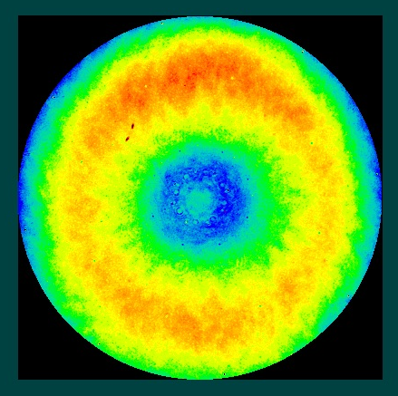
LMA
Mastered absorption and scatter but struggled with uniformity and AR reflectivity
12 nm PV 11 nm PV 4 nm PV 5 nm PV
Feb 2011 Mar 2015
160 mm diameter
Specification – no change in Zernike coefficient > 0.5 nm
___________
When is it Good Enough? Ask Hiro

Slide 6
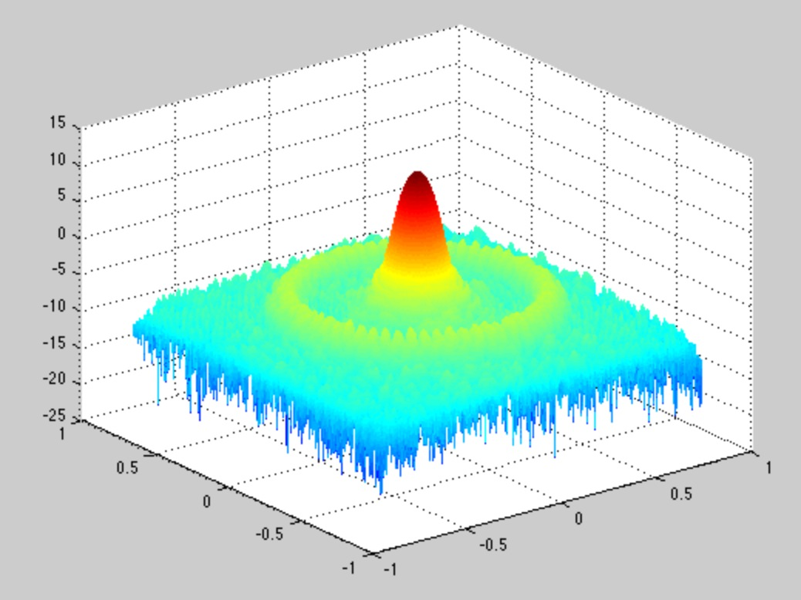
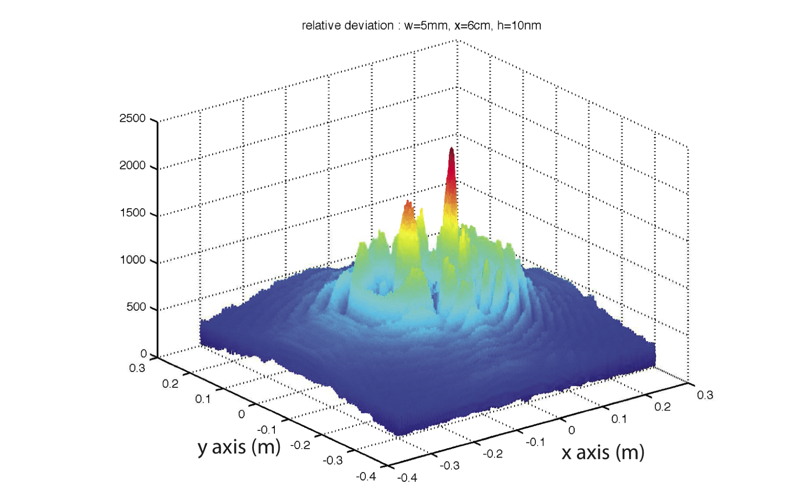
Optical Static Interferometer Simulation (SIS)
FFT Propagation
Coupled optical cavities
Multiple frequencies
Edge diffraction and apertures
Real mirror figure errors

Slide 7
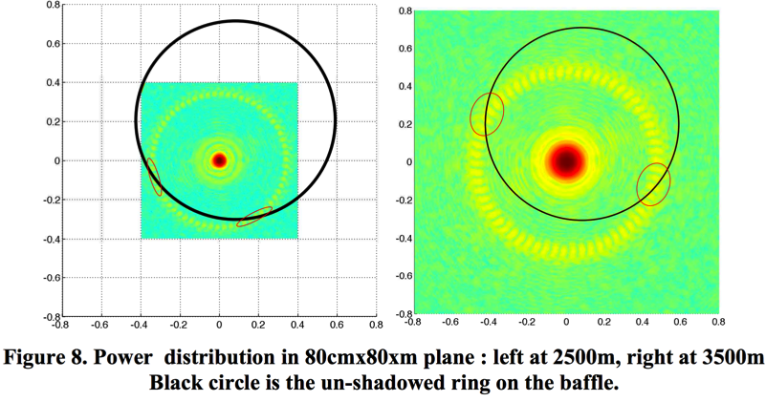
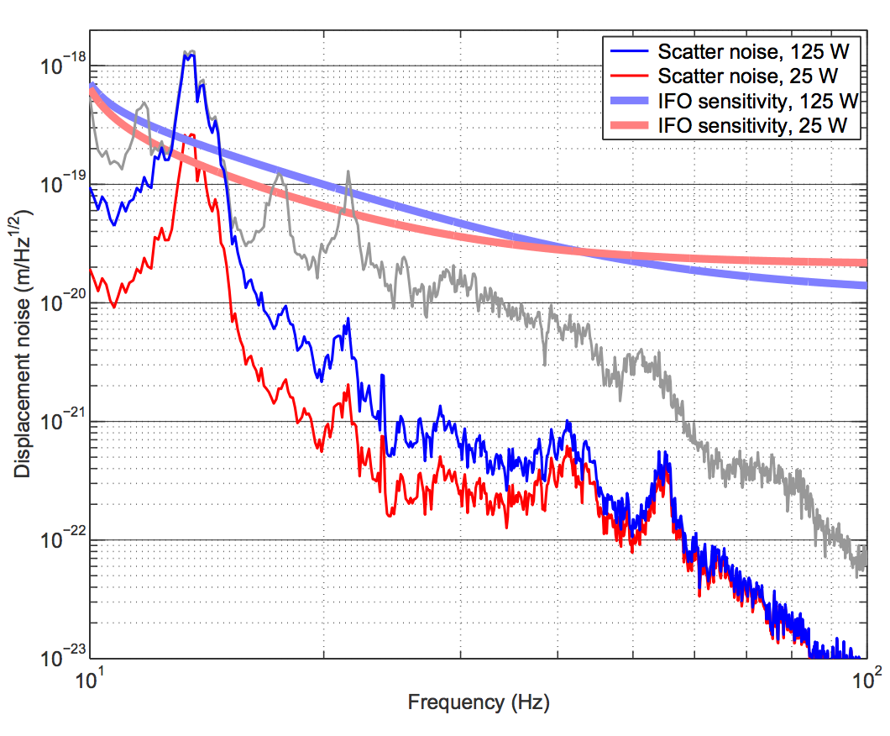
Problems Along the Way
Spirograph figure error
AR Reflectivity
Excess absorption
Large radius figure error
532 Transmission

Slide 8
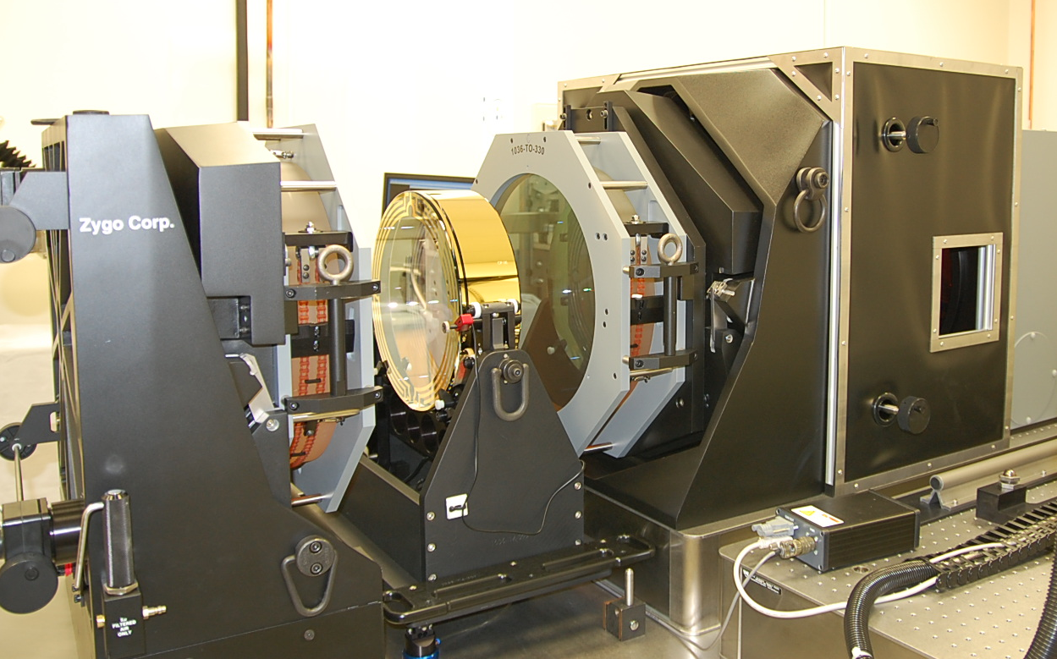
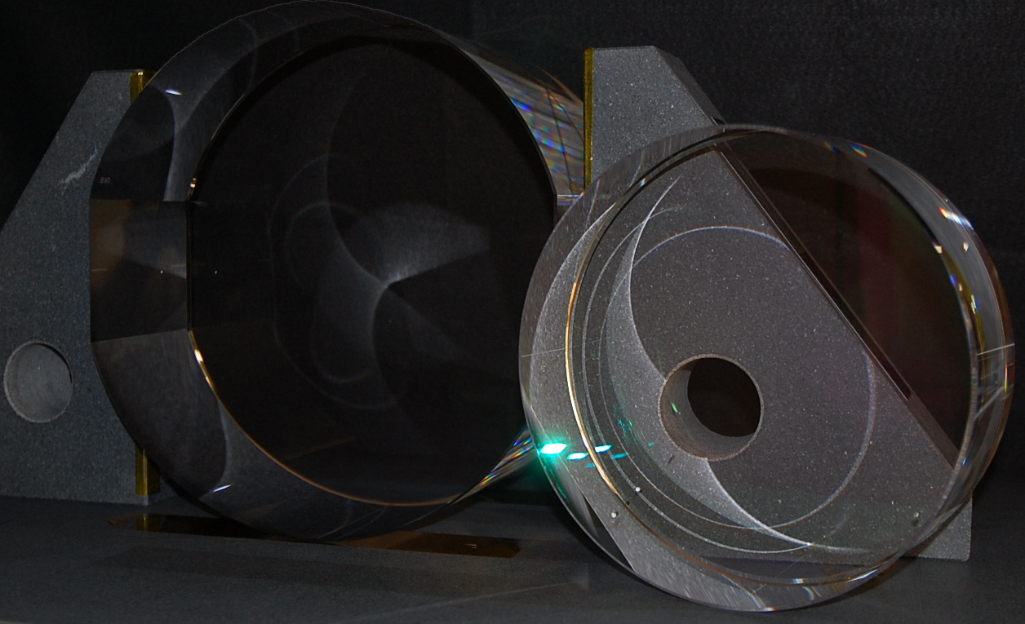
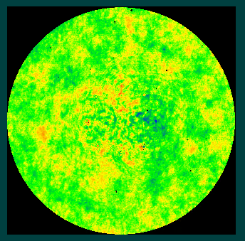
Fizeau Metrology
40 cm
λ/2000
1064 nm
0.05 nm rms
30 mm Φ
Notes:
Center 30 mm of ITM07 – recently installed at LHO rms of 0.05 nm

Slide 9
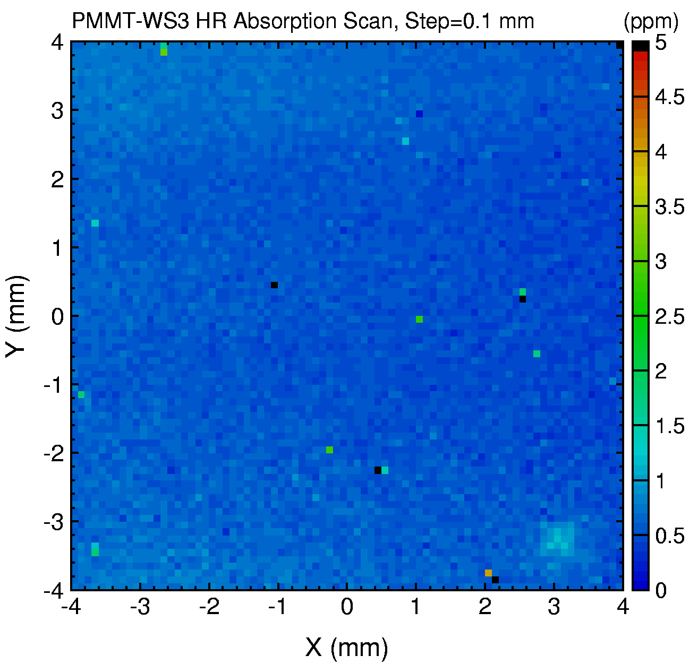
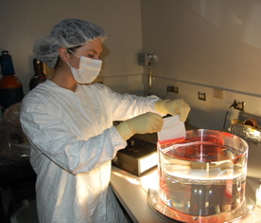
Reflectivity, Transmission, Scattered Light, Absorption
Reflectivity
Transmission
Scattered light
Absorption

Slide 10
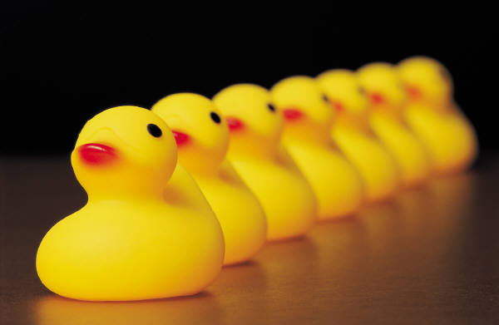
A path to production for A+
Pathfinder - Competitive demonstration of all specifications on a full size optic by a vendor with full scale coating capacity
  Competitive bid ~ 3 months
  Selection and kickoff, review performance specifications ~ 1 month
  Development
    Phase 1: Demonstration on small pieces
    If successful proceed to Phase 2
    Phase 2: Demonstration on full size optic
  Review final data at vendor
  Confirm final measurements at LIGO

Slide 11
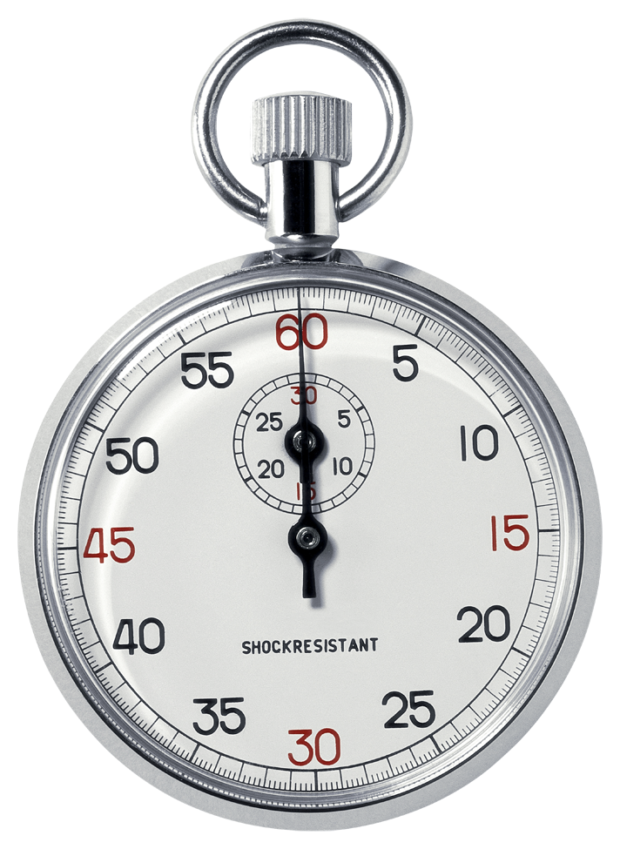
Manufacturing and Timetable
Advanced LIGO polishing 3 years total
  56 total optics, 26 test masses
  Contract – 2009
  First delivery 2010
  Final delivery 2012
  Throughput rate of 2/month once things got rolling
Advanced LIGO Test Mass coating 6 years total
  Contract – 2009
  First delivery 2011
  Final delivery 2015
  Throughput rate of 2/month once things got rolling

Slide 13
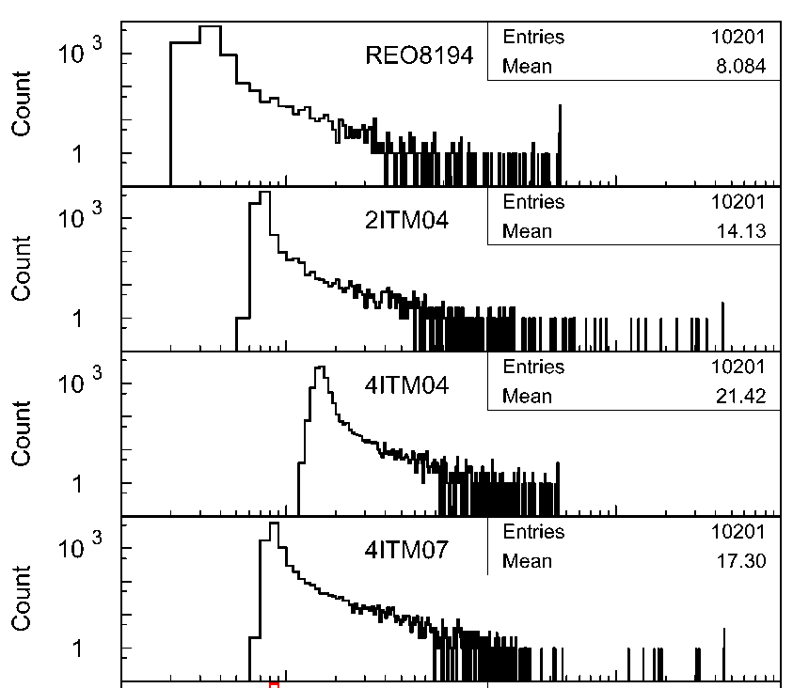
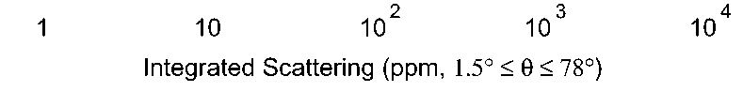
Scatter histograms
An indication of etching
Lower end represents the base microroughness
High end represents point defects
See LIGO-G080162 for details
Notes:
This is not a full integration

Slide 14
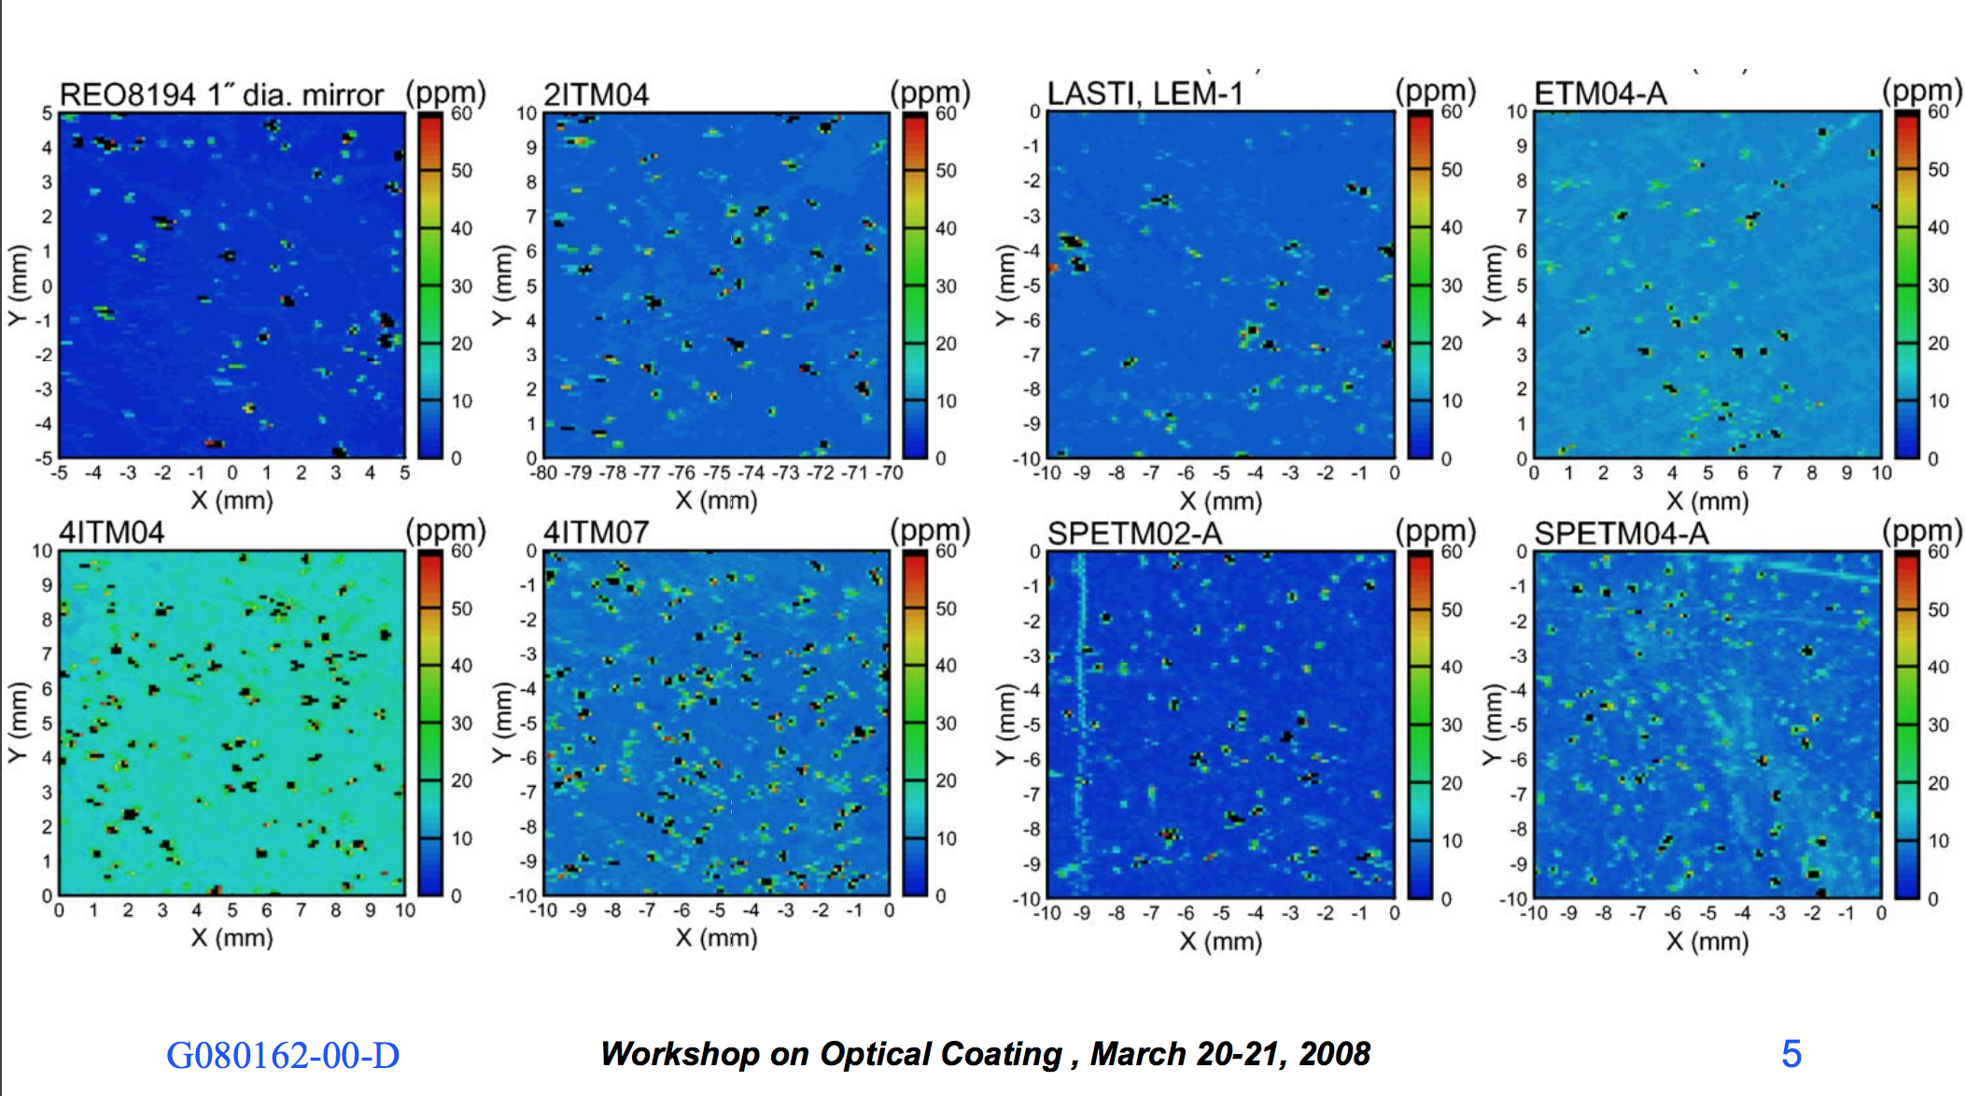
From Optical Coating Workshop 2008

Slide 15
