Slide 1
Zemax model of OFI bench for input to OFI shroud

Slide 2
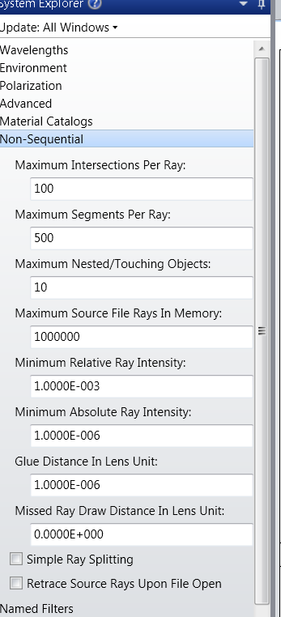
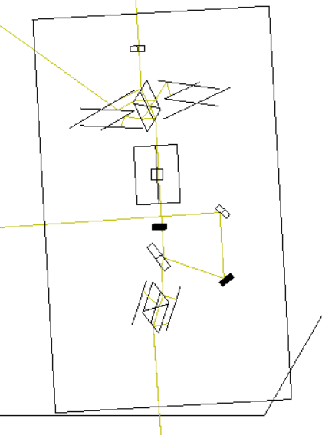
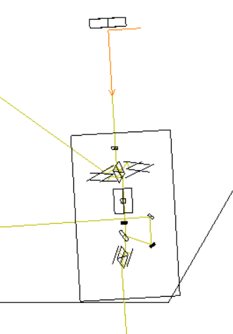

Slide 3
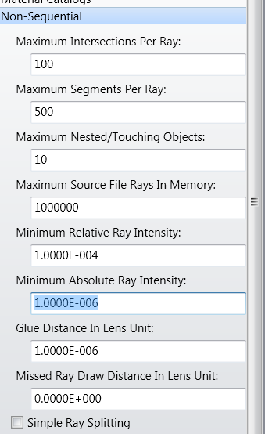
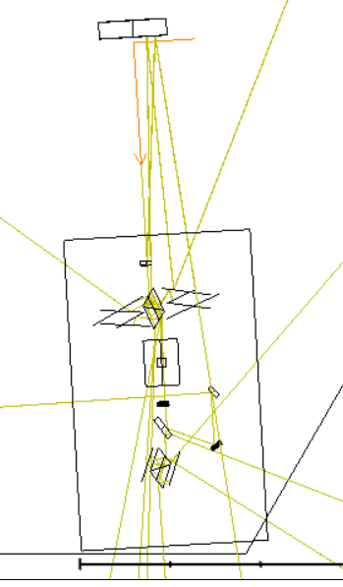
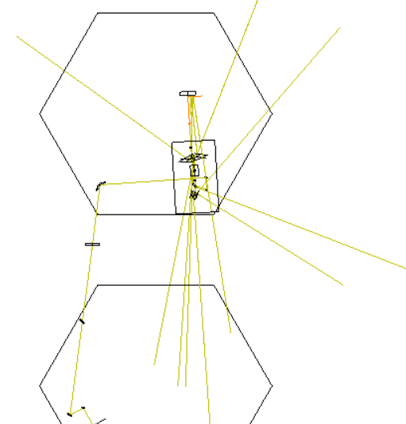

Slide 4
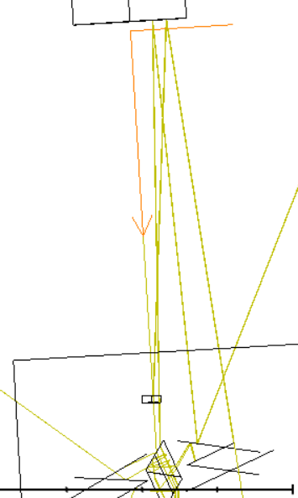
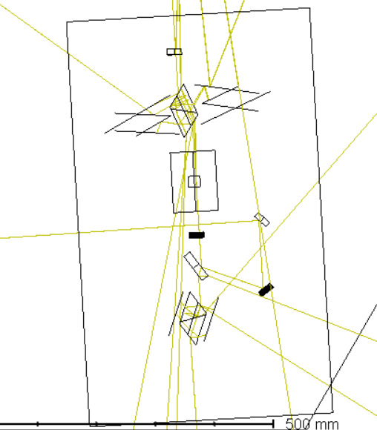

Slide 5
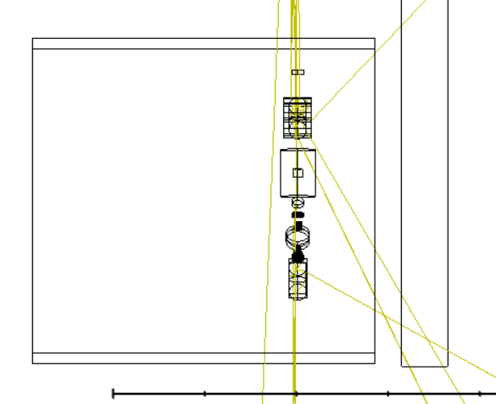

Slide 6
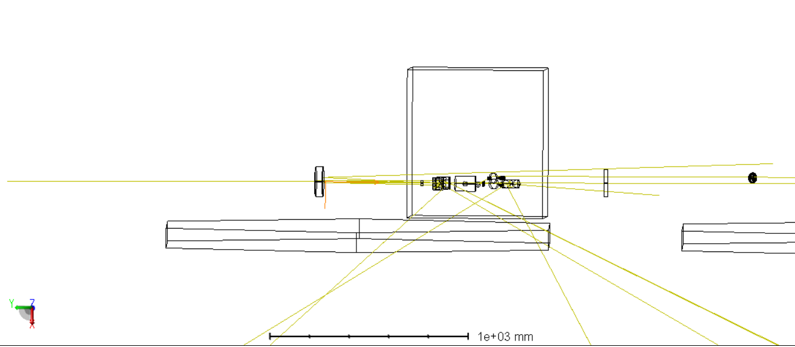

Slide 7
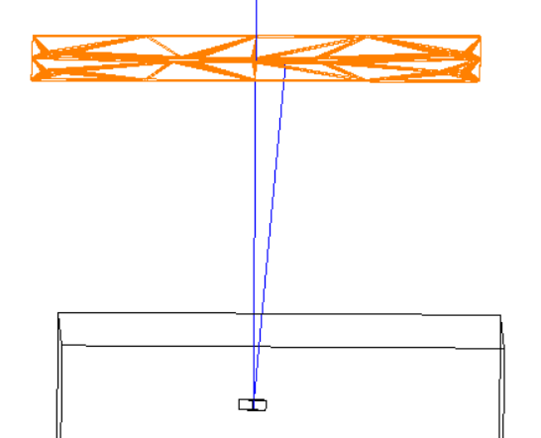
Input Wedge ghost beam dumped on SRM-AR baffle

Slide 8
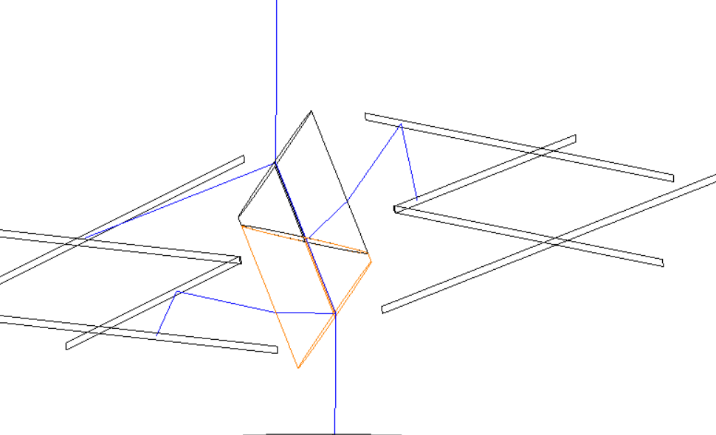
Brewster prism 1st order dumped by ‘W’ baffles

Slide 9
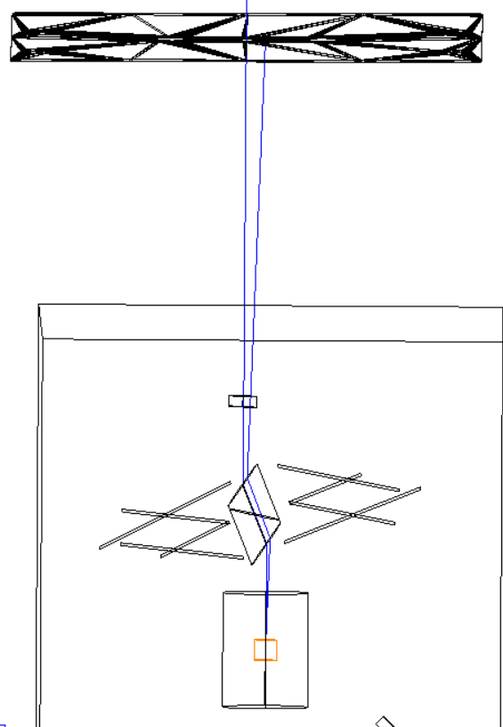
TGG Crystal front face dumped by SRM-AR baffle

Slide 10
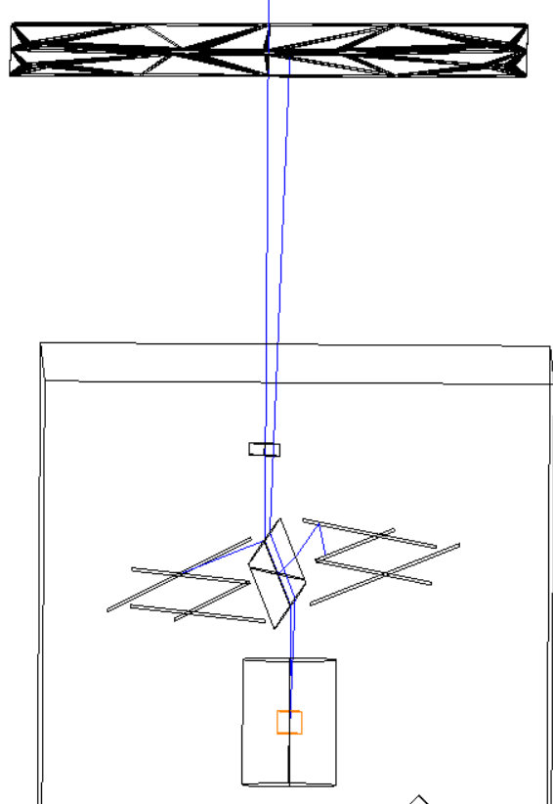
TGG Crystal back face dumped by SRM-AR baffle

Slide 11
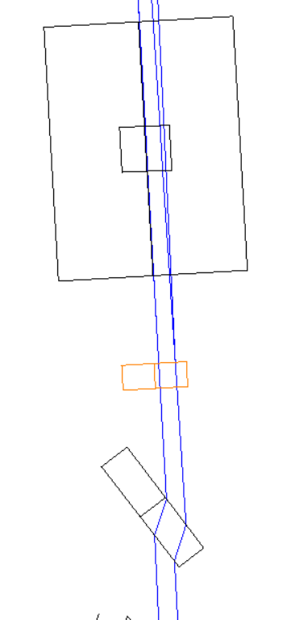
Half Wave Plate
No wedge?
Ghost beam goes to SRM, reflected from HR face and returns. Makes it all the way back through OFI

Slide 12
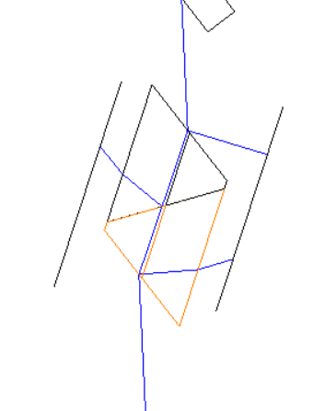
Output Brewster prism dumped by small baffles on OFI bench

Slide 13
OFI SQZ M2
No wedge?
Both TFP beams shown
Both hit OFI SQZ M1
Similar path to TFP ghost beams, possible clipping on HWP

Slide 14
OFI SQZ M1
No wedge?
Both TFP beams shown
Similar path to TFP ghost beams

