Slide 1
Status of LIGO detectors
Sheila Dwyer for the LSC
G1800941

Slide 2
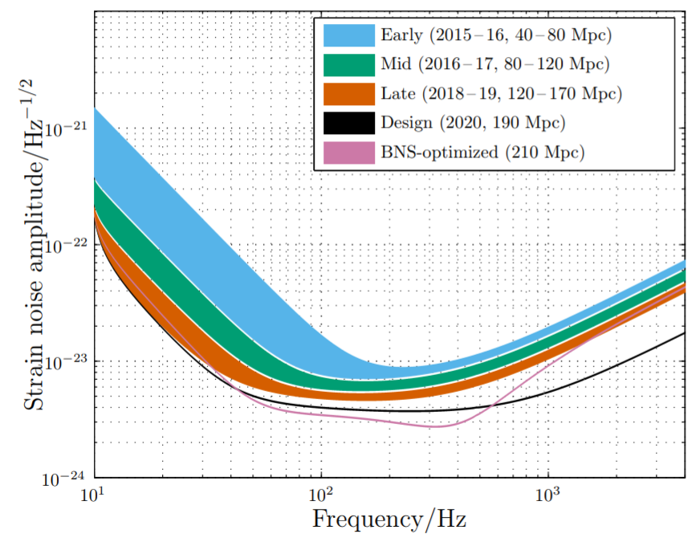
Observing plan
Successful first observing run in 2015 and second run late 2016-2017
Current upgrades to reach target range of 120 Mpc for NS-NS inspirals for observations starting early in 2019
Living Rev Relativ (2018) 21:3 DOI:10.1007/s41114-018-0012-9

Slide 3
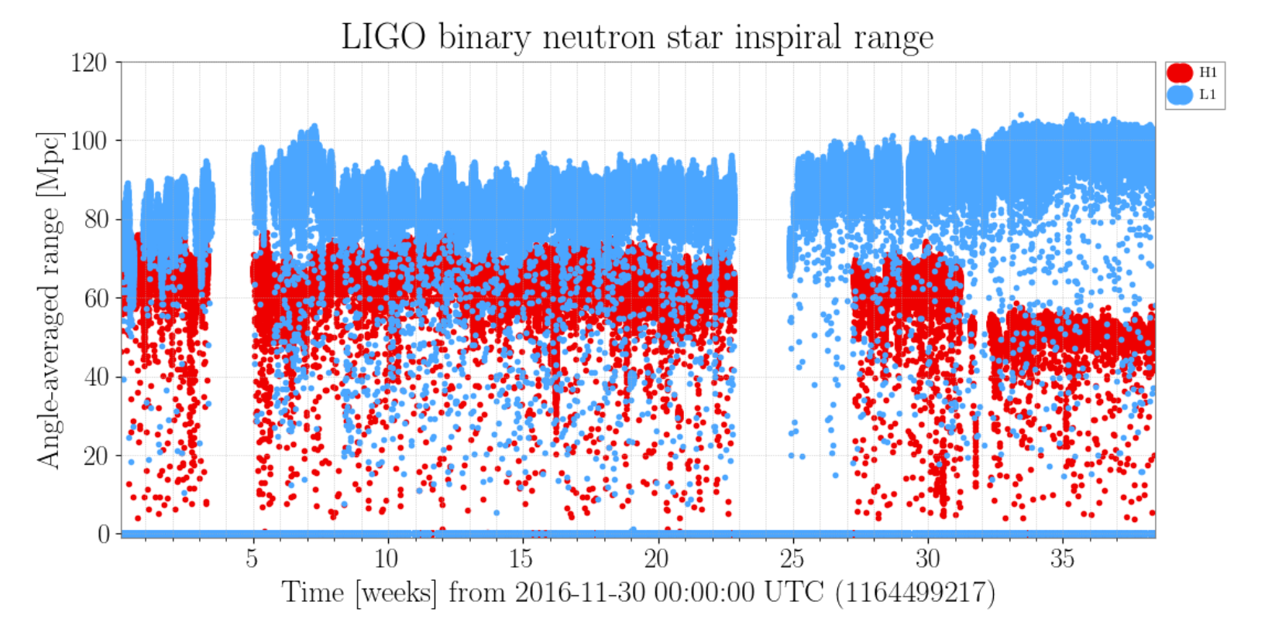
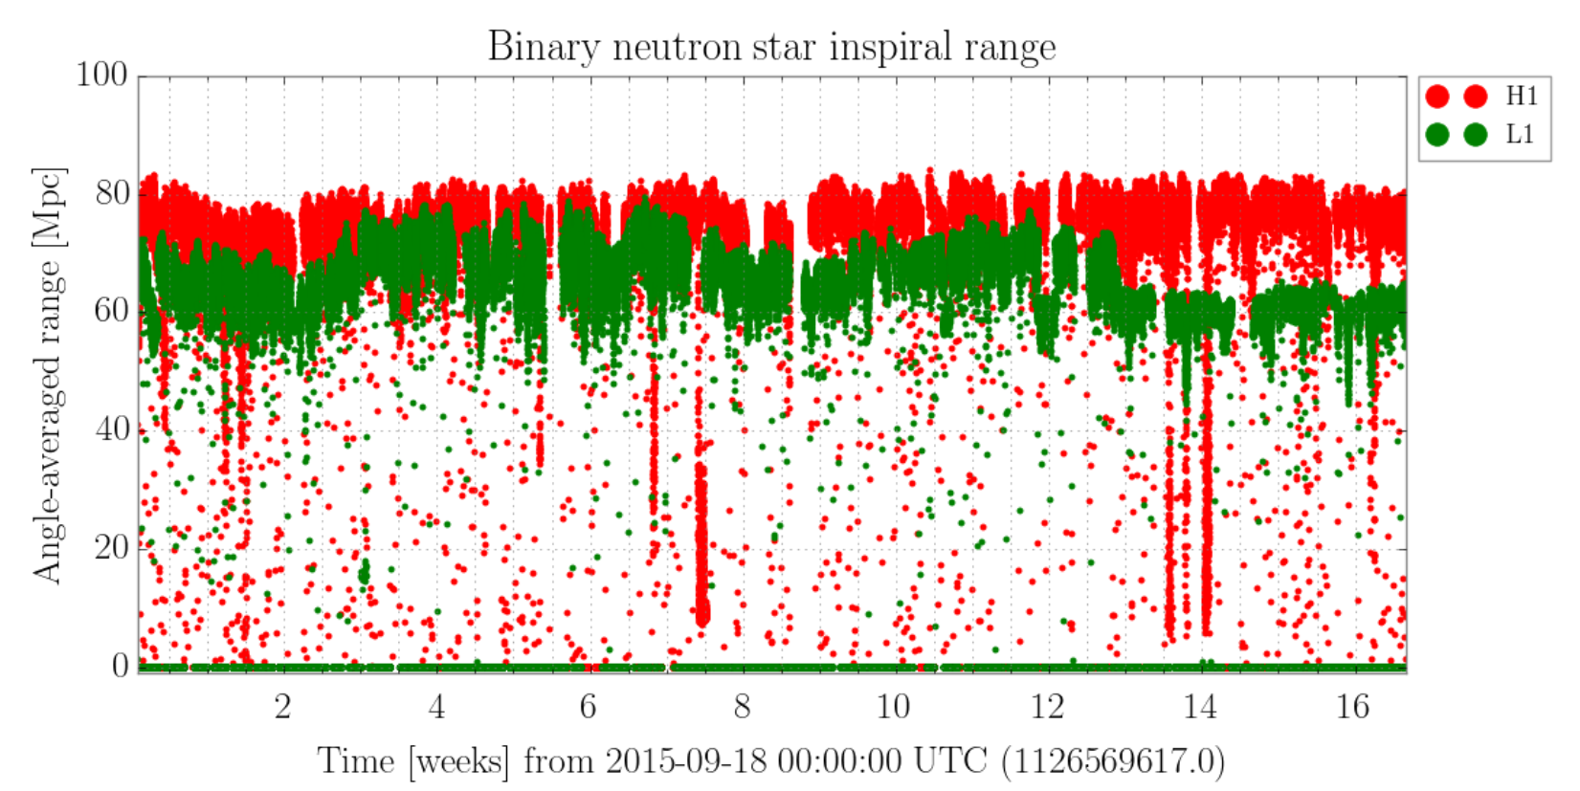
First and second observing runs
Offline noise subtraction gives a 20% improvement in range for Hanford during O2

Slide 4
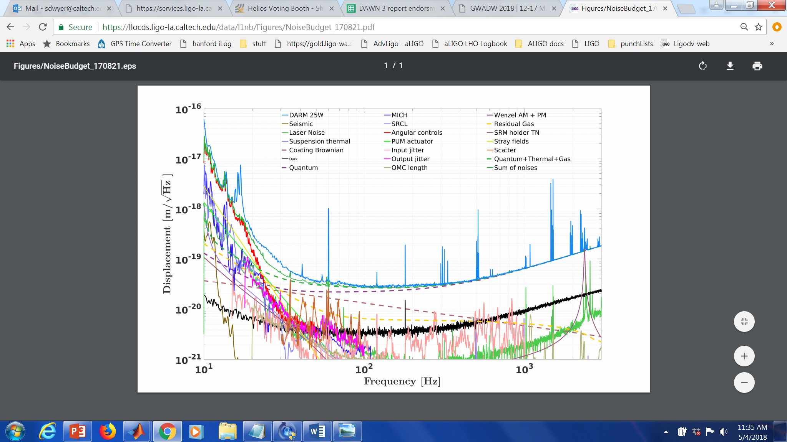
Livingston noise budget August 2017

Slide 5
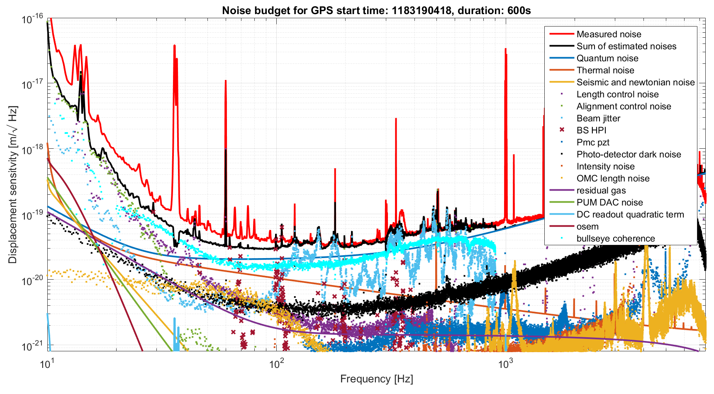
Hanford noise budget early July 2017

Slide 6
What are we doing now?
Using lessons learned from second observing run commissioning
  Hanford attempted high power operations
  Livingston concentrated on low frequency noise
In the midst of a major hardware upgrade at both LIGO sites
  High power
  Laser noise
  Squeezing
  Signal recycling mirror change
  Stray light control
  Electric field sensors
  Test mass replacements

Slide 7
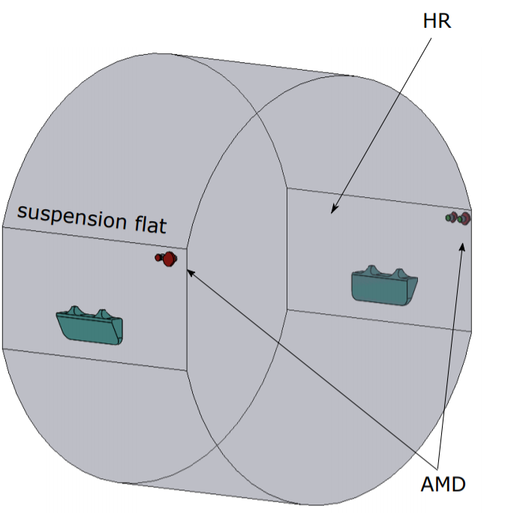
High power stability and control
See controls session tomorrow from 4 to 5:30
Both sites have now operated with ~40W input power (150-200kW circulating power)
  New radiation pressure instability seen at both sites
  Thermal compensation
  Parametric instabilities
    Active damping tried
    Acoustic mode dampers now being installed
S Gras, S Biscans

Slide 8
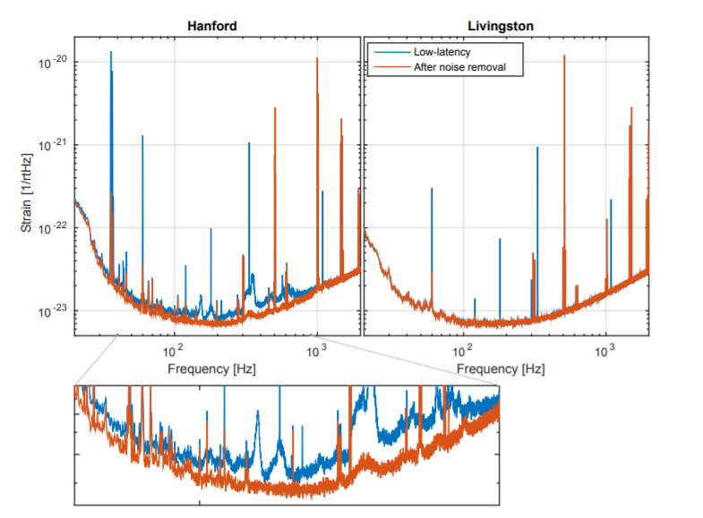
High power at Hanford : Laser jitter
Jitter subtraction gives a 20% improvement in range for Hanford during O2
J Driggers et al P1700260

Slide 9
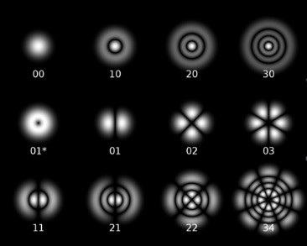
Higher order mode coupling to gravitational wave signal
Laser table
Interferometer
Output mode
cleaner
Input mode
cleaner
Transmitted
Only 00 modes detected
Angular jitter
(water cooling,
acoustic noise)
Mitigation strategies:
1) Reduce amplitude of higher order modes (high power laser change)
2) Reduce couplings to 00 mode in interferometer (test mass replacement)
Attenuated
Converted to 00 mode by misalignment and mode mismatch in interferometer
Beam size jitter
(High power
oscillator)

Slide 10
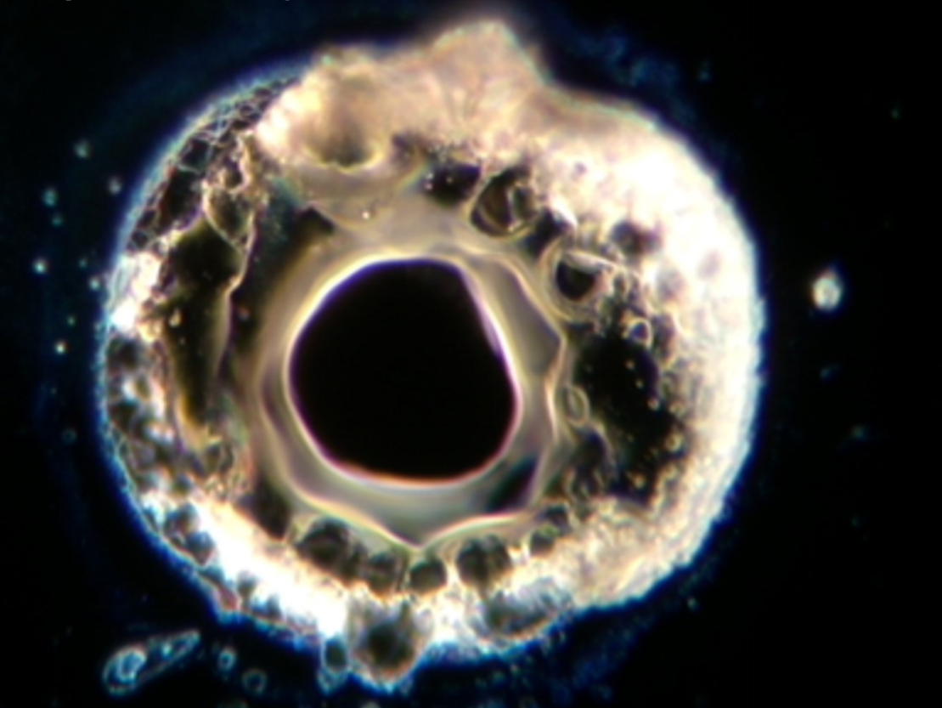
Hanford test mass spot absorber
Anomalous absorption spot found on one Hanford input test mass
May have been responsible for increased jitter coupling
This test mass has now been replaced
Photo: G Billingsley

Slide 11
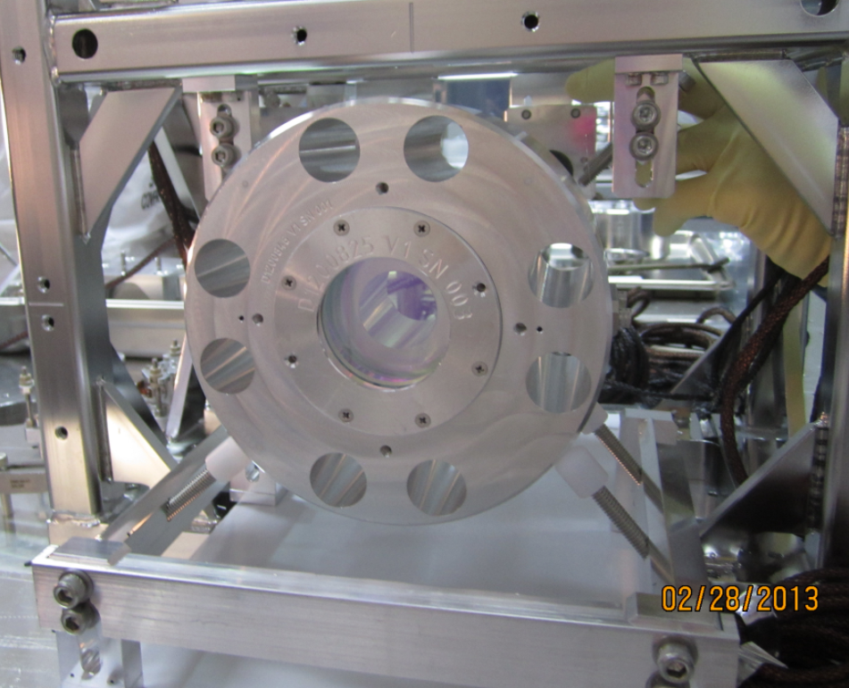
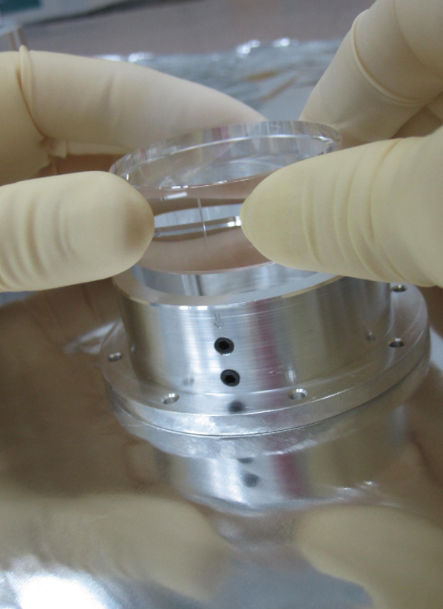
Signal recycling (extraction) mirror replacement
First signal recycling mirror used a composite mass to allow for quick changes of reflectivity
Thermal noise at 3.3kHz from PEEK screw used in composite mass
SRM replaced with a full optic
Transmission changed from 37% to 32.3%, moving DARM cavity pole from 350/380 Hz to 450 Hz
Photos: D Sellers M Hetize LHO alog 27530

Slide 12
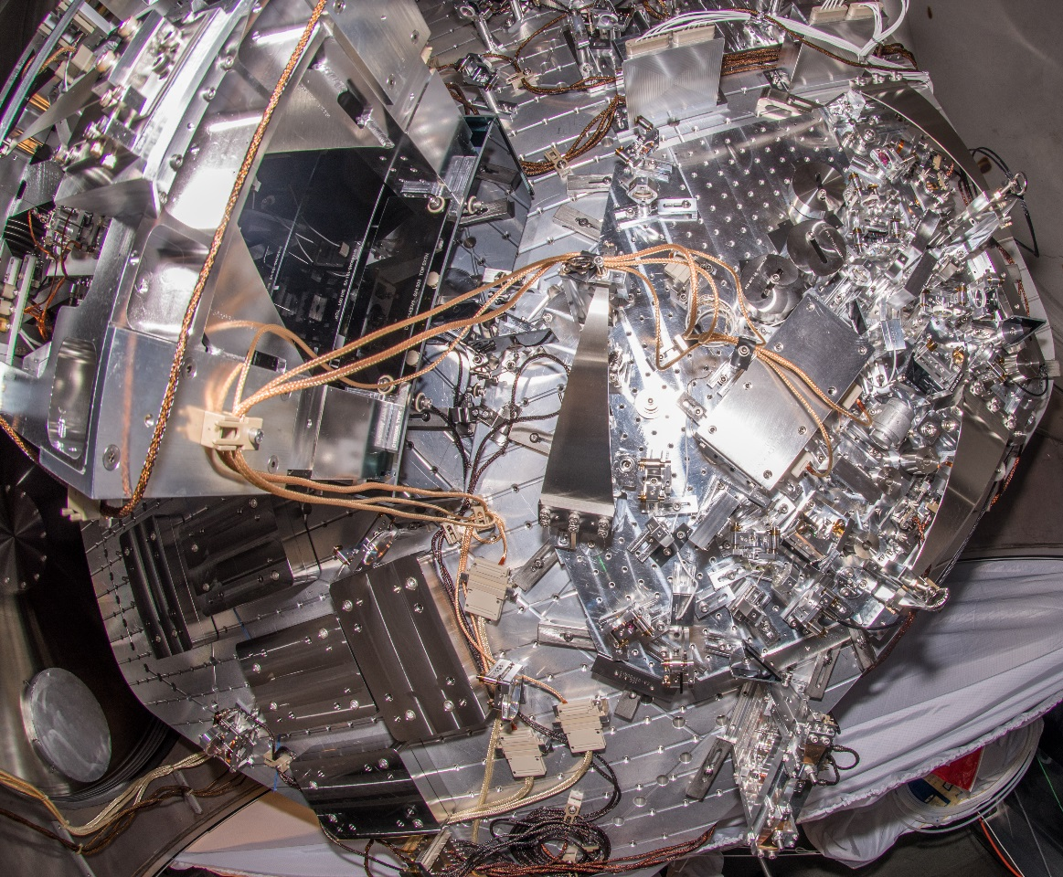
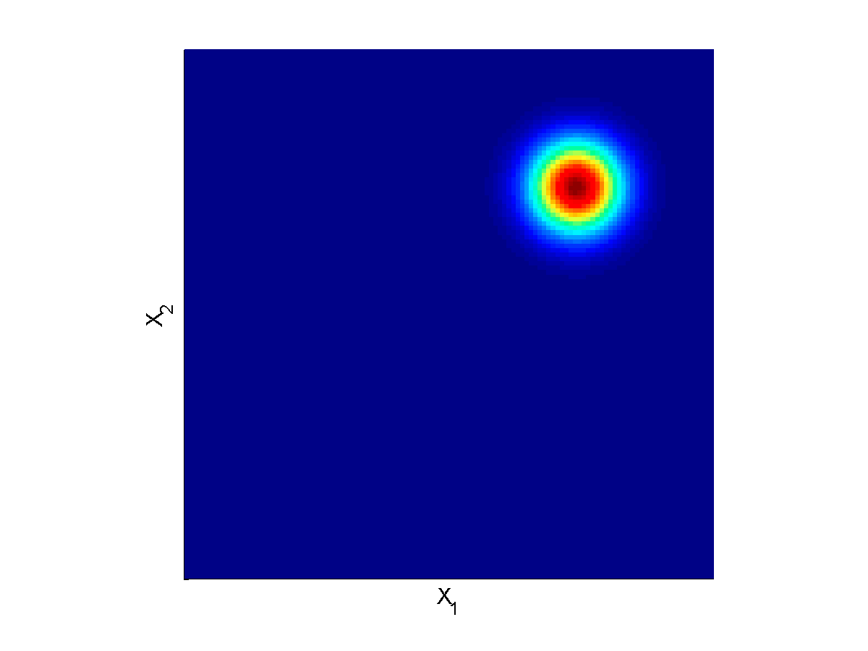
Squeezing!
Squeezers now installed at both sites
Laser
Photo: M Tse

Slide 13
Squeezing preliminary results
Early results from Livingston
Around 1 dB of squeezing measured
Goal is to 3dB of squeezing (40% shot noise reduction)
Plot: L Barsotti

Slide 14
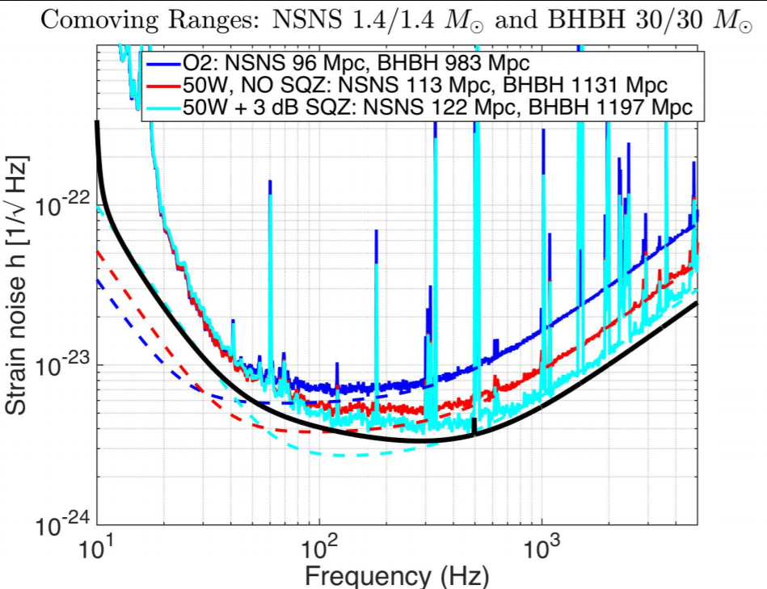
Projection of noise improvements from high power and squeezing: Livingston 120 Mpc
L Barsotti

Slide 15
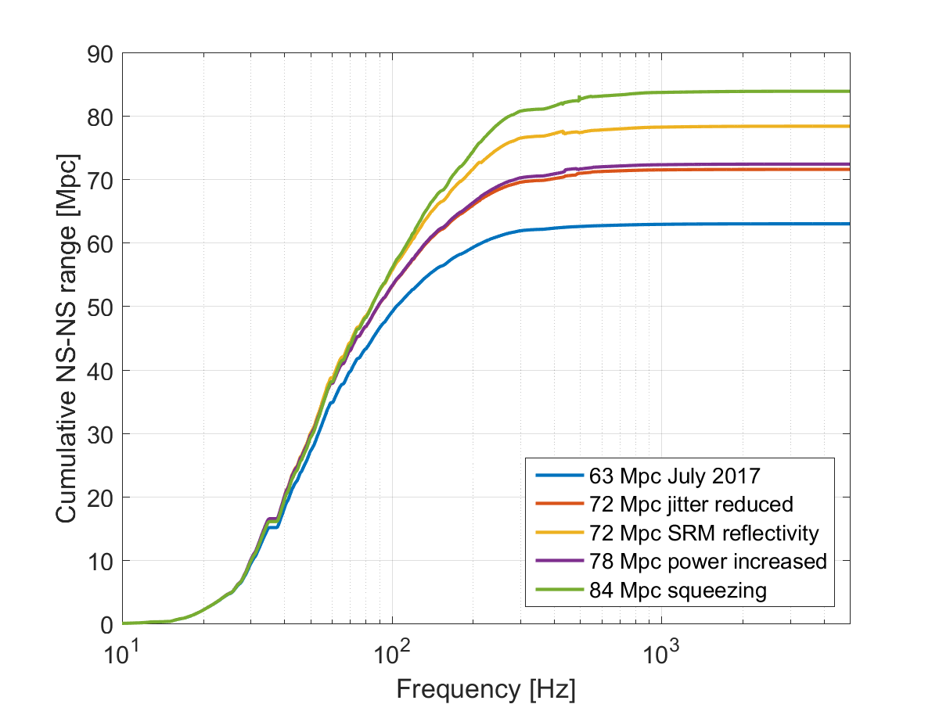
Projection of noise improvements from high power and squeezing: Hanford
Hanford needs to improve low frequency noise in order to reach sensitivity goal for next observing run

Slide 16
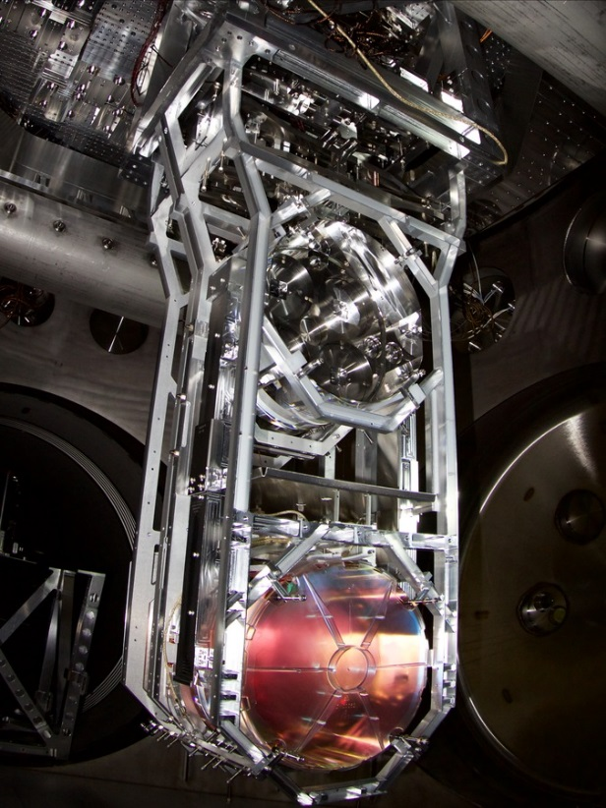
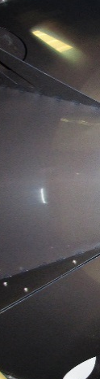
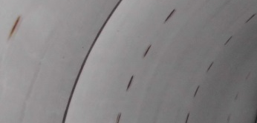
Scattered light
Mitigation strategies:
1) Reduce amplitude of light in spurious path
2) Reduce motion of scattering objects
2) Scatters off of less well isolated objects (baffles)
1) Light scatters out of main interferometer beam (Anti reflection coatings, imperfections in optics)
3) Light re-enters interferometer creating spurious interferometer

Slide 17
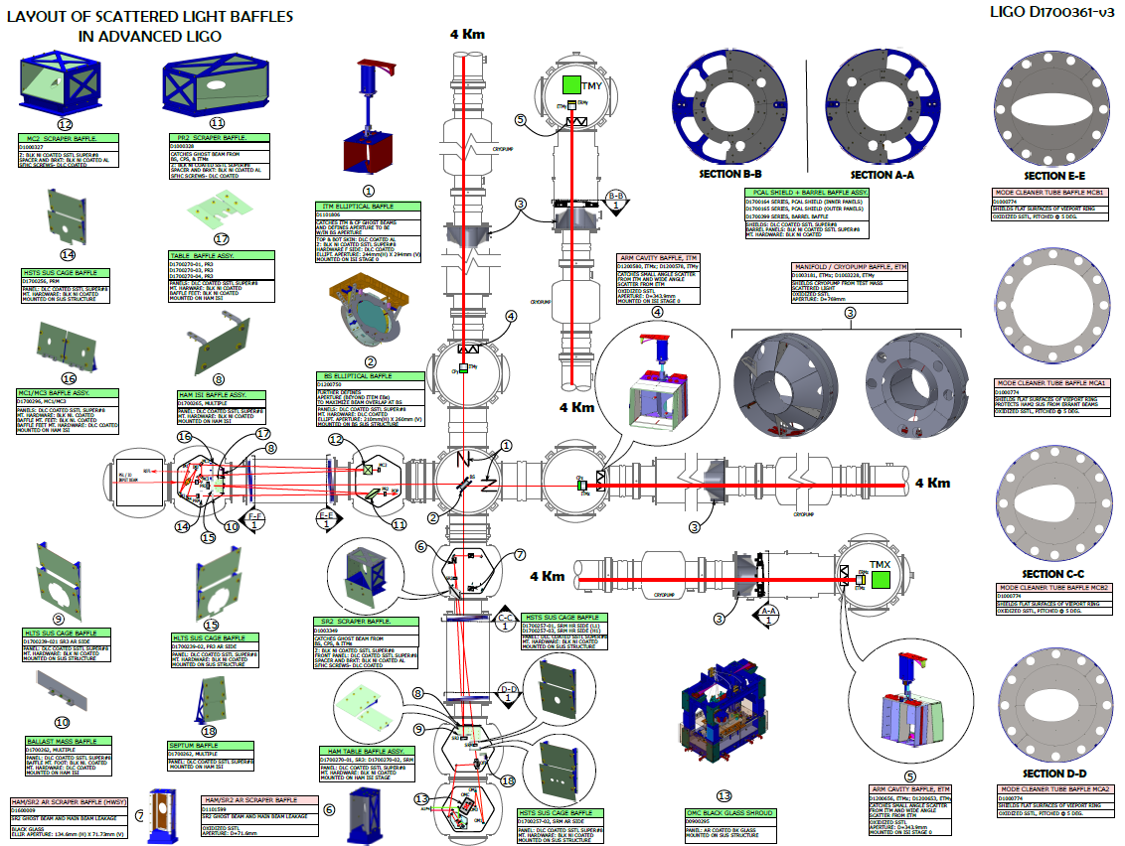
Stray light control:
Removing some baffles which caused noise
Adding new baffles
Modifying some baffles

Slide 18
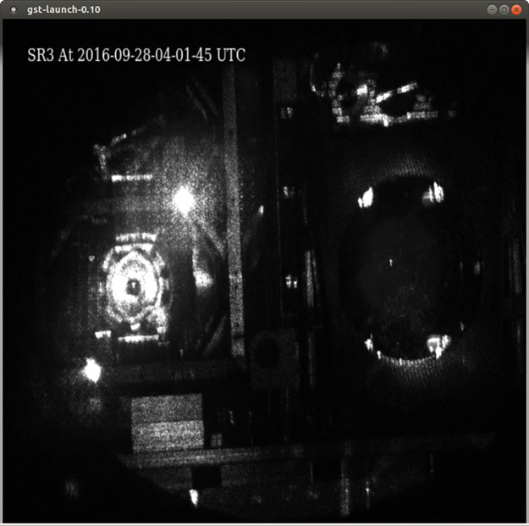
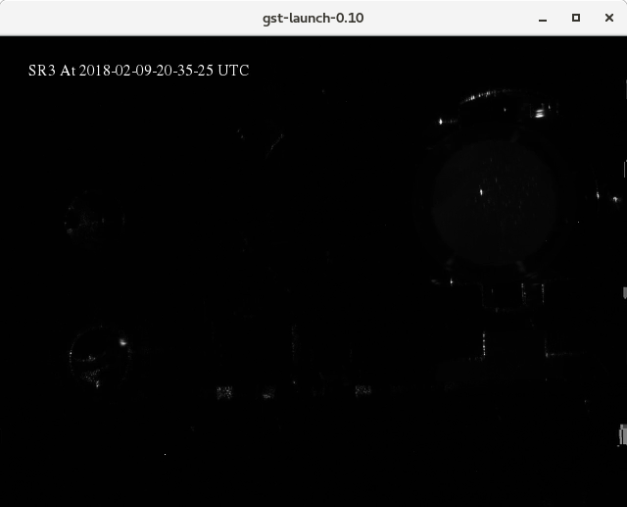
Reducing scattered light with baffles
Posted by Valera Frolov to LLO aLog (#28312)
Posted by Alena Ananyeva to LLO aLog (#36113)
Slide courtesy C Austin

Slide 19
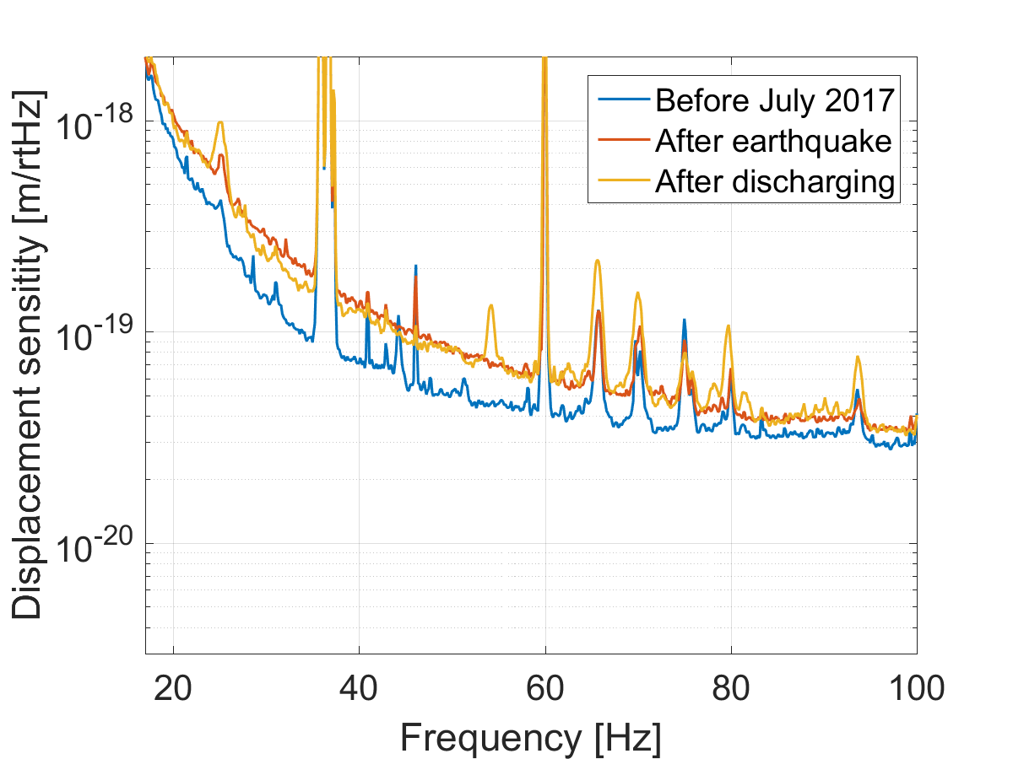
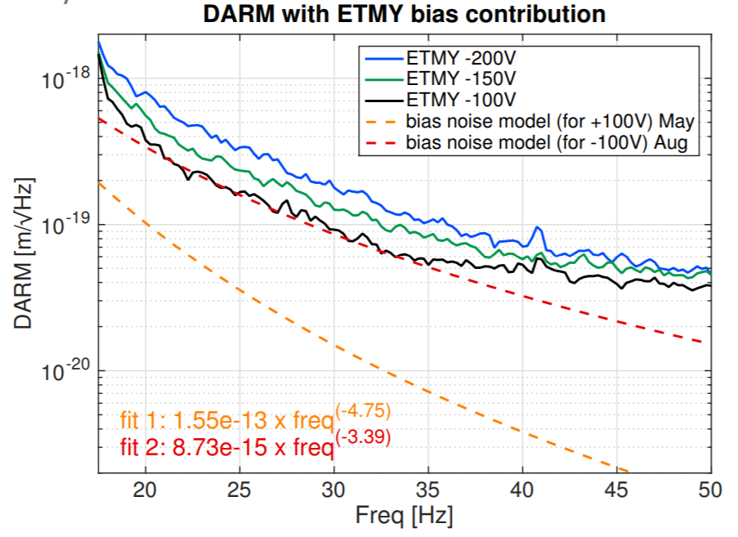
Charge on optics and noisy electric fields
Large earthquake added charge to Hanford test masses
Noise dependence on static electric fields around test mass at Livingston
We will soon have test mass discharging systems in place for all test masses
A Effler G1800748

Slide 20
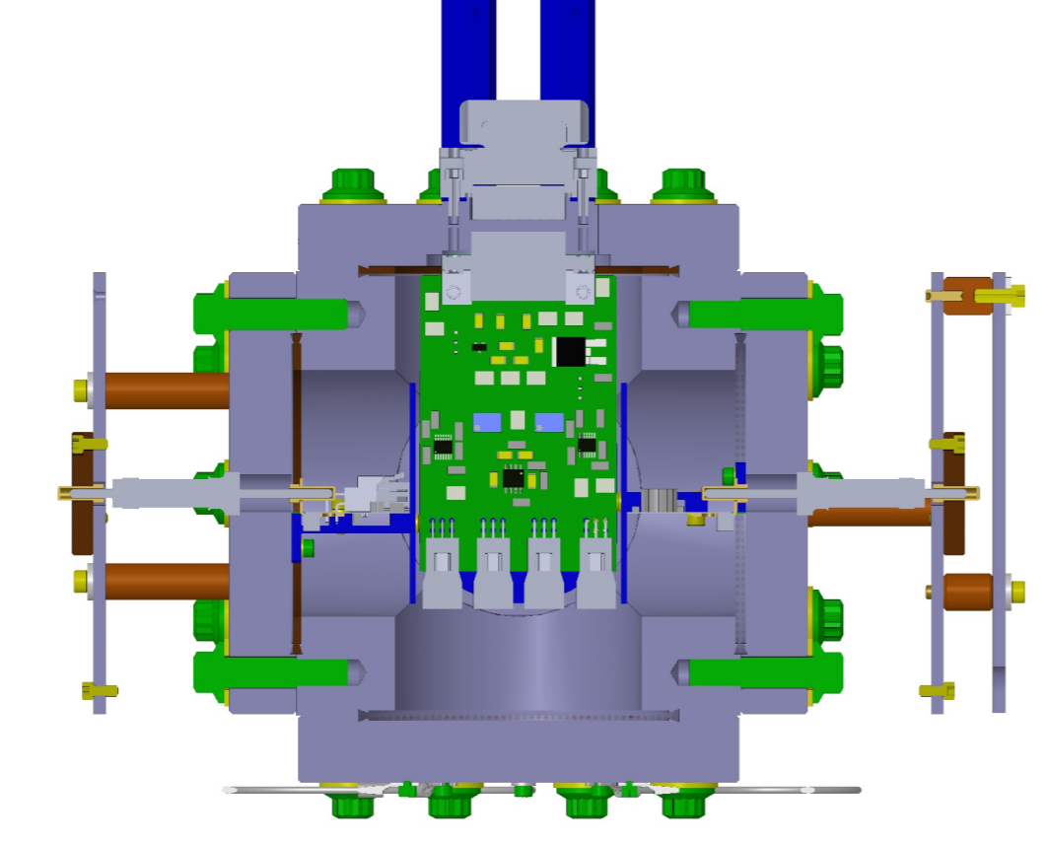
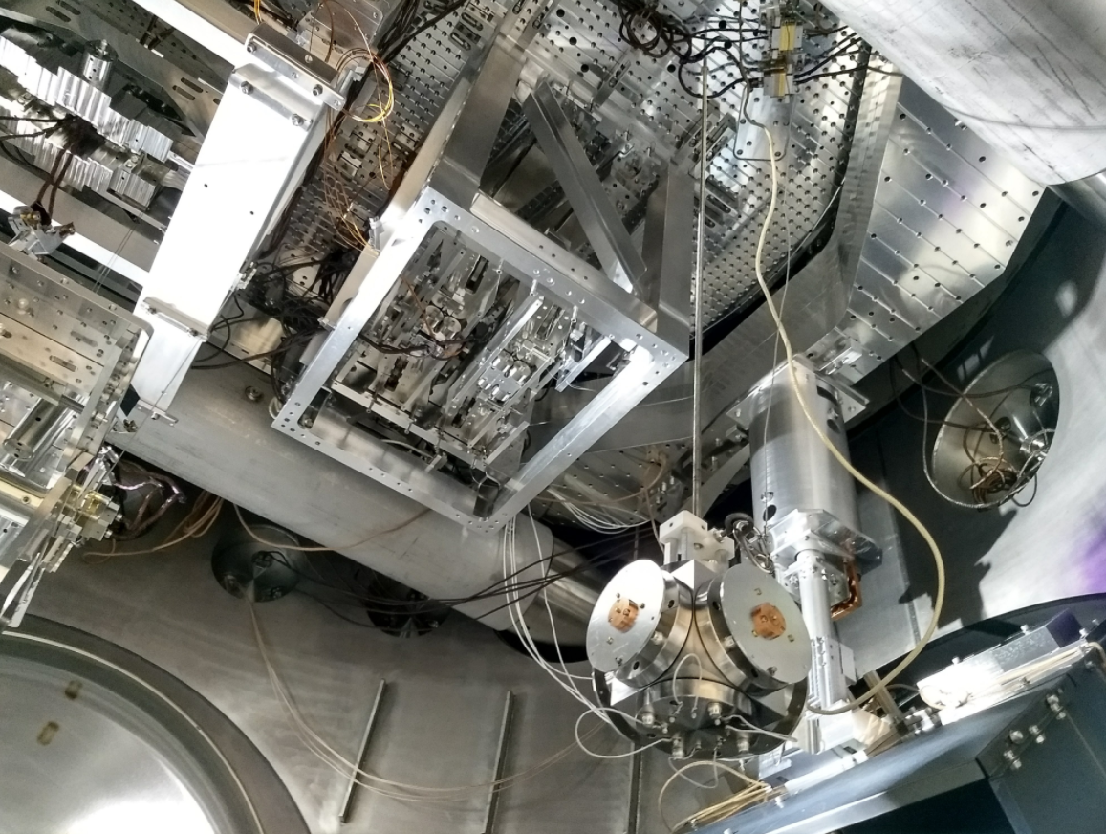
Electric Field Meters
Sensor for stray electric fields will be installed in one end chamber at each site
Photo: G Mansell C Cahillane
Design: G1800293

Slide 21
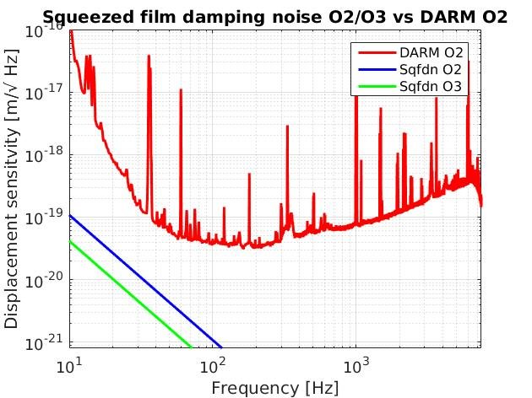
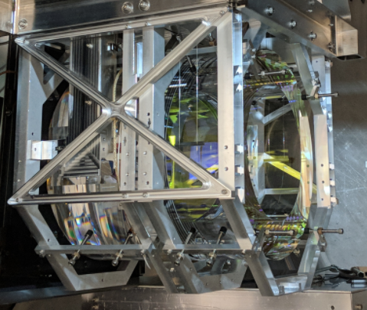
Squeezed film damping residual gas noise
Residual gas trapped between test mass and reaction mass makes a force noise (squeezed film damping)
Cutting a hole in the reaction mass should reduce squeezed film damping noise by almost a factor of 3
Photo: J Kissel
Plot: R Macas

Slide 22
Summary of LIGO status
Both LIGO sites finishing in vacuum work in the next couple of months
Full locking at both sites in June/July
Changes for high frequency sensitivity: increasing circulating power, squeezing
Changes for low frequency: Stray light control, test mass discharging, electric field sensors, annular reaction masses
For Livingston a clear path from O2 sensitivity to 120 Mpc goal, Hanford must improve low frequency noise to reach 120 Mpc

Slide 23
O3 plans
The next observing run will start when both LIGO instruments are ready (performance goal of 120 Mpc or better)
This is expected to be early 2019
Alerts will be public, with latency of a few minutes
Binary black hole detections should become routine

Slide 24
Extra slides

Slide 25
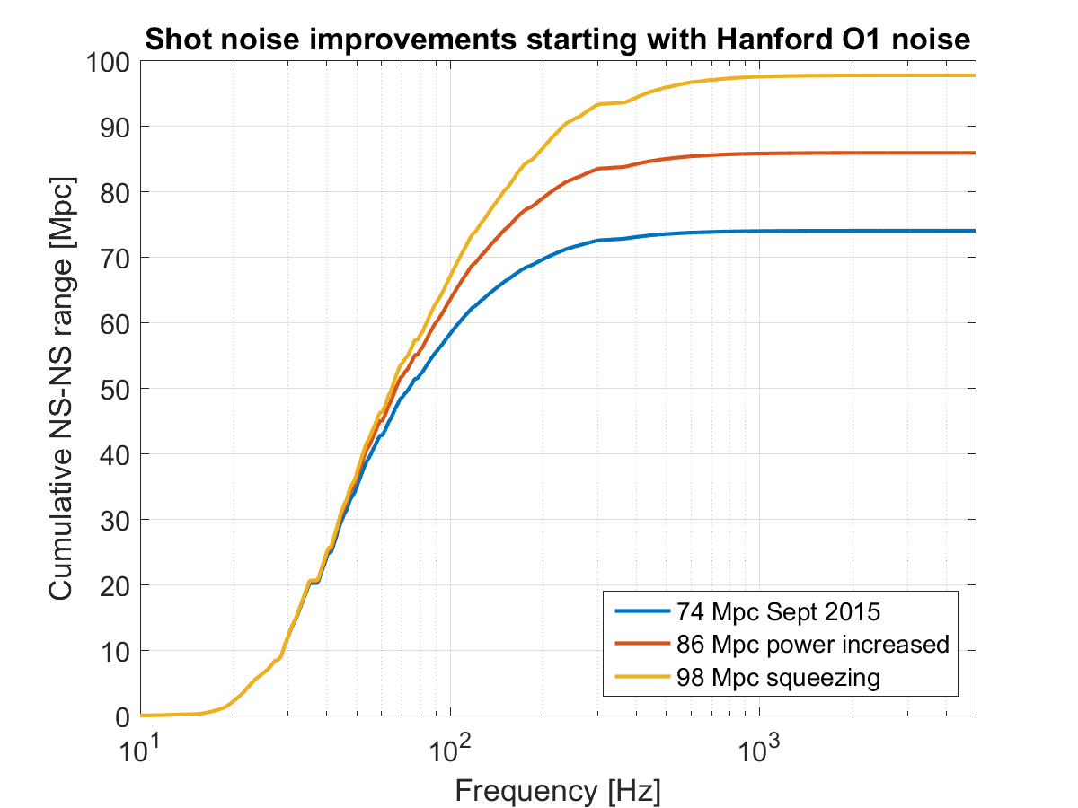

Slide 26
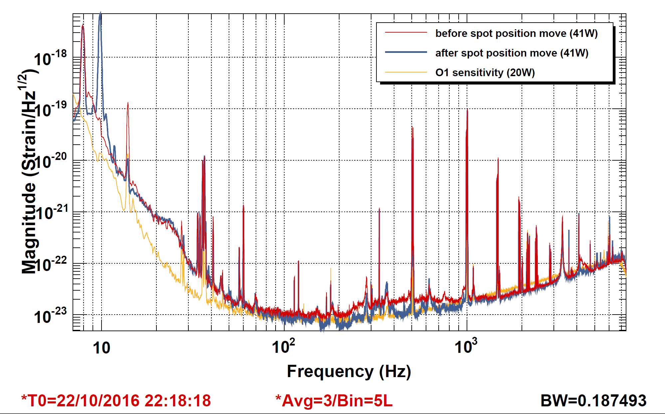
Jitter with high power laser

Slide 27
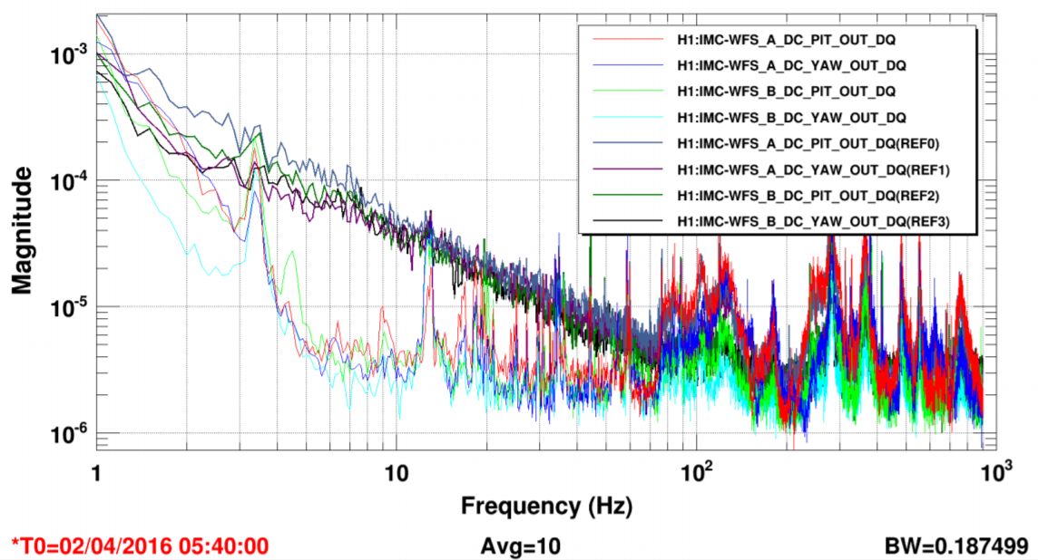
Reduced input jitter from 70 W amplifier
Dark colors – High power oscillator used at Hanford for O2
Light colors- 35W laser used during O1

