Slide 1
Cosmic Explorer R&D

Slide 2
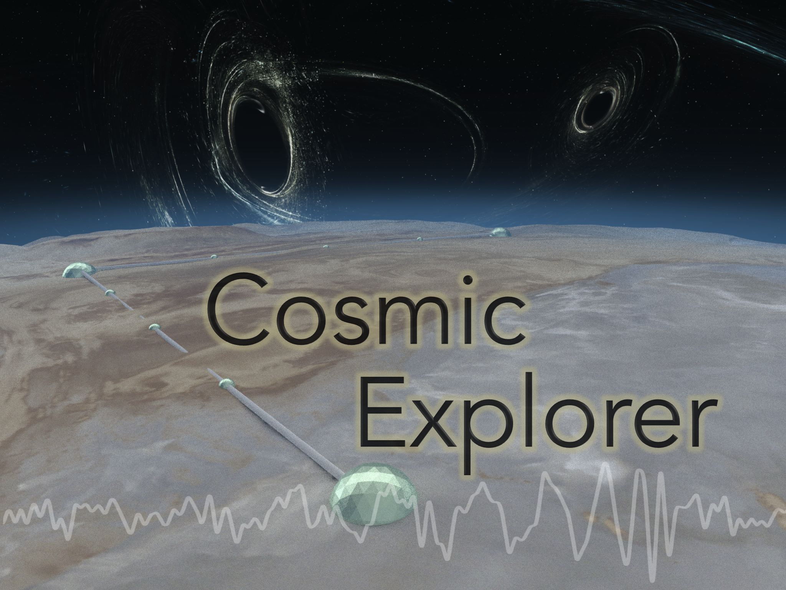
Cosmic Explorer

Slide 3
What is CE?
The target design is essentially a 40km Voyager
  Which really means “the best tech available when the time comes to decide”. If things go well, that will be Voyager tech.
So, then there is no R&D needed (beyond Voyager) right?
  not really.
  Making the interferometer longer means that the beams are bigger
  by at least a factor of 2
  the mirrors are more massive (factor of ~10)
  the curvatures are larger (flatter), which impacts contrast and alignment
  the tubes are expensive, and thus only as big as necessary – scattering
  4kHz FSR – frequency servo implications?

Slide 4
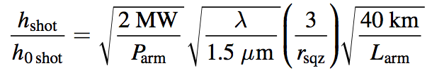
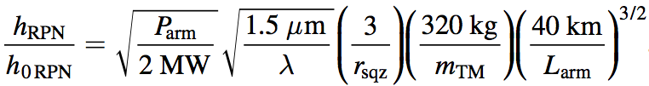
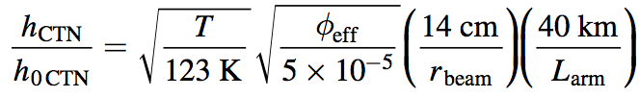

How do fundamental noises scale?
Just 1/L, right? Nope…
Shot Noise
while maintaining bandwidth
Radiation Pressure Noise
while maintaining bandwidth
Coating Thermal Noise
constant loss angle…
Residual Gas Noise
facility limit…

Slide 5
How do fundamental noises scale?
Just 1/L, right? Nope…
Shot Noise
while maintaining bandwidth
Radiation Pressure Noise
while maintaining bandwidth
Coating Thermal Noise
constant loss angle…
Residual Gas Noise
facility limit…

Slide 6
How do fundamental noises scale?
Just 1/L, right? Nope…
longer wavelength?
need more power…
Shot Noise
while maintaining bandwidth
Radiation Pressure Noise
while maintaining bandwidth
Coating Thermal Noise
constant loss angle…
Residual Gas Noise
facility limit…

Slide 7
How do fundamental noises scale?
Just 1/L, right? Nope…
Shot Noise
while maintaining bandwidth
Radiation Pressure Noise
while maintaining bandwidth
Coating Thermal Noise
constant loss angle…
Residual Gas Noise
facility limit…

Slide 8
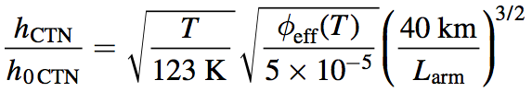
How do fundamental noises scale?
Just 1/L, right? Nope…
Shot Noise
while maintaining bandwidth
Radiation Pressure Noise
while maintaining bandwidth
Coating Thermal Noise
loss angle dependence?
Residual Gas Noise
facility limit…

Slide 9
Scaling Up… an example
better
Exploring the sensitivity of next generation gravitational wave detectors
(2017) CQG 34, 044001
longer

Slide 10
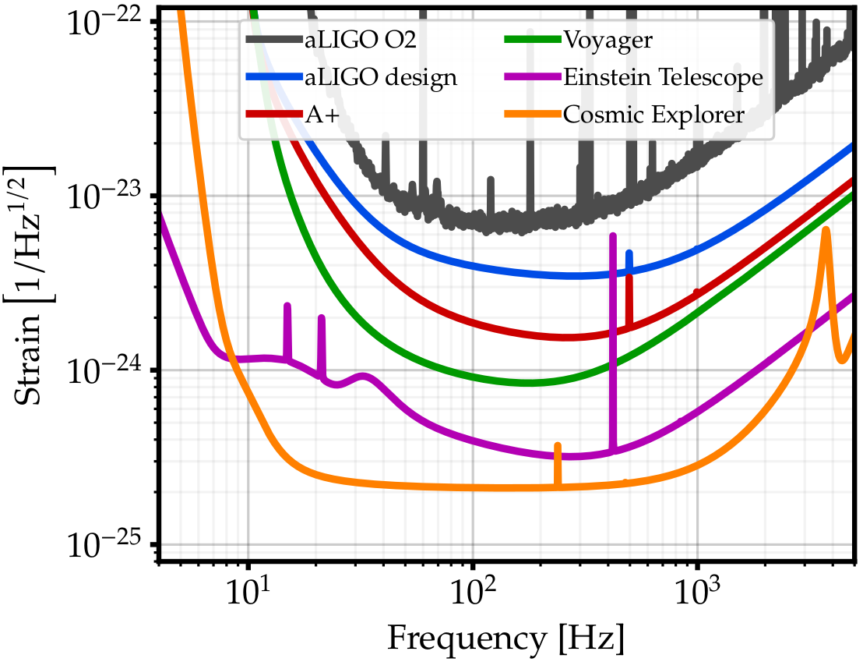
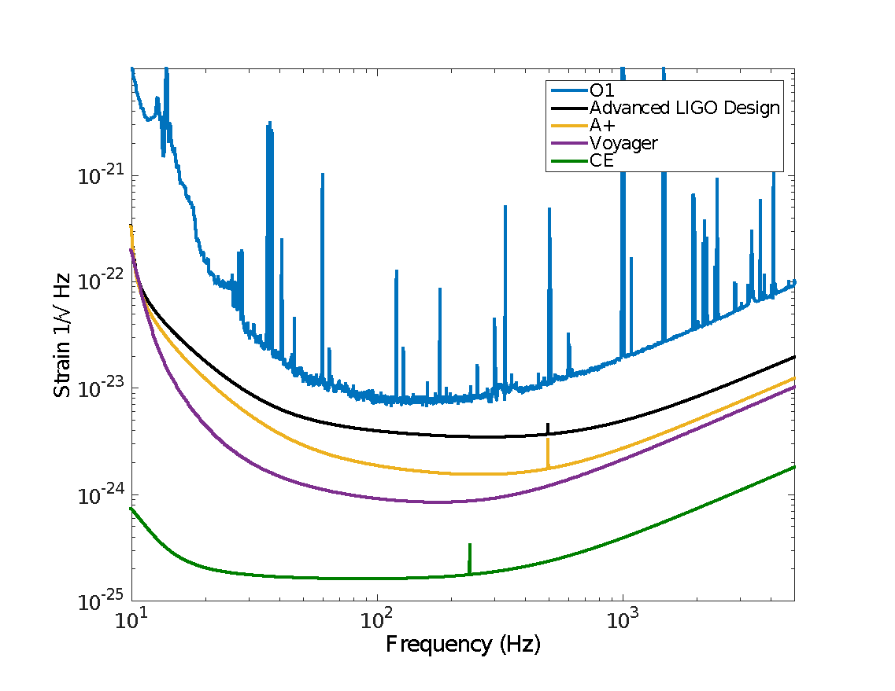
Example of curve progression
LIGO-T1500293
better
Exploring the sensitivity of next generation gravitational wave detectors
(2017) CQG 34, 044001
longer
PRELIMINARY

Slide 11
BBH and BNS from the entire Universe!
PBH?
First Stars Formed
High SNR Signals!
BNS
BBH
Credit: Evan Hall

Slide 12
Why 40 km?
The bandwidth of an interferometer tends to shrink as it gets longer
  a 40 km detector is limited to roughly 4 kHz bandwidth, or at least that is where the response of the detector becomes complicated (it leaves the long-wavelength limit)
  there is a lot of potentially interesting physics at high frequencies (NS EOS, CCSN, …)
  the low-frequency end of the band does not move down much as you go longer, so the detection band narrows with increasing length
Costs grow quickly with length above ~ 40km
  surface excavation depth is quadratic in length, and that earth must be moved (presumably to the ends to use as fill)
  flat of bowl-shaped locations become scarce for longer sites
Frequency-dependent responses in third generation gravitational-wave detectors.
Physical Review D, 96(8), 084004

Slide 13


Why 40 km?
Costs grow quickly with length above ~ 40km
  surface excavation depth is quadratic in length, and that earth must be moved (presumably to the ends to use as fill)
  flat of bowl-shaped locations become scarce for longer sites

Slide 14
Known Unknowns – Big Mirrors
Getting big enough substrates for Voyager poses a problem, but apparently one that can be addressed. What about CE?
  Can we make silicon mirrors big enough for CE (~1m diameter)?
  If, for whatever reason, we end up with the initial version of CE running at room temperature on silica, the substrate production may also be challenging, but probably less so.
Polishing seems doable, but better than aLIGO would be good
Coating these large optics will be non-trivial
  for IBS coatings, it is “just a matter of engineering” (easy to say)
  for crystalline coatings, it may be more challenging

Slide 15
Known Unknowns – High Power
The power level in Advanced LIGO was set to optimize the range given the radiation pressure – shot noise trade-off.
This was an intrepid choice, which we evidently lack the courage to repeat
for good reasons
But how high can
we go with power?
  x16 power to gas
  noise, and pumps
  are cheap…
more power?

Slide 16
The Message
A few areas have been investigated, but more than anything we need to anticipate the problems that will arise in 40km detectors
see Evan’s talk on 3G mirror surface figure requirements
  Tuesday 11am
alignment control will certainly be a big issue
  see Control session, Sunday 4pm
higher power? There is a lot of white space under there…

Slide 17
spares…

Slide 18

Where could we put a 40km detector?

Slide 20
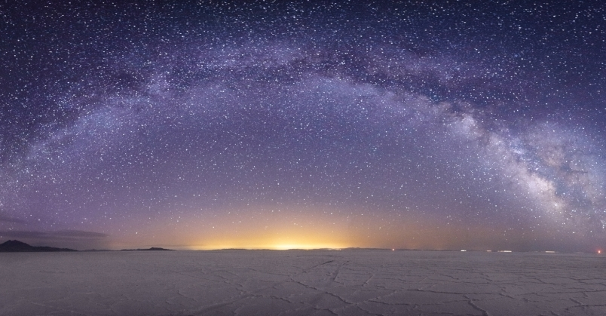
Places like this…
Bonneville Salt Flat, Utah

Slide 21
Where could we put a 40km detector?

Slide 23
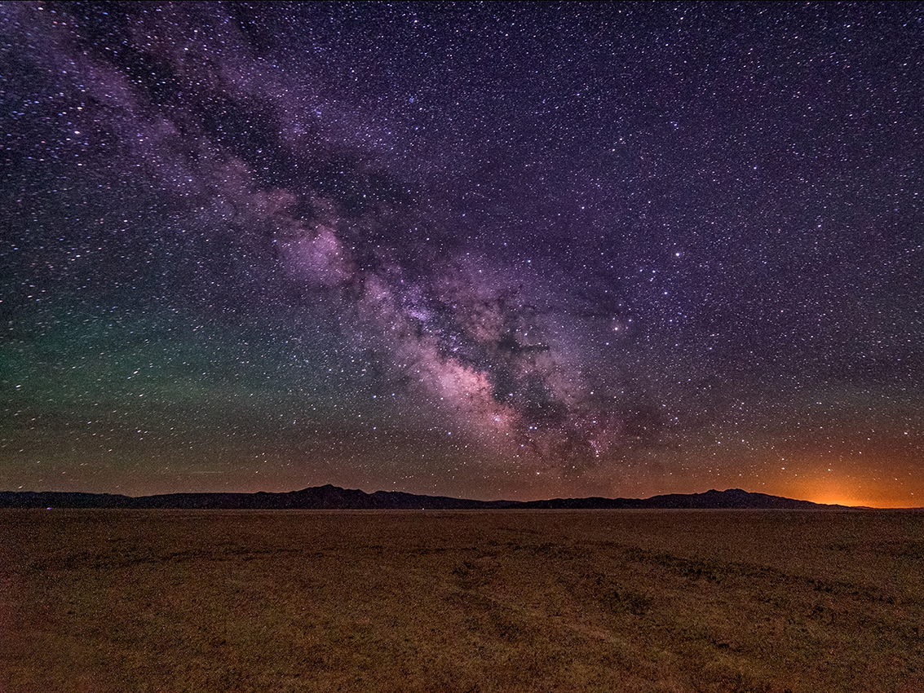
or like this…
Black Rock, Nevada

