Slide 1

Why Machine Learning?
Zsuzsa Marka
Columbia Experimental Gravity group
GWADW2018

Slide 2
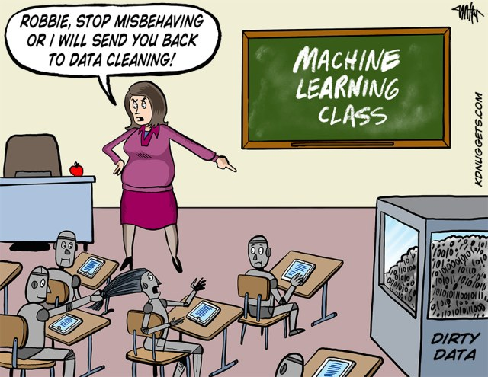

Slide 3
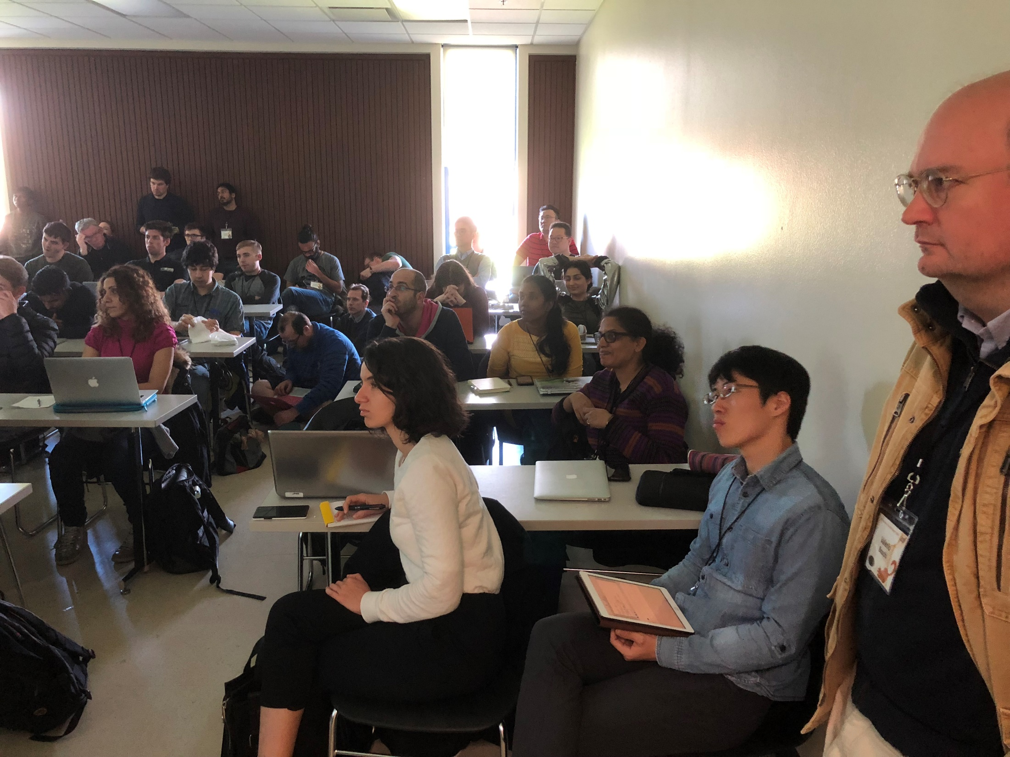

Slide 4
For a recent collection of ongoing activities in LVC MLA group see
2018 April APS presentation (Kai Staats)
LIGO Document G1800169

Slide 5
Circa 2006
The expected signals have a very low signal to noise ratio (SNR) with uncertain and varied waveforms.
Evolutionary computing based search algorithms can be trained to find signals in non-Gaussian noise.
  We used realistic interferometric detector noise as opposed to Gaussian noise to evolve the population of our algorithm.
Tests with Burst injections (SG, Q:8.9, 250Hz) at 90%CL:
generation 100: 2.7×10⁷ false alarms / year for peak amplitude 3.5
2.3×10⁷ false alarms / year for peak amplitude 5
generation 199: 1.6 × 10⁵ false alarms / year for peak amplitude 3.5
6.5 × 10⁻⁶ false alarms / year for peak amplitude 5
It took roughly five days to complete 199 generations on a 64 bit, 1.8 GHz processor with a 1 MB cache and 1 GB DDR PC3200 RAM.

Slide 6
For every Discovery there are numerous subthreshold events in the Data
Can ML help to design a deeper search?
Matching Matched Filtering with Deep Networks for Gravitational-Wave Astronomy
Hunter Gabbard, Michael Williams, Fergus Hayes, and Chris Messenger
Phys. Rev. Lett. 120, 141103, 2018
“Since the claim of matched-filtering optimality is applicable only in the Gaussian noise case, there exists the potential for deep networks to exceed the sensitivity of existing matched filtering approaches in real data.”

Slide 7
The era will come when the statistical properties of the detector Noise background will be intertwined with common detections and even more sub-threshold GW events
=> estimation of significance will be more difficult
=> how will we determine the background?

Slide 8
The Unknown Unknown
-Provided that it exists and as long as it is a transient, burst searches are ?well?-equipped to find such signal
More detectors will be tremendous help
If multimessenger counterpart exist would be even better
Presently the Unknown Unknown is a Data Characterization problem
**as long as the signal is in Gaussian noise**.

Slide 9
Data and Detector Characterization are intertwined
The community has tremendous experience to characterize hoft data
+ look for transients in a large number of additional channels and find correlations with hoft
KUDOS to detchar personnel
Data Cleaning in O2 is also proven useful ☺
The burst searches can be still be limited by detector related glitch rate.

Slide 10
Characterize the Auxiliary Channel Data in order Characterize the DETECTOR
Humans
can primarily identify low-dimensional and more obvious correlations in the data
are less likely to take advantage of correlations that are buried in the noise and only reveal themselves upon deep statistical analysis over multiple instances
An immense number of recorded channels – the high dimensionality gives rise to both a statistical and computational challenge

Slide 11
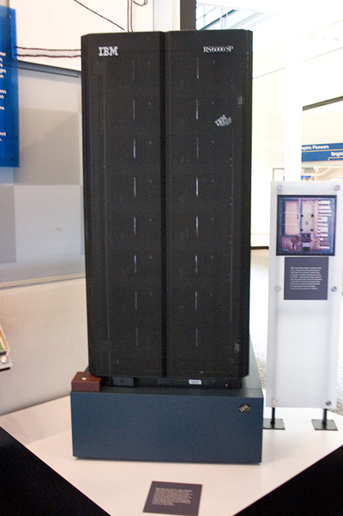

High Dimensionality Example: Protein Folding
Pérez, A., Morrone, J.A., & Dill, K.A. (2017). Accelerating physical simulations of proteins by leveraging external knowledge. Wiley interdisciplinary reviews. Computational molecular science, 7 5.

Slide 12
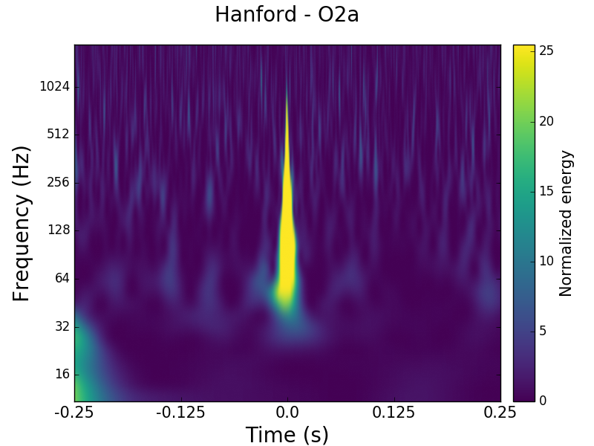
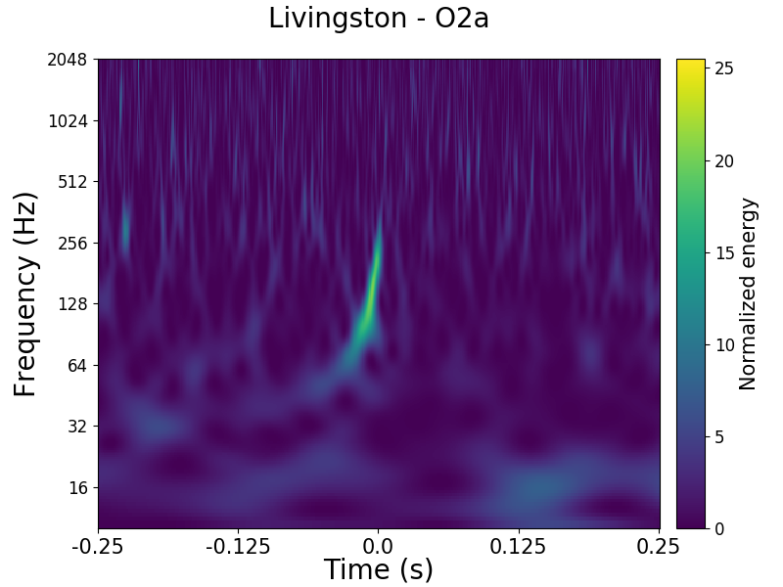
The GOOD news
We have tremendous amount of data and for certain situations we can create more!
A LOT
HANDFUL
As long as we know the waveform we can use injections
Images are from Gravity Spy on zoniverse.org

Slide 13
Supervised/Unsupervised
Classification and unsupervised clustering of LIGO data with Deep Transfer Learning
Phys. Rev. D, 2018, by Daniel George, Hongyu Shen, and E. A. Huerta

Slide 14
One does not have to understand what the ML ‘black box’ does…
As long as it is proven useful
Usual precautions apply:
  one must study and understand the problem very deeply to be successful
  ‘garbage in garbage out’
    Filtering of time series - do we need to filter?
    Training set size
    Down-selection of channels
    How do we represent the input data?

Slide 15
Data Representation Example: Drug Discovery
Recurrent Neural Networks
1.5 million SMILES structures
Learned to generate chemically correct new structures
DRD2 dataset (dopamine type 2 receptor activity) ~350000 samples, ~7000 active
model generates structures of which more than 95% are predicted to be active
Olivecrona et al. “Molecular De-Novo Design through Deep Reinforcement Learning”, 2017

Slide 16
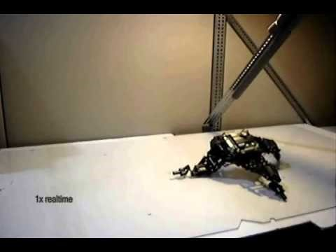
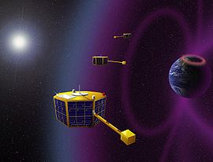
It does not have to be a problem that is only solvable by ML, as long as it is cheaper and faster by ML
Automatic design and manufacture of robotic lifeforms
H Lipson, JB Pollack, Nature 406 (6799), 974
Hornby, Gregory S.; Al Globus; Derek S. Linden; Jason D. Lohn (September 2006). Automated antenna design with evolutionary algorithms
Artist rendering, NASA S5 mission
Notes:
Control? Can an evolved control scheme lead s not to lose lock?

Slide 17
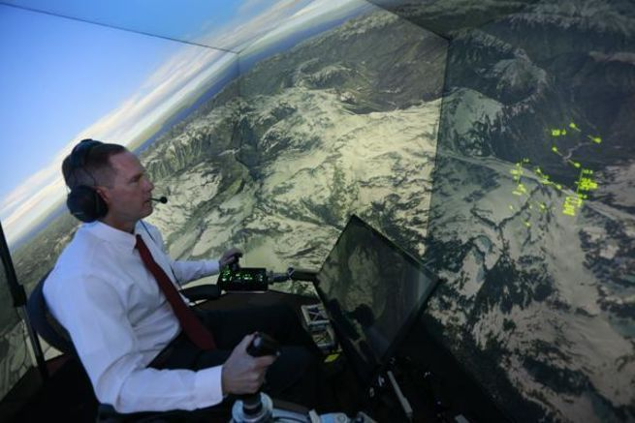
Better, Cheaper and Faster than Humans
Retired United States Air Force Colonel Gene Lee in simulated air combat versus an A.I.
Image by Lisa Ventre, University of Cincinnati
Faster is key for the Open Public Alerts era
ML can become the tool for automatizing detchar activities that are near-real time data analysis related
Ernest et al., Genetic Fuzzy based Artificial Intelligence for Unmanned Combat Aerial
Vehicle Control in Simulated Air Combat Missions, J Def Manag 2016, 6:1

Slide 18
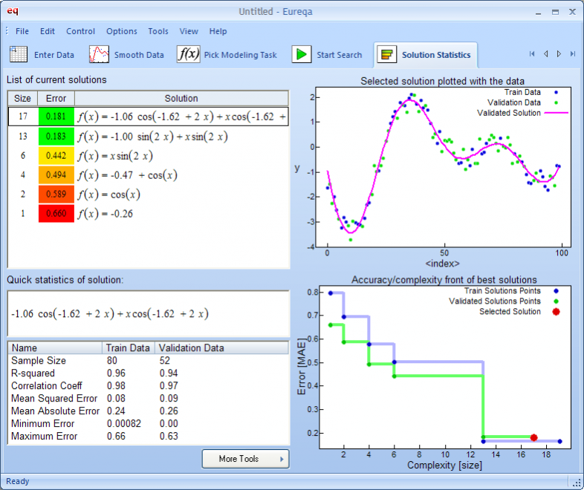
Chance to study, understand and solve the problem off-line
Distilling free-form natural laws from experimental data, M Schmidt, H Lipson - Science, 2009

Slide 19
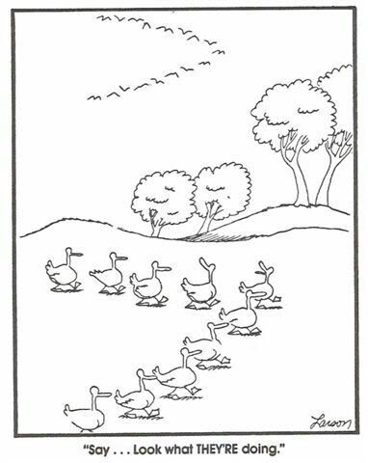
ML can solve some problems
but it is just a TOOL
we must study and understand the problem very deeply to be successful
Notes:
So what can we do with all these?

Slide 20
