Slide 1
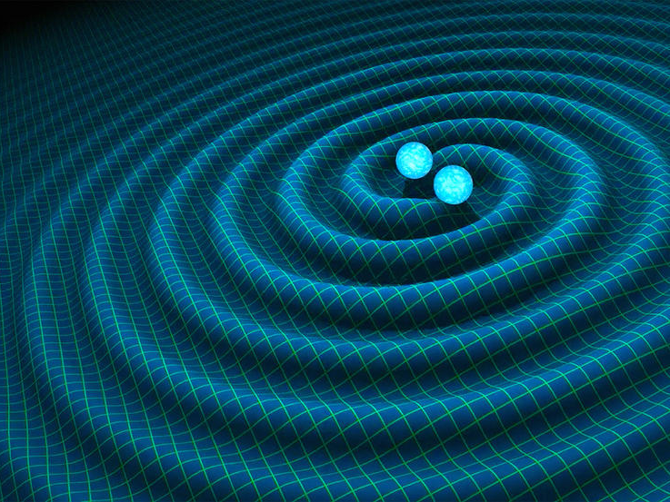
Modeling and Measuring Eccentricity in Binary Black Hole Inspirals
Simona Miller
Smith College ‘20
LIGO SURF 2018
Mentors: Jonah Kanner, Alan Weinstein, Tom Callister
DCC: LIGO-T1800231-v1

Slide 2
Outline
What is orbital eccentricity and where does it come from (BBH formation mechanisms)?
Modeling eccentricity
What happens if we try to fit a circular template to an eccentric signal?
If we know eccentricity is present, how well can we measure it?

Slide 3
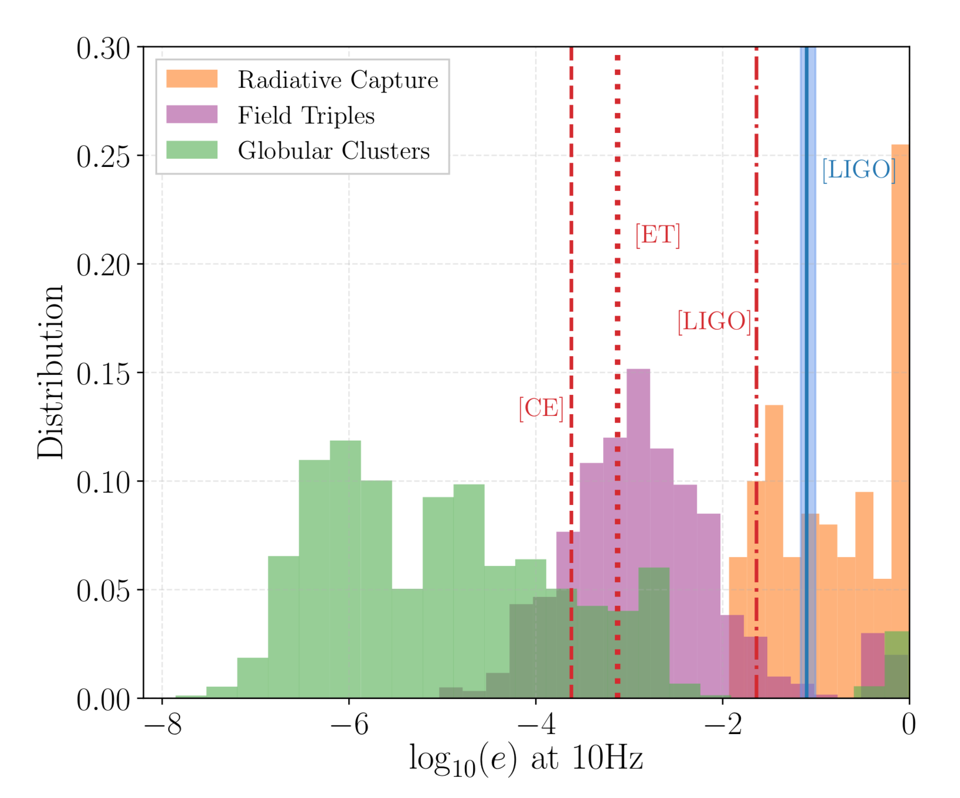
Background
Eccentricity = deviation from circularity
Motivation: eccentricity can tell us about BBH formation mechanisms
Common binary evolution – expected to be circular in the LIGO band
Dynamical capture – capture close to merger so eccentricity still present
Hierarchical triples – one BBH orbited by another BH; eccentricity induced by angular momentum exchange (Kozai-Lidov mechanism)
Lower, Marcus E., et al. “Measuring eccentricity in binary black hole inspirals with gravitational waves,” (2018)

Slide 4
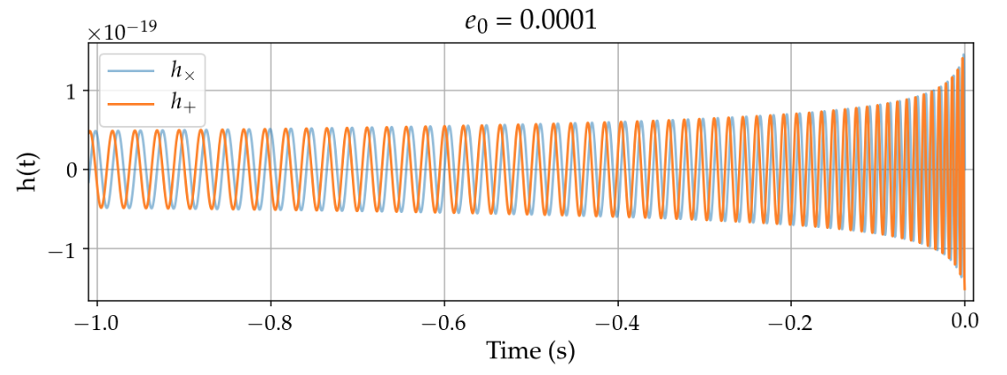
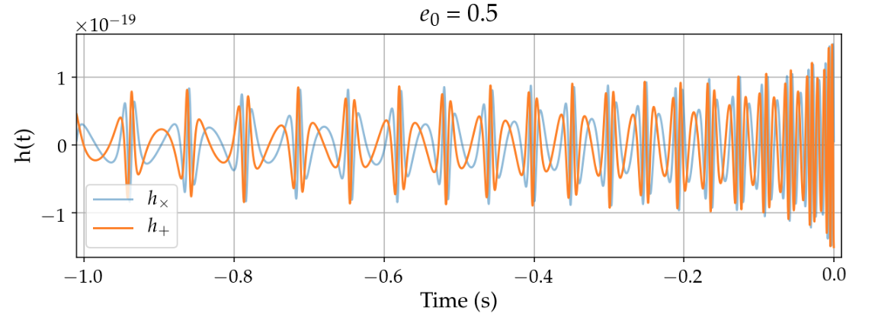
Background
“Shape” of gravitational waveform from binary black hole determined by intrinsic parameters: mass, spin, and eccentricity
However, eccentricity is currently poorly modeled
Only one waveform in LALSuite
Inspiral phase only
Negligible eccentricity
Non-negligible eccentricity

Slide 5
Modeling Gravitational Waveforms from Eccentric Binary Black Holes

Slide 6
Modeling Eccentricity
I modeled the:
Orbital precession → Time evolution of eccentricity
Plus and cross polarizations of the inspiral phase of an eccentric waveform in the time domain
Phase of eccentric waveform

Slide 7
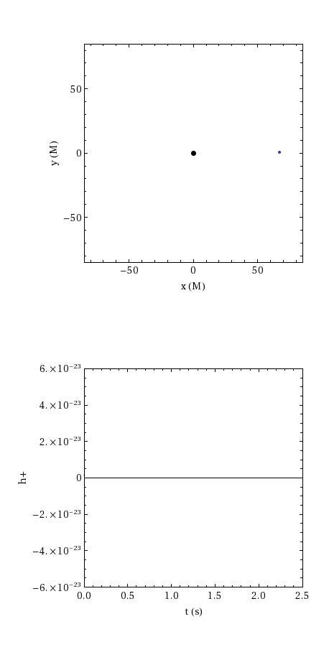
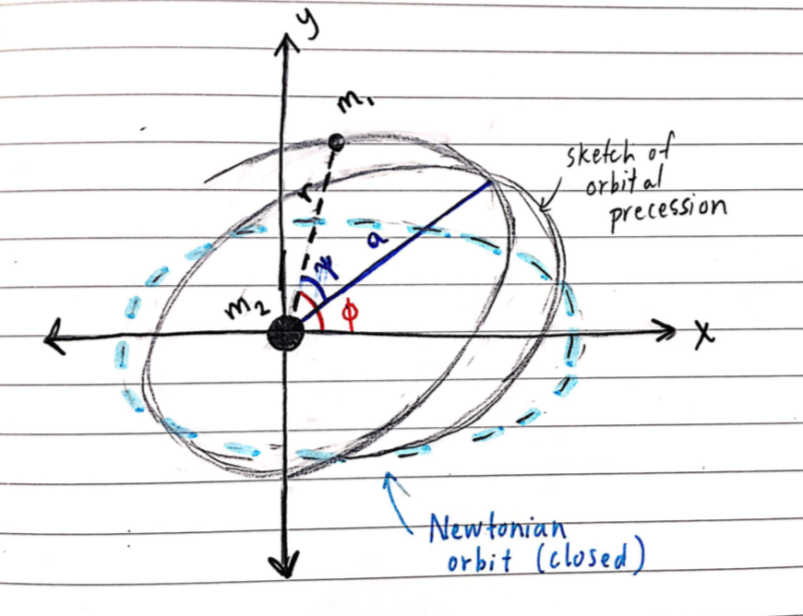
Modeling Eccentricity: Orbits
Newtonian orbits vs. GR effects
Orbital precession
Can still characterize with P_{orb} and e
But, due to gravitational radiation, P_{orb} and e are evolving in time
Eccentricity affects modulation of amplitude and frequency of waveform.

Slide 8
Modeling Eccentricity: Time Evolution
Same masses, initial frequency, and initial separation

Slide 9
My Waveform
Bursts at periastron passage

Slide 10
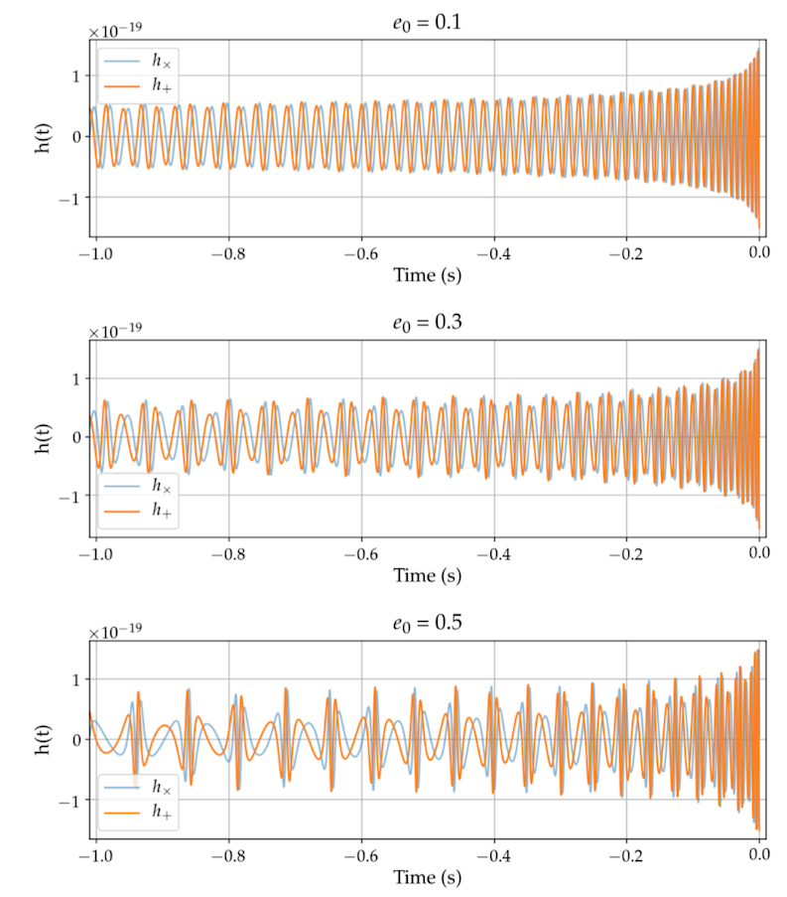
My Waveform
EccentricTD

Slide 11
Modeling Eccentricity: Phase Angle Evolution
Matched filtering keys in on the phase of waveform
Phase can be extracted without a specific template/waveform model
Can therefore be used to measure eccentricity directly → develop a statistic for this

Slide 12
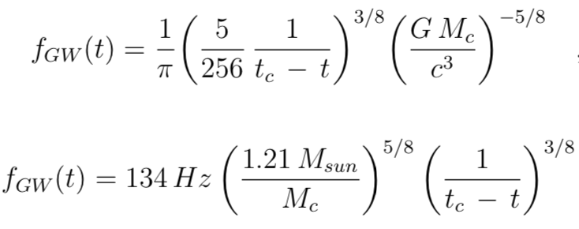
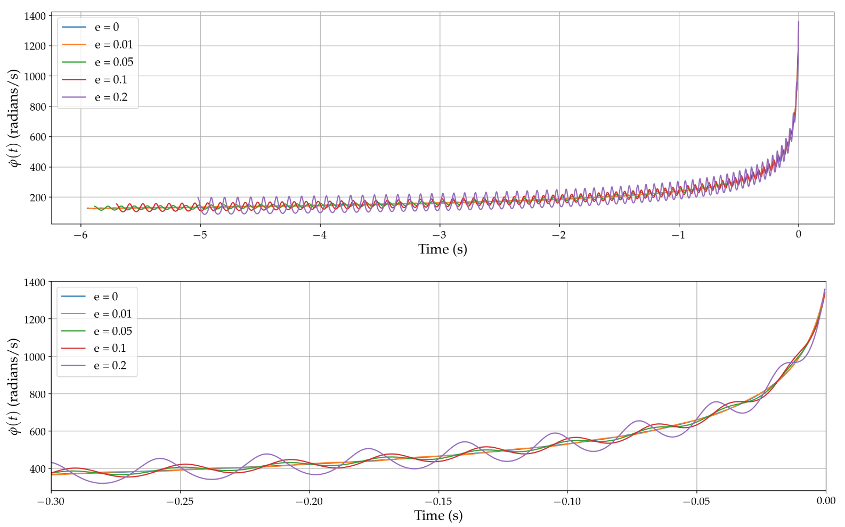
Modeling Eccentricity: Phase Evolution
when e = 0
.
Chirp shape + sinusoidal component
Fitting for t_{c} and M_{c} → estimated chirp mass with 3.2% error
Future work includes deriving expression for sinusoidal component

Slide 13
Measuring Eccentricity

Slide 14
Methodology
Simulated eccentric signals (“injections”) using EccentricTD model with Gaussian noise from aLIGO Design noise curve
Calculated fraction of SNR (signal to noise ratio) lost if we assume a signal is circular when it has eccentricity
Calculated likelihood distributions for parameters
Circular template
Eccentric template
Expected degeneracies/biases – focus on e₀ and mass parameters

Slide 15
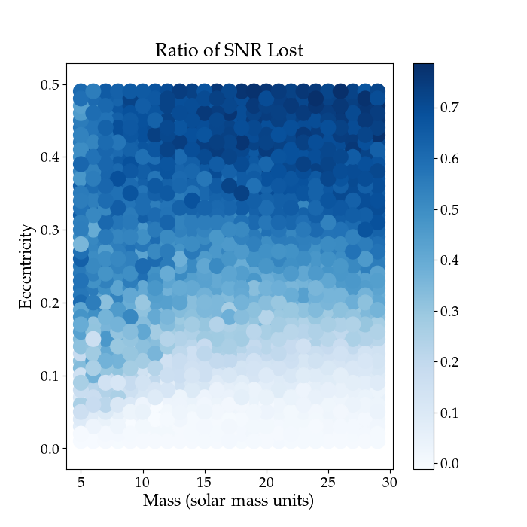
Extracting an eccentric signal with a circular template: Lost SNR
Fraction of SNR Lost
How much SNR is lost if we try to use a quasi-circular “vanilla” template to recover an eccentric signal?

Slide 16
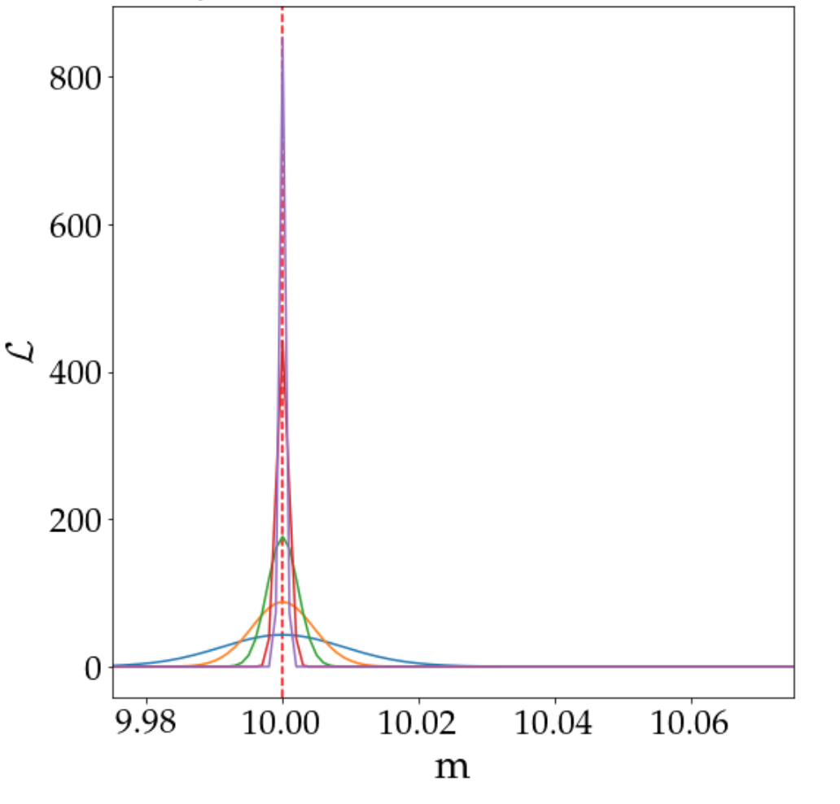
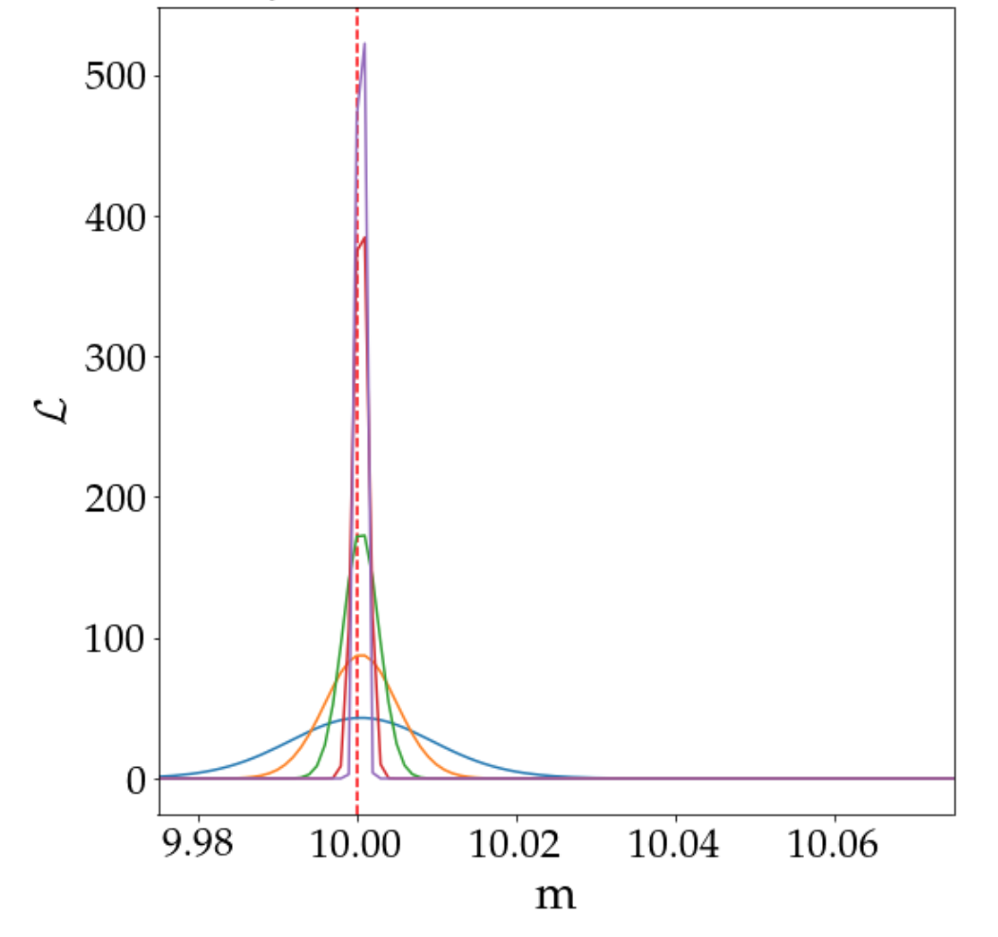
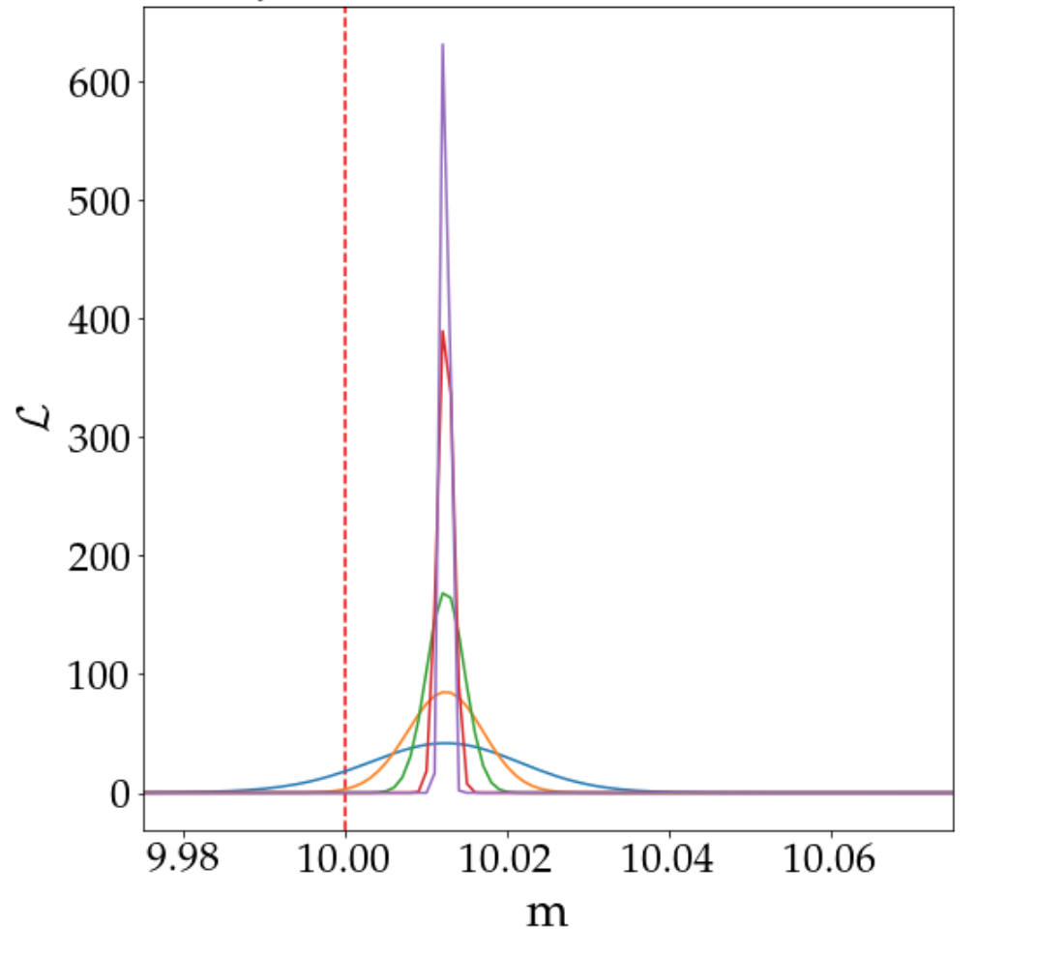
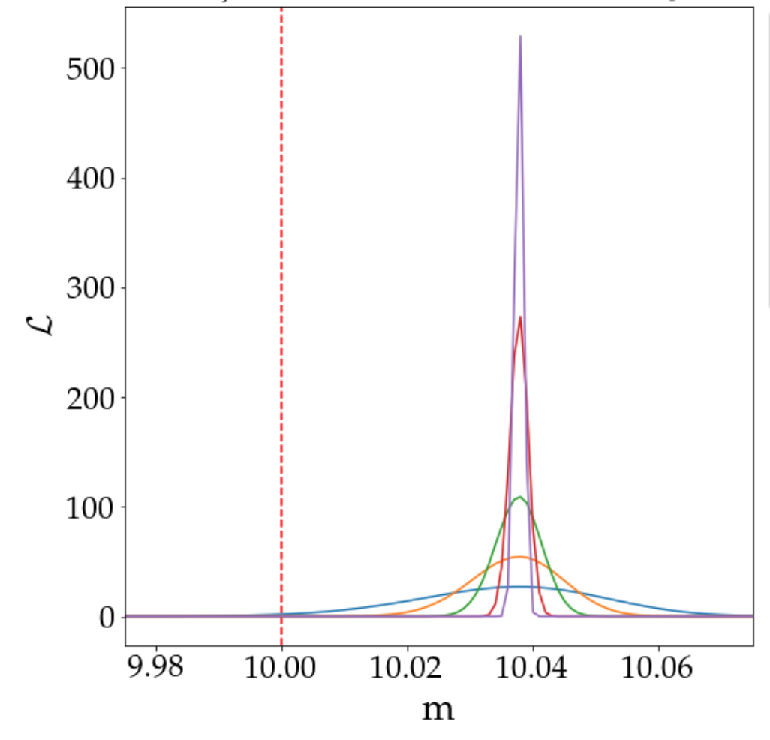
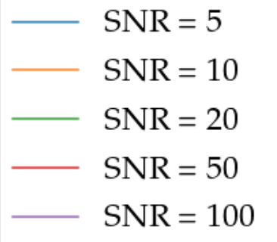
Extracting an eccentric signal with a circular template: Likelihood Distributions
e₀ = 0
e₀ = 0.01
What happens if we try to recover the mass parameter from an eccentric signal using a quasi-circular template?
As e₀ increases, our estimates for mass become more and more biased → Explanation: duration in LIGO band.
e₀ = 0.05
e₀ = 0.1

Slide 17
Extracting an eccentric signal with an eccentric template: 1D
e₀ = 0.001
e₀ = 0.01
e₀ = 0.1
All parameters except eccentricity fixed – e.g. we know M_{tot} and q by some superhuman knowledge

Slide 18
Extracting an eccentric signal with an eccentric template: 1D
Confidence intervals – where does 90% of the data fall? 50%? N%
With what confidence can we say e ≠ 0?
At SNR >= 5, can detect eccentricities greater than 0.1
For an SNR of, say, 10, we can likely detect eccentricities down to ~0.04
Assuming all other parameters are known
aLIGO Design noise curve, f_{low} = 20 Hz

Slide 19
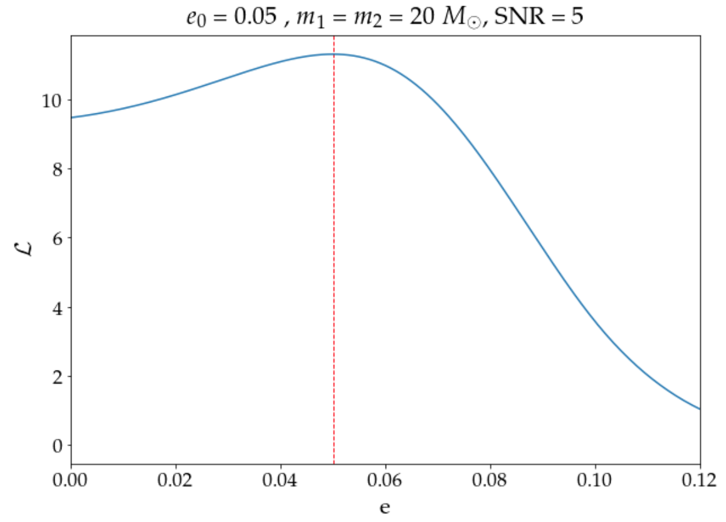
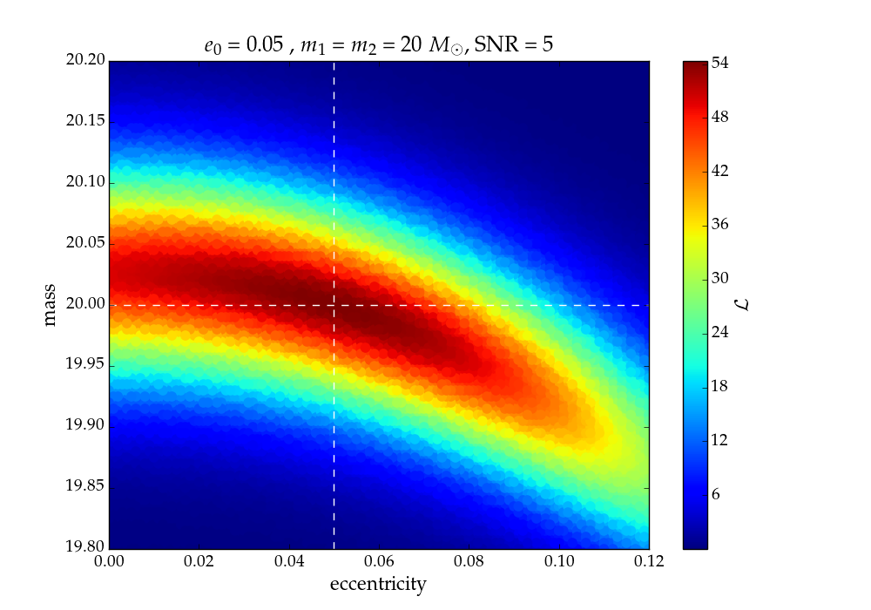
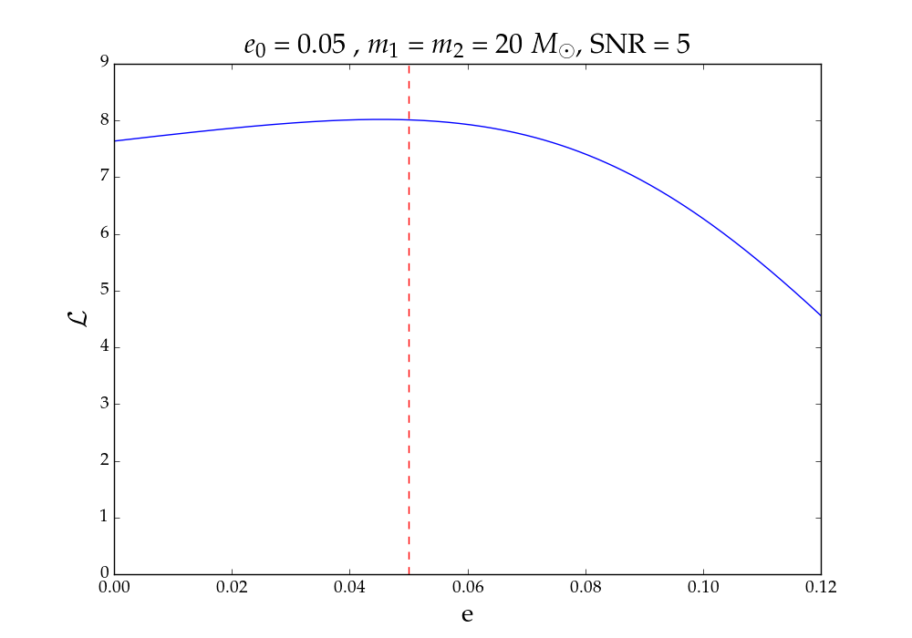
Extracting an eccentric signal with an eccentric template: 2D
What happens if instead of just recovering eccentricity, we also recover mass?
An example:
“knowing” mass
marginalizing over mass

Slide 20
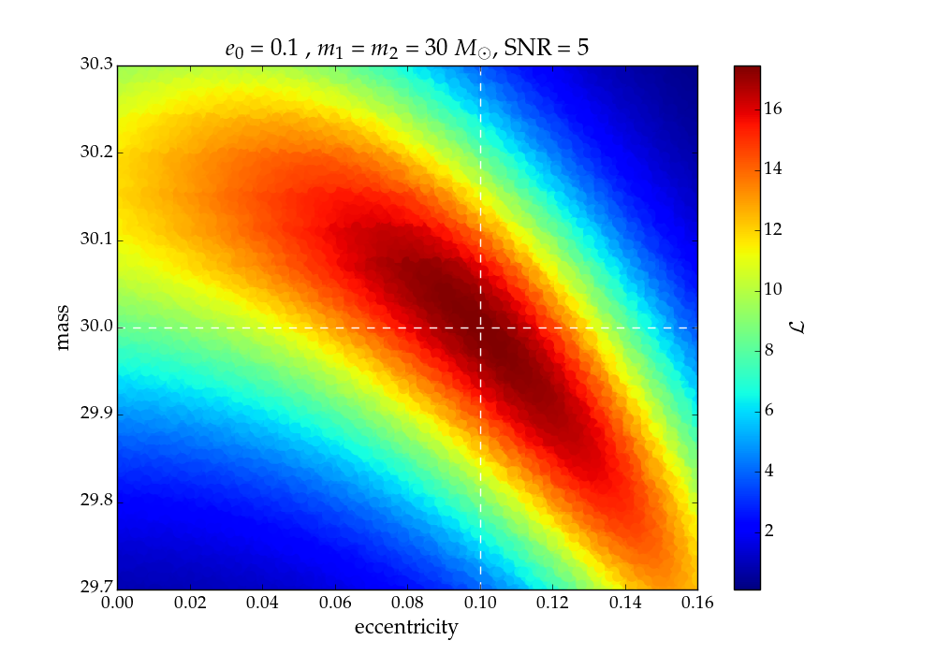
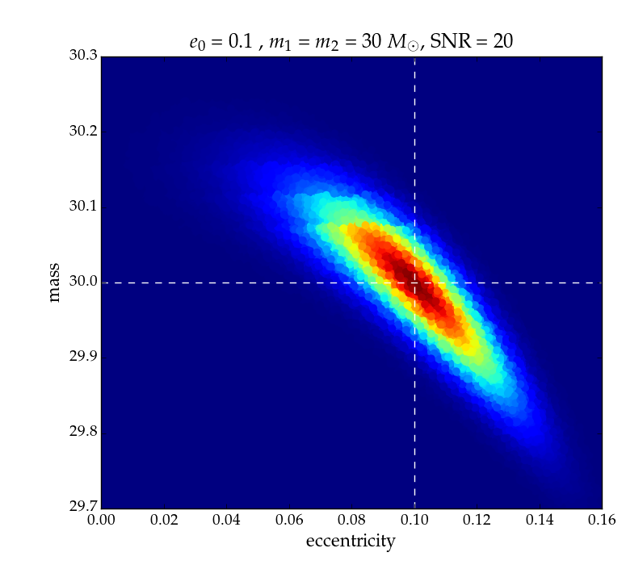
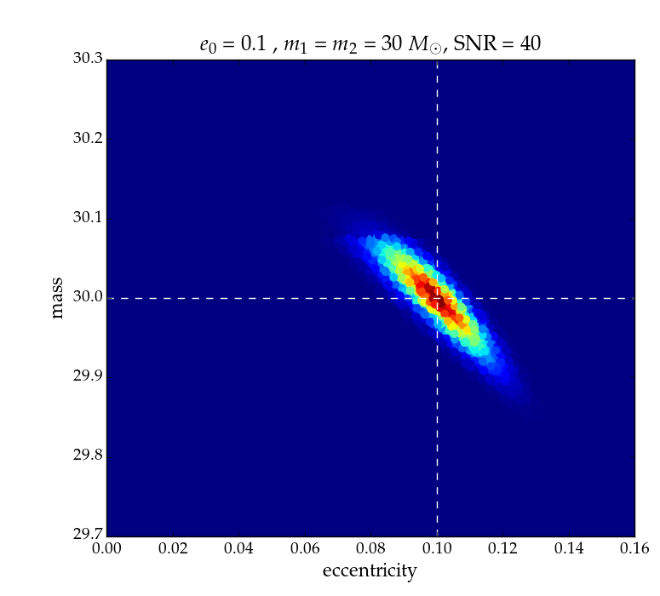
e₀ = 0.1,
m₁ = m₂ = 30 M_{sun}
Various SNRs
SNR = 5
SNR = 20
SNR = 40

Slide 21
Conclusions
Bursts at periastron passage characterize eccentric waveform
Sinusoidal component of phase evolution
Extracting an eccentric signal using a quasi-circular waveform causes a loss in SNR a prohibits our ability to accurately estimate the mass of the system
At reasonable SNR (~10) we can detect eccentricities of down to 0.04 with ~90% confidence, assuming all other parameters are known.
Eccentricity is somewhat degenerate with mass parameters.
Big picture: Eccentricity is important for determining BBH formation mechanisms.
Future/offshoots: model-independent e statistic, degeneracies with spin

Slide 22
References
Blanchet, Luc. “Gravitational Radiation from Post-Newtonian Sources and Inspiralling Compact Binaries,” Living Rev. Relativity, 17 /lrr-2014-2 (2014)
Biwer, C. M., et al. ”PyCBC Inference: A Python-based parameterestimation toolkit for compact-object merger signals,” (2018)
Callister, Thomas A. “Improving Models of Eccentric Compact Binary Inspirals,” University of Cambridge, (2014)
East, William B., et al. ”Observing complete gravitational wave signals from dynamical capture binaries”, Phys. Rev. D, 87 (2013), [arXiv:1212.0837v2]
Lower, Marcus E., et al. ”Measuring eccentricity in binary black hole inspirals with gravitational waves,” (2018)
Maggiore, Michele. Gravitational Waves: Theory and Experiments, Volume 1, Oxford University Press, (2008).
PyCBC: Free and open software to study gravitational waves, https://pycbc.org/
Randall, Lisa and Zhong-Zhi Xianyu. ”Induced Ellipticity for Inspiraling Binary Systems,” (2018), [arXiv:1708.08569v2]
Samsing, Johan. ”Eccentric Black Hole Mergers Forming in Stellar Clusters,” (2017), [arXiv:1711.07452]
Sathyaprakasch, B.S and Bernard F. Schutz, “Physics, Astrophysics, and Cosmology with Gravitational Waves,” Living Rev. Relativity, lrr-2009-2, (2009): http://www.livingreviews.org/lrr-2009-2.

Slide 23
Acknowledgements
Jonah Kanner
Alan Weinstein
Tom Callister
LIGO Lab
Caltech SFP
LIGO SURF

Slide 24
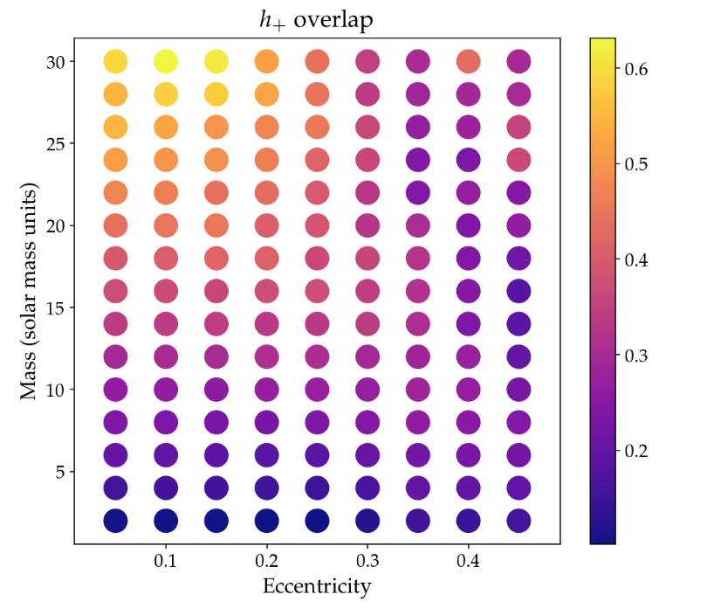
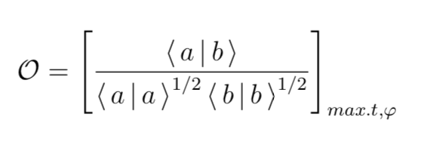
Comparing My Model with EccentricTD
Overlap: essentially dot product between two waveforms
As mass increases, waveform spends less time in the LIGO band – less room for mismatch between waveforms.
As eccentricity increases, the features from eccentricity become more pronounced – differences in models more prominent.
Differences likely come from Newtonian approximations for energy and angular momentum.

Slide 25
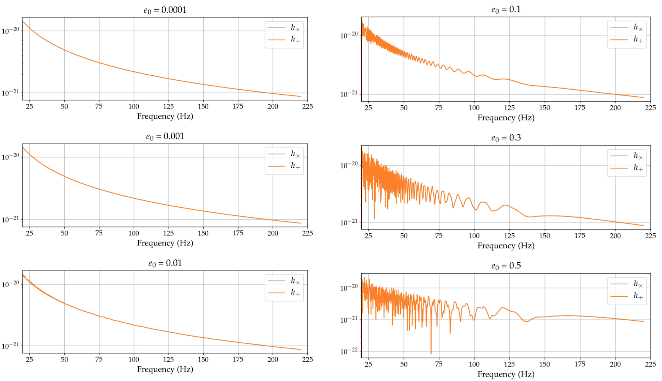
EccentricFD: Frequency Domain

Slide 26
Phase Evolution

Slide 27
Phase Evolution

Slide 28
Confidence Levels at Lower SNRs

Slide 29
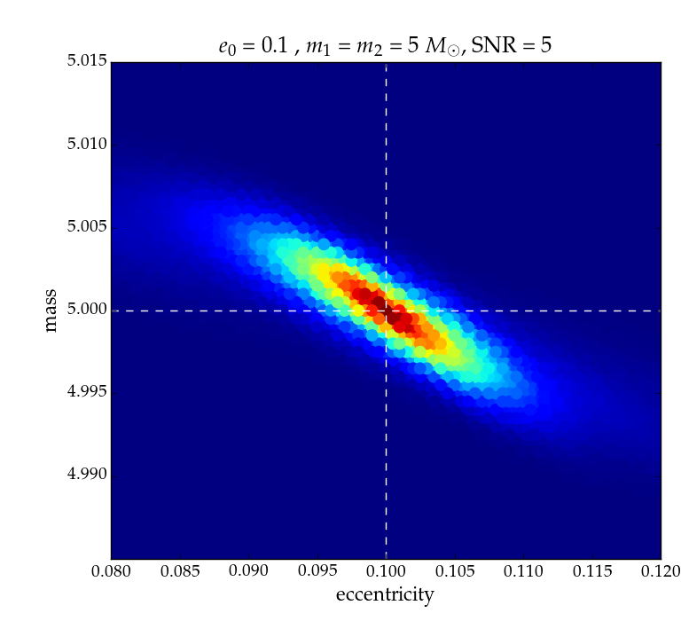
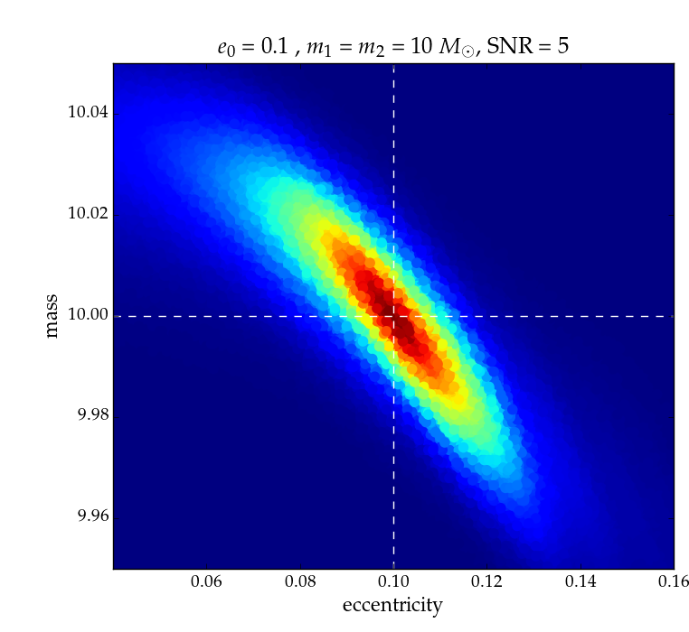
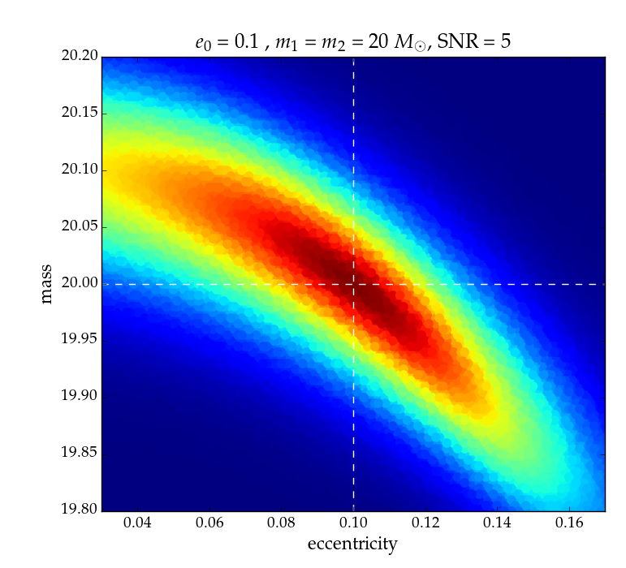
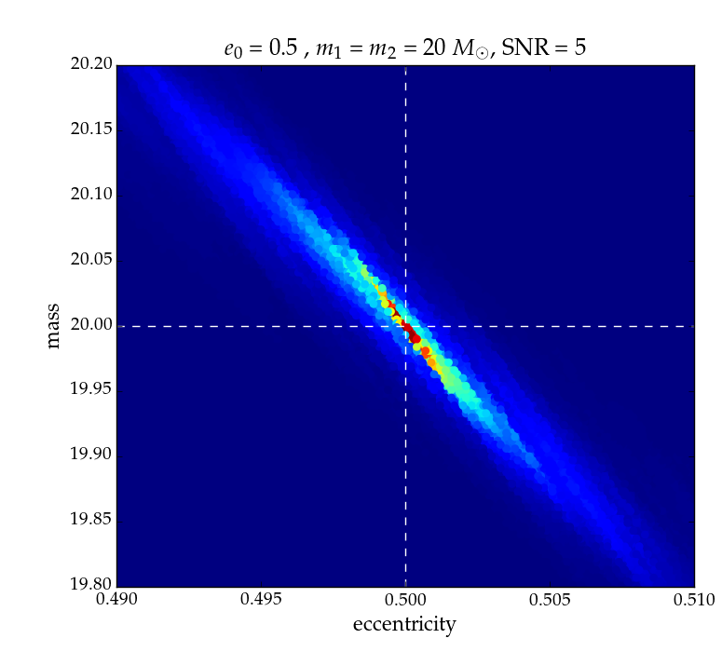
SNR = 5
Mass ratio = 1
Various total mass and eccentricities
m₁ = m₂ = 20 M_{sun}
e₀ = 0.05
m₁ = m₂ = 5M_{sun}
m₁ = m₂ = 10 M_{sun}
m₁ = m₂ =30 M_{sun}
e₀ = 0.1
e₀ = 0.5

Slide 30
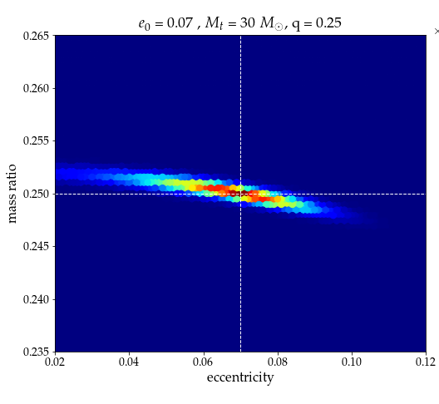
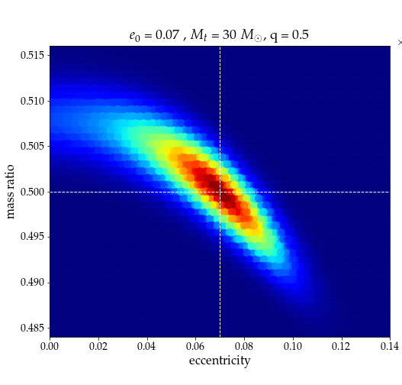
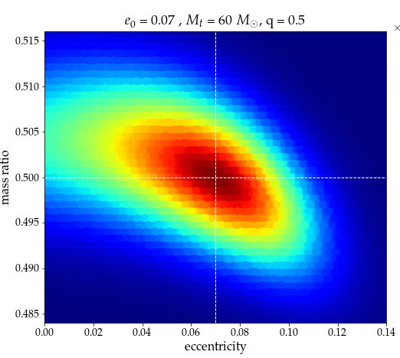
More Degeneracies: Mass Ratio
e₀ = 0.07,
SNR = 10
M_{tot}= 30 M_{sun}
q = 0.25
M_{tot}= 30 M_{sun}
q = 0.5
M_{tot}= 60 M_{sun}
q = 0.5

Slide 31
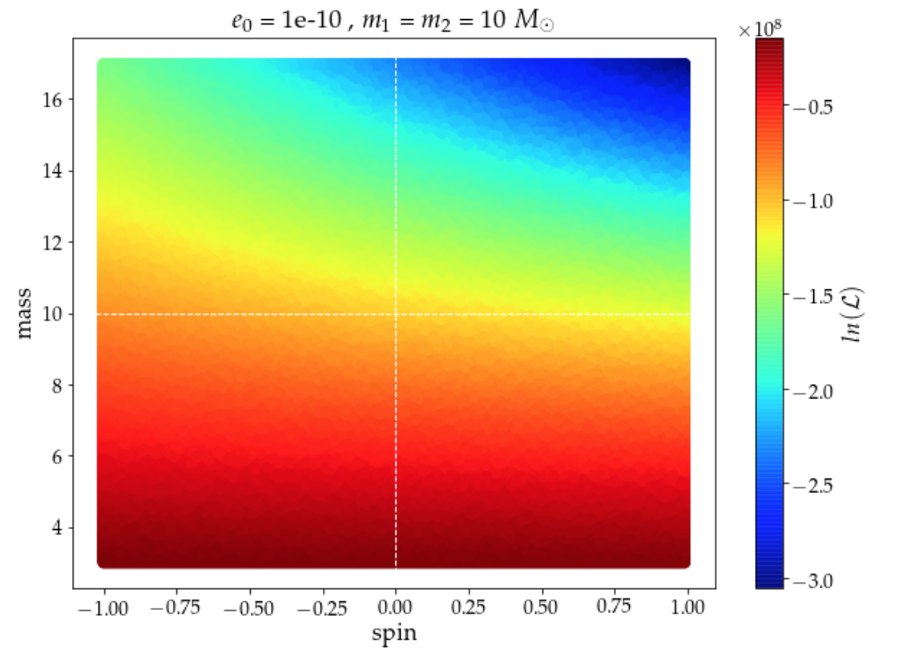
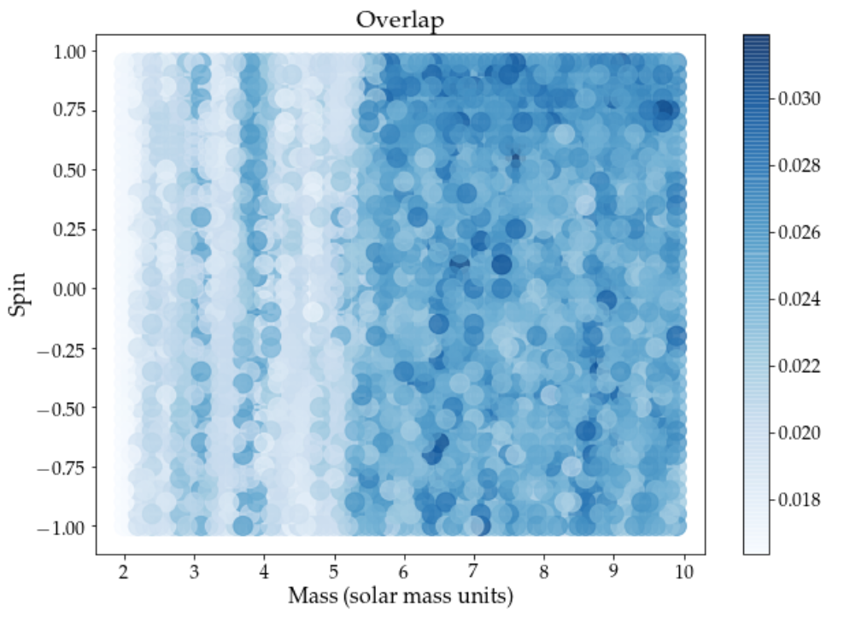
More Degeneracies: Spin?
What if we don’t know that a signal is eccentric and assume it is circular with aligned spin?
Problems: differences in LALSuite waveforms at e=0, s=0
Overlap (essentially dot product between waveforms) all < 0.04
e_{0, injected} = 0.1

Slide 32
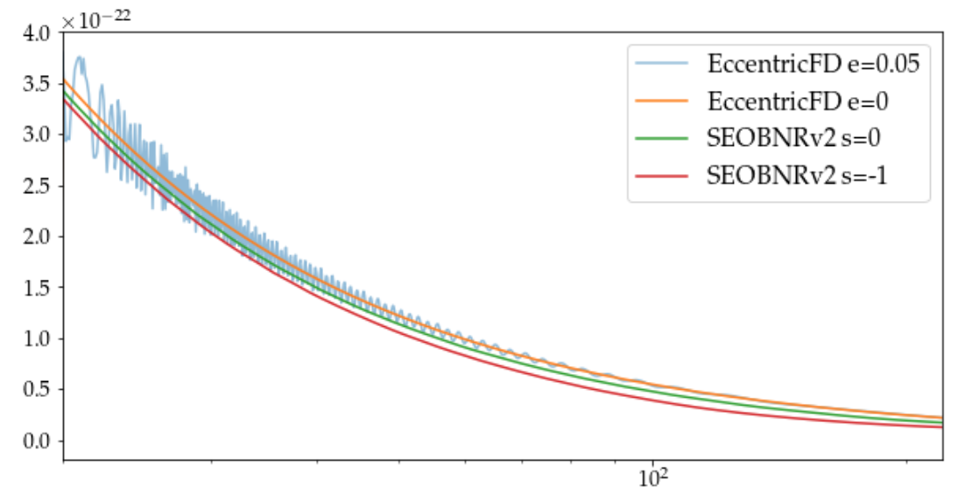
Problems when Comparing Spinning and Eccentric Templates
h
Frequency (Hz)

