Slide 1
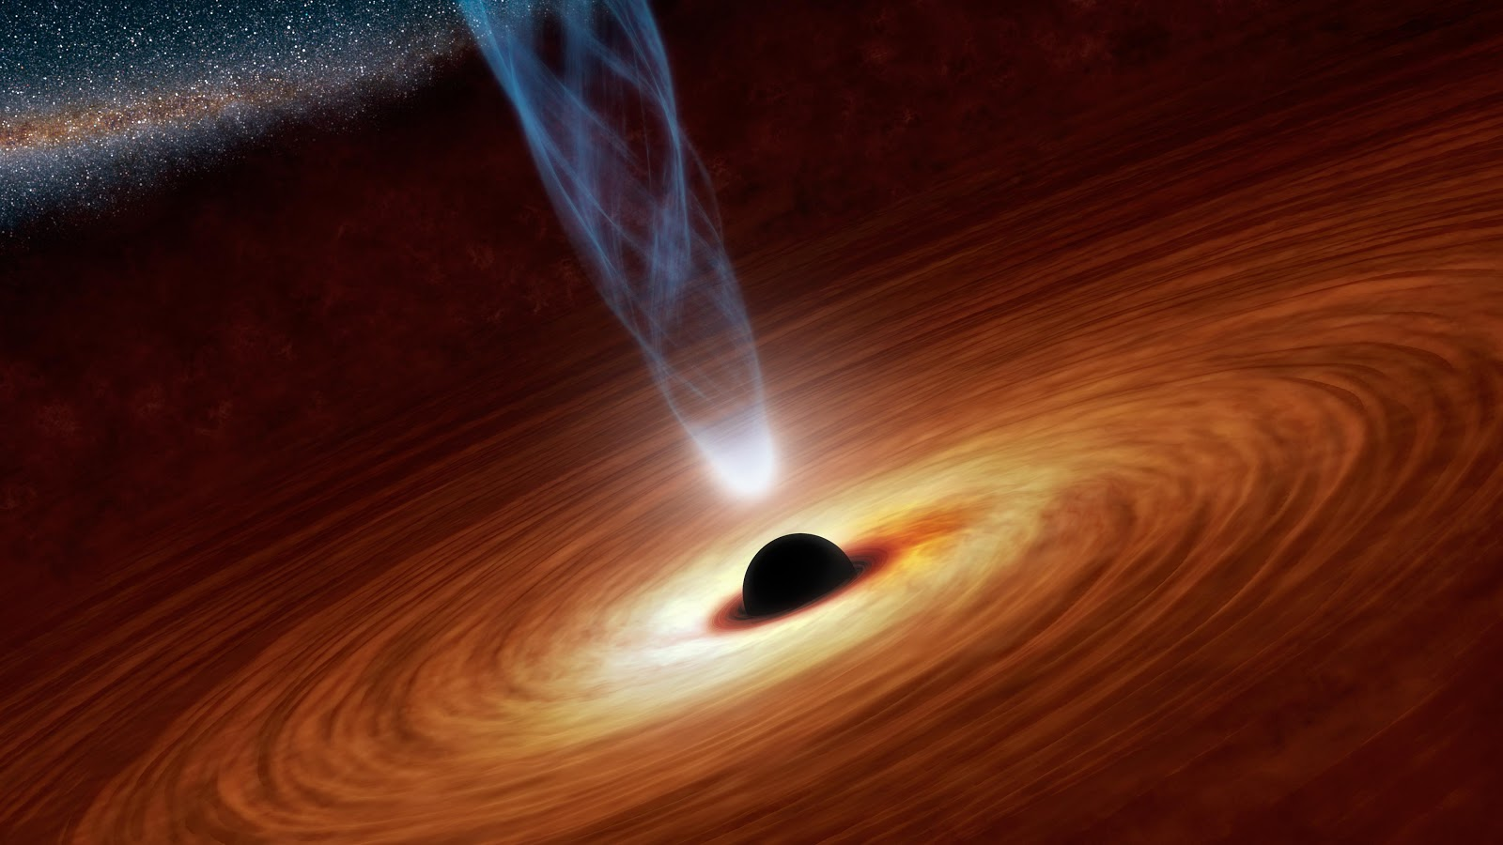
Neutron stars and black holes: the relics of massive stars
Evan Goetz
Detector Scientist, LIGO Hanford
LIGO-G1801452

Slide 2
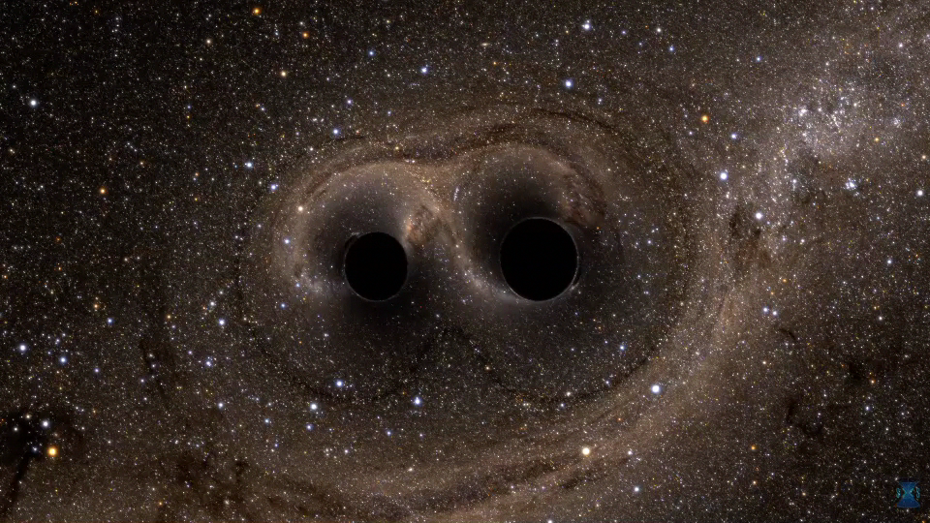
Some cool things about General Relativity
Solutions to equations predict orbital motion, bending of light, weird time effects, black holes, etc.
Spacetime is dynamical: gravitational waves
Credit: ligo.caltech.edu

Slide 3
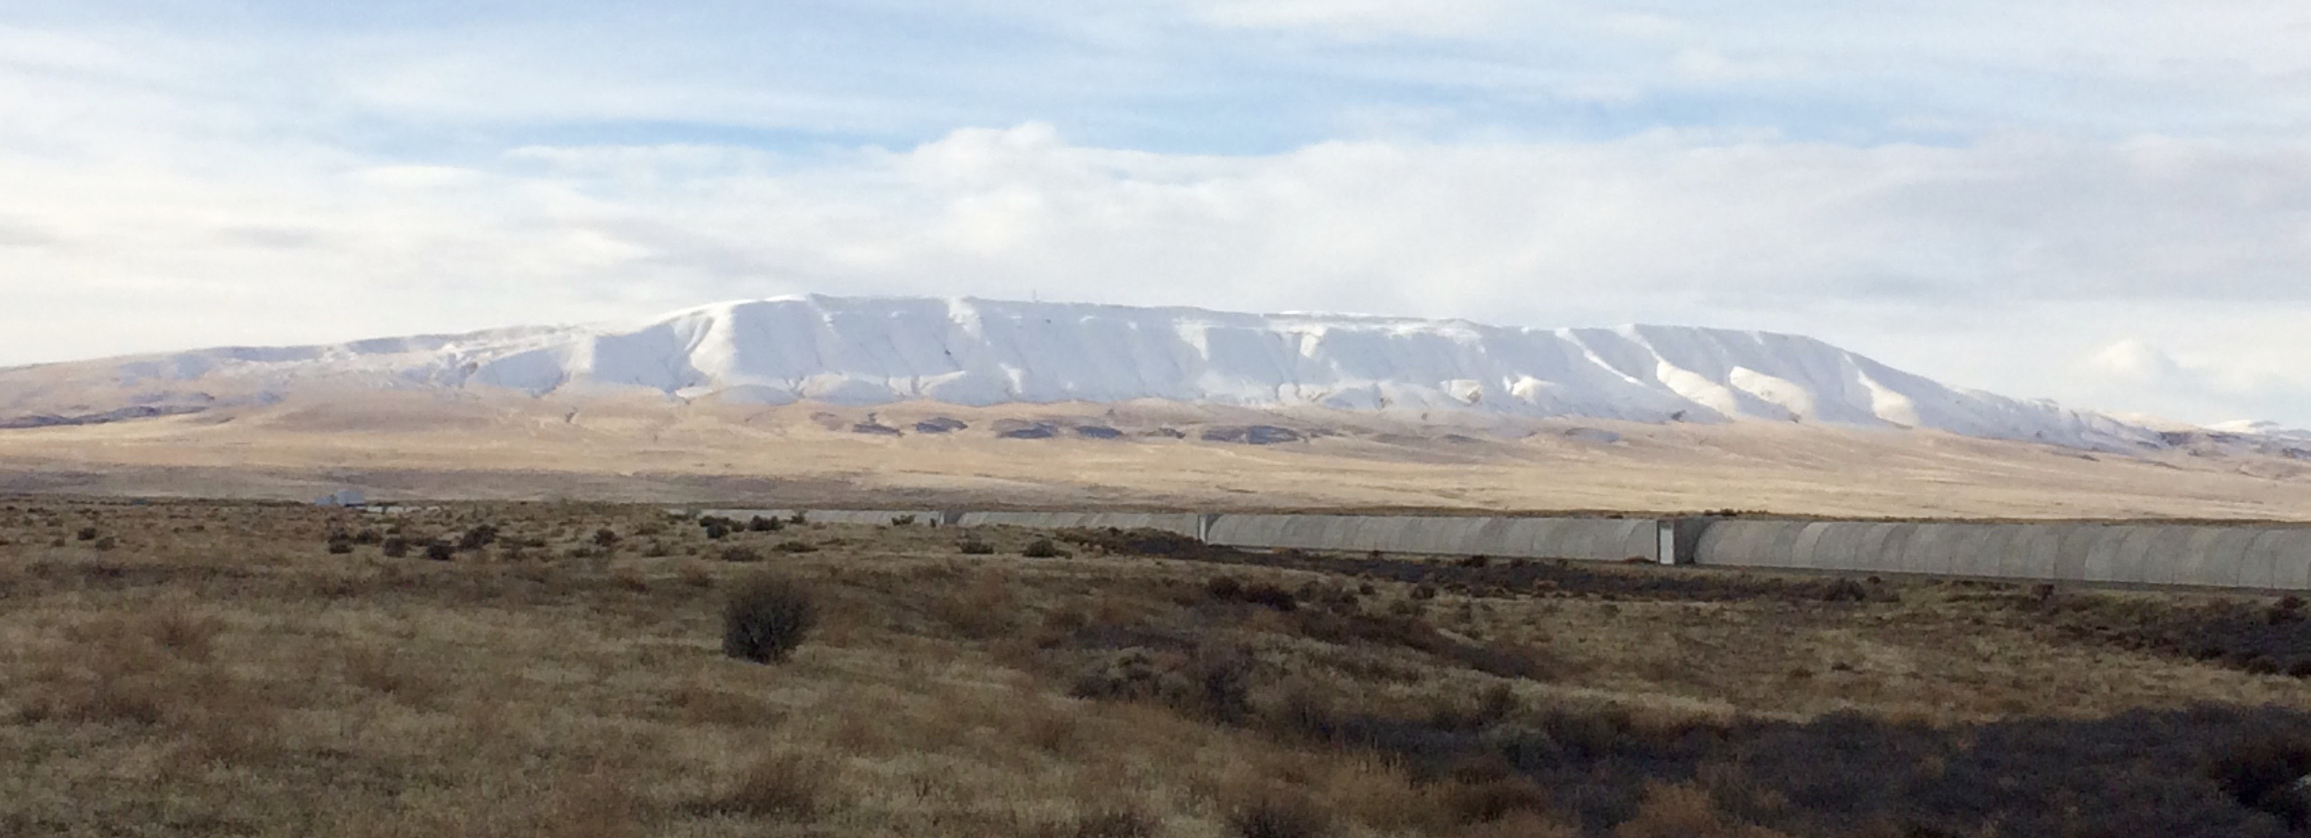
Outline
Stellar evolution
Neutron stars
Black holes
Gravitational waves

Slide 4
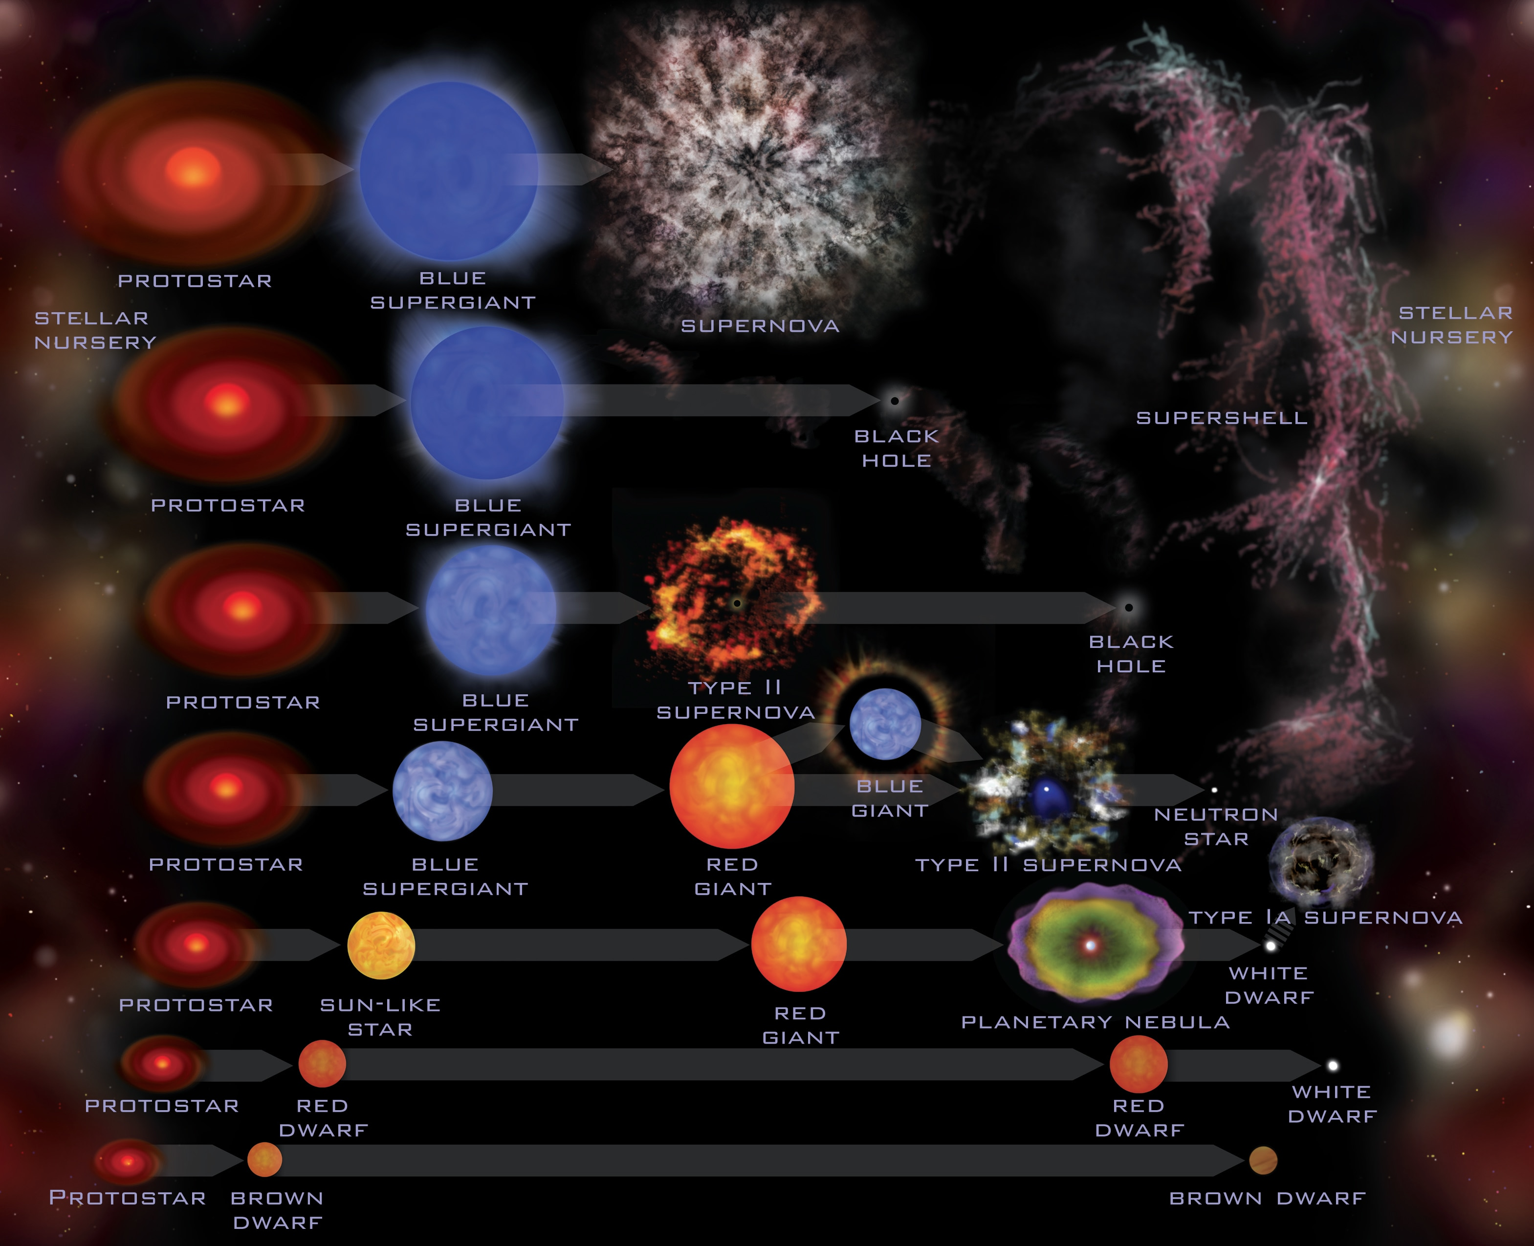
Stellar evolution
www.jpl.nasa.gov

Slide 5
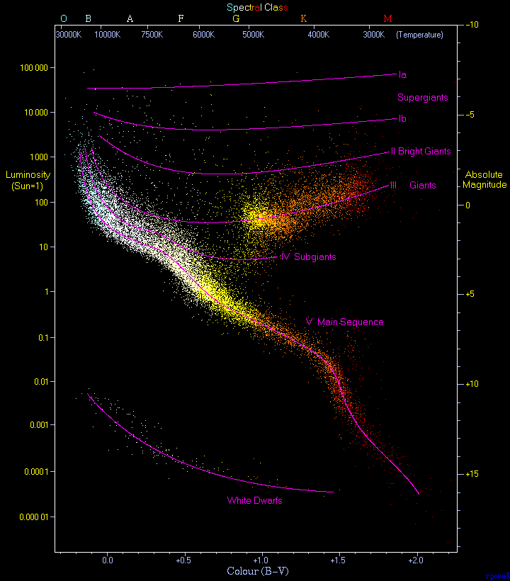
HR diagram
wikipedia.org

Slide 6
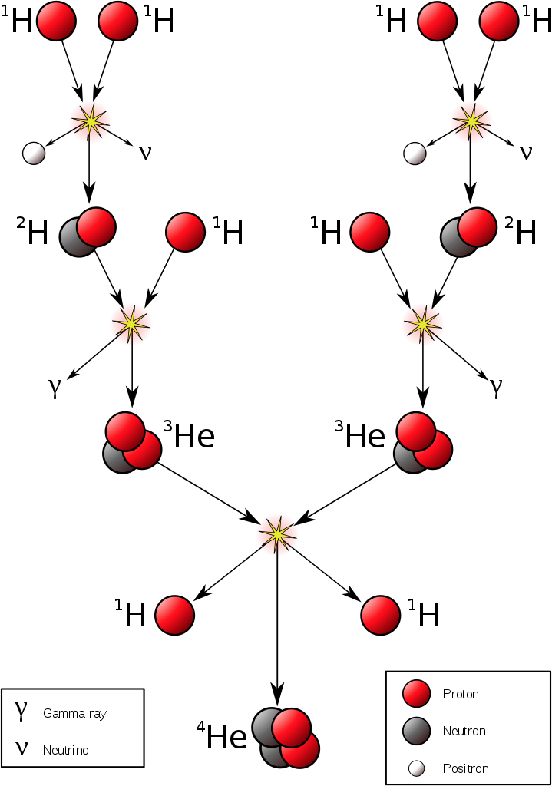
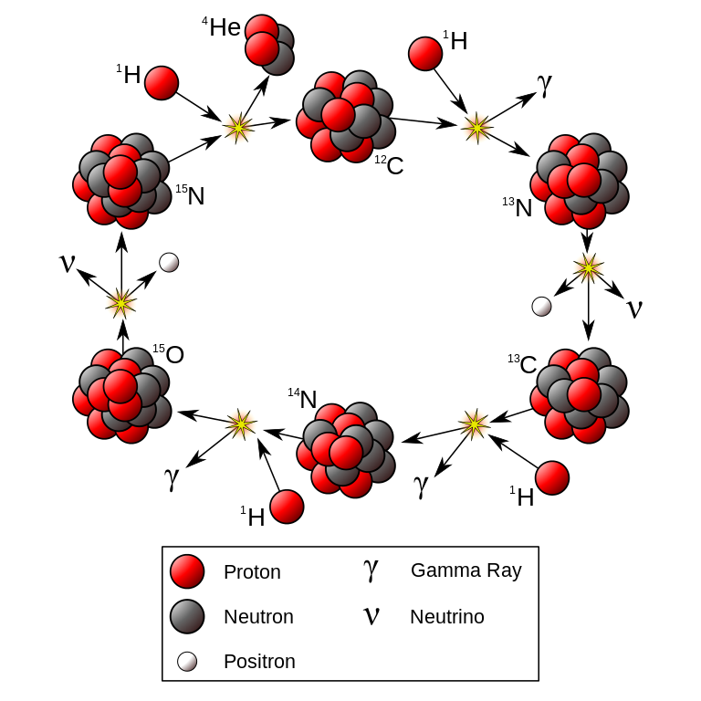
Nuclear fuel burning
p-p chain fusion (low mass stars) CNO cycle fusion (higher mass stars)
Just examples, many other nuclear pathways…
wikipedia.org

Slide 7
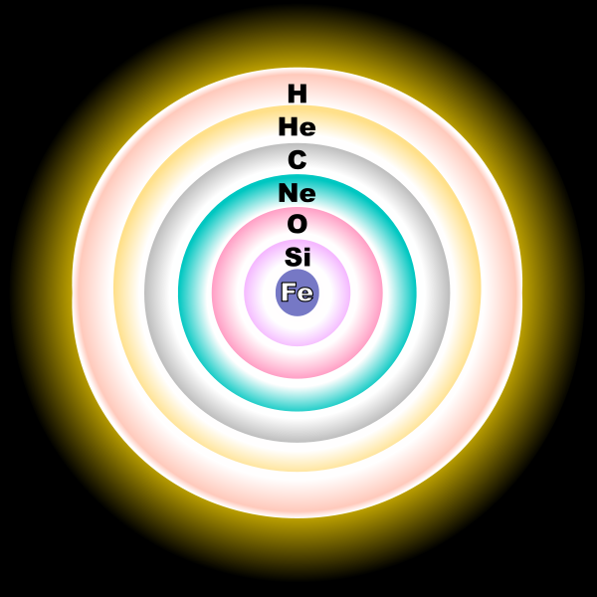
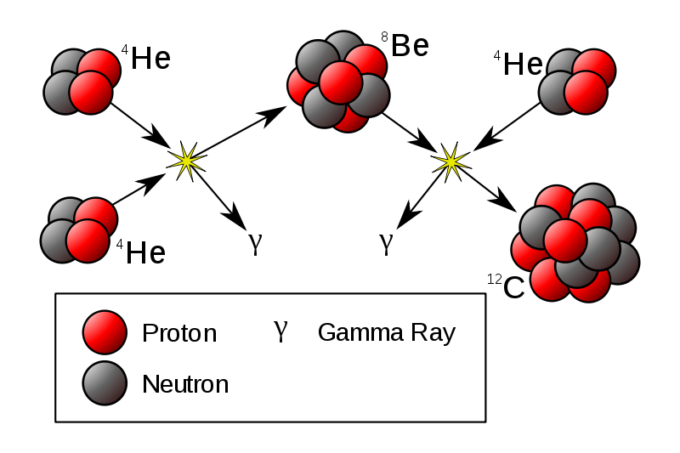
Life of a star goes on
Late stages of a high mass star
Triple-alpha process
(near end of low mass star)
wikipedia.org

Slide 8
End of life
www.jpl.nasa.gov

Slide 9
Tale of a massive star end of life
Exact physics of collapse/SN is very complicated!
“Useless” iron core of star
Hydrostatic equilibrium fails and star collapses
Inverse beta decay as core collapses
Shock wave results in supernova explosion
Collapsing core may halt because of neutron degeneracy pressure – neutron star
Collapse may continue – black hole

Slide 10

Neutron stars
Proposed in 1933 by Baade and Zwicky
Dense, relic of massive star
Supported by neutron degeneracy pressure
Made up of mostly neutrons
Very strong magnetic fields
Interesting: an isolated neutron decays to a proton in approx. 11 min.; why doesn’t a NS decay?
http://www.mpifr-bonn.mpg.de/research/fundamental/forces

Slide 11
Known neutron stars (pulsars)
First pulsar discovered in 1967 in Jocelyn Bell and Antony Hewish
ATNF catalog: 2636 pulsars (July 2018) and counting!

Slide 12
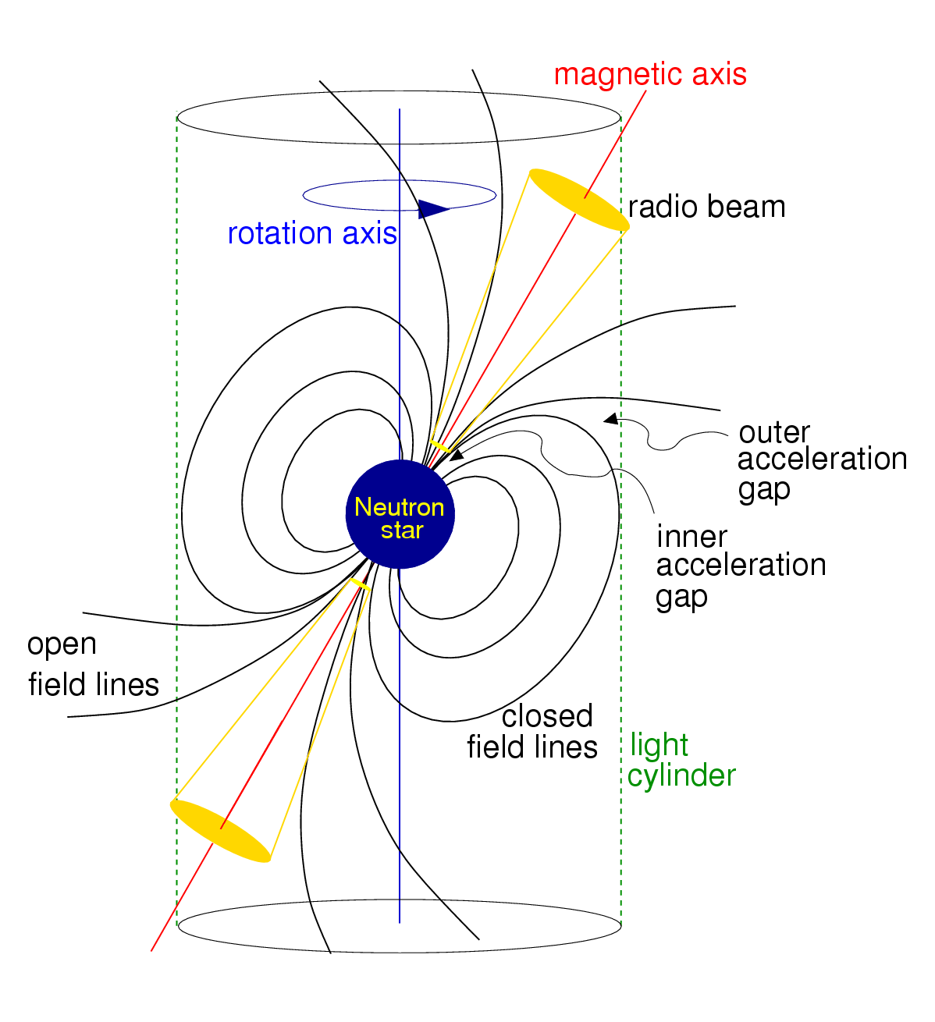
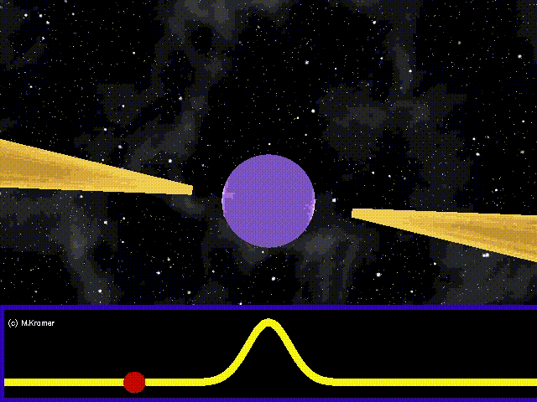
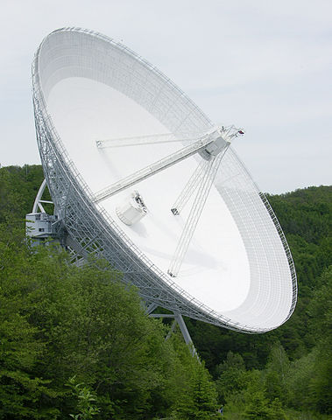
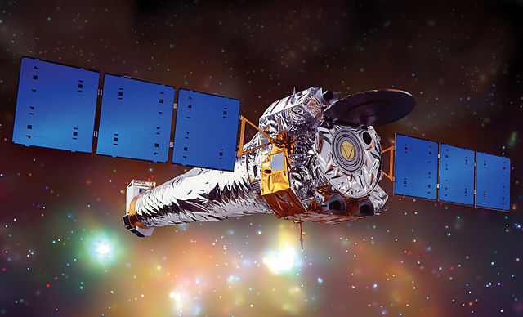
Observing pulsars (EM)
wikipedia.org

Slide 13
Fascination with neutron stars
Matter under extreme conditions
Probe fundamental physics
Structure of neutron star
Equation of state
  Pressure vs density
  Mass vs radius
Another equation of state: ideal gas law

Slide 14
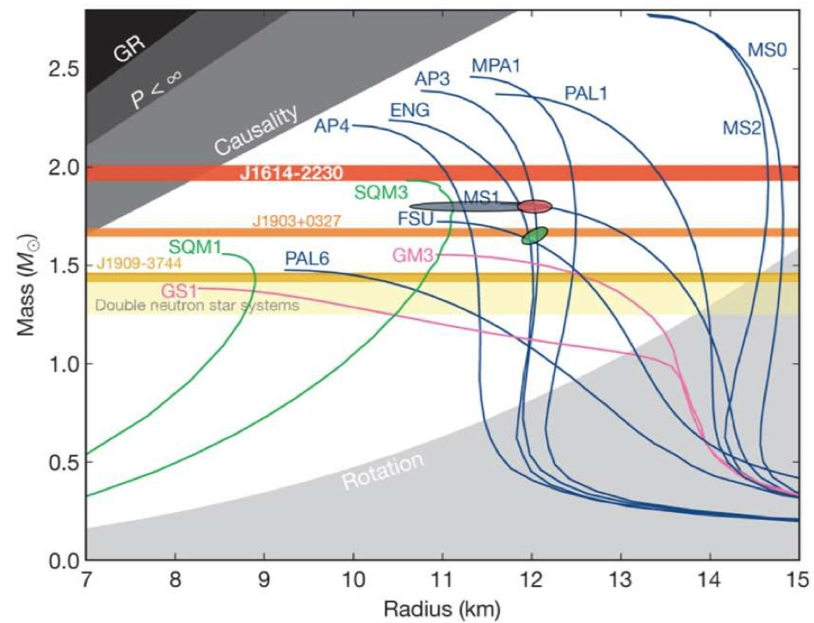
Equation of state
http://sci.esa.int/loft/49338-equation-of-state-for-neutron-stars/

Slide 15
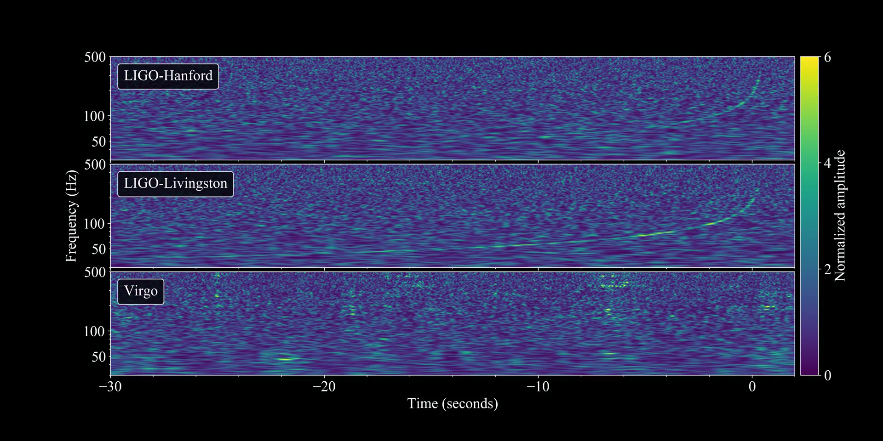
August 17, 2017, 5:41 am PDT
Credit: LSC-Virgo Collaboration

Slide 16

August 17, 2017, 5:41 am PDT
Credit: LSC-Virgo Collaboration

Slide 17
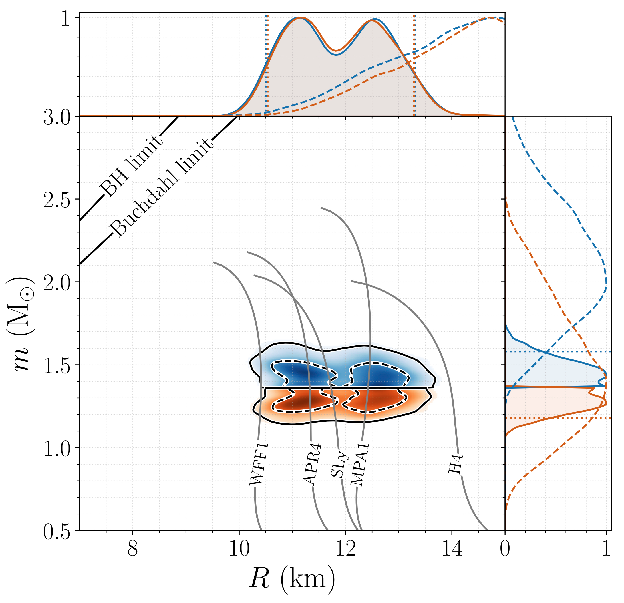
Equation of state measured in GWs
arXiv:1805.11581 [gr-qc]

Slide 18
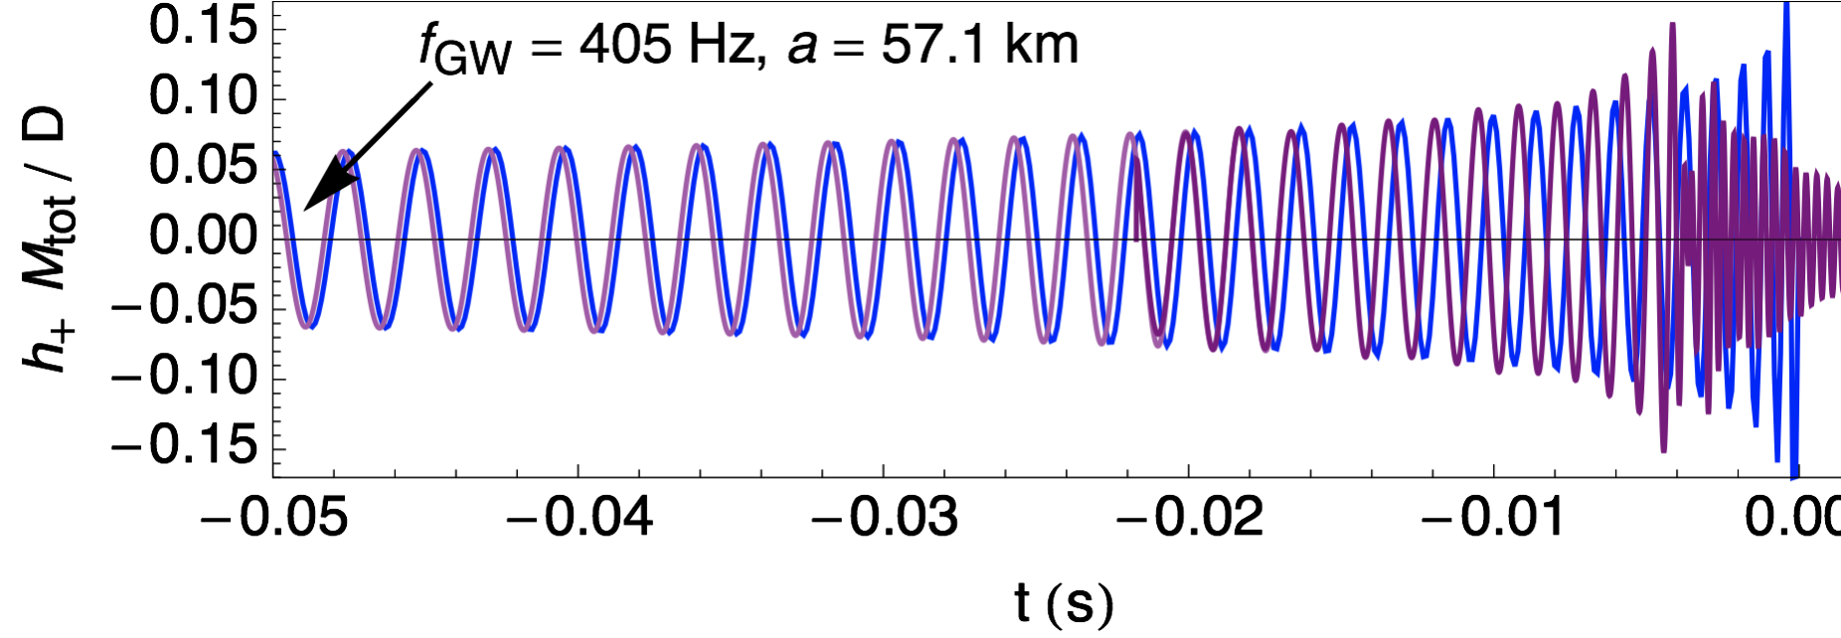
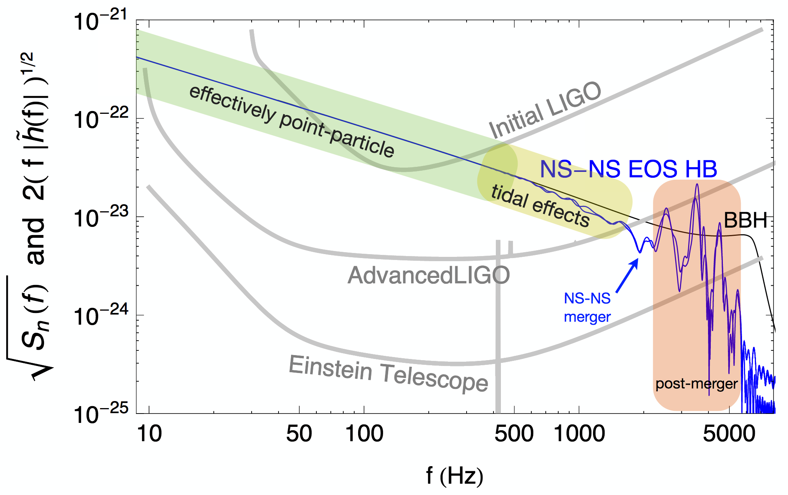
Tidal deformations impact GW waveform
J. Read LIGO-G1702037

Slide 19
Black holes
Understood early on from mathematics of GR
Completely described by 3 physical values:
  Mass, angular momentum, electric charge
At first, the idea seemed crazy: singularities?!
Does nature really create such objects?

Slide 20
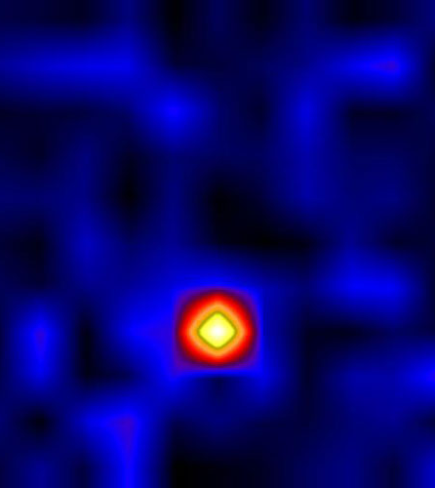
First evidence: Cygnus X-1
X-ray source discovered in 1964
Few years later found to be in a binary
Rapid x-ray variability (few times per second)
Implies small size (light crossing time)
Because
the object has to be a BH
Cyg X-1 was the subject of the infamous Hawking-Thorne bet; Hawking conceded the bet ☺

Slide 21
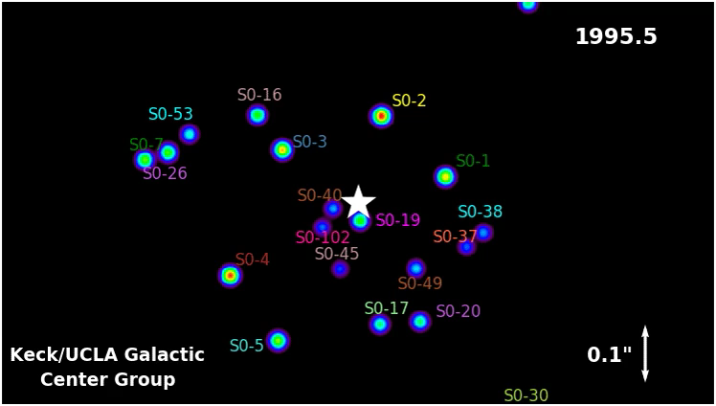
Supermassive black holes

Slide 22
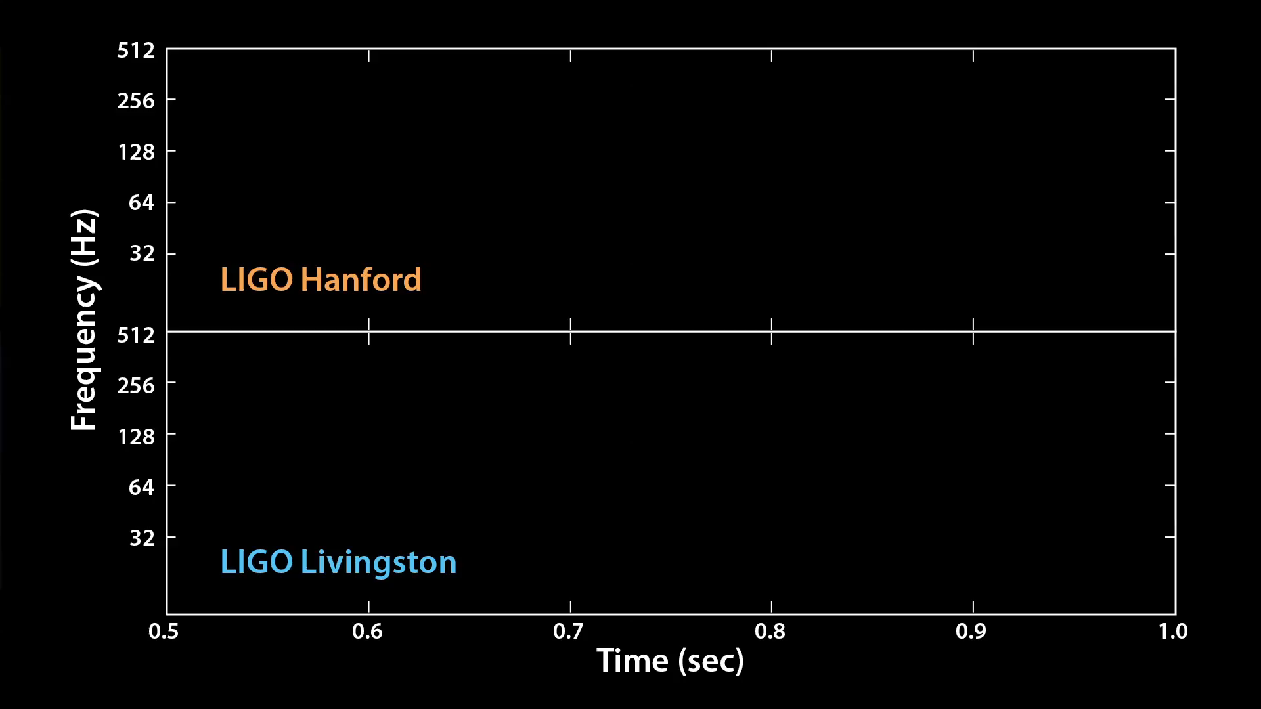
Direct evidence: GW150914

Slide 23
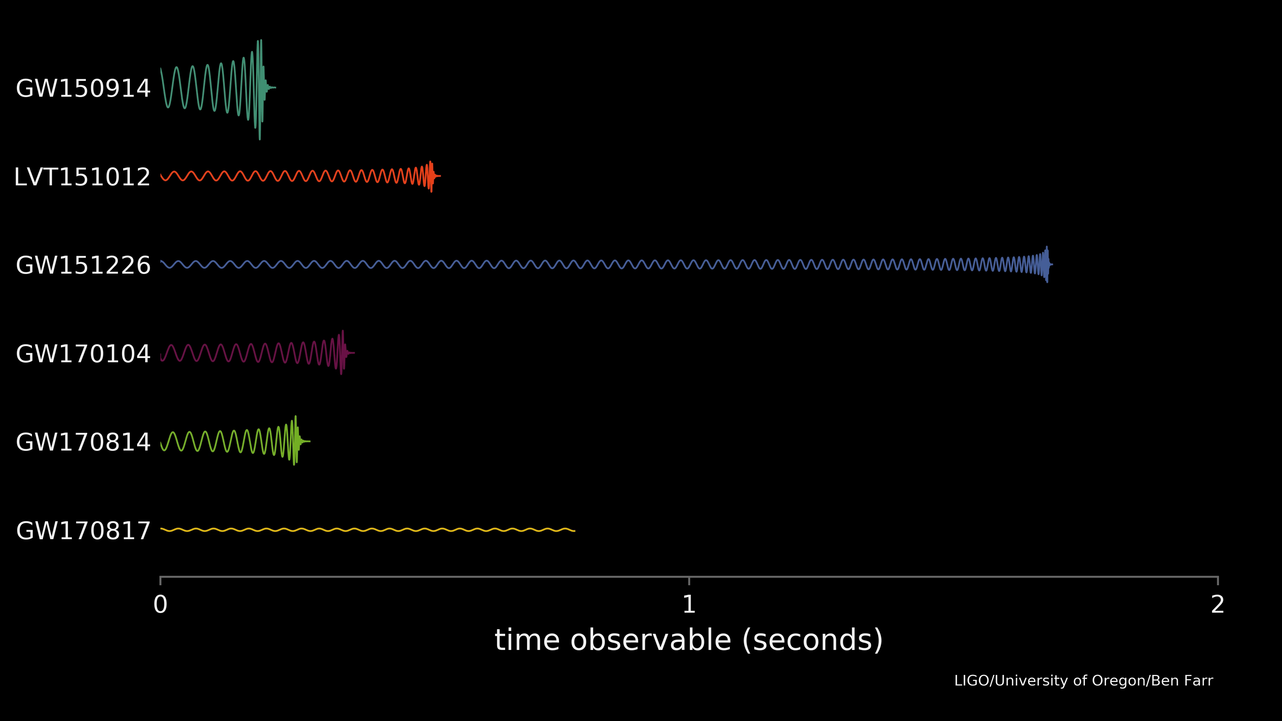
Colliding neutron stars and black holes

Slide 24
Compact binary coalescence GW waveform
Rich, detailed information carried in the inspiral, merger, and ringdown
Inspiral:
  Distance to source, spin of components, precession, masses, tidal distortion
Merger:
  Total mass, tidal distortion, progenitor of remnant
Ringdown:
  Final mass, remnant formation

Slide 25
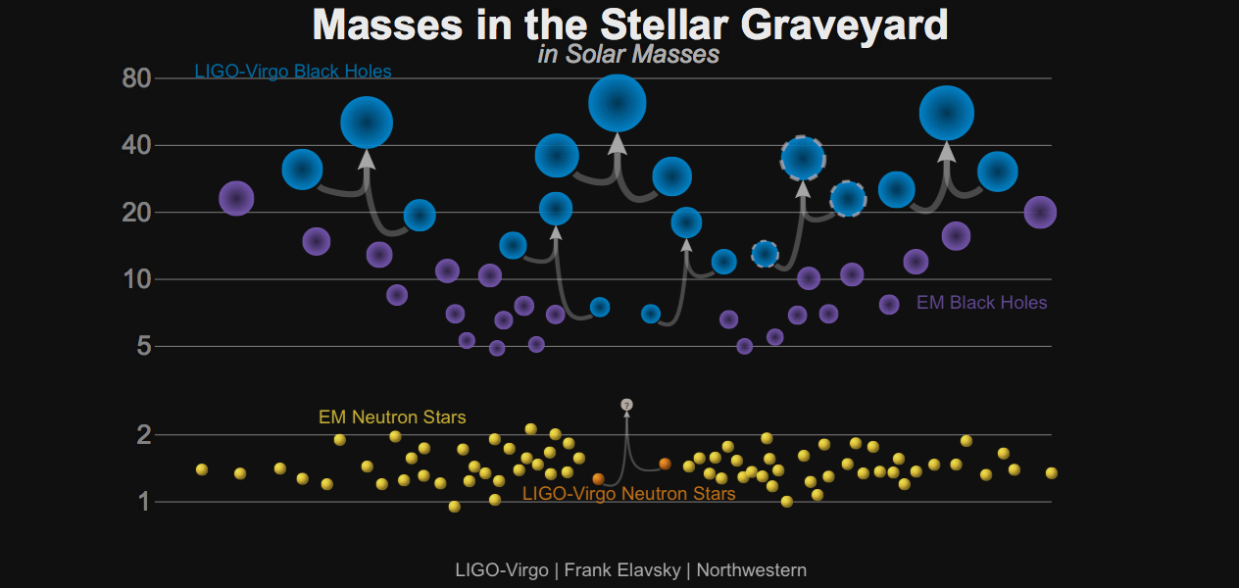
Stellar remnants and mergers

Slide 26
Open questions
Narrowing in on NS equation of state – more observations will help; continuous GWs?
Merging NSs can provide an alternative measurement of the Hubble constant; will it resolve the tension from current EM measurements?
How do supermassive BHs form? Are there intermediate mass BHs?
Can GWs help answer fundamental questions about the nature of BHs?

Slide 27
Other really cool things about GR
Physicists are using the accurate pulse arrival times of several pulsars to create a galactic-scale GW detector (Pulsar Timing Array)
Black holes obey the laws of thermodynamics and can “evaporate” (Hawking radiation)
When compact objects merge, a DC shift in gravitational potential may be observed (gravitational memory)

Slide 28
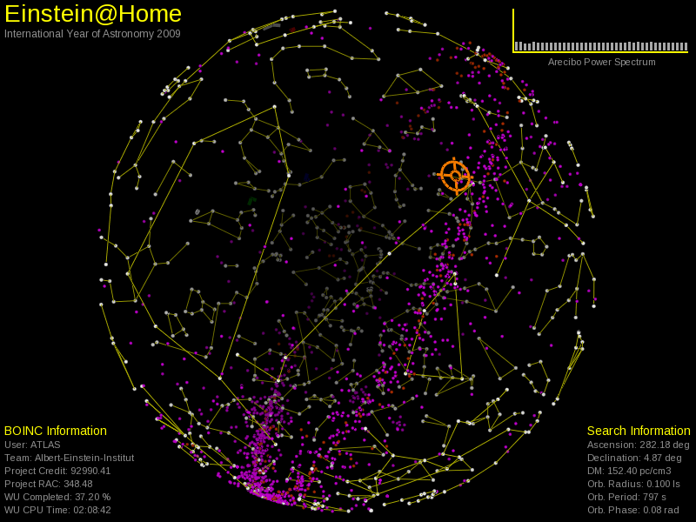
Volunteer computing: Einstein@home

Slide 29
Summary
Death of a massive star is not the end of scientific study
Neutron stars and black holes provide rich environment of studying extremes physics not achievable in the lab
GWs provide unique insight and complement EM observations
Era of multi-messenger astronomy is here and you can get involved!

Slide 30
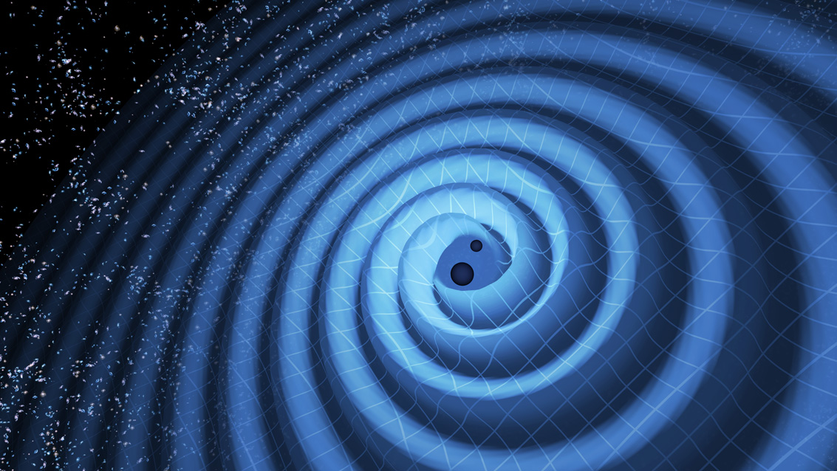
Thank you!

