Slide 1
Noise Subtraction in the gstlal Calibration Pipeline
Aaron Viets
LIGO DCC Document G1801495-v9

Slide 2
Outline
Calibration line subtraction
  Methods
  Results
Power mains line subtraction
  Methods
  Results
Broadband noise subtraction
  Methods
  Results

Slide 3
Calibration Line Subtraction
Option 1: Use the calibration model to compute lines in h(t) using injection channels.
    Provides a quick check of calibration accuracy relative to Pcal at those frequencies.
    Confirms that the calibration (the kappas) does not change on very short timescales.
  Negligible impact on latency
Option 2: Compute transfer functions between h(t) and appropriate witness channels.
  Does not rely on calibration accuracy, and can therefore be done effectively even when calibration models are not reliable.
  Negligible impact on latency

Slide 4
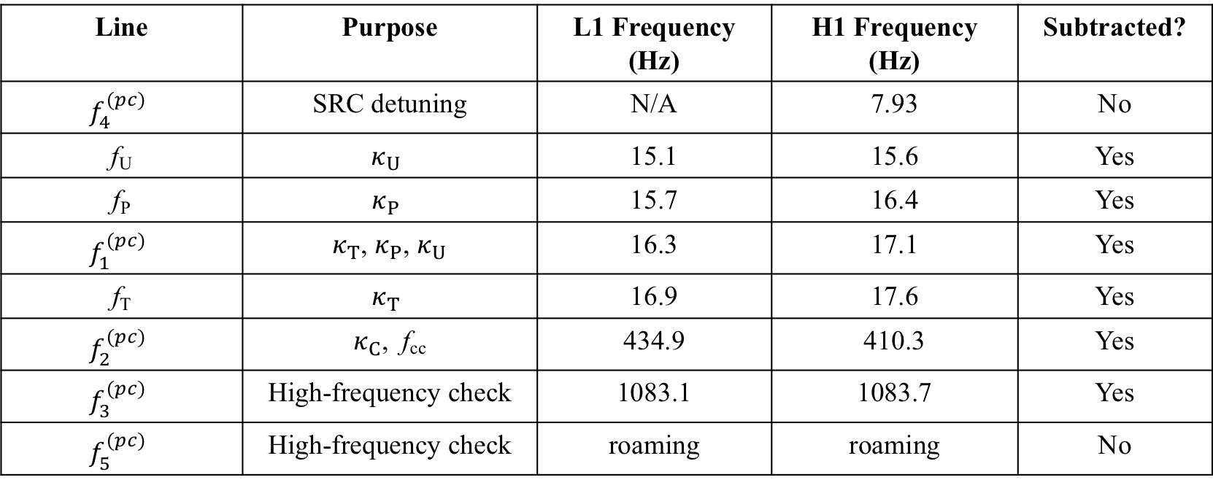
Calibration Line Frequencies
Line | Purpose | L1 Frequency (Hz) | H1 Frequency (Hz) | Subtracted?
$$f_{4}^{(pc)}$$ | SRC detuning | N/A | 7.93 | No
f_{U} | $$κ_{U}$$ | 15.1 | 15.6 | Yes
f_{P} | $$κ_{P}$$ | 15.7 | 16.4 | Yes
$$f_{1}^{(pc)}$$ | $κ_{T}$, $κ_{P}$, $κ_{U}$ | 16.3 | 17.1 | Yes
f_{T} | $$κ_{T}$$ | 16.9 | 17.6 | Yes
$$f_{2}^{(pc)}$$ | $κ_{C}$, f_{cc} | 434.9 | 410.3 | Yes
$$f_{3}^{(pc)}$$ | High-frequency check | 1083.1 | 1083.7 | Yes
$$f_{5}^{(pc)}$$ | High-frequency check | roaming | roaming | No

Slide 5
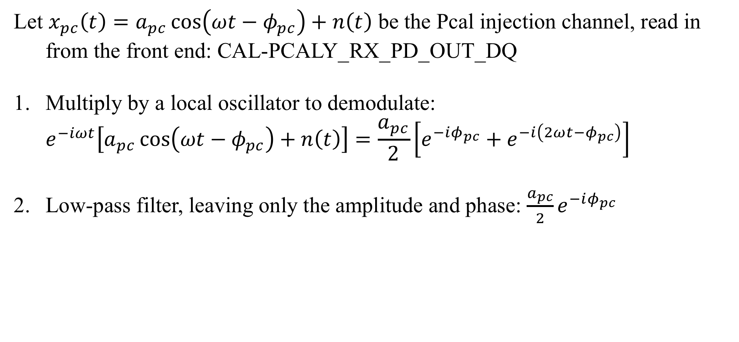
CAL Line Subtraction Option A – Pcal Lines
Let $x_{pc}\left(t\right)=a_{pc}\cos\left(ωt−φ_{pc}\right)+n\left(t\right)$ be the Pcal injection channel, read in from the front end: CAL-PCALY_RX_PD_OUT_DQ
Multiply by a local oscillator to demodulate:
$e^{−iωt}\left[a_{pc}\cos\left(ωt−φ_{pc}\right)+n\left(t\right)\right]=\frac{a_{pc}}{2}\left[e^{−iφ_{pc}}+e^{−i\left(2ωt−φ_{pc}\right)}\right]+n(t)e^{−iωt}$
Low-pass filter, leaving only the amplitude and phase: $\frac{a_{pc}}{2}e^{−iφ_{pc}}$

Slide 6
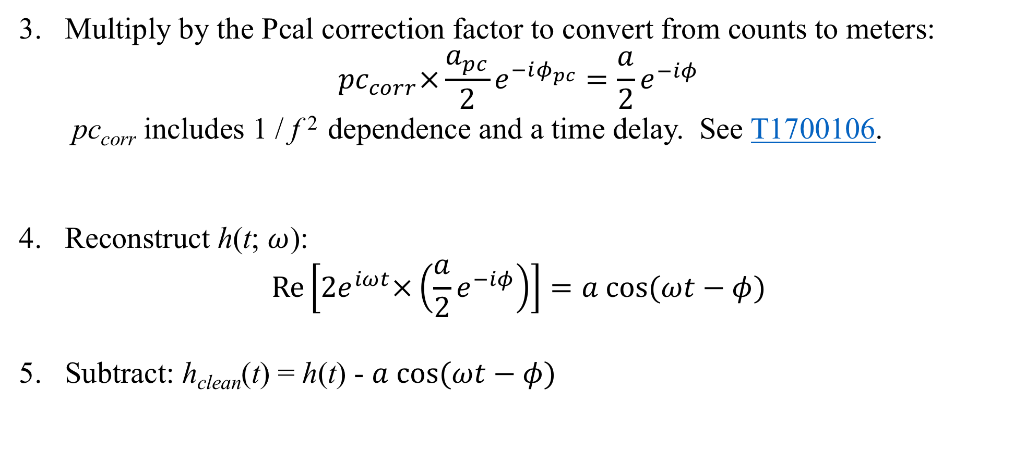
CAL Line Subtraction Option A – Pcal Lines
3. Multiply by the Pcal correction factor to convert from counts to meters:
$${pc}_{corr}×\frac{a_{pc}}{2}e^{−iφ_{pc}}=\frac{a}{2}e^{−iφ}$$
pc_{corr} includes 1 / f ² dependence and a time delay. See T1700106.
4. Reconstruct h(t; $ω$):
$$Re\left[2e^{iωt}×\left(\frac{a}{2}e^{−iφ}\right)\right]=a cos⁡(ωt−φ)$$
5. Subtract: h_{clean}(t) = h(t) - $a cos⁡(ωt−φ)$

Slide 7
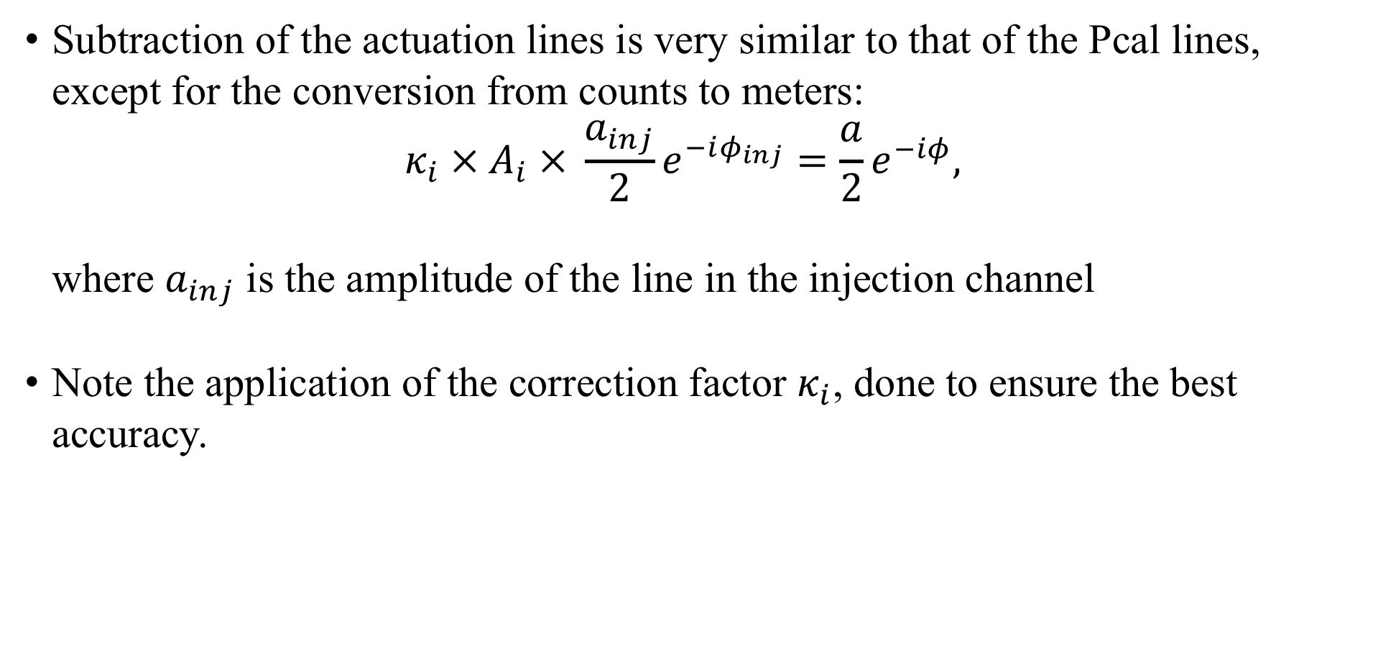
CAL Lines Option A – Actuation Lines
Subtraction of the actuation lines is very similar to that of the Pcal lines, except for the conversion from counts to meters:
${κ_{i} × A}_{i} × \frac{a_{inj}}{2}e^{−iφ_{inj}}=\frac{a}{2}e^{−iφ},$
where $a_{inj}$ is the amplitude of the line in the injection channel
Note the application of the correction factor $κ_{i}$, done to ensure the best accuracy.

Slide 8
General Line Subtraction (CAL Lines B)
Witness and EPICS channels:
Channel Name | Purpose | Current L1 Value | Current H1 Value
CAL-PCALY_RX_PD_OUT_DQ | Subtract Pcal lines | N/A | N/A
SUS-ETMX_L3_CAL_LINE_OUT_DQ | Subtract TST/L3/ESD line | N/A | N/A
CAL-CS_TDEP_SUS_LINE3_REF_A_ TST_NOLOCK_ [REAL / IMAG] | Subtract TST/L3/ESD line | -1.11638141e-15 - 2.69608368e-16 i | 5.31342527e-17 + 2.31051358e-16 i
SUS-ETMX_L2_CAL_LINE_OUT_DQ | Subtract PUM/L2 line | N/A | N/A
CAL-CS_TDEP_SUS_LINE2_REF_A_ PUM_NOLOCK_ [REAL / IMAG] | Subtract PUM/L2 line | 2.04484822e-15 + 2.18105139e-16 i | -1.79675665e-18 + 9.40864182e-19 i
SUS-ETMX_L1_CAL_LINE_OUT_DQ | Subtract UIM/L1 line | N/A | N/A
CAL-CS_TDEP_SUS_LINE1_REF_A_ UIM_NOLOCK_ [REAL / IMAG] | Subtract UIM/L1 line | 4.78670848e-18 + 1.0887087e-18 i | 3.89767406e-18 + 9.09782576e-19 i
PEM-EY_MAINSMON_EBAY_1_DQ | Subtract Power Mains lines | N/A | N/A

Slide 9
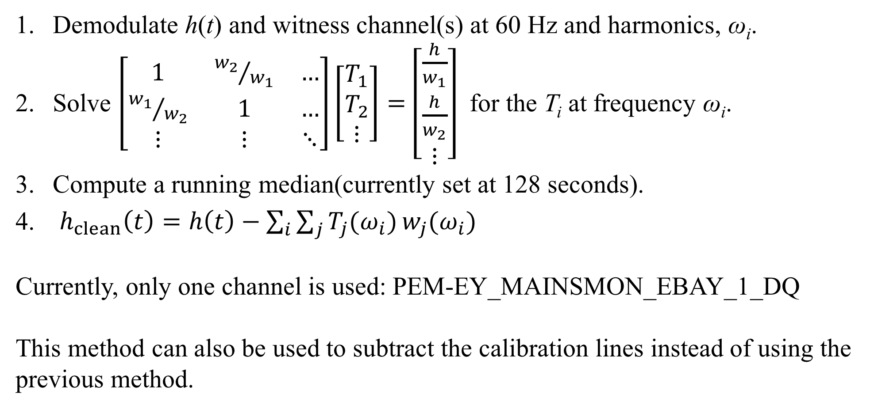
General Line Subtraction (CAL Lines B)
Demodulate h(t) and witness channel(s) at 60 Hz and harmonics, ω_{i}.
Solve $\left[\begin{matrix}1 & {w_{2}}/{w_{1}} & … \\ {w_{1}}/{w_{2}} & 1 & … \\ ⋮ & ⋮ & ⋱\end{matrix}\right]\left[\begin{matrix}T_{1} \\ T_{2} \\ ⋮\end{matrix}\right]=\left[\begin{matrix}\frac{h}{w_{1}} \\ \frac{h}{w_{2}} \\ ⋮\end{matrix}\right]$ for the T_{i} at frequency ω_{i}.
Compute a running median(currently set at 128 seconds).
$h_{clean}\left(t\right)=h\left(t\right)−\sum_{i}{\sum_{j}{T_{j}(ω_{i})}w_{j}(ω_{i})}$
Currently, only one channel is used: PEM-EY_MAINSMON_EBAY_1_DQ
This method can also be used to subtract the calibration lines instead of using the previous method.

Slide 10
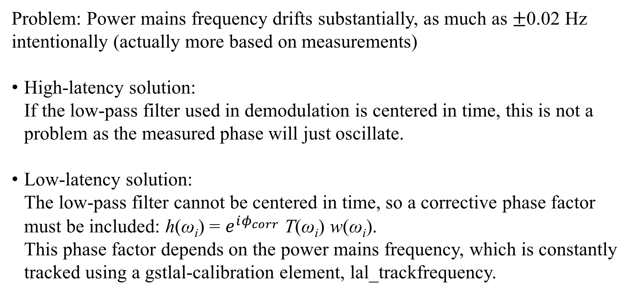
Power Mains Line Subtraction
Problem: Power mains frequency drifts substantially, as much as $±$0.02 Hz
intentionally (actually more based on measurements)
High-latency solution:
If the low-pass filter used in demodulation is centered in time, this is not a problem as the measured phase will just oscillate.
Low-latency solution:
The low-pass filter cannot be centered in time, so a corrective phase factor must be included: h(ω_{i}) = $e^{iφ_{corr}}$ T(ω_{i}) w(ω_{i}).
This phase factor depends on the power mains frequency, which is constantly tracked using a gstlal-calibration element, lal_trackfrequency.

Slide 11
Calibration Line Subtraction Results
H1
L1
(Mistake with line-frequency update last week!)

Slide 12
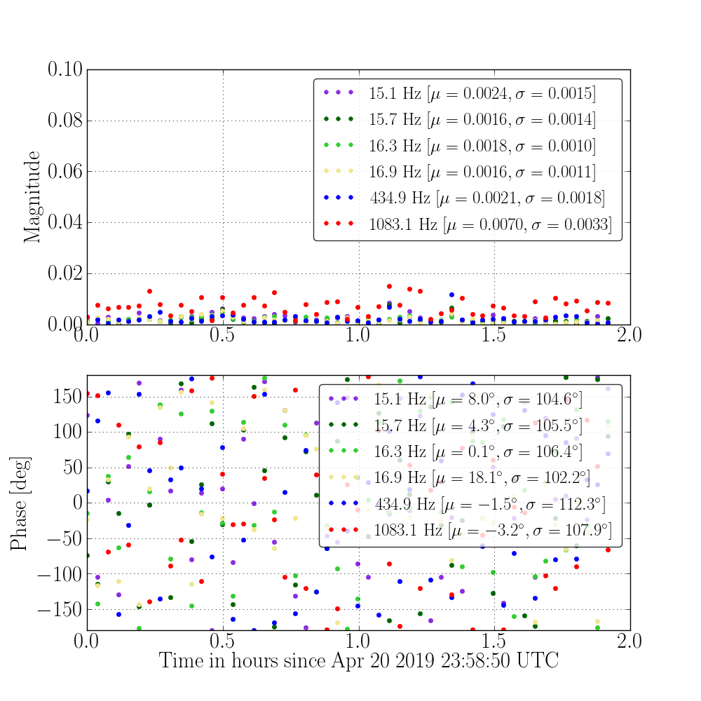
Calibration Line
Subtraction Results
(L1)
Transfer functions of
h_{clean}(t) / h(t) are shown
at each calibration line
frequency for 2 hours.

Slide 13
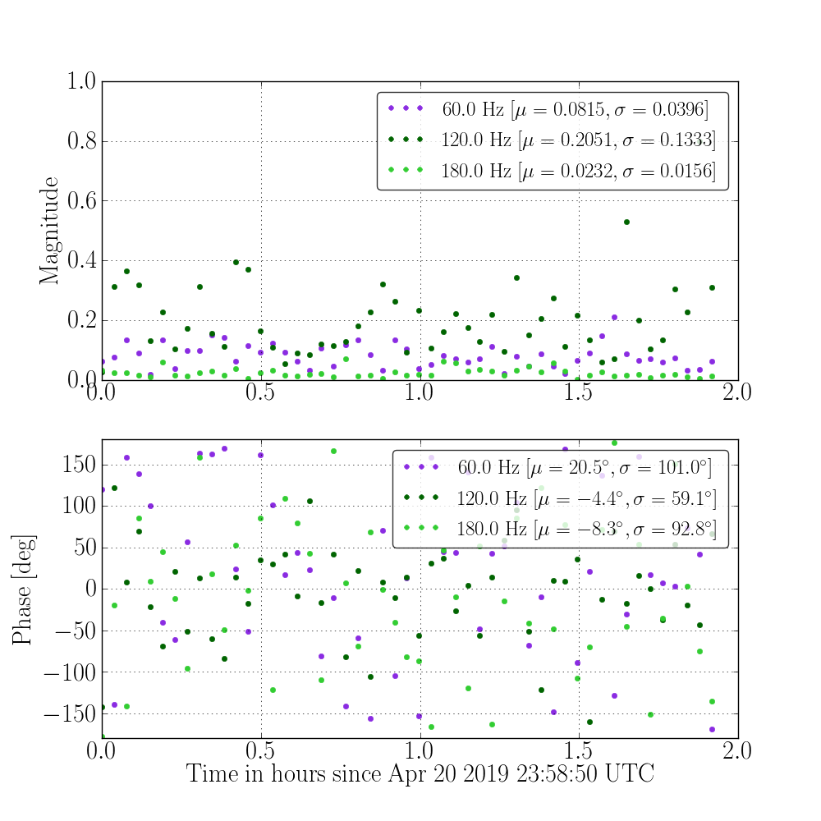
Low-latency Power
Mains Subtraction
Results (L1)
60-Hz line has the highest SNR,
so removing it has the most
impact.

Slide 14
Line Subtraction – Alternative Method
Why not just compute a transfer function between witnesses (e.g. Pcal) and h(t) and apply a filter at all frequencies?
Computational cost – Filtering is expensive, and the calibration lines are already demodulated to compute the kappas.
This method can only affect h(t) at selected frequencies, reducing the risk of side-band noise.
It may take longer to average over noise in transfer functions computed at all frequencies. Since line subtraction is done before broadband noise subtraction, this allows those transfer function to be computed with less delay.

Slide 15
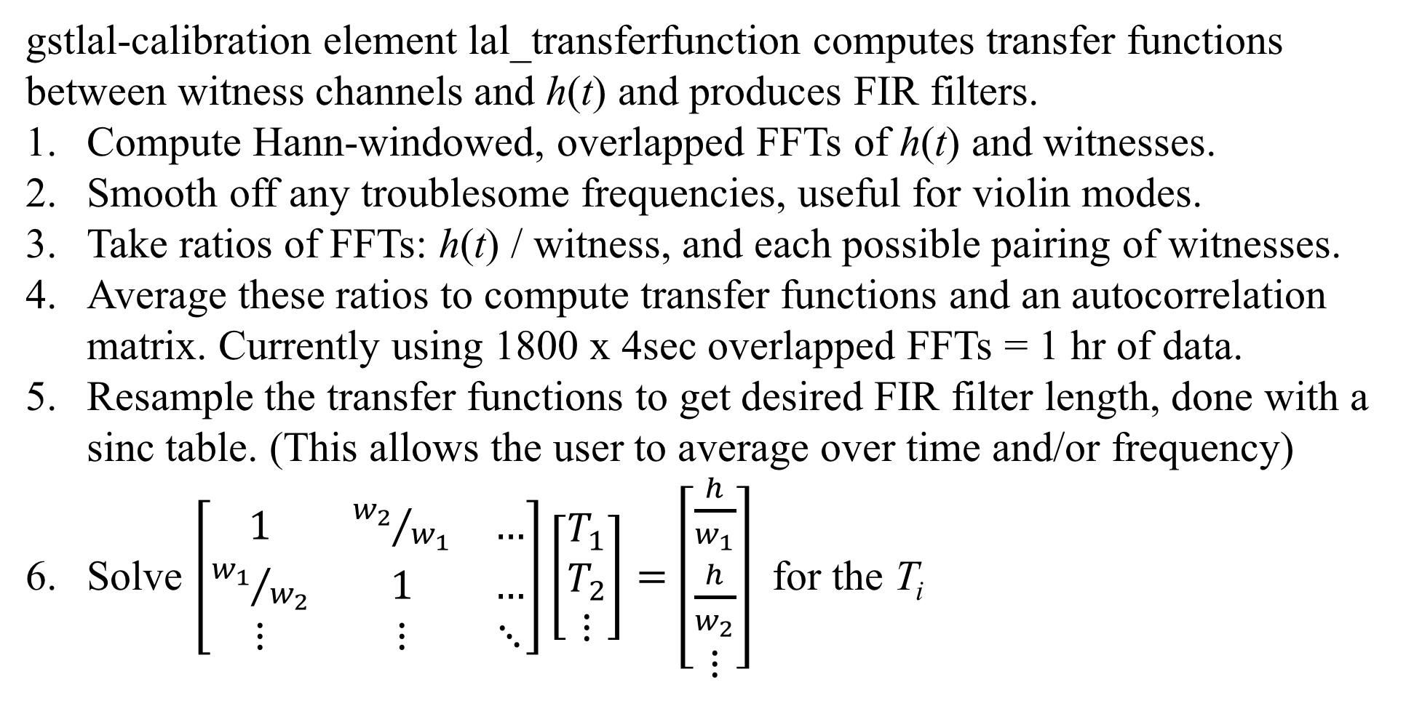
Broadband Noise Subtraction
gstlal-calibration element lal_transferfunction computes transfer functions between witness channels and h(t) and produces FIR filters.
Compute Hann-windowed, overlapped FFTs of h(t) and witnesses.
Smooth off any troublesome frequencies, useful for violin modes.
Take ratios of FFTs: h(t) / witness, and each possible pairing of witnesses.
Average these ratios to compute transfer functions and an autocorrelation matrix. Currently using 1800 x 4sec overlapped FFTs = 1 hr of data.
Resample the transfer functions to get desired FIR filter length, done with a sinc table. (This allows the user to average over time and/or frequency)
Solve $\left[\begin{matrix}1 & {w_{2}}/{w_{1}} & … \\ {w_{1}}/{w_{2}} & 1 & … \\ ⋮ & ⋮ & ⋱\end{matrix}\right]\left[\begin{matrix}T_{1} \\ T_{2} \\ ⋮\end{matrix}\right]=\left[\begin{matrix}\frac{h}{w_{1}} \\ \frac{h}{w_{2}} \\ ⋮\end{matrix}\right]$ for the T_{i}

Slide 16
Broadband Noise Subtraction
Multiply T_{i} by any high- or low-pass filters (currently a high-pass at 10 Hz).
Take an iFFT to make a FIR filter.
Smooth off the edges with a Tukey window.
Send new filter to lal_tdwhiten to apply to witness.
Subtract from h(t)
Repeat steps 1-11 with any additional sets of witnesses that should be handled separately. (Note: witness channels can be handled in parallel or in series.)

Slide 17
Broadband Noise Subtraction
Low-latency:
  Gated with GRD-ISC_LOCK_OK
  Updates transfer functions and FIR filters every 1000 seconds (config-file option) and at the start of every lock stretch.
  There will be 300 seconds (or our choice of FFT time) of data at the start of the first lock stretch after restarting the pipeline that will not be cleaned.
  Testing indicates that this has negligible impact on latency (perhaps ~ 0.1 s).
High-latency:
  Gated with GRD-ISC_LOCK_OK
  Updates transfer functions and FIR filters every 4096s (config-file option).
  In order to clean as much data as possible, wait for transfer functions to be ready before producing frames.
  To make output independent of start time, the data being subtracted from is the same data used to compute transfer function. This cannot be done in low latency.

Slide 18
Spectrum Comparison
8192s of data is from around GW170817. TFs computed with 4096s of data and updated once every 4096s.

Slide 19
BNS Range
8192s of data from
around GW170817.
TFs computed with
4096s of data and
updated once every
4096s.

Slide 20
Noise Subtraction Transfer Function
Averaged over ~22
hours of data
Transfer functions
update every 4096s.
Phase difference is mostly
consistent with zero,
indicating updates are
frequent enough.
Updating every 10 hours
resulted in significant
deviation from zero.

Slide 21
Noise Subtraction with Calibration Lines
Same 20-hr dataset was used
here, without calibration line
subtraction.
Purpose is to see impact,
if any, on calibration
accuracy.
Noise subtraction still works
with calibration lines. Line
frequencies were smoothed
over in the transfer functions.

Slide 22
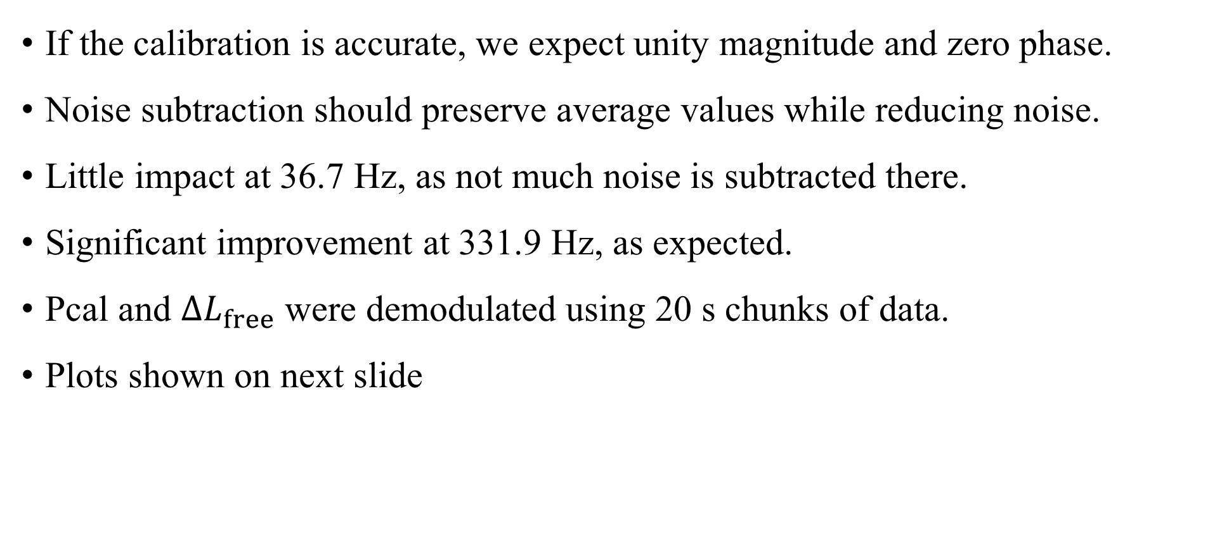
Pcal-to-DARM ratio comparison
If the calibration is accurate, we expect unity magnitude and zero phase.
Noise subtraction should preserve average values while reducing noise.
Little impact at 36.7 Hz, as not much noise is subtracted there.
Significant improvement at 331.9 Hz, as expected.
Pcal and $∆L_{free}$ were demodulated using 20 s chunks of data.
Plots shown on next slide

Slide 23
Pcal-to-DARM ratio comparison

Slide 24
Effect on Latency
Latency was computed by measuring the difference in real time between when data enters and leaves the gstlal calibration pipeline. 1-second frames were used for this test.
Six cleaning
filter updates
occurred during
the time plotted.

Slide 25
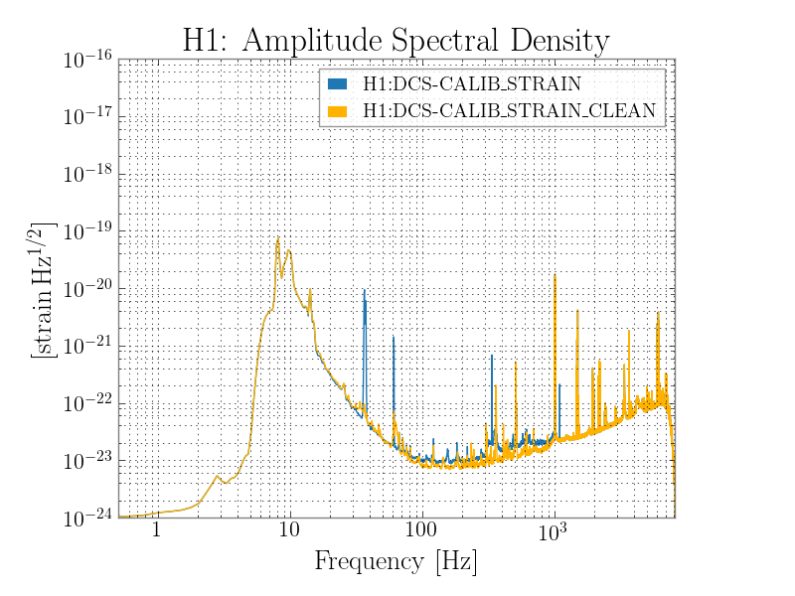
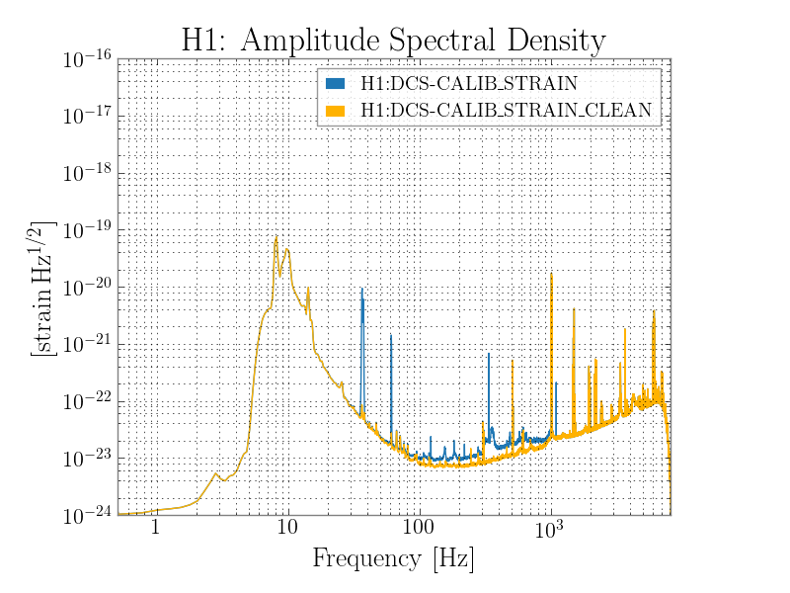
What about glitches?
A loud glitch could corrupt transfer functions. Taking a median instead of a mean minimizes the effect of large outliers. A loud glitch in H1 data on 2017-08-23 was used for this comparison, where transfer functions were computed from ~13 minutes of data.
Mean Median

Slide 26
New CALIB_STATE_VECTOR Bits
26: LINE_SUBTRACTION_OK
- Bandpass h(t) and cleaned h(t) in a chosen frequency band, and compute the
RMS. If RMS[clean h(t)] < RMS[h(t)] in that band, bit is on, else off.
- Main purpose is to check calibration line subtraction.
27: NOISE_SUBTRACTION_OK
- Bandpass h(t) and cleaned h(t) in a chosen frequency band, and compute the
RMS. If RMS[clean h(t)] < RMS[h(t)] in that band, bit is on, else off.
- Main purpose is to check noise subtraction in most effective band.
28: NOISE_SUBTRACTION_GATE
- Checks if the calculation of transfer functions is being gated

Slide 27
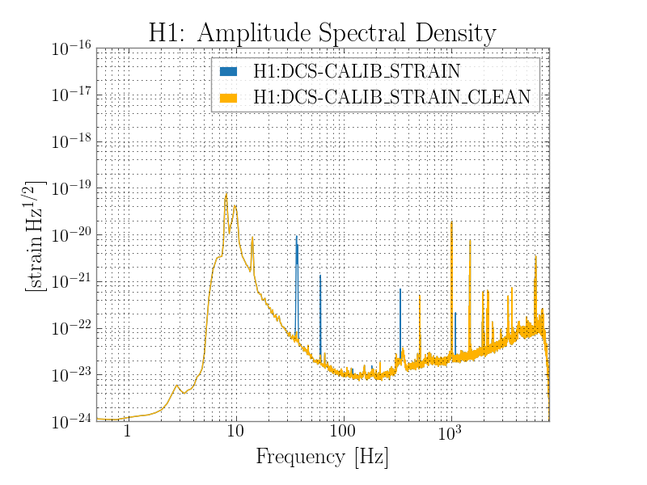
What about filter transitions?
Filters are tapered in using
half of a Hann window over
10 seconds of transition
time.
The plot on the right shows
an ASD comparison using
100s of data starting before
filters are computed. Each
plot in the next slides is
shifted 10s later until the
transition is over.

Slide 28

What about filter transitions?
Filters are tapered in using
half of a Hann window over
10 seconds of transition
time.
The plot on the right shows
an ASD comparison using
100s of data starting before
filters are computed. Each
plot in the next slides is
shifted 10s later until the
transition is over.

Slide 29

What about filter transitions?
Filters are tapered in using
half of a Hann window over
10 seconds of transition
time.
The plot on the right shows
an ASD comparison using
100s of data starting before
filters are computed. Each
plot in the next slides is
shifted 10s later until the
transition is over.

Slide 30
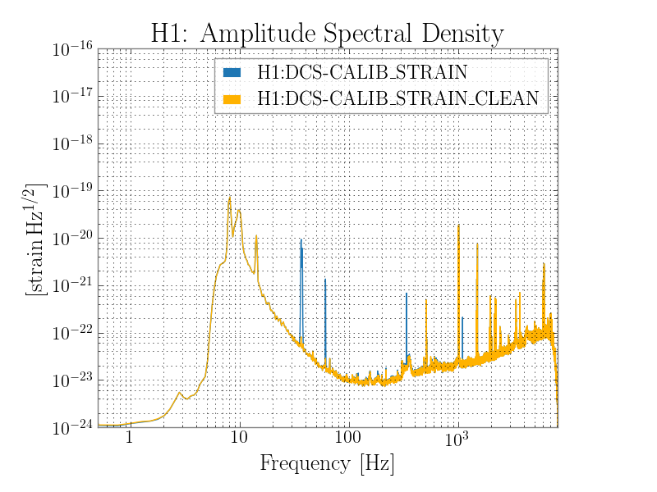
What about filter transitions?
Filters are tapered in using
half of a Hann window over
10 seconds of transition
time.
The plot on the right shows
an ASD comparison using
100s of data starting before
filters are computed. Each
plot in the next slides is
shifted 10s later until the
transition is over.

Slide 31

What about filter transitions?
Filters are tapered in using
half of a Hann window over
10 seconds of transition
time.
The plot on the right shows
an ASD comparison using
100s of data starting before
filters are computed. Each
plot in the next slides is
shifted 10s later until the
transition is over.

Slide 32

What about filter transitions?
Filters are tapered in using
half of a Hann window over
10 seconds of transition
time.
The plot on the right shows
an ASD comparison using
100s of data starting before
filters are computed. Each
plot in the next slides is
shifted 10s later until the
transition is over.

Slide 33

What about filter transitions?
Filters are tapered in using
half of a Hann window over
10 seconds of transition
time.
The plot on the right shows
an ASD comparison using
100s of data starting before
filters are computed. Each
plot in the next slides is
shifted 10s later until the
transition is over.

Slide 34
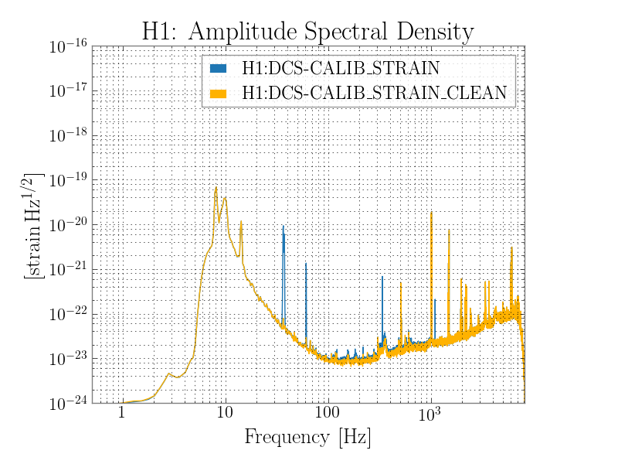
What about filter transitions?
Filters are tapered in using
half of a Hann window over
10 seconds of transition
time.
The plot on the right shows
an ASD comparison using
100s of data starting before
filters are computed. Each
plot in the next slides is
shifted 10s later until the
transition is over.

Slide 35

What about filter transitions?
Filters are tapered in using
half of a Hann window over
10 seconds of transition
time.
The plot on the right shows
an ASD comparison using
100s of data starting before
filters are computed. Each
plot in the next slides is
shifted 10s later until the
transition is over.

Slide 36

What about filter transitions?
Filters are tapered in using
half of a Hann window over
10 seconds of transition
time.
The plot on the right shows
an ASD comparison using
100s of data starting before
filters are computed. Each
plot in the next slides is
shifted 10s later until the
transition is over.

Slide 37
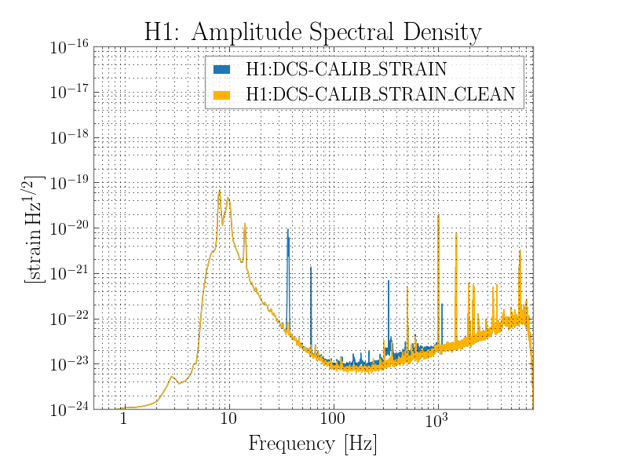
What about filter transitions?
Filters are tapered in using
half of a Hann window over
10 seconds of transition
time.
The plot on the right shows
an ASD comparison using
100s of data starting before
filters are computed. Each
plot in the next slides is
shifted 10s later until the
transition is over.

Slide 38
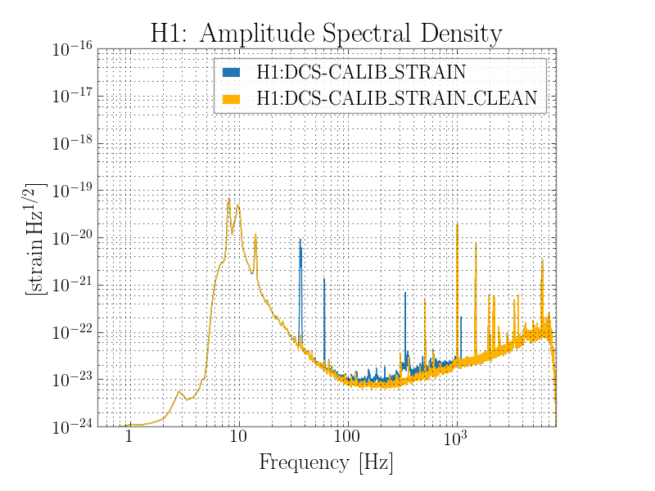
What about filter transitions?
Filters are tapered in using
half of a Hann window over
10 seconds of transition
time.
The plot on the right shows
an ASD comparison using
100s of data starting before
filters are computed. Each
plot in the next slides is
shifted 10s later until the
transition is over.

Slide 39

What about filter transitions?
Filters are tapered in using
half of a Hann window over
10 seconds of transition
time.
The plot on the right shows
an ASD comparison using
100s of data starting before
filters are computed. Each
plot in the next slides is
shifted 10s later until the
transition is over.

Slide 40

What about filter transitions?
Filters are tapered in using
half of a Hann window over
10 seconds of transition
time.
The plot on the right shows
an ASD comparison using
100s of data starting before
filters are computed. Each
plot in the next slides is
shifted 10s later until the
transition is over.

Slide 41
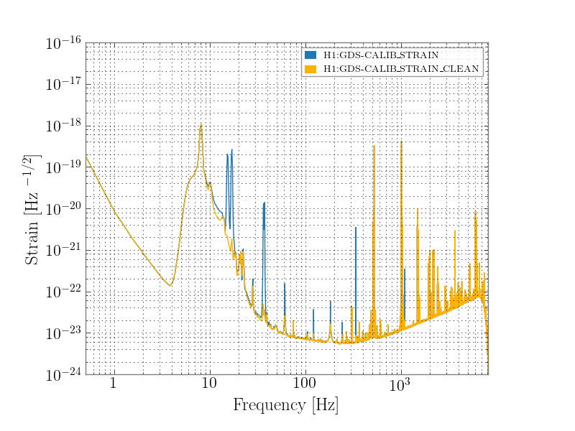
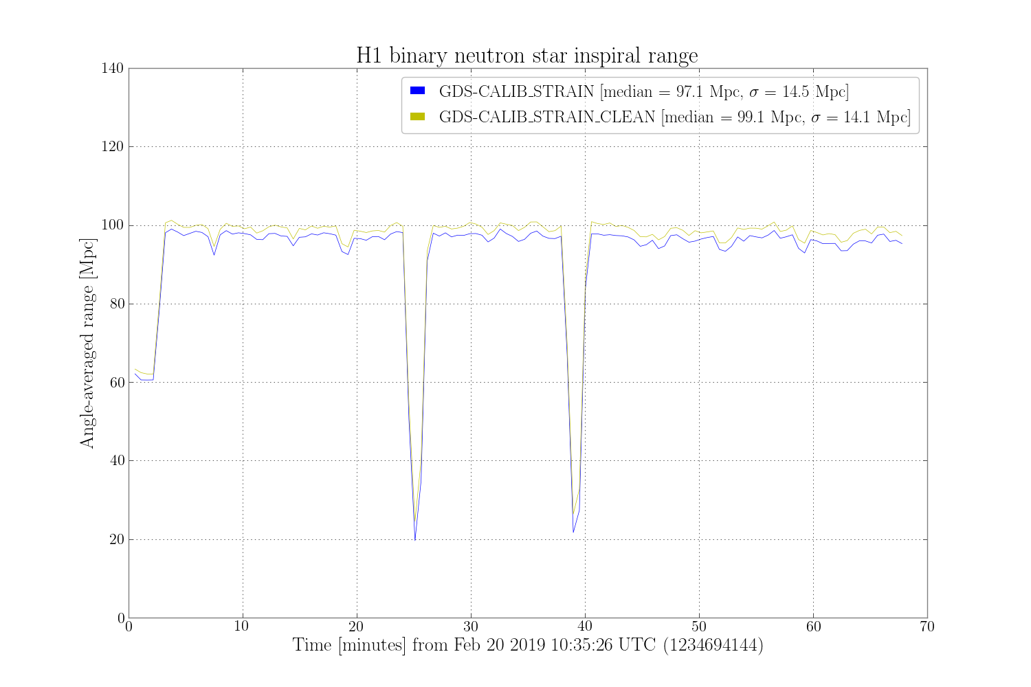
So far in ER13/ER14…
Smaller impact, 6.3% increase in detectable volume in this instance.
Spectrum comparisons coming soon on calibration testing tab of summary pages.

Slide 42
References
J. C. Driggers et al. “Improving astrophysical parameter estimation via offline noise subtraction for Advanced LIGO.” arxiv: 1806.00532 (2018).
D. Davis et al. “Improving the Sensitivity of Advanced LIGO Using Noise Subtraction.” arxiv: 1809:05348 (2018).
L. Tsukada et al. “Application of a zero-latency whitening filter to compact binary coalescence gravitational-wave searches.” Phys. Rev. D 97, 103009 (2018).

