Slide 1
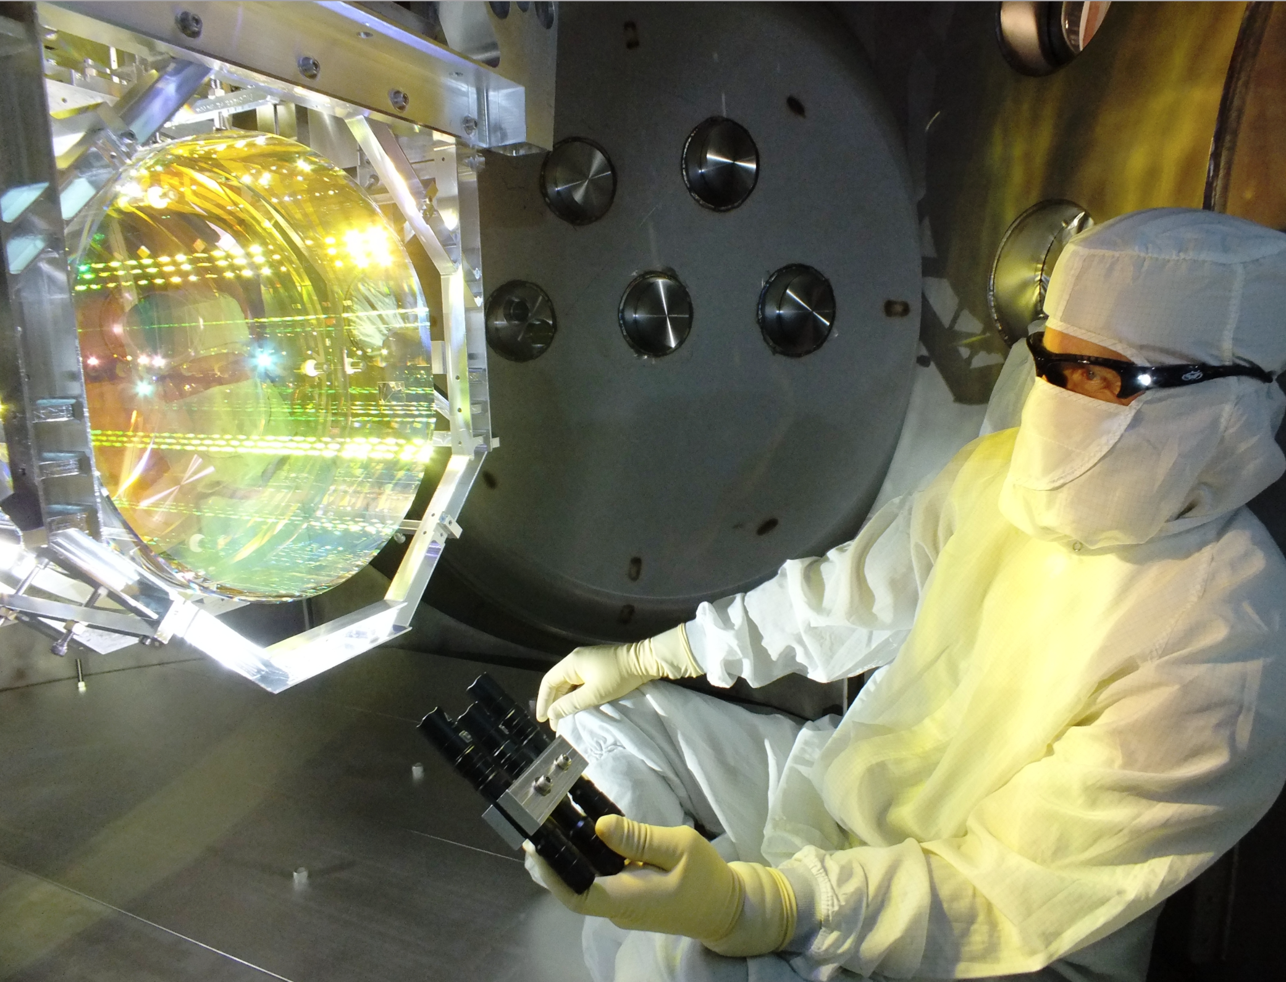
Optical Challenges in LIGO:
Past and Future
Stan Whitcomb
CREOL IA Symposium
15 March 2019
LIGO-G1900303-v1

Slide 2
This story begins 1.3 Billion years ago,
in a distant galaxy…

Slide 3
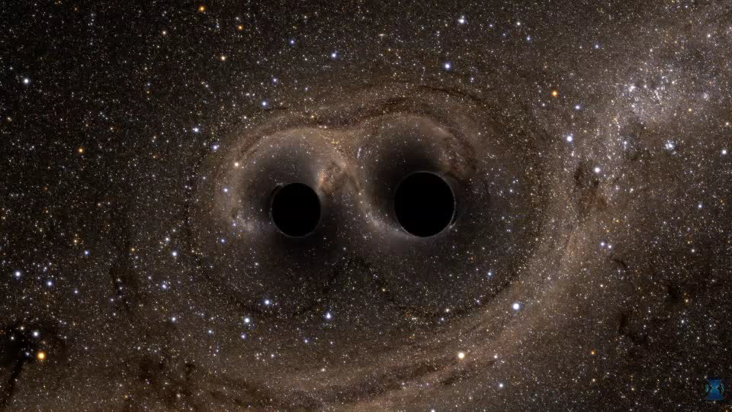
Two Black Holes
in Close Orbit
Black Hole #1
36X more massive than the Sun
210 km in diameter
Black Hole #2
29X more massive than the Sun
170 km in diameter

Slide 4
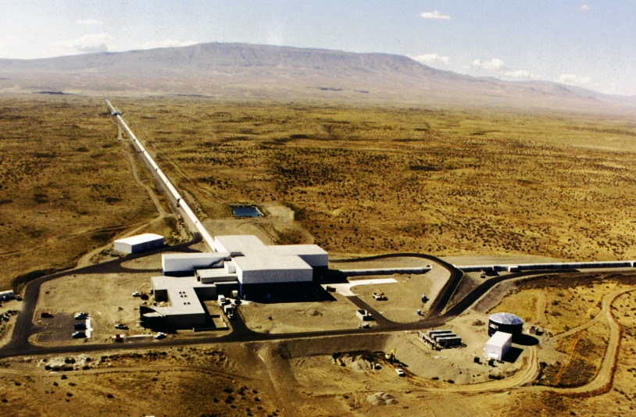
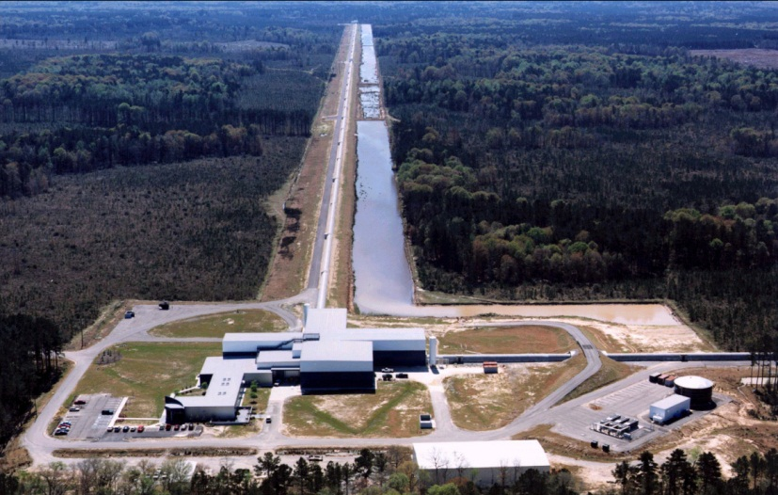
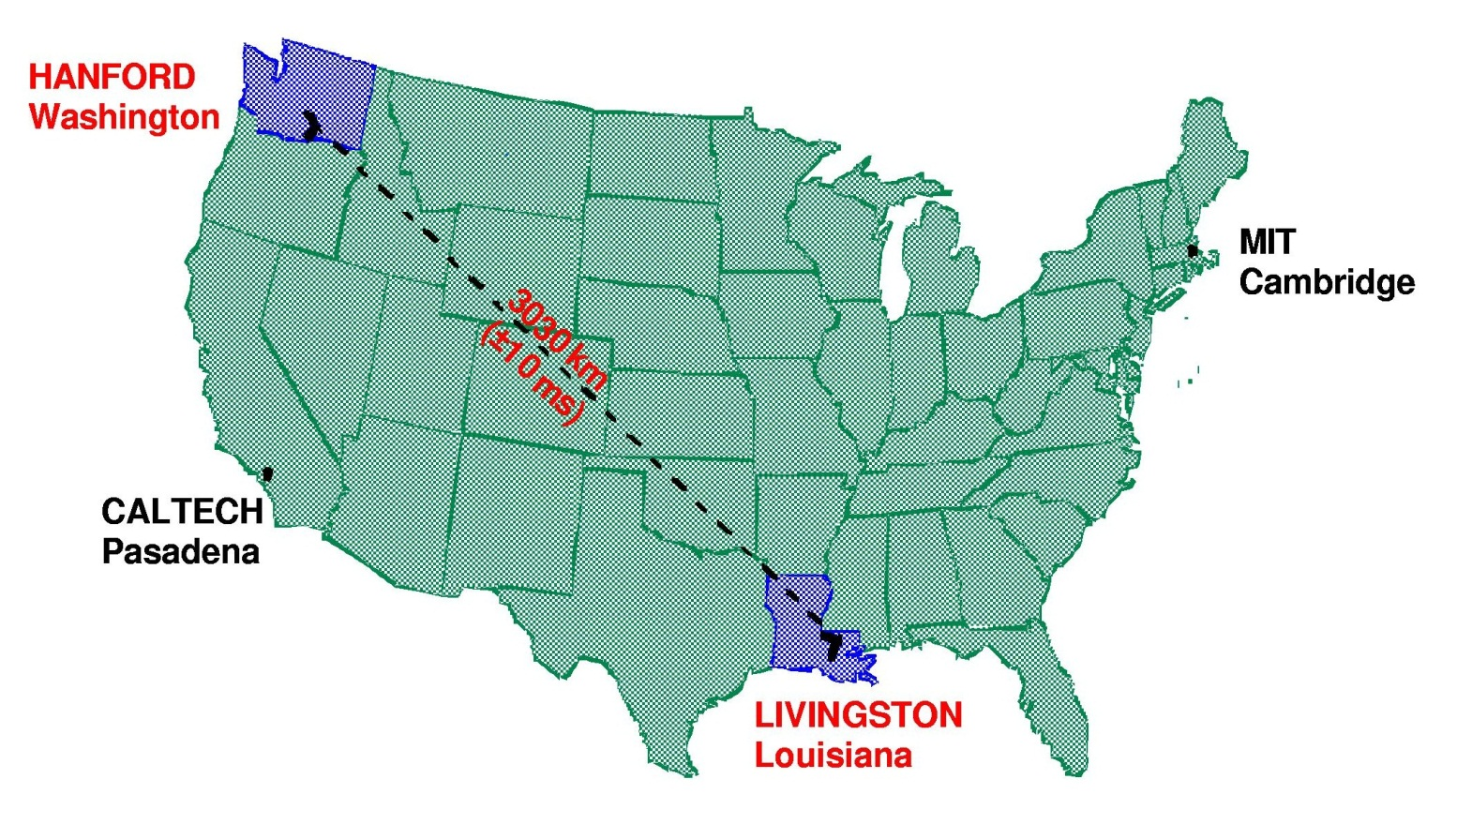

Then on 14 September 2015, at the LIGO sites…

Slide 5
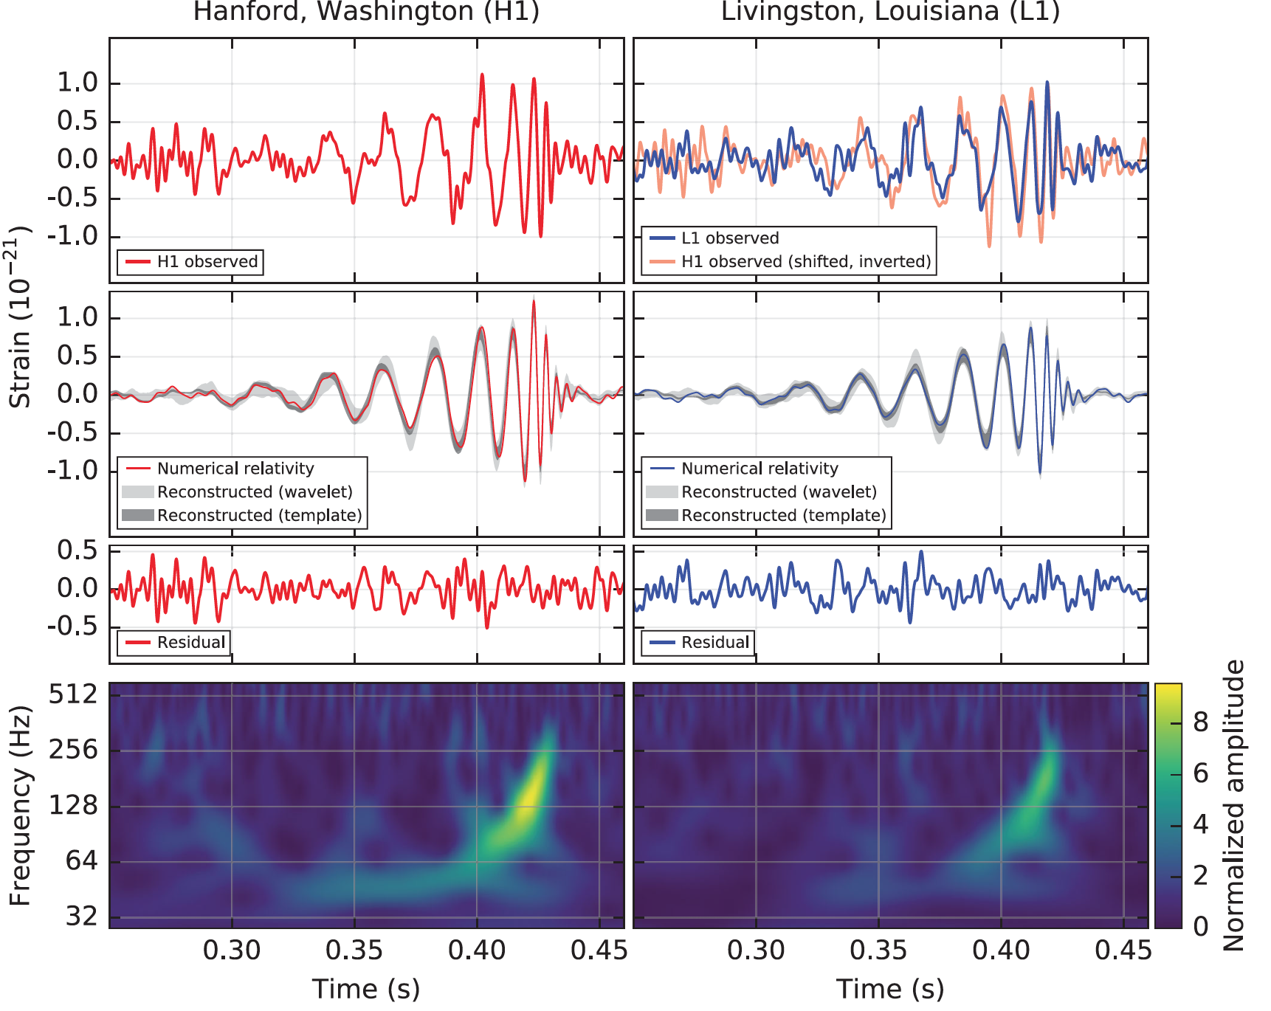
B. P. Abbott et al. (LIGO Scientific Collaboration and Virgo Collaboration), Observation of Gravitational Waves from a Binary Black Hole Merger, Phys. Rev. Lett. 116, 061102 (2016)

Slide 6
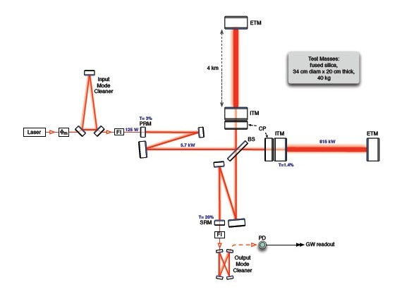
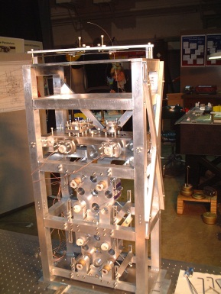
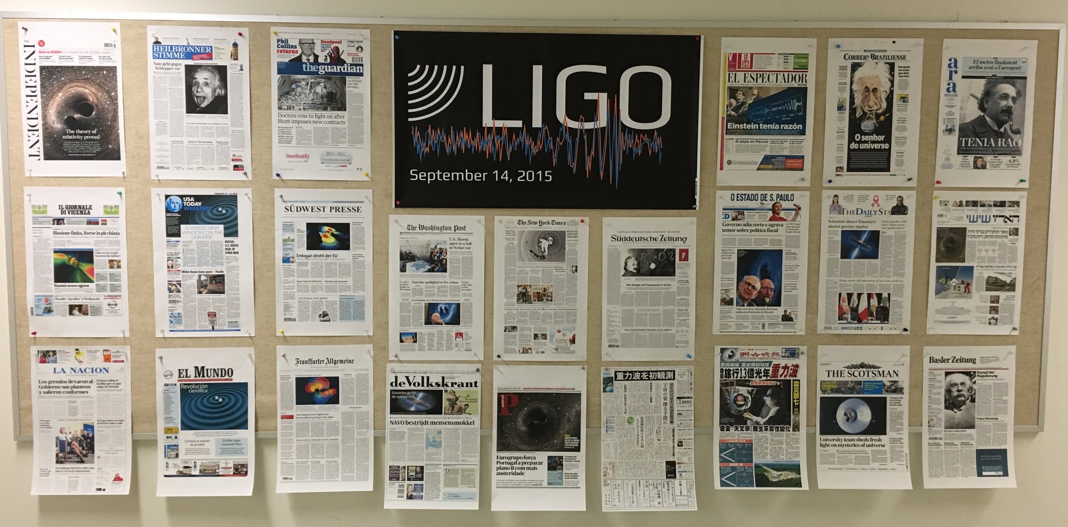
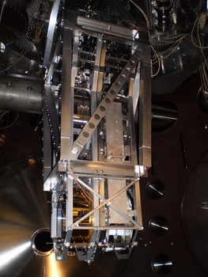
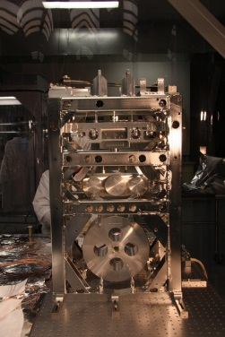
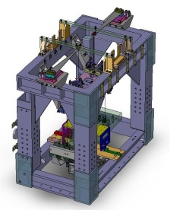
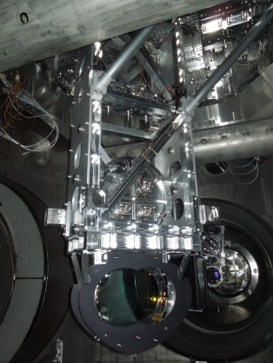

Slide 7
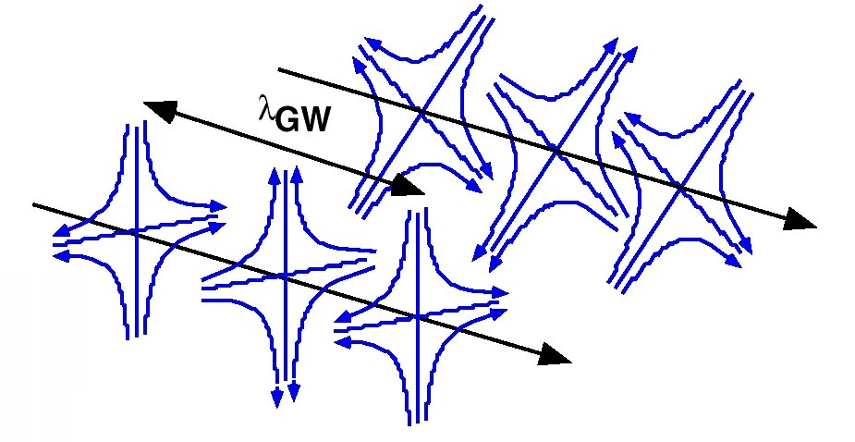
Gravitational Wave Basics
Einstein (in 1916) recognized gravitational waves in his theory of General Relativity
  Necessary consequence of Special Relativity with its finite speed for information transfer
  Most distinctive departure from Newtonian theory
Time-dependent distortions of space-time created by the
acceleration of masses
  Propagate away from the
  sources at the speed of light
  Pure transverse waves
  Two orthogonal polarizations
Requires huge masses and relativistic accelerations
h ~10⁻²¹ for plausible astrophysical sources

Slide 8
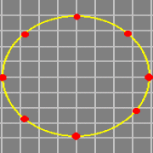
Effect of Gravitational Wave
Gravitational wave travelling INTO the plane of this slide
Changes the separations of “free masses”

Slide 9
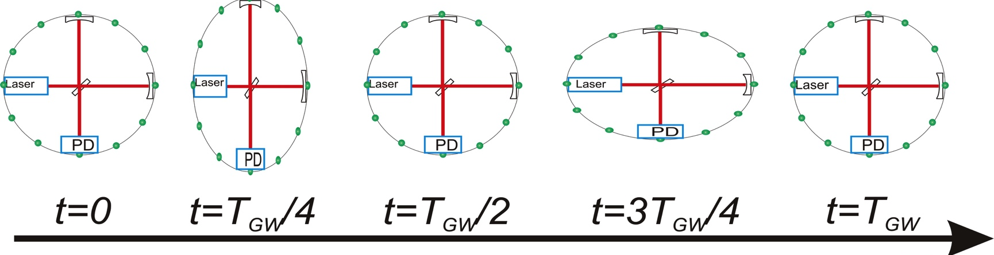
Detecting GWs with Interferometry
Earliest concepts show interferometer mirrors mounted on a “free test mass”
Weiss, 1972

Slide 10
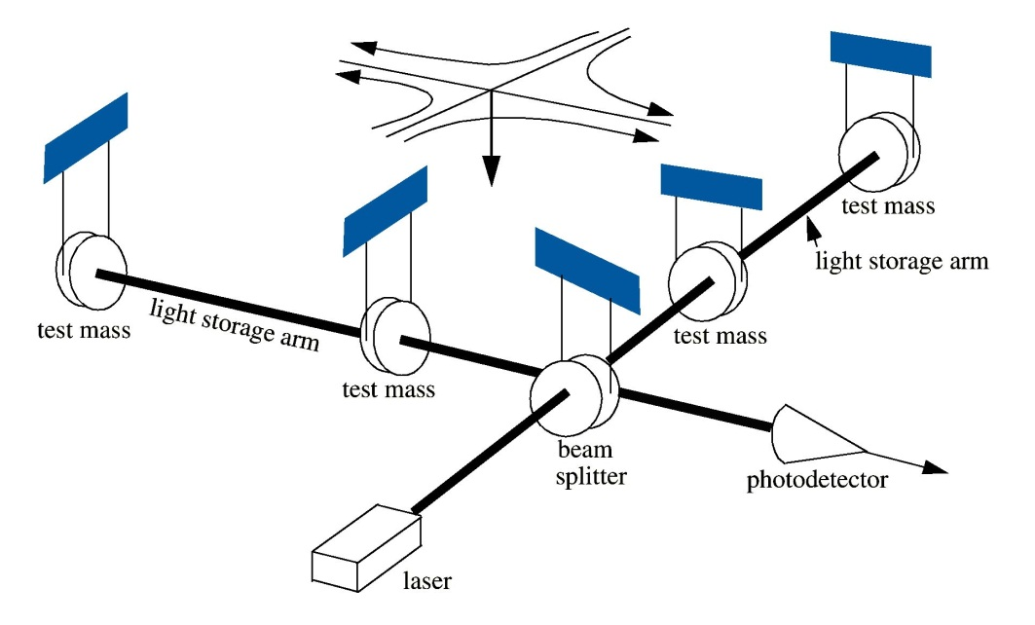
Detecting GWs with Interferometry
Suspended mirrors act as “freely-falling” test masses in horizontal plane for frequencies f >> f_{pend}
For a LIGO detector,
L ~ 4 km, h ~ 10^{–21}
ΔL ~ 10⁻¹⁸ m

Slide 11
Must act like a free mass in GR
Ultra-high purity fused silica
~35 cm diameter, 40 kg
Test Mass

Slide 12
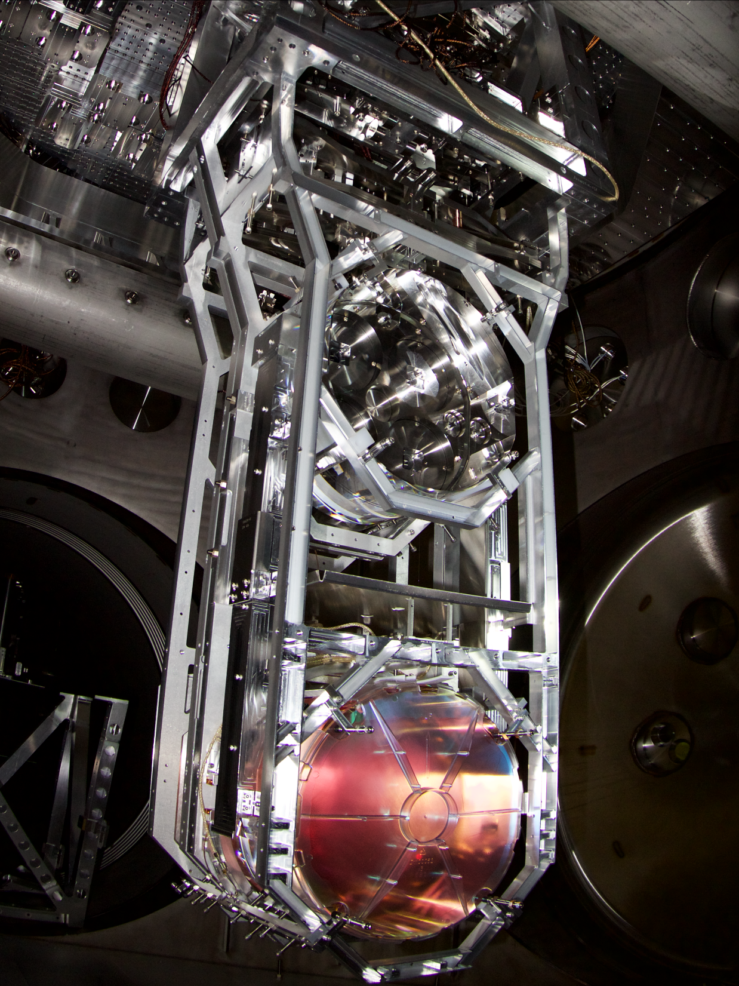

Four-stage pendulum suspension
Monolithic fused silica suspension fibers
Low thermal noise
Low noise actuation
Test Mass Suspension

Slide 13
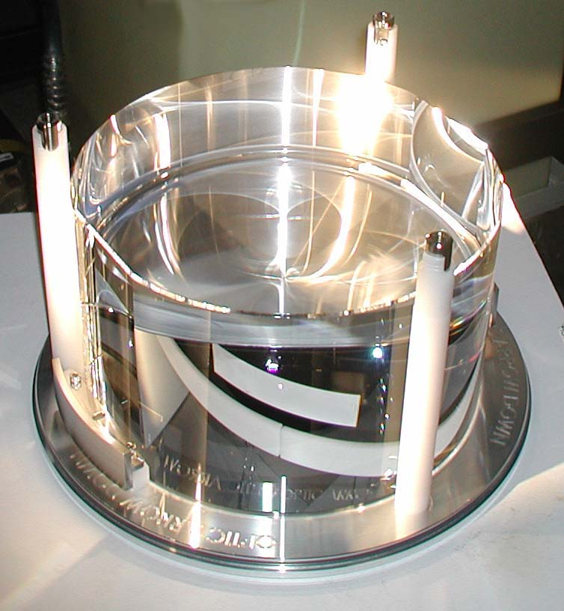
Core Optics Specifications
Challenging optical requirements:
ROC match to <1%
λ/1000 surface figure
< 0.5 ppm absorption
~10 ppm scatter
0.1 % coating uniformity

Slide 14
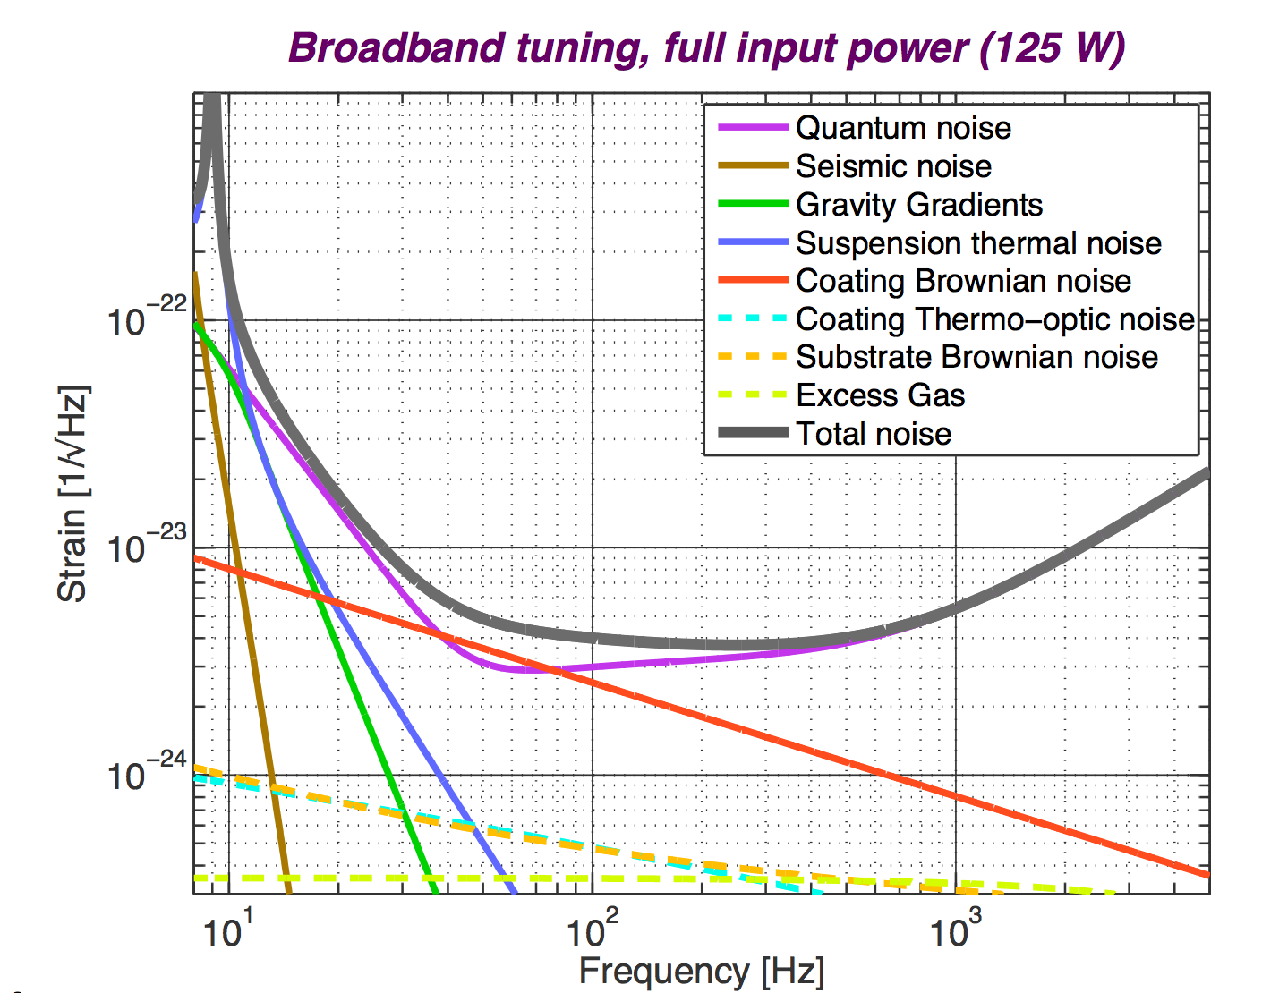
Precision Interferometry =
Controlling Measurement Noises
Displacement Noise
  Seismic noise
  Radiation Pressure
  Thermal noise
    Suspensions
    Optics
Sensing Noise
  Shot Noise
  Residual Gas
Technical Noises:
Hundreds of them…
Notes:
Explain top level three noise sources
Do animation explaining limitations and as a way of previewing next slides

Slide 15
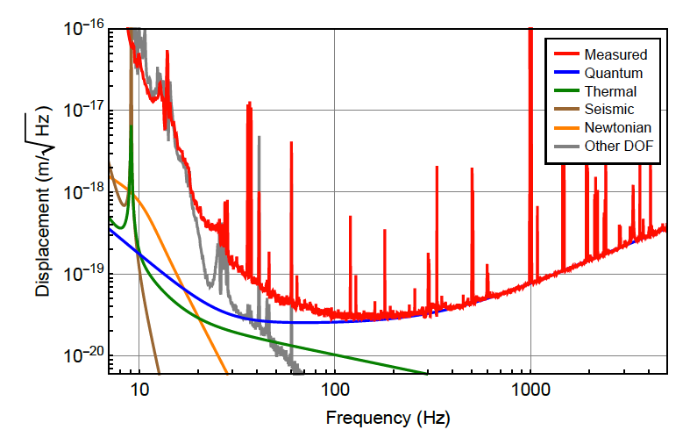
Advanced LIGO Detector Sensitivity During O1
Displacement Noise
  Seismic noise
  Radiation Pressure
  Thermal noise
    Suspensions
    Optics
Sensing Noise
  Shot Noise
  Residual Gas
Technical Noises:
Hundreds of them…
Arm Cavity Power P_{arm} = 100 kW
Optical Challenge for the Future:
Quantum Noise
Abbott, et al. ,LIGO Scientific Collaboration and Virgo Collaboration, “GW150914: The Advanced LIGO Detectors in the Era of First Discoveries”, Phys. Rev. Lett. 116, 131103 (2016).

Slide 16
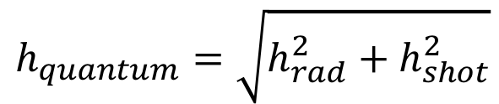
Two Aspects to Quantum Noise
m
SHOT NOISE:
Photon counting noise
RADIATION PRESSURE NOISE: Noise caused by photon
pressure on mirrors
LASER
Photo-Detector
$$h_{quantum}=\sqrt{{h_{rad}^{2}+h}_{shot}^{2}}$$
Measurement frequency
Slide courtesy of L. Barsotti
Notes:
h_shot, h_rad

Slide 17
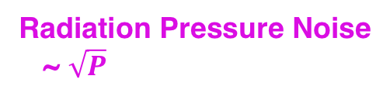
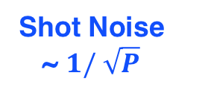
Standard Quantum Limit
Trade-off in Power
Between Shot Noise
and Radiation-
Pressure Noise
Standard
Quantum
Limit (SQL):
Uncertainty of
test mass position
due to Heisenberg
Uncertainty Principle
Radiation Pressure Noise
~ $\sqrt{P}$
Shot Noise
~ $1/ \sqrt{P}$

Slide 18
Reduce Quantum Noise?
Quantum noise RPN SN
  Make the interferometer longer
  Heavier test masses & more optical power
  Inject of squeezed states of light

Slide 19
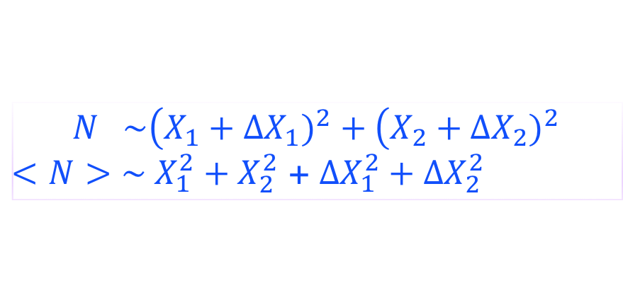

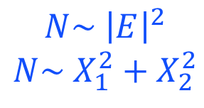
Ball and Stick Picture of Quantum Optical Noise
Quantized Electromagnetic Fields
Quadrature Field Amplitudes
Classical Quantum
Coherent State
$$N\sim {\left|E\right|}^{2}$$
$$N\sim X_{1}^{2}+X_{2}^{2}$$
$$N \sim \left(X_{1}\right.+{∆X}_{1})^{2}+\left(X_{2}\right.+{∆X}_{2})^{2}$$
$<N>\sim X_{1}^{2}+X_{2}^{2}$ + ${∆X_{1}^{2}+{∆X}_{2}^{2}}_{}$
Heisenberg’s uncertainty principle $∆X_{1}∆X_{2}≥1$
Equivalent to ½ photon

Slide 20
How Does Quantum Noise
Enter the Measurement?
Interferometer
arms set to
interfere the light
back toward laser—
both the stick and the ball!
-> no shot noise either?
No such thing as Quantum Noise?
Beamsplitter acts
the same on the
stick and the ball!
-> no radiation pressure noise?

Slide 21
Quantum Noise in an Interferometer
Even when amplitude of the field is zero, the noise fuzz ball remains
=> “vacuum” fluctuations
Radiation pressure noise
  Coherent intracavity field +
  X₁ quantum fluctuations
  ➔ fluctuating force on mirrors
Laser
X₂
X₁
X₂
Shot noise
  Coherent signal field +
  X₂ quantum fluctuations
  ➔ fluctuating amplitude at PD
X₁

Slide 22
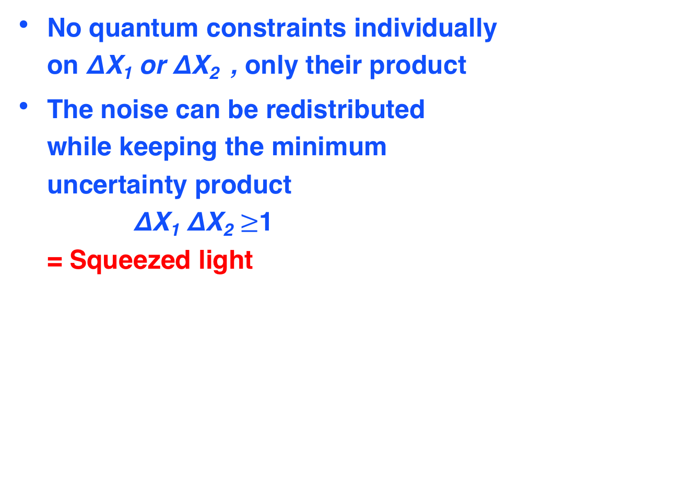
Squeezing
No quantum constraints individually
on ΔX₁ or ΔX₂ , only their product
The noise can be redistributed
while keeping the minimum
uncertainty product
ΔX₁ ΔX₂ $≥$1
= Squeezed light

Slide 23
Squeezing
Particularly useful two states
Amplitude squeezing
(Phase anti-squeezing)
Phase squeezing
(Amplitude anti-squeezing)

Slide 24
Squeezing in an Interferometer
Laser
X₂
X₂
Simple squeezing gives exactly the same effect as a change in laser power
X₁
X₁
X₂
X₁

Slide 25
Does it Really Work?
Squeezing in Action
3.5 dB
(1/1.5)
2.1 dB
(1/1.27)
LSC, Nature Physics 7, 962 (2011)
LSC, Nature Photonics 7, 613–619 (2013)

Slide 26
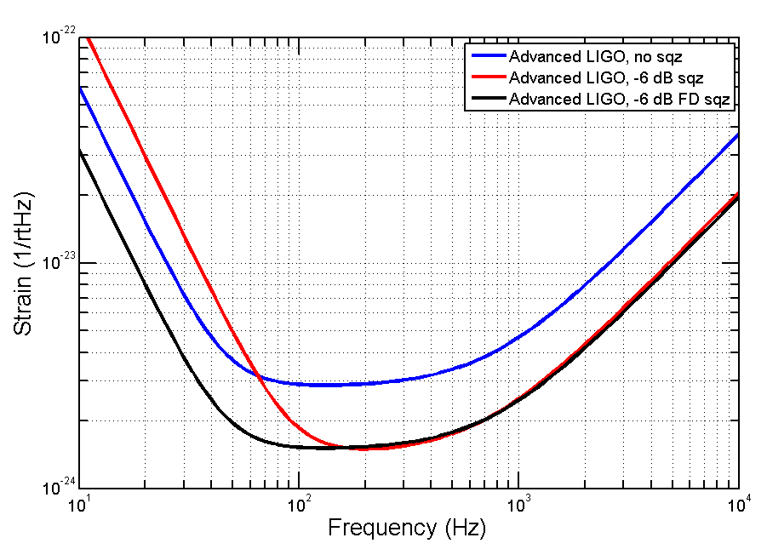
Best of Both Worlds?
Rotate the squeezing quadrature as a function of frequency
Radiation pressure
Shot noise

Slide 27
Summing Up
Detection of gravitational waves is already giving important new information about the Universe on its largest scales
Made possible by advances in optics and precision interferometry
Future advances will require us to confront the quantum nature of measurement

