Slide 1


Absolute Uncertainty in the GW Detector Network:
Status Update and Debrief from NIST Workshop
J. Kissel, for the World-wide collection of GW Detector Calibration Groups, the LVK, and NIST

Slide 2
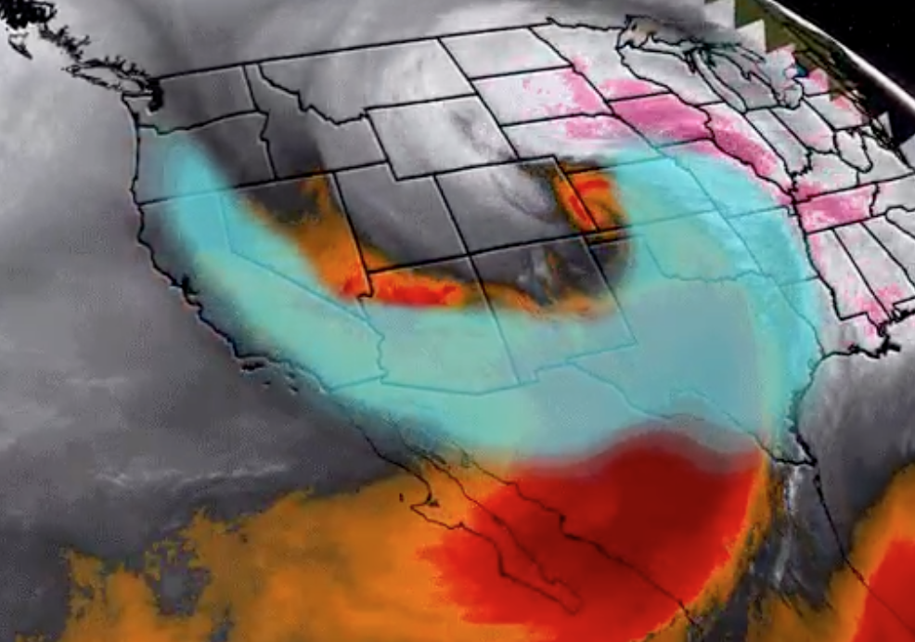
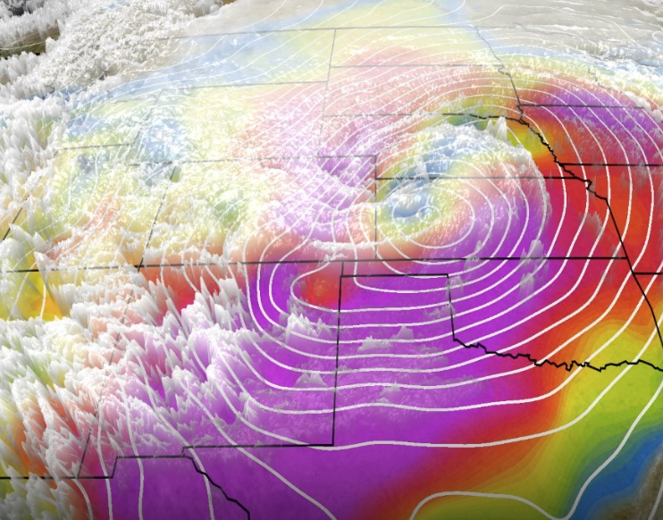
Well… THAT Happened
Denver / Boulder
Winter Storm Ulmer destroyed all plans for attendees to fly into Denver
  Many attendees delayed
  Several attendees had cancel all together
  Workshop reduced to one day (last Friday, 2019-03-18)

Slide 3
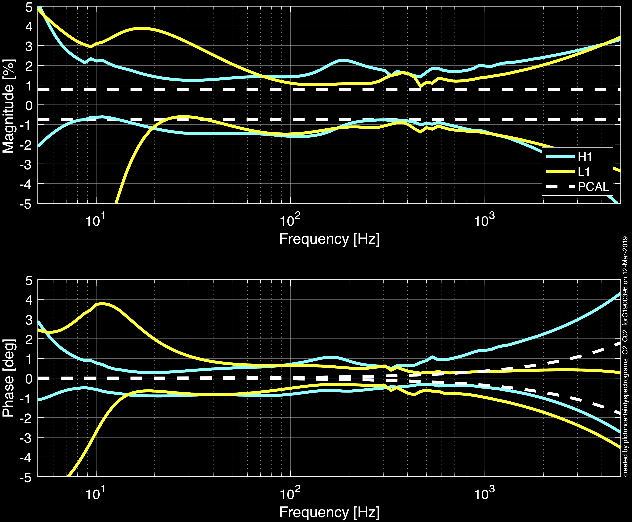
Where left off in O2
The combination of
statistical uncertainty
remaining systematic error
unknown systematic error
is numerically evaluated to form a 68% confidence interval, but roughly,
68% C.I. for L1
68% C.I. for H1
68% C.I. for PCAL
(
1
)
²
(
∂ C
)
²
(
G
²
∂ A
²
)
(
)
∂ h ² ≈ ∂ R ² ≈
_________
____
+
_________
____
1 + G
C
1 + G
A
+ Systematic Errors

Slide 4
How to Measure the DARM Loop
With all loops closed and the detector running at its best sensitivity, we request a series of in-loop excitations to obtain direct measurements of the sensor and actuator
d_{exc}
d_{err}
)
x_{pc}
(
1 + G
)
(
C
C =
_________
____
____
____
_________
x
x
d_{IN2}
pc_{exc}
pd_{pc}
1
1 + G
Complex Transfer
Functions w/ Full IFO
Absolute Scale Factor
d_{err}
(
pc_{exc}
)
pd_{pc}
(
A_{i} C
)
1 + G
A_{i} =
_________
____
____
____
_________
x
x
a_{i,exc}
d_{err}
x_{pc}
1 + G
C
Our measurements of C and A are
ratios of complex transfer functions
>> the frequency-dependent, magnitude and phase are important for uncertainty in A and C

Slide 5
Focus on the IFO Measurements
d_{exc}
d_{err}
x_{pc}
C =
____
x
____
x
____
d_{IN2}
pc_{exc}
pd_{pc}
Complex Transfer
Functions w/ Full IFO
Absolute Scale Factor
d_{err}
pc_{exc}
pd_{pc}
A =
____
x
____
x
____
a_{i,exc}
d_{err}
x_{pc}

Slide 6
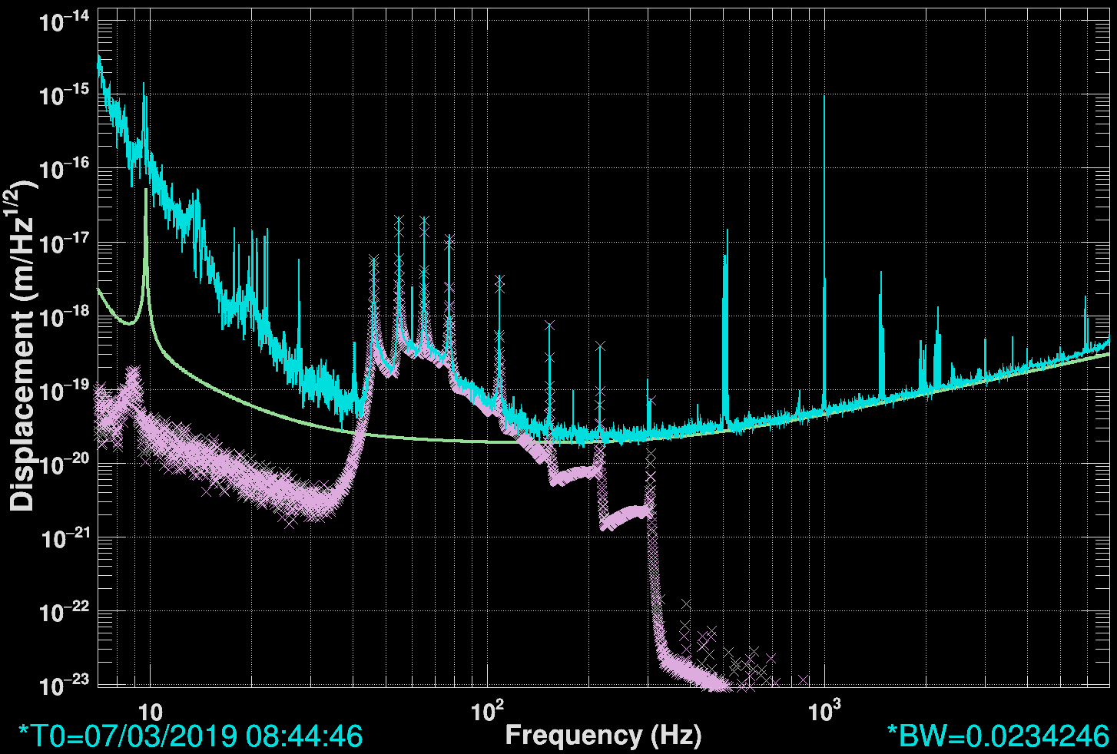
Example Measurement
d_{err}
This is what it looks like when we measure
____
pc_{exc}
“Swept Sine” Excitation
Reconstructed,
Live, ΔL
Cartoon
Target ΔL
Taken during lowest noise state, in loop
Two measurements per function
Actuator strength vs. Detector Noise limited!
Reconstructed
PCAL RX PD x_{pc}

Slide 7
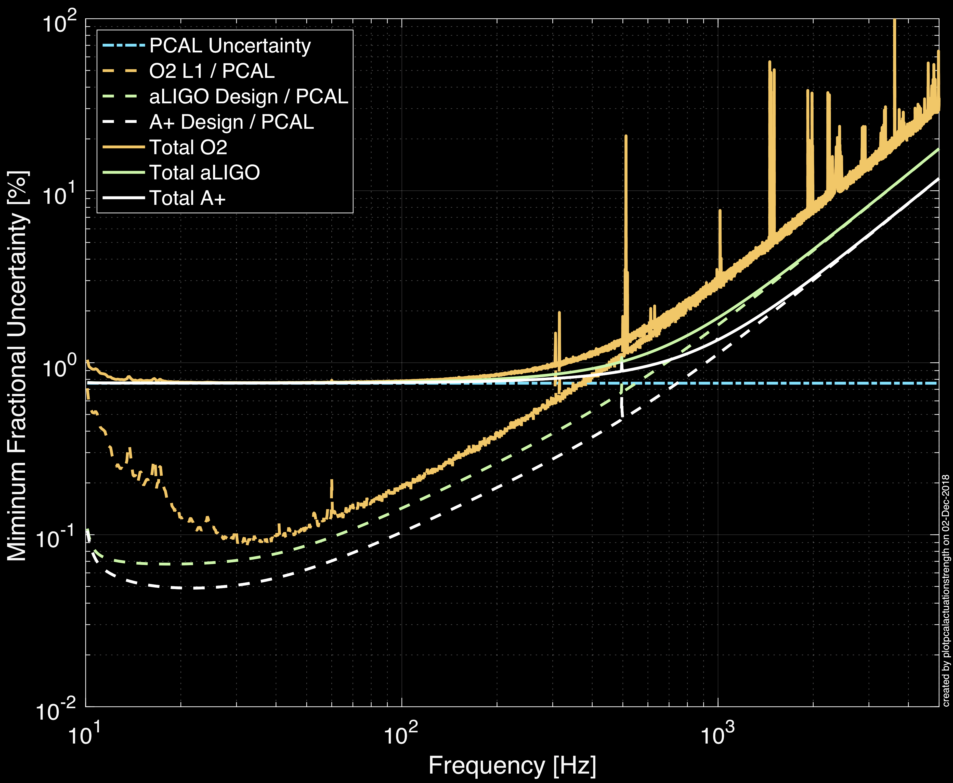
Limitations (using O2 PCAL Uncertainty)
d_{err}
____
pc_{exc}
Absolute reference limits where detector is most sensitive
Actuator strength limits where noise is worse
Black Holes and Pulsars
Neutron Stars and Supernovae

Slide 8

But We’re Improving…
WSK
We now have built and compared
FOUR Working Standards
to be held at each site, all referenced to the Gold Standard and thus NIST
WSV
GS
WSH
Reduces intra-network systematic bias
Improves sky-localization (for example)
WSL
WSI

Slide 9
But We’re Improving…
LIGO PCAL Parameter | O2 [1] | O3 [2]
Laser Power (NIST - GS) | 0.51 | 0.35
Laser Power (GS - WS) | 0.03 | 0.10
Laser Power (WS - RX) | 0.05 | 0.10
Optical Efficiency | 0.37 | 0.10
Angle of Incidence | 0.07 | 0.07
Mass of test mass | 0.005 | 0.005
Rotation | 0.40 | 0.20
Total | 0.75 | 0.50
Overall improved between O2 & O3!
[1] Karki, S., et al. RSI 87.11 (2016): 114503.
[2] Sudarshan Karki’s talk from the Workshop

Slide 10
Workshop Take-away:
NMIs are Excited!
Our discoveries have stimulated excitement in the global power standards community.
  “New” acronym: National Metrology Institutes (NMIs)
  EUROMET study revisited – see slides 11 and 12
NIST reduced their standard uncertainty for us for O3 (special signature required!)
  see slide 9
On their own, current NIST reference system for laser power is old and difficult to improve; they are already planning on upgrading their systems
  see slide 13 and 14
https://dcc.ligo.org/cgi-bin/DocDB/DisplayMeeting?conferenceid=1029

Slide 11
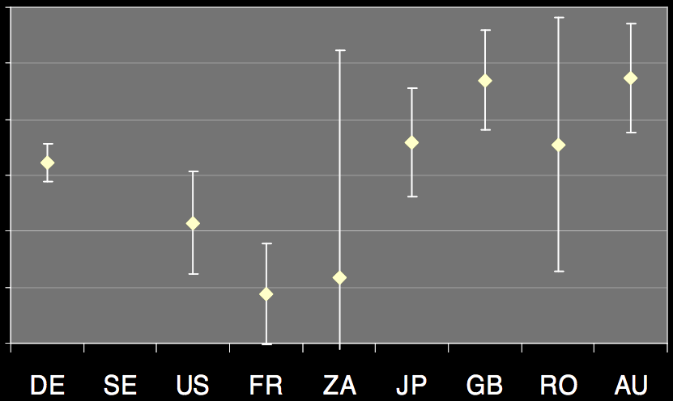








Review of EUROMET Study
NIST didn’t and doesn’t take it in to account
Consensus – Initial concerns from GW community about “the plot” has been initially overblown.
Proper statistical interpretation [3,4]:
  NIST value and all others consistent with Consensus Estimate C.I.
  Except France, who has since found ~2% systematic error (in the right direction)
Response of a Photodetector
Percent Difference from Weighted Mean Response of a Photodetector
3%
2%
1%
0%
-1%
-2%
-3%
Figure 9
Kück Metrologia 47.1A (2010): 02003.
Remember this scary plot?
[3] Amanda Koepke’s Talk at NIST Workshop
[4] Jimmy Dubard’s Talk at NIST Workshop

Slide 12
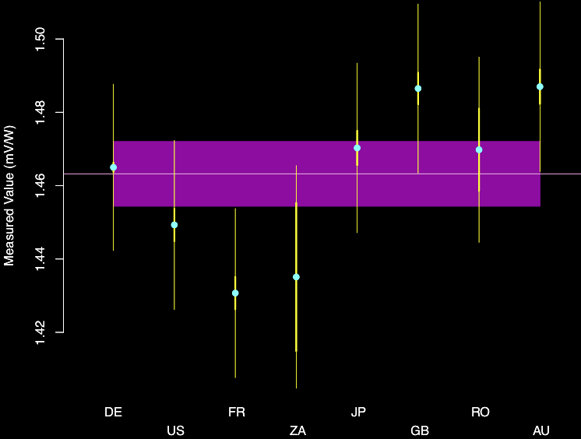
EUROMET Study Concerns Settled
“Dark” Unknown
Uncertainty
Reported
Value
Consensus
Value
Reported
Uncertainty
68% CI for
Consensus
Don’t be scared.
Data from Table 12, “Nd:YAG 1W” Kück Metrologia 47.1A (2010): 02003.
Results from consensus.nist.gov, encouraged by Amanda Koepke’s Talk

Slide 13
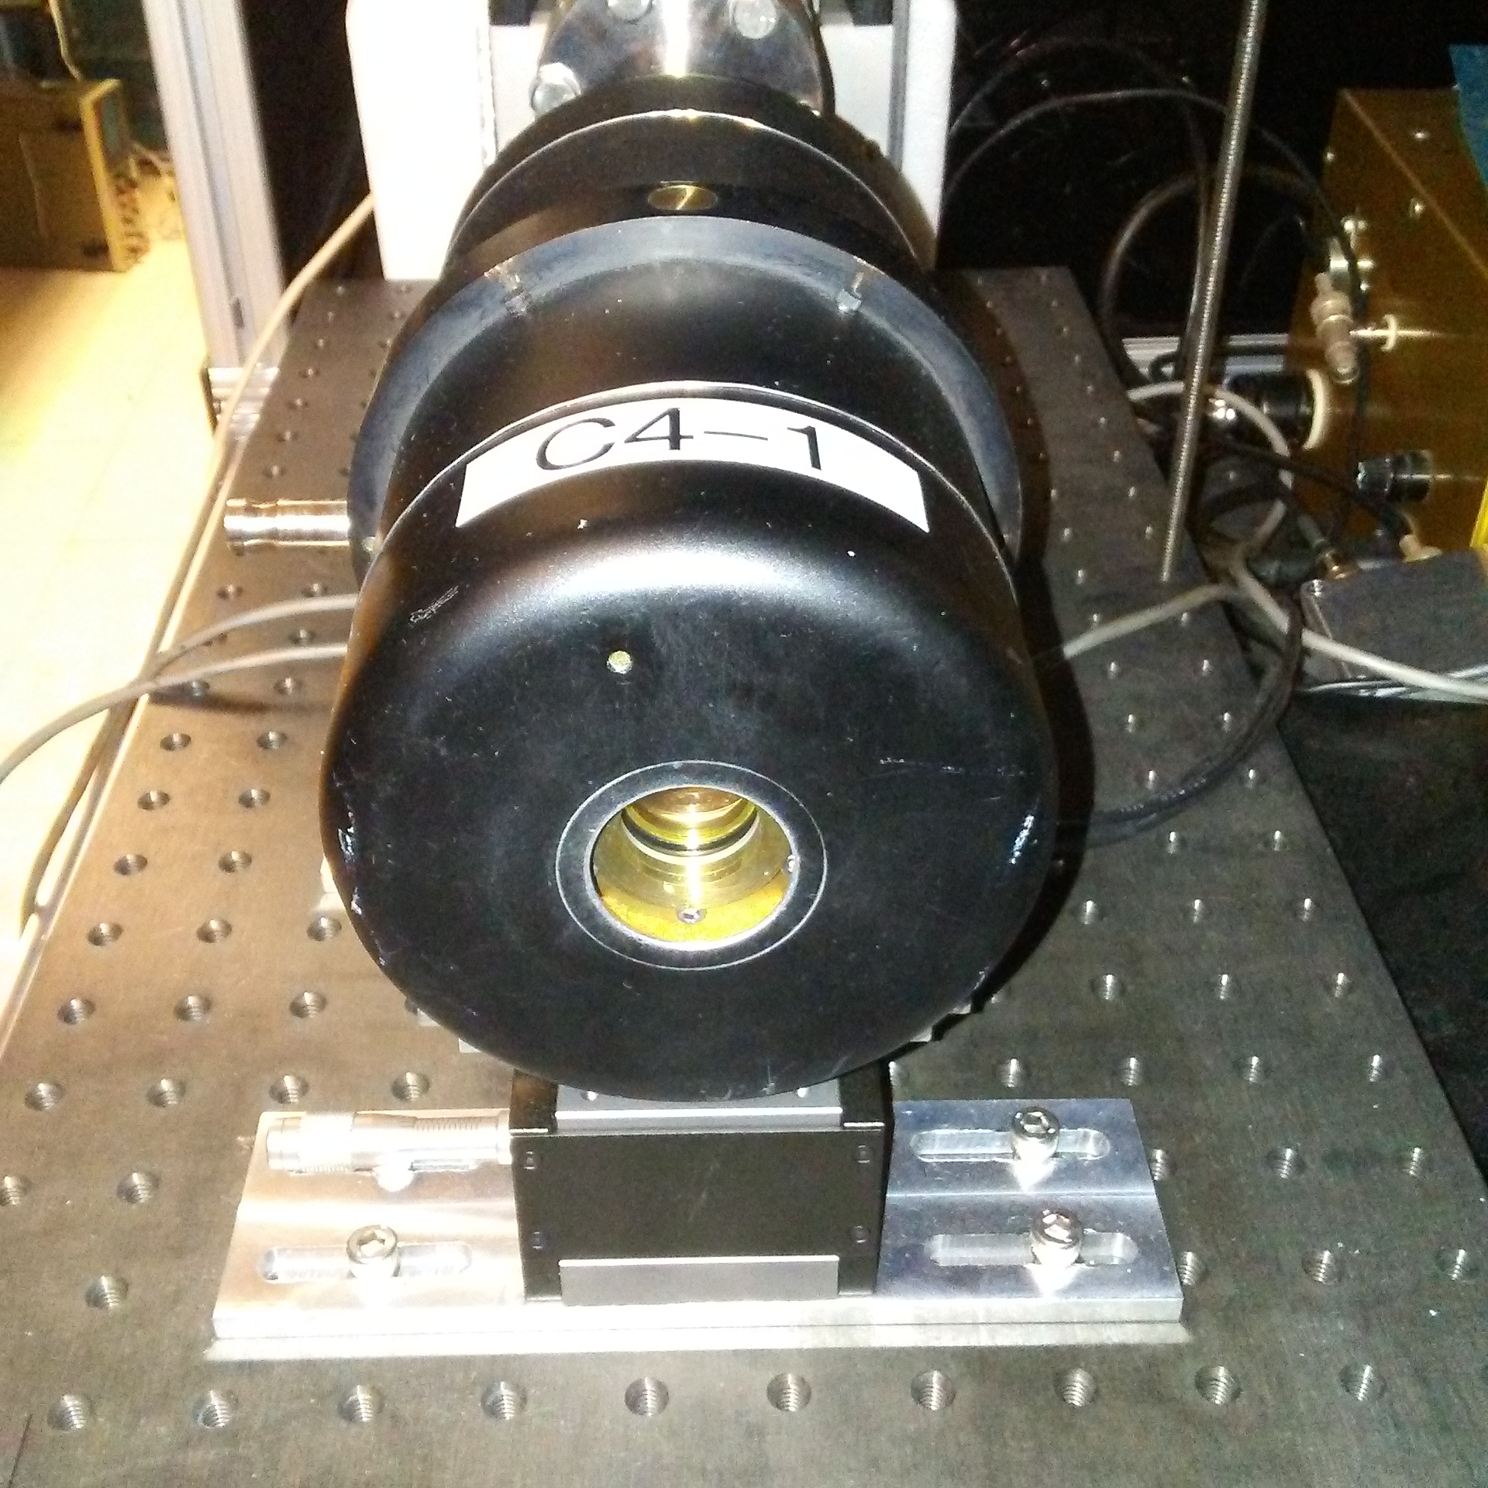
The Present at
Calorimeter
Insulating shell
Heater windings
Isothermal vacuum shell
Thermal dampening shell
Electrical-Substitution heater windings
DC Amplifier
Carbon-Black absorbing cavity
1° Wedge Window
Multi-Junction thermopile/Weak thermal link
Transfer method: beam splitter compares two calorimeters, then DUT replaces one of them
Primary calorimeter traceable to the kilogram (now Planck’s Constant) via electrical substitution
Some recent improvements to optical systematics of method, external to calorimeter
Further improvements to transfer method (and thus its uncertainty) require characterization of parts internal to calorimeter
Results from Matt Spidell’s Talk at Workshop

Slide 14
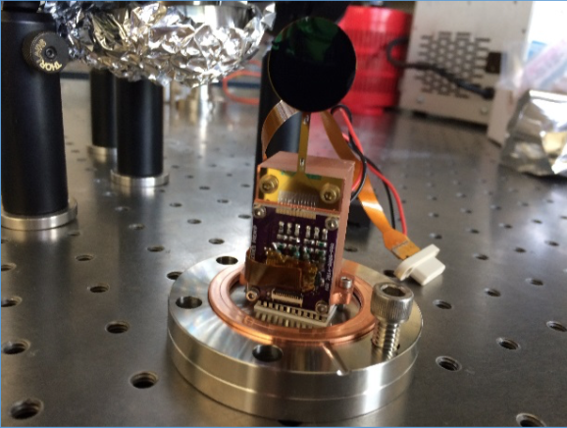
The Future at
Room Temperature Bolometer
20 mm
Absorber
Heat Link
Requirements:
Thermistors
2 cm beam diameter
100 μW – 100 mW
325 nm – 1.93 μm
2 minute time constant
Mostly off-the-shelf
Heater
0.05% = 68% C.I.
time-scale = “next few years”
Si substrate
Peltier heater around perimeter
Vertically aligned carbon nanotube absorber
Transition edge sensor or commercial off-the-shelf thermistor or thin-film VOx for temperature measurement
Results from Michelle Stephen’s Talk at Workshop

Slide 15
The Message: Continue As Normal
NIST will be implementing a new primary reference
  on pace with our observing runs and improved sensitivity
  The challenge is now on us >> preserve that absolute uncertainty all the way to the end stations and through the interferometers
All GW interferometers now have PCAL system and all are traceable to NIST.
[Bonus Slides] Observatories will continue to research new/different standards in parallel on a “best effort” basis
  VIRGO will continue to with Laser Wavelength reference, and move forward with improved NCAL system
  LIGO will re-visit Laser Wavelength and RF Oscillator references, and move forward with NCAL system
  KAGRA is pushing hard on the NCAL effort, likely will try other methods

Slide 16
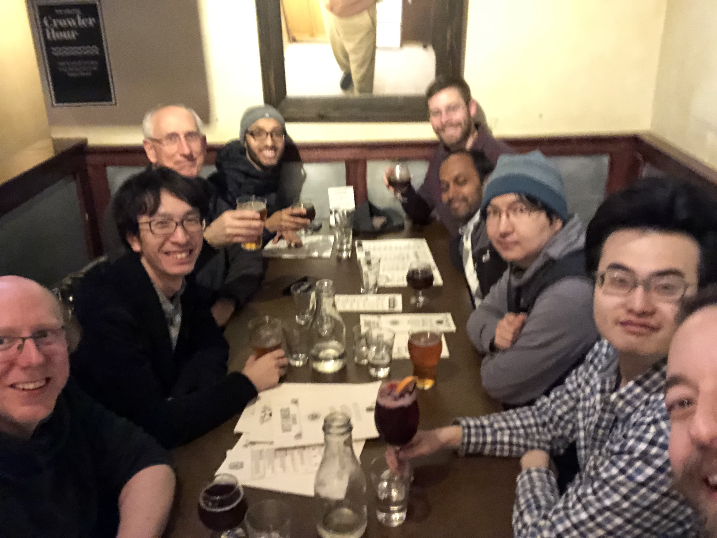
Thank you!

Slide 17
BONUS SLIDES

Slide 18
Workshop Event on DCC
NIST, Labsphere and other NMI attendees graciously agreed to share their talks
All talks are available on DCC event page:
https://dcc.ligo.org/cgi-bin/DocDB/DisplayMeeting?conferenceid=1029

Slide 19
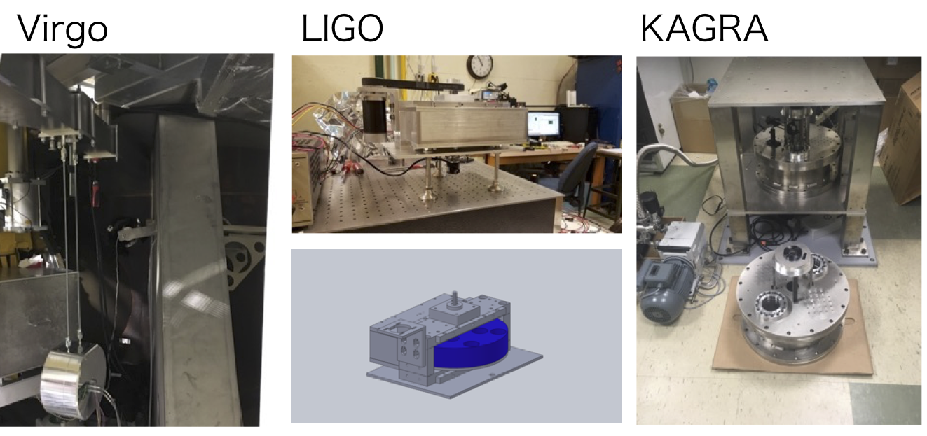



GCAL or NCAL
World-wide excitement continues about Gravitational or Newtonian calibrators
Develop on a “best effort” basis
https://wiki.ligo.org/Calibration/NewtonianCalibrator
ncal@ligo.org
Search “NCAL” or “GCAL” on DCC

Slide 20
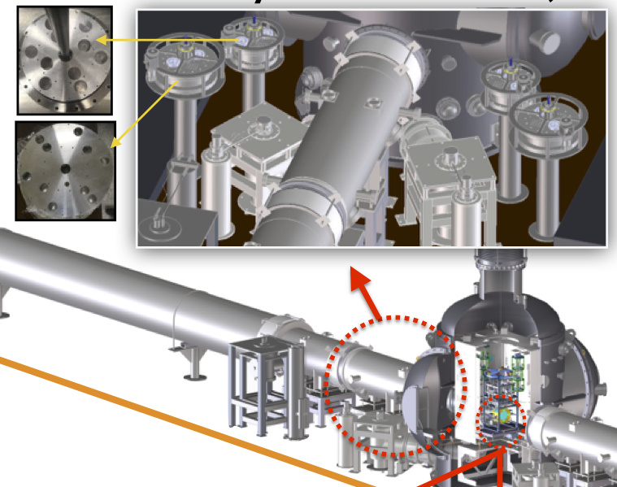
KAGRA Going All Out!
2
3
FOUR GCALs surrounding one test mass
In concert with photon calibrator with 20 W laser
An almost 3G calibration setup!
1
4
Inoue, Yuki, et al. Phys Rev D 98.2 (2018): 022005.
See Many more details in Yuki’s Workshop Talk

Slide 21
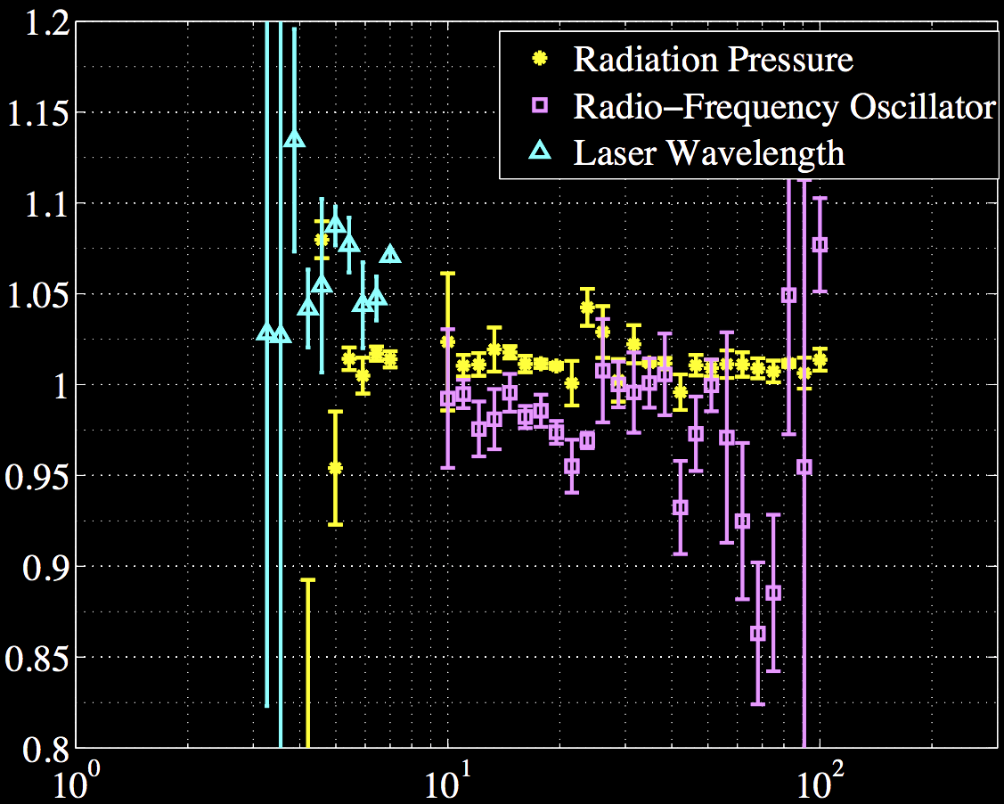
LSC Fellows Revive other Methods
In GW150914 paper, LIGO published a comparison of 3 methods
  Laser Wavelength (old standard)
  Radio Frequency Oscillator (re-invented using ALS)
  Radiation Pressure (PCAL)
Now detectors are better understood and controlled
LSC Fellows Dripta Bhattacharjee (LHO) and Rachel Gray (LLO) will support PCAL, NCAL, and resurrect the pre-O1 study, and do it more justice
Relative Actuation Strength (arb.)
Frequency (Hz)
Always in seek of ”The Truth,” …

