Slide 1
Advanced LIGO Detectors in O3
Aaron Buikema
MIT LIGO Lab
for the LIGO Instrument Team
GR22/Amaldi13
10 July 2019
LIGO-G1900455

Slide 2
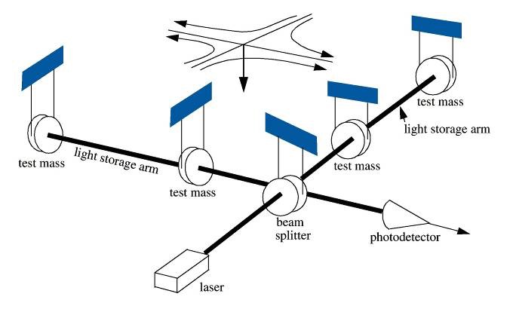
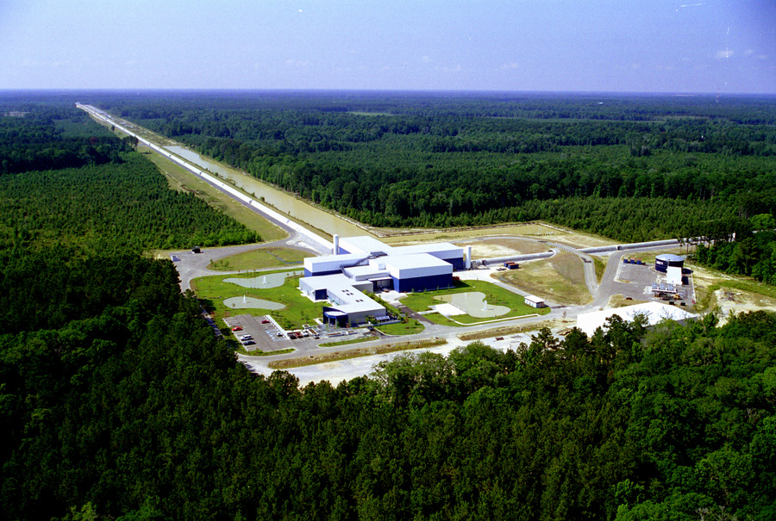
O1/O2 were very successful…but we want more!

Slide 3
Third Observing Run (O3)
19 month commissioning break after O2
Triple detector network: LIGO Hanford (LHO), LIGO Livingston (LLO), and Virgo
Began 1 April 2019, run for ~1 year (O2 was 9 months)
Observing full time w/ Tuesday maintenance and ~6 hrs/week of commissioning
Most sensitive run yet!
Notes:
KAGRA to join at end of year

Slide 4
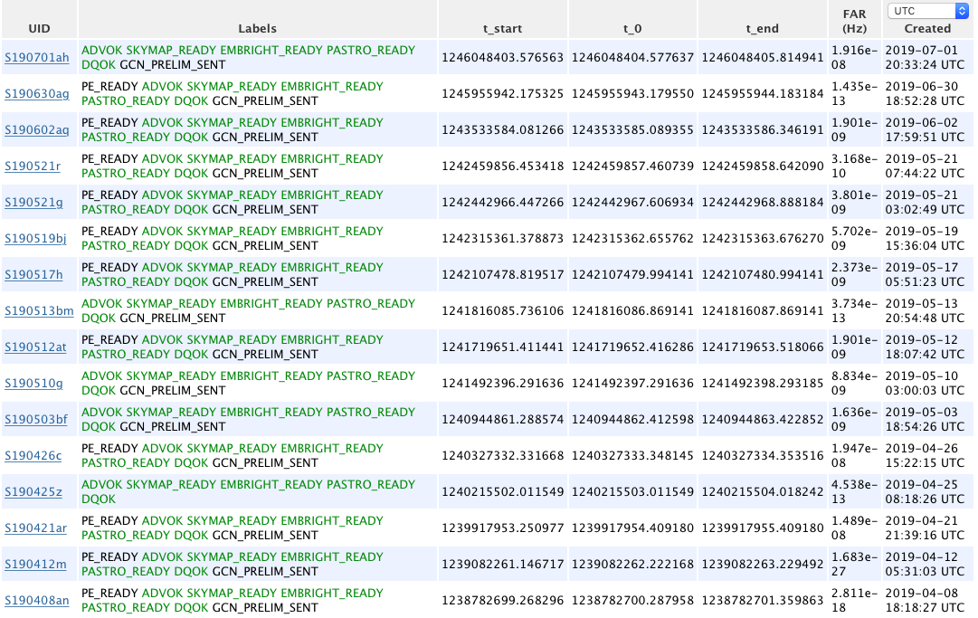
First run with public alerts
16 17 18 GW candidates in O3 so far
Compared to 11 confirmed events from O1/O2
https://gracedb.ligo.org/latest/
Notes:
Note to reviewers, this is public page

Slide 5
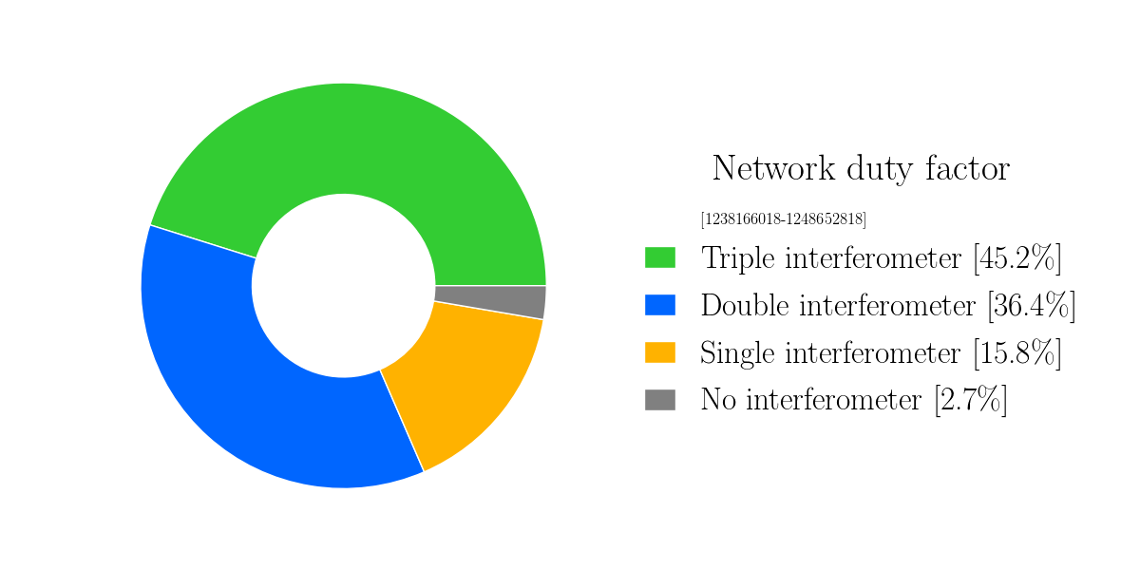
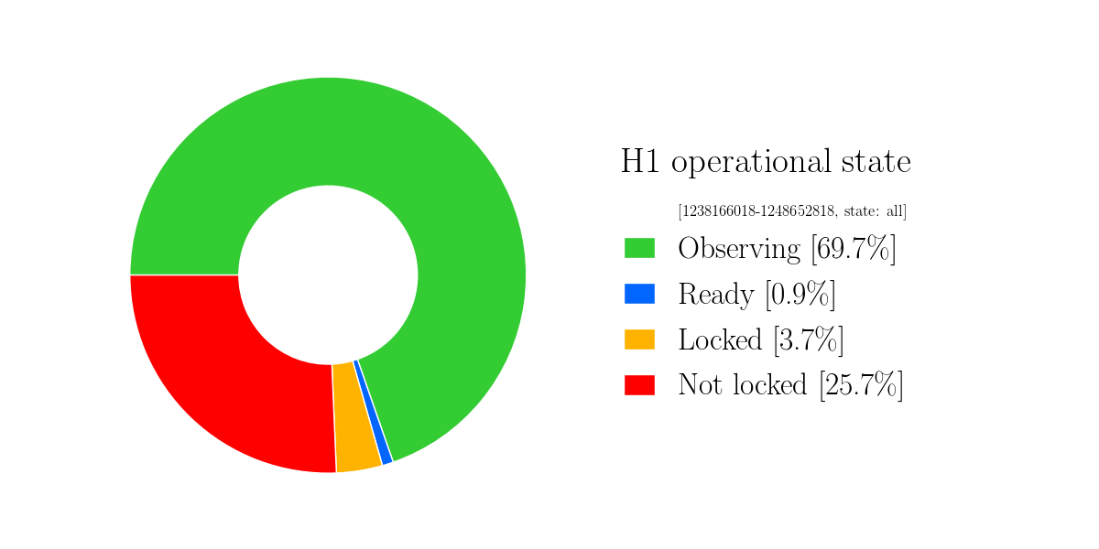
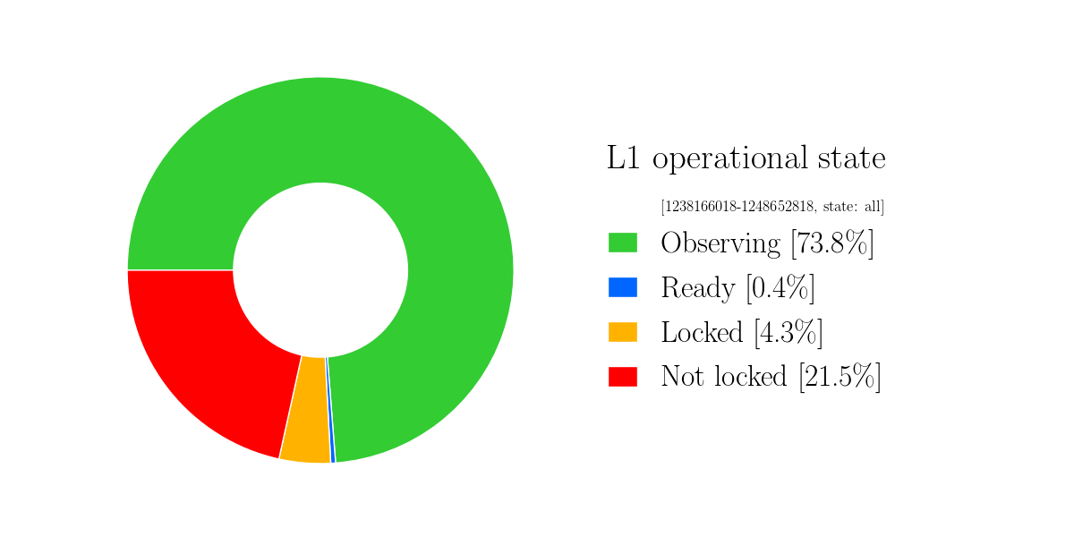
O3 So Far

Slide 6
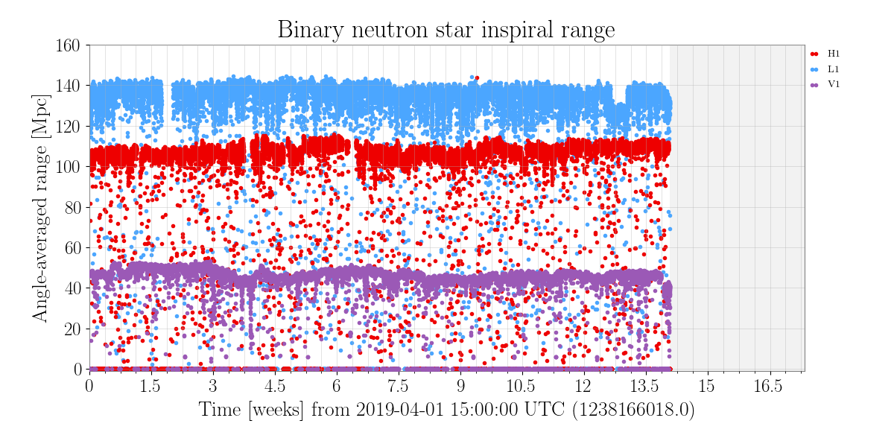
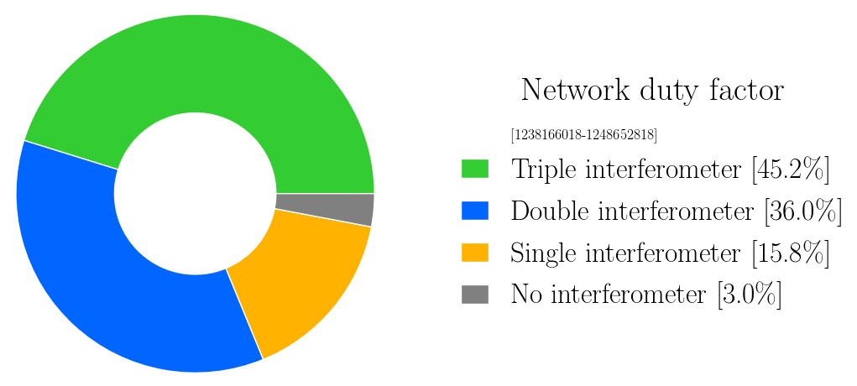
O3: Most Sensitive Run Yet
Notes:
Long-term bump at LLO is from squeezer being offline

Slide 7
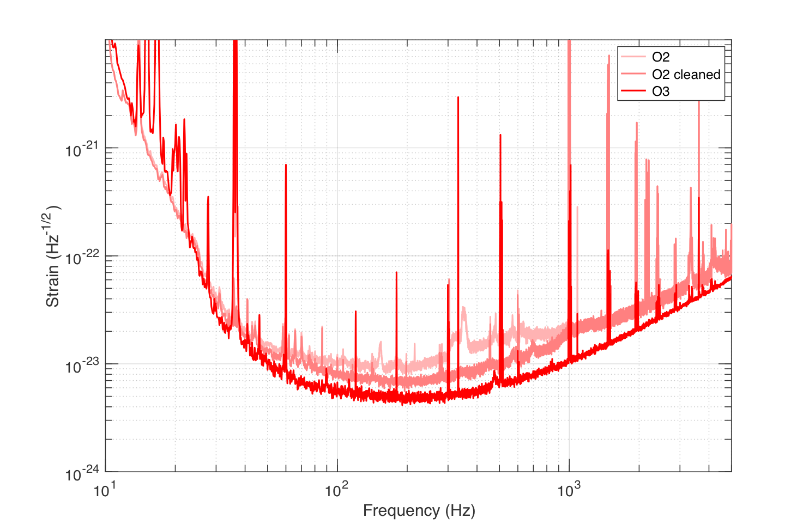
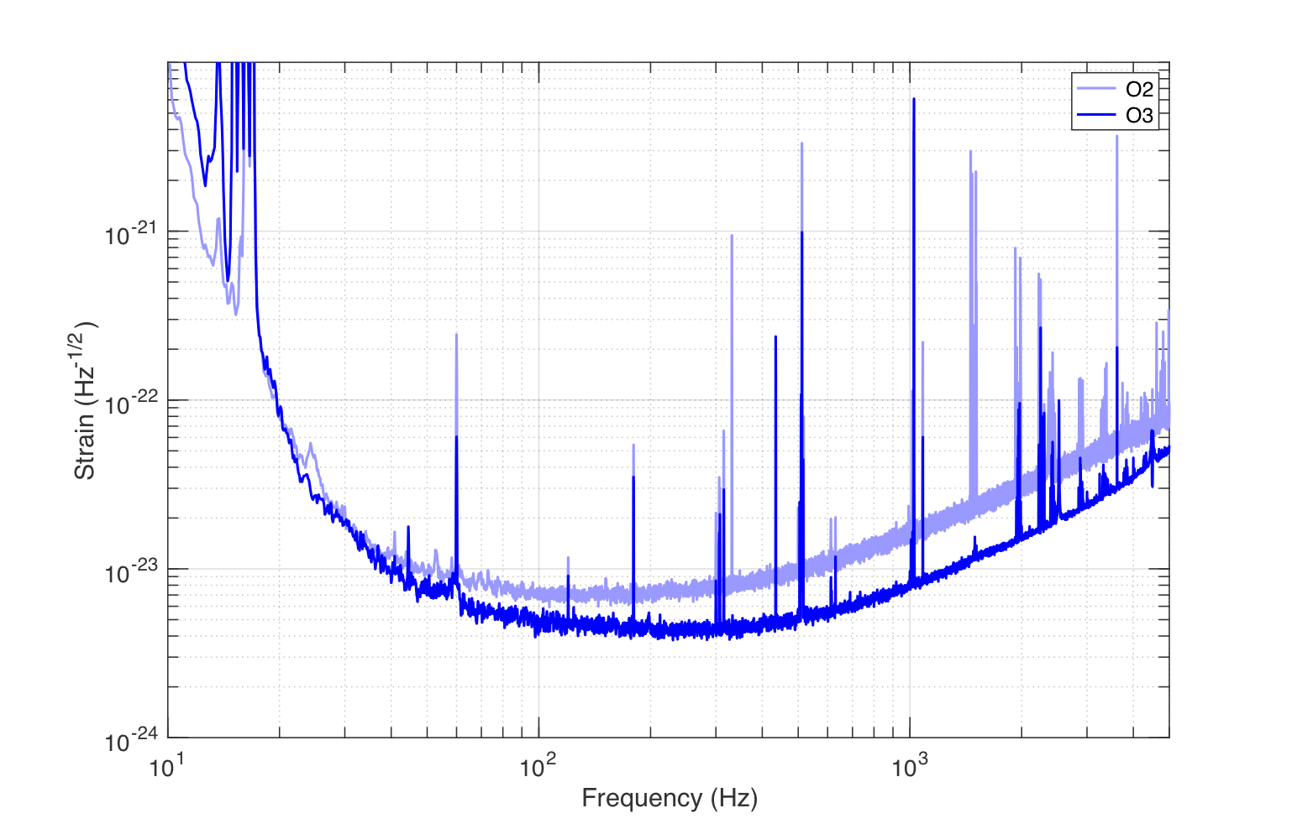
O2/O3 Comparison
O3 (O2) | Hanford | Livingston
Input Power [W] | 37 (30) | 46 (25)
Intracavity Power [kW] | 190 (120) | 230 (100)
BNS Range, 1.4 Msolar [Mpc] | 110 (65‡) | 140 (100)
BBH Range, 30 Msolar [Mpc] | 800 | 1100
Duty Cycle | 70% (62%*) | 74% (61%*)
‡82 after cleaning
*Includes planned engineering break

Slide 8
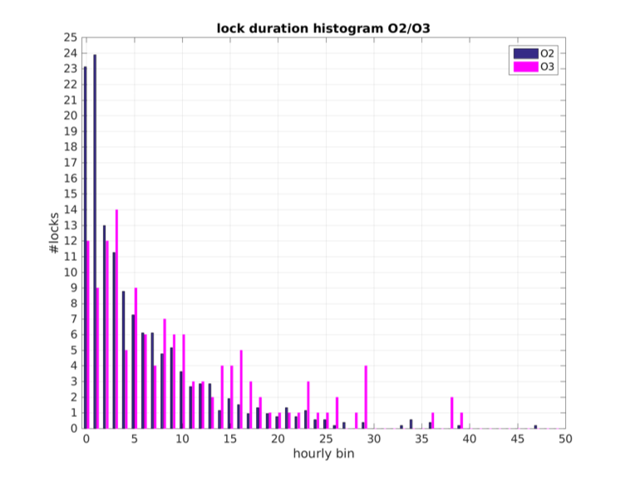
Improved reliability
Total O2 lock losses = 717/240 days ~ 3/day
Total O3 lock losses = 137/74 days < 2/day
Record 101 hr lock
G1901122-v3
Notes:
Note that this was after a few weeks into O3 @ LLO
A. Pele

Slide 9
How did we get here?
Notes:
By any metric, detectors have improved significantly since O2!

Slide 10
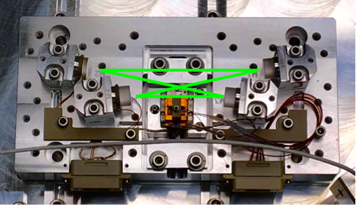
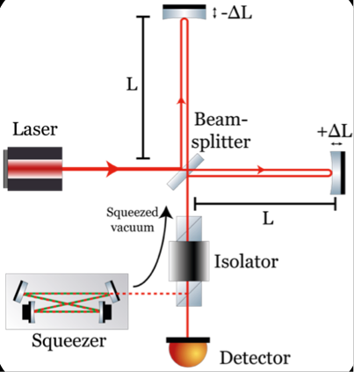
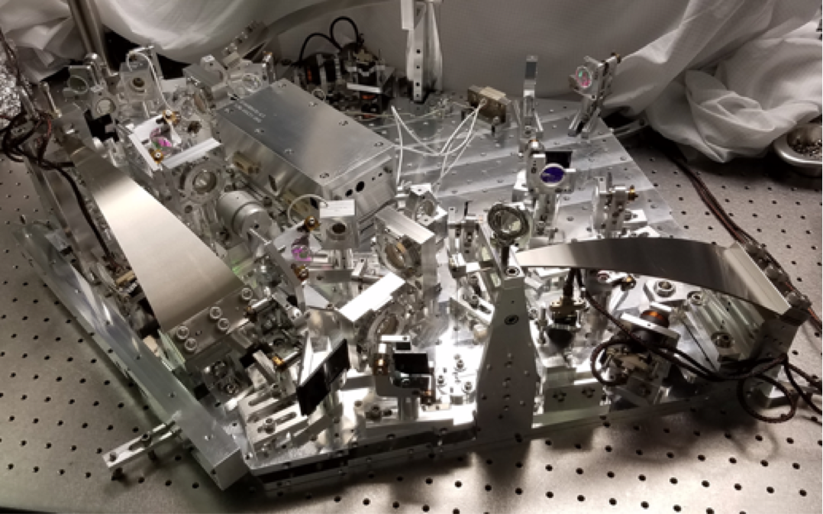
In-vacuum Squeezer
Injection of squeezed vacuum reduces shot noise

Slide 11
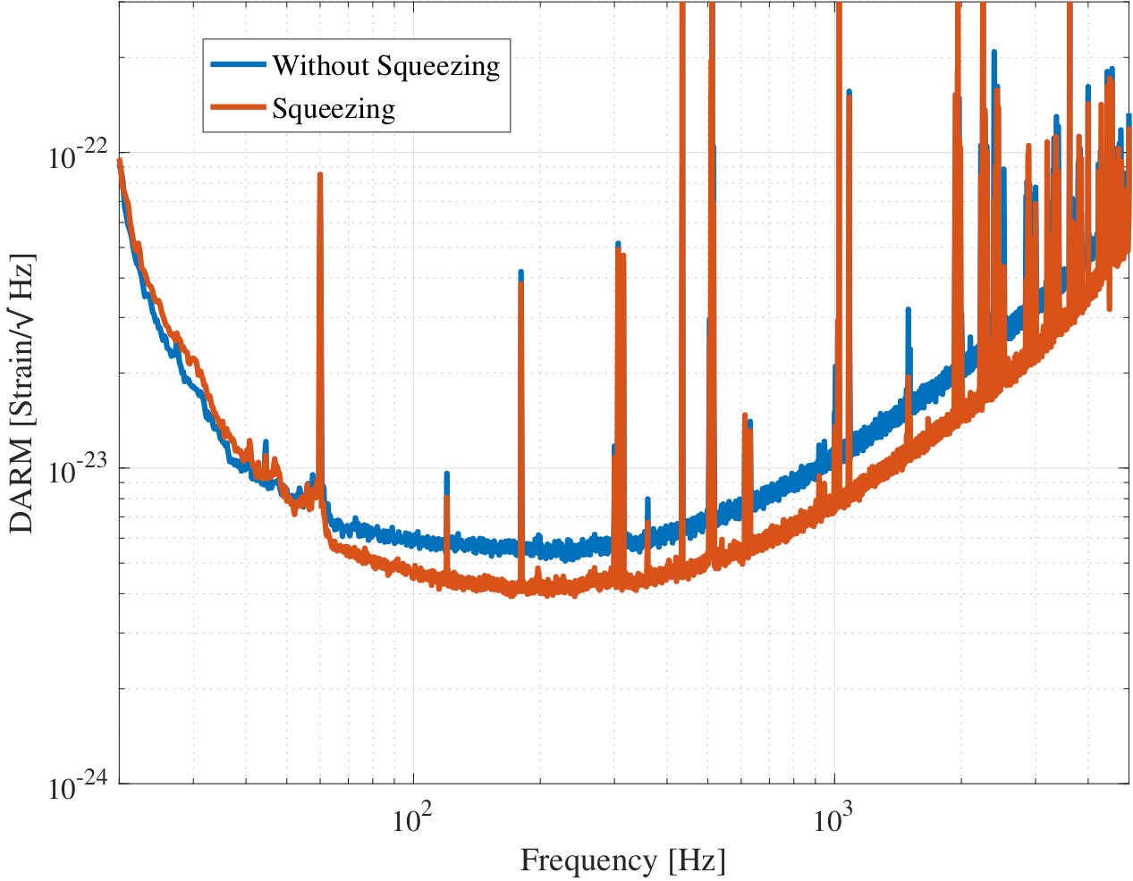
Squeezer Performance
LLO
3.2 dB (5.5 dB anti-sqz)
⇒ 17 Mpc increase in BNS range
LHO
2.2 dB (4.4 dB anti-sqz)
⇒ 14.5 Mpc increase in BNS range
No degradation in sensitivity
Limited by excess loss
Known ~20%, measured ~40%
Quantum radiation pressure noise?
LLO log 45069
Notes:
Make note of QRPN
“Degradation” defined by seeding and backscatter noise

Slide 12
Squeezer Reliability
Fully automated
Active angular control
Duty cycle >98% (1 April – 17 May)

Slide 13
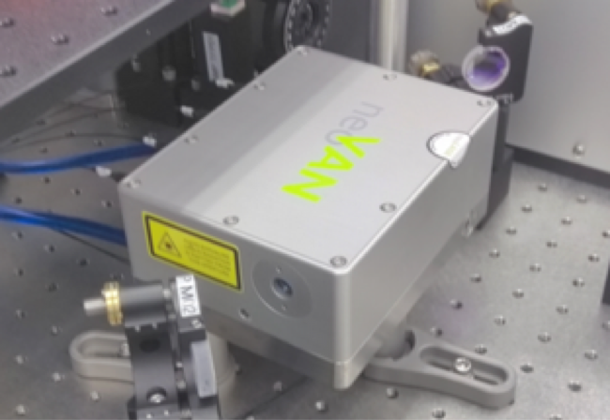
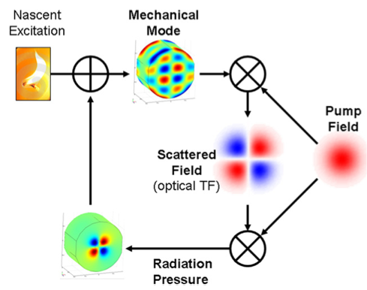
Increasing Power
Parametric Instabilities
High-Power Sources
Thermal Effects
Notes:
Thermal effects can become problem!!!

Slide 14
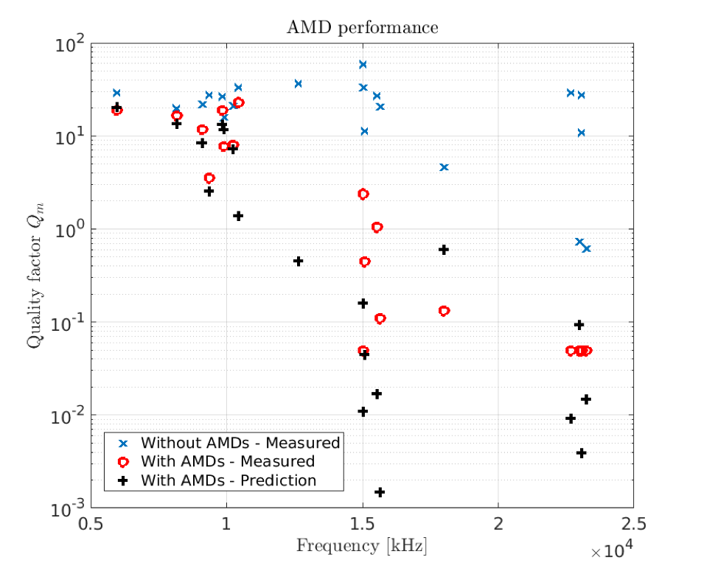
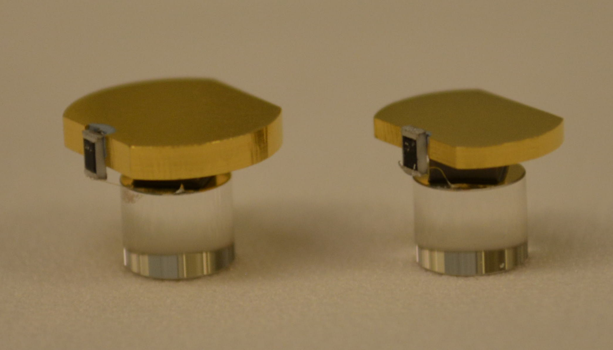
Acoustic Mode Dampers (AMDs)
Tuned to damp test mass mechanical body modes
Installed on all test masses
Successfully suppress parametric instabilities!
Negligible increase to thermal noise
Notes:
Damp body modes of test masses

Slide 15
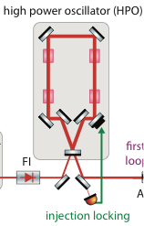
New Pre-stabilized Laser
Replace high-power oscillator with 70 W amplifier (neoLASE neoVAN-4S)
Lower water flow for improved jitter
~50 W available to interferometer
70 W Amplifier
Notes:
Otherwise keep everything else on PSL table

Slide 16
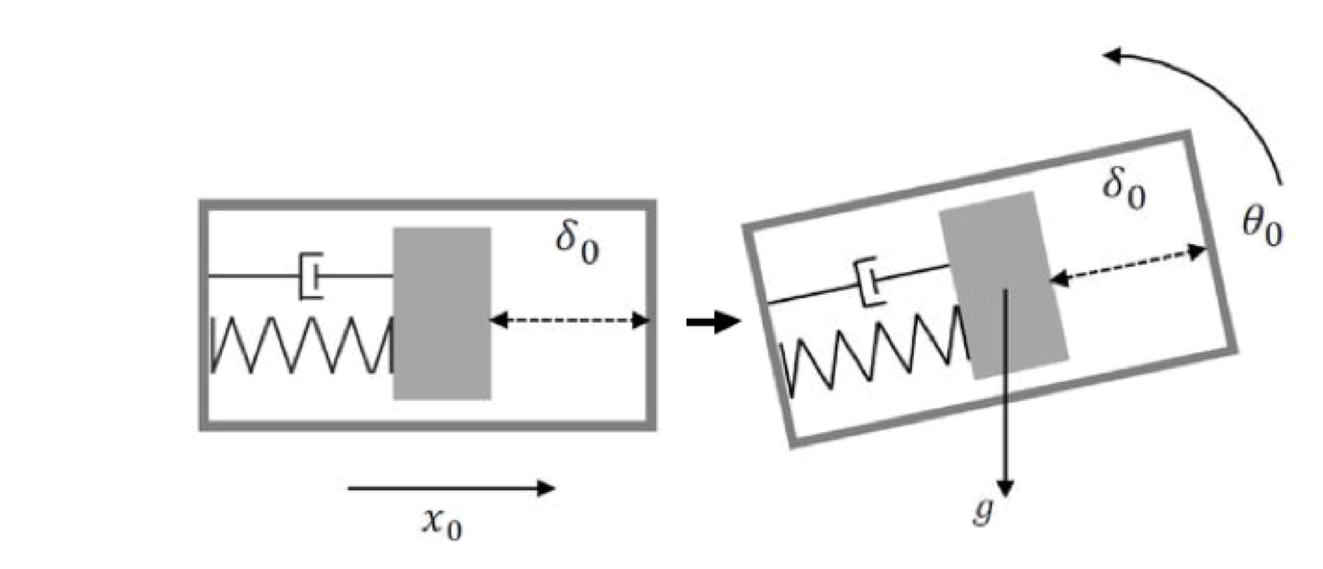
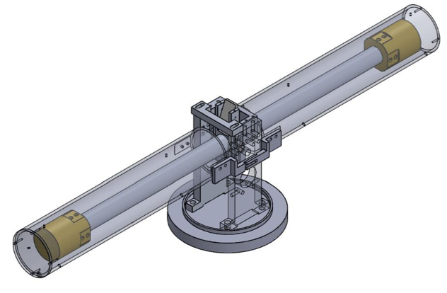
Beam Rotation Sensor
Idea: remove tilt coupling to seismometer signals
1-m long beam
4.5 kg-mass
Cu-Be flexures
Resonance ~3-8 mHz
Autocollimator readout
University of Washington
Notes:
Flexure thickness 10-15 µm

Slide 17
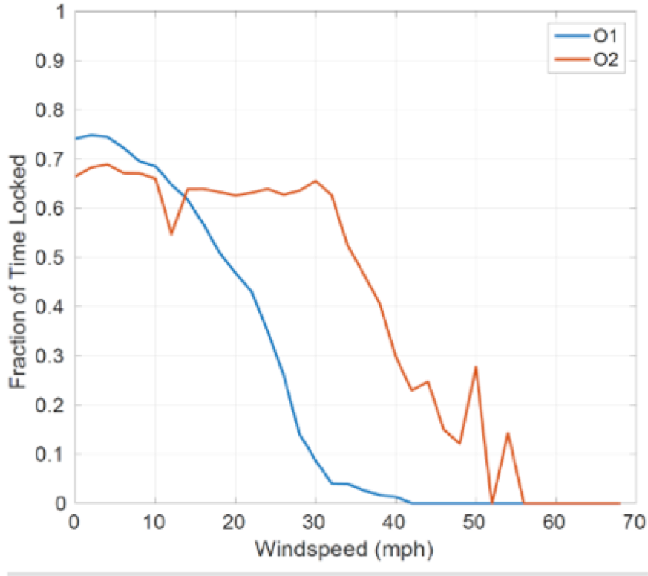
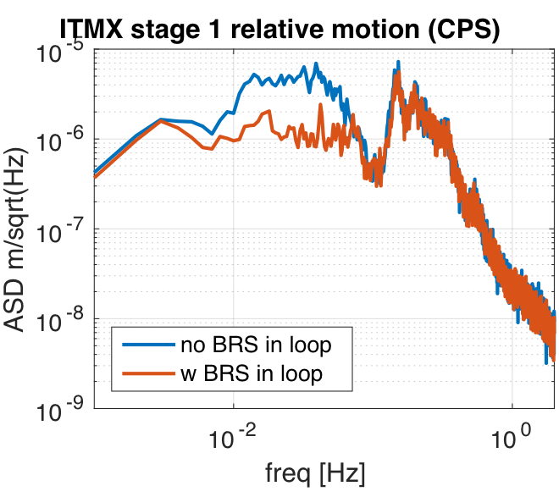
Beam Rotation Sensor
Installed at LHO prior to O2, now also at LLO
Improvement of ~3x at LLO and improves locking in windy conditions
Notes:
Compare signal between stage 1 platform and “ground”

Slide 18
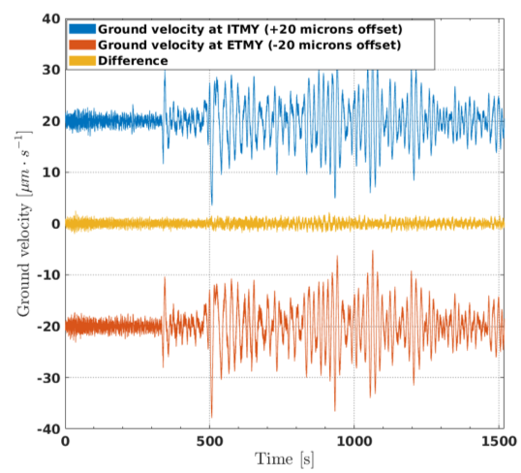
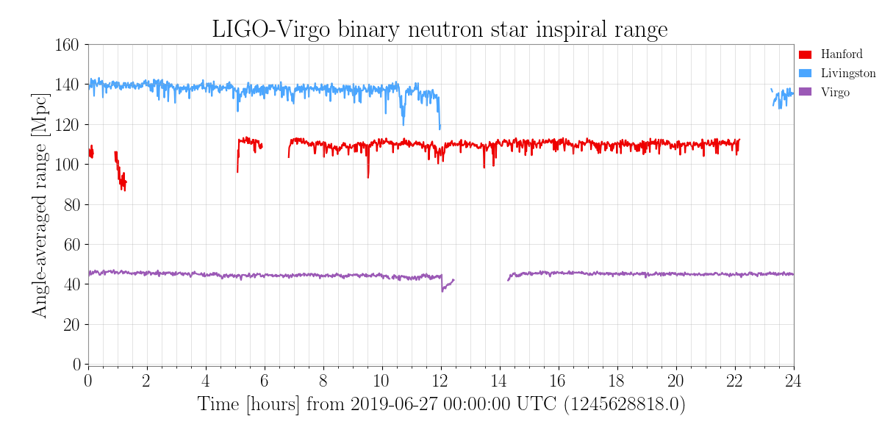
Earthquake Resilience
Idea: only isolate differentially during earthquake
To be implemented at LLO
Improves duty cycle
S. Biscans
M 6.3 earthquake near New Zealand
LHO log 50236
Notes:
Mention that acquiring lock is the hard part, where problems creep up

Slide 19
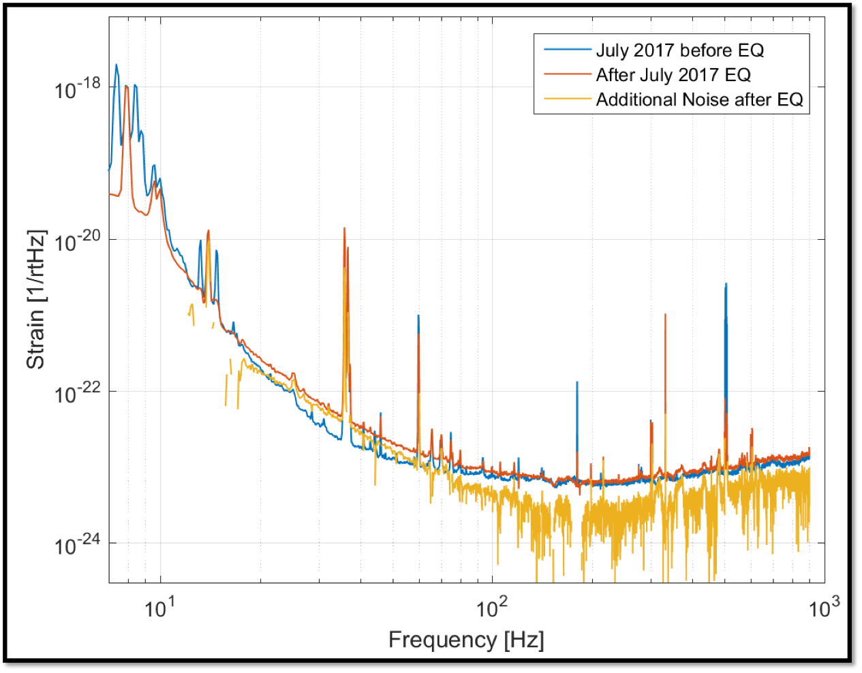
Stray Electric Fields and Optic Charge in O2
Increase in noise after Montana EQ July 2017
Noise largely disappeared after optic discharge
Additional excess noise in certain actuator configurations
Suggests optic charge and/or stray E fields
Notes:
Mention coupling to cage motion (“metal structure surrounding optic”)

Slide 20
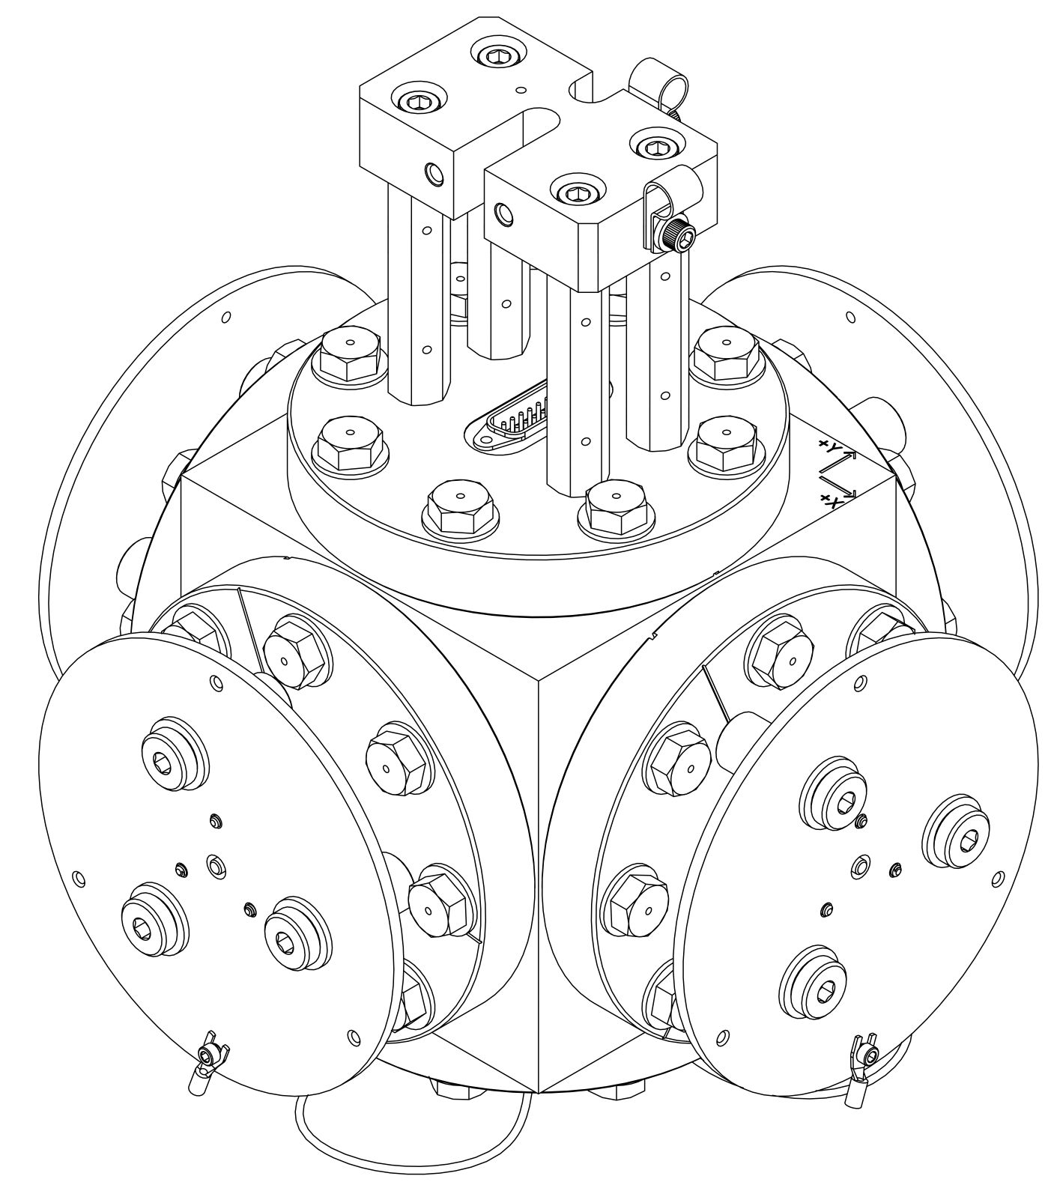
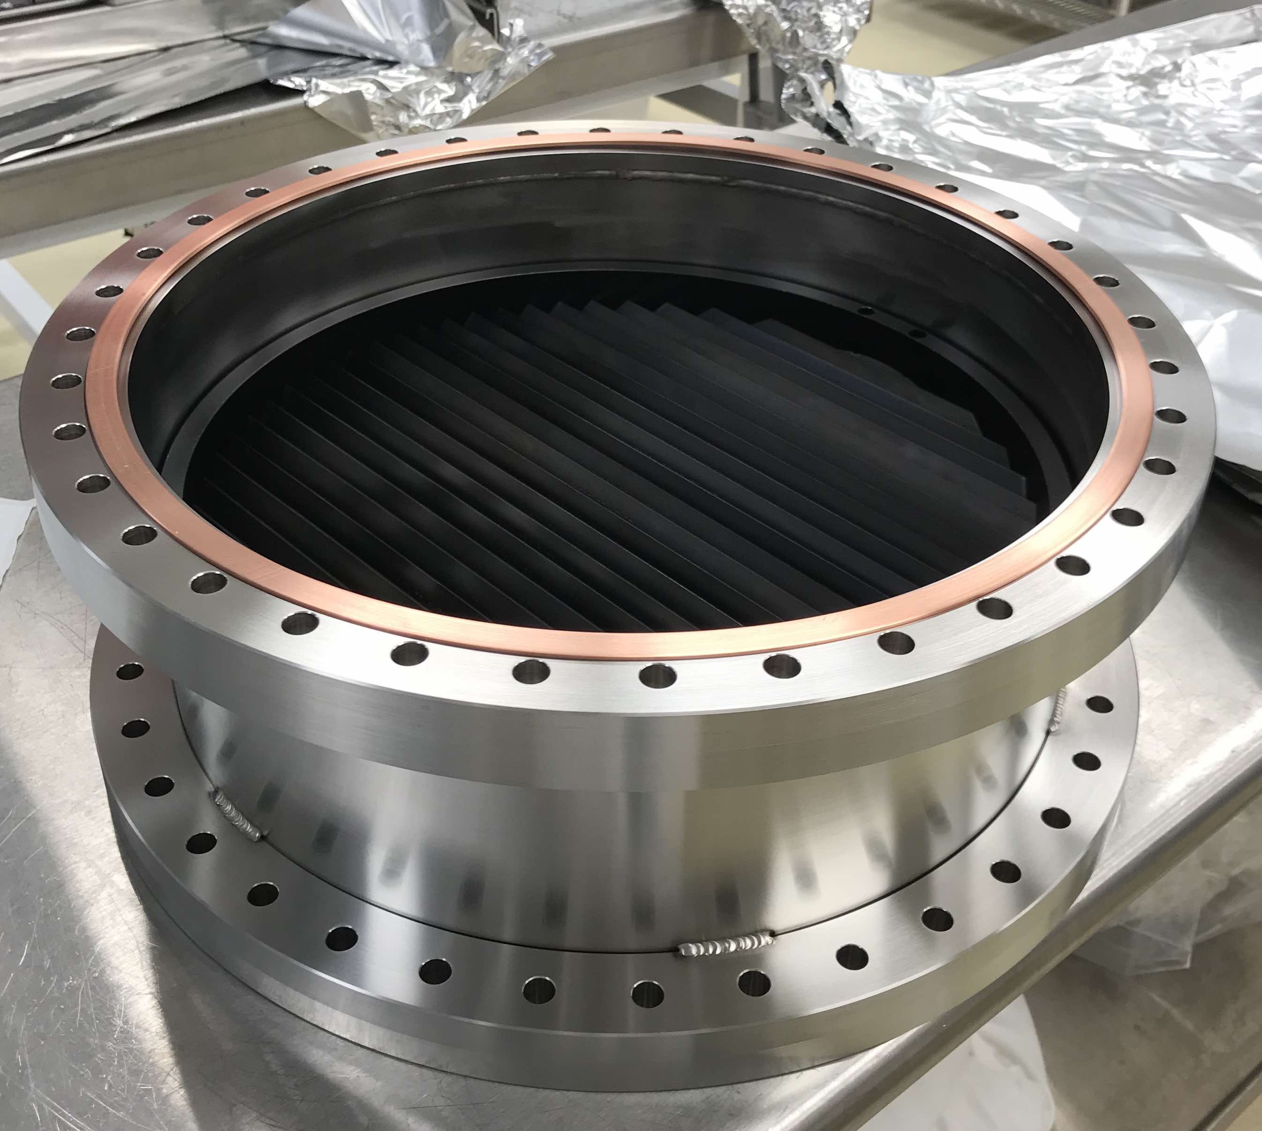
Stray Electric Fields and Charge
Installed electric field meter in chamber to monitor fluctuating electric fields
Viewport injections suggest large-scale E Fields >100x below current sensitivity
Additional tests to understand and mitigate local E fields
Chevron baffles installed on ion pumps
Notes:
Dual-axis, differential read-out
Excess noise from DAC

Slide 21
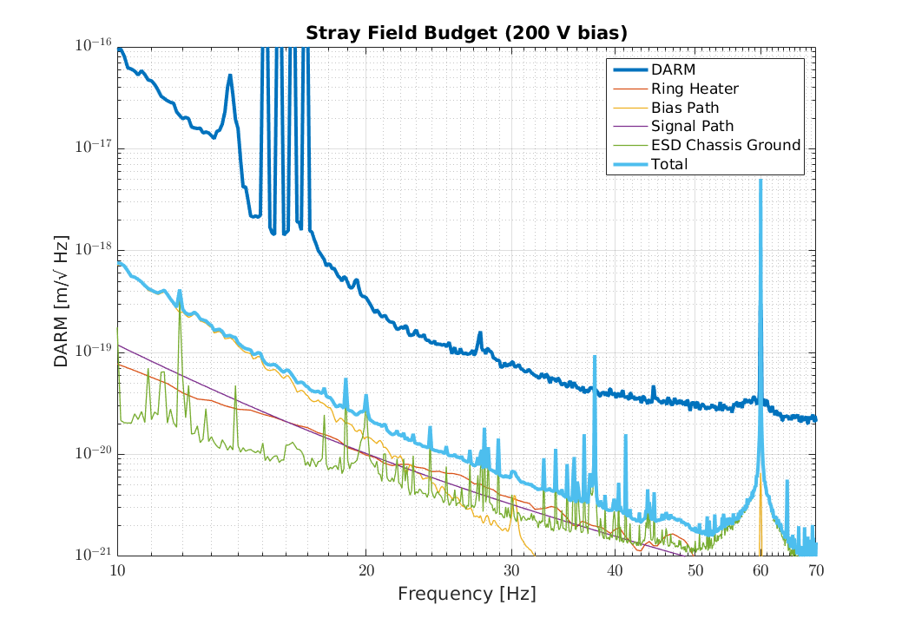
Stray Field (After)

Slide 22
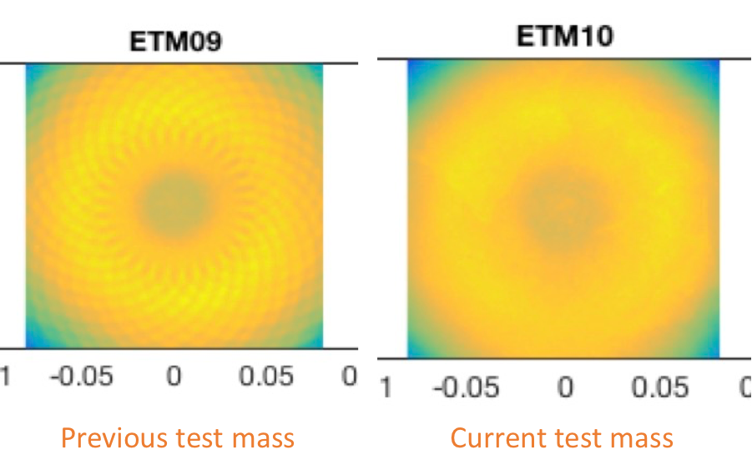
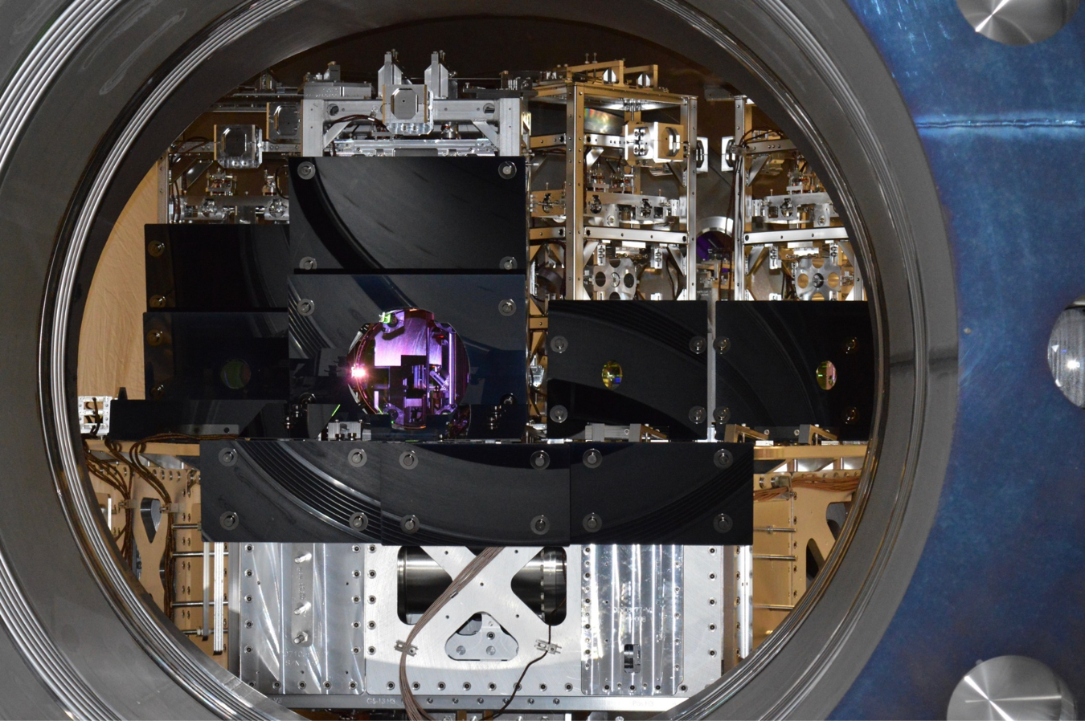
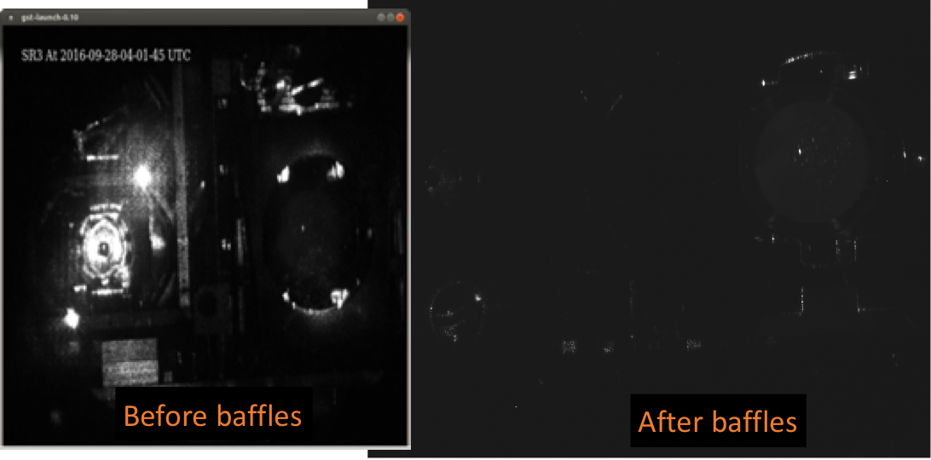
Scattered Light Mitigation
End masses replaced
Decreased scatter loss
~10% increase in power buildup
Installation of additional baffles

Slide 23
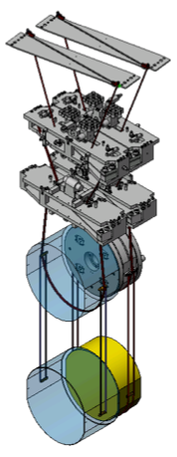
Other improvements
New annular reaction masses to reduce squeezed film damping
Signal recycling angular control scheme
New signal recycling mirror (T 37%->33%) and holder (thermal noise)
Reduced vibration on primary laser table
Improved actuator filtering to improve resistance to fast transients
Tweaks to angular control loops
J. Romie
Notes:
Many other minor modifications

Slide 24
Where else can we improve?

Slide 25
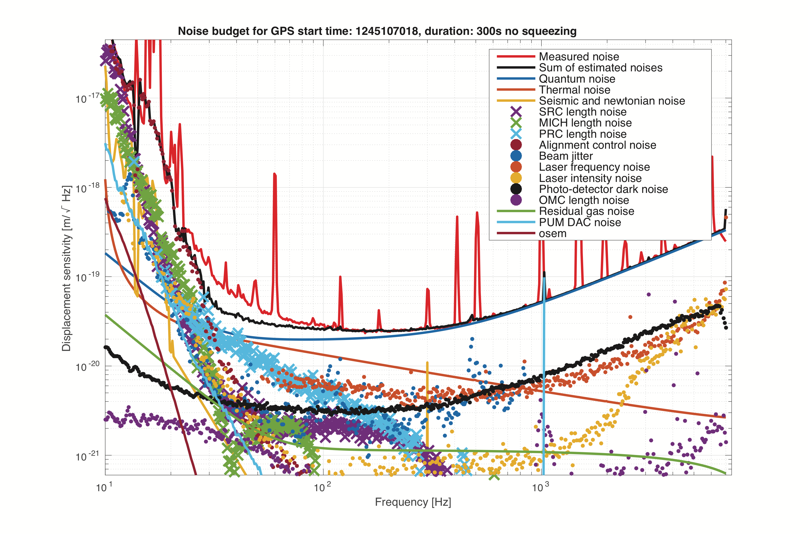
LHO Noise Budget
ASC
?????
Shot Noise

Slide 26
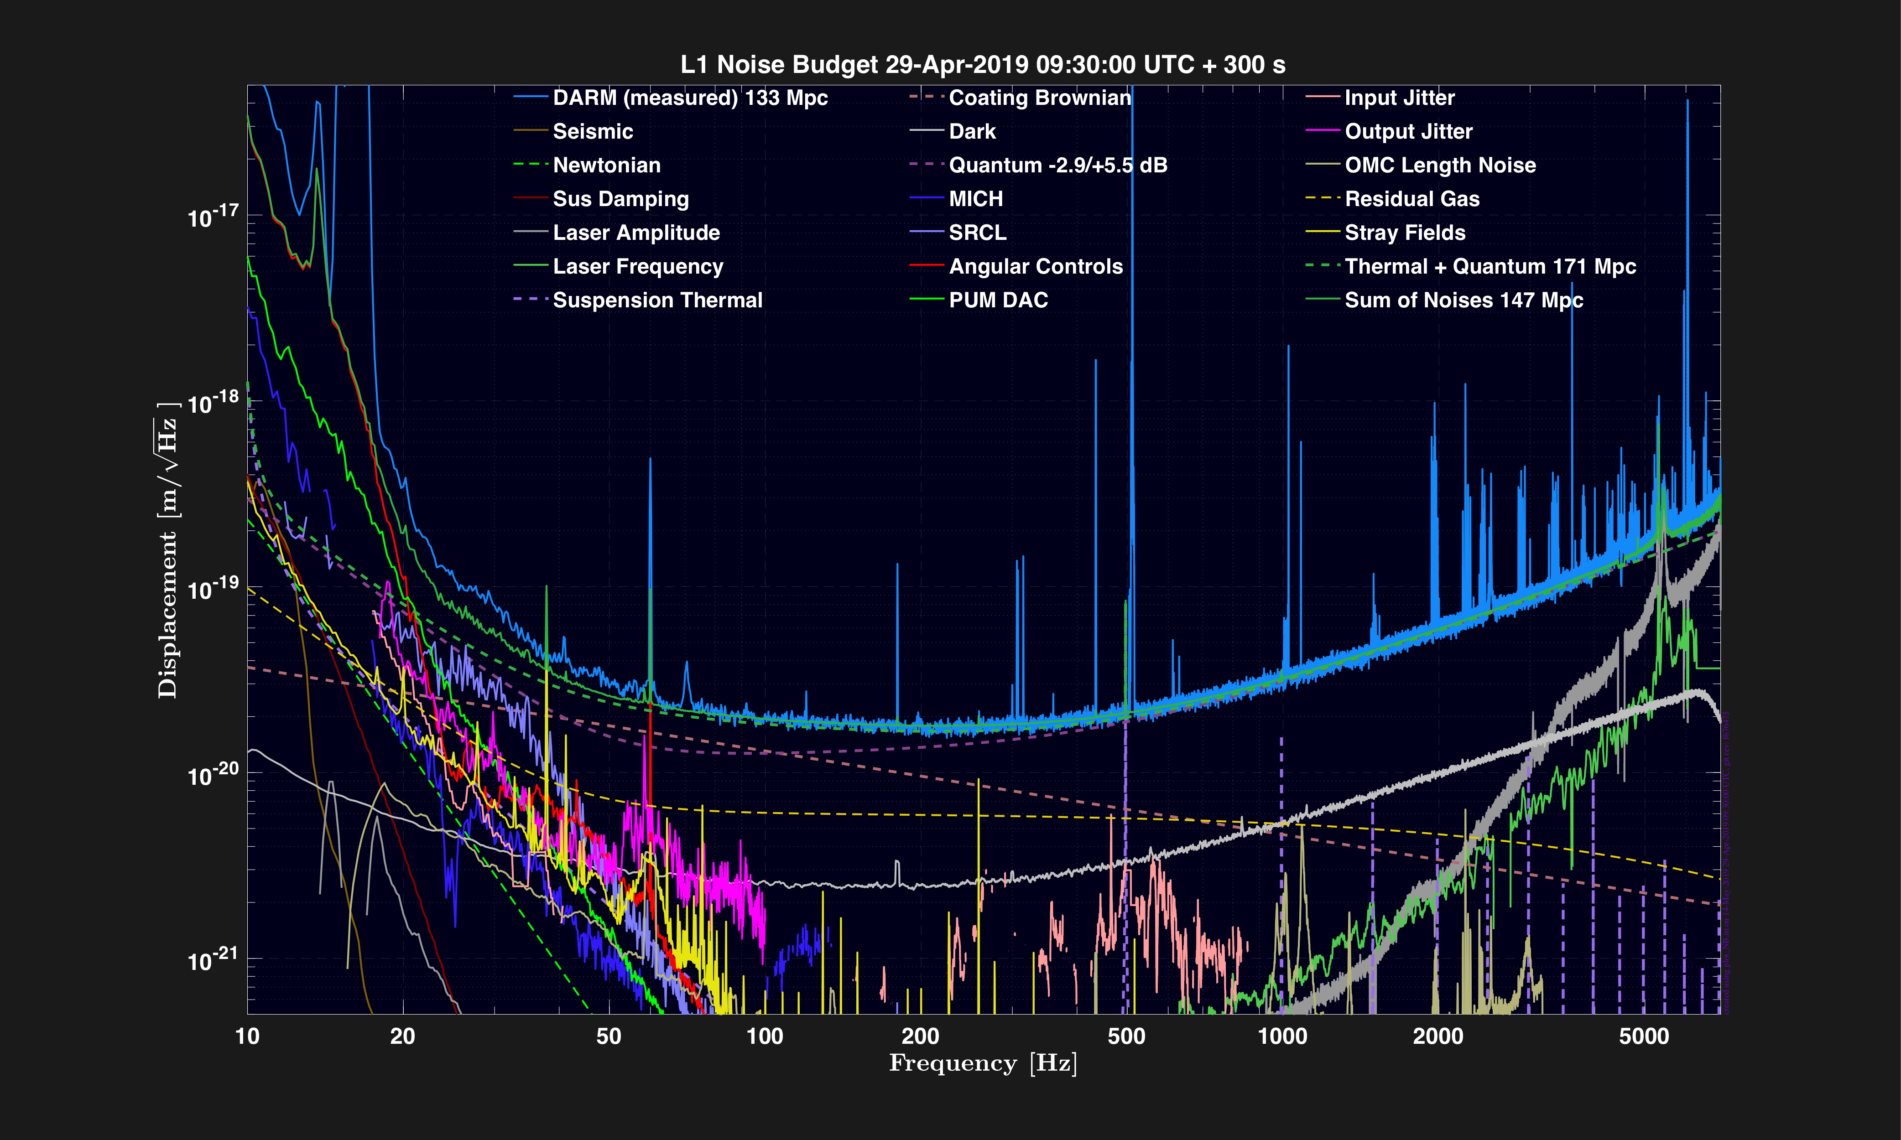
LLO Noise Budget
ASC
?????
Shot Noise
Notes:
Emphasize bumping up against coating thermal noise

Slide 27
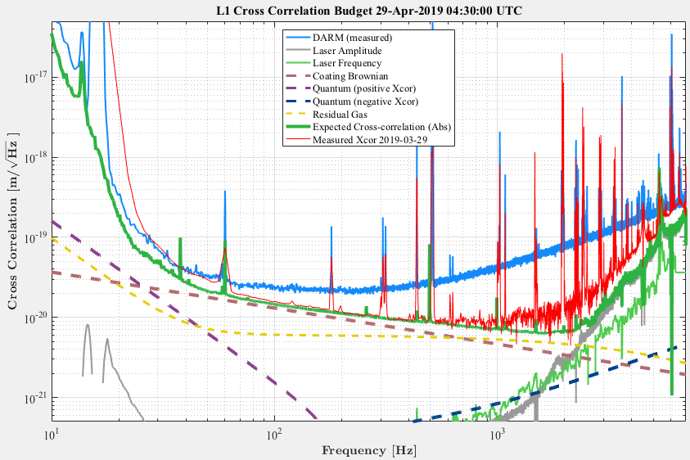
Looking below shot noise
LLO Log 45915
Notes:
Emphasize that coating thermal noise right where expect, and starting to bump up on it
ALSO DARM is a little lower with squeezer on compared to this measurement

Slide 28
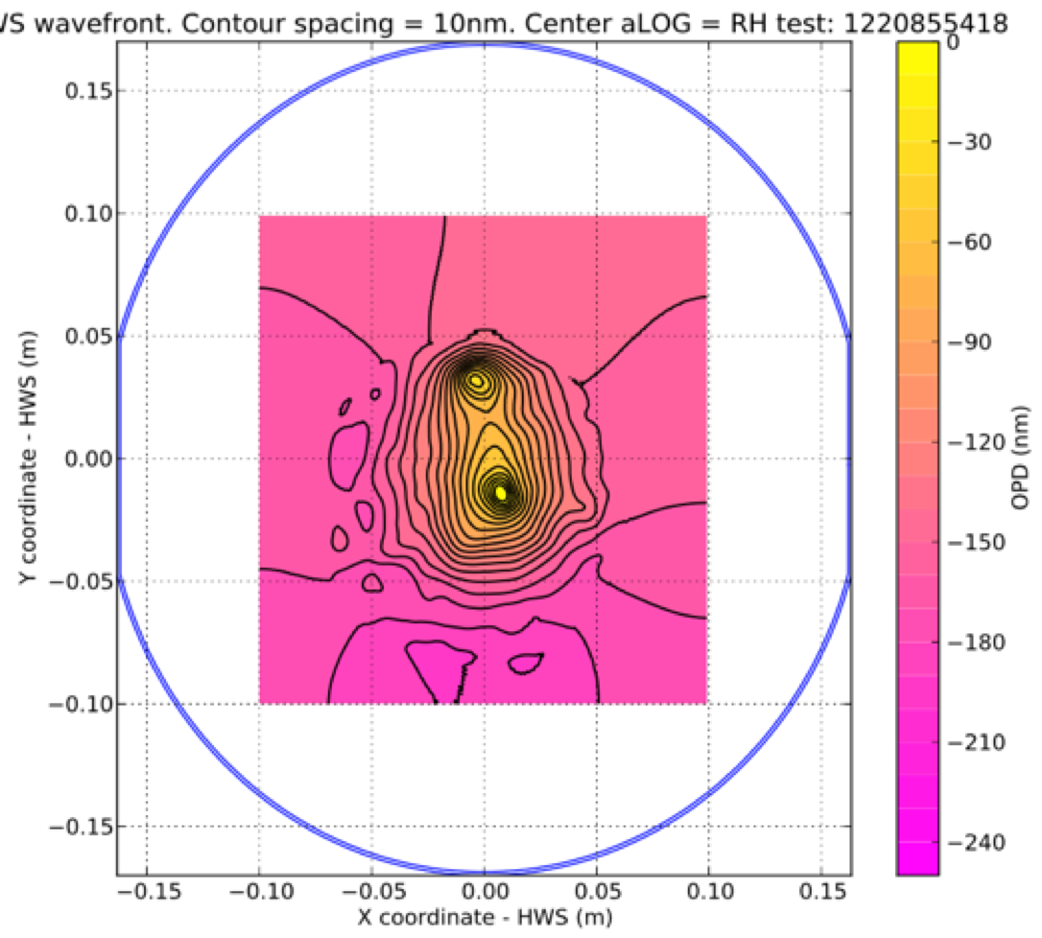
Point Absorbers on Coating
LHO ITMY
LLO ETMX
Notes:
Point absorbers ~0.1-1 ppm (overall), ~100 µm, absorption >1e4 ppm

Slide 29
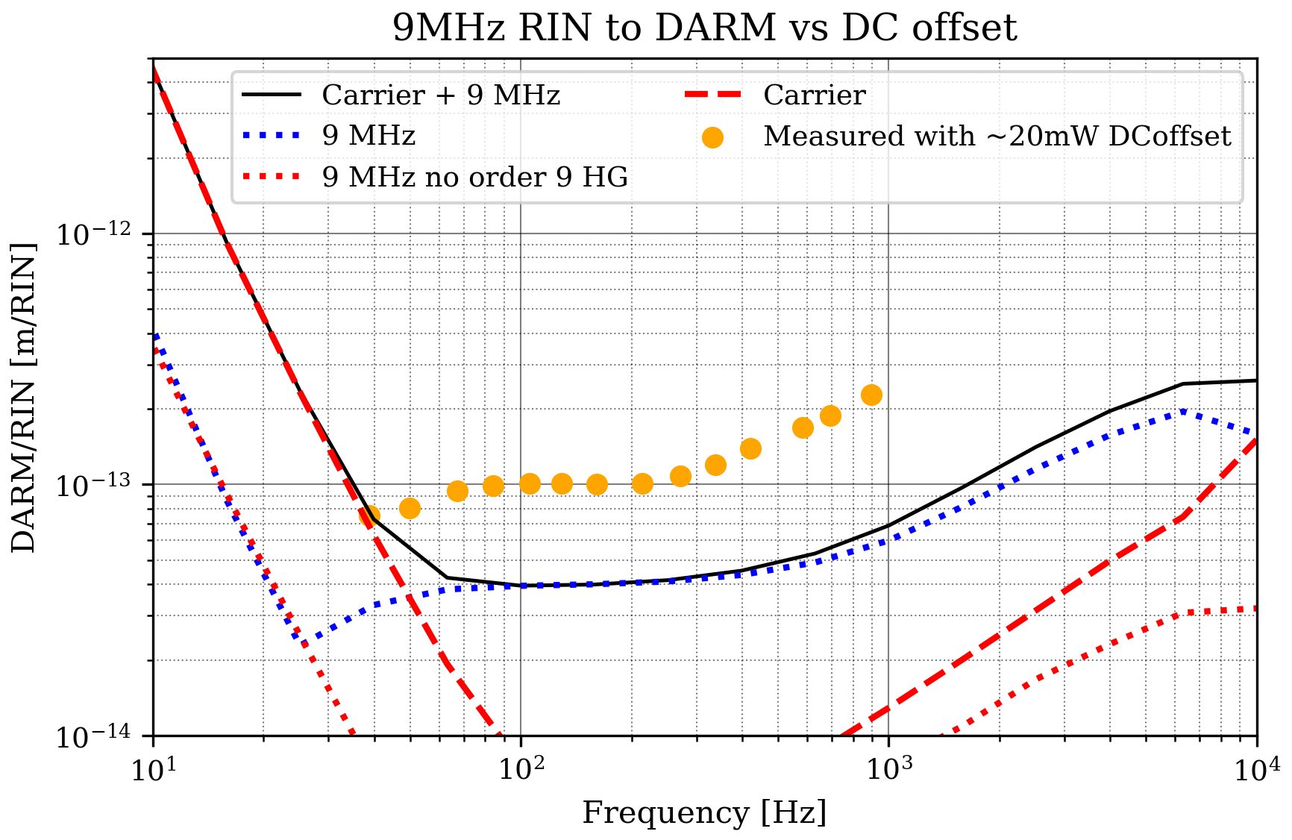
Point Absorbers
LLO log 43138
Limit power buildup
Can’t correct with ring heaters
Negatively affects angular control signals
Couples in jitter noise
May be responsible for increased intensity noise coupling via scatter
Can’t correct with thermal compensation
LHO log 47253
Notes:
@ LLO, point observer issue at ETMY
Understand qualitatively, but not quantitatively
9th-order mode of 9 MHz sideband transmitted through OMC
Because can’t correct with TCS, suggestive of local deformity (point absorber!)

Slide 30
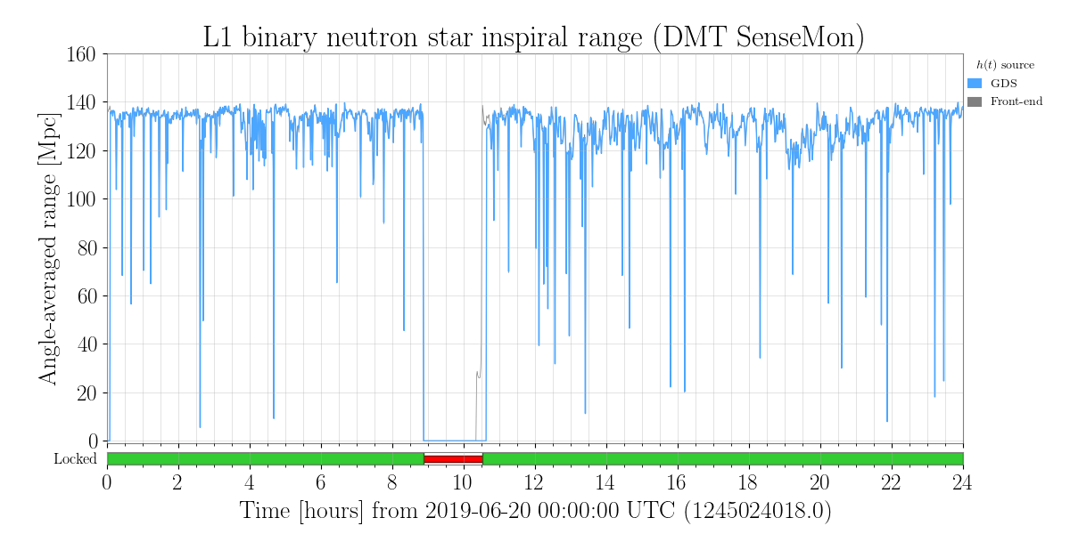
Open Questions
Point absorbers
How can we compensate for them?
How can we detect and/or remove these before installation?
Scattering + anthropogenic noise @ LLO
Low-frequency mystery noise
LLO X arm pressure increase
Notes:
Mention possibly using CO2 laser and custom masks
Lots of studies on where scattering is coming from, but still don’t understand origin

Slide 31
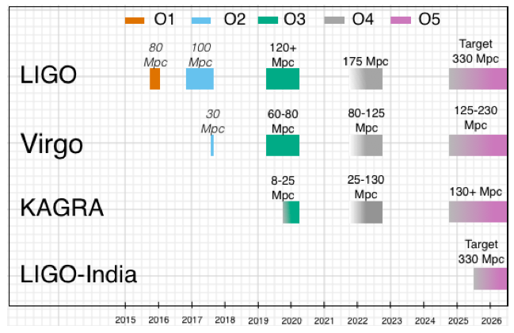
Schedule
A+
KAGRA join end of 2019
One month commissioning break in October 2019
Run ends ~1 May 2020
Prep for O4/A+
You are HERE
P1200087-v50
Notes:
Mention that A+ is like Virgo+ (post-aLIGO in same facility), some prep for A+ will begin before O4

Slide 32
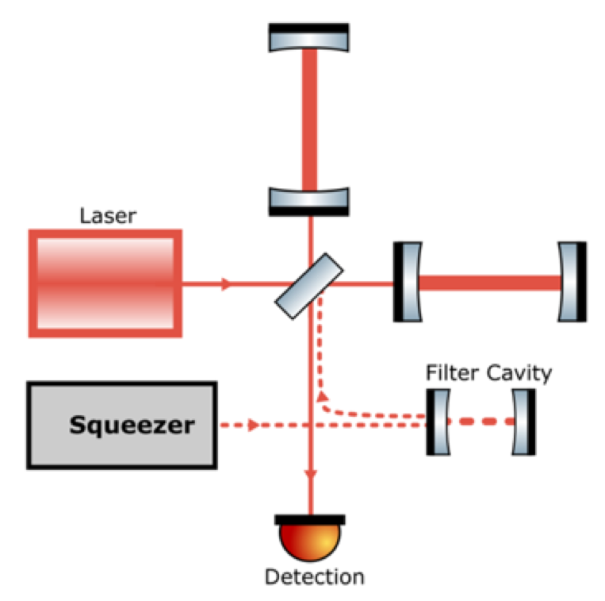
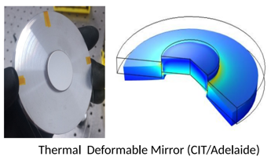
Next Steps
More squeezing:
Understand excess loss
Increase squeezing level (more green power, OPO finesse)
Low-loss Faraday isolator
See D. Tanner poster
Adaptive mode-matching to IFO
Frequency-dependent squeezing
More scatter mitigation
Increased power
Swap test masses?
Notes:
Advertise poster

Slide 33
Questions?

Slide 34
Extras

Slide 35
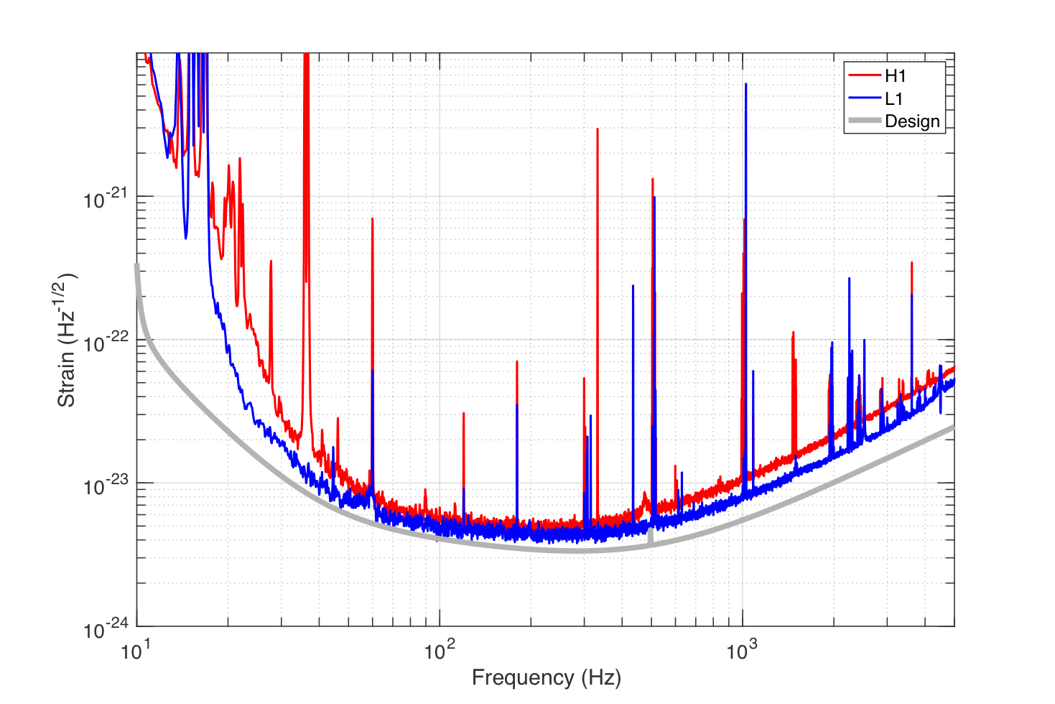
H1/L1 Sensitivity

Slide 36
LIGO-G1900203

Slide 37
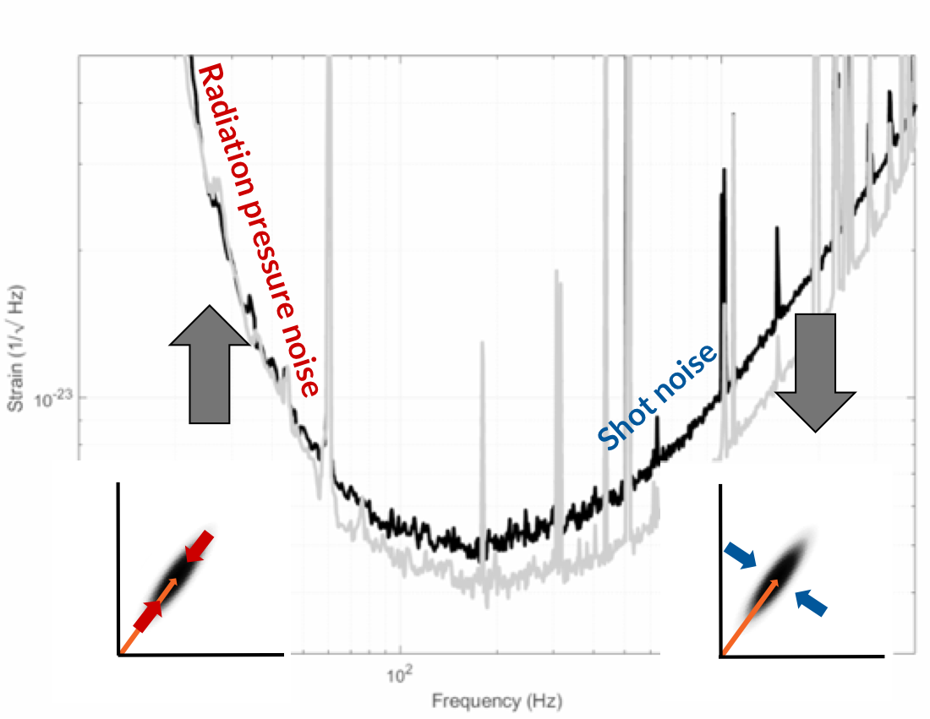

Slide 38
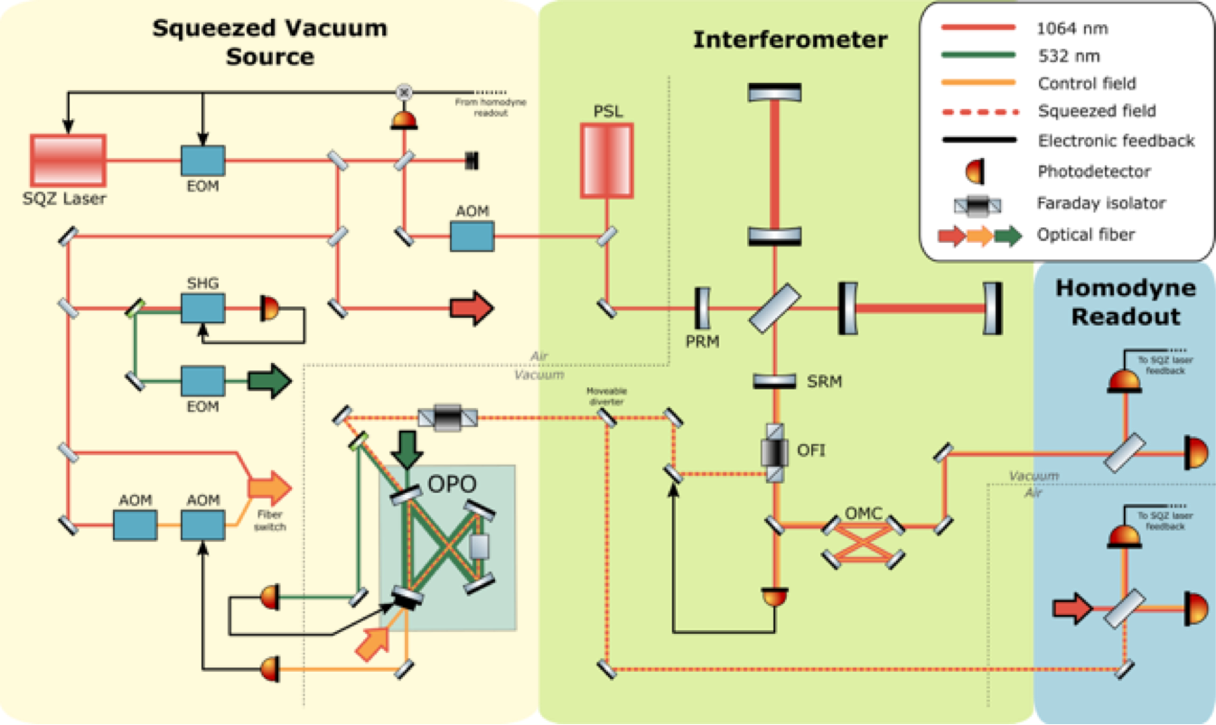
Squeezer Control

Slide 39
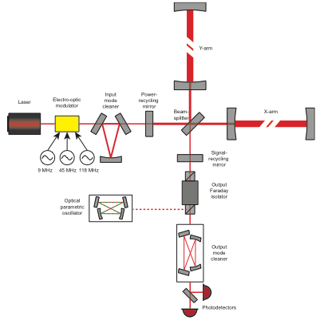
IFO Layout

Slide 40
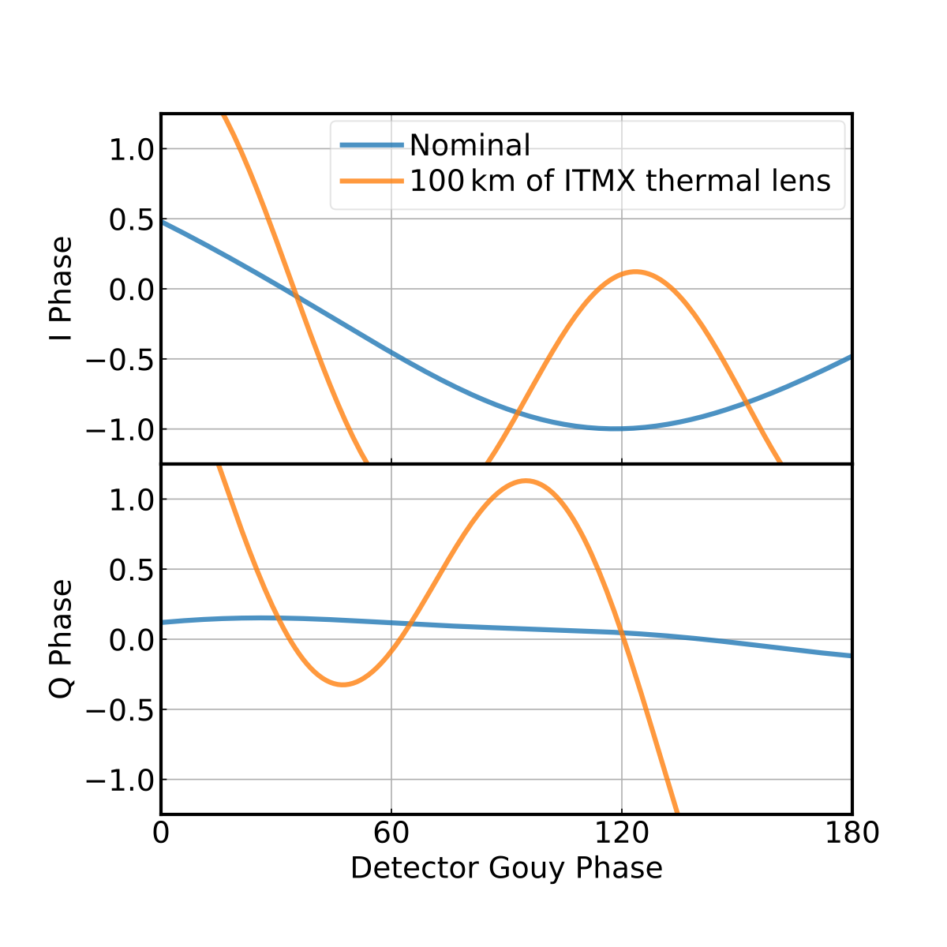
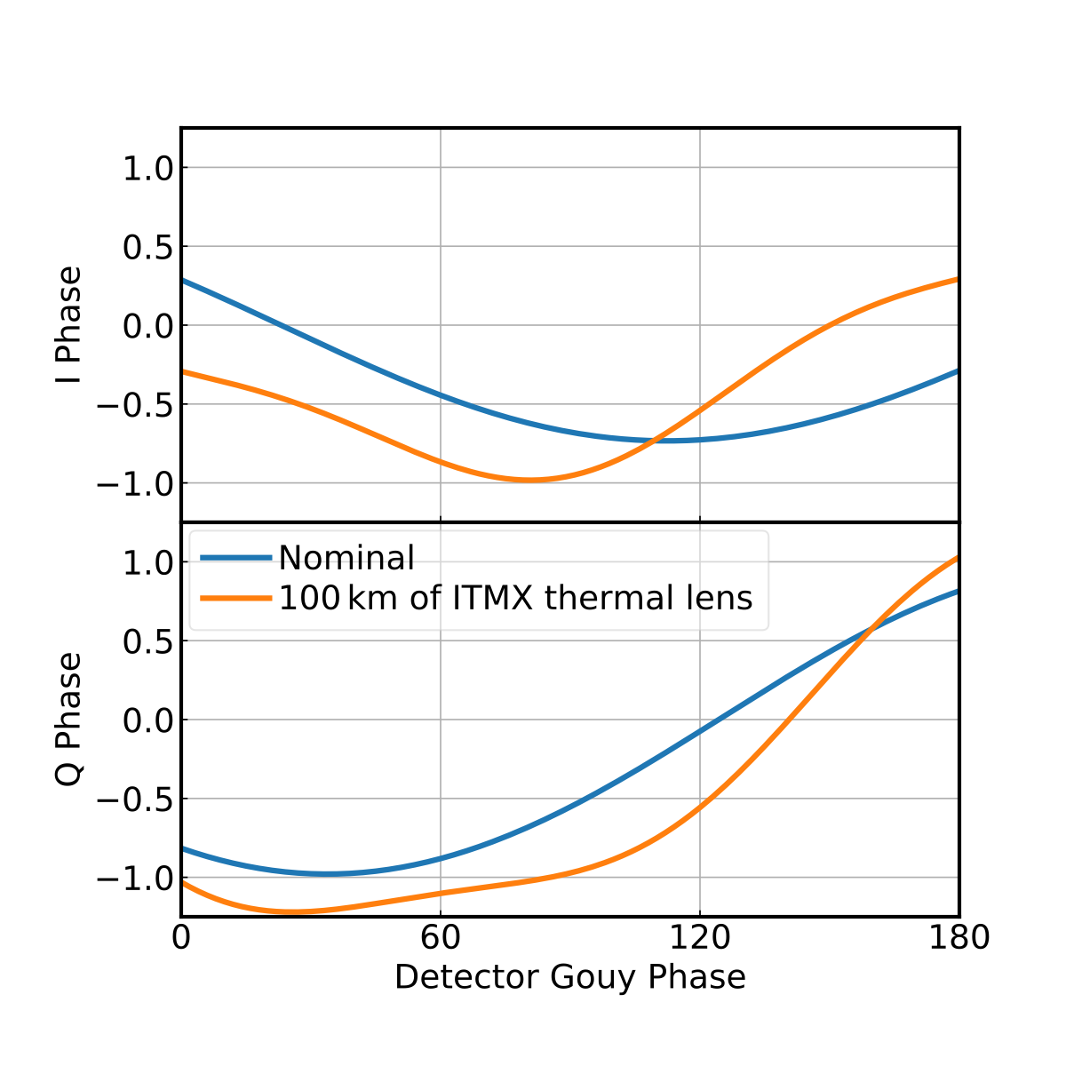
SRC ASC
Old (36 MHz)
New (118-36 = 72 MHz)
Credit: Hang Yu
Notes:
Inject sidebands at 9, 45, and 118 MHz now

Slide 41
Electrostatic Drive (ESD)
LIGO-G1501197
$$F=A(V_{bias}-δV_{sig})^{2}$$
J. Romie
$$=A(V_{bias}^{2}+δV_{sig}^{2}-2V_{bias}δV_{sig})$$

Slide 42
Excess ESD Noise Coupling
Chamber
ESD Driver
Cage
ESD
Other
electronics
Notes:
Grounding is done in star pattern (“correctly”). Can’t filter out this effect

Slide 43
G1901195

Slide 44
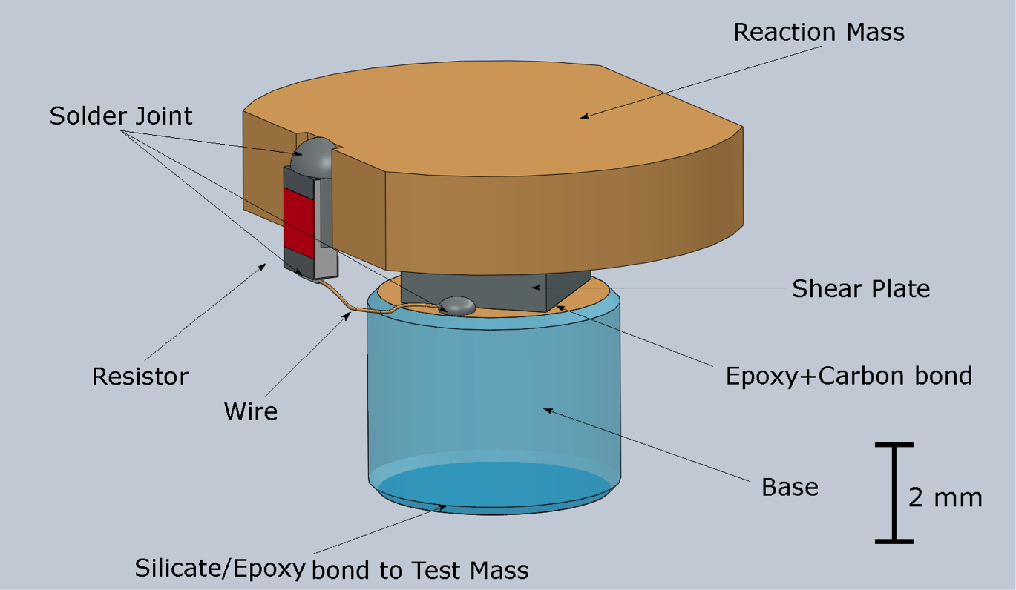
AMD Details
G1800454

