Slide 1
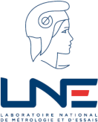
Laser Power meter calibrations at LNE
J. Dubard, O. Enouf, F. Issard, P. Pinot, Z. Silvestri
LCM-LNE-CNAM
GW (Gravitational Wave) Metrology Workshop, March 14-15, 2019

Slide 2
OUTLINE
Introduction
Calibration capabilities
Traceability
New development in laser power measurement based on radiation pressure
Conclusion
2

Slide 3
INTRODUCTION
French metrology is managed by LNE and is based on:
4 National institutes: LNE, CNAM, CEA-LNHB, SYRTE-OP
6 DI’s (ENSAM, IRSN, CETIAT, LTFB, LADG, TRAPIL)
Radiometry-Photometry:
CNAM: set-up the references according to CCPR KC
LNE: set-up complementary references (laser power, fiber optics, radiance,…), and transfert to industry
3

Slide 4
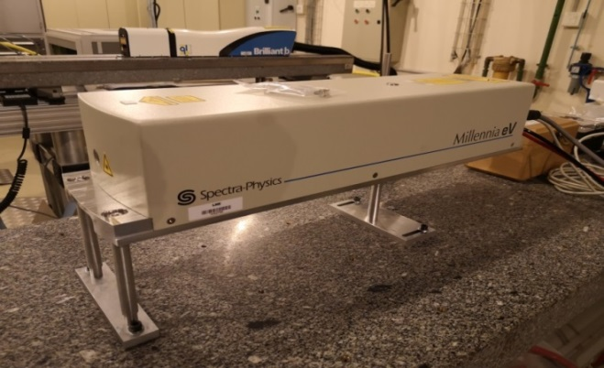
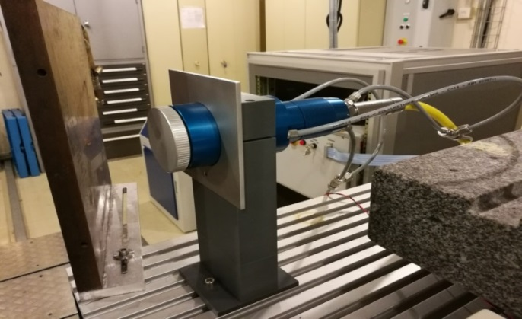
Calibration capabilities
Power measurement
Wavelengths (nm): 532, 633, 1064, 1070, 10600
Power range: 0.1 mW to 1 kW
Laser sources
Spectra-Physics | 127 | 633 | 40 mW | 2 mm
Spectron Laser Systems | SL 301 | 1064 | 4 W single 50 W multi | 4 mm
MPB tech | GN-802-MES | 10600 | 15 W | div
Spectra-Physics | Millennia eV25 | 532 | 25 W | 3 mm
IPG PHOTONICS | P30-001298 | 1070 | 1100 W | 14 mm
4

Slide 5
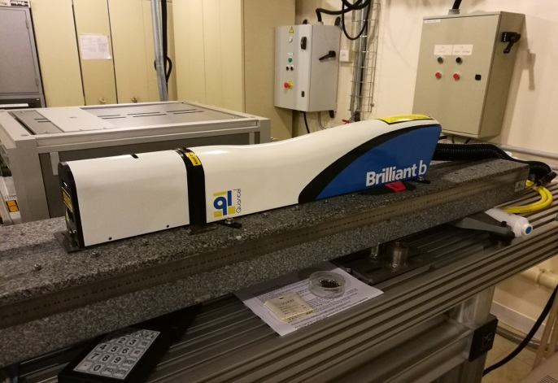
Calibration capabilities
Energy measurement
Wavelengths (nm): 1064, 532, 355
Energy: up to 700 mJ
Laser: QUANTEL, Brilliant B
Pulse width: 7 ns
Repetition rate: 20 Hz
5

Slide 6
Calibration capabilities
CMC
6

Slide 7
TRACEABILITY
Traceability through home made laser power meters
7

Slide 8
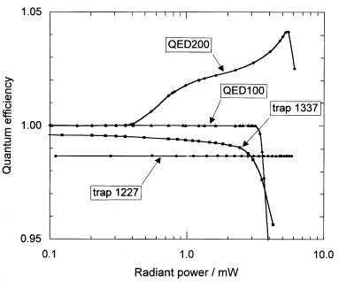
TRACEABILITY
Previous traceability was through the electrical quantities. This has shown a systematic error of 2 % (EUROMET comparison 156)
Nowdays traceability is to the cryogenic radiometer through a Si trap detector:
3 Hamamatsu S1227 SI detector
Calibrated at a power levels of 100 µW and 500 µW
Linearity has been demonstrated at 5 mW (cryogenic radiometer) and at 20 mW (comparison to PMOD scale with 0.1% agreement)
« Nonlinearity of the quantum efficiency of Si reflection trap detector at 633 nm », K-D. Stock et al, Metrologia, 35, 1998
8

Slide 9
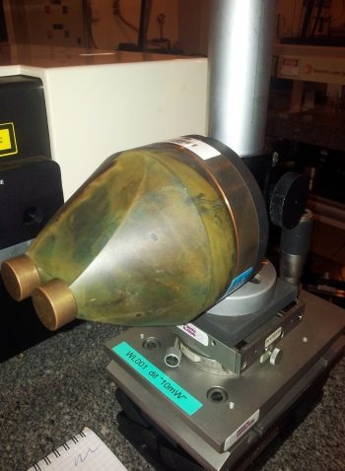
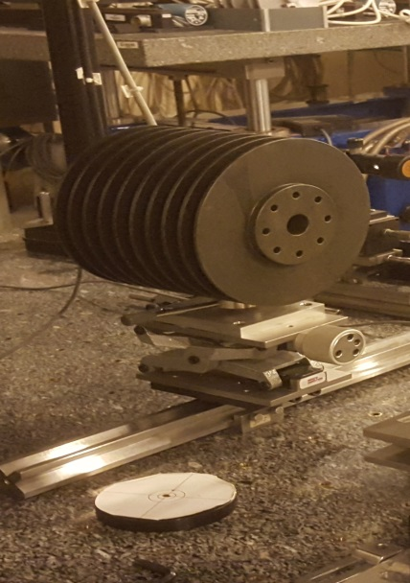
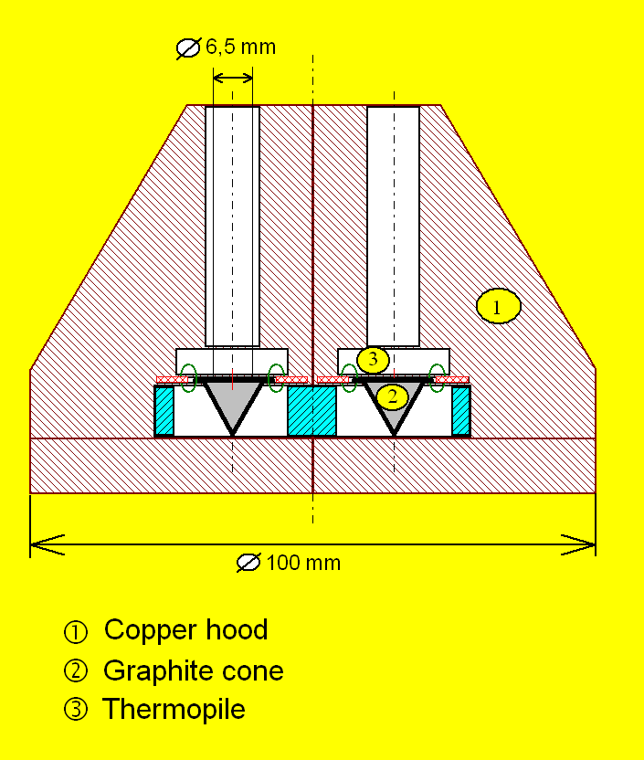
TRACEABILITY
Cryogenic radiometer
λ: 488, 514, 633
P: 100 -500 µW
WL001
Si Trap detector
λ: 532
P: 500 µW -5 mW
Radiometer WL001
Conduction
WLR2
λ: 532
P: 100 mW + Attenuator
Radiometer WLR2
Conduction + electrical substitution
9

Slide 10
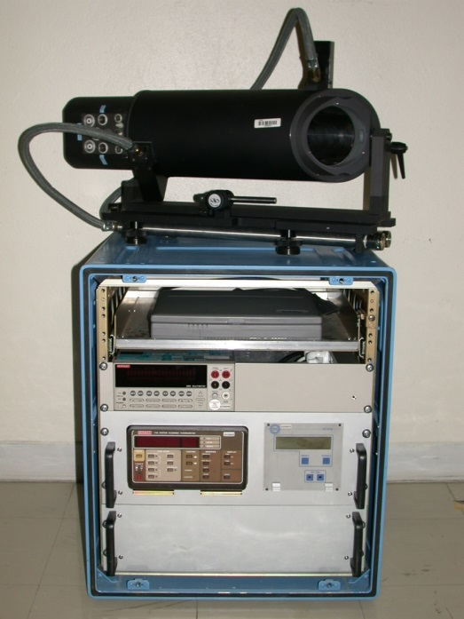
TRACEABILITY
Radiometer WLR2
Conduction + electrical substitution
λ: 532
P: 10 W+ Attenuator
Radiometer CLR01
Conduction + electrical substitution
λ: 1070
P: 300 W+ Attenuator
Radiometer CLR5
Conduction + electrical substitution
λ: 1070
P: 1000 W+ Attenuator
Radiometer CLR30
Conduction + electrical substitution
10

Slide 11
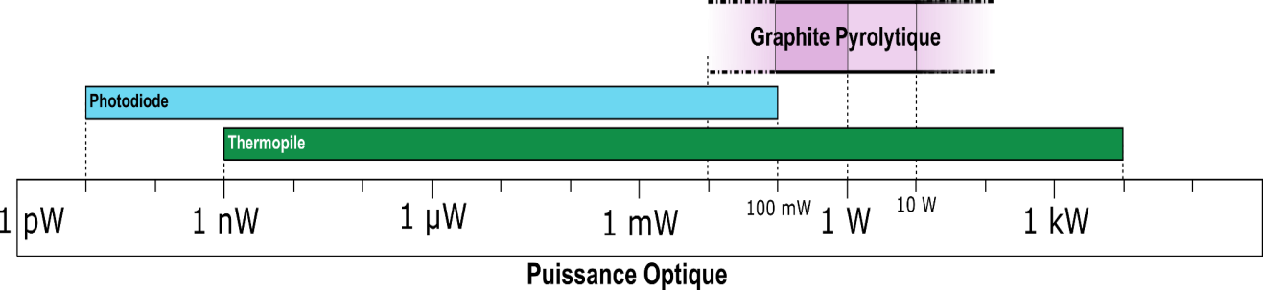

NEW DEVELOPMENT: radiation pressure
> Development of an absolute standard of an optical power meter
Directly traceable to the new SI
Based on pressure radiation using magnets + pyrolytic graphite (PyC)
Range 100 mW – 10 W
Wavelenght range 0,5 µm < λ < 10,6 µm
Expected relative uncertainty 1 %
Cryogenic radiometer is not necessary
Alternative to thermopiles and complementarity to photodiodes
Simple, compact and reliable design
Possible use on an operational laser beam for laser intensity and stability control
(surgery, additive manufacturing ...)
11

Slide 12

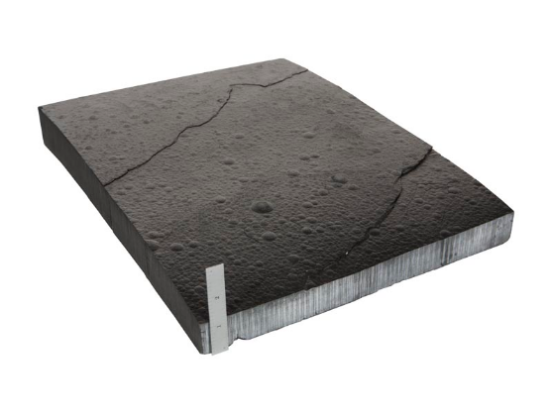
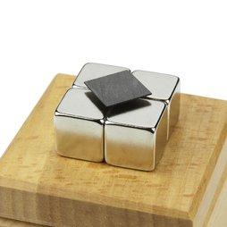
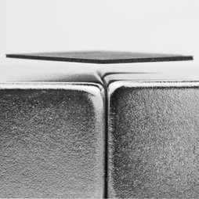
Pyrolytic graphite
NEW DEVELOPMENT: radiation pressure
Main characteristics of Pyrolitic Craphite
  CVD fabrication
  Consisting of a stack of layers of graphene
  Ultra pure and non-porous
  Anisotropic properties :
  → Thermal and electrical conductivities
  → Diamagnetic (χ _{z}=-4,5 × 10⁻⁴ χ _{x,y}=-8,5 × 10⁻⁵)
z
y
x
Diamagnetic
material
Magnet
PyC
Repulsive
force
Repulsive
force
0,5 mm
PyC in levitation on NdFeB magnets
at room temperature
supermagnete.fr
supermagnete.fr
NdFeB magnets
12

Slide 13
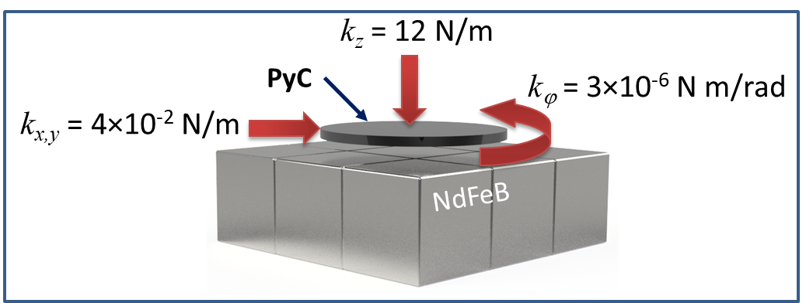
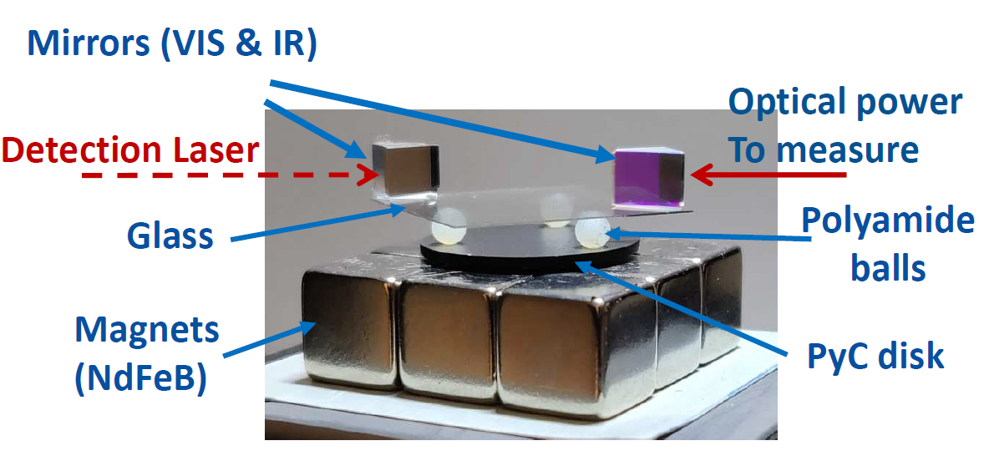
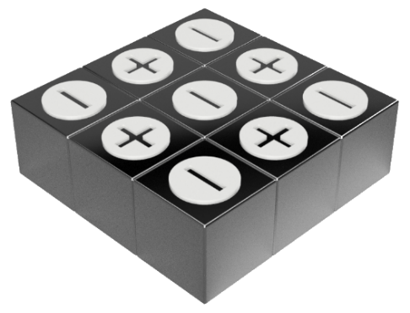
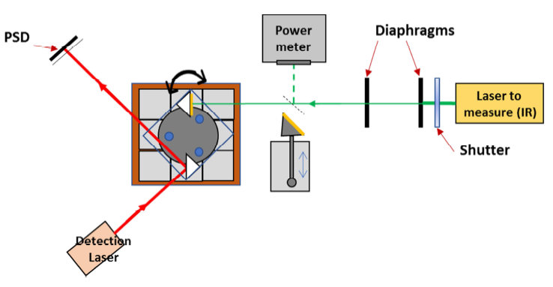
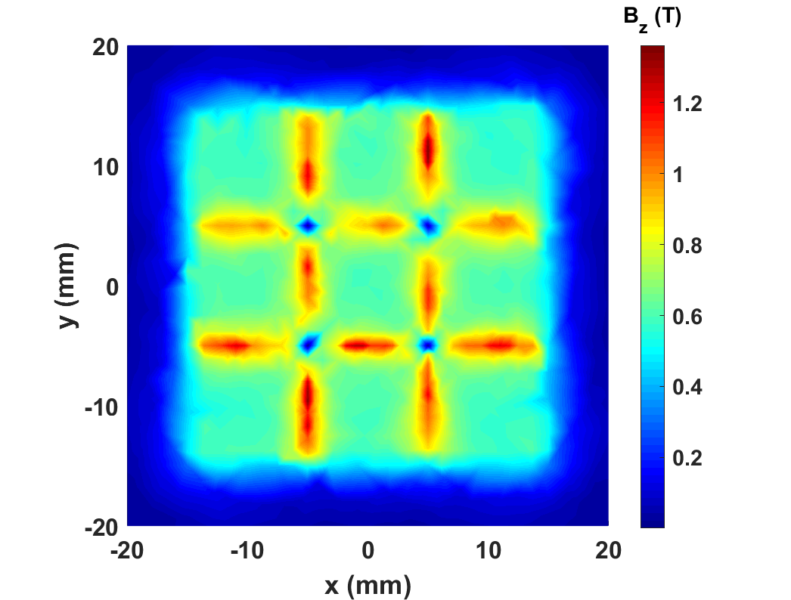
NEW DEVELOPMENT: radiation pressure
k_{i} : spring constant
Arrangement of 9
NdFeB magnets
Mass of the optical part: 1.18 g
2D distribution of B
Simulation Ansys
P. Pinot et Z. Silvestri, Optical power meter using radiation pressure measurement, Measurement, Vol. 131, (2019)
13

Slide 14
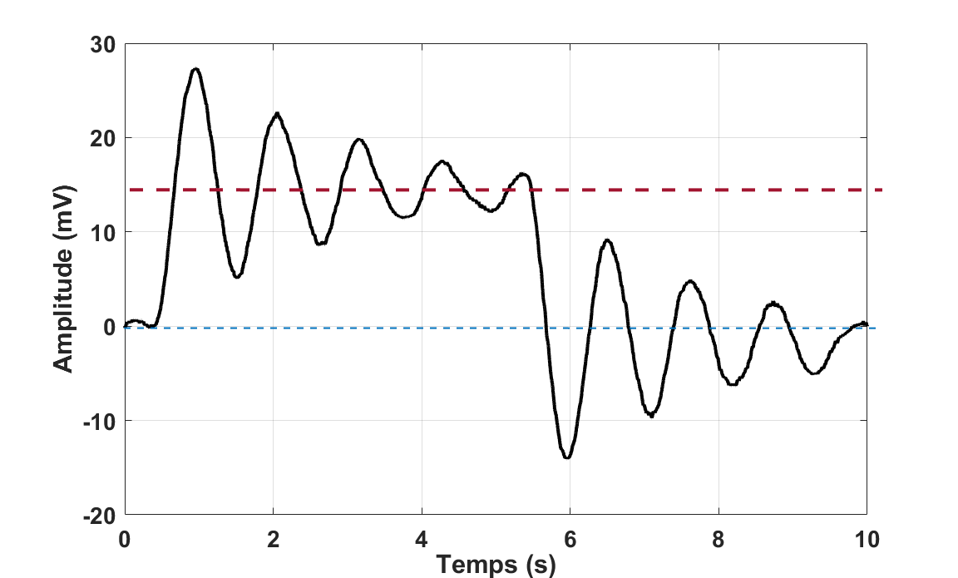
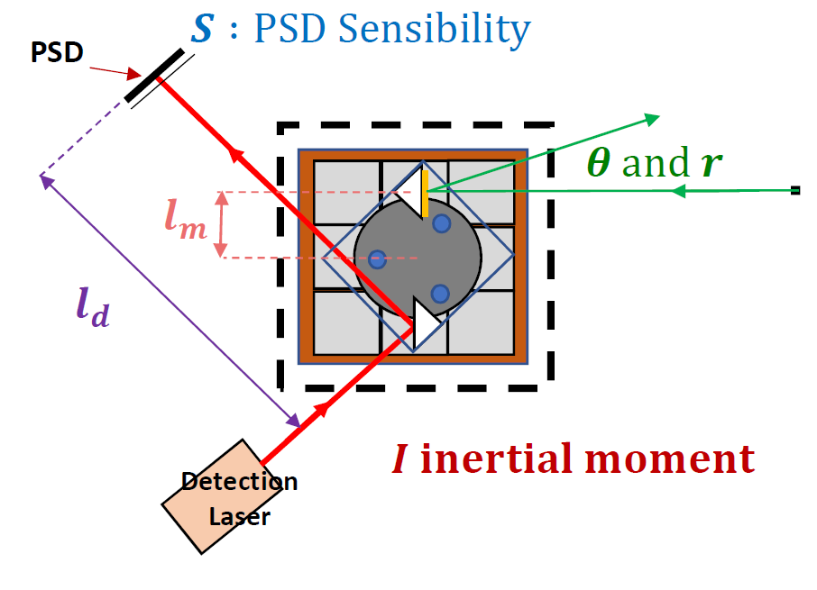
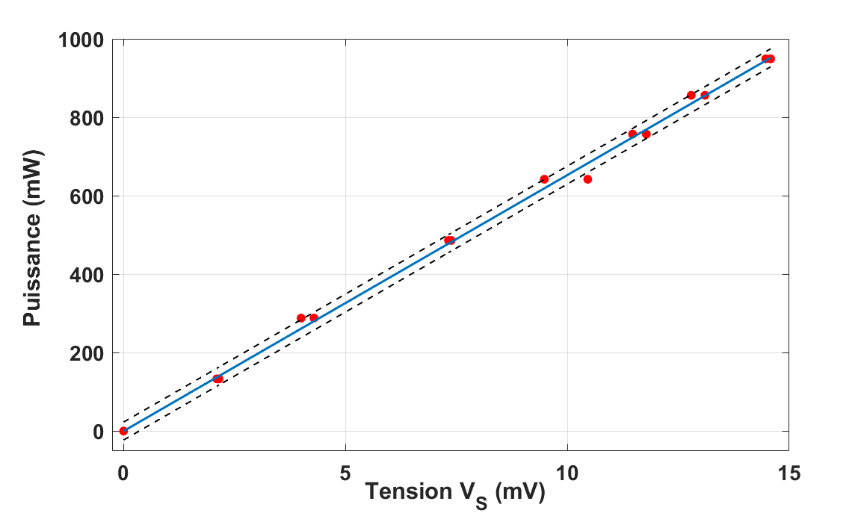










First results
NEW DEVELOPMENT: radiation pressure
$$δ :log decrement$$
$$V_{S}$$
$T_{d}$ : period
$P=\frac{cπ^{2}I\left(8+δ+\frac{δ^{2}}{π^{2}}\right)}{8l_{d}ST_{d}^{2}l_{m}rcosθ}V_{S}$
Relative uncertainty :
Now → 7 %
Objective → 1 %
$T_{d}$ = 1,1 s
$$δ =0,18$$
$$l_{d}=16 cm$$
$$θ=0,04 rad$$
$l_{m}$ = 1 cm
r = 0,999
S = 1,75 V/mm
$I=\text{8.32×10}\text{−8}$ kg m⁻²
14

Slide 15
CONCLUSION
Calibration capabilities up to 1 kW CW with uncertainty from 1.3% (500 µW) to 2.7% (1 kW)
New development of a power meter based on radiation pressure using pyrolitic graphite levitation property
Intermediate range of power (100 mW - 10 W)
Compact, simple and transportable
Directly traceable to the new SI
Temperature and vibration sensitive
Uncertainty down to 1%
15

Slide 16
Thank you for your attention
16

