Slide 1
LISA Status
Robin Stebbins
GSFC Emeritus, JILA-University of Colorado
GWANW Meeting, LIGO Hanford
24 June 2019

Slide 2
LISA Status
Mission Concept
Sources
Science
Programmatics
  Project organization
  LISA Consortium
  Budget and schedule
NASA activities
  Study organization
  Astro2020 decadal
  Technology development

Slide 3
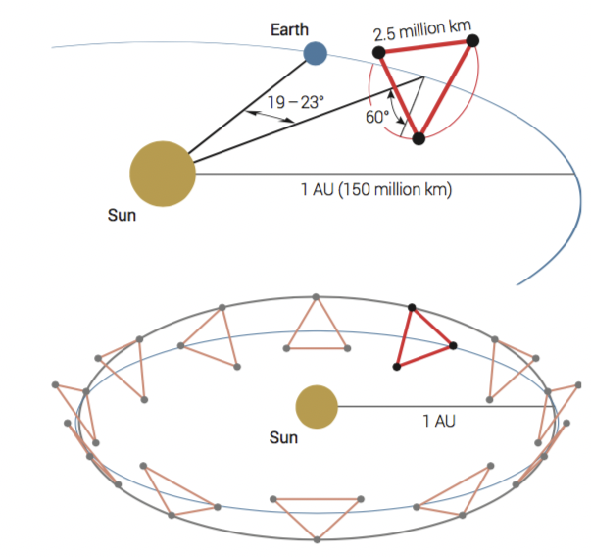
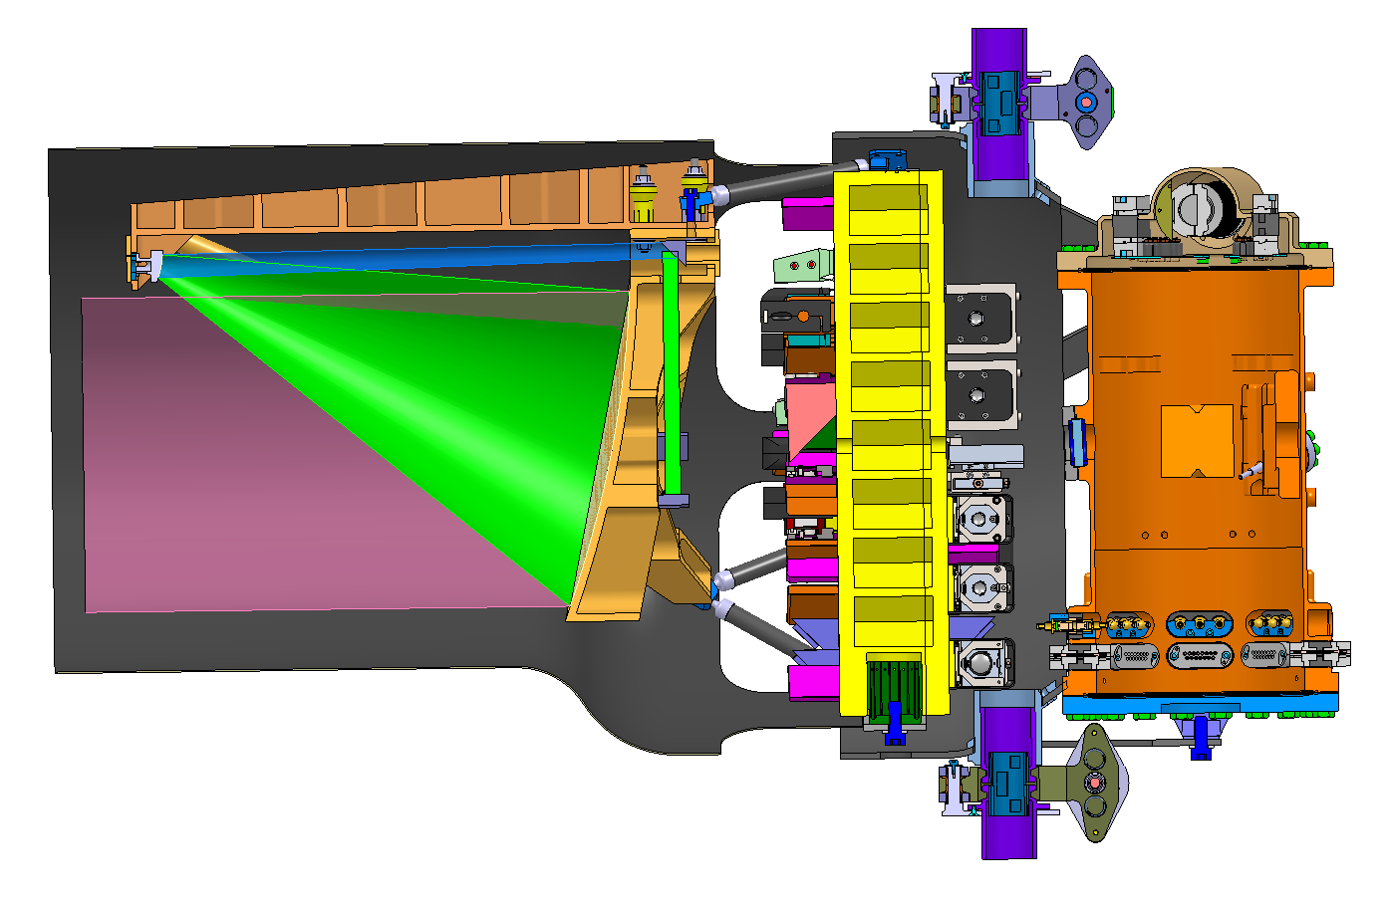
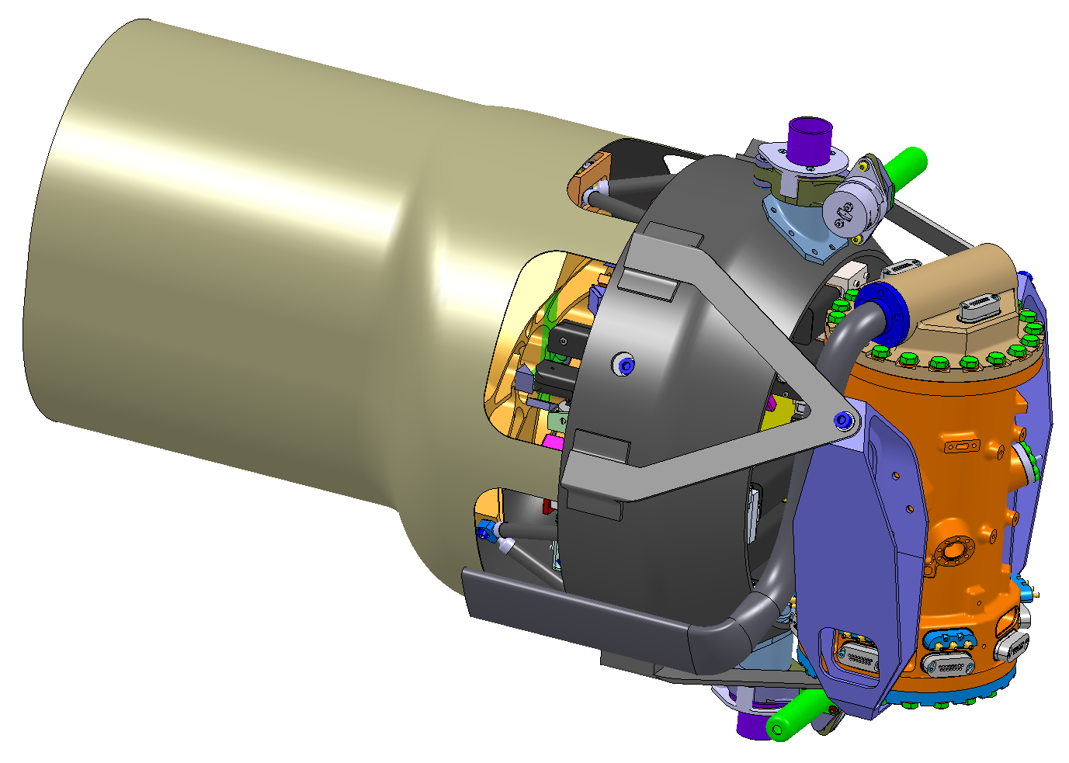
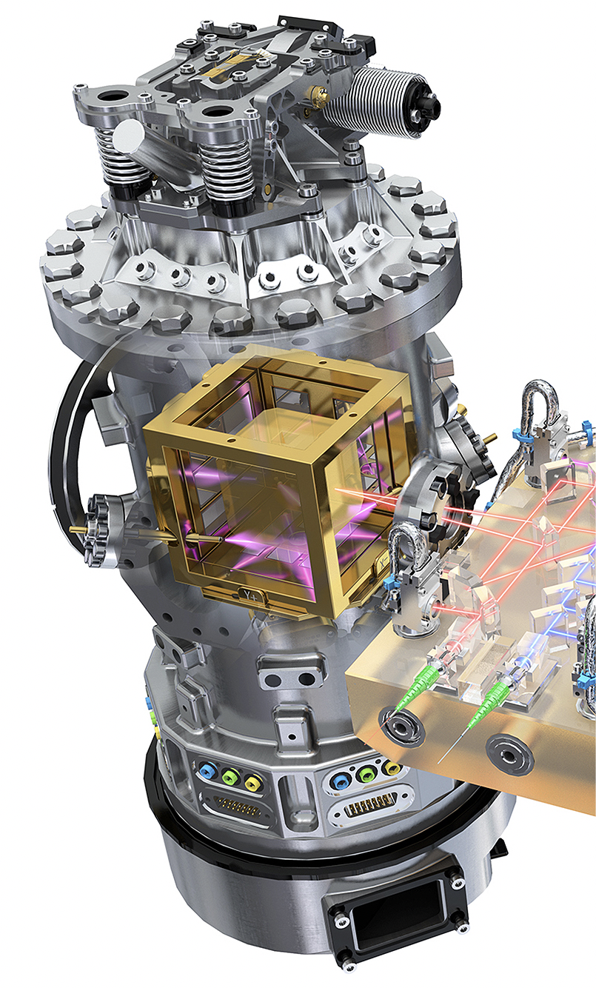
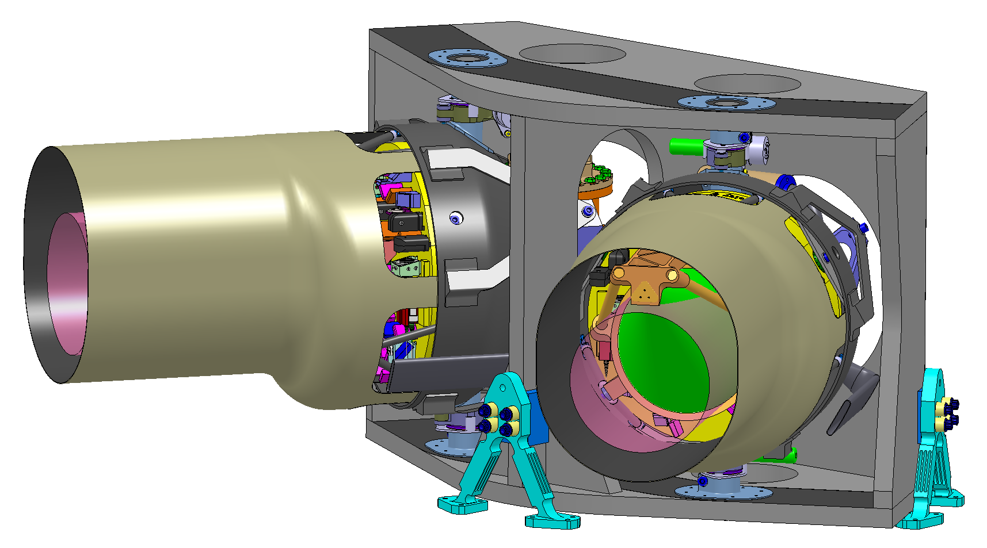
Critical elements of the mission concept
Laser interferometer using triangular constellation of spacecraft in heliocentric orbits
Continuous laser interferometric ranging with picometer sensitivity
Arms millions of kilometers long
Drag-free masses with femto-g disturbances
Time delay interferometry (TDI)

Slide 4
Instrument
Characteristic | LISA
Operating band | 0.1mHz – 0.1 Hz, 20µHz – 1 Hz goal
Armlength | 2.5 Mkm, could be 1-10 Mkm, set by orbit choices and evolution, and system design choices.
Limiting noises | Spurious low-frequency forces: thermal effects, residual gas, stray electrostatics, shot noise, cross-couplings
Directional information | Orbital motion gives amplitude modulation, frequency modulation and phase modulation
Polarization information | Instantaneous from 2 interferometers, evolves with time.
Instrument lifetime | Fixed, up to 10 yrs. No repairs. Lifetime limited by consumables and orbital evolution.
Outstanding technology challenges | Reliability of lasers and microthrusters, system robustness, stray light

Slide 5
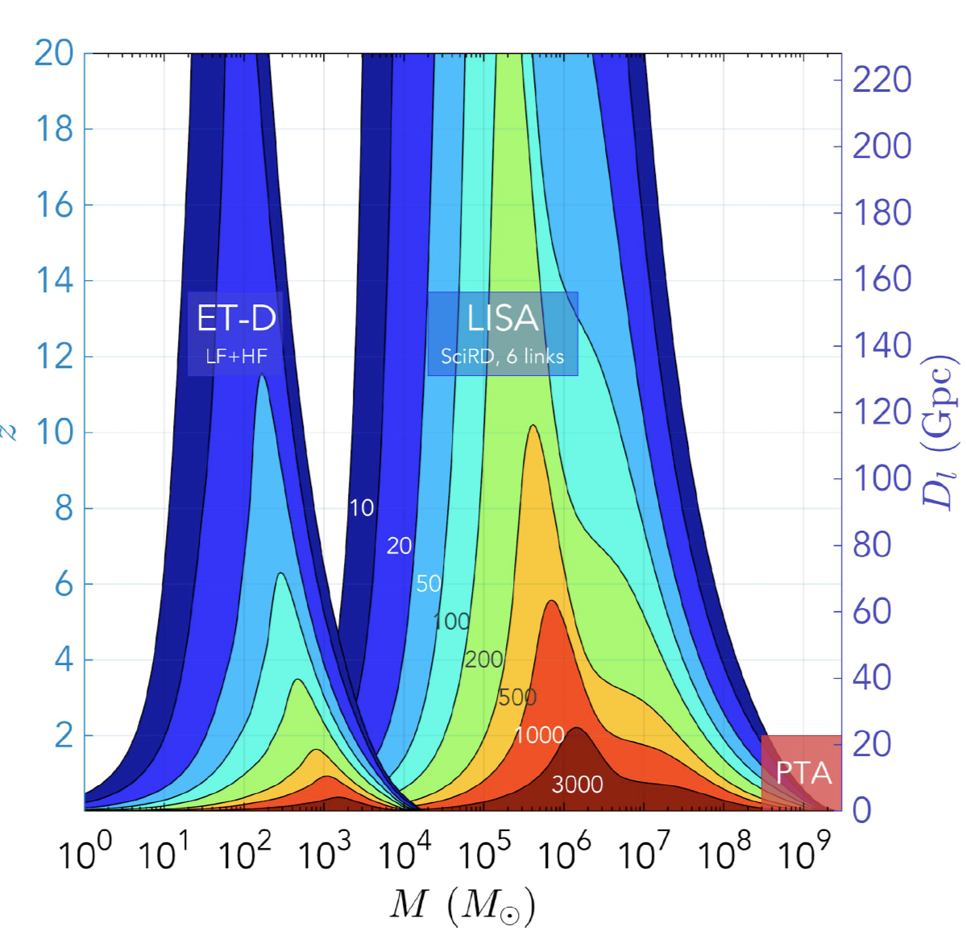
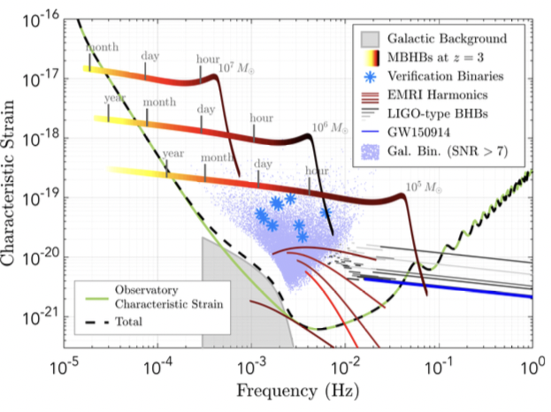
LISA Science
Credit: N. Cornish, M. Hewitson, and the LISA and ET Teams. Created for the Gravitational Wave International Committee (GWIC).

Slide 6
LISA Sources
MBHBs: ~100 10⁴ - 10⁷ M_{sun} inspirals/mergers/ringdowns out to z~20
Stellar-mass compact objects: ~3x10⁴ quasi-stationary WD/NS/BH binaries in the galaxy, confusion foreground, optical counterparts
EMRIs & IMRIs: ~100s/yr EMRIs, rate uncertain
IMBHs (10² - 10⁴ M_{sun} ): Detection to high z, rate unknown
Massive stellar BHs (<10² M_{sun} ): ~100 BH early inspirals out to z~0.1, crossing into the 3G band to merge
Bursts and backgrounds: Possibly cosmic strings, bursts, discoveries.

Slide 7
LISA signals and data analysis
Tens of thousands of superimposed sources, requiring simultaneous fitting
SNRs up to 10⁴ enable high precision measurement of source parameters, like mass, spin vectors, orbital parameters, distance, sky location
All sky instrument with sky location encoded in the waveforms through amplitude, frequency and phase modulation
Merger events weekly, sources emerging and disappearing constantly
Most galactic binaries and EMRIs are detectable for the duration of the mission
MBH mergers predicted weeks to months in advance. Prediction alerts will be sent out, with progressively improving information.
Source information improves with weekly-monthly catalog updates
Sagnac mode allows monitoring the instrument noise constantly.

Slide 8
LISA Science
Study the formation and evolution of compact binary stars in the Milky Way Galaxy
Trace the origin, growth and merger history of massive black holes across cosmic ages
Probe the dynamics of dense nuclear clusters using extreme mass-ratio inspirals (EMRIs)
Understand the astrophysics of stellar origin black holes
Explore the fundamental nature of gravity and black holes
Probe the rate of expansion of the Universe
Understand stochastic GW backgrounds and their implications for the early Universe and TeV-scale particle physics
Search for GW bursts and unforeseen sources

Slide 9
Noise Requirements, derived from Science Requirements

Slide 10
Project Organization
ESA-led mission. NASA is a junior partner. JAXA may join. Roles and responsibilities not finalized.
ESA Study Office formed, System Engineering Office staffed.
Instrument proposal by LISA Consortium
Phase A (Conceptual Design) is in progress
  Competing prime contractors: Airbus Defence and Space GmbH and Thales Alenia Space S.p.A.
  Instrument contract to AEI/Hannover
  Activities: Mission Definition Review (MDR) completed, trade studies, design consolidation, contract management, technology development, Mission Consolidation Review (MCR) in progress
Science Study Team (SST): Science Requirements Document completed, Athena/LISA Working Group, Data Policy study in progress.

Slide 11
LISA Consortium
Successful proposal for instrument design, following successful mission proposal (L3)
Consortium formed
  Organizational structure, bylaws, topical groups, working groups, etc. created
  ~14 member states + US members
  >1,000 members
Responsible for development and provision of nationally funded contributions (Moving Optical Subassembly and subsystems) and provision of data processing
Activities: instrument design, key performance parameters, internal and external interfaces, model plan, AIVT plan, science and data analysis preparation, instrument simulation, etc.
Join at elisascience.org

Slide 12
Schedule and Budget
Schedule
June 2017 – LISA selected as L3
May 2018 – Phase A started
2018-2020 – Phase A
Mid 2020 – Formulation Review
2020 – Phase B1 start
2024 – Adoption
2025 – Phase B2, C and D
2034 – Launch
+6.5 yrs – Ferry, commissioning, baseline science operations
+4 yrs – Extended operations
Budget (very rough)
ESA L-class cap – 1.04 Beuro
Member states - ~200 Meuro, TBC
NASA - $400M for flight system + $100M for science analysis

Slide 13
NASA Organization
Study Office: Study Manager, Study Scientist, Systems engineer
NASA LISA Study Team (NLST): 18 members, Kelly Holly-Bockelmann chair
LISA Core Team: GSFC, JPL and U Florida scientists and technologists
More info at lisa.nasa.gov
Activities
  Participate in mission formulation (management, system engineering, design definition, requirements flow-down, trade studies, etc.)
  Support HQ with analysis and studies (e.g., data center, data policy)
  Participate in Consortium activities
  Prepare for Astro2020
  Technology development

Slide 14
LISA Technology Development
Heritage of LISA Pathfinder and GRACE Follow-On missions.
Telescope
Laser
Charge management system
Phasemeter
Microthrusters
Optical bench manufacture
Precision mechanisms

Slide 15
Summary
LISA is established and advancing at both ESA and NASA.
Phase A is approaching the midway mark; MCR in progress.
ESA, NASA, Member States and Consortium are all examining their roles and responsibilities.
Technology development on track for nominal schedule
NLST
  On track with decadal preparations
  Various outreach activities
  Carrying out ‘analyses’ as requested

