Slide 1
Mitigating LIGO Point Absorbers with High-Order Thermal Compensation
Edita Bytyqi
Mentors: Jon Richardson, Aidan Brooks, Rana X Adhikari

Slide 2
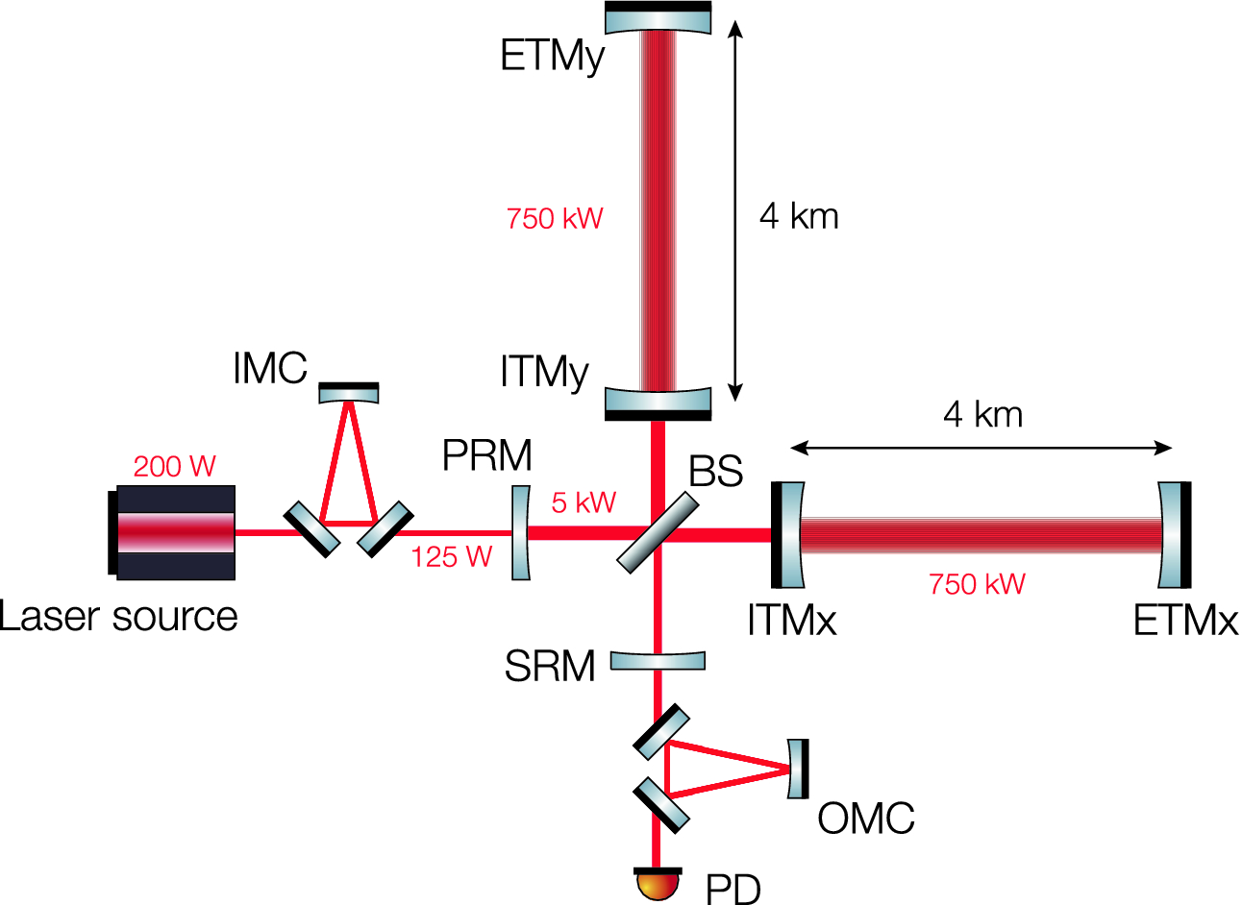
The role of optical cavities in GW detection
Álvarez M.D. (2019) Near-Unstable Cavities for Future Gravitational Wave Detectors. In: Optical Cavities for Optical Atomic Clocks, Atom Interferometry and Gravitational-Wave Detection. Springer Theses (Recognizing Outstanding Ph.D. Research). Springer, Cham

Slide 3
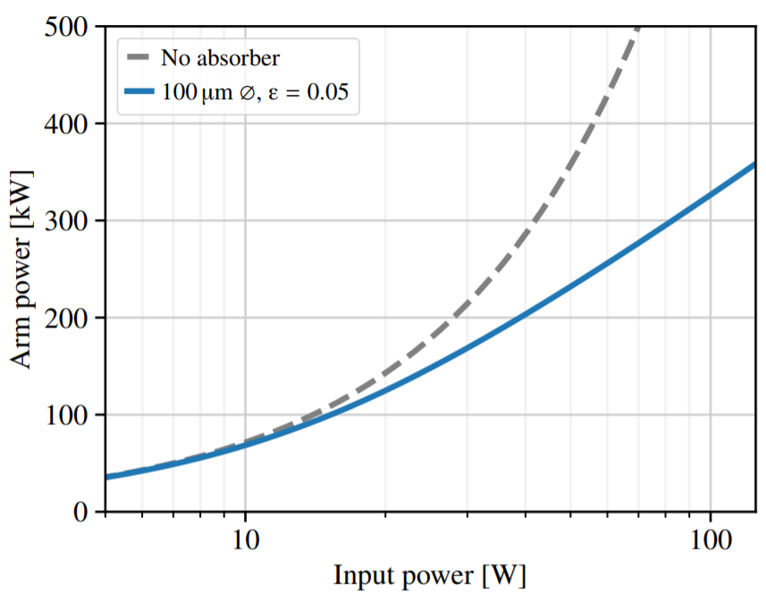
Point absorbers on the aLIGO test masses
1. A. Brooks, G. Vajente et al., “The point absorbers,” (2019), G1900203-v3.
2. E. D. Hall, “The effect of a point absorber in an arm cavity,” (2019).

Slide 5
Higher order mode generation
L = 4 km
TEM₀₀
Point Absorber
TEM_{mn}
Loss
G. Vajente, "In situ correction of mirror surface to reduce round-trip losses in Fabry–Perot cavities," Appl. Opt. 53, 1459-1465 (2014) [modified]
Notes:
Imperfect mirrors couple a fraction of the fundamental input mode into higher order modes (HOM)
The generated HOM propagate inside the cavity and can reach resonance leading to more power loss
HOM scattering is amplified by defects on the end mirror’s surface

Slide 6
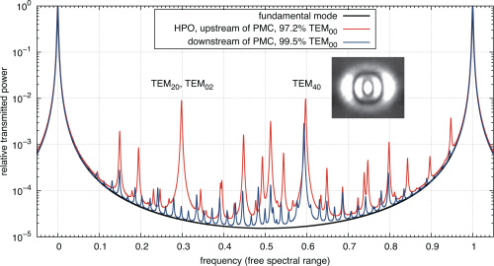
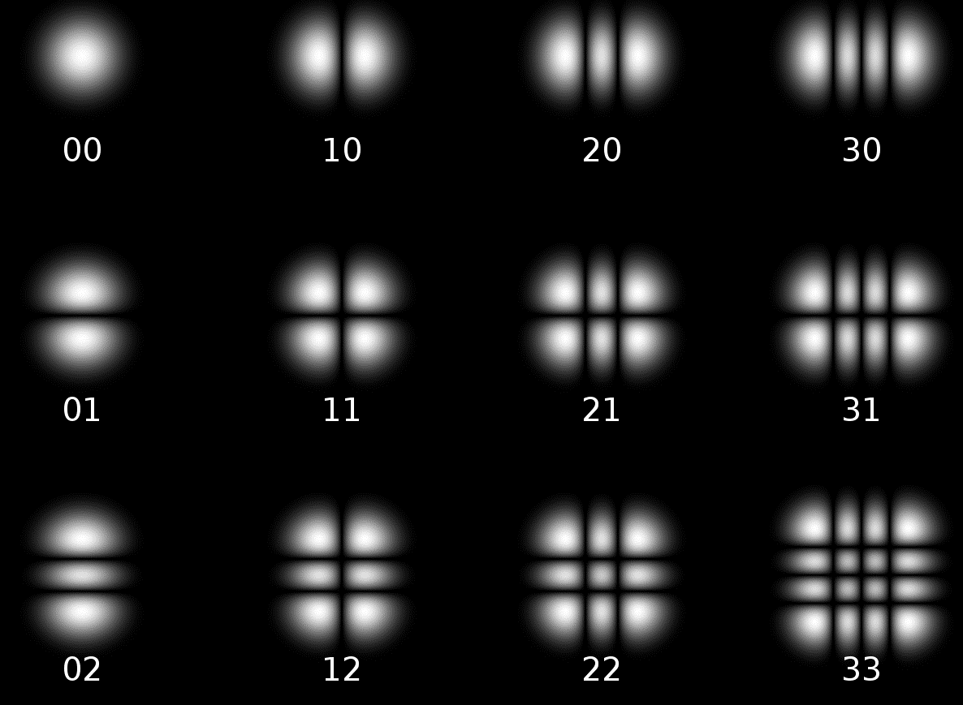
TEM Hermite Gauss propagation modes
TEM₇₀
P. Kwee, C. Bogan, K. Danzmann, M. Frede, H. Kim, P. King, J. Pöld, O. Puncken, R. L. Savage, F. Seifert, P. Wessels, L. Winkelmann, and B. Willke, "Stabilized high-power laser system for the gravitational wave detector advanced LIGO," Opt. Express 20, 10617-10634 (2012)

Slide 7
Thermal compensation system design
Point Absorber
Thermally generated surface deformation
h = 20 cm
d = 34 cm
Notes:
Project a heat pattern on the aLIGO mirrors to reduce HOM losses
Use a spherical reflector with a known ROC to focus radiant heat produced by a cartridge heater
Minimum delivery distance ~ 20 cm
Spot size ~ 1.4 cm

Slide 8
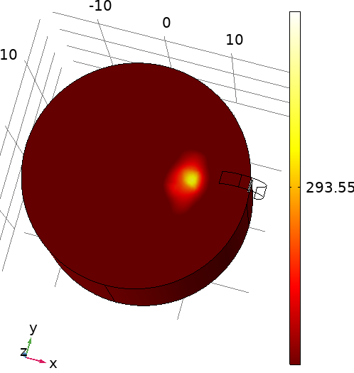
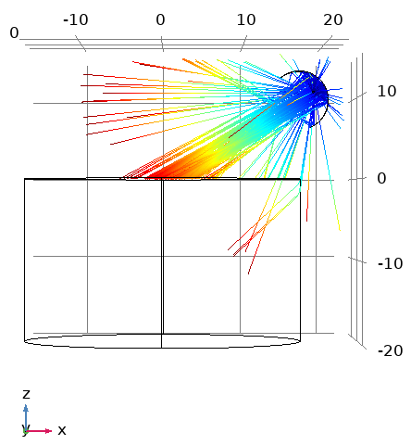
Finite-element analysis of design
Ray Trajectories
3D Temperature Profile
293.8
cm
Optimized Parameters:
ROC
Reflector Geometry
Height (z)
Constraints:
Delivery distance
Heater position
x-position > R_{test mass}
293.3
T [K]
Notes:
Ref geom (ROC, cut)

Slide 9
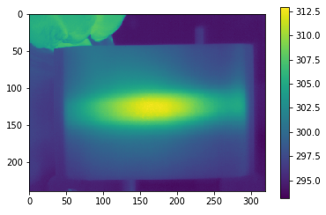
Measuring the heat distribution
T (K)
IR Image: Heat distribution pattern produced by TCS
Reflector ROC (cm) | 3.6 | 1.75
Delivery distance (cm) | 10 | 5
Thermal Profile FWHM (cm) | 2.85 | 1.9

Slide 10
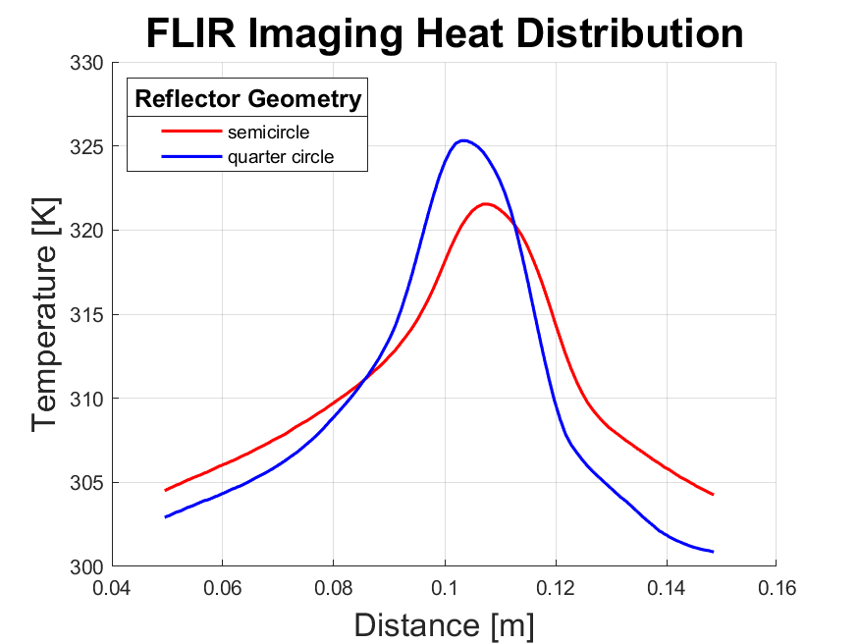
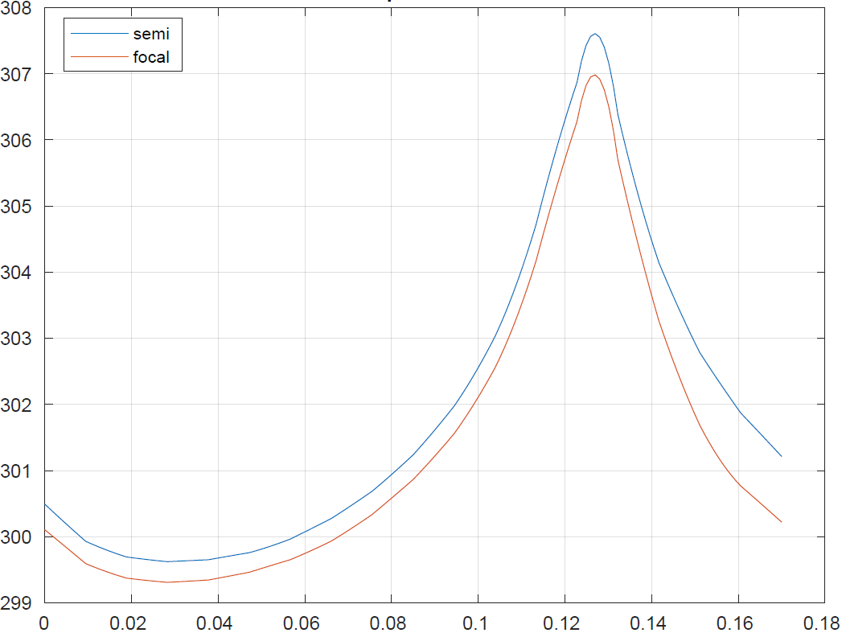
Simulation vs Experiment Temperature Profile
COMSOL Radial Temperature Profile
quarter
FWHM = 3 cm
FWHM = 6.2 cm
FWHM = 1.9 cm
FWHM = 6.1 cm

Slide 11
Experimental Setup
2

Slide 12
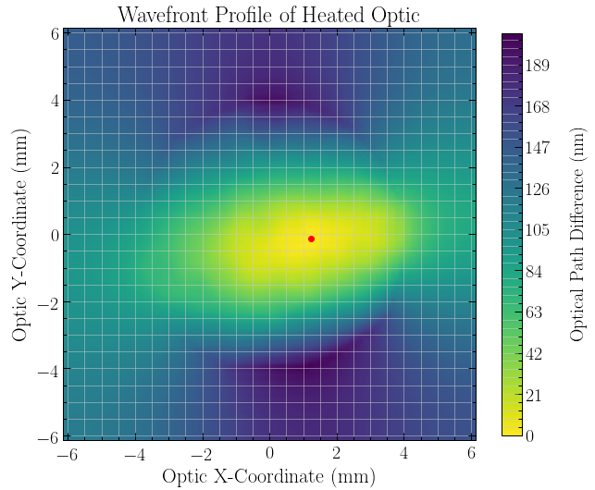
Hartmann Wavefront Sensor Measurement
Experimental Setup:
ROC = 1.75 cm
Radiated Power = 25 W
Delivery distance = 6 cm
Notes:
Lab results: HWS OPD contour, FLIR images to determine reflector focus spot size
Semi-circle vs focal point cut reflector

Slide 13
Conclusions and future work
Obtained thermal profile can be used to actuate 7th order modes
Further parameter optimization is necessary for a better system
LIGO noise requirements
Vacuum compatibility considerations

Slide 14
Acknowledgements
I would like to thank my mentors: Jonathan Richardson, Aidan Brooks, and Rana Adhikari for their help and guidance through all parts of the project.

Slide 15
Thank you for your attention!
Questions?

