Slide 1
Data-driven modeling of peak luminosity of black hole mergers
Afura Taylor | TAPIR | Mentor: Dr. Vijay Varma

Slide 3
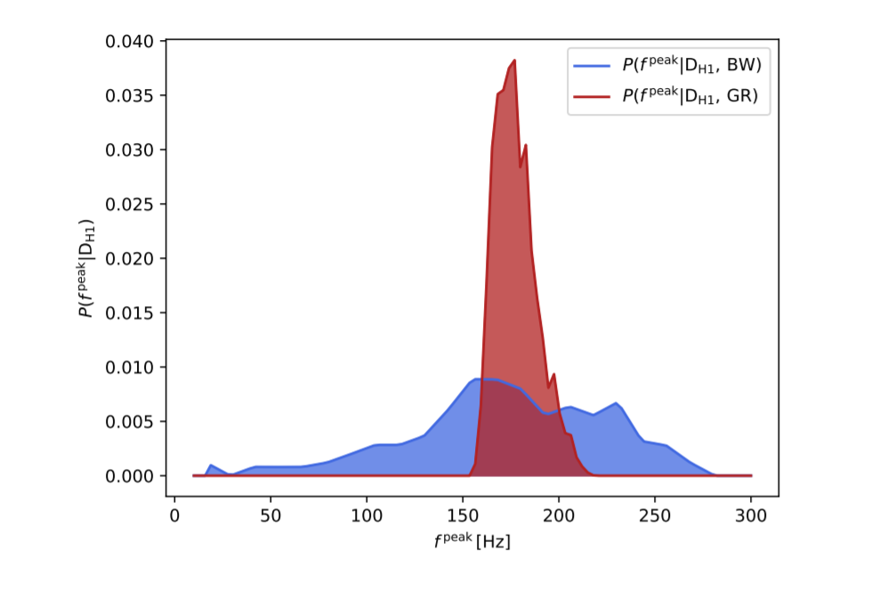
Testing General Relativity (GR)
Wavelet Approximation
Peak Luminosity Fit
arxiv: 1811.08744
Notes:
Add citation arxiv:1913:2323
Add arrows to remember
Red: GR+BBH+peak luminosity fit
Blue:Wavelet approximation, theory+model independent

Slide 4
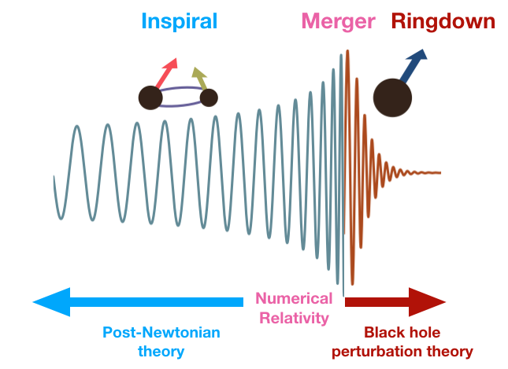
Waveform Calculation

Slide 5
Peak Luminosity
which utilizes....
Notes:
Expansion in v/c, velocity of system. Break down near peak bc speed is so high
Numerical simulations-only thing that can give you the full merger and ringdown. Inspiral, merger, ringdown

Slide 6
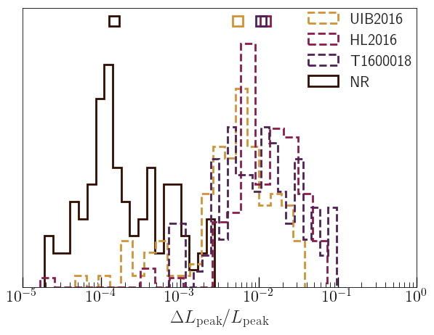
NR Simulations Compared to Current Models
Notes:
Mention: These models are currently used in LIGO analysis

Slide 7
Current Approach: Phenomenological Fits
arxiv: 1612.09566
Notes:
Add citation
Expansion in v/c, velocity of system. Break down near peak bc speed is so high
Numerical simulations-only thing that can give you the full merger and ringdown. Inspiral, merger, ringdown

Slide 8
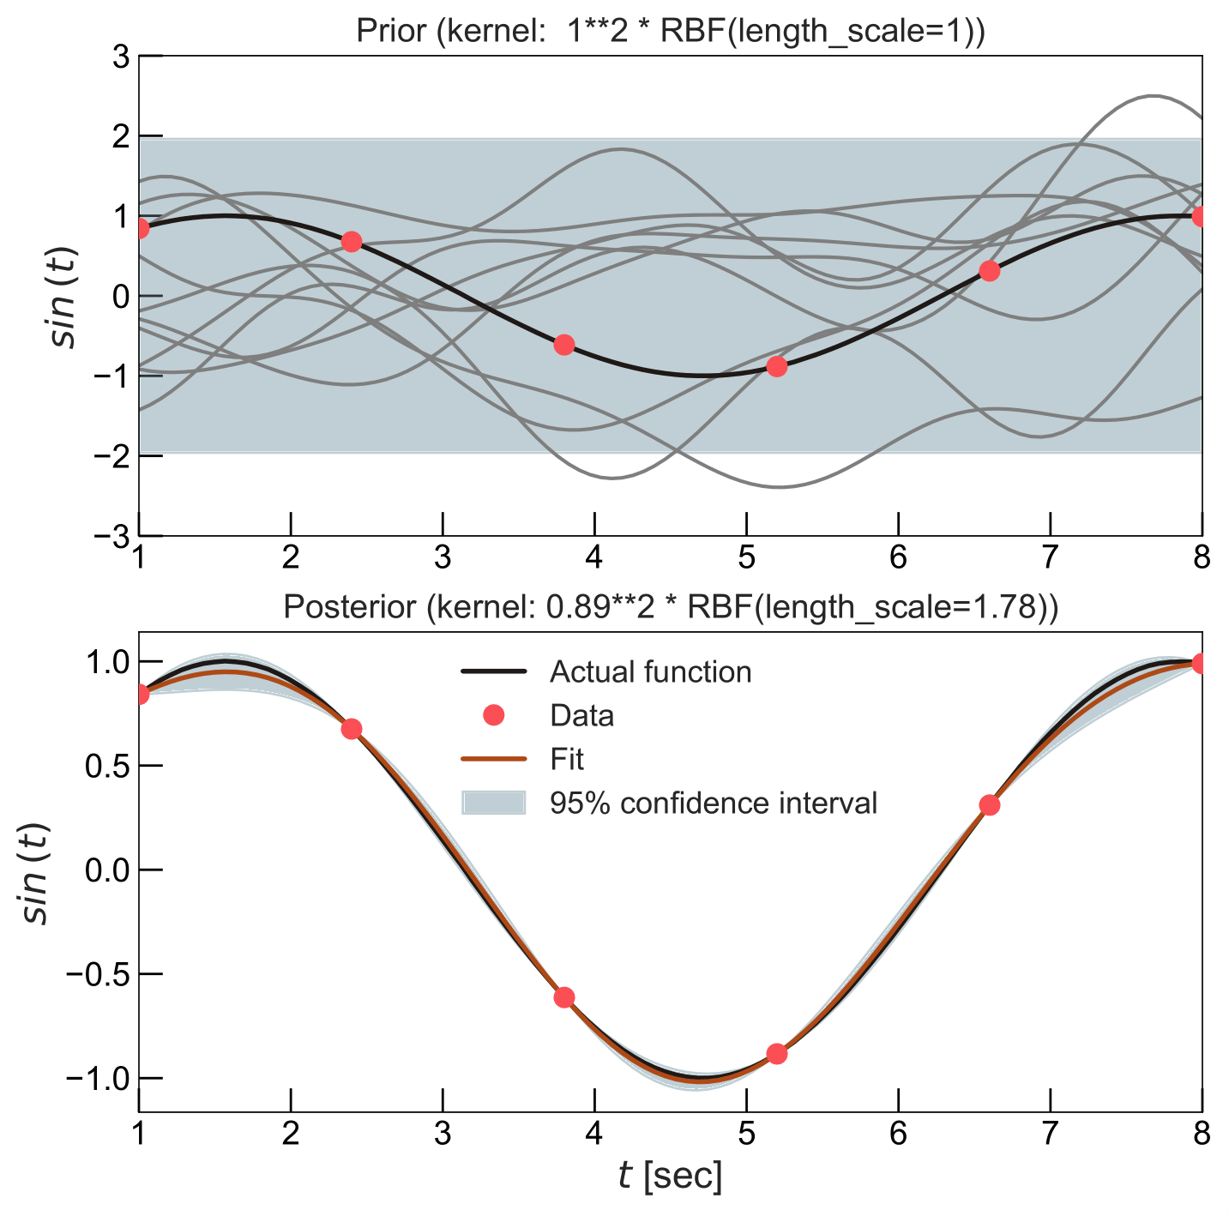
Gaussian Process Regression (GPR)
Notes:
Draw functions from the prior range, throw away functions that don’t agree with the data

Slide 9
Aligned and Precessing BBH Models

Slide 10
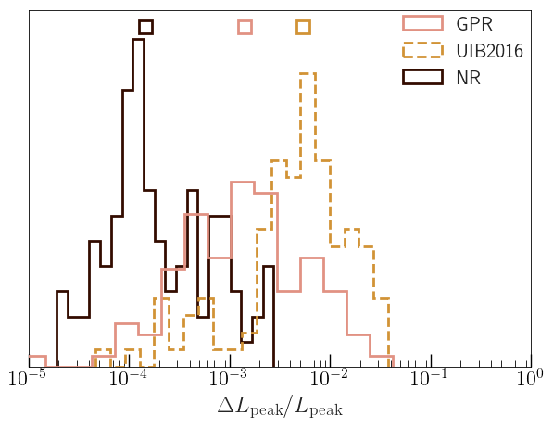
Results: Aligned System

Slide 11
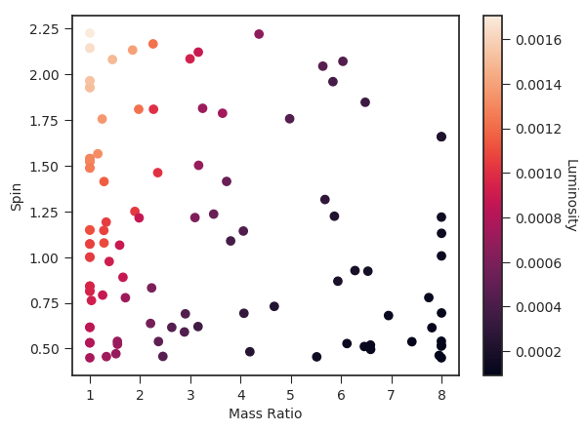
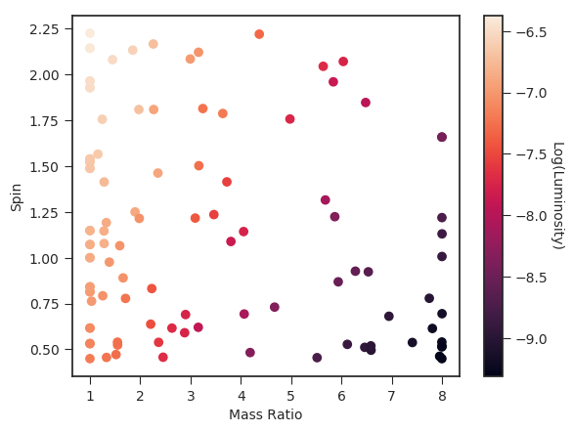
Smoothing the Parameter Space
Fitting to L_{peak}
Fitting to log(L_{peak})

Slide 12
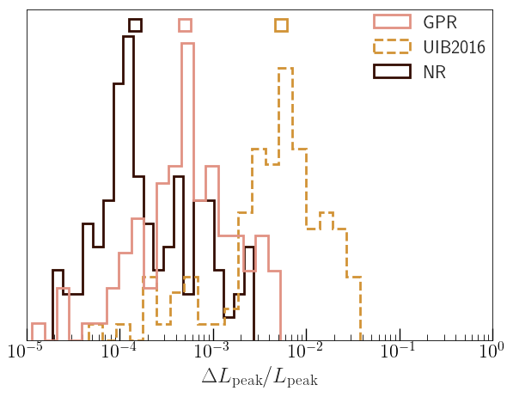
Results: Aligned System, Smoothed Parameter Space

Slide 13
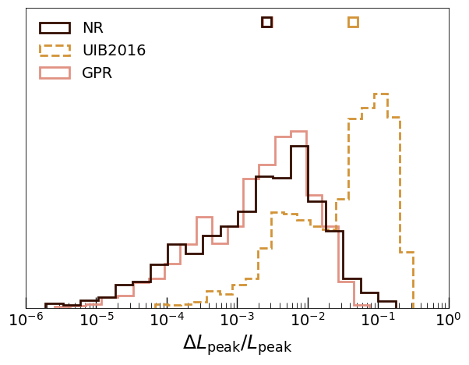
Results: Precessing System

Slide 14
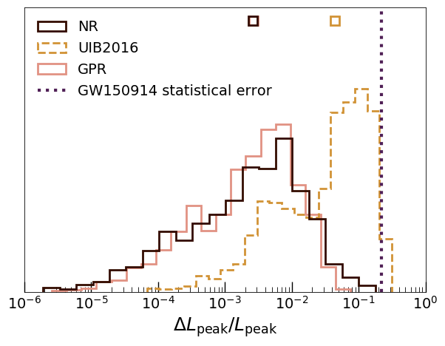

Slide 15
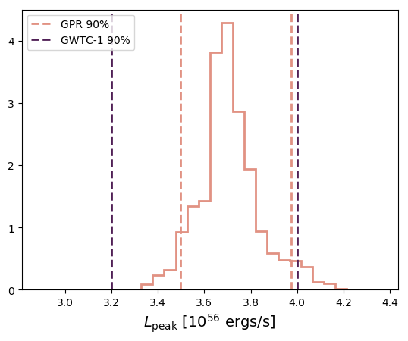
GW150914 Peak Luminosity Calculation

Slide 16
Summary
Order of magnitude increase of accuracy in peak luminosity model
GPR vs current models
Error of current models comparable to the statistical error of peak luminosity of GW150914
Possible improvement in peak luminosity measurement of GW150914
Future Work:
Create surrogate models for other “peak” values
Run on all GWTC-1 catalog events

Slide 17
Acknowledgements
Vijay Varma
Mark Scheel, Saul Teukolsky
NSF
LIGO Lab

Slide 18
Summary
Order of magnitude increase of accuracy in peak luminosity model
GPR vs current models
Error of current models comparable to the statistical error of peak luminosity of GW150914
Possible improvement in peak luminosity measurement of GW150914
Future Work:
Create surrogate models for other “peak” values
Run GPR model on all GWTC-1 catalog events

