Slide 1

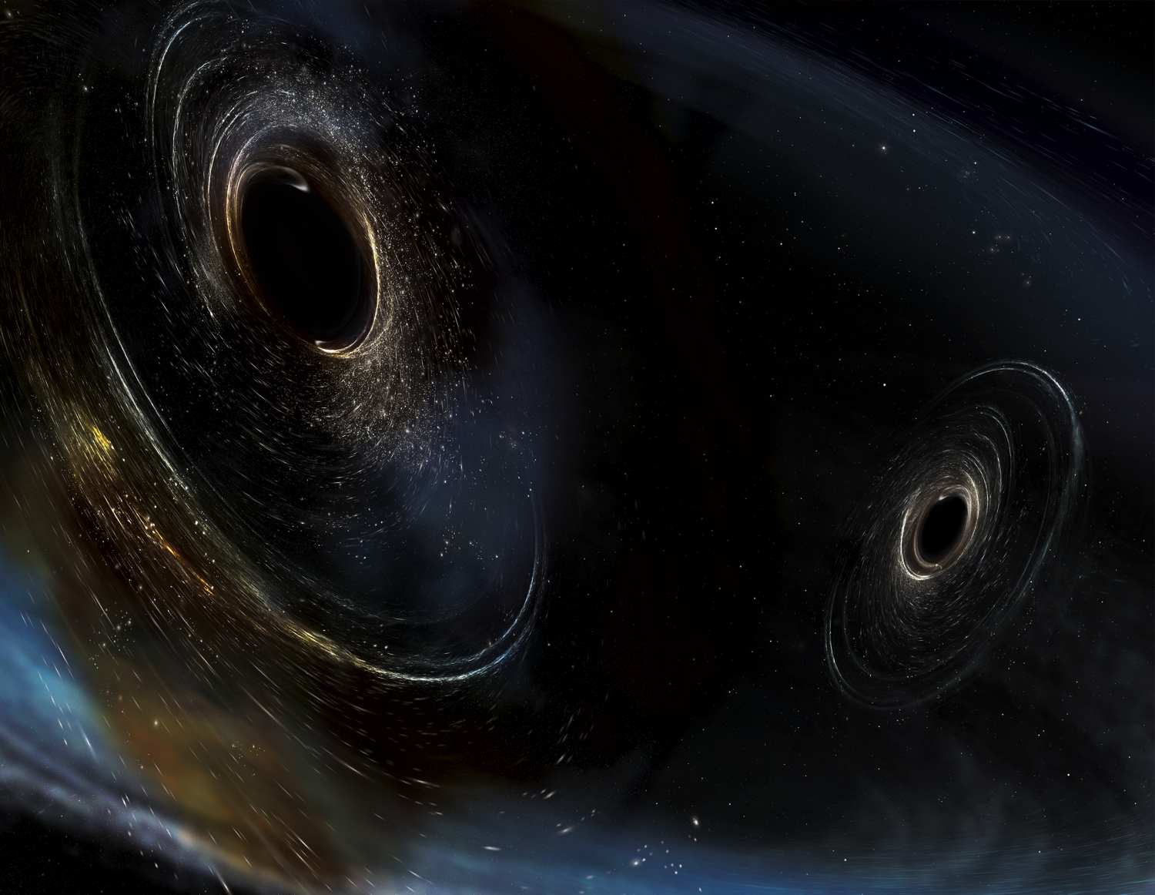




FUTURE
LASER INTERFEROMETER
GRAVITATIONAL WAVE OBSERVATORIES
& VACUUM REQUIREMENTS
Chandra Romel, LIGO Hanford Caltech
AVS 66th International Symposium & Exhibition
Columbus, OH
20-25 October, 2019
LIGO-G1901913
Image Credit: Aurore Simmonet/SSU

Slide 2
Topics
- Existing Gravitational Wave Observatories
- Vacuum Requirements
- 3G Gravitational Wave Observatories
- Technologies for 3G Large Vacuum
- Path Forward

Slide 3
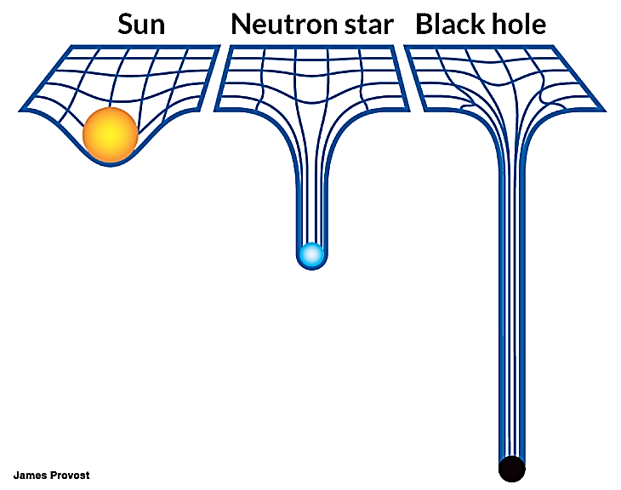
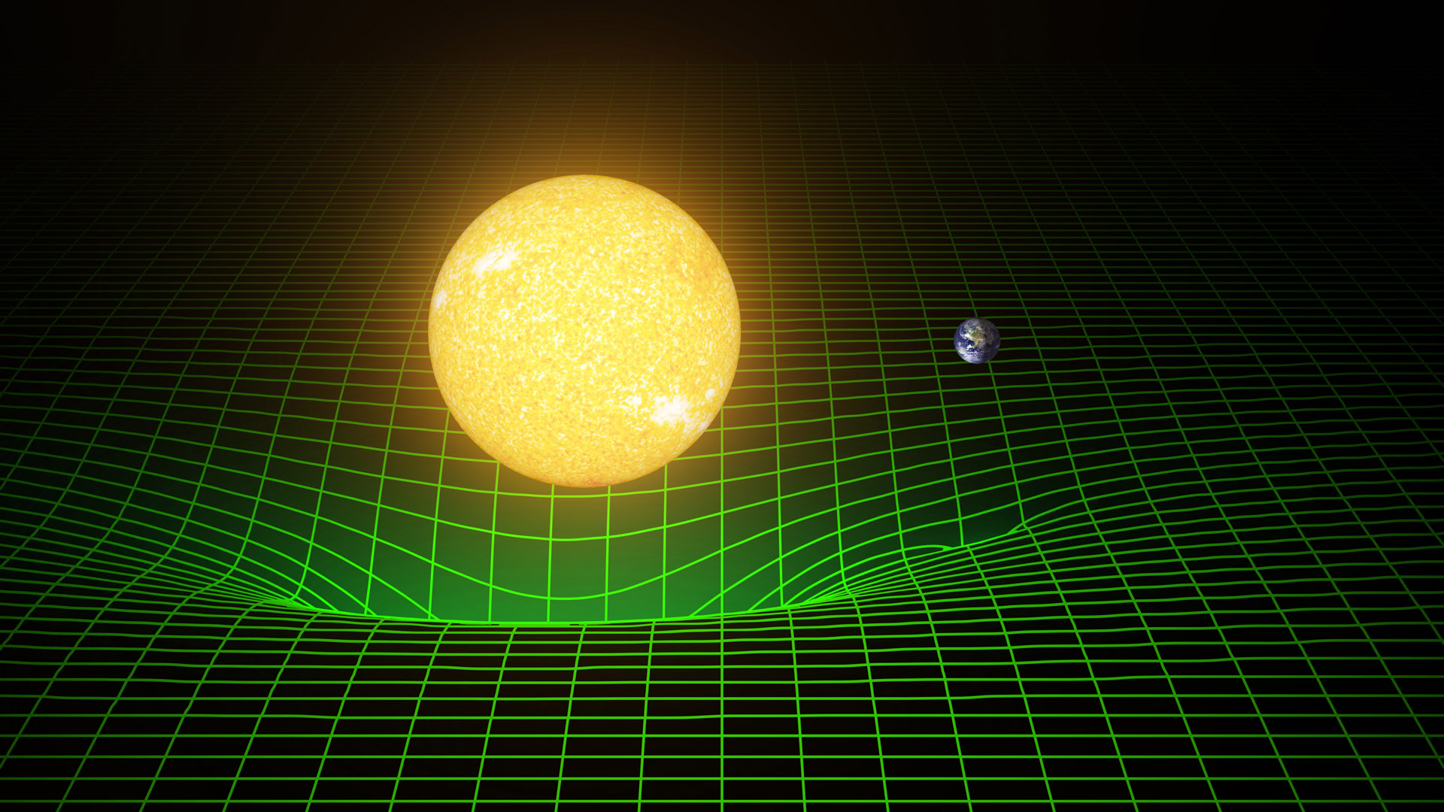
Gravity & Curved Space-time

Slide 4
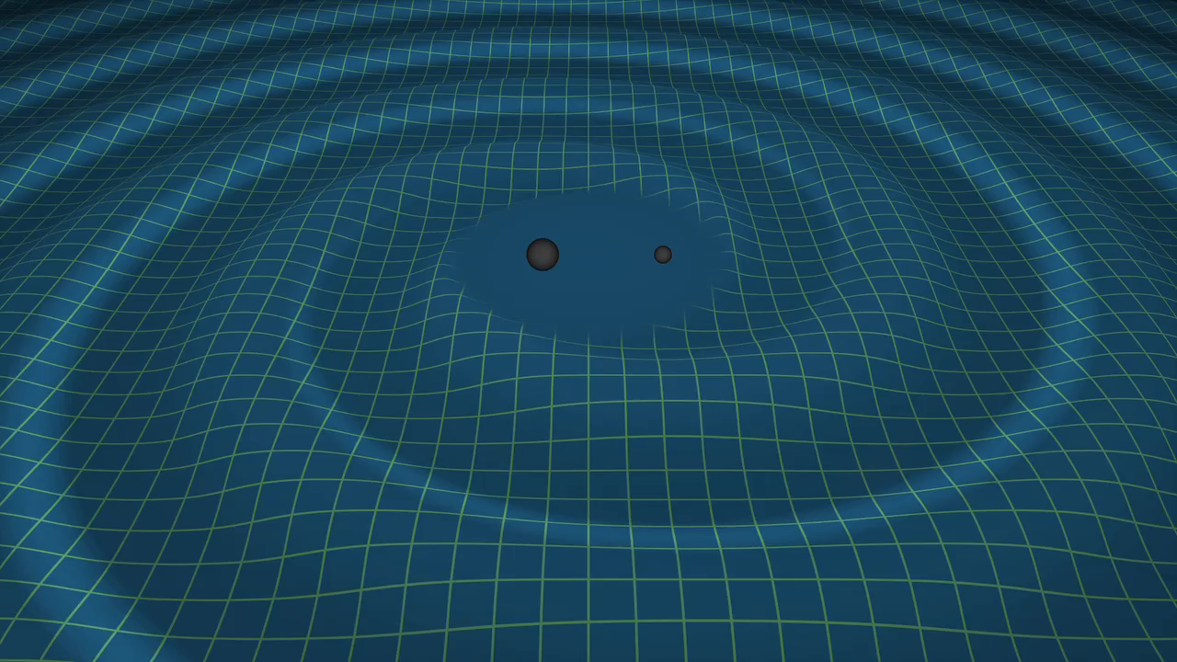
Gravitational Waves
Credit: LIGO/Tim Pyle

Slide 5
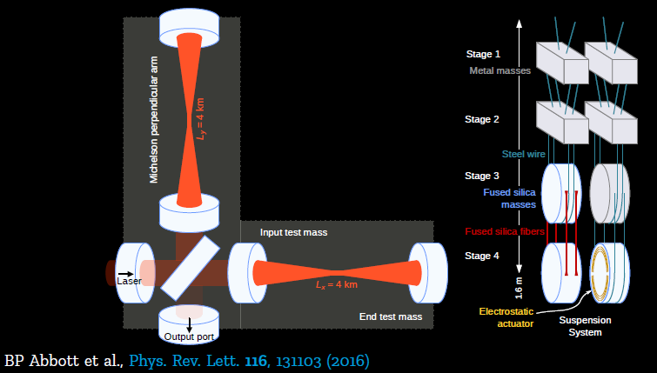
Typical Interferometer

Slide 6
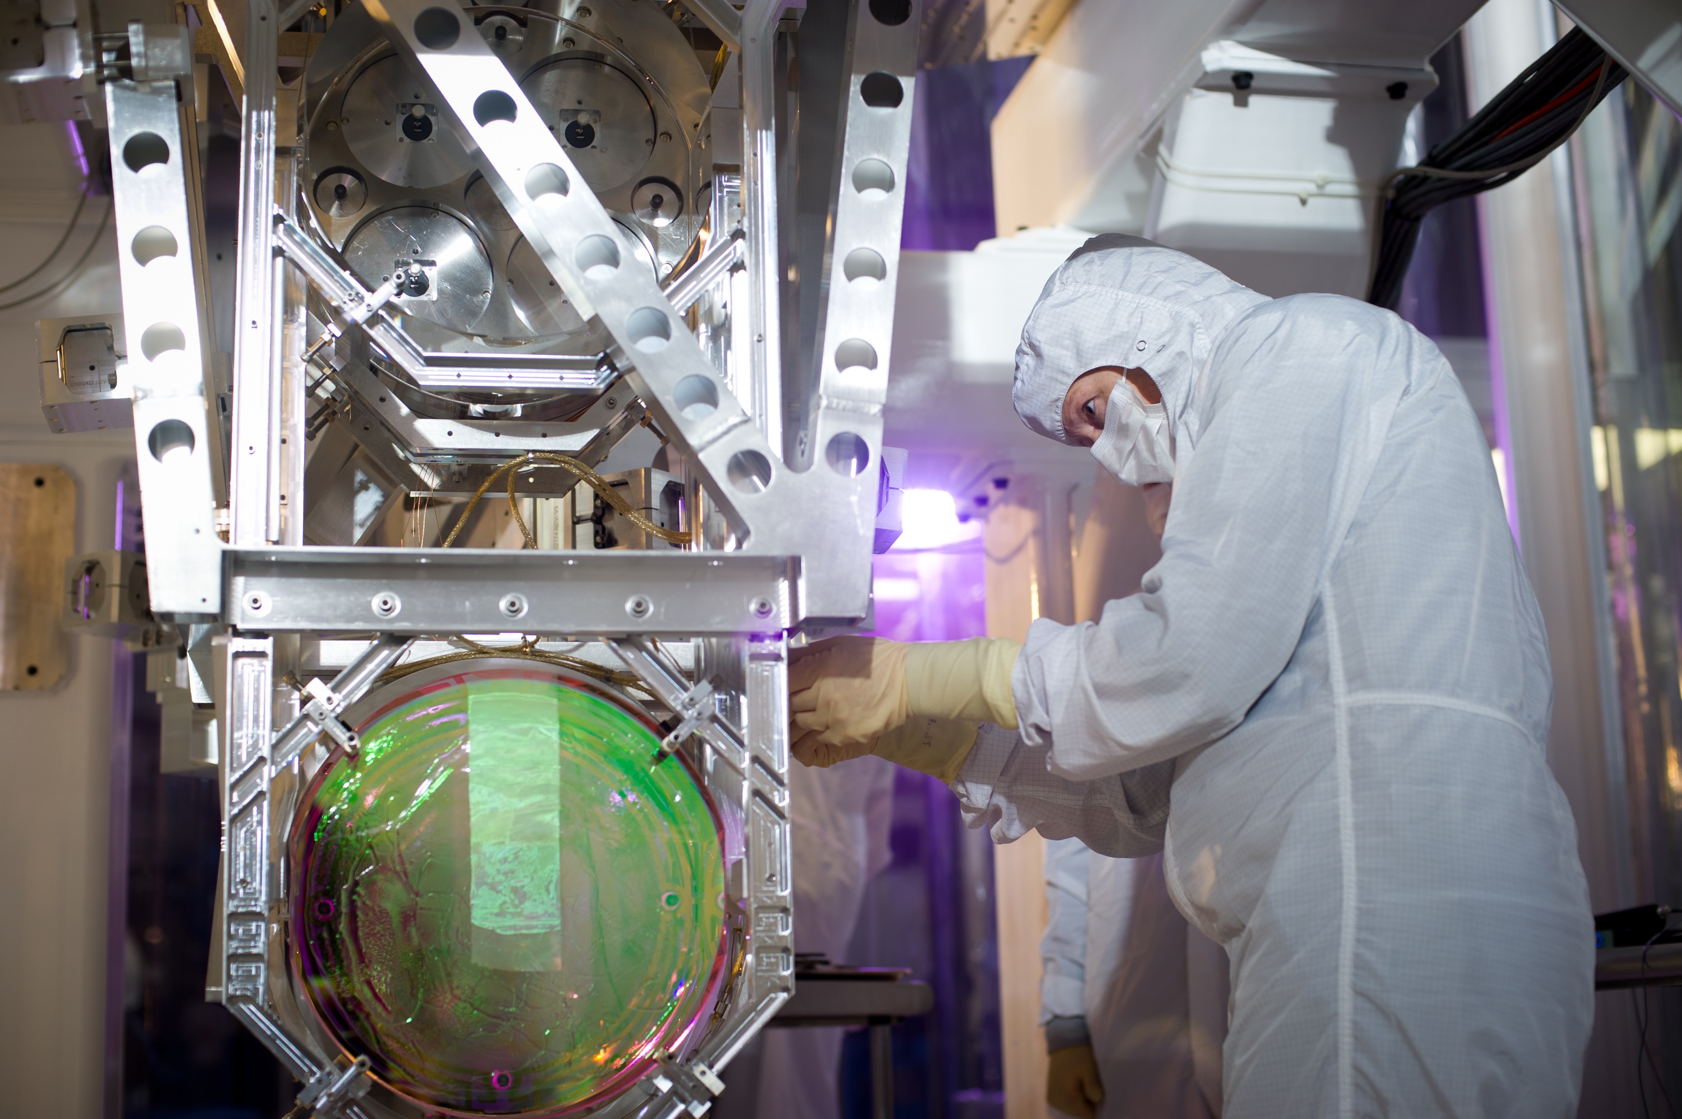
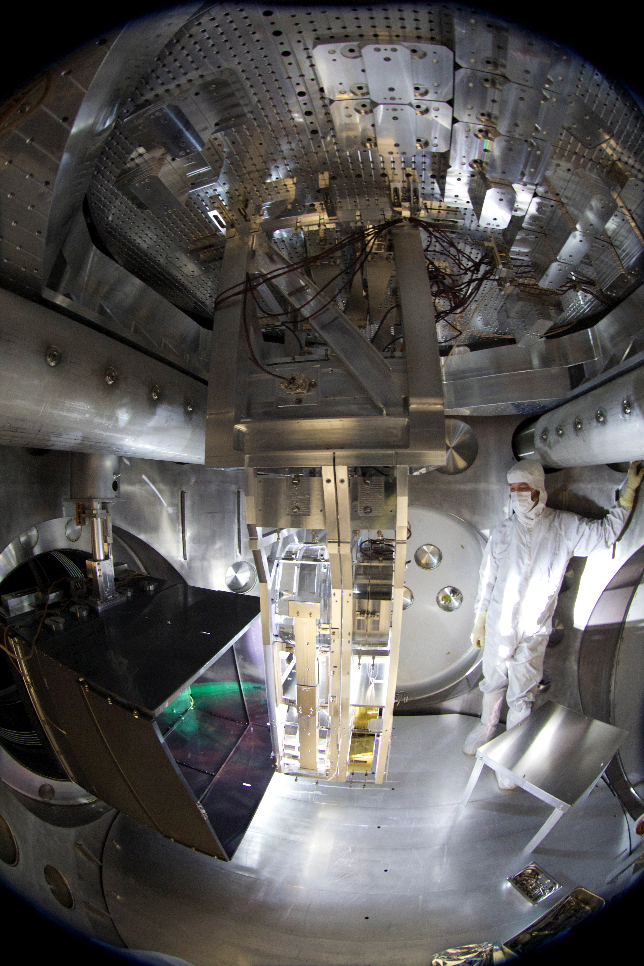
LIGO’s Crown Jewels

Slide 7
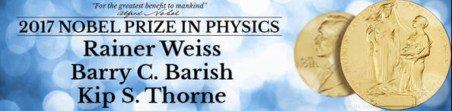
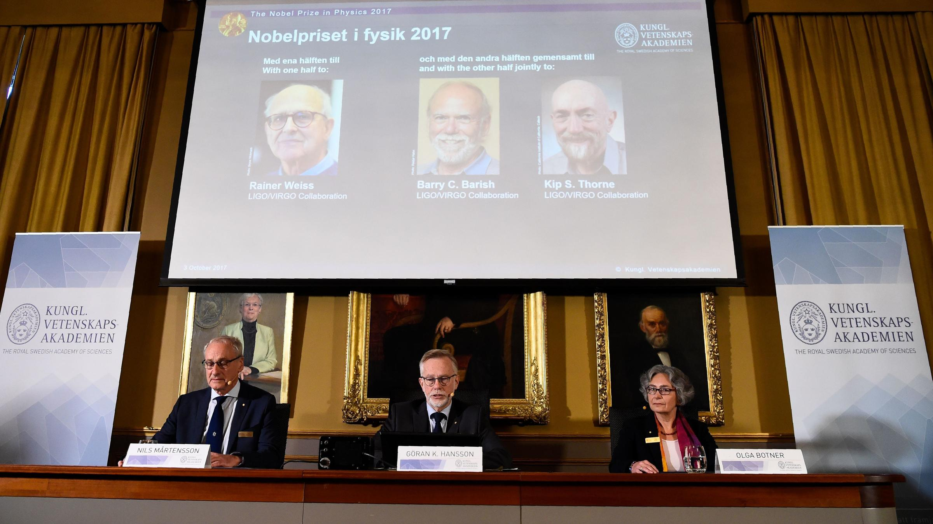

Slide 8
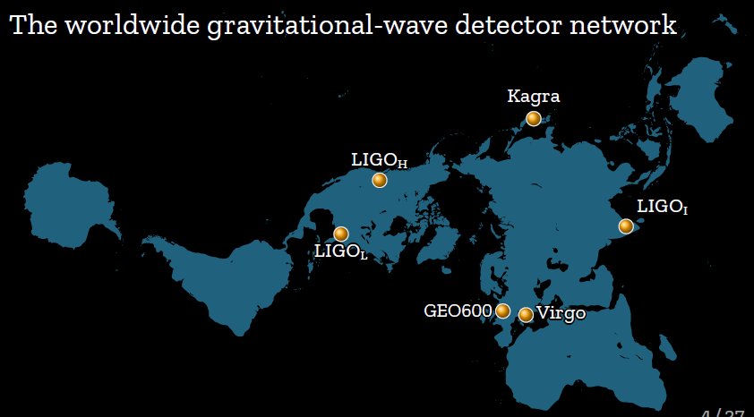
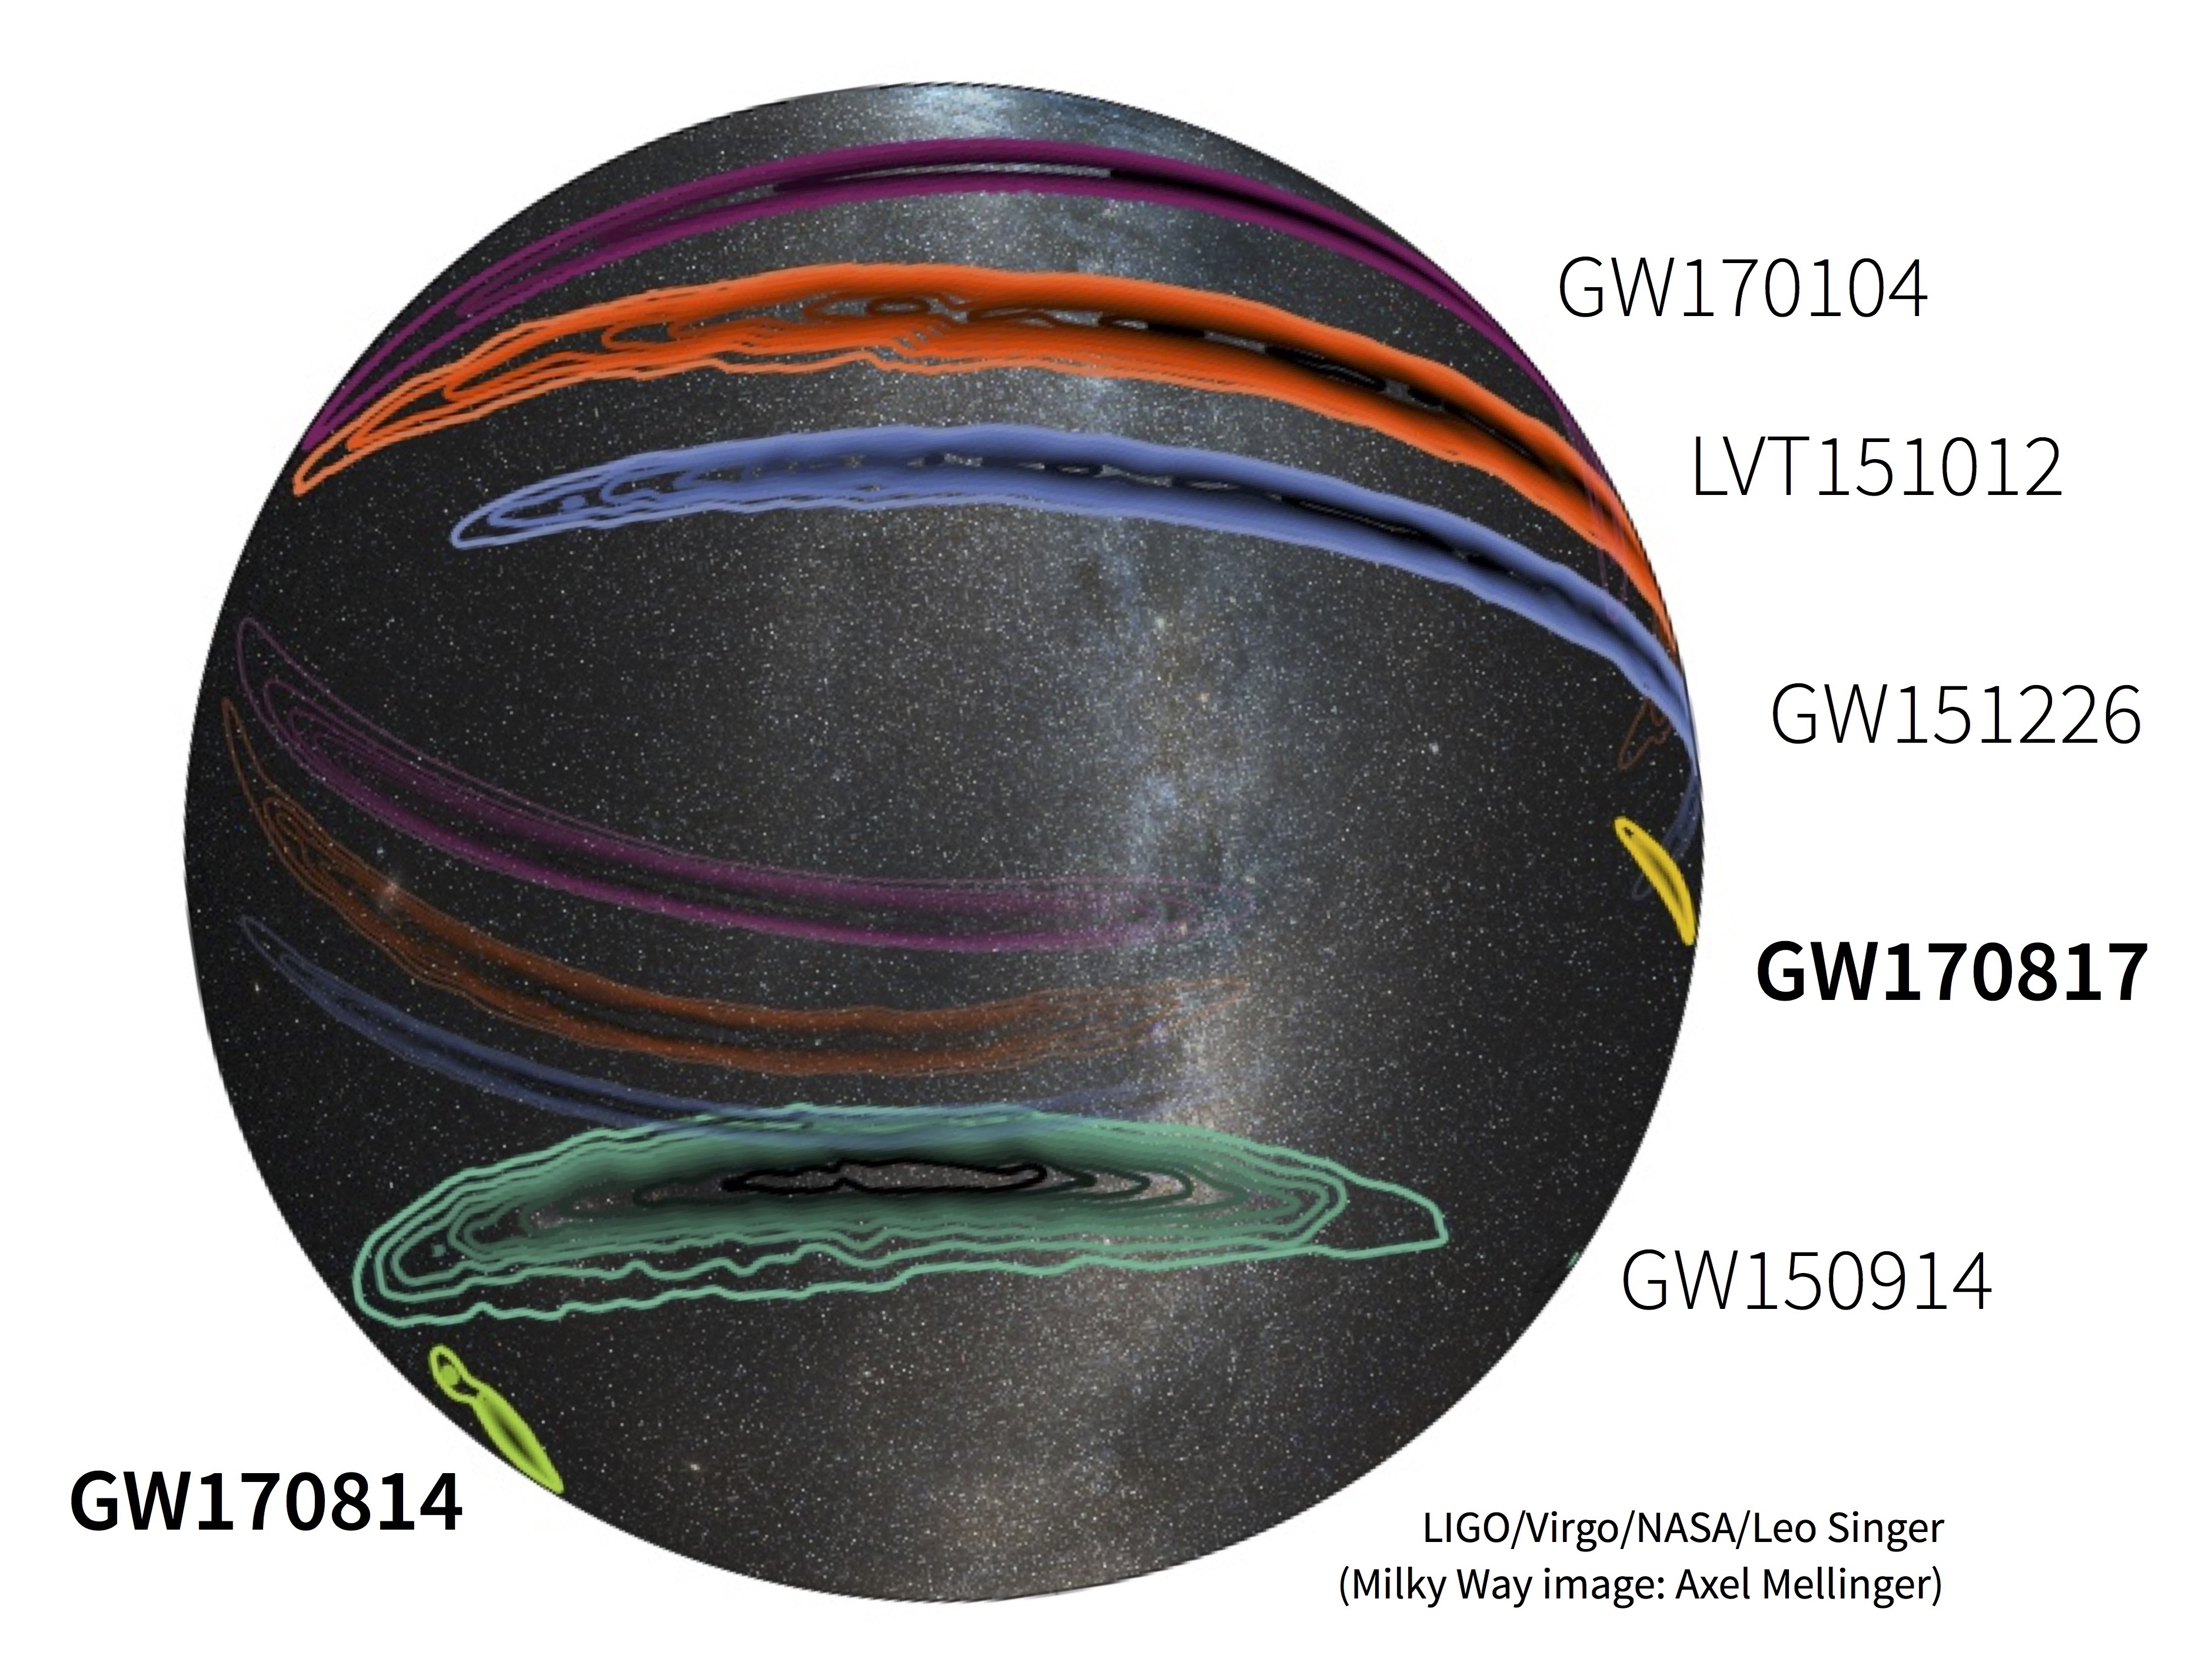
Global GW Detector Network

Slide 9
A “Small” Problem
A wave’s strength is measured by the strain induced in the detector,
We can calculate expected strain at Earth;
If we make our interferometer arms 4,000 meters long,
!!
A ten-thousandth the size of an atomic nucleus

Slide 10
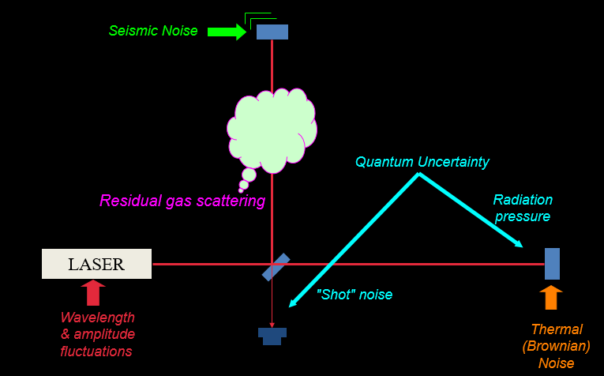
The Enemies: NOISE

Slide 11
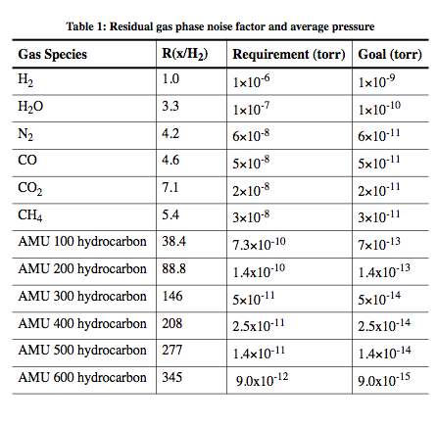
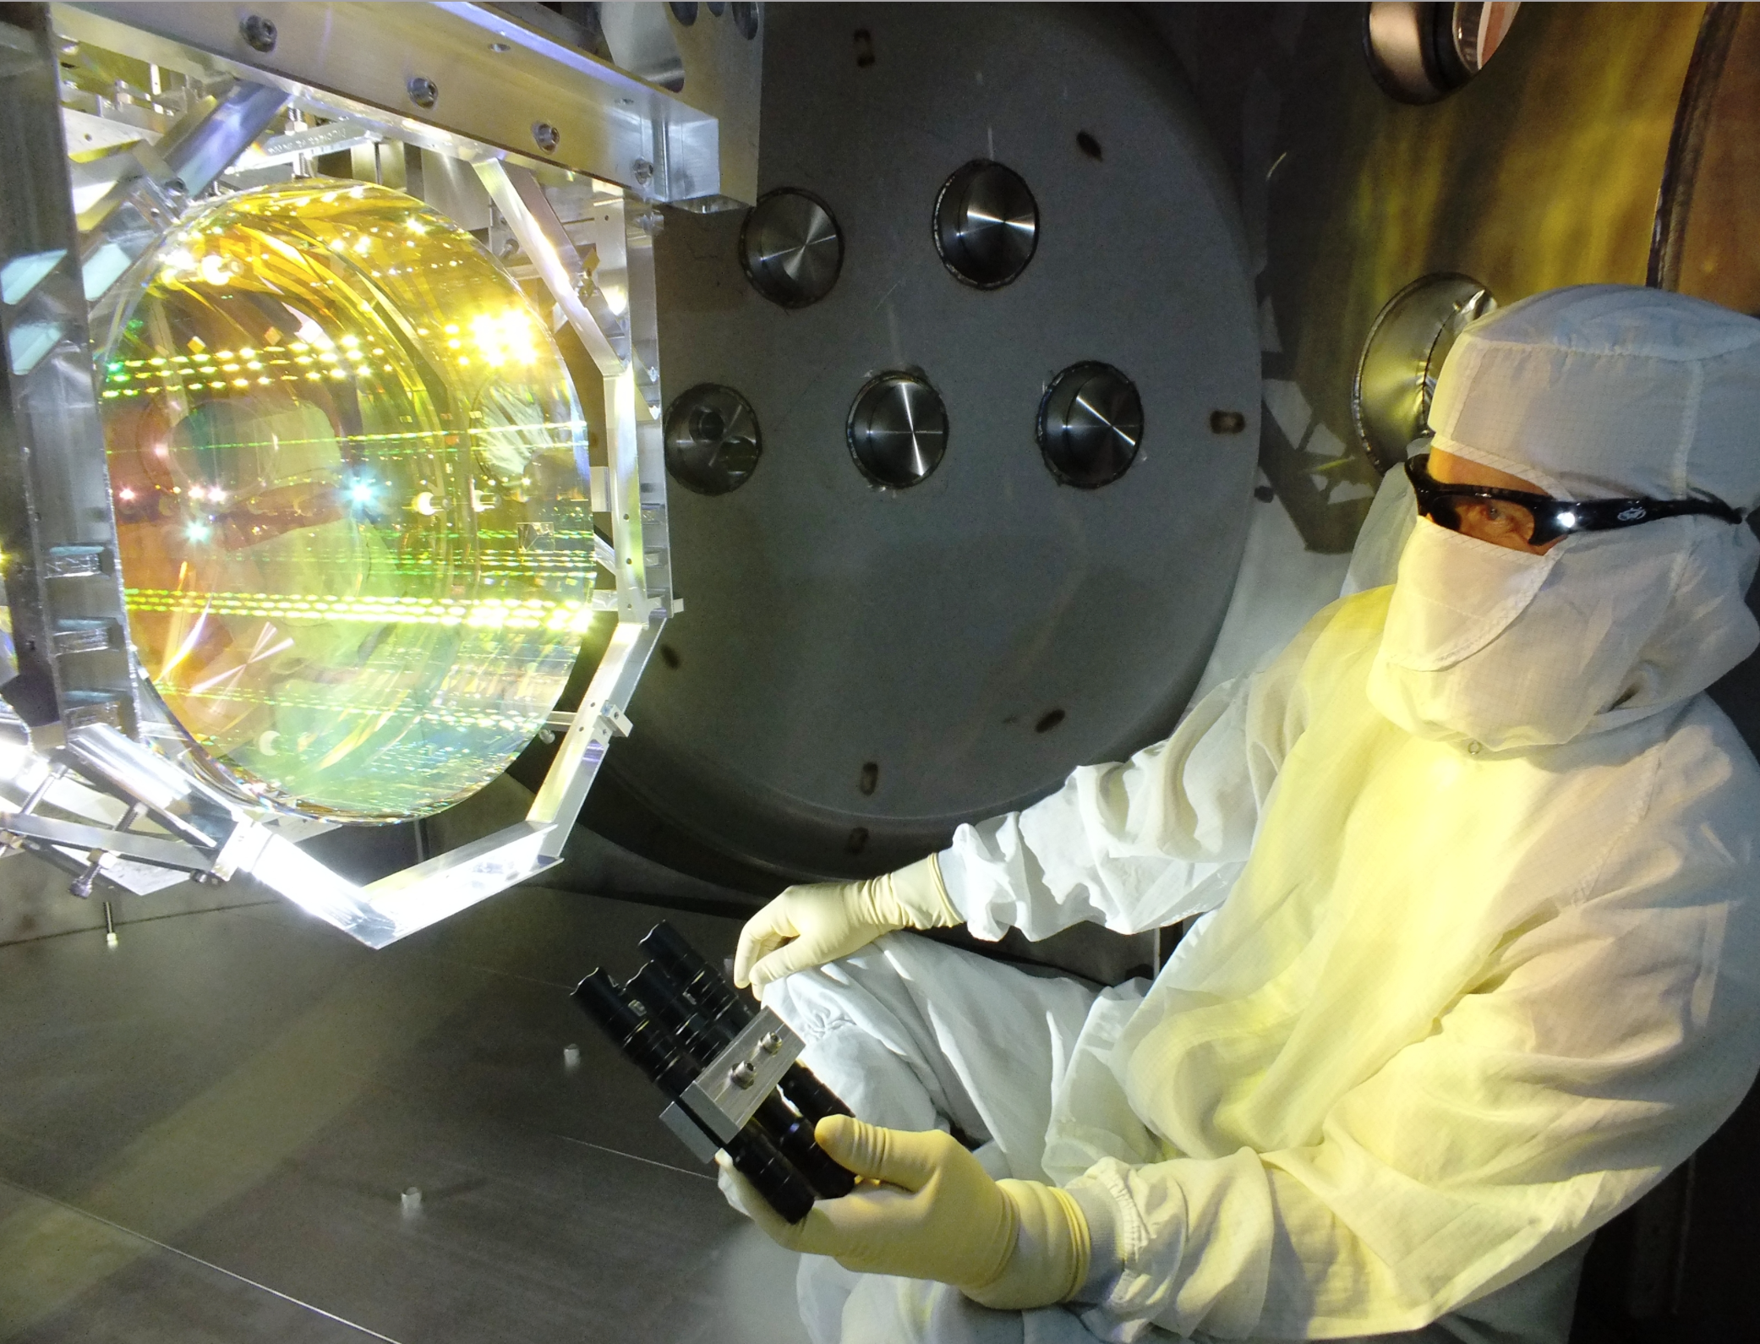
Vacuum Requirements
Brownian noise due to gas impact
    Exacerbated by small gaps
      P(H₂) < 10⁻⁸ Torr
Contamination of optics
    Mirror absorption budget: < 0.1 ppm change
    over operating life
    Hydrocarbons: < 1 monolayer/10 years
    Particles: < one 10 µm particle on any mirror
Light scattering phase noise from residual gas
    A function of molecular polarizability and
    thermal speed
    Primary goals for beam tubes:
      ➔P(H₂) < 10⁻⁹ Torr
      ➔P(H₂O) < 10⁻¹⁰ Torr

Slide 12
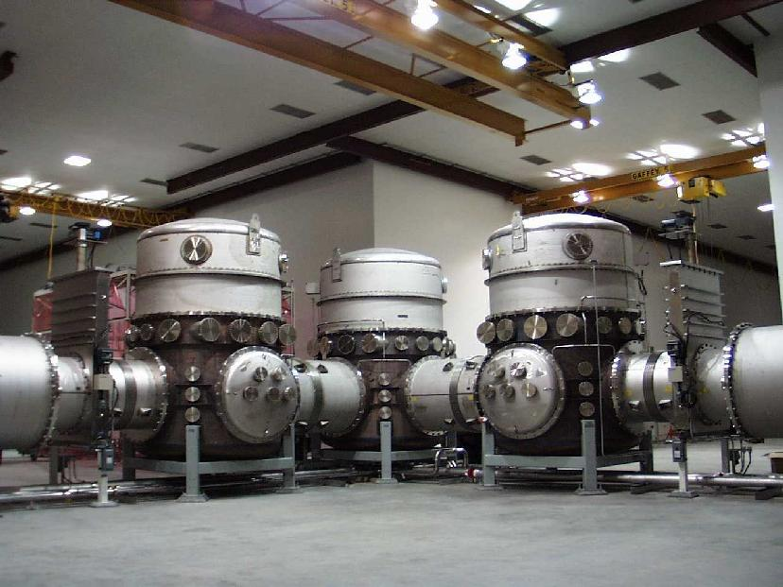

LIGO is Really Two Vacuum Systems (at each site)
Vacuum Equipment
Chambers, pumps, instruments-
“Vacuum Equipment”
  Houses detector apparatus
  Isolation (valves), access (doors)
  Electrical, mechanical, optical penetrations/interfaces
  Pumping & instrumentation
  Somewhat “conventional”
  F:A ~ 10⁻² ls⁻¹cm⁻²
Beam tubes
  Just a long hole in the air;
      Never to be vented
  Highly “unconventional”
    10 million liters (per site)
    300 million cm² (per site)
    200 l/s char. conductance
  F:A ~ 10⁻⁵ ls⁻¹cm⁻²

Slide 13
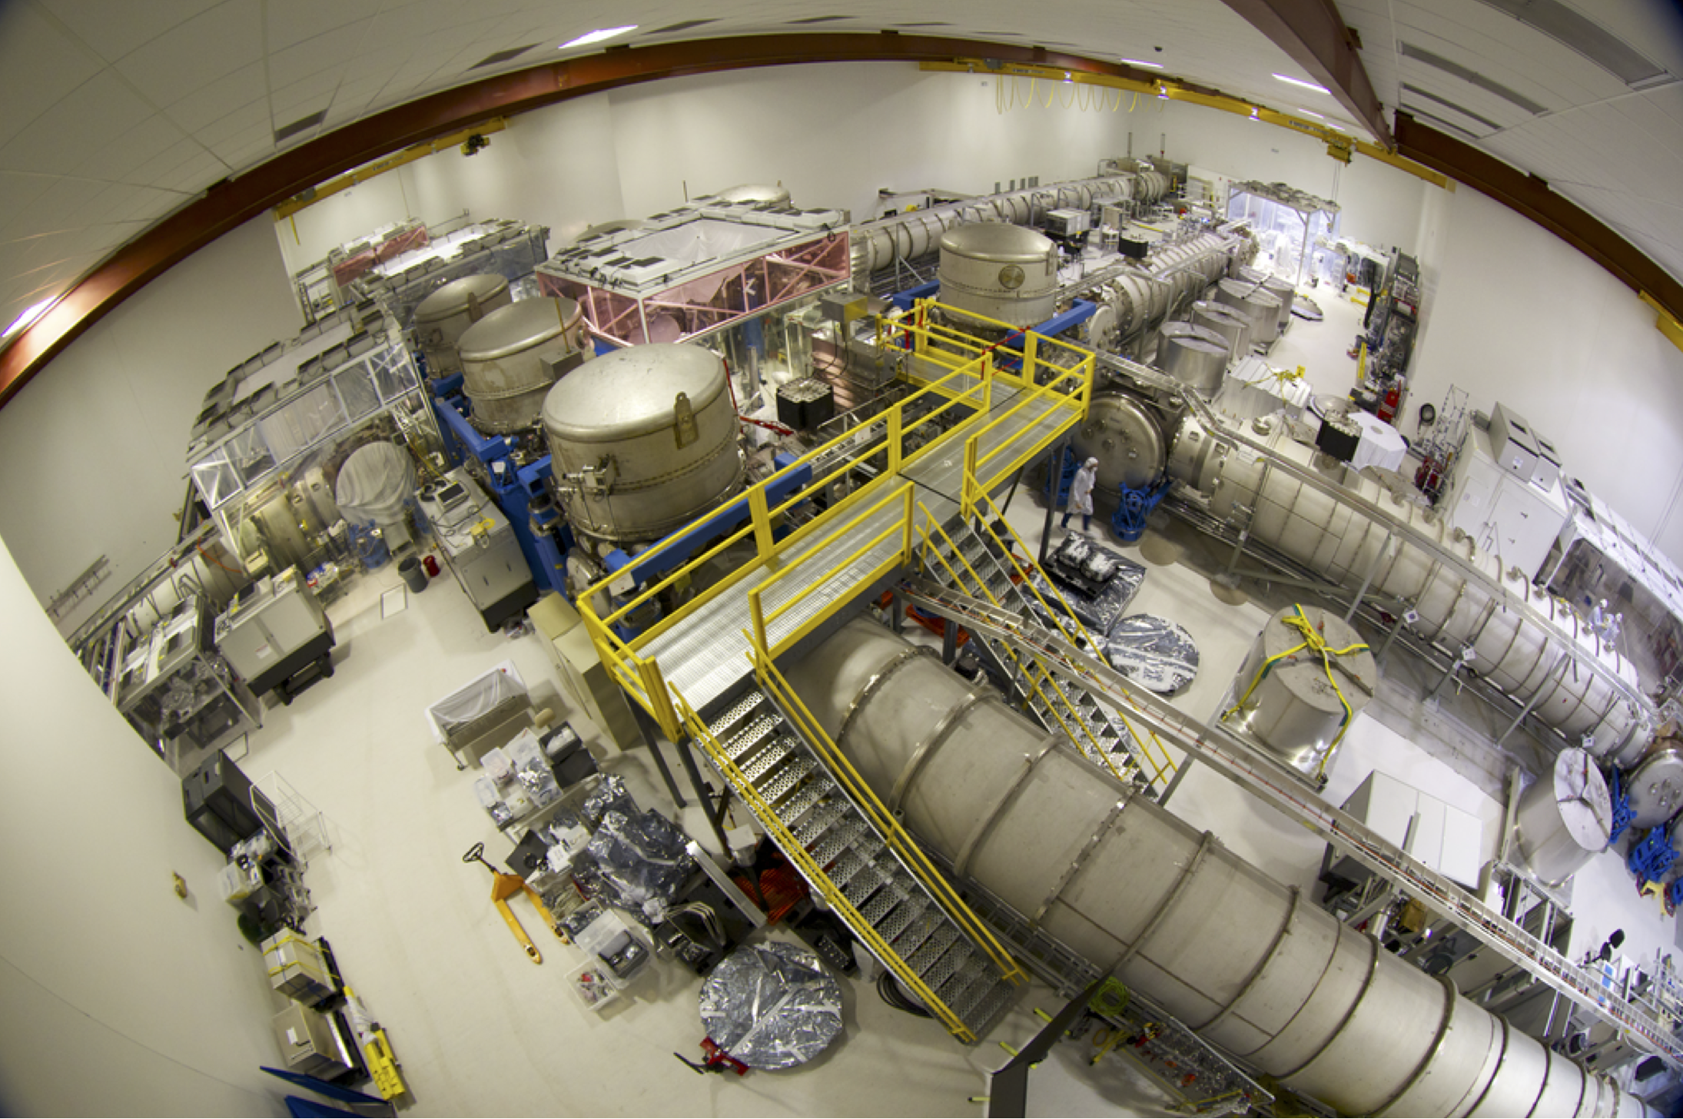
LIGO Vacuum Equipment, LHO Corner Station

Slide 14
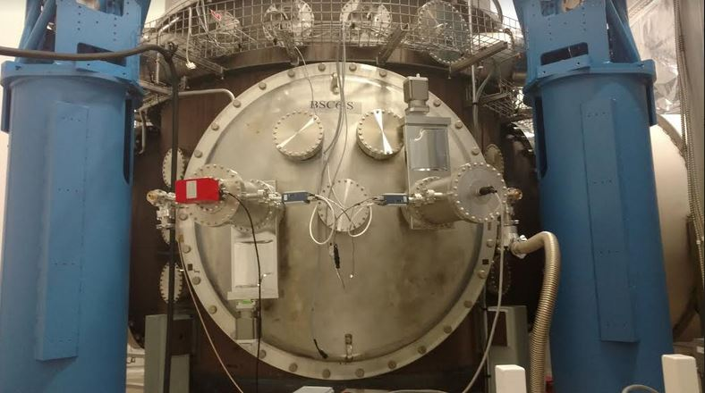
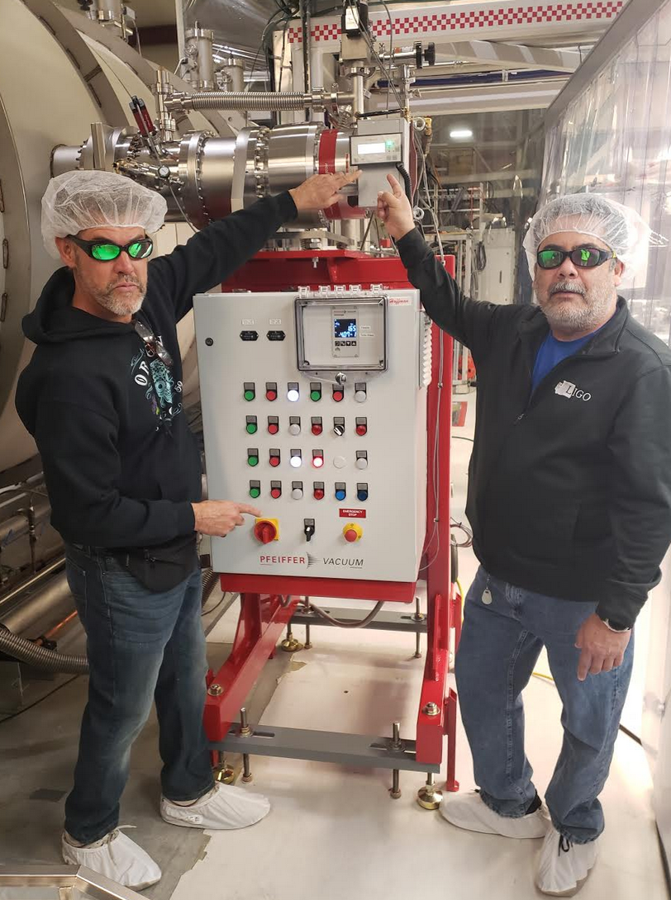
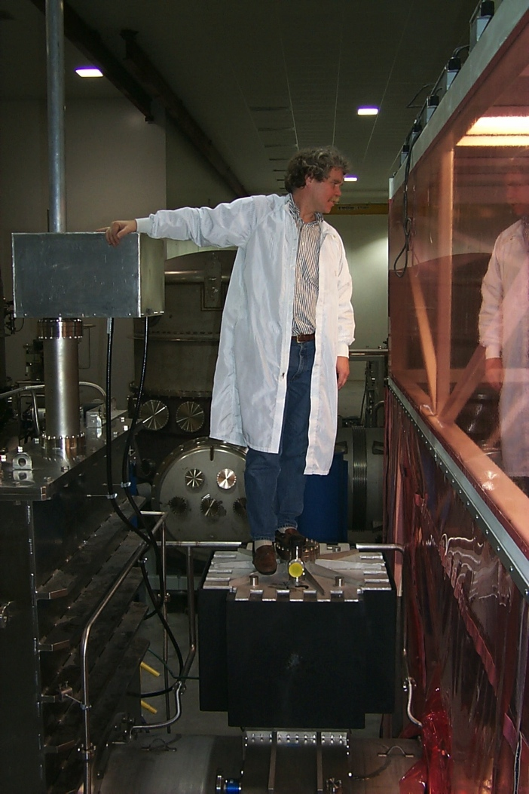
Pumping for Non-Condensibles
Maglev turbos for initial evacuation only
Ion pumps assisted by NEGs in normal operation
NO rotating or vibrating machinery allowed during interferometer operation

Slide 15
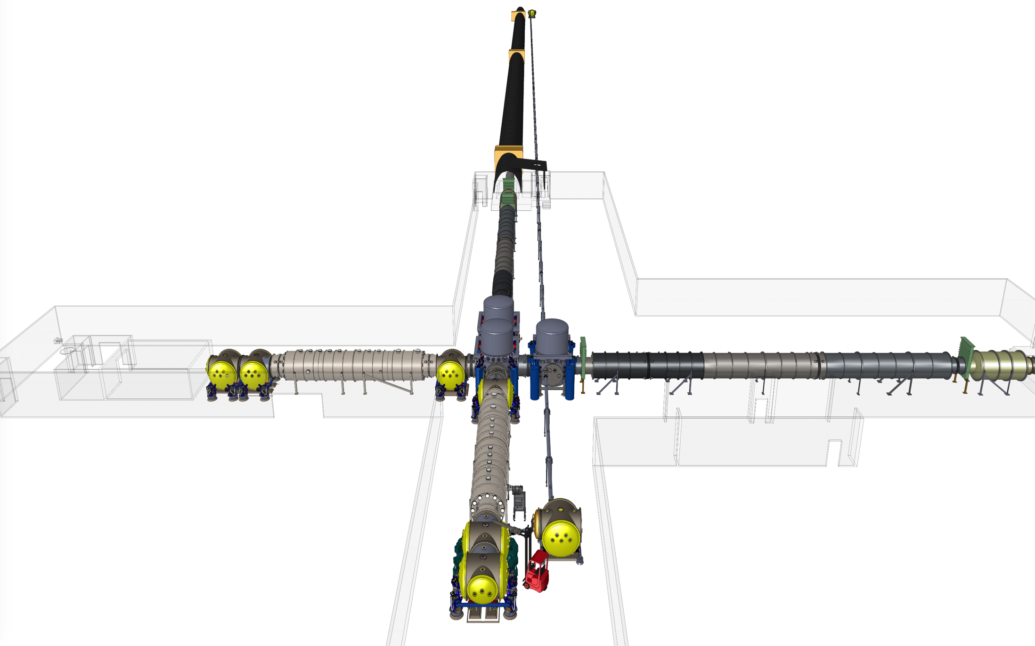
A+ Upgrade
1.7x distance ~ 5x volume

Slide 16
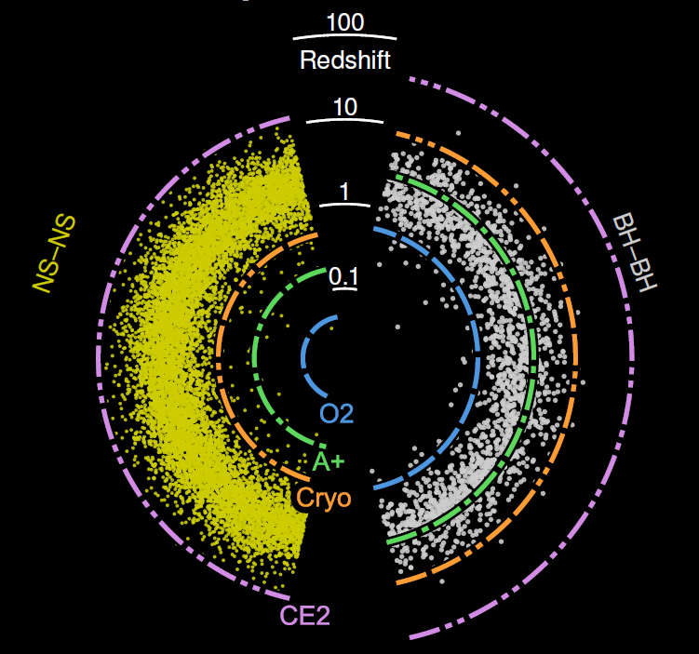
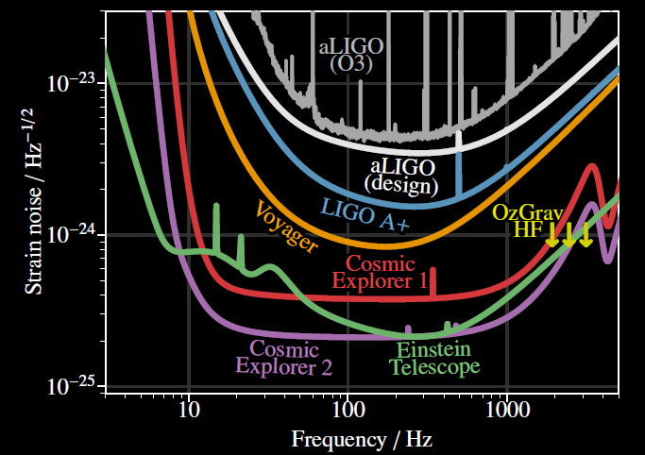
Sensitivity
Courtesy of E. Hall, LIGO MIT

Slide 17
Future Gravitational Wave Detectors

Slide 18
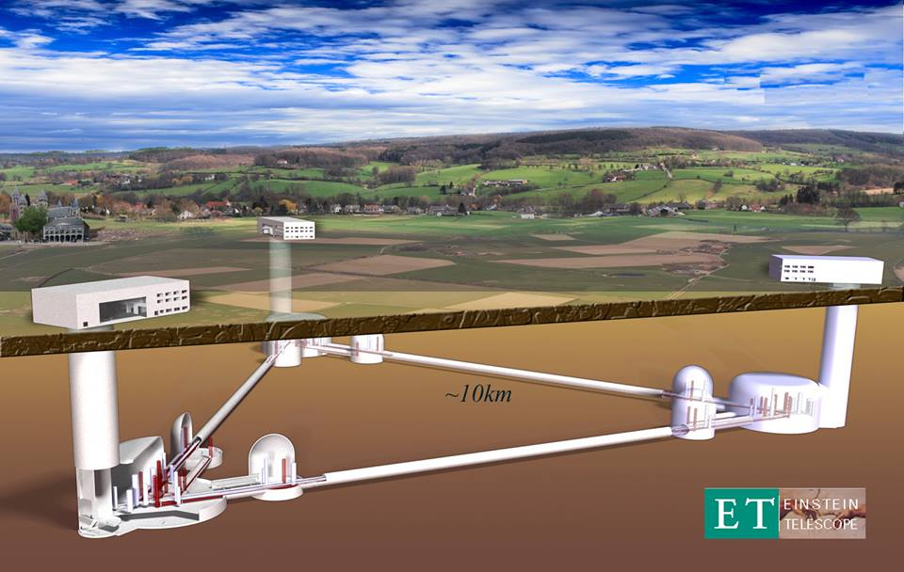
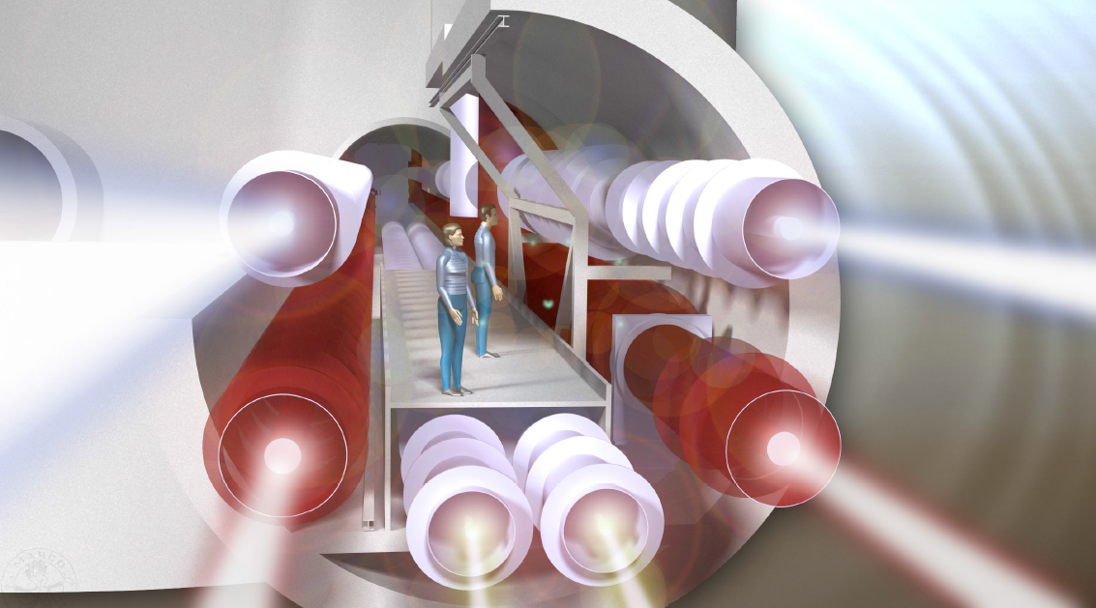
Einstein Telescope www.et-gw.eu

Slide 19
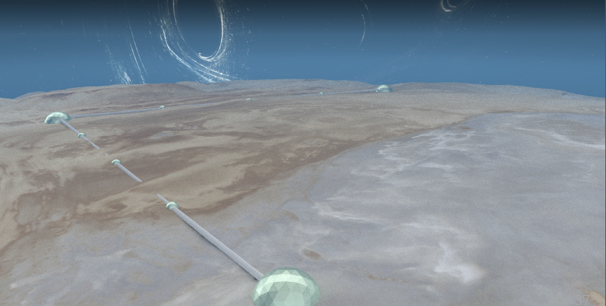
Cosmic Explorer www.cosmicexplorer.org

Slide 20
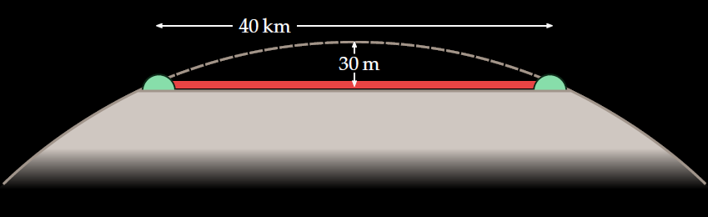
What is Cosmic Explorer?
40 km L-shaped facility on the Earth’s surface
2030s: room-temperature glass detector
2040s: cryogenic silicon detector
Collaborating institutions in the US:
Caltech: R. Adhikari, Y. Chen¹; Cal State Fullerton: G. Lovelace¹, J. Read, J. Smith; Penn State: B. Sathyaprakash¹; Syracuse: S. Ballmer¹, D. Brown; MIT: M. Evans^{1,2}, S. Vitale
Three-year horizon study funded by the NSF, 2018–2021
¹PI
²Lead PI

Slide 21
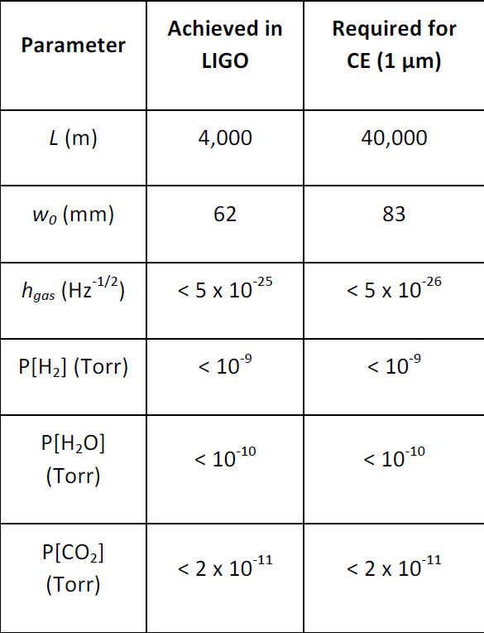
CE Vacuum Requirements

Slide 22
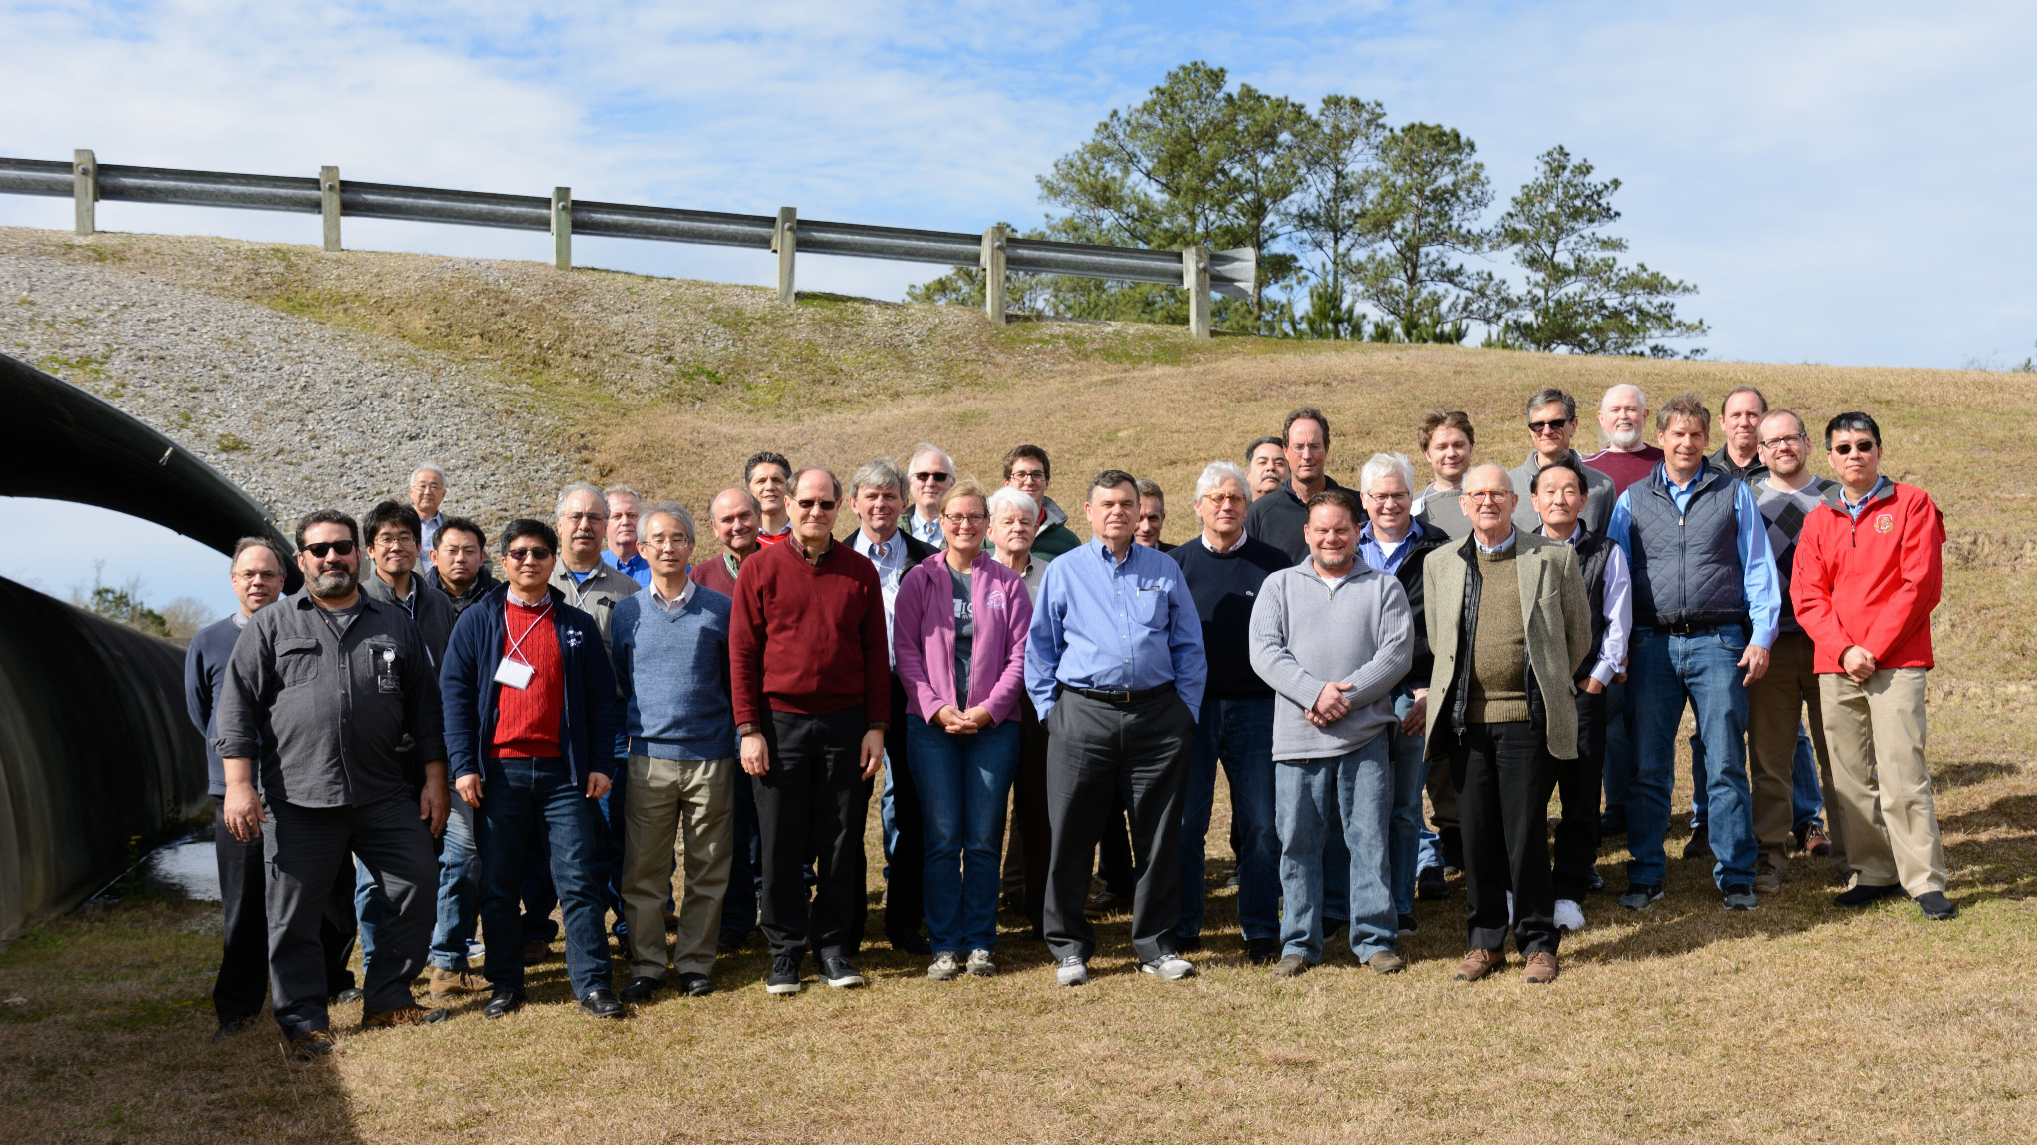
Blue Sky Large Vacuum Workshop
Goal: examine vacuum design concepts & technologies to aid detailed design & engineering studies of CE and ET
Held at LIGO Livingston on January 29-31, 2019
38 attendees, organized by H.F. Dylla, R. Weiss, M.E. Zucker
Sponsored by NSF & Caltech/MIT LIGO Lab
Proceedings available @ https://dcc.ligo.org/LIGO-P1900072/public

Slide 23
Working Groups
Conventional single-wall vacuum systems
  - Cost reduction options of single wall beamtube technology and material options
Non-conventional vacuum technology
  - Cost reduction options including nested vacuum tubes with thin, bakeable UHV shell inside robust outer wall
Novel surface treatment for conventional and UHV materials
  - Surface modifications and coatings to meet UHV and optical requirements
Vacuum pumping for conventional and nested systems
  - Pumping schemes and scenarios for obtaining UHV for both conventional single wall and nested differential pressures

Slide 24
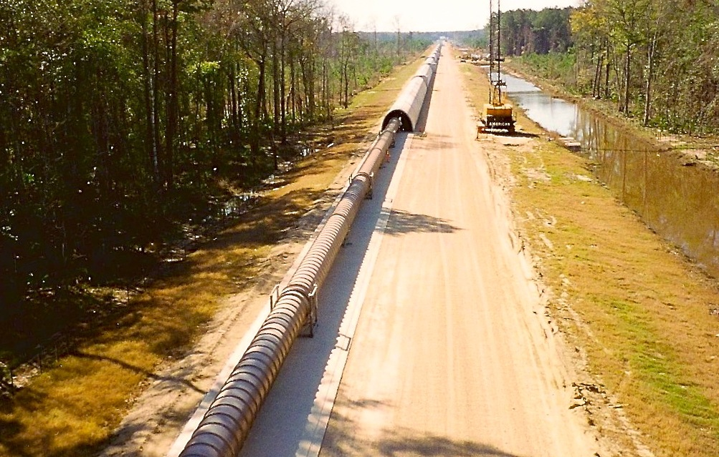
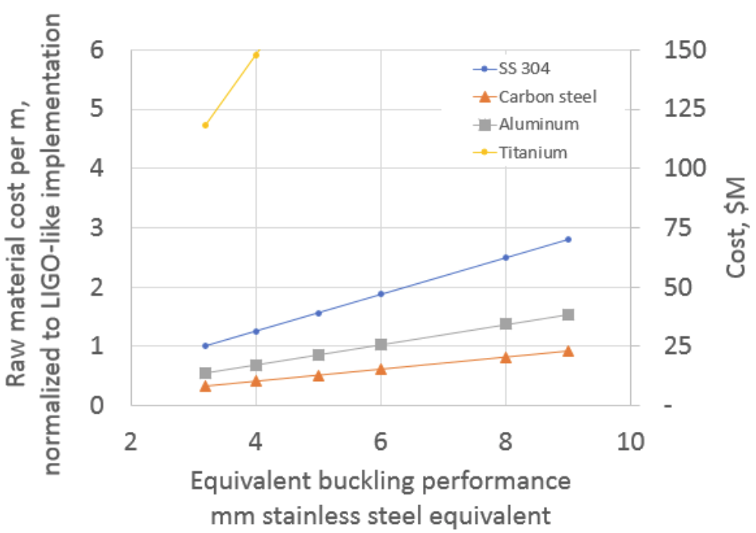
WG1: Single Wall Beamtube
Co-chairs: C. Baffes (FNAL) and D. Henkel (Rimkus Consulting Group, Inc.)
Material evaluation
  304L SS well understood
  Al offers low H₂ outgassing and relatively low cost; dissimilar metal welding a challenge –~4000 bellows w/40 mm stroke for 120C bake
  Mild steel lower cost alternative offering low H₂ outgassing through Ruhrstahl-Hausen processing¹
Fabrication Techniques
  Spiral vs longitudinal welding
  Seamless and Al extrusion
  Explosion bonding vs hot isostatic pressing
  vs adhesive bonded transition
Surface & Bakeout
  Reflective surface bad; smooth surface good
  100C bakeout via iterative traveling ‘hot tent’ and ppb ultra dry viscous air flow – no isolation valves needed
LIGO Beamtube
9000 m³ volume/site
30000 m² area/site
50 km of spiral welds
~10⁻⁹ torr
budget ~ $40M (1997)
$2500/m
$50/lb
  Figure courtesy of C. Baffes, FNAL
  ¹Chongdo Park, et. al., J. Vac. Sci. Technol. A 34(2), 021601-1 2016

Slide 25
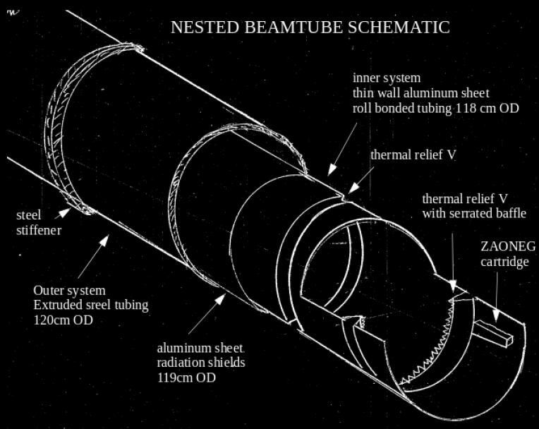
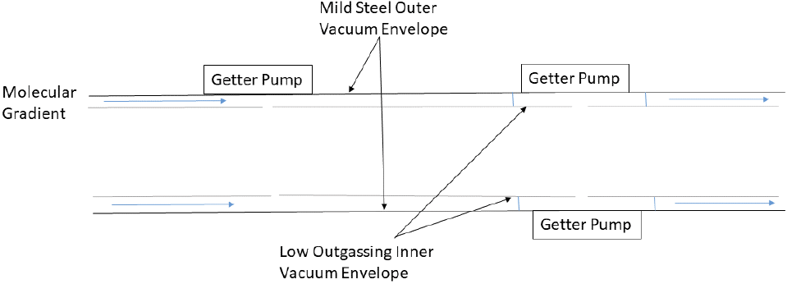
WG2: Nested Beamtube
Co-chairs: J. Noonan (ANL) and D. Manos (William and Mary)
Nested design conceived by R. Weiss
Concentric tubes
  Thin, bakeable inner shell ½-1.5 mm thick Al with vibration dampening
  Robust outer tube holds rough to HV; mild steel or FRP
  Sealed or shared volumes
  Annulus or soft sealing valves/shutters

Slide 26
WG3: Novel Surface Treatments
Co-chairs: J. Fedchak (NIST) and J. Feicht (LIGO)
1 μm TiN coating on SS to minimize water adsorption¹
Vacuum degassing at foundry reduces H₂ in mild steel²
Magnetite (Fe₃O₄) on mild steel to prevent corrosion
Electrochemical conversion for low-reflection surface (blue/black surface)
Diamond-like carbon (DLC) coating
Amorphous silicon (a-Si)
UV light sources and ozone considered
Dry purge cleaning and “cycle purge” method
NIST will perform outgassing measurements using SRG technique of mild steel and TiN, DLC coated chambers
  ¹Y. Saito, et. al., Vacuum 53, 353 (1999)
  ²C. Park, et. al., JVST A34, 021601 (2016)

Slide 27
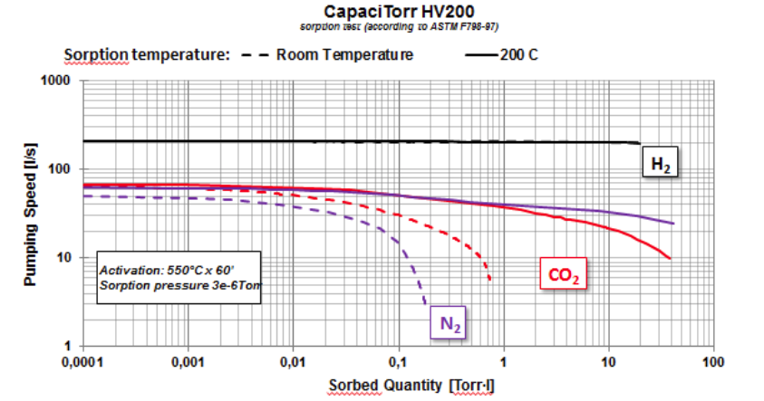
WG4: Pumping
Co-chairs: Y. Li (Cornell) and P. Chiggiato (CERN)
40 km sectored into 10 km segments for independent pump down
10 km segments reduced to 2 km sections for installation intervals and bake out
Automated venting for nested system to avoid buckling
Rough to 10⁻² Torr → turbo to 10⁻⁵ Torr → cryopumps or ZAO NEG+IP to trap H₂0 during bake
Ne-He cryo cycles to condense N₂, O₂, Ar
Ti sublimation pumping for distributed getter pumping
Pump interval ~ 250 m during bake and 1000 l/s per 1 km during operation
Pressure gauges every 100-250 m to localize leaks
Data courtesy of SAES

Slide 28
Path Forward
Carry out single wall and nested beamtube concepts to next level of detailed design, engineering, and cost studies
Consider mild steel alloys and Al in addition to SS, detailing surface treatment, coatings, and material transitions
Study best options for outer vessel material in nested system
Quantify TiN, DLC, a-Si, Fe₃O₄ coating effectiveness for H₂0 adsorption, scale and particulate, welding interference, and optical characterization
Collaborate with NIST, Jlab, and CERN on outgassing studies
Follow-up workshop is planned for April 2020 at CERN:
  Research agenda layout for short-term R&D to quantify cost-benefit of material choices and surface treatments identified

Slide 29
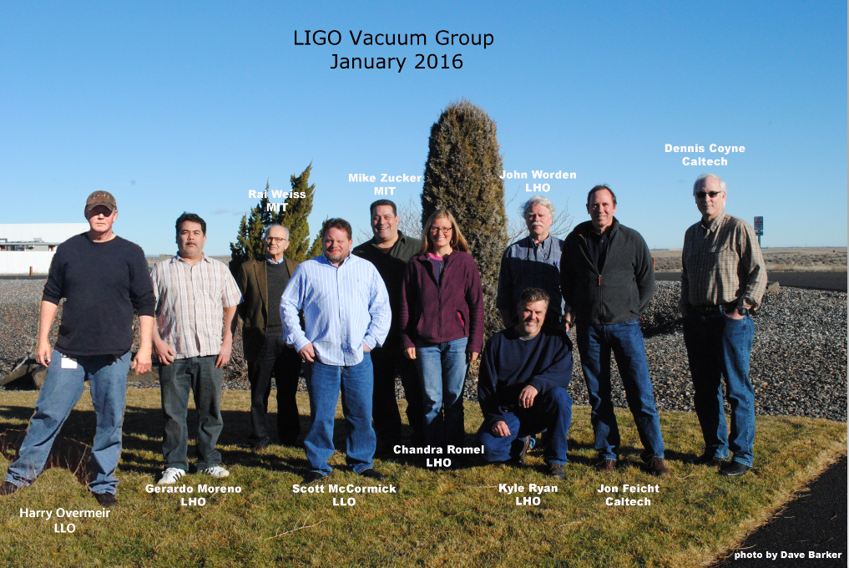
Acknowledgements
Thank you to the US National Science Foundation
award PHY-1846124
Thank you to all attendees of the Large Vacuum Workshop. Special thanks to F. Dylla, R. Weiss, M. Zucker for organizing, and to co-chairs for leading working groups and composing reports.

Slide 30
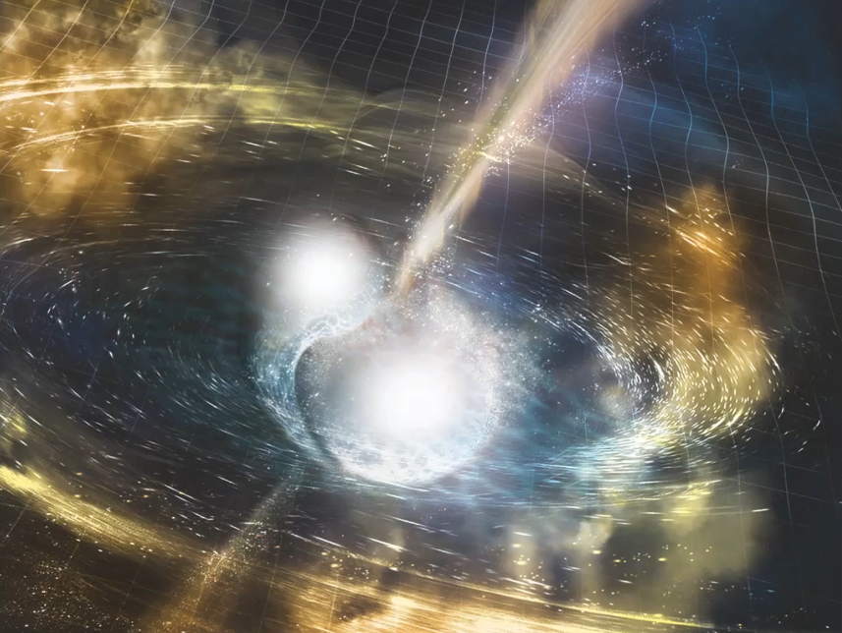
THANK YOU

