Slide 1
The Effect of Winds at the LIGO Hanford Observatory on the Search for Burst Gravitational Waves
Amber L. Stuver, Ray Dean, Matt Caesar
Villanova University

Slide 2
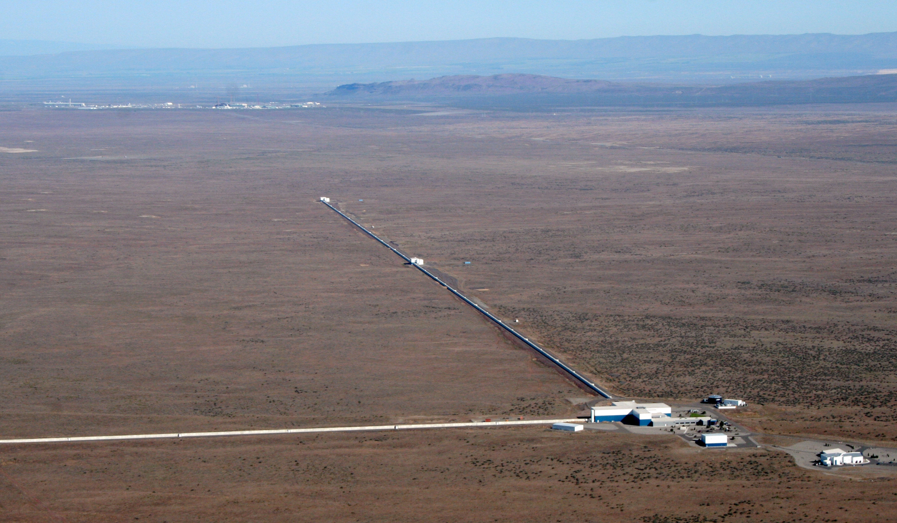
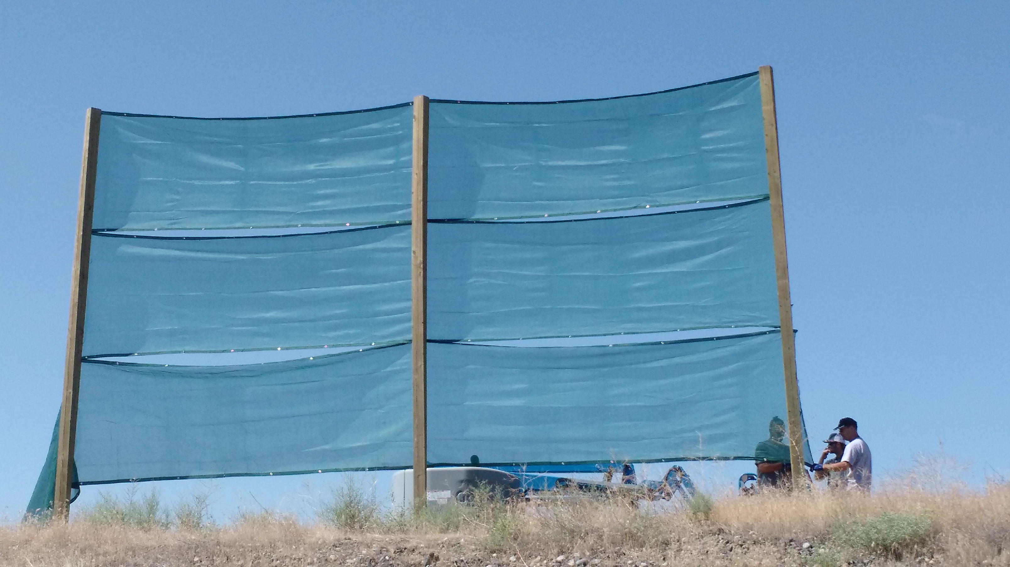
LHO and Wind
Wind fence prototype:
High winds are prevalent at the Hanford detector. A wind fence has been proposed to help mitigate effects like loss of observing time and higher glitch rates in data. This investigation is meant to inform on the potential effects reduced winds would have on the search for burst (short, unmodeled) gravitational waves.

Slide 3
Investigation
Characterize wind properties
Examine the effect of wind on Omicron triggers
Gives a measure of the general glitch rate
Examine the effect of the wind on cWB background triggers
Gives a measure of the effect of the search for burst GW
The results shown here reflect only data collected during the first 11 weeks of O3a (3 Apr – 20 Jun 2019).

Slide 4
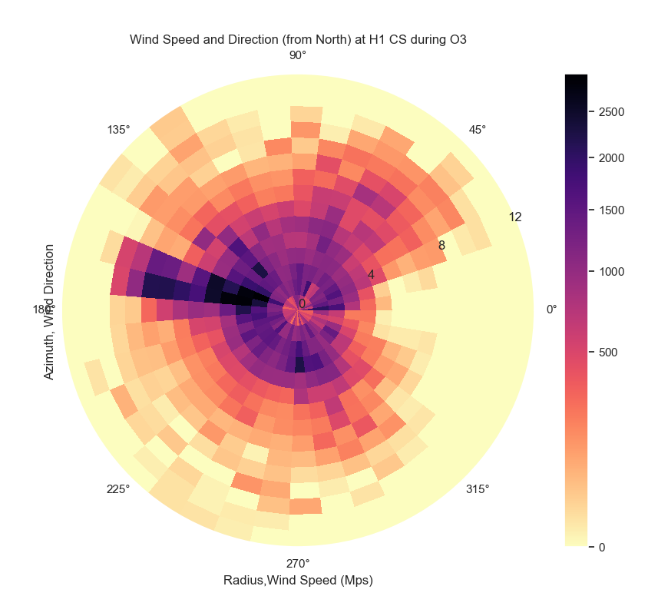
Wind Properties
We characterized the wind speed and direction.
The wind is more likely to be directed between 160º to 170º and have a higher speed when oriented in this way.
We also found that the mean wind speed is slightly lower when the detector is locked (2.666 ± 0.007 m/s) than when it is not (2.796 ± 0.019 m/s), p < 0.01.
Dates: 3 Apr – 5 June 2019

Slide 5
Omicron Glitch Rate WRT Wind Speed
SNR ≥ 8: Wind Speed (m/s) | Rate (Above/ Below)
1 | 2.0026
1.5 | 2.1190
2 | 2.2619
2.5 | 2.4157
3 | 2.2850
3.5 | 2.2462
4 | 2.3064
4.5 | 2.4400
5 | 2.5672
5.5 | 2.6958
6 | 3.2389
6.5 | 3.8249
7 | 4.5370
7.5 | 5.6737
8 | 5.8671
8.5 | 6.5918
9 | 7.1000
9.5 | 5.5287
Omicron is a transient event analysis that can be used to detect generic noise artifacts. The Omicron glitch rate is a measure of data quality.
Omicron Glitch (SNR ≥ 8) Rate vs. Wind Speed
rate SNR ≥ 8; 70 bins
wind speed [m/s]
Dates: 1 May – 20 Jun 2019

Slide 6
Coherent WaveBurst Background
Coherent WaveBurst (cWB) is the primary burst search algorithm.
The background rate is generated by introducing non-physical time shifts between data streams from multiple detectors to measure the false alarm rate and probability.
We investigated how the cWB background changes WRT wind speed.
Between 3 Apr – 20 Jun 2019, a total background time of 946.543 years was observed.

Slide 7
Wind Speed Distributions

Slide 8
False Alarm Rate & Probability
No Wind Speed Selection

Slide 9
False Alarm Rate & Probability
Wind speed ≥ 5 m/s
Notes:
non-zero lag time for the false alarm rate was estimated by scaling: t_bkgrnd*(# threshold triggers/total triggers).

Slide 10
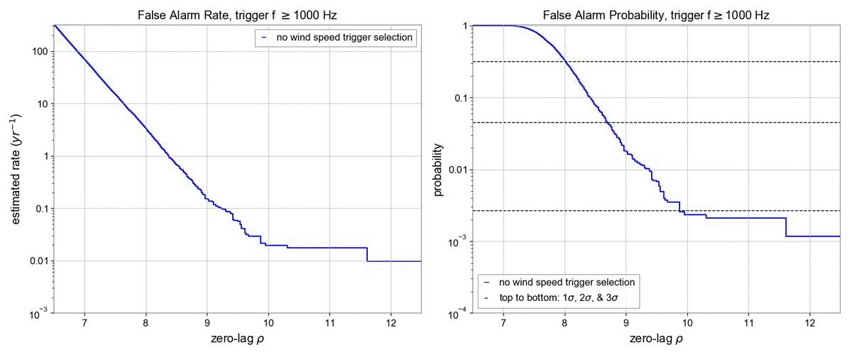
False Alarm Rate & Probability
Animation: Increasing Wind Speed

Slide 11
Conclusions
The average wind speed when the detector is locked is lower than when it is not.
While it is observed that the trigger rate can increase up to 700% at high mean wind speeds, the number of triggers observed at these wind speeds is small; it is expected that mitigating high winds would have a positive but modest benefit to Omicron.
cWB: Comparison of the change in ρ between windy and less windy times shows a fairly consistent increase 0.2 in ρ. A wind fence will have a positive effect of the search for burst GW.

