Slide 1
ETM11 absorber locations and images
LMA HR coating run C14058
Zhang, Billingsley
2019

Slide 2
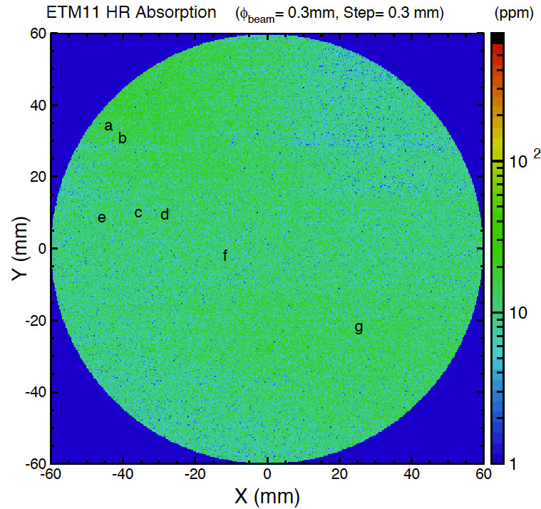
Full report at
LIGO-E1500140

Slide 3
ETM11 Absorber Catalog
No | Scan | Mea. X (mm) | Mea. Y (mm) | Micro. X (mm) | Micro. Y (mm) | X-Step | Y-Step | Signal (V) | Absorption (ppm, 0.3 mm beam) | Max. absorption (ppm, 60 um beam) | Microscope 50x Measurement (divisions) | Microscope Final dimension using calibration of 2µm/divison with 50x objective (µm) | Optic X (mm) from center | Optic Y (mm) from center
ETM11a | 62519 | 191.663 | 76.99 | -179.052 | 83.623 | -151 | -110 | 1.71E-05 | 97 | 13300 | 5 x 2 | 10 x 4 | -45 | 33
ETM11b1 | 62519 | 195.513 | 80.591 | -175.203 | 87.225 | -138 | -98 | 5.00E-05 | 285 | 38400 | 4 | 8 | -41 | 29
ETM11b2 |  |  |  |  |  |  |  |  |  |  | 3 | 6
ETM11c | 62519 | 200.832 | 101.29 | -169.883 | 107.924 | -123 | -29 | 1.36E-05 | 77 | 16500 | 7 x 3 | 14 x 6 | -36 | 9
ETM11d | 62519 | 207.971 | 101.887 | -162.745 | 108.521 | -99 | -27 | 1.72E-05 | 103 | 2210 | 9 | 18 | -29 | 8
ETM11e | 62519 | 189.798 | 102.786 | -180.918 | 109.419 | -157 | -24 | 1.17E-05 | 67 | 6020 | 4 x 2 | 8 x 4 | -47 | 7
ETM11f | 62519 | 224.352 | 113.594 | -146.364 | 120.228 | -41 | 12 | 4.21E-05 | 254 | 19800 | 7 x 5 | 14 x 10 | -13 | -4
ETM11g | 62519 | 261.547 | 133.091 | -109.169 | 139.724 | 81 | 77 | 9.85E-06 | 57 | 8760 | 4 x 3 | 8 x 6 | 25 | -23

Slide 4
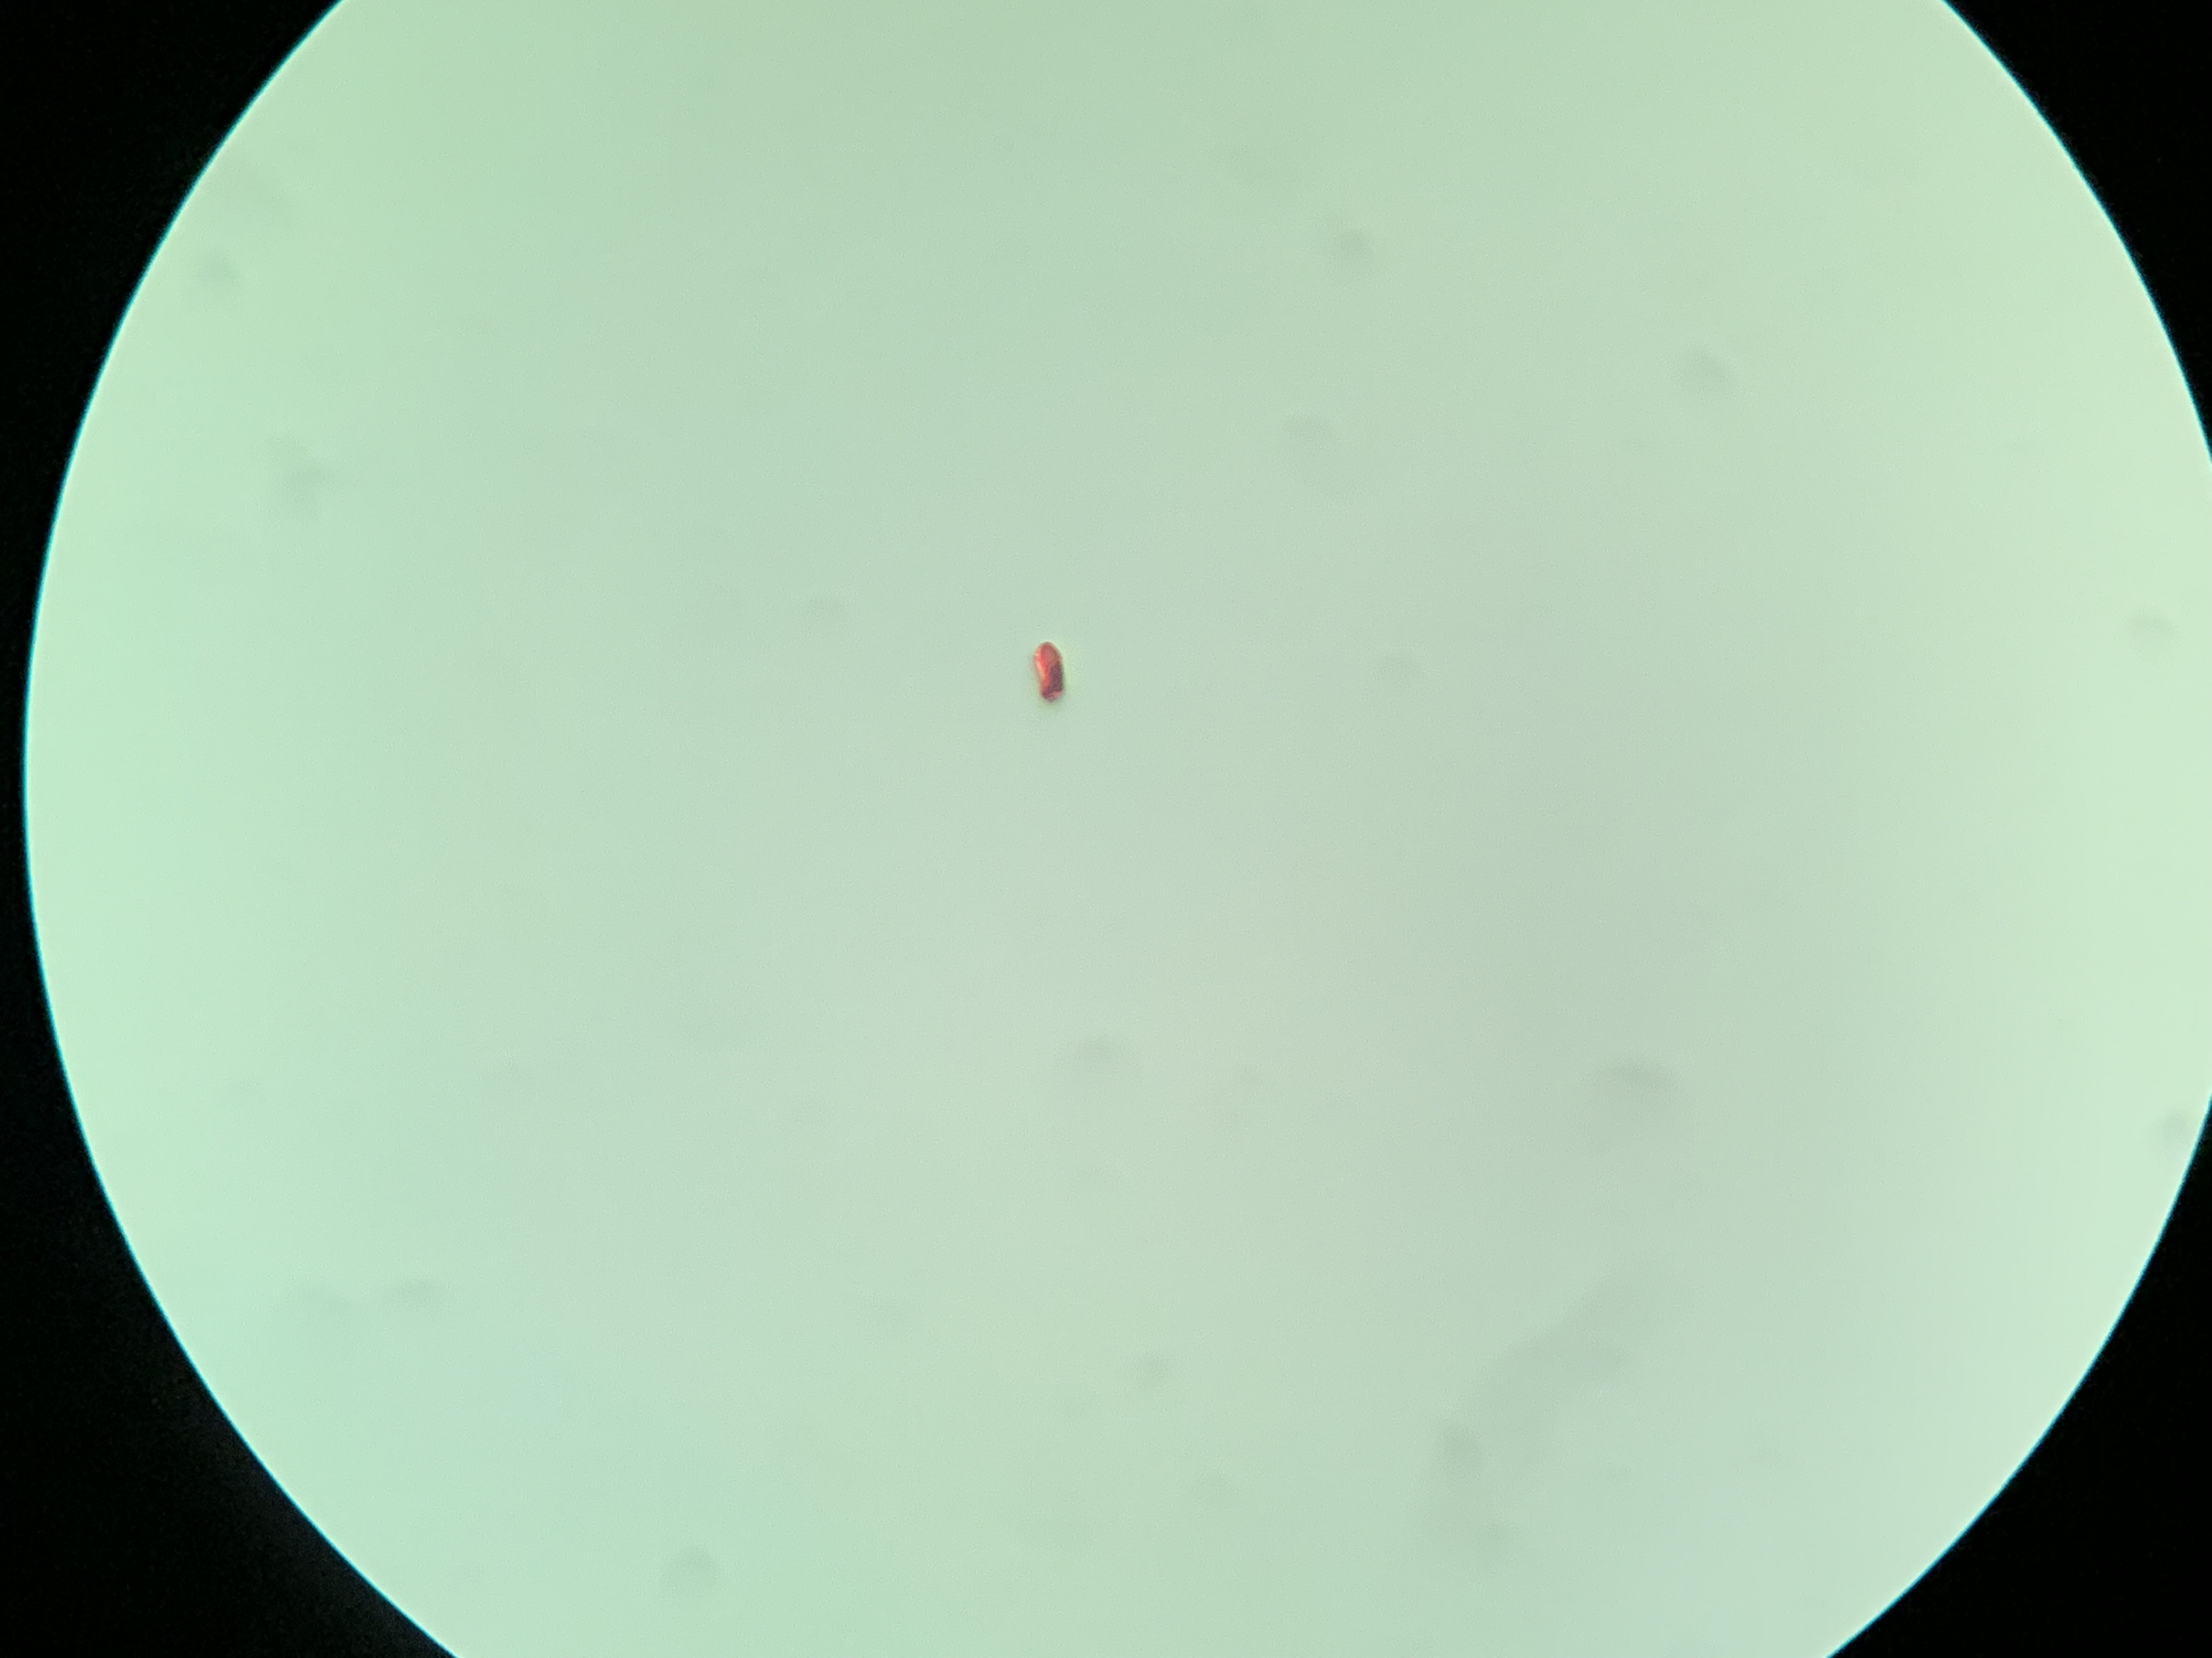
Point a ~10 x 4 µm

Slide 5
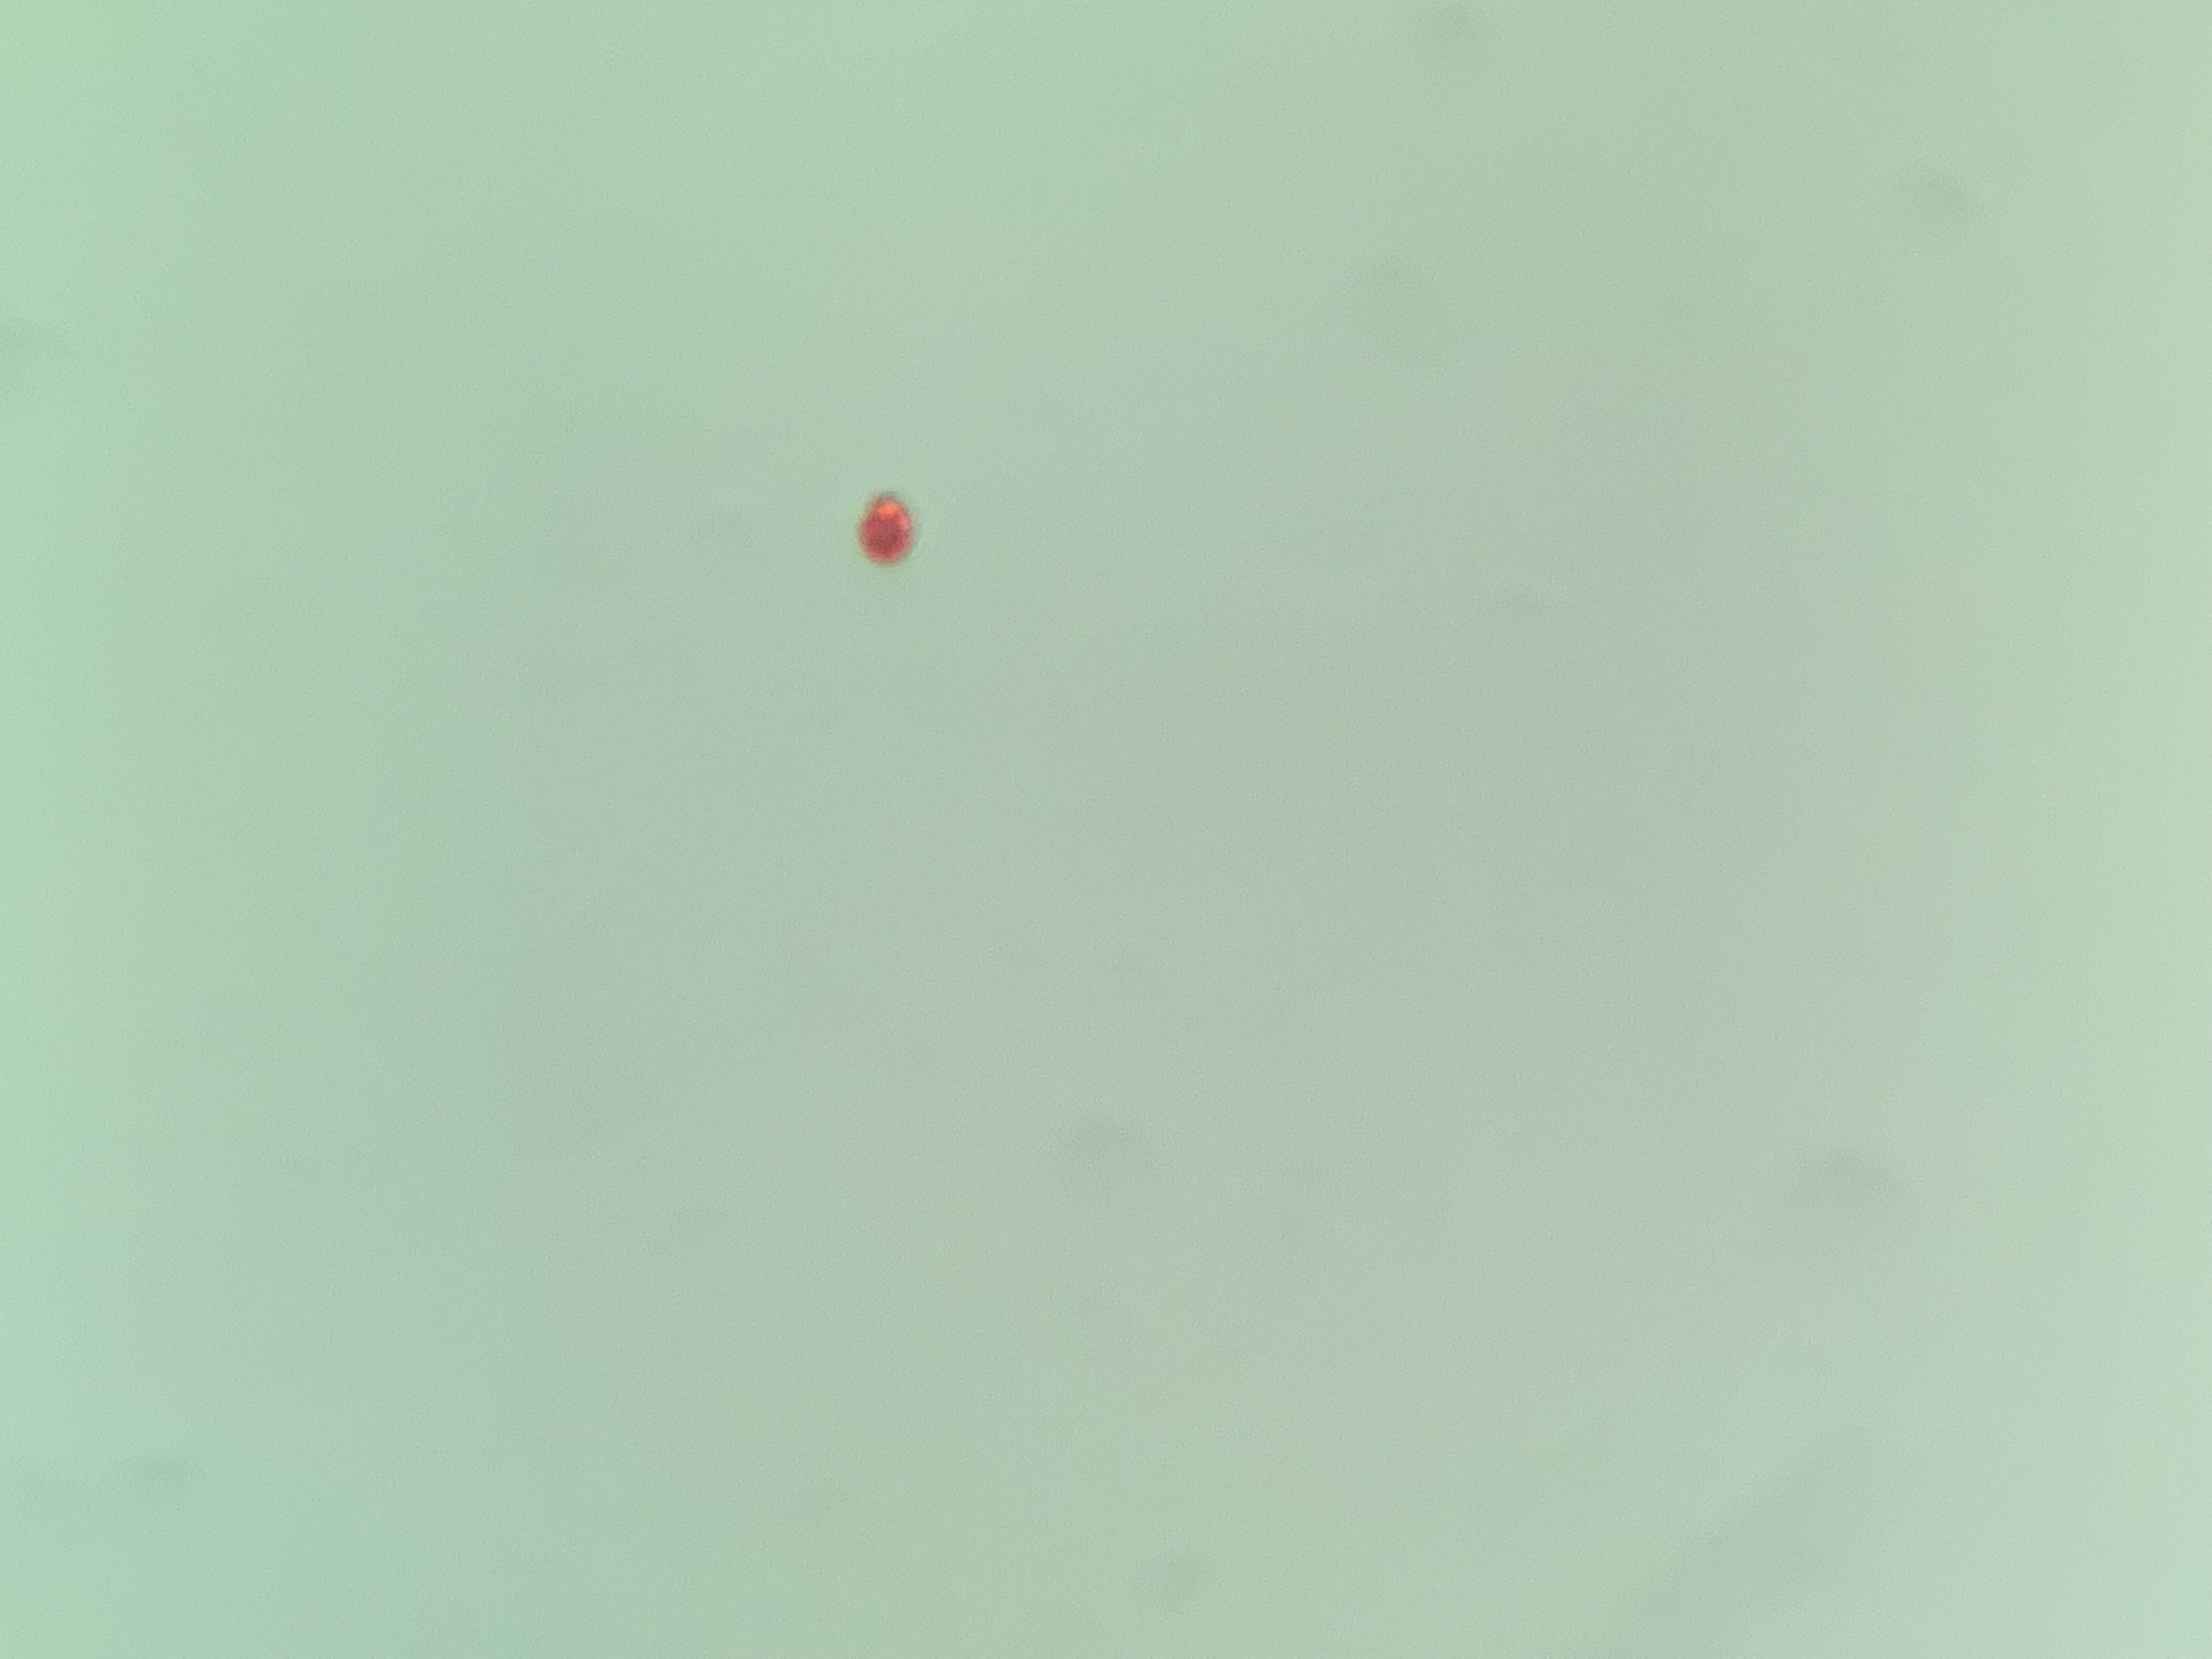
Point b1 ~ 8 µm

Slide 6
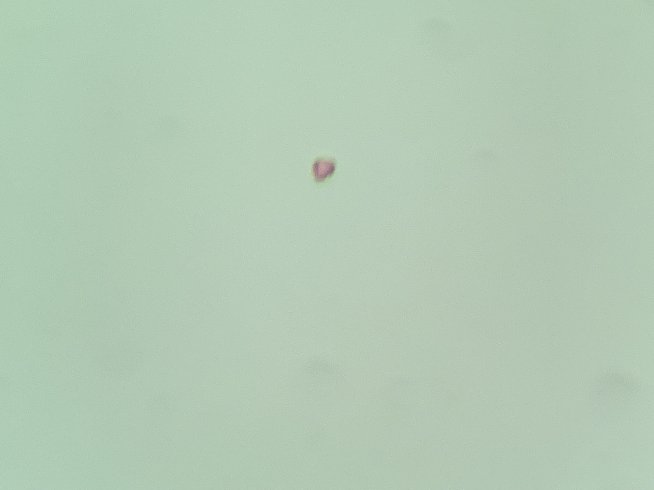
Point b2 ~ 6 µm

Slide 7
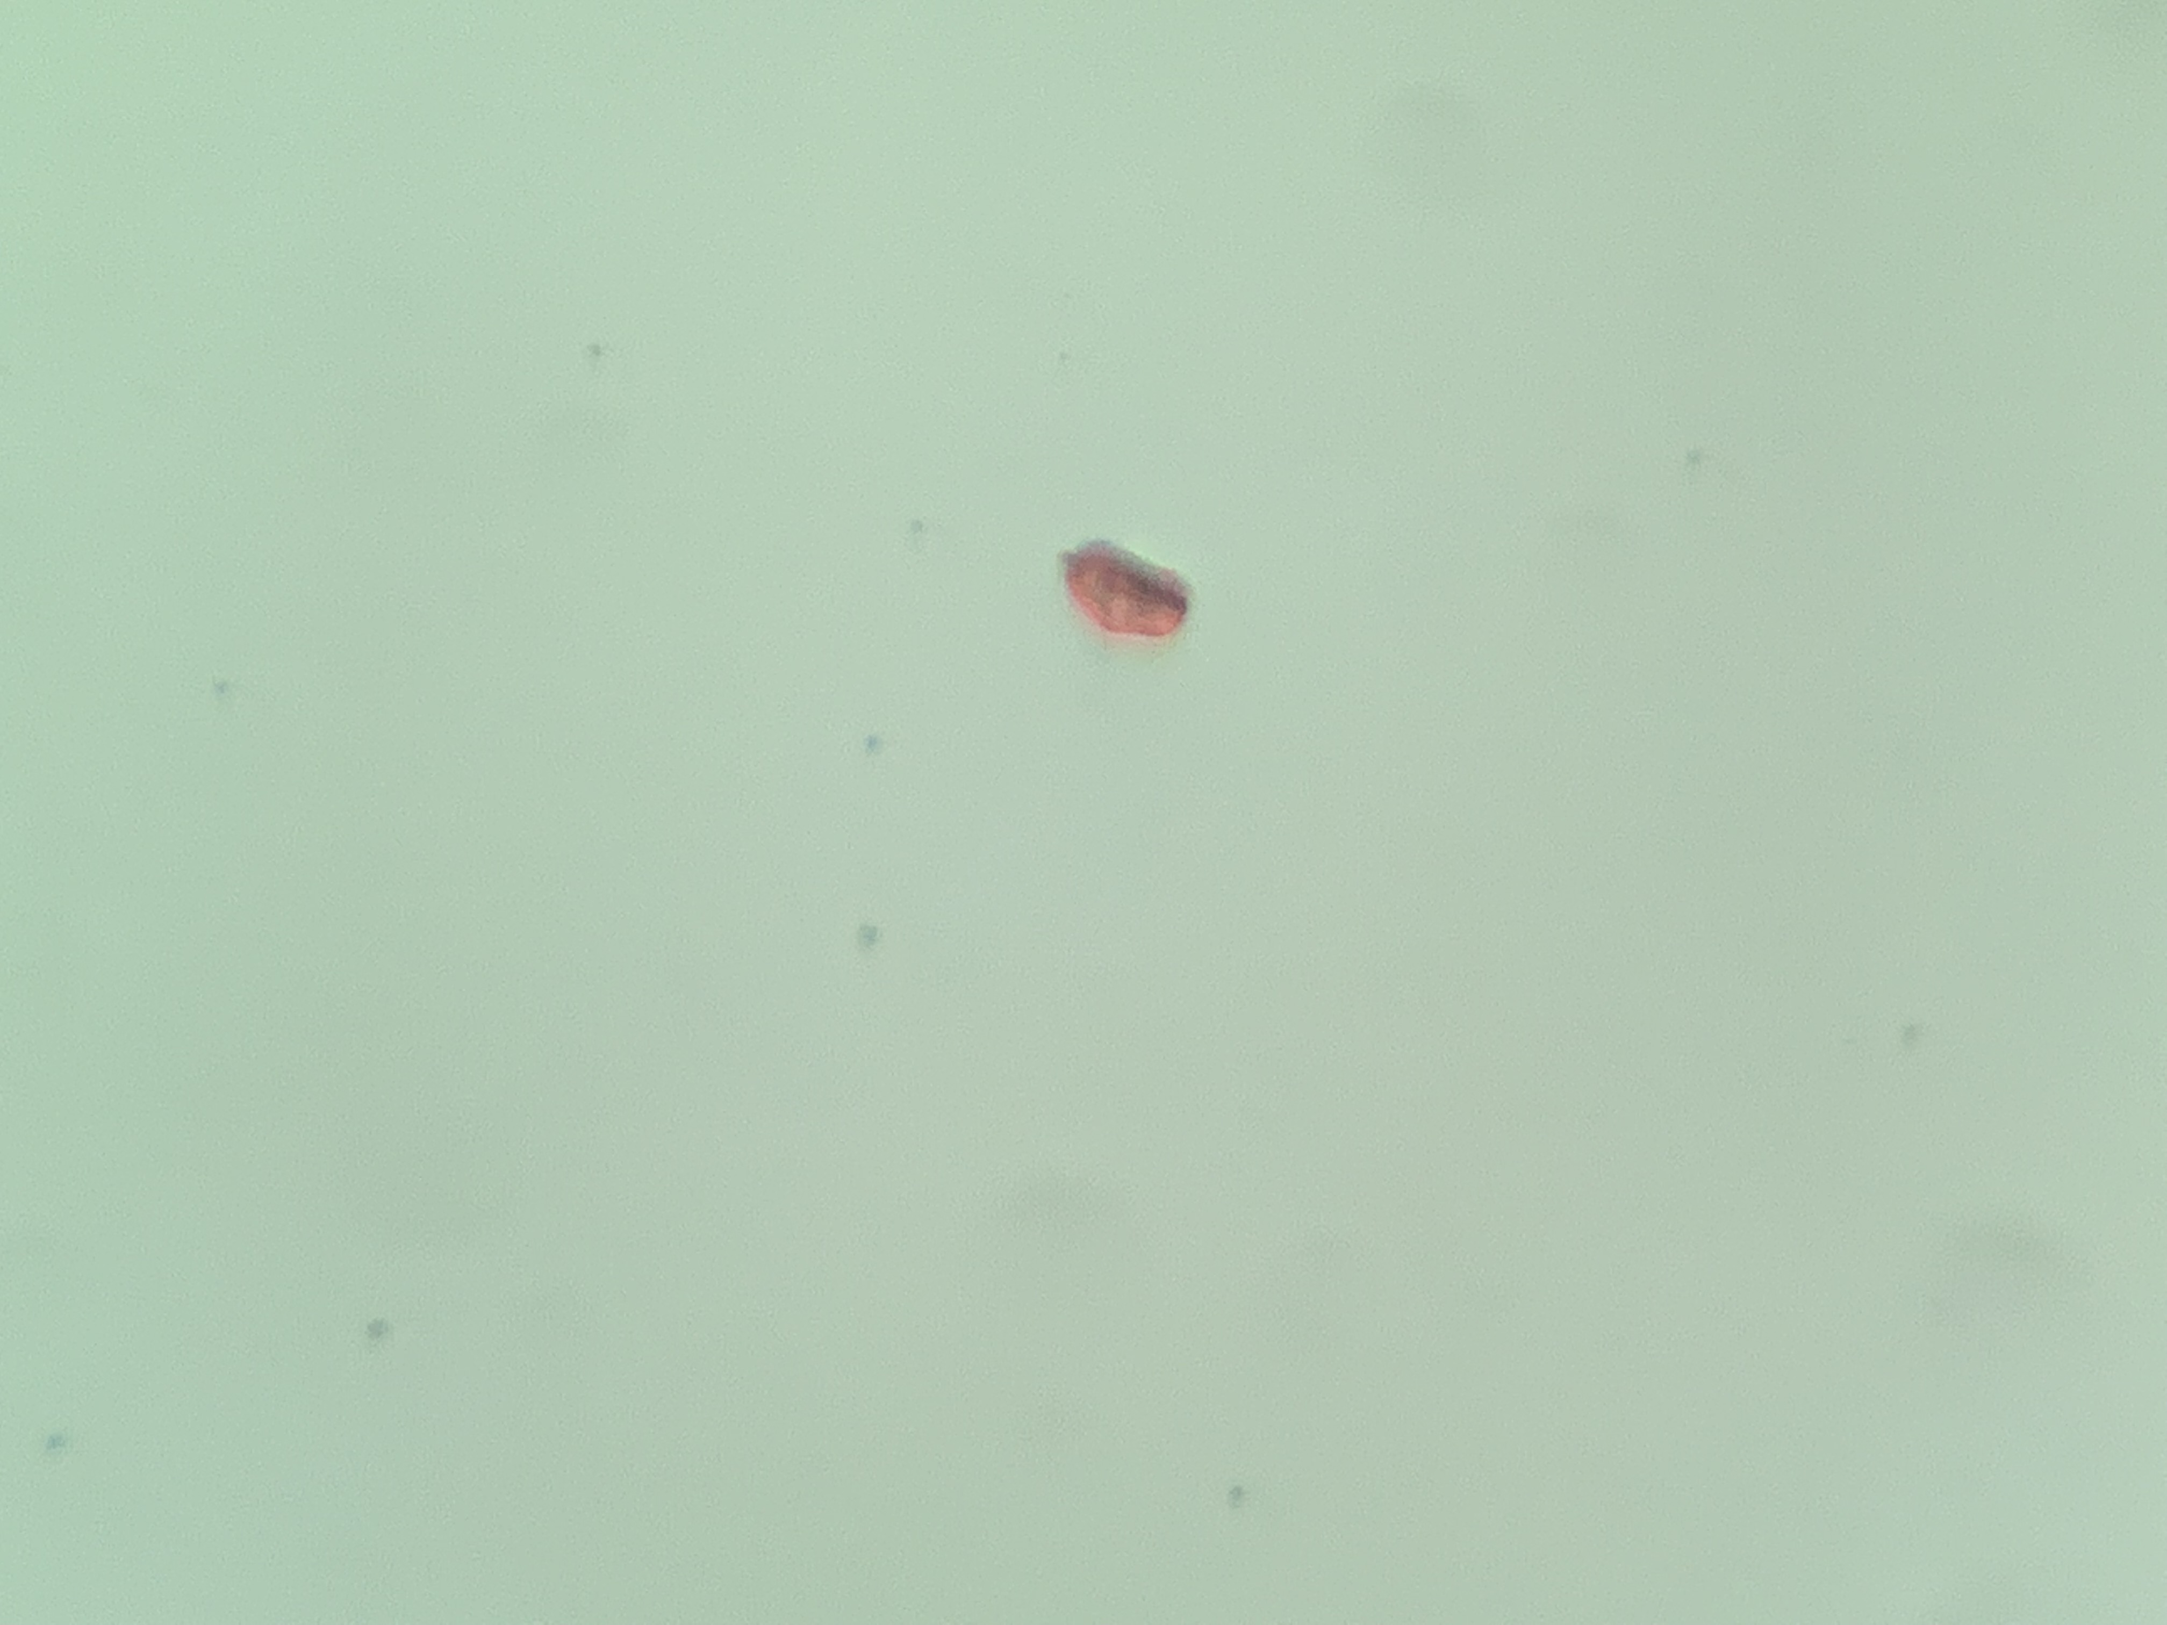
Point c ~ 14 x 6 µm

Slide 8
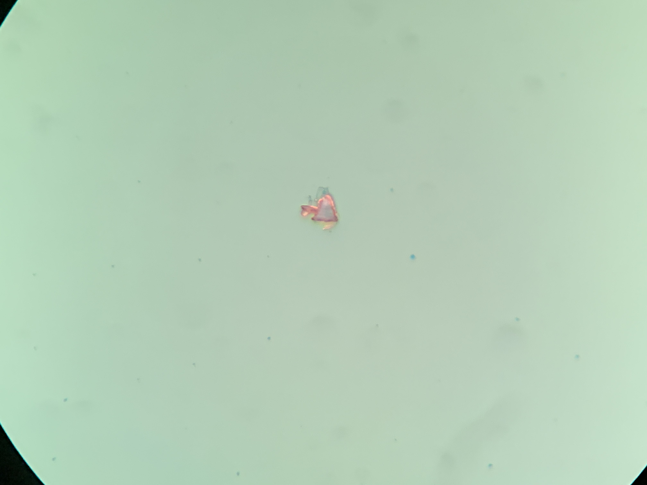
Point d ~18 µm across base

Slide 9
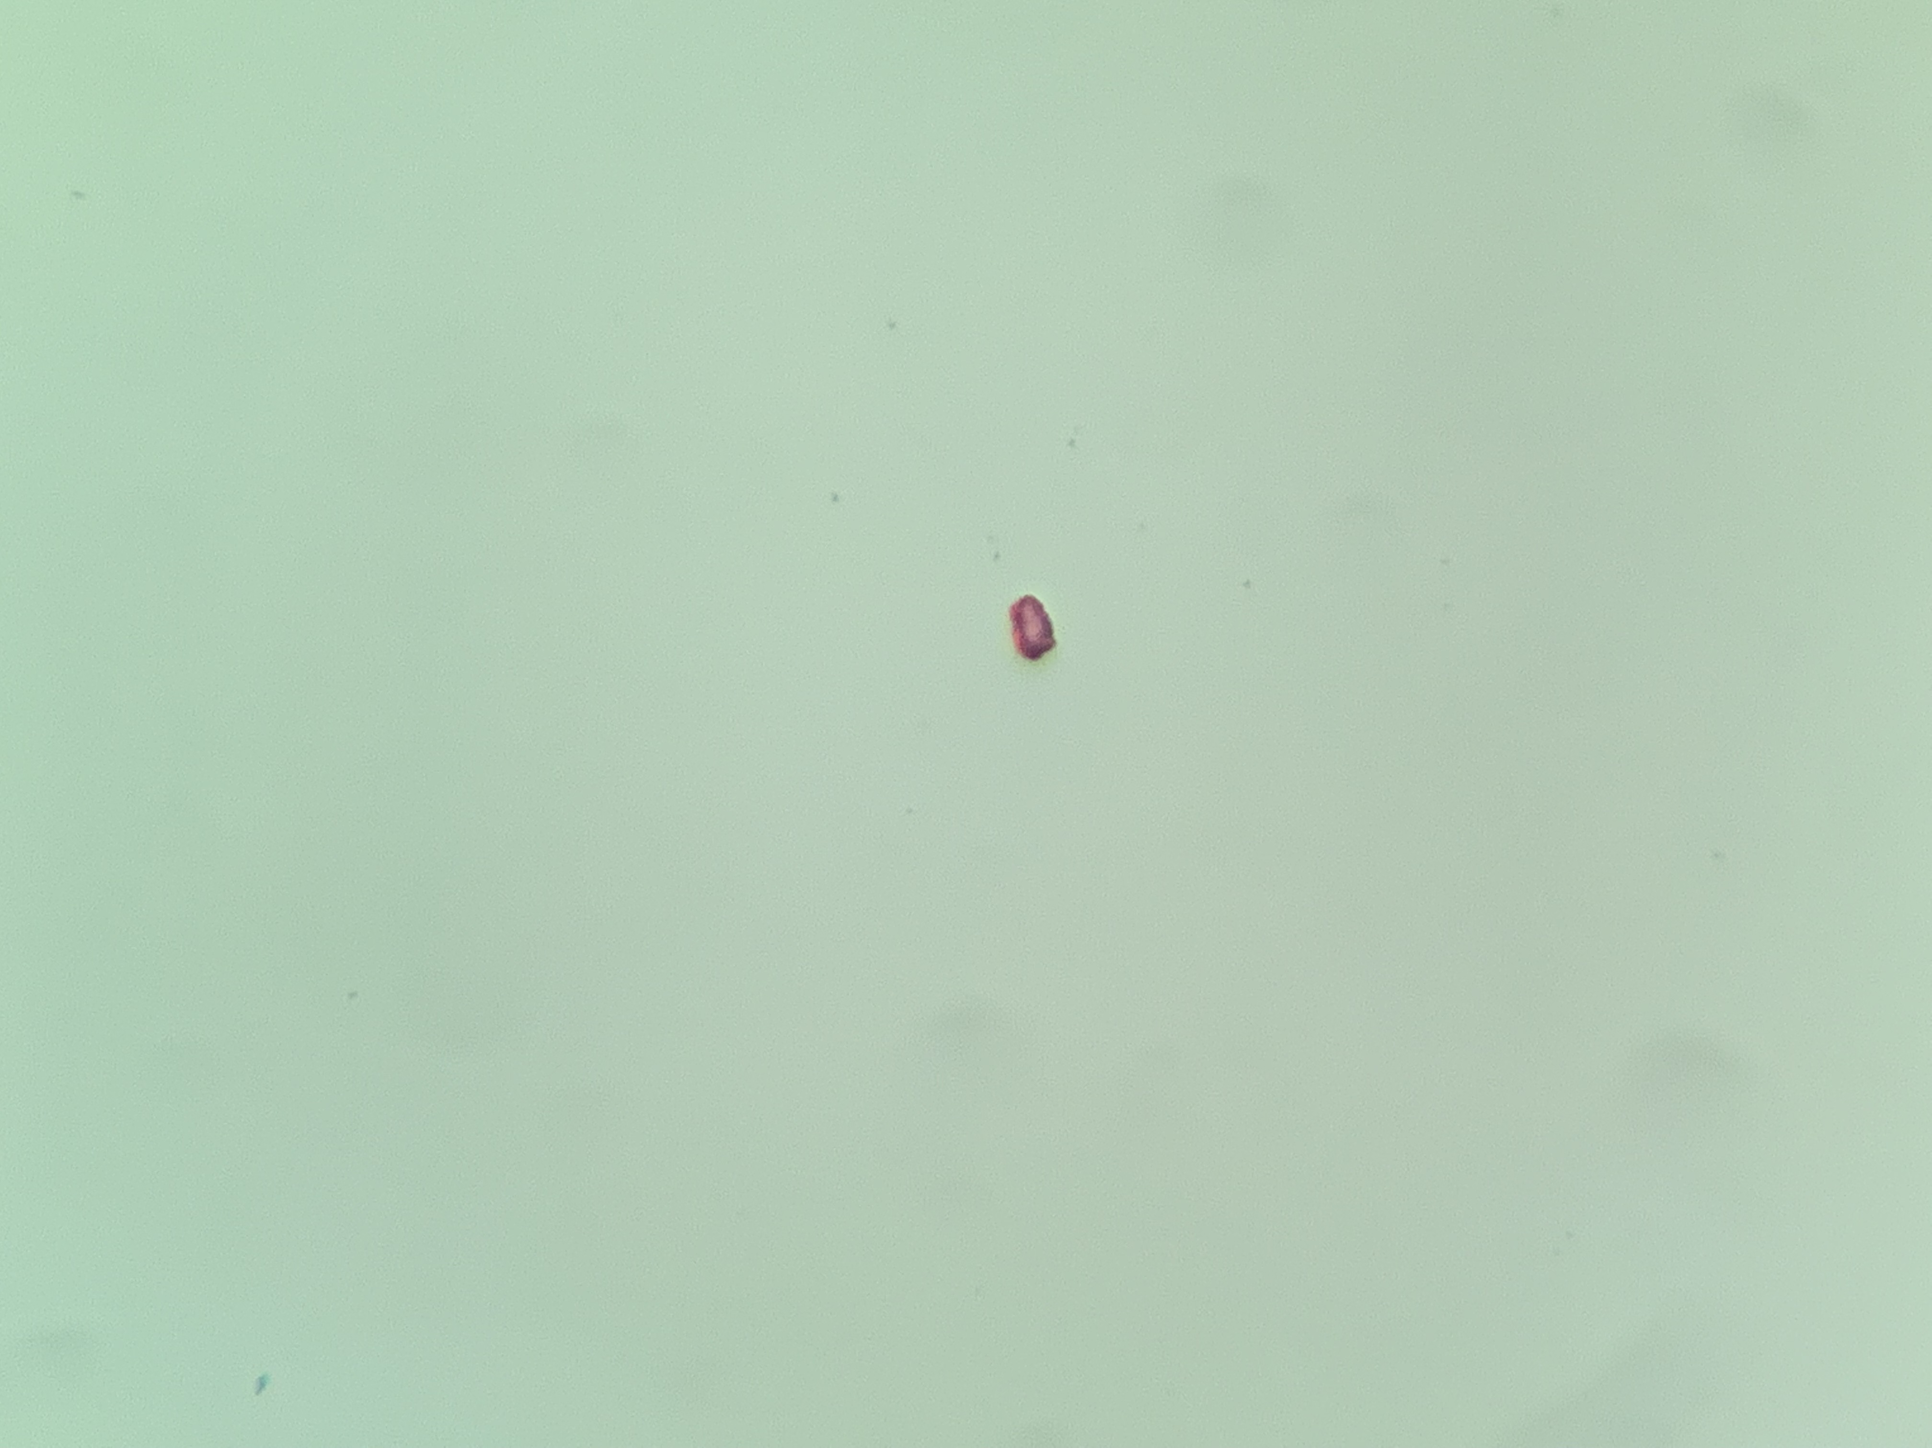
Point e ~ 8 x 4 µm

Slide 10
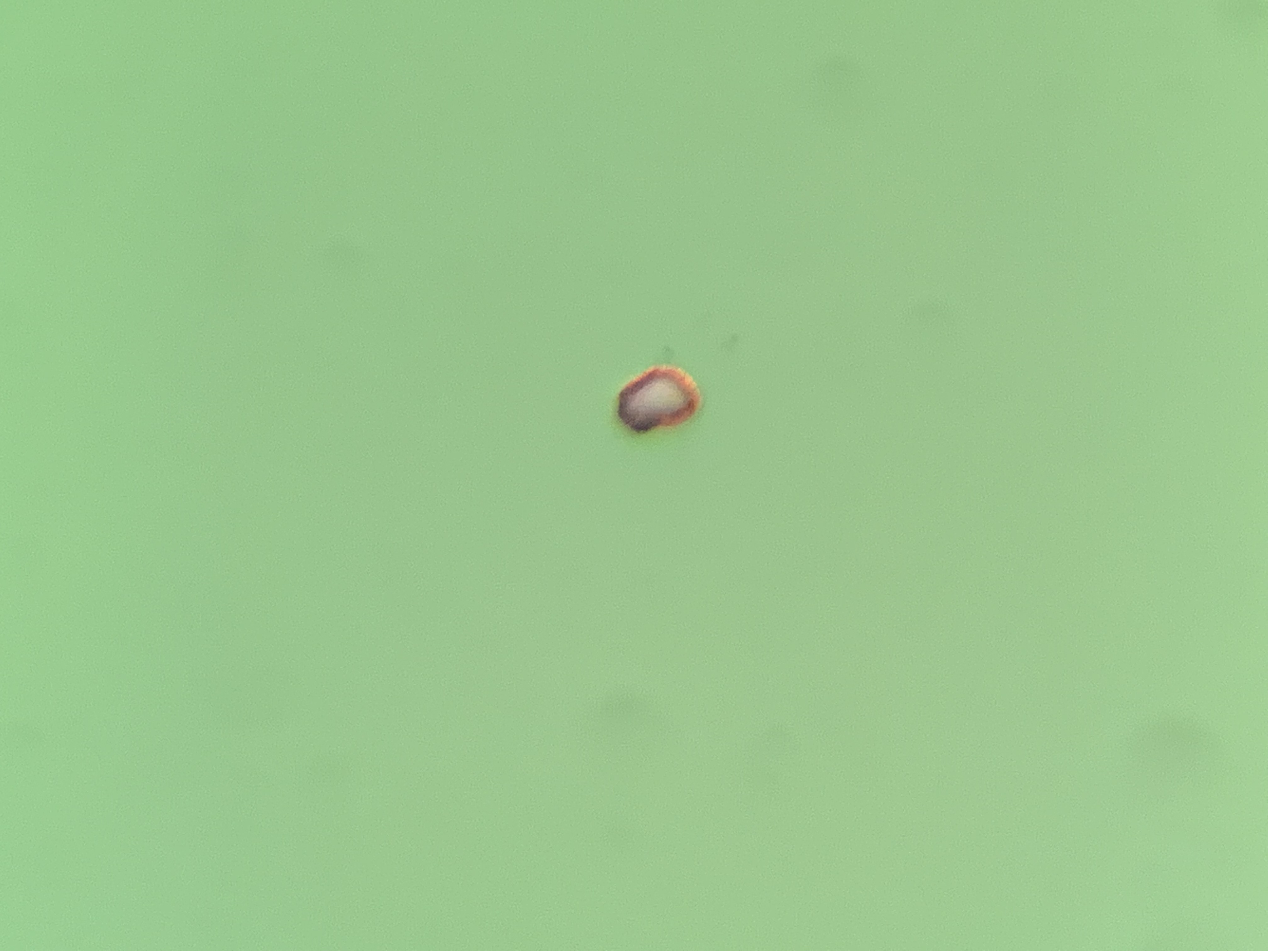
Point f ~ 14 x 10 µm

Slide 11
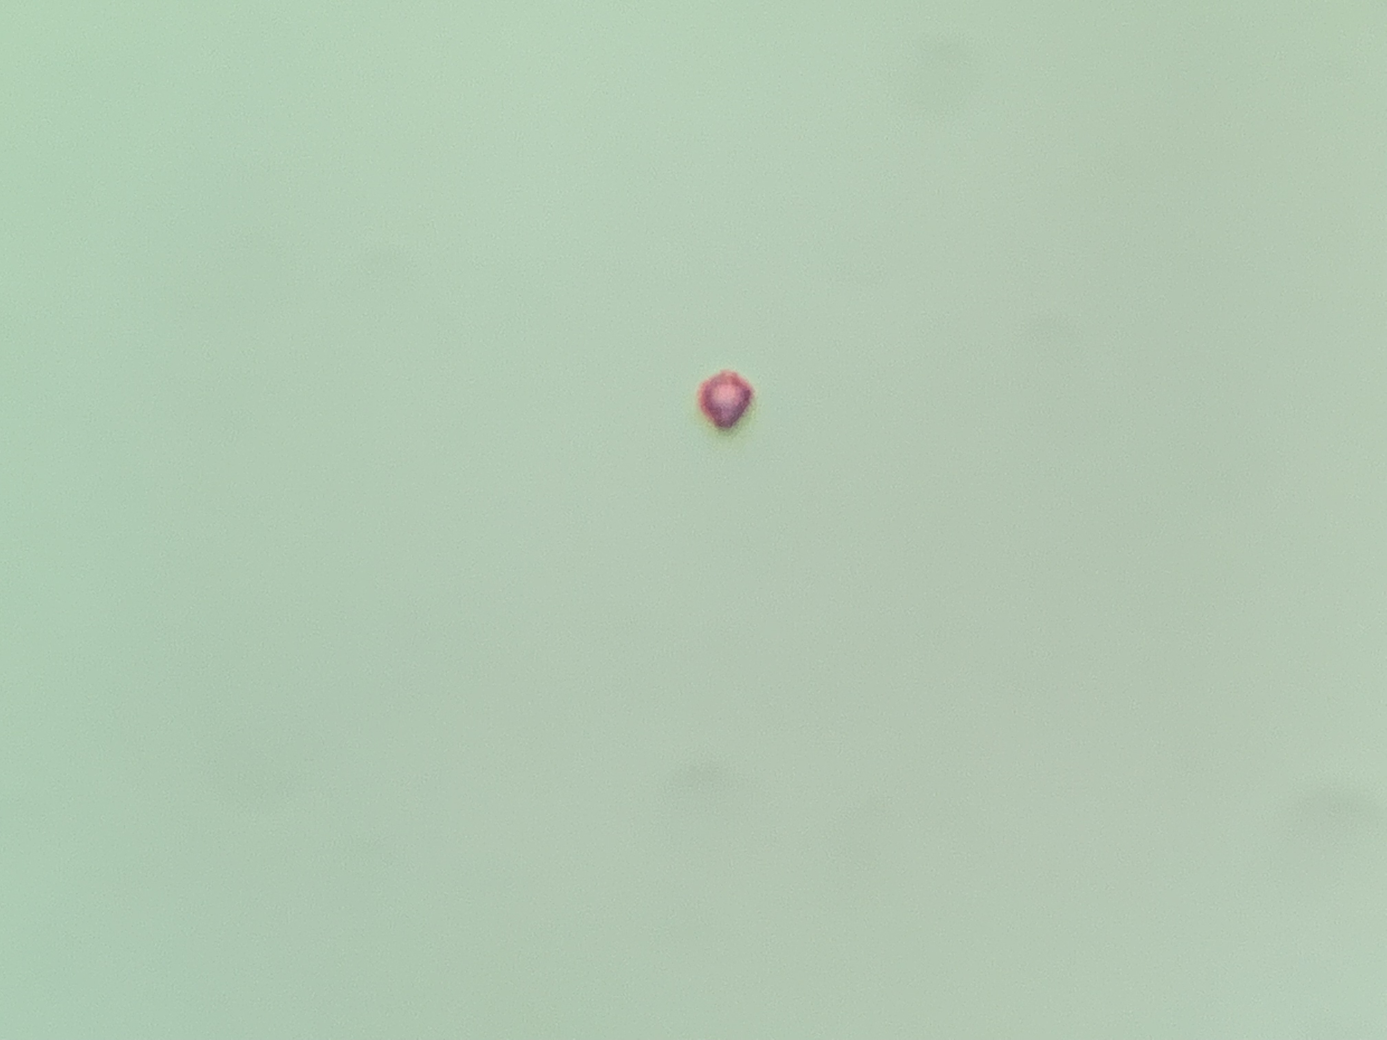
Point g ~ 8 x 6 µm

