Slide 1
Using adaptive filtering to track long-transient gravitational waves with varying frequency and amplitude
Rebecca White
Mentor: Ling Sun

Slide 2
Overview
Introduction
Background/Motivation
Goals
Simulated Signal
Methods
What is iWave?
Simulation Parameters
Results
iWave’s Tracking Abilities
Sensitivity of iWave
Conclusions/Future Work

Slide 3
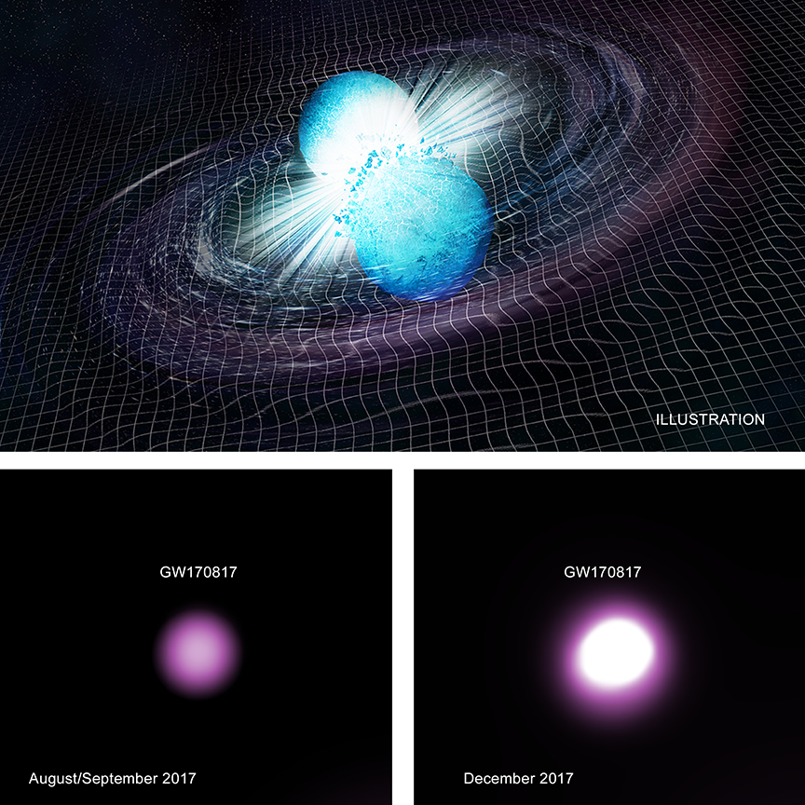
Introduction: Background/Motivation
Compact Binary Coalescence (CBC) Gravitational Waves (GW)
3 types: Binary Black Holes (BBH), Binary Neutron Star (BNS), and Neutron Star-Black Hole Binary (NSBH)
LIGO has detected 14 confirmed GW events, most of them being BBHs
11 confirmed events in O1/O2
3 confirmed events in O3 so far
During LIGO’s 2nd observing run, BNS merger GW170817 was detected

Slide 4
Introduction: Background/Motivation (cont.)

Slide 5
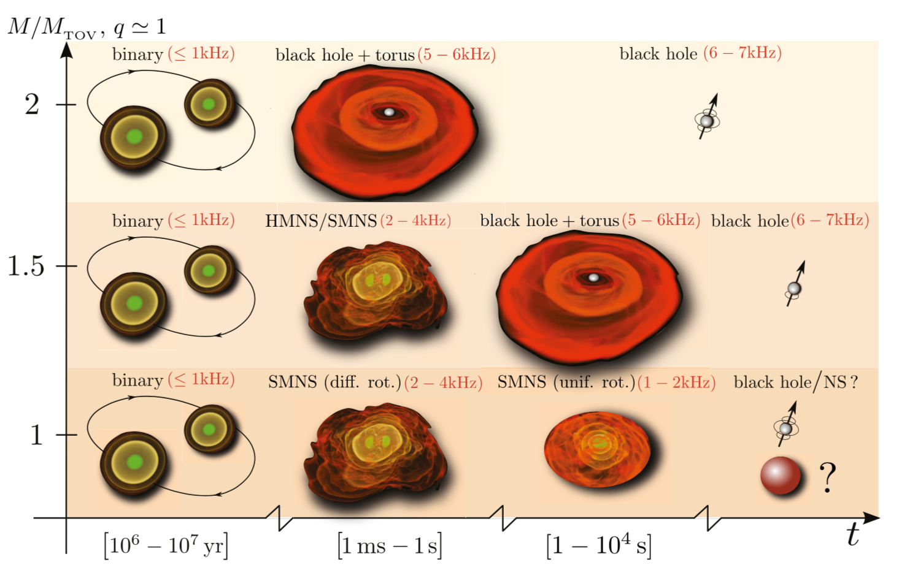
Introduction: Background/Motivation (cont.)
Binary neutron star postmerger remnants
The object created after a BNS causes a gravitational wave
Detecting postmerger remnant helps us understand more about what happens after the BNS collision and the Nuclear equation of state
Many publications trying to find remnant of GW170817
Postmerger remnant signals have not been detected
Image: Baiotti & Rezzolla (2017)

Slide 6
Introduction: Goals
Part 1 – Explore the capability of iWave to track and detect weak long-transient GW signals like BNS post-merger remnants and quantify the sensitivity
Part 2 – Track, study, and remove instrumental spectral lines from the interferometric data

Slide 7
Simulated Signal
Parameters:
$f_{gw, 0}$ = initial frequency (Hz)
$t$ = time array (s)
$τ$ = spindown timescale (s)
$n$ = breaking index
$I_{zz}$ = principal moment of inertia (g*cm²)
$ε$ = ellipticity of the star
$d$ = distance to the source (Mpc)
Models GW emission from a rapidly spinning-down millisecond magnetar born after the BNS merger happens at t=0
Frequency calculated by: $f_{gw}\left(t\right)=f_{gw, 0}{\left(1+\frac{t}{τ}\right)}^{\frac{1}{1−n}}$
Amplitude calculated by: $h_{0}\left(t\right)=\frac{4π^{2}G}{c^{4}}{\frac{I_{zz}ε}{d}f}_{gw}^{2}(t)$

Slide 8
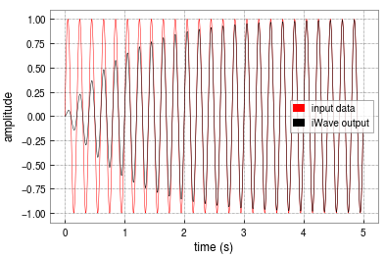
Methods: What is iWave?
Hybrid method of a traditional phase locked loop (PLL) and an adaptive filter
Traditional PLL that replaces the reference oscillator with an adaptive filter
iWave characterizes the oscillating input $x_{n}$ through the output $y_{n}$ in this iteration equation: $y_{n}=e^{−w}e^{iΔ}y_{n−1}+\left(1−e^{−w}\right)x_{n}$
Parameters:
$\frac{1}{w}$ = sample number in one e-folding relative to the previous samples
$Δ$ = freq. in radians per sample
$y_{n−1}$ = previous output

Slide 9
Methods: Simulation Parameters
Parameters used to test iWave:
$f_{gw, 0}$ = 2000 Hz
$t$ = optimal observing time with 10000 s being the maximum
$n$ = 5
$I_{zz}$ = 1.e45 g*cm²
$ε$ = 0.01
Detector ASD = 4e-24 1/√Hz
Only testing in a single detector
Frequency calculated by: $$f_{gw}\left(t\right)=f_{gw, 0}{\left(1+\frac{t}{τ}\right)}^{\frac{1}{1−n}}$$
Amplitude calculated by: $$h_{0}\left(t\right)=\frac{4π^{2}G}{c^{4}}{\frac{I_{zz}ε}{d}f}_{gw}^{2}(t)$$

Slide 10
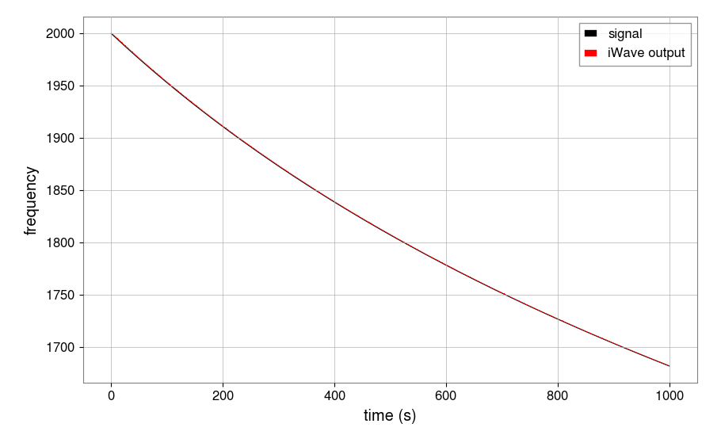
Results: iWave’s Tracking Abilities
Simulate waveform at different distances from the detector so the signal will be at different amplitudes once it reaches the detector
$d$ = 1 Mpc
$τ$ = 1000 s
iWave locks onto the signal frequency

Slide 11
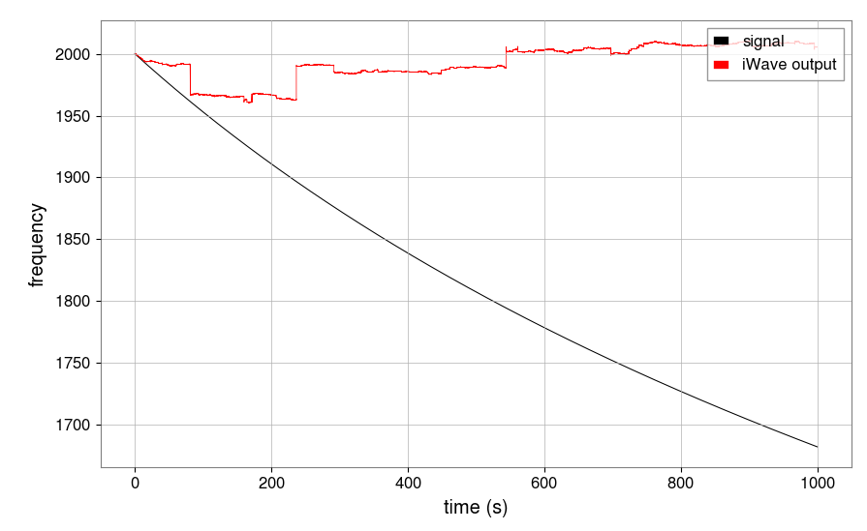
Results: iWave’s Tracking Abilities (cont.)
$d$ = 4 Mpc
$τ$ = 1000 s
iWave loses the signal part-way through the tracking
As the freq. decreases, so does the amplitude

Slide 12
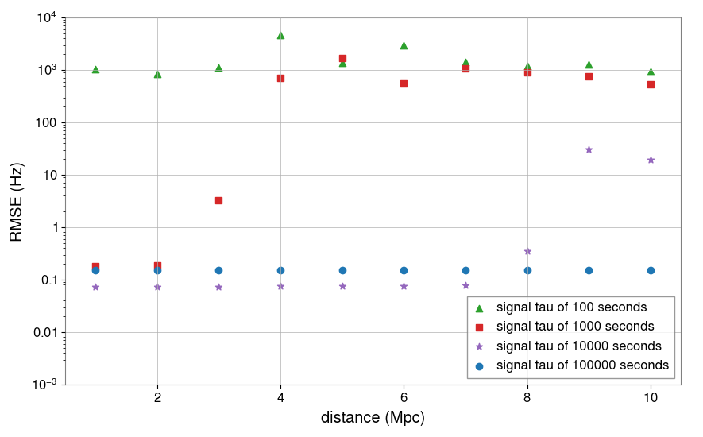
Results: Sensitivity of iWave
170817 was 40 Mpc away
iWave is not sensitive enough to detect remnant from 170817
Consistent with other studies

Slide 13
Conclusions/Future Work
iWave is unable to track rapidly changing signals
iWave is best at tracking signals that gradually change
It can be applied to low-latency follow-ups of BNS postmerger remnant
Can be used in preparation for future BNS events

Slide 14
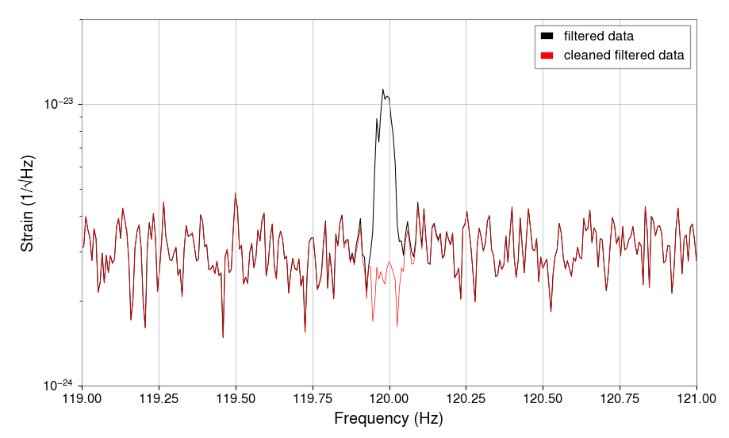
Conclusions/Future Work (cont.)
Still need to carry out more studies to test iWave’s sensitivity to long-transient GW signals
Part 2 – track, study, and remove instrumental spectral lines from the interferometric data
Example: tracking/cleaning 120 Hz power main line

Slide 15
Acknowledgements
A special thanks to:
My mentor Ling Sun
The iWave Group – Edward Daw, Ian Hollows, Timesh Minstry
National Science Foundation (NSF)
NSF REU Program
Caltech LIGO SURF program
LIGO Laboratory

