Slide 1

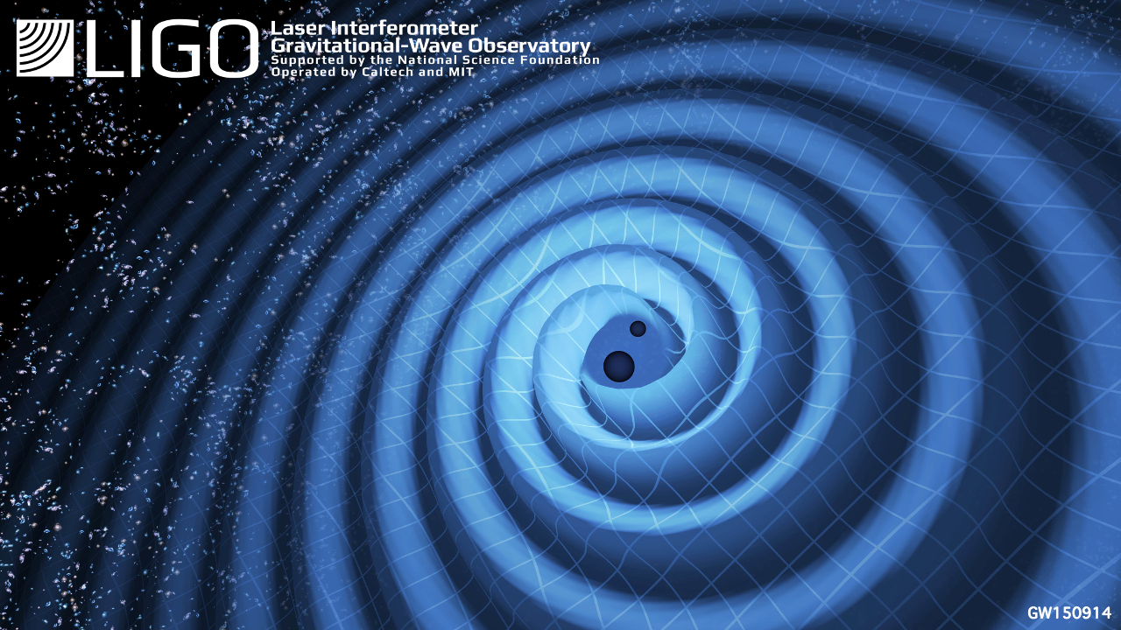
Do Binary Black Hole Merger Events Observed by LIGO-Virgo in their Third Observing Run Agree with Waveforms from General Relativity? A Residual Study
Final Presentation for LIGO SURF 2020 August 28th, 2020
Student Researcher: Erin Wilson
Mentors: Dr. Alan J. Weinstein, Dicong Liang

Slide 2
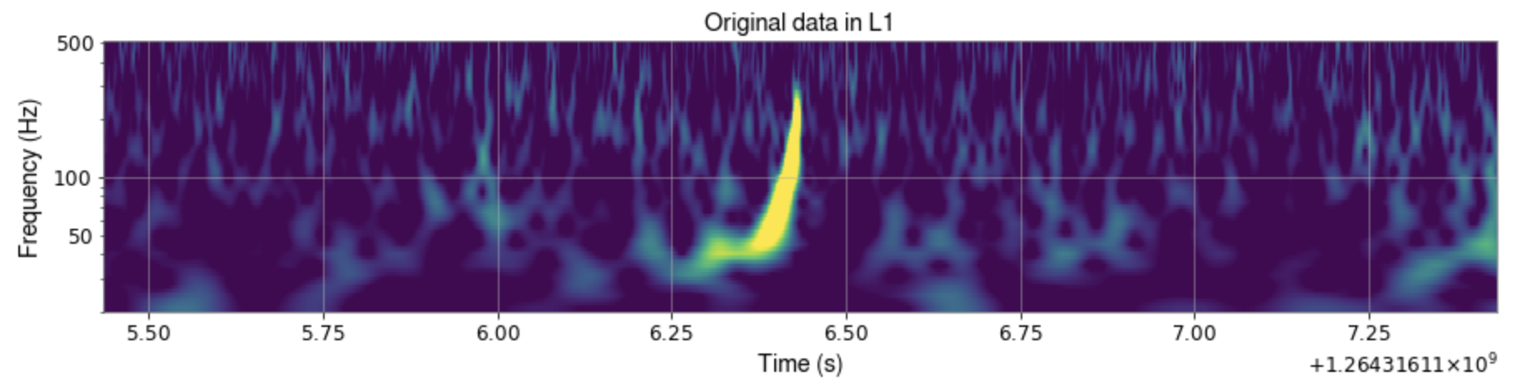
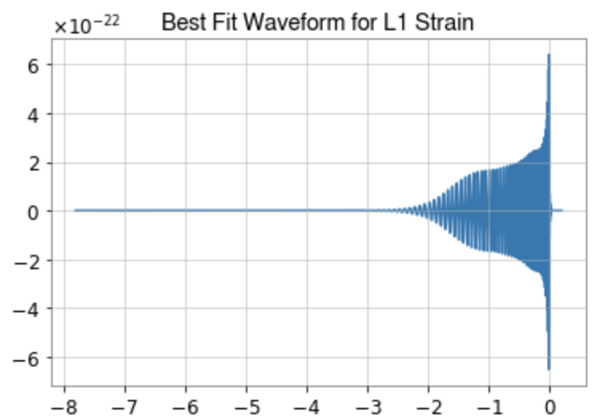
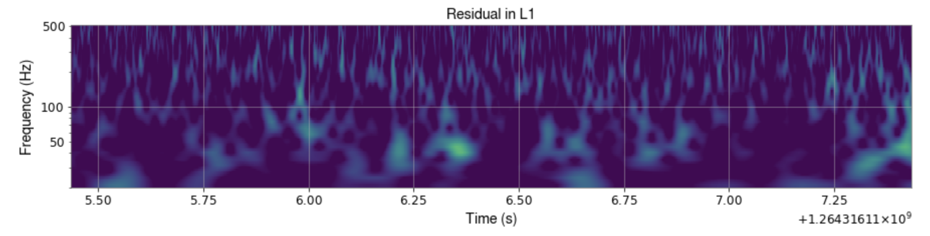
What is A Residual?
LIGO data streams can be described as
d(t) = s(t) + n(t),
where far away noise approximately Gaussian
When a GR template [h(t)] is subtracted from the data series, what is left is known as a residual:
r(t) = [s(t)-h(t)] + n(t) =? n(t)
Event S200129m (O3b)

Slide 3
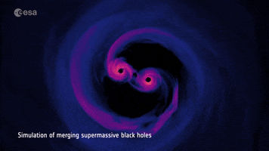
Motivation: Why is This Important?
Are the signals observed in the LIGO detectors consistent with the waveforms derived from General Relativity?
If they are, we can be confident that we understand the source of these signals
If they aren’t then:
Perhaps the waveforms don’t capture all the relevant physics such as spin precession, higher order modes, and eccentricity
Perhaps the waveforms are insufficiently numerically accurate
Perhaps there is excess noise in the detectors (glitches) that we don’t understand
Maybe General Relativity is wrong!!

Slide 4
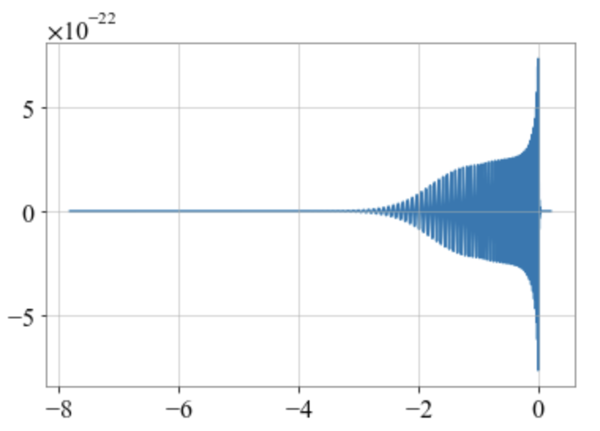
Creating the Best Fit Waveform
1
Best fit waveforms are created from parameter estimation samples, which are generated by Bilby
- 1. Includes all 15 BBH parameters along with the detector antenna response
Using max likelihood value for each parameter will aid in creating more accurate waveform templates

Slide 5
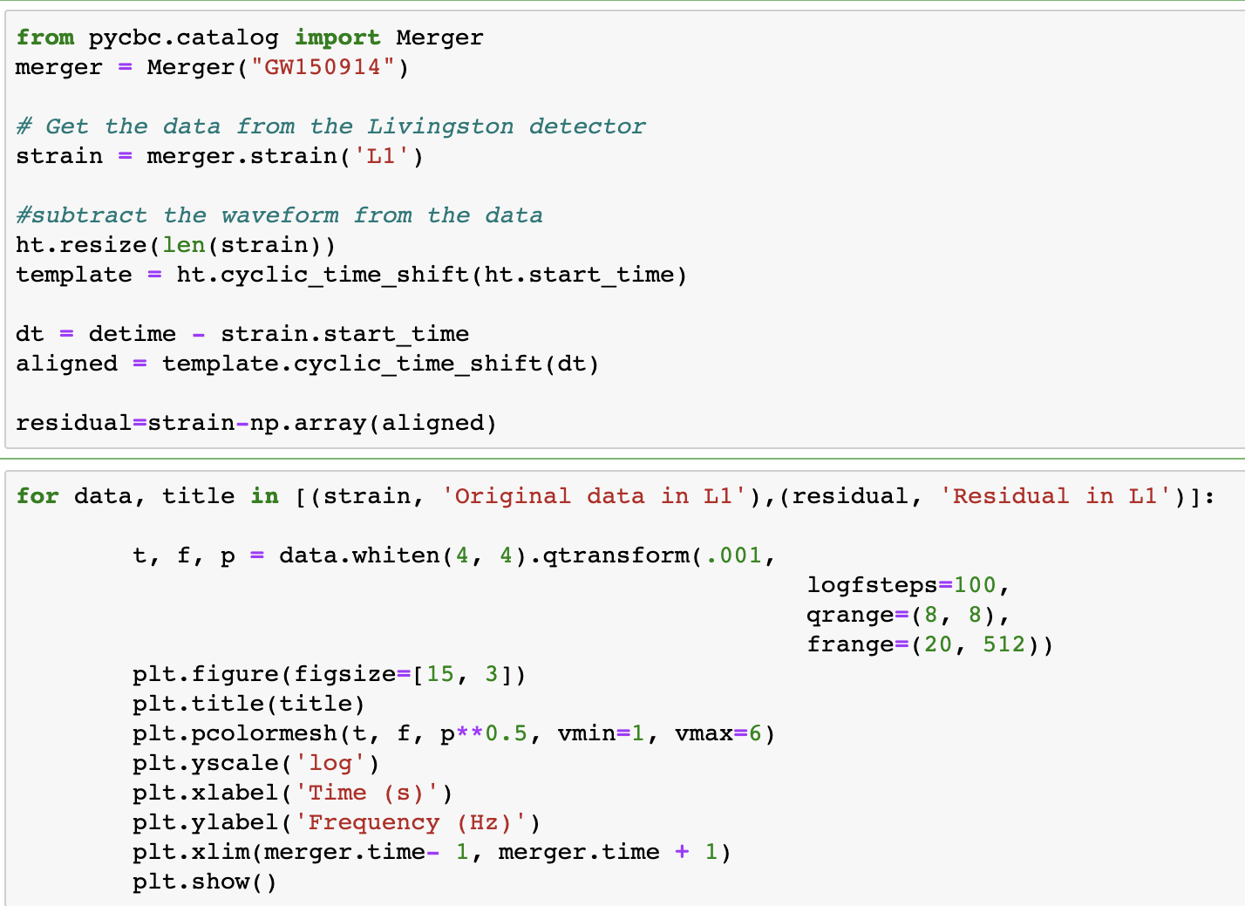
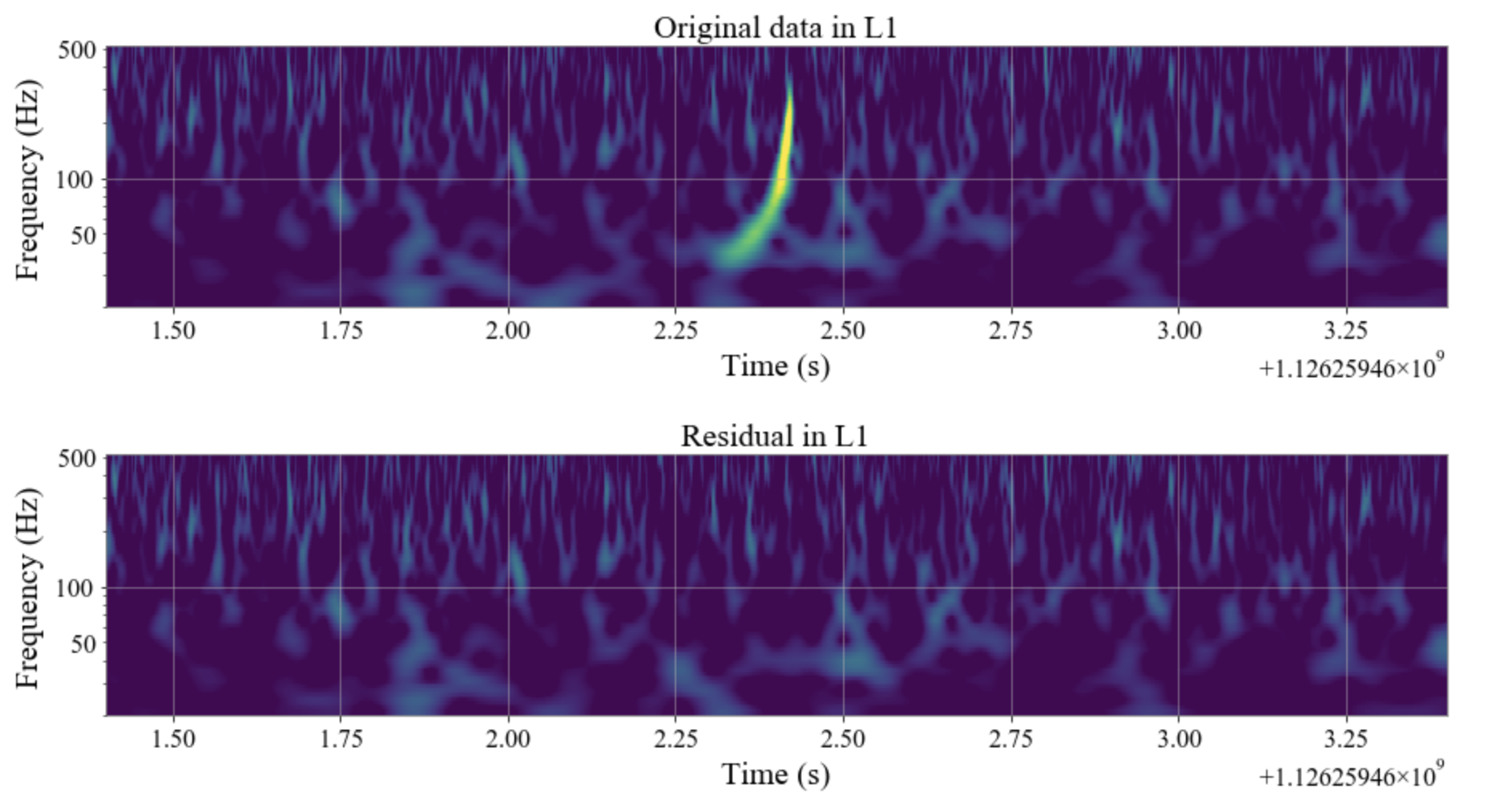
Creating the Residual

Slide 6
Gaussian Analysis
As discussed last time, a Gaussianity test can be used to determine if the resulting residual consists of only instrumental noise
However, this only works well for loud signals. How do can we double check that there isn’t any left over signal in residuals of quieter events?
GW150914
GW151012

Slide 7
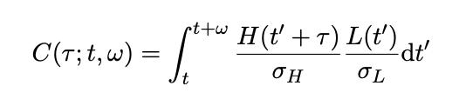
Correlation Analysis: And Why It’s Important
Cross Correlation between the residual data from Hanford (H) with residual data from Livingston (L)
Correlation Coefficient close to 1 or -1: data are correlated between the two detectors
Correlation Coefficient close to 0: data are not correlated between detectors; signal subtraction is sufficiently precise

Slide 8
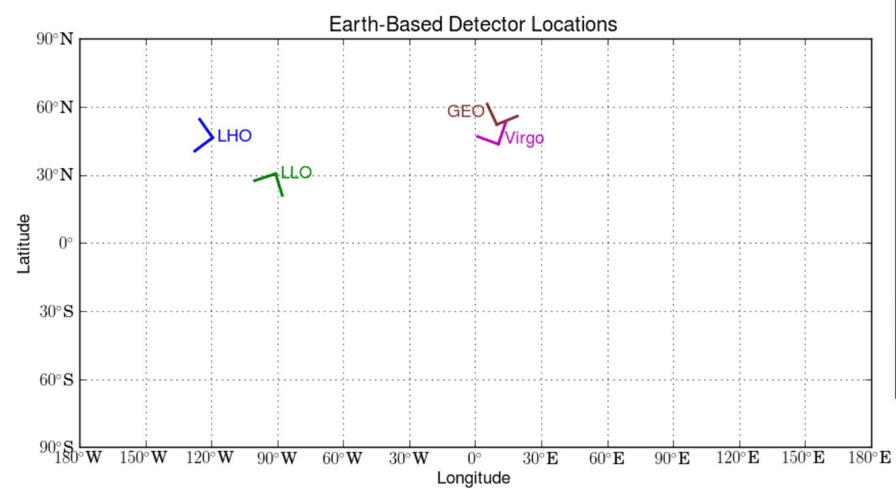
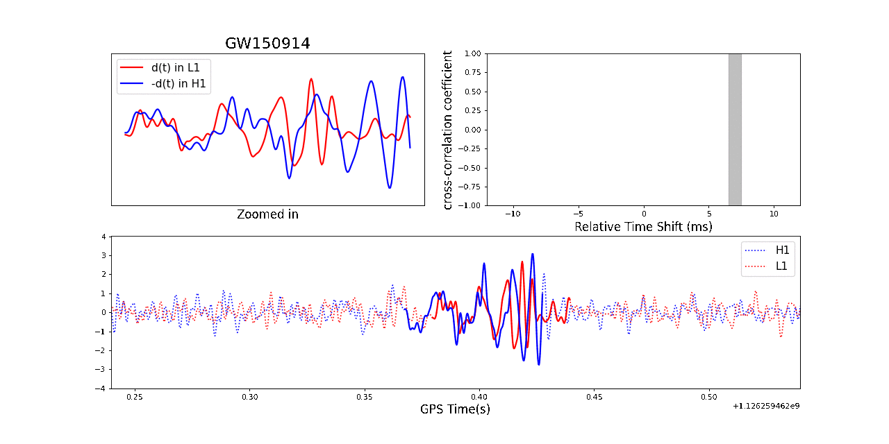
Correlation Analysis: And Why It’s Important Cont.

Slide 9
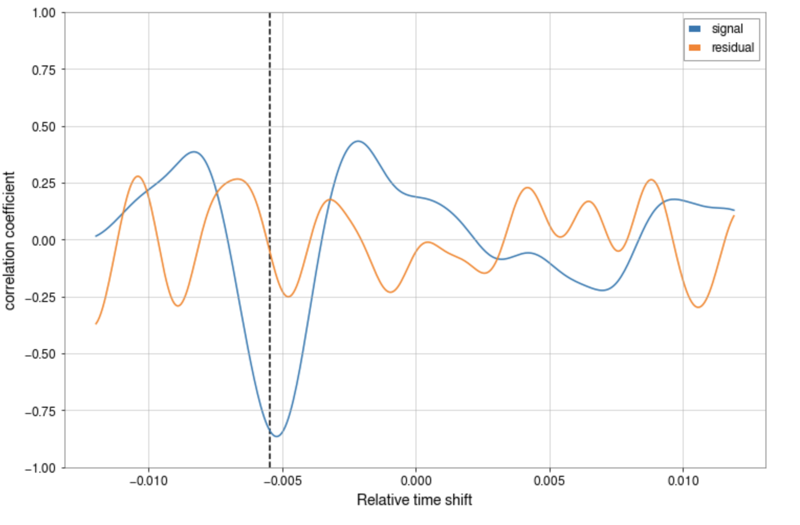
Correlation Analysis of O3b Event S200129m
Accounting for the time shift, the residual generated for the residual in both detectors for event S200129m has a correlation coefficient of -0.25, while the multiplied data series has a correlation coefficient of -0.8.

Slide 10
Future Short-term and Long-term Work
Short-Term Goals:
We will want to apply this analysis to all 80+ events (GWTC-1, GWTC-2, GWTC-3)
We may find discrepancies requiring further investigation. We may even find evidence for waveforms that lack relevant physics or even failure of GR in the strong-field, highly dynamical regime that LIGO is probing.
Long-Term Goals:
We want to automate this process so that can be applied to the much higher rate of gravitational waves from BBH events in O4.
Ultimately, we want to find out whether we truly understand gravitational waves from astrophysical sources, or whether there’s more to be learned about the sources, the waves, and gravity itself.

Slide 11
Acknowledgements
A Warm and Special Thanks to:
Dr. Alan J. Weinstein,
Dicong Liang,
Jennifer Sanchez,
Zoe Haggard, my colleagues,
LIGO Summer Undergraduate Research Fellowship,
Carl A. Rouse Fellowship, Caltech Student Faculty Program, and the National Science Foundation Research Experience for Undergraduates

Slide 12
Any Questions?

Slide 13
Thank You for Listening!

