Slide 1


Measuring the Hubble Constant with Dynamical Tides in Inspiraling Neutron Star Binaries
James Sunseri
Mentor: Hang Yu

Slide 2
Introduction
goal of cosmology is to understand how the universe came to be and what it will be in the distant future
Gravitational waves were theorized by Albert Einstein and only recently has it been possible to use them for cosmology
This was done with the famous discovery of GW170817 and the use of multi-messenger astronomy
We try to expand and refine a preexisting theoretical method proposed by (Messenger & Read 12) to do cosmology without light
Notes:
For decades now the goal of cosmology is to understand how the universe came to be and what it will be in the distant future
Gravitational waves were theorized by Albert Einstein in his theory of General Relativity and only in the past decade has it been possible to use them for cosmology
This was done with the famous discovery of GW170817 and the use of multi-messenger astronomy. Multi-Messenger meaning the use of both light and GW to learn more information about the event in question.
The goals of our research this summer have been to help expand and refine a preexisting theoretical method proposed by (Messenger & Read 12) that can use gravitational waves without the need of multi-messenger astronomy to do cosmology

Slide 3

The Problem
There is a growing problem in the astronomy community known as the “Hubble Tension” with cosmological consequences
To understand this problem we need to review some basic cosmology:
Hubble - Lemaître Law$:v=cz=H_{0}d$
This is the observation that objects are moving away from Earth with velocities proportional to their distance
Type Ia Supernovae Standard Candle Results: $H_{0}≈74.03±1.42 km s^{−1}Mpc^{−1}$
(Riess et. al ‘19)
The Cosmic Microwave Background Results: $H_{0}≈67.4±0.5 km s^{−1}Mpc^{−1}$
(Plank Collaboration et. al ‘18)
This disagreement has been creating a problem for astronomers and needs addressing
Notes:
AFTER POINTS
With Light, it is easy to infer the redshift z but hard to get the distance. Which is why we need standard candles (Type-Ia SNe) or standard rulers (acoustic peaks in CMB). With GW it is the opposite. The amplitude of a waveform directly gives you the distance, and it is hard to measure the redshift. So the key is to measure redshifts with GW

Slide 4
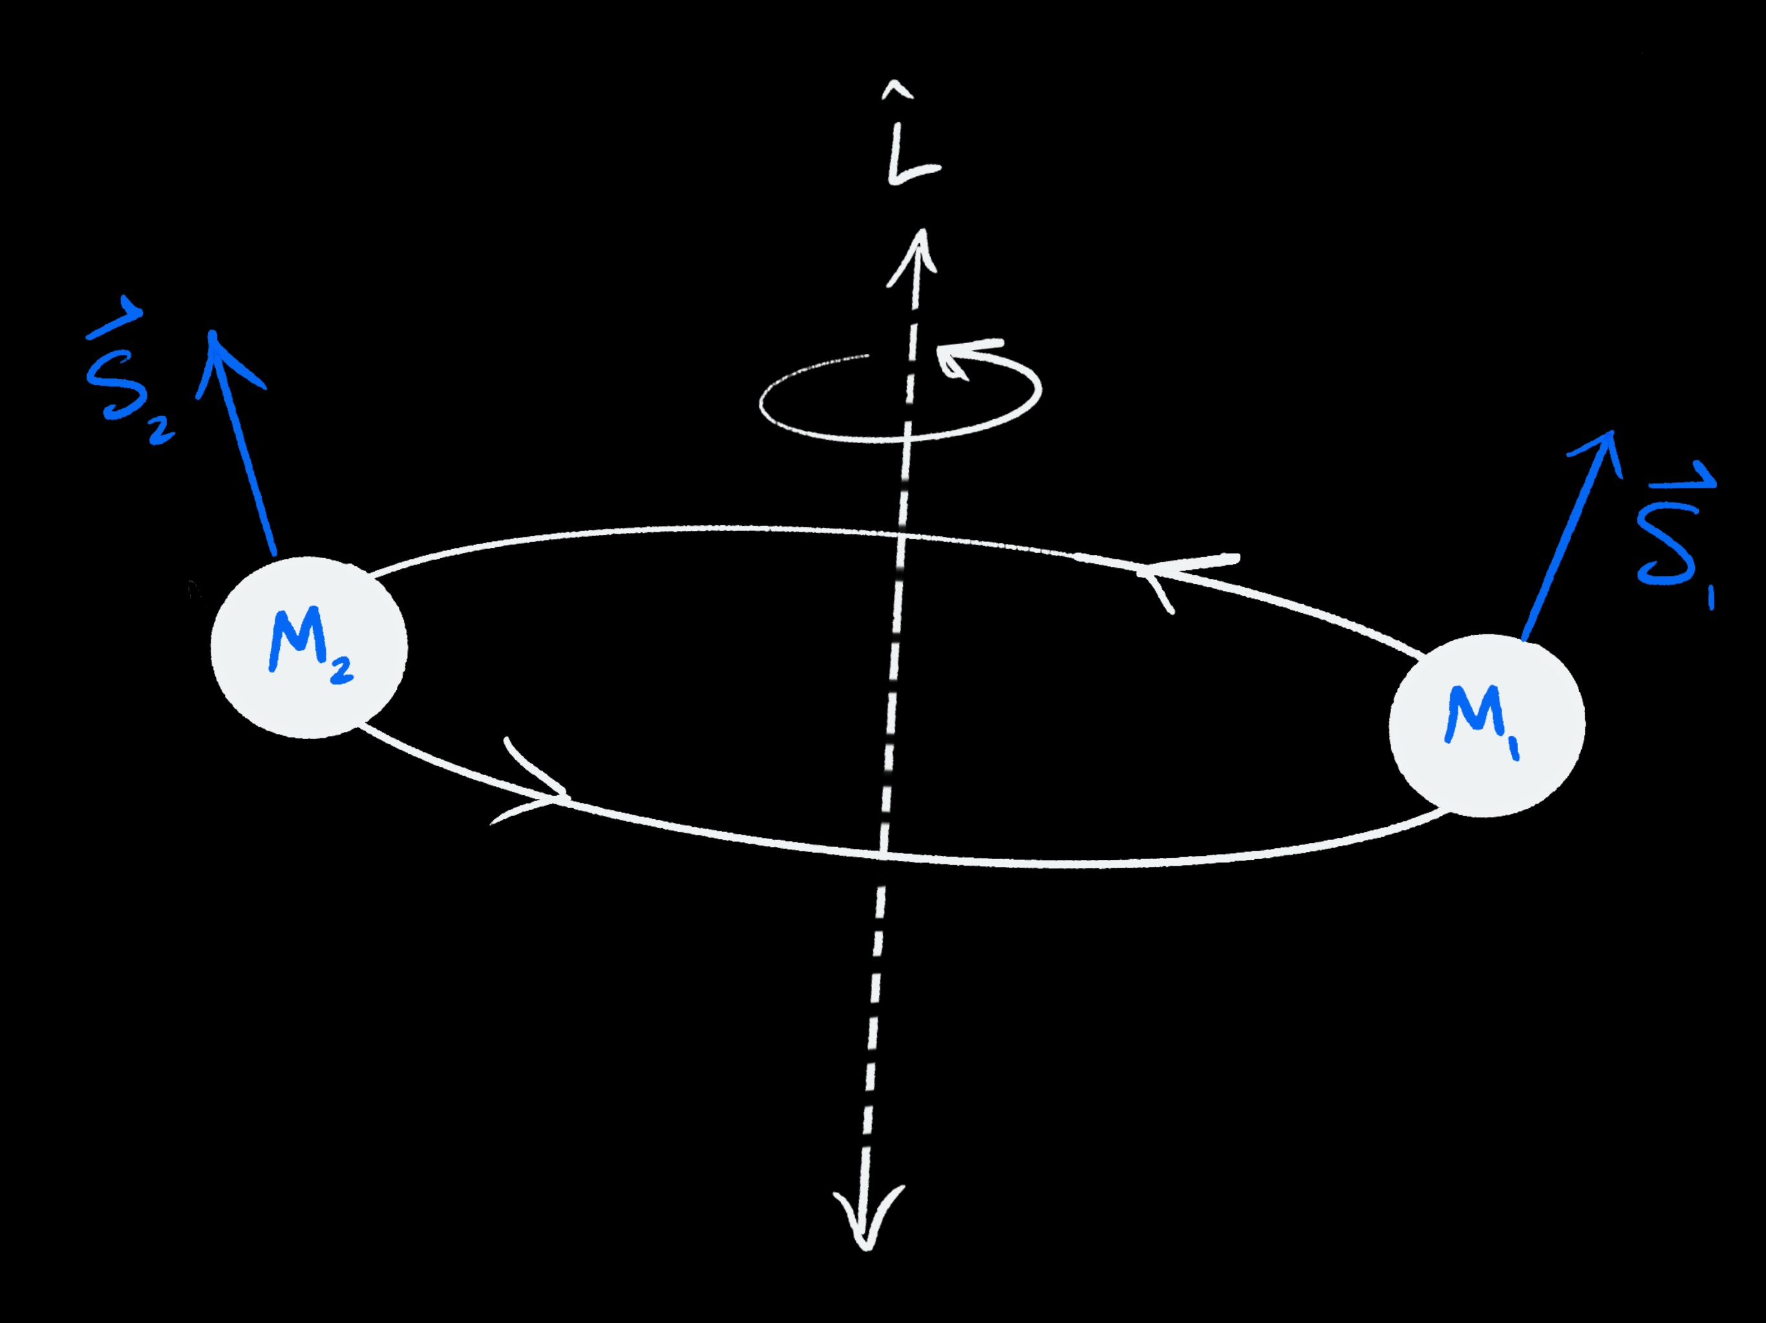

Binary Neutron Star Merger
Our work is done in the frequency domain $\tilde{h}\left(f\right)={A(f)e}^{i Φ\left(f\right)}$
$Φ\left(f\right)=φ_{tidal}\left(f\right)+φ_{point particle}\left(f\right)$
Point Particle Phase is PN effect so $M→M\left(1+z\right)$ to compensate for $f$ → $\frac{f}{1+z}$ to preserve the phase (Redshifted Parameters)
Tidal Phase is not PN effect, it is internal NS physics. The mass does not follow the same redshift effect. (Not Redshifted Parameters)
Contains Redshift
Contains Luminosity Distance
Notes:
START:
-A detection of a coalescing neutron star binary is received as a waveform in the time domain $h(t)$ which is then compared with known models to determine needed parameters for the GW Event. After receiving a waveform in the time domain from the detectors, we move to the frequency domain to do our work. The waveform in the frequency domain has a typical structure where there is an amplitude and a phase. Within the amplitude one can measure luminosity distance and within the phase one can measure the redshift
-within that phase there is actually two major contributions, we have a tidal phase contribution (caused by the internal physics of NS) and a point particle orbit approximation phase contribution (caused by the dynamics of the binary).
-PP phase is actually a post-Newtonian effect so as frequency travels through space it is redshifted, yet the phase we detect is not… so in order to preserve the phase shift the mass information must be inversely redshifted
-The tidal phase is not Post Newtonian, it is actually internal physics of a neutron star. so it does not follow the same redshift effect. So by comparing the mass parameters in the waveform from the PP phase and the Tidal Phase we should be able to extract a redshift. This is analogous to EM measurements of redshifts through spectroscopy. For atomic elements we know that they have standard atomic transitions that correspond to specific lab signatures in a spectra. By comparing the observed signatures one can determine how redshifted an object is compared to the laboratory value. In this case one could think of a NS as the “atom” and its internal modes are serving as the atomic transitions. One can then infer the z by comparing the measured mode frequencies to the expected value in the "lab" frame, just like how z is inferred in EM through specta.
-What do I mean by a tidal phase shift? Well NS have tidal forces acting on them when an inspiral is forming. During this time a NS internal modes are becoming excited at certain specific frequencies. One could think of a wineglass for an example. A wineglass has a set of eigenmodes corresponding to its eigenfrequencies where the glass vibrates to make a pitch, make note that this only happens at these specific frequencies. So a NS has a set of eigenfrequencies and eigenmodes, and with these one should be able to predict the NS internal mode contributions to the waveform if the EOS is well known.
So we have similar concept to spectroscopy with light except what we are actually measuring is essentially reversed. Where with light we measure redshifts easily, then use complicated techniques to extract a distance. And with GW it is actually relatively easy to measure distances since they are directly in the amplitude of the waveform but it is difficult to extract that redshift which requires complicated techniques.

Slide 5
Tidal modes
What is a f-mode?
Previous work done by (Messenger & Read ‘12) makes use of the f-mode phase contributions within a neutron star to “break a degeneracy between the system’s mass parameters and redshift” assuming EOS is well known
This allows for a measurement of both luminosity distance and redshift simultaneously
Notes:
F- mode corresponds to the "fundamental mode" which is actually a strong presence in phase shift. It characterizes the large scale distortion of the NS
Previous work done by (Messenger & Read ‘12) makes use of the f-mode phase contributions within a neutron star to “break a degeneracy between the system’s mass parameters and redshift” assuming EOS is well known
This allows for a measurement of both luminosity distance and redshift simultaneously. Where the Luminosity distance is measured from the amplitude and the redshift is measured from the phase shift

Slide 6
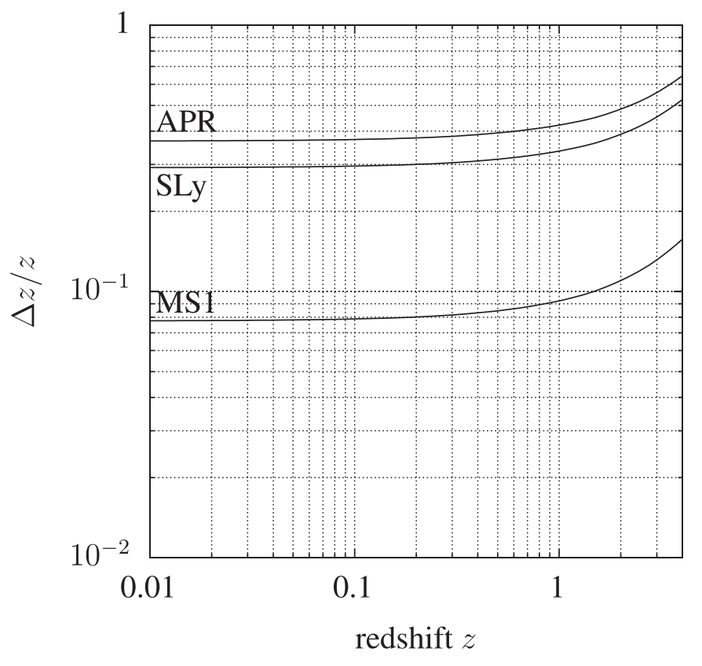

Tidal modes
The top figure is a plot of the phase shift due to tidal effects from the f-mode alone
The bottom is Figure 1 of (Messenger & Read ‘12) which shows how accurately one could measure $z$ with respect to z
(Messenger & Read ‘12)
Notes:
- Using f-modes Messenger and Read were able to get relative errors less than 1 for low redshifts

Slide 7
Tidal modes
The biggest problem with f-modes is that their resonance occurs at a frequency that is too large (beyond what the detectors are capable of detecting)
g-modes have too small of an effect to be detectable but achieve resonance within frequency band
r-modes are not as strong as f-modes but they achieve resonances within the LIGO/Virgo frequency band.
Notes:
F- mode corresponds to the "fundamental mode" which is actually a strong presence in phase shift without being resonantly excited
G-modes corresponds to Gravity Modes and is a byproduct of interactions between buoyancy and gravity
R- modes refers to "Rossby Modes" which is a restoring force as a result of rotational spin motion (Coriolis force)
F, g, and p modes are all Light like while R modes are actually magnetic like. This has the implication that the f,g,p modes can be excited by a newtonian potential while but the R mode is excited by the gravitomagnetic potential which is inherently a GR effect.

Slide 8
Tidal modes
Above is the f-mode tidal phase contribution
Below is the r-mode tidal phase contribution discussed in (Flanagan & Racine ‘07)
Now we compare spin parameter 𝜒, for Point particle it is not redshifted, for tidal it is redshifted
Notes:
Notice the f-mode doesn't have a discontinuous step (resonance) like we see in other inertial modes
R-modes phase shift magnitude is a factor of 10 less than the f-mode contribution which is not desirable for our relative error plot
F-mode is characterized as a large scale distortion but the r-mode is a resonance feature and corresponds to a resonance jump (discontinuous)

Slide 9


More inertial Modes
We looked a new paper written by (Poisson ‘20), in which he utilizes 4 inertial modes
All together the total tidal phase contribution becomes significantly larger than only one r-mode
Notes:
We further motivate the use of poisson's paper because it allows us to break a degeneracy between z and the inclination angles of each star for a single r-mode
This degeneracy is broken because each inertial mode phase in each star is dependent on the corresponding star's inclination angle. So for each given star there is 4 separate modal dependencies on that star's inclination angle as opposed to only one.

Slide 10

Results
Top: $ψ_{1}, ψ_{2}=\frac{π}{3},\frac{π}{6}$ , $Ω_{1}, Ω_{2}=30 ∗2π, 50 ∗2π$
Bottom: $ψ_{1}, ψ_{2}=\frac{π}{3},\frac{π}{6}$ , $Ω_{1}, Ω_{2}=80 ∗2π, 100 ∗2π$
Notes:
The inclination angle is very important in determining how precisely we could measure z
In selecting our inclination angles we aim to maximize the total phase shift amplitude. As stated on the previous slide, there are 4 inertial modes. Each mode has a different trigonometric dependency on inclination angle.
At a first glance one would try to maximize all 4 inertial modes, but as shown on previous slides the r-mode phase contribution is actually negative, this cancels out the effects of the second inertial mode.
This creates a bit of a challenge because in order to maximize the phase contributions from the other inertial modes we need to pick inclination angles which are a bit unrealistic or non probabilistic where the stars are essentially anti-aligned with the orbital angular momentum
This creates a bit of a struggle for picking an inclination angle set so we show several here

Slide 11

results
Top: $ψ_{1}, ψ_{2}=\frac{3π}{4},\frac{5π}{6}$ , $Ω_{1}, Ω_{2}=50∗2π, 30∗2π$
Bottom: $ψ_{1}, ψ_{2}=\frac{3π}{4},\frac{5π}{6}$ , $Ω_{1}, Ω_{2}=100∗2π, 80∗2π$

Slide 12
Summary
This is important because a successful measurement of redshift without light has large implications on the “Hubble Tension”
Multi-Messenger astronomy is not always reliable, having a ”backup” method incase it is not possible to observe a BNS is extremely valuable
Tidal modes allow for us to measure a redshift in the waveform which is inherently difficult to do with GWs
Notes:
This is important because a successful measurement of redshift without light has large implications on the “Hubble Tension”. It could tell us that our understanding of electromagnetism is simply not accurate enough and we are not taking something into account. It could also mean that our understanding of physical theories is missing a crucial facet that we need to uncover.
Multi-Messenger astronomy is not always reliable, having a ”backup” method incase it is not possible to observe a BNS is extremely valuable. In the current state of multi-messenger astronomy we have to be fairly lucky that all the conditions are right for the coordination to work and actually make multiple measurements of an object in time.
If the EOS is well known, then Tidal modes allow for us to measure a redshift in the waveform which is inherently difficult to do with GWs But with this we are able to calibrate the hubble constant independently of electromagnetic measurements.

Slide 13
Future work
Our goals in the future will be to accurately incorporate the 4 inertial modes of (Poisson ‘20) with the original f-modes used in (Messenger & Read ‘12)
This will hopefully make a significantly large phase shift which will correspond to a more precise measurement of redshift
explore how much more relaxed our assumptions can become about the EOS of the NS
Notes:
Our goals in the future will be to accurately incorporate the 4 inertial modes of (Poisson ‘20) with the original f-modes used in (Messenger & Read ‘12)
This will hopefully make a significantly large phase shift which will correspond to a more precise measurement of redshift
We also aim to explore how much more relaxed our assumptions can become about the EOS of the NS

Slide 14
References
B. P. Abbott and et al. A gravitational-wave standard siren measurement of the Hubbleconstant.Nature, 551(7678):85–88, November 2017.[2]
Chris Messenger and Jocelyn Read. Measuring a cosmological distance-redshift rela-tionship using only gravitational wave observations of binary neutron star coalescences.Physical review letters, 108(9):091101, 2012.[3]
Curt Cutler and Eanna E Flanagan. Gravitational waves from merging compact binaries:How accurately can one extract the binary’s parameters from the inspiral waveform?Physical Review D, 49(6):2658, 1994.[4]
Eric Poisson. Gravitomagnetic tidal resonance in neutron-star binary inspirals.PhysicalReview D, 101(10):104028, 2020.
Eanna E Flanagan and Etienne Racine. Gravitomagnetic resonant excitation of rossbymodes in coalescing neutron star binaries.Physical Review D, 75(4):044001, 2007.
Planck Collaboration, Aghanim, N., Akrami, Y., et al. Planck 2018 results. vi. cosmological parameters, 2018
Adam G. Riess, Stefano Casertano, Wenlong Yuan, Lucas Macri, Beatrice Bucciarelli,Mario G. Lattanzi, John W. MacKenty, J. Bradley Bowers, WeiKang Zheng, Alexei V.Filippenko, and et al. Milky way cepheid standards for measuring cosmic distances andapplication to gaia dr2: Implications for the hubble constant.The Astrophysical Journal,861(2):126, Jul 2018.

Slide 15
Acknowledgements
Thank you to:
My Mentor: Hang Yu
LIGO Lab, The Caltech LIGO SURF Program, the National Science Foundation, and the NSF REU program.

Slide 16
Questions
Thank you for listening

