Slide 1
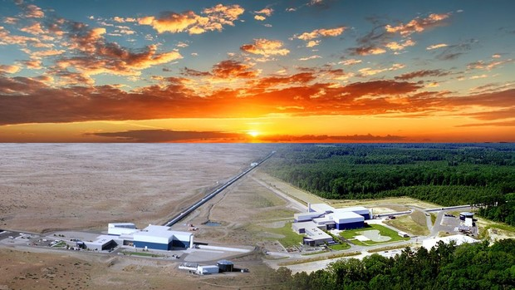
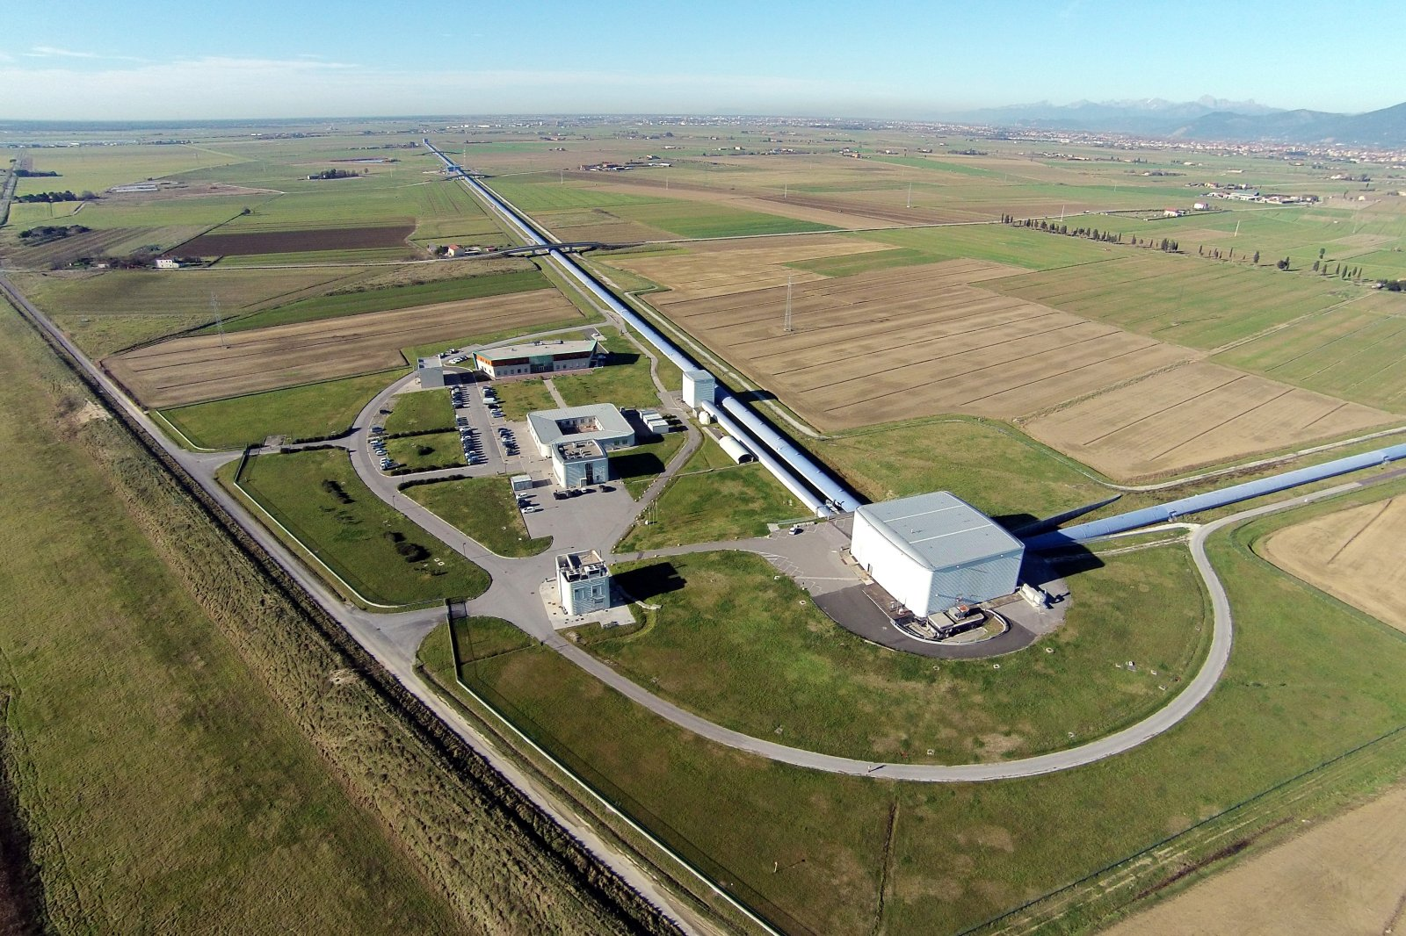
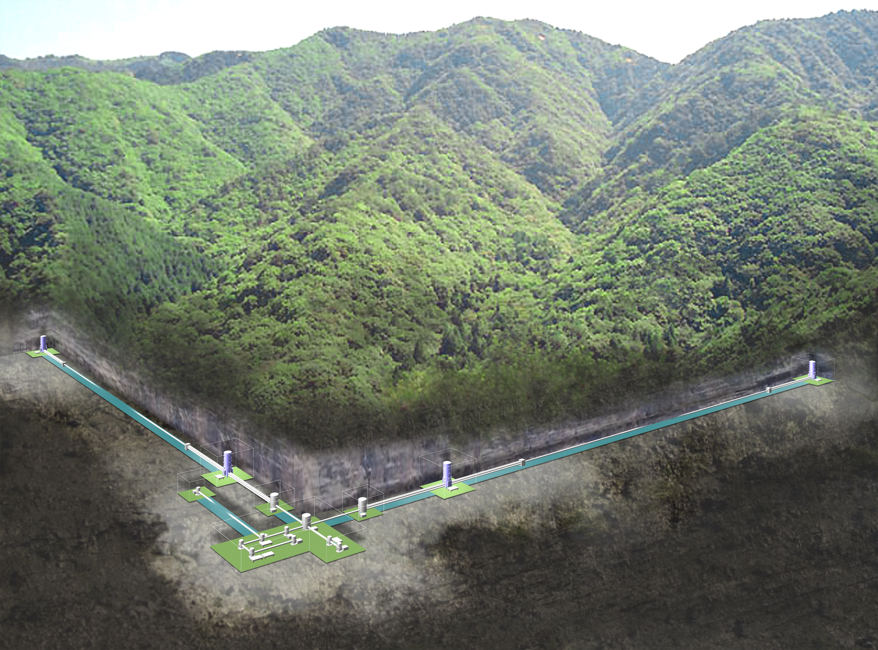




LVK Status, June 2020
Keita Kawabe

Slide 2
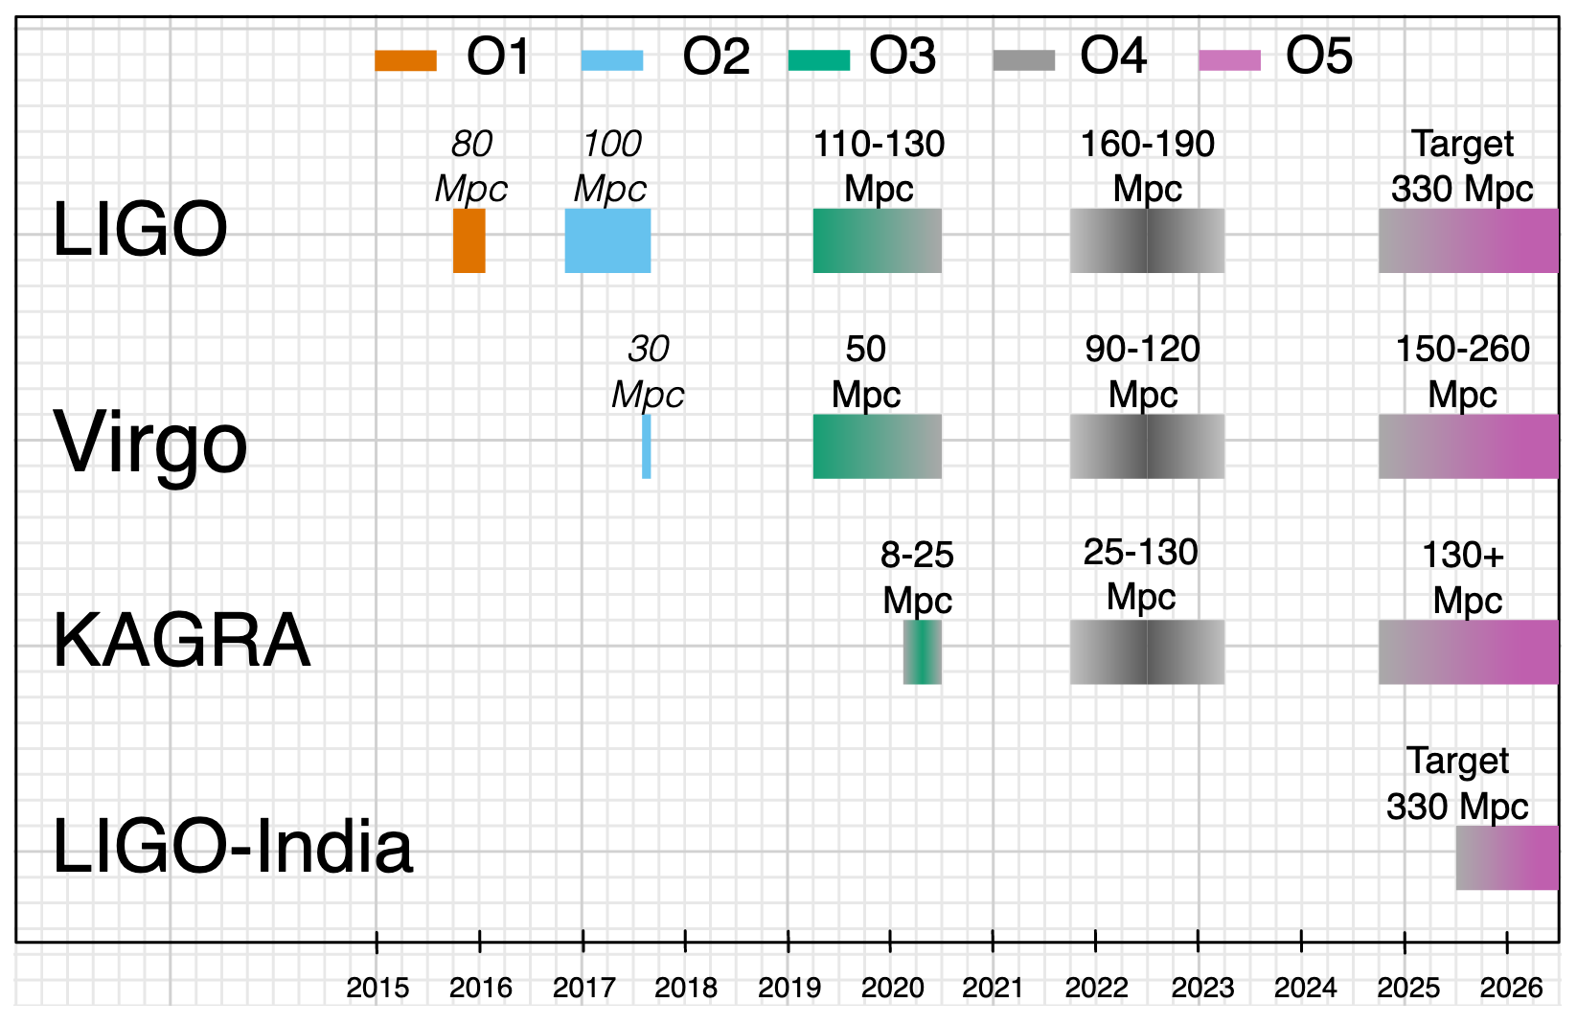
Big-ish picture
More discoveries,
1st BNS, GW MMA era began.
Fix things, upgrades, some A+ elements in advance.
1st discoveries,
All BBH.
Even more discoveries, low latency public alerts.
A+: The best LIGO could do with existing facility, many cool upgrades.
Caution: Pre-COVID. Also before we concluded O3.

Slide 3
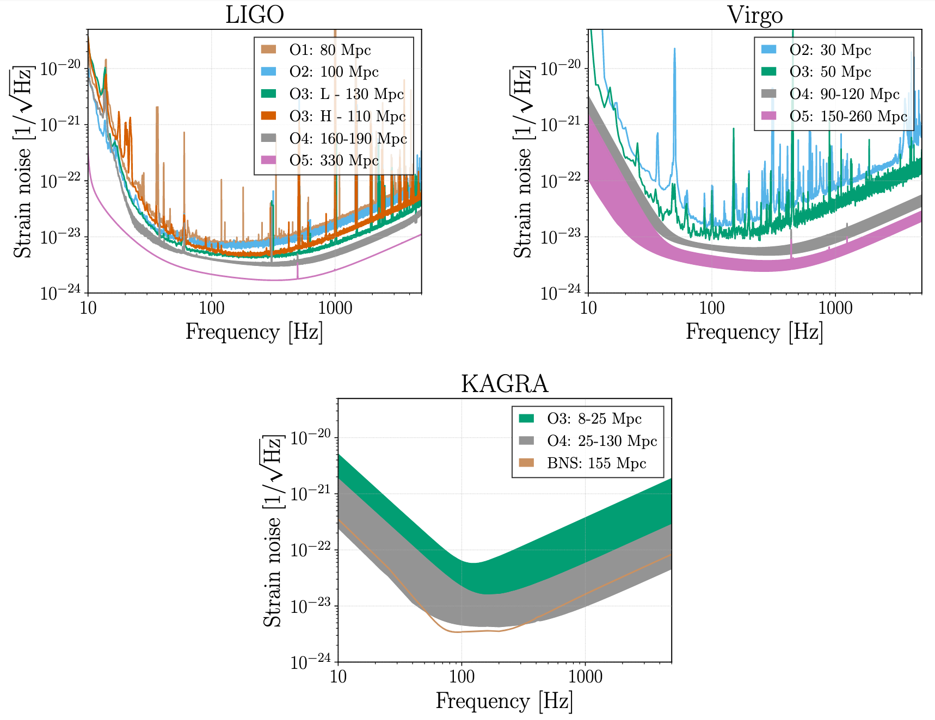
(I’ll skip this: Strain noise of the detectors for observation runs past and future)

Slide 4
I’ll talk about
LIGO-centric report of O3.
Future, COVID, how LIGO, Virgo and KAGRA are working (or not).

Slide 5
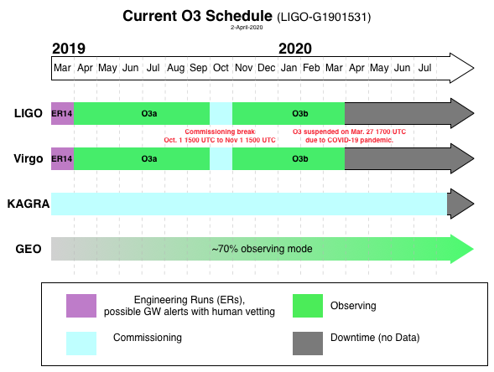
O3 timeline
O3 began April 1, 2019
1 month commissioning break in October 2019.
Was scheduled to end on April 30, 2020.
Suspended due to COVID-19 on March 27, 2020.
KAGRA observation Feb. 25 – Mar. 10, 2020 (not a part of O3.)
GEO-KAGRA short run O3GK, Apr. 7-21, 2020.
June 18, 2020: Decision not to pursue resuming O3.
K Obs
O3GK
O3GK

Slide 6
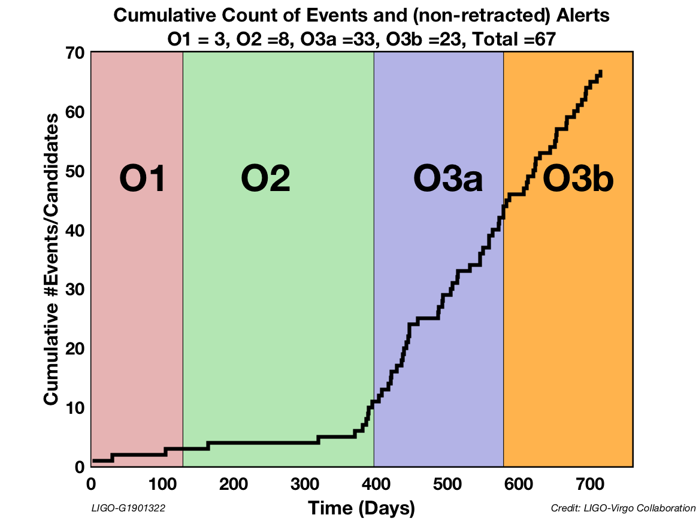
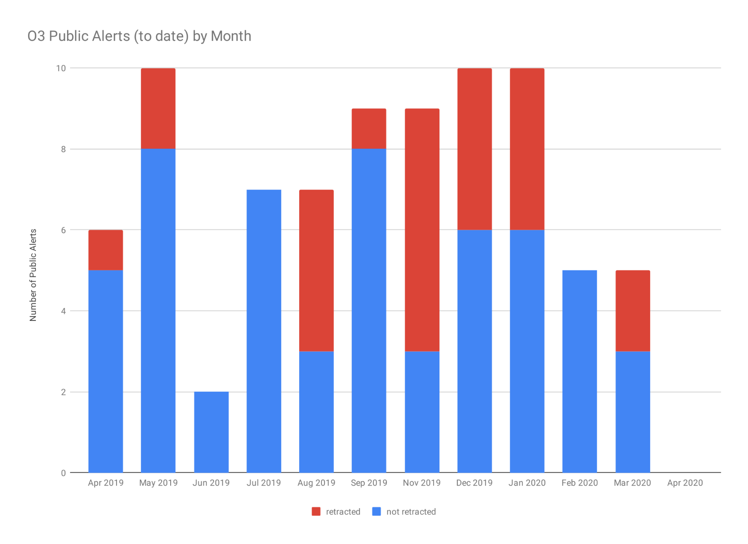
O3: A great success! Many public alerts, many discoveries.
Total Public Alerts in O3 | 80
Not Retracted | 56
Retracted | 24
GW190412: Large mass ratio BBH (~30 and ~8 Msun).
GW190425: Likely BNS @ ~ 160+-70 Mpc.
GW190814: “Mass gap” event (~2.6+-0.1 and ~23+-1 Msun).
GW190521 near future.
O3a catalog near future.

Slide 7
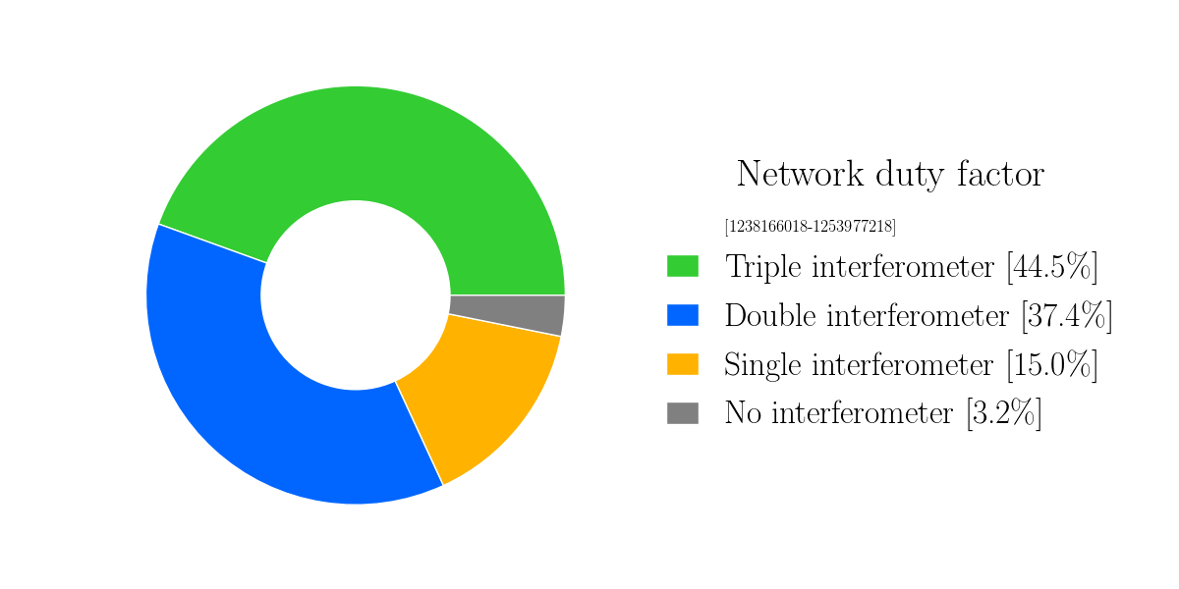
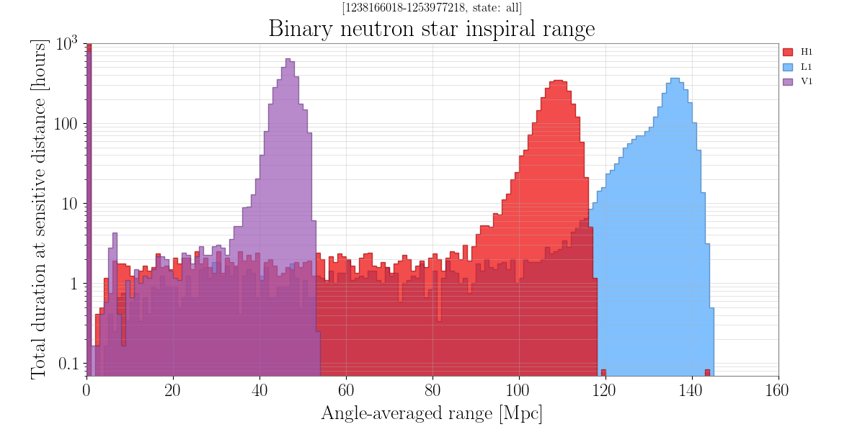
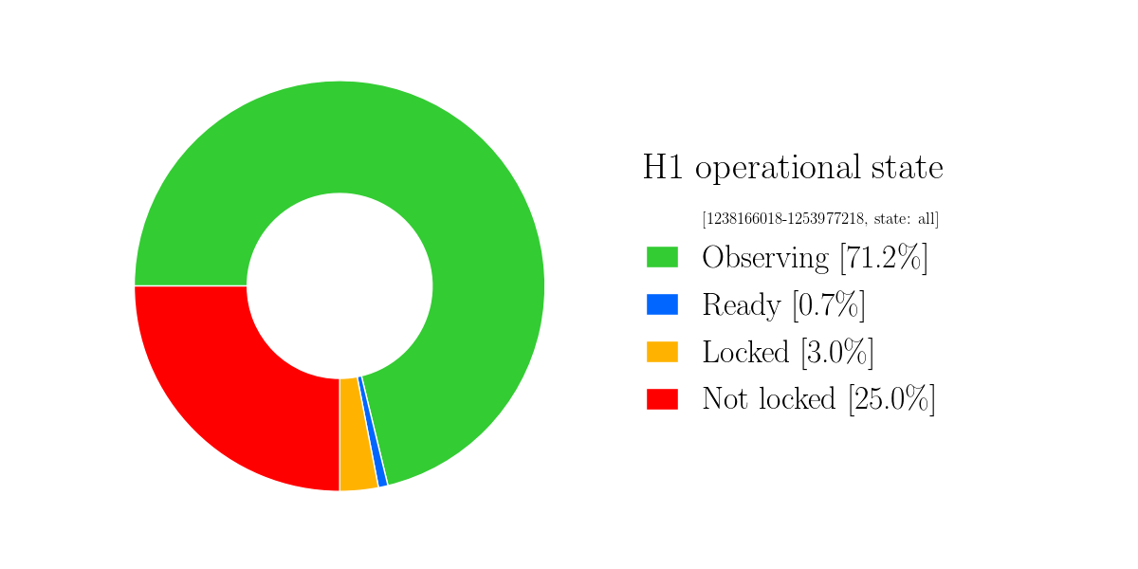
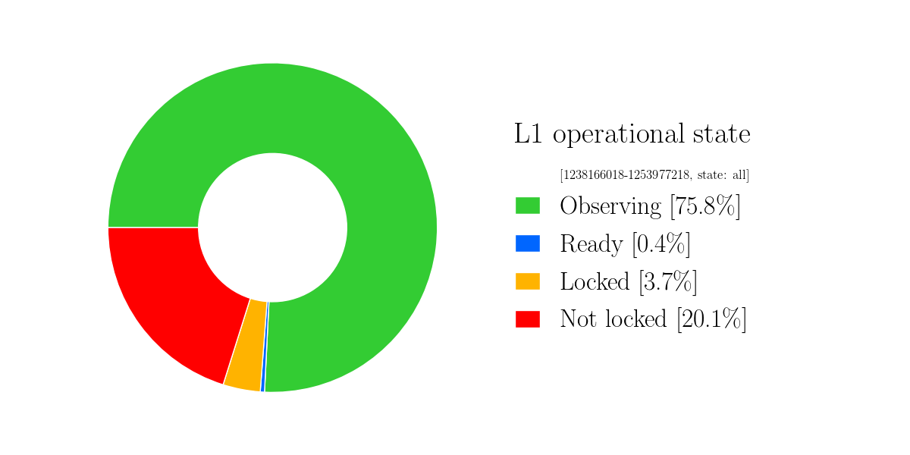
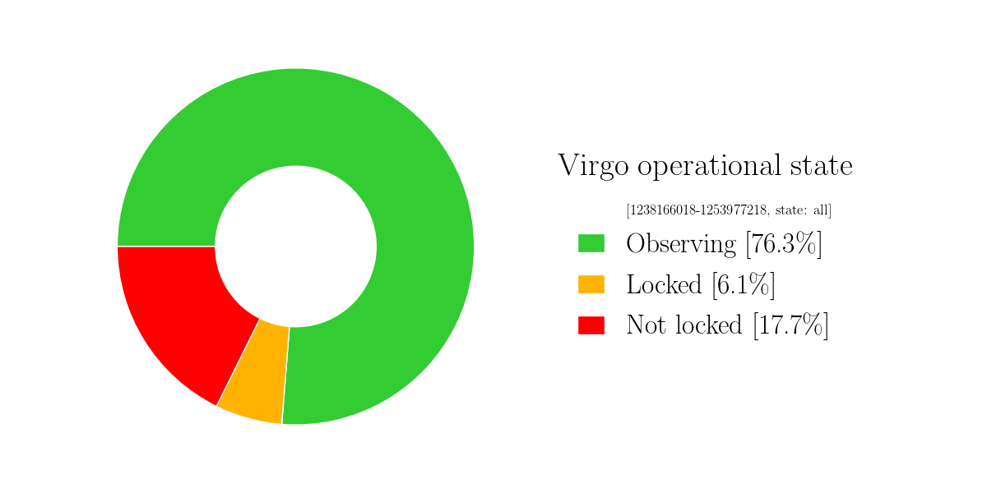
O3a Performance

Slide 8
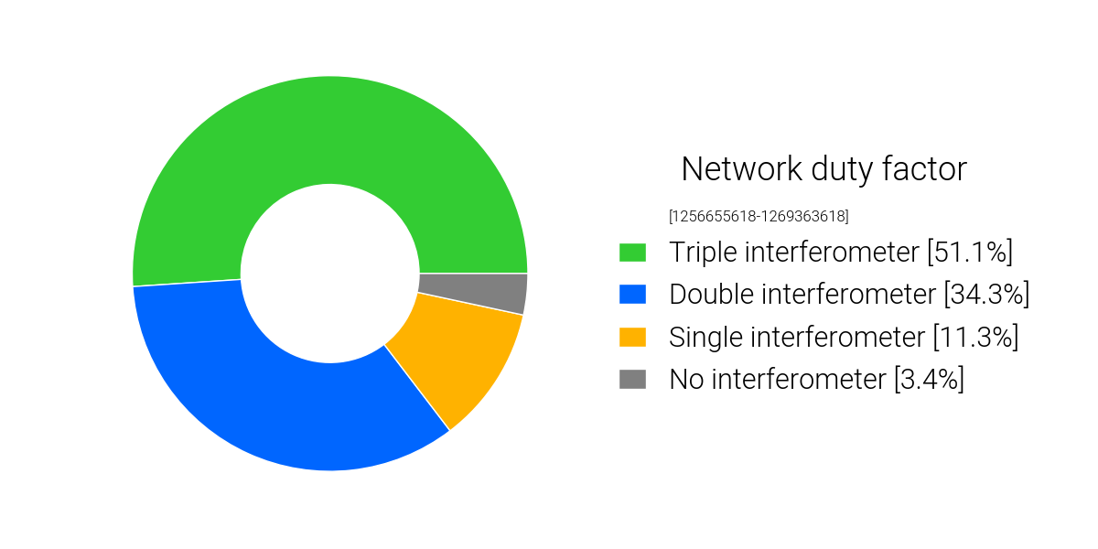
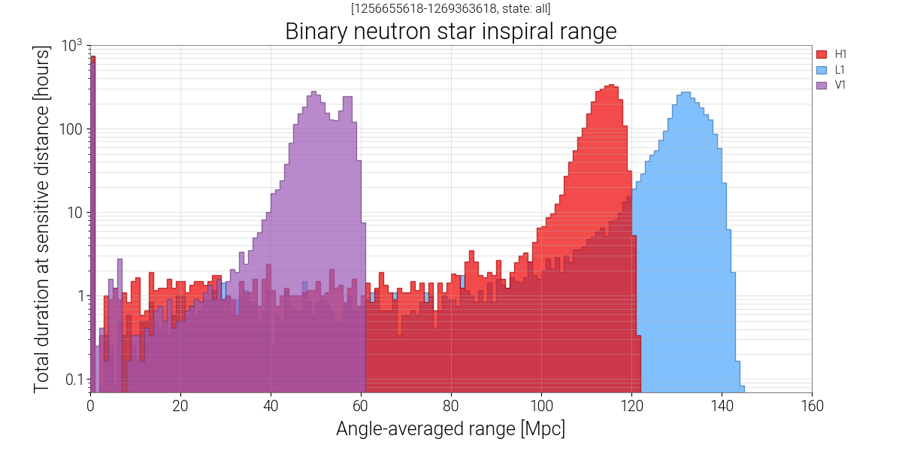
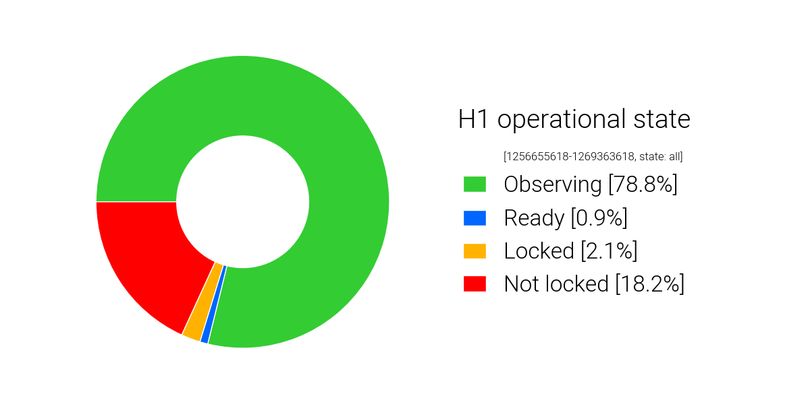
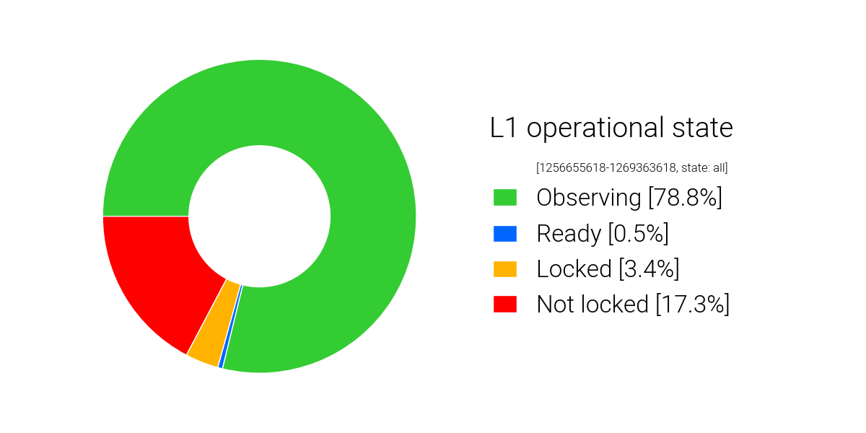
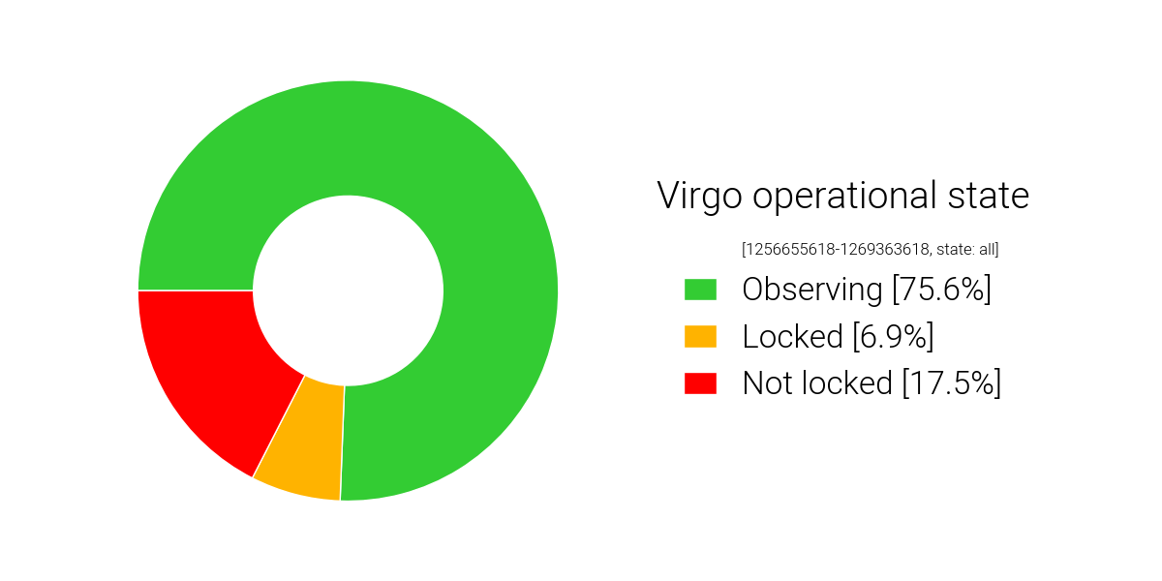
O3b Performance
(KAGRA BNS range ~600kpc in Feb-Mar, 700k~1Mpc in O3GK)

Slide 9
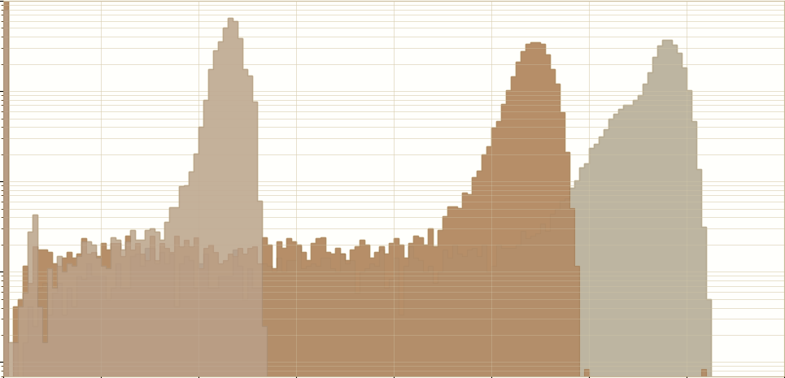
October Commissioning Break Impact
V1 range improved.
H1 range improved:
  Various SQZ improvements.
  Other tunings (e.g. spot position)
L1 range reduced:
  New point absorbers appeared which limited power buildup in the arms.
  Some of the lost sensitivity was recovered by improved tuning of the squeezer.
Some other improvements (e.g. glitch rate), see bonus slides, Jenne’s talk, Detchar talks.

Slide 10
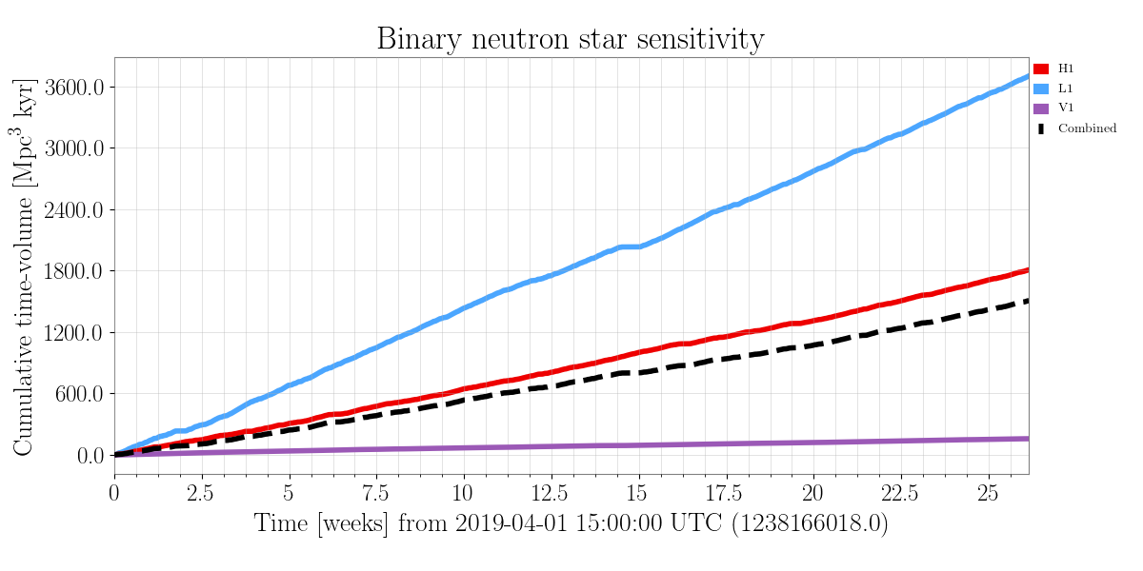
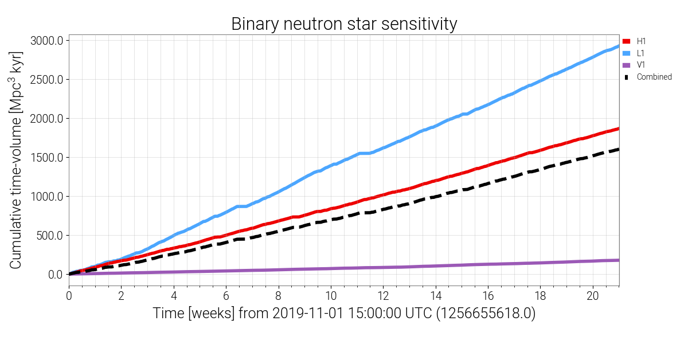
Still a win: More BNS volume-time coverage in less than 5 months (148.08 days) than in 6 months (183 days).
O3a
O3b

Slide 11
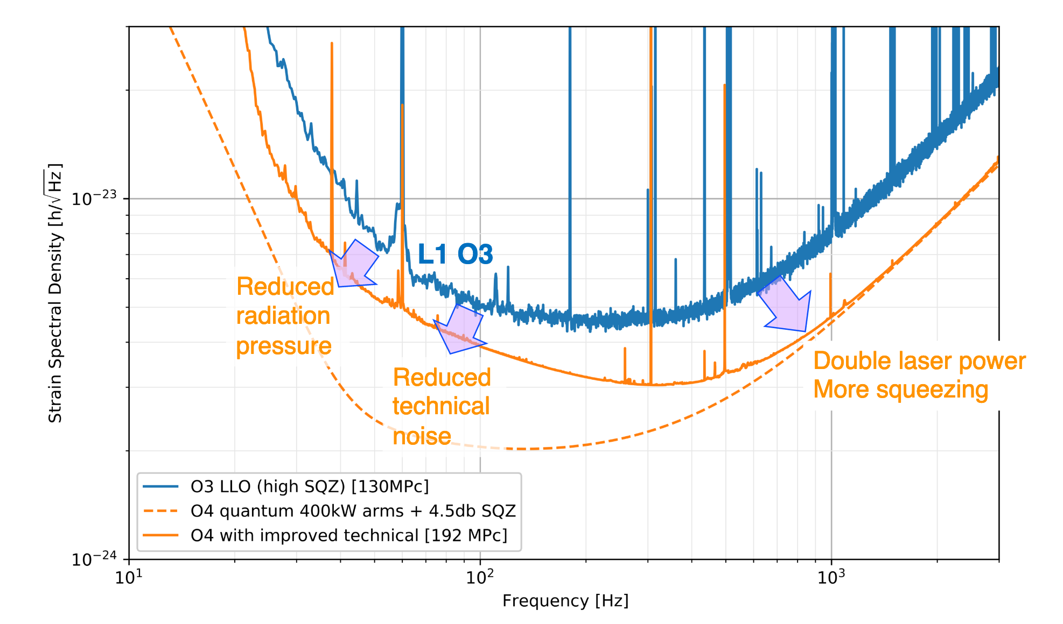
O4: This is what LIGO wants to implement.
(filter cavity for SQZ)
(better Faraday Isolator, limited active wavefront control)
(scattering etc.)
400kw in the arm (new laser, new ITMY for H1, new ETMs for both)

Slide 12
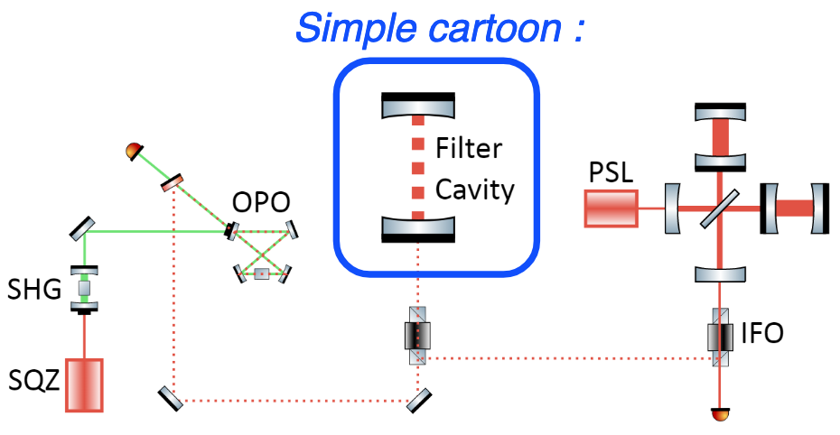
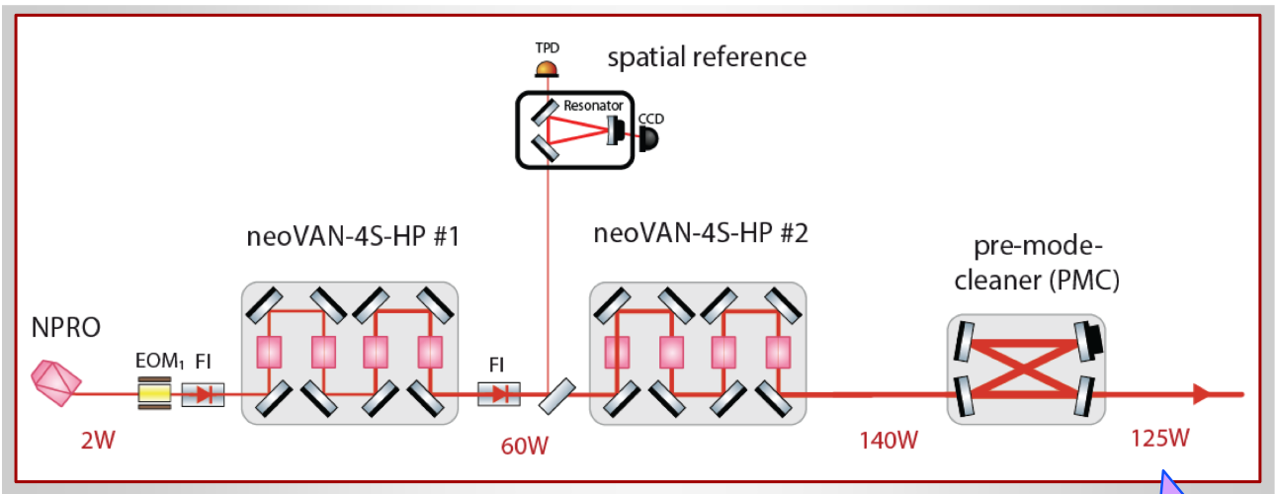
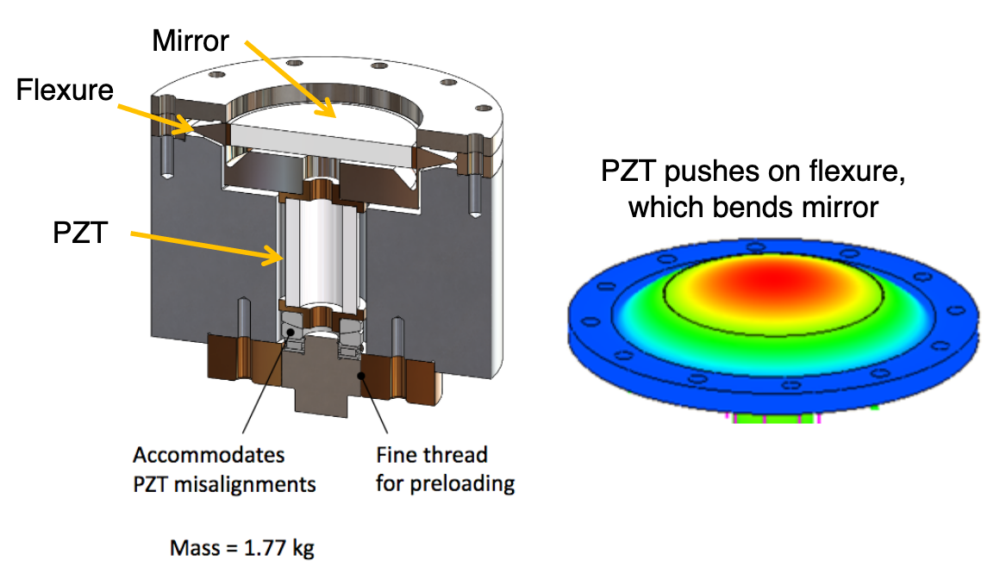
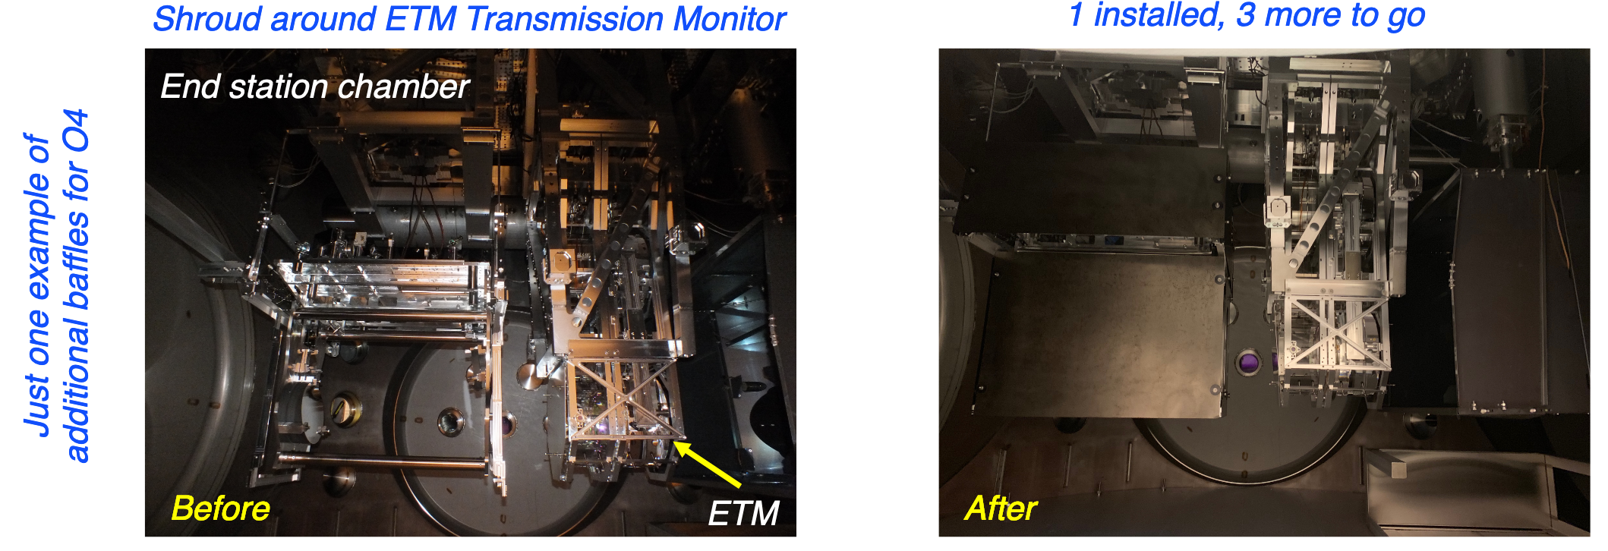
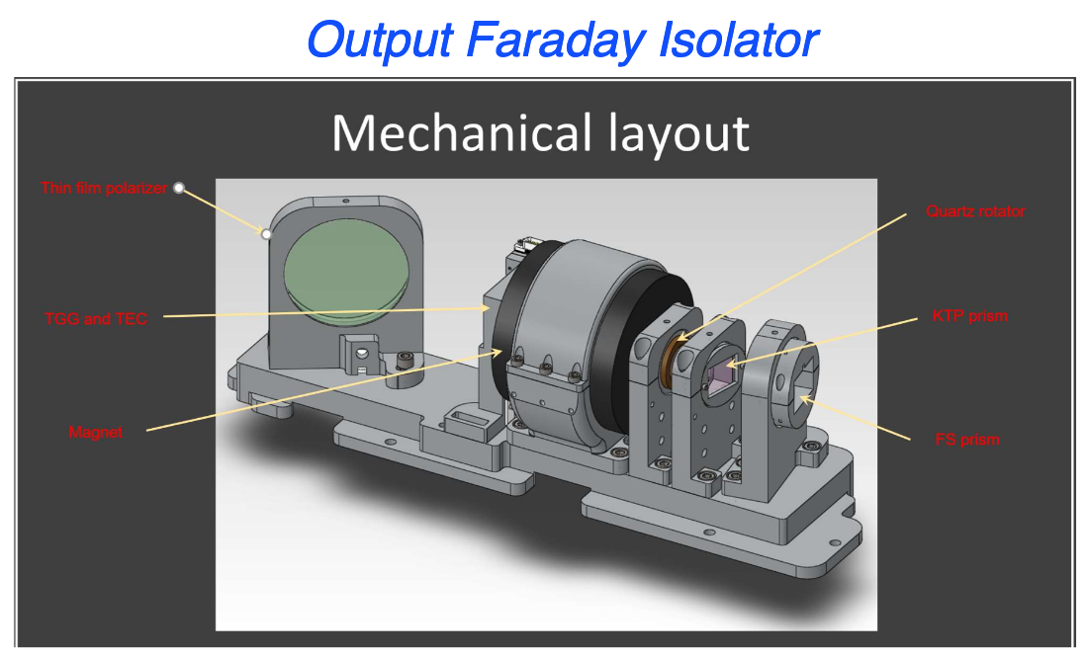
New mirrors, a bunch of technical upgrades.
FC
(filter cavity for SQZ)
(better Faraday Isolator, limited active wavefront control)
(scattering etc.)
400kw in the arm (new laser, new ITMY for H1, new ETMs for both)

Slide 13
But, COVID.
O3 was cut short by 1 month.
LHO and LLO: LIGO-Phase 3 (L2000119) as of now, i.e. still shut down. No site activities except to maintain the integrity of the detector and the observatory facilities.
  WA: Benton and Franklin Co (LHO): 2 of 3 Counties in WA that is still in WA Phase 1 (most restrictive).
  Louisiana (LLO): Sate-wide Phase 2 since June 5 (one step looser than Phase 1). On June 22, transition to Phase 3 was postponed for at least 22 days.

Slide 14
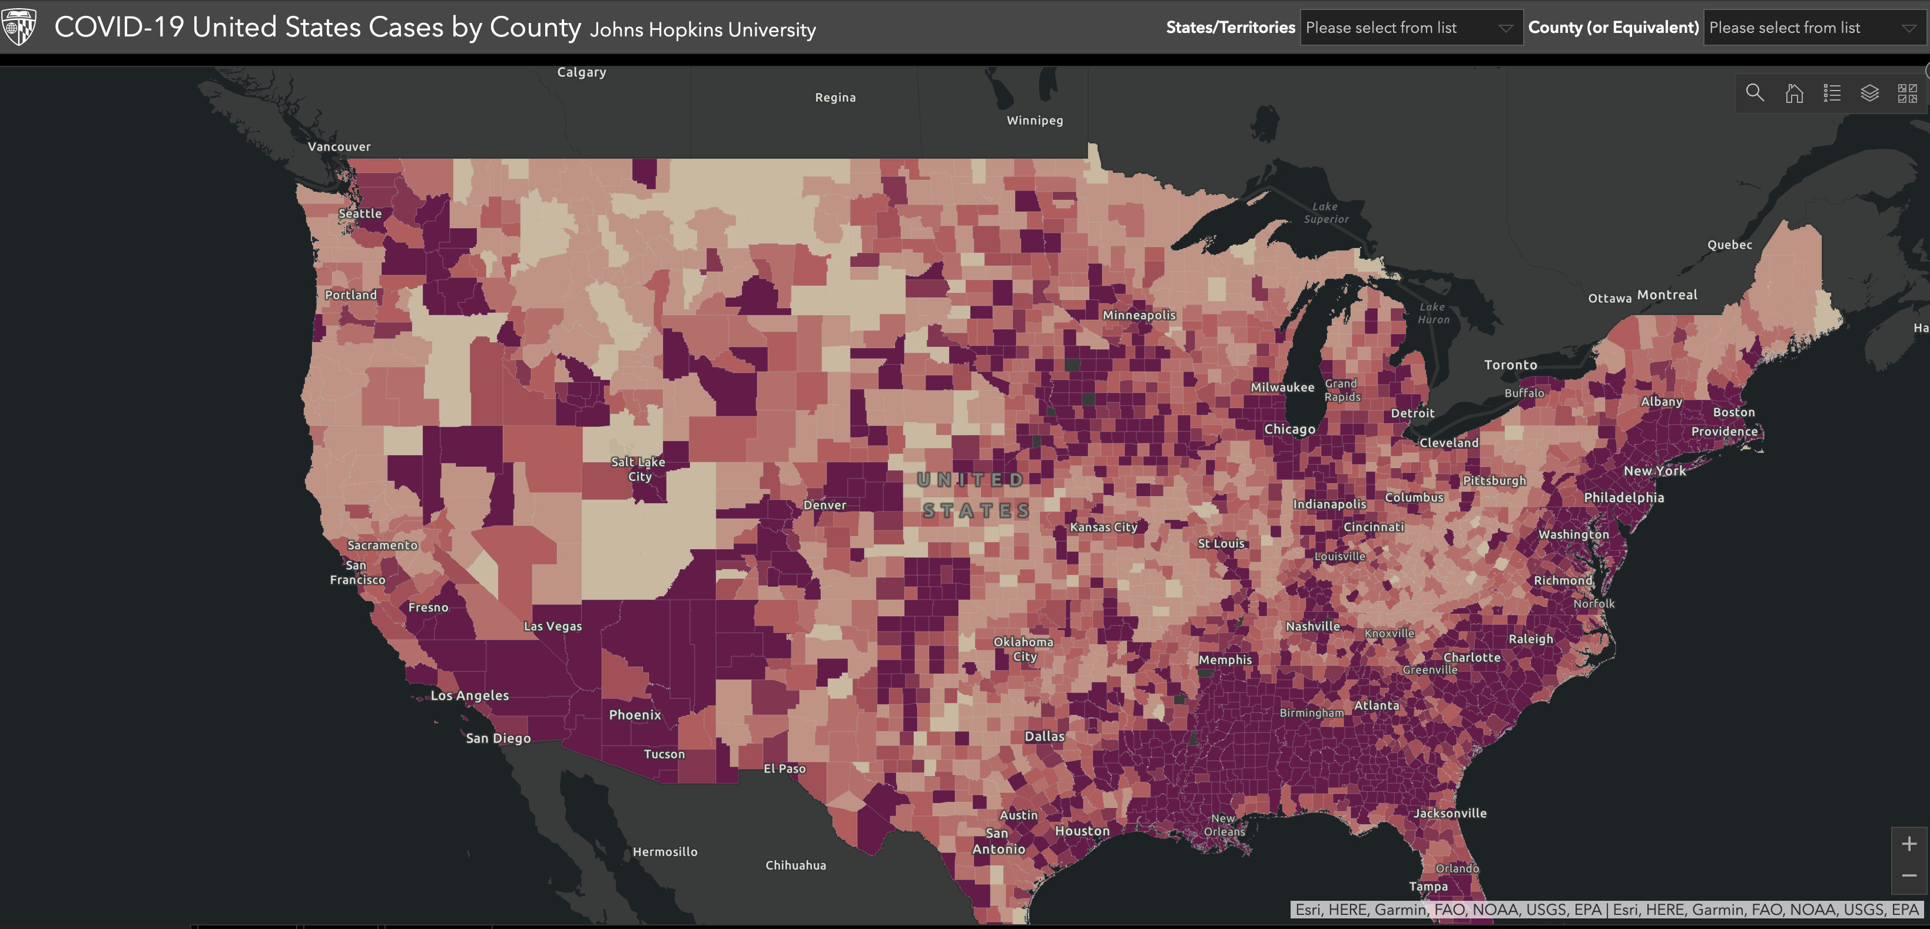
LIGO locations on COVID map.
LHO
LLO

Slide 15
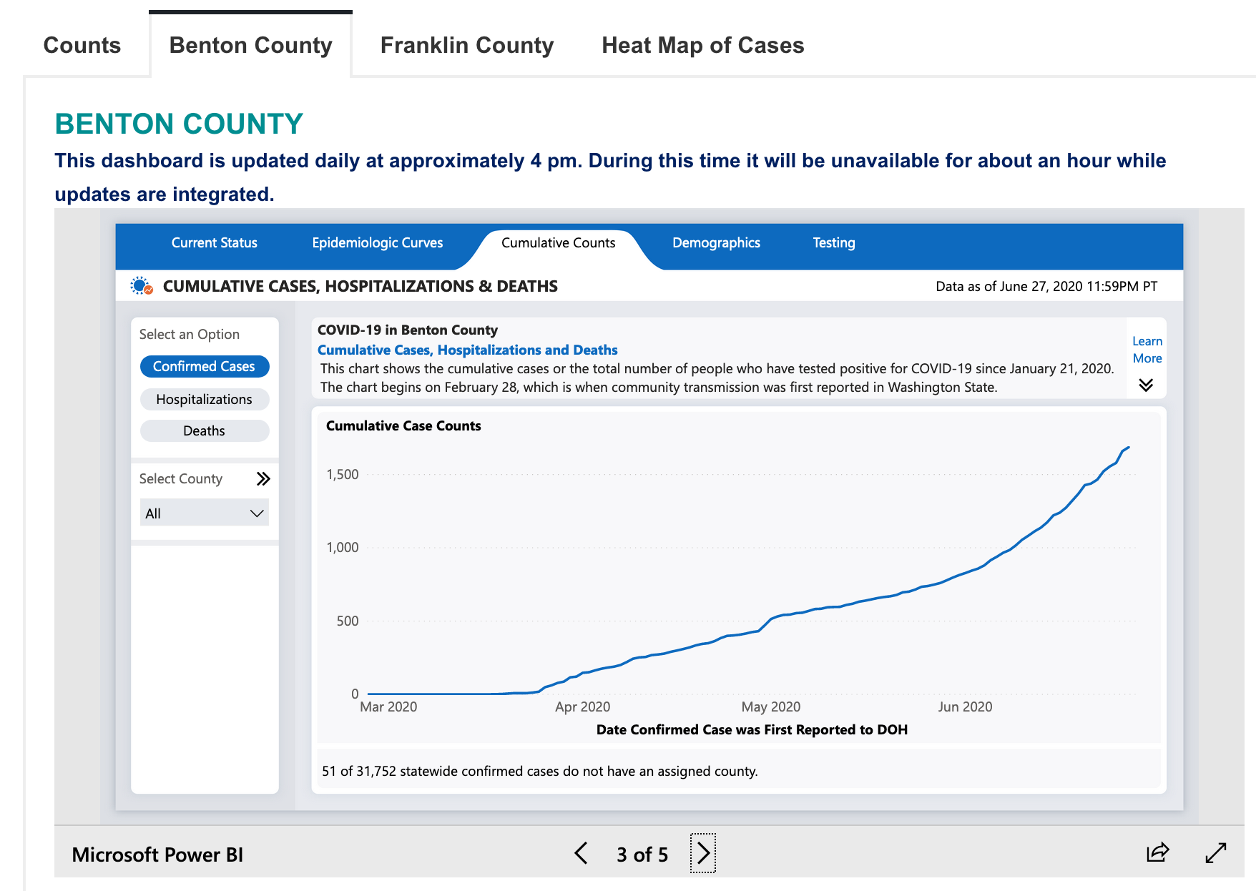
1st wave isn’t gone at LHO
LHO

Slide 16

It will take some time until we flatten the curve here. But we’ll do it eventually.
LHO

Slide 17
Impact on O4 (BNS 160~190Mpc) and A+ (BNS ~330Mpc target).
Day-by-day schedule slip. May/June are already gone, at least a few weeks of July too.
No solid date for LIGO-Phase 2 transition yet.
  LIGO MIGHT be able to transition without waiting for State- or County-level transition, though that’s not preferred.
Even in LIGO-Phase 2, work won’t be as efficient due to physical distancing and limited number of people in chamber etc.
People are making plans e.g. safety guideline, modified work protocol etc. to transition to Phase 2, modify installation schedule etc.
Both LHO and LLO will first resurrect H1 and L1 to O3-level. Jenne’s talk about LHO status.

Slide 18
Virgo in Italy. Saner.
Situation is improving every week. People are working at the site.
Adding Signal Recycling (or RSE)
  Mirror arrived, gluing spacers and magnets.
  SR payload will be assembled and installed inside the tower at mid-July.
Adding guided lock acquisition like LIGO/KAGRA
  Components of the auxiliary laser system are in production; the first complete SHG system should be ready and tested by end July to be installed in one terminal building;
Infrastructure works for Frequency Dependent Squeezing (filter cavity etc.) are in progress.
  Increasing the height of the tunnel for filter cavity (FC).
  Central 150 m of the FC vacuum pipe have been installed.
  All the other components (opticsl, mechanics, electronics) either are in production or have been ordered;

Slide 19
KAGRA in Japan. Saner.
U-Tokyo-Level 1 (30% of full capacity).
Almost no new cases in Toyama, Japan, so 50% capacity is allowed at the site. Might loosen up further on July 6.
O4 upgrade work starts in July.
  Fixing/modifying all suspensions.
  Dual Recycling with ASC (as opposed to no RSE, no full ASC).
  Adding heater to cryostat.
  Fixing leaks.
  Adding baffles.
Commissioning for sensitivity improvement scheduled from July 2021.

Slide 20
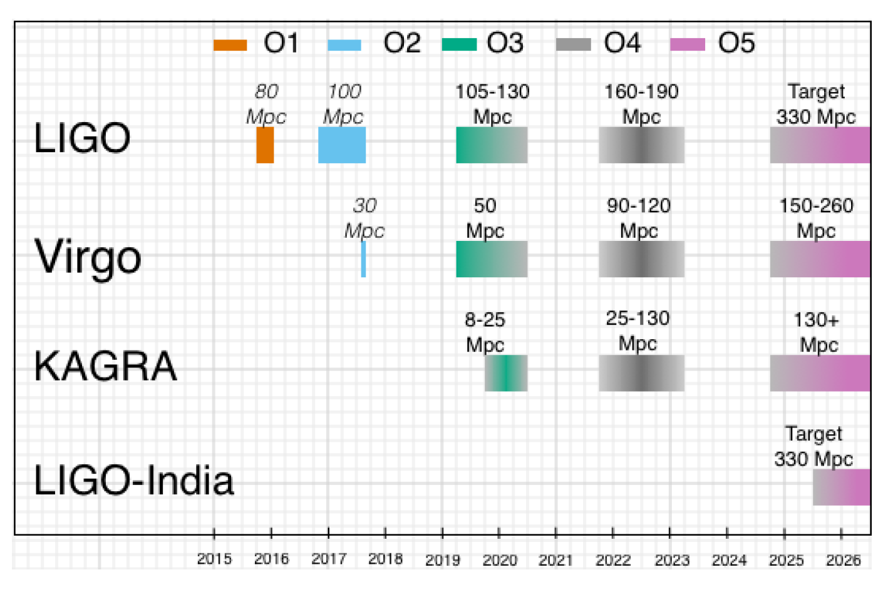
Pre-COVID Plan again. Lots of uncertainties. But we’ll come back with greater performance than O3.

Slide 21
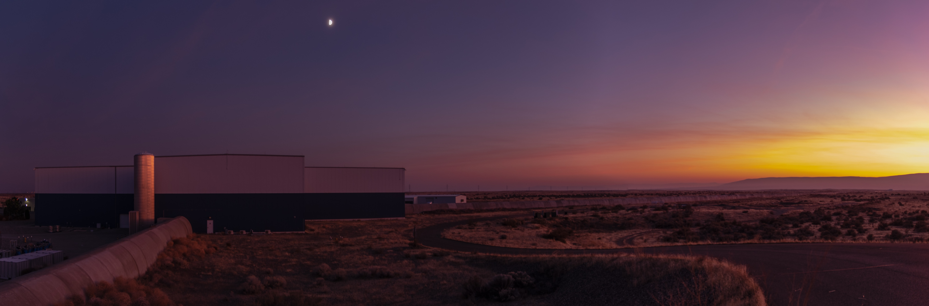
Thank you, let’s listen to Jenne’s LHO Status talk.

Slide 22
Bonus: KAGRA
A detector next to Super-K, Kamioka mine, Japan.
  Cryogenic sapphire mirrors to reduce thermal noise.
  Underground for smaller seismic displacement and seismic Newtonian noise.
Everything installed, but no successful Signal Recycling (or rather Resonant Sideband Extraction) yet.
Cryogenic operation!
  Increased absorption at 30k and below: “Ice” layer of the residual gas molecules. Engineering solution under study.
  This is an important problem to solve for ALL 3G detectors.
Inhomogeneous birefringence of sapphire turns out to be a serious problem. Mitigation strategy under study.
BNS range ~600kpc in observation, Feb 25-Mar 10, 2020. Didn’t join O3 at this point.
O3GK with GEO600, Apr 7-Apr 21 2020, 0.7~1Mpc(?).

Slide 23
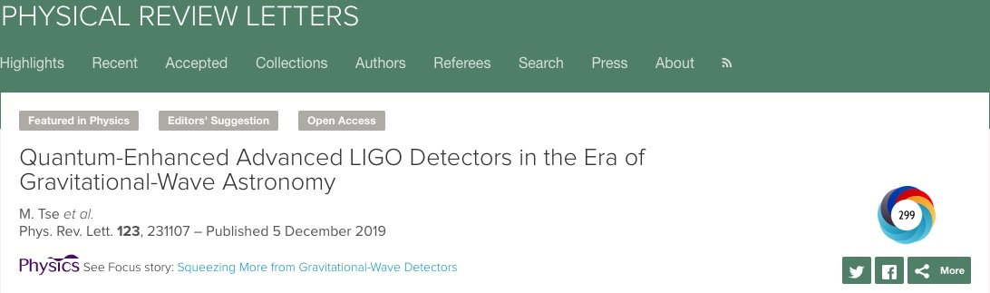
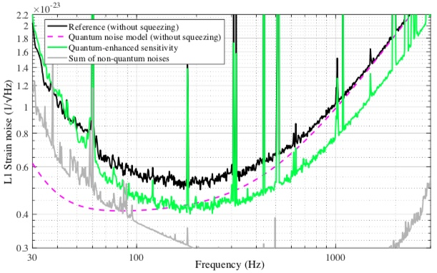
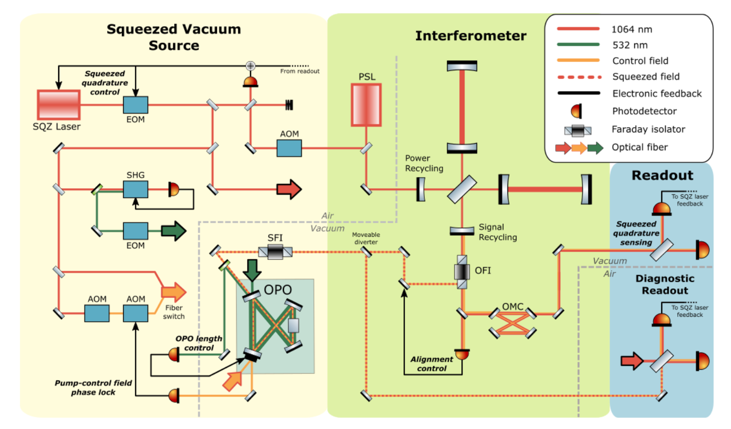
(Bonus: Squeezing)
Started using SQZ in O3a to improve quantum noise for high frequency.

Slide 24
Bonus: What is a point absorber?
Localized small (≤ 100μm),
highly absorbing (> 1E4 ppm)
on test mass HR surface
Resulting thermal lens/surface deformation
(example)
ITM
AR
HR
Arm cavity (≈ 200kW)
Example change in temperature
α = 100%, diameter = 100μm
Then ΔT = 800K

Slide 25
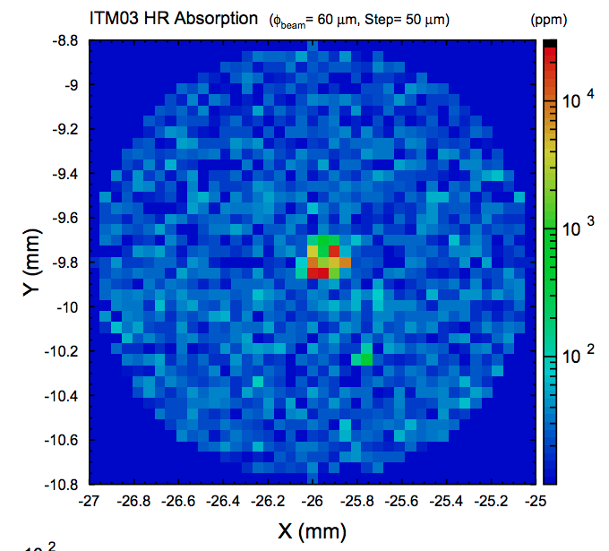
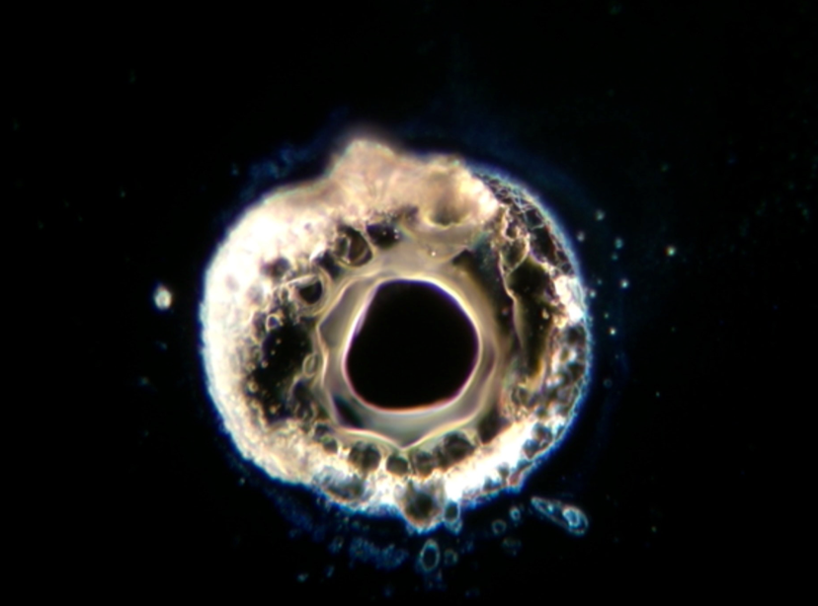
Measured Point Absorbers
Majority of optics measured show one or more point absorbers
  Hartmann sensor (in-situ)
  Photothermal common-path interferometry
  Thermal imaging camera (under investigation)
Image credit: Liyuan Zhang and GariLynn Billingsley

Slide 26
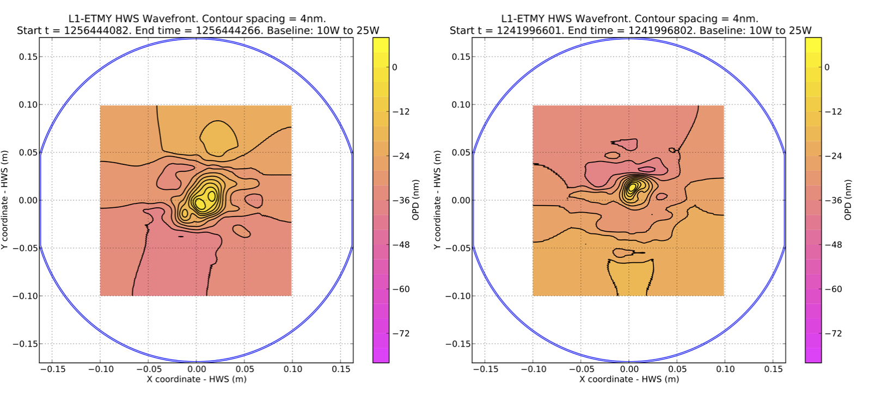
(Bonus: New Point Absorbers at LLO in O3b)

Slide 27
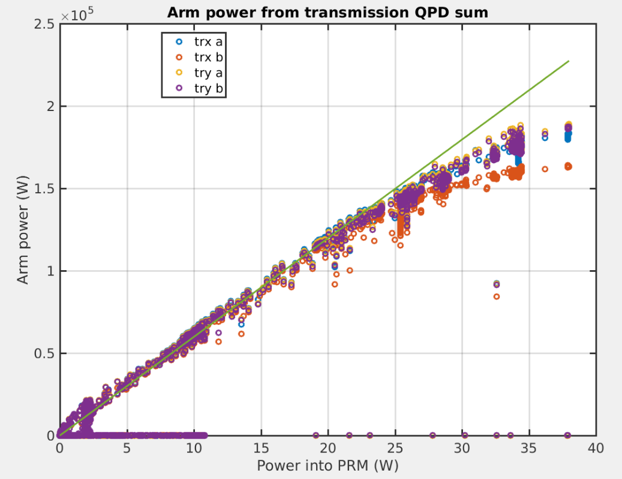
(Bonus: Point Absorbers)
Hanford’s large point absorber on ITMY limits circulating power and shot noise limited sensitivity
Livingston circulating power reduced by 25% for O3b
  Tuning squeezing recovered BNS range
MIT and CIT groups are investigating possible point absorber mitigation strategies
LLO alog 42639 Valera Frolov

Slide 28
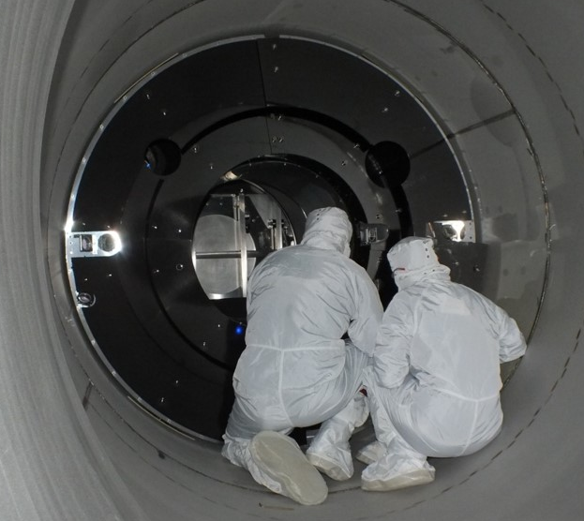
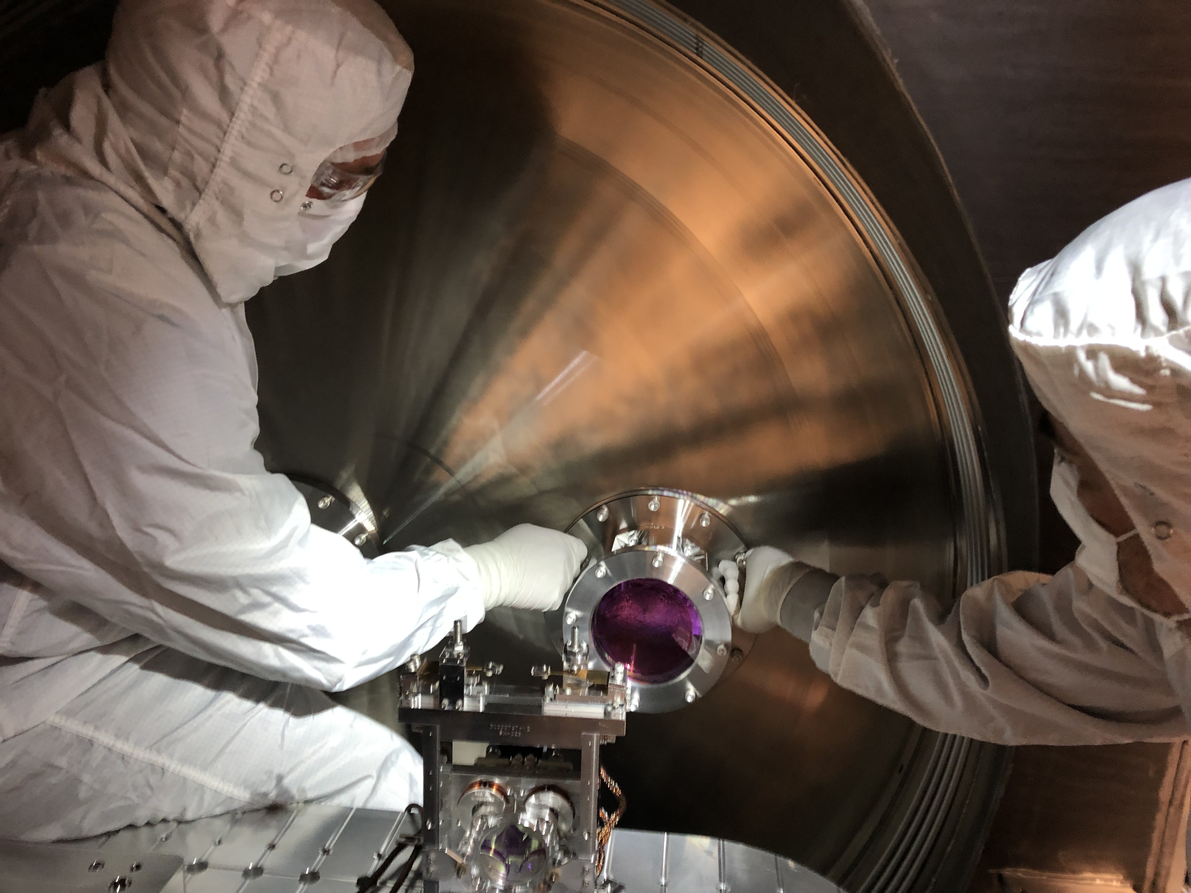
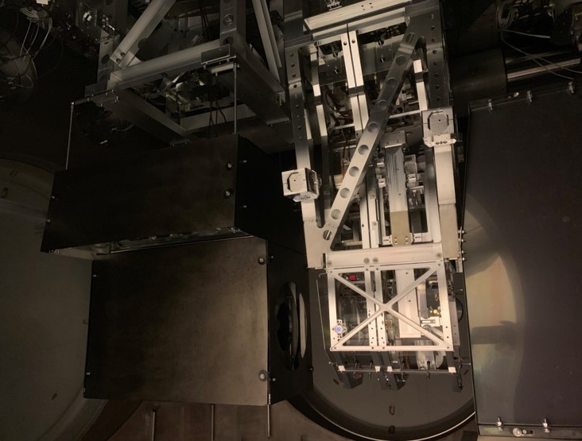
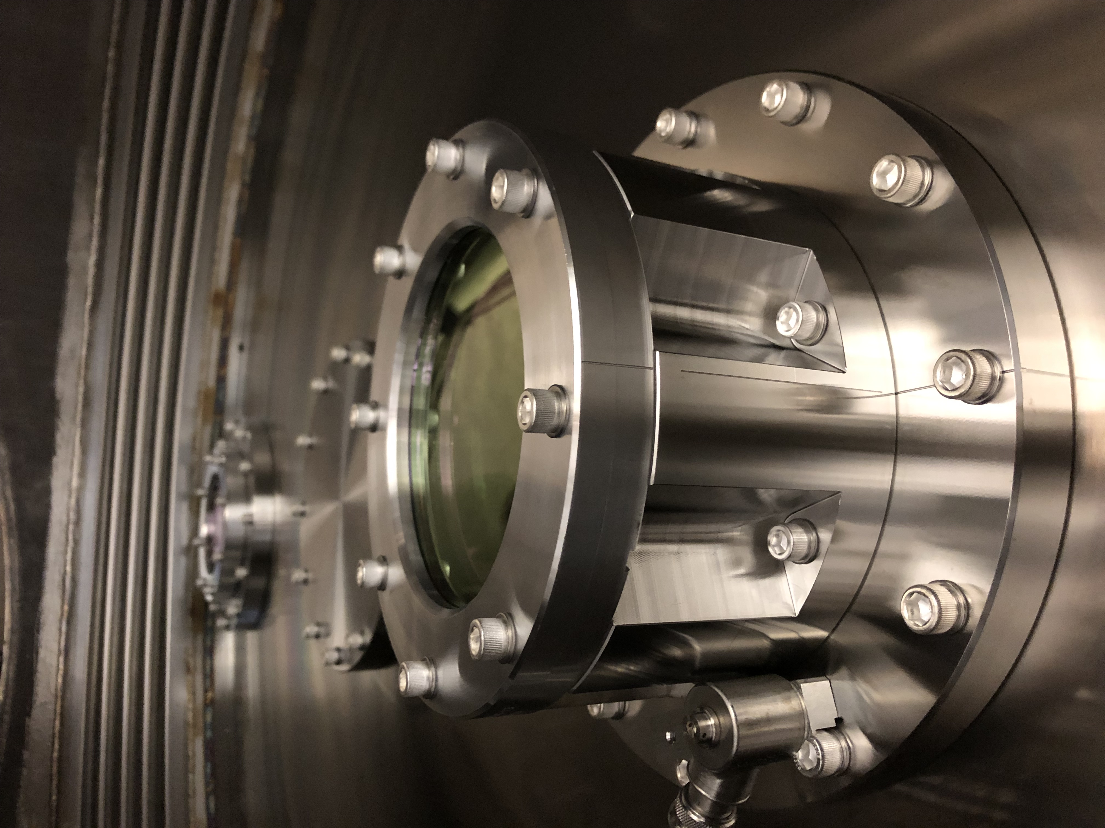
Scattered Light Upgrades During October Vent
Angled septum window
  LLO
  LHO
Pcal baffles (EX & EY)
TMSX shroud
Nozzle baffles
Images from: https://www.ligo.caltech.edu/WA/news/ligo20191104

Slide 29
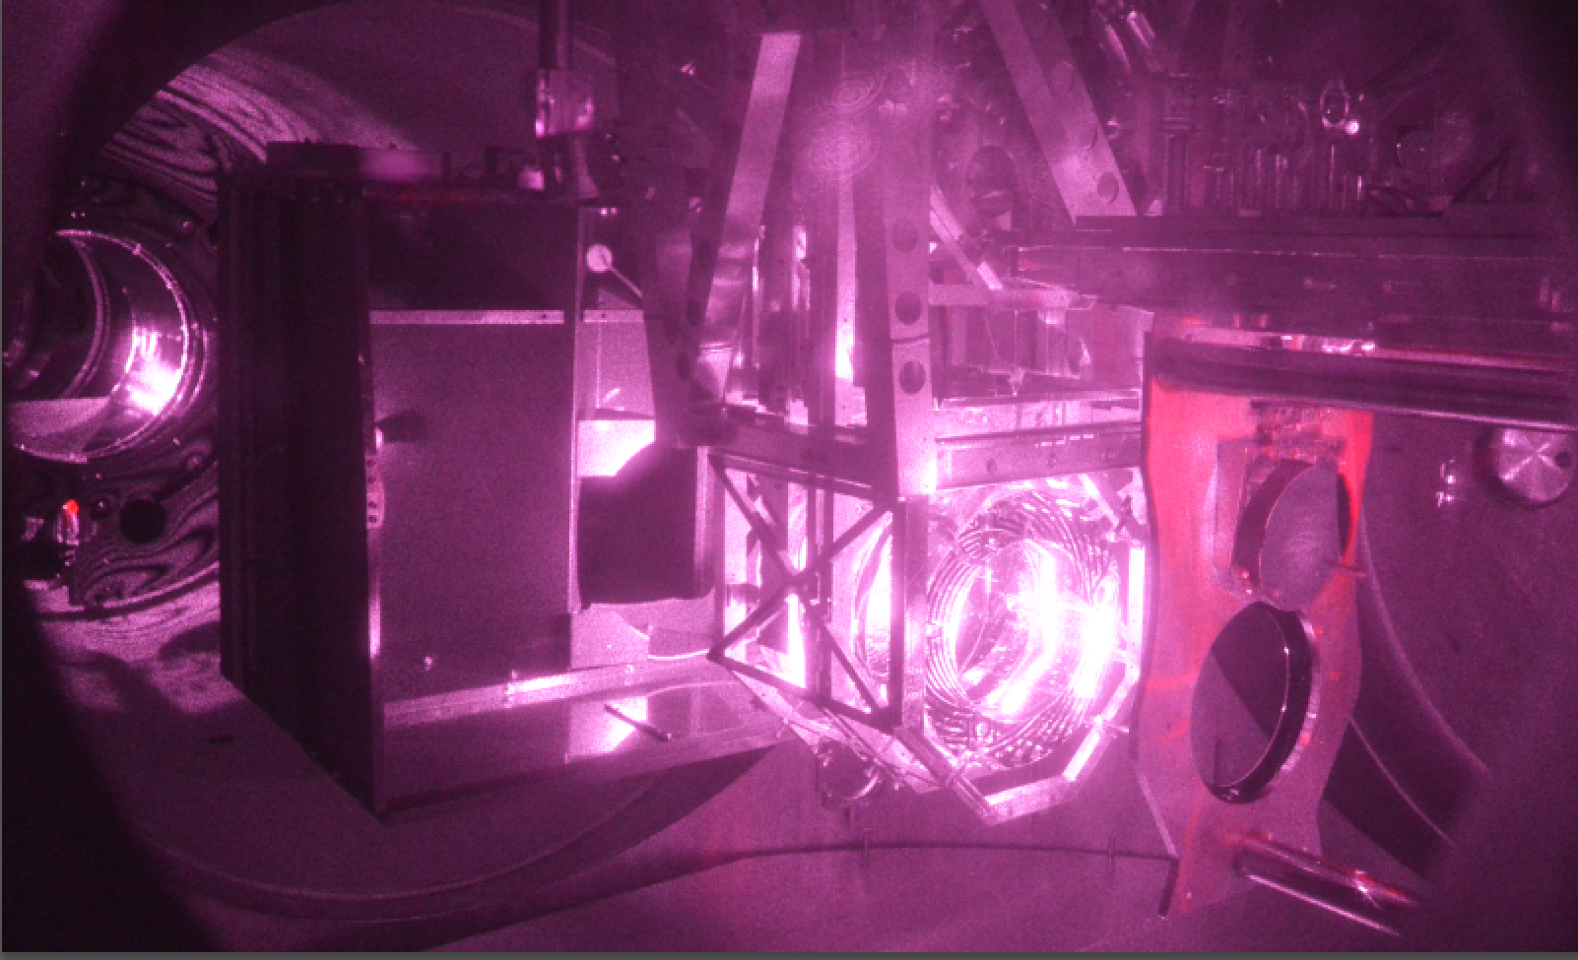
O3 Lessons Learned: Scattered Light
Photographed while at full sensitivity, lit by scattered infrared beam.
ETMY
ETMX
lit by scattered main beam (observation sensitivity)
cryo-baffle
transmission monitor (TMS)
p-cal periscope
arm cavity baffle (ACB)
ETMY test mass
annular reaction mass with electrostatic drive traces (concentric lines)

Slide 30
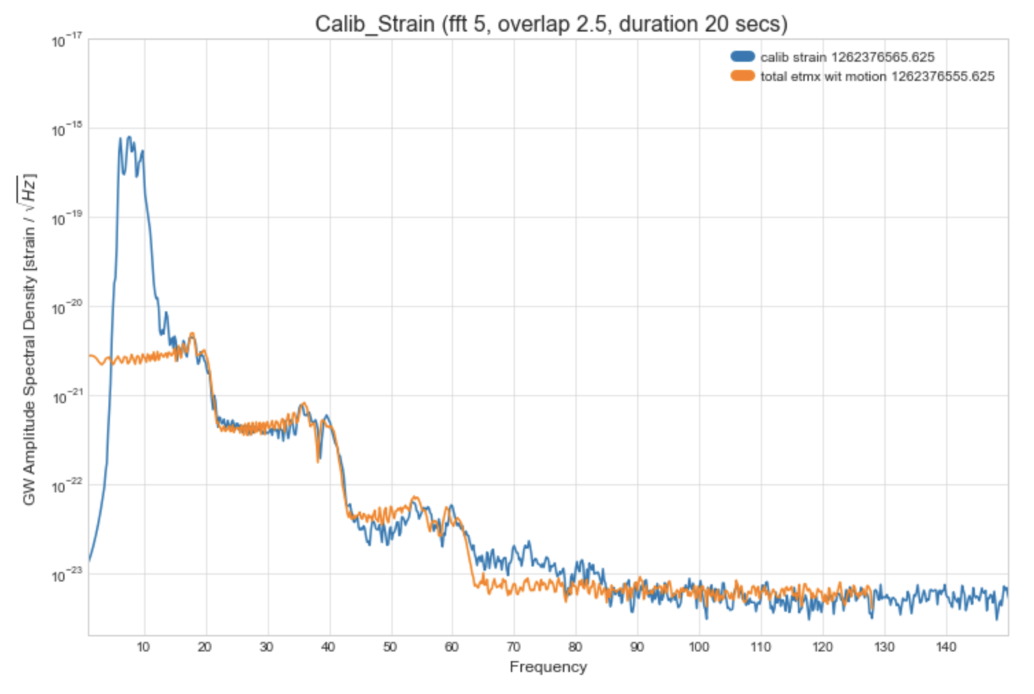
O3 Lessons Learned: R0 Tracking
Feed L2 Length OSEM signal back to R0 to reduce relative motion between test and reaction mass

Slide 31
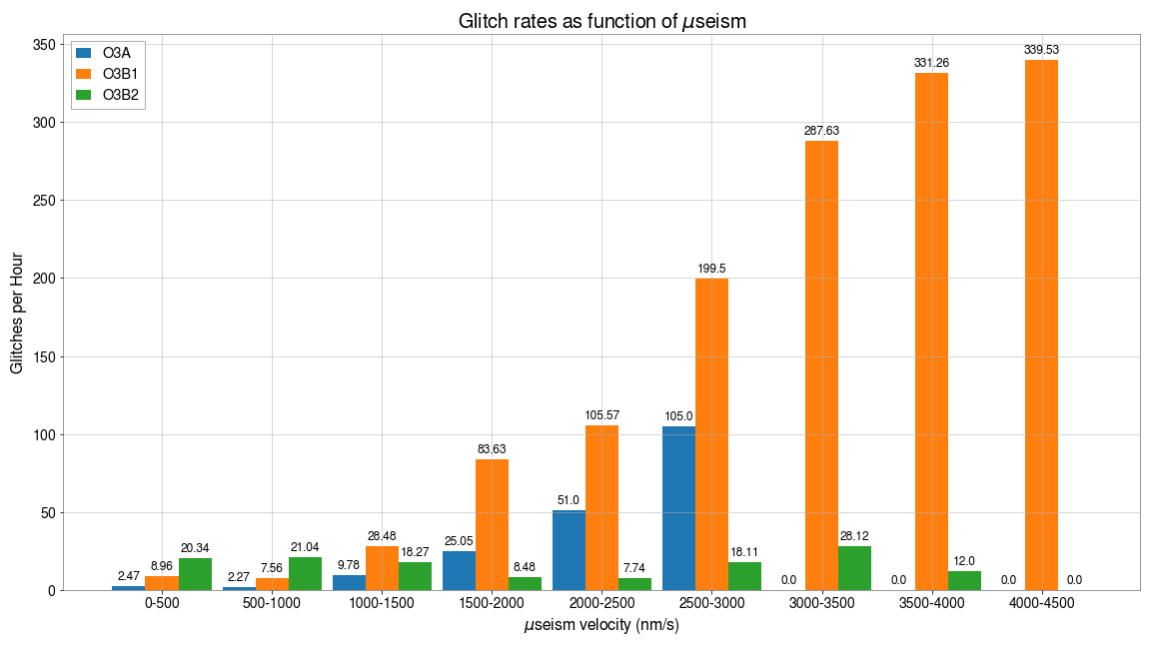
3) Glitch rate reduced at LLO
Rate of glitches identified by GravitySpy as scattered_light greatly reduced at microseism above ~1 micron/sec
SNR of glitches also reduced (Sidd alog 51594)

Slide 32
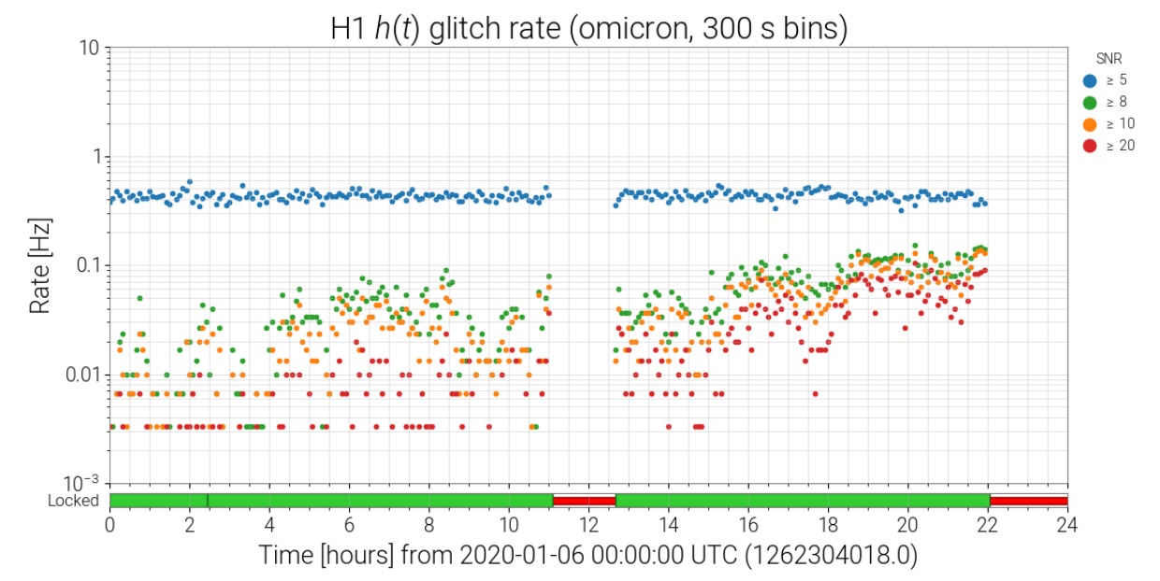
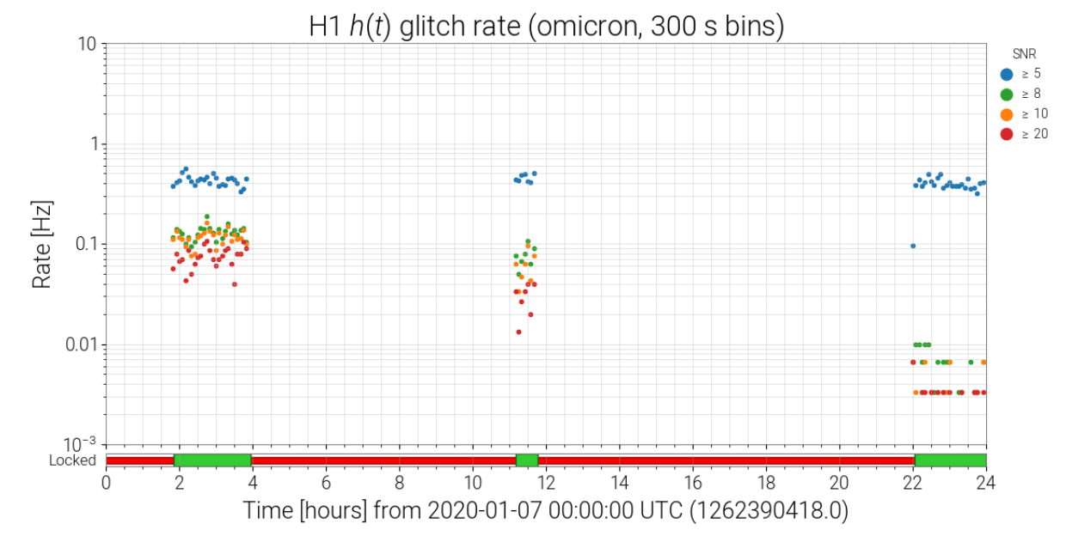
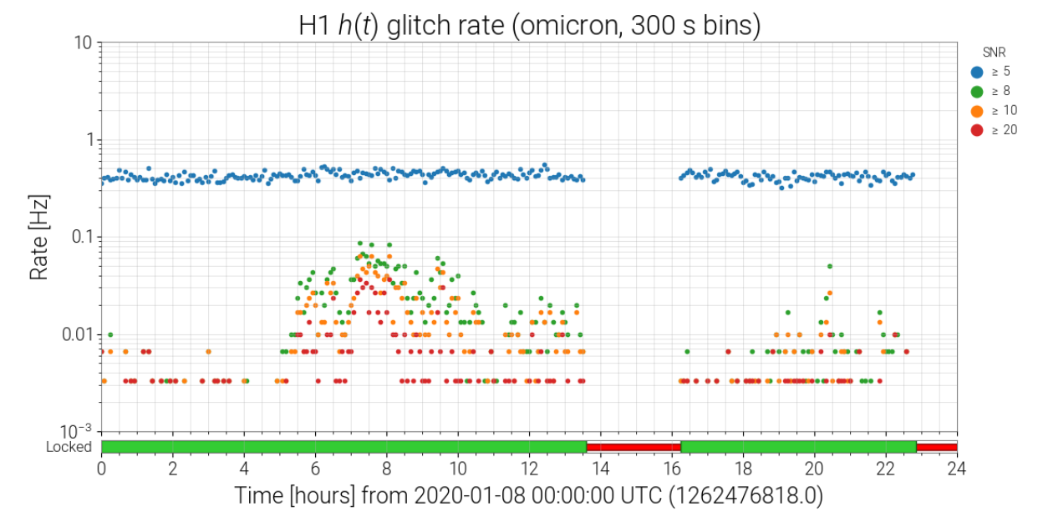
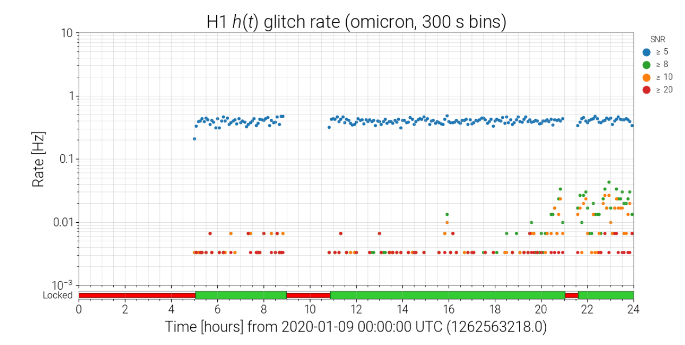
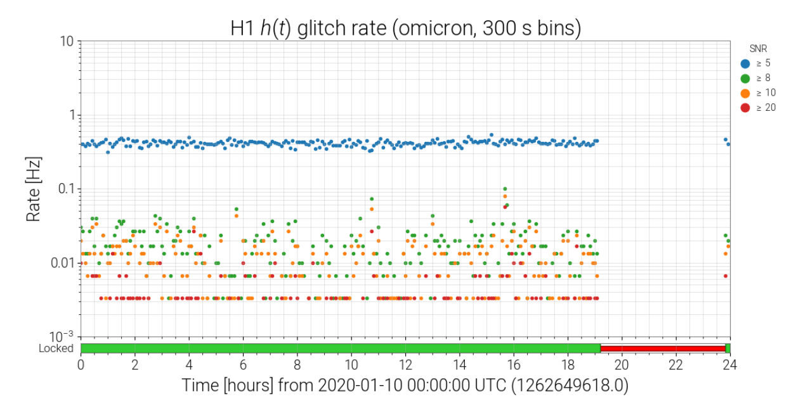

































4) Glitch rate reduced at LHO
Next level of scattering requires ~4 times higher microseism to produce excess glitching; investigating new dominant source – ACB, TMS, etc.
R0-tracking
Old threshold for microseism to produce excess glitches
New threshold
18 days
Pathlength variation amplified by multiple reflections between ESD traces and test mass HR surface
change: Jan 14, 2020

Slide 33
O3 Lessons Learned: Earthquake Robustness
Source: E. Schwartz via email (from paper in progress)

Slide 34



O3 Lessons Learned: Wind Resistance
Wind Fence installed at the end stations in LHO during O3.
Promising early results, analysis of impact still in progress.

Slide 35
Automation and Remote Operation
H1 and L1 have high duty factors. Stay locked for ~80% of shifts.
H1 relocks without intervention about half of the time.
Livingston interferometer usually requires some minimal intervention. This was improving before run was suspended.
CDS teams prepared remote work infrastructure to allow relocking from home.
Automated alerts of various problems via text and email.
Unattended operations trial at both LIGO sites, midnight to 8 am local at Hanford and 4 am to 8 am local at Livingston.
Expect much more development for O4.

Slide 36

Bonus: Retraction example: S190518bb
Obvious clues:
  [H1, L1, V1, netrowk] SNR = [11.7, 3.2, 5.0, 13.1].
  [H1, L1, V1] chisquared=[2.7, “none”, 1.05].
  Huge scattering noise in H1 starting -20s.
  Tight localization because the source needs to be in dark spot of L1.

Slide 37

Bonus: Retraction example: S190518bb
Obvious clues:
  [H1, L1, V1, netrowk] SNR = [11.7, 3.2, 5.0, 13.1].
  [H1, L1, V1] chisquared=[2.7, “none”, 1.05].
  Huge scattering noise in H1 starting -20s.
  Tight localization because the source needs to be in dark spot of L1.
Later we found a rare local earthquake was hitting the site.

Slide 38

End of Bonus Slides

