Slide 1
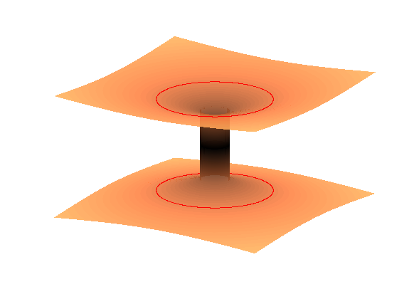
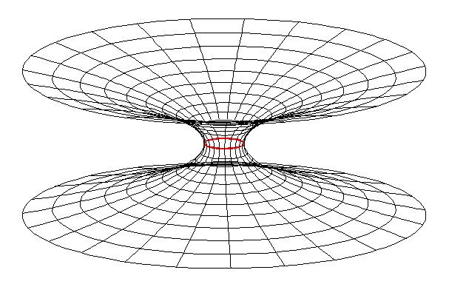
The Einstein-Rosen Bridge and the Schwarzschild Wormhole
Gregory Mendell
LIGO Hanford Observatory
LIGO-G2001423
Notes:
1
1
In the middle is a cartoon black hole spacetime diagram. But on the left and right are precise mathematical maps I created of the curved space in and around a Schwarzschild black hole. These show the Einstein-Rosen Bridge and the Schwarzschild Wormhole and I’ll explain them in this talk.

Slide 2
Would you believe you could fall into hole in completely empty space, a hole from which nothing can escape, not even light?
Notes:
2
2
First, why are we so fascinated by black holes? I think it is because of this question. Einstein’s theories says gravity is warped spacetime. And just like electromagnetic fields can exist without sources of electricity or magnetism, a hole in warped spacetime can exist without matter or energy.

Slide 3
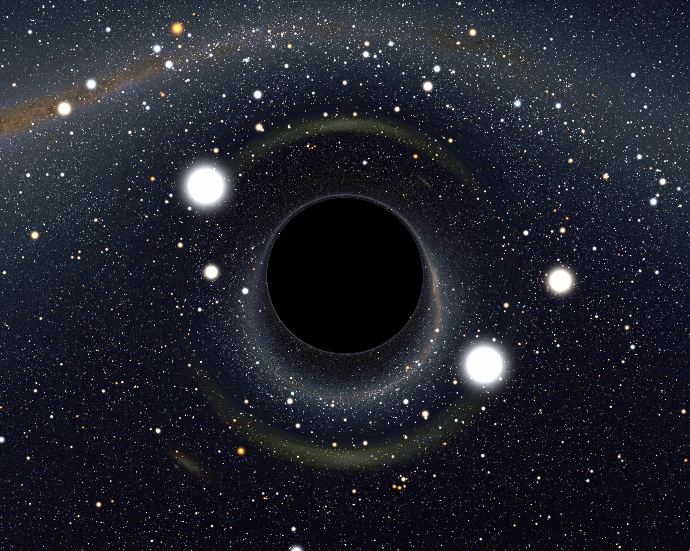
Black Holes are:
Event Horizon
Our Universe
2. Holes in Space
0
Time
Credit: Alain Riazuelo, IAP/UPMC/CNRS
Space
1. Black
3. Space & Time Warps
Escape Velocity = Speed of Light
Schwarzschild 1916; Einstein & Rosen 1935; many others in the 1960s
Notes:
Mathematically, a black hole is a spacetime warped so much there is a boundary called the event horizon where the escape velocity becomes the speed of light. Thus, black holes are black. But they are also holes in space and they are nature’s ultimate time warps. So next is a crash course in relativity.

Slide 4
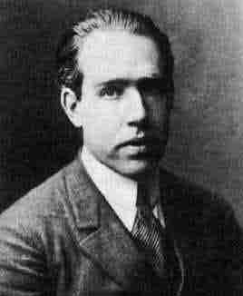
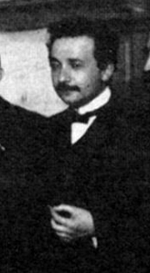
Niels Bohr
Time Dilation
Albert Einstein
Δx=vΔt
cΔT
cΔt
ΔT= Δt 1-v²/c²
Δ = change in
T = time measured by motorcycle riders
t = time measured by Bohr and Einstein
v = speed of motorcycles
c = speed of light
Start
Warning: thought experiment only; do not try this at home.
Motorcycle: http://en.wikipedia.org/wiki/Motorcycle_racing
Notes:
4
4
Because of the way electromagnetism works, Einstein postulated the speed of light is independent of motion. So today we are not surprised a laptop works the same in space as on Earth. But the consequence is shown here. The motorcycle riders send a light pulse between them, but pass Bohr and Einstein at speed v, who see the pulse travel a longer distance. Thus, by the Pythagorean theorem, the riders measure less time as given by the time dilation formula.

Slide 5
The Pythagorean Theorem Of Spacetime
c²ΔT² + v²Δt² = c²Δt²
c²ΔT² = c²Δt² - v²Δt²
c²ΔT² = c²Δt² - Δx²
c = 1 light-year/year
ΔT² = Δt² - Δx²
(Usually known as the spacetime interval)
Notes:
5
5
Here’s the cool part. Herman Minkowski and others realized one could rearrange the time dilation formula to give give the spacetime interval, shown here. When this is drawn on a spacetime diagram, the square of the hypotenuse of a triangle is the difference, not the sum, of the squares of the other two sides. This is key to understanding black holes.

Slide 6
Example
t
Spacetime
c = 1 light-year/year
ΔT² = Δt² - Δx²
Δt = 30 years; Δx = 29 lt-yrs.
v = 96.7% the speed of light
ΔT² = 30² – 29² = 59 yrs²
ΔT = 7.7 years
ΔT
Δt = 30 years
x
Δx = 29 light-years
Notes:
6
6
For example, assume a spaceship travels 29 light-years in 30 years of time, as shown. But the time measured in the spaceship is 30 squared minus 29 squared equals 59, and the square root gives 7.7 years. Now, to go to curved spacetime you simply change to using infinitesimals, which gives arc length. Thus, General Relativity generalizes the above to 4D arc length formulas.

Slide 7
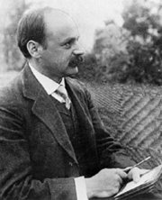
Schwarzschild Black Hole
Karl Schwarzschild
Object Schwarzschild Radius
You 1 thousand, million, million, millionth the thickness of a human hair
Earth 1 cm (size of marble)
Sun 3 km (2 miles)
Escape Velocity
Schwarzschild Radius
LIGO-G0900422-v1
Notes:
7
7
That’s what this is. In 1916 Schwarzschild found the spherically symmetric vacuum solution to Einstein’s Field equations. There is no matter or energy in this, The mass M is an integration constant. Note the minus sign between space and time coordinates. And note there is a radius, the Schwarzschild radius, where the escape velocity is the speed of light. Therefore, this is the arc length formula for a black hole.

Slide 8
Embedding Diagram
Schwarzschild for t = 0, θ = π /2:
Flat space cylindrical coordinates:
z
(Surface of revolution about z-axis.)
y
x
LIGO-G0900422-v1
Notes:
8
Most of us cannot visualize curved spacetime. But we can visualize a 2D curved surface. So, if we take the t = 0, theta = pi/2 slice of the black hole, this gives the 2D arc length formula at the top. To visualize this, drop that surface into flat 3D space. And, with a bit of math …

Slide 9
Black Hole Embedding Diagram
Schwarzschild solution to General Relativity for t = constant, θ = π /2:
z
The Schwarzschild Wormhole or Einstein-Rosen Bridge (Flamm 1916, Physikalische Zeitschrift. XVII: 448; Einstein & Rosen 1935, Phys. Rev. 48 73; Misner & Wheeler 1957, Ann. Phys. 2: 525)
y
x
LIGO-G0900422-v1
Notes:
9
9
You get this: a parabola revolved around the z-axis. This is the Einstein Rosen Bridge. In general, visualized 2D slices like this are called embedding diagrams. Note the red circle is the event horizon, and circles that go around it map to circles below. But if you go straight to the event horizon you follow a parabola and come out in a mirror image of where you went in! So this is a wormhole!

Slide 10
Einstein-Rosen Bridge
Our Universe
Another Universe?
LIGO-G0900422-v1
Notes:
10
But where do you come out? Somewhere else in your universe? Or in another universe? Either way, it’s pretty cool mathematics, and this forms the basis of the diagrams you’ve seen in text books and in movies of wormholes. But there are two big problems with this!

Slide 11
Falling Into A Black Hole
∞ yrs
60 yrs
Singularity
☺
40 yrs
20 yrs
😐
 3.5 hrs
Black Hole
☺
Event Horizon
😐
☺
😐
Another Universe?
😐
☺
Event Horizon
White Hole
Singularity
LIGO-G0900422-v1
-∞ yrs
Notes:
11
Number one, t was set to a constant. The previous slide is static. Furthermore, any t chosen immediately goes to the other universe. It never goes inside the black hole. This is shown on this cartoon spacetime diagram: 20 yrs, 40 yrs, etc., all go to the other universe as soon as they reach the horizon. It took 40+ years to figure out what was happening.

Slide 12
Embedding Diagram Inside The Black Hole
Schwarzschild for r = R, θ = π /2:
ds² = c²[2GM/(Rc²)-1]dt² + R²dφ².
Flat space cylindrical coordinates:
ds² = dz² + dr² + r²dφ².
Comparing, in the flat space r = R = constant = a cylinder! So:
ds² = dz² + R²dφ²
and need to match up z with t via:
dz² = c²[2GM/(Rc²)-1]dt².
z
y
x
LIGO-G0900422-v1
Notes:
12
First note, inside the horizon the dt and dr terms in the arc length formula switch signs! But!!! The sign determine what is space and what is time. Inside the horizon, r is a place in time and t is a place in space. The algebra above shows that for time = constant slices, which are r = constant slices inside the horizon, the embedding diagram is a cylinder! But as time flows into the future r goes to zero and the diameter of the cylinder go to zero as its length increases to infinity.

Slide 13
Eddington Finkelstein Coordinates
If we introduce the following form of the Eddington Finkelstein time coordinate, t',
ct = ct' – (2GM/c²)ln|rc²/(2GM) – 1|
outside the horizon, and
ct = ct' – (2GM/c²)ln|1-rc²/(2GM)|
inside the horizon, then inside or outside, we get
ds² = -c²[1-2GM/(rc²)]dt'² + 4GM/(rc²)dt'dr + [1+2GM/(rc²)]dr² + r²dθ² + r²sinθ²dφ².
Note that there is no coordinate singularity at the horizon.
LIGO-G0900422-v1
Notes:
13
Therefore, if you fall into a black hole, you get spaghettified. To show this, we need a different coordinate that goes through the horizon into the black hole. The t prime coordinate above works. One then plays the same game to produce embedding diagrams and joins parabolas to cylinders. There is no unique way to do this since space is relative. But for a particular choice we get what is shown next.

Slide 14
Schwarzschild Worm Hole
LIGO-G0900422-v1
Notes:
14
This is the Schwarzschild worm hole that goes through the interior of the black hole. But it’s not static! The cylinder’s diameter shrinks to zero, and its length grows to infinity as time progresses, forming a singularity!

Slide 15
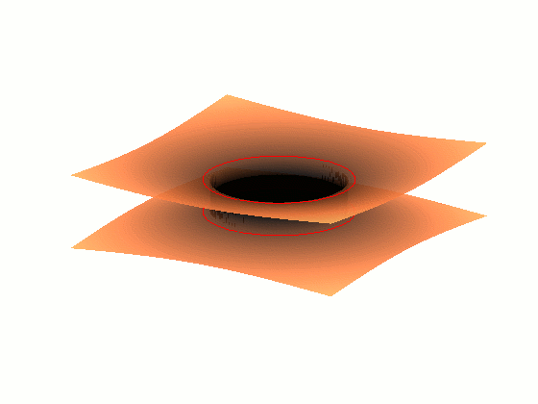
Embedding With Interior Dynamics
Our Universe
Another Universe
LIGO-G0900422-v1
Notes:
15
It looks like this. Thus, this is the first problem with this worm hole. You have to go faster than light to get through it. So you can’t get through it. Instead you are caught in the singularity. In more complicated black holes, like the Kerr one, it looks like you could get through, but those worm holes are unstable and collapse, and this is a general property of worm holes.

Slide 16
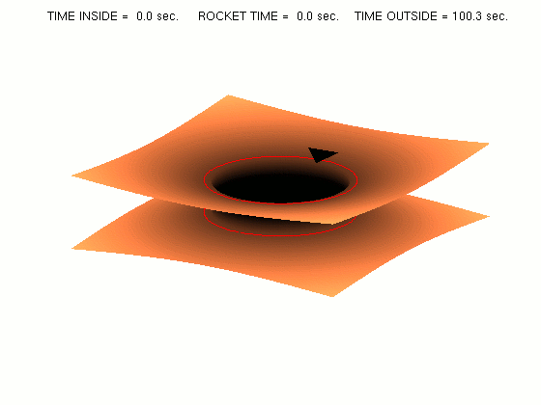
Non-traversable Wormhole
Our Universe
Another Universe
LIGO-G0900422-v1
Notes:
16
16
Here’s a triangle shaped spacecraft entering a black hole. Outside, clocks tick to infinity before the spacecraft enters the black hole. But inside the black hole the spaceship is spaghettified in the singularity in 10’s of seconds. (I’ve worked this out for the 4 million solar mass black hole at the center of our galaxy.)

Slide 17
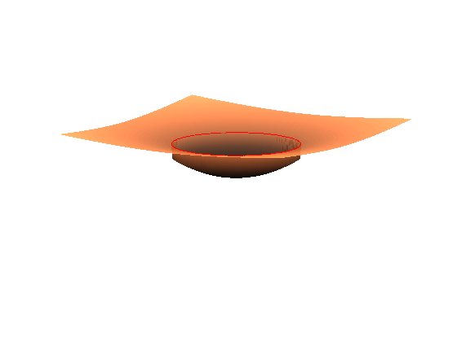
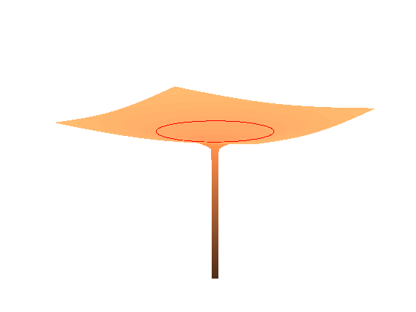
Stellar Collapse To Form A Black Hole
When pressure can no longer support a star's gravity its mass falls through its horizon.
And it collapses to a Singularity.
Notes:
17
Here’s problem number 2. For mathematical black holes, time exist from minus infinity to plus infinity outside the horizon. The math doesn’t include how the black hole forms. For that you need matter, for example the collapsing core of a massive star. This still forms a hole is space, but the hole doesn’t join on anywhere! So there is no wormhole. Thus, what I’m saying is, black holes do exist, they are holes in space, but there is matter down inside the hole. And the hole still forms a singularity and all the matter inside is spaghettified.

Slide 18
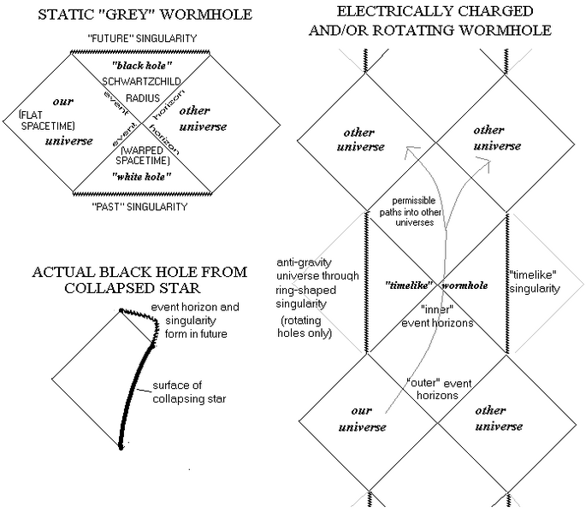
Penrose Diagrams & Black Holes
Schwarzschild Black Hole
t = ∞
t = -∞
Figures: http://en.wikipedia.org/wiki/Penrose_diagrams
LIGO-G0900422-v1
LIGO-Gnnnnnn-00-W
Notes:
18
Another kind of diagram, which I used for the cartoon black hole are conformal spacetime diagrams called Penrose diagrams. I won’t go into these, but here are some from the Wikipedia. They show that inside a rotating black hole there is an infinite series of universes. There are also universes with negative mass black holes and closed time-like curves, i.e., time machines. But there all cloaked behind horizons. And when a rotating black hole forms, none of this crazy stuff inside is formed.

Slide 19
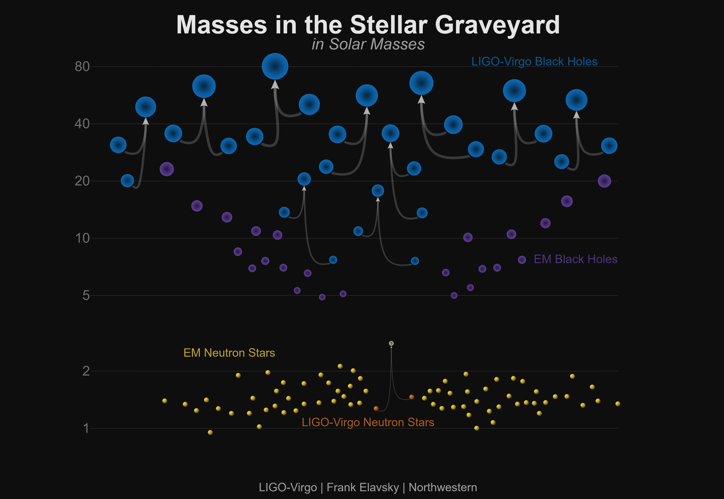
Credit: ligo.caltech.edu
Notes:
Here’s the exciting conclusion. LIGO is detecting gravitational waves from black hole mergers, and the waves correspond to those given by General Relativity. So something like General Relativity’s black holes must exist. However, if we include quantum physics, there are other issues to consider, like Hawking radiation and some very strange ideas about observable quantum effects just outside the horizon and the black hole firewall information paradox. But that’s for another talk.

Slide 20
The End
Notes:
20
20
Are there any questions?

