Slide 1
T2000526 Ink and First Contact Damage test
Sample SN 0919
Zhang, Billingsley

Slide 2
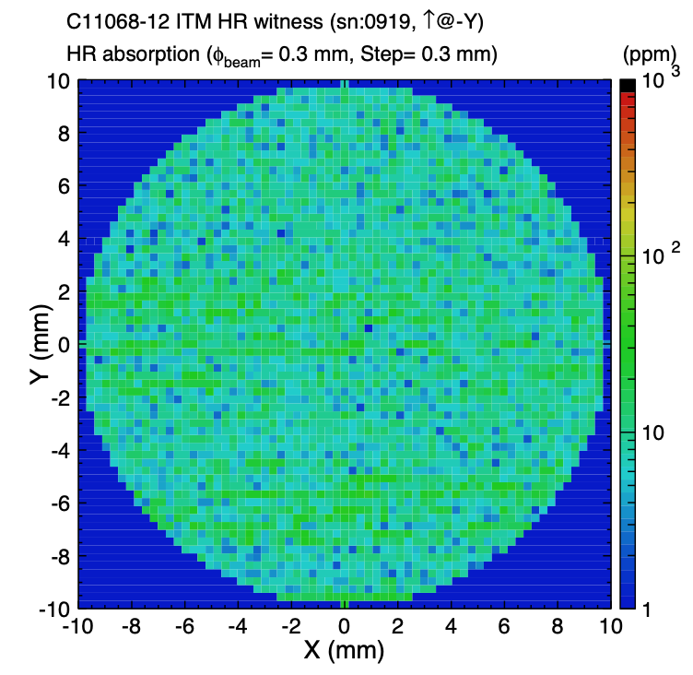
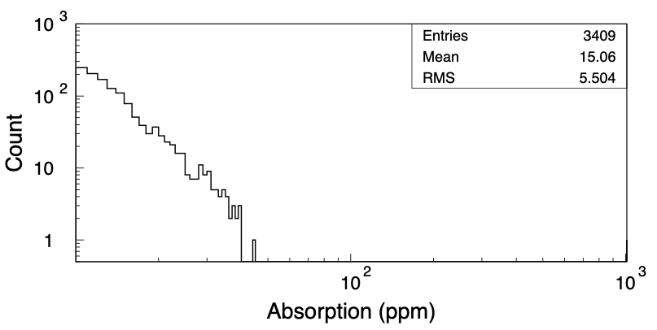
Witness sample 0919 ITM-type HR witness sample, Initial Absorption Scan, no absorbers found

Slide 3
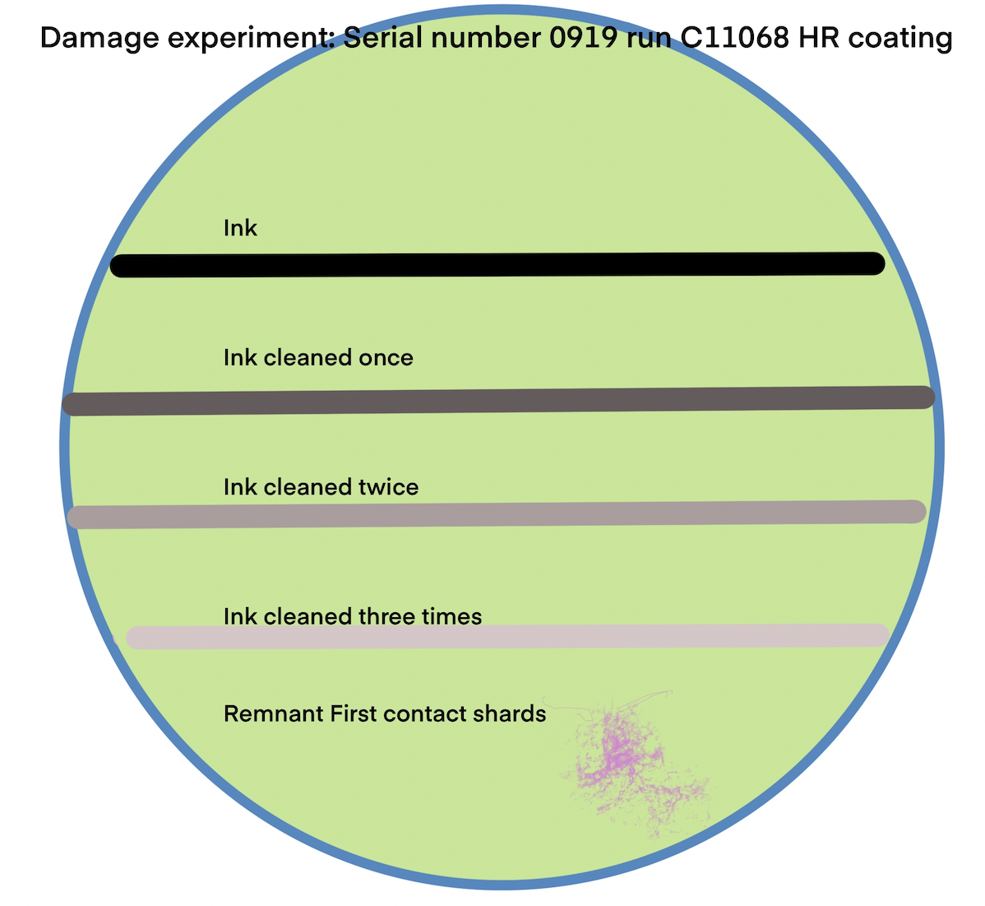
Experimental Plan
Witness sample 0919 coating run C11068 HR coating
First line applied near the bottom (label “ink cleaned three times”)
Wait several hours until completely dry
Apply a thin layer of first contact with brush
Wait several hours before removing
Second line applied (label “ink cleaned twice”)
Clean both lines as above
Third line applied (label “ink cleaned once”)
Clean all three lines as above
Fourth line applied (label “ink”)
Very thin patch of first contact applied at the bottom
Wait several hours
Pull leaving traces
Irradiate in RTS 2W/mm² - Inspect
Irradiate in RTS 20W/mm² - Inspect
Irradiate in RTS 200 W/mm² - Inspect

Slide 4
A note on First Contact
A thin layer does not allow for much solvent to work on the contaminant
Once the contaminant is freed from the surface, it is entangled in the polymer
First contact is optimally adherent soon after drying, ideally being removed within an hour of application for a poured layer - less for a painted layer.
This experiment seeks to employ the worst of both conditions -
a very thin layer
an 8 hour drying time

Slide 5
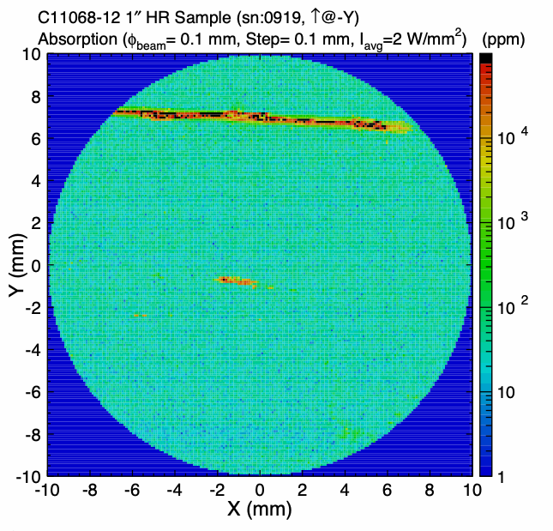
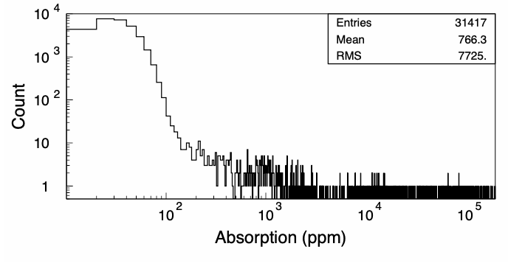
Scan at 2 W/mm²

Slide 6
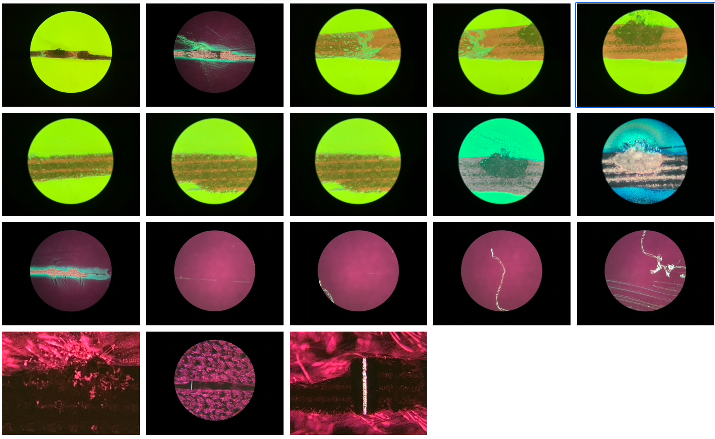
Inspection after 2 W/mm²
Only one damage site; in line 4 “ink”
Tracks of the scan can be seen in line 4 “ink”
Confirmation of damage is best seen looking through the optic.
Ink from other lines can be seen under the microscope

Slide 7
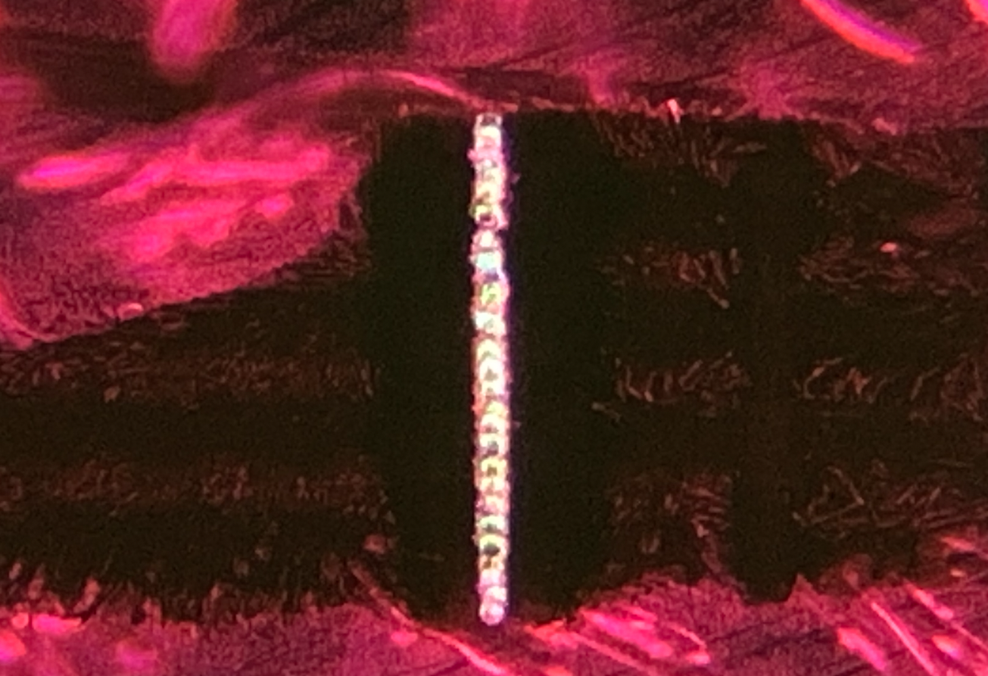
Damage found at 2W/mm² in one location. Easiest to see when viewed through the optic Possibly at another power level, done during stage movement.

Slide 8
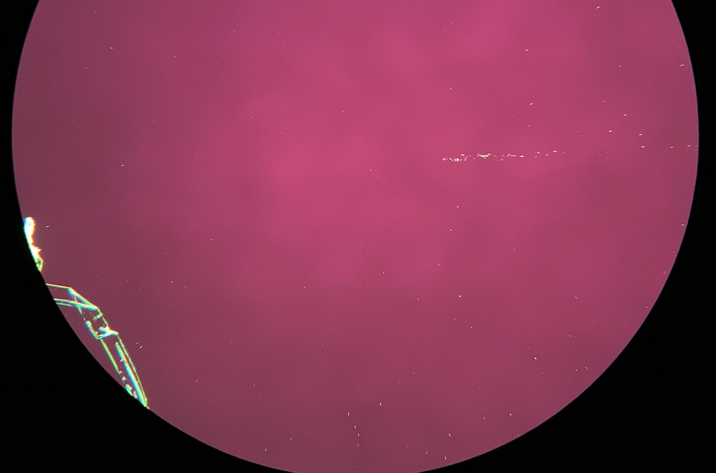
The ghost of line one
A ghost of the first ink line can be seen near some First Contact shards

Slide 9
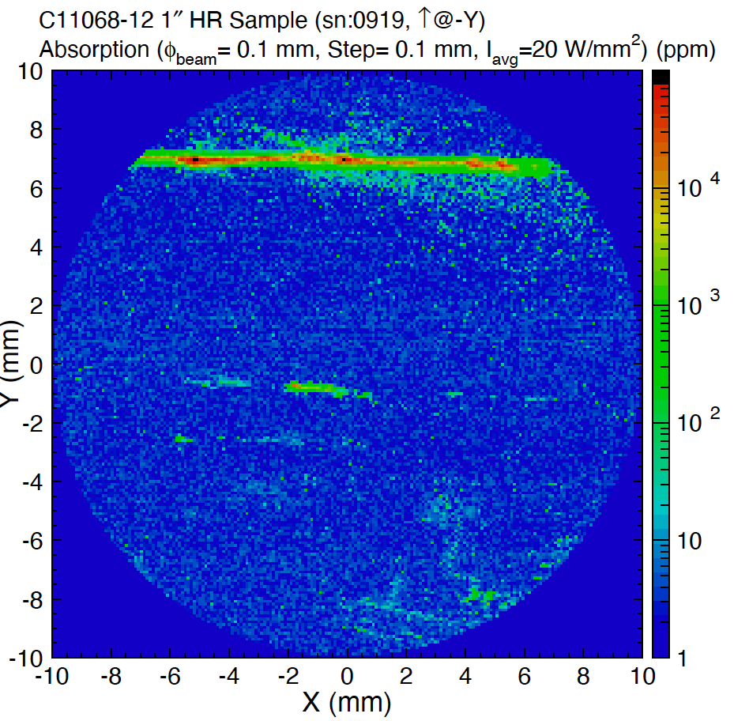
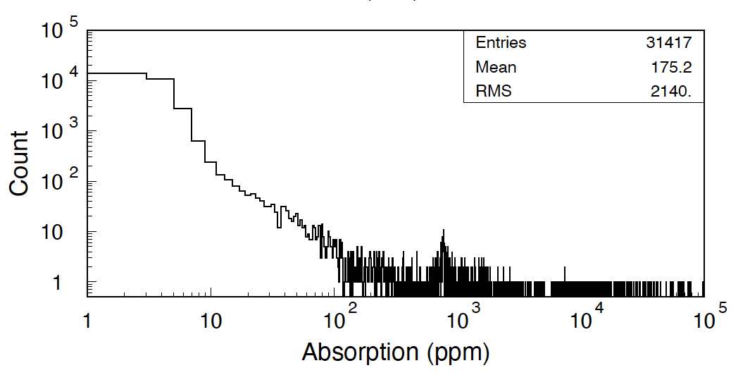
Scan at 20 W/mm²
The four lines can be seen
The first contact can be seen

Slide 10
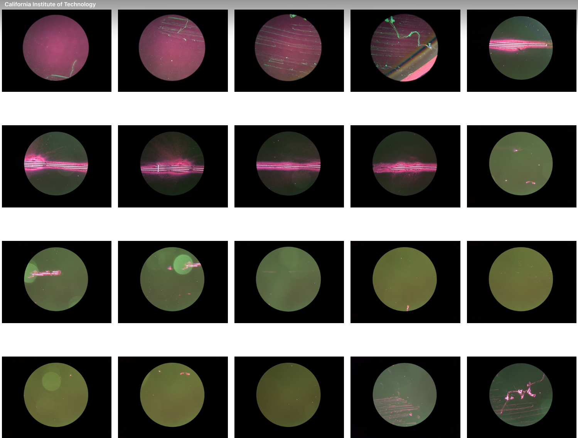
Inspection after 20 W/mm²
Excessive Damage on line 4- Ink
Damage on lines 2 and 3
No Damage on line 1
No Damage in First Contact
Perhaps one damage site that was not on a line? We usually clean before this type of test, but the sample is getting quite dirty. (below)

Slide 11
No damage in line 1,
The remaining, visible part of line 1 - no damage
Viewed on the front of the optic in dark field. Cannot be seen through the optic (in DF)

Slide 12
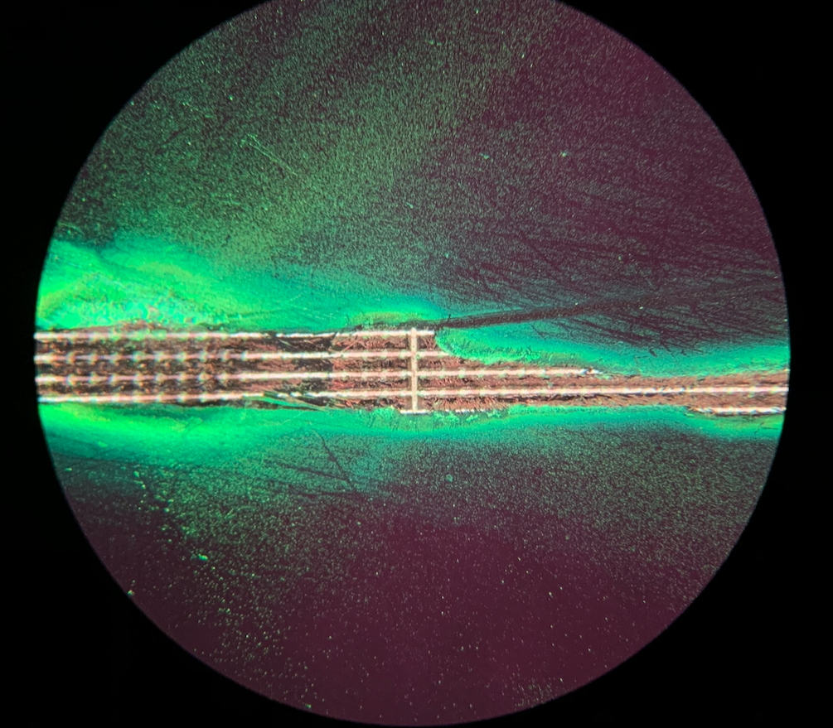
Viewed through the optic in dark field

Slide 13
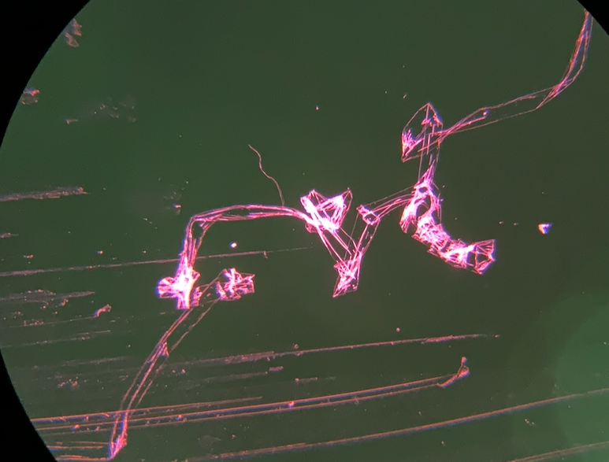
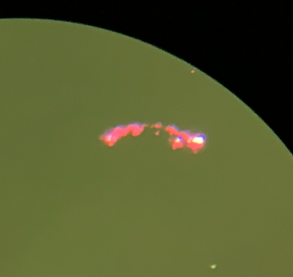
Viewed through the optic in dark field
Small damage site in line 2 First contact shard shows no damage

Slide 14
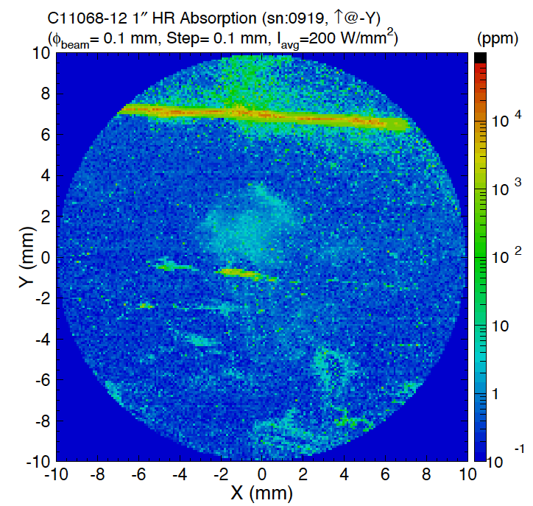
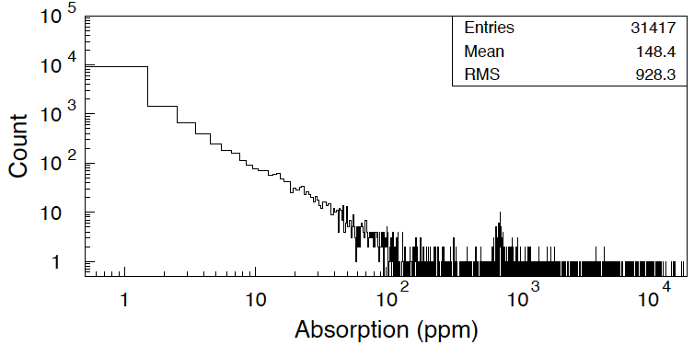
Scan at 200 W/mm²
The optic is quite dirty at this point.
The four lines can be seen
The first contact can be seen

Slide 15
Inspection after 200 W/mm² - Optic now cleaned

Slide 16
How it actually turned out - after all damage runs
Ink (line 4)
1 FC cleaning (line 3)
2 FC cleaning (line 2)
3 FC cleaning (line 1)
First Contact string
First Contact film
All lines are at least partially visible, even with the high background from the mount and the damage

Slide 17
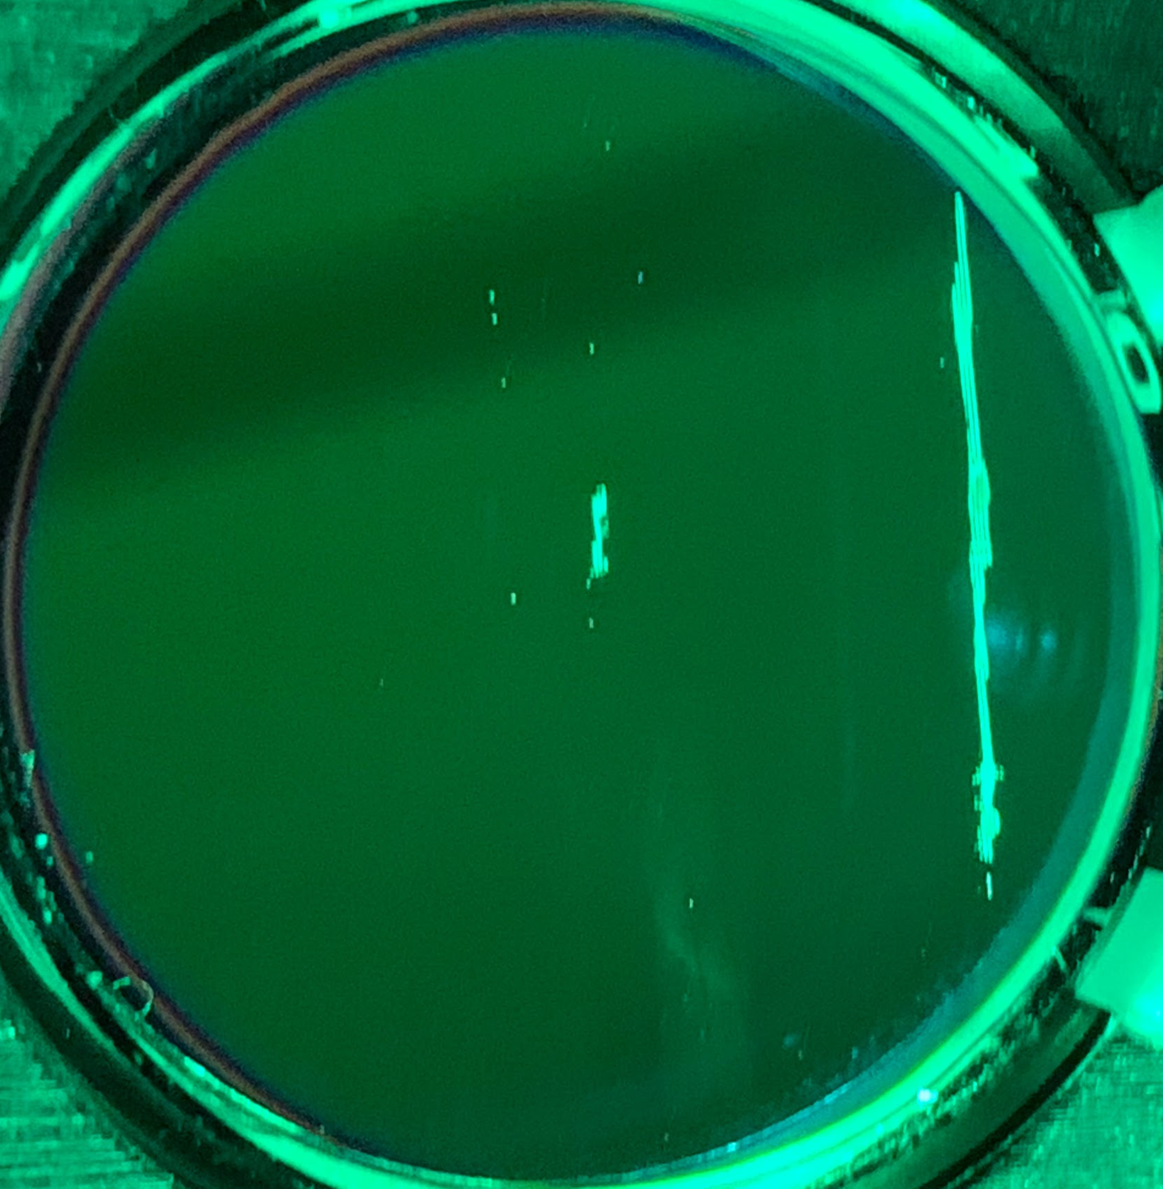
After cleaning
Ink (line 4)
1 FC cleaning (line 3)
2 FC cleaning (line 2)
3 FC cleaning (line 1)
First Contact string
First Contact film

Slide 18
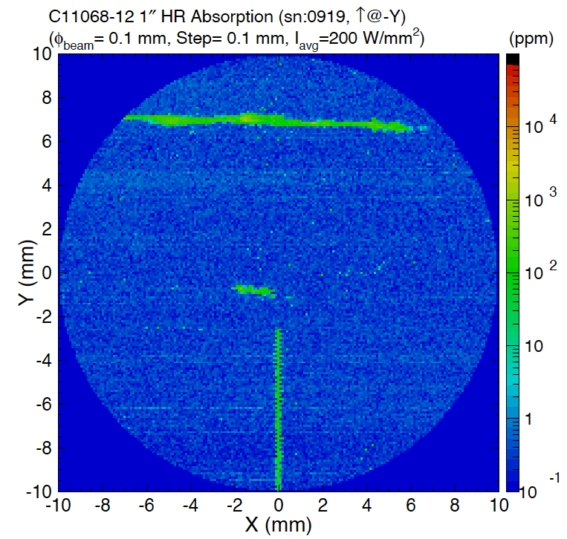
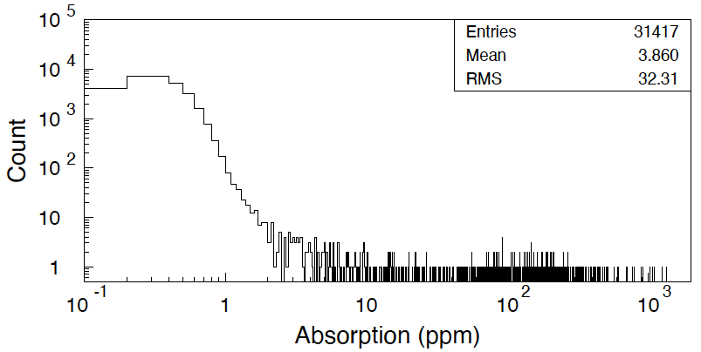
Absorption measurement after cleaning (and unintentional damage)

Slide 19
Comparing before/after cleaning
Accidental damage occurred after cleaning at (0,-y) when irradiated with 2000 w/mm² Not clear if there is still absorption, or if the signal comes from distortion

Slide 20
Damage filled with first contact after cleaning
Attempted Cleaning:
Acetone Soak in ultrasonic bath ~ 1 hour
No noticeable change
First Contact thinner in ultrasonic bath ~ 1 hour
No noticeable change
Images are at different magnifications

Slide 21
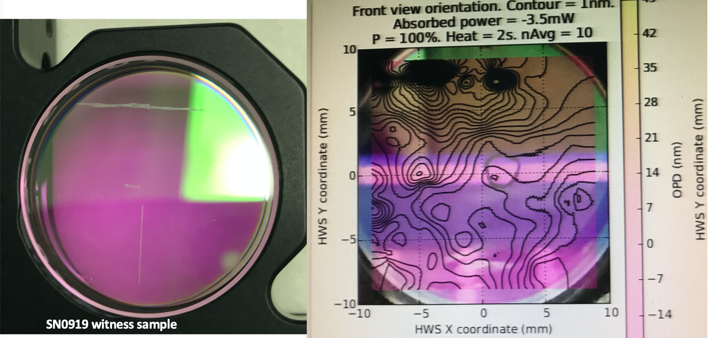
Does HWS see absorption from First Contact?
OR from embedded ink?

Slide 22
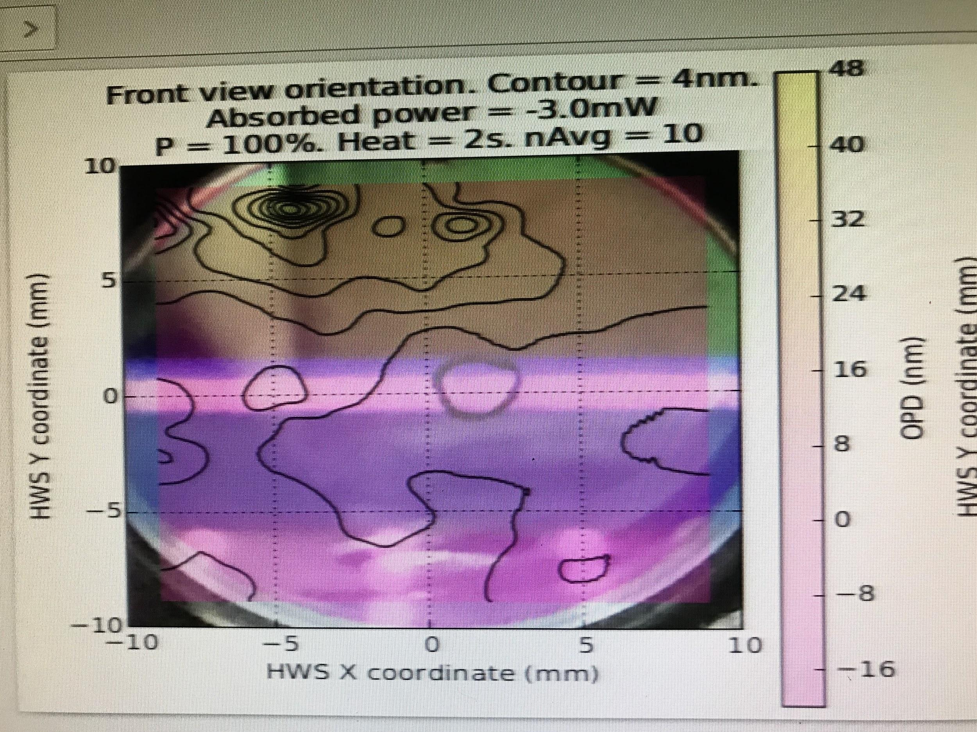

Slide 23
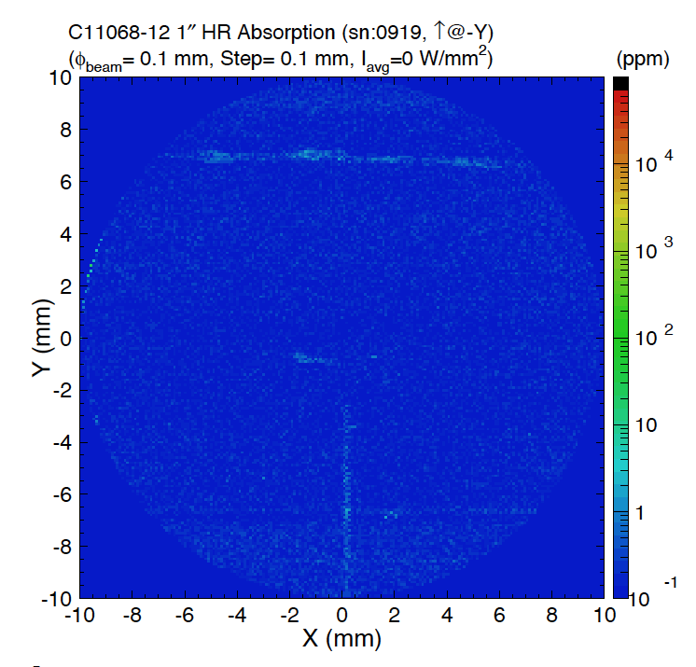
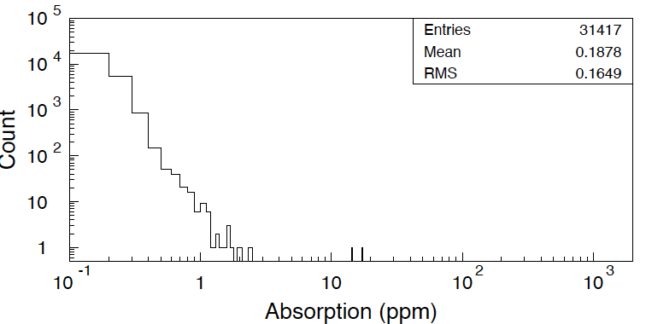
Probe (HeNe) beam background, no pump beam
An RTS scan with the IR (pump) beam off. A slight increase of the background at the damaged points is due to lower He-Ne transmission, making the noise equivalent absorption appear larger.

Slide 24
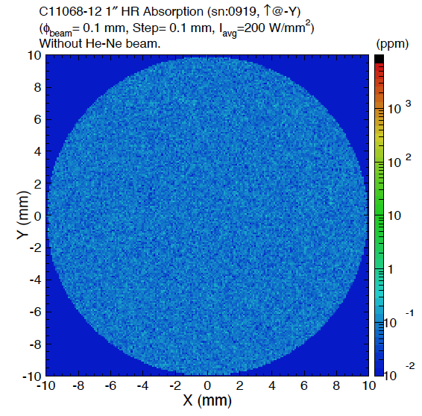
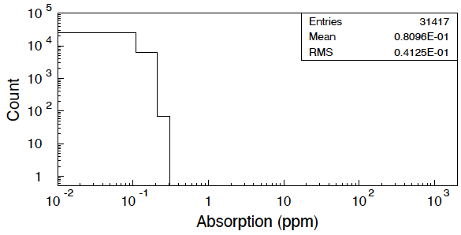
No scatter signal beyond background from Pump beam

Slide 25
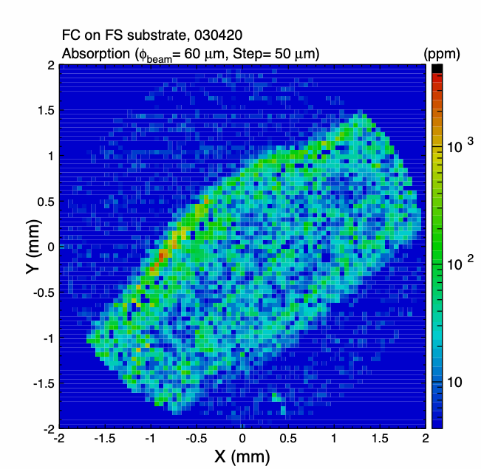
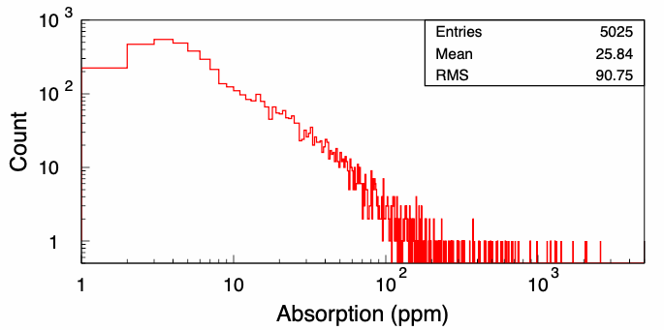
First Contact absorption on an uncoated optic 60W/mm² No damage identified after FC removal

Slide 26
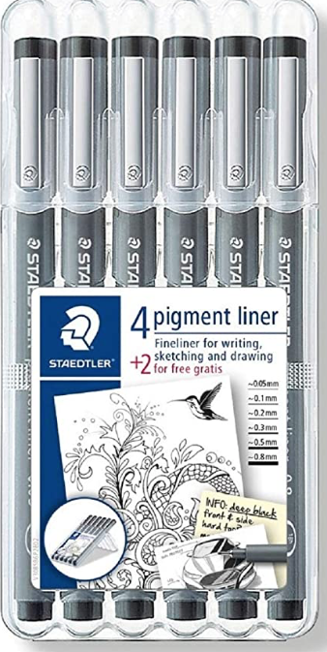
The ink that we use for optic fiducials

