Slide 1
Characterizing the figure change expected after coating at LMA
Pen-ITM02 was measured by LMA before and after coating in order to determine the characteristics of the LMA plume that change optic figure after coating. The inverse of this plume will be removed at the polishing step using Ion Beam Figuring.
G. Billingsley
LIGO-T2000643-v1

Slide 2
Choosing data - Overview of the measurements taken at LMA* before coating
Face 1-------------1a---1b---1c---1d--1e
Face 1-------------1a---1b---1c---1d--1e
Face 1-------------1a---1b---1c---1d--1e
Tilt and power trends for the pre-coating data that was supplied by LMA, analyzed in the center 160 mm diameter
In order these plots show:
5 sets - pen_ITM02_avge - these data sets are averages of the others? Fringe position varies
20 sets - pen_ITM02_Face1 Fringe Right
5 sets - pen_ITM02_face1a Fringe Center
5 sets - pen_ITM02_face1b Fringe Right
5 sets - pen_ITM02_face1c Fringe Left
5 sets - pen_ITM02_face1d Fringe Up
5 sets - pen_ITM02_face1e Fringe Center
The ~5nm change in power is due to the fringe position, this would be a significant source of error for us. So the ideal conditions for before/after measurement are when the mass is at a constant temperature, and at a similar alignment.
*Pen-ITM02 has parallel surfaces, so S1 fringes are not resolvable in the lab at CIT. LMA has a different system and can resolve these.
Original data reside on the LIGO user drive COREOPT keyed to PEN-ITM02 measurement

Slide 3
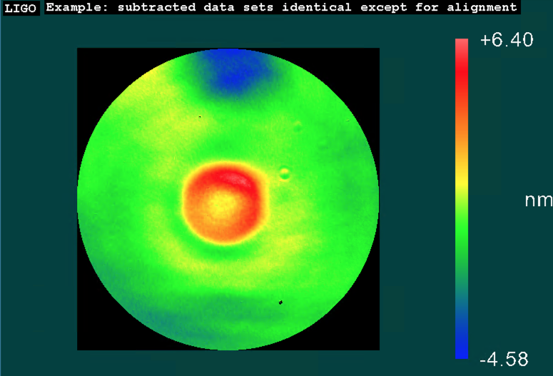
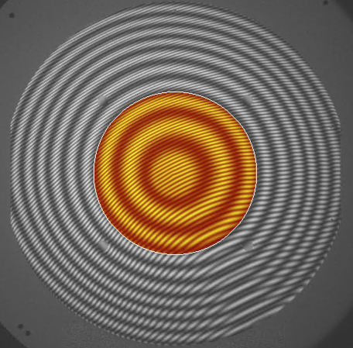
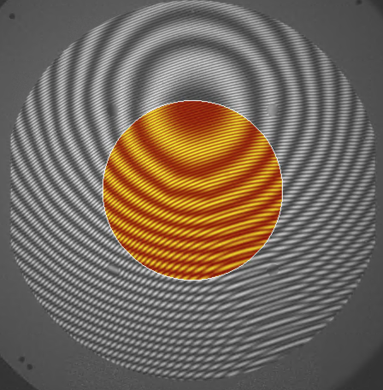
Example of subtracting data sets at different tilt in the presence of multiple fringes.
Set 1e-1d

Slide 4
Pre and Post coating figure measurement uncertainty
We see that y-tilt is changing a lot in set 1a from before coating, In the LIGO figure measurement lab this indicates a changing temperature. The tilt in set 1e is fairly stable so these are the best “before” coating data. The difference in saggita is ~2nm between 1a and 1e, it is hard to know if this is because of the fringe position or an unstable temperature.
For the “after” coating data, we want to duplicate the set 1e conditions with a stable temperature in order to minimize the effect of fringe centering. Probably the best control we have now is to duplicate the tilt conditions in set 1e: Xtilt average: -43 nm Xtilt range: 0.5 nm Ytilt average: -54 nm Ytilt range: 30 nm As measured in the center 160 mm diameter, using the Zygo “auto aperture” feature.
After-coating data supplied by LMA appear quite stable, and similar to set 1e conditions. Xtilt average: -35 nm Xtilt range: 2.9 nm Ytilt average: -34 nm Ytilt range: 3.6 nm

Slide 5
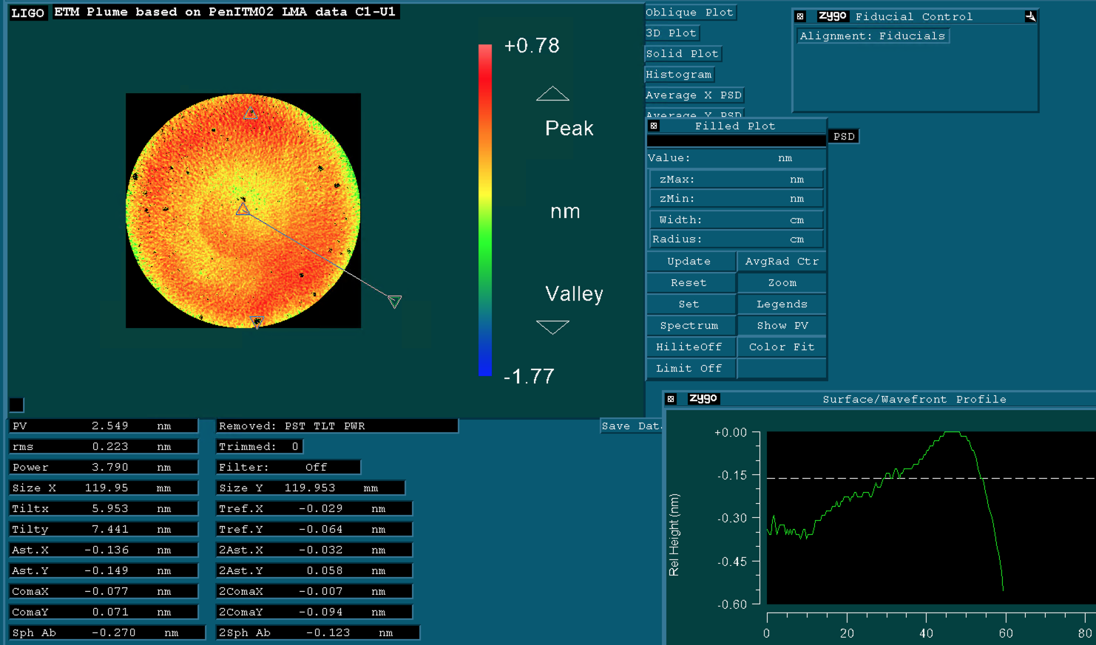
Change after coating (120mm diameter) with power removed.
The cross section below is an average of the data over all radii.
Compare this to the LIGO estimate based on the ITM data (next page). The power is different, but this MIGHT be attributed to the greater coating stress from the thick ETM coating.

Slide 6
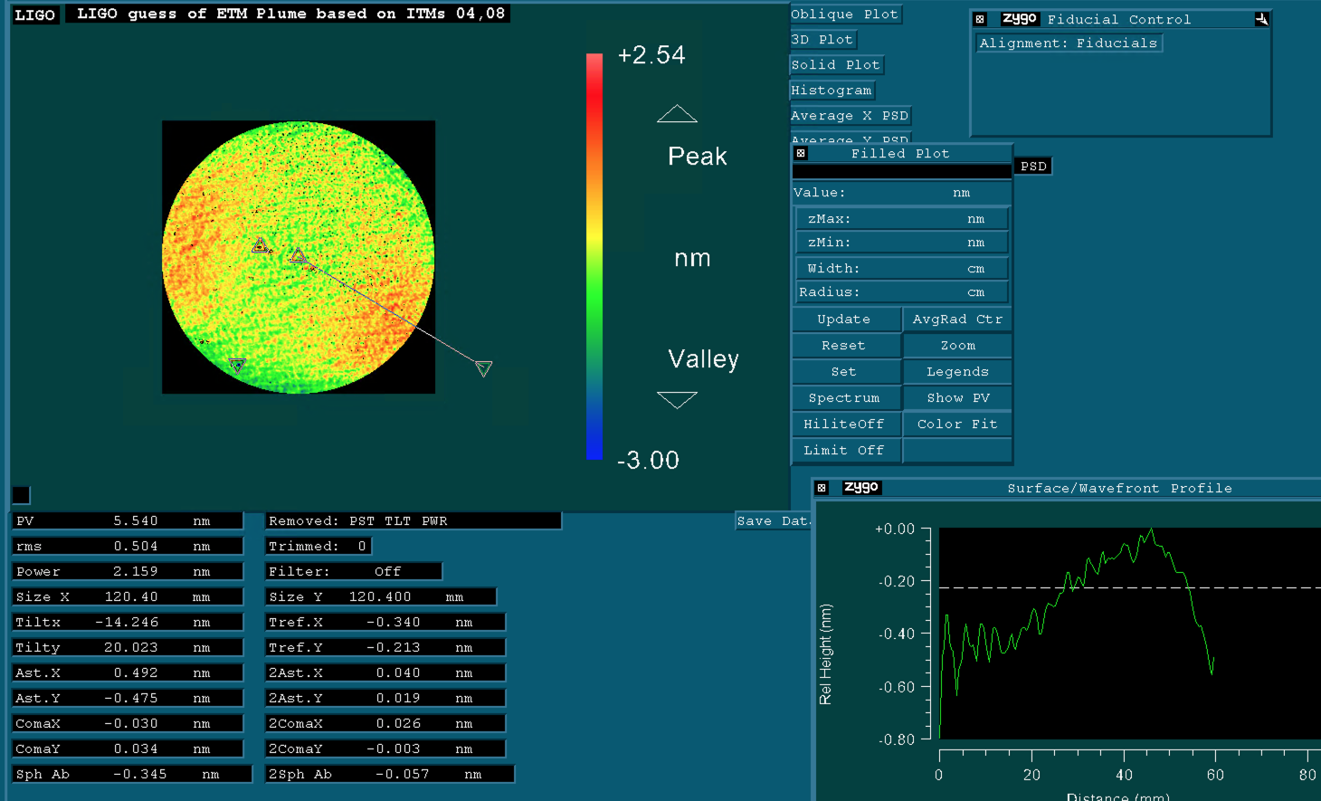
Calculated change after coating (120mm diameter) with power removed. This is estimated from ITM04 and ITM08 data, these were coated without a mask. See LIGO-T2000398
The cross section below is an average of the data over all radii.

Slide 7
We appear to have a relative uncertainty of ~ 2 meters
We were lucky with aLIGO TMs. Coating stress is comparable to ^{1/}Uniformity error
T2000644 All analysis on 160 mm diameter | SN | Uncoated ROC, Polish Vendor (m) | Uncoated ROC, LIGO (m) | ∂ ROC LIGO-polish vendor (m) | After Coating ROC, LIGO (m) | ∂ coating ROC - LIGO-LIGO (m) | ∂ coating ROC - LIGO-Polish vendor (m) | ∂ Saggita After coating LIGO-Polish vendor (nm) | ∂ Saggita, stress (calculated by B. Sassolas) (nm) | ∂ Sag due to coating uniformity?? (nm)
mask 1 | ETM07 | 2250.8 |  |  | 2240 |  | -11.14 | 7.1 | -2.95 | 10.0
mask 1 | ETM08 | 2249.3 |  |  | 2242 |  | -7.74 | 4.9 | -2.95 | 7.9
mask 1 | ETM09 | 2250.8 |  |  | 2242 |  | -8.42 | 5.3 | -2.95 | 8.3
mask 1 | ETM12 | 2249.0 | 2246.6 | -2.4 | 2239 | -7.7 | -10.1 | 6.4 | -2.95 | 9.4
mask 2 | ETM11 | 2250.6 | 2248.8 | -1.8 | 2250 | 1.2 | -0.6 | 0.4 | -2.95 | 3.3
mask 2 | ETM14 | 2251.0 | 2248.9 | -2.1 | 2251 | 2.09 | -0.04 | 0.0 | -2.95 | 3.0
mask 3 | ETM10 | 2250.1 |  |  | 2248 |  | -2.43 | 1.5 | -2.95 | 4.5
mask 3 | ETM13 | 2249.7 | 2247.6 | -2.1 | 2244 | -3.4 | -5.54 | 3.5 | -2.95 | 6.5
mask 3 | ETM15 | 2249.9 | 2247.2 | -2.7 | 2245 | -1.8 | -4.46 | 2.8 | -2.95 | 5.8
mask 3 | ETM16 | 2249.6 | 2247.5 | -2.1 | 2247 | -0.6 | -2.68 | 1.7 | -2.95 | 4.6
no mask | PEN-ITM02 | 2498 |  |  | 2491 |  | -7 | 3.6 | -2.95 | *6.5
~ 2 nm spread within mask 1
~ 2 nm spread within mask 2
*see page 12

Slide 8
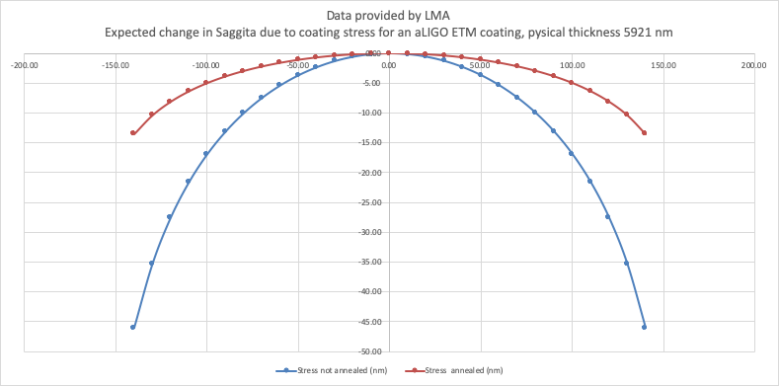
Expected stress deformation see C2000282 source: LMA

Slide 9
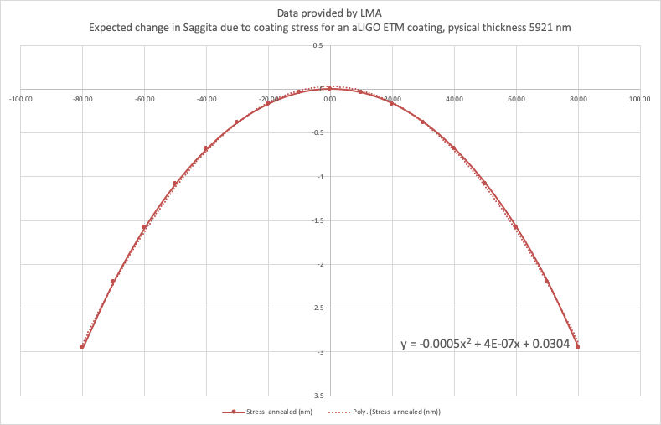
Second order fit to stress prediction is good over the center 160 mm Ø

Slide 10
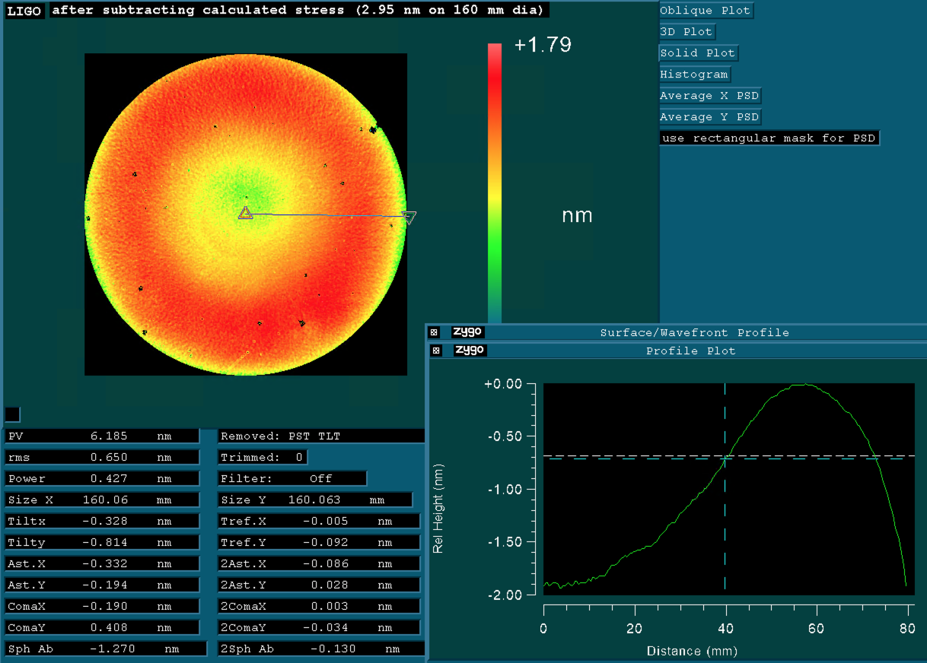
Significant Spherical Aberration remains after subtracting expected change due to stress

Slide 11
Suggestions for Specification Change
ROC spec → 2240 ± 10 m
Make the ROC tolerance symmetric ± 10 m (was -5 +15) this fixes vendor response polish all to ROC = 2250 m
Compensate for stress change (∂ saggita = -2.95 nm, 160 mmØ) which would flatten out by ~5 meters (2245 → 2240)
Expected Results
Consistency should be good to ~ 2 m Absolute accuracy is unchanged/unknown to better than ± 7 meters Same measurement system - proof of concept working in our IFO now.

Slide 12
Notes on the substrate, a penultimate mass
The Pen-ITM02 substrate was not annealed before coating
The substrate was provided to LIGO by Glasgow University as part of aLIGO. The vendor was Heraeus, the substrate was polished by Optimax see Q1300005.
Material HOQ-310 purchased under C0900072
*We are unable to determine if this material is as stable as the Heraeus 312 used for ETM fabrication. We therefore rely on the data from previous coatings of aLIGO ETMs to indicate the sign and magnitude of the expected change.
HSF data from the coating of Pen-ITM02 are used in creating the composite final figure for ETM repolish. Similarity among coating runs done with the same mask are a compelling reason to calculate the change in saggita as being solely due to coating on the stress effect.

