Slide 1
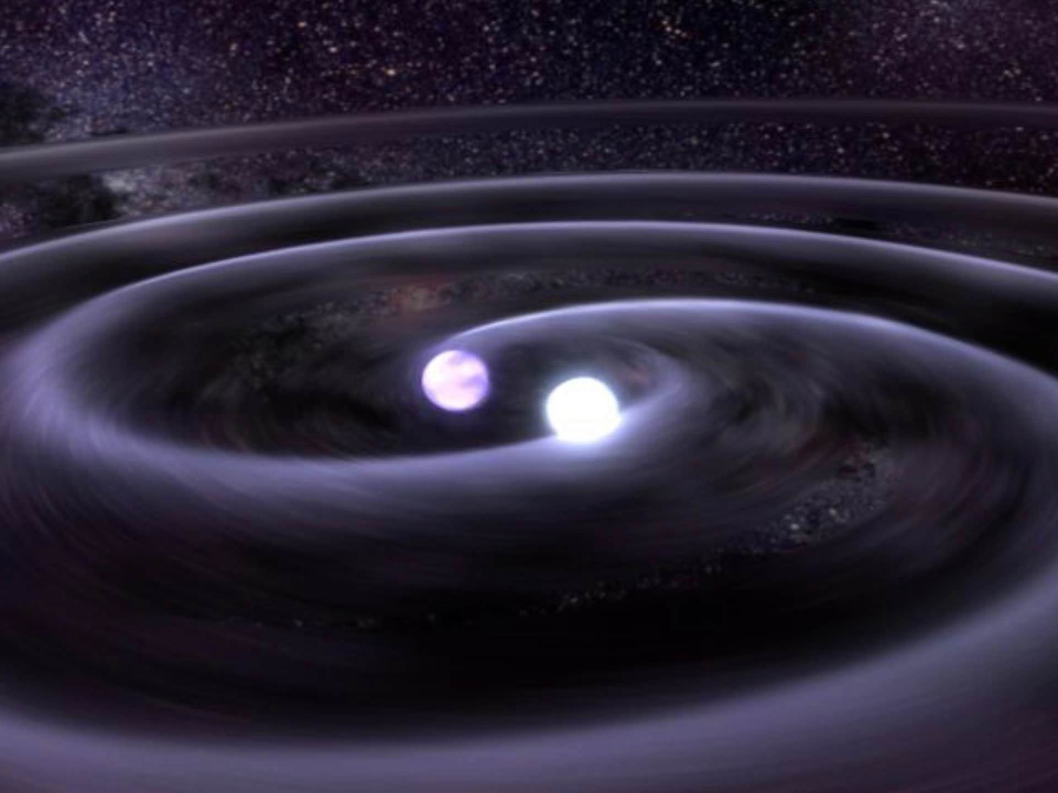
Rates of compact binary mergers from LIGO/Virgo observations
T. Dent (IGFAE, University of Santiago de Compostela)
for the LIGO Scientific & Virgo Collaborations
LIGO Document G2100014-v3

Slide 2
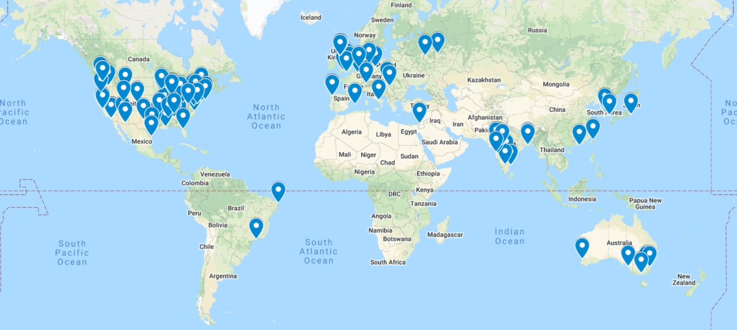
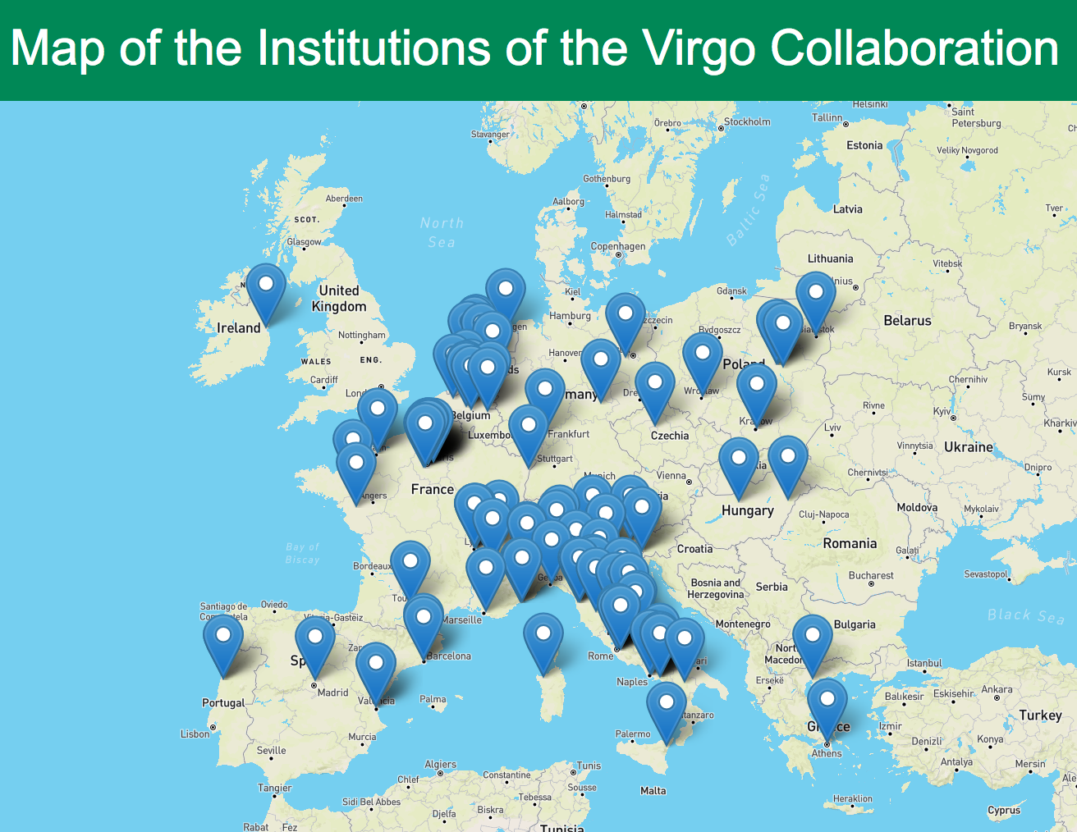
LIGO – Virgo collaborations

Slide 4
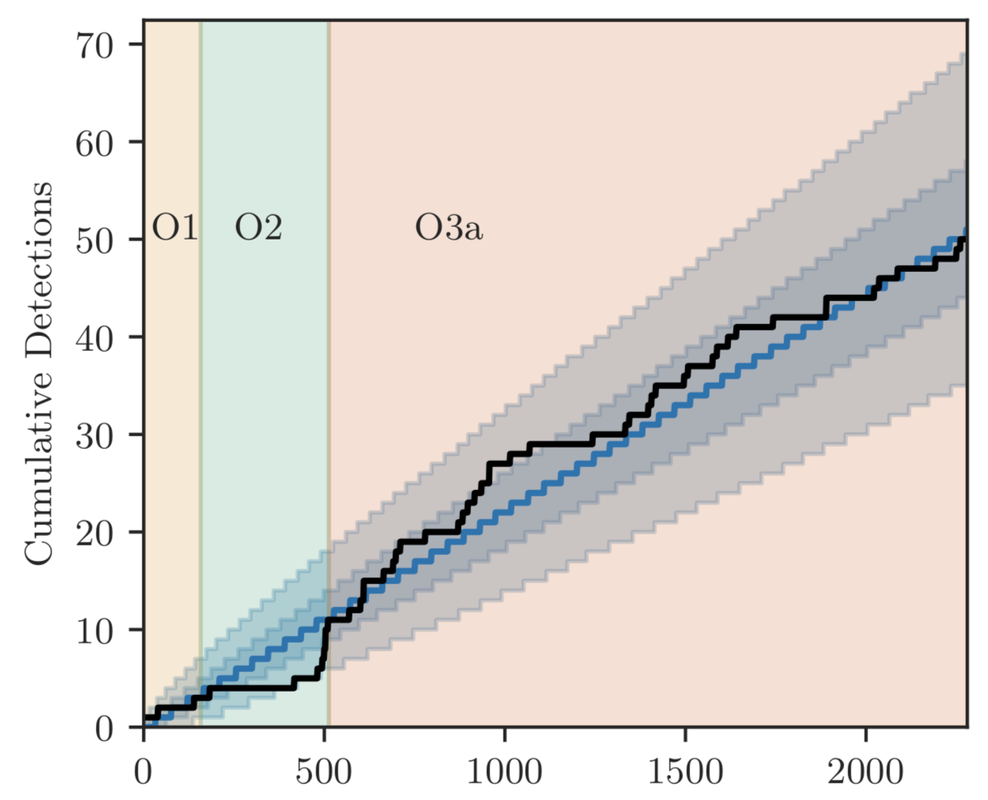
LSC-Virgo O3 run : Where we are
O3 : 2019 Apr 1 – Oct 1 (O3a) Nov 1 – 2020 Mar 27 (O3b)
Many GW signals !
‘GWTC-2’ : O3a catalog See talks of A. Effler, S. Sachdev in T01,
M.Isi in E01, many other L-V related talks
Approximate cumulative sensitivity
https://arxiv.org/abs/2010.14527

Slide 5
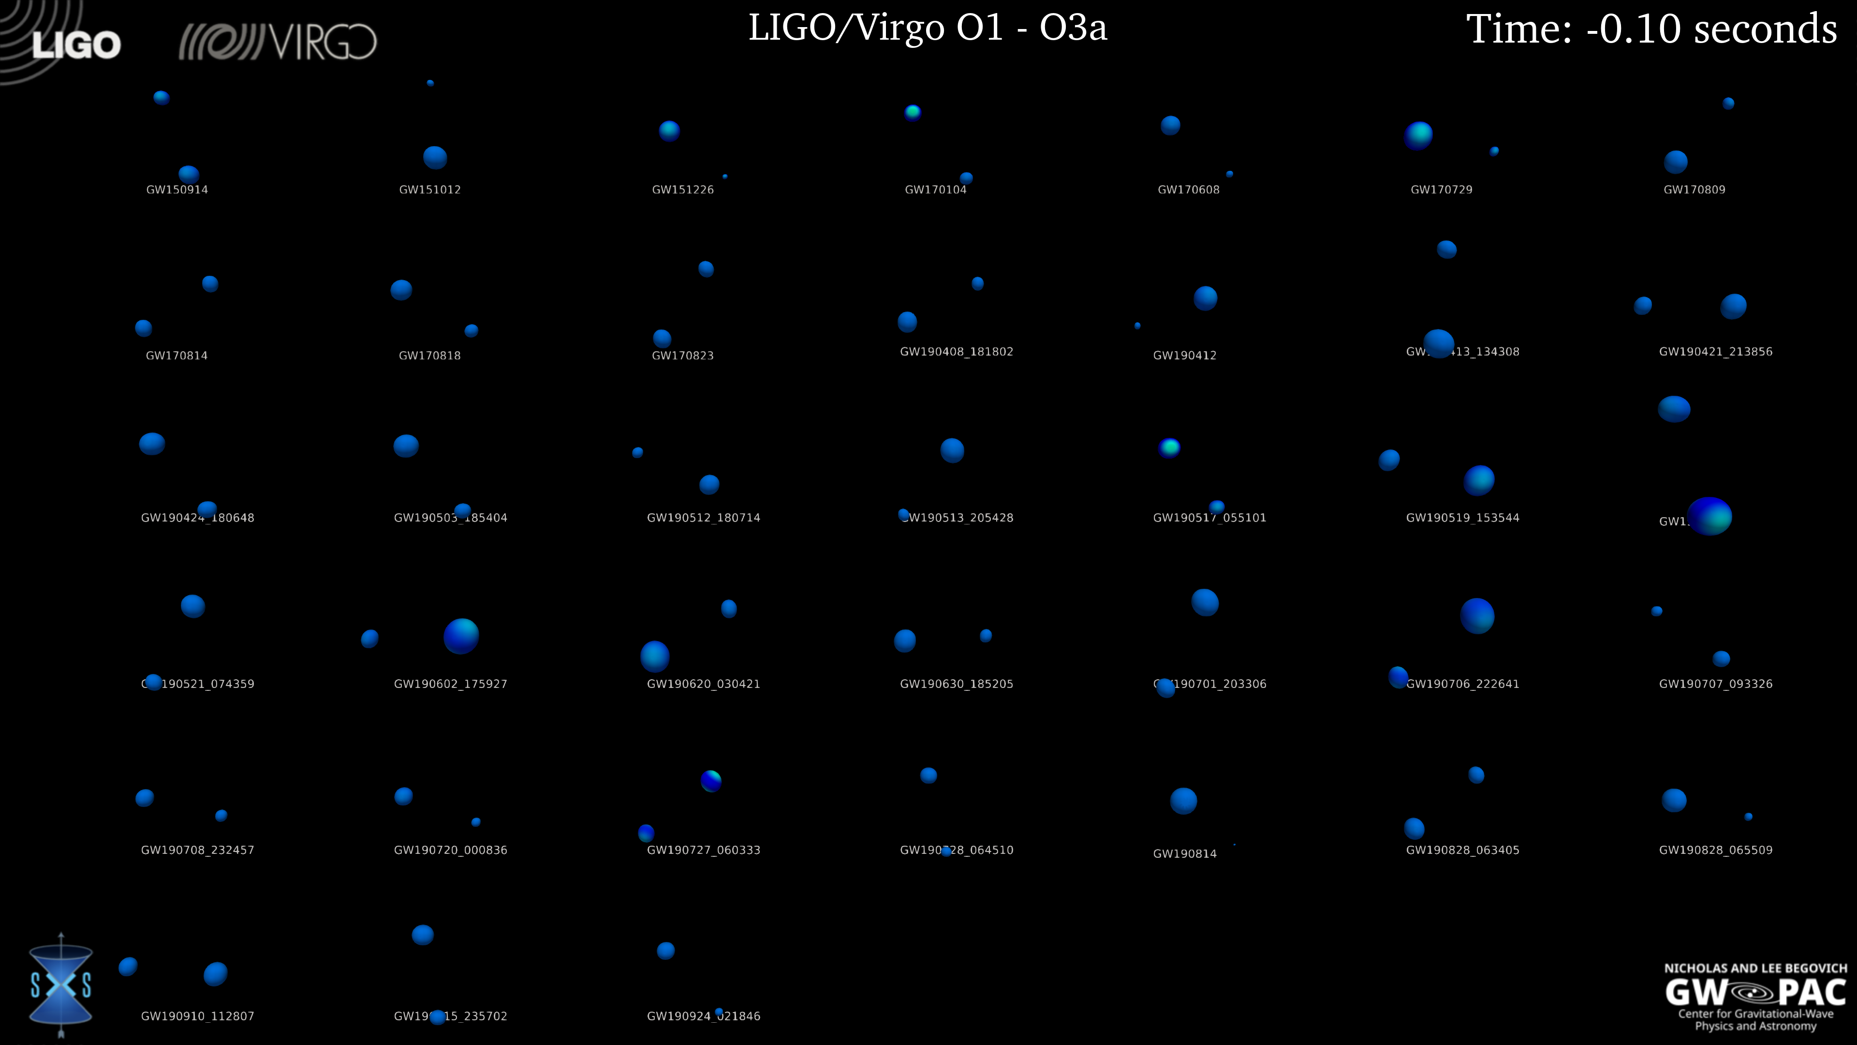
Signals are all binary mergers (so far)...
https://youtu.be/oF_C-HfUamE

Slide 6
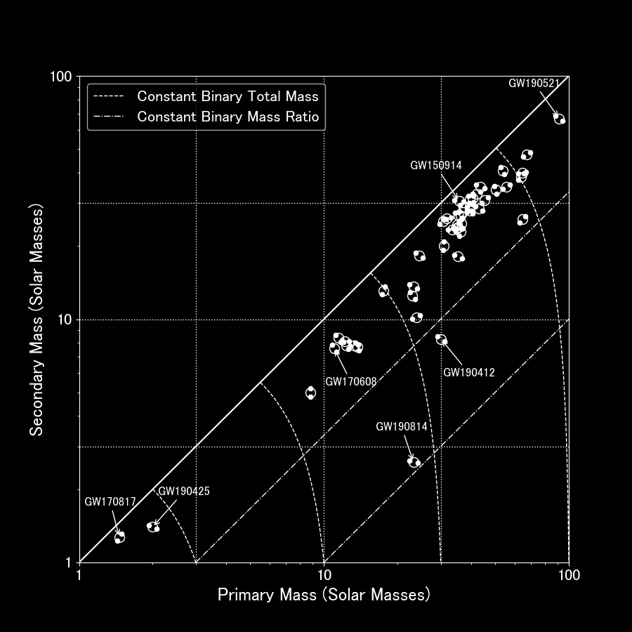
https://www.ligo.org/science/ Publication-O3aPopulations/
Broad BBH population
Outliers .. ?
BNS detections

Slide 7
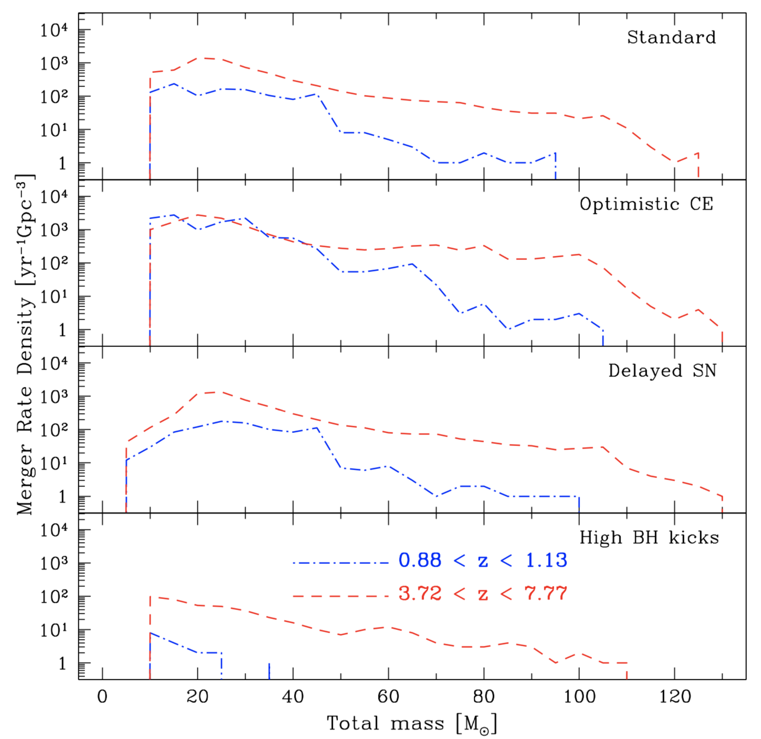
Astrophysical models vs. GW detections
Astrophysics modelling ⇒ expected merger distribution over redshift, masses, spins, ...
Models do not predict individual merger parameters
GW detections ⇒ distribution ‘samples’
Dominik et al. Astrophys.J. 779 (2013) 72

Slide 8
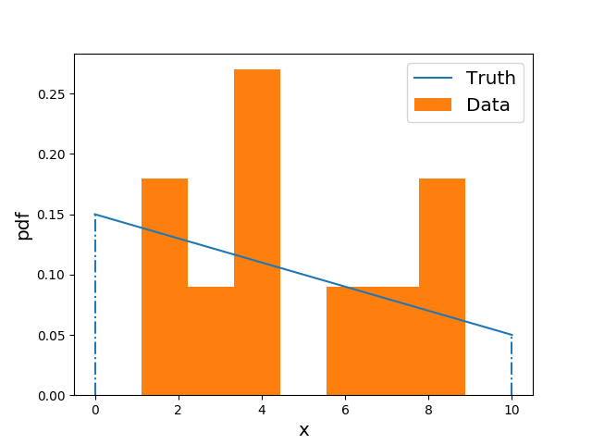
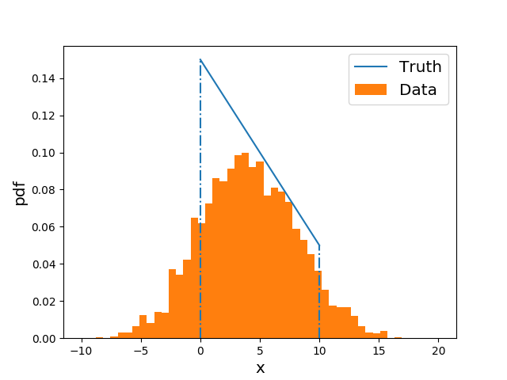
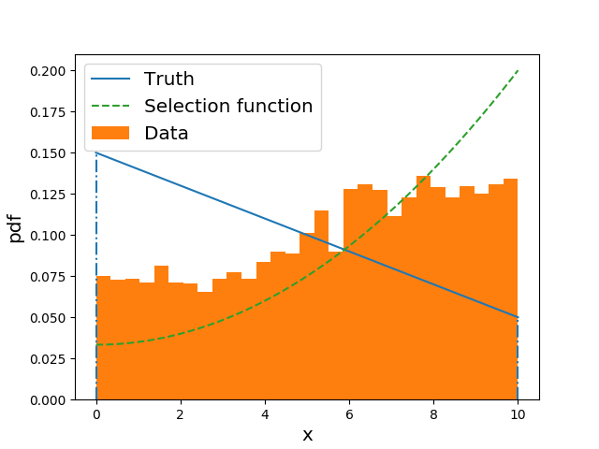
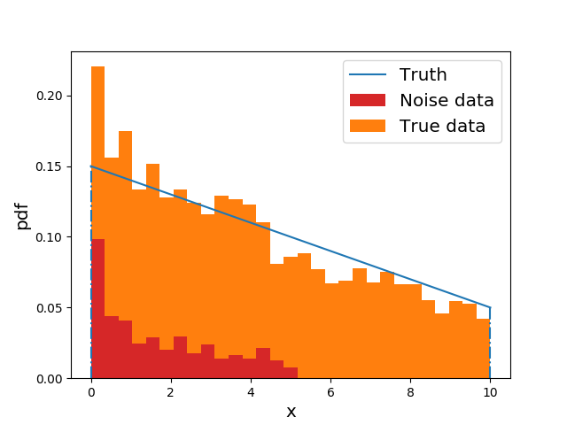
Hazards of GW population analysis
Low # statistics
Measurement error
Selection bias
Noise contamination

Slide 9
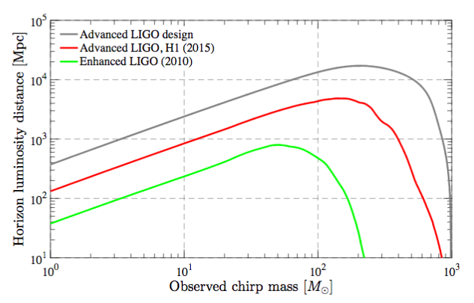
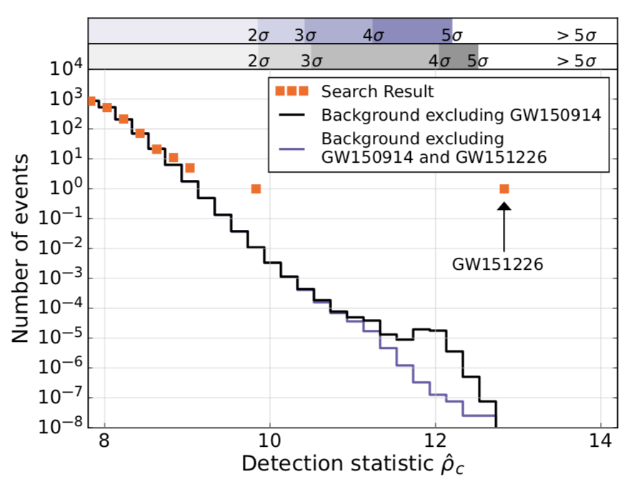
Strategies & solutions
Simplified / ‘straw man’ models
Bayesian hierarchical inference
Search sensitivity estimation
Search background estimation
LIGO, Phys. Rev. D 93, 112004 (2016)
LVC, Phys.Rev.X 6 (2016) 4, 041015

Slide 10
Strategies & solutions
Simplified / ‘straw man’ models
in future we will have large # statistics
Bayesian hierarchical inference
Search sensitivity estimation
Search background estimation

Slide 11
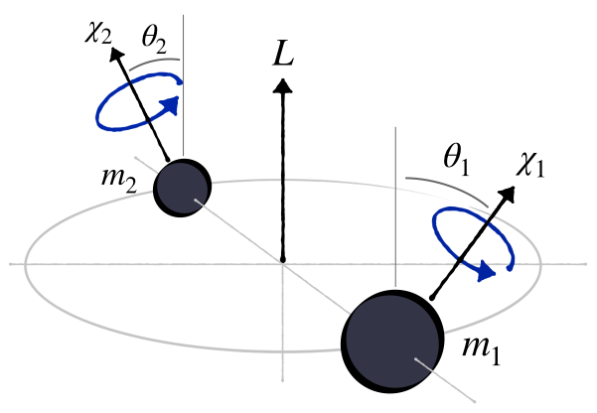
Compact binary merger parameters
2 × mass
6 × spin
3 × location (d/z, RA, dec)
3 × rotation (𝜄, 𝜙, 𝜑_{c})
Time of merger 𝑡_{c}
image credit : T. Callister

Slide 12
“Population properties of compact objects from [GWTC-2]”
Paper accepted, ApJL https://dcc.ligo.org/LIGO-P2000077/public https://arxiv.org/abs/2010.14533
Mass models & population properties
Spin models & population properties
Redshift dependence
Summary rate estimates
Outlier analysis

Slide 13
Mass models – power-law & beyond
Use simple ‘straw person’ models to describe data (not derived from astro modelling !)
O1-O2 results : p(m1) consistent with truncated power law, p(m2|m1) consistent with power law
LVC, https://dcc.ligo.org/LIGO-P2000077/public

Slide 14
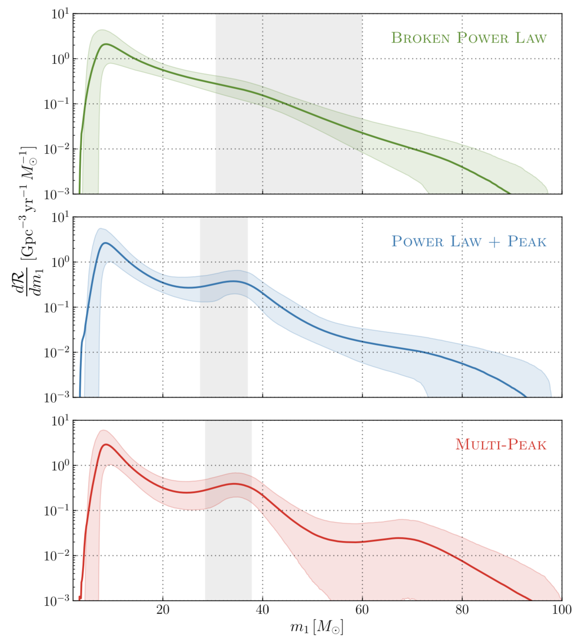
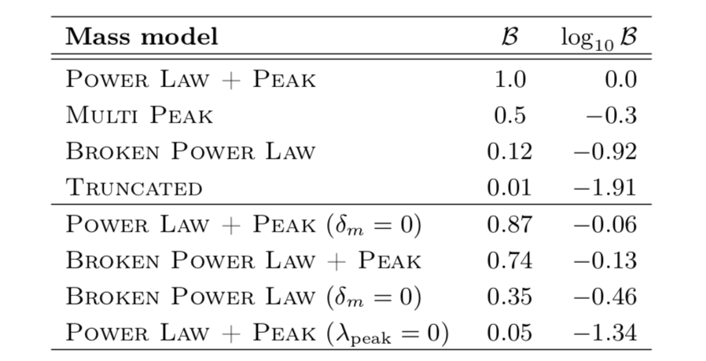
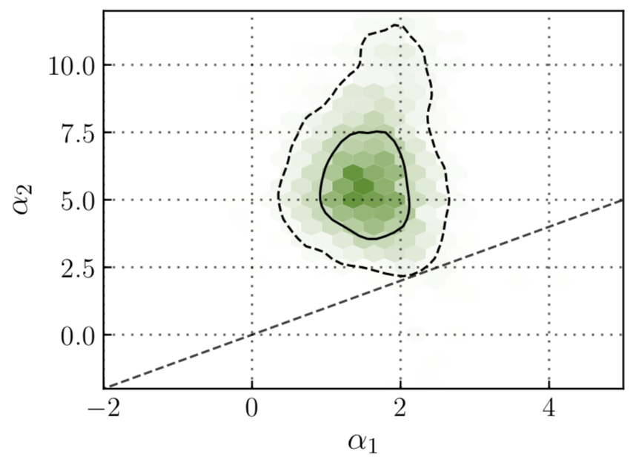
BH mass spectrum has feature(s) !
bla
LVC, https://dcc.ligo.org/LIGO-P2000077/public

Slide 15
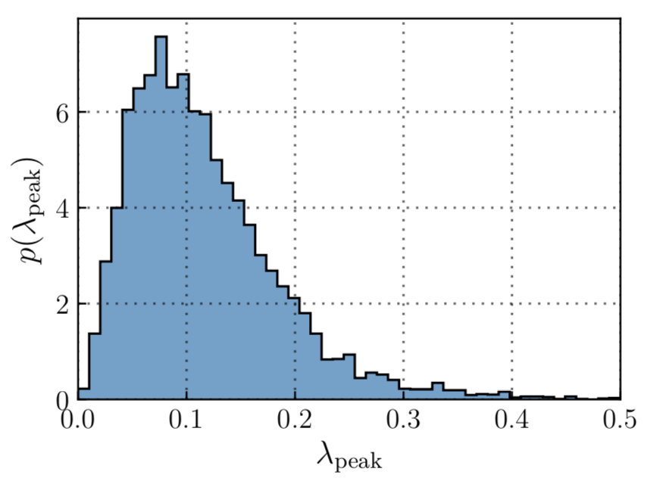
BH mass spectrum has feature(s) !
bla
LVC, https://dcc.ligo.org/LIGO-P2000077/public

Slide 16
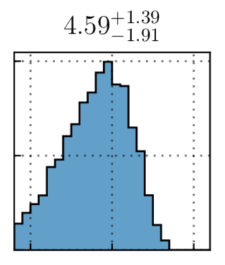
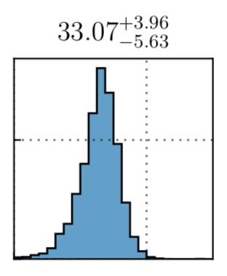
Mass spectrum parameters
Minimum BH mass not well determined
Gaussian peak centred @ 30-40 M☉
LVC, https://dcc.ligo.org/LIGO-P2000077/public

Slide 17
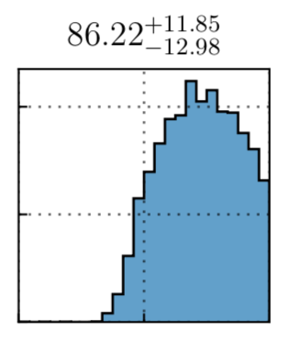
Mass spectrum parameters
Astrophysical interpretation .. ?
Maximum mass >~70 M☉, large uncertainty
Baxter et al. arXiv:2104.02685
LVC, https://dcc.ligo.org/LIGO-P2000077/public

Slide 18
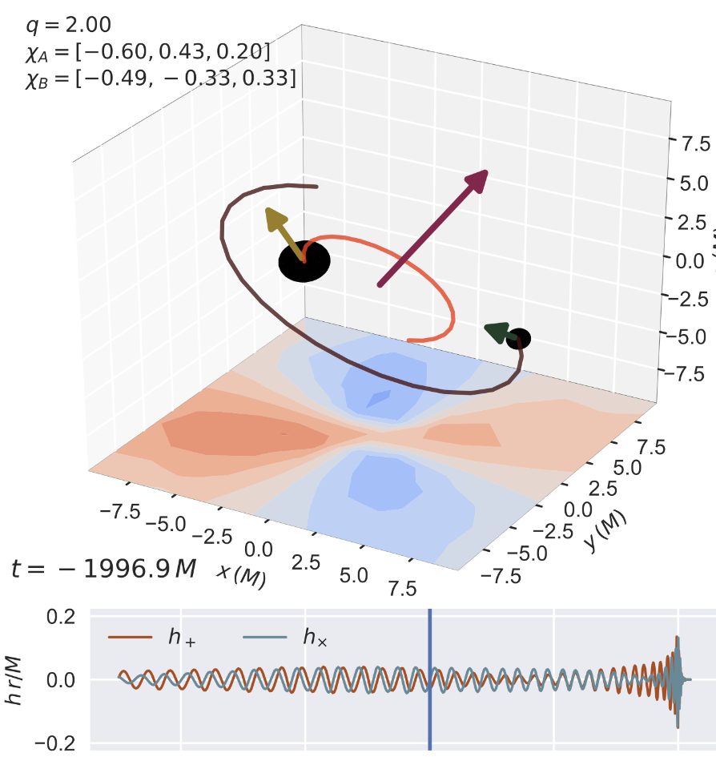
BH spin evidence
Spins affect GW signal in two ways
Orbit-aligned spins speed up or slow down inspiral
In-plane spins cause orbit to precess around total ang. mom.
image credit: V. Varma

Slide 19
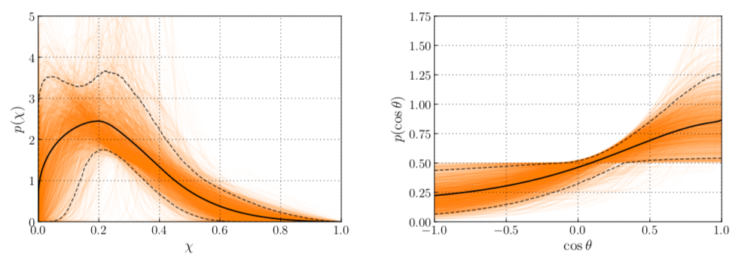
Spin magnitude / tilt inference
LVC, https://dcc.ligo.org/LIGO-P2000077/public
Mostly small but nonzero spins
Mostly small tilts (spins close to orbit-aligned) but some highly tilted / anti-aligned

Slide 20
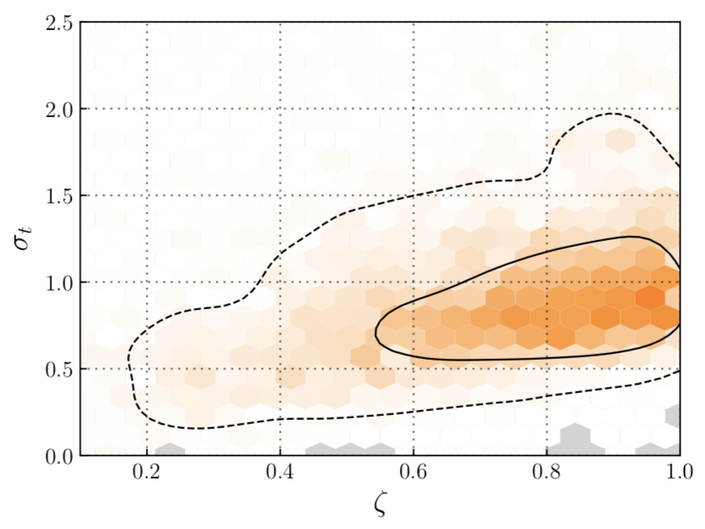
Evidence for in-plane (precessing) spin
Width of cos(tilt) Gaussian
Fraction with preferentially aligned spins
LVC, https://dcc.ligo.org/LIGO-P2000077/public
No single binary merger has strong evidence for 𝜒_{p} > 0
May be caused by BH formation kicks (isolated binaries)
or dynamical formation, or ...

Slide 21
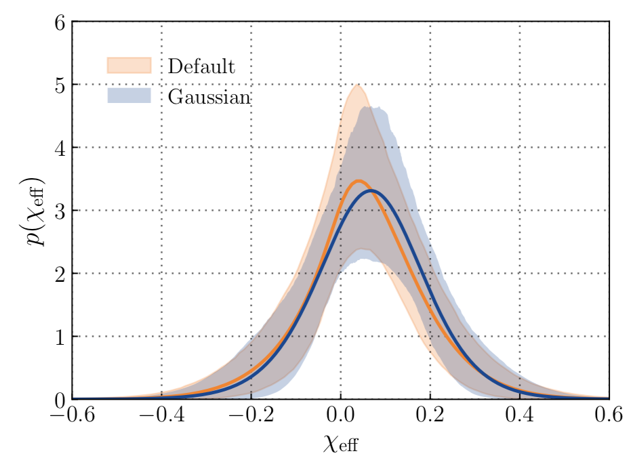
Evidence for tilts beyond 90°
LVC, https://dcc.ligo.org/LIGO-P2000077/public
𝜒_{eff} < 0 implies one or both spins anti-aligned with orbit
~12% to ~44% of binaries have such spins
Suggests more than 1 formation channel active eg Zevin et al. Astrophys.J. 910 (2021) 2, 152

Slide 22
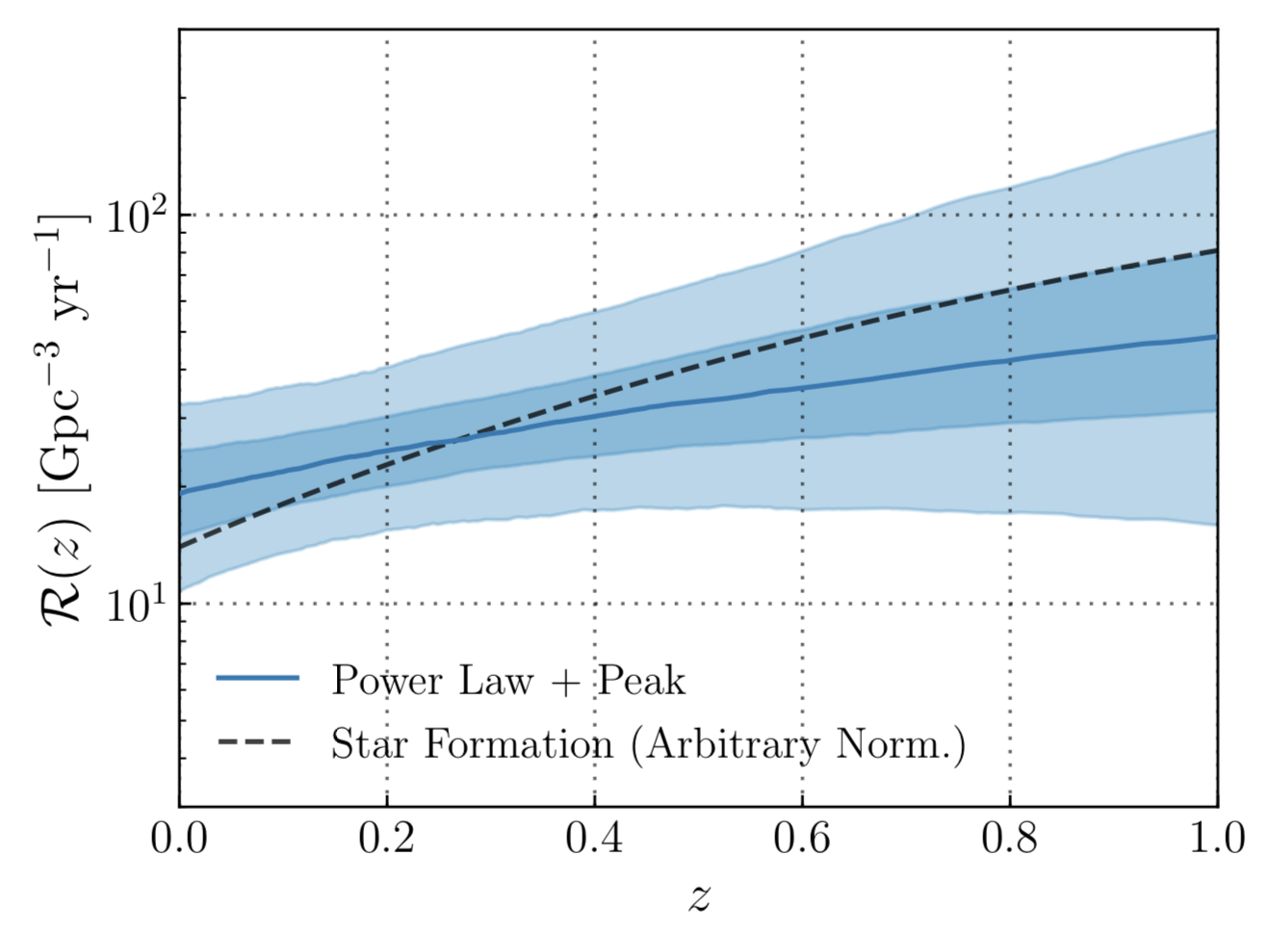
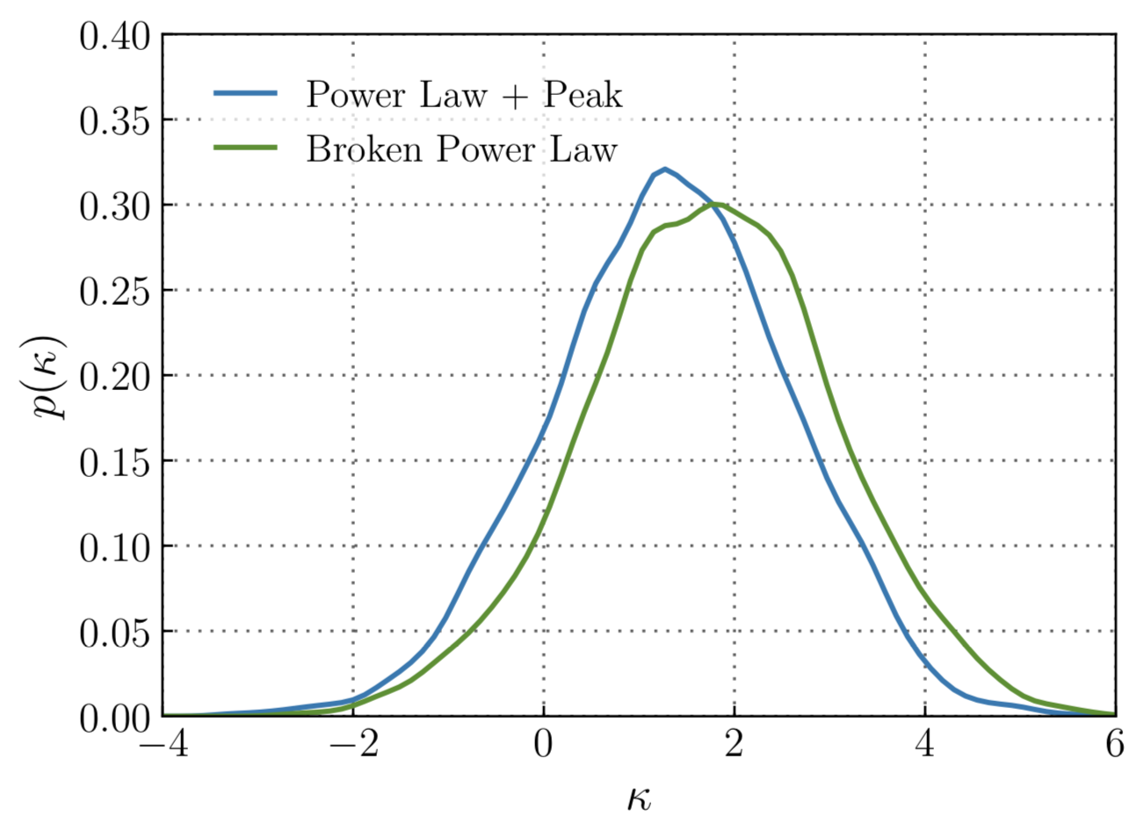
Redshift evolution
LVC, https://dcc.ligo.org/LIGO-P2000077/public
Comoving rate probably increases with z
Probably more slowly than M-D SFR ~(1+z)^{2.7}

Slide 23
Merger rate summary
BBH rate (constant comoving)
allowing redshift evolution
BNS rate assuming masses uniform on (1,2.5) M☉
NSBH rate limit (O1-O2)
(90% credible, 1.4+5 M☉ systems)
to be updated with O3 data in upcoming publications
Other merger rate limits : IMBH, sub-solar mass, eccentric binaries ...
LVC, https://dcc.ligo.org/LIGO-P2000077/public
LVC, Phys. Rev. X 9, 031040 (2019)
LVC, Phys. Rev. D 100, 064064 (2019)
LVC, Phys. Rev. Lett. 123, 161102 (2019)
LVC, Astrophys. J. 883, 149 (2019)

Slide 24
Outlier analysis
Events with apparently ‘extreme’ mass parameters
Consider impact of population model (~prior) on measured event masses
Compare with most extreme expected event
Check if inferred population is consistent under inclusion/exclusion of event

Slide 25
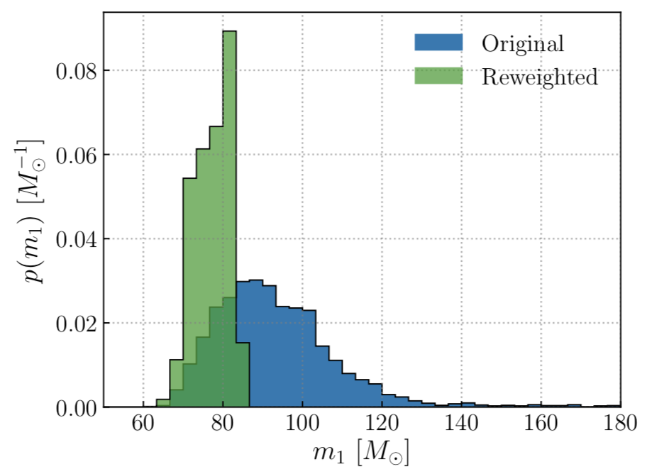
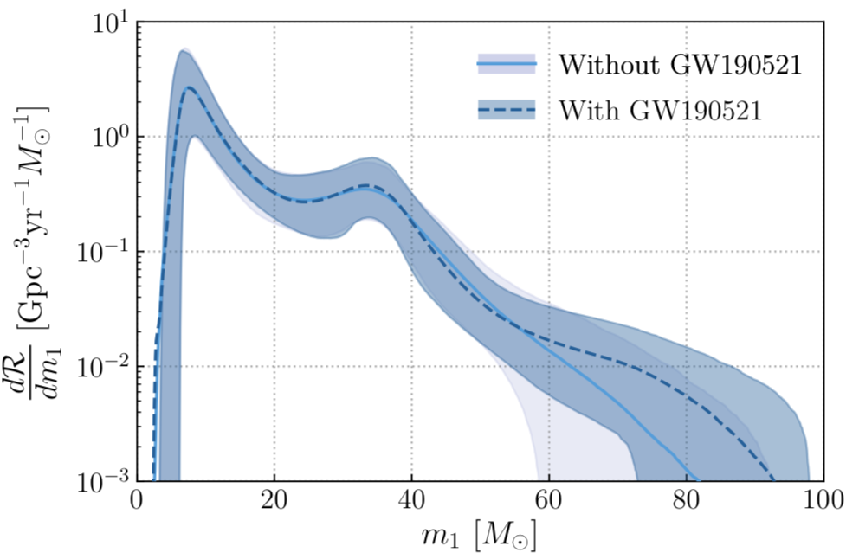
GW190521 – the heaviest BBH
Masses (M☉)
remnant is first directly detected IMBH
Apply population prior to mass measurement (Power-law Peak)
BBH distribution with/without event consistent
LVC, Phys.Rev.Lett. 125 (2020) 10, 101102 & Astrophys.J.Lett. 900 (2020) 1, L13
LVC, https://dcc.ligo.org/LIGO-P2000077/public

Slide 26
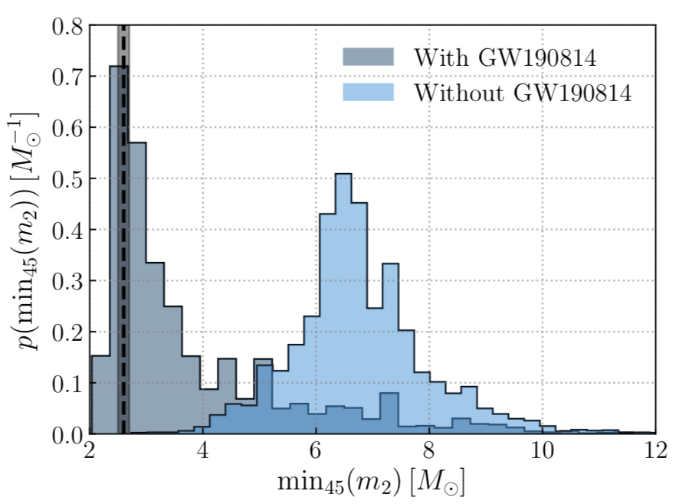
GW190814 – the ‘mystery object’
Primary ~23 M☉ BH, secondary
Either super-heavy NS or super-light BH
LVC, Astrophys.J.Lett. 896 (2020) 2, L44
Clear outlier in secondary mass & mass ratio
Probability <0.02% of seeing as small a m2 or m2/m1 over 45 events
Indicates potential origin distinct from BBH population
LVC, https://dcc.ligo.org/LIGO-P2000077/public

Slide 27
Summary & outlook
Detections up to O3a : ‘large’ BBH population but so far only hints at astrophysical features
Excess of BBH with mass around 33 M☉
Binary spins are not all orbit-aligned !
2 BNS ⇒ not yet a ‘population’
GW190814 challenges usual classifications
O3b : 5 more months at ~equal sensitivity
O4 : 2022+, with KAGRA : watch this space !

Slide 28
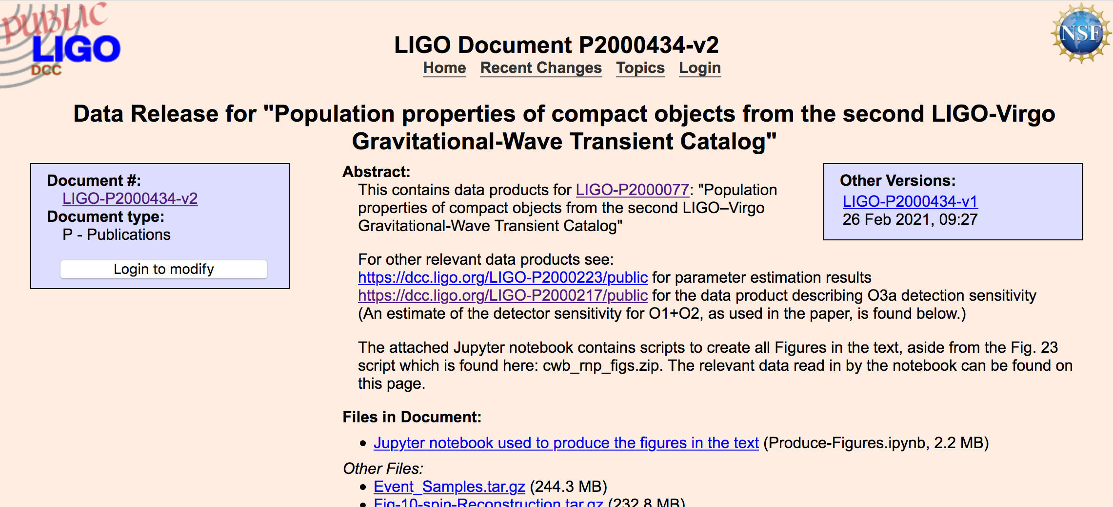
LVC public data products
GW Open Science Center data on GWTC-2
Data release : population model samples, notebook to reproduce figures
https://www.gw-openscience.org/eventapi/html/GWTC-2/
https://dcc.ligo.org/LIGO-P2000434/public

Slide 29
Related Rate/Pop talks
Daniel Wysocki - Compact binary populations following O3a
Maya Fishbach - Cecilia Payne-Gaposchkin Award Finalist (2021): LIGO-Virgo's Biggest Black Holes and the Mass Gap
Vicky Kalogera - Filling in the Mass Gap: GW190814
Philippe Landry - Distinguishing the Nature of the Lighter Compact Object in the Binary Merger GW190814
Gayathri V. - The Heaviest Black Holes of LIGO/Virgo
Brendan O’Brien - LIGO-Virgo binary black holes in the pair-instability mass gap
Salvatore Vitale - New spin on LIGO-Virgo binary black holes
Vijay Varma - Constraining recoil kicks for LIGO-Virgo binary black hole populations
Javier Roulet - Characterizing the Population of Binary Black Holes with Detections of Arbitrary Significance
Nicholas DePorzio - Distinguishing Black Hole Binary Formation Channels With Eccentricity Measurements and Other New Gravity Wave Probes

Slide 30
Ready for your Questions
This material is based upon work supported by NSF’s LIGO Laboratory which is a major facility fully funded by the National Science Foundation.

Slide 31
Backup slides

Slide 32
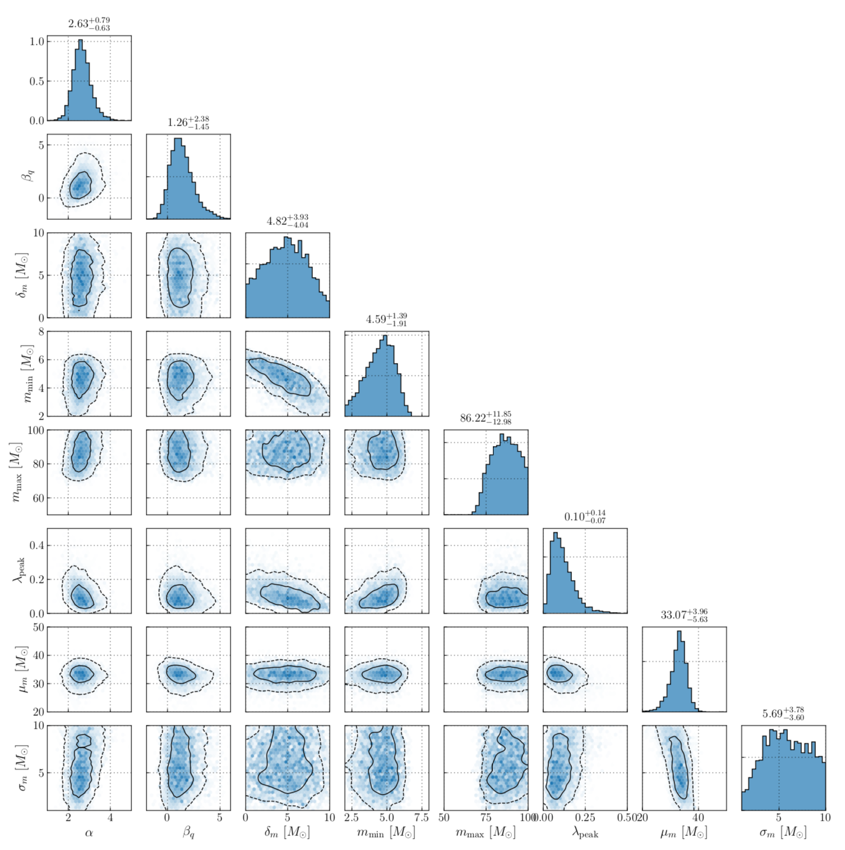
PowerLaw + Peak parameters
LVC, https://dcc.ligo.org/LIGO-P2000077/public

Slide 33
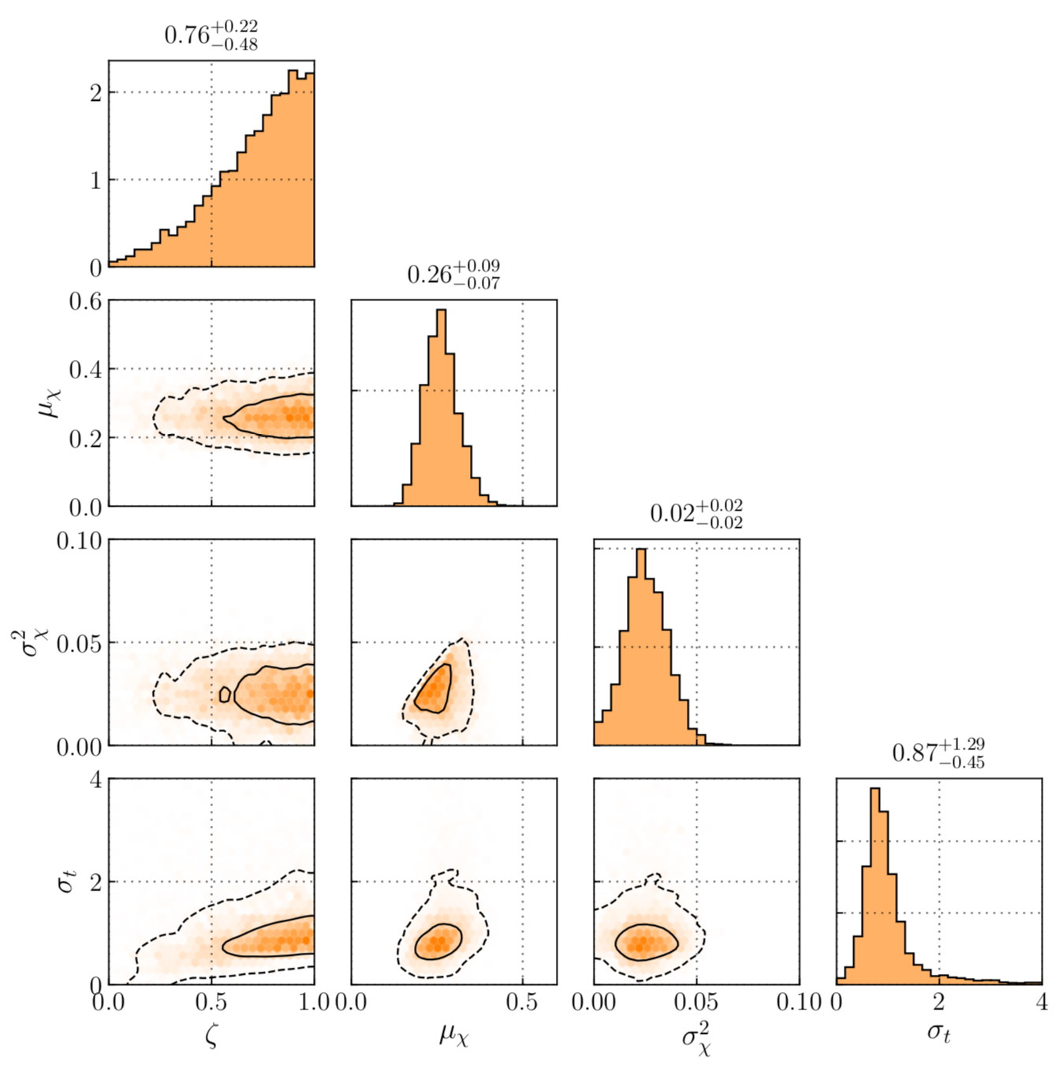
‘Default’ spin model parameters
LVC, https://dcc.ligo.org/LIGO-P2000077/public

Slide 34
‘Default’ spin model
Model spin magnitudes as Beta
Tilts (cos 𝛳) described by mixture : 𝜁 * truncated Gaussian + (1 - 𝜁 ) * uniform

Slide 35
‘Multi Spin’ parameters
LVC, https://dcc.ligo.org/LIGO-P2000077/public
Investigate whether spin properties depend on mass
Also allow secondary spin to differ from primary
Trends but no conclusive evidence

Slide 36
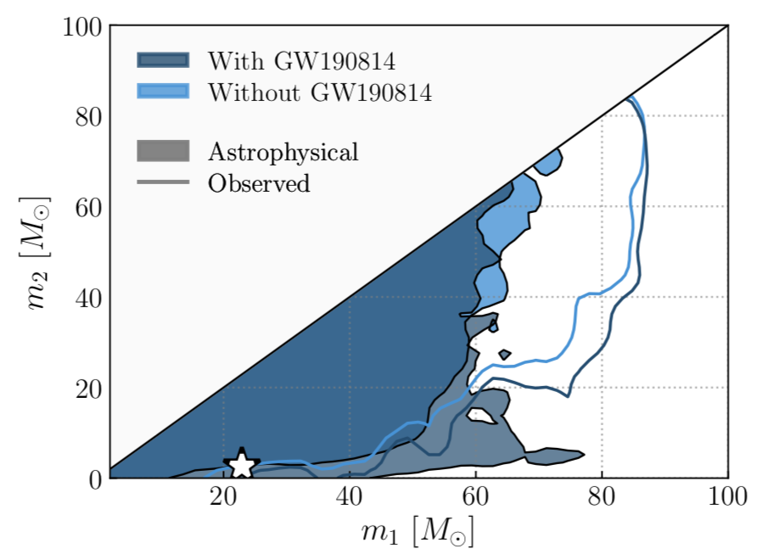
GW190814 masses
LVC, https://dcc.ligo.org/LIGO-P2000077/public
m1-m2 values outside region covering expected detections (99%)

