Slide 1

GW astronomy at UBC/TRIUMF
Jess McIver for the UBC team
June 29, 2021
GWANW 2021
LIGO DCC G2101374

Slide 2
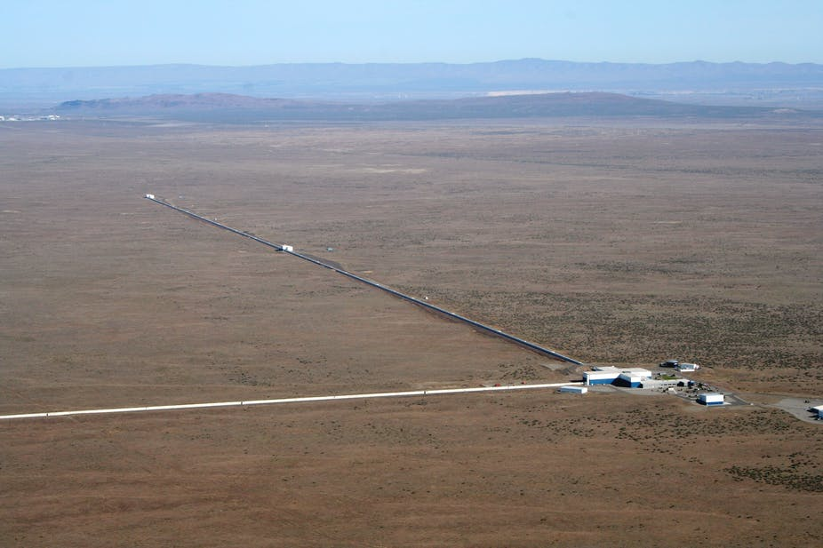
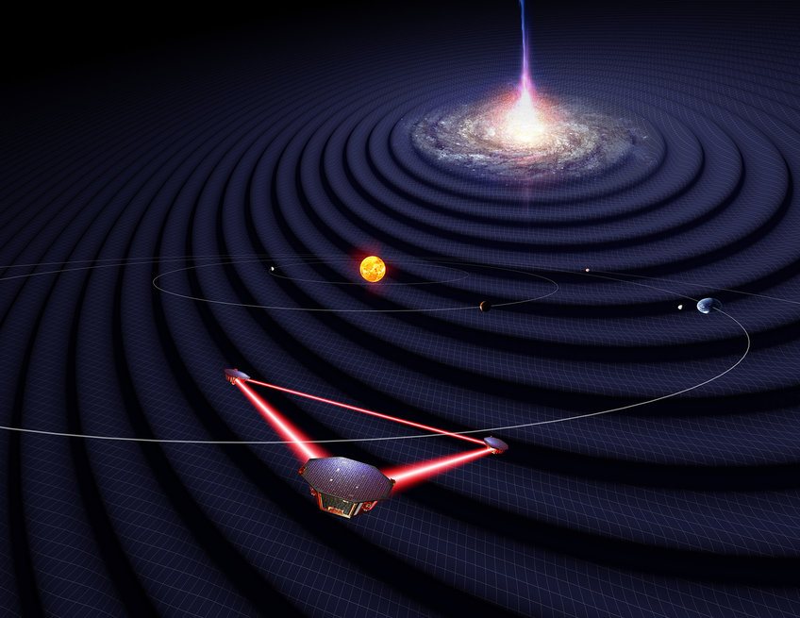
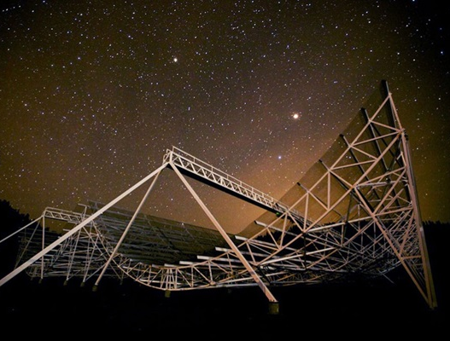
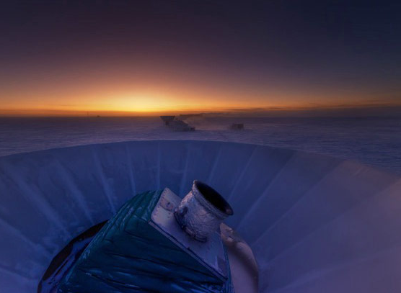
Across the GW spectrum: UBC and TRIUMF
Ground based interferometers
UBC LIGO group
UBC GW astrophysics group
Space based interferometers
UBC-TRIUMF LISA group
Pulsar Timing Arrays/FRBs
UBC CHIME team
B-mode polarization
Search for B-mode polarization at UBC

Slide 3
Multi-messenger astronomy and tests of GR with ground-based GW detectors at UBC

Slide 4
arXiv 2105.05238

Slide 5
The UBC LIGO team: astrophysics
In collaboration with Beverly Berger (Stanford), Priti Ragnekar (Stanford) and Raymond Ng (UBC)

Slide 11
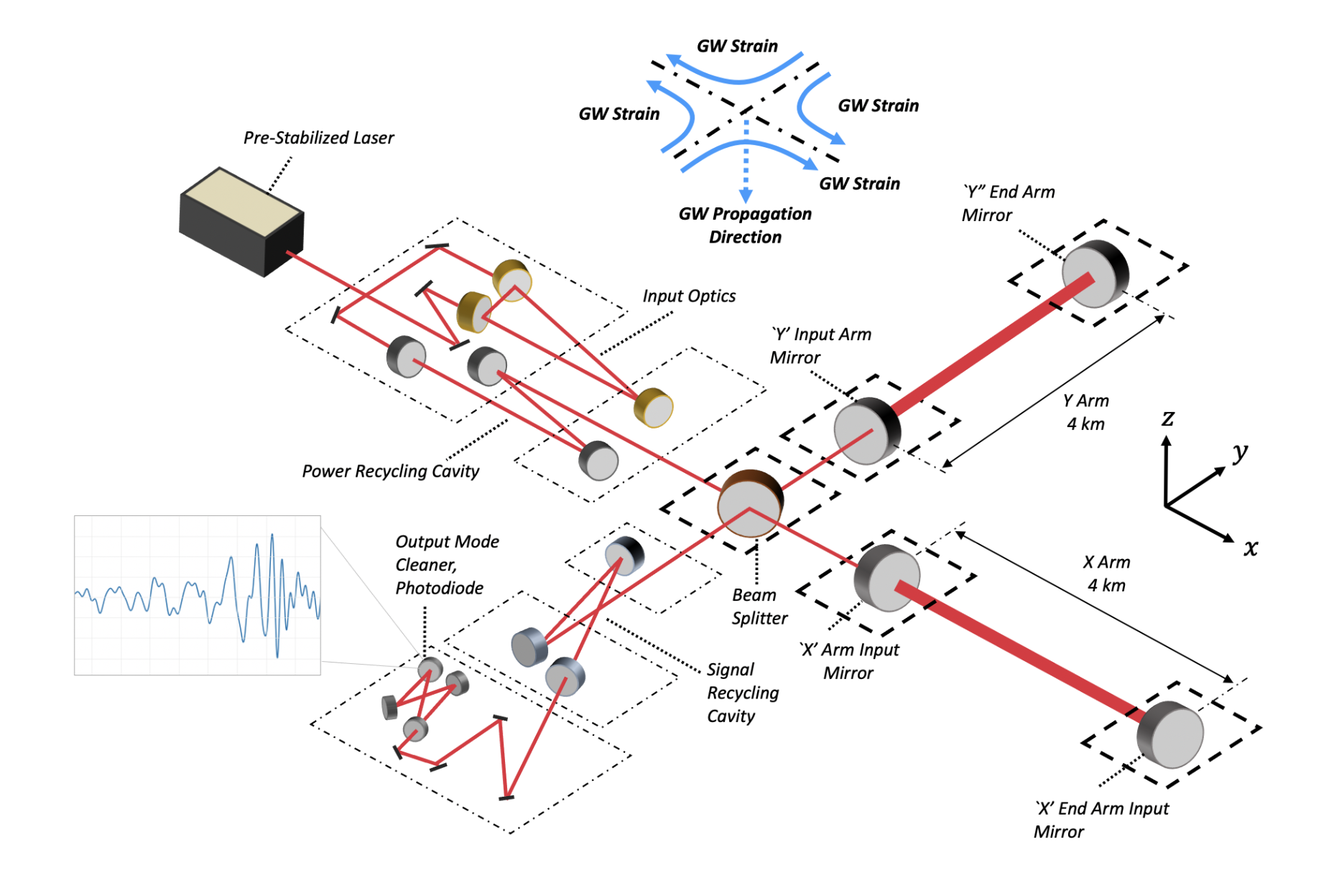

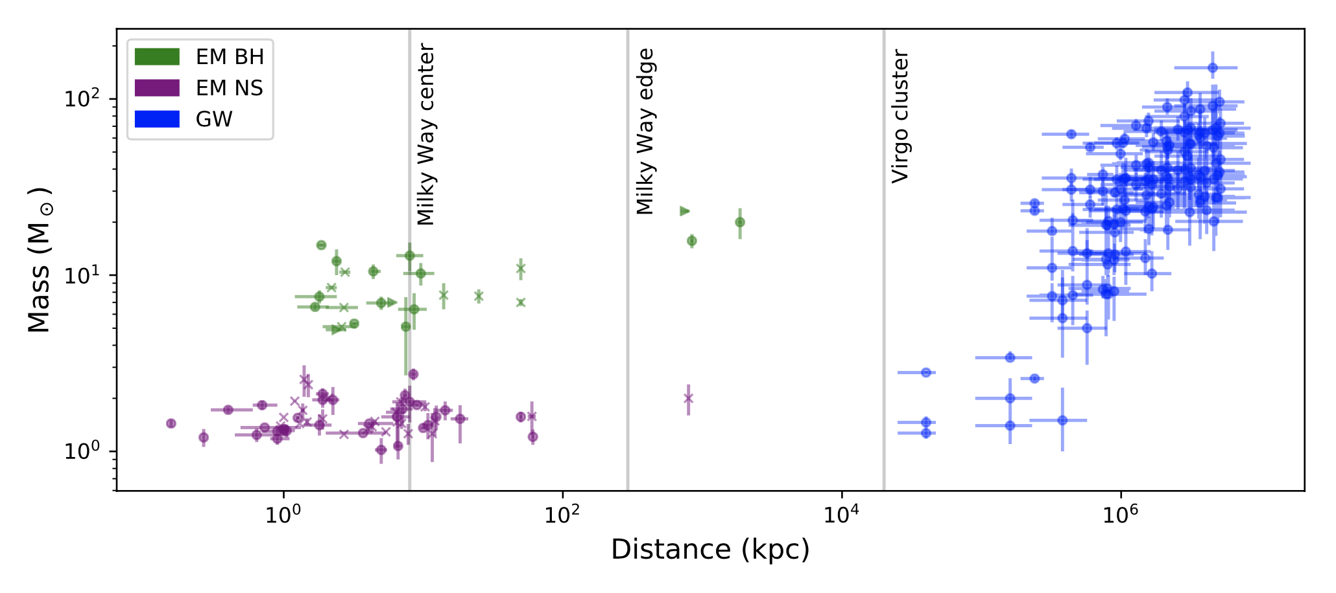
New review paper in part by the UBC team:
Introduction to GW sources and the Advanced LIGO detectors at the undergraduate level.
Coming soon to Contemporary Physics (and hopefully also the arXiv)

Slide 12
The UBC LIGO team: GW detector coatings

Slide 14
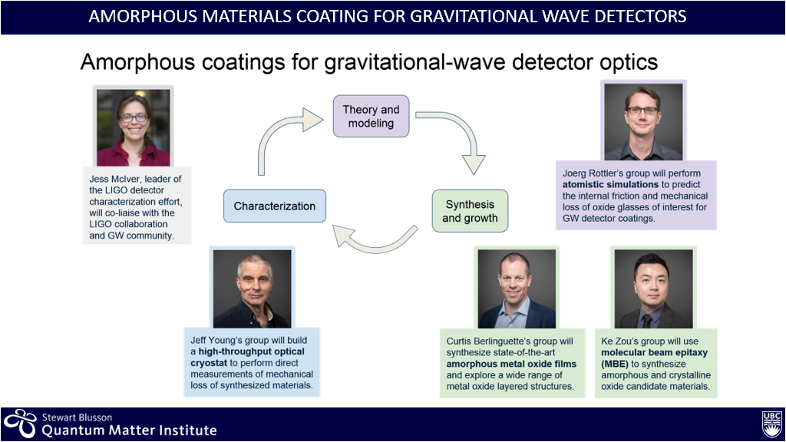

Slide 15
Microdisk measurements with laser doppler vibrometer​
Kirsty Gardner, Matthew Mitchell, Chang Ge
In collaboration with David Dvorak, Jeff Young, Ke Zou, Andree Coschizza, Joerg Rottler, Daniel Wong, Curtis Berlinguette.
Part of the SB Quantum Matter Institute’s ‘Disorder and entropy as design principles’ Grand Challenge

Slide 16
Laser Doppler Vibrometer (LDV)
incident
laser
beam
reflected
laser
beam
Measurements done at room temperature and in ambient atmosphere
Piezo chip actuates microdisks
Doppler shift of reflected laser beam used to measure motion of single disk
Software generates spectra of microdisks, as well as animation of microdisk motion
microdisks
piezoelectric chip
Diagram of experimental setup for LDV measurements of microdisks using a piezoelectric chip actuator.

Slide 17
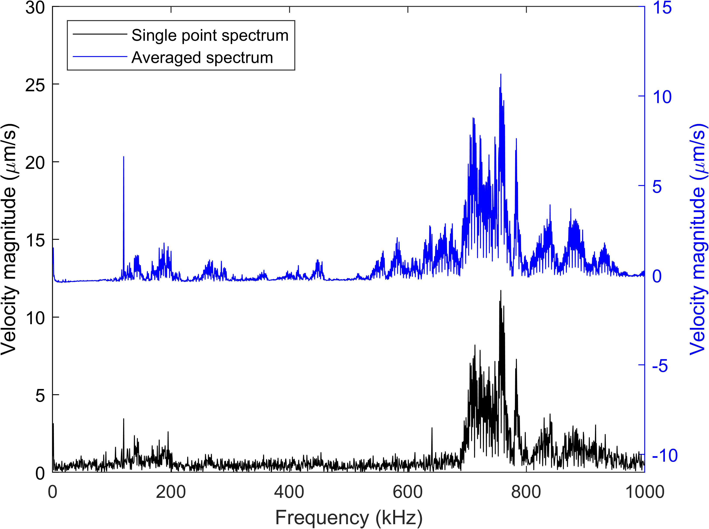
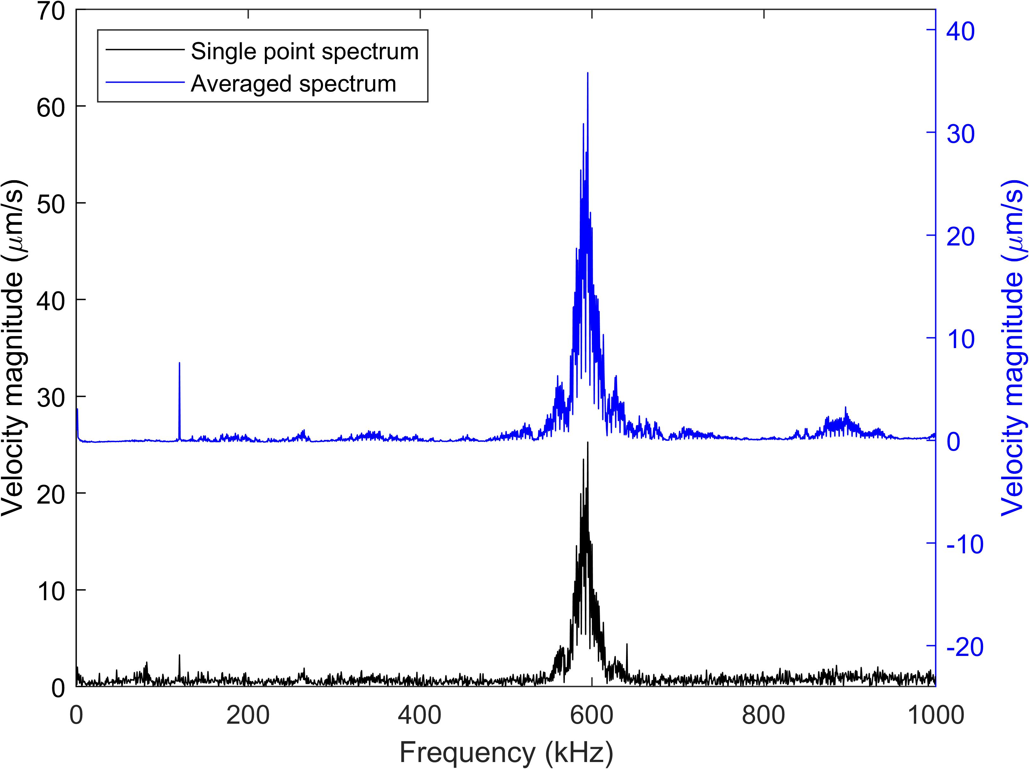
Spectra of Uncoated Microdisks
a)
b)
a) Spectra from a disk of radius 71.5 µm, showing a resonance at approximately 750 kHz.
b) Spectra from a disk of radius 80.0 µm, showing a resonance at approximately 600 kHz.

Slide 18
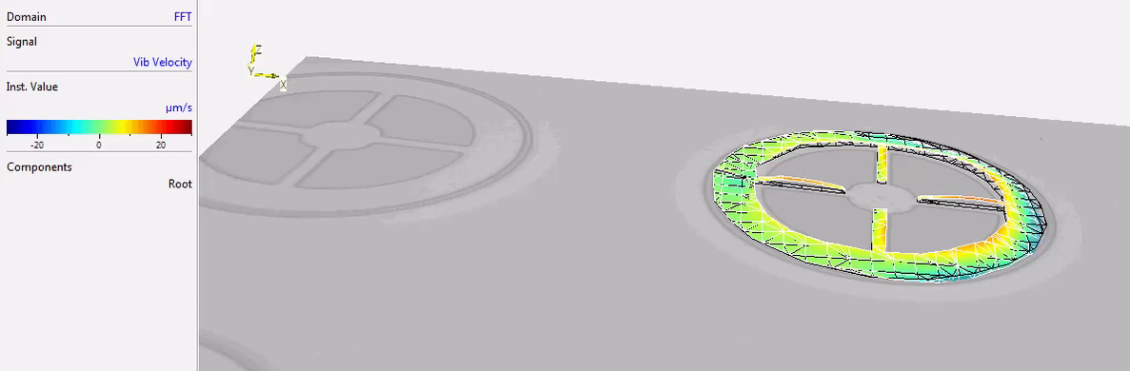
Animation of vibrational mode
Figure 3. Video of the mode shape of the smallest disk (radius 71.5 µm) at 760 kHz, showing the motion of the microdisk.

Slide 19
The UBC-TRIUMF LISA team
Djuna Croon (PI), Evan Goetz, Jess McIver, David Morrissey, Scott Oser

Slide 20
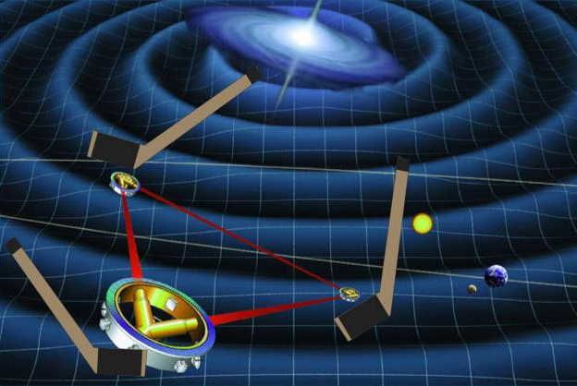
The LISA Canada 2021 workshop
Well attended
>300 registrants (100+ Canadian)
Over 150 participants on Zoom on Day 1
Featured:
Overview of LISA science and the LISA experiment
Introduction to each working group in the LISA Consortium and how to plug into ongoing research
Discussion of Canadian contributions to LISA
Most talks are available on YouTube (please ask for the links)
Coming soon: white paper summarizing the outcomes of the workshop.

Slide 21
The UBC CHIME team

Slide 22
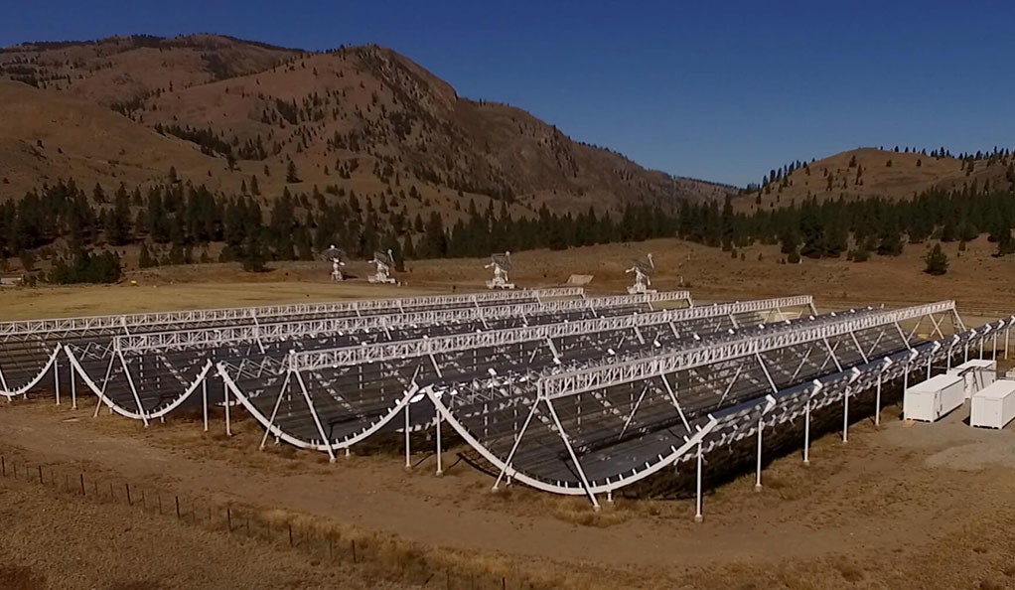
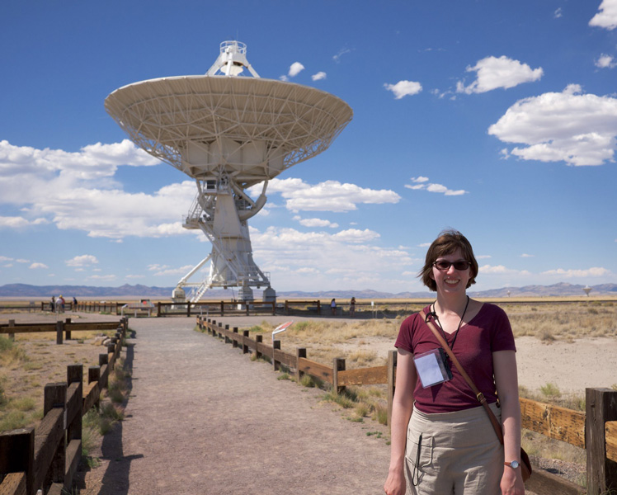
What is CHIME/Pulsar?
Deborah Good for the UBC CHIME team
The Canadian Hydrogen Intensity Mapping Experiment
    Radio transit telescope, observes the whole sky each day
    No moving parts: as the Earth rotates, we see different parts of the sky.
    Frequency range: 400-800 MHz
CHIME/Pulsar system
    Creates 10 tied-array tracking beams, which let us digitally ”point” at pulsars and track them across the sky.
    We can observe up to 10 pulsars at a time, 24/7. We observe each pulsar for about 15 minutes.
    An automated scheduling software ensures pulsars are observed equitably, based on pre-assigned priorities.
Image: Richard Shaw

Slide 23
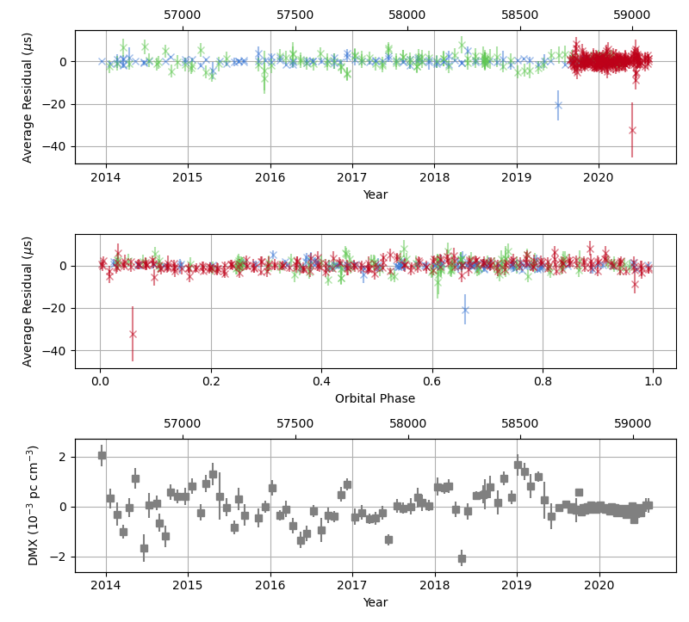
Adding CHIME/Pulsar data to NANOGrav
Why include CHIME/Pulsar data in what is already a good dataset?
  Low frequency observations are valuable, particularly for better constraining the interstellar medium.
  CHIME/Pulsar has a wide fractional bandwidth, allowing it to act as a laboratory for wideband timing developments.
  Daily observation cadence adds unprecedented density to our sampling for timing solutions.
Is this working? Early results suggest yes!
  For our test sources, RMS residuals < 5 us; weighted RMS residuals < 3 us.
  Study of dispersion measure variation is in its infancy, but we already have evidence CHIME/Pulsar will be valuable.
Example: PSR J1125+7819
Green & Blue = epoch-averaged GBT TOAs; Red = epoch-averaged CHIME TOAs
Figure: Deborah Good

Slide 24
The search for B-modes at UBC

Slide 25
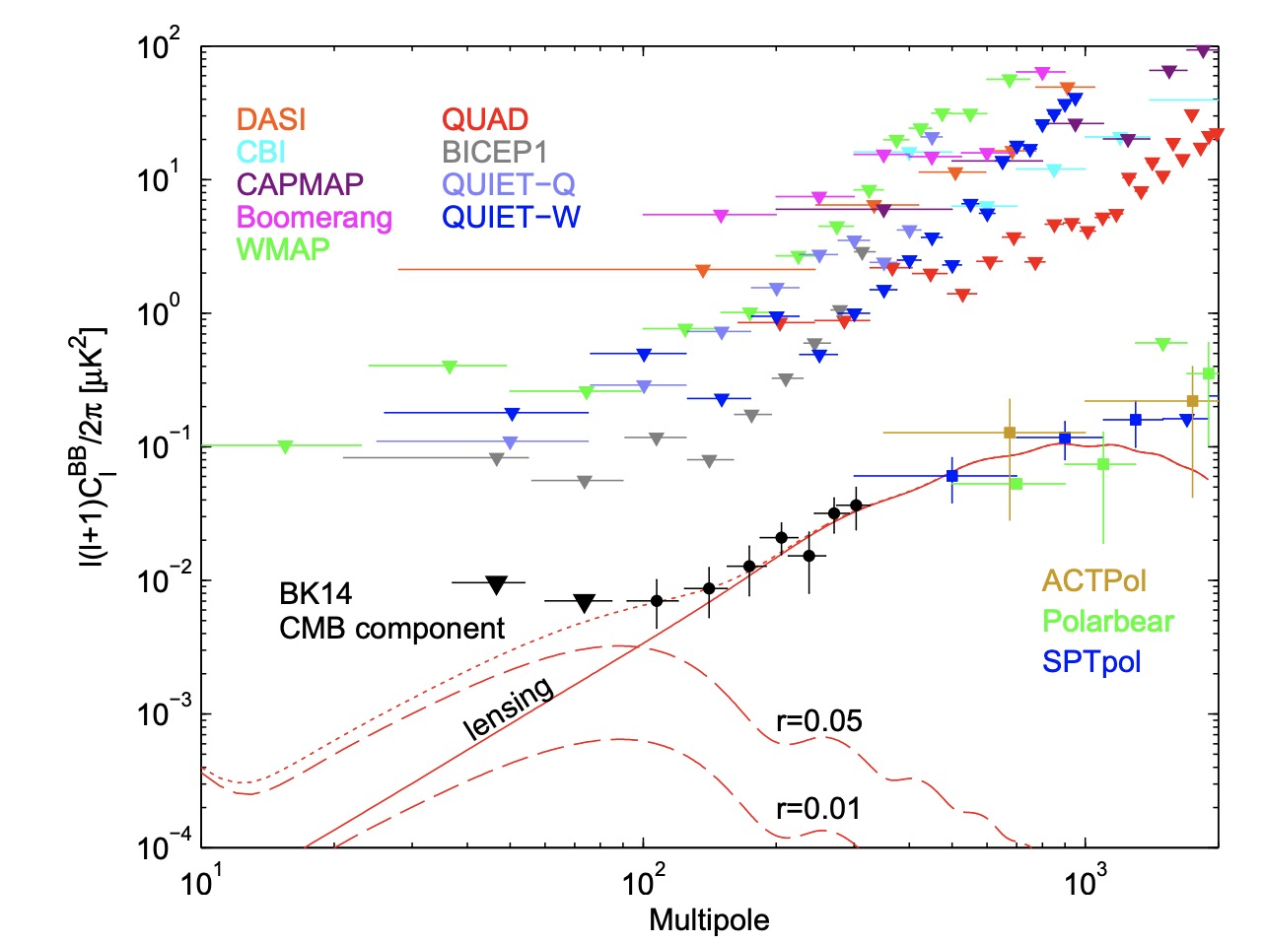
The search for B-modes at UBC I: Bicep/Keck
BK PRL (2018)
Odd parity polarization patterns of the CMB, called B-modes, arise from tensor perturbations of the metric imprinted at the end of inflation. They become gravitational radiation much later, after they pass within the horizon. The anticipated angular power spectrum is shown at left by the dashed red curves labelled with r, the tensor fraction of the primordial power spectrum.
Expect better data on a few months time scale as we publish spectra based on 4 or 5 years more data.
Expect substantially better data in a few years with deployment of the Bicep Array , replacement of the SPT telescope with the TMA and coordinated BK / SPT analysis to remove the ‘foreground’ B-mode spectrum arising from gravitational lensing by z~2 galaxies. (solid red line).
UBC designed the detector control and readout electronics for CMB experiments ABS, Act, Bicep, CLASS, CMB-S4, … ..Keck, .. Piper, .. Spider, … ZEUS-2
At UBC: Sofia Fatigoni, Mandana Amiri, Don Wiebe, Mark Halpern.

Slide 26
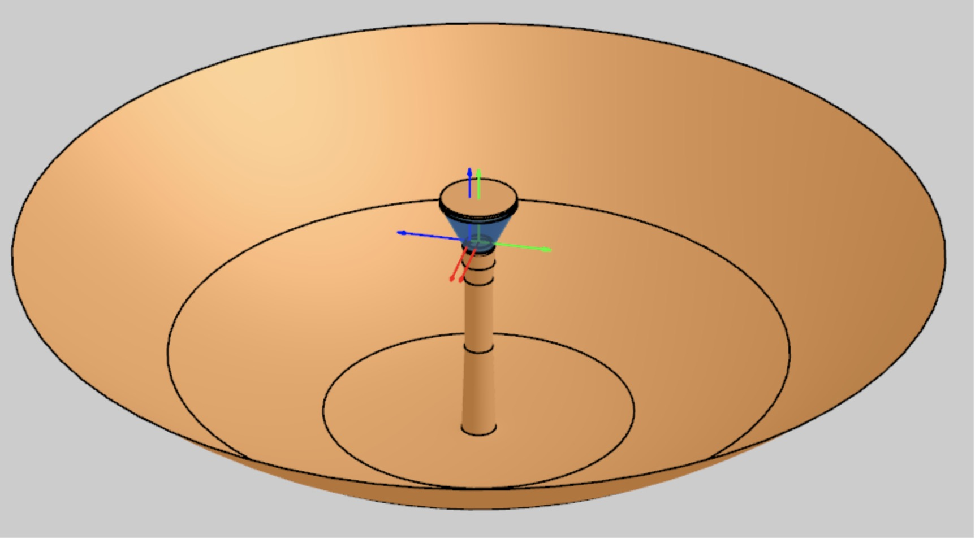
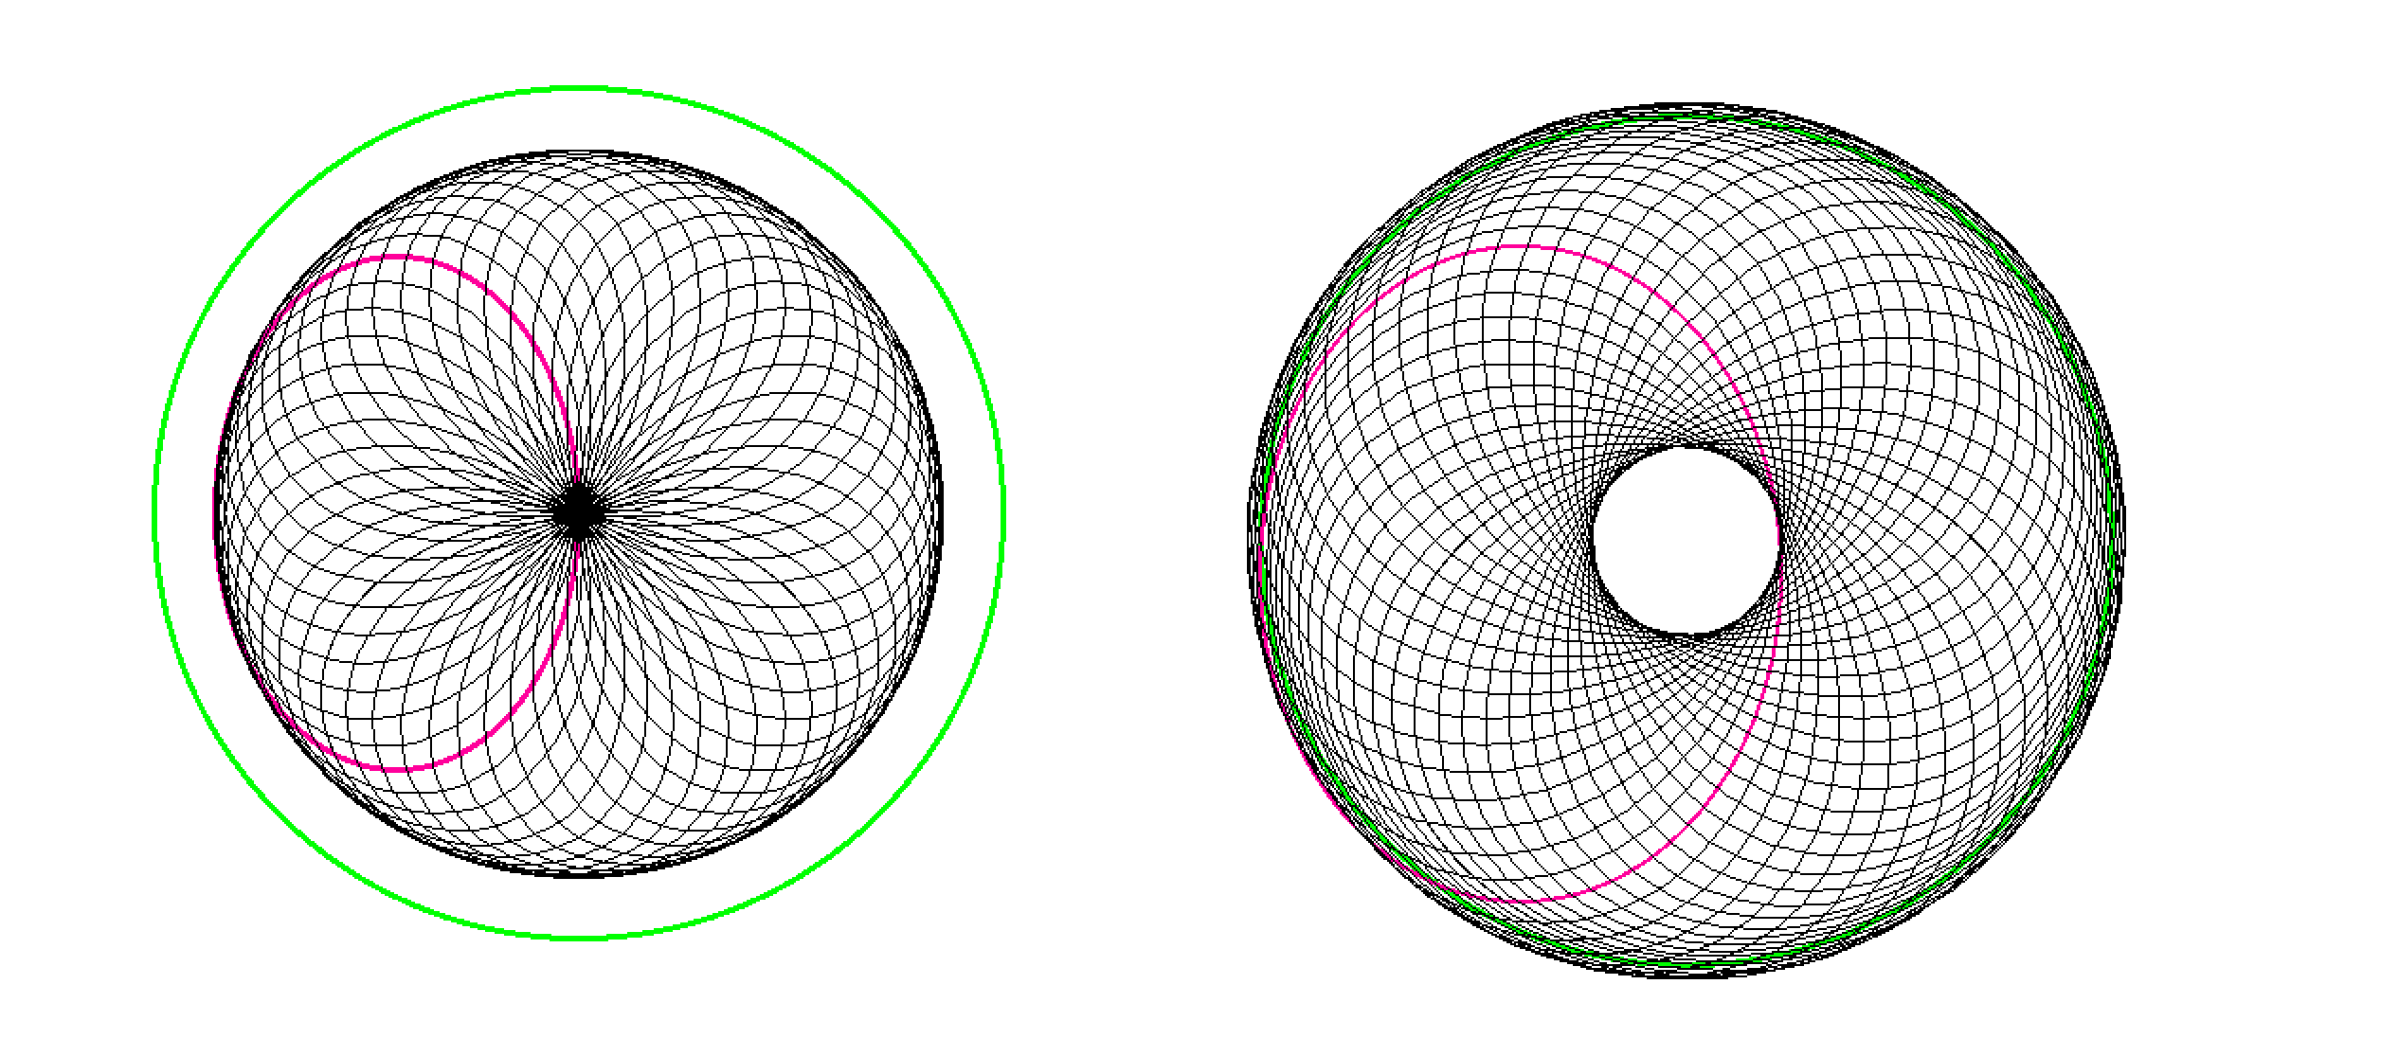
The search for B-modes at UBC II: CGEM
The Canadian Galactic Emission Mapper is a program to map polarized galactic emission at 10 GHz with enough sensitivity and enough control of systematic errors that the data can be used to clean the few nK of residual synchrotron from B-Mode search maps made at CMB frequencies.
The instrument consists of a single 4m aperture dish scanning azimuthally at fixed elevation angle, at 1 rpm. The system scans the full northern sky as the Earth turns, as is illustrated by our logo.
The CGEM team: Gary Hinshaw, Bruce Veidt, Mandana Amiri, Tom Landecker, Madison Allen, Josh MacEachern, Ed Wollack, Mark Halpern, Artem Davidov, Parham Zarei
Daily sky coverage of the Northern hemisphere for the elevation angles 40º and 50º. The green line is δ=0.

